Slide 1
ePIC SRO DAQ
ePIC WG Conveners: Fernando Barbosa (JLAB), Jin Huang (BNL) , Jeff Landgraf (BNL)
EIC Project Electronics CAM: Fernando Barbosa (JLAB)
EIC Project DAQ CAMs: Dave Abbott (JLAB), Jeff Landgraf (BNL)

Slide 2
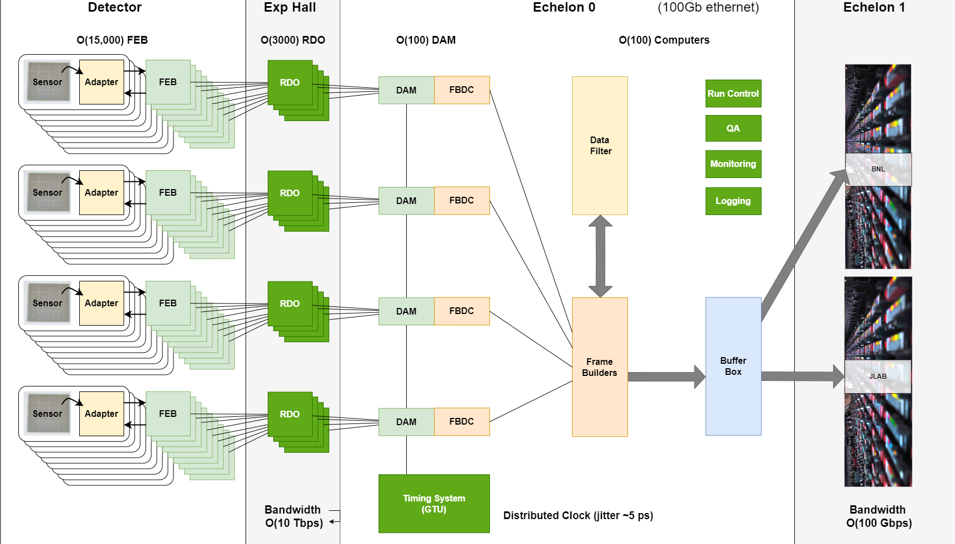
EIC Streaming DAQ/Computing Architecture
Collider Characteristics
1260 Bunches arriving at 98.5Mhz (10.15ns bunch separation)
1.015us abort gaps (100 bunches)
$\sqrt{s }$ ⇒ 20 – 141 GeV
𝓛_{max} ⇒ 10³⁴ cm⁻² s⁻¹
Electron, proton, and light nuclei beams can be polarized
Each bunch can have different polarization states
DAQ must tag data to specific bunch crossings
Need to track luminosity for each bunch crossing
Detector
24 subdetectors / varied technologies
MAPS, MGDS, 4 PI Electron / Hadron Calorimetry using SiPM, RICH using SiPM/HRPPD, AC-LGAD, Far back/forward
Physics Performance
Maximum DIS rate ~500kHz
Large number of Channels
Low occupancy

Slide 3
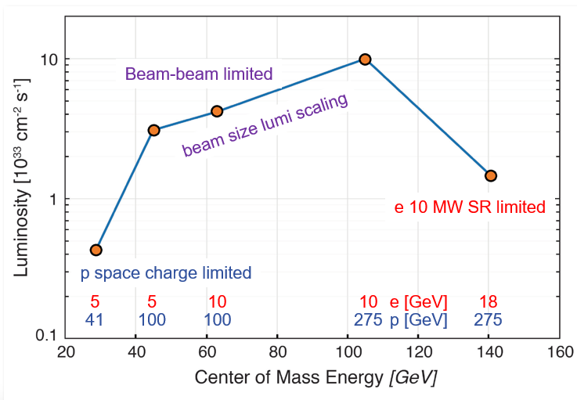
Summary Data Flow
Worst case Data Flow
“Worse Case Data Flow”
𝓛_{max} ⇒ 10³⁴ cm⁻² s⁻¹
10 x 275 GeV DIS
DIS rate ~500kHz
After 9 x 10⁹ (1-MeV n_{eq} / cm²) delivered fluence
300kHz DCR in dRICH
200x rate with no damage
At Worse Case
Need a factor of 20 reduction
PCI/Eth
Eth
Detector
FEB
Copper
RDO
Fiber
DAM
Readout Computer
Aggregate | 2.0 Tb/sec
Noise | 1.6 Tb /sec
Signal from Physics + Background | 400 Gb / sec
Aggregate | 109 Gb/sec
Collision Signal | 62 Gb/sec
Synchrotron Rad | Under design
Electron Beam | 4.5 Gb/sec
Hadron Beam | 1.0 Gb/sec
Noise | 41 Gb/sec
Aggregate | 2.0 Tb/sec
Per RDO (Avg) | 0.7 Gb/sec

Slide 4
ePIC DAQ uses streaming architecture
DAQ
Definition of streaming is “No L0 trigger”
All data is zero suppressed by the front end electronics
No system wide deadtime in normal operation
Collaboration should have the full ability to make data selection cuts on the widest possible criteria
Flexible event selection, data selection and background characterization
But subject to an overall throughput budget of ~100Gb/sec
ePIC Streaming will include
Capabilities for hardware and firmware based triggering
Capability for flow control
Zero suppression & aggregation within data packets
Greater sensitivity to noise
Greater sensitivity to backgrounds
Computing
Definition of streaming is “Process data as it arrives”
Fast Analysis (~3 weeks not months or years) using automation of calibration and reconstruction.
Requires some overlap between DAQ/computing
Automation of calibrations
Mapping calibration dependencies
Mapping application of calibrations
Mapping evolution of calibrations
QA and monitoring can make use of full offline structure
Consistent schemes and language for data/metadata
Event selection / tagging / and accounting

Slide 5
SRO Challenges
Associated with ePIC detector in particular
24 large scale detectors, >16 Billion Pixels, >8 Million Channels, Limited space, low material budgets
Updates of existing ASIC / Readout technology: ITS3/Mosaics, Timepix, Astropix, EICROC, CALOROC, ALCOR, FCFD, SALSA
Custom FEB development making use of synergy where possible
Associated with Lack of L0 Trigger
Data Synchronization, Mixed 40MHz/100Mhz ASIC tech
GTU interface to collider
Common DAM/RDO hardware and protocol implementing fixed latency command delivery to ASICs
Reconstructed clocks via fiber over fast command delivery path as per TCLINK, lpGBT
Sensitivity to noise
Sensitivity to beam background
Detailed studies of beam backgrounds (e-beamGas, p-beamGas, Synchrotron Radiation & others)
Data paths with high enough bandwidth to readout worse case
Interest in data reduction techniques: High Level Noise Reduction via HLT/ML mechanisms, compression, feature finding, cluster finding, header aggregation / format manipulations
Associated with need to reconstruct data as it arrives (make computing more like a DAQ)
Distributed computing (interactions and roles of two echelon 1 facilities + echelon 2 & 3 + sharing code/tasks with echelon 0)
Automation of Calibration
Early attention to calibration workflows
Tools for mixed human/automated calibration
Automation of reconstruction chain under dynamic data taking situations
Orchestration Tools (Panda / ERSAP)
Object Store / Data Tracking Tools (Ceph / Rucio)
Data Model (podio usage)
Reconstruction Chain Tools (Jana2 adaptation for streaming)
Reconstructing time-frame based data and selecting events

Slide 6
Backup…

Slide 7
Data Reduction
General Principles
Don’t remove any information unless required by throughput / storage requirements
If any information is removed, write out a fraction of data without removing the information (in conjunction with the reduced data)
Any filtering / data reduction code needs to be documented and available for access by the collaboration
Additional Distinctions
There are several distinct reasons to avoid un-recoverable early analysis, but not a strong enough case to be dogmatic!
If reduction is done after storage of raw files, then if a problem in the method is found the analysis can’t be repeated
This is an unavoidable point, but note that the same is true of a streaming reconstruction. Our proposed streaming model is broken if repeated reconstruction must be performed due to bugs.
If the analysis is done early (e.g. traditional trigger) quality is suspect because one doesn’t have full information available
In the streaming concept the full information is available in the echelon 0 computing
There is the potential for much larger analysis farms in the computing facilities which can do more sophisticated analysis

Slide 8
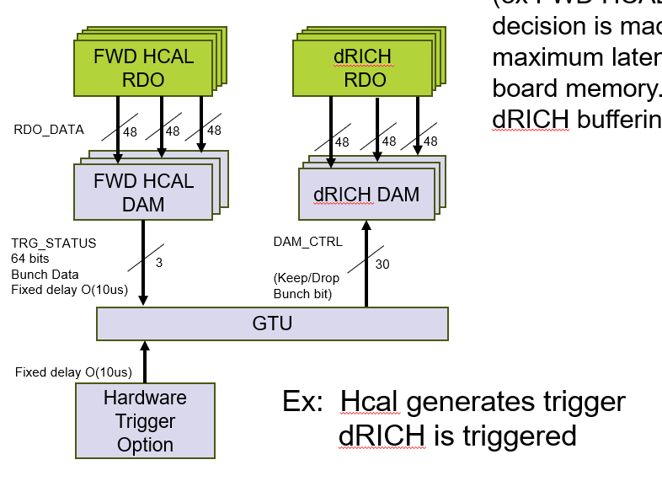
Data Reduction Particulars
Non-destructive reduction techniques:
Compression (Standard or ML techniques)
Reduction of ASIC data inefficiencies (e.g. unhit channels that are read out due to segmentation)
Aggregation of headers
Techniques that drop information:
(1-d) cluster finding for ADC data
SALSA / Discrete readouts (although feature finding might be built in)
(2-d) cluster finding
Feature finding
Convert CALOROC (ADC sequence,TOA,TOT) → (TOA, ADC_{eq} )
High Level Noise Rejection
The plan for the dRICH at high DCR rates is to implement this at the DAM level
Cross-Detector evaluation to select BX ranges to readout dRICH Hits
ML analysis to select real hits
High Level Noise Reduction (Like firmware trigger)

Slide 9
Data Reduction Particulars (2)
Averages / Histograms
Luminosity detectors have about 100 channels of data to be read out at 197MHz
Pure stream of hits @ ~160Gb/sec.
Handle this in DAM board
Sum and write out sum each BX (1.6Gb/sec)
Sum each beam bucket and write out each channel sum every Time Frame (40 Mb/sec)
Simple Analysis
An example might be the SciFi Barrel Ecal which obtains positions by subtracting times from readouts on each end. This subtraction could change 2 hits to 1 effective hit
Arbitrary Deadtime
This is the worst / last-ditch method for reducing data volumes
Typically to be exercised for short periods when electronics modules are misbehaving or for uncontrolled beam backgrounds
Will be initiated when data on RDO path must be truncated.

Slide 10
Data Transfer to Echelon 1
Principles
Equal transfer to both echelon 1 facilities (Both receive copies of data)
The desired transfer time to the echelon 1 is O(seconds) for fast feedback
Buffering for up to several days is available in Echelon 0
Details not yet fully defined
Data transfer mechanisms are under discussion
Orchestration is under discussion
Are reconstructions done twice or are they split between echelon 1 facilities?
How is QA organized
Some QA needed in echelon 0
Physics based QA expected at echelon 1
SDCC
IP-6
BNL ePIC
Echelon 1
ePIC DAQ
Echelon 0
DAQ
ROOM
400Gbps
4Tbps
400Gbps
ESNET
To JLAB ePIC
Echelon 1

Slide 11
Streaming Data Structure
Time Frames are unit of building data within DAQ system
At most 2¹⁶ bunch crossings (660 us)
O(5MB)
Time frames will contain data from all detectors
Time frames are not tied to revolutions of the beam
Do not want persistent effects due to time frame borders being correlated with spin states
Super Time Frames are unit of management of data within S&C
And extended number of Time Frames O(1000)
Time Ordered
Dense (non-overlapping)
ePIC State Machine
Will have continuously running subsystems (24/7) [scaler / luminosity ]
Will have subsystems turned on/off and set to different modes at different times [beam sensitive detectors / detectors with complex configuration / calibration]
Will have subsystem failures (down to RDO level at least), and also intend to have capability for auto-recovery of electronics where possible.
Will have low level failures / timeouts / overruns. The strategy is to mark effected channels and write out unaffected channels

Slide 12
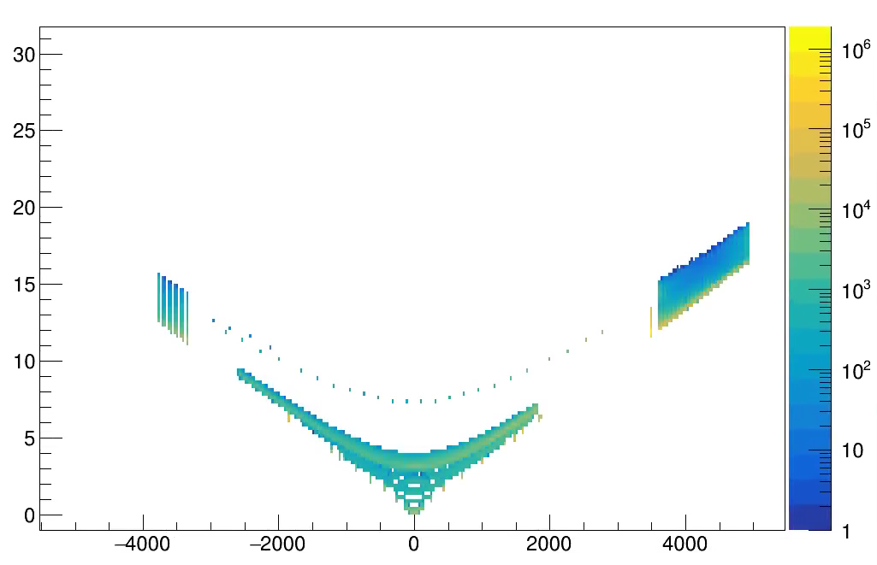
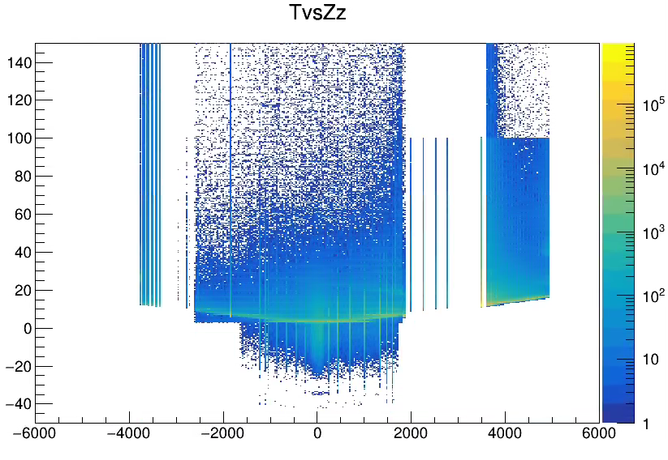
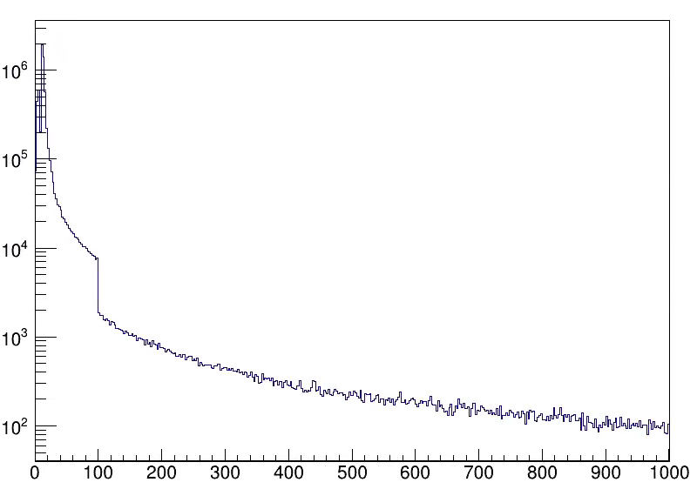
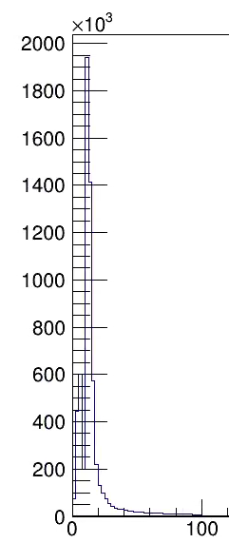
Time Frames (Hit Structure)
Produced Particles
At speed of light
ePIC hits will be marked by a time, not by any association to physics event.
Meaning of times varies by detector
2-8 us resolution for MAPS
25-30 ps resolution for AC-LGAD
Precision doesn’t necessarily match up (e.g. MAPS time value will be quantized at 2-8 us values)
Time storage may differ from presentation (40Mhz / 100MHz)
Time referenced to absolute time of hit, not in any way to the event. Hits from same event have significantly different time values!
Electronics Time Jitter and drift will be low < O(10ps), but must be calibrated to obtain absolute synchronization at this level.
T (ns)
Z (mm)
Simulated

Slide 13
Time Frame (Physical Structure)
The assumption is that time frames can easily be read into memory (2-10 MB / time frame), and so random access is efficient
Physical Structure will reflect convenience and efficiency of DAQ processing
Buffers following structure of data producers
To degree possible buffers are handled as containers (with sub-buffers)
More advanced levels of DAQ do have capability of manipulating sub-buffers (e.g. adding to stream, or removing them from the stream, but not modify them*)
DAM 1
RDO 1
RDO 2
…
RDO N
DAM 2
RDO 1
RDO 2
…
RDO N
DAM 3
RDO 1
RDO 2
…
RDO N
DAM 4
RDO 1
RDO 2
…
RDO N
Time
Frame
DAM “N”
RDO 1
RDO 2
…
RDO N
SC
Echelon 0 Additions

Slide 14
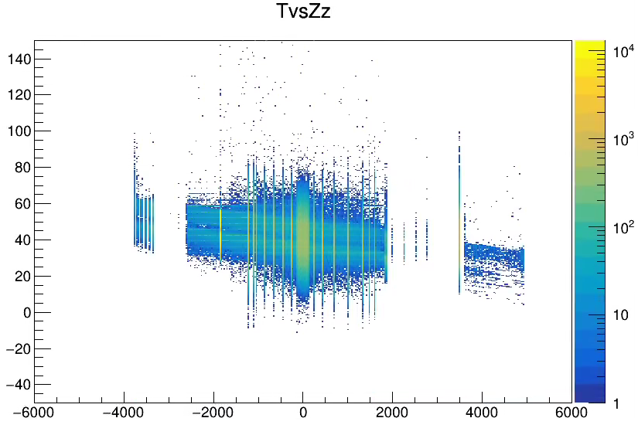
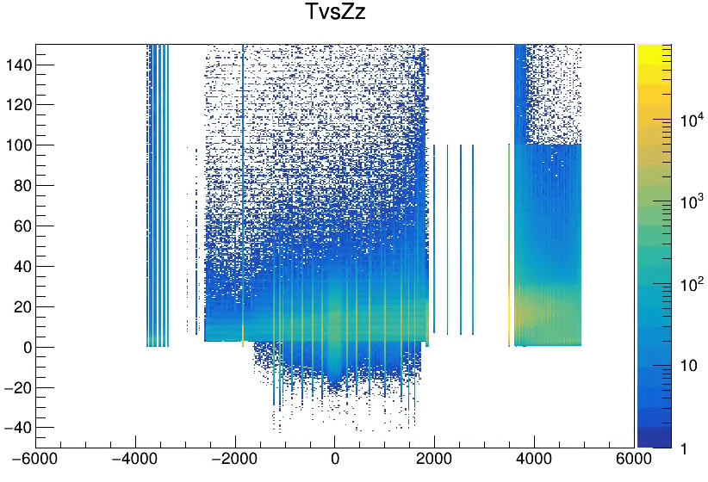
Event Timing
Electron Beam Gas
Simulation (RecHits)
DIS
Proton Beam Gas

Slide 15
Recommendations from PDR 1
Given the requirement for a backup triggered readout for RICH, it is necessary to carefully define the physics trigger rate, trigger conditions, and trigger latency in order to facilitate design of the RICH front-end.
ePIC depends upon a flexible scheme in which sufficient bandwidth is available for data to the dRICH DAM in the worst case. (> 4x safety). The selecting detectors (ex FWD HCAL) generate information characterizing beam in O(10us). The decision is made by the GTU and returned to DAM boards with fixed latency. The maximum latency is orders of magnitudes less than available buffering in DAM board memory. A hardware trigger is supported by the GTU but uses the same dRICH buffering scheme and delays as the firmware trigger option.
FWD HCAL RDO
FWD HCAL RDO
FWD HCAL RDO
FWD HCAL RDO
FWD HCAL RDO
FWD HCAL RDO
FWD HCAL RDO
dRICH
RDO
RDO_DATA
48
48
48
48
48
48
FWD HCAL DAM
dRICH DAM
FWD HCAL DAM
dRICH DAM
Activitiy | Notes
Data Arrives at DAM | <=10us from Bunch Crossing
Data Evaluation (DAM) | 100ns
TRG_STATUS to GTU | Data transmitted to GTU after fixed delay from source crossing O(10us)
Trigger Evaluation on GTU | Fixed Latency O(100ns)
Keep/Drop Bit to DAM | Fixed Latency O(40ns)
Drop data / forward data | Drop Forward after fixed time O(11us)
DAM Buffer | 16GB
Buffer Time available | 2.6 seconds
FWD HCAL DAM
dRICH DAM
TRG_STATUS
64 bits
Bunch Data
Fixed delay O(10us)
DAM_CTRL
3
(Keep/Drop
Bunch bit)
30
GTU
Fixed delay O(10us)
Hardware Trigger Option
Ex: Hcal generates trigger
dRICH is triggered

