Slide 1
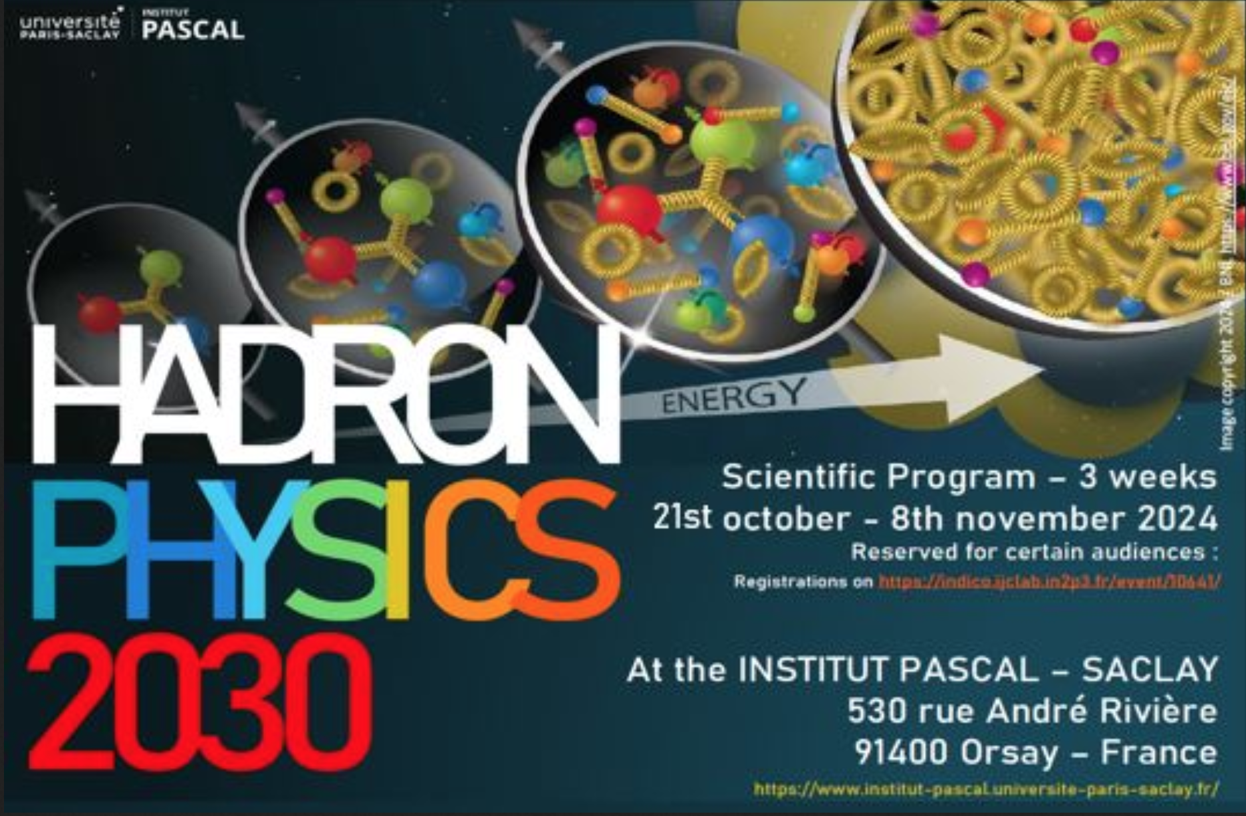
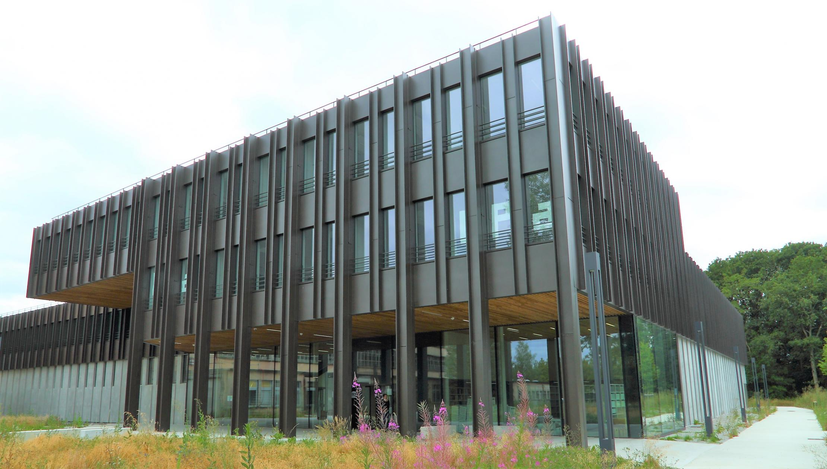
The Hadron Physics 2030 Program
at the
Institut Pascal of the Université Paris-Saclay
HP2030 @ https://indico.ijclab.in2p3.fr/event/10641/
Andrei Afanasev, Marco Battaglieri, Maxime Defurne, Douglas Higinbotham, Cédric Lorcé, Silvia Niccolai, Eric Voutier, Xiaochao Zheng and the HP2030 participants
Positron Working Group Meeting
January 22nd, 2025

Slide 2
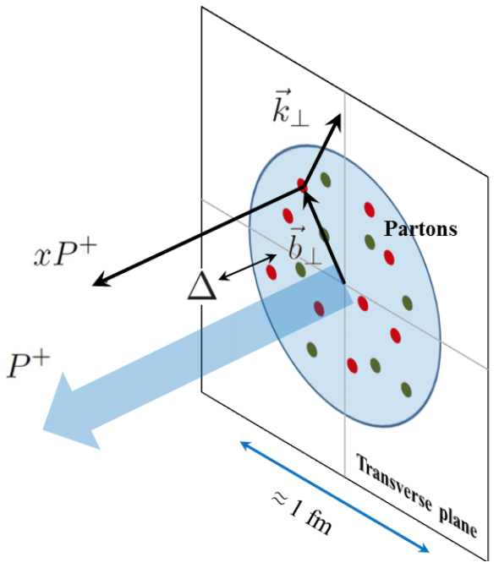
Hadron Physics 2030
The HP2030 program associated two initiatives :
one MDHS theoretically oriented and the other JPhys⁺⁺ more experimentally oriented.
MDHS : Multidimensional Hadron Structure at the Dawn of the High-Precision Era
C. Mézrag and collaborators
The scientific goal of MDHS was to initiate the reflexion about the theoretical and phenomenological tools needed to exploit the full potentiality of high-precision data (JLab, EIC) and to connect experimental data with hadron structures.
JPhys⁺⁺ : Physics Opportunities with Jefferson Lab Positron and Energy Upgrades
E. Voutier and collaborators
The scientific goal of JPhys⁺⁺ was to develop and obtain the scientific material necessary for new experimental proposals and new directions of research in support of the JLab Upgrade Initiatives.
https://indico.ijclab.in2p3.fr/event/10641/
2/35
January 22nd, 2025

Slide 3
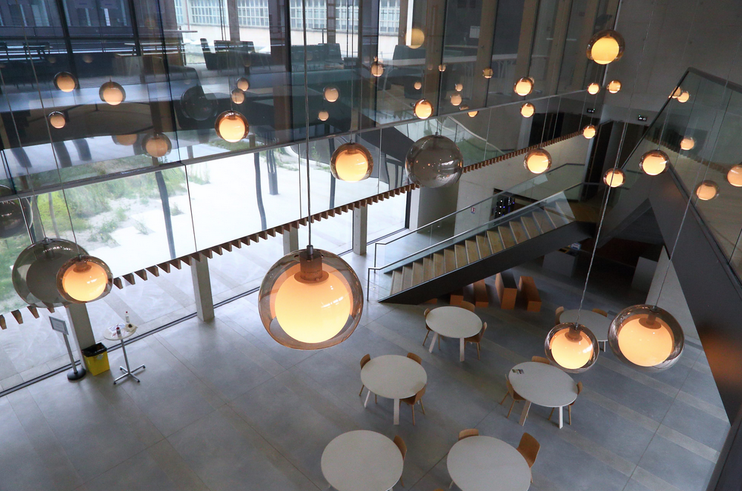

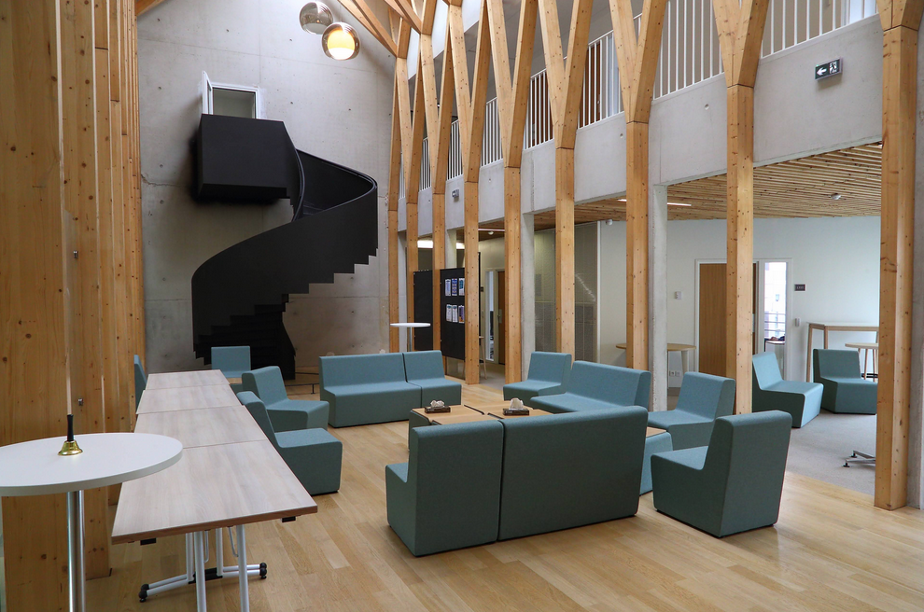
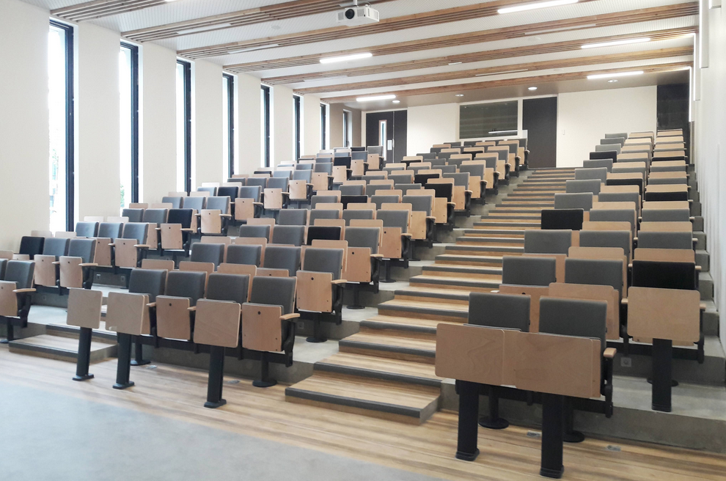






Hadron Physics 2030
The HP2030 program was hosted and supported by the Institut Pascal of the Université Paris-Saclay which operates similarly to the ECT Trento or the INT Seattle, covering however a wider domain of Science.
HP2030 ran over 3 weeks from October 21st up to November 8th and gathered 107 participants for different period of times and with an hybrid participation mode during the last week.
3/35
January 22nd, 2025

Slide 4
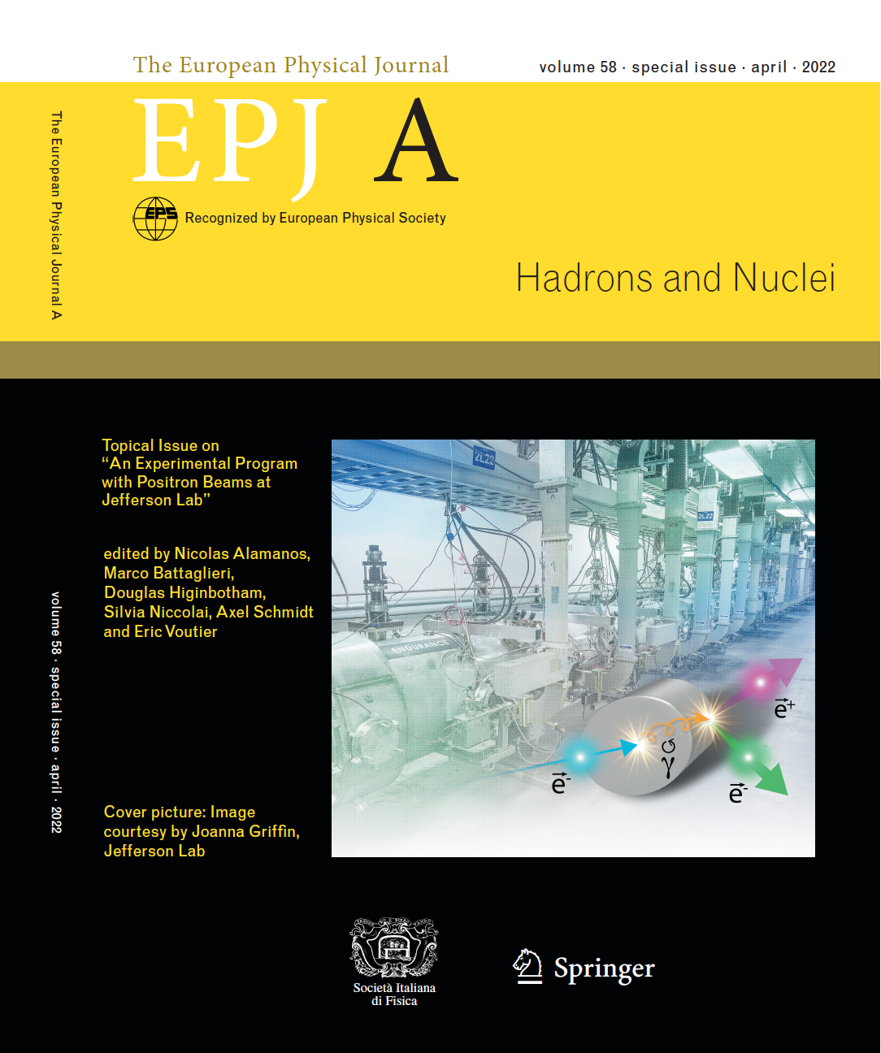

JLab Positron Working Group
The JLab Positron Working Group (PWG) developed the perspectives of an experimental program with positron beams at CEBAF in a topical EPJ A issue.
This document constitutes the JLab Positron White Paper, gathering 19 single contributions and a summary article, all peer-reviewed.
JLab PWG = $\sim$250 Physicists
from 75 Institutions and 16 countries
(Jefferson Lab Positron Working Group) A. Accardi et al. EPJ A 57 (2021) 261
Subscribe to the JLab Positron Working Group mailing list pwg@jlab.org
4/35
January 22nd, 2025

Slide 5
JLab Positron Physics Program
The Positron Experimental Program at JLab represents today 6 approved proposals (C1) validating the 3 pillars of the JLab Positron White Paper and representing 412 days of single hall running.
NUMBER | TITLE | PHYSICS THEME | CONTACT PERSON | HALL | DAYS AWARDED | SCIENTIFIC RATING | PAC DECISION
PR12+23-002 | Beam Charge Asymmetries for Deeply Virtual Compton Scattering on the Proton at CLAS12 | GPDs | Eric Voutier | B | 100 | A- | C1
PR12+23-003 | Measurement of Deep Inelastic Scattering from Nuclei with Electron and Positron Beams to Constrain the Impact of Coulomb Corrections in DIS | TPE | Dave Gaskell | C | 9.3 | A- | C1
PR12+23-006 | Deeply Virtual Compton Scattering using a positron beam in Hall C | GPDs | Carlos Muñoz Camacho | C | 137 | A- | C1
PR12+23-008 | A Direct Measurement of Hard Two-Photon Exchange with Electrons and Positrons at CLAS12 | TPE | Axel Schmidt | B | 55 | A | C1
PR12+23-012 | A measurement of two-photon exchange in unpolarized elastic positron–proton and electron–proton scattering | TPE | Michael Nycz | C | 56 | A- | C1
PR12+24-005 | A dark photon search with a JLab positron beam | BSM | Bogdan Wojtsekhowski | B | 55 | A- | C1
C1 = Conditionally Approved with Technical Review by the Lab
+ 6 Letters of Intent...
5/35
January 22nd, 2025

Slide 6










Ce⁺BAF Working Group
Contact grames@jlab.org for joining the group
T. Abe, J. Benesch, A. Bogacz, M. Bruker, L. Cardman, J. Conway, S. Covrig, P. Degtiarenko, Y. Enomoto,
S. Gessner, P. Ghoshal, S. Gopinath, J. Grames, J. Gubeli, C. Gulliford, S. Habet, G. Hays, C. Hernández-García,
D. Higinbotham, A. Hofler, R. Kazimi, M. Kostin, V.O. Kostroun, F. Lin, V. Lizarraga-Rubio, K. Malher,
Y. Morikawa, S. Nagaitsev, E. Nanni, S. Ogur, G. Palacios-Serrano, N. Raut, B. Rimmer, Y. Roblin, A. Seryi,
K. Smolenski, M. Spata, M. Stutzman, R. Suleiman, A. Sy, N. Taylor, D. Turner, A. Ushakov, C. Valerio-Lizarraga, E. Voutier, H. Wang, S. Wang, M. Yamamoto, S. Zhang, Y. Zhang
(Ce⁺BAF Working Group) J. Grames et al. JACoW IPAC2023 (2023) MOPL152
S. Habet et al. JACoW IPAC2022 (2022) 457 R. Kazimi et al. JACoW IPAC2023 (2023) WEPA035 A. Sy et al. JACoW IPAC2023 (2023) MOPM081
Ushakov et al. JACoW IPAC2023 (2023) WEPM120
S. Wang et al. JACoW IPAC2024 (2024) MOPC51 M.W. Bruker et al. JACoW IPAC2024 (2024) MOPC52 A. Sy et al. JACoW IPAC2024 (2024) MOPC53
A. Ushakov et al. JACoW IPAC2024 (2024) MOPC54 T. Lengler et al. JACoW IPAC2024 (2024) TUPC81
6/35
January 22nd, 2025

Slide 7
JPhys⁺⁺ Objectives
The purpose of the JPhys⁺⁺ program was to push further the physics reach of JLab Upgrade Initiatives, investigating physics potentialities at LERF and Ce⁺BAF
Physics @ LERF
at very low beam energies
I_{e} < 10 mA P_{e} > 80% T_{e} < 10 MeV
I_{p} < 10 nA P_{p} < 60% T_{p} < 10 MeV
Physics @ Ce⁺BAF
at high beam energies
I_{p} > 50 nA P_{p} > 60% T_{p} < 12 GeV
I_{p} > 1 μA P_{p} < 10% T_{p} < 12 GeV
Physics @ LERF
at low beam energies
I_{e} < 1 mA P_{e} > 80% T_{e} < 150 MeV
I_{p} > 50 nA P_{p} > 60% T_{p} < 123 MeV
I_{p} > 1 μA P_{p} < 10% T_{p} < 123 MeV
7/35
January 22nd, 2025

Slide 8
JPhys⁺⁺ Overview
Scientific Program
(Jefferson Lab Positron Working Group) A. Accardi et al. EPJ A 57 (2021) 261
The JPhys⁺⁺ program developed over a period of 3 weeks, the first 2 in-person and the last in hybrid mode, with a specific attention on the discussion time.
The scientific program was organized around 4 principal thematics covering the 3 pilars of the JLab Positron White Paper, and a few general presentations.
Form Factors
&
Multi-Photon Exchange
Nucleon & Nuclear
Generalized Parton Distributions
Hadron Mass
&
Meson Structure
Electroweak Processes
&
Test of the Standard Model
General Presentations
Whitney Armstrong – High-precision hadron structure: charge symmetry violation in PDFs and fragmentation function
Valerio Bertone – A brief introduction to TMD factorization
Douglas Higinbotham – Overview of the Jefferson Lab long term schedule: from 12 GeV to positrons and beyond
Charlotte van Hulse – Exclusive processes at the LHC and synergies with the EIC
Patrizia Rossi – The Jefferson Lab 22 GeV upgrade
Andriy Ushakov – Positron beams for 12 GeV CEBAF
8/35
January 22nd, 2025

Slide 9
JPhys⁺⁺ Overview
CEBAF / Ce⁺BAF / JLab22
D. Higinbotham @ HP2030
Considering a notional DOE budget profile, Ce⁺BAF construction may potentially start early 2030s.
Activities | Fiscal Year
 | 24 | 25 | 26 | 27 | 28 | 29 | 30 | 31 | 32 | 33 | 34 | 35 | 36 | 37 | 38 | 39 | 40 | 41 | 42
Moller Project and Experiment
SoLID
Positron Source (R&D)
CEBAF Upgrade preCDR/preplan
Positron Project (potential)
Positron Physics
22 GeV Development (R&D)
22 GeV Project (potential)
EIC Project (partner with BNL)
CEBAF Up
9/35
January 22nd, 2025

Slide 10
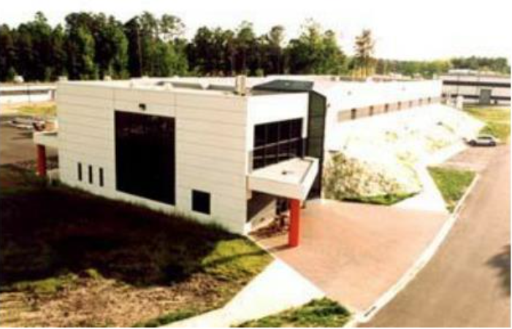
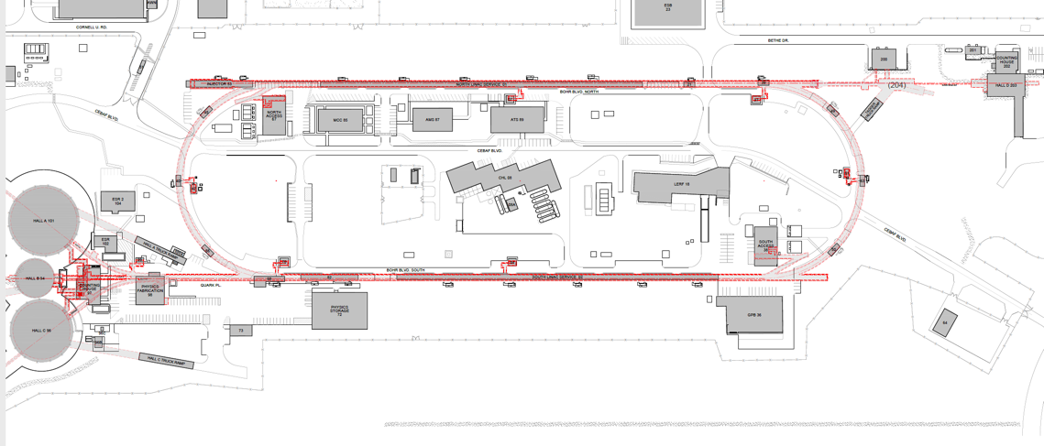
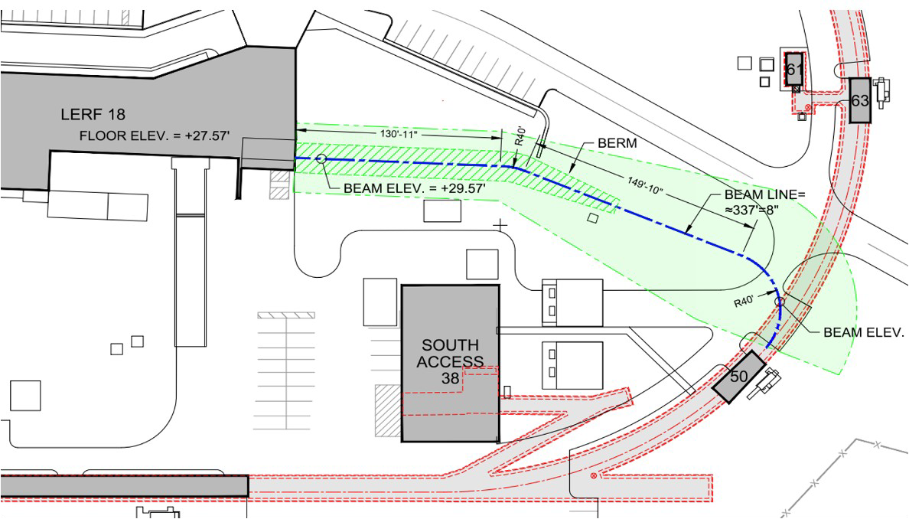
JPhys⁺⁺ Overview
The Ce⁺BAF Project
A. Ushakov @ HP2030
LERF
CEBAF Polarized
Electron Injector
123 MeV e⁺ Beam
Injected to NL
North Linac
West Arc
New e⁺ Injector
at LERF
East Arc
123 MeV e⁺
New Beamline
to CEBAF Tunnel
South Linac
New Transport Line
along SL and West Arc
LERF – Low Energy Recirculation Facility
J. Grames et al., IPAC’23, MOPL152
10/35
January 22nd, 2025

Slide 11
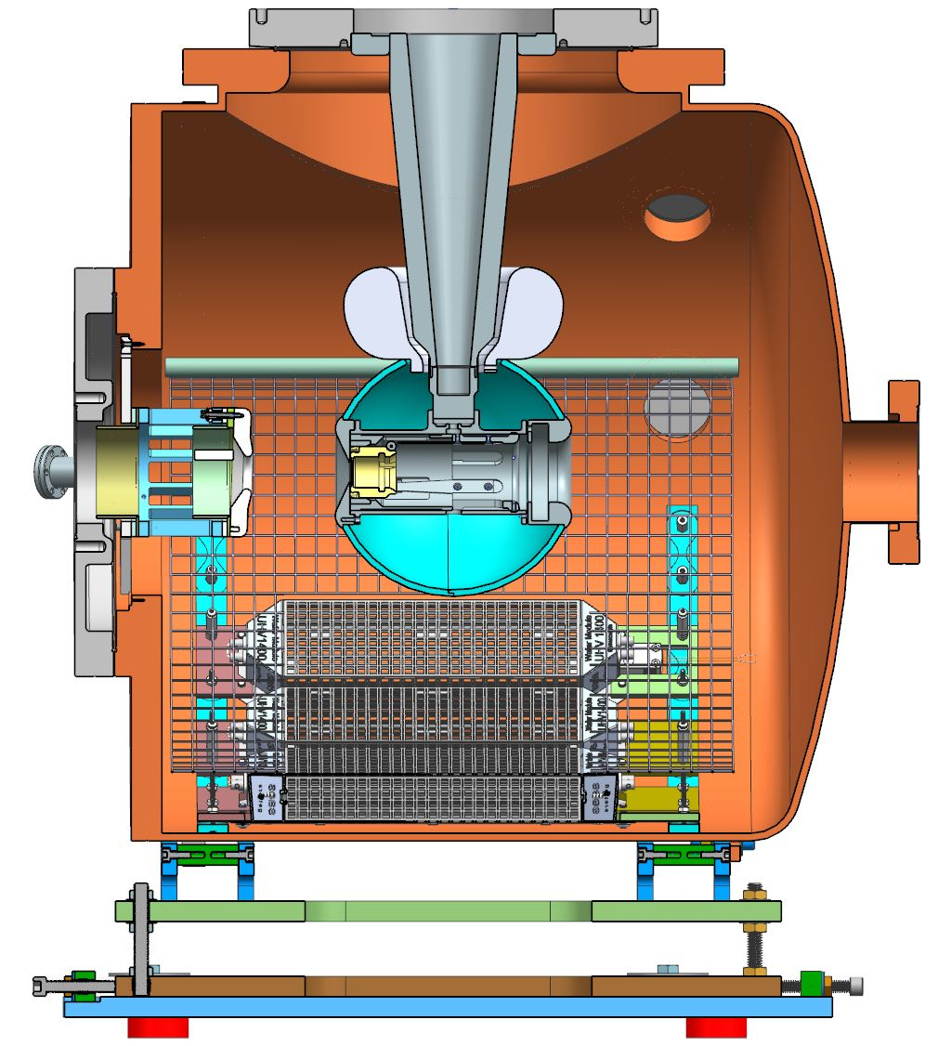
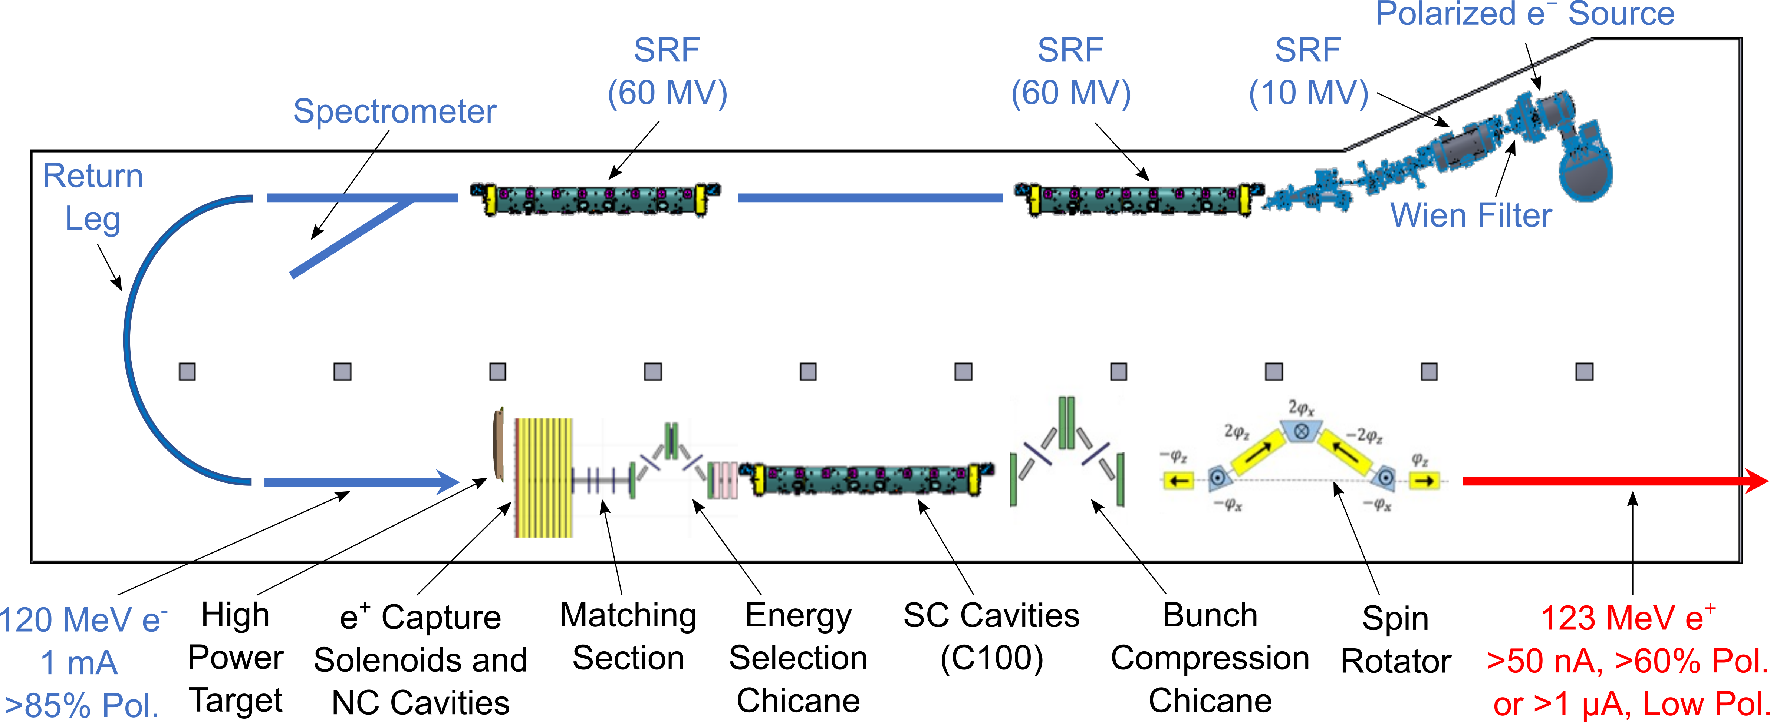
JPhys⁺⁺ Overview
e⁺ @ LERF
A. Ushakov @ HP2030
The critical risk areas (mA polarized e⁻ source, high power target, capture cavities) are currently investigated.
Within the 2 coming years, a 10 MeV high power test bench will be available at LERF.
e⁻ source : JLab LDRD – FY25-26
Solid target : DOE FY24 R&D for Next Generation Nuclear Physics Accelerator Facilities – FY25-26
Liquid target : DOE SBIR Phase 2 – FY25-26
Cavities : DOE HEP Advanced Positron Concepts, US-Japan Coll. (SLAC/JLab/KEK) – FY25-26
Target Test Area
To CEBAF
Ce⁺BAF White Paper
within 18 months
11/35
January 22nd, 2025

Slide 12
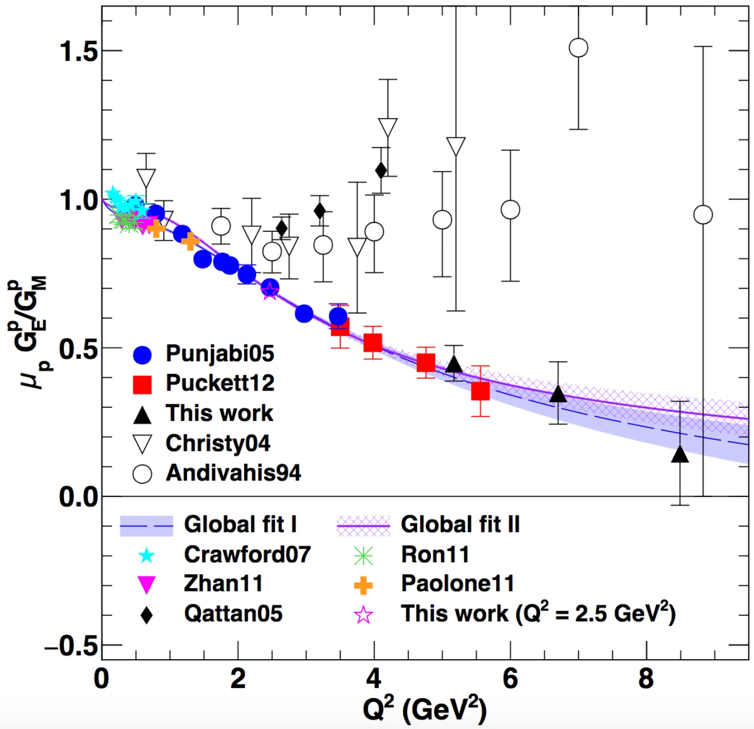
Form Factors & Multi-Photon Exchange
JLab e⁺-Program : Pillar 1
A.J.R. Puckett et al. PRC 96 (2017) 055203
Andrei Afanasev – QED corrections and Two-Photon Exchange in 3D imaging of hadrons
Harut Avagyan – Target fragments in SIDIS and connection with exclusive processes
Jan Bernauer – Opportunities for unpolarized Two-Photon Exchange measurements at Jefferson Lab
Ethan Cline – The Two-Photon Exchange experiment at DESY
Ethan Cline – Two-Photon Exchange and proton form-factor measurements with MUSE
Alexandre Deur – Measurement of the axial form factor at JLab using inverse β-decay
Dipangkar Dutta – PRad/DRad with positrons
Eric Fuchey – Measurement of Two-Photon Exchange in electron- and positron-neutron scattering
Dave Gaskell – Testing Coulomb corrections in DIS and SIDIS with positron beams
Franziska Hagelstein – Two-Photon Exchange in spectroscopy (and scattering)
Tyler Hague – Accessing Two-Photon Exchange in inclusive Deep-Inelastic Scattering with unpolarized e⁺/e⁻ ratios
Doris Jakubaßa-Amundsen – Radiative corrections to the parity-violating spin-asymmetry in elastic eA collisions
Tim Kolar – Nuclear density dependence of polarization transfer in A(e,e’p) reaction
Stinson Lee – Evaluation of Two-Photon Exchange for semi-inclusive deep-inelastic electron-nucleon scattering
Atharva Naik – Pion contribution to Two-Photon Exchange of elastic muon-proton scattering
Michael Nycz – A measurement of Two-Photon Exchange in unpolarized elastic e⁺p and e⁻p scattering
Andrew Puckett – Polarization transfer in positron-proton elastic scattering
Axel Schmidt – Probing Two-Photon Exchange through polarization observables
Marc Shlegel – The transverse nucleon single-spin asymmetry in inclusive DIS caused by a Two-Photon Exchange
Karl Slifer – Potential physics with positrons and the Solid Polarized Target
Yannick Ulrich – Radiative corrections to lepton-nucleon scattering with McMule
Q² (GeV²)
12/35
January 22nd, 2025

Slide 13
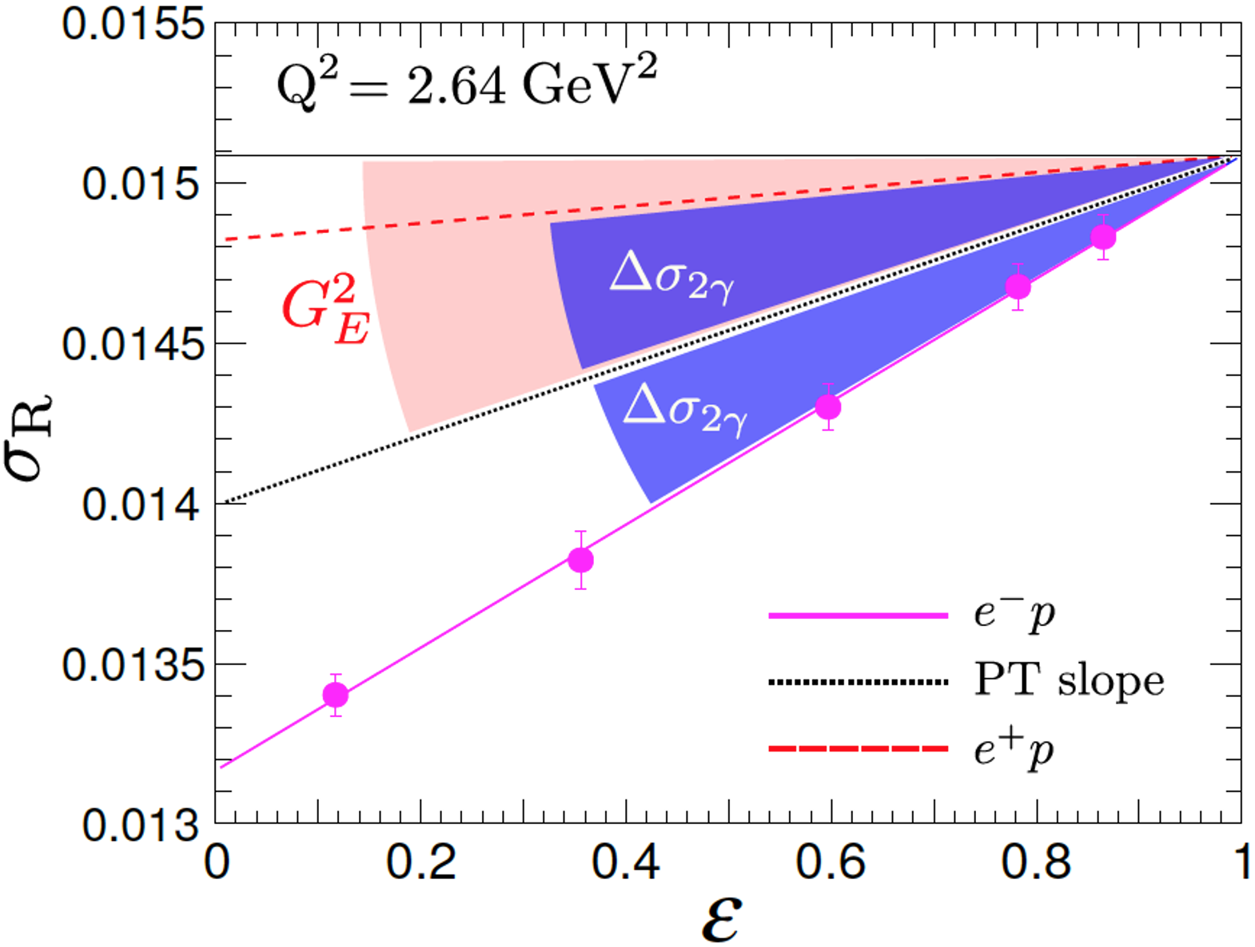
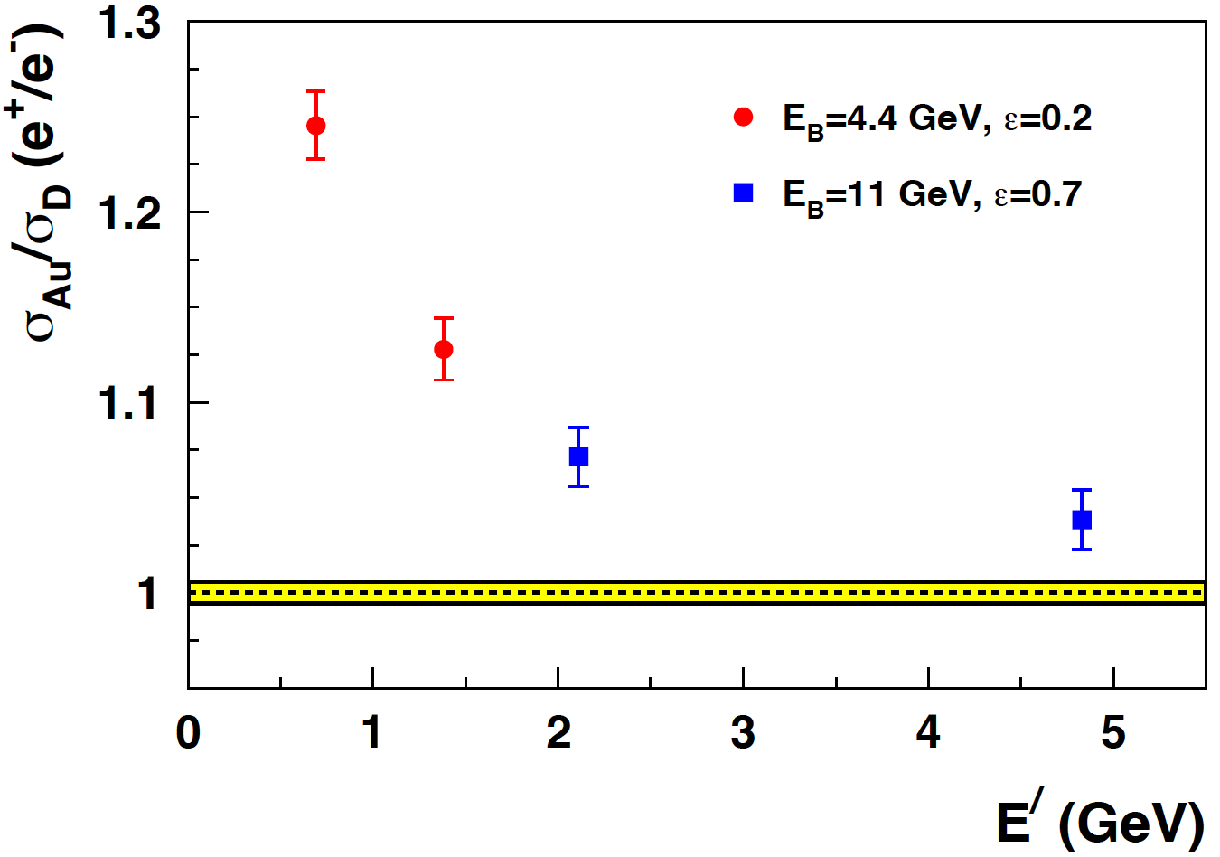
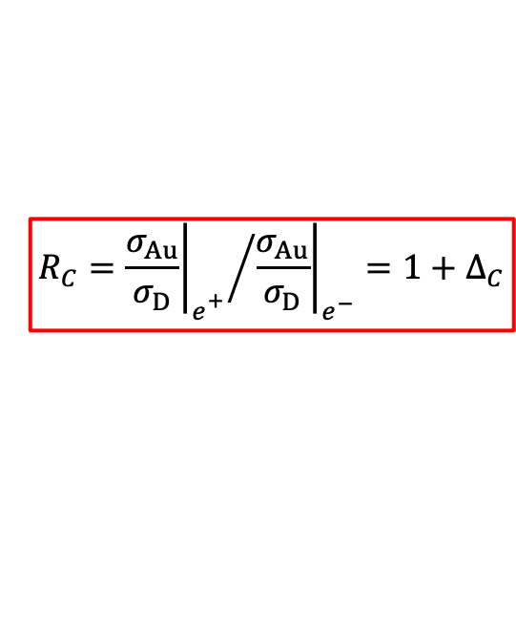


Form Factors & Multi-Photon Exchange
Current Status
J.C. Bernauer et al. EPJA 57 (2021) 144 J. Arrington, M. Yurov, EPJ A 57 (2021) 319 J.C Bernauer @ HP2030
D. Gaskell @ HP2030 M. Nycz @ HP2030
The multi-photon experimental program of the JLab PWG presently consists of the measurement of Two-Photon Exchange in electron and positron elastic scattering off protons and of Coulomb corrections in Deep Inelastic Scattering.
$$R_{2γ}=\frac{σ_{e^{+}}}{σ_{e^{−}}}≈1+δ_{2γ}$$
$$R_{C}={{\left.\frac{σ_{Au}}{σ_{D}}\right|}_{e_{}^{+}}}/{{\left.\frac{σ_{Au}}{σ_{D}}\right|}_{e^{−}}}=1+∆_{C}$$
$$σ_{R}=G_{M}\left(G_{M}±{∆′}_{σ_{2γ}}\right)+\frac{ε}{τ}G_{E}\left(G_{E}±∆_{σ_{2γ}}\right)$$
PR12+23-008 A. Schmidt et al.
PR12+23-012 M. Nycz et al.
PR12+23-003 D. Gaskell et al.
13/35
January 22nd, 2025

Slide 14
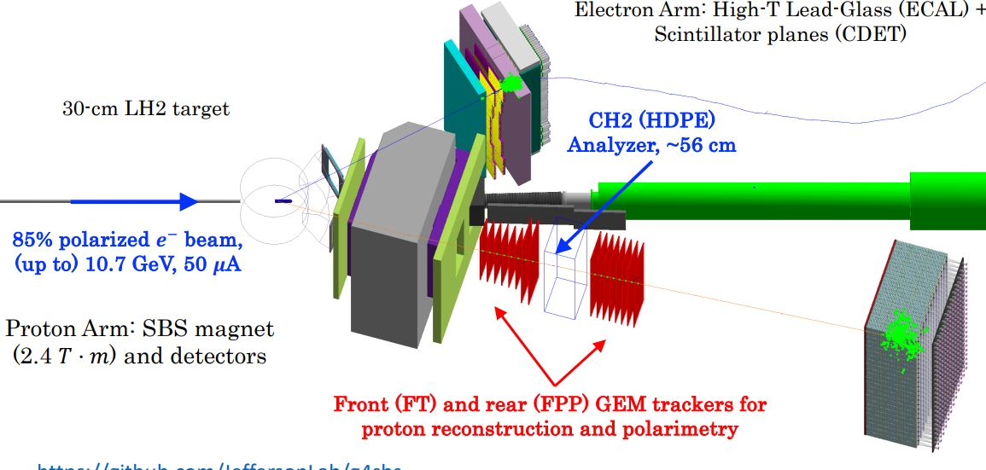
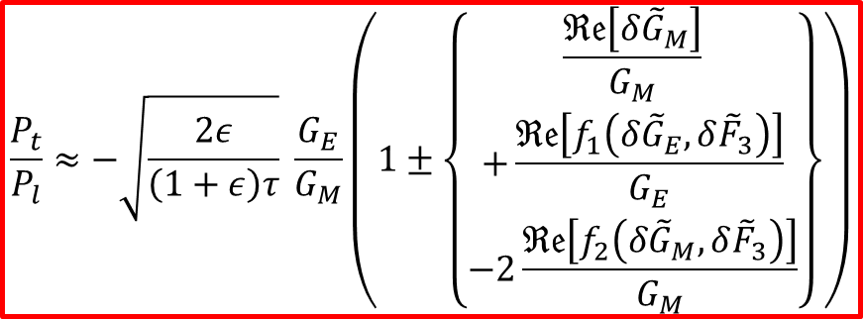
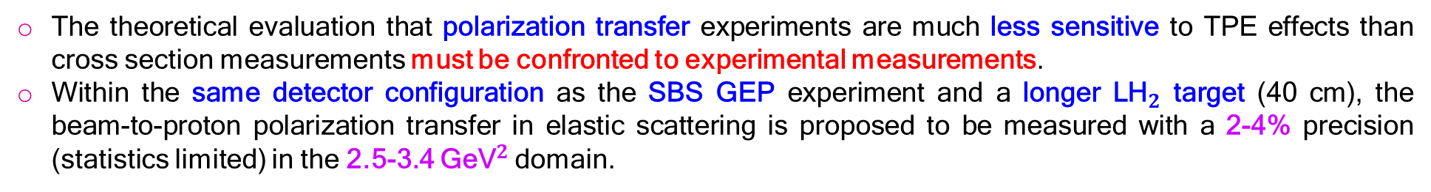

Form Factors & Multi-Photon Exchange
Polarization Transfer
A.J.R. Puckett, J.C. Bernauer, A. Schmidt EPJ A 57 (2021) 188 A.J.R. Puckett, J.C. Bernauer, A. Schmidt et al. LOI12+23-008 A.J.R. Puckett @ HP2030
The theoretical evaluation that polarization transfer experiments are much less sensitive to TPE effects than cross section measurements must be confronted to experimental measurements.
Within the same detector configuration as the SBS GEP experiment and a longer L${\text{H}}_{2}$ target (40 cm), the beam-to-proton polarization transfer in elastic scattering is proposed to be measured with a 2-4% precision (statistics limited) in the 2.5-3.4 ${\text{GeV}}^{2}$domain.
$$\frac{P_{t}}{P_{l}}≈−\sqrt{\frac{2ε}{\left(1+ε\right)τ}} \frac{G_{E}}{G_{M}}\left(1±\left\{\begin{aligned}\frac{ℜ𝔢\left[δ{\tilde{G}}_{M}\right]}{G_{M}} \\ +\frac{ℜ𝔢\left[f_{1}\left(δ{\tilde{G}}_{E},δ{\tilde{F}}_{3}\right)\right]}{G_{E}} \\ −2\frac{ℜ𝔢\left[f_{2}\left(δ{\tilde{G}}_{M},δ{\tilde{F}}_{3}\right)\right]}{G_{M}}\end{aligned}\right\}\right)$$
40 cm LH2 target
60% polarized ${\text{e}}^{+}$ beam
2.2-4.4 GeV, 50 nA
SBS magnet
2.4 T.m
14/35
January 22nd, 2025

Slide 15
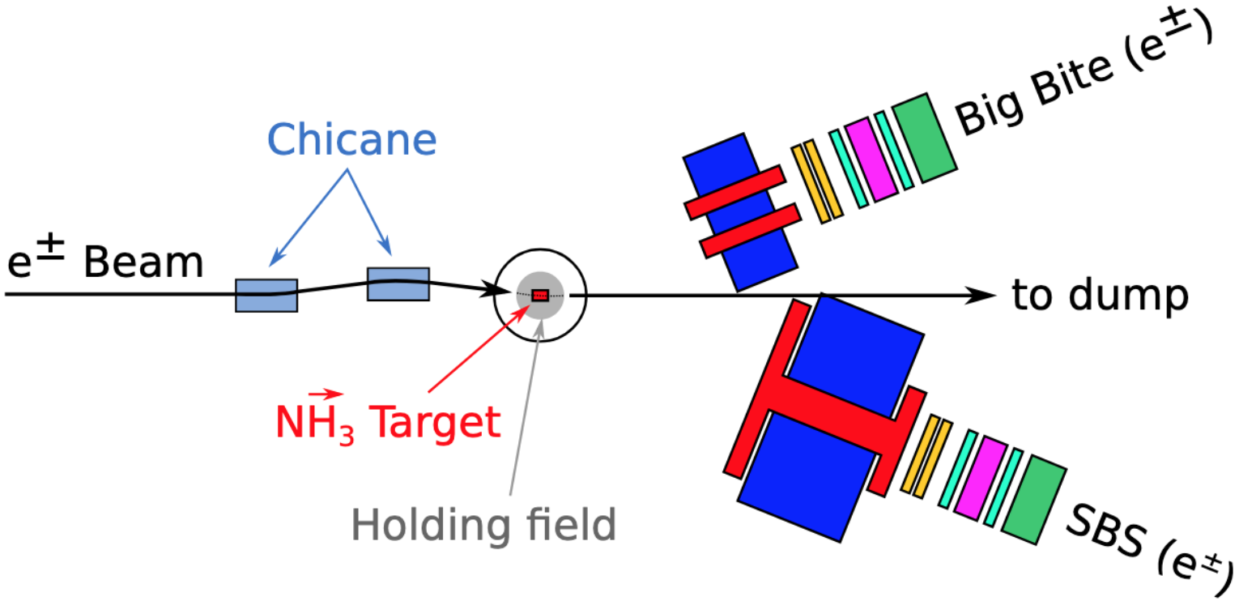
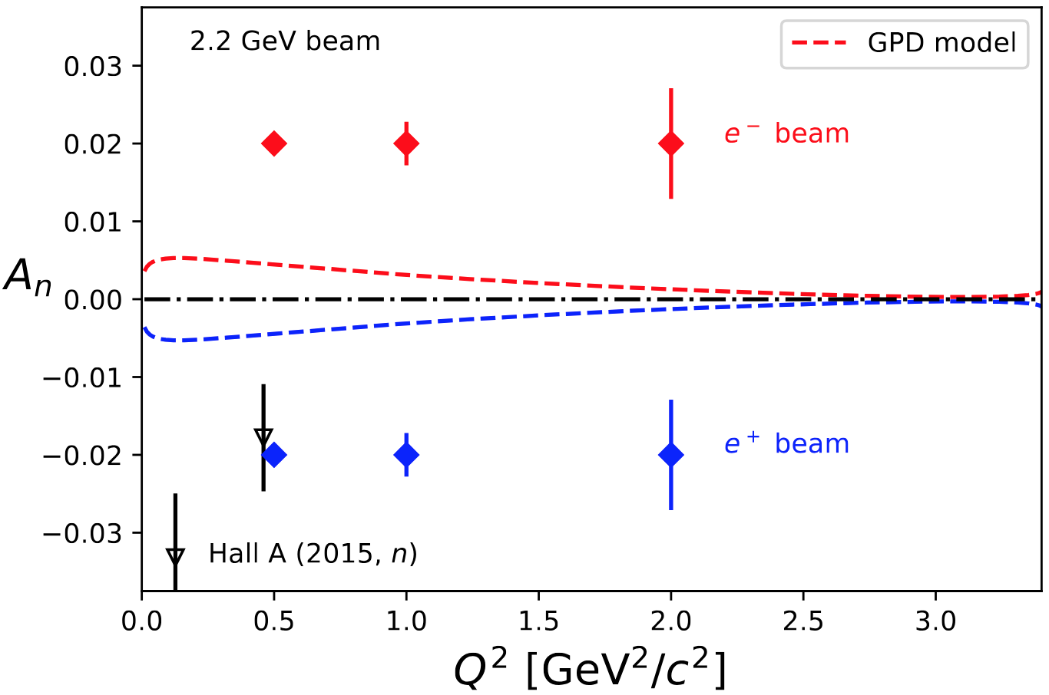
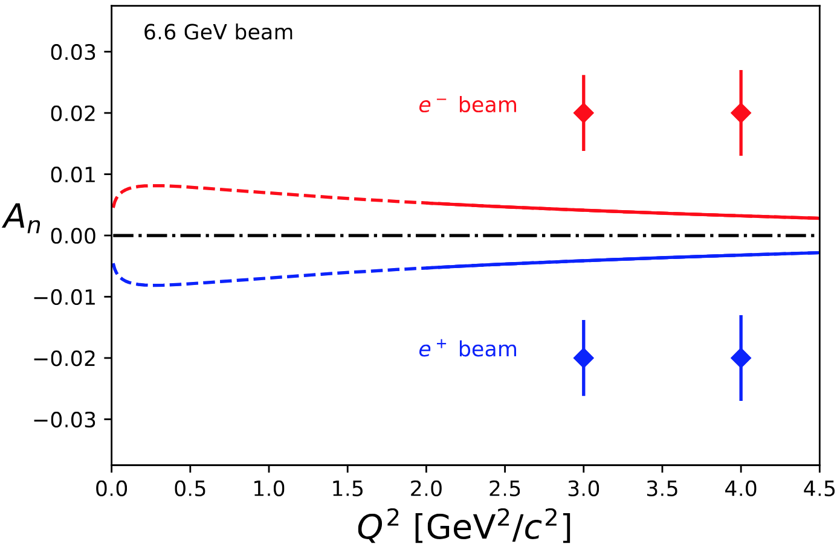
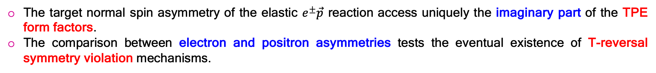
Form Factors & Multi-Photon Exchange
Target Normal Spin Asymmetry
G.N. Grauvogel, T. Kutz, A. Schmidt EPJA 57 (2021) 213 A. Schmidt @ HP2030
The target normal spin asymmetry of the elastic $e^{±}\vec{p}$ reaction access uniquely the imaginary part of the TPE form factors.
The comparison between electron and positron asymmetries tests the eventual existence of T-reversal symmetry violation mechanisms.
$$A_{n}≅\frac{2ε\left(1+ε\right)}{τ} {\left(G_{M}^{2}+\frac{ε}{τ}G_{E}^{2}\right)}^{−1} \left\{G_{E} ℑ𝔪\left[f_{3}\left(δ{\tilde{G}}_{M},δ{\tilde{F}}_{3}\right)\right]−G_{M} ℑ𝔪\left[f_{1}\left(δ{\tilde{G}}_{E},δ{\tilde{F}}_{3}\right)\right]\right\}$$
A_{n} proposal under study using CLAS12 and CEBAF e⁻ beam within Run Group H featuring a transversally polarized target.
15/35
January 22nd, 2025

Slide 16
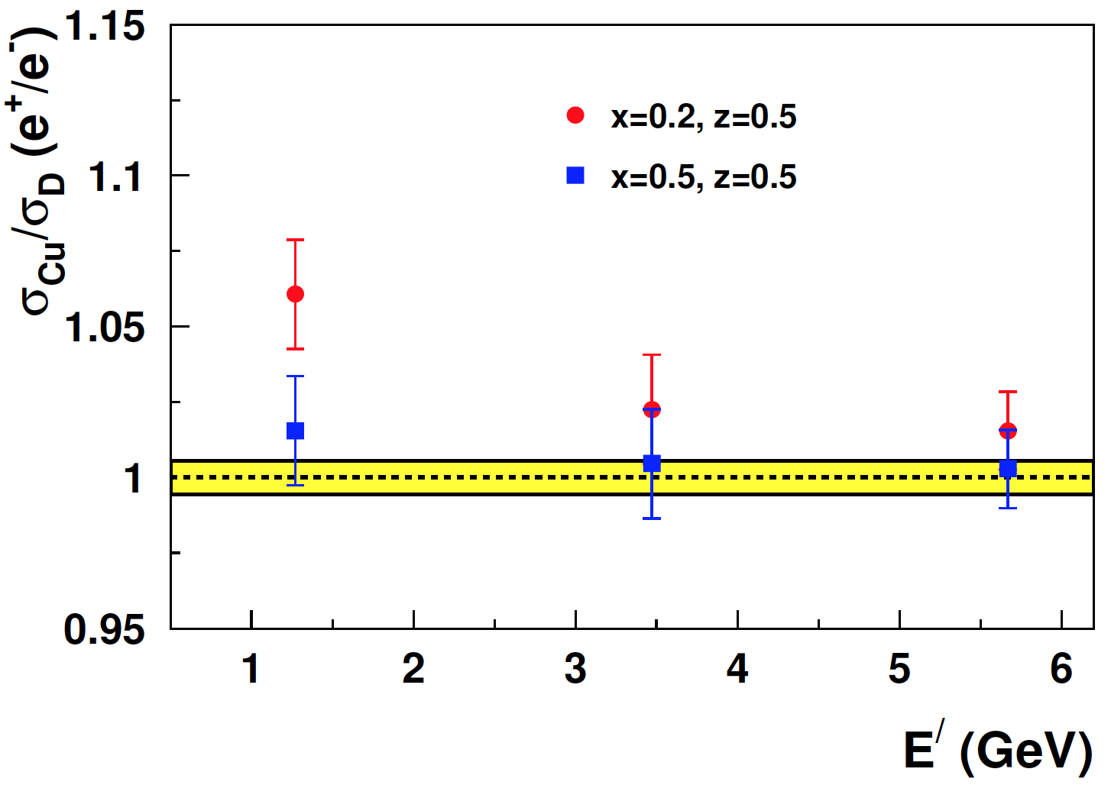
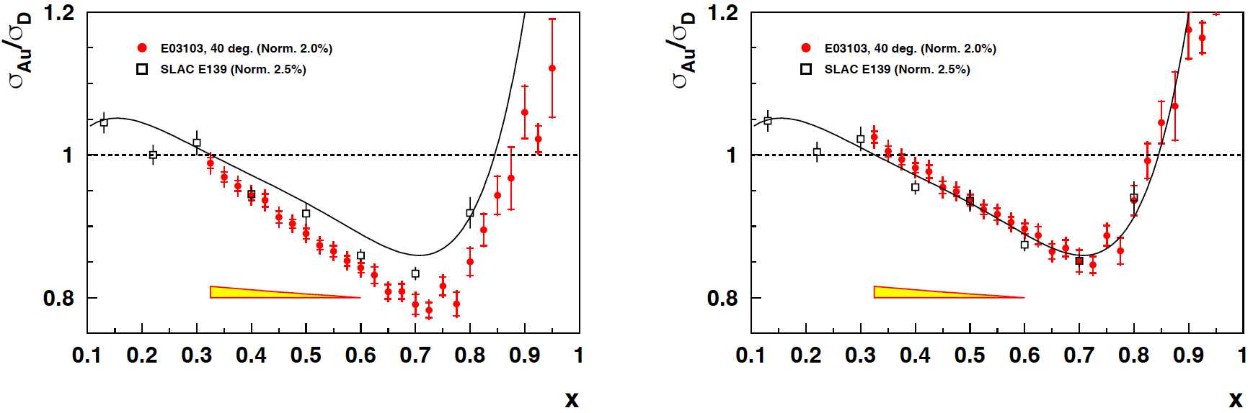
Form Factors & Multi-Photon Exchange
Coulomb Corrections in SIDIS
D. Gaskell @ HP2030
The appropriate description of Coulomb Corrections is of relevance for the understanding of the nuclear dependency of physics phenoma : the EMC effect in DIS experiments, the nucleus dependence of σ_{L}/σ_{T} in SIDIS measurements...
Prescriptions have been derived in the quasi-elastic domain of which application to DIS and SIDIS regimes must be experimentally confirmed.
Projections
(40 days)
Impact of Coulomb corrections on JLab Hall C EMC data, determined from the Improved Effective Momentum Approximation.
16/35
January 22nd, 2025

Slide 17
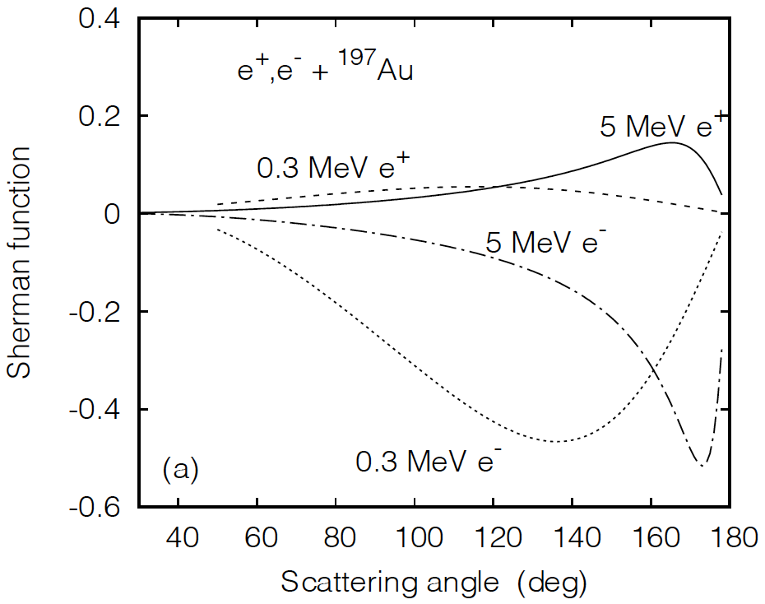
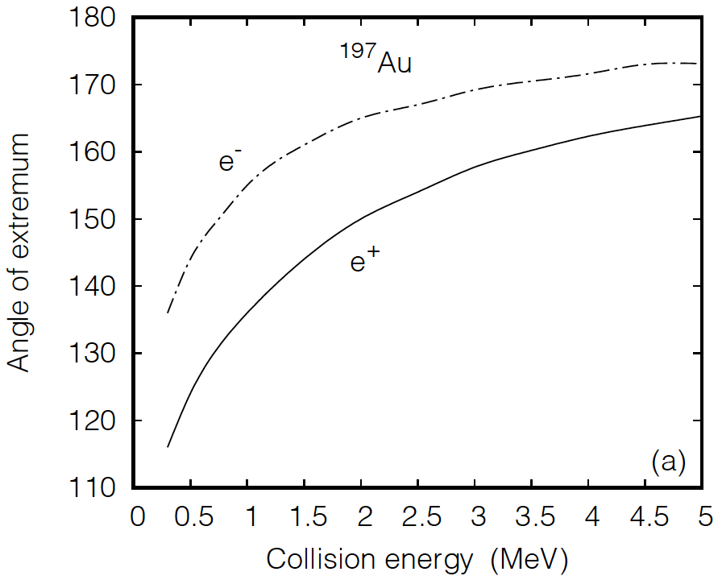
Form Factors & Multi-Photon Exchange
Beam Normal Spin Asymmetry @ LERF
D. Jakubaßa-Amundsen @ HP2030
Multi-Photon Exchange is responsible of the sensivity of the elastic $e^{±}A$interaction to the transverse polarization of the incoming lepton beam, which is expressed in the Sherman function.
The same principle operates the 5 MeV Mott polarimeter at the CEBAF injector.
The measurement of the angular distribution of the Sherman function with polarized e⁻ and e⁺ in 1-10 MeV range is an opportunity for the commissionning of the Ce⁺BAF e⁻/e⁺ source at LERF and is of interest to electron and positron polarimetry.
17/35
January 22nd, 2025

Slide 18
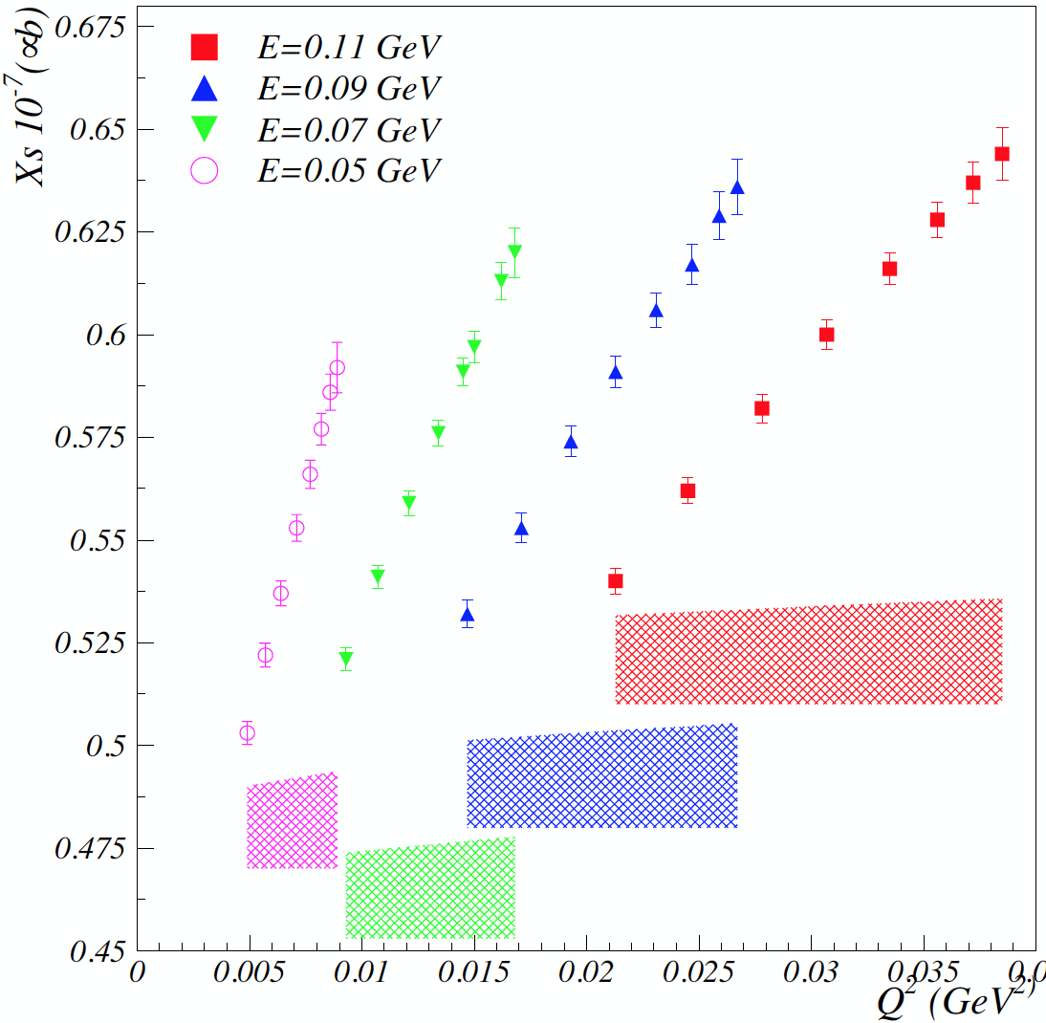
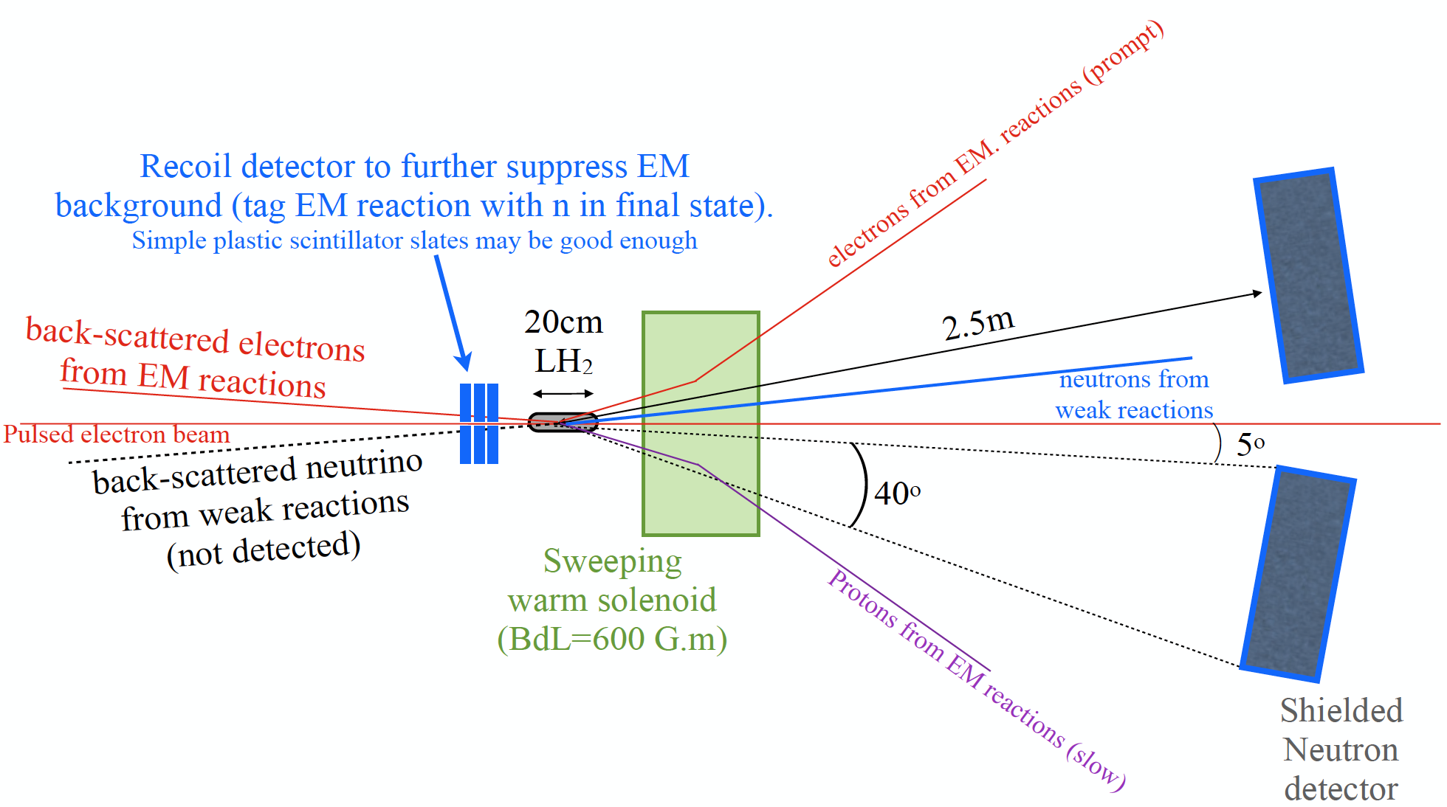

Form Factors & Multi-Photon Exchange
Axial Form Factor @ LERF
A. Deur @ HP2030
Taking advantage of a high intensity (I_{e} < 1 mA), highly polarized (P_{e} > 80%) electron beam with low energy (T_{e} < 150 MeV), the axial form factor G_{A}(Q²) of the proton can be measured in elastic scattering, that is inverse β-decay.
The experiment does not require new technology but demands a well-designed detector and very efficient background suppression techniques.
Inverse β-decay is the cleanest access to G_{A}(Q²)
${\vec{e}}^{−}+p⟶n+ν_{e}$
- Pulsed (50 MHz) electron beam
- High efficiency neutron detector
- Sweeping magnet
- Electron recoil detector
- High purity LH₂ target with Be windows
60 days @ I_{avg} = 100 μA
4% systematics bands
2
)
18/35
January 22nd, 2025

Slide 19
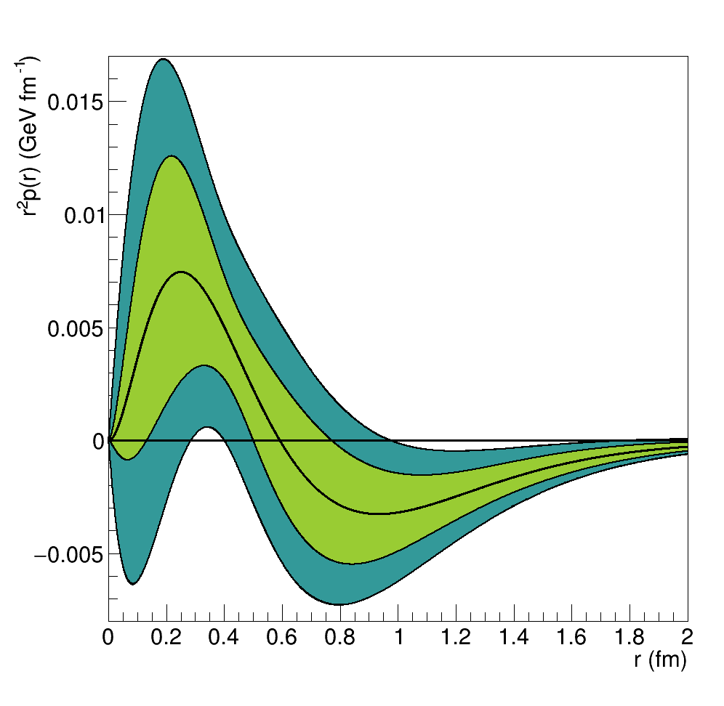
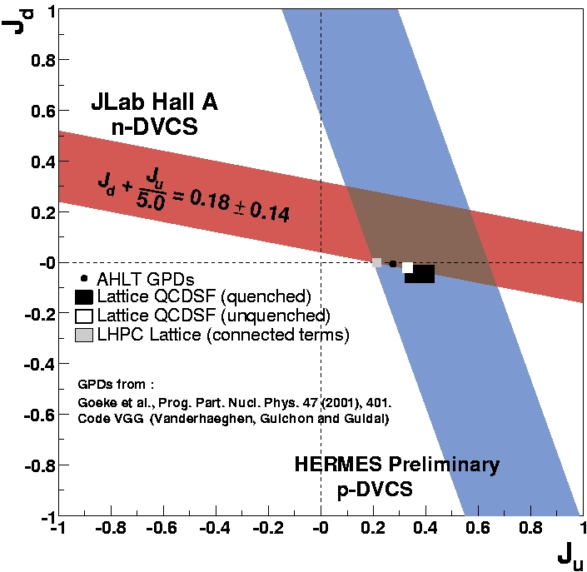
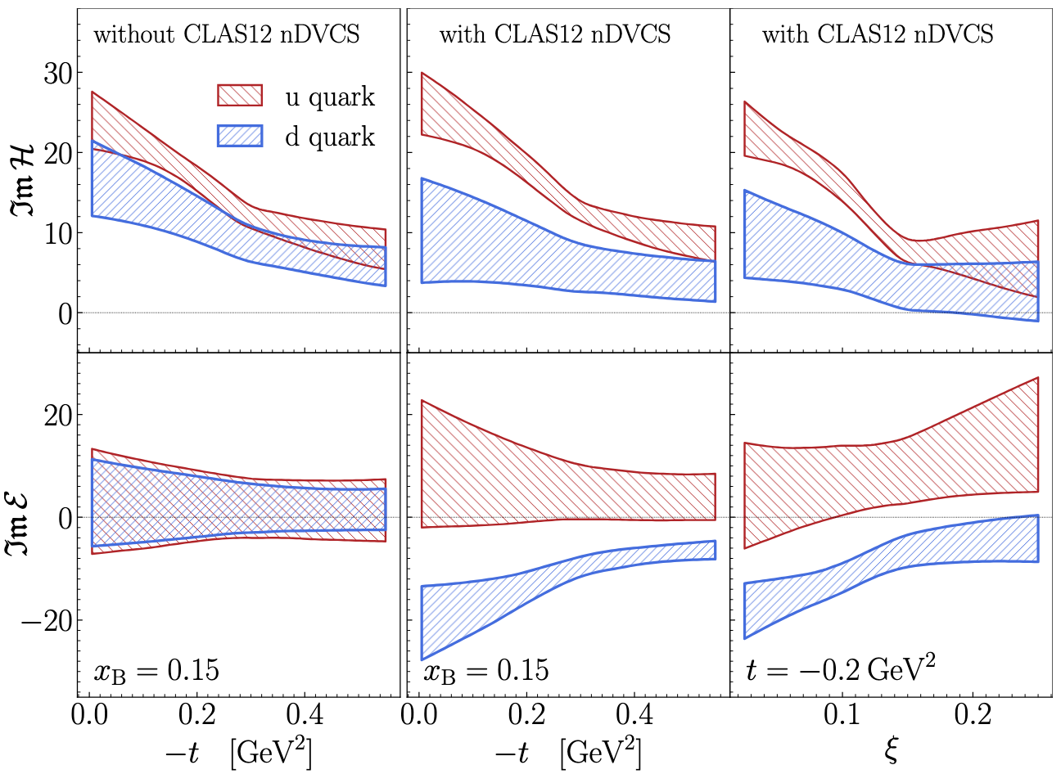
Hadron Structure
V. Burkert, L. Elouadrhiri, F.-X. Girod, Nat. 557 (2018) 396
JLab e⁺-Program : Pillar 2
Juan-Sebastian Alvarado – Feasibility of DDVCS measurements within JLab and EIC acceptance
Volker Burkert – The D-term gravitational form factor from CLAS at 6 GeV
Volker Burkert – DVCS with positron beams on protons at CLAS12
Alexandre Camsonne – DDVCS prospects at large virtuality
Wim Cosyn – High energy reactions with a (polarized) deuteron
Raphaël Dupré – Nuclear GPDs with the ALERT program at Jefferson Lab
Hervé Dutrieux – Future of GPD extractions: phenomenology and lattice QCD
Yoshitaka Hatta – Nucleon and nuclear gravitaional form factors
Melany Higuera – Applications of novel computational techniques for the determination of the gravitational form factors
Hao Huang – Deeply Virtual Compton Scattering experiments with the Neutral Particle Spectrometer in Hall C at Jefferson Lab
Adam Hoballah – Analysis tools in the light of positron beams
Nicole d’Hose – Use of positive and negative polarized muon beams to study exclusive reactions
Xiangdong Ji – Proton mass, physics of energy momentum form factors &GPDs global analysis
Victor Martinez-Fernandez – DDVCS and TCS for JLab, EIC and EIcC
Zein-Eddine Meziani – The proton gluonic gravitational form factor: mass, scalar, and pressure densities
Rachel Montgomery – Meson structure via tagged Deep Inelastic Scattering at future JLab
Asmita Mukherjee – Gravitational form factors and mechanical properties of a dressed quark
Silvia Niccolai – Deeply Virtual Compton Scattering on the neutron with positron beam
Noémie Pilleux – Deeply virtual Compton scattering on longitudinally polarized protons and neutrons in ND₃ with CLAS12
Samy Polcher-Rafael – DVCS on longitudinally polarized proton with the CLAS12 experiment at JLab
Matteo Rinaldi – Generalized parton distributions of light nuclei
Craig Roberts – Insights into the emergence of mass studies of pion and kaon structure
Peter Schweitzer – D(t) form factor of proton and neutron
Pawel Sznajder – Phenomenology of Generalized Parton Distributions
Pawel Sznajder – Exclusive production of a photon pair
Marc Vanderhaeghen – Partonic structure of baryons and transition GPDs
Li Xu – Neutron DVCS cross section extraction at the CLAS12 experiment
Feng Yuan – The path toward multidimensional hadron structure at small-x
Zhiwen Zhao – SoLID GPD program
M. Mazouz et al. PRL 9 (2007) 242501
d
A.W. Thomas, PRL 101 (2008) 102003
A. Hobart et al. PRL 133 (2024) 211903
19/35
January 22nd, 2025

Slide 20
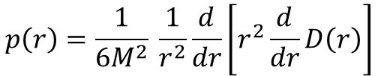
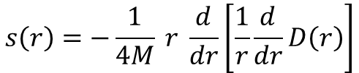
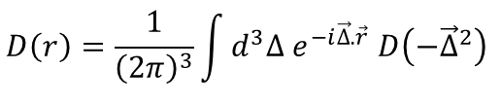
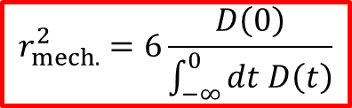
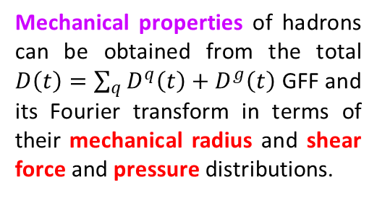
Hadron Mass & Meson Structure
Gravitational Form Factors
V.D. Burkert, L. Elouadrhiri, F.-X. Girod, C. Lorcé, P.E. Shanahan RMP 95 (2023) 041002
Experimental access to the Gravitational Form Factors (GFFs) of hadrons is the novel quest for understanding nucleon structure and dynamics.
GFFs may be probed indirectly in various exclusive processes: (Double) Deeply Virtual Compton Scattering, Time-Like Compton Scattering, Meson Production, J/Ψ production at threshold...
$\left\langle p′ | {\hat{T}}_{μν}^{q} | p\right\rangle =\overline{u}\left(p^{′},\vec{s}′\right) \left[M_{2}^{ q}\left(t\right) \frac{P_{μ}P_{ν}}{M}+J^{q}\left(t\right) \frac{i\left(P_{μ}σ_{να}+P_{ν}σ_{μα}\right)Δ^{α}}{2M}+D^{q}\left(t\right) \frac{Δ_{μ}Δ_{ν}−g_{μν}Δ^{2}}{4M}\right]u\left(p,\vec{s}\right)$
Mass/energy distribution
Angular momentum distribution
Forces & pressure distribution
Mechanical properties of hadrons can be obtained from the total $D\left(t\right)=\sum_{q}{D^{q}\left(t\right)}+D^{g}\left(t\right)$ GFF and its Fourier transform in terms of their mechanical radius and shear force and pressure distributions.
$$s\left(r\right)=−\frac{1}{4M} r \frac{d}{dr}\left[\frac{1}{r}\frac{d}{dr}D\left(r\right)\right]$$
$$D\left(r\right)=\frac{1}{{\left(2π\right)}^{3}}\int{d^{3}∆ e^{−i\vec{∆}.\vec{r}} D\left(−{\vec{∆}}^{2}\right)}$$
$$p\left(r\right)=\frac{1}{6M^{2}} \frac{1}{r^{2}}\frac{d}{dr}\left[r^{2}\frac{d}{dr}D\left(r\right)\right]$$
$$r_{mech.}^{2}=6\frac{D\left(0\right)}{\int_{−∞}^{0}{dt D\left(t\right)}}$$
20/35
January 22nd, 2025

Slide 21
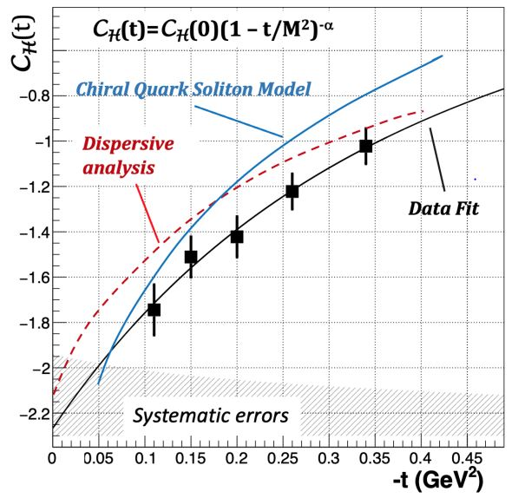
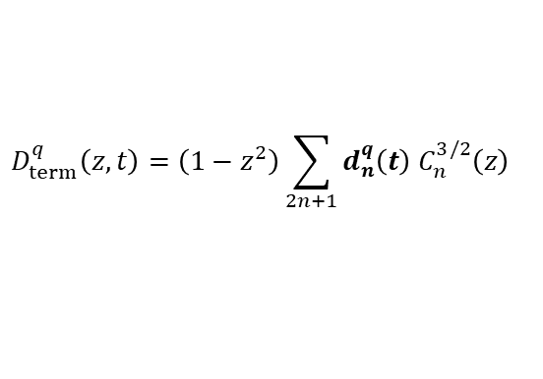

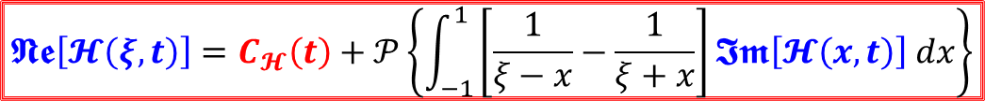
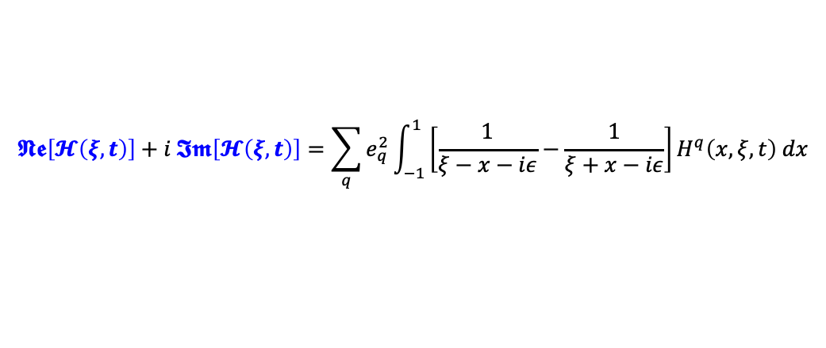
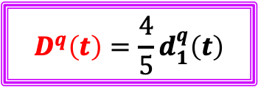
Hadron Mass & Meson Structure
Experimental Access to D(t)
V.D. Burkert, L. Elouadrhiri, F.-X. Girod, Nature 557 (2018) 39
The GFF D(t) can be accessed from the skewness dependence of the 2nd Mellin moment of the GPDs H and E which requires the GPDs knowledge over the whole physics phase space.
$$\int_{−1}^{1}{x H^{q}\left(x,ξ,t\right) dx}= M_{2}^{q}\left(t\right)+ξ^{2} D^{q}\left(t\right) \int_{−1}^{1}{x E^{q}\left(x,ξ,t\right) dx}=2 J^{q}\left(t\right)−M_{2}^{q}\left(t\right)−ξ^{2} D^{q}\left(t\right)$$
GPDs are accessed through Compton Form Factors (CFFs) which real and imaginary parts are related by a fixed-t dispersion relation
V.D. Burkert et al. RMP 95 (2023) 041002
$$𝕹𝖊\left[𝓗\left(ξ,t\right)\right]+i 𝕴𝖒\left[𝓗\left(ξ,t\right)\right]=\sum_{q}{e_{q}^{2}}\int_{−1}^{1}{\left[\frac{1}{ξ−x−iε}−\frac{1}{ξ+x−iε}\right]H^{q}\left(x,ξ,t\right) dx}$$
$$𝕹𝖊\left[𝓗\left(ξ,t\right)\right]=C_{𝓗}\left(t\right)+𝒫\left\{\int_{−1}^{1}{\left[\frac{1}{ξ−x}−\frac{1}{ξ+x}\right]𝕴𝖒\left[𝓗\left(x,t\right)\right] dx}\right\}$$
LO
$$C_{ℋ}\left(t\right)=2\sum_{q}{e_{q}^{2}}\int_{−1}^{1}{\frac{D_{term}^{q}\left(z,t\right)}{1−z}} dz$$
$$D_{term}^{q}\left(z,t\right)=\left(1−z^{2}\right)\sum_{2n+1}{d_{n}^{q}\left(t\right) C_{n}^{3/2}\left(z\right)}$$
$$D^{q}\left(t\right)=\frac{4}{5}d_{1}^{q}\left(t\right)$$
21/35
January 22nd, 2025

Slide 22
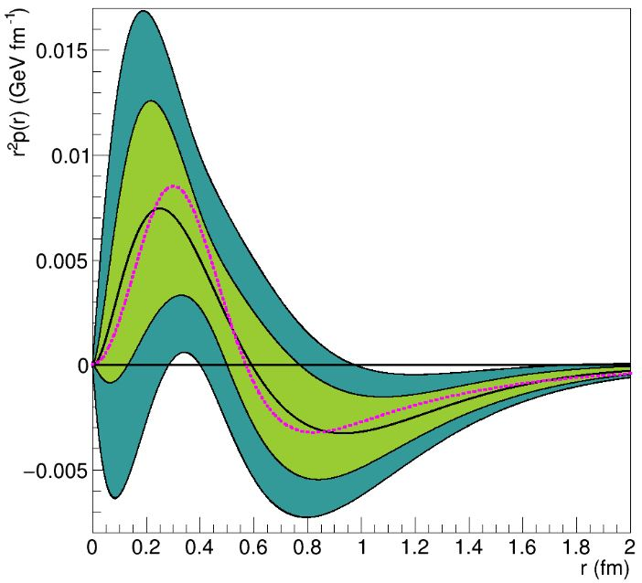
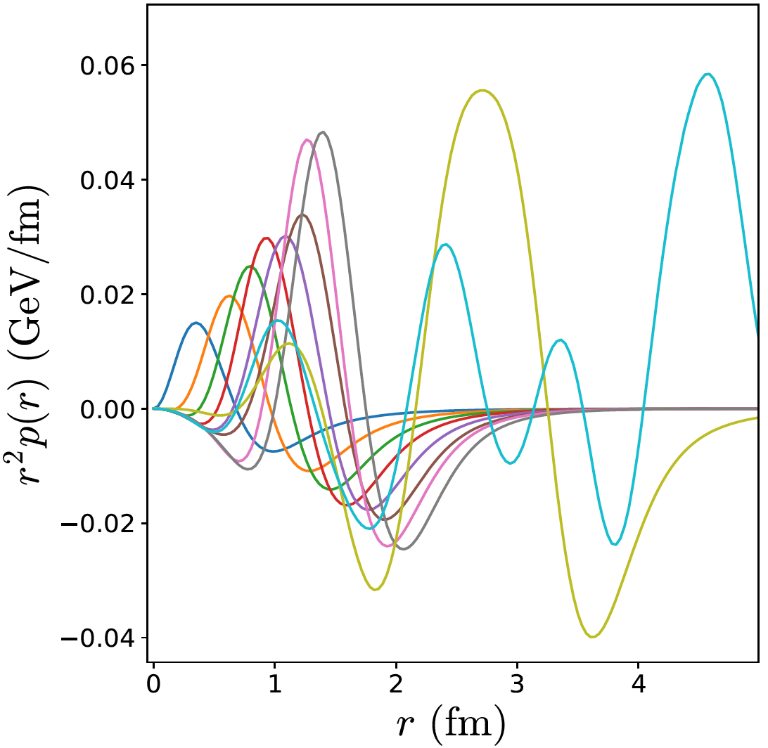
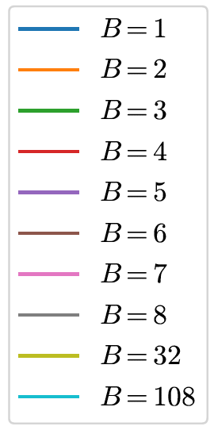
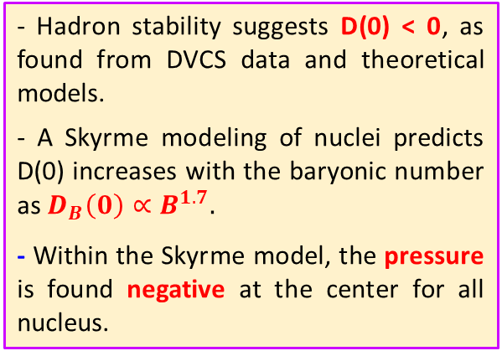

Hadron Mass & Meson Structure
Dynamical Imaging
V.D. Burkert @ HP2030 Y. Hatta @ HP2030
Measuring independently the real and imaginary parts of $𝓗$ provides access to D(t) and the mechanical properties of hadrons.
V.D. Burkert et al. RMP 95 (2023) 041002
A.G. Martin-Caro et al. PRD 110 (2024) 034002
$$r_{mech.}^{p}=0.634±0.057 fm< r_{E}^{p}$$
Data fit
χQSM
- Hadron stability suggests D(0) < 0, as found from DVCS data and theoretical models.
- A Skyrme modeling of nuclei predicts D(0) increases with the baryonic number as $D_{B}\left(0\right)∝B^{1.7}.$
- Within the Skyrme model, the pressure is found negative at the center for all nucleus.
Repulsive
pressure
Confining
pressure
Skyrme model evaluations
V.D. Burkert, L. Eloudrhiri, F.-X. Girod, Nature 557 (2018) 396
M.V. Polyakov, P. Schweitzer, IJMP A 33 (2018) 1830025 A.G. Martin-Caro, M. Huidobro, Y. Hatta PRD 108 (2023) 034014
22/35
January 22nd, 2025

Slide 23
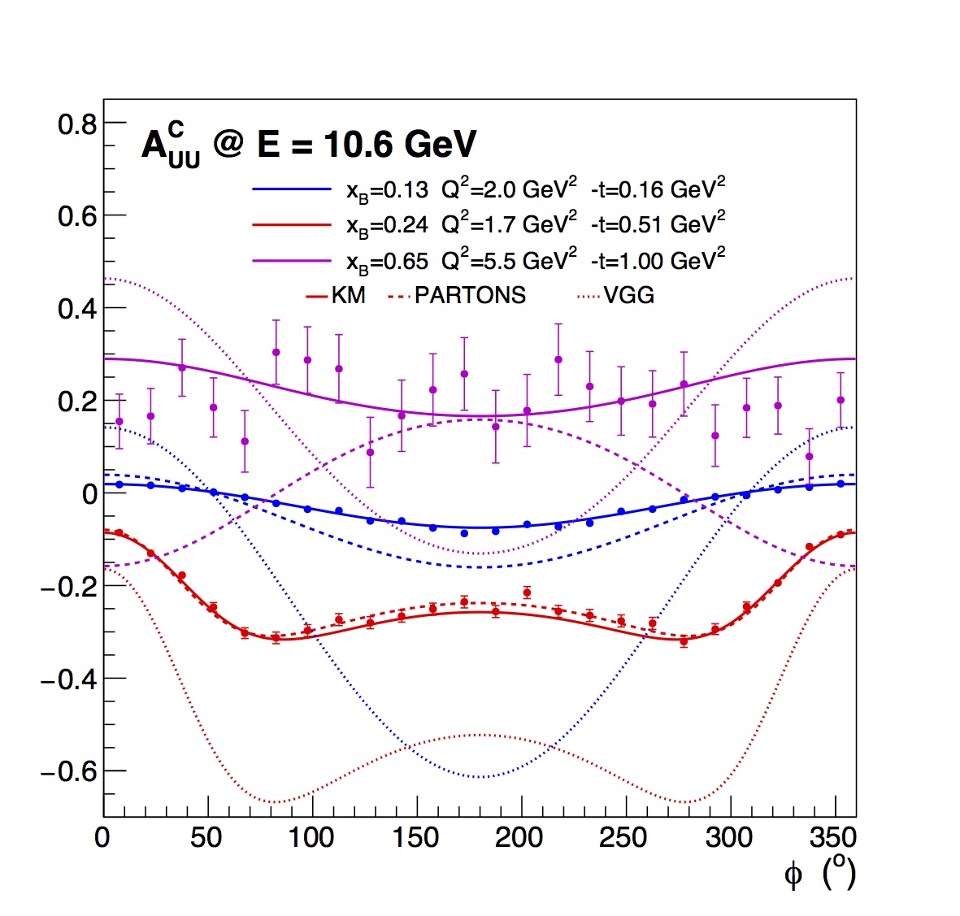
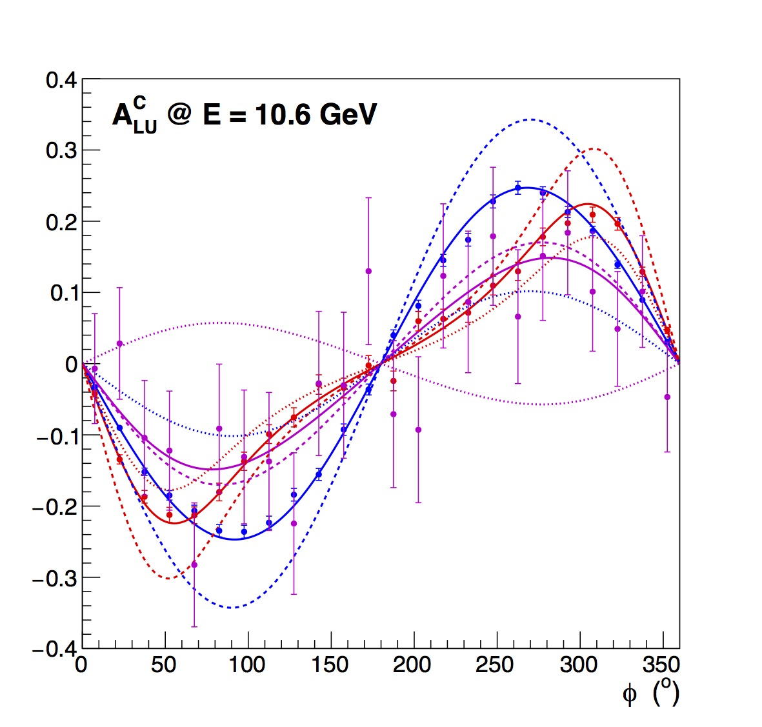
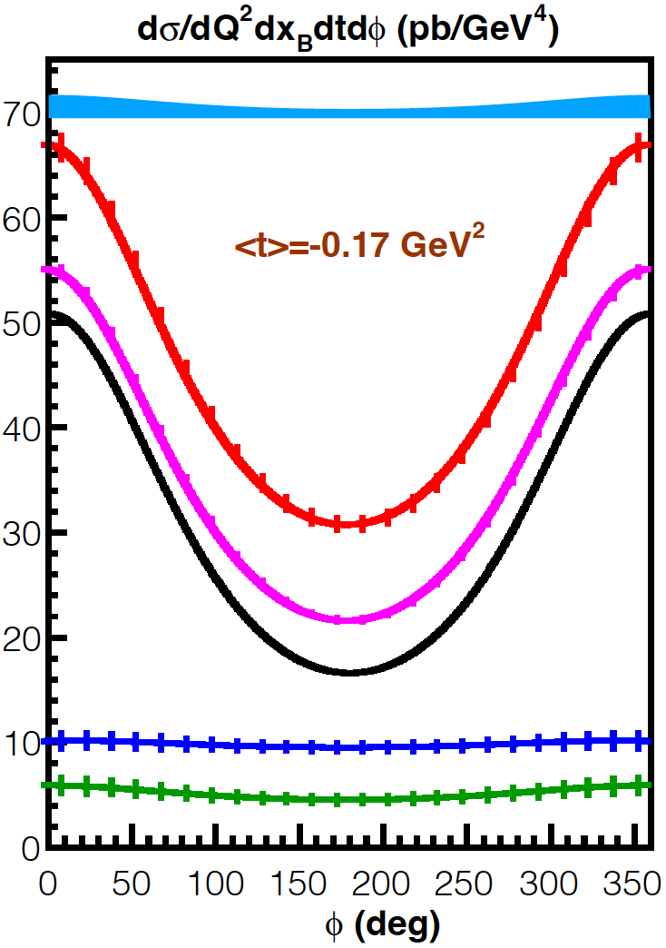
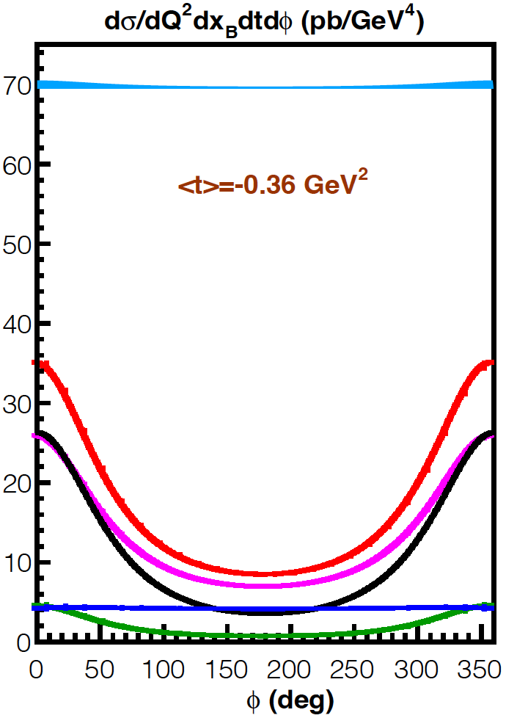







Nucleon & Nuclear Generalized Parton Distributions
Current Status
A. Afanasev et al. EPJ A 57 (2021) 300 V.D. Burkert et al. EPJ A 57 (2021) 186 V.D. Burkert @ HP2030
$$\left(Q^{2},x_{B}\right)$$
The comparison between electron- and positron-induced photon production enables the separation of the 4 unknown amplitudes of the (e,epγ) process.
Particularly it isolates the components of the DVCS$⨂$BH interference amplitude, providing a clean access to the real part of CFFs.
$$ξ≅ {x_{B}}/{\left(2−x_{B}\right)}$$
GPDs
$${d^{5}σ}_{00}^{±}={d^{5}σ}_{BH}+{d^{5}σ}_{DVCS}∓{d^{5}σ}_{INT}$$
$$A_{UU}^{C}=\frac{d^{5}σ_{INT}}{{d^{5}σ}_{BH}+{d^{5}σ}_{DVCS}}$$
$$A_{LU}^{C}=\frac{d^{5}{\tilde{σ}}_{INT}}{{d^{5}σ}_{BH}+{d^{5} σ}_{DVCS}}$$
x_{B} = 0.36 Q² = 4.0 GeV²
PR12+23-006 C. Muñoz Camacho et al.
PR12+23-002 E. Voutier et al.
23/35
January 22nd, 2025

Slide 24


Nucleon & Nuclear Generalized Parton Distributions
Control of Systematics
A. Hoballah @ HP2030 N. d’Hose @ HP2030
The physics of interest is extracted from the comparison of electron and positron observables which is more challenging than the comparison of helicity dependent observables for a given beam polarity.
Different : data taking period, detector, and experimental conditions.
Machine learning techniques applied to DVCS events selection using a Boosted Decision Tree approach allows to measure BSAs within the eγ topology, improving kinematic coverage, statistics and reducing systematics.
- BSAs under CLAS collaboration review.
- Cross section analysis in progress.
- Extension to polarized targets (BTA).
Switching the Torus and Solenoid polarities, electrons and positrons follow the same detector path contrary to protons.
J.S. Alvarado et al., CLAS Note 2024-003
24/35
January 22nd, 2025

Slide 25


Nucleon & Nuclear Generalized Parton Distributions
DVCS off neutrons
S. Niccolai et al. EPJ A 57 (2021) 226 H. Huang @ HP2030 S. Niccolai @ HP2030 L. Xu @ HP2030
The real part of the Compton Form Factor E_{n}, of importance for the Ji sum rule, the Gravitational Form Factors of the neutron, and for flavor separation is hardly constrained experimentally without Beam Charge Asymmetry data.
A. Hobart et al. PRL 133 (2024) 211903
$$A_{UU}^{C}∝\frac{1}{F_{2}}ℜ𝔢\left[ξ{\tilde{H}}_{n}−\frac{t}{4M^{2}}E_{n}\right]$$
e⁺ and e⁻ beams
e⁺ and e⁻ beams
e⁻ beam only
e⁻ beam only
- CLAS12 BSAs recently published.
- BONUS12 analysis in progress.
- ALERT experiment to run in 2025.
- NPS experiment recently completed.
- CLAS12 cross section analysis in progress.
25/35
January 22nd, 2025

Slide 26




Nucleon & Nuclear Generalized Parton Distributions
DVCS off Helium
S. Fucini et al. EPJ A 57 (2021) 273 W. Cosyn @ HP2030 R. Dupré @ HP2030 M. Rinaldi @ HP2030
The association of the ALERT recoil detector and the CLAS12 spectrometer together with high-energy electron and positron beams offer a new tool to investigate the nuclear force and a new path to study the EMC effect.
$ℜ𝔢\left[ℋ_{A}\left(ξ,t\right)\right] = 𝒫\int_{0}^{1}{\left[\frac{1}{ξ+x}+\frac{1}{x−ξ}\right]H_{A}\left(x,ξ,t\right) dx} = \frac{1}{π}𝒫\int_{0}^{1}{\left[\frac{1}{ξ+x}+\frac{1}{x−ξ}\right]ℑ𝔪\left[H_{A}\left(x,x,t\right)\right] dx}−δ\left(t\right)$
Connected to
the nuclear D-term
Unpolarized Beam Charge Asymmetry
⁴He
³He
ALERT @ CLAS12
Nuclear tomography & dynamics
Sensitivity to neutron GPDs
26/35
January 22nd, 2025

Slide 27




Nucleon & Nuclear Generalized Parton Distributions
DVCS off Polarized Targets
N. Pilleux @ HP2030 S. Polcher Rafael @ HP2030
Similarly to unpolarized targets, the lepton beam charge allows to separate the interference amplitudes from the DVCS and BH amplitudes, and provides an access to higher twist effects.
$∝$ to the imaginary part
of a CFF linear combination
Leading twist
Higher twist
$${d^{5}σ}_{PS}^{e}={d^{5}σ}_{P0}^{e}+S \left[{{P d}^{5}∆σ}_{BH}+\left({{Pd}^{5}∆σ}_{DVCS}+{ d}^{5}∆{\tilde{σ}}_{DVCS}\right)−e\left(P{d^{5}∆σ}_{INT}{+{ d}^{5}∆\tilde{σ}}_{INT}\right) \right]$$
$∝$ to the real part
of a CFF linear combination
$$𝒞_{LP}^{DVCS}= 4\frac{1−x_{B}}{{\left(2−x_{B}\right)}^{2}}\left[ℋ{\tilde{ℋ}}^{∗}+\tilde{ℋ}ℋ^{∗}\right]−\frac{x_{B}^{2}}{{\left(2−x_{B}\right)}^{2}}\left[ℋ{\tilde{ℰ}}^{∗}+\tilde{ℰ}ℋ^{∗}+\tilde{ℋ}ℰ^{∗}+ℰ{\tilde{ℋ}}^{∗}\right]$$
$$−\frac{x_{B}}{{\left(2−x_{B}\right)}^{2}}\left(\frac{x_{B}^{2}}{2}+\left(2−x_{B}\right)\frac{t}{4M^{2}}\right)\left[ℰ{\tilde{ℰ}}^{∗}+{\tilde{ℰ}ℰ}^{∗}\right]$$
$$𝒞_{LP}^{INT}=\frac{x_{B}}{2−x_{B}}\left(F_{1}+F_{2}\right)\left[ℋ+\frac{x_{B}}{2}ℰ\right]+F_{1}\tilde{ℋ}−\frac{x_{B}}{2−x_{B}}\left[\frac{x_{B}}{2}F_{1}+{\frac{t}{4M^{2}}F}_{2}\right]\tilde{ℰ}$$
How precise could be achieved a relative DVCS cross section measurement on a polarized target ?
27/35
January 22nd, 2025

Slide 28



Nucleon & Nuclear Generalized Parton Distributions
DDVCS Projections
S. Zhao et al. EPJ A 57 (2021) 240 K. Deja et al. PRD 107 (2023) 094035
J.S. Alvarado et al. @ HP2030 V. Martinez-Fernandez et al. @ HP2030 Z. Zhao @ HP2030
Phase space and statistics projections have been obtained with the EpIC event generator for 100 days of beam at ${10}^{37}{\text{cm}}^{−2}$.${\text{s}}^{−1}$ within the SoLID_{μ} and μCLAS12 detector acceptances, with elementary physics constraints.
$p_{e}>$ 1 GeV/c ${ p}_{μ}>$1 GeV/c
$W>2 GeV {Q′}^{2}+Q^{2}>1 {GeV}^{2}$
Sensitive BSA and BCA measurements can be achieved.
Kinematic coverage
Beam Spin Asymmetry
Beam Charge Asymmetry
28/35
January 22nd, 2025

Slide 29



Electroweak Processes & Test of the Standard Model
JLab e⁺-Program : Pillar 3
Patrick Achenbach – Dark matter searches with high intensity lepton beams
Adi Askenazi – The e4nu program at JLab
Sebastian Baunack – The P2 experiment at Mainz: search for beyond standard model physics
Mariangela Bondi – BSM physics at JLab: new opportunities with secondary beams and CEBAF positron upgrade
Antonino Fulci – Secondary beams at the Jefferson Laboratory
Gaia Lanfranchi – Feebly interacting particles: status and prospects @ CERN
David Mack – Searches for BSM interference terms in unpolarized and polarized Bhabha scattering
Guillermo Megias – Electron and positron reactions with nuclei of interest for neutrino experiments
Cornellis Mommers – Low-mass dark sector searches with deuteron photodisintegration
Enrico Nardi – Atoms as electron accelerators
Mauro Raggi – Positron beams for dark sector searches
Richard Trotta – Measurement of the asymmetry A_{d} between e⁺/e⁻ in ²H deep inelastic scattering
Richard Trotta – Challenges in the C_{3q} measurement: insights and open discussion
Weizhi Xiong – Resonance PV asymmetry measurement with SoLID
μ±-CERN
e±-SoLID
projected
29/35
January 22nd, 2025

Slide 30




Electroweak Processes & Test of the Standard Model
Current Status
B. Wojtsekhowski, P. Achenbach, A. Gasparian, N. Liyanage, B. Raydo, W. Xiong et al. PR12+24-005 (2024)
P. Achenbach @ HP2030
Based on the PRad-II detector setup, a sensitive search for the $A^{′}$-boson in the 15-90 MeV mass range will be performed in the $e^{+}e^{−}$–annihilation.
The kinematic correlation between the energy $E_{γ}$ and the angle $θ_{γ}$ of the produced photon allows to determine the $A^{′}$-mass.
$$M_{A^{′}}^{2}=2m_{e}^{2}+2 m_{e}\left(E_{+}−E_{γ}\right)−4 E_{+}E_{γ}{\left[\sin\left(\frac{θ_{γ}}{2}\right)\right]}^{2}$$
PR12+24-005 B. Wojtsekhowski et al.
30/35
January 22nd, 2025

Slide 31







Electroweak Processes & Test of the Standard Model
Deuteron Photodisintegration
C.J.G. Mommers, M. Vanderhaeghen, PRD 109 (2024) 095010 C.J.G. Mommers @ HP2030
While the ATOMKI anomaly was measured on a nucleus, the neutron coupling to Light Dark Matter (LDM) particles is comparatively much less constrained than the proton coupling.
Within a technical scheme similar to the measurement of neutron polarizabilities, the $γd→e^{+}e^{−}np$process at backward kinematics would provides stringent constraints on pseudoscalar and axial couplings.
$$δm_{e^{+}e^{−}}≤0.1{MeV}/{c^{2}}$$
Pseudoscalar LDM
Axial LDM
B.S. Schlimme et al. NIM A 1013 (2021) 165668
31/35
January 22nd, 2025

Slide 32



Electroweak Processes & Test of the Standard Model
Dark Bhabha
D. Mack @ HP2030
As a pure QED process, the interpretabilty of Bhabha scattering offers the possibilty to search for a Beyond Standard Model (BSM) signal by looking at deviations from QED predictions from the interference between QED and BSM amplitudes.
Adding transverse polarization, either beam or/and target, provides access to never measured double spin observables testing high order QED effects and potentially interested for BSM signal search.
A_{TU} : might be used to test higher order QED effects or to search for the imaginary part of light scalar or tensor novel amplitudes.
A_{TT’} : optimally sensitive to the real part of light scalar or tensor novel amplitudes.
A_{LT} : not particularly sensitive to new (pseudo) scalar interactions but A_{LT}+A_{TL} might be.
1%
Within a naive modelling of A’-production with a 10⁻³ coupling magnitude, the variation of the cross section would produce a characteristic signal.
32/35
January 22nd, 2025

Slide 33






Electroweak Processes & Test of the Standard Model
Electroweak Coupling @ C${\text{e}}^{+}$BAF
X. Zheng, J. Erler, Q. Liu, H. Spiesberger, EPJA 57 (2021) 5 R. Trotta @ HP2030
X. Zheng et al. PR12-21-006 (2021)
Comparing unpolarized electron and positon DIS scatterings accesses the $C_{3q}$ axial-axial neutral current coupling, and the $F_{3}^{γZ}$structure function.
$${C_{3_{d}^{u}}=−2 g}_{A}^{e}g_{A}^{q}=±\frac{1}{2}$$
$A_{d}^{e^{+}e^{−}}≈−108 Y\left(y\right) R_{q}\left(x\right)\left(2C_{3u}−C_{3d}\right) Q^{2}$
(in ppm/GeV²)
μ±-CERN
$$A_{d}^{e^{+}e^{−}}=\frac{dσ\left(e^{+}d\right)−dσ\left(e^{−}d\right)}{dσ\left(e^{+}d\right)+dσ\left(e^{−}d\right)}$$
e±-SoLID
projected
$A_{d}^{e^{+}e^{−}}=\frac{G_{F}}{2\sqrt{2} πα}\frac{g_{A}^{e}}{2}Y_{3}\frac{F_{3}^{γZ}}{F_{1}^{γ}}Q^{2}$
33/35
January 22nd, 2025

Slide 34







Electroweak Processes & Test of the Standard Model
Atoms as Accelerators
F. Arias_Aragon, L. Darmé, G. Grilli di Cortona, E. Nardi, arXiv:2407.15941
The Hadronic Vacuum Polarization (HVP) is the leading theoretical uncertainty in the determination of ${\left(\text{g}\text{−2}\right)}_{μ}$.
Serious disagreements on $σ_{had}$ exist among different experiments as well as between data driven and lattice QCD results for HVP.
Taking advantage of the relativistic motion of inner atomic shells electrons of high Z materials,
the $e^{+}e^{−}⟶π^{+}π^{−}$ cross section can be measured at C${\text{e}}^{\text{+}}$BAF
over a s-range of interest for the determination of ${\left(\text{g}\text{−2}\right)}_{μ}$.
$$a_{μ}^{HVP}=\int_{s_{th.}}{ds σ_{had}\left(s\right)} K\left(s\right)$$
$$s_{±}=s_{0}±2 E_{e^{+}}\left\langle p_{nl}^{z}\right\rangle −{\left\langle p_{nl}\right\rangle }^{2}$$
C${\text{e}}^{+}$BAF
$$2m_{e}\left(E_{e^{+}}+m_{e}\right)$$
Atom acceleration effects have already been observed in Møller polarimetry.
L.G. Levchuk, NIM A 345 (1994) 496
34/35
January 22nd, 2025

Slide 35
Summary & Outlook
The experimental program with positron beam at Jefferson Lab is extending, pushing further the physics reach of each pillar of the JLab PWG program.
Multi-Photon Exchange : new channels of investigation of MPE effects (elastic, DIS, SIDIS) are emerging as well as novel projects to study the electroweak structure of the nucleon.
Generalized Parton Distributions : measurements of neutron and nuclei CFFs will be revisited after the completion of current electron beam experiments (CLAS12, NPS, ALERT).
Tests of the Standard Model : novel channels have been proposed.
The JLab positron program is most likely to last longer than the currently planned 3 years.
Keeping positron capabilities in the 22 GeV era would be most valuale for JLab physics reach.
The Ce⁺BAF R&D program is currently addressing the critical risk areas with the development of prototypes and test benches at LERF.
There are strong opportunities for an experimental physics program at LERF with electron and positron beams which could start as early as within 3 years.
35/35
January 22nd, 2025

