Slide 1
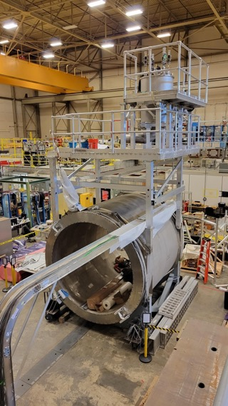
What’s happening for SoLID at the lab now…
Proposed ~$30M “redirect” to support SoLID project (JLab Operations to take on more dependencies – magnet, some infrastructure,…)
Planning to put forward at February LMBB
Requires some strategy (MOLLER project issues now cause concern)
Two Capital Equipment projects already in place
Magnet refurbishment and testing
Data acquisition
Working with DOE research to identify preR&D opportunities
Supporting electronics testing and trigger development
Meet with DOE research (Gulshan) monthly
Pre-R&D plan white paper, need to submit soon!
Encouraged to consider another white paper for GEM ASIC development
Staff continuing to assist in development

