Slide 1
Development of μRGroove detectors
Siqi He
On behalf of UTSC-MPGD Group
2025 SoLID Collaboration Meeting , Jan-10-2025

Slide 2
Outline
Introduction
10cm×10cm μRGroove
50cm×50cm μRGroove
Low-mass Cylindrical μRGroove
Summary & Outlook

Slide 3
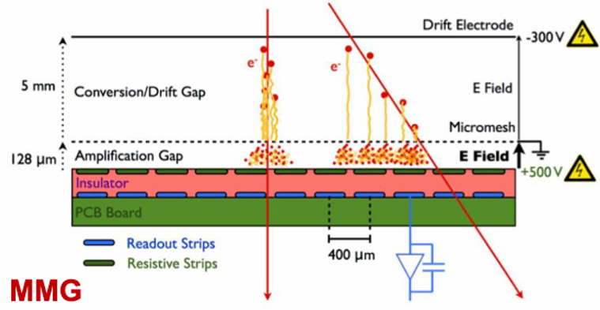
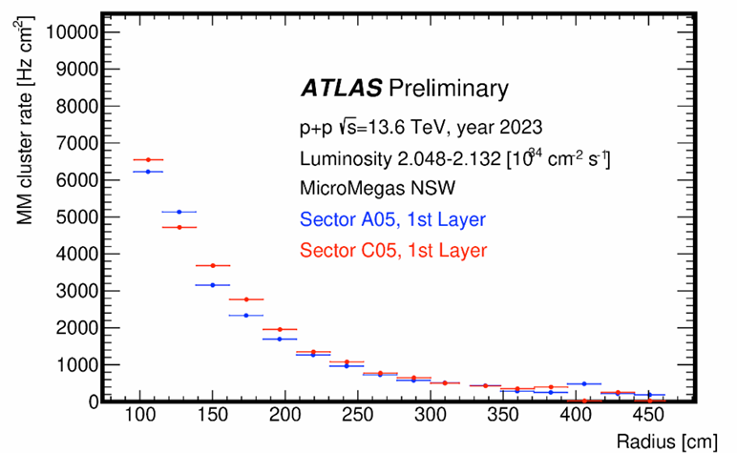
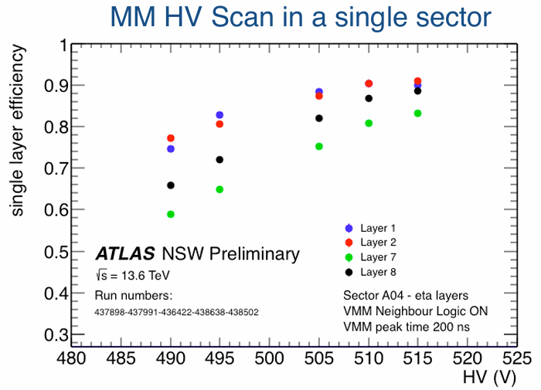
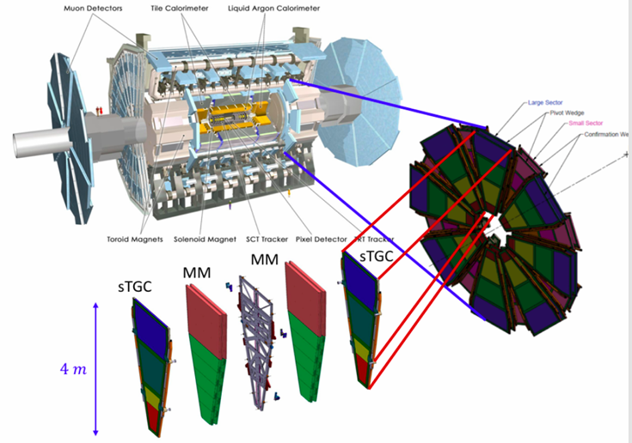
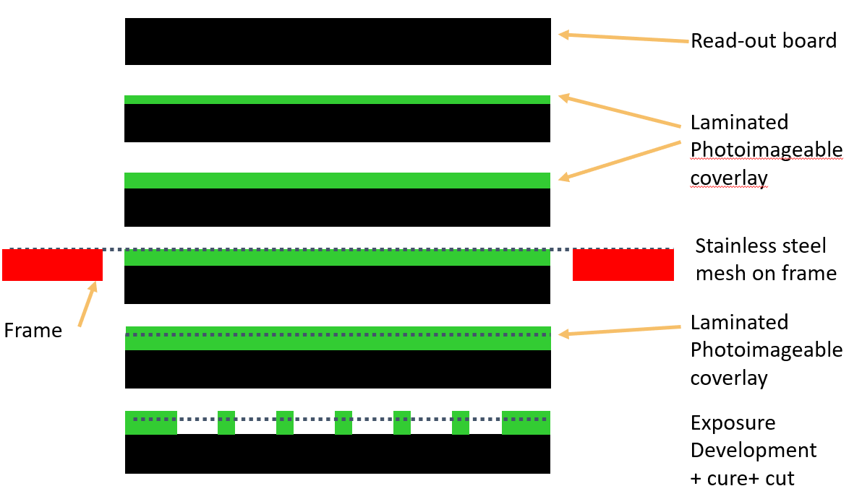
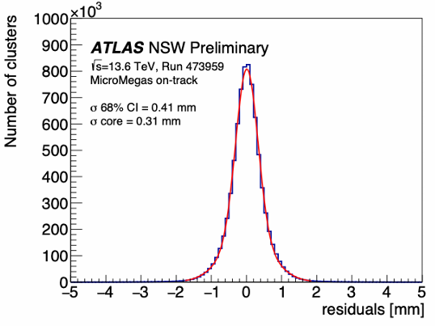
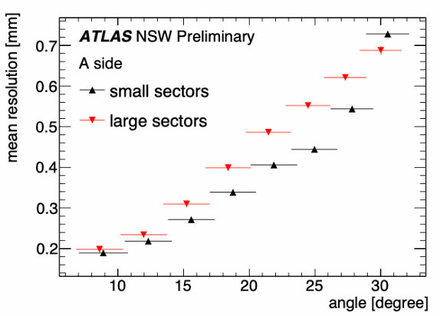
Large area MPGD for trigger/tracking
MM chamber in ATLAS NSW
CERN-LHCC-2013-006, ATLAS-TDR-020
ATLAS New Small Wheel Micromegas:
Production complication of Bulk production
Cluster rate: 6-7kHz/cm² at small radius area
99% tracking efficiencies while single layer efficiency is ~80 - 90%
Average spatial resolution reconstructed by CC: ~350μm
Sala, ATLAS NSW performance studies, Pisa Meeting 2024

Slide 4
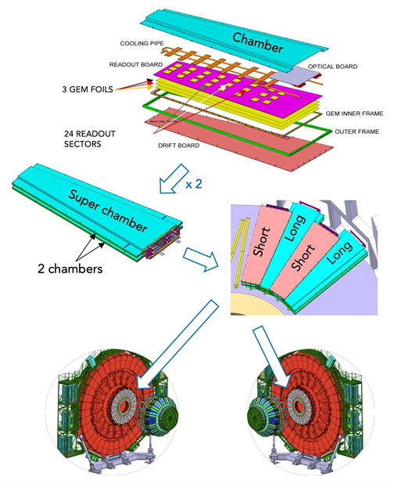
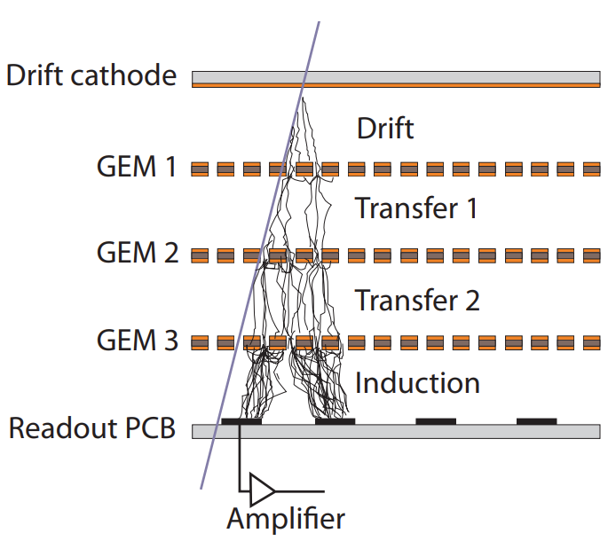
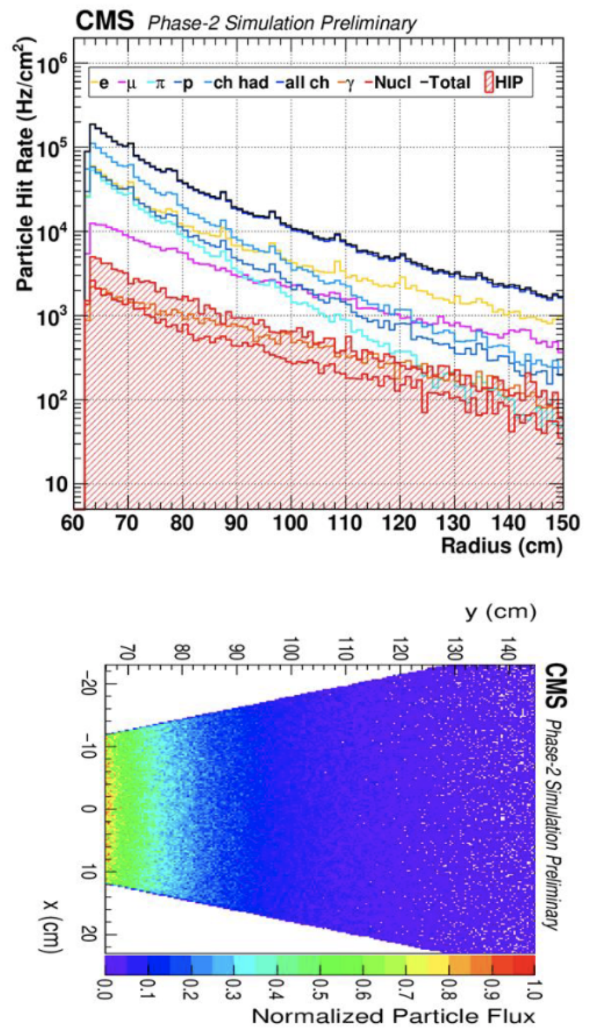
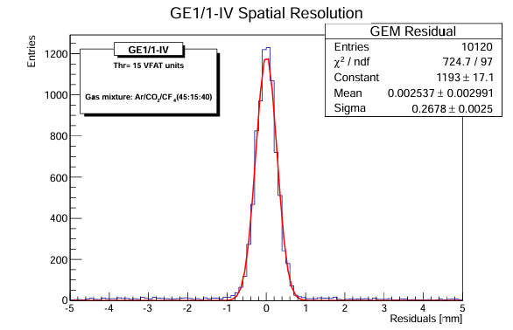
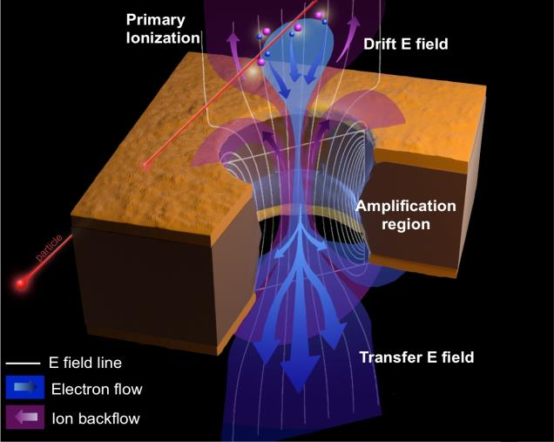
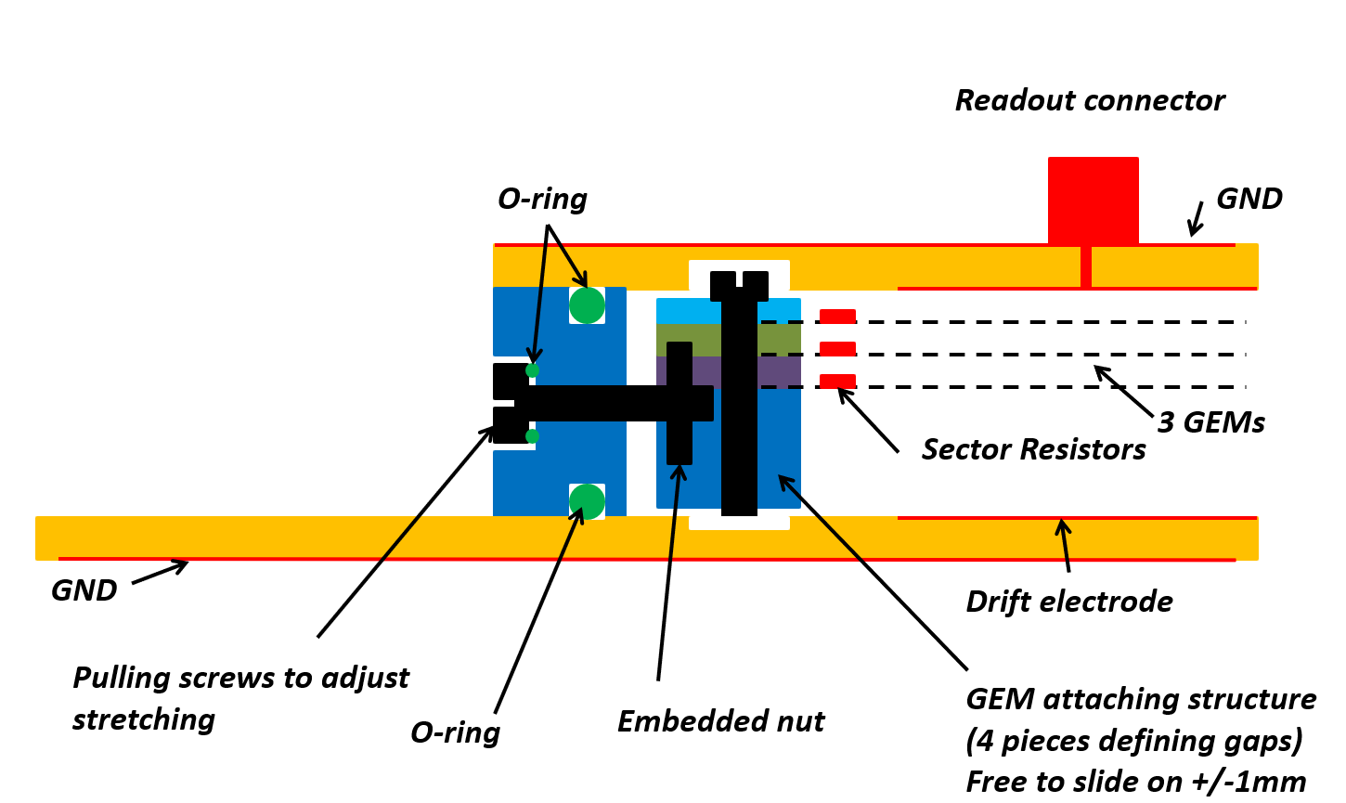
Large area MPGD for trigger/tracking
GEM chamber in CMS MS
CERN-LHCC-2015-012, CMS-TDR-013
CMS Forward Muon System GEM:
mechanical limitation of Self-stretch process
Expected hit rate: 2-144kHz/cm²
average efficiency is ~93.8%
Spatial resolution of prototype: ~267μm
Archana, Experience with the Triple-GEM detectors at the LHC CMS experiment, Pisa Meeting 2024

Slide 5
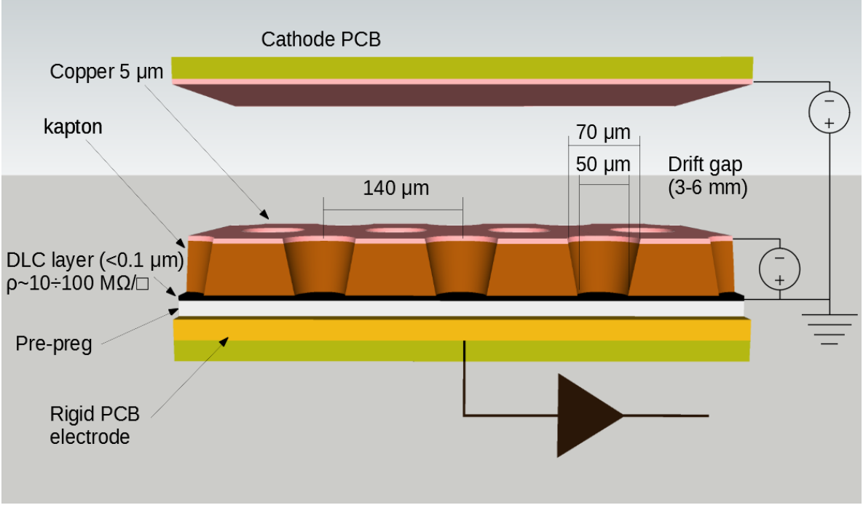
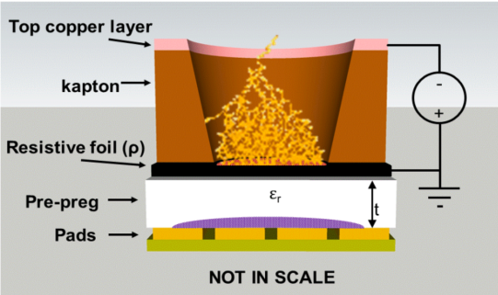
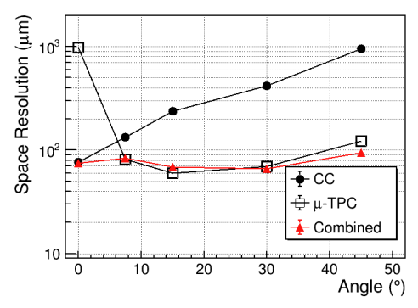
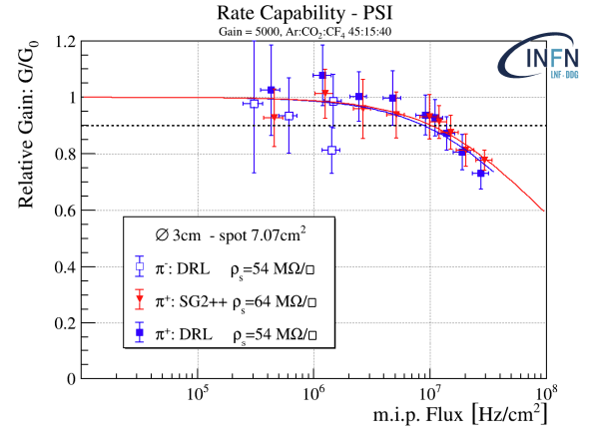
Large area MPGD for trigger/tracking
μRWELL
G. Bencivenni at J.Phys.Conf.Ser. 1498 (2020) 012003
Matteo at, The μ-RWELL for future HEP challenges, MPGD2024
micro-Resistive WELL:
Single stage MPGD without tension requirement
Simple structure and Easy assembly
Various prototypes: Good spatial resolution (<100μm) and High rate capability (1~10MHz/cm²)

Slide 6
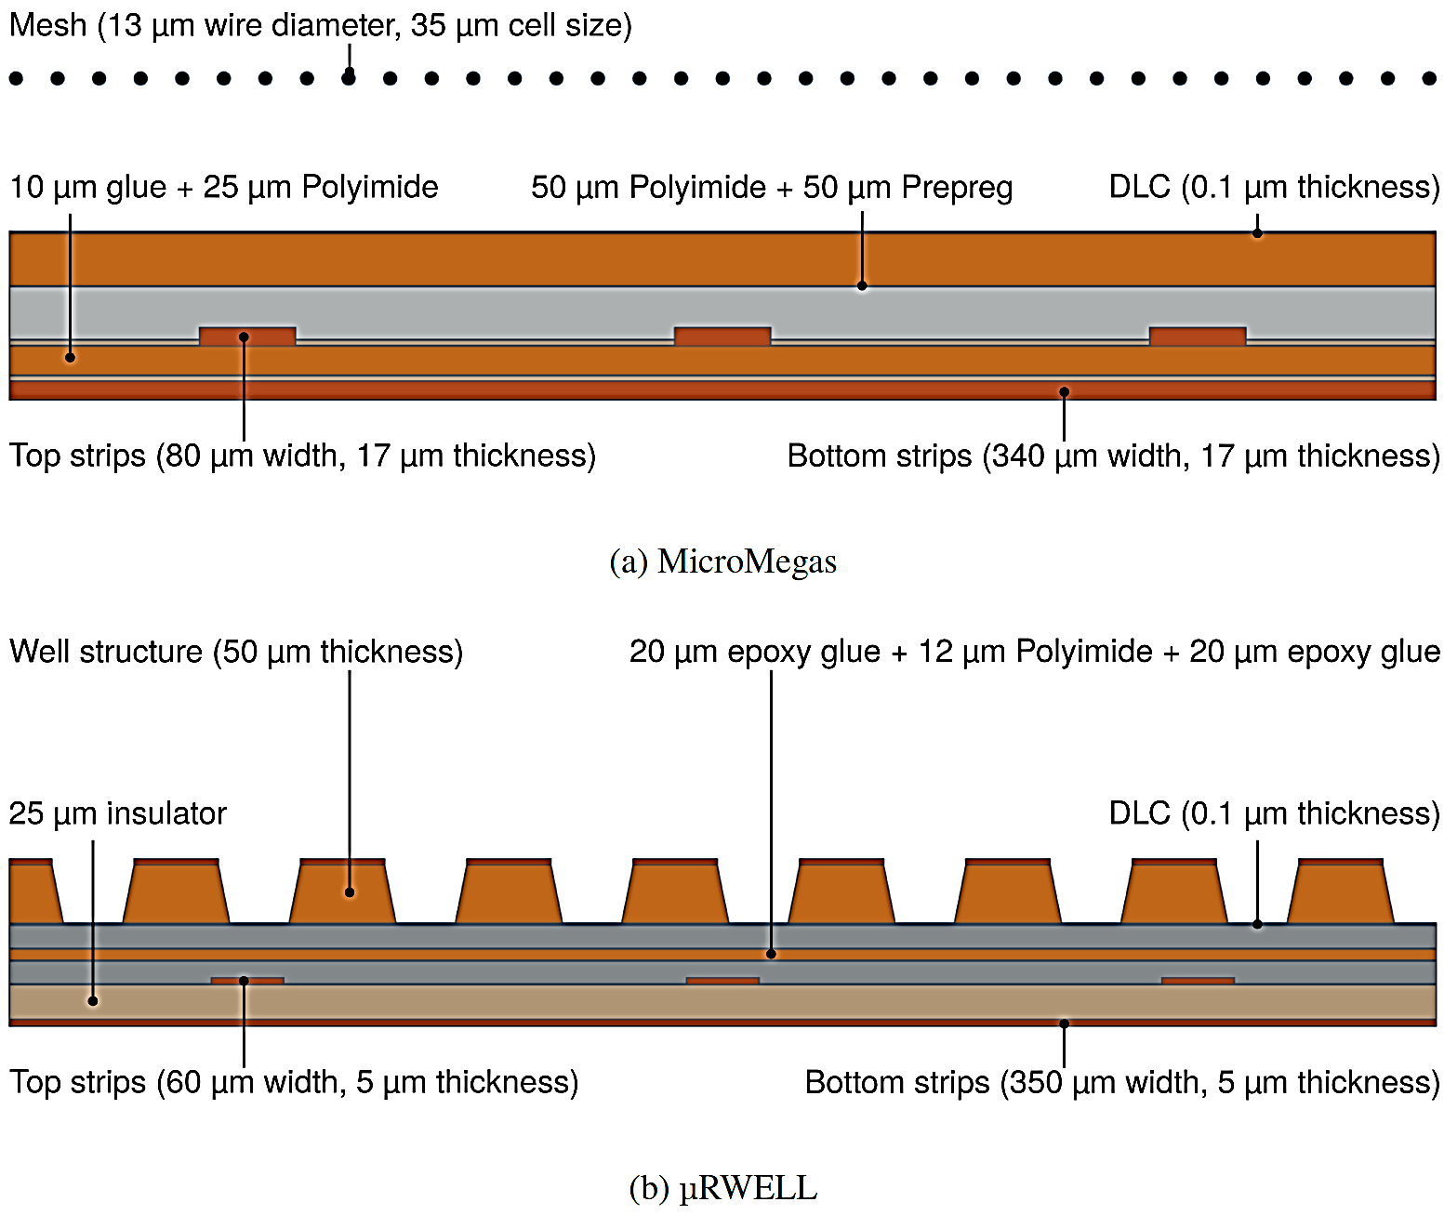
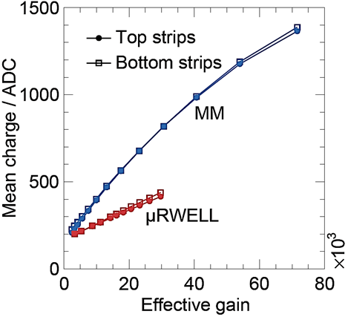
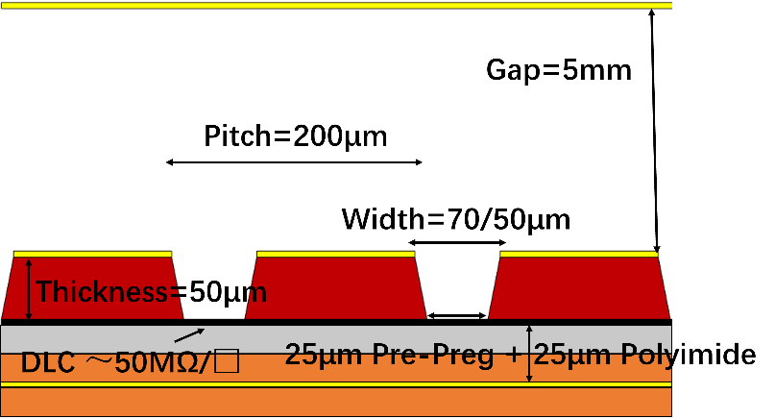
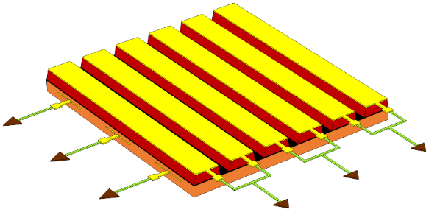
micro-Resistive Groove
μRGroove
L. Scharenberg et al 2024 JINST 19 P05053
Siqi He, RD51 Mini-Week, 02/27/2023
Q_{MM} > Q_{μRWELL}: less parasitic capacitance of readout strips and longer drift distance of the avalanche charge for MM.
Large area means much larger capacitance which will significantly reduce signal amplitude.
X and Y readout strips of 2D strip-readout MPGD only receiving ~50% of the total induced charge.
The cathode of μRGroove itself can be used as 1D-readout strip.
Decoupled X&Y readout strips, no induced charge sharing effect, increased signal amplitude.
Compatible with all the techniques developed for the μRWELL manufacture.
Easy clean, which is one of the most important performance for the end user.

Slide 7
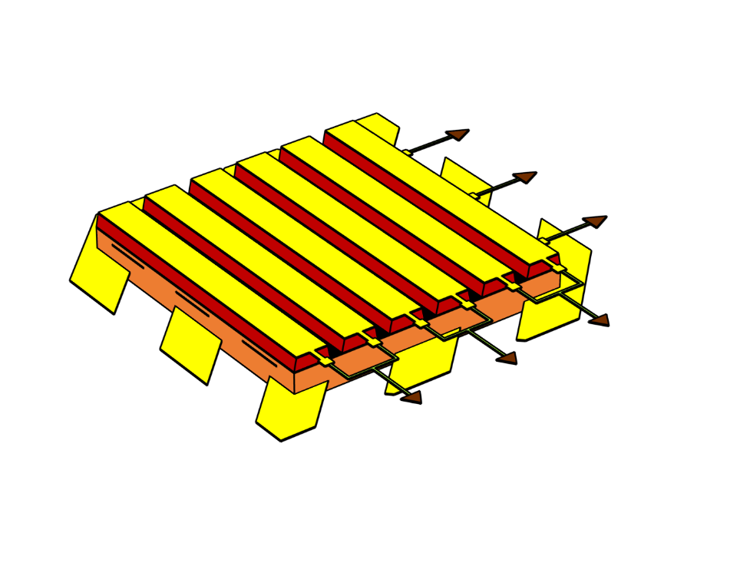
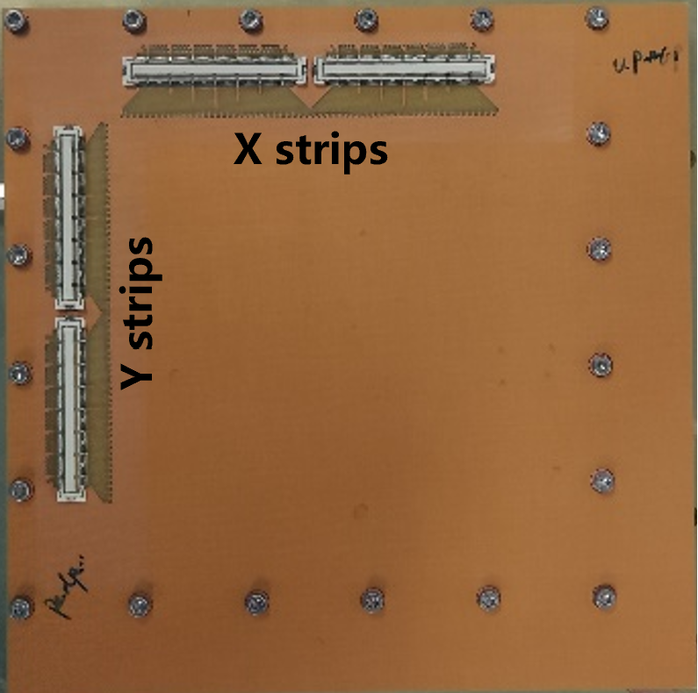
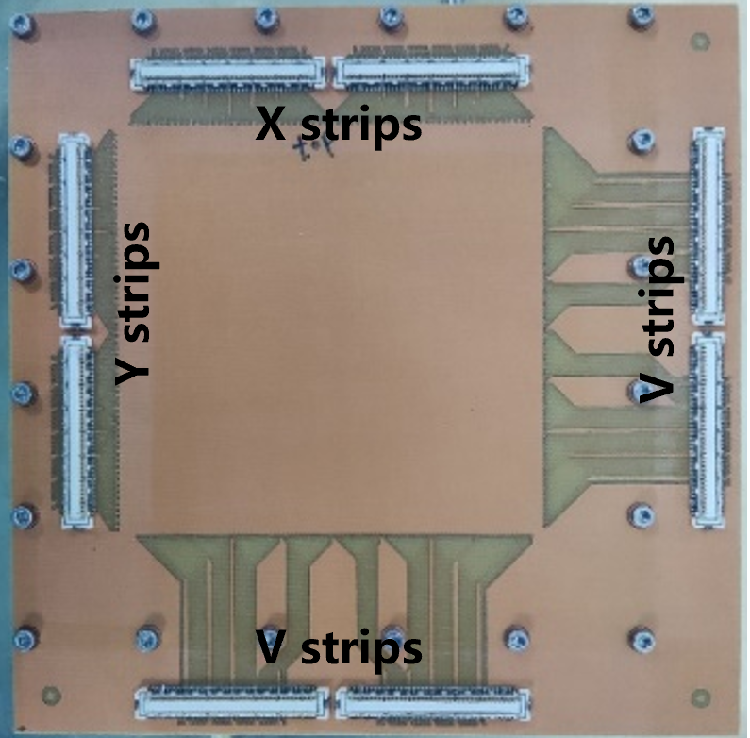
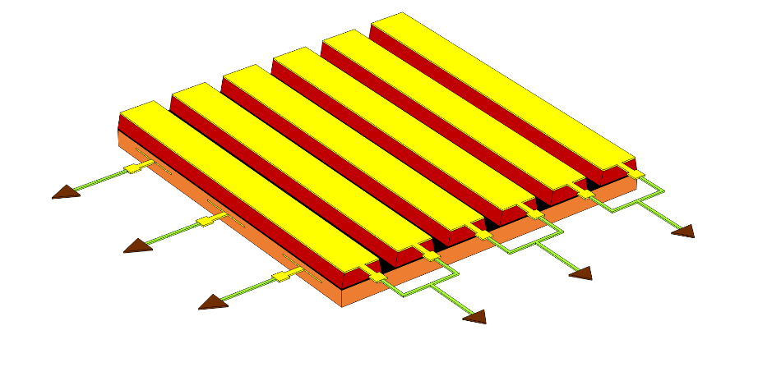
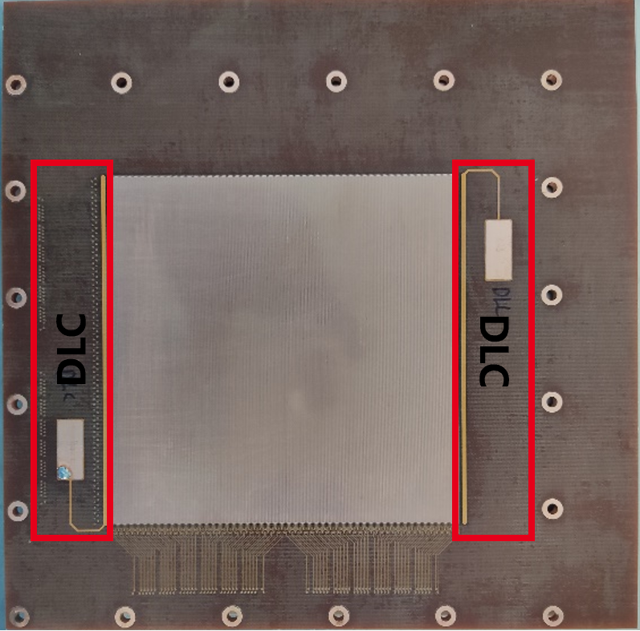
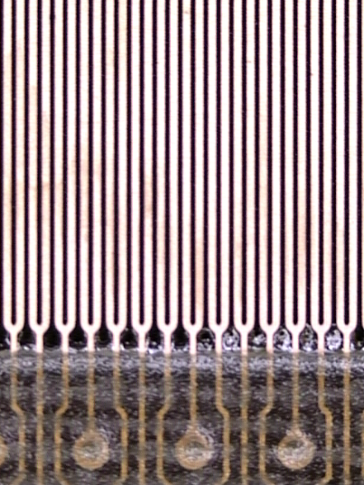
10cm×10cm μRGroove
2D-readout (XY) μRGroove
3D-readout (XYV) μRGroove
Y strips
Y strips
X strips
V strips
X strips
Two version prototypes of 10cm×10cm
Groove pitch: 200μm, 2 grooves are connected as 1 X strip
For 2D-version, Y pitch: 400μm, Y width: 260μm
For 3D-version, Y/V pitch: 400μm, Y/V width: 60μm/350μm angle of YV: 45°
To verify μRGroove structure and charge sharing effect.

Slide 8
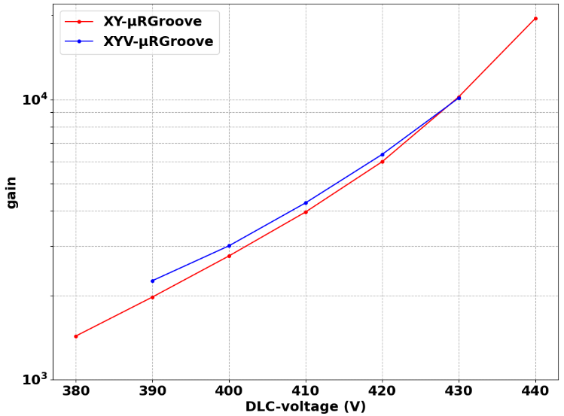
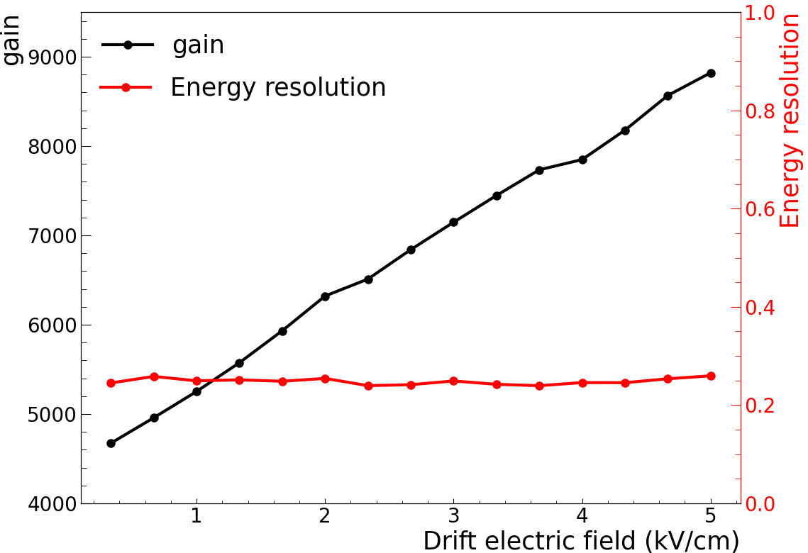
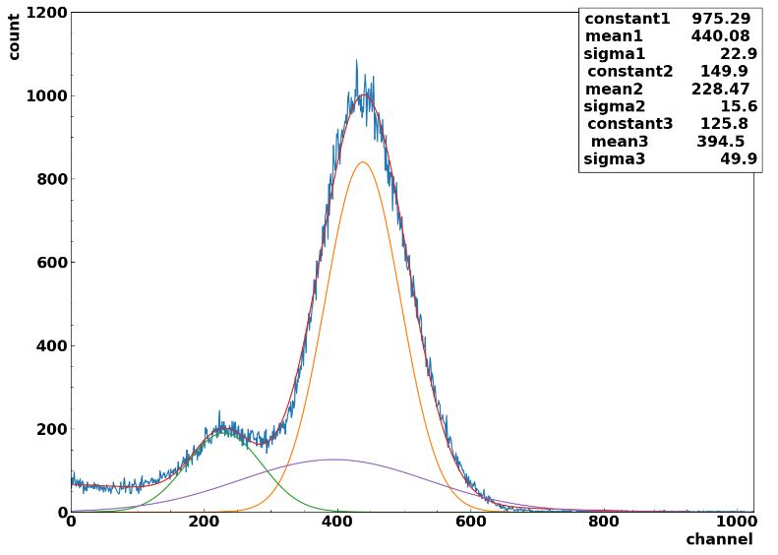
Effective Gain and energy resolution
Gas: Ar/iC₄H₁₀ (95/5)
Source: 8.1keV Cu X-ray
Effective gain up to 10⁴
(by signal amplitude spectrum)
Energy resolution is about 25%
As the drift electric field becomes larger, the gain increases almost linearly, and the energy resolution remains unchanged.
XY-μRGroove

Slide 9
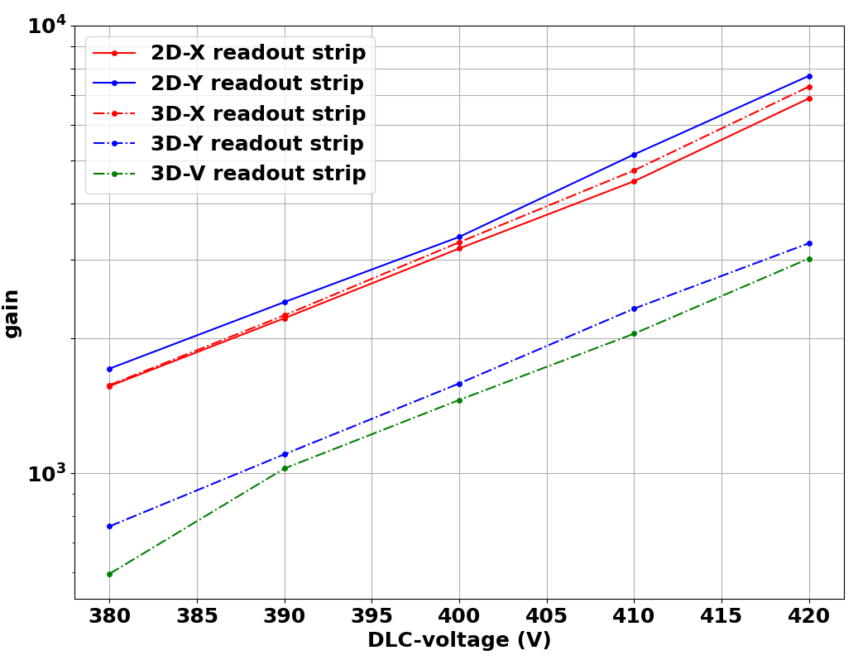
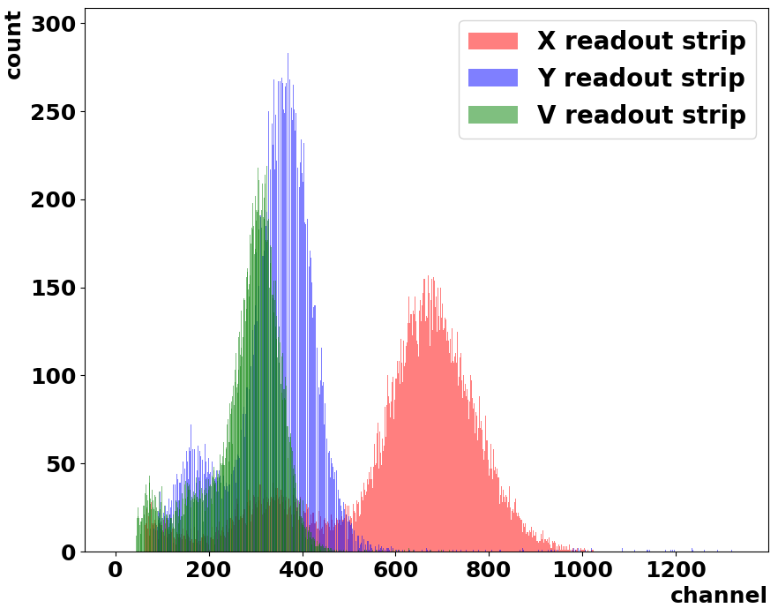
Induced charge sharing effect
For 2D-μRGroove with this Layerstack, ^{2D}Q_{Y} ≈ ^{2D}Q_{x}
For 3D-μRGroove with this Layerstack, ^{3D}Q_{Y} + ^{3D}Q_{V} ≈ ^{2D}Q_{Y} ≈ ^{3D}Q_{X}
When the distance from the top and bot readout to the DLC is different, the induced charge will be different.
Avoiding the charge sharing can significantly increase the induction signal.

Slide 10
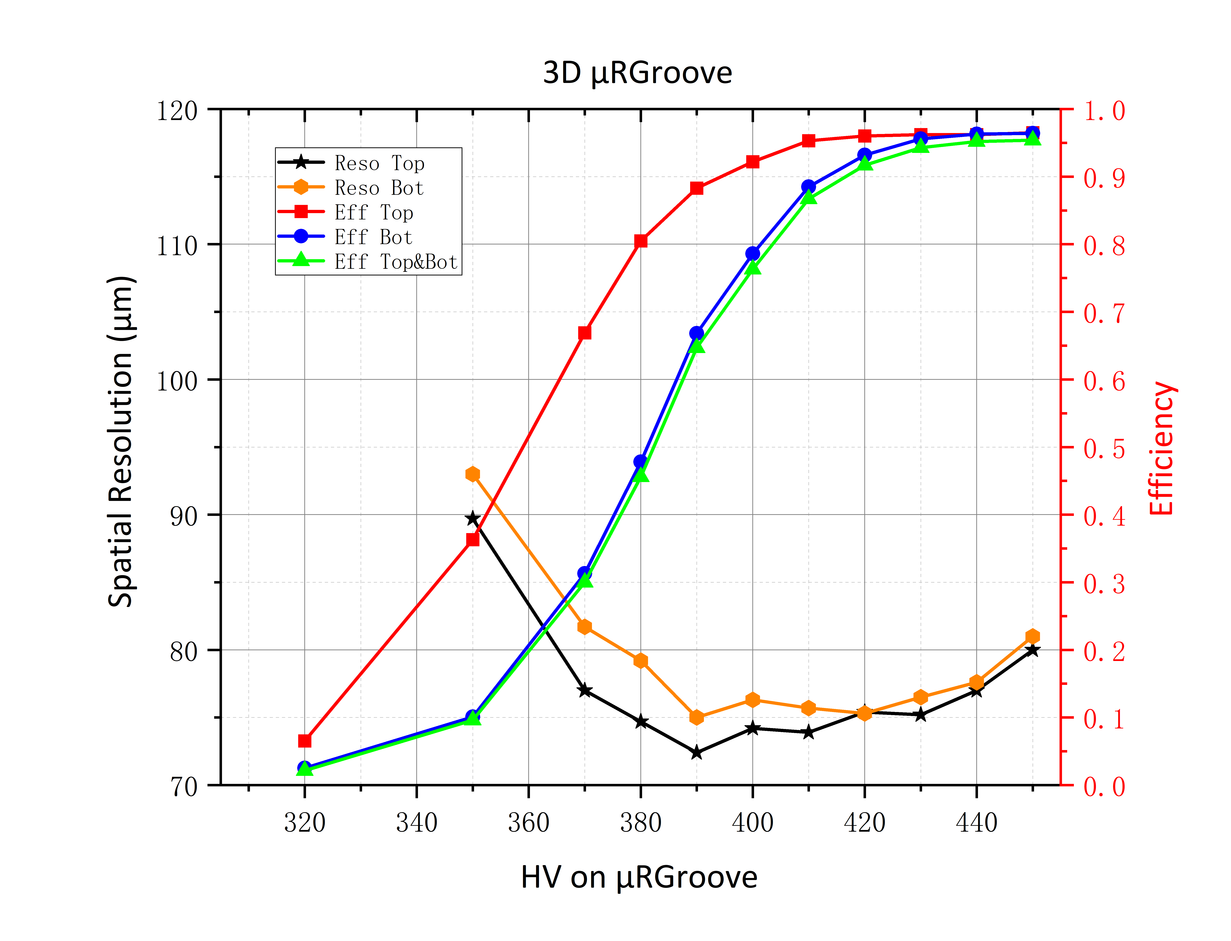
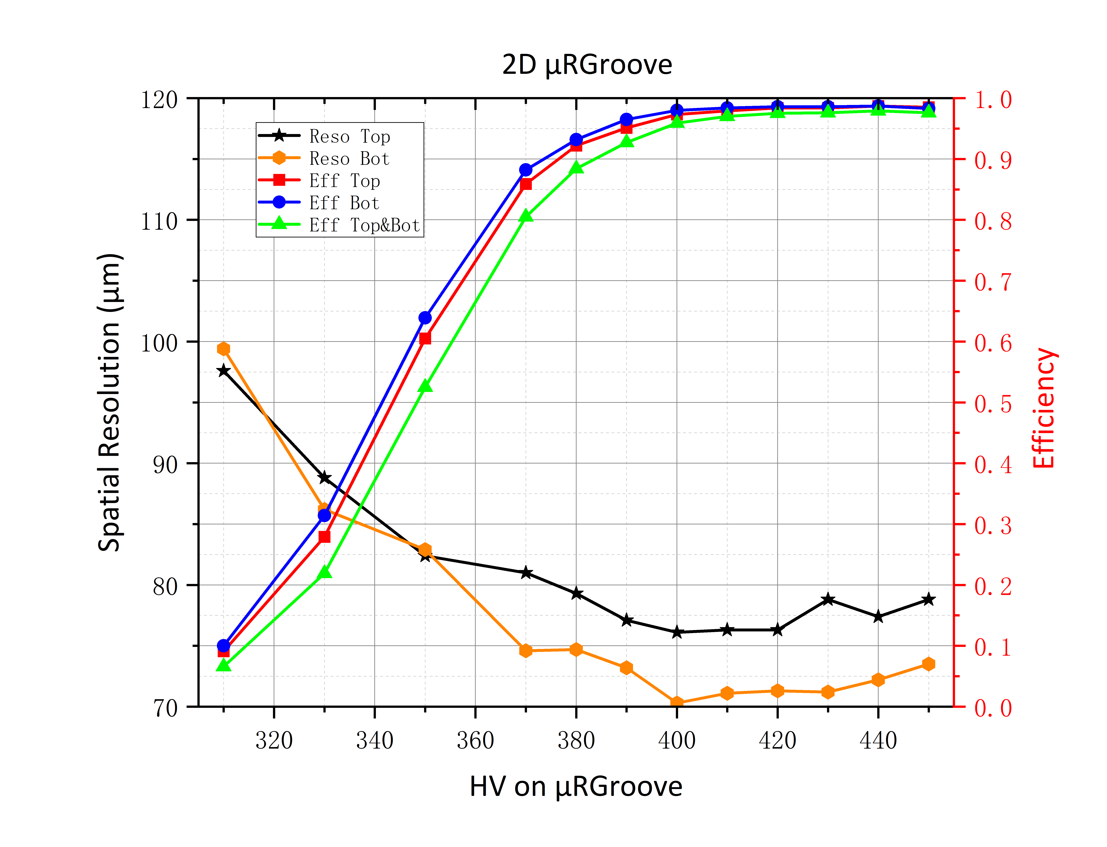
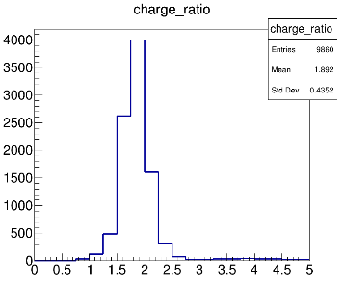
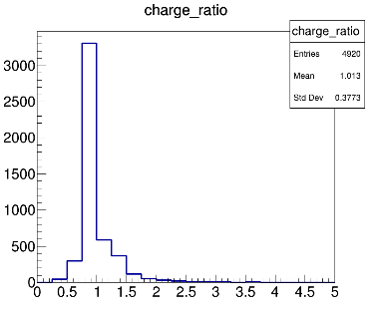
Detection efficiency & Spatial resolution
Drift: 2kV/cm
Gas gap: 5mm
X strips
2D-μRGroove
3D
at CERN SPS beamline
~1°
Y strips
2D
Only X and Y readout is tested with V-strip float at first .
Incomplete alignment results in slightly worse spatial resolution for X strips
The combined efficiency is about 95.6% and enter plateau at ~430V
Spatial resolution is better than 80μm
Charge radio of X/Y is about 1.89
The combined efficiency is about 97.9% and enter plateau at ~410V
Spatial resolution is ~76μm for X readout and 70μm for Y readout
Charge radio of X/Y is about 1.013

Slide 11
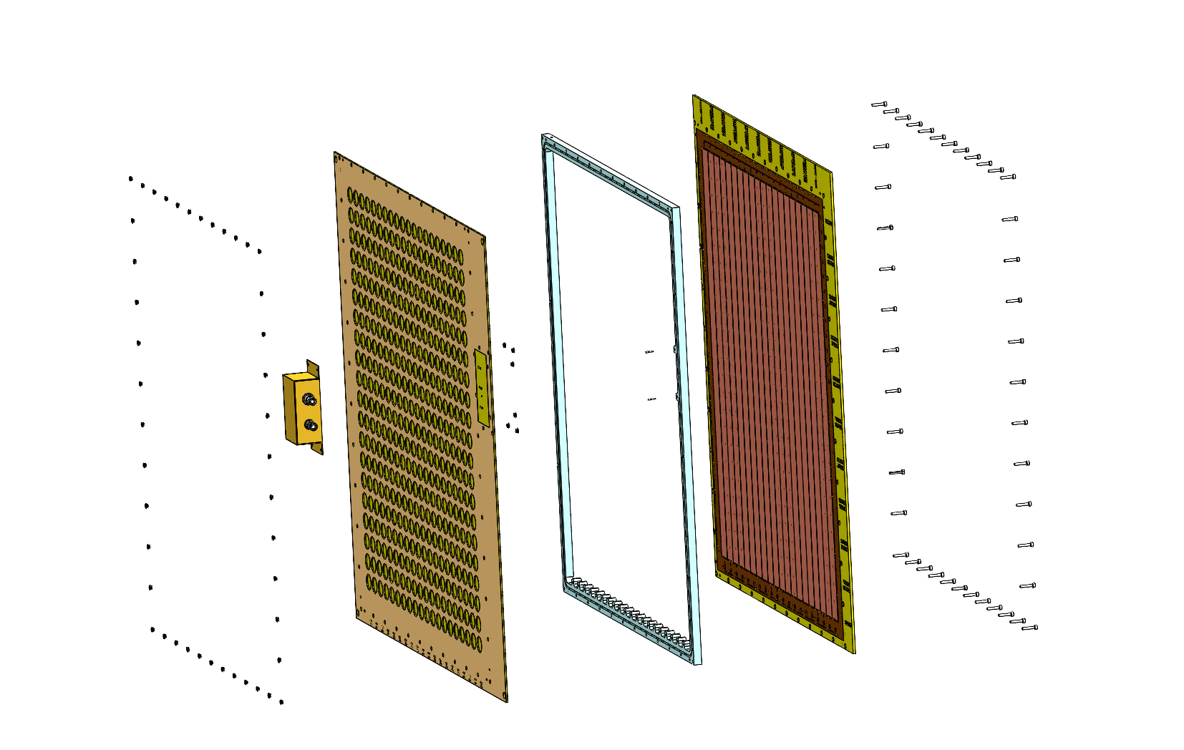
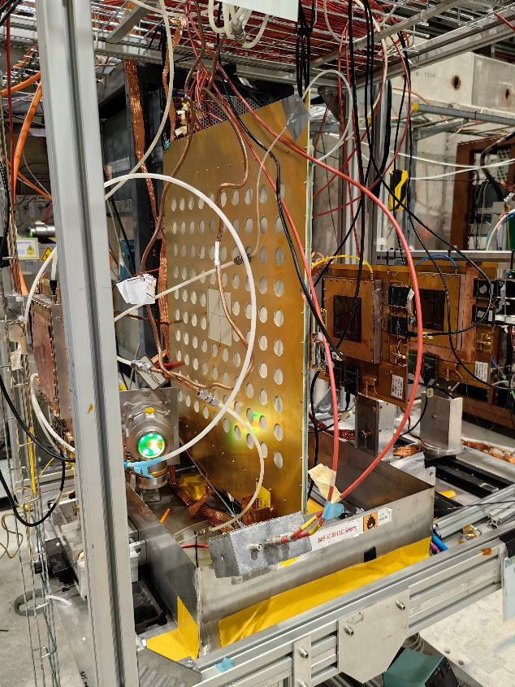
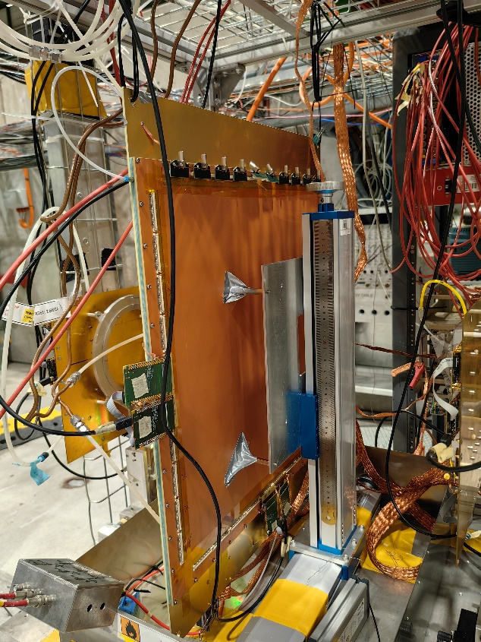
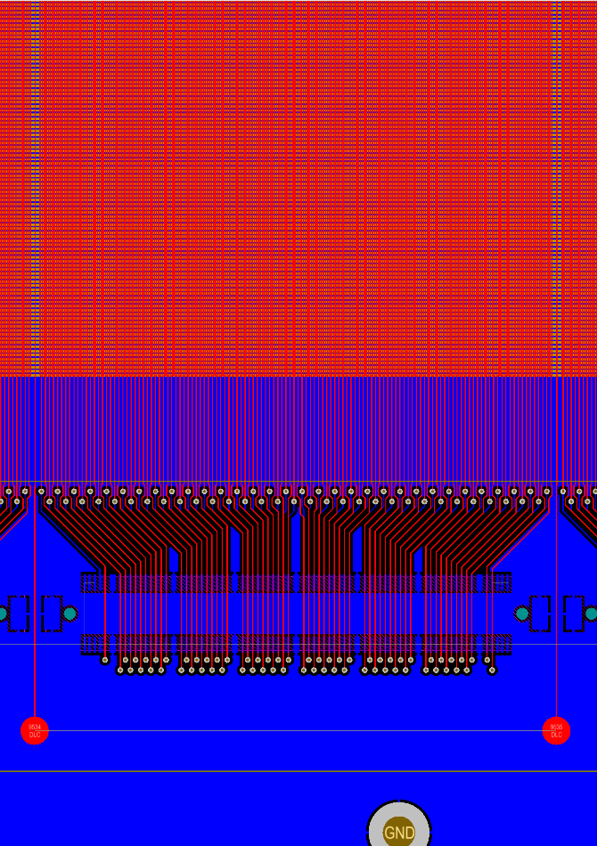
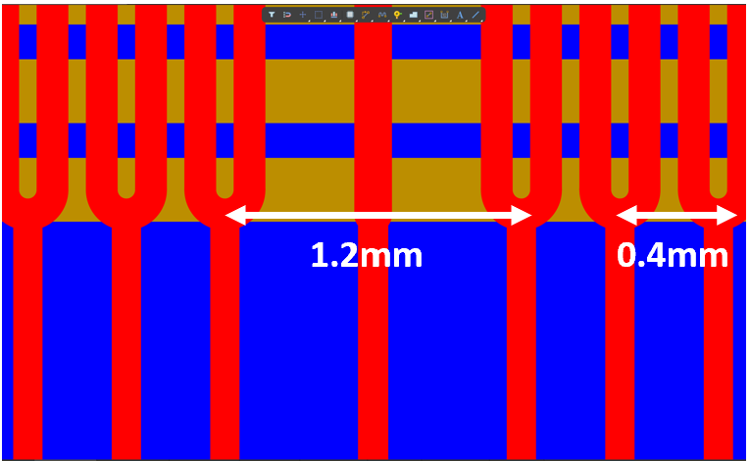
50cm×50cm 2D-μRGroove
2 readout strips are replaced by a PEP GND line in each 128 readout strips;
The central 10cm×10cm area is connected to the electronic system for testing with the rest readout strips grounded
Same setup of beam test
Dead Area (TOP): 2/128=1.5625%

Slide 12
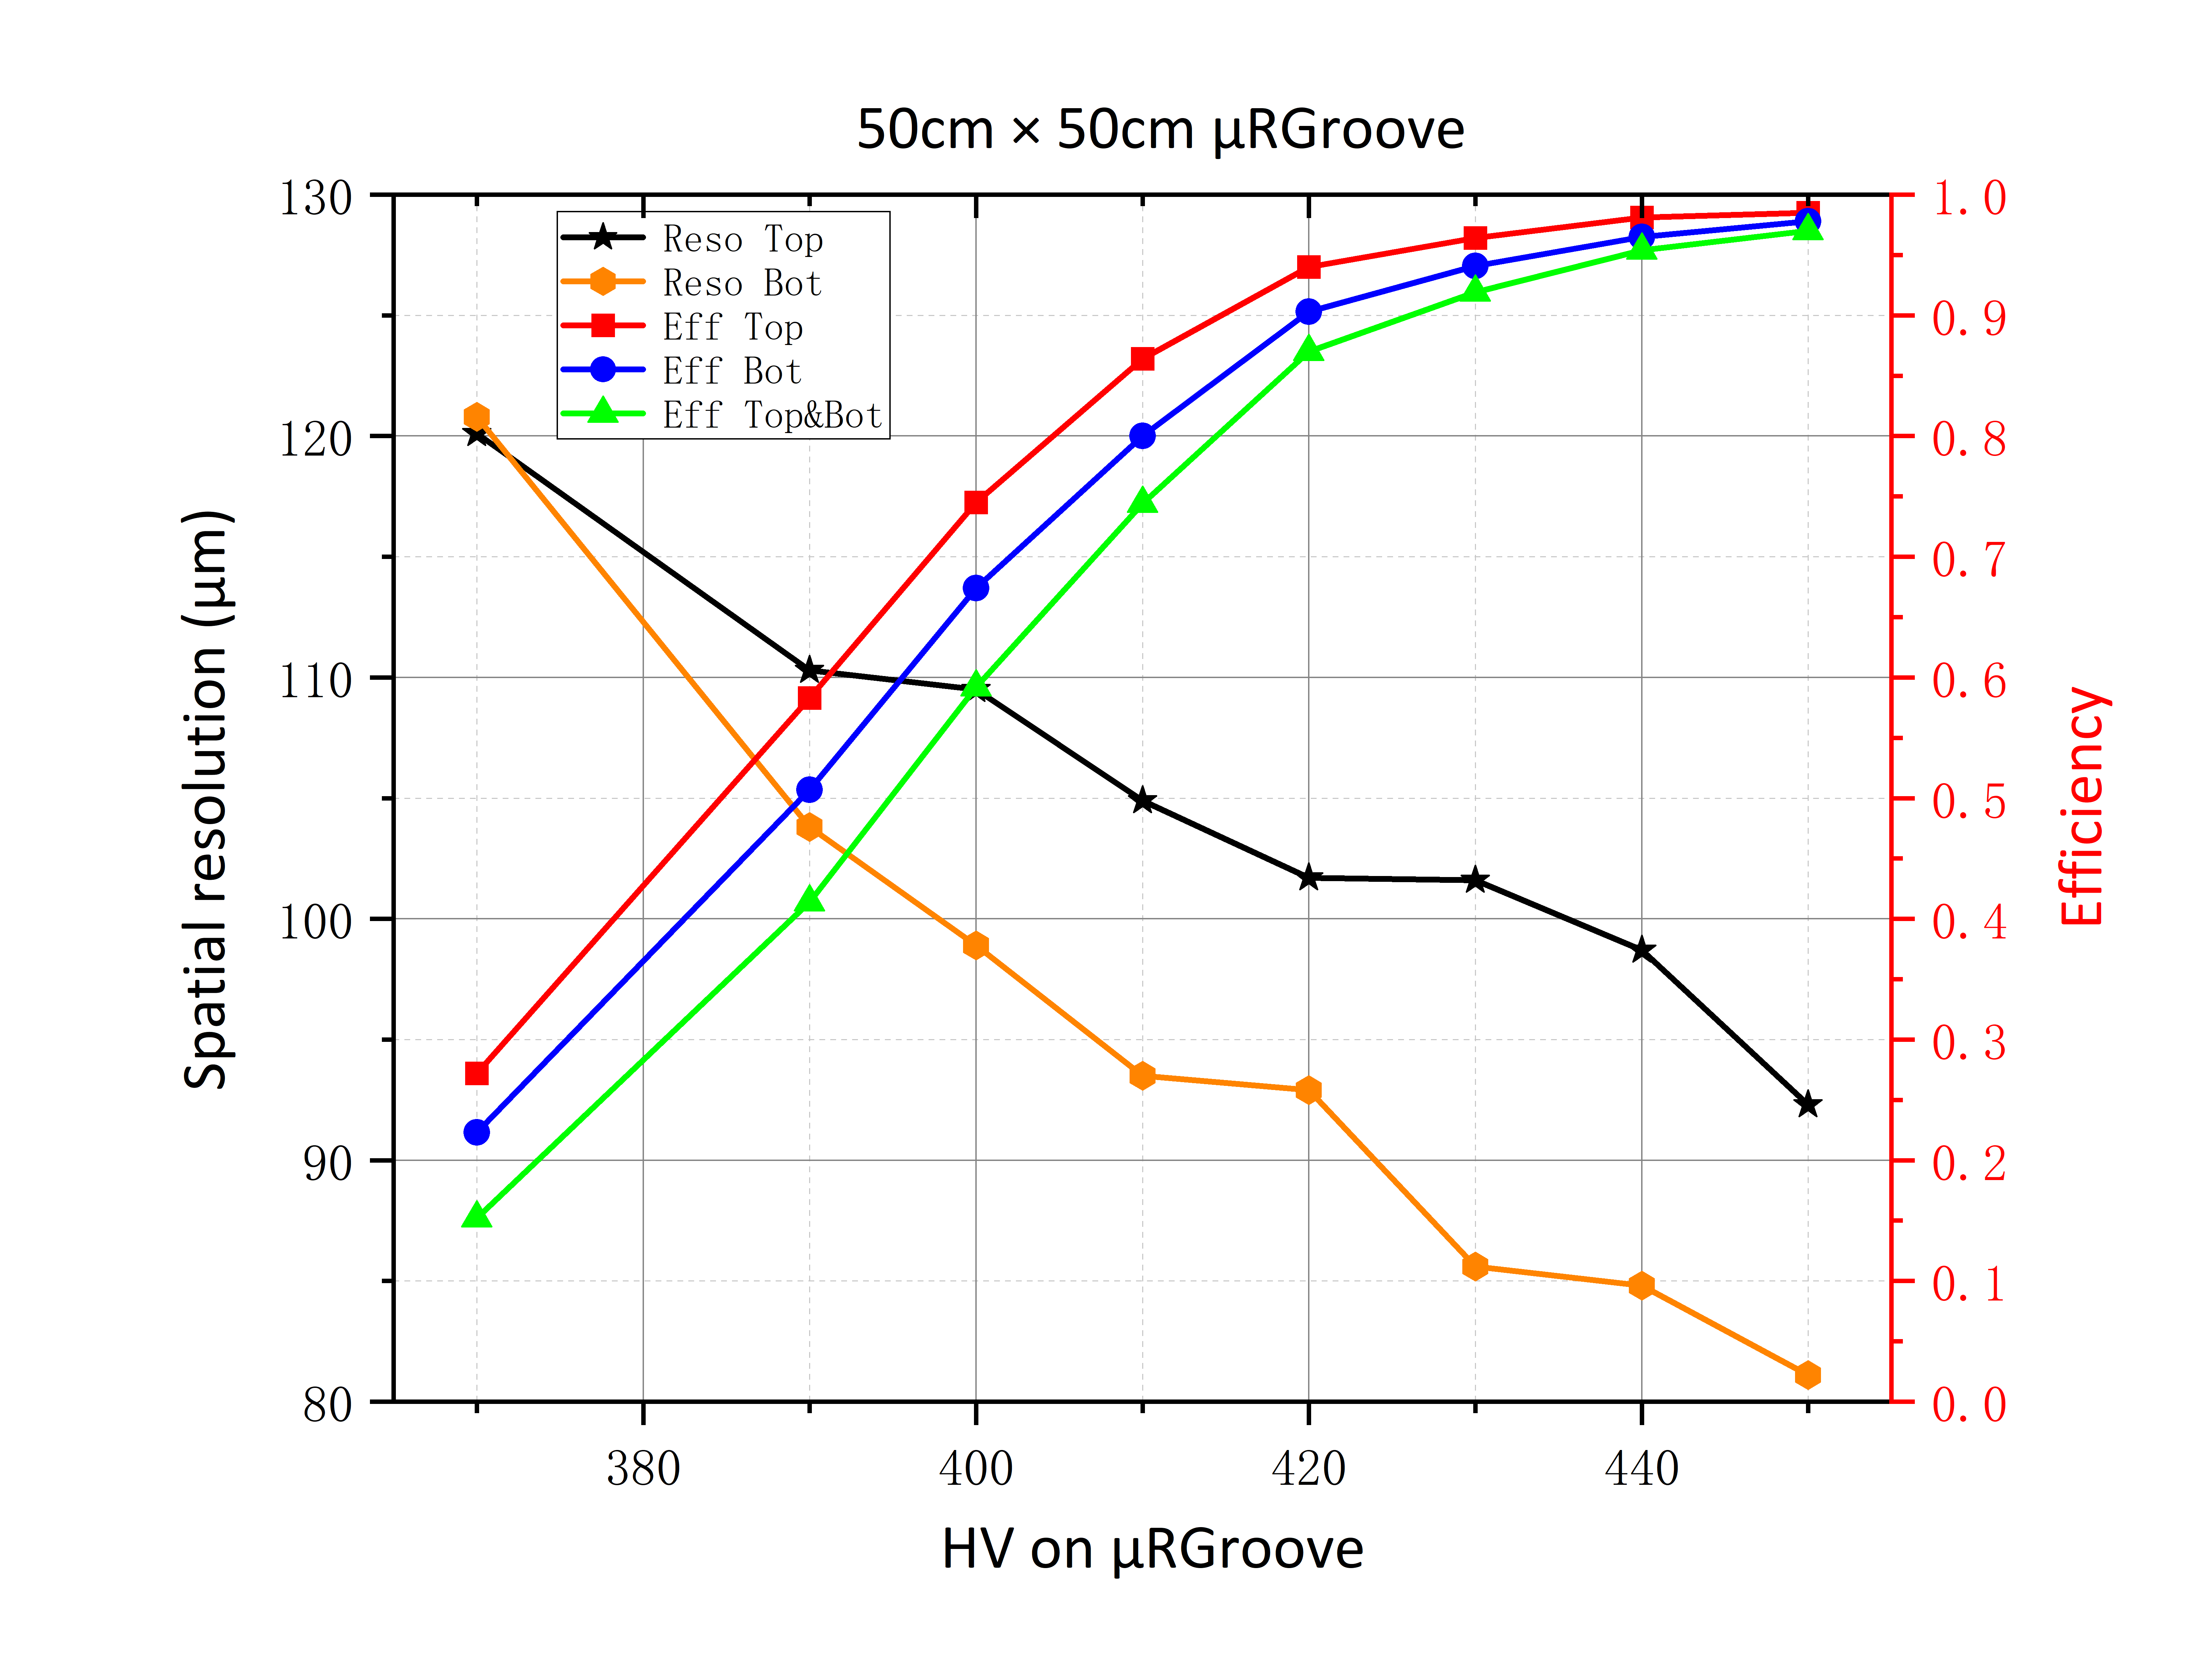
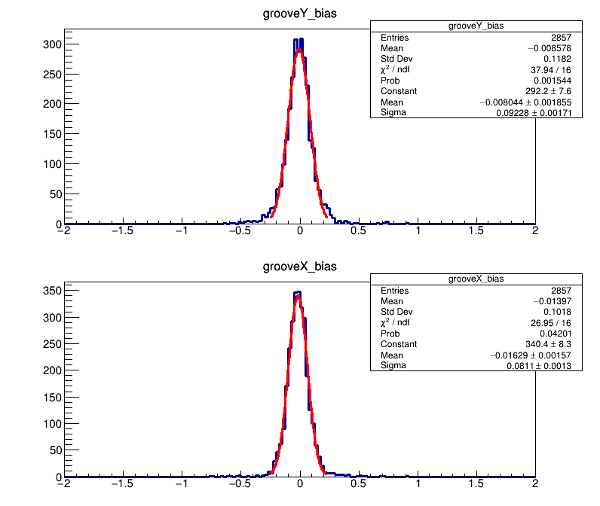
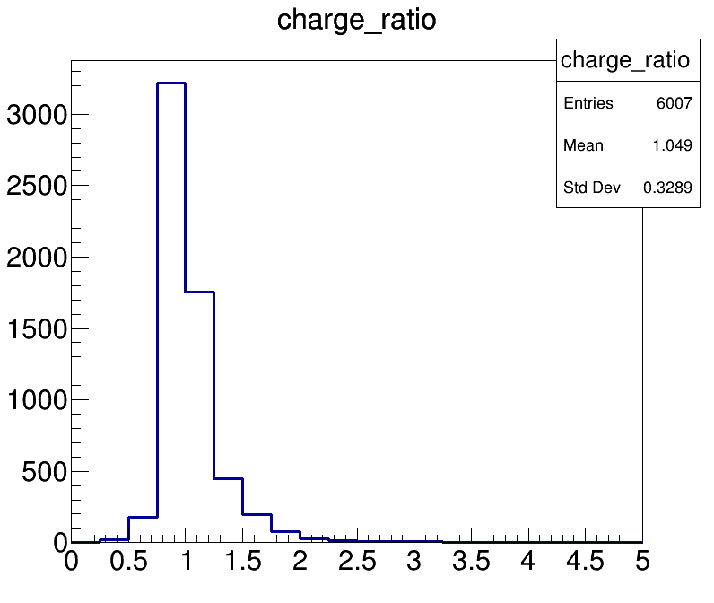
Beam test of 50cm×50cm μRGroove
Drift electric field is 2kV/cm with 5mm gas gap.
The combined efficiency is about 96.9% and enter plateau at ~450V
Spatial resolution is ~93μm for X readout and ~81μm for Y readout
Charge radio of X/Y is about 1.049
Much Larger capacitance causes smaller signal amplitude at the same working voltage and higher voltage entering plateau.
Incomplete alignment results in worse spatial resolution for X strips

Slide 13
Rate capability of Fast-grounding μRWELL
Matteo, Update on Technology Transfer of µ-RWELL , Last RD51 Collaboration Meeting
Fast Grounding is the key design for high rate capability
Fast grounding μRWELL:
PEP-groove design
PEP-dot design
Similar to 50cm×50cm μRGroove

Slide 14
Rate capability of Fast-grounding μRWELL
For both designs，rate capability >10MHz/cm²

Slide 15
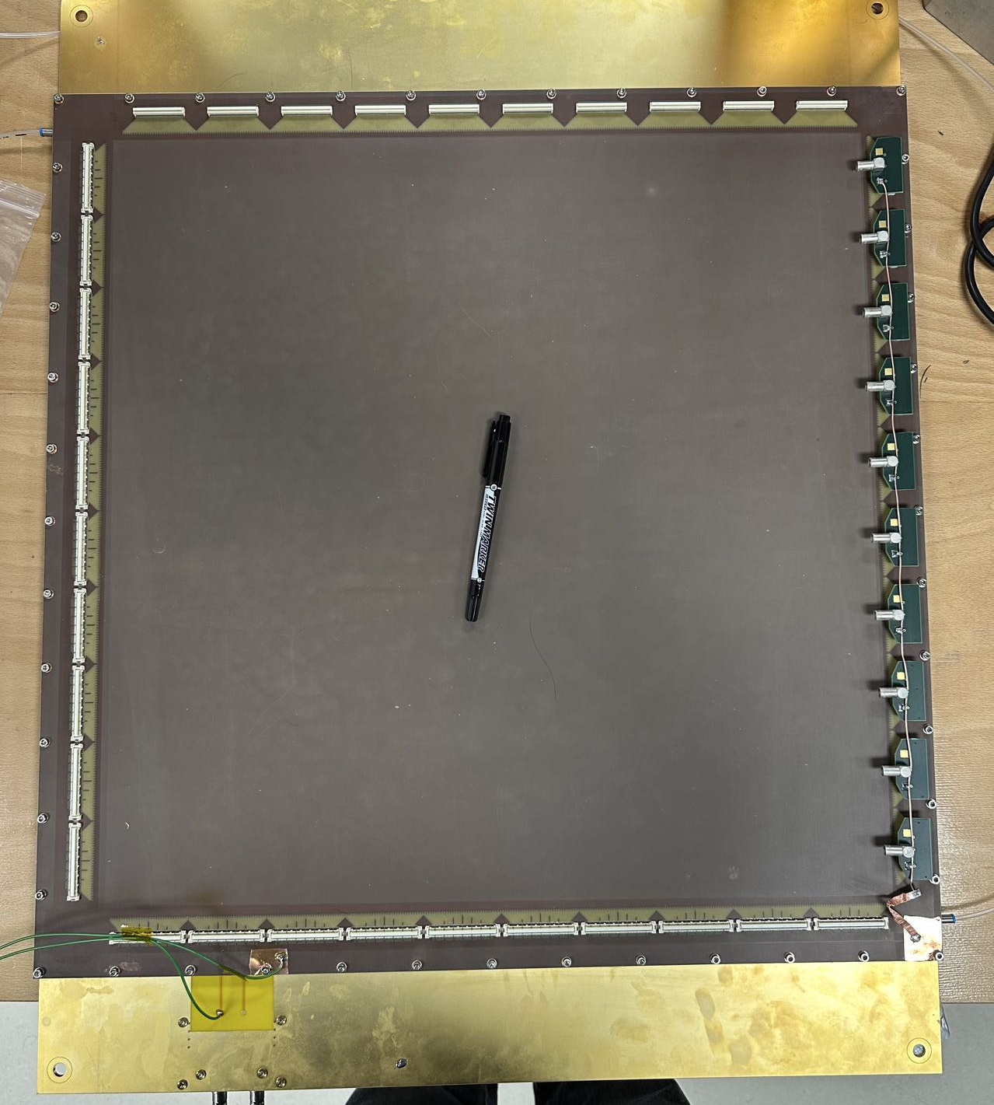
Rate capability of Fast-grounding μRGroove
Still ongoing
2 readout strips are replaced by a PEP GND line in each 128 readout strips;
50cm×50cm μRGroove is designed as PEP-groove fast grounding.
Testing will be conducted and hopefully similar results will be obtained

Slide 16
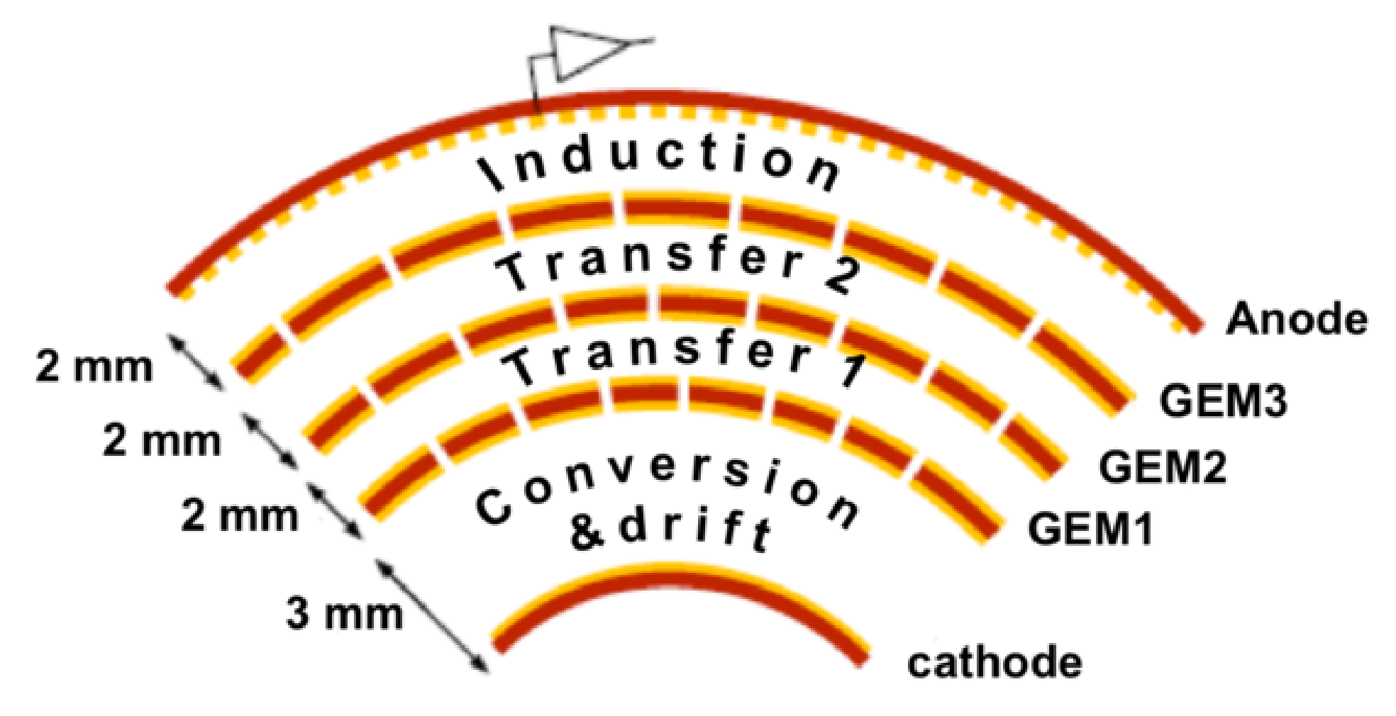
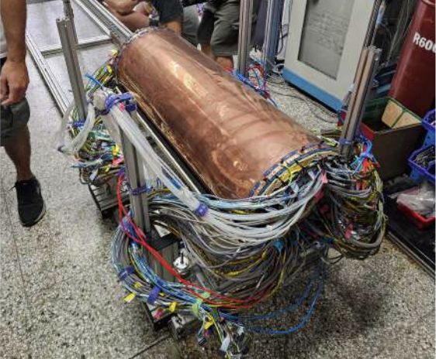
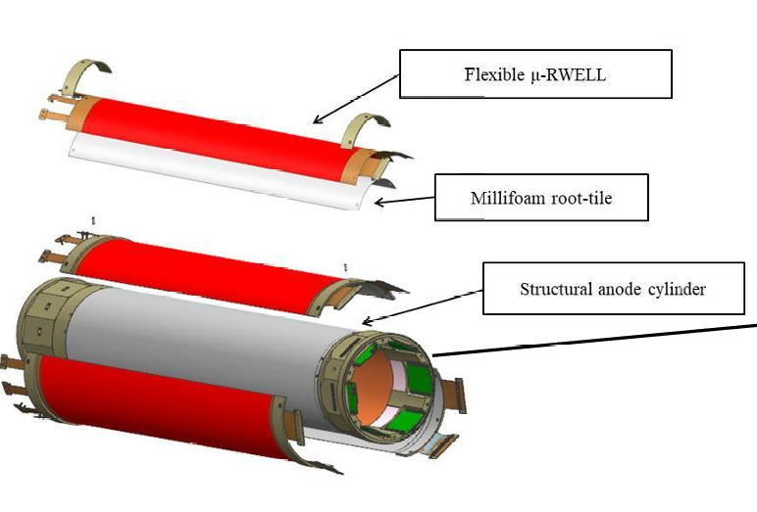
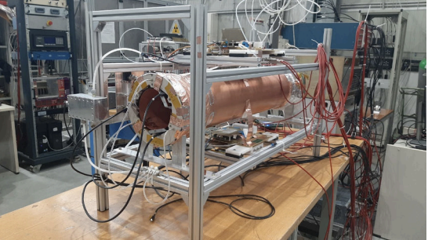
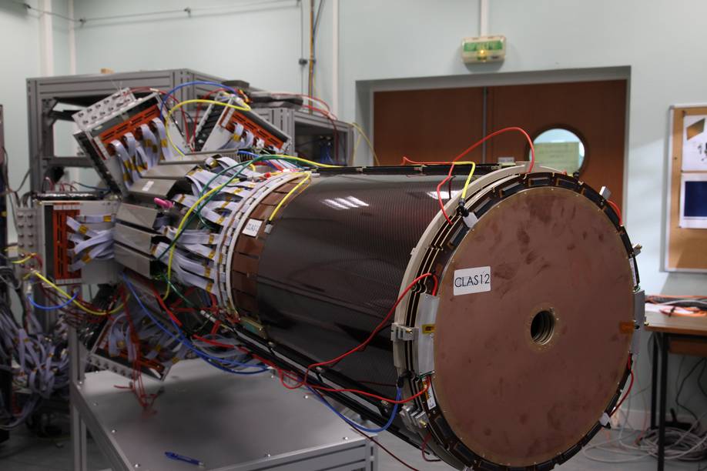
Low-mass Cylindrical MPGD
BESIII c-GEM
Max size：D=323.8mm，L=847mm
Material budget: ∼ 0.5%X₀
Spatial resolution by CC method(<5°): ∼200μm
Detection efficiency for MIP：∼95%
INFN-LNF c-μRWELL prototype
Size：D=168.5mm，L=600mm
Material budget: ∼ 0.6%X₀
Spatial resolution by CC method(<3°): ∼460μm
Detection efficiency for MIP：>95%
CLAS12 c-Micromegas
Max Size：D=207.5mm，L=712mm
Material budget: No public data found yet
Spatial resolution: ∼432μm (5T)
Detection efficiency：∼90%

Slide 17
A Cylindrical μRGroove prototype
1st Prototype
DLC HV
Drift HV
V readout
U readout
1st C-μRGroove prototype for STCF-ITKW:
Size of active area: D=131.0mm, L=100.0mm;
Out cylinder is drift and inner is μRGroove-PCB
Both cylinders contain independent support structures
Detachable mechanical design
Low-mass electrode design
Total material budget: ~0.23%X₀

Slide 18
Gain and energy spectrum measurement
Setup：
Gas: Ar:iC₄H₁₀/95:5
Source: ⁵⁵Fe
Readout from X strips (cathode)
V strips are grounded
Ortec142AH/671 + MCA
Gain measured by signal amplitude spectrum
~1h@gain : 5100
Energy resolution: ∼26%;
Effective gain: 4000~10000;
Similar signal amplitude on X&V readout strips;
Good stability if the humidity can keep low enough;
3 sectors not work (8 sectors in total);
Bad gain uniformity, caused by the gas(flow);

Slide 19
Beam test
Setup：
Gas: Ar:CF₄:CO₂/45:40:15
Readout from U strips (top cooper of μRGroove)
V strips are grounded
3 micromegas trackers
APV25+SRS+mmDAQ
C-
0mm
465mm
646mm
925mm
C-μRGroove
2024. 06-07
MM1
C-μRGroove
MM3
MM2

Slide 20
Detection efficiency and spatial resolution
Charge Center of gravity(CC) for perpendicular tracks
After correction
$$y=\left(r+\frac{d}{2}\right)×\sin{\frac{l}{r}}+pos_mid$$
Find the middle area.
Alignment and rotation correction
Position correction of circular surface
$l$ $:$ reconstructed position
$y:$ truth hit position
$pos_mid$: middle point
Spatial resolution for perpendicular tracks: 83~93μm.
Detection efficiency >95%.
Wrinkles may degrade spatial resolution

Slide 21
First result of micro-TPC
Alignment
&rotation cor.
μTPC
Position correction of circular surface
Constant ratio timing
A algorithm of μTPC has been developed
with the incident angle is >8°, the spatial resolution obtained by the μTPC is better(~114μm).
Time advanced
correction

Slide 22
Summary
10cm×10cm planar μRGroove
Maximum Gain > ${10}^{4}$. Energy resolution ~25% with nice stability
Combined efficiency is about 95.6% for 3D-version and 97.9% for 2D-version
Spatial resolution is about 70-80μm for both versions.
50cm×50cm planar μRGroove
Combined efficiency is about 96.9%
Spatial resolution is better than 100μm
1st Cylindrical μRGroove
Max gain is 4000-10000, Energy resolution ~26% at first test.
For perpendicular tracks: Detection efficiency >95%, spatial resolution <100μm
For oblique incident tracks: preliminary result of μTPC is ~120μm

Slide 23
Outlook
Test the rate capability of 50cm×50cm μRGroove
Develop μTPC algorithm and Analyze beam data of C-μRGroove beam test in magnetic fields
Improve the C-μRGroove prototype, mainly about uniformity and wrinkle issues
Optimize the detector structure, such as Thick-μRGroove (with 75μm APICAL)
Gap=5mm
Pitch=200μm
Thickness=75μm
Width=90/70μm
75μm-Thick μRGroove
DLC ~50MΩ/□

Slide 24
Backup

Slide 25
Super Tau-Charm Facility
STCF is an e + e- collider operating at $\sqrt{s}$=2～7 GeV with a peak luminosity of $0.5×{10}^{35}$cm⁻²s⁻¹.
Track detection under extremely high luminosity requires the ITK performance includes:
Ultra-Low Material Budget (<0.3%X₀)
Good Spatial resolution (<100μm)
Handle high occupancy operated in μTPC mode
……
Damping Ring
150 m
Collider Ring
1000m
LINAC
400 m
Detector
Possible Solutions：
Cylindrical MPGDs
Detector Candidates: μRGroove

Slide 26
Beam test: Setup
μRGroove
Beam line: SPS - H4
Particle: 150GeV/c Muon
Electronics: SRS + APV25 + mmDAQ
μRGroove gas: Ar/iC₄H₁₀ (90/10)
Micromegas trackers gas: Ar/CO2 (93/7)

Slide 27
C-μRGroove: Low-Mass Electrode
LM Drift & GND are both made
Zhou Lin, RD51 Collaboration Meeting, 21/06/2023
DLC: Diamond Like Carbon

Slide 28
C-μRGroove: Manufacture
Drift electrode
Rohacell foam
Kapton/GND
Kapton/GND
Rohacell foam
V strip film
Det.&U-strip film
Total material budget: ~0.23%X₀

Slide 29
C-μRGroove: Electrodes design
Layer stack of μRGroove
μRGroove/U Strips
V Strips
Layer stack of V readout
U/V 2D strip-readout, pitch of U strips is 0.4mm, Pitch of V strips is 0.8mm, angel between UV is 15°

Slide 30
Beam test with magnetic filed
Setup：
Gas: Ar:CF₄:CO₂/45:40:15
Readout from X strips (cathode)
V strips are grounded
APV25+SRS+mmDAQ
Distance between forward and backward triggers is ~8m
3 μRGroove trackers
0.5-1.5Tesla magnetic filed
0mm
143mm
493mm
663mm
Magnet
2024. 09-10
μRgroove1&2
C-μRGroove
μRgroove3

Slide 31
Beam test with magnetic filed
For perpendicular tracks, CC method
For perpendicular tracks, CC method
0 Telsa
1 Telsa
Spatial resolution is ~400μm
Bias: ~1.592mm, sigma: ~400μm
Lorenz angle: ~17.7°
Spatial resolution is ~94μm as a reference @B=0T
For 150GeV/c muon, $m≈P$
$r=\frac{mv}{Bq}≈500m$ @B=1T
Trackers’ hit map shift caused by long distance between triggers.
Further analysis based on μTPC needed

Slide 32
The Size of 3-layer ITKW
Size of active area:
Layer0: D=131.0mm, L=100.0mm;
Layer1: D=131.0mm, L=380.0mm;
Layer2: D=229.4mm, L=650.0mm;
Layer3: D=327.9mm, L=920.0mm;

