Slide 1




Heavy Gas Cherenkov Update
Zhiwen Zhao and Garth Huber
SoLID Collaboration Meeting
Jan 9-10, 2025

Slide 2
Outline
Simulation and engineering
U of Regina funding update

Slide 3
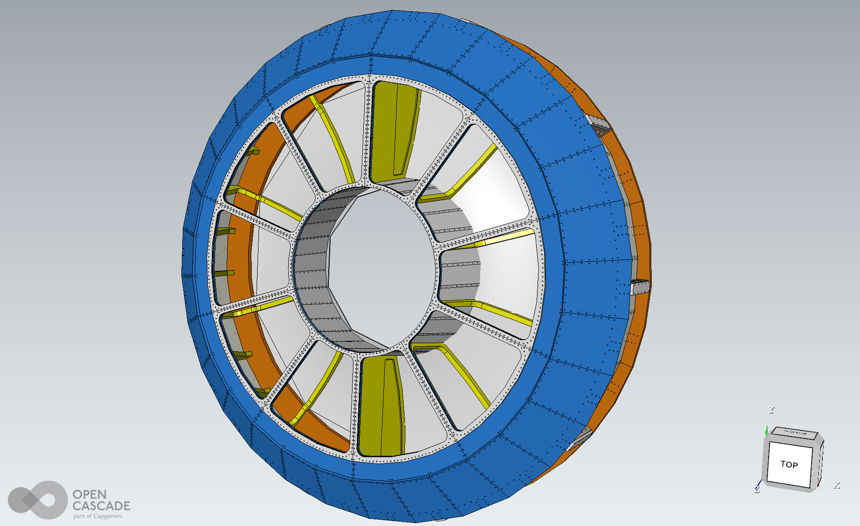
HGC block study
It is always better if block is not needed!
Due to installation plan, HGC needs two C-shaped tanks separated vertically
This means there are two “blocks” at phi=90,270deg
Each block is 1-2inch thick and made of 2 Aluminum plates

Slide 4
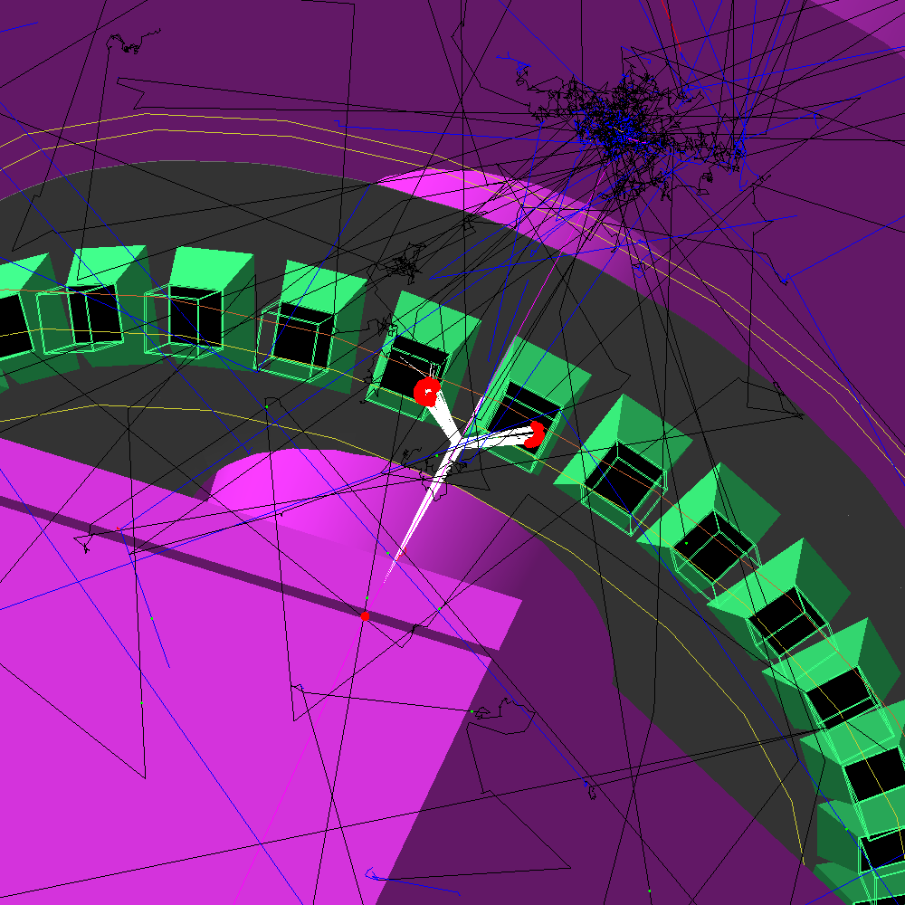
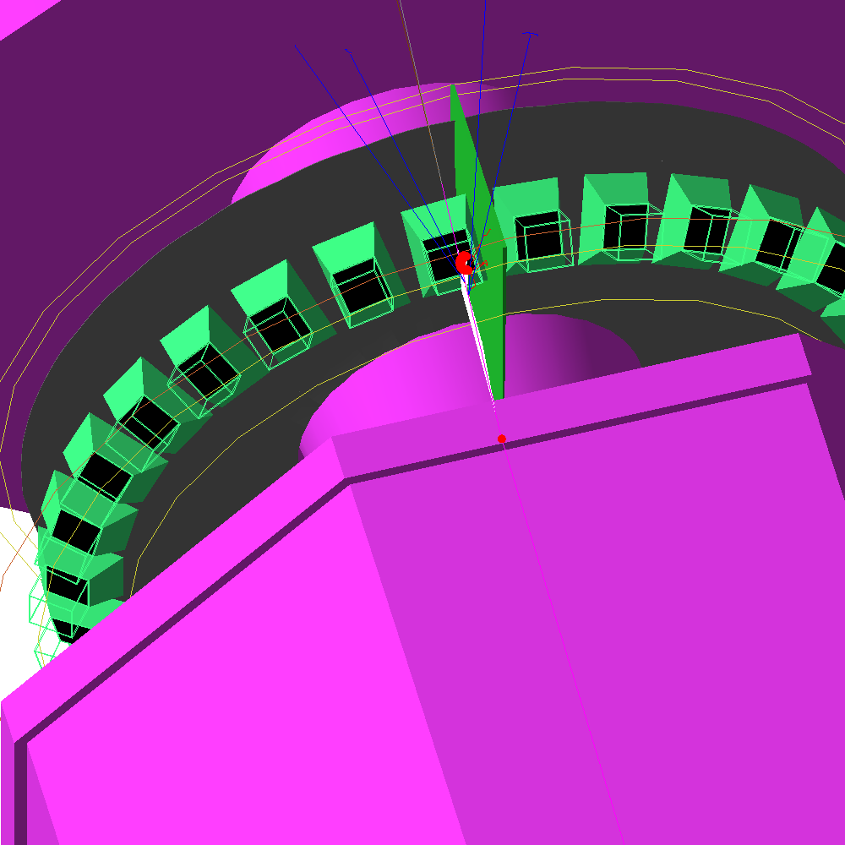
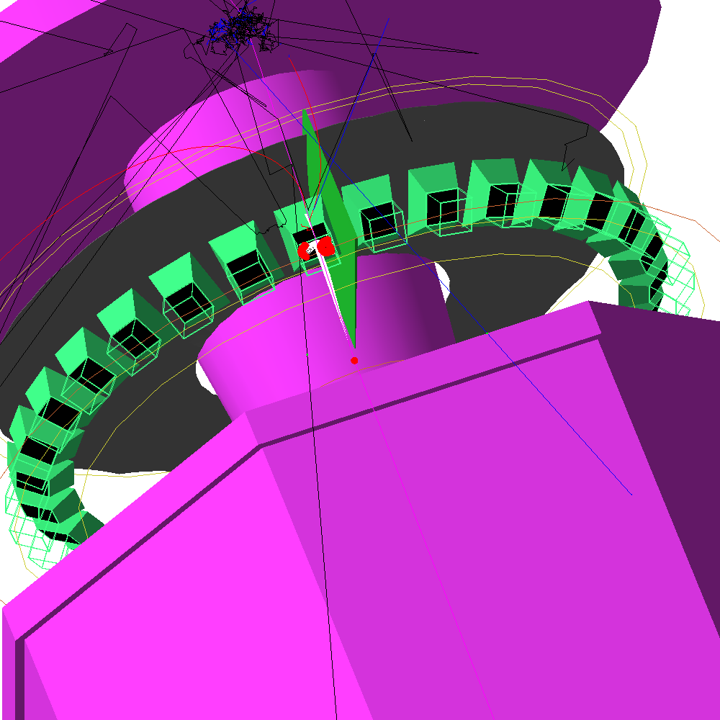
HGC block study
No block
Al block
mirror block
For SIDIS_He3 setup, charged pions from target bent by solenoid field about 10-30deg in phi at the HGC entrance
At certain angles, Cherenkov photons are collected by two neighboring mirrors
Al blocks stop the photons going to the mirror in the other C tank
Testing if mirrored block (with thin reflective films attached) can recover those photons

Slide 5
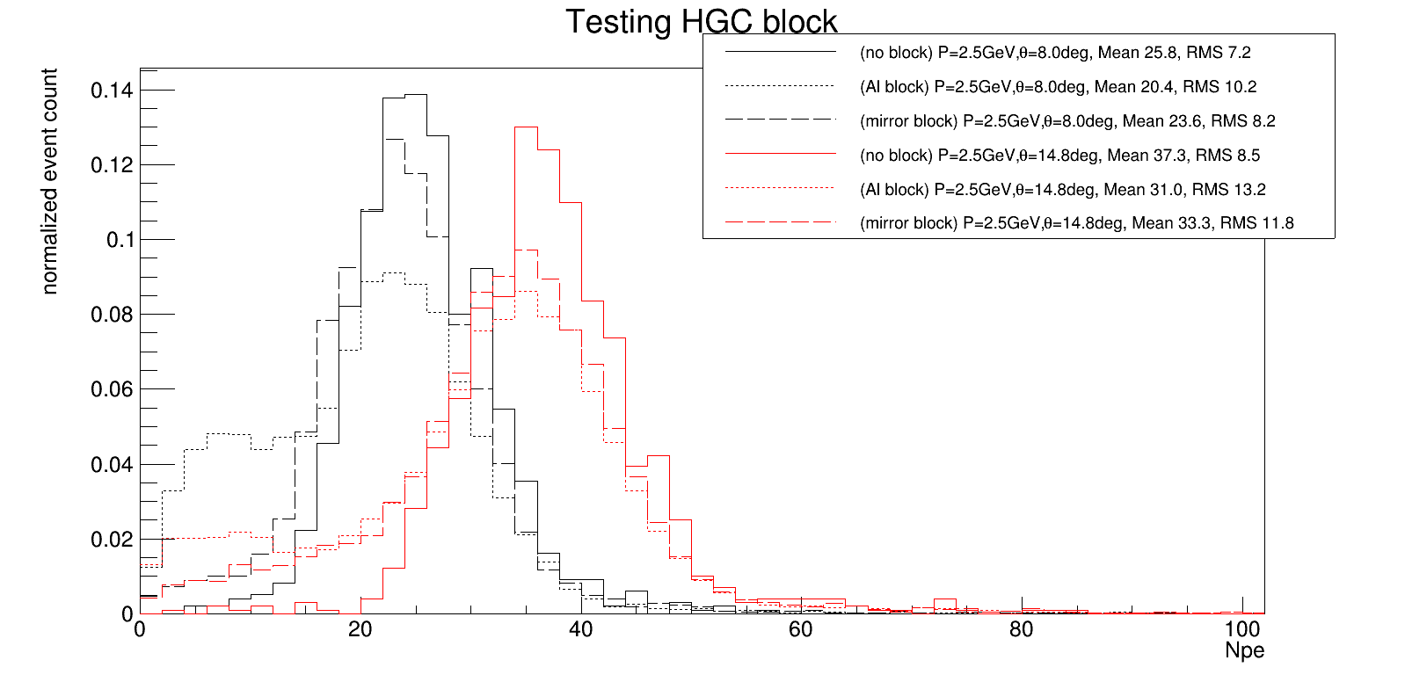
HGC block study
Sim safety factor 2 is not added
Testing largest pion bending at P=2.5GeV, theta=8deg,phi=57-63deg,and P=2.5GeV, theta=14.8deg,phi=67-73deg
Mirrored block can recover performance pretty well
Next to test SIDIS_NH3 setup and how block affects detectors behind

Slide 6
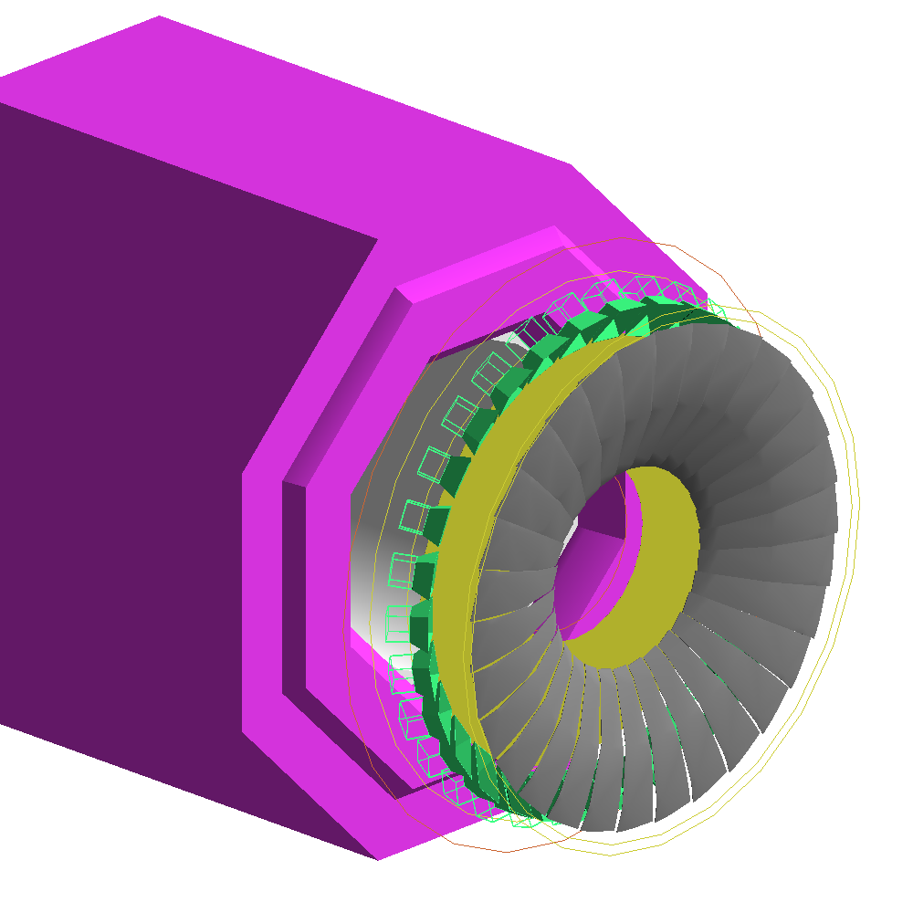
HGC mirror study
The goal is to understand mirror misalignment tolerance and further optimization
For SIDIS_He3 setup, testing “roll” now.
Do “yaw” and “pitch” later. Then SIDIS_NH3 setup
Roll will leave gaps between mirrors

Slide 7
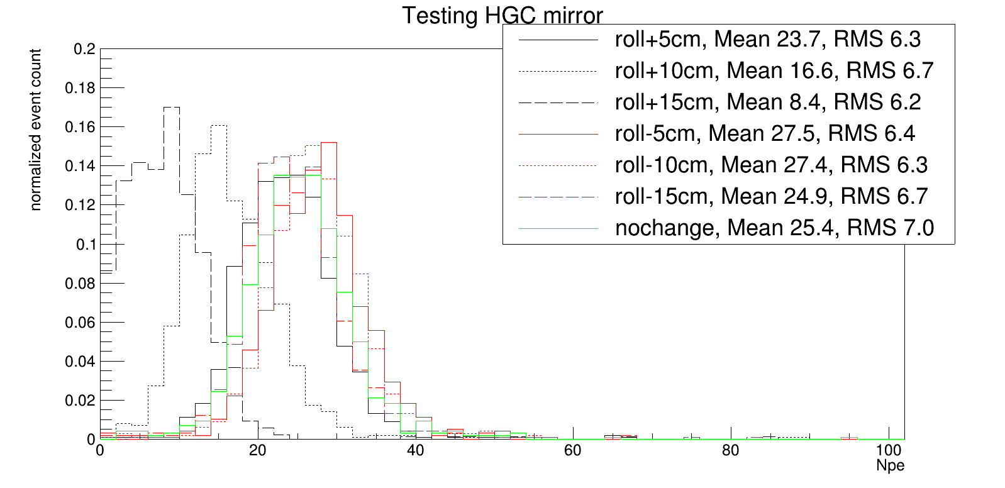
HGC mirror study
Sim safety factor 2 is not added
One type of charged pions is sensitive to one direction of roll, but of course HGC needs to be careful with both
More study needed

Slide 8
Engineering work
Monthly meetings between Duke and Regina to finalize parts of HGC design not incorporated in the prototype
  Ongoing
    readout assembly as pressure and light seal enclosures
    Vessel materials list for bulk item order
  Next
    Mirror mounting
    Other small things

Slide 9
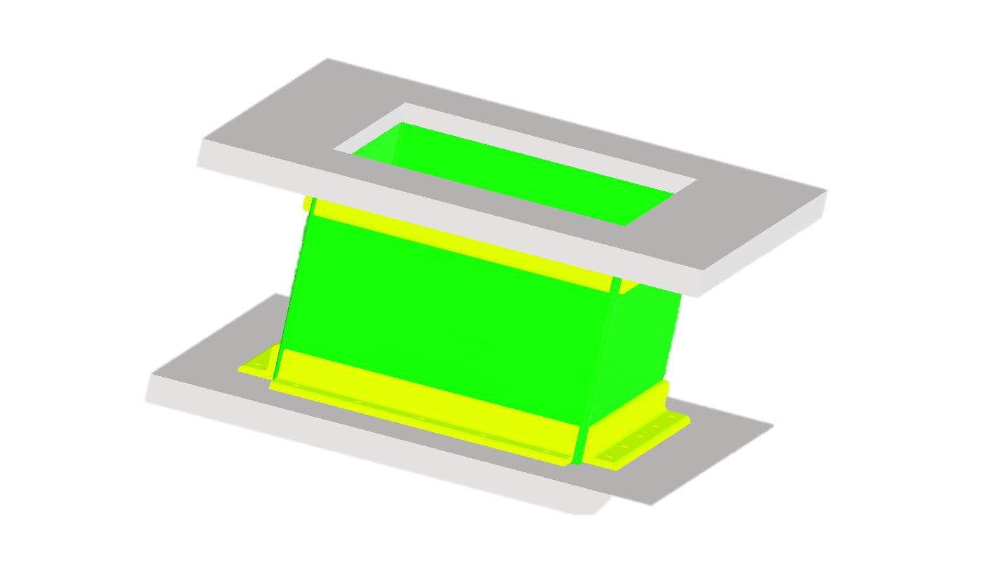
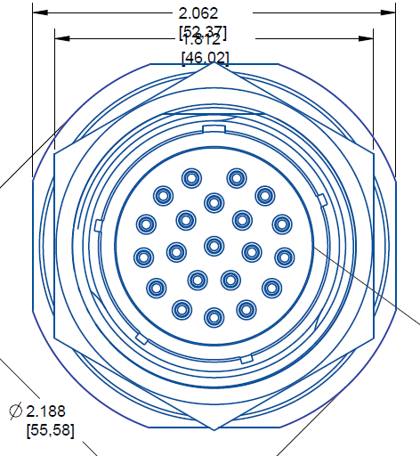
Design and test readout assembly
Aluminum square housing
  fix onto the blue plate by O-ring and/or epoxy
  Magnetic shielding mounted on the housing
Aluminum cap will mount electronic board with PMTs
  use O-ring to connect to Aluminum square housing so it can open for installation and repair
  Use high density hermetic connectors with protection covers as cable feedthrough
Mark Emamian
(Duke Engineer)
Make a small prototype and do standalone test first

Slide 10

Vessel materials list
dimension | Quantity | mat
96x48x1 | 2 | 6061-T6
96x48x1 | 5 | 6061-T6
51x50x1 | 10 | 6061-T6
72x48x2 | 8 | 6061-T6
62x48x2 | 5 | 6061-T6
52x48x1 | 10 | 6061-T6
55x55x0.25 | 10 | 6061-T6
45x45x0.04 | 10 | 2024-T3
Fit parts into rectangle shaped Al plates to minimize waste

Slide 11



Canadian Funds for SoLID HGC Vessel
Our grant application through CFI Innovation Fund (IF) 2023 competition was successful
  Canada Foundation for Innovation (CFI) is a Federal Agency that funds research infrastructure. There is a ~C$400 million IF competition every two years, covering all disciplines
  CFI funds must be matched by other agencies to qualify for award, typically provincial or institutional funds
  This can reduce pressure on funds provided by US–DOE
Funds Awarded (Canadian Dollars)
$509.5k
$300k
$209.5k
TOTAL
$1019k

Slide 12
Status Update
UofR and JLab have agreed on the wording of an International Cooperative Research and Development Agreement (ICRADA) covering:
  Ownership and de facto control of infrastructure
  Reporting and audit requirements
    e.g. documentation, if required, of in-kind contributions by JLab
  Intellectual property rights
As of mid-December, this agreement was sent for review and approval to USDOE and CFI
Once their agreement is obtained, the ICRADA can be signed by JLab and UofR
Funds will be released by CFI only after the ICRADA is in force

Slide 13
Status Update
There is a deadline by which CFI funds must be spent
UofR has issued a Request for Tender (RFT) for SoLID HGC Vessel, to determine cost increases since 2022 application
  Three detailed proposals were received. We reviewed all three, including site visits to the vendors and Q&A by email.
  Dyna Industries (Regina, SK) was selected as the vendor, based on the best combination of technical merit, cost, and indigenization.
  This is NOT the same vendor which made the HGC vessel prototype. That was Industrial Machine and Manufacturing (Saskatoon, SK), which was very similar technically but at significantly higher cost.
  Dyna has been informed of our choice, but we are waiting for funds to be transferred by CFI before proceeding further.
RFT assumes we purchase bulk items (aluminum, nuts & bolts, etc) in 2025, with machining and pressure testing to occur 2026–27, delivery to JLab in 2027–28

