Slide 1
ECal and SPD Updates
The SoLID ECal Working Group + ECal Beam Test Analysis Team
SoLID Collaboration Meeting
January 9-10, 2025

Slide 2
Outline
Hall C ECal Beam Test Overview
Beam Test Analysis Progress and Review
Summary and Outlook

Slide 3
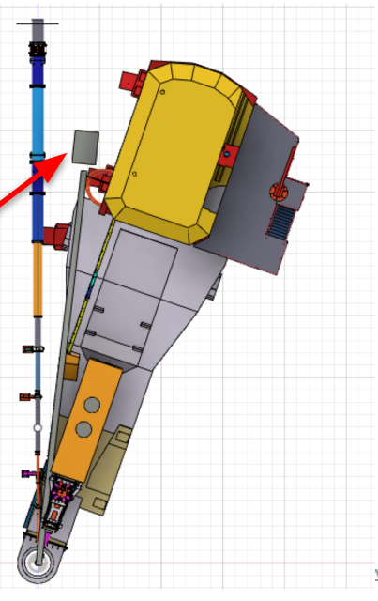
FY22 Hall C Beam Test Overview
Goal was to study ECal and SPD performance under high rate, high radiation
Installed in Hall C in summer – fall 2022
Three stages:
80 deg beam-left in Fall 2022, low rate “commissioning”
7 deg beam-right in Jan 2023, high rate part 1
18 deg beam-right in Feb-March 2023, high rate part 2
de-install in March 2023
Analysis was focused on:
Comparison of data with simulation (see Ye’s talk)
detector performance and stability from low to high rate
ECal and SPD PID performance
Report now ready for review by collaboration, is part of it publishable?

Slide 4
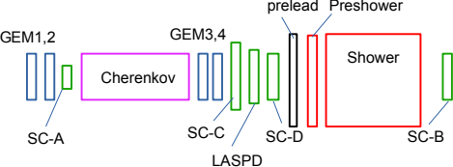
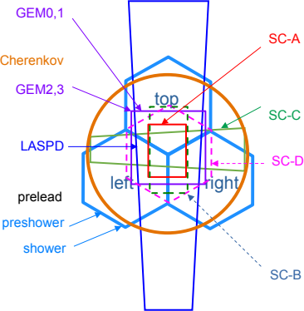
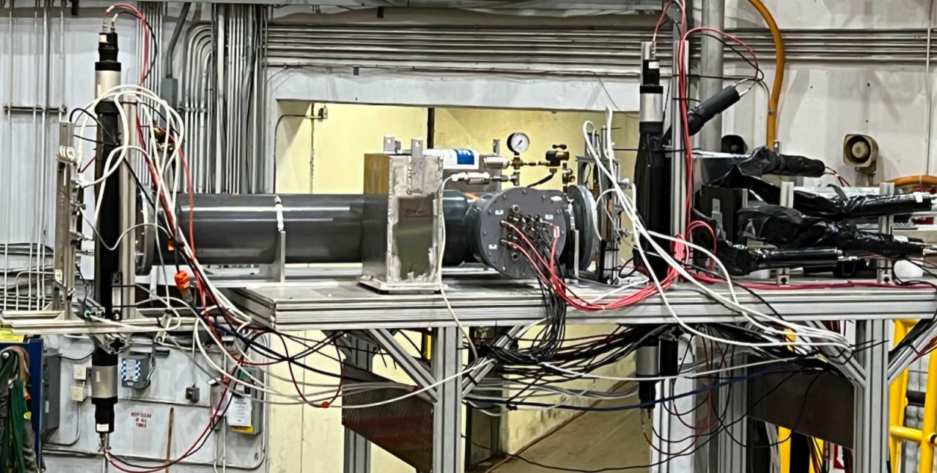
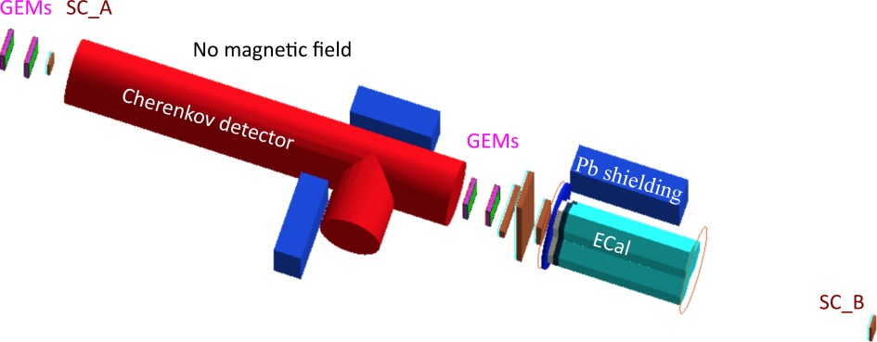
Setup Overview

Slide 5
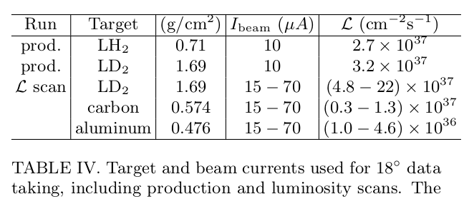
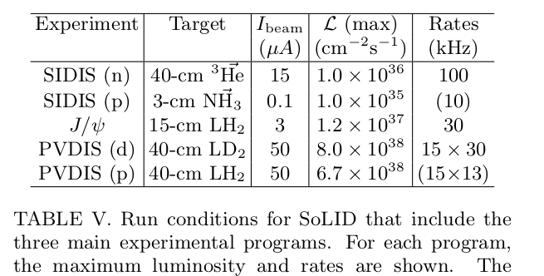
Most/all 18-deg data were taken during E12-10-003 (deuteron electro-disintegration)
Test Overview

Slide 6
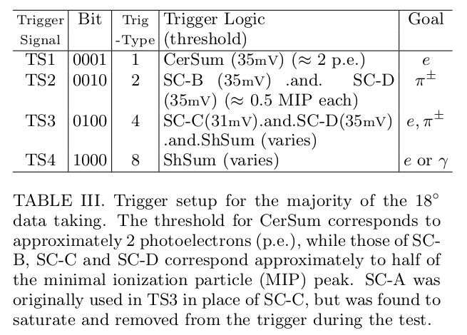
Test Overview

Slide 7
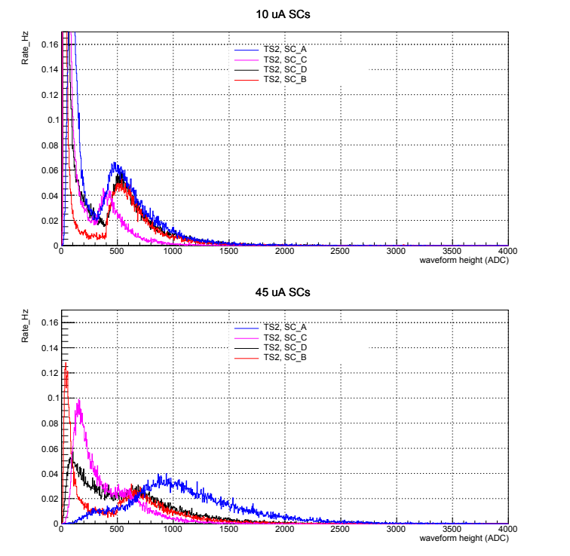
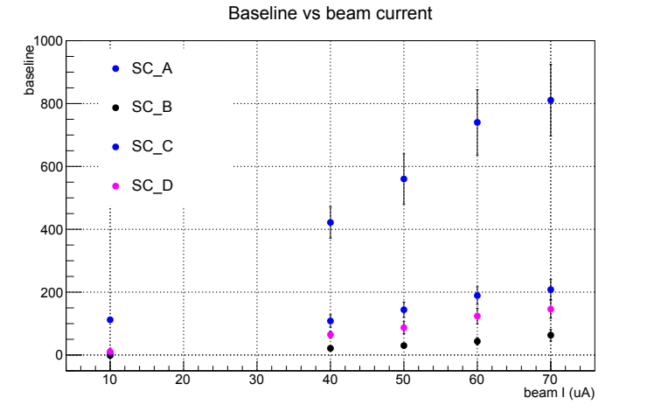
Scintillator Performance and Stability
SC-A failed to trigger at 40 uA
Baseline rises above 50 mV (trigger threshold)
Anode current reaches max 100 uA
SC-B,C,D MIP shift consistent with baseline shift

Slide 8
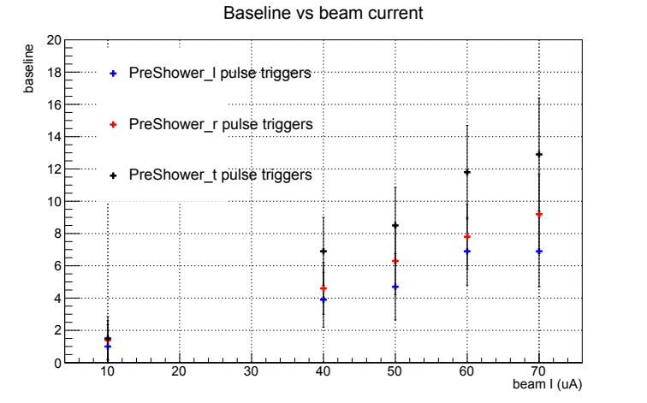
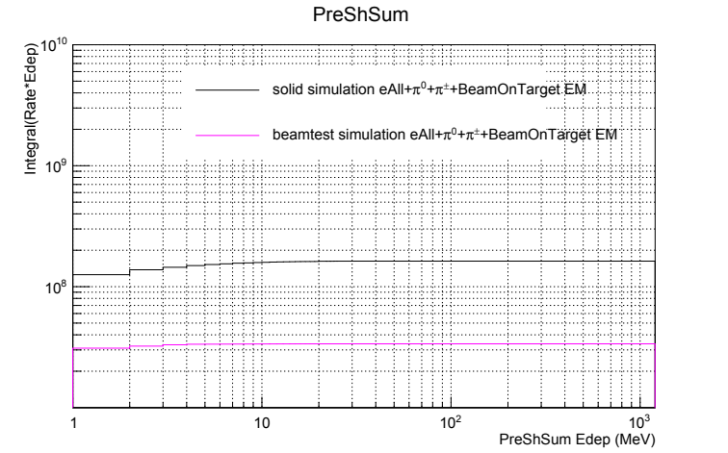
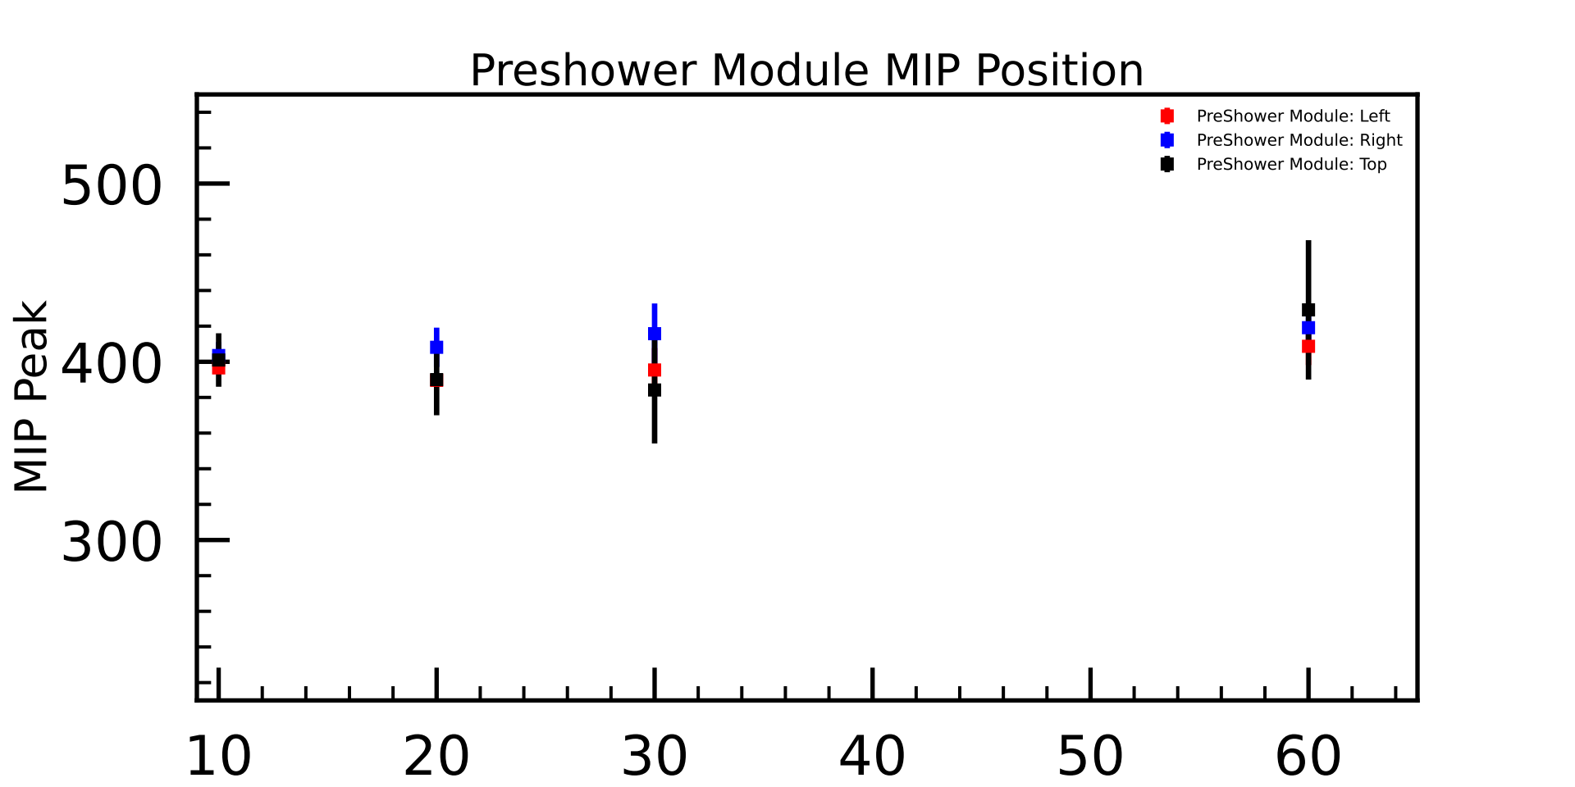
PreShower Performance and Stability
All three preshower baseline show slight increase from 10 to 70uA
MIP position remains quite stable
At 40uA beamtest, baseline shift of 10 ↔ 2.4 uA in PMT anode current
Consistent with radiation dose simulation:
(per module)

Slide 9
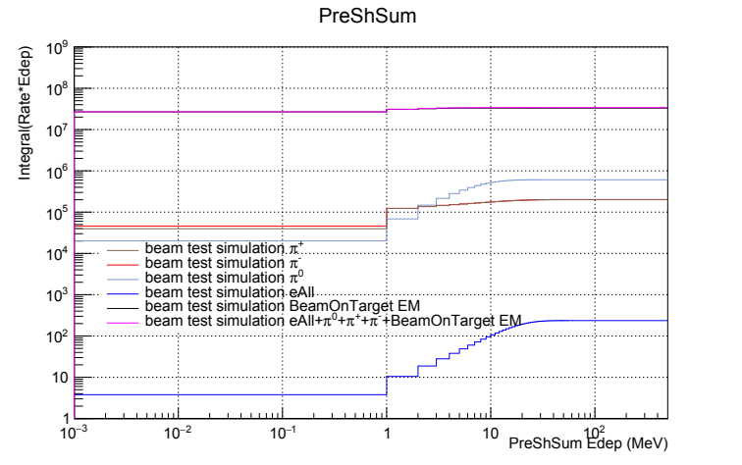
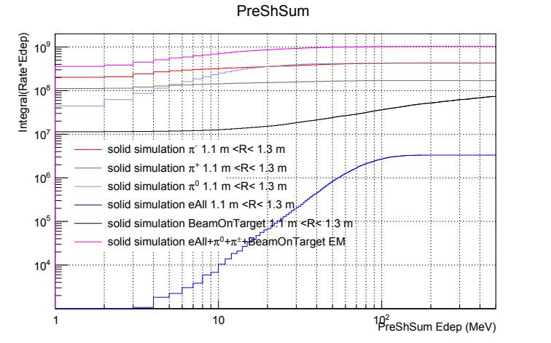
PreShower Radiation Dose
Radiation dose in Preshower is about factor five lower than SoLID PVDIS running
radiation dose in the Preshower of SoLID PVDIS is 3 times that of Pre-CDR, due to Pre-CDR only accounted for beam-on-target background:

Slide 10
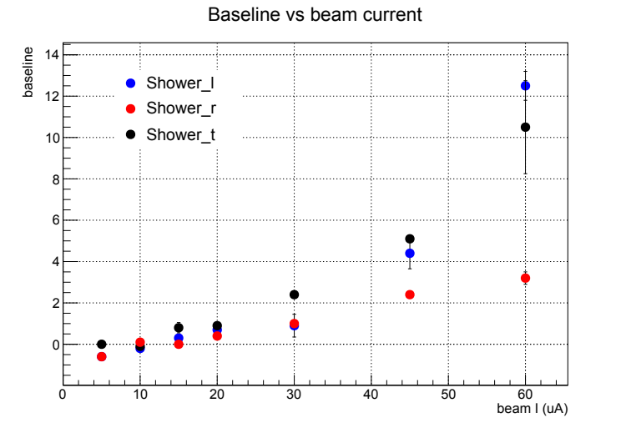
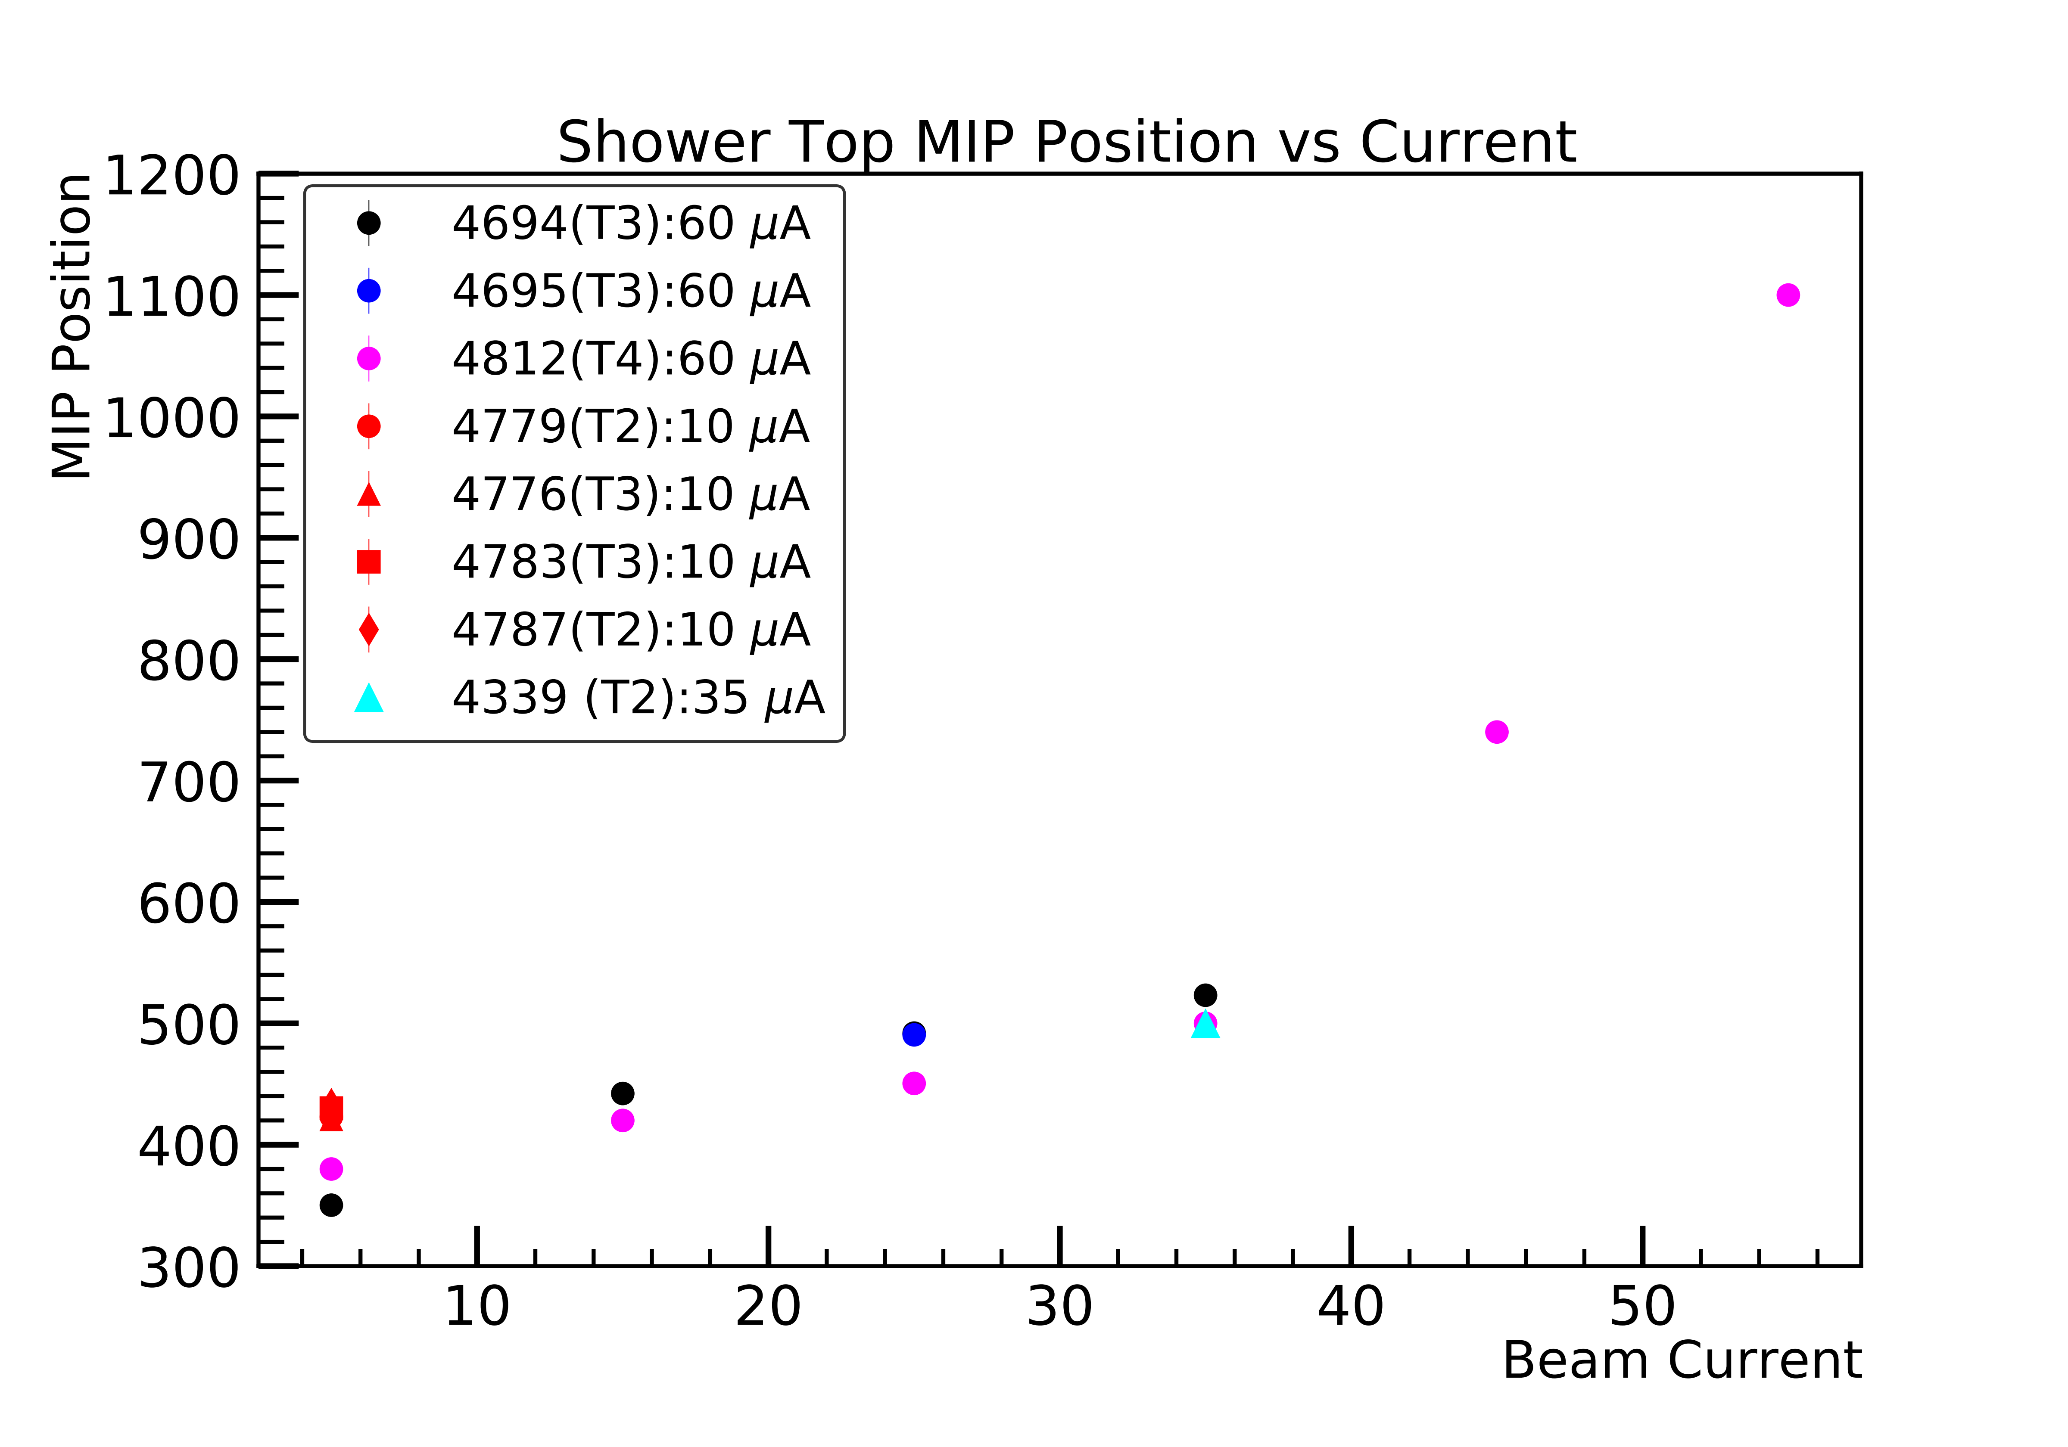
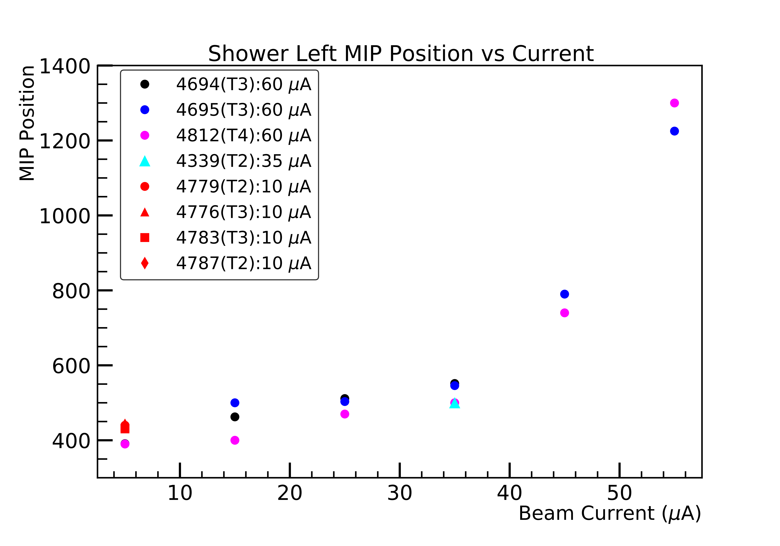
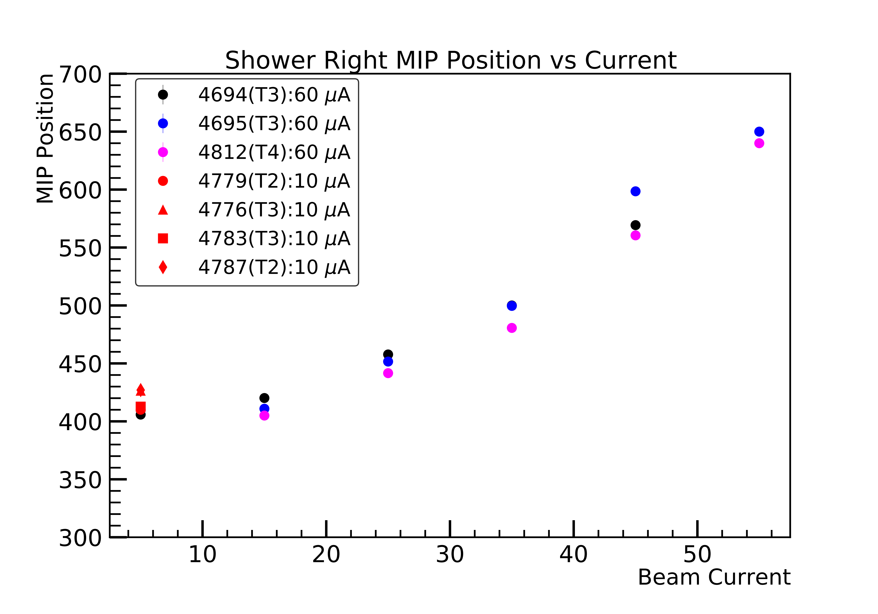
Shower Performance and Stability
All three shower modules showed baseline shift (larger anode current than Preshower due to lack of pre-amps)
MIP position shifts nonlinearly with beam current above the baseline shift, indicating PMT gain shifts

Slide 11
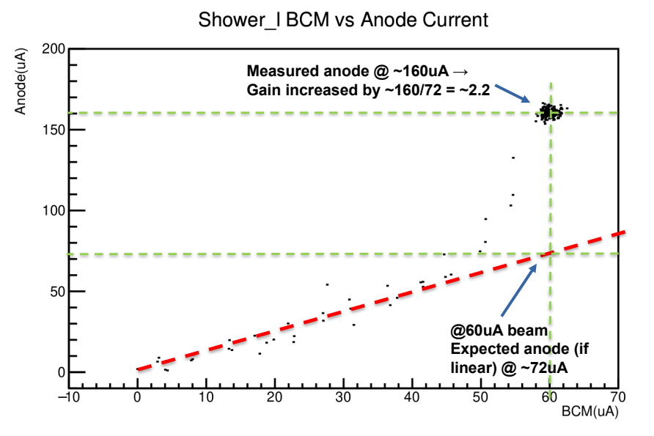
Shower PMT Gain Shift
Figures made by Ben Raydo (JLab)
Non-linearity starts at an anode current of 50 uA (Shower Left) or 20-30 uA (Shower Right, Top) – vs. PMT max recommended anode current of 100 uA!

Slide 12
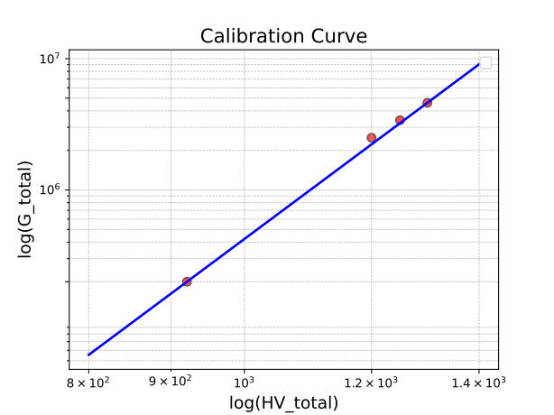
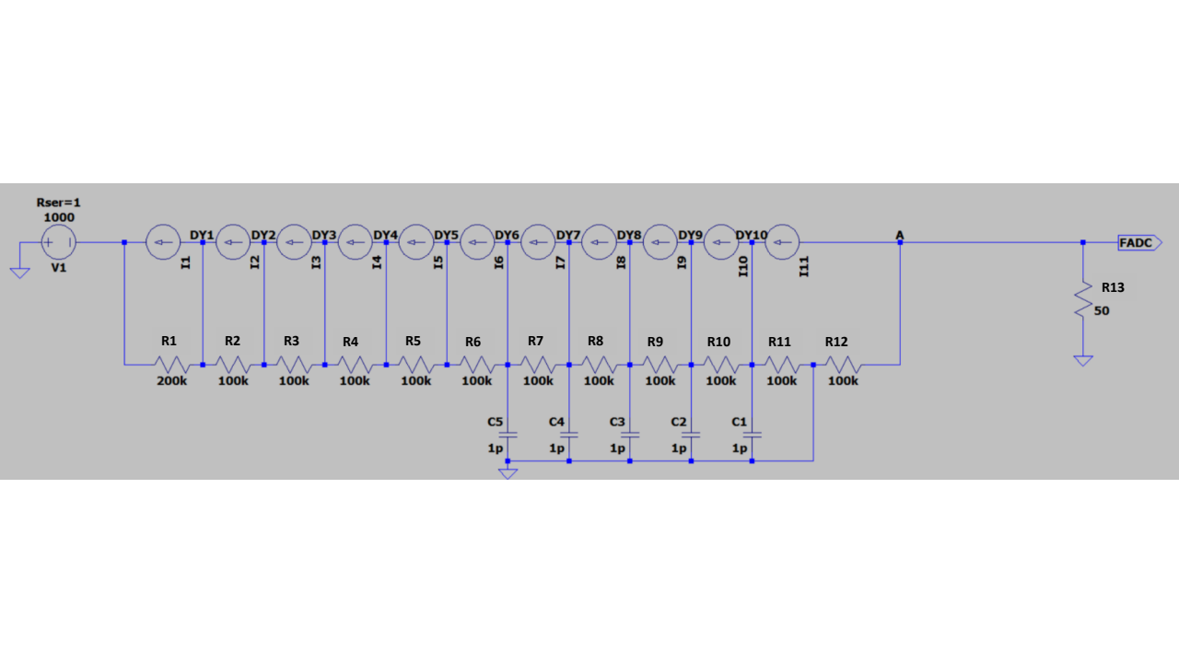
Shower PMT Gain Shift Study

Slide 13
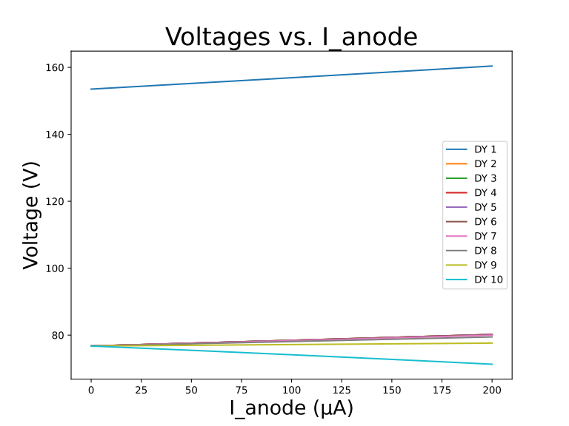
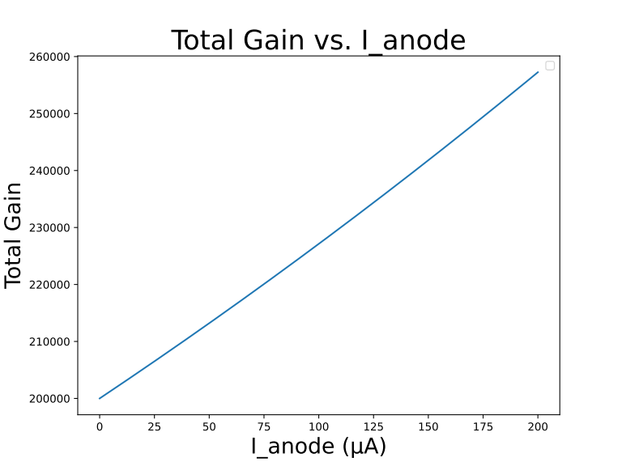
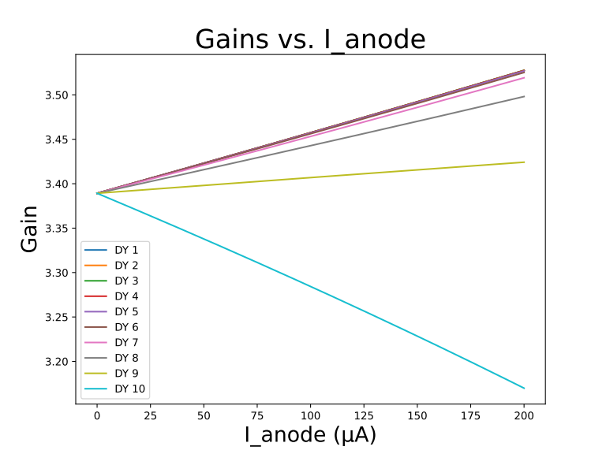
Shower PMT Gain Shift Study
Work done by Sean Pawlowski (UVA)
Total gain shifts is of order 20-30%, factor 10 smaller than data
Remaining non-linearity due to change in dynode emission, or something else

Slide 14
Shower PMT Gain Shift To Do
Several issues contributed to the PMT gain shift during the beam test:
PMT anode current too high (non-negligible to divider current)
PMT HV divider redistribution and gain shift – our study shows a Total gain shift of order 20-30%, factor 10 smaller than data
Possible change in PMT dynode emission behavior
Concern: non-linearity appears at only ½ to ¼ of the max anode current

Slide 15
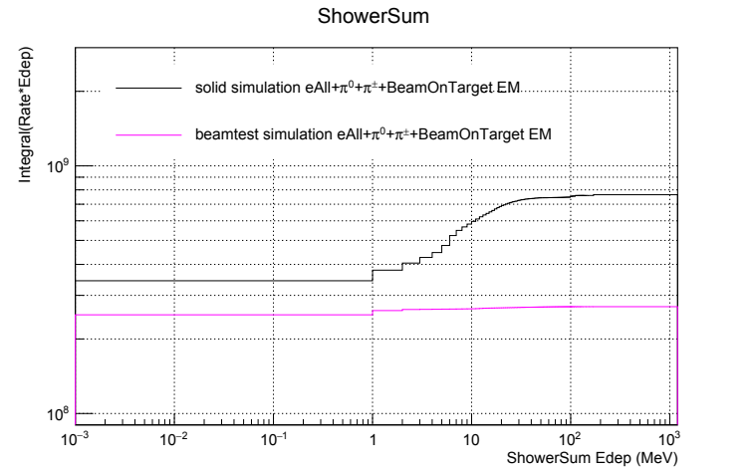
Shower Radiation Dose
the radiation dose per Shower module of SoLID PVDIS running is approximately 3 times higher than that of the beam test.
Radiation dose in Shower for beam test consistent with the observed (high) anode current
Radiation dose in Shower for SoLID PVDIS consistent with the preCDR

Slide 16
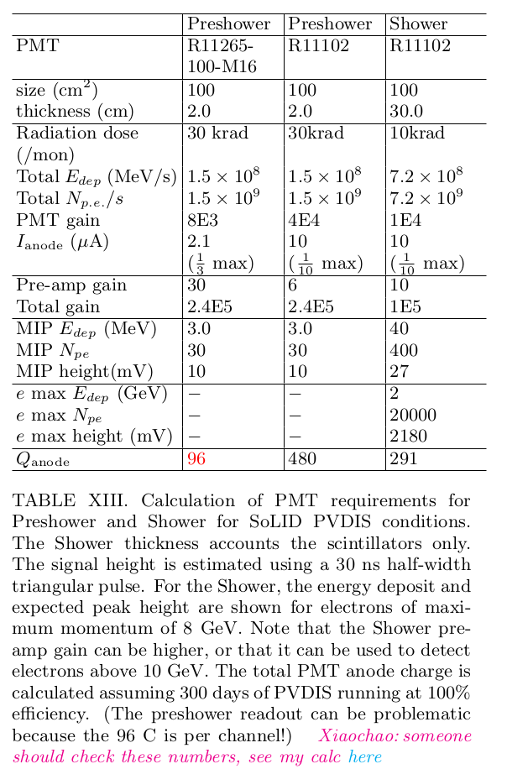
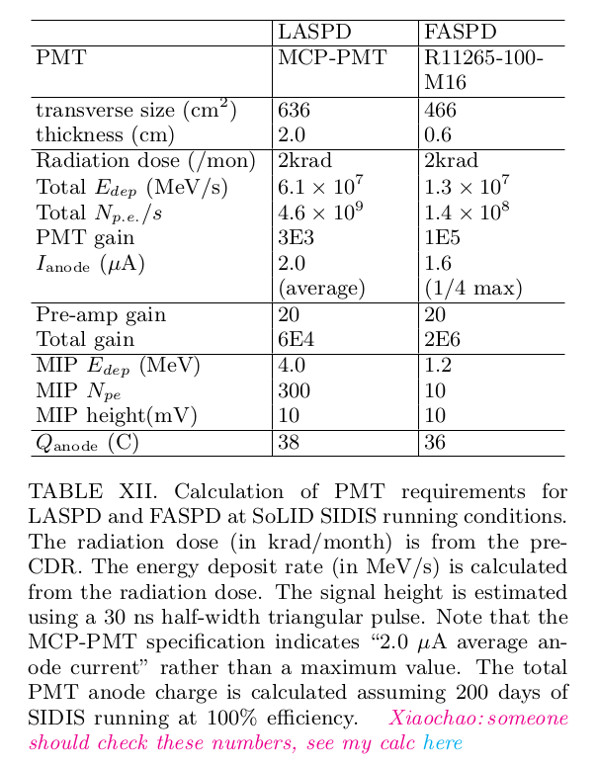
SoLID Readout Considerations

Slide 17
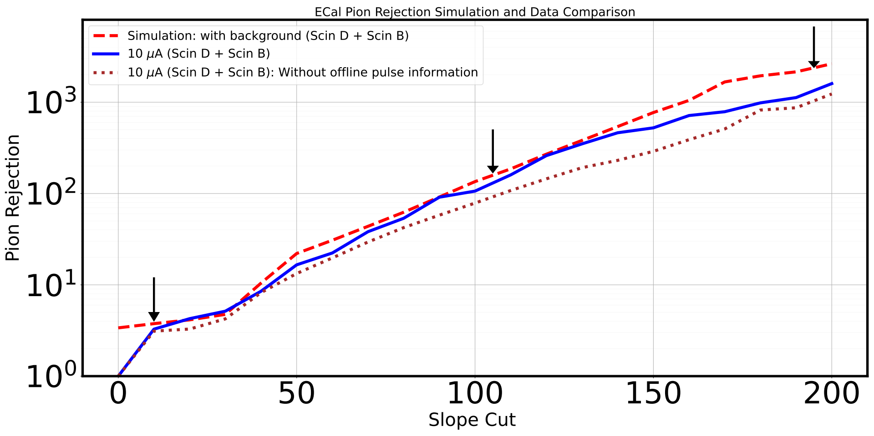
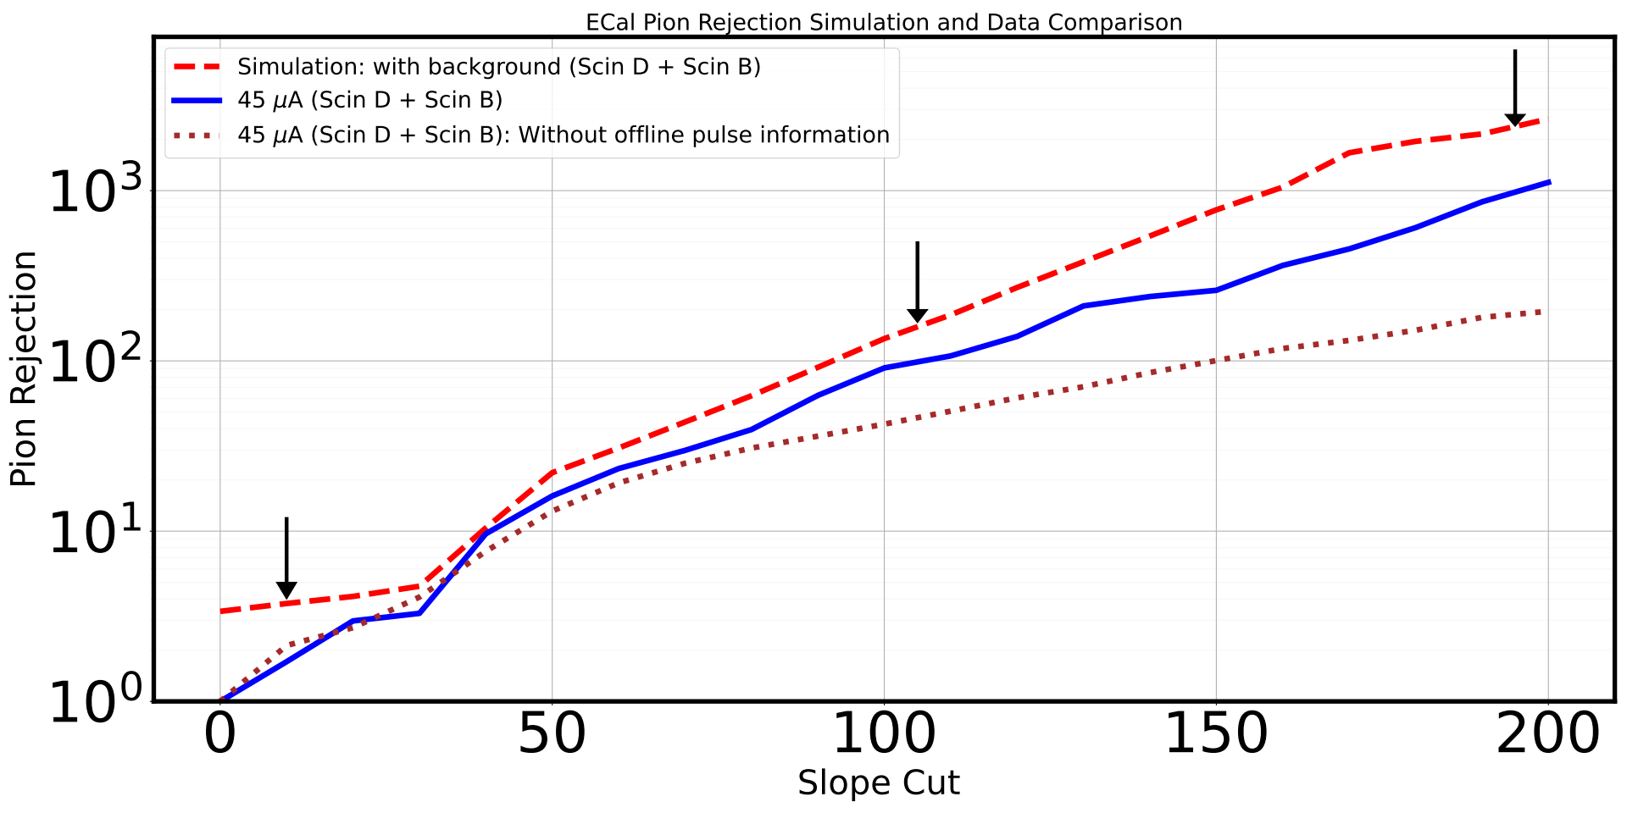
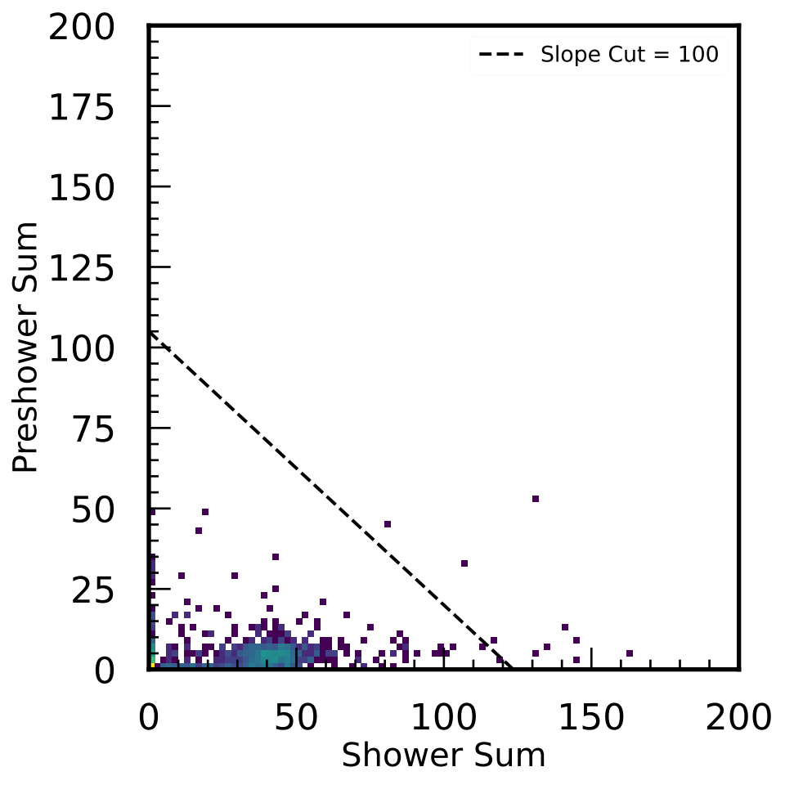
PID Performance
Charged Pion Samples: TS2 events with:
• CerSum<100
• SC-C>500
• LASPD-T(B)>10
A “slope cut” is then applied to study pion rejection of ECal
• Arrows in the figure correspond to a 95% electron efficiency for electrons in ranges of (0-1], (1-2], and (2-3] GeV, as determined by simulation
• The three curves are: simulation, data with waveform “cleaning”, and data without waveform “cleaning”
• These appear to satisfy SoLID requirements (offline and triggering), up to the rates tested

Slide 18
Beam test summary
Analysis of the beam test is complete and report 99% ready for review and comments by the collaboration
Would be nice if some of these are publishable
(AI/ML PID analysis will need to wait for later)
Some followup study or measurement is ideally needed:
PMT passive base bench testing
Cherenkov mirror reflectivity
Effect of material non-uniformity in ECal energy resolution (as shown in FTBF report)
For SoLID ECal, we still need (pre)R&D on:
MAPMT readout of Preshower (unless we decide on using regular PMTs – much safer but higher cost)
MCP-PMT readout of LASPD
PMT active base design and testing → R&D

Slide 19
Backup Slides

Slide 20
