Slide 1
Reforming the Semi-Inclusive DIS
Harut Avakian (JLab)
CLAS12 collaboration meeting
JLab, Nov 14, 2024
  What is SIDIS?
  Understanding of physics backgrounds→ need for multidimensional measurements critical for JLab and beyond, EIC, in particular
  Interpretation of leptoproduction require studies of hadronic correlations going from ep→e’πX to ep→e’ππX and ep→e’pπX
  Making SIDIS observables consistent with theory
  Summary

Slide 2
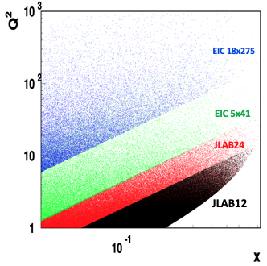
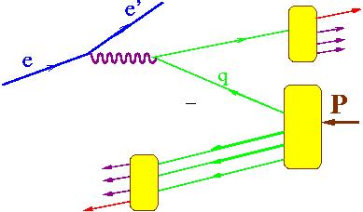
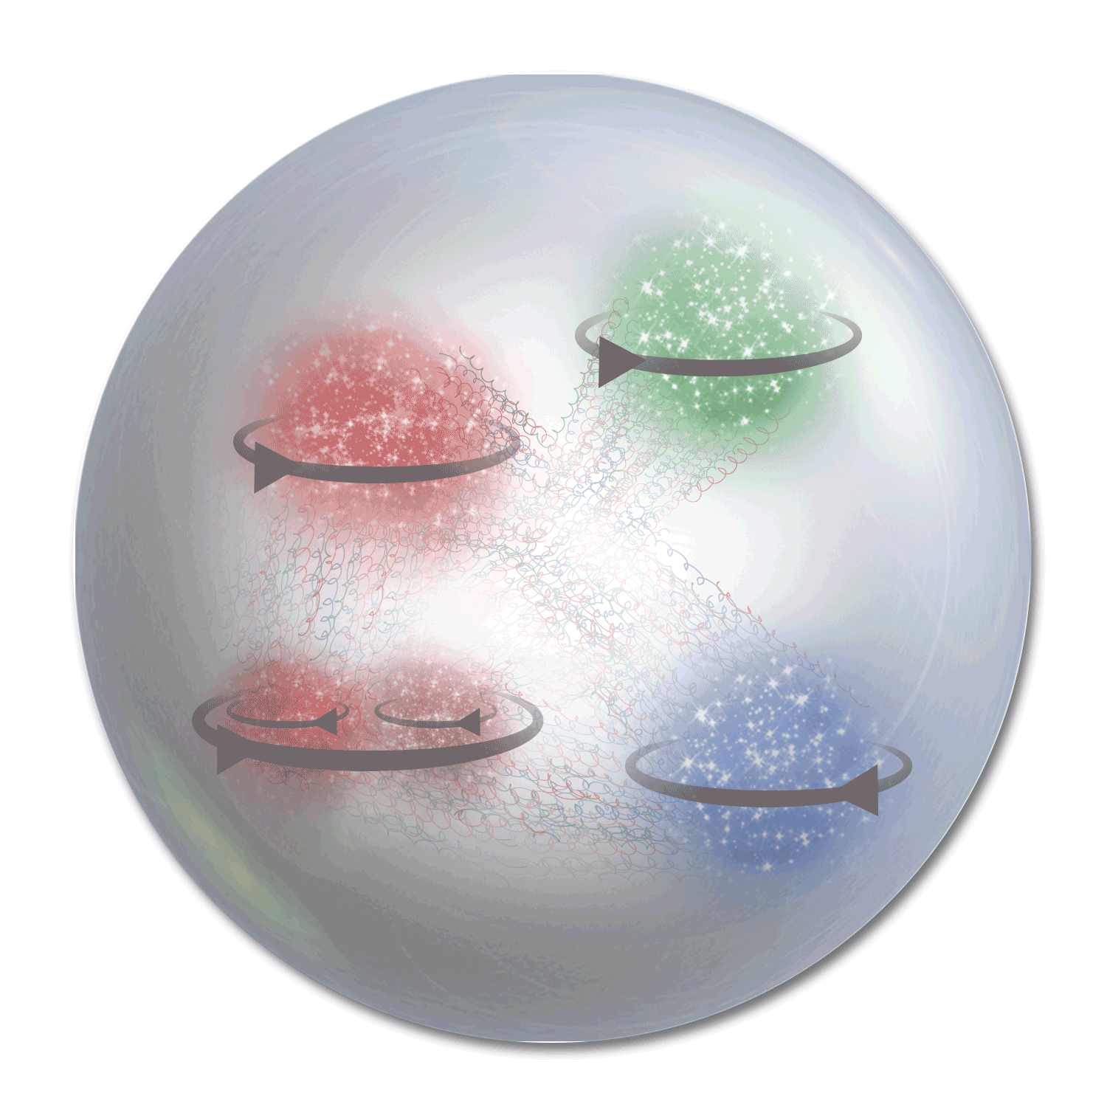




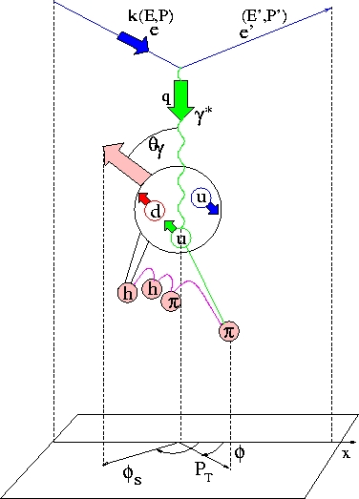
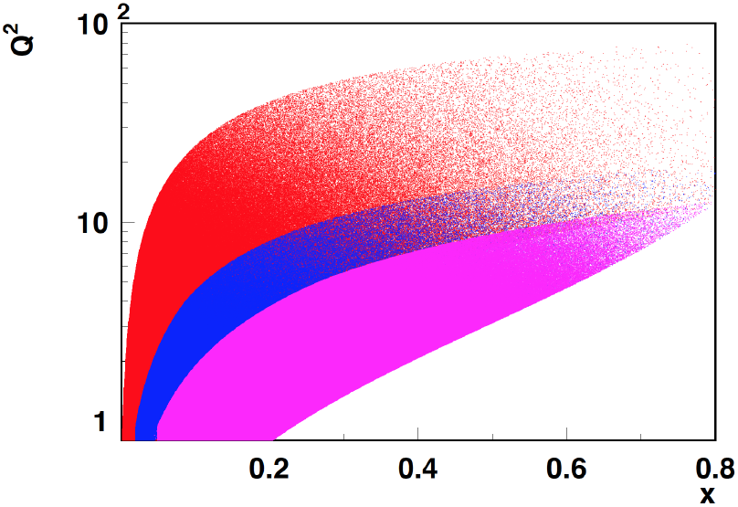

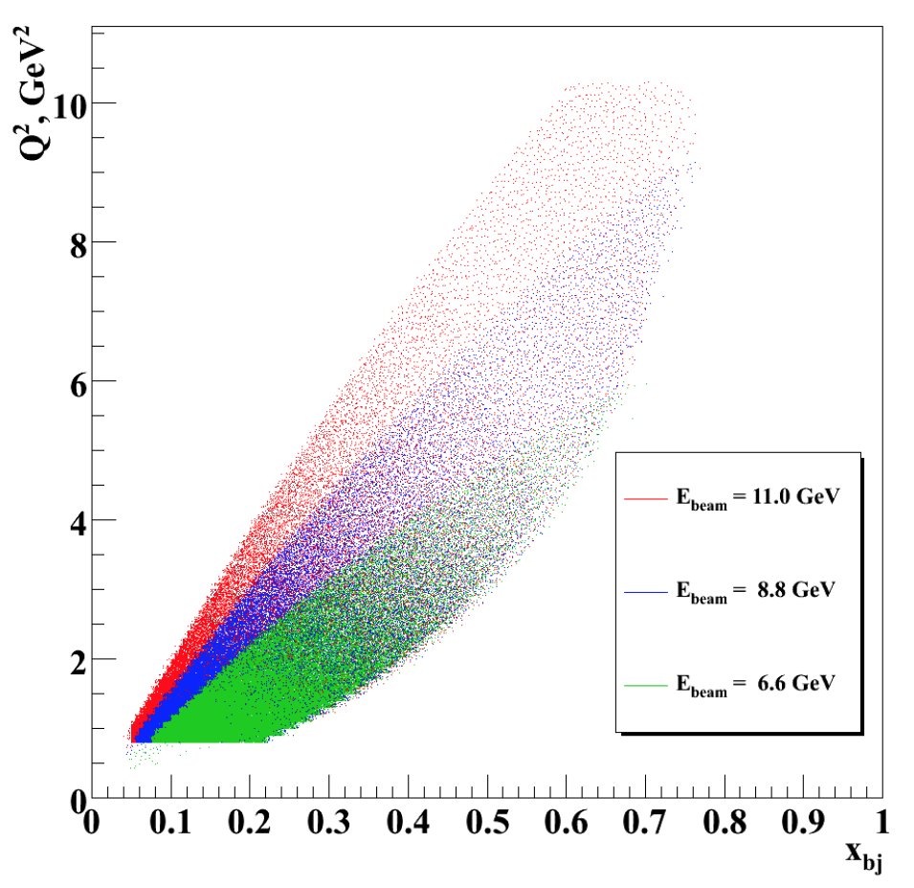
Polarized Leptoproduction
x_{F} – fractional momentum in the CM frame
x_{F}>0 (current fragmentation, CFR)
h
P
h
x_{F}<0 (target fragmentation,TFR)
y
COMPASS
HERMES/JLab24
x
JLab12
z
JLab7/9/11
in eN→e’hX
6D (x,Q²,z,P_{T},φ,φ_{S})
z

Slide 3
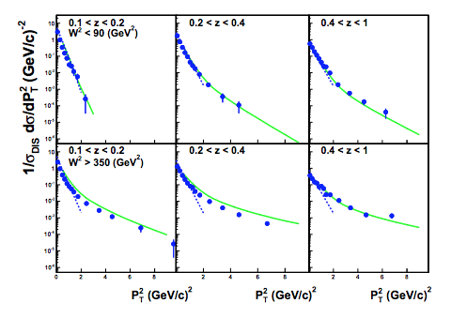
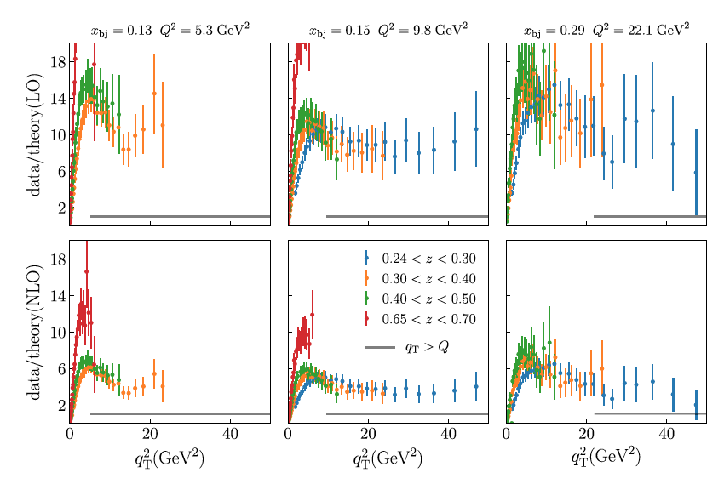


Multiplicities of hadrons in SIDIS
Anselmino et. al: hep-ph/0606286
non-perturbative
perturbative
2007
2018
Gonzalez-Hernandez et al, PRD 98, 114005 (2018)
Early attempts to use collinear and pQCD contributions (solid line) to fit EMC data
quark transverse momentum, assuming a direct link with pion transverse momentum
Perturbative contributions underestimate the multiplicities by an order of magnitude for all accessible kinematics at COMPASS
Notes:
On the other hand, the multiplicity clearly show the PT dependence of the SIDIS cross section. Here for example are shown the multiplicities extracted by Compass, Hermes and the JLAB on a lograritmic scale. In the convolution of the TMDs, it is convenient to assume a Gaussian Ansatz for the transverse momentum description. The transverse momentum of quark is then extracted using a Fit with a Gaussian PT dependence on the data. But how can you see from the plot on the right, the distribution follow a Gaussian in PT for low PT (meaning below 0.8) and another for higher PT. High PT in the context of this presentation means above the 0.8 GeV^2 region. In addition different experiment at different energies shows a different PT distribution as can be seen from the plots on the left side where the multiplicity of Compas. Hermes and JLAB are compared. However TMD are universal functions and therefore the extraction should be universal among all experiments. It is important to understand the origin of these discrepancies, The different slope can be due to TMD evolution that makes the distribution wider and to the lower phase space available for the hadron production. The origin of the high PT tale can be due to perturbative contributions or non perturbative contributions.

Slide 4
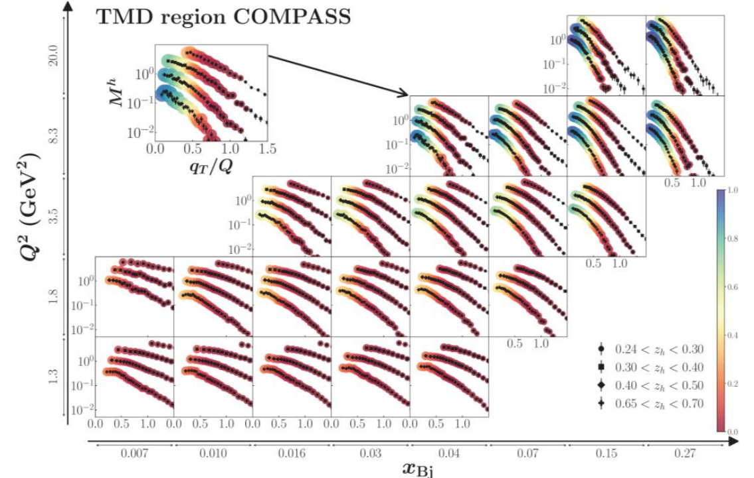
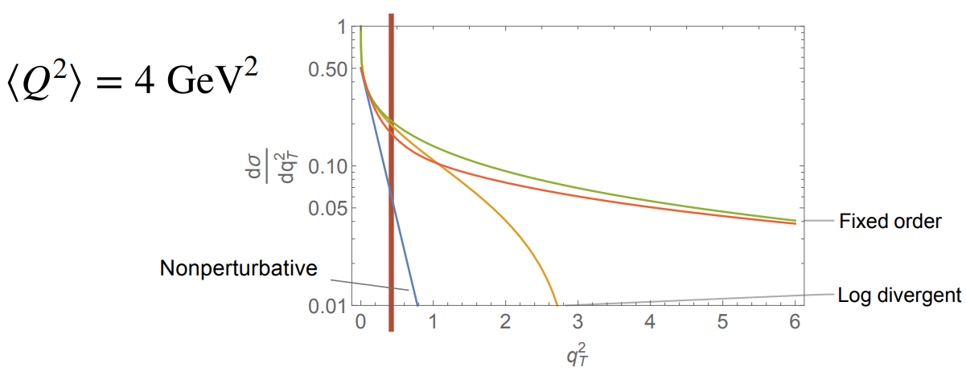
SIDIS of ehX: q_{T}-crisis in TMD theory
Perturbative approach: TMD region = where the log divergence of the fixed-order calculation dominates (resummation is required)
Significant fraction of polarized SIDIS data is currently considered by phenomenology to be outside of the TMD region
What data input exactly drives down the nonperturbative part?
TMD region we currently have
i
How far in P_{T} or q_{T} =P_{T}/z, extends the TMD region

Slide 5

SIDIS in JLab: comments from theory
Statement:
“… SIDIS data has shown that there are basic open questions concerning the semi-inclusive pion/kaon production mechanisms at few-GeV energies, regarding e.g vector mesons and longitudinal photons....
Meaning:
JLab has problems specific for low energies, which should be solved, before THE theory of TMDs could be applied
Possible conclusion:
All problems are due to “few-GeV”, will magically vanish at higher energies, and TMDs can be studied in the valence region [in multidimensional space] at higher Q² using THE theory [no need to deal with higher twists/correlations of quarks/hadrons/…....]

Slide 6

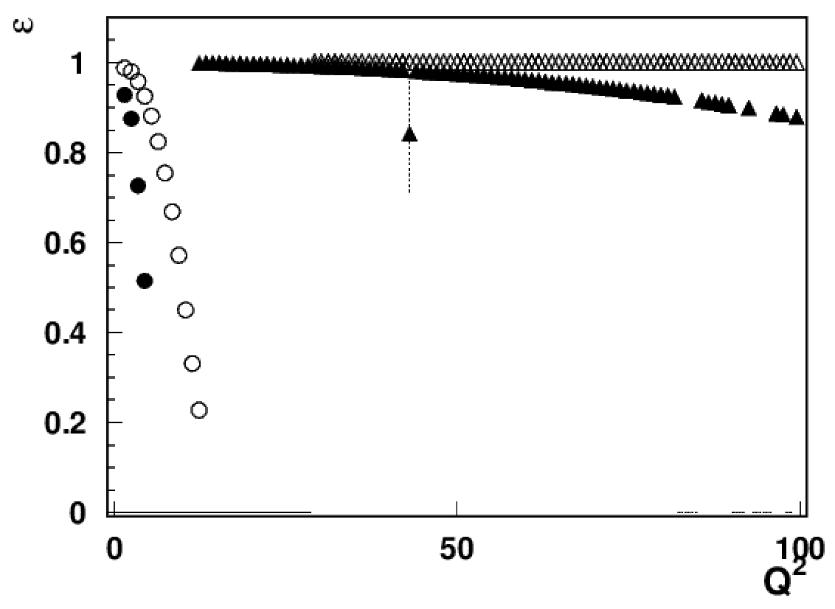
Addressing PAC/theory comments
What exactly are identified so far sources of “factorization breakdown” in SIDIS and where is the evidence that “few GeV” matters?
1) Longitudinal photon
EIC18x275
EIC5x41
For a given x&Q² the contribution from longitudinal photon increases at higher energies (ex. at EIC 5 times bigger at Q²~10, x~0.3 than at JLab )
JLab studies of impact of longitudinal photons critical for interpretation of polarized SIDIS, including EIC data
JLAB12
JLab24/HERMES
x=0.3

Slide 7
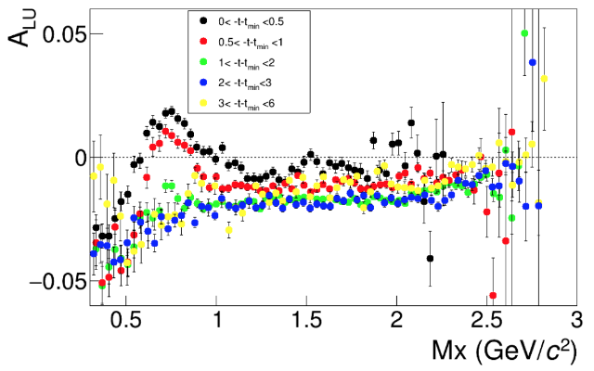
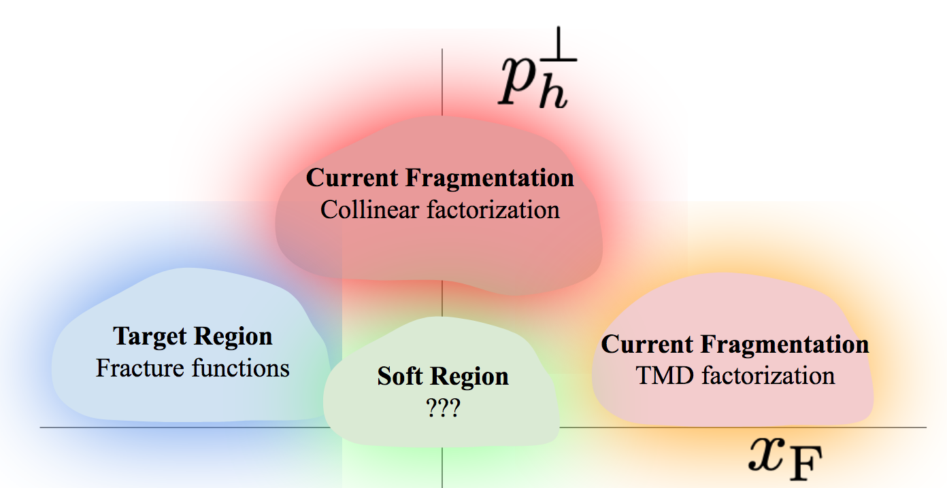
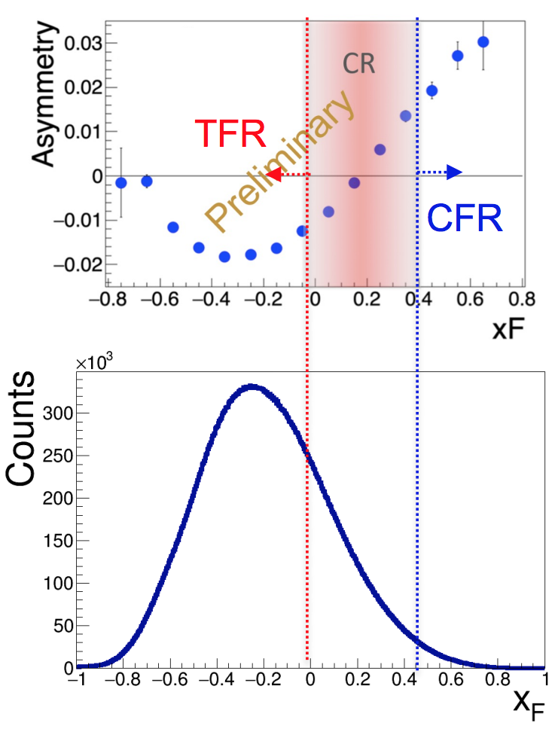
Beam SSAs as a tool to separate regions and contributions
2) Separating Target Fragmentation Region TFR from Current fragmentation region (CFR)
F. Benmokhtar & Duquesne U.
ep→e’pX
SIDIS
Major difference only for protons at small t!
With beams in polarized SIDIS typically always polarized, beam SSA can serve as a tool to separate
kinematical regions (CFR/TFR)
dynamical contributions
cut on M_{X} eliminate exclusive VMs
Negative sign of the SSA (plateau) defines the TFR dominance

Slide 8
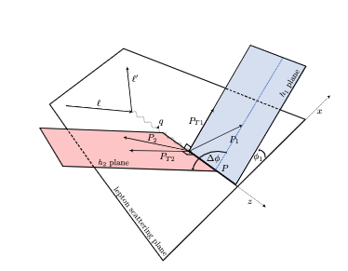
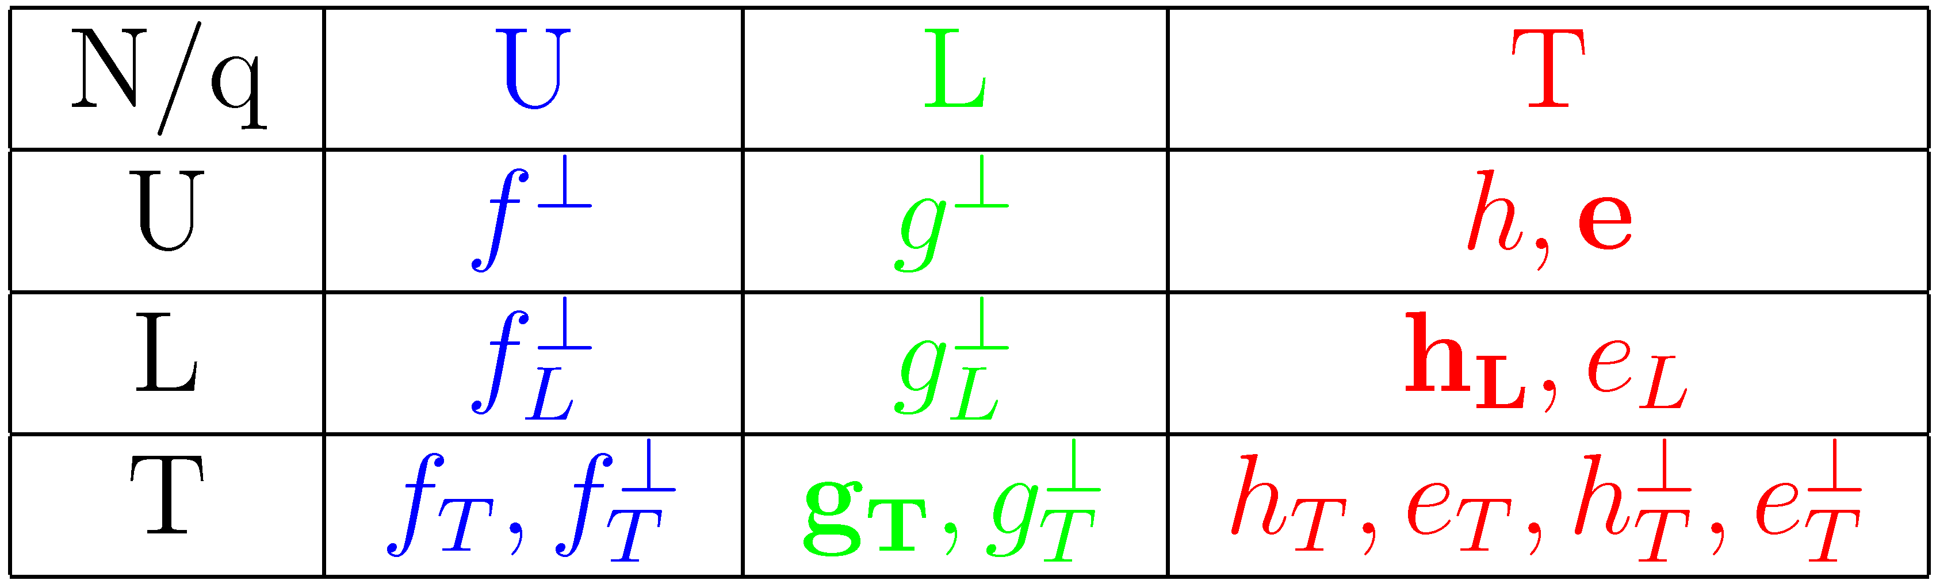
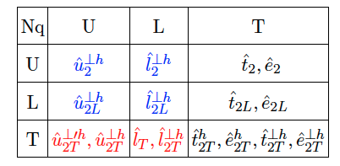
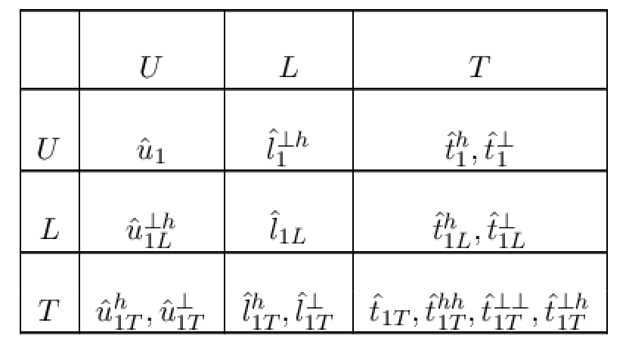
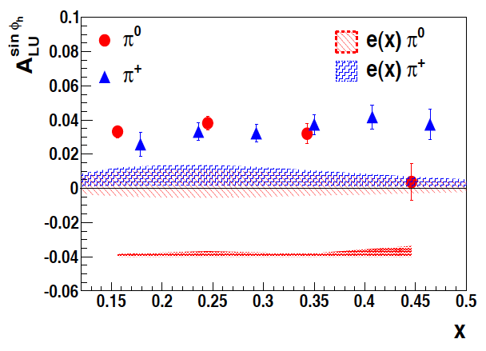
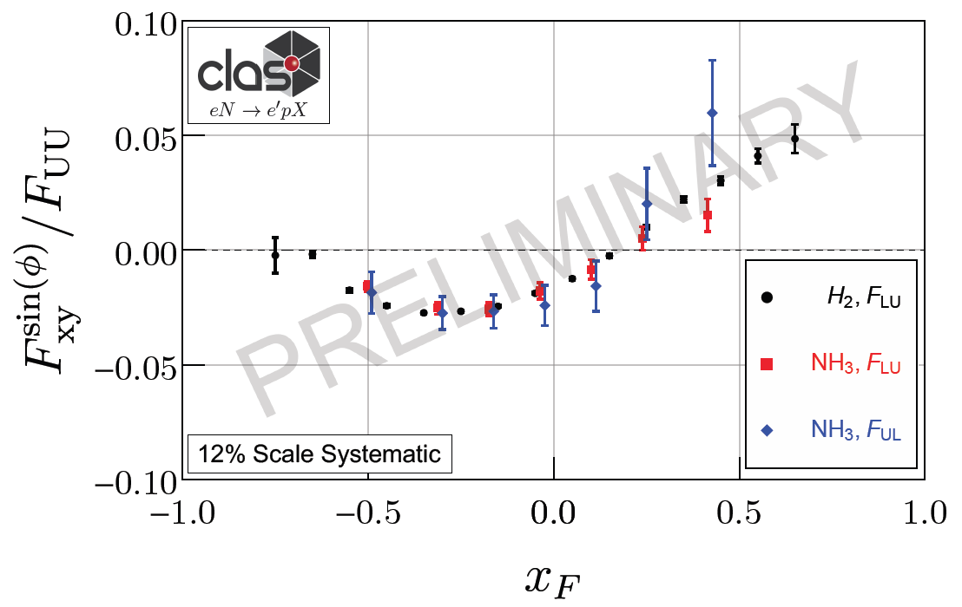
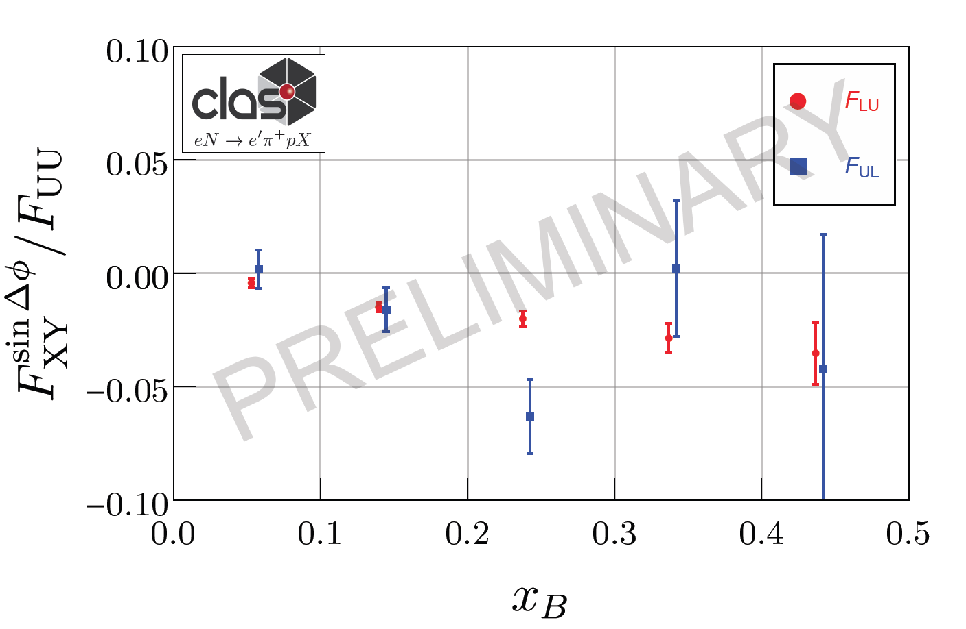
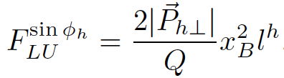

Longitudinal Beam SSA in CFR/TFR
CFR→Higher Twist TMDs
TFR→Higher Twist Fracture Functions
TFR/CFR→Leading Twist Fracture Functions
N/q
Fatiha’s talk
LT longitudinally pol. quarks in Unp. proton
Longitudinally polarized quarks most likely responsible for observed Single Beam Spin asymmetries

Slide 9
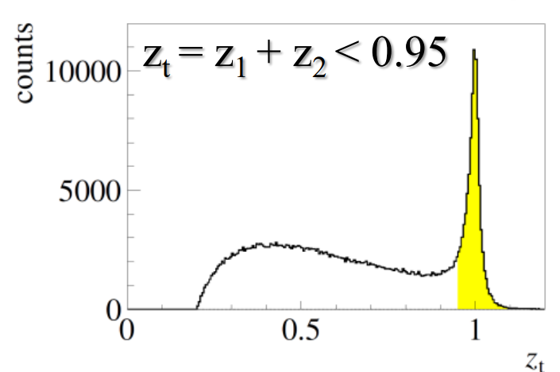
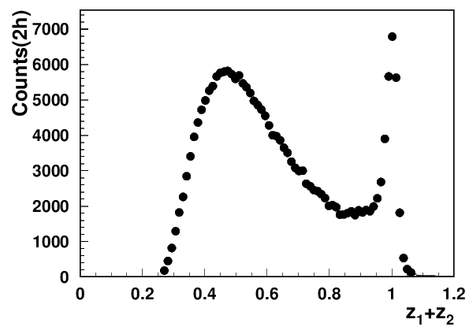
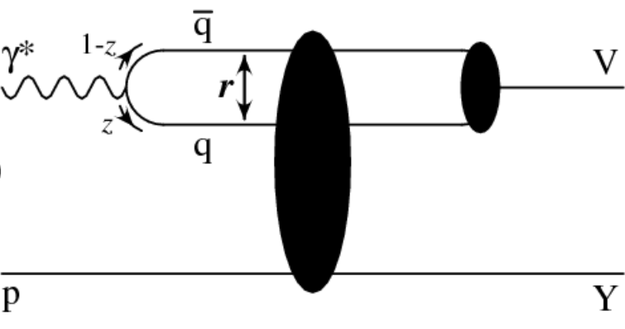
Addressing PAC/theory comments
What exactly are identified so far sources of “factorization breakdown” in SIDIS and where is the evidence that “few GeV” matters?
COMPASS 2h
CLAS12
Q²=2 GeV²
x=0.2
3) Diffractive VMs (ρ⁰)
CLAS12 measurements indicate the 2hadron exclusive sample is dominated by “diffractive rho0”produced at very small t
indication: most of the ρ⁰ are longitudinally polarized
note: higher the Q² lower is ε
Consistent with ~10% of diffractive DIS in inclusive DIS, exclusive rho contributes ~20% to charged pion SIDIS making studies of those rhos, crucial for interpretation in terms of TMDs of SIDIS data
Studies of exclusive processes require high resolution and multidimensional measurements !!!

Slide 10


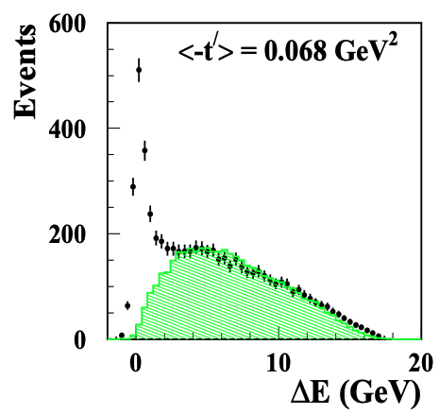
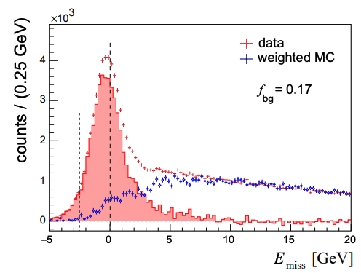
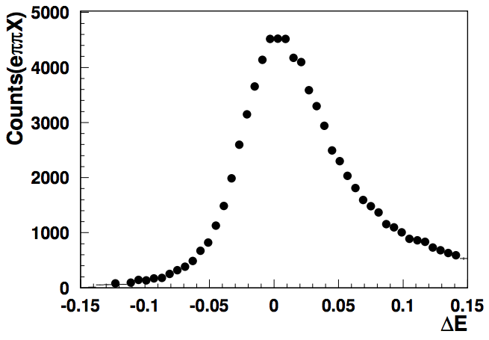
Understanding exclusive rhos and SDME validations
Exclusivity condition defined by the missing Energy:
CLAS12 (width <0.1GeV)
HERMES(width ~0.6GeV)
COMPASS(width ~2GeV)
~10% of data
Guarantying the “exclusivity” requires good resolutions (get worse at higher energies)
Subtraction procedure relays on normalization, based on exclusive limit of LUND-MC
All distributions have have tails, indicating the RC may not be negligible
Extraction of SDMEs, will require validation in the multi-D space (significant samples)

Slide 11
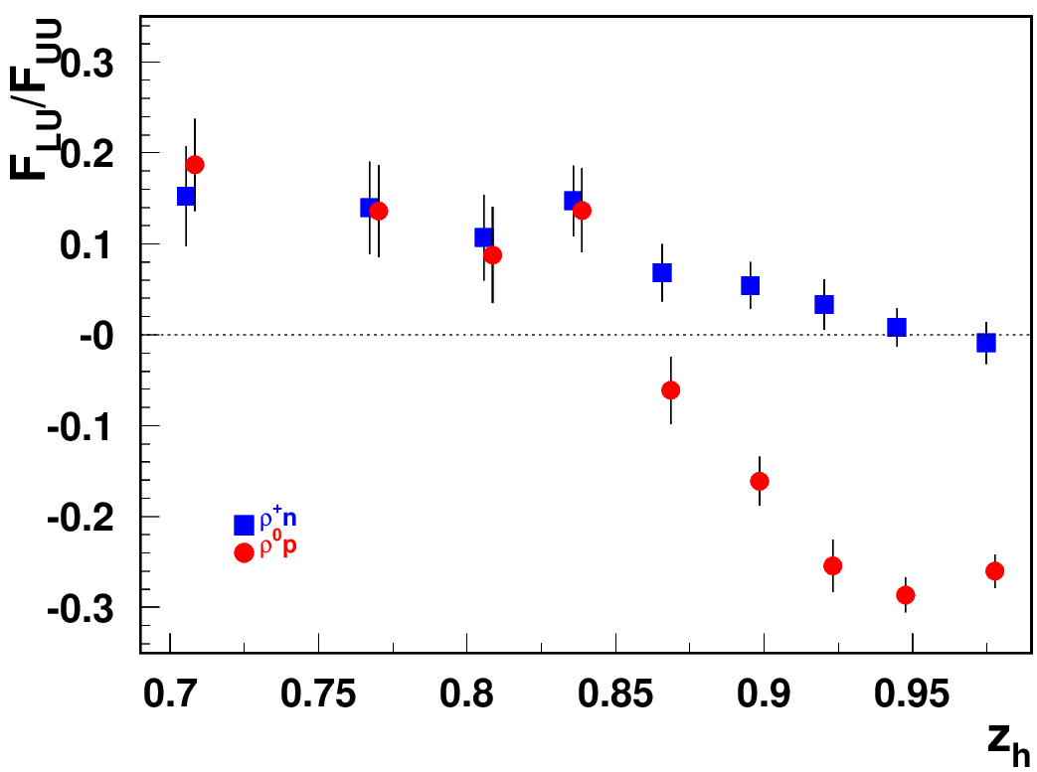
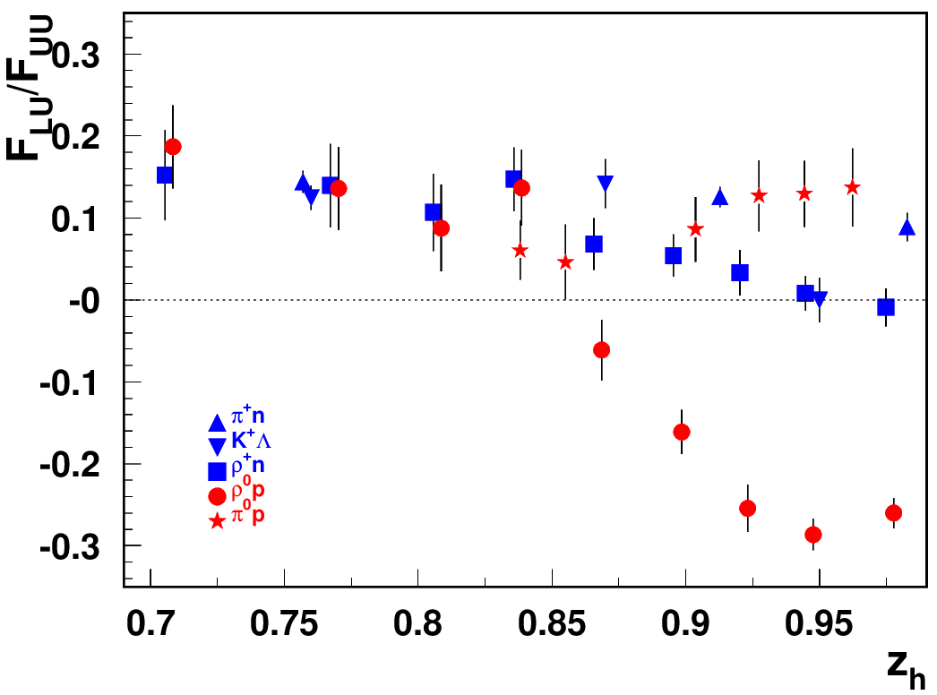
Separating the “diffractive” kinematics
Comparison with exclusive ρ+ and other non-diffractive channels clearly indicates the kinematics where the “diffractive rho0” shows up (increases at higher energies)
Comparison with other exclusive states, including the ρ⁰ at higher t, indicate the contributions from quark exchange mechanisms negligible in large z kinematics
Beam SSA for exclusive states
Diffractive VMs (ρ⁰)
+preliminary data on ep→e’pφ (A_{LU}=-0.084+/-0.038)
Beam SSA can be used to separate dynamical contributions
At higher energies (COMPASS/HERMES) no major effect were observed, as high resolution and multidimensional measurements are critical !!!

Slide 12
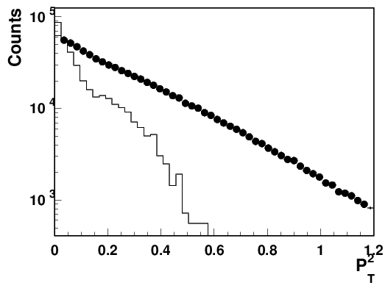

Contributions of “diffractive rho0s” in SIDIS
G.Matousek (Duke) & N.Trotta (UCONN)
0.18<x<0.22
0.5<z0.7
Q²=2 GeV²
total eπ+X
Estimated ~20% contributions from rho, mainly show up at low P_{T} in SIDIS
The “diffractive” rho will bias extractions of TMDs, unless properly subtracted in multidimensional space of SIDIS measurements.
Notes:
Lorenz invariant amplitudes

Slide 13

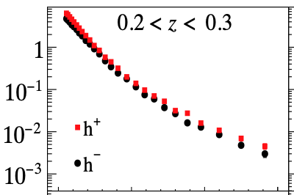
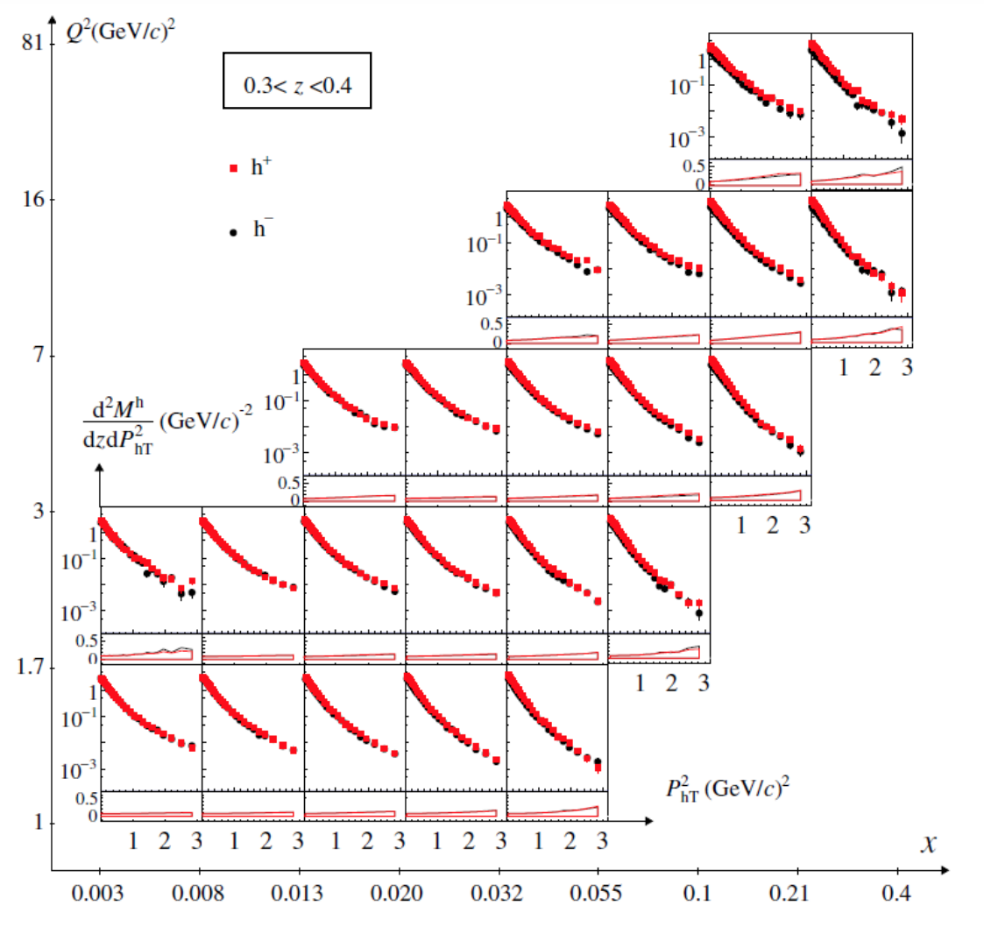


q_{T}-crisis or misinterpretation
https://arxiv.org/pdf/1709.07374.pdf
5km
“Nanga Parbat”
Fit
8km
Ararat-Fit
P_{T}²
New procedure: Fit from P_{Tmin} up
P_{T}min can be lower at higher Q², as the contributions from diffractive rho decreases with Q²
at higher Q² the slope in P_{T} changes, why?
Higher the Q² lower the ε
→ less diffractive rho at higher Q² filling the low P_{T} in pion SIDIS.
Challenging for theory to explain the correlation of P_{T} and Q
need experimental subtraction of rhos (proton detection will help)
Notes:
Some impact of the limitation on the experimental data you can see from the two plots for JLab and COMPASS at lower and higher energy ranges. The cut excludes practically all PTs starting from ~1GeV the region, where the effects are large and measurable

Slide 14
Excluding the “diffractive” rho from SIDIS
Depending on how we exclude the exclusive rho we can have several versions of experimental samples of inclusive hadrons, each with their own bias:
1) Standard SIDIS (eN→ehX, h=π,K,..) within the full accessible kinematics, corrected for acceptance and RC, measured in the multidimensional space
  →eπX biased with respect to theory by presence of contributions from diffractive rho, contributing to ~20% of counts, in low P_{T}, with contributions to SSA ~10 times higher
2) Standard SIDIS (eN→eπX) within the full accessible kinematics, corrected for acceptance and RC, measured in the multidimensional space, with subtracted in multi-D bins for rho0 contributions (“rho-subtracted SIDIS”)
  →requires measurements of pions from diffractive rho in multidimensional space, means detailed studies of SDMEs of rhos, requiring good precisions and huge statistics, also for all polarization observables, extensive validation needed, little known RC
SIDIS subsamples (eN→epπX, eN→eππX) within the full accessible kinematics, allowing clear eliminiation of rho0 contributions using cuts on missing masses of epX or eππX
(“rho-free SIDIS”)
  →biased by the presence of additional hadron in TFR (epX) or CFR (eppX), may need a new phenomenology
  requires measurements of dependence on M_{X} to understand the bias,
  Theory should be able to evaluate the bias from the presence of an additional hadron

Slide 15
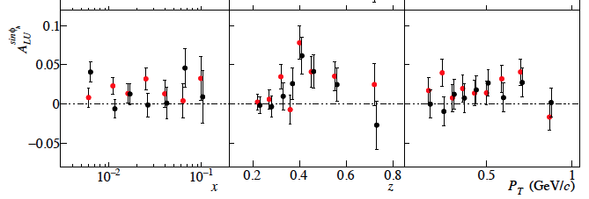
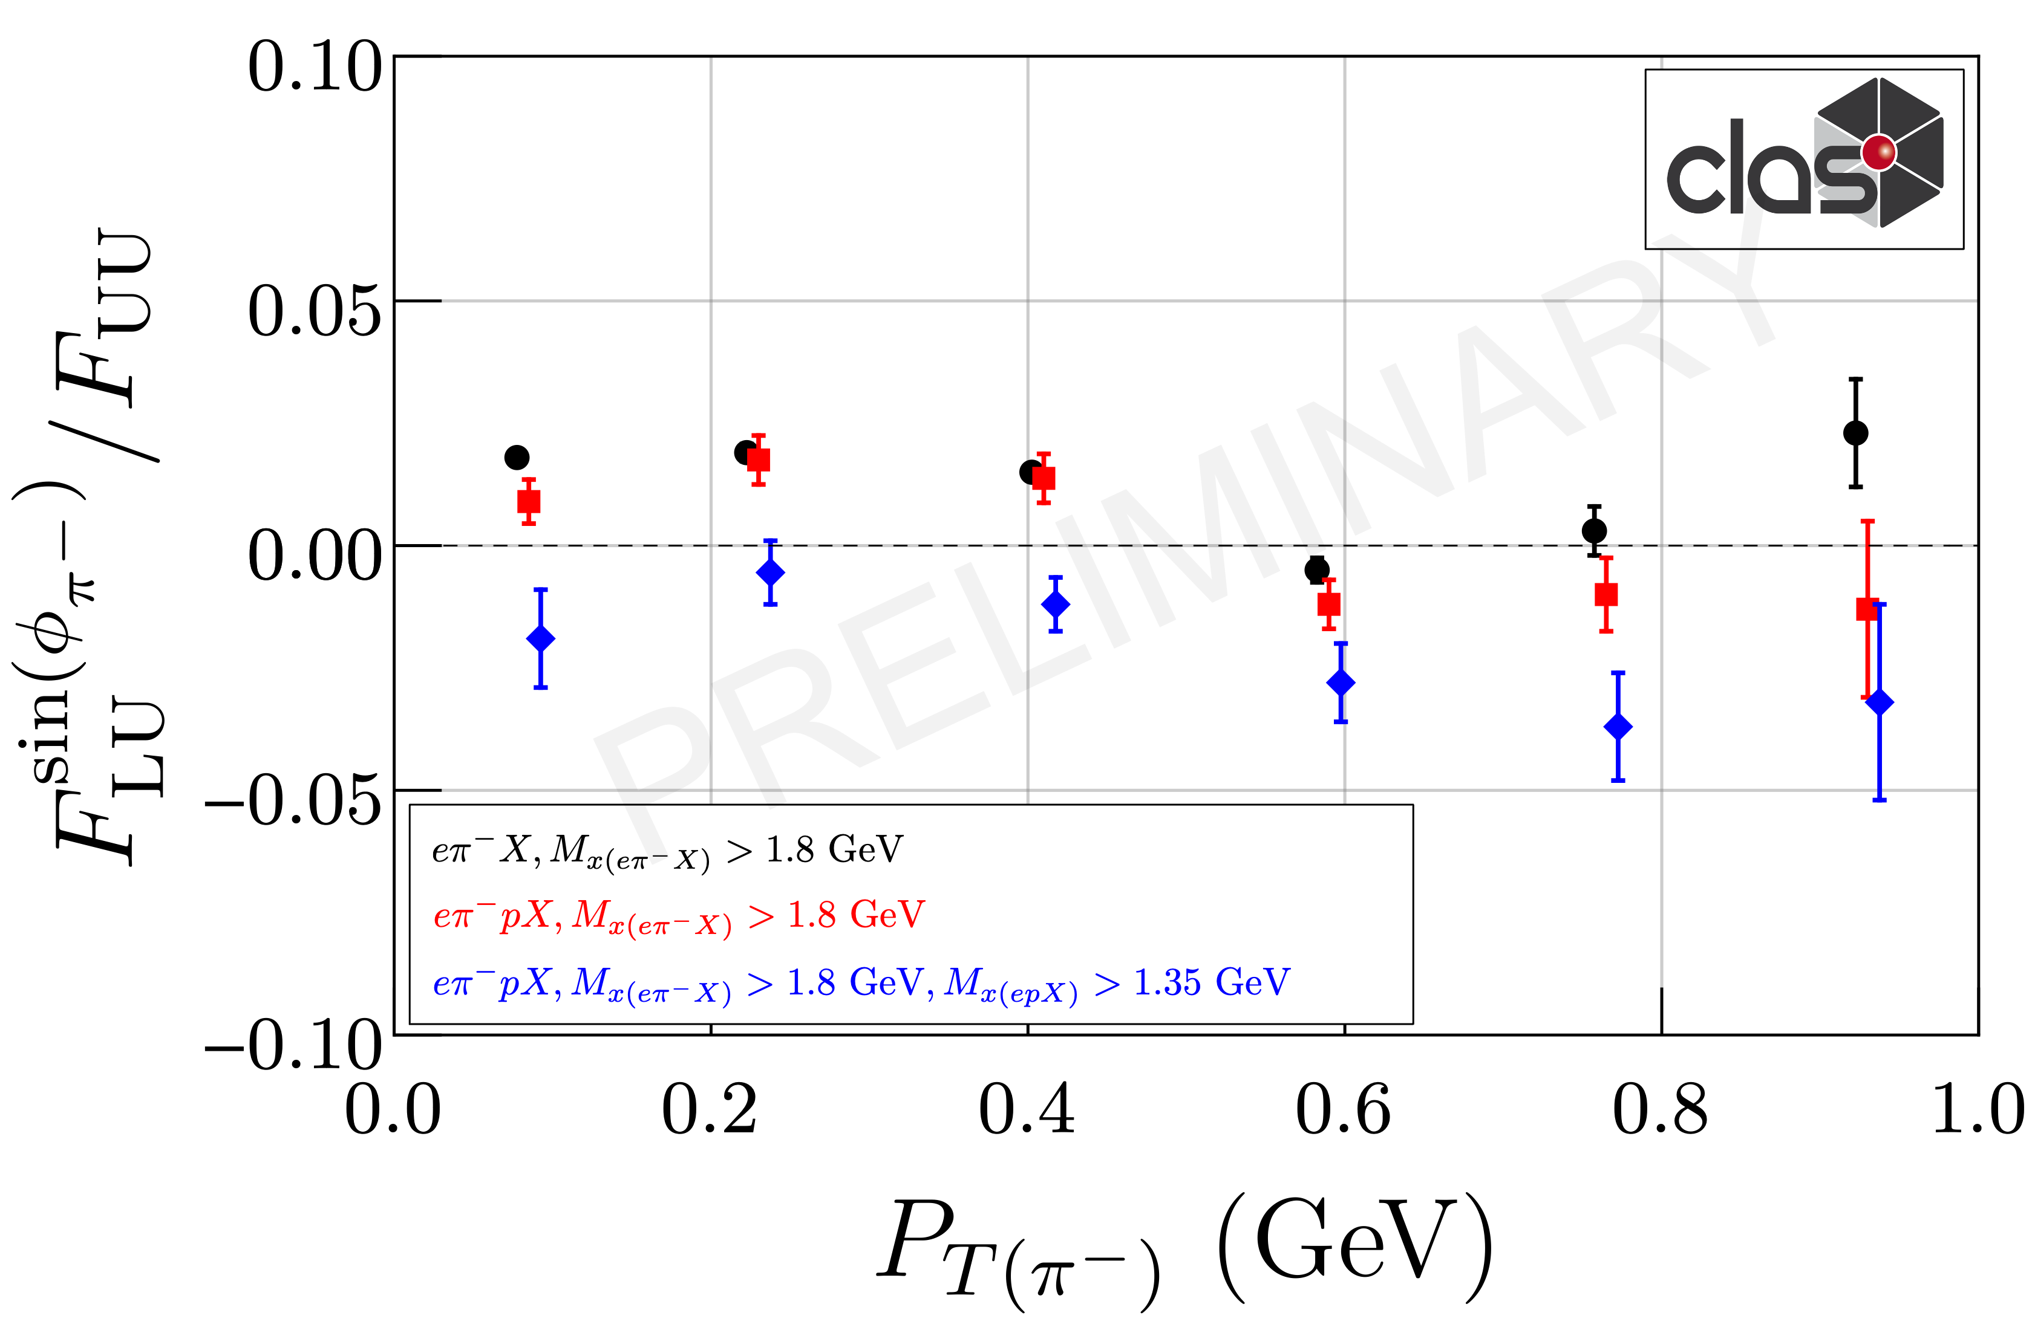
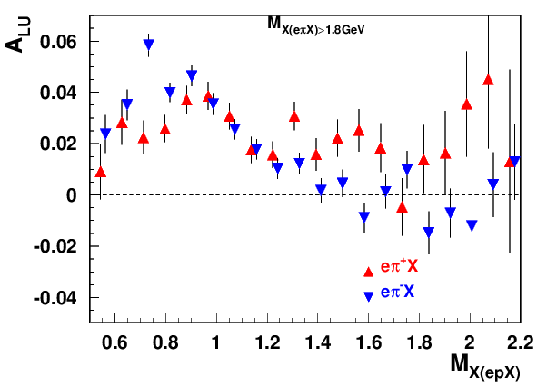

Exclusive ρ contributions to π: P_{T}-dependence
COMPASS→“Positive trend”
“ρ-free” SIDIS
0.1<P_{T}<0.3, 0.4<z<0.6
π− and π+ show similar behavior
COMPASS→“Positive trend” also reproduced when additional proton in TFR detected (red)
The same sign and size of π+ and π- SSA indicates the rho0 may not be properly subtracted(require detailed MC studies, which require proper SDMEs)
While VM contributions are ~20% in multiplicities in SSA they can be >100%
Detection of the target proton introduces much smaller bias on the inclusive charged pion SSA, than the exclusive rho contributions

Slide 16
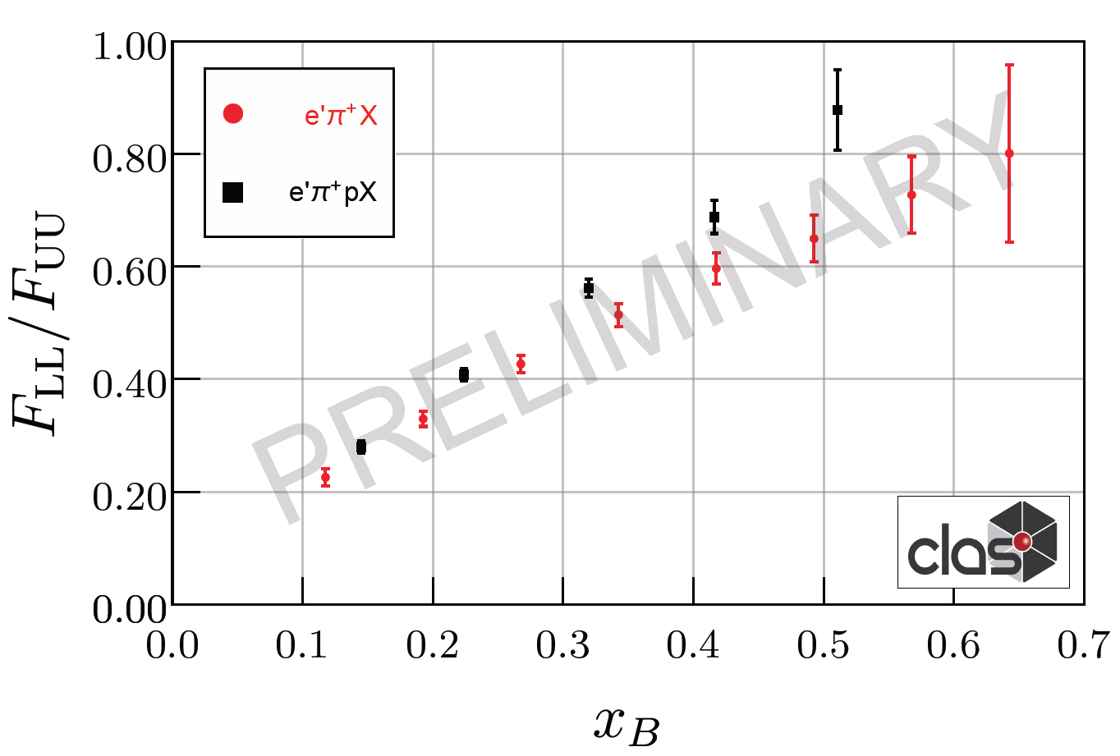
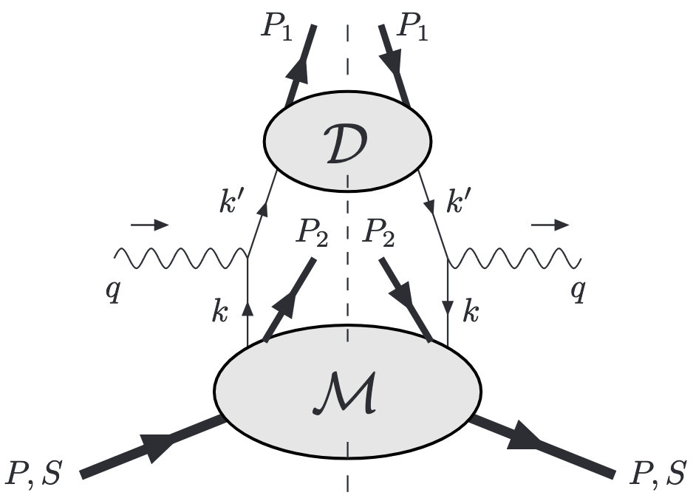
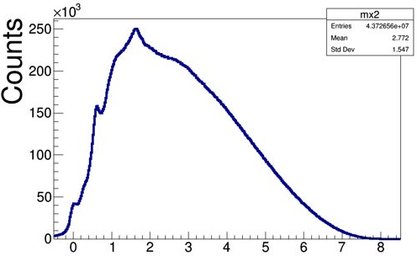
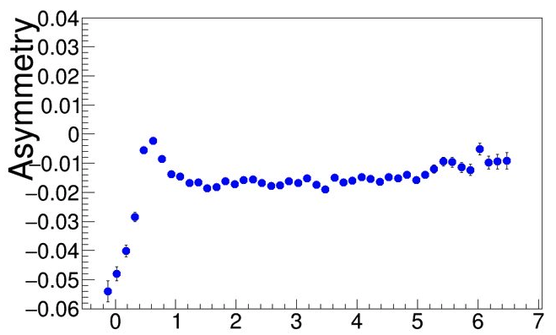
Longitudinally polarized quarks in B2B SIDIS
ep→e’pπX
N/q
Detection of proton allows elimination of exclusive rho!
Possible theory formalisms:
φ
f₂
Formalism based on fracture functions (Anselmino, Barone, Kotzinian (back-to-back, b2b, hadron production, DSIDIS)
Semi-exclusive processes, involving GPDs/GTMDs on proton side (TFR) and FFs on pion side (CFR) Yuan and Guo
HEMP
SIDIS (“ρ free”)
Differences in A_{LL} , due to different weights on PDFs can provide additional info on impact of possible ingredients
Measurements of A_{LL} for ρ⁰ indicate very small values, and can be one of the reasons for higher A_{LL} with protons with a M_{X} cuts above 1.5 GeV (excluding exclusive ρ⁰ )
Higher A_{LL} will change the phenomenology used last 40 years in DIS and SIDIS studies!!!
ep→e’pρ⁰ /ω
x_{F}<0
Beam SSA
M_{X}²(ep→e’pX)
ep→e’pπ⁰

Slide 17
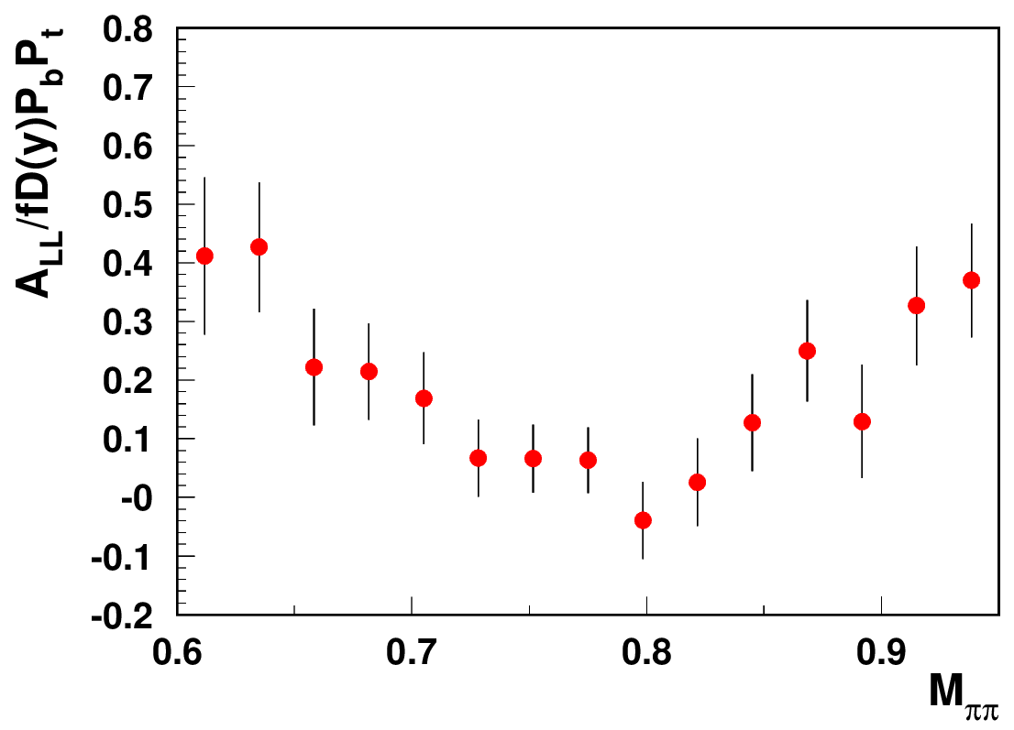
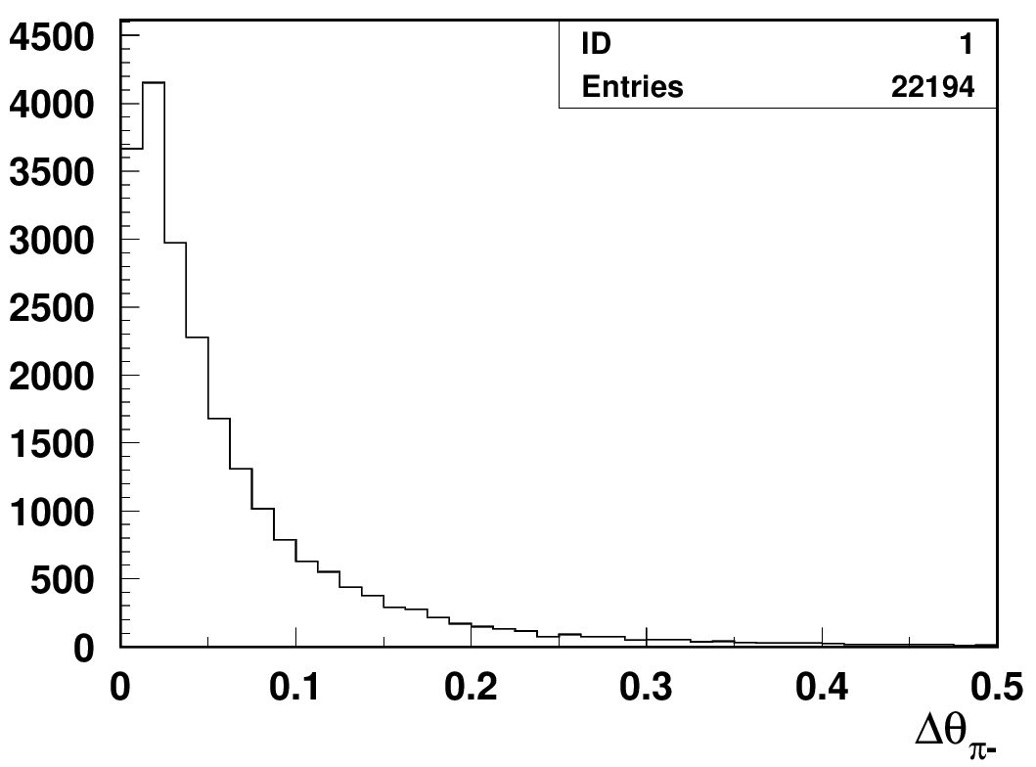
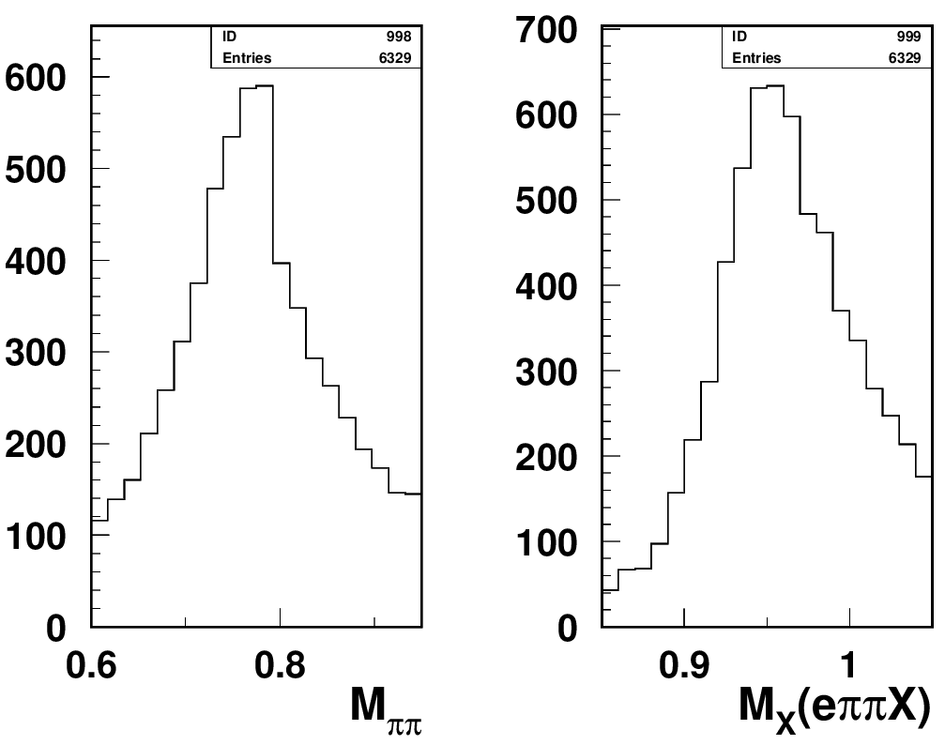
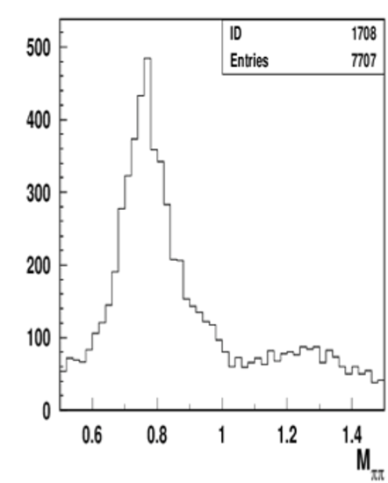
Studies of ρ⁰ impact with longitudinally polarized NH₃ target
Separating exclusive dihadrons
CLAS12 Preliminary
calculated
θ
measured
cut on Δθ <1º beetween measured and calculated π−
ep->e’p’π⁺π⁻
Require the angle of negative pions is within a degree from calculated from e’,p,π+ assuming exclusive e’,p,π+π- event.
exclusive 2 pion bck has bis positive A_{LL}
Measurements of A_{LL} for ρ⁰ indicate very small values (with ~10-20% bck, likely negative ~ -2-10% ), and can be one of the reasons for higher A_{LL} with protons with a M_{X} cuts above 1.35 GeV (excluding exclusive ρ⁰ )
Need clear separation of hydrogen from NH₃
and diffractive exclusive ρ0s from exclusive π+π−

Slide 18
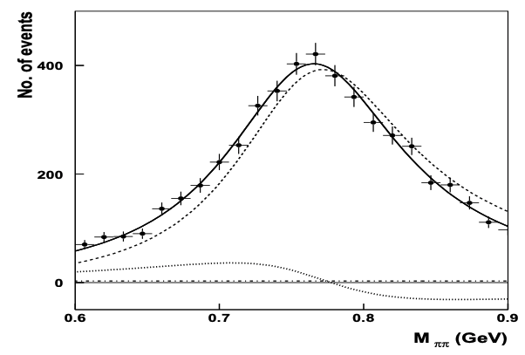
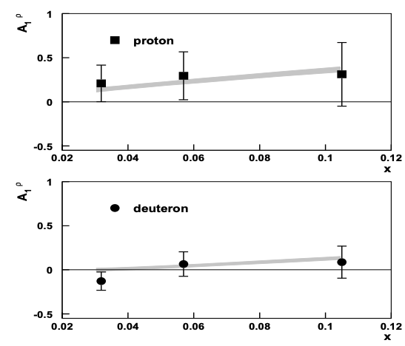
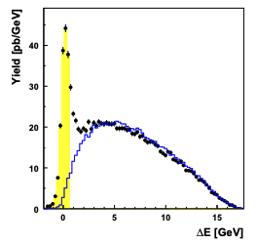
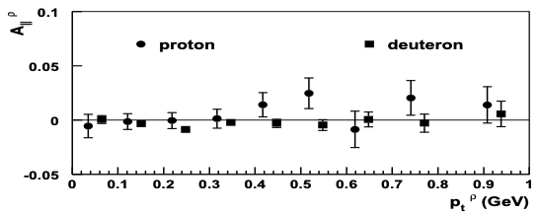
A_{LL} studies of exclusive ρ⁰ : HERMES
A_{1ρ}=0.23 ± 0.14±0.02
1D plots can be really misleading need multi-D
For a proper extraction of multiplicities and spin-azimuthal modulations of exclusive ρs, clean separation is needed for ρ⁰, and longitudinally polarized ρ⁰ signal, in particular
At low P_{T}, where the background is smaller, the asymmetry indeed tend to be negative
Accounting of ρ⁰ will change the phenomenology of helicity distributions

Slide 19
SUMMARY
Studies of QCD dynamics with controlled systematics involving Semi-Inclusive DIS, requires multidimensional measurements of cross sections/multiplicities/asymmetries as a function of all involved kinematical variables (including P_{T} and φ). Need reform in theory-phenomenology-experiment coordination
  For interpretation of the SIDIS data it is critical to separate contributions from different structure functions, as well as separation of different production mechanisms in a given structure function (including VMs)
  The diffractive VM contributions, violate the factorized picture of SIDIS based on the dominance of the leading twist contributions, and the “rho free SIDIS” may help to address the challenges of phenomenology
Need better coordination of efforts in theory-phenomenology-experiment
New tools, such as AI,ML,… combined with enhanced hardware resources would allow qalitatively new methods for data analysis (LoI suggested). The JLab current and incoming data is absolutely critical for future studies of 3D and can be utilized to test the new approaches.

Slide 20
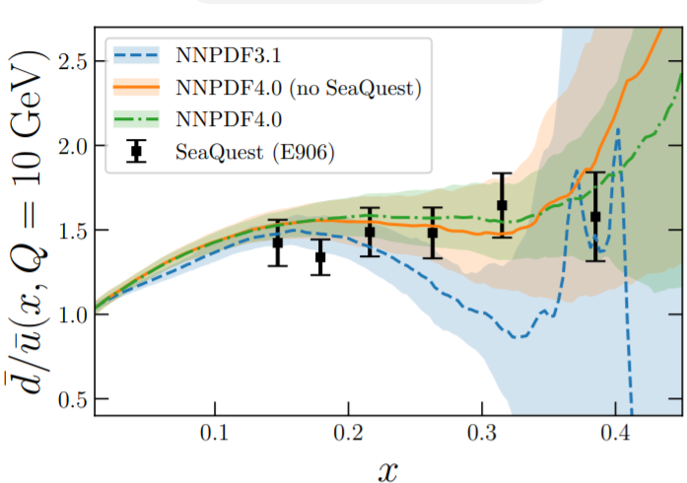
Understanding the QCD: from observables to QCD dynamics
Main goal to study the non-perturbative QCD dynamics in 3D space in details
JLAB uniqueness:
The superior luminosity of CEBAF, high resolutions of detectors, and ability for multidimensional and multiparticle detection, makes the JLab unique in disentangling the genuine intrinsic transverse structure of hadrons encoded in 3D partonic distributions (TMDs and GPDs) with controlled systematics in the kinematics dominated by valence quarks.
Understanding of hard scattering data at Q²<10 GeV² critical for multidimensional measurements, needed for understanding the QCD dynamics
The leptoproduction, with hadrons detected in the final state, from experimental point of view, in simplest case of a single hadron, is a measurement of observables in 5D space (x,Q²,z,P_{T},φ), 6D for transverse target, +φ_{S}
  Collinear SIDIS (last 50 years), is just the proper integration of observables, over P_{T},φ,φ_{S}

Slide 21
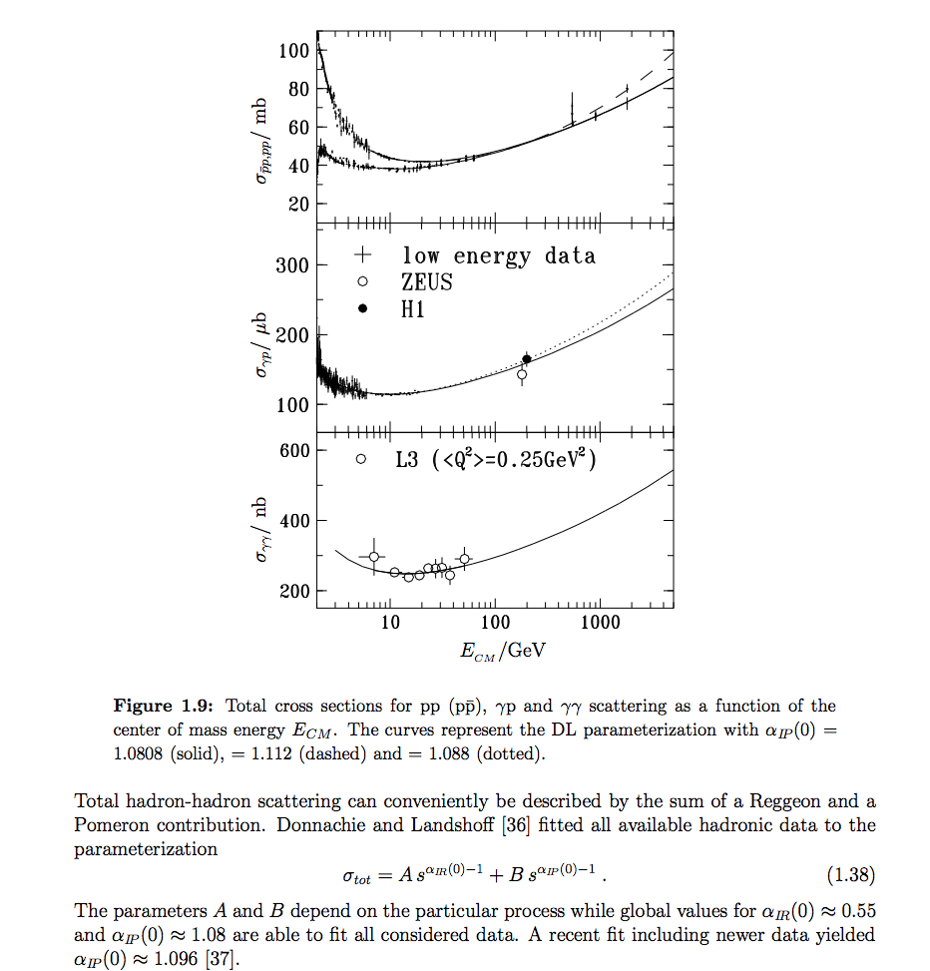

x-section

Slide 22

TMD theory problems
Perturbative approach: TMD region = where the log divergence of the fixed-order calculation dominates (resummation is required)
Significant fraction of polarized SIDIS data is currently considered by phenomenology to be outside of the TMD region
What data input exactly drives down the nonperturbative part?
TMD region we currently have
TMD region we expect to be extended
i
A. Bacchetta
How far in P_{T} or q_{T} extends the TMD region
Further steps to increase the coverage of large P_{T} critical for SIDIS, JLab in particular

Slide 23

Understanding exclusive rhos and SDME validations

Slide 24

Understanding exclusive rhos and SDME validations

Slide 25

Understanding exclusive rhos and SDME validations

Slide 26


Exclusive ρ⁰ (π+π−) contributions
Given detector resolutions and possible backgrounds the best option for studies of ep→e’p ρ⁰ will be detection of all 4 particles e’p,π+,π−
One can make invariant masses and missing masses of all combinations
ex. M_{X} (e’π+π−X) or M_{π+/π−} , M_{X}(e’p π+), M_{X}(e’p π−) also cuts calculated vs measured θs
θ
Plans: publish x-sections/multiplicities and SSAs of exclusive ρ(π+π−)
cut on Δθ <2º beetween measured and calculated π−
cuts on missing masses
cuts on invariant masses
10.5GeV
6.5GeV
at higher energies ρ more dominant
7.5GeV
6.5GeV
7.5GeV
10.5GeV

Slide 27




Beam SSA in exclusive π+π−
At large z (small t) the beam SSA of exclusive dihadrons goes sharply negative indicating dominance of some (non u-quark) contributions
Most SSA for the large z dihadron sample localized around the rho-mass (dominated by the exclusive rho)
→The beam SSA is related to exclusive rho0s

Slide 28



Radiative effects: impact on missing mass
Claim RC is negligible
solid→ reconstructed values
dashed→ e- generated
dotted/dash-dotted
→π generated
HERMES
LUND-MC description of the exclusive limit will be important in evaluation of the tail.
Energy loss of final state particles creates a shoulder (mainly e- for CLAS12)

Slide 29









“ρ-free SIDIS” free: target proton bias
ep→e’ππX
ep→e’pππX
+ x_{Fproton}<0
ep→e’pππX
+ x_{Fproton}<0
+ M_{X}(epX)>1.05 GeV
x=0.3(0.25<x<0.35)
Q²=2 GeV²
Q²=3 GeV²
Q²=4 GeV²
While the detected proton introduces slight difference in the kinematic distributions, the cut on the proton missing mass makes significant impact (clear at large z).
Notes:
Lorenz invariant amplitudes

Slide 30










Exclusive dihadrons from CLAS12
Q²=2 GeV²
Q²=3 GeV²
Q²=4 GeV²
x=0.2
Fraction of rho decreases with Q²
Q²=2 GeV²
Q²=3 GeV²
Q²=4 GeV²
Q²=5 GeV²
x=0.3
Q²=2 GeV²
Q²=3 GeV²
Q²=4 GeV²
Q²=5 GeV²
x=0.4
Notes:
Lorenz invariant amplitudes

Slide 31

Understanding exclusive rhos and SDME validations

Slide 32

Understanding exclusive rhos and SDME validations

Slide 33

Understanding exclusive rhos and SDME validations

Slide 34

Understanding exclusive rhos and SDME validations

Slide 35
Exclusive dihadrons from CLAS12
Q²=2 GeV²
Q²=3 GeV²
Q²=4 GeV²
x=0.2
Fraction of rho decreases with Q²
Q²=2 GeV²
Q²=3 GeV²
Q²=4 GeV²
Q²=5 GeV²
x=0.3
Q²=2 GeV²
Q²=3 GeV²
Q²=4 GeV²
Q²=5 GeV²
x=0.4
Notes:
Lorenz invariant amplitudes

Slide 36

Studies of rhos at COMPASS
tails may be significant, also because of RC

Slide 37


SFs up to twist 3
For SIDIS we have the full set of contributions from twist-2 and twist-3
including (Twist-2TMD x Twist-3FF) and (Twist-3TMD x Twist-2 FF)
ex.
Higher Twist TMDs
Twist-3 TMD
Most likely dominant in SSA
Twist3 GPDs (also calculated on lattice)
Request to theory to provide similar contributions for the exclusive hadron production. So far only Twist-3 contributions from Twist-2 GPDs (Kroll&Goloskokov,…)

Slide 38




CLAS12 Studies: Data vs MC
Using PEPSI (LUND) generator
Filled symbols data
Open symbols MC
Kinematic distributions, z,x_{F},P_{T}-distributions of protons, and widths are in good agreement with LEPTO
TFR may be a valuable source for studies of widths in hadronization
Expect significantly better separation of TFR and CFR at JLab24
Notes:
One more slide showing perfect agreement between data and experiment for inclusive protons, which are predominantly produced in the target fragmentation region.

