Slide 1

Λ Beam Spin Asymmetry Studies using RGA Pass-2 Fall-18 Data
CLAS12 Collaboration Meeting
November 14, 2024
Veronique Ziegler

Slide 2
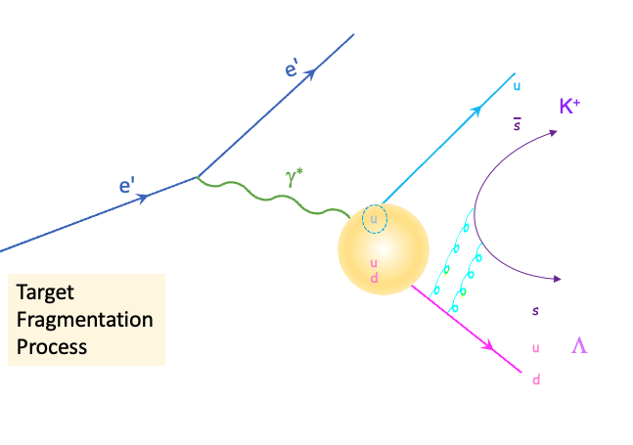
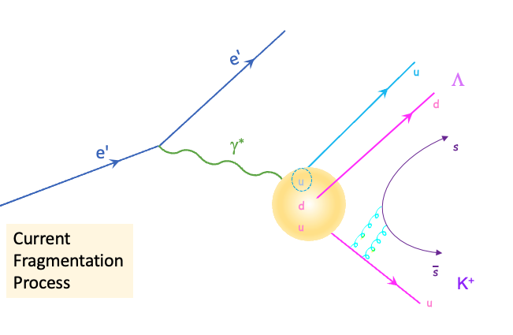
Motivation
Beam Spin Asymmetry is a tool to understand hadronization.
  Exclusive and semi-exclusive processes ep → e’ Λ X (X=K^{(*)+}, K⁰π⁺, …) to separate:
      kinematical regions (Target and Current Fragmentation Regions)
      dynamical contributions
  Results for various exclusive channels such as ep→e’p(n, Δ)π (S.Diehl)
  and ep → e’ Λ(Σ) K⁺ (D.Carman) and semi-inclusive ep→e’p X (F.Benmokhtar*)
  *https://indico.jlab.org/event/910/contributions/15545/attachments/11958/18774/Benmokhtar-epX-Analysis-Collaboration-Nov-24.pdf
    Comparison of these results with BSA for ep → e’ Λ X can add another
    piece to the puzzle of production mechanism off a polarized quark
    inside an unpolarized proton
  Exclusive Λ→ pπ⁻ reconstruction advantages:
    More accurate reconstruction of the azimuthal angle
    Less background than using missing mass method, narrower Λ signal
    Allows to study contributions above ground-state K production
2

Slide 3
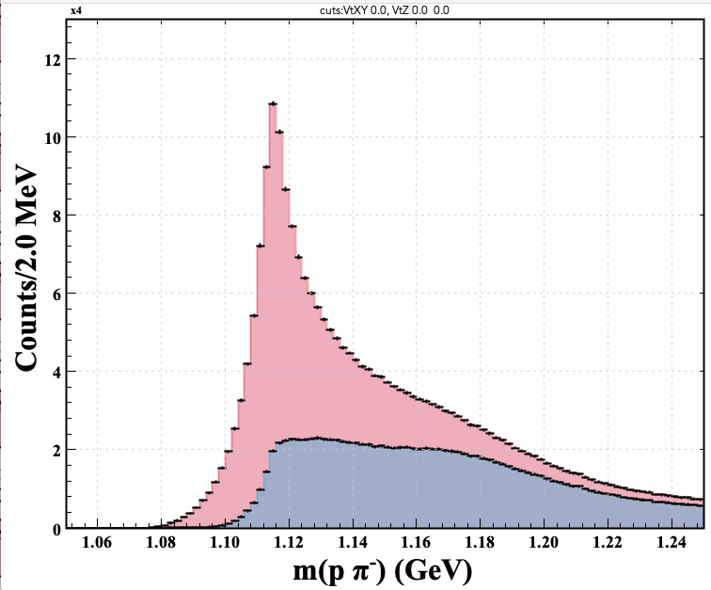
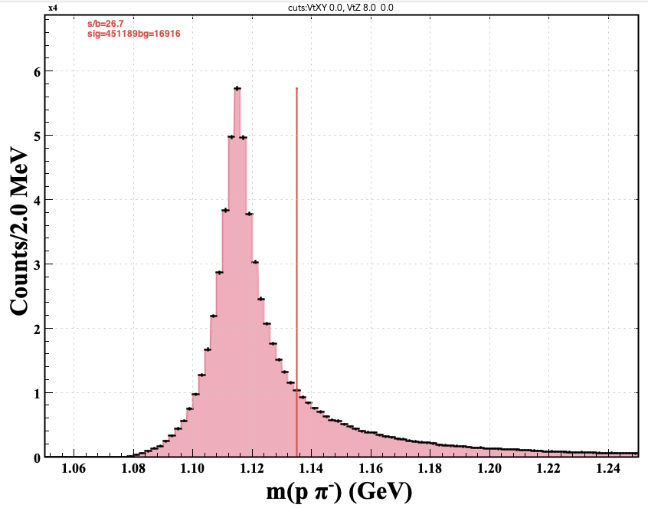
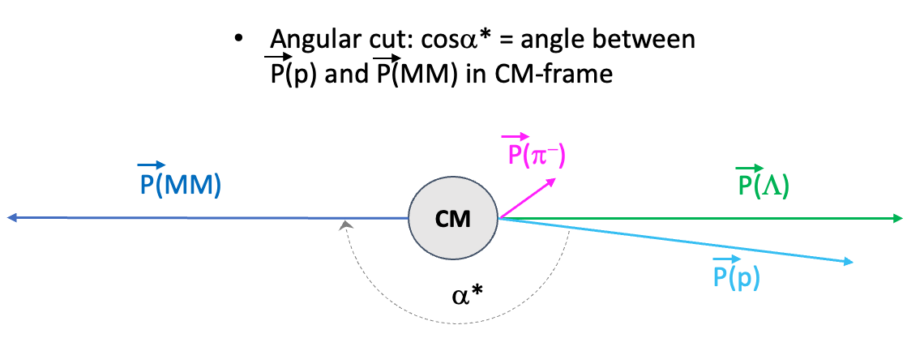
Λ Candidate Selection
Selection of ep→ e (pπ⁻) X events using Fall18 (in- and out-bending) Pass-2 RGA data
Skim these events using detached vertex reconstruction algorithm
    Creates analysis bank with vertex and momenta of each track and track pair candidate at the reconstructed detached vertex
    Topology: p & π⁻ in FD: improved resolution and signal-to-background ratio (study documented in Λ skim CLAS note)
    PID (|χ²_{PID}|<15) selection criteria for p and π⁻
    Require the vertex between p and π⁻ to be reconstructed with doca<5 cm
    Require Λ vertex to be downstream of the e- vertex
    Require the cosine of the angle between the proton and pion computed assuming the Λ PDG mass between +/- 1
    Subsequent vertex displacement (wrt e- vtx) optimization
After vertex displacement (wrt e- vtx) selection:
Δvz > 0 cm
Δvz > 8 cm
cosα* < -0.99
Require cosα* < -0.99
cosα* > -0.99
*c,f. My talk on Λ skim in Hadron Spectroscopy session

Slide 4
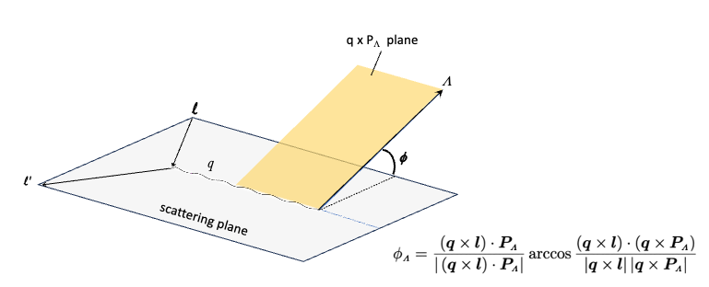
BSA for 1<Q²<10 GeV², 2<W<4.5 GeV
+ helicity
- helicity
+ helicity
& - helicity
F = A sin (phi)
+ helicity m(pπ⁻) spectra for each φ bin
- helicity m(pπ⁻) spectra for each φ bin
Clean Λ distributions for all φ bins ➔ no background subtraction needed

Slide 5
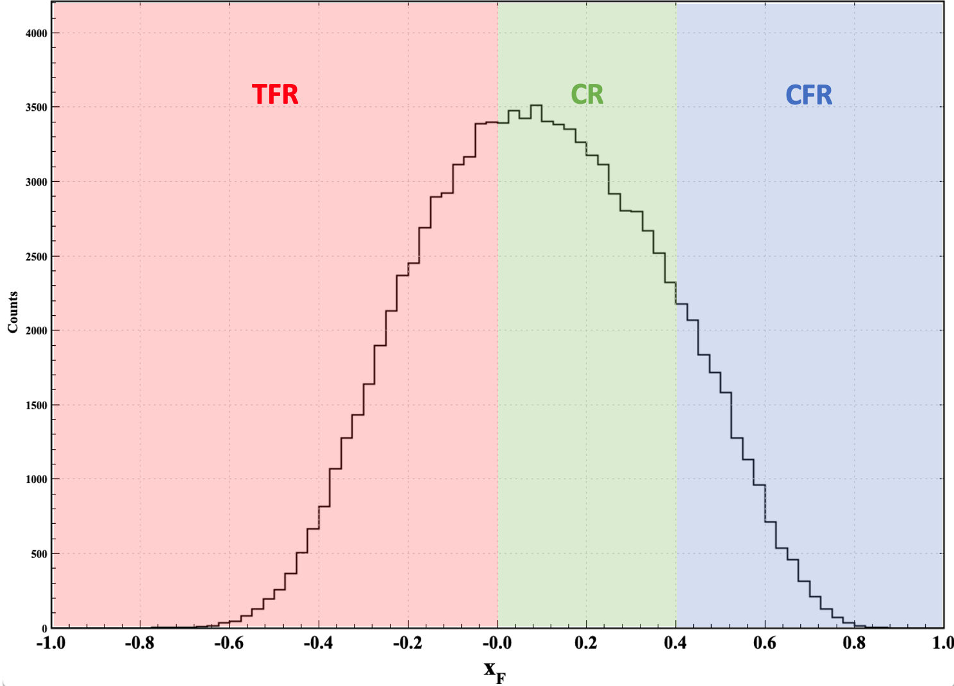

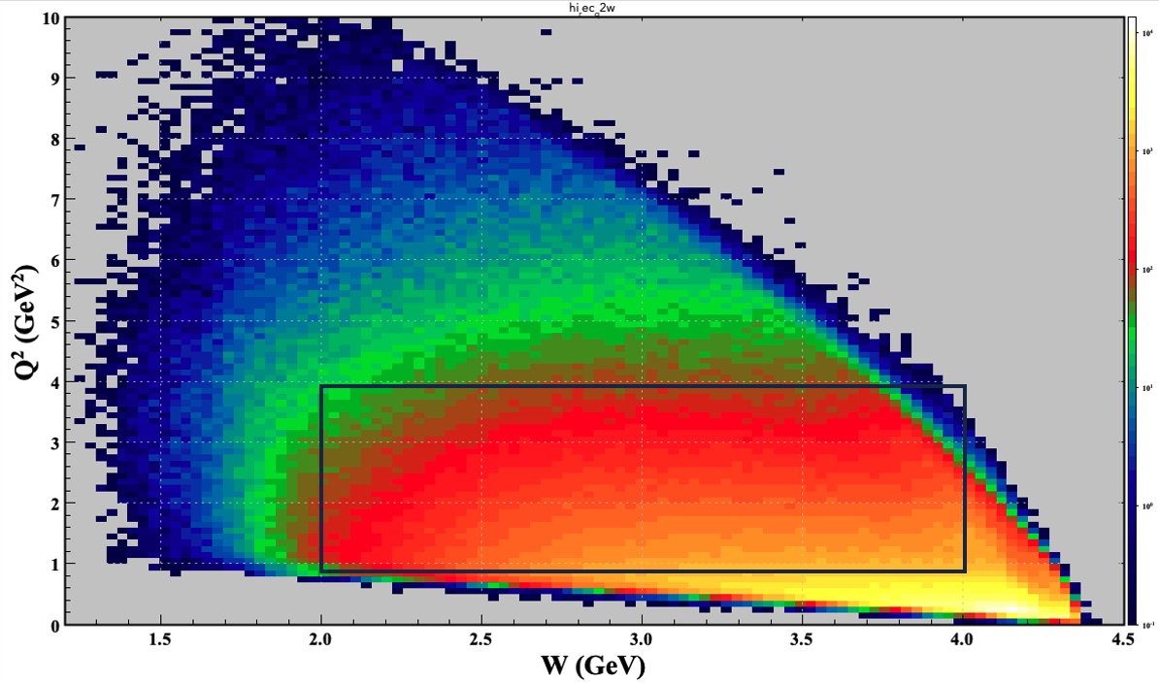
BSA as a Function of x_{F}
Obtain BSA as a function of x_{F} to study Λ polarization behavior in the Target, Center, and Current Fragmentation Regions
Selected range: 1 < Q² < 4 GeV²;
2 < W < 4 GeV
~uniform Q²,W bins
SR
( )
SR = Soft Region
5

Slide 6
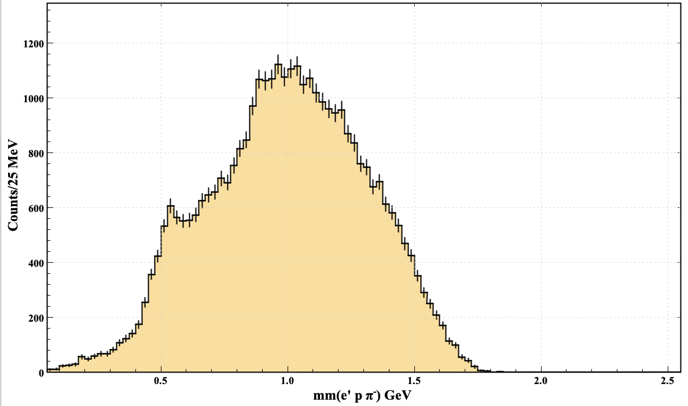
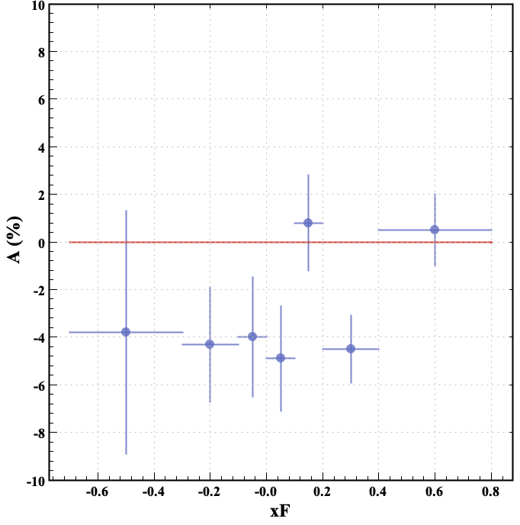
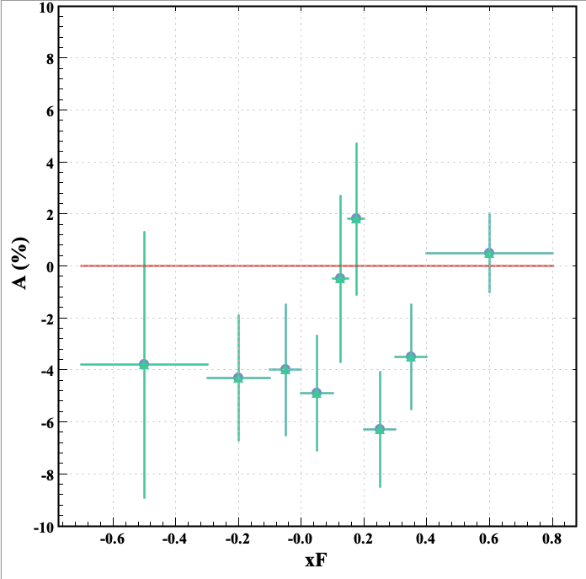
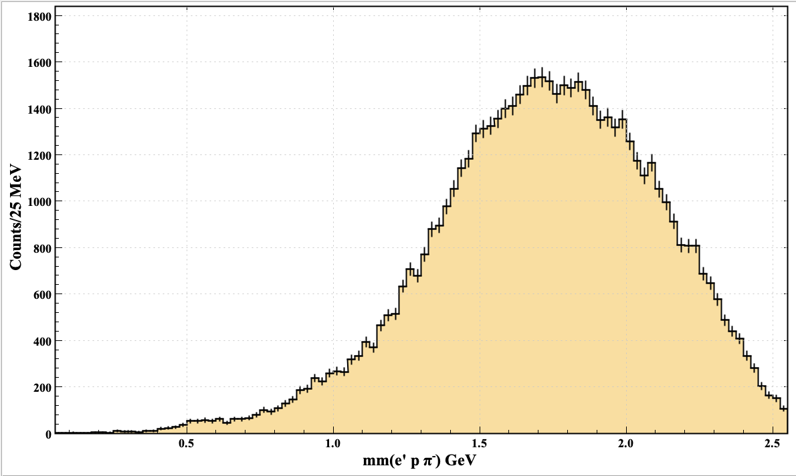
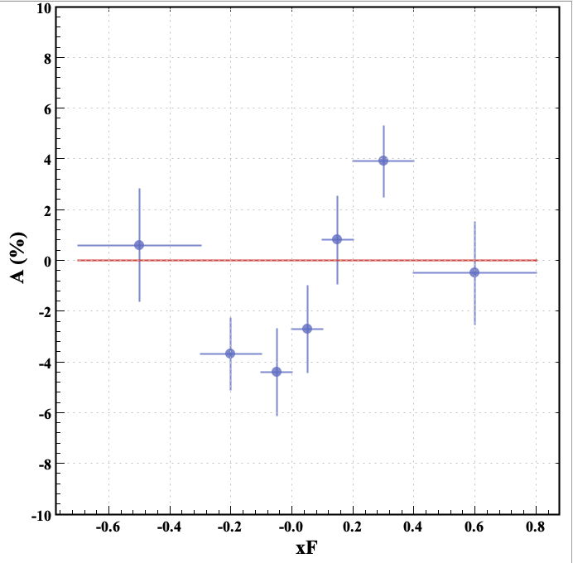
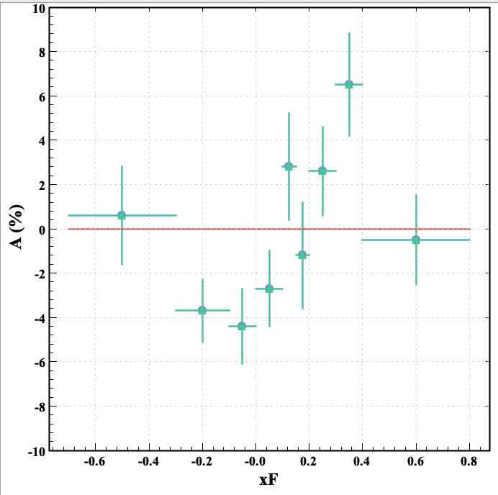
BSA as a Function of x_{F}
1 < Q² < 4 GeV²
MM(e’Λ) (integrated over x_{F})
2<W<3 GeV
finer binning for x_{F}>0
3<W<4 GeV
Different behavior in the CFR (x_{F}>0) for W>3 GeV where the K⁺ contribution is suppressed
6

Slide 7
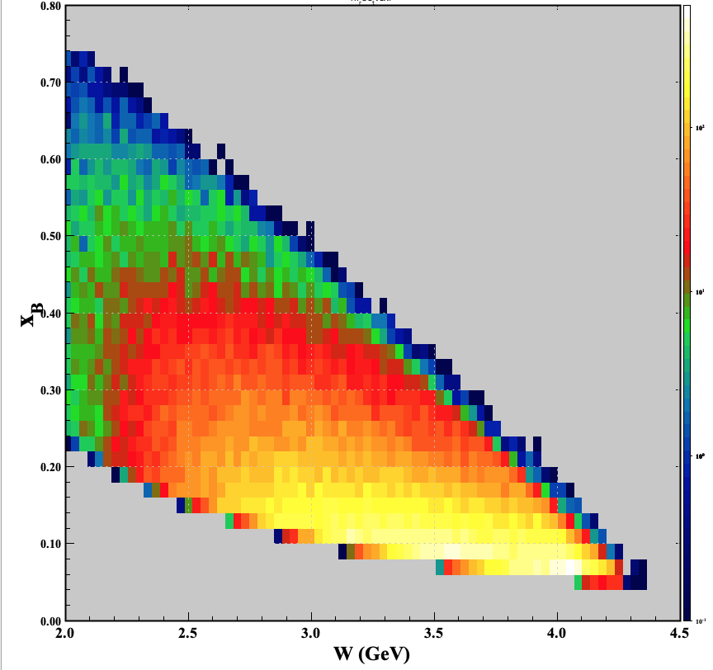
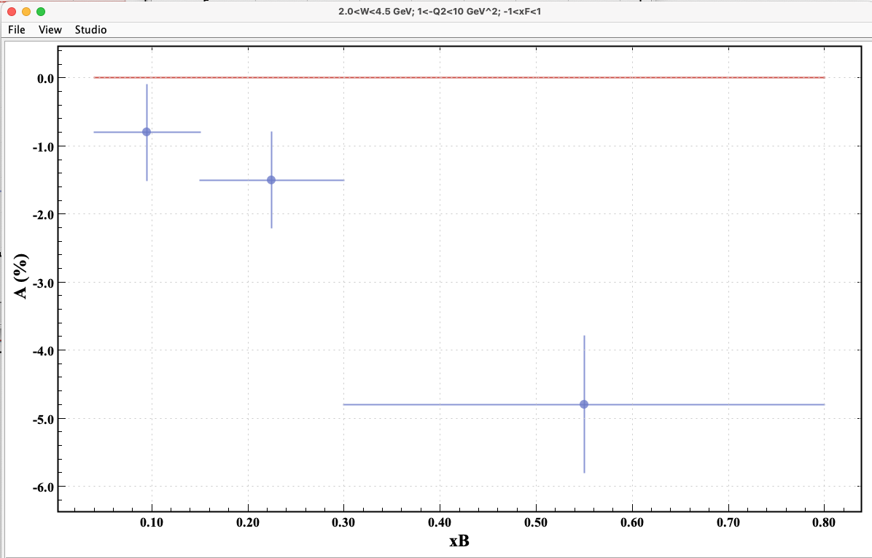
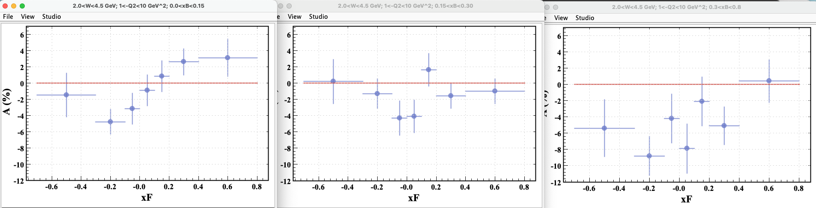
BSA as a Function of x_{F} and x_{B}
x_{B} = Q²/ 2M_{p} ν ~ fraction of the target proton’s momentum carried by the struck quark
At low x_{B}: low momentum parton representation of nucleon & gluon dominance ➔ insight into Λ production mechanics off the proton
x_{B} bin 1 ~ W > 2.7 GeV → K⁺ suppressed
x_{B} bin 3 ~ W < 3.5 GeV → K⁺ not suppressed
For each bin in x_{B} obtain BSA as a function of x_{F}
x_{B} bin 1 2 3
7

Slide 8
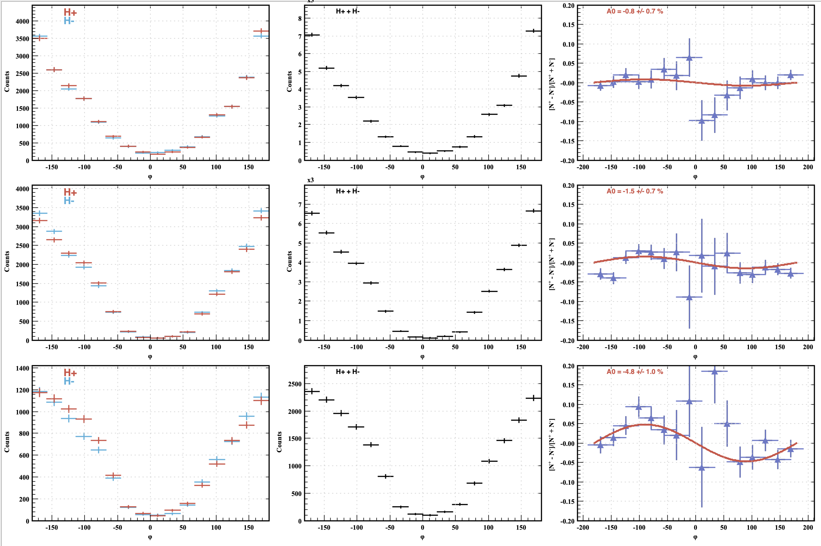
BSA as a Function of x_{B}
Selected range : 1 < Q² <10 GeV²; 2< W < 4.5 GeV
Larger BSA at large x_{B}
  Integrated over x_{F}
Likely effect from ep→e’ΛK⁺ where angular distribution has dips near +/- 180 deg. due to cosφ, cos2φ interference convoluted with acceptance
8

Slide 9
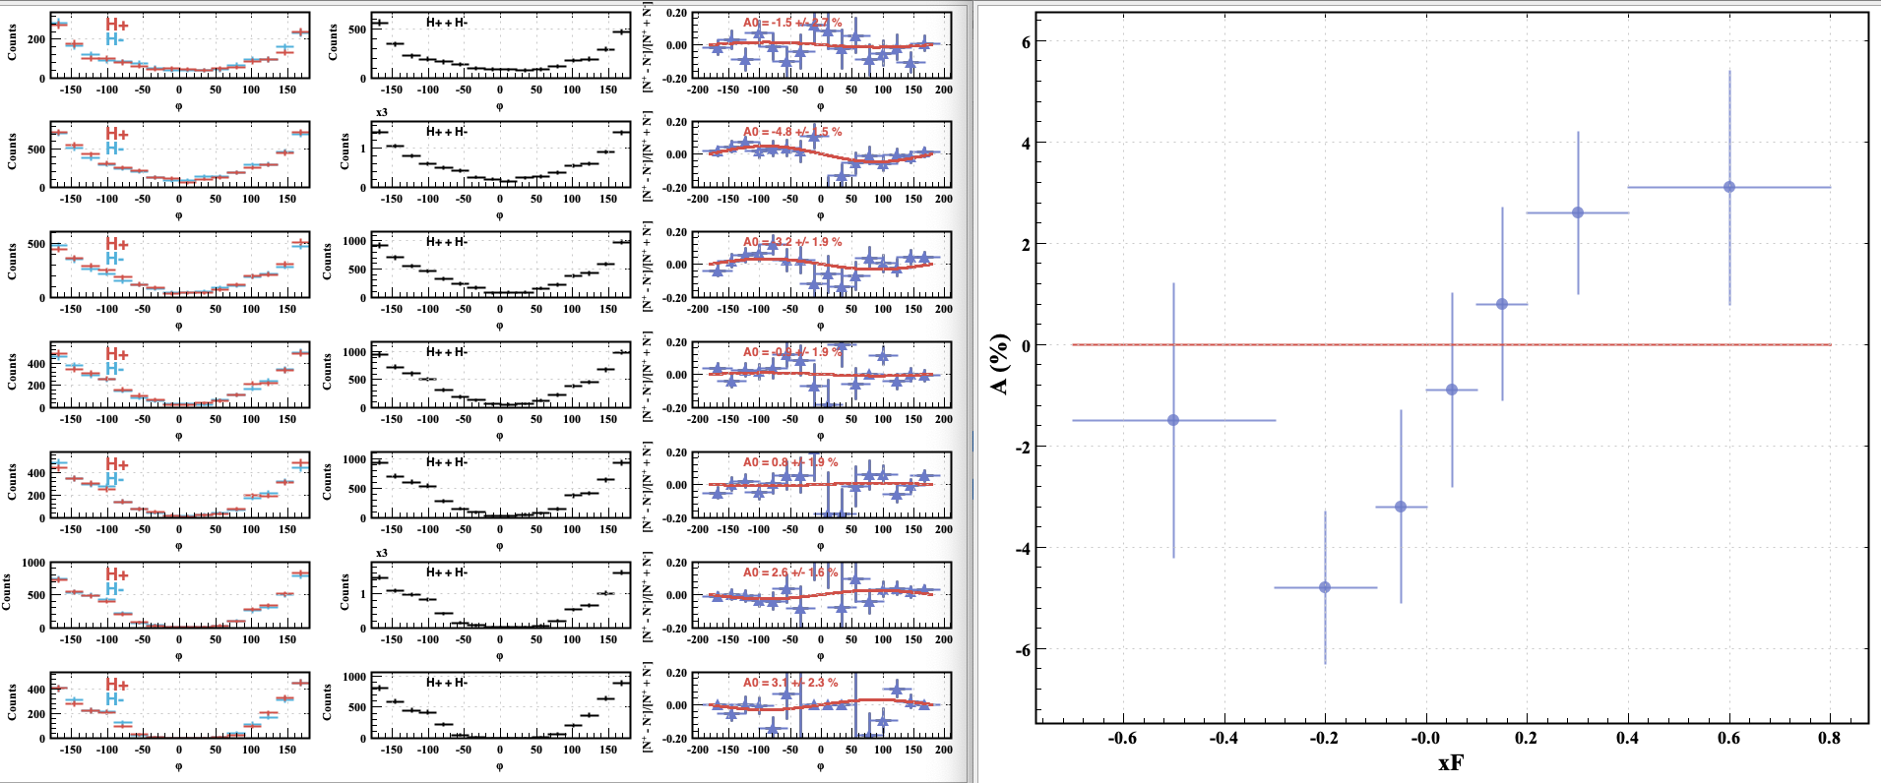
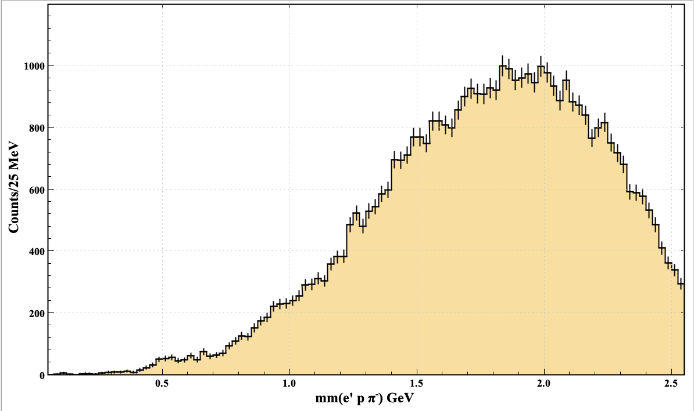
BSA as a Function of x_{F} for x_{B} < 0.15
1 < Q² < 10 GeV²; 2 < W < 4.5 GeV
MM(e’Λ) (GeV)
No obvious K (K*) contribution to the reaction ep → e’ΛX
9

Slide 10
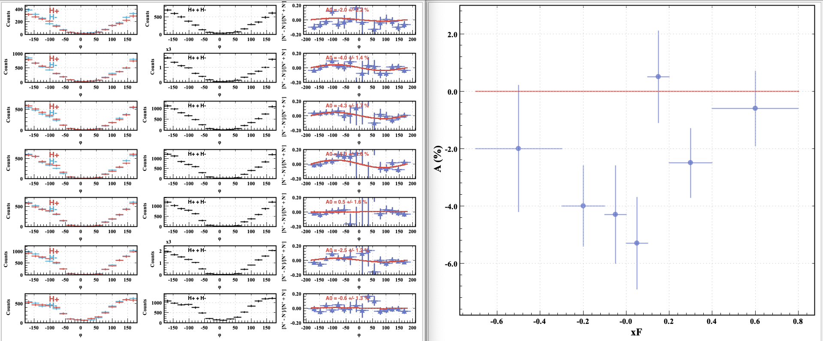
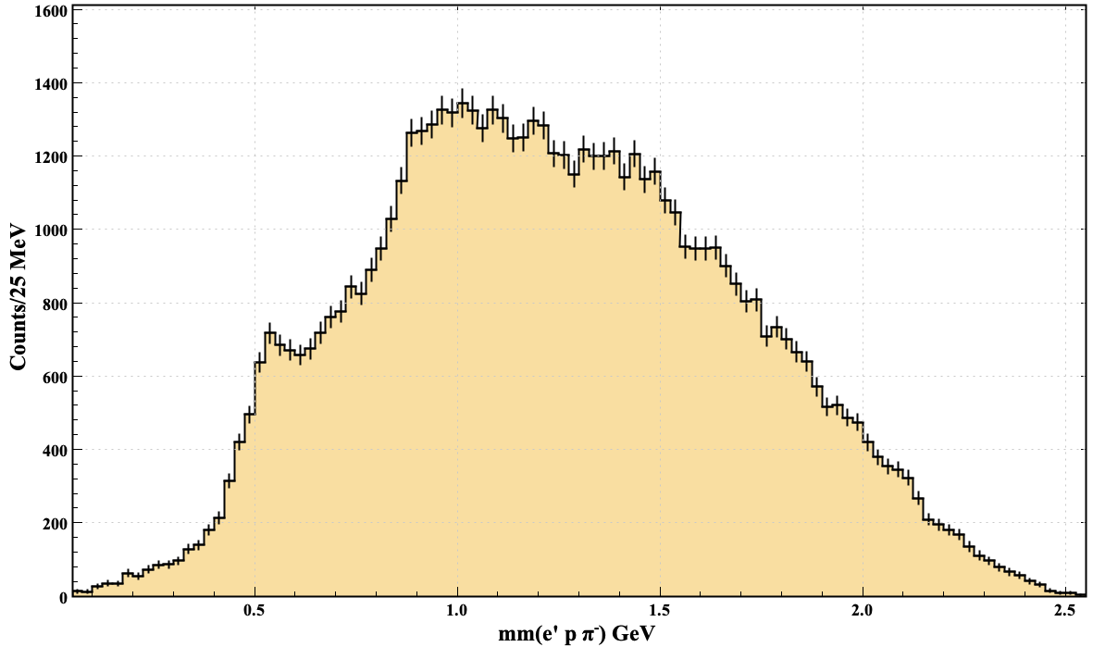
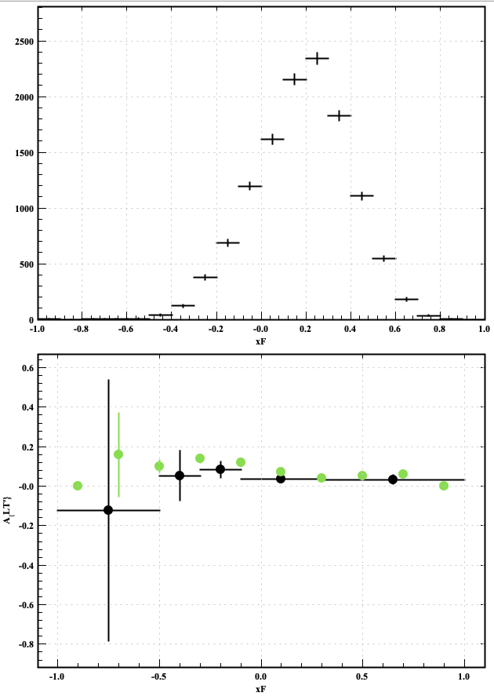
BSA as a Function of x_{F} for x_{B} > 0.15
1 < Q² < 10 GeV²; 2 < W < 4.5 GeV
MM(e’Λ) (GeV)
K contributions contribute to larger negative average A_{LT’}
Analysis of eK⁺Λ events (φ_{K}) shows that the value of A_{LT}’ does not change sign as a function of x_{F}
A_{LT’} vs x_{F} wrt K⁺ →phase diff.
BSA for K⁺Λ
events from RGK data at 6.535 GeV
vs x_{F} for Q² =1.0 - 4.5 GeV²
(D.Carman’s analysis)
Obvious X=K⁺ contribution to the reaction ep → e’Λ X
10

Slide 11
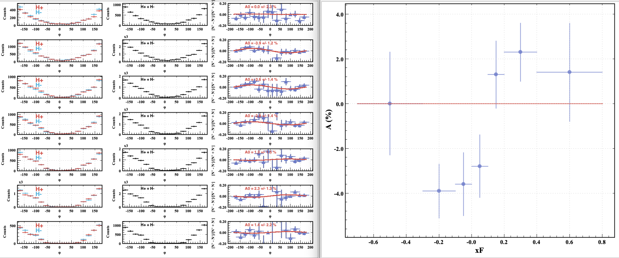
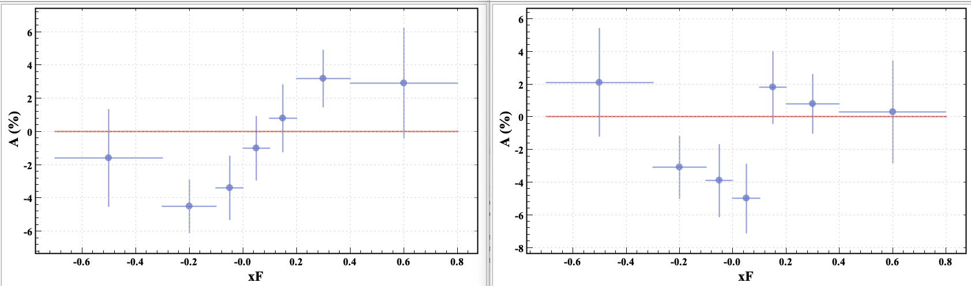
BSA as a Function of x_{F} for MM>1.2 GeV
1 < Q² <10 GeV²; 2 < W < 4.5 GeV
Require MM(eΛ) >1.2 GeV to remove K (K*[892]) contributions
Sign flip seen in both regions of x_{B} but position of minimum seems to shift depending on x_{B}
x_{B} < 0.15
x_{B}> 0.15
A_{LT’} vs x_{F} for 2 regions of x_{B}
11

Slide 12
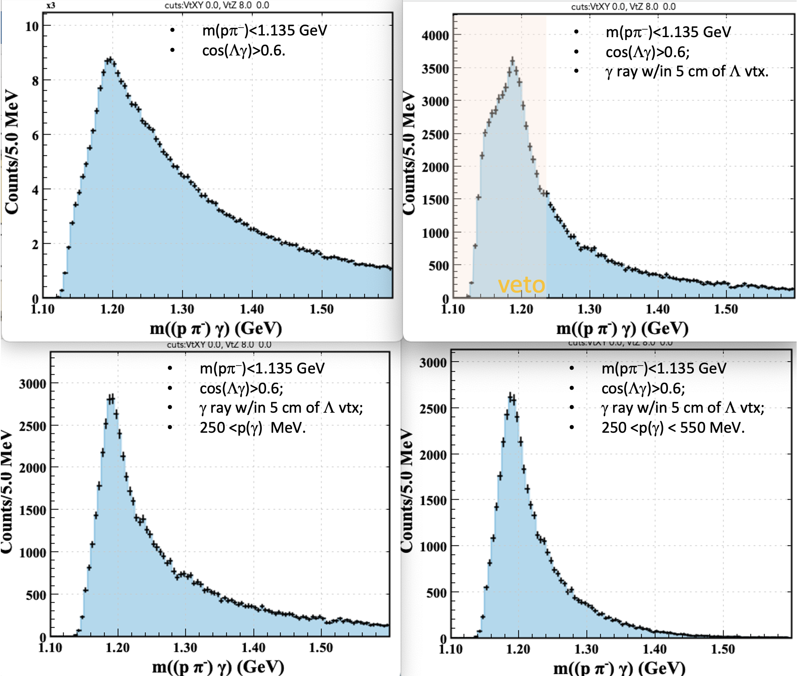
Contamination from e p→e’ (Σ→Λ γ) X Events
The selected Λ → pπ- can be produced in the reaction e p→e’ (Σ→Λ γ) X
This is a background to the reaction e p→e’ Λ X
To reduce the contribution from this background a veto on the γ is imposed :
Σ→Λ γ candidate selection
rejecting events where there is a photon spanning an angular cone (cos ζ = 0.6) wrt Λ momentum vector
Missing mass against e⁻ pπ⁻ for selected Λ ◊ pπ⁻ events
m(pπ⁻)<1.135 GeV
Σ veto on photon and m(Λγ) from the reaction Σ→Λ γ
Observed Σ⁰→Λ γ signal from 4-momentum addition of a γ with the selected Λ
12

Slide 13
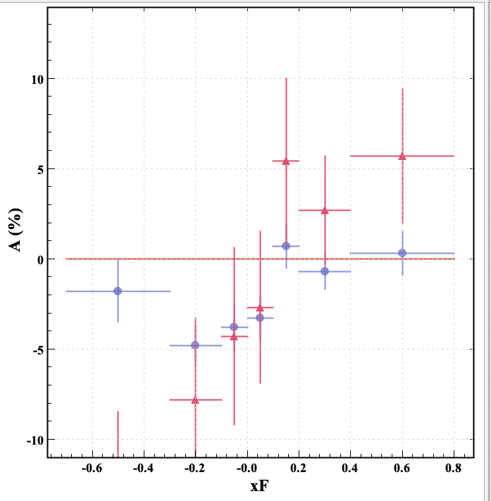
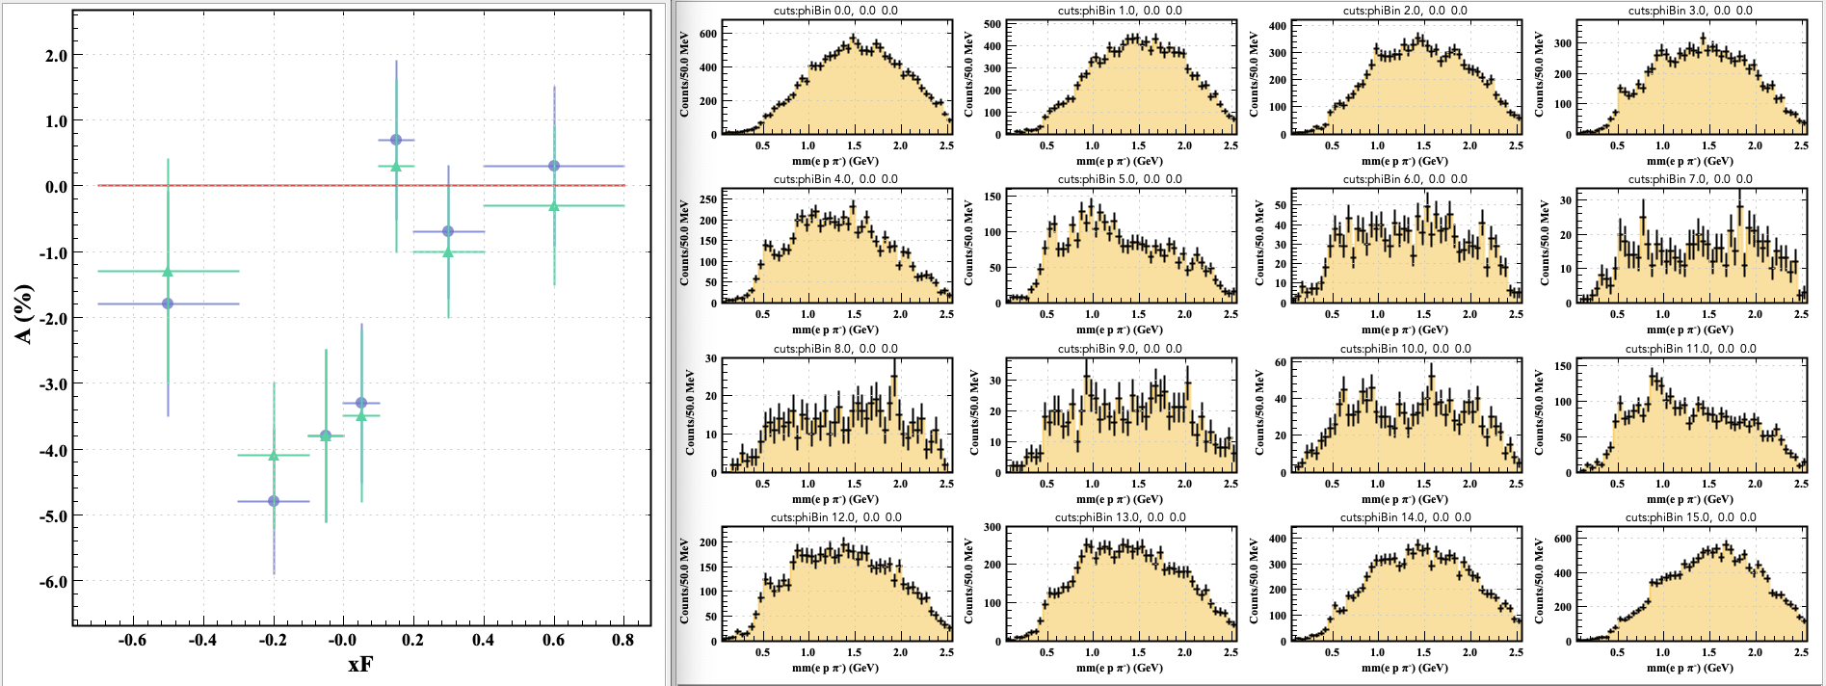
Study of Σ Contamination from e p→e’ (Σ→Λ γ) X Events
Selected e p→e’ (Σ→Λ γ) X Events
Selected e p→e’ Λ X Events
With Veto against e p→e’ (Σ→Λ γ) X Events
Selected e p→e’ Λ X Events
Little effect of veto on BSA distribution

Slide 14
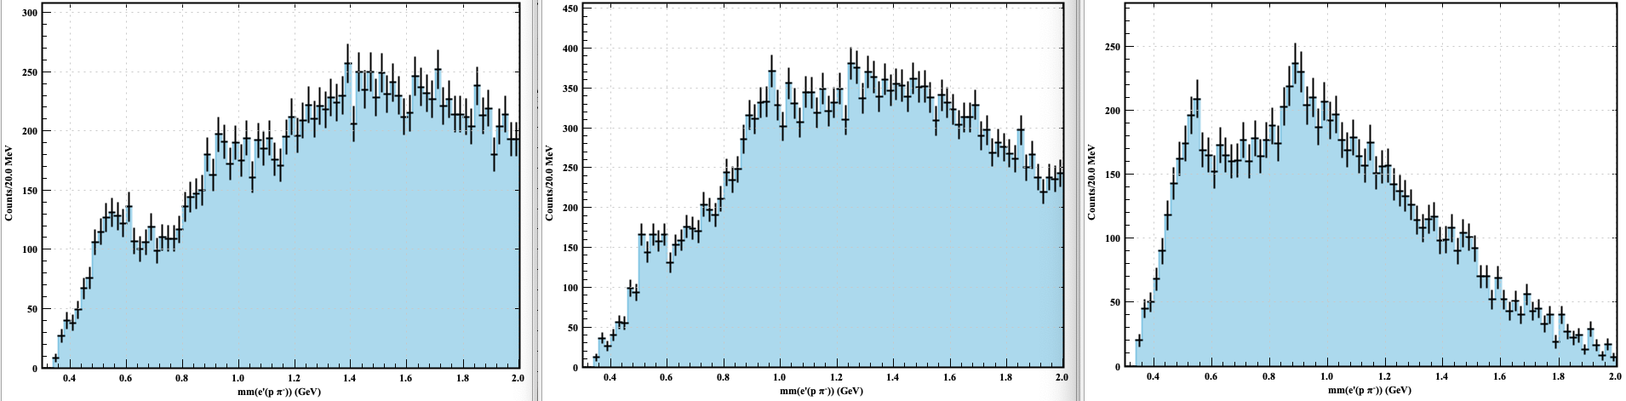
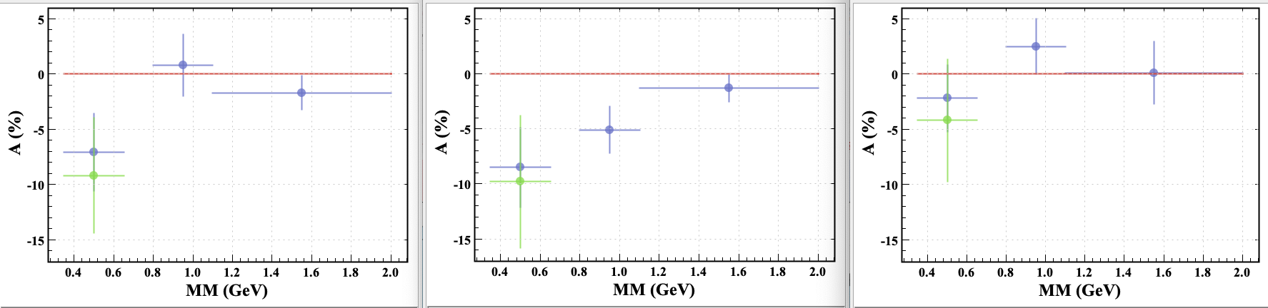
BSA as a Function of MM with γ Veto*
* Veto against cos(Λγ)>0.6
TFR
SR
CFR
The difference between the blue and green data points gives an estimate of the contribution of the background under the K⁺ peak
K⁺Λ events

Slide 15
Observations
A BSA (with φ computed wrt the Λ) sign flip is observed in the CFR when the contribution to ep → e’ Λ X from the reaction ep → e’ Λ K⁺ is negligible:
  Region MM > 1.2 GeV
  Region x_{B} < 0.15
  Region W > 3 GeV
When the reaction ep → e’ Λ K⁺ is not negligible the BSA as a function of x_{F} is negative for all values of x_{F}.
The contamination from the reaction ep → e’ Σ(◊Λγ) X has minimal impact on the BSA behavior as a function of x_{F}.
  x_{B} < 0.15
A_{LT’} vs x_{F}(K)
With Veto against e p→e’ (Σ→Λ γ) X Events
Selected e p→e’ Λ X Events
15

Slide 16
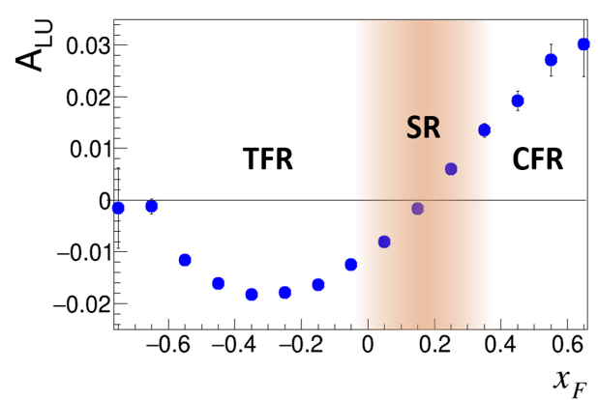
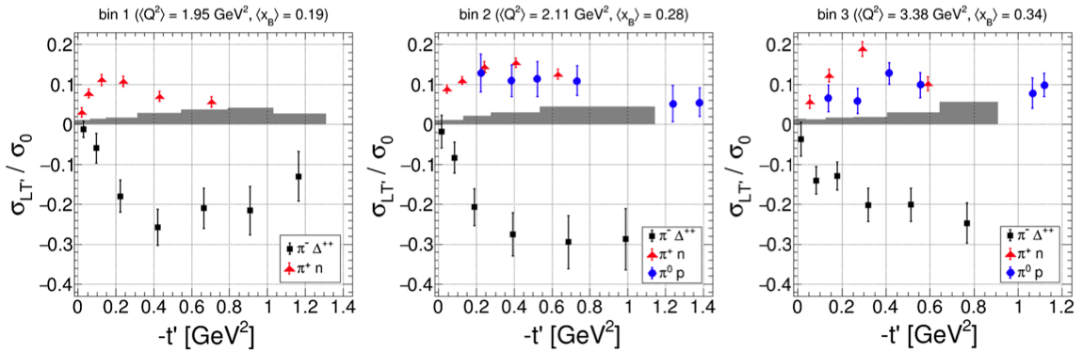
Interpretation
F. Benmokhtar
Behavior (in region with minimal K⁺ contribution) similar to what is observed for the reaction ep →e’p X
Polarized u-quark kicked out likely responsible for sign of BSA in T- and C-FR
  Quark dynamics govern s-quark spin orientation for Λ K^{+(*)} final states
  Polarization of struck quark in the proton shown to be responsible for sign of asymmetry
  ep →e’p X
  ep →e’Λ X
  x_{B} < 0.15
γ* kicks out a longitudinally polarized u quark
γ* kicks out a longitudinally polarized d quark in reaction ep → e’ π⁻Δ⁺⁺
S. Diehl et al. PRL 131, 021901 (2023)
16

Slide 17
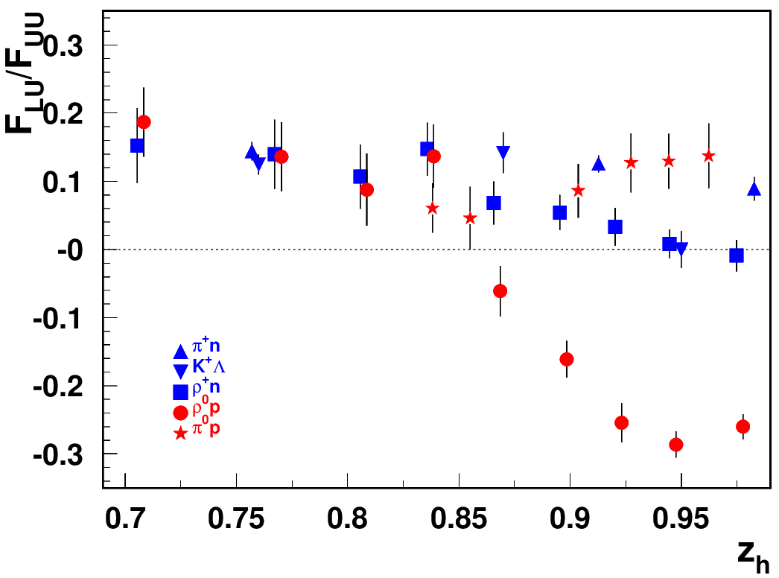
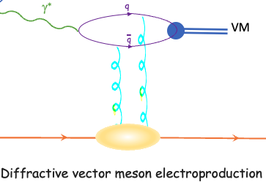
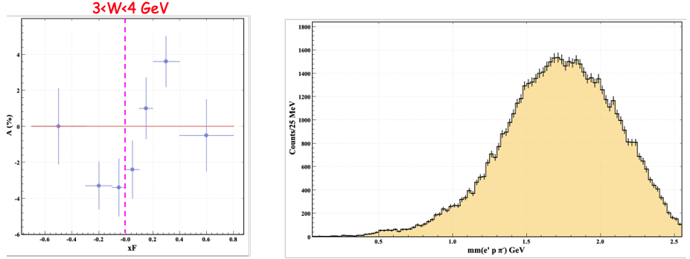
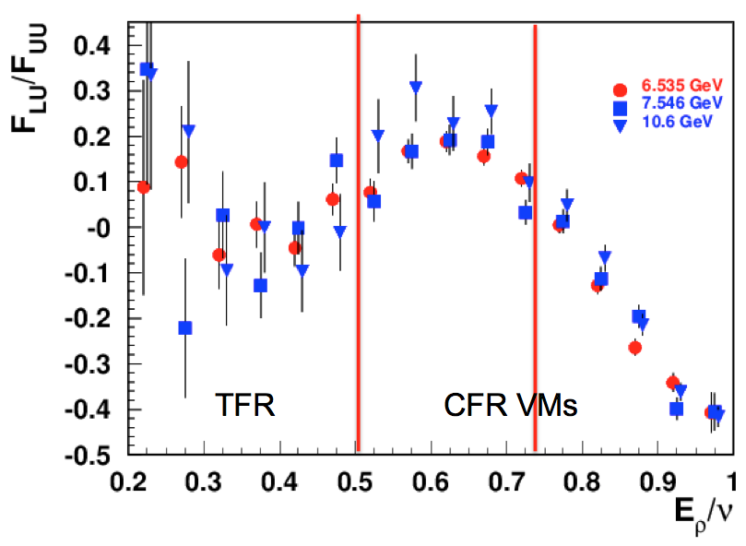
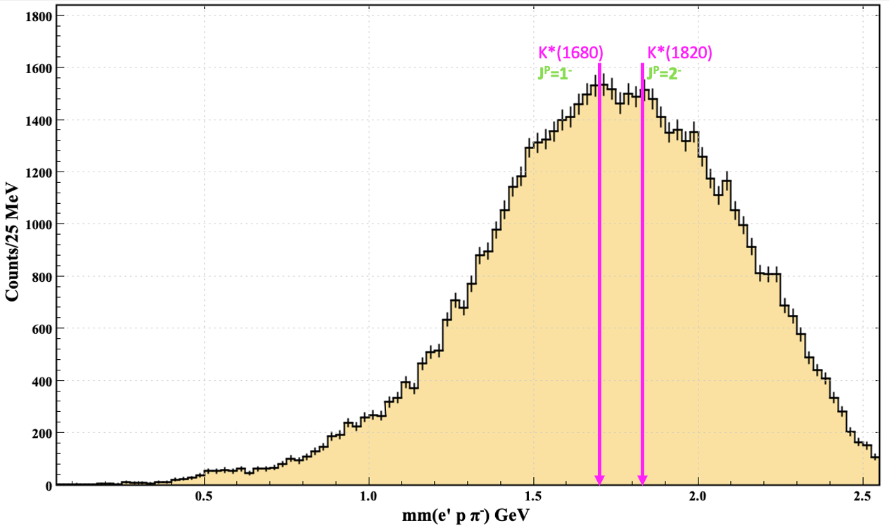
Interpretation ~ “diffractive” kinematics separation
H. Avakian
Behavior for exclusive ρ⁰p final state different from ρ⁺p final state
At high z_{h} =E_{h}/ν , effect from “diffractive” ρ⁰
Difference between quark-exchange and gluon-exchange processes
  BSA sign flip possibly resulting from gluon-exchange dynamics
  ep→e’ΛK⁺ channel: non-diffractive channel
  For Λ semi-exclusive channel, BSA sign flip in CFR could come from excited kaon
    Production mechanism of the K-meson in the Target
non-“diffractive” channels
“diffractive” ρ⁰ (VM)
ρ⁰
17

Slide 18
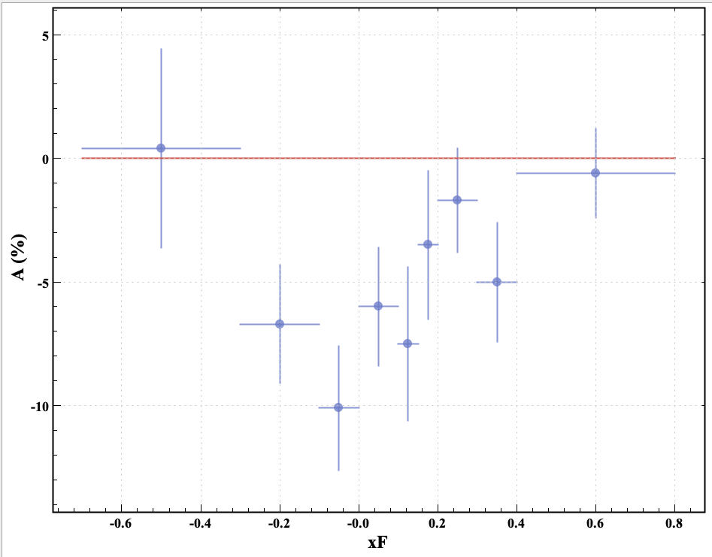
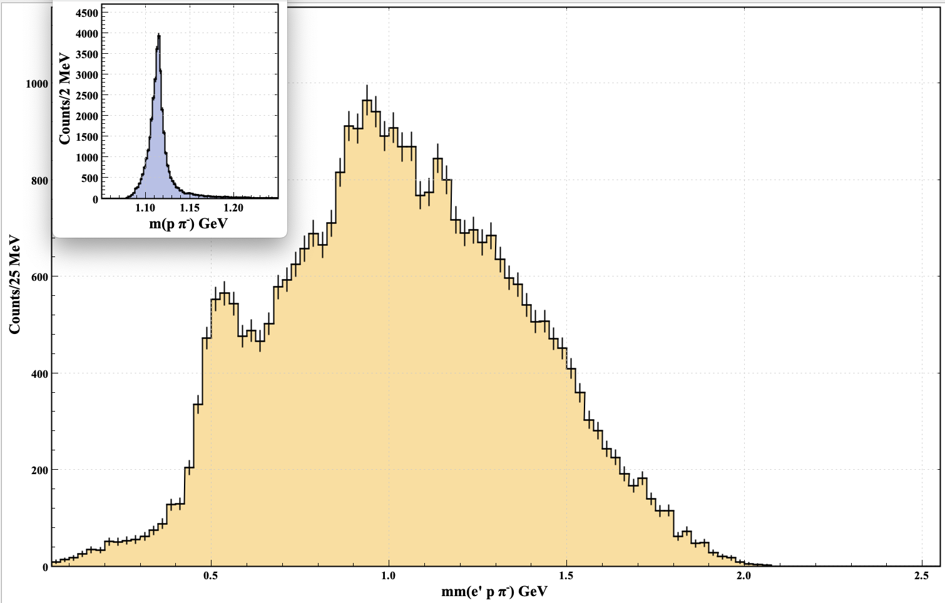
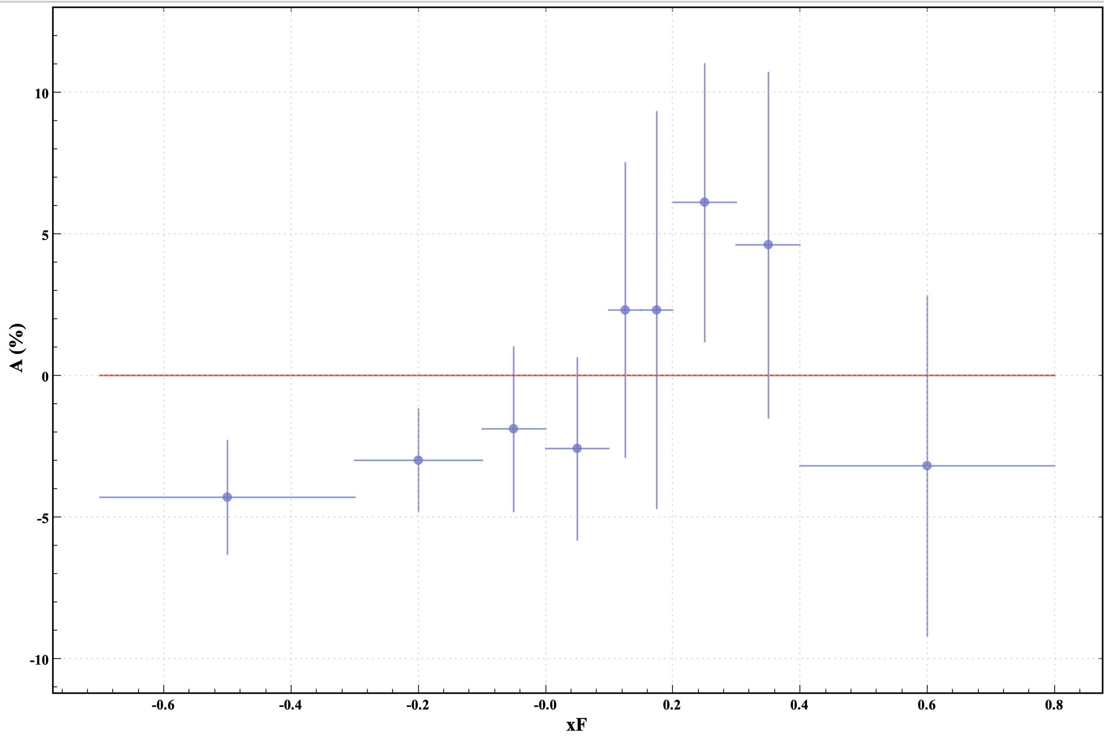
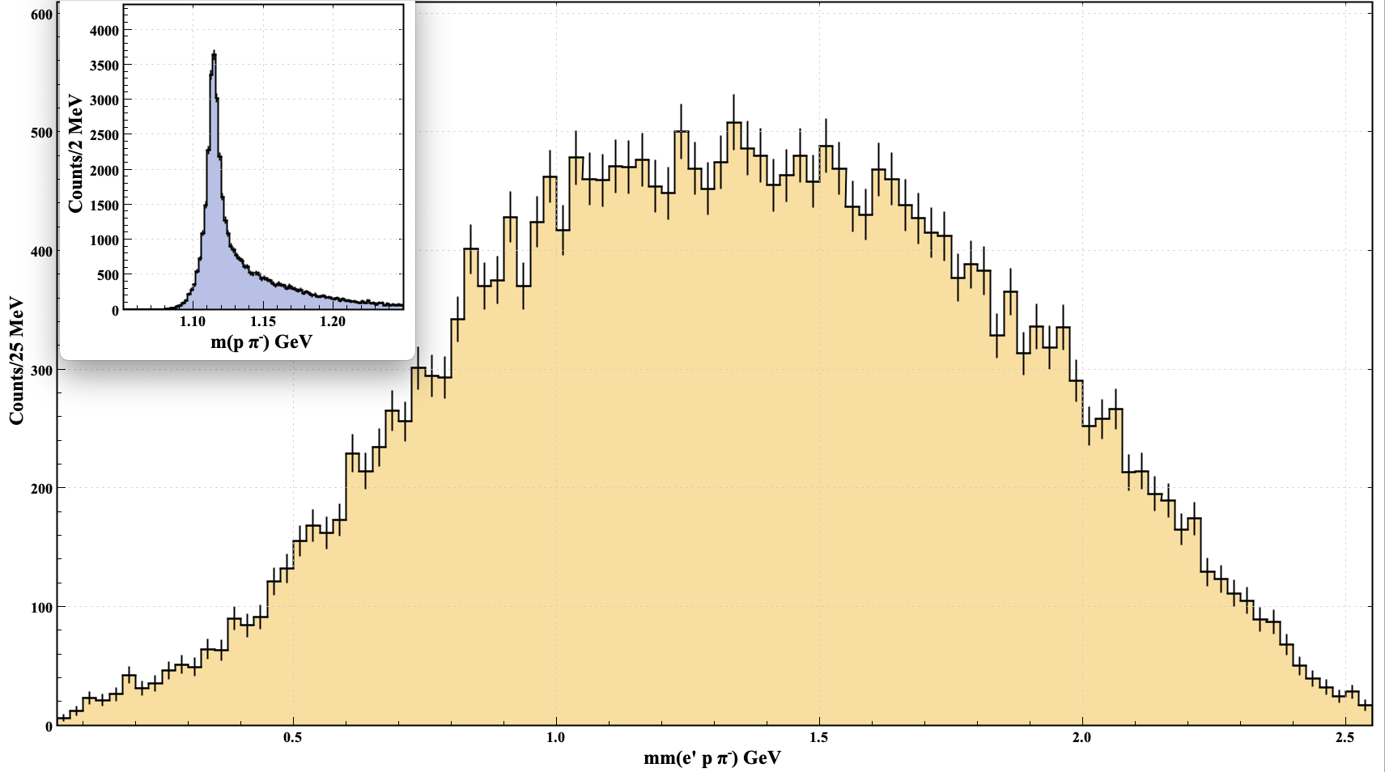
Outlook
Try to identify which reaction is responsible for the BSA sign flip in the CFR
  A lot more statistics needed
  Use nuclear target data (RGC), deuteron target data (RGB)
Analysis combining different datasets
  Different data sets with different beam energies → combining distributions to be taken into consideration
  → different targets possibly requiring different
  background rejection cuts, take Fermi motion* into account
RGK 6.5+7.5 GeV
LH
RGC Fall+Summer22
NH₃
* Fermi motion (not taken into account) affects MM
RGK analysis consistent with RGA ep→e’ΛK⁺ results
  Dominant kaon contribution
RGC analysis indicative of possible sign flip evidenced in RGA analysis when kaon contribution is suppressed
18

Slide 19
BACKUP SLIDES

Slide 20
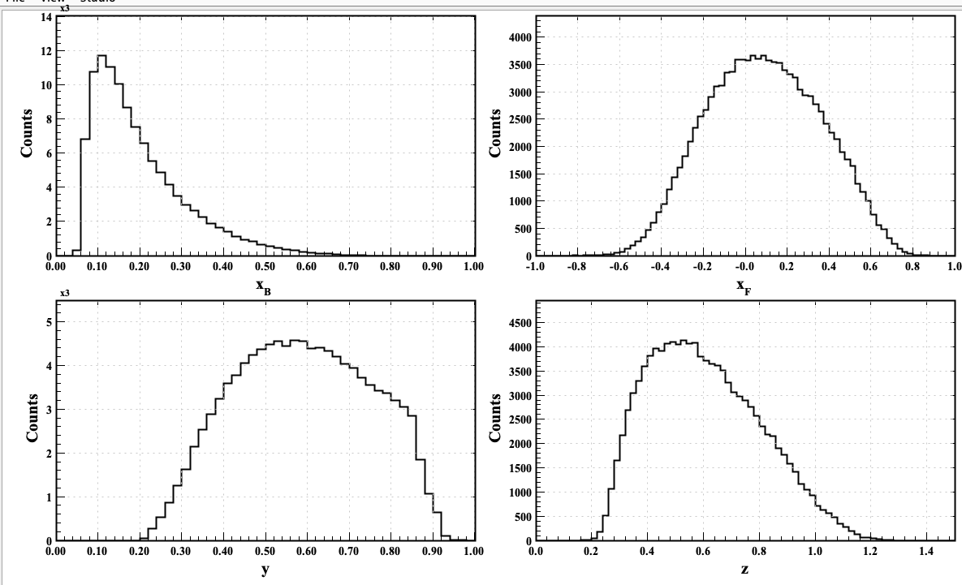
DIS Variables
20

Slide 21
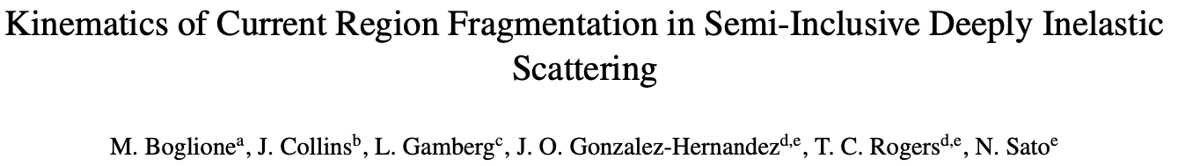
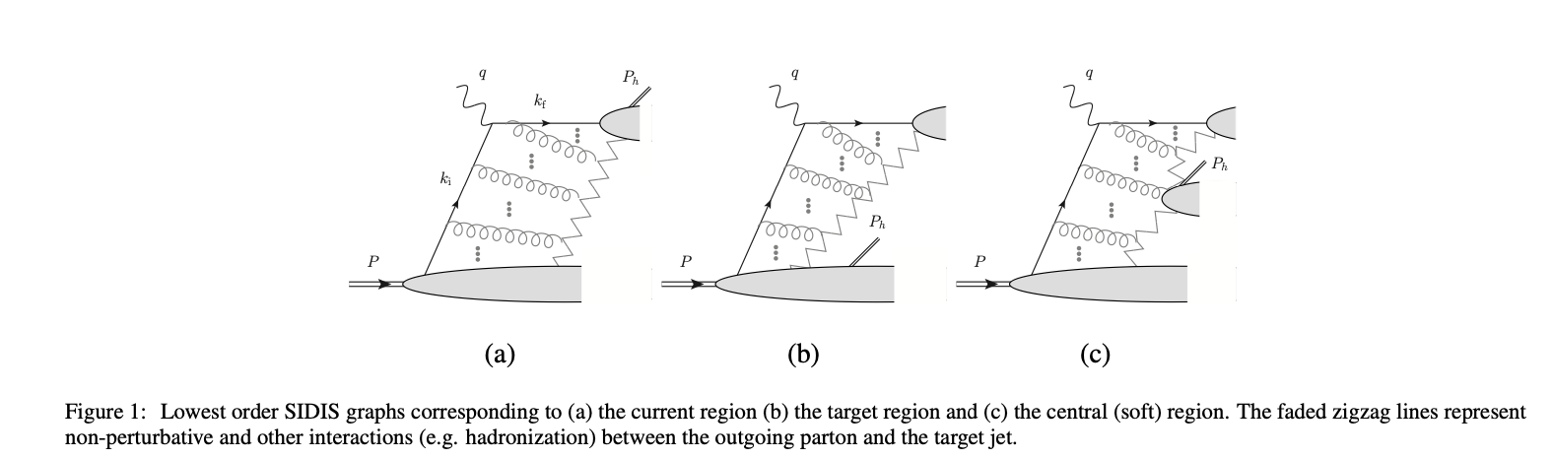
Fragmentation Processes
21

Slide 22
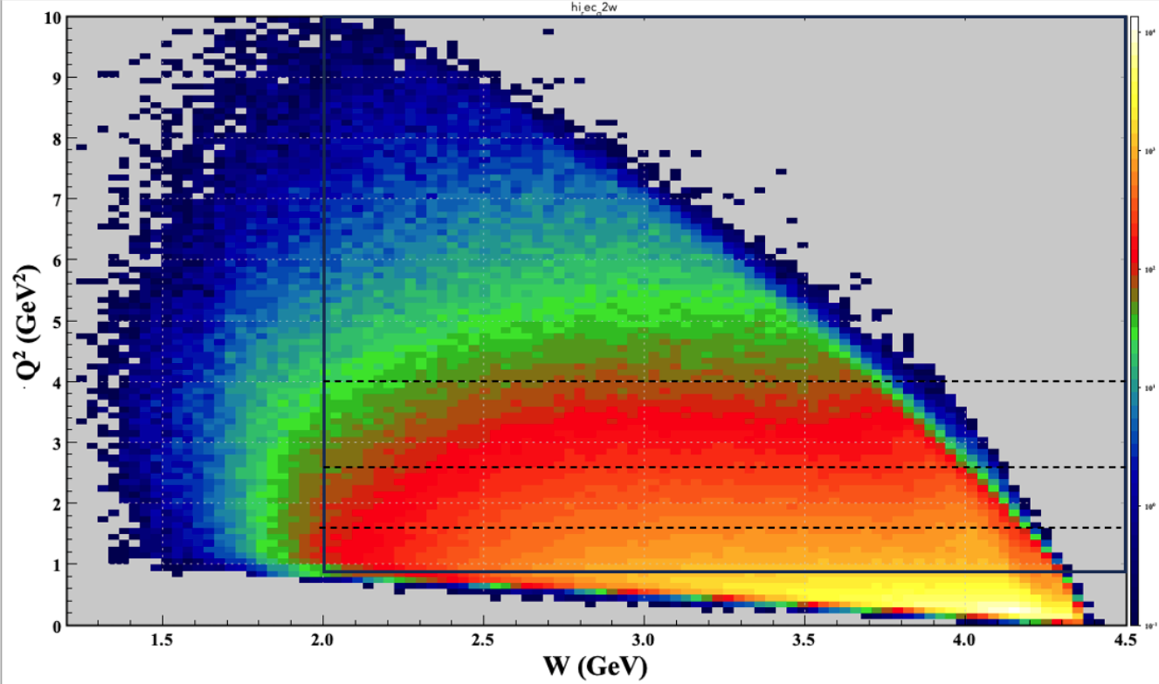
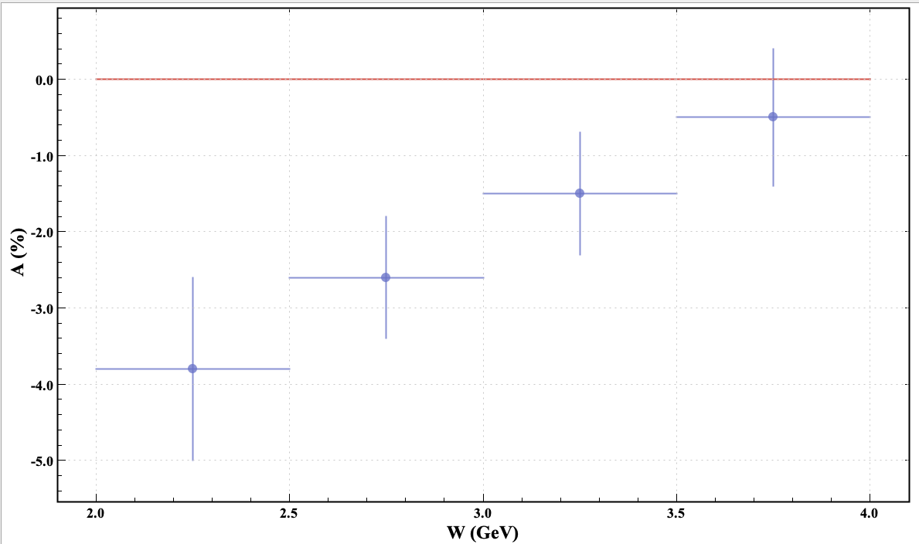
BSA as a Function of W and Q²
Selected range: 1 < Q² <10 GeV²; 2< W < 4.5 GeV
22

Slide 23
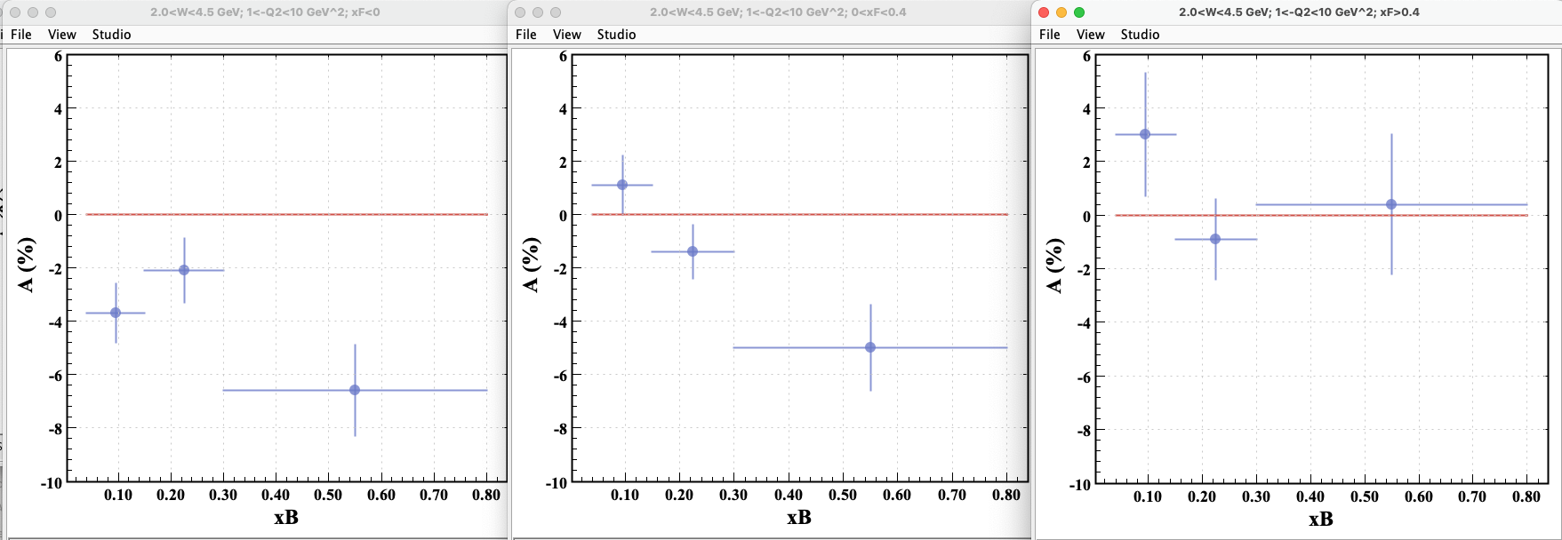
BSA as a Function of x_{B}
BSA as a function of x_{B} in Target and Current regions
TFR
CR
CFR
23

Slide 24
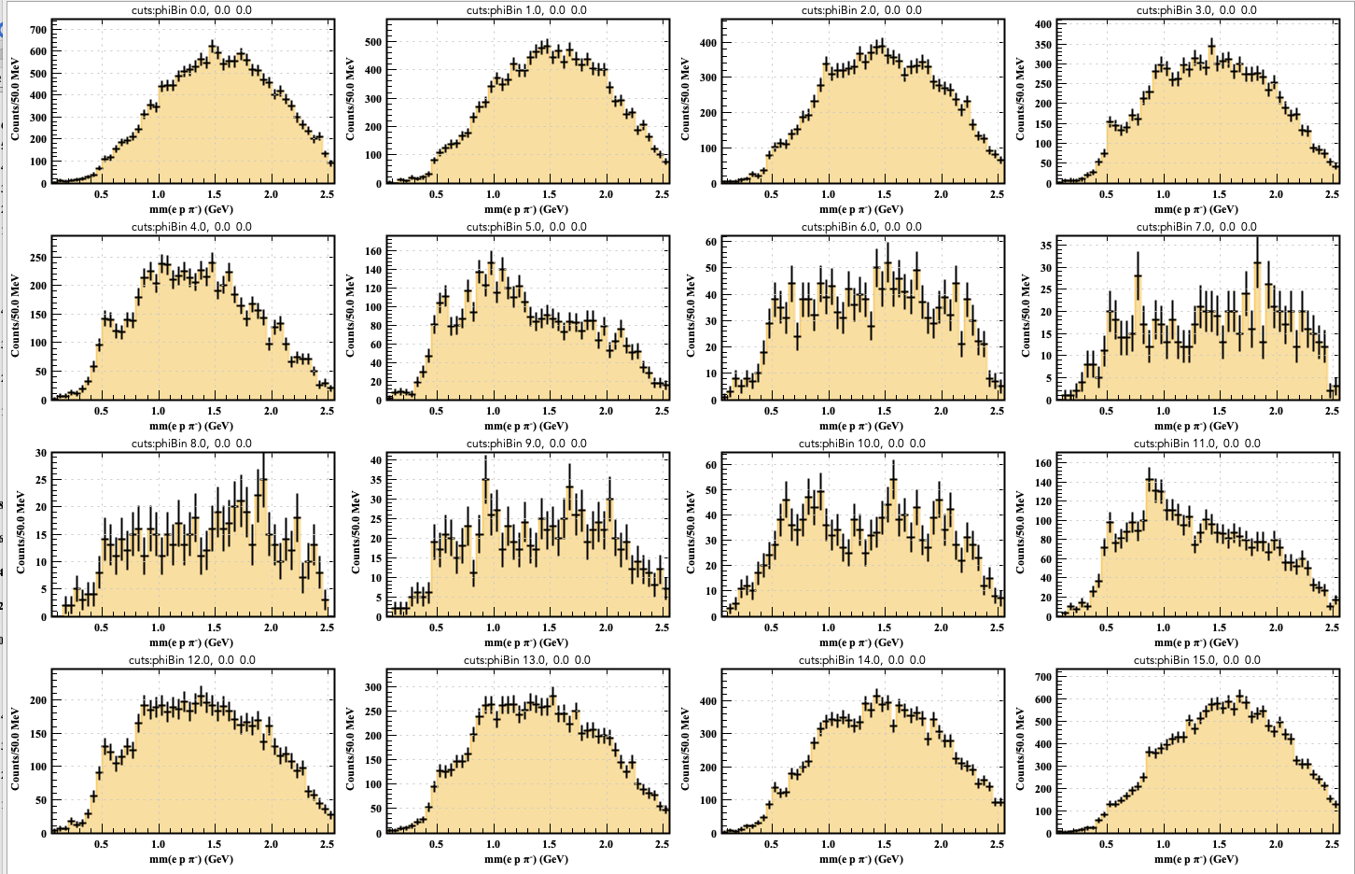
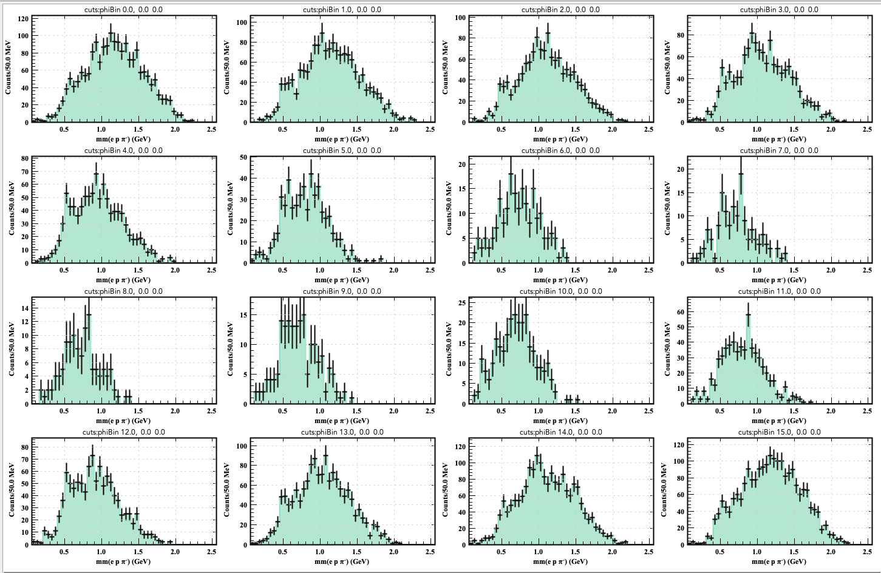
K(*)⁺ Contributions in the CFR
1 < Q² < 10 GeV²; 2 < W < 4.5 GeV; 0 < x_{B} < 1
All Fragmentation Regions
CFR
Enhanced K* contributions
24

Slide 25
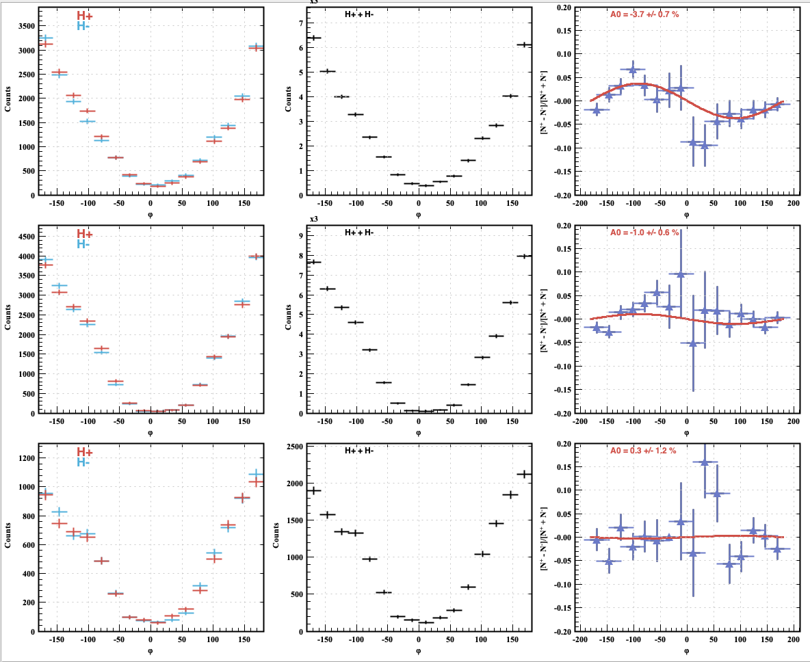
BSA as in 3 Fragmentation Regions
TFR
1 < Q² <10 GeV² 2 < W < 4.5 GeV
CR
CFR
~ flat in CFR
25

Slide 26


BSA as in 3 Fragmentation Regions [over all x_{B}]
TFR
CR
CFR
MM spectra in 3 fragmentation regions for each bin in φ_{Λ} of the BSA distributions
Bins corresponding to f = A sinφ extrema
26

