Slide 1
High Luminosity Upgrade of CLAS12
Rafayel Paremuzyan
CLAS collaboration meeting, Nov 12-15, 2024, Jefferson Lab

Slide 2
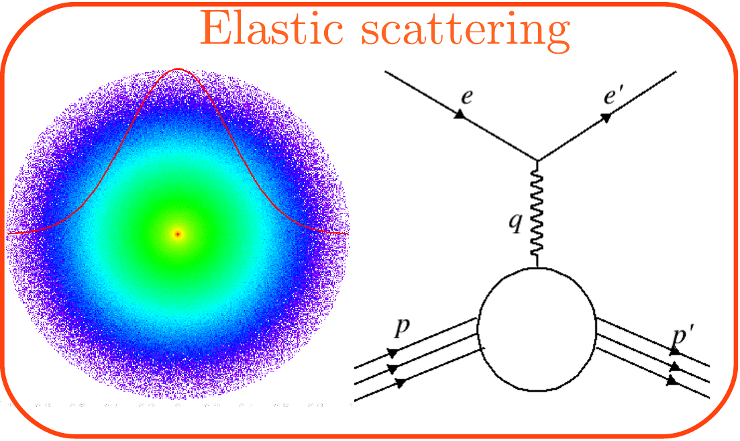
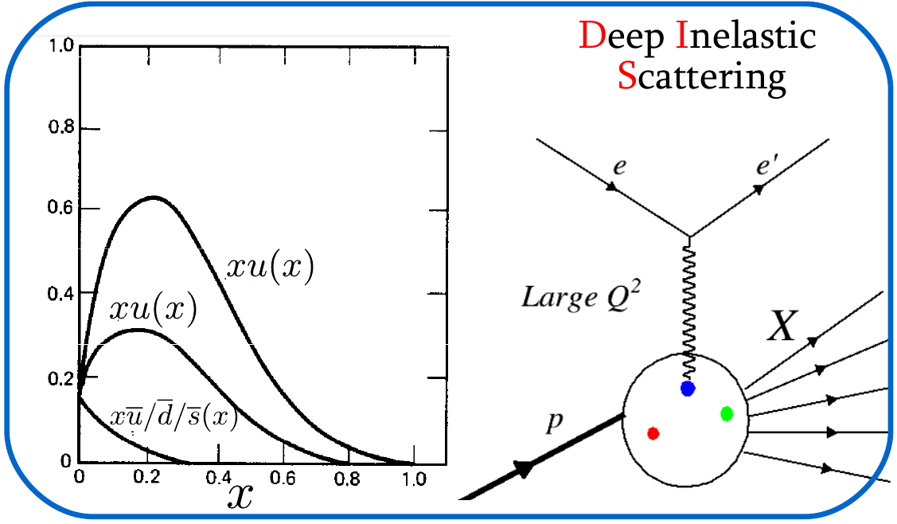
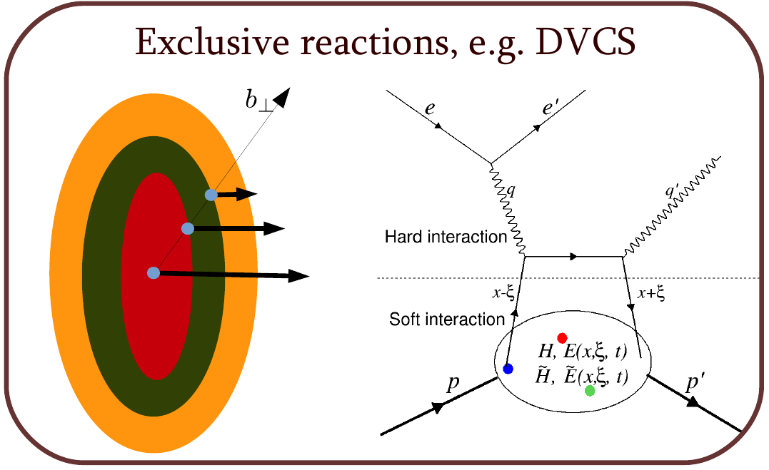
Introduction
A big part of JLab 6 GeV and 12 GeV experiments is devoted to the nucleon structure studies through Generalized Parton Distributions.
Hard Exclusive processes
GPDs combine aspects of elastic form factors and PDFs.
Depend on three variables, x, 𝜉, and t.
Accessible through deep exclusive reactions
More than a dozen of completed and planned experiments in Halls A, B and C

Slide 3
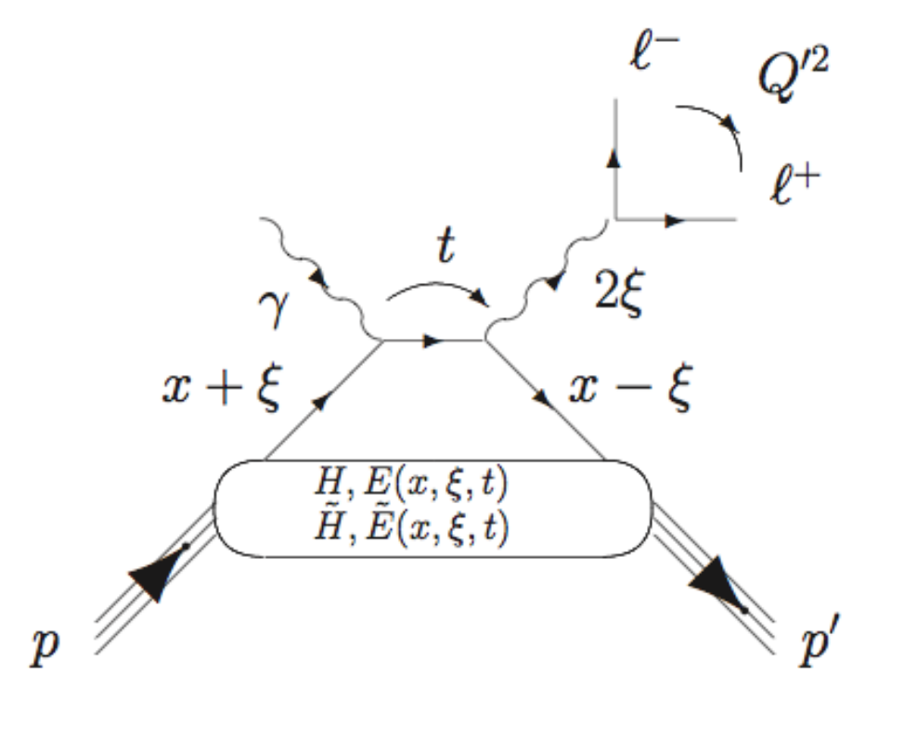
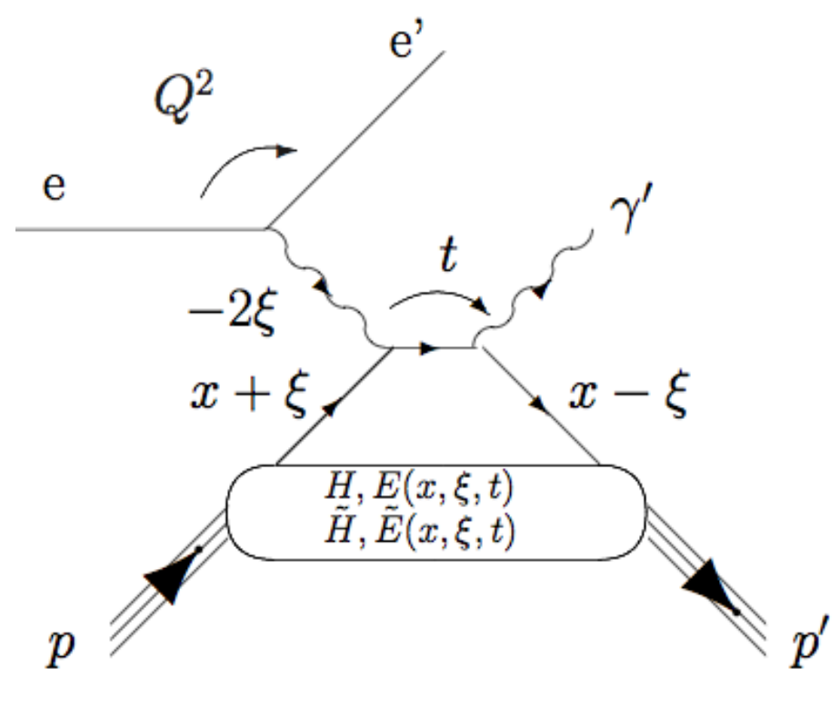
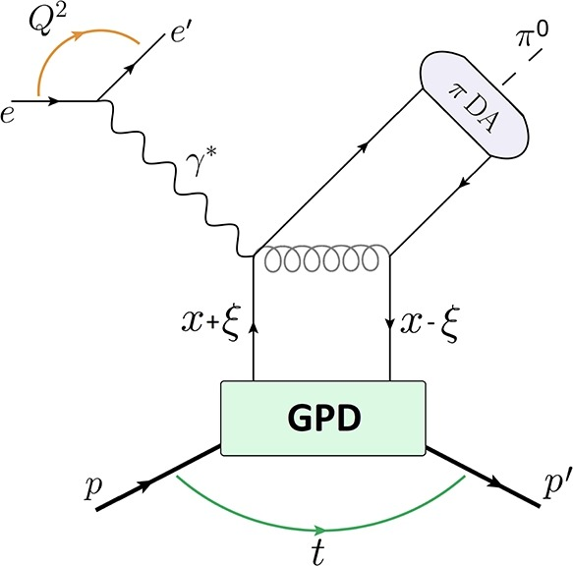
Hard exclusive reactions experimentally studied at JLab
DVCS
DVMP
TCS
Few of recent representative publications
DVCS
DVMP
TCS
DVCS on Neutron e-Print: 2406.15539
DVCS on proton: Phys.Rev.Lett. 130 (2023) 21
DVCS x-sec in Hall-A: in: Phys.Rev.Lett. 128 (2022) 25, 252002
DVMP π⁰ with CLAS12: Phys.Lett.B 849 (2024) 138459
DVMP π⁰ in Hall-A: Phys.Rev.Lett. 127 (2021) 15, 152301
Phys. Rev. Lett. 127, 262501, arXiv:2108.11746
Lots of measurements are published: beam and target spin symmetries, x-sec, different targets etc.
Extraction of GPDs from those measurements is not a trivial task...

Slide 4
How to access GPDs experimentally
DVCS
DVCS/TCS amplitudes are proportional to
Same for (H̃, E, Ẽ)
GPDs enter observables as an integral over x, with an exception when the observable is proportional to the Im part of the scattering amplitude.
There one access GPDs at x=𝜉
Certainly, an important gain of information, however, not enough to independently map out GPDs.
TCS
The way to avoid integration over x outside the x=𝜉 phase space is DDVCS, which allows mapping GPDs along all three variables (x, 𝜉, and t) independently.

Slide 5
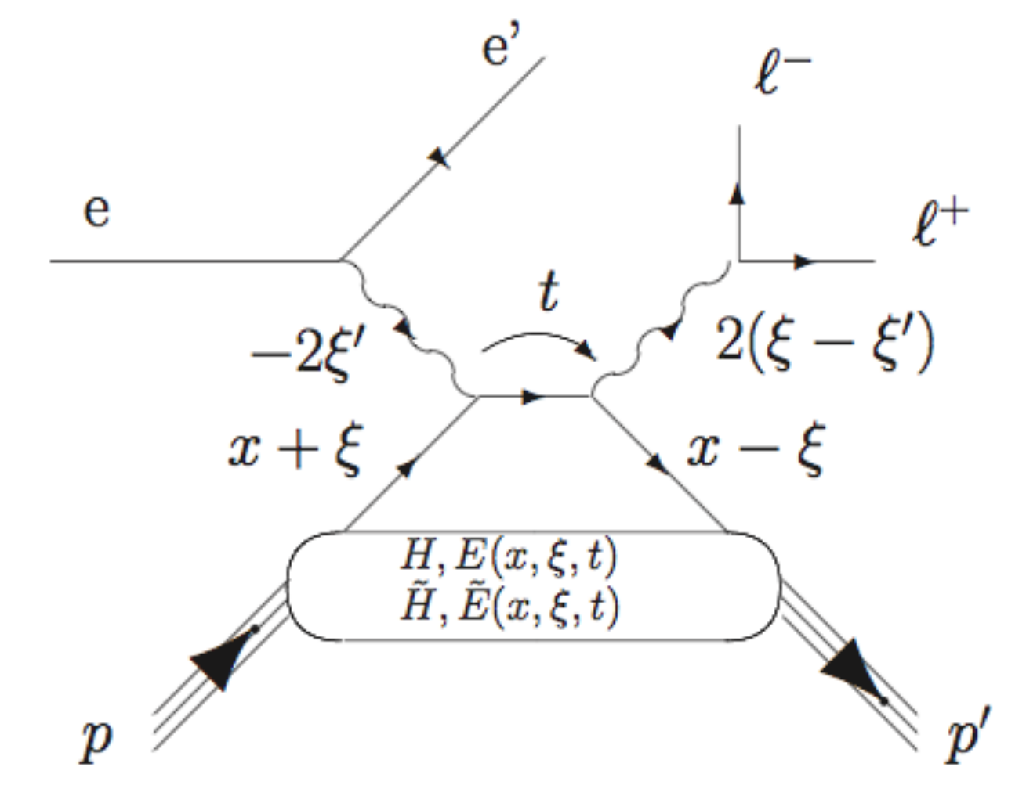
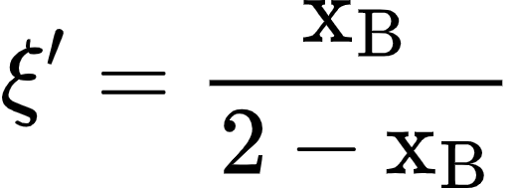
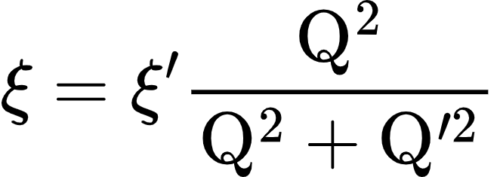
Double DVCS
Kinematics of two photons are described by 𝜉 and 𝜉'.
Q²<Q^{’2}
Q²>Q^{’2}
x=-𝜉
x=𝜉
Quark propagators between two photons now reads as:
Observables (e.g. BSA) proportional to the Im part of the amplitude, allow direct measurement of GPDs at (x=2𝜉' - 𝜉, 𝜉, t) points.
Here one can get away from the x=𝜉 line by varying virtualities of incoming and outgoing photons

Slide 6
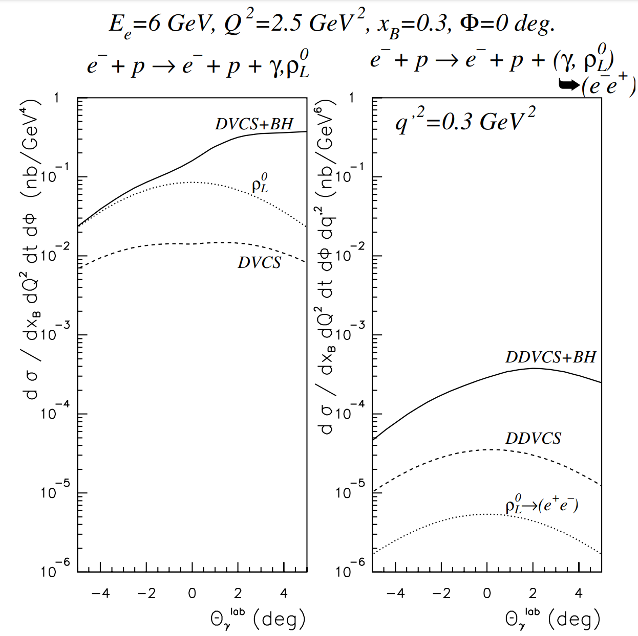
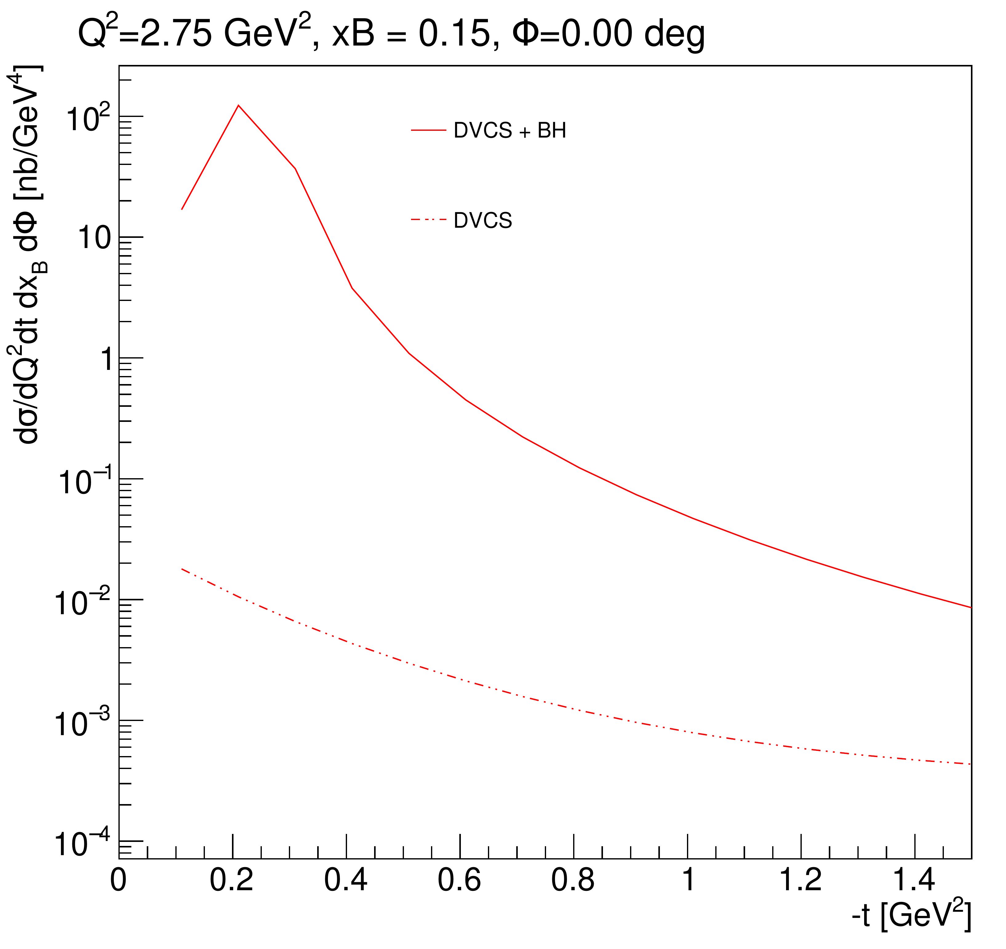
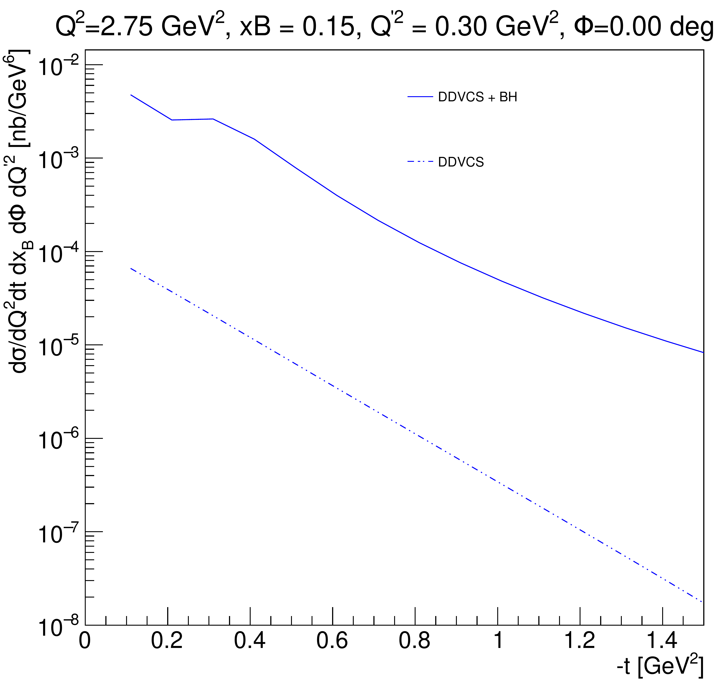
Cross-sections
The downside of the DDVCS is it involves an additional 𝛼_{e} which makes the DDVCS cross-section 2-3 orders of magnitude smaller than the DVCS cross-section.
With standard CLAS12 detector package it is unrealistic to get sufficient statistics in a reasonable data taking time
12 GeV kinematics
Using M. Guidal's code
Phys.Rev.Lett. 90 (2003) 012001
Luminosity upgrade is a must for a DDVCS measurement.

Slide 7
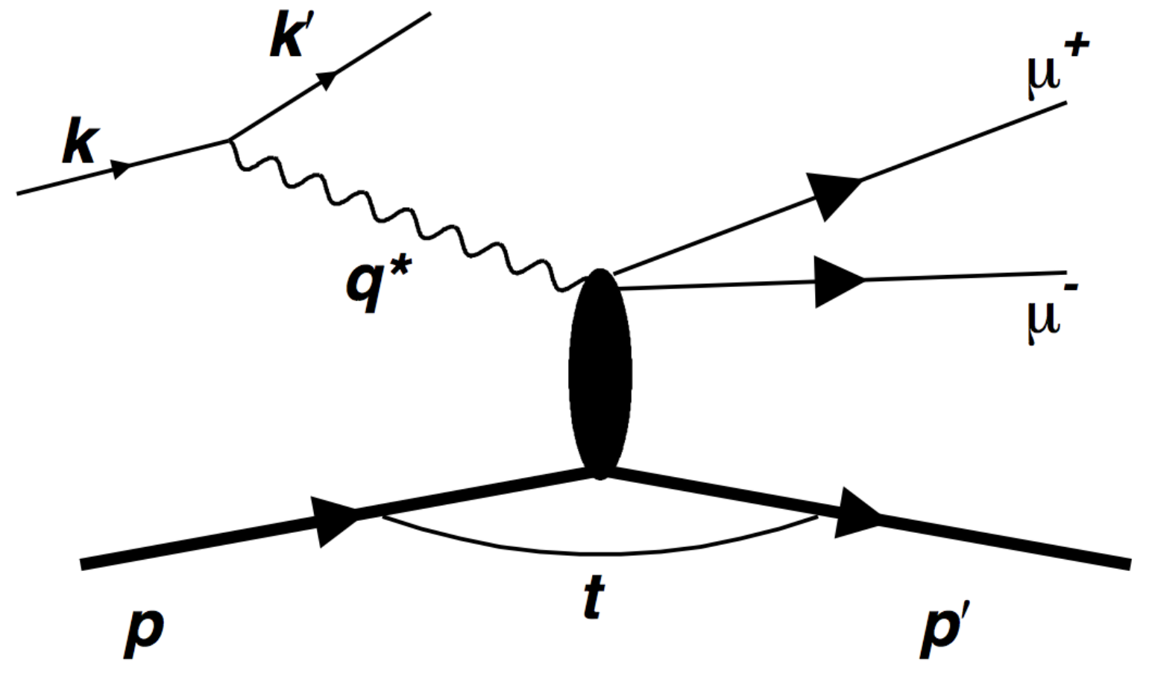
The proposed measurement
The reaction of interest is ep → e′𝝁⁻𝝁⁺p
Based on LOI12-16-004
The timelike photon is identified through the detection of 𝝁⁻𝝁⁺ pair (to avoid the Interference between the beam and the decay electron.)
Requires a muon detection
Proposed Luminosity: 10³⁷ cm⁻²s⁻¹.
We plan to detect at least e′𝝁⁻𝝁⁺, and the proton kinematic will be deduced from the missing momentum analysis, if proton is outside of the acceptance.

Slide 8
Detector configuration
Detector should handle luminosities 10³⁷ cm⁻²s⁻¹.
Main limiting factor is occupancies in the Drift chamber
Should be able to detect muons
Remove HTCC
Not needed for muon detection
Install a Moeller cone (tungsten material) extending up to 7.5 deg polar angel
To reduce huge rate of Moeller electrons
Add a new PbWO₄ calorimeter that covers 7◦ to 30◦ polar angular range with 2π azimuthal coverage
To recover electron detection
Next to the PbWO₄ calorimeter add thick tungsten shield/absorber covering the full FD region
To absorb all electromagnetic and hadronic background originating from the target.
Install new MPGD detectors in front of and around the calorimeter
To be able to reconstruct vertex parameters (angles and positions)

Slide 9
Transformation from CLAS12 to 𝝁CLAS12
Animation created by https://ezgif.com
Drawings by Bob Miller

Slide 10
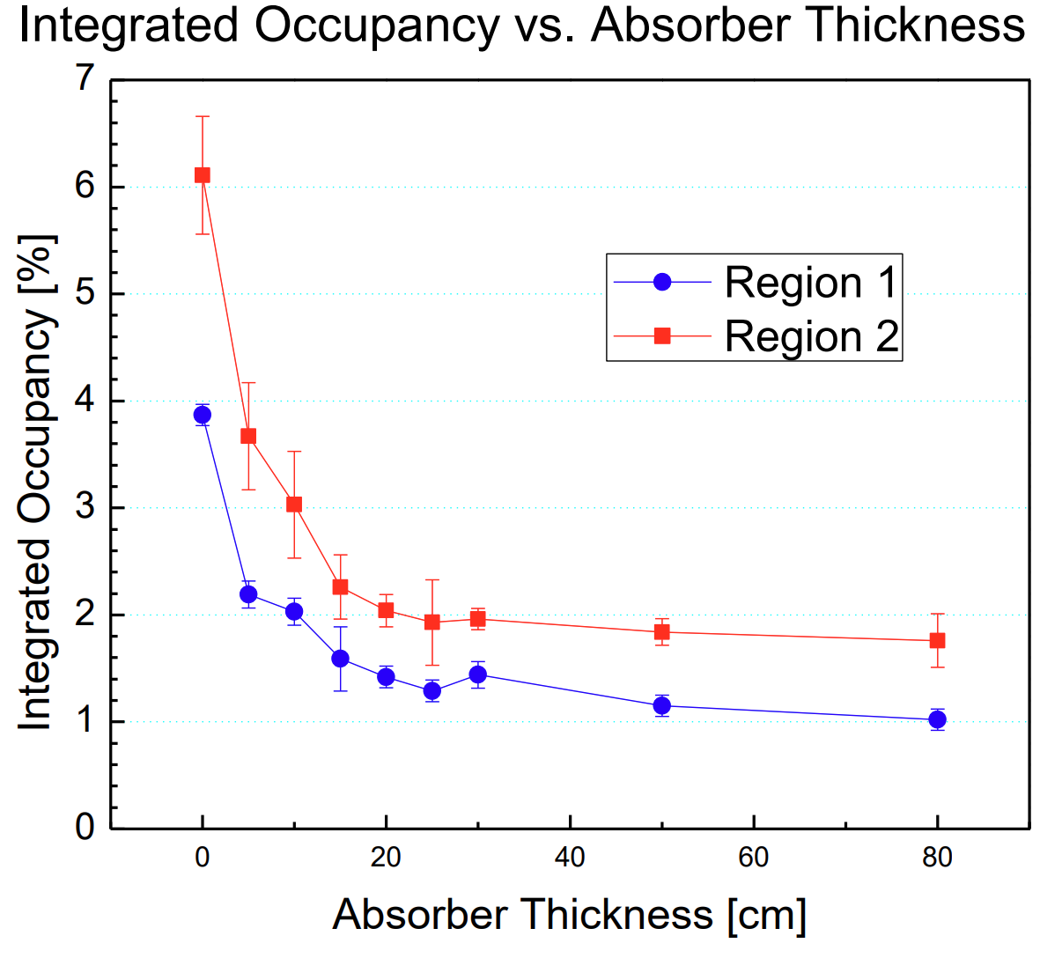
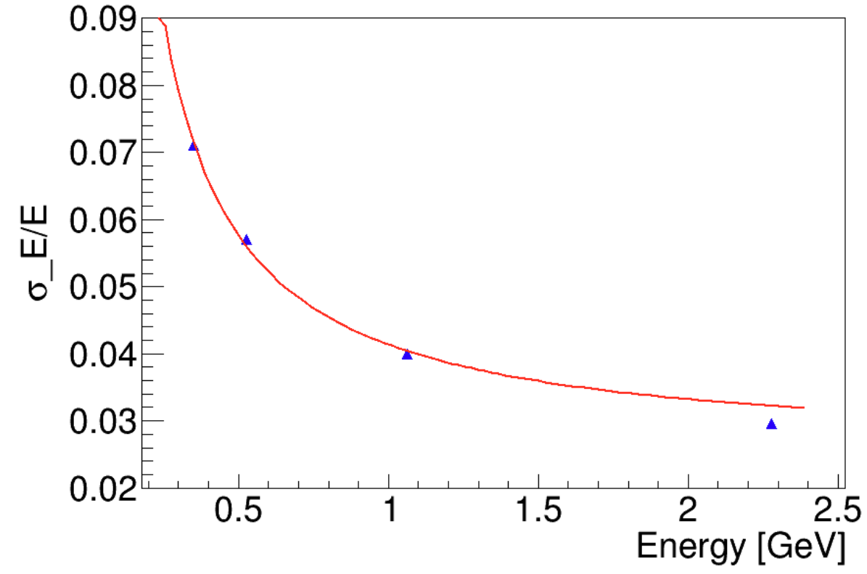
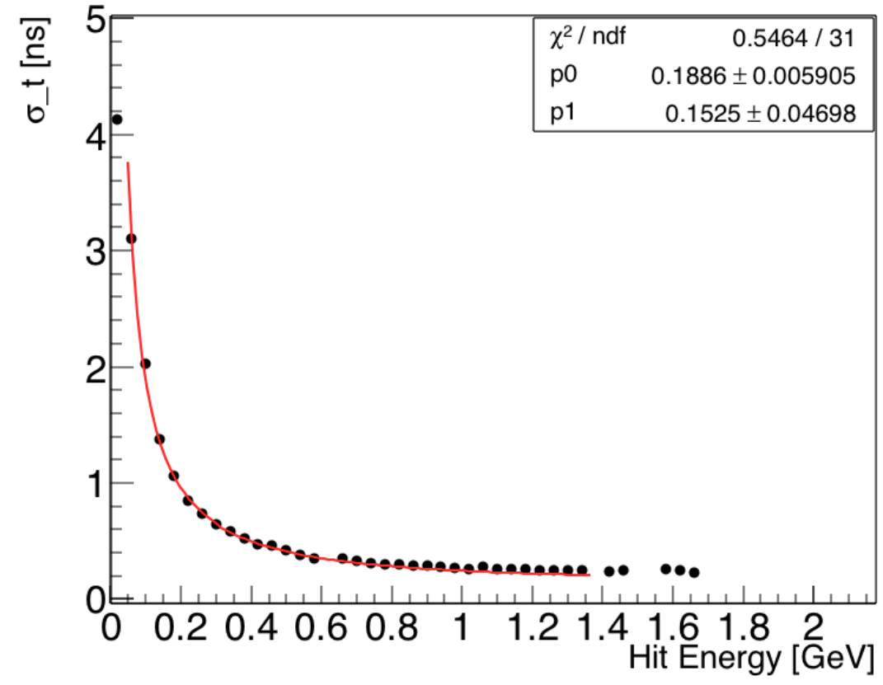
Particle Rates
An absorber with a thickness of 30 cm was used to bring DC occupancies to an acceptable level.
Rates were studied for protons, pions, electrons and photons by placing a scoring plane between 4.8° and 35° at 40 cm from the target.
The tot rate from all particles at 5° is less than 0.5 MHz/cm².
Trigger rate:
Requiring 5 hits FDC AND MIP signature in calorimeter have 75/95 KHz for positive/negative single tracks:
Using a 50 ns coincidence time this translates into about 360 Hz
Electromagnetic calorimeter
Serves as an additional shielding for EM background.
7◦ – 12◦, crystals are 13 mm x 13 mm to keep rates per crystal at an acceptable level
Above 12◦, crystals 20mm x 20 mm will be used
Readout: APD from the downstream face of crystals
Similar crystals and readout were used during the DVCS calorimeter, and HPS electromagnetic calorimeter
Expected rates at 7◦ is around 1.5 MHz
Similar rates were observed in HPS experiment on close to the beam crystals.
HPS time resolution
HPS energy resolution
Rates on MPGD trackers
Highest rates at 7° is less than < 0.6 MHz/cm²

Slide 11
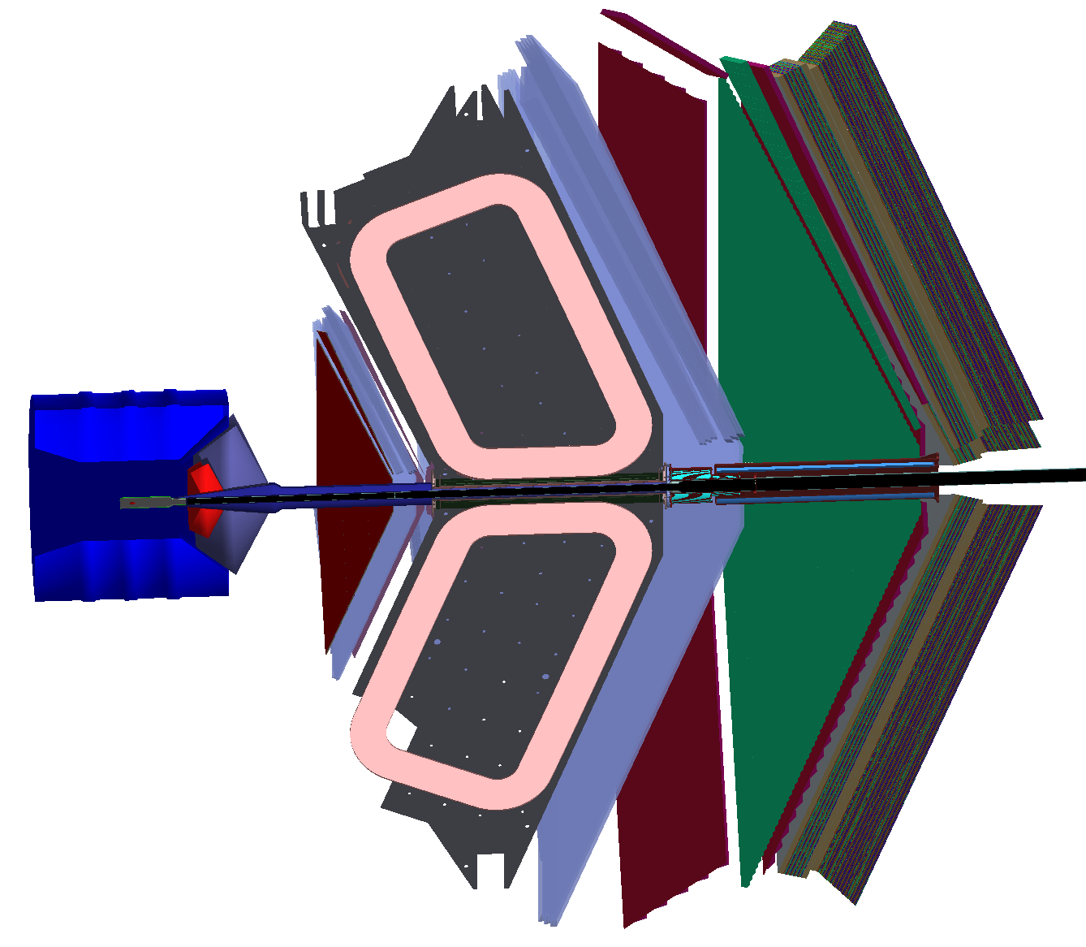
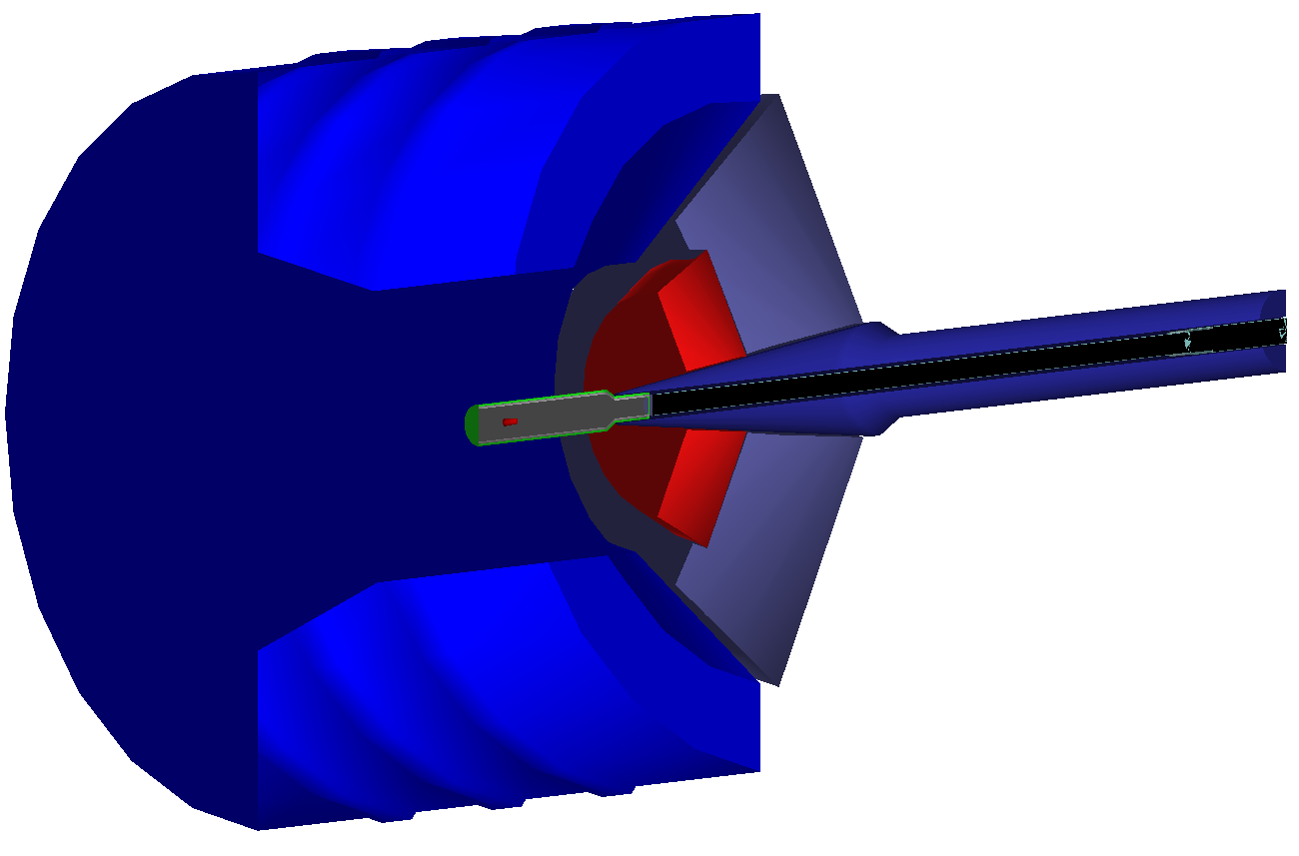
Geant4 simulations
Thanks to Mauri and Raffaella, the DDVCS configuration is now in OSG.
 | 𝜃_{min} [deg] | 𝜃_{max} [deg] | P_{min} [GeV] | P_{max} [GeV]
p | 0 | 180 | 0 | 10.6
e⁻ | 5 | 40 | 0.4 | 10.6
𝜇⁻ | 5 | 40 | 0.5 | 10.6
𝜇⁺ | 5 | 40 | 0.5 | 10.6
E_{b} = 10.6 GeV
Q² [GeV²] (0.9 - 10)
M(𝜇𝜇) > 1.2 GeV²
-t [GeV²] (0.01 - 7)
Events are generated by GRAPE then passed through GEMC using OSG "ddvcs" configuration
Tungsten Shied
Calorimeter

Slide 12
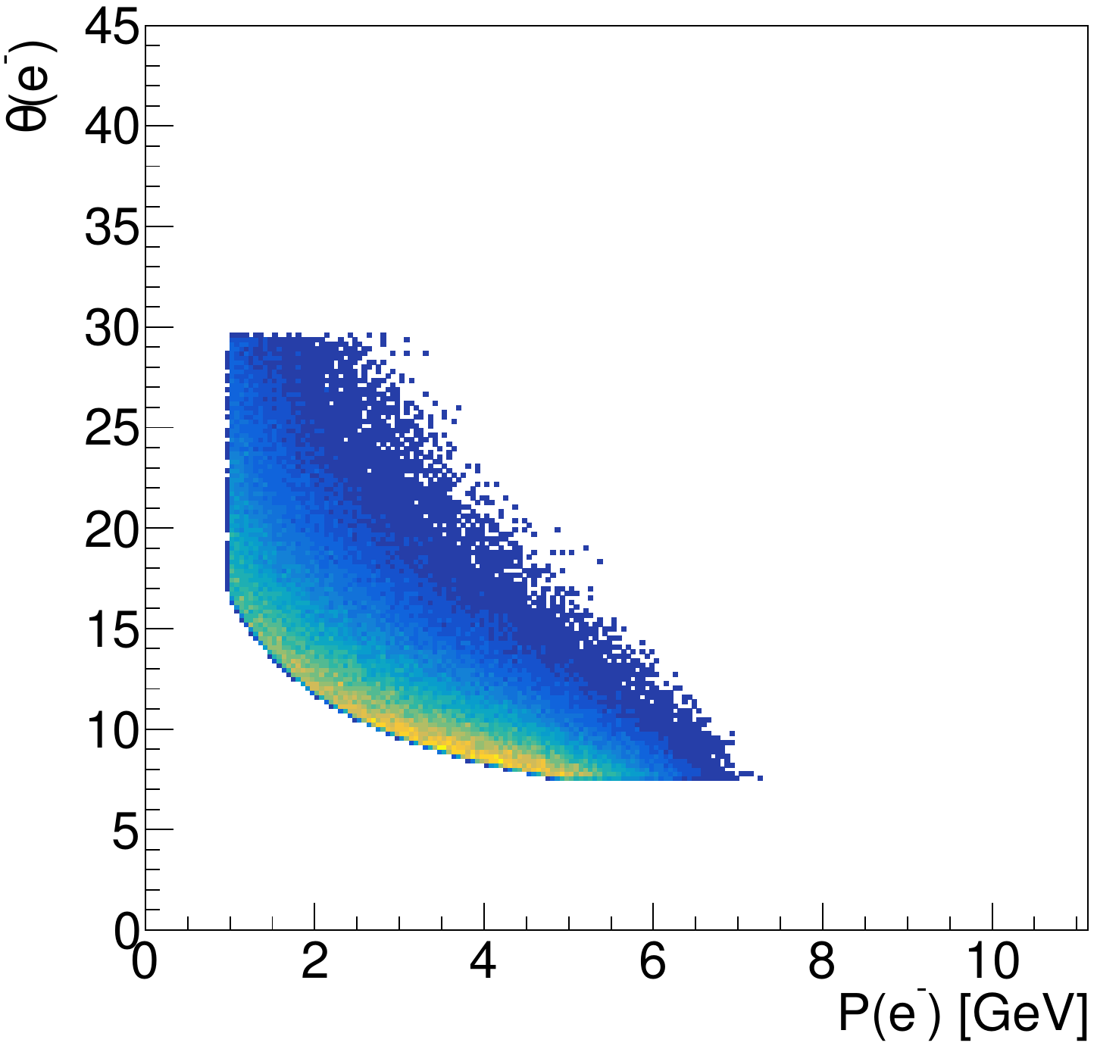
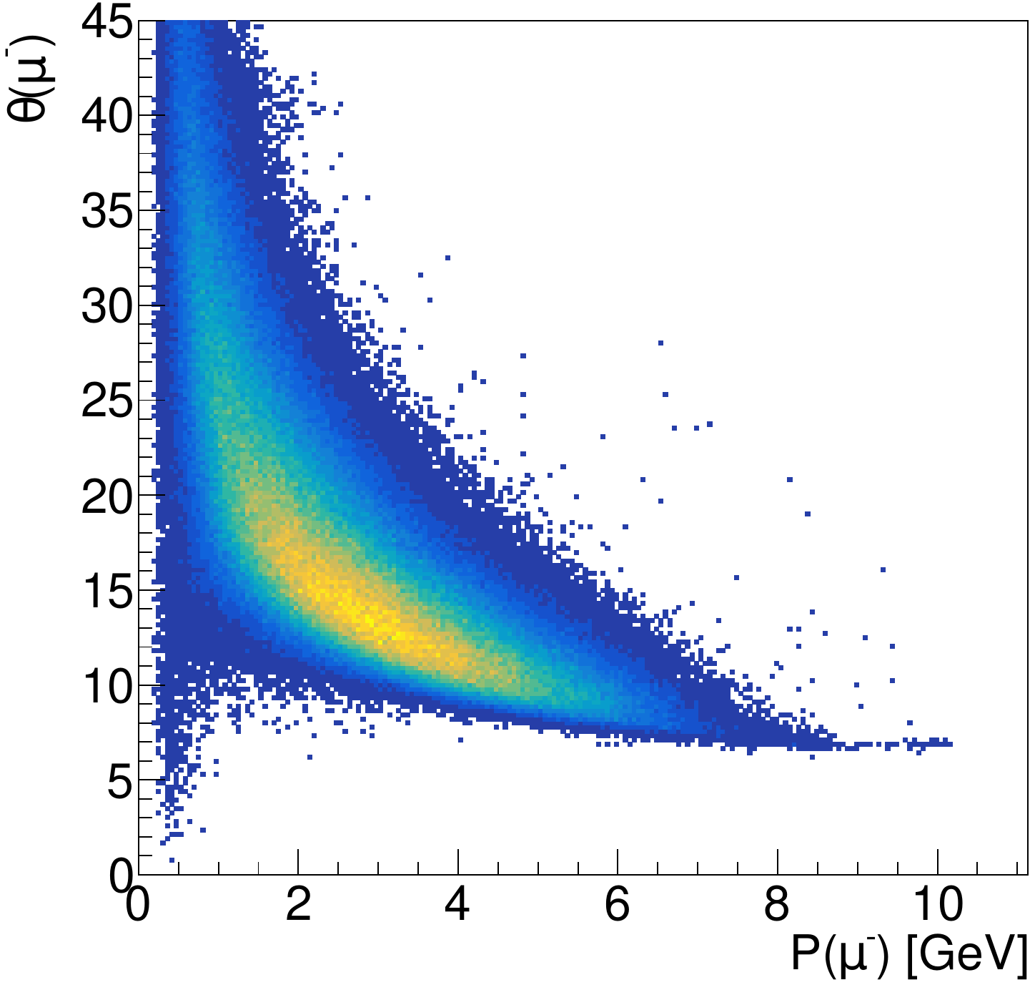
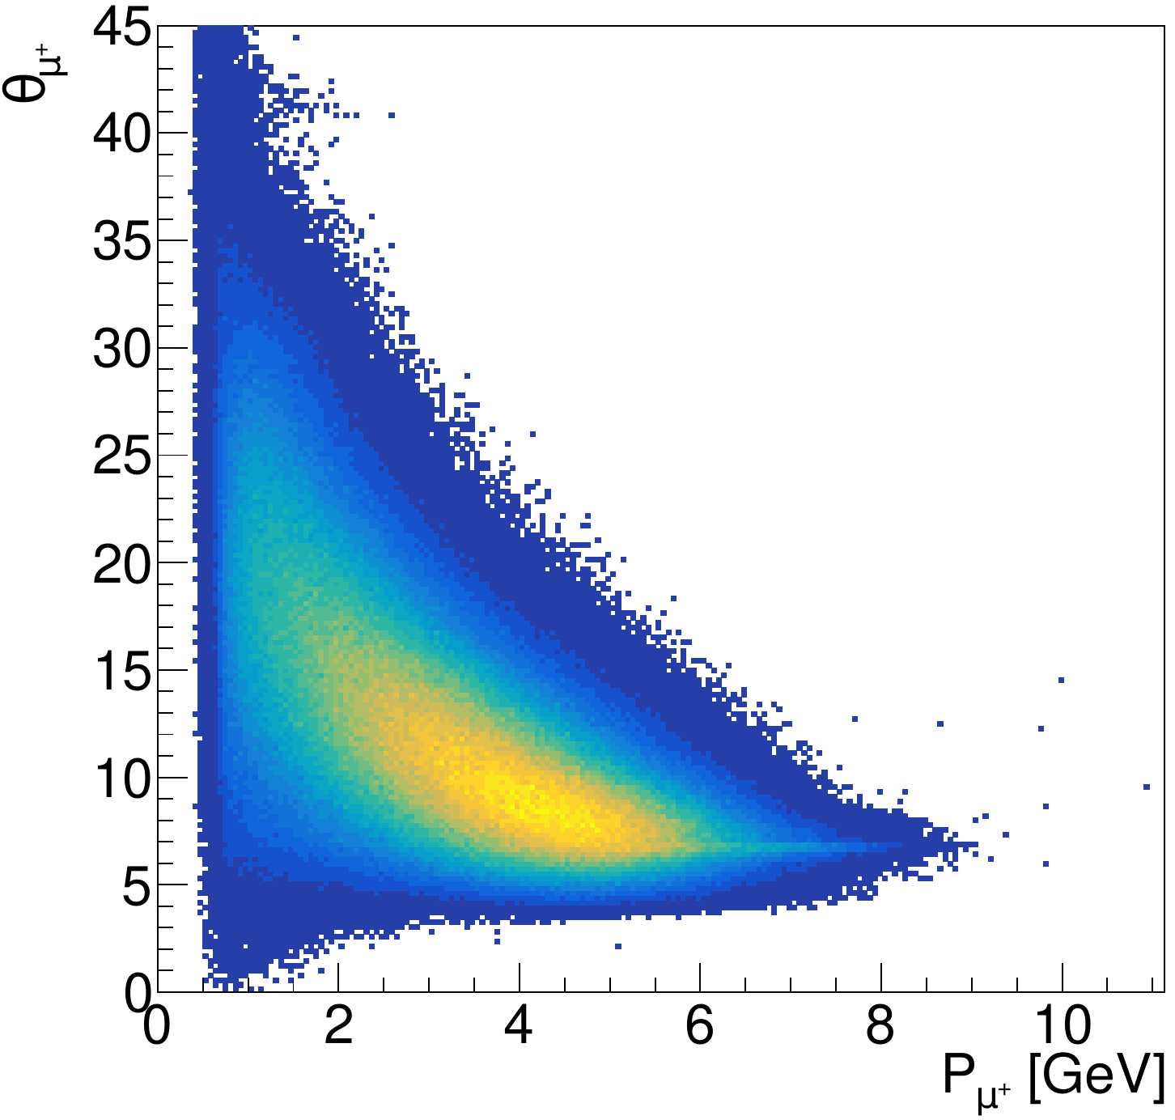
Reconstruction
No proton reconstruction is required
Electron: MC four momentum is used, and just rectangular cuts are applied on P and 𝜃.
1 < P [GeV] < 11
7.5 < 𝜃 [deg] < 29.5
𝜇⁻: pid = -211 or 13
𝜇⁺: pid = 211 or -13
𝜇⁻
𝜇⁺
e⁻​
Q² > 0.9 GeV², Generator cut).

Slide 13
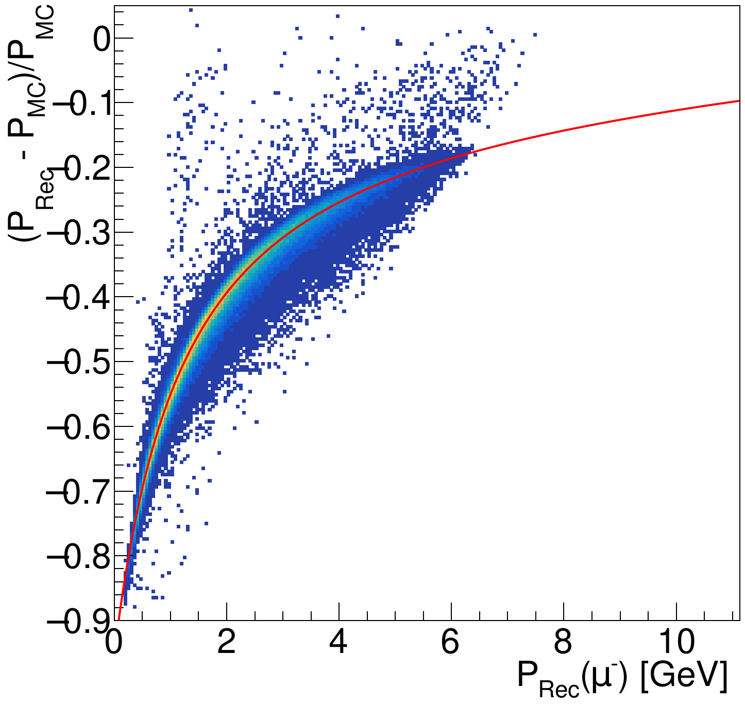
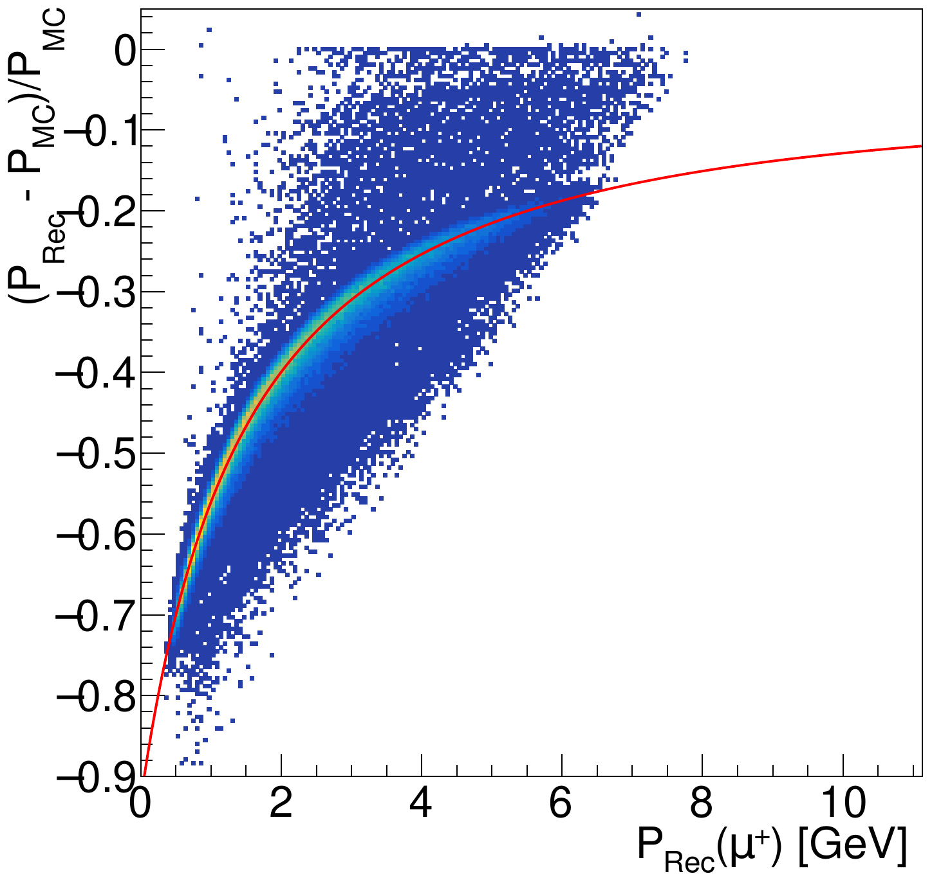
Momentum (Eloss) corrections
Fit function:
𝜇⁻​
𝜇⁺​
Not surprisingly we have a huge energy loss

Slide 14
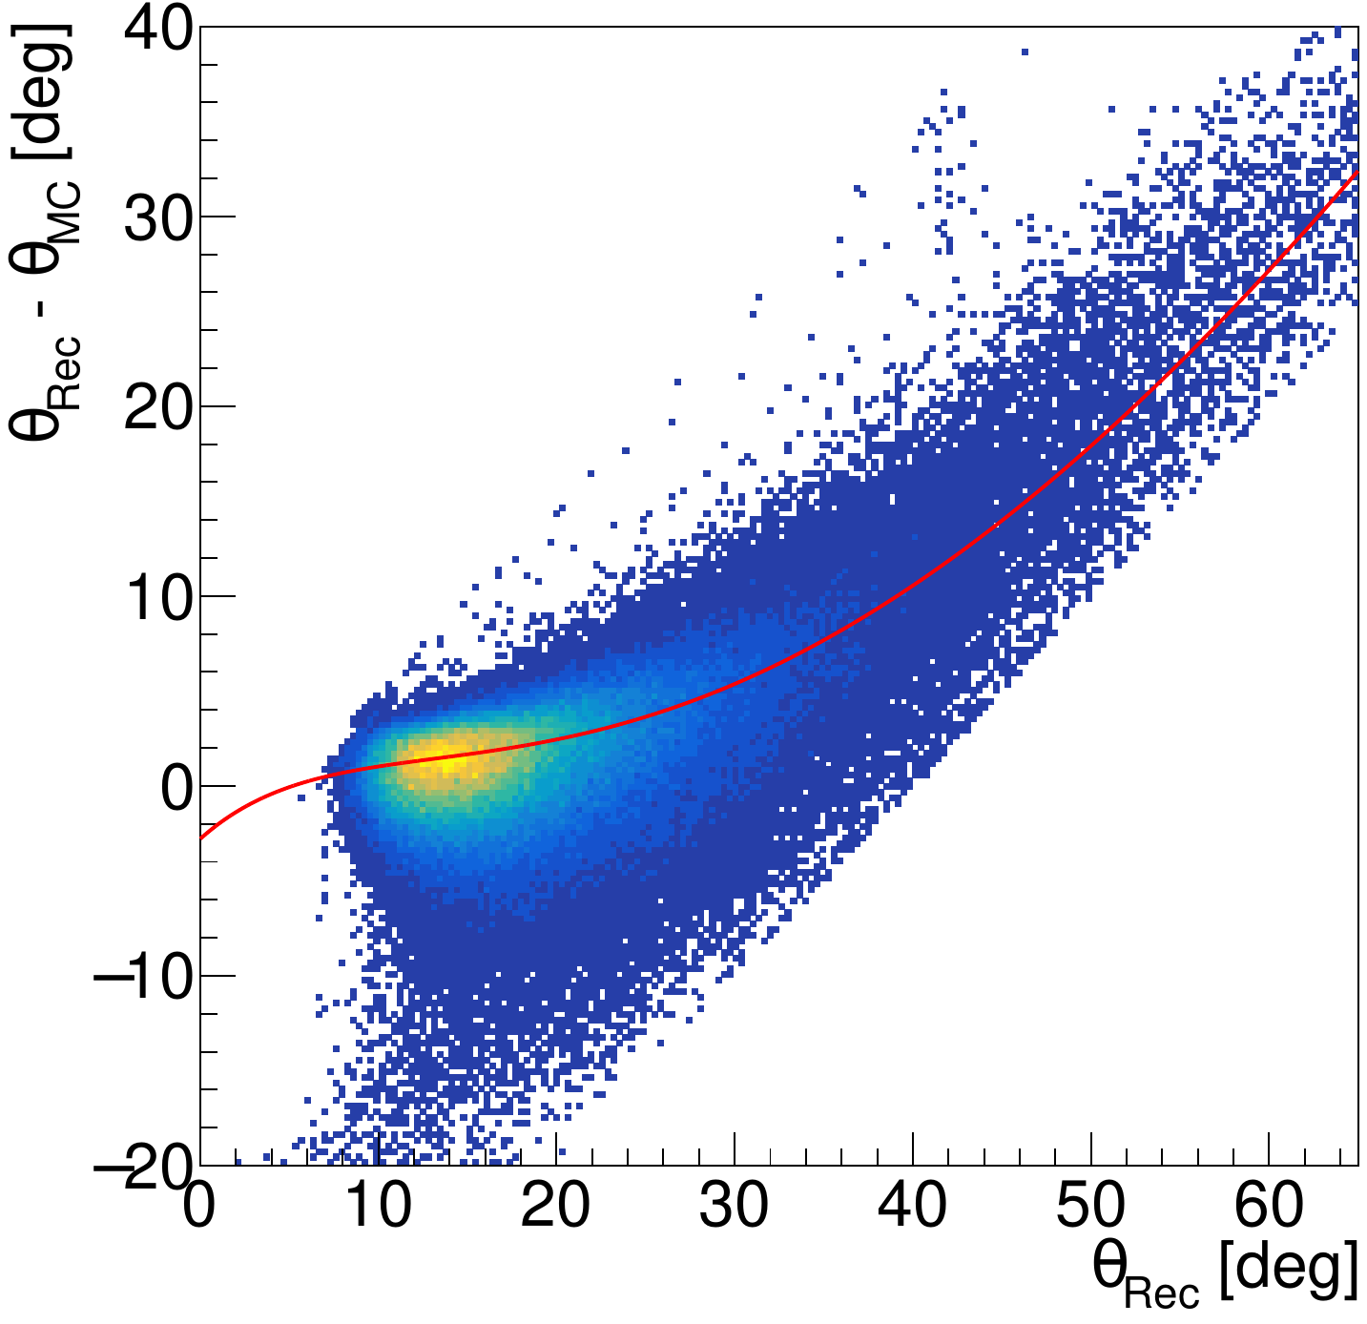
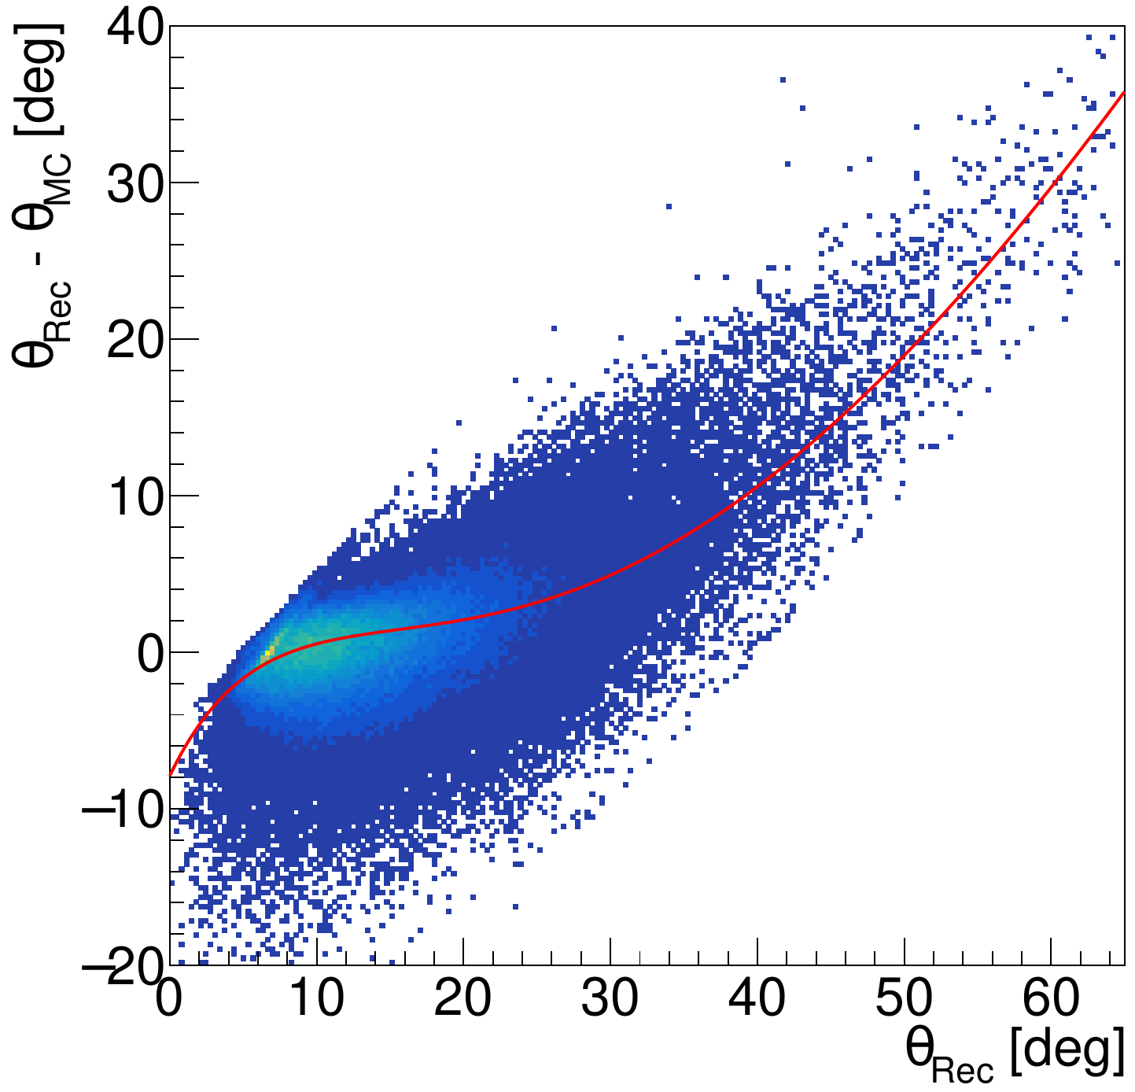
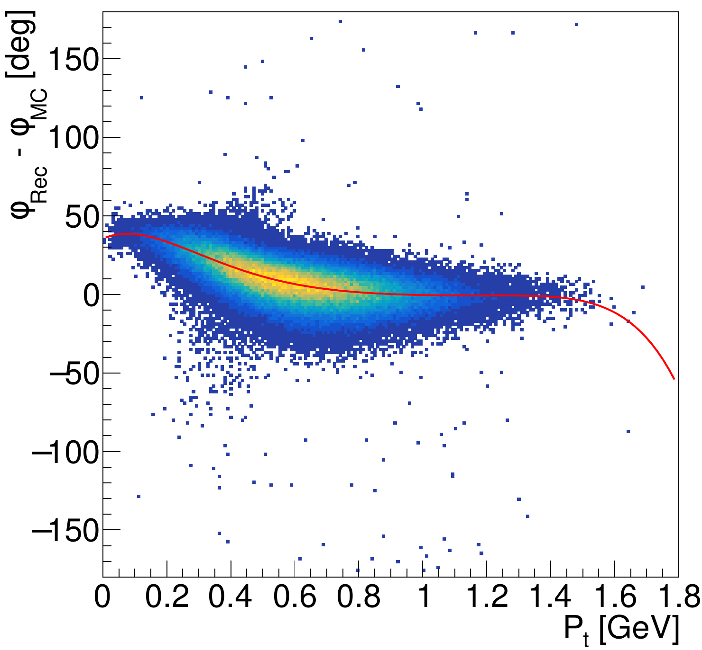
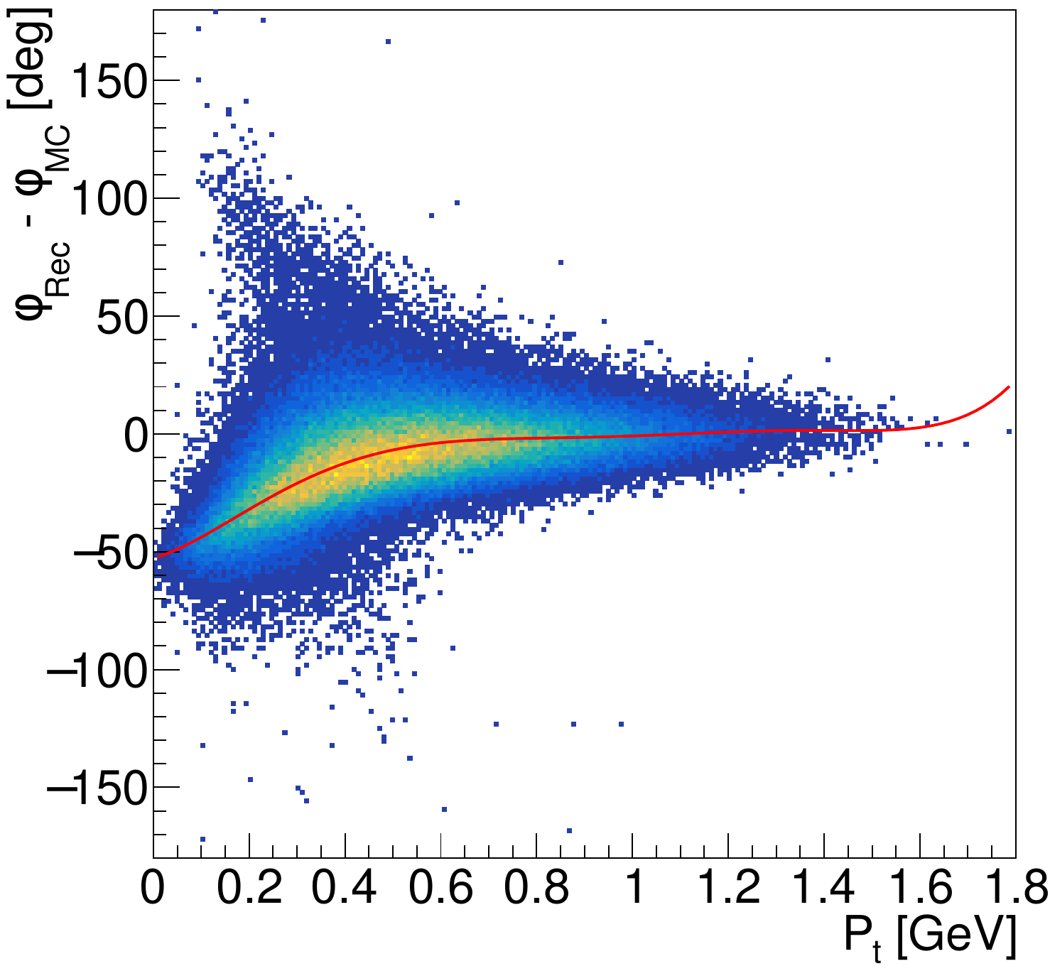
Angular corrections
𝜃 is corrected as a function of 𝜃.
𝜇⁻​
𝜇⁺​​
Fit function
𝜇⁻​​
𝜇⁺​​​
ᵠ is corrected as a function of P_{T}
Fit function

Slide 15
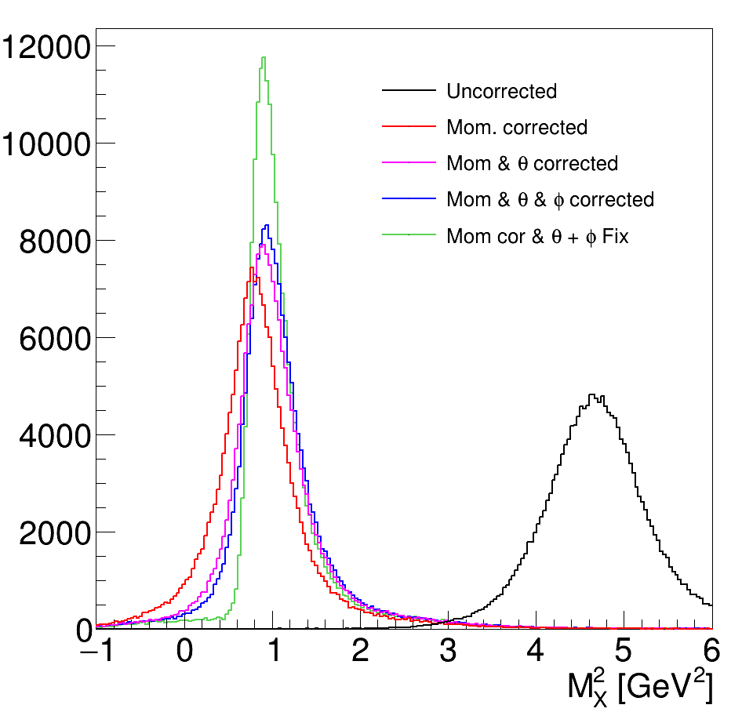
Missing mass
The effect of the momentum correction is huge (as it is expected)
Assuming no vertex detectors, angular corrections also improve the missing mass resolution, but not too much
Installing vertex detectors will significantly improve the missing mass.
See Florian's talk about currently ongoing works on high rate 𝜇RWELL detectors at JLab.

Slide 16
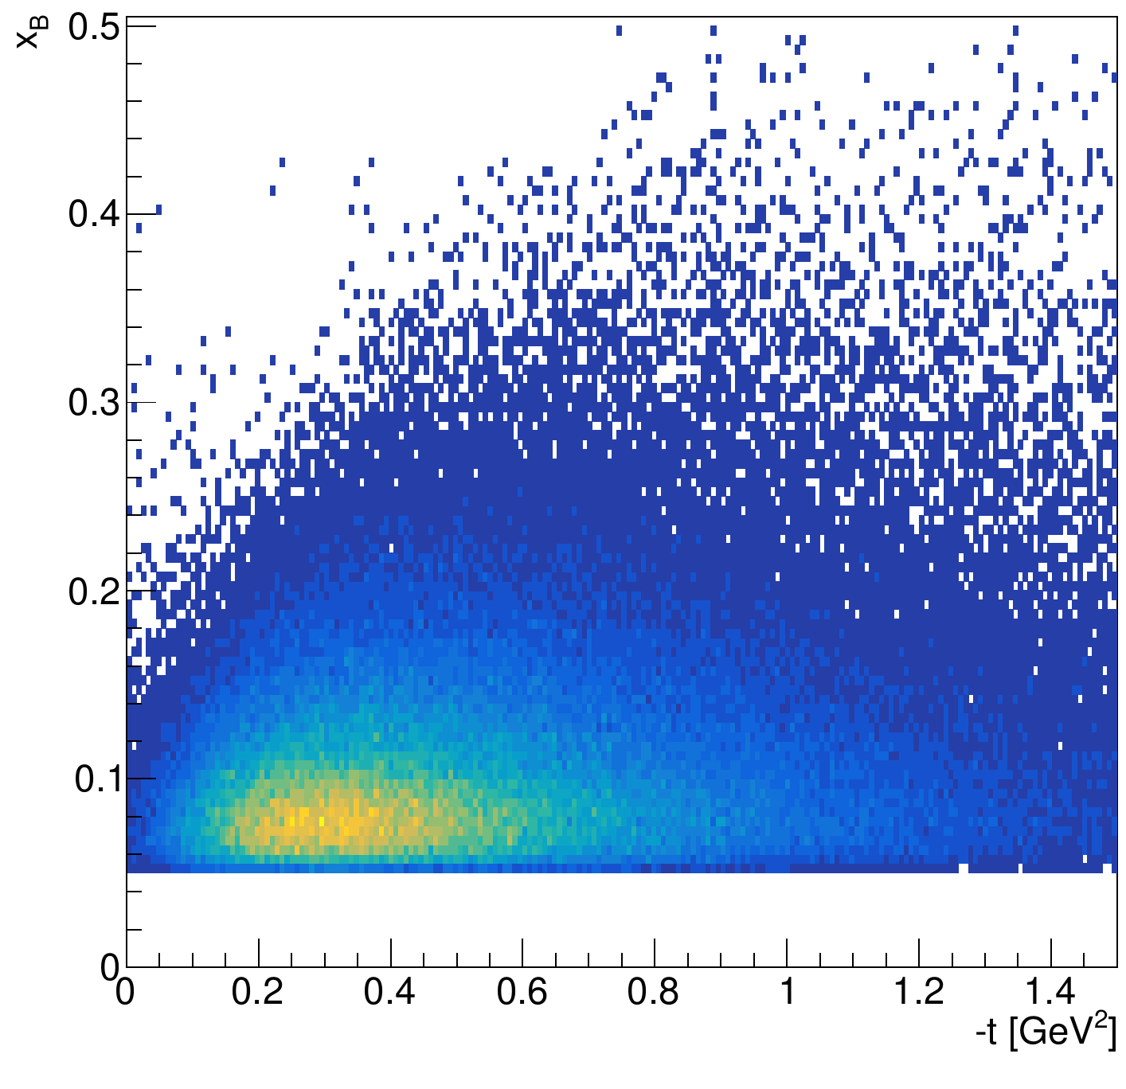
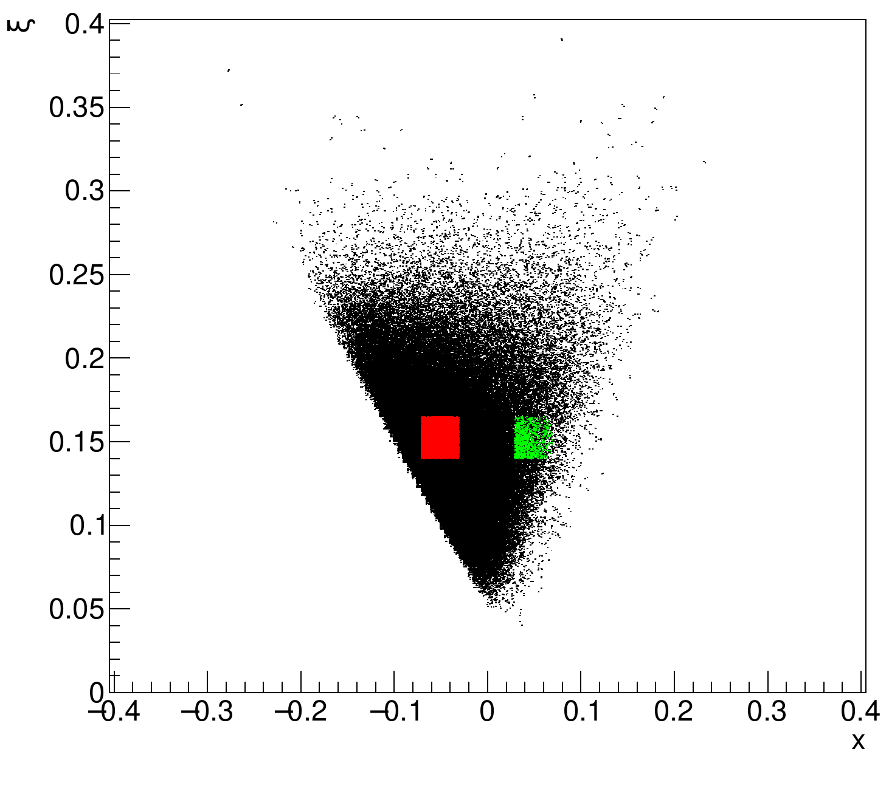
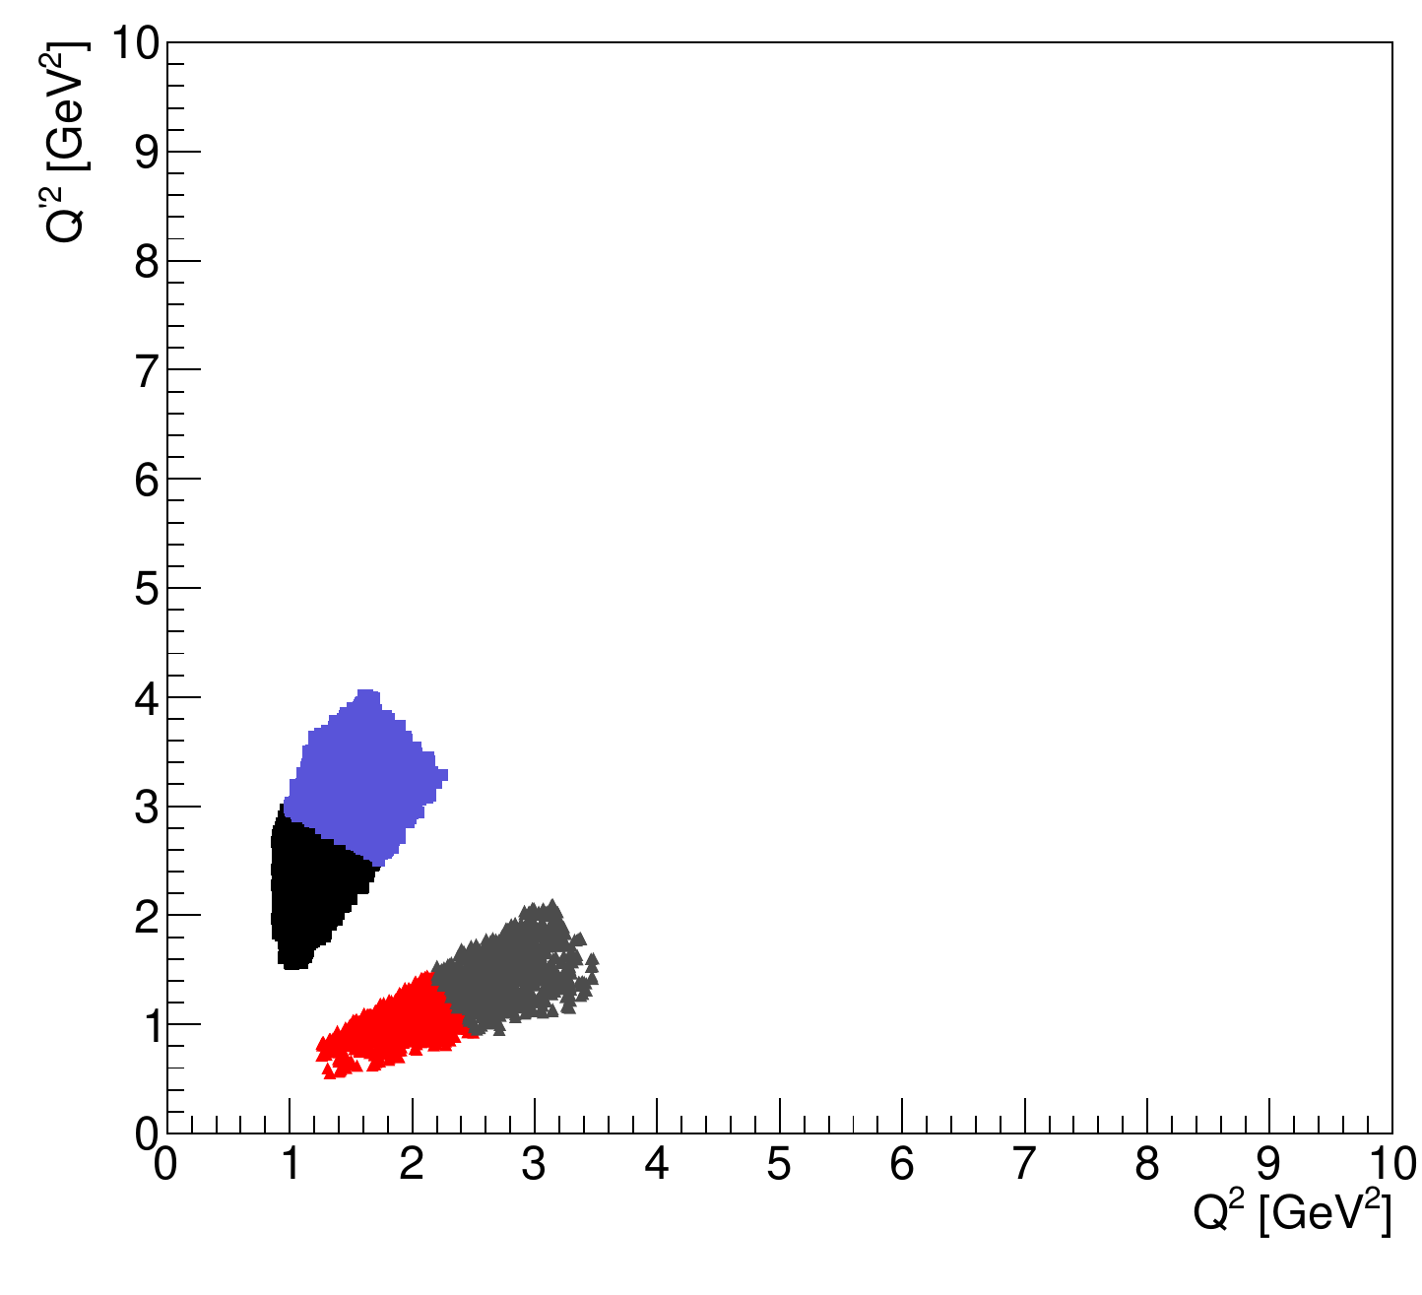
Kinematic coverage
-t < 0.5 GeV² region is selected for further analysis
Two regions in the "𝜉 vs x" phase space are selected for further analysis.
-0.07 < x < -0.03 && 0.14 < 𝜉 < 0.165
0.03 < x < -0.07 && 0.14 < 𝜉 < 0.165
Note: Two regions only for this talk, in general we can map out in a larger region
For each of selected region two bins of "Q'² vs Q²" are selected
This should help to check if the scaling works
A fixed "𝜉 vs x" point corresponds to a fix Q'²/Q² ratio.

Slide 17
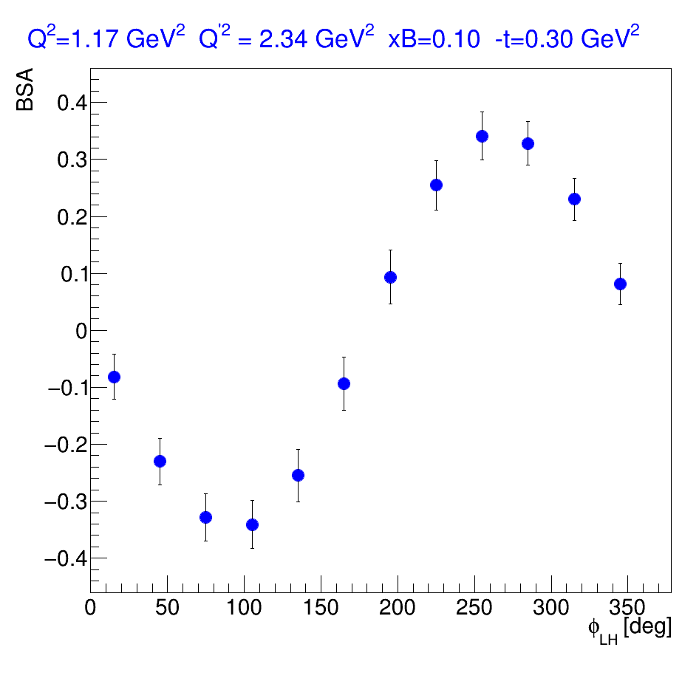
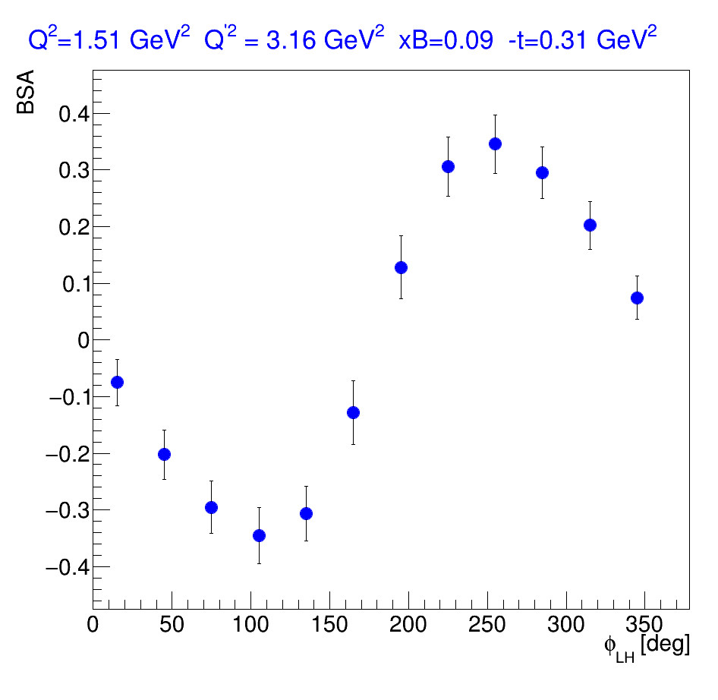
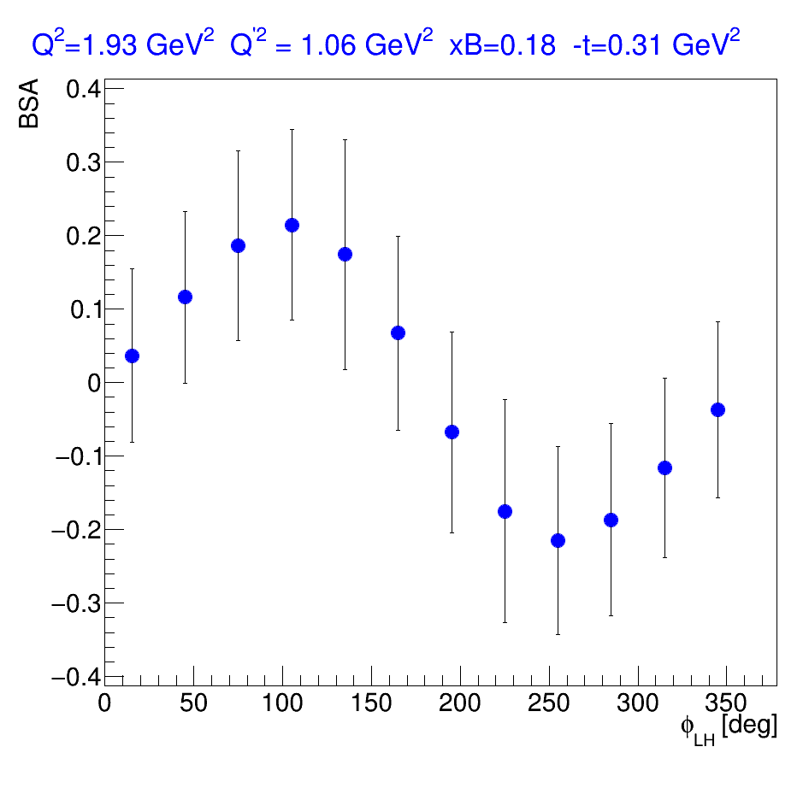
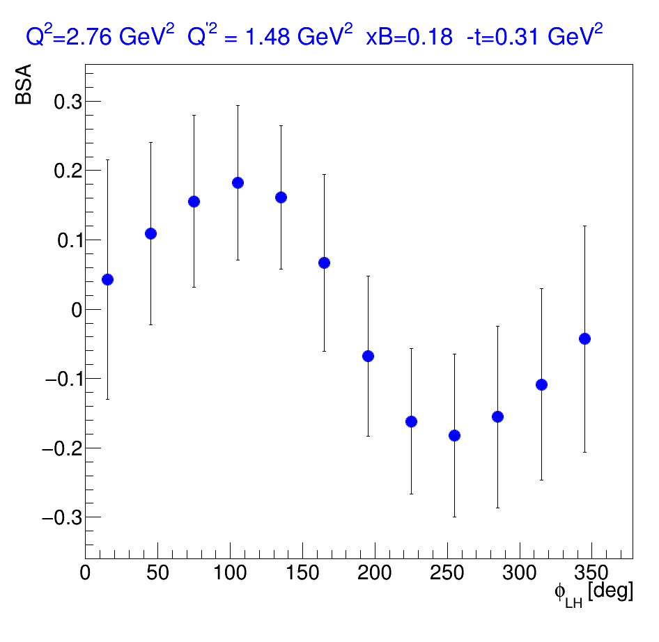
Estimation on uncertainties
Eb = 10.6 GeV
200 days @10³⁷cm⁻²s⁻¹
Beam polarization P = 80%
Asymmetries are obtained using M. Guidal's code

Slide 18
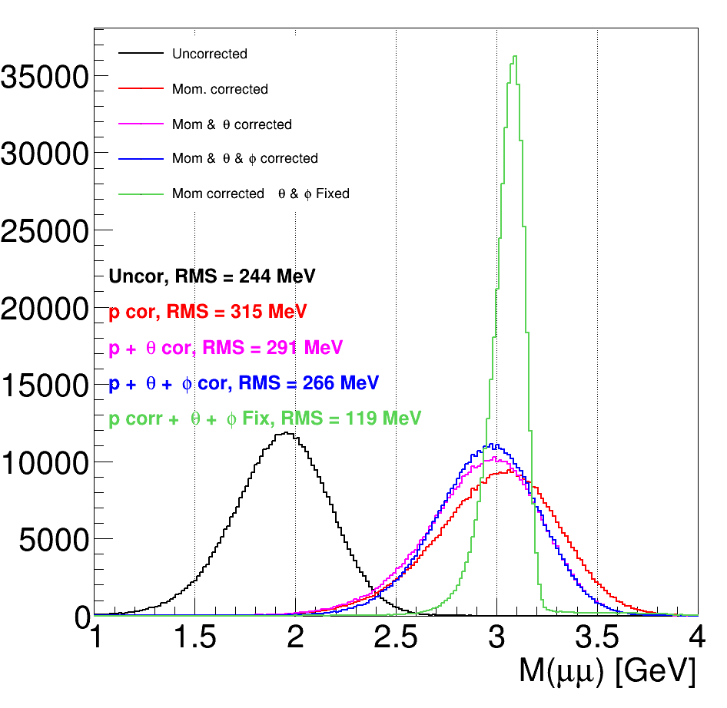
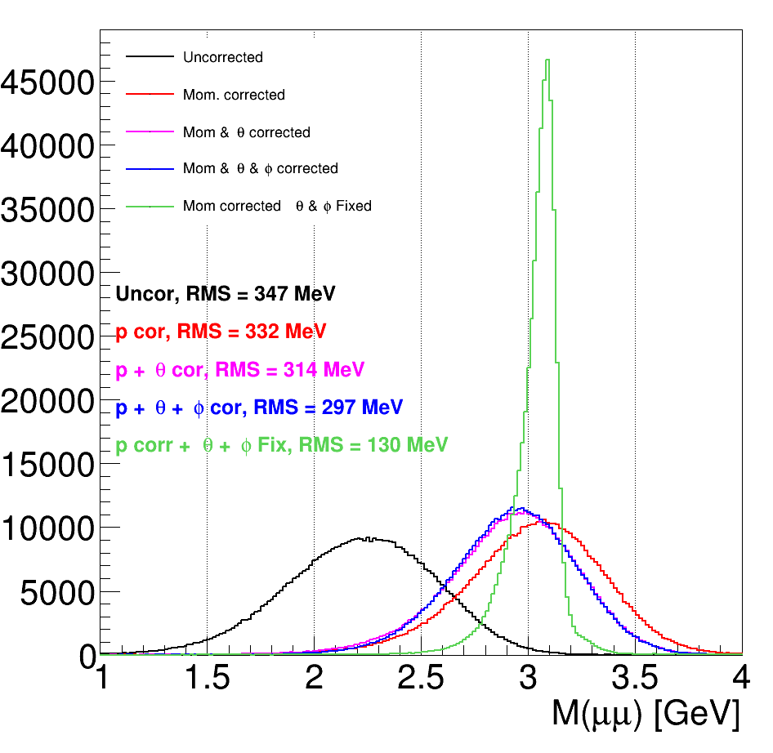
J/psi
Eb = 10.6 GeV
Eb = 22 GeV
With tracking detectors in front of the target, we should be able to significantly improve the mass resolution

Slide 19
Summary
DDVCS is an important process for the extraction of GPDs
It has not been measured because of it very low cross-sections
Relatively modest upgrade of the CLAS12 detector will allow to measure the DDVCS
MPGD tracking detectors before the shielding are crucial for a precise reconstruction of the reaction kinematics
See Florian's talk on the current development of high rate MPGDs
We plan to go for a full proposal next PAC
Similar initiative exists for submitting DDVCS with SOLID

