Slide 1

Observation of ΛΚ∗(892) in electroproduction using RGK Pass-2 Fall-18 Data
CLAS12 Collaboration Meeting
Nov 14, 2024
Veronique Ziegler

Slide 2
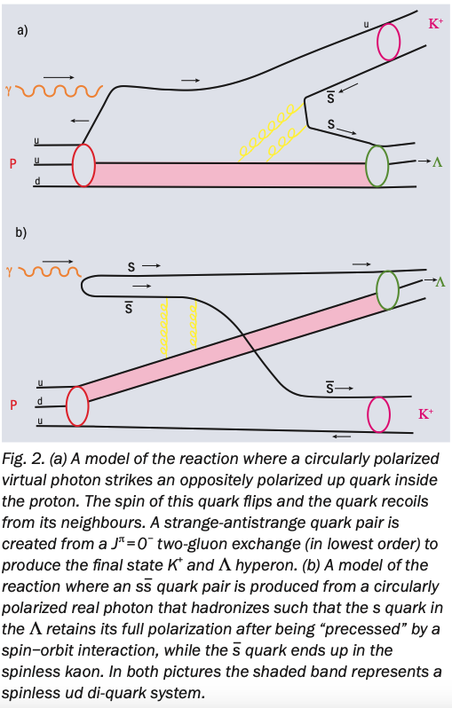
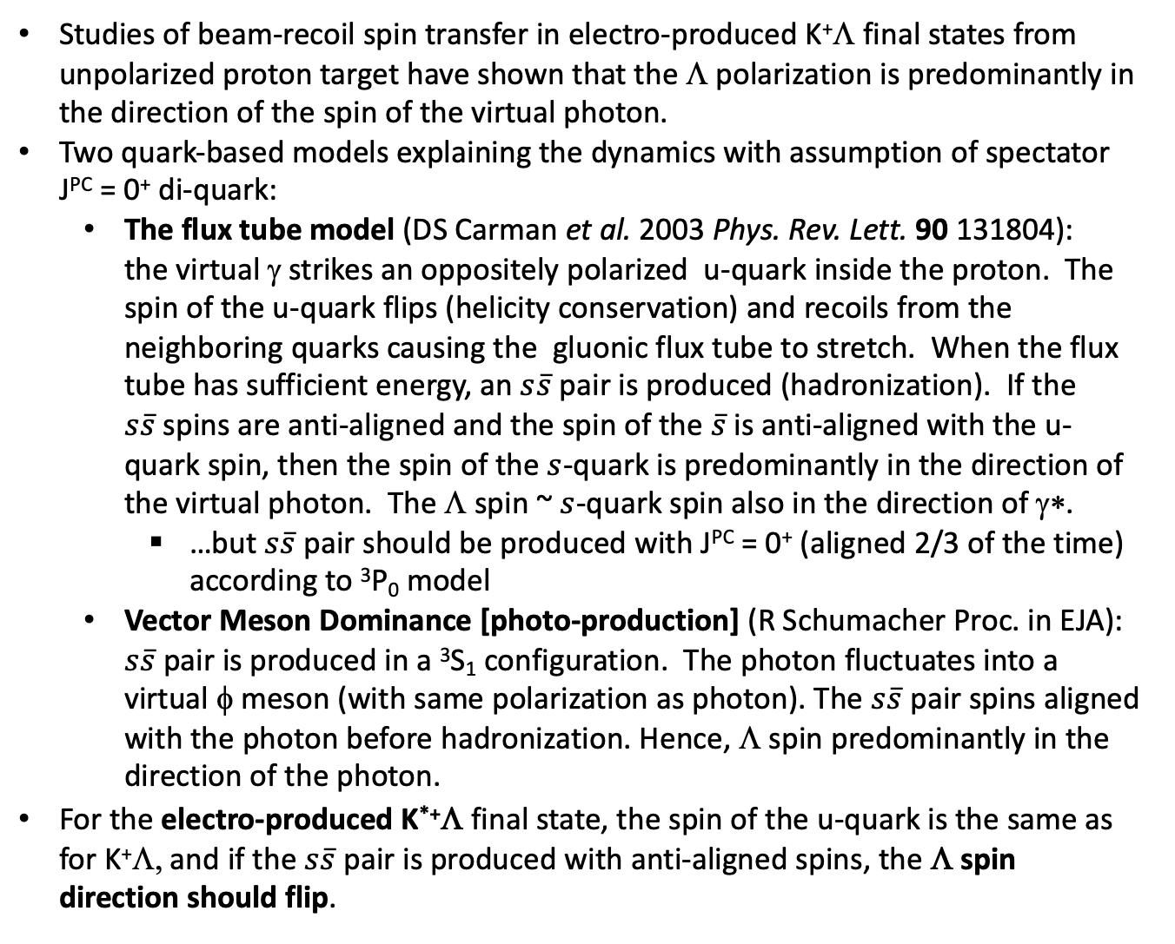
Motivation
D.S. Carman, T.-S.H. Lee, M.D. Mestayer, R.A. Schumacher, "Polarized Hyperons Probe Dynamic of Quark Spin",
CERN Courier September 2007
Studies of beam-recoil spin transfer in electro-produced K⁺Λ final states from unpolarized proton target have shown that the Λ polarization is predominantly in the direction of the spin of the virtual photon.
Two quark-based models explaining the dynamics with assumption of spectator J^{PC} = 0⁺ di-quark:
  The flux tube model (DS Carman et al. 2003 Phys. Rev. Lett. 90 131804): the virtual γ strikes an oppositely polarized u-quark inside the proton. The spin of the u-quark flips (helicity conservation) and recoils from the neighboring quarks causing the gluonic flux tube to stretch. When the flux tube has sufficient energy, an $s\overline{s}$ pair is produced (hadronization). If the $s\overline{s}$spins are anti-aligned and the spin of the $\overline{s}$ is anti-aligned with the u-quark spin, then the spin of the $s$-quark is predominantly in the direction of the virtual photon. The Λ spin ~ $s$-quark spin also in the direction of γ∗.
    …but $s\overline{s}$ pair should be produced with J^{PC} = 0⁺ (aligned 2/3 of the time) according to ³P₀ model
  Vector Meson Dominance [photo-production] (R Schumacher Proc. in EJA): $s\overline{s}$ pair is produced in a ³S₁ configuration. The photon fluctuates into a virtual φ meson (with same polarization as photon). The $s\overline{s}$ pair spins aligned with the photon before hadronization. Hence, Λ spin predominantly in the direction of the photon.
For the electro-produced K^{*+}Λ final state, the spin of the u-quark is the same as for K⁺Λ, and if the $s\overline{s}$ pair is produced with anti-aligned spins, the Λ spin direction should flip.

Slide 3
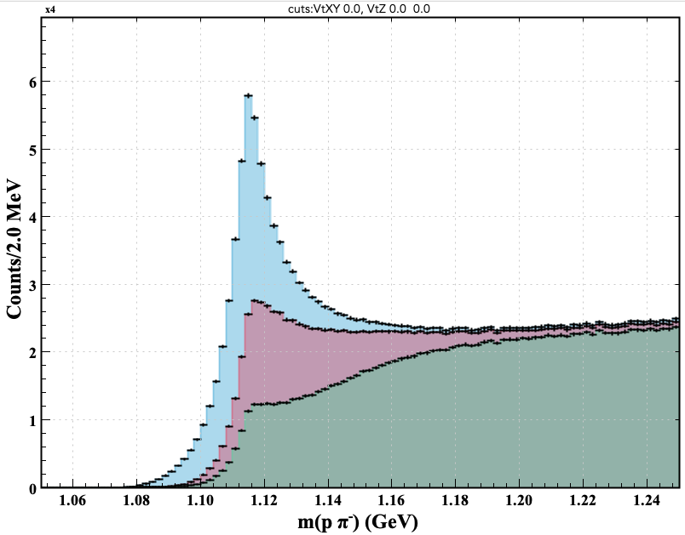
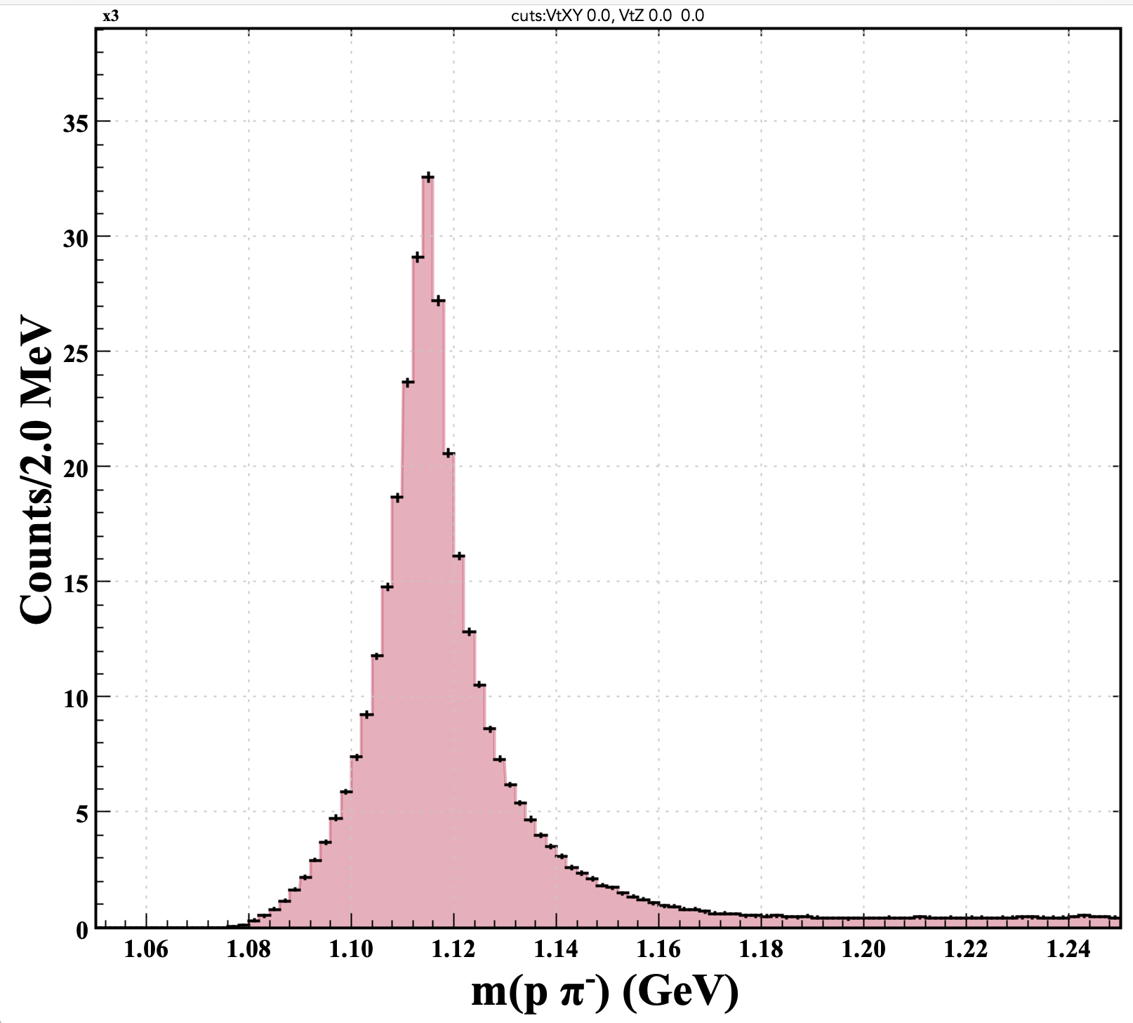
Λ Candidate Selection
Selection of ep→ e (pπ⁻) X events using Fall18 (6.5 and 7.5 GeV) Pass-2 RGK data
Skim these events using detached vertex reconstruction algorithm
    Creates analysis bank with vertex and momenta of each track and track pair candidate at the reconstructed detached vertex
    Topology: p & π⁻ in FD: improved resolution and signal-to-background ratio (study documented in Λ skim CLAS note)
    PID (|χ²_{PID}|<15) selection criteria for p and π⁻
    Require the vertex between p and π⁻ to be reconstructed with doca<5 cm
    Require Λ vertex to be downstream of the e- vertex
    Require the cosine of the angle between the proton and pion computed assuming the Λ PDG mass between +/- 1
    Subsequent vertex displacement (wrt e- vtx) optimization
    Angle between proton momentum and MM in CM-frame: cosα* < -0.99
Δvz > 0 cm
cosα* < -0.99
Small peaking background but higher S/B
cosα*>-0.99
cosα*>-0.98

Slide 4
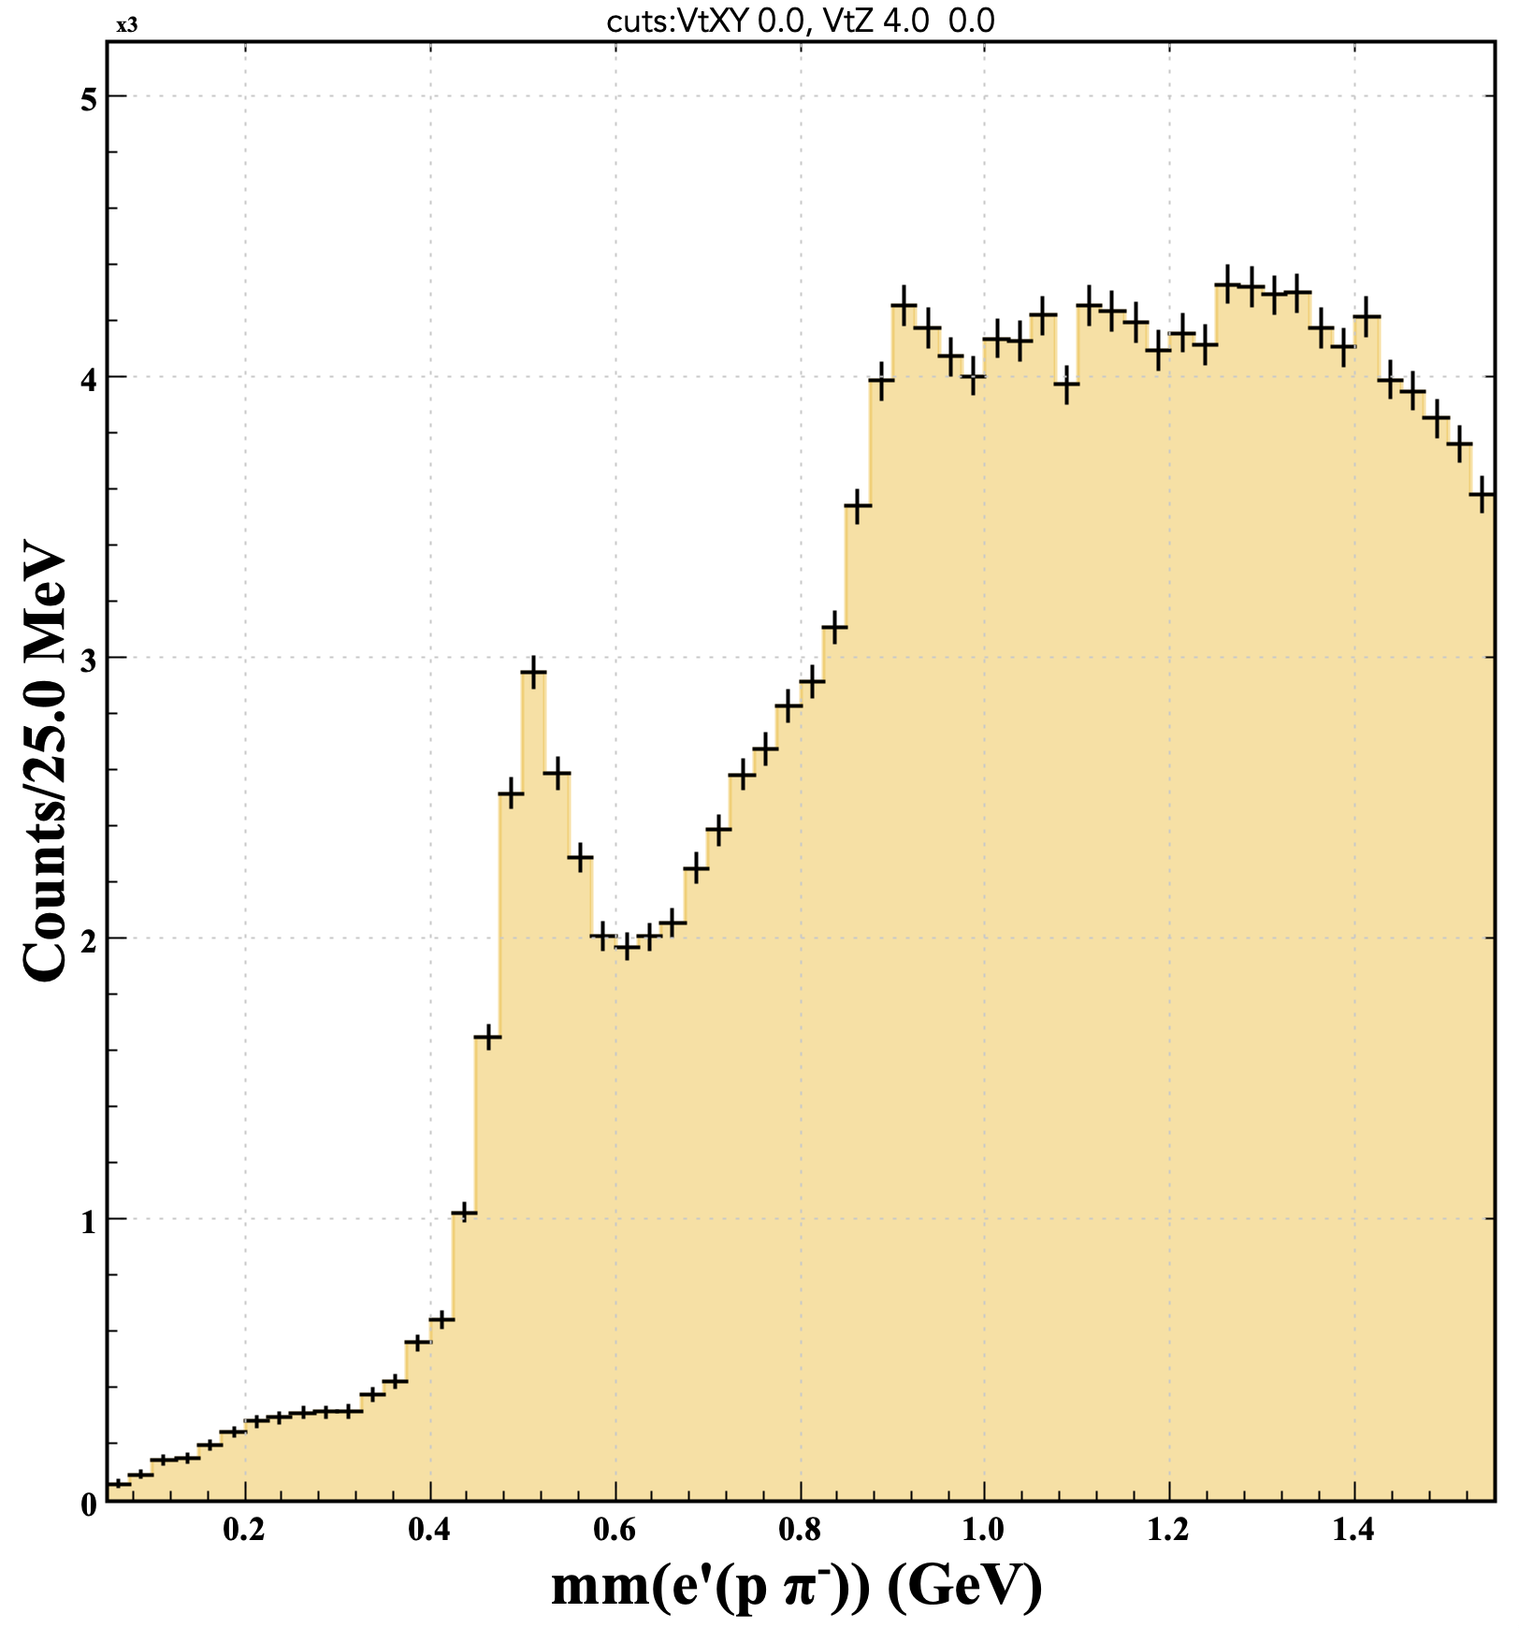
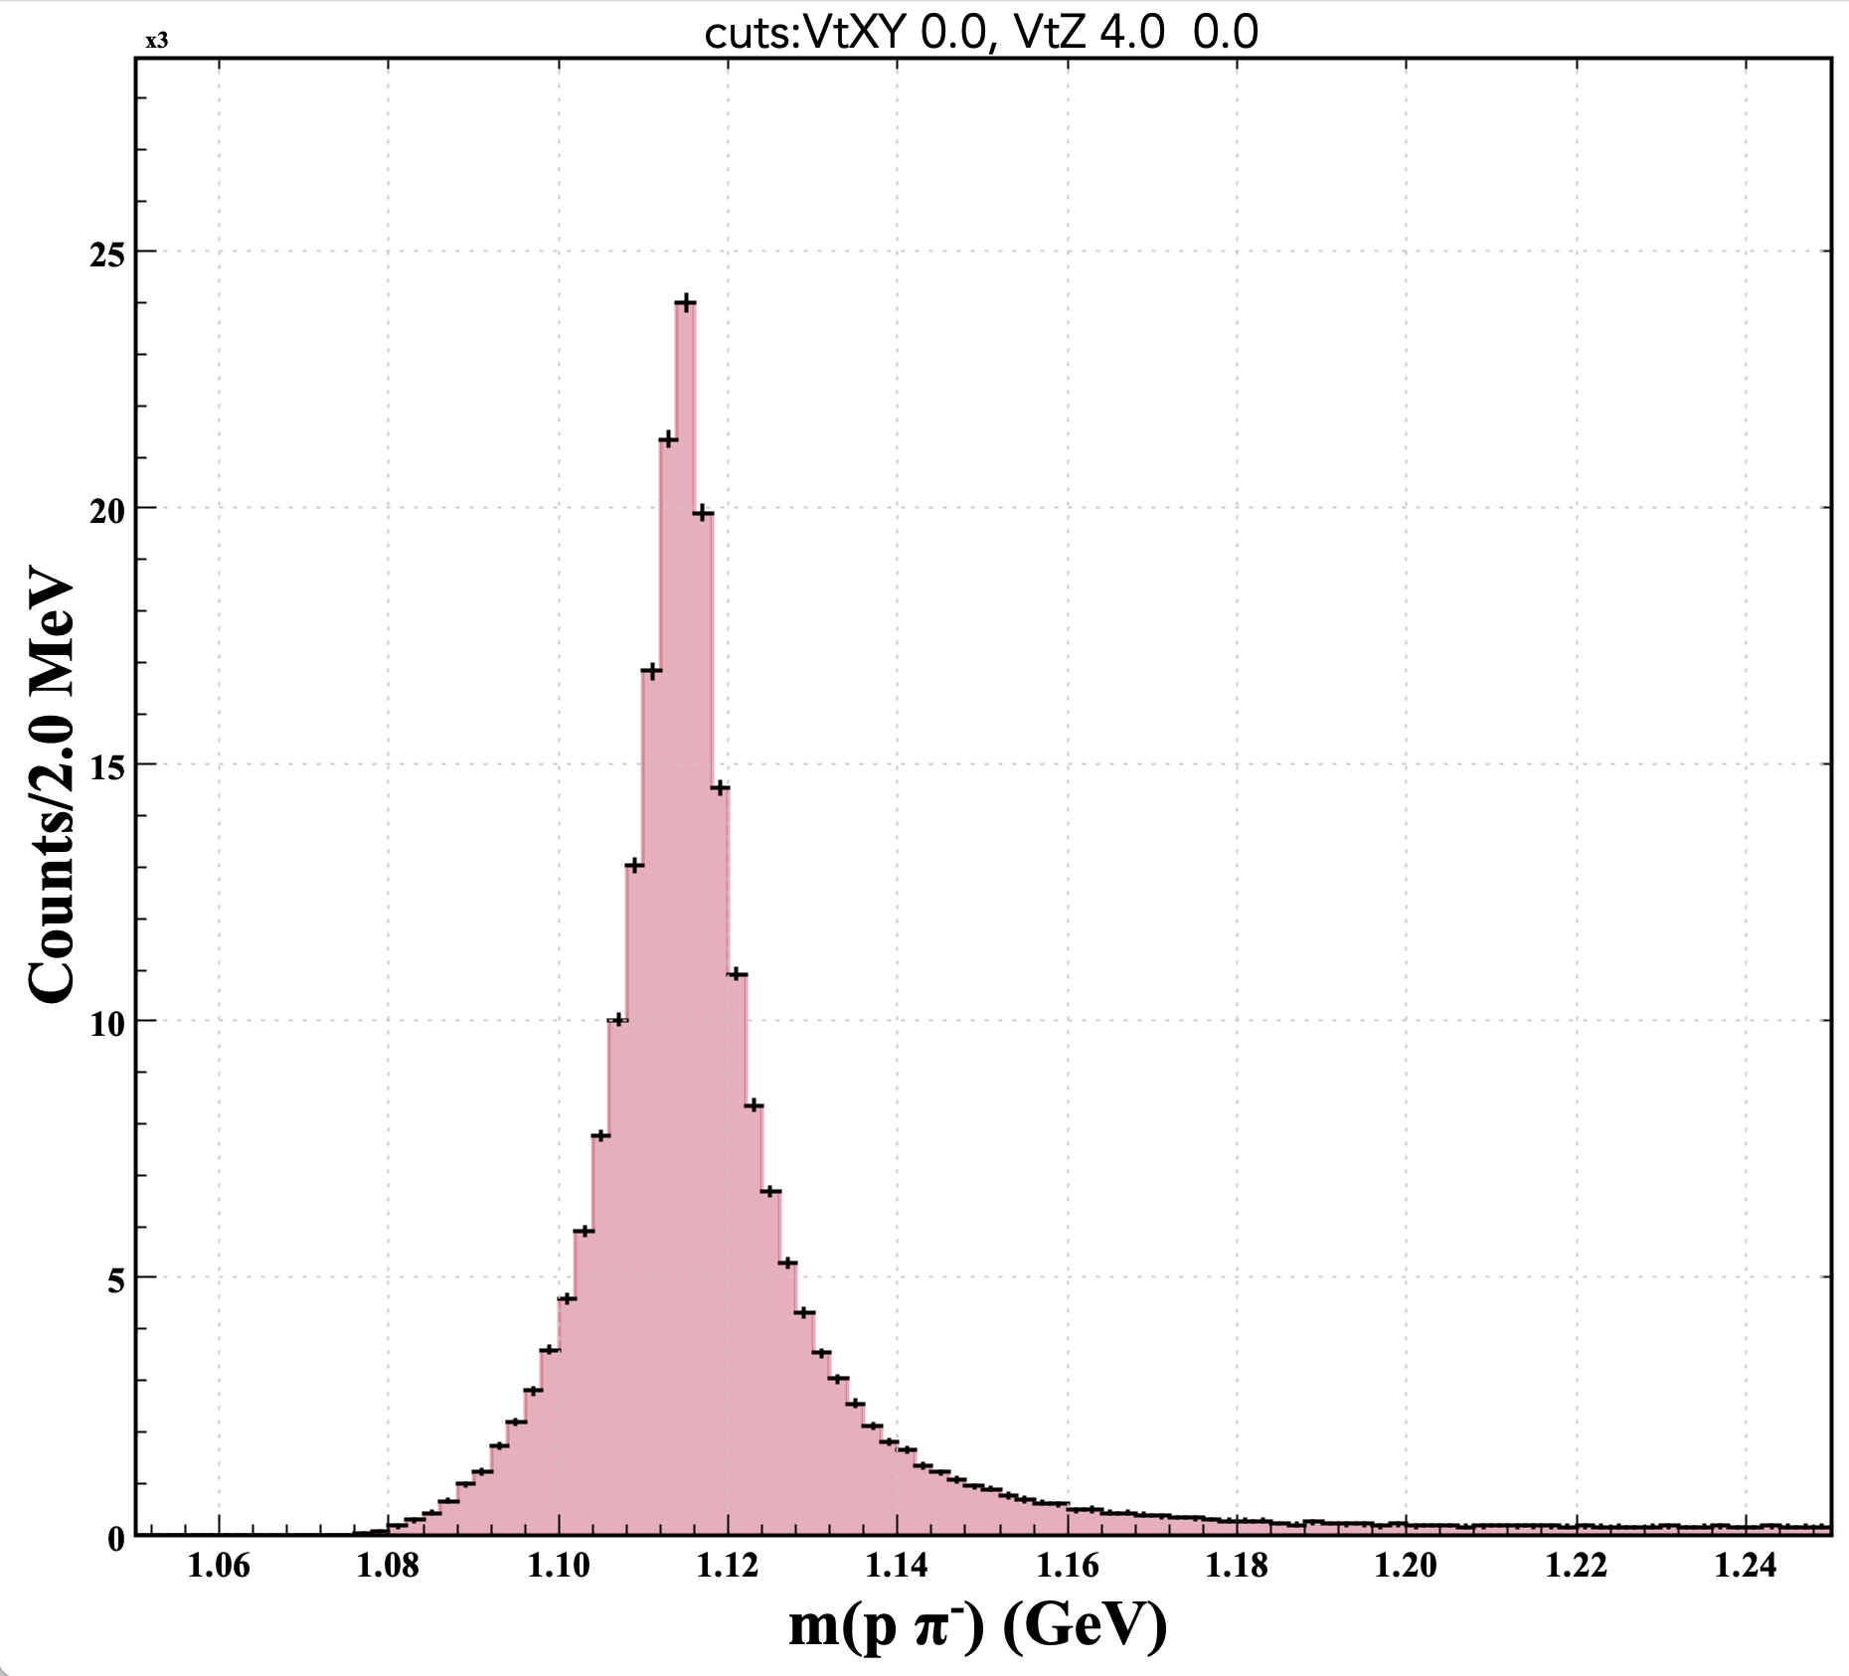
Study of Λ Recoil Candidates
Missing mass against e⁻ pπ⁻ for selected Λ ◊ pπ⁻ events
m(pπ⁻)<1.135 GeV
Δ(Vz_{Λ} – Vz_{e}) > 4 cm
  Decrease background in mm region above kaon mass
selected Λ signal region
recoil
Clear K+ signal
Evidence for K*(892)+ on top of high background

Slide 5
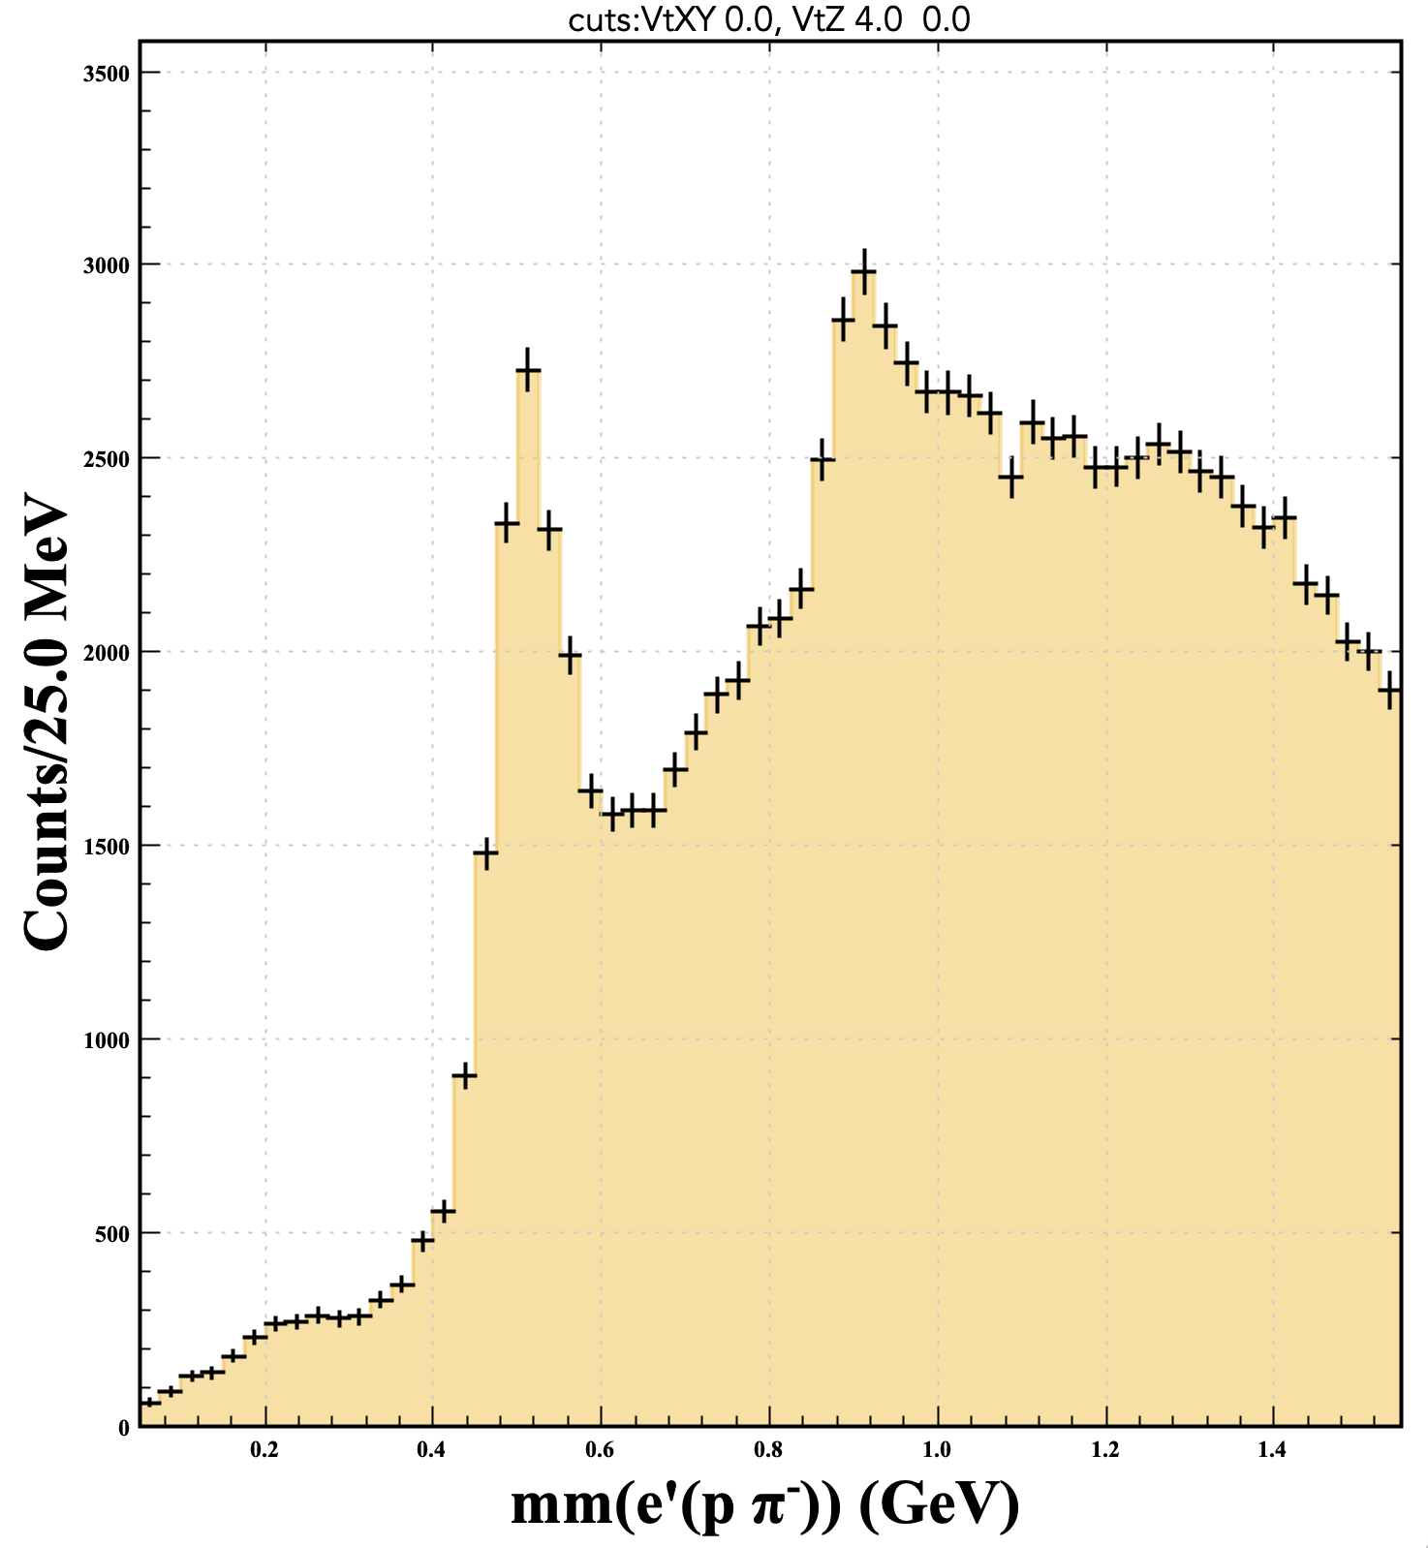
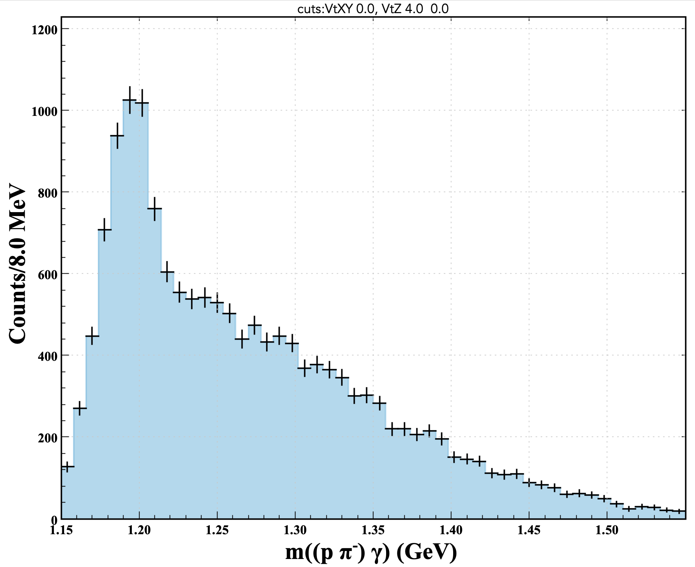
Rejection of γ Contamination from e p→e’ (Σ→Λ γ) X Events
Missing mass against e⁻ pπ⁻ for selected Λ ◊ pπ⁻ events
m(pπ⁻)<1.135 GeV
Σ◊Λγ veto--> rejecting events where there is a photon spanning an angular cone (cos ζ = 0.6) wrt to the Λ momentum vector
Evidence for K*(892)⁺ above high background
Photons from the reaction e p→e’ (Σ→Λ γ) X contribute to background in the MM spectrum
Applying a cut to reject γ’s within an angular cone of the Λ candidate reduces the background under the observed K*(892)⁺ spectrum
MM spectrum
Observed Σ⁰→Λ γ signal from 4-momentum addition of a γ (rejected by the veto) with the selected Λ
  m(pπ⁻)<1.135 GeV
  cos(Λγ)>0.6;
  γ ray w/in 5 cm of Λ vtx;
  250 <p(γ) < 550 MeV.

Slide 6
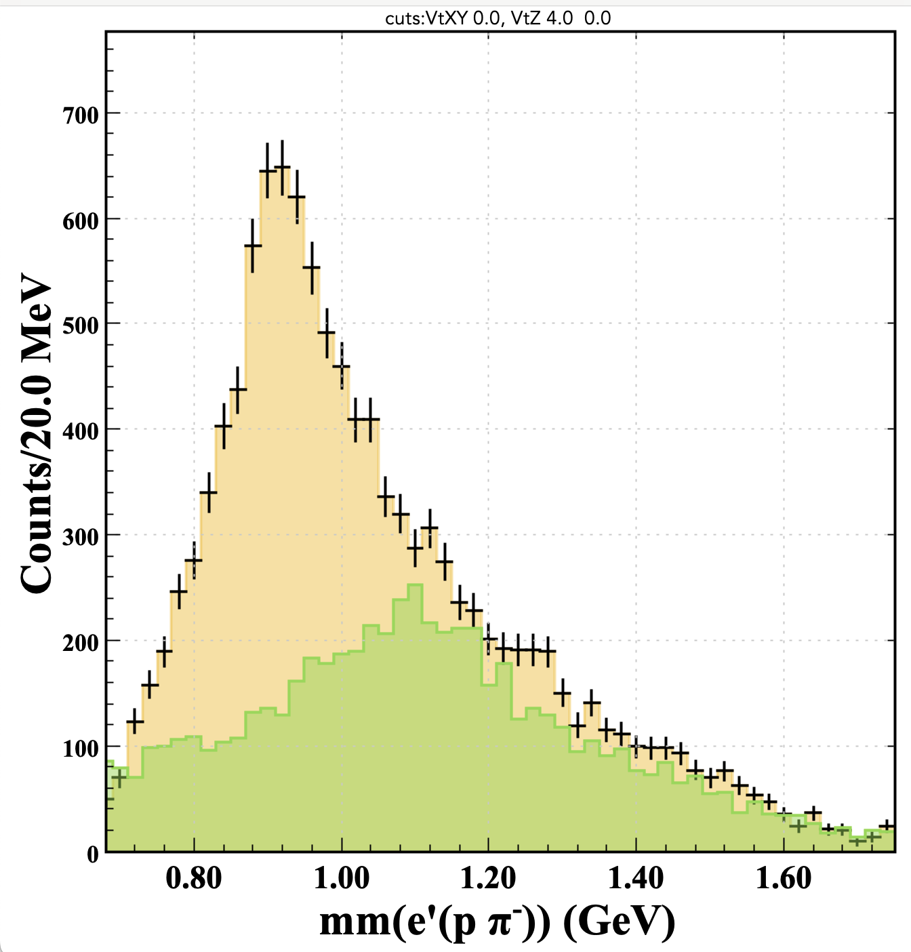
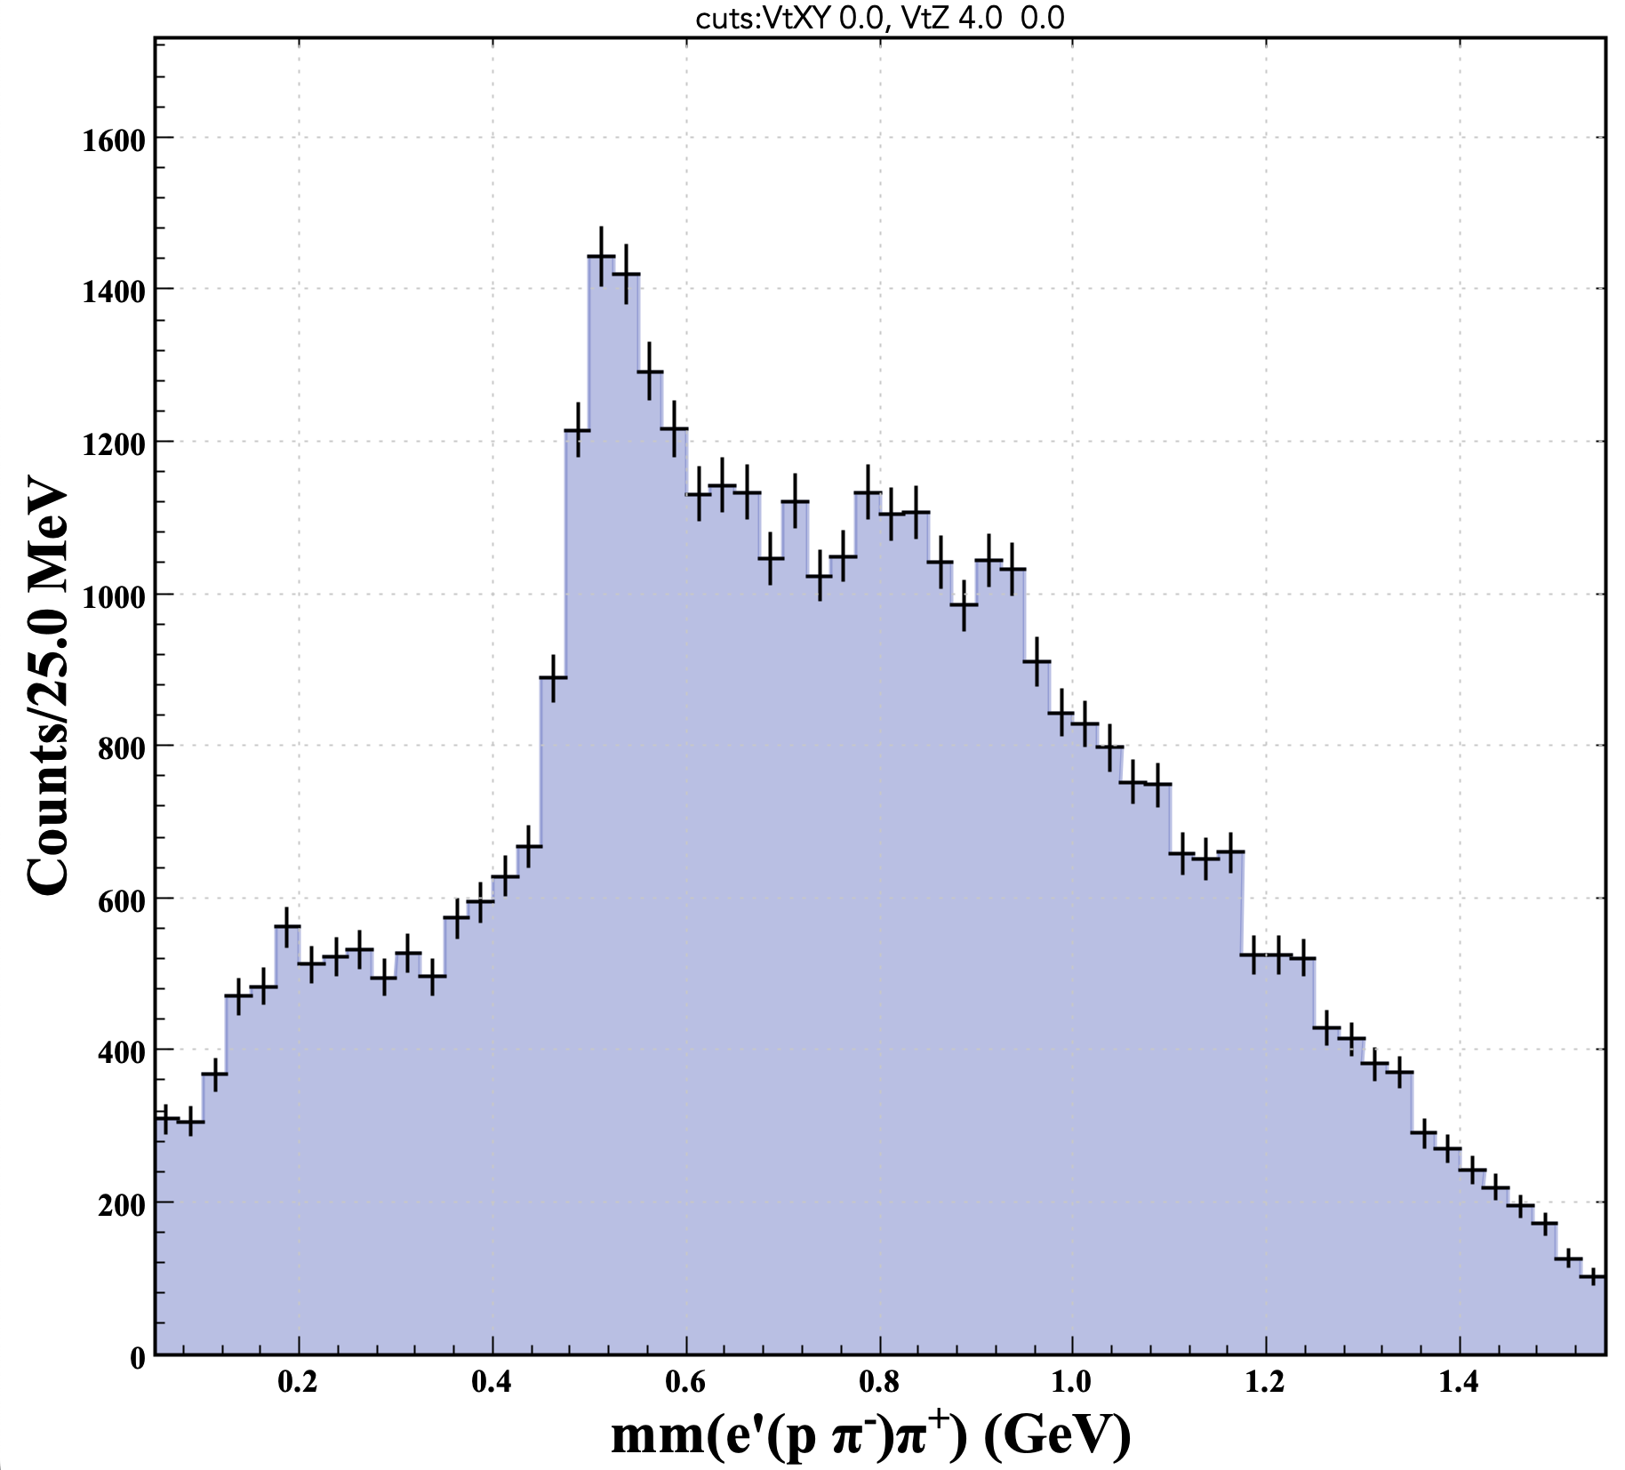
K*(892)⁺ Signal Extraction
Additional cuts
Requiring a π⁺ in the event satisfying the condition that [mm(( pπ⁻) π⁺)] be within the K⁰ signal region
Clear evidence for K*(892)⁺
Requiring a π⁺ in the event and obtaining the missing mass against e’ (Λ→pπ⁻) π⁺ yields a clear K⁰ peak
The missing mass against e’ (Λ→pπ⁻) after selecting the K⁰ signal region isolates the K* peak
The K⁰ sideband region is shown in green
K⁰
6

Slide 7
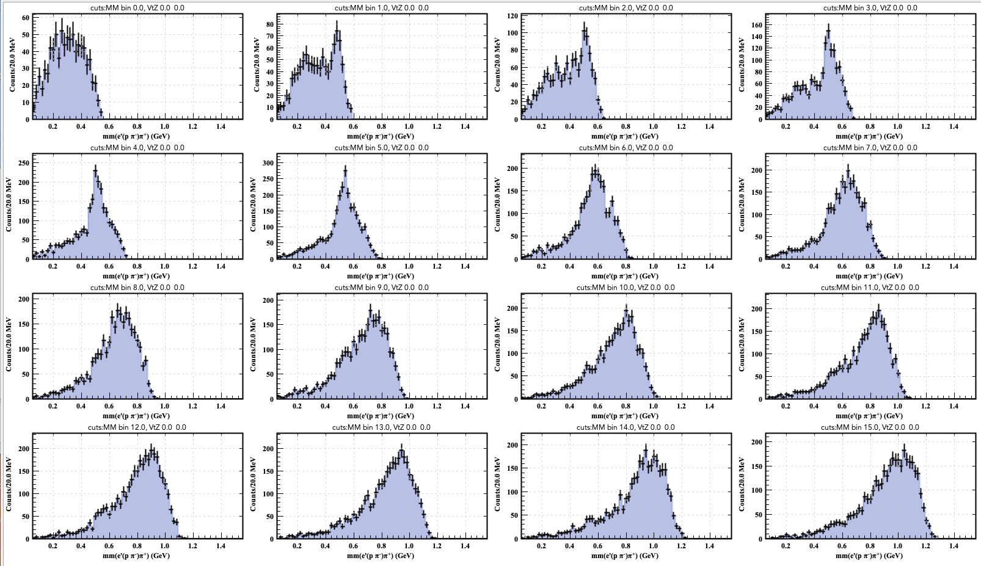
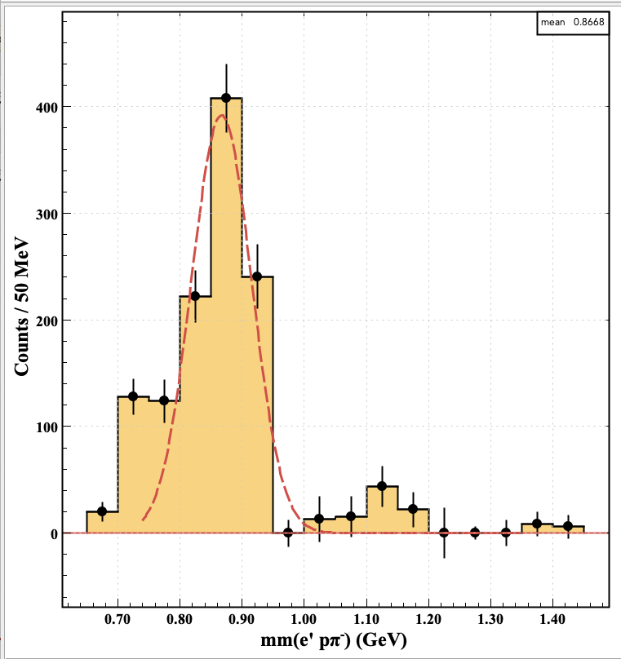
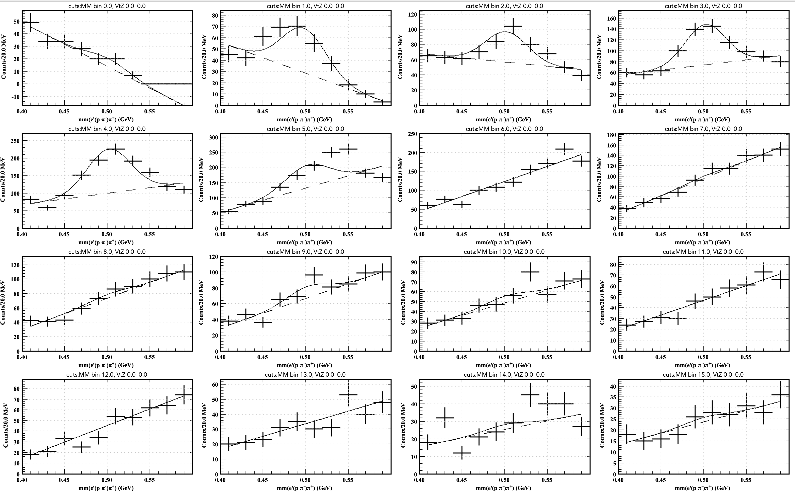
K*(892)⁺ Background Subtraction
MM(e’ (Λ→pπ⁻) π⁺ ) distributions for each mm(e’pπ⁻) bin
K⁰ background-subtracted
Very little background (systematics due to fit procedure)
K*(892)⁺ signal extraction → measure yield
Observation of ΛK(892)* channel
Zoom with fit
For each bin of the mm(e’pπ⁻) spectrum obtain the mm(e’p π⁻π⁺) distribution and extract the K⁰ yield

Slide 8
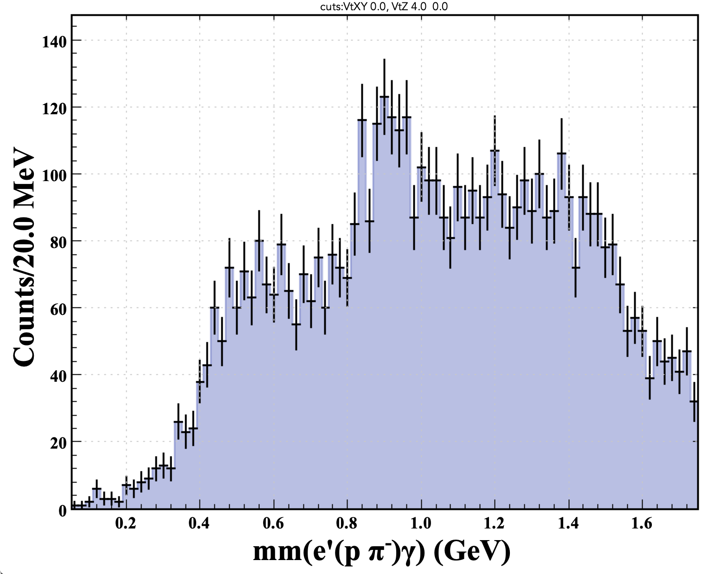
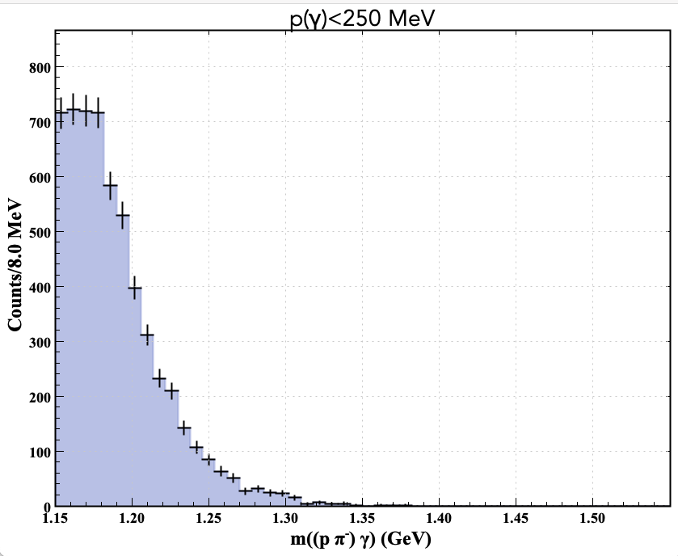
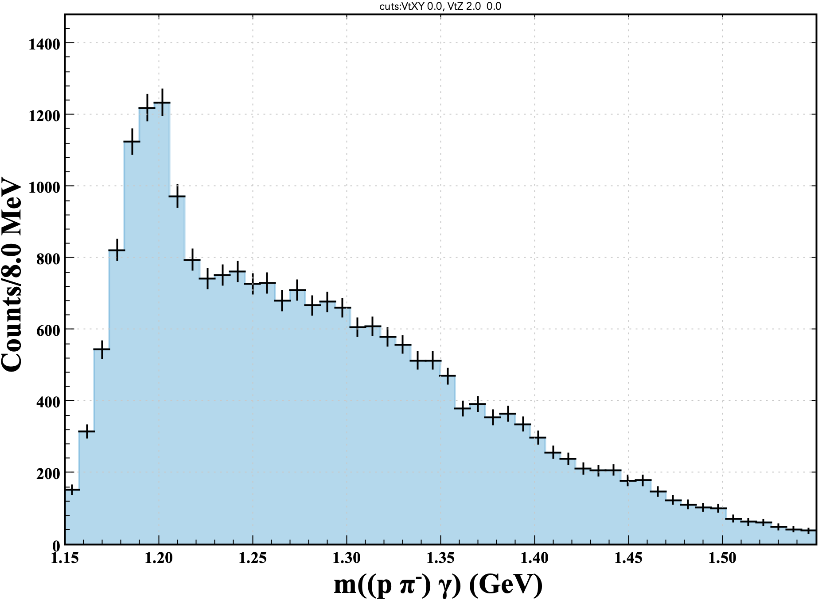
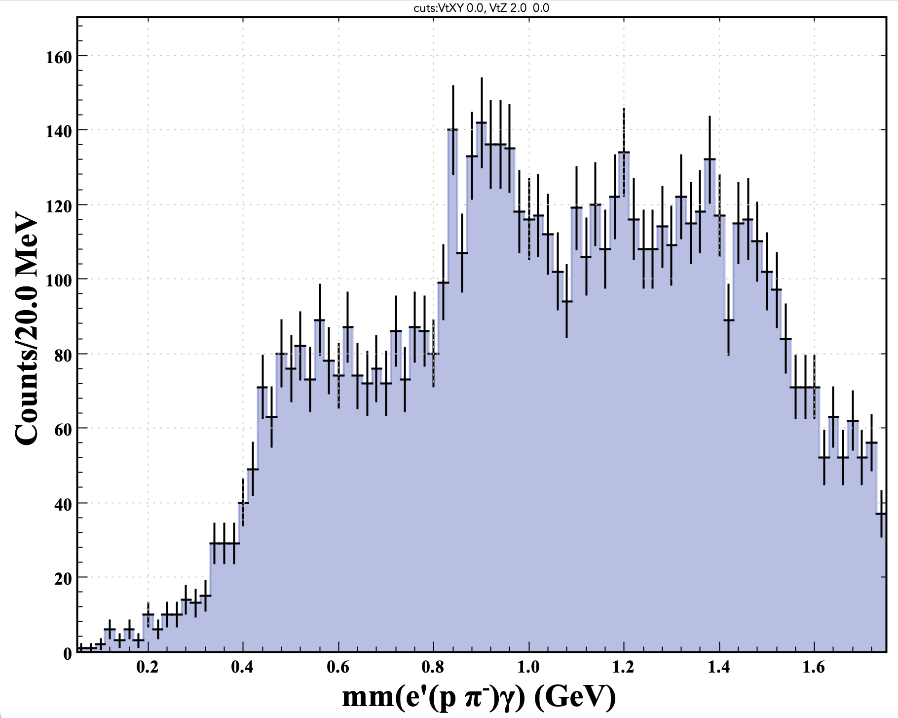
Reconstruction of e p→e’ (Σ→Λ γ) X Events
p(γ)>250 MeV
Sigma reconstruction cuts
  doca between the Λ vertex and the γ trajectory line w/in 5 cm;
  cos(Λγ)>0.6;
  m(pπ−)<1.135 GeV
  p(γ) cuts
Clear evidence for K*(892)⁺ in recoil
Δ(Vz_{Λ} – Vz_{e}) > 4 cm
recoil
Events rejected by p(γ)>250 MeV cut
Δ(Vz_{Λ} – Vz_{e}) > 2 cm
recoil
8

Slide 9
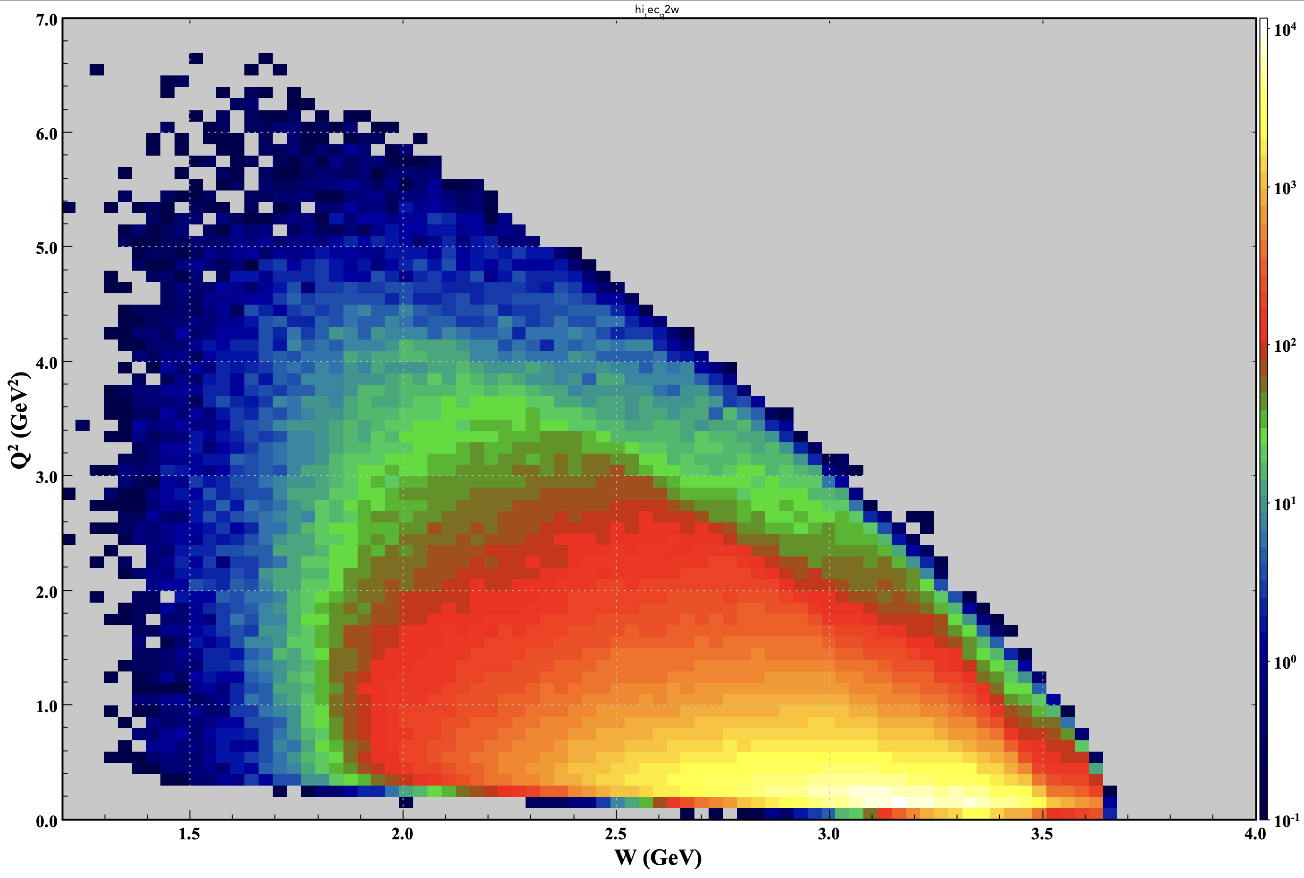
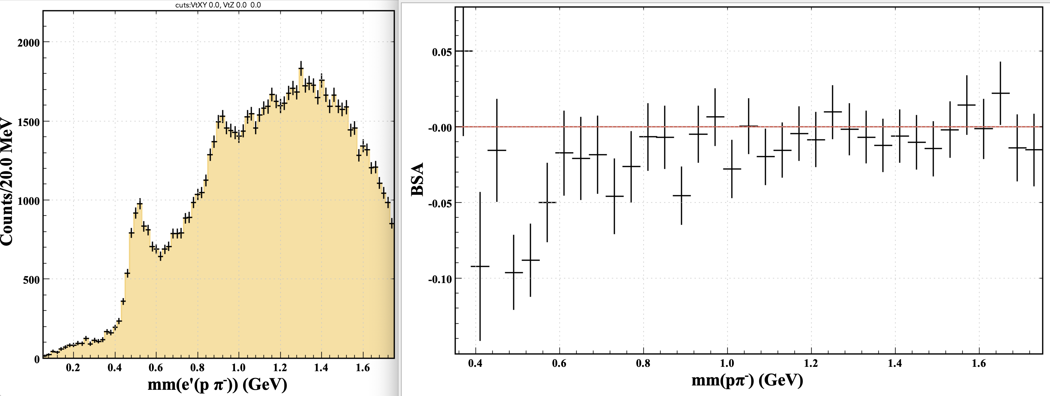
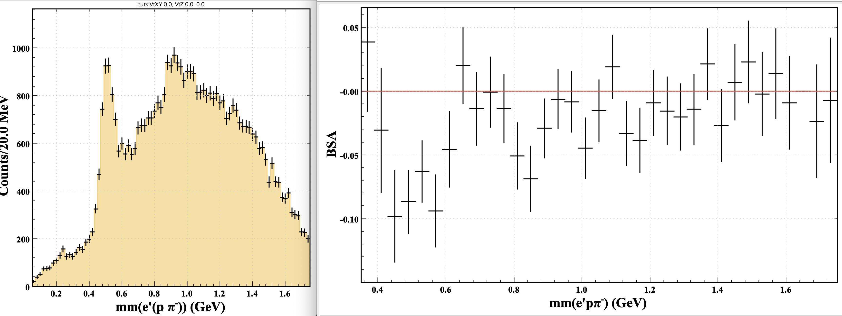
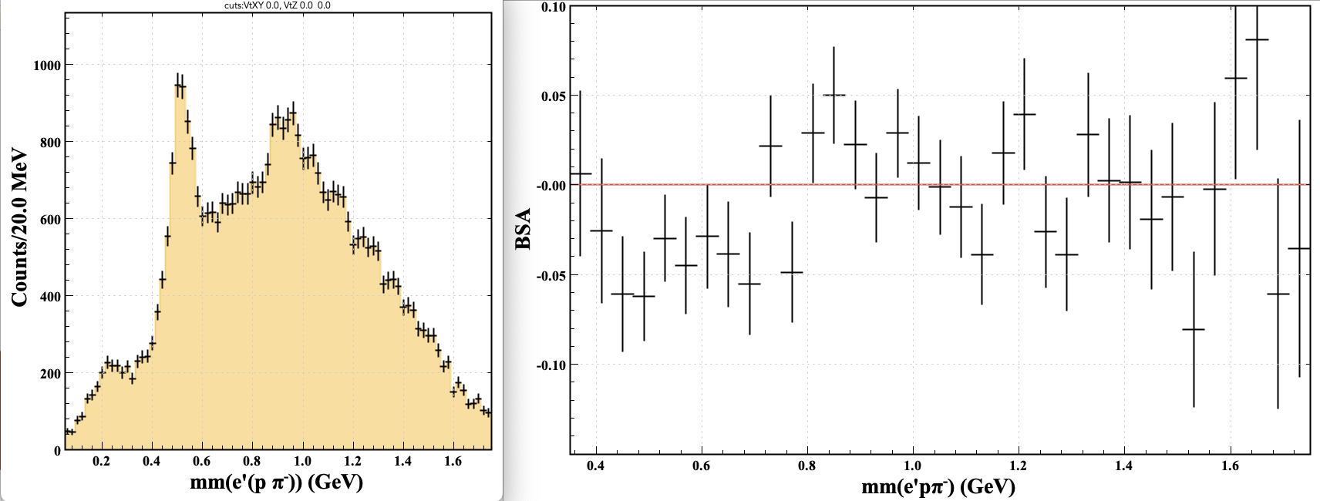
BSA Q² Dependence
W> 1.5 GeV Events
-Q² < 0.5 GeV²
0.5 < -Q² < 1.0 GeV²
BSA as a function of MM
Q² dependence of BSA
Enhanced K*(892) signal-to-background ratio at higher Q²
Possible BSA sign flip between the K and the K* seen at higher Q²
More statistics needed
-Q² > 1.0 GeV²

Slide 10
Outlook
Evidence for reactions ep → e’ Λ(Σ⁰) K*⁺
  Study of reaction ep → e’ Λ K*⁺ important to shed light into hadronization process involved in Λ production
  CLAS published results on photoproduction
    W. Tang et al. (CLAS Collaboration), "Cross Sections for the gamma p --> K^{*+}Lambda and gamma p --> K^{*+}Sigma⁰ Reactions Measured at CLAS", Phys. Rev. C 87, 065204 (2013).
    I. Hleiqawi et al. (CLAS Collaboration), "Cross Sections for the gamma p --> K*⁰Sigma+ Reaction at Egamma = 1.7 - 3.0 GeV", Phys. Rev. C 75, 042201 (R) (2007).
  No current results on electroproduction
Possibility of cross section measurement & comparison of induced polarization of the Λ in the reaction ep → e’ Λ K⁺ to the reaction ep → e’ Λ K^{*+}
  Binning in different kinematics variables requires more statistics → wait for complete 2024 dataset

Slide 11
BACKUP SLIDES

Slide 12
RGA Fall18

