Slide 1

A Λ Skim for CLAS12
CLAS12 Collaboration Meeting
Nov 14, 2024
Veronique Ziegler

Slide 2
Motivation
Events containing a Λ particle produced in CLAS12 with rates sufficient to yield interesting results for strangeness electro- and photo-production.
Exclusive reconstruction of Λ candidates allows to search for several reactions involving a baryon with strangeness S = 1, 2, 3 with improved resolution over the missing against kaon(s).
Exclusive reconstruction of the Λ allows for precision beam spin asymmetry and polarization measurements that can be compared with previous inclusive measurements where only the proton was measured.
Exclusive Λ → pπ⁻ reconstruction allows use of detached vertex of the Λ wrt a reference vertex (i.e. e⁻) which is a powerful tool to reject the background under the Λ candidate peak.
Λ → pπ⁻ selection criteria studied using RGK runs 19334, 19335, 19336, 19337, 19339, 19340, 19341, 19343, 19348, and 19349 collected during the Spring of 2024. Validation done on RGK 6.5, 7.5 GeV data sets and RGA Fall-18, Spring-19 datasets.

Slide 3
Detached Vertex Finder Algorithm
Vtx from REC bank=
Doca to beam axis obtained from tracking
Solid line = track (Vtx_x, Vtx_y, Vtx_z, Px, Py, Pz) from REC bank
Dashed line = representation of trajectory used in determination of Doca of track1 to track2
For each track
  Swim backwards to fixed Z to get starting point of trajectory
  Swim forward to fixed Z to get starting point of trajectory
Compute Doca of track2(1) to track1(2) obtained from swimming track2(1) where the swimming is stopped when the Doca to trajectory2(1) is minimal
Compute r as the distance between the so-obtained doca points of each track
Vtx from REC bank
Beam axis
Vtx from REC bank
Swim backwards to fixed Z to get starting point of trajectory
Swim forward to fixed Z to get starting point of trajectory
Doca of track2 to track1 obtained from swimming track2 where the swimming is stopped when the Doca to trajectory2 is minimal
Doca of track1 to track2 obtained from swimming track1 where the swimming is stopped when the Doca to trajectory2 is minimal

Slide 4
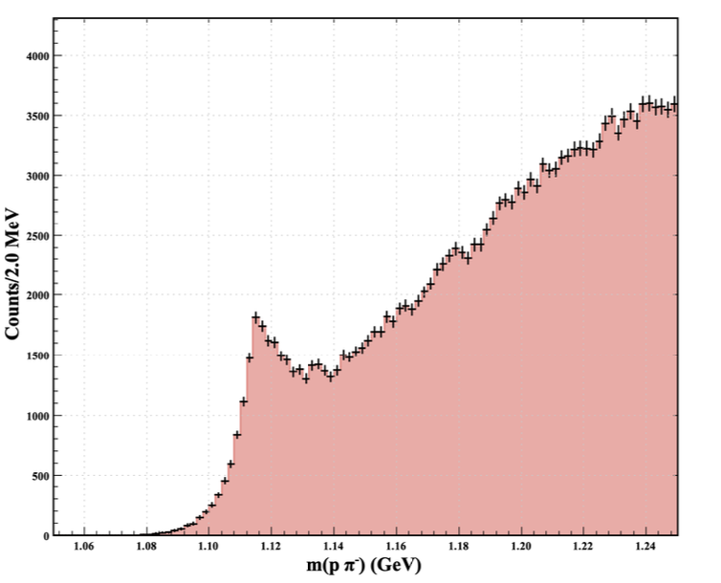
Λ Candidate Skim Selection Criteria (1)
Electro-production data
Effect of vertex displacement cuts
  longitudinal vertex displacement (wrt e− vertex) cuts (dz) in increments of 2.0 cm (from 0 to 12.0 cm) from left to right on the horizontal axis
  values of the transverse vertex displacement cuts (dxy) in increments of 0.25 cm (from 0 to 1.5 cm) from top to bottom on the vertical axis
Topology: p & π⁻ in FD: improved resolution and signal-to-background ratio
PID (|χ²_{PID}|<15) selection criteria for p and π⁻
Require the vertex between p and π⁻ to be reconstructed with doca<5 cm
Analysis requirement: Λ vertex to be downstream of the e- vertex (not @skim-level)
+(Vz(Λ) – Vz(e-))
+(Vxy(Λ) – Vzy(e-))
m(pπ−) spectrum for (pπ⁻) track pairs combined using the common vertex finding algorithm

Slide 5
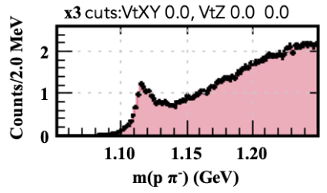
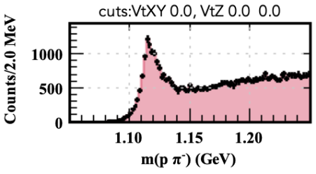
Λ Candidate Skim Selection Criteria (2)
Require the cosine of the angle between the proton and pion computed assuming the Λ PDG mass between +/- 1
+(Vz(Λ) – Vz(e-))
+(Vxy(Λ) – Vzy(e-))
With of vertex displacement cuts

Slide 6
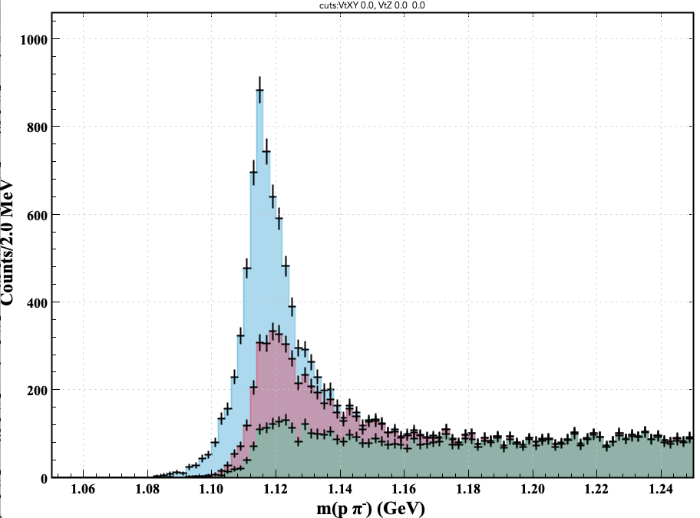
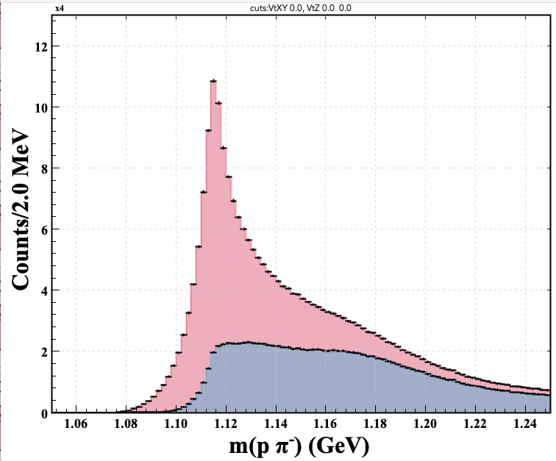
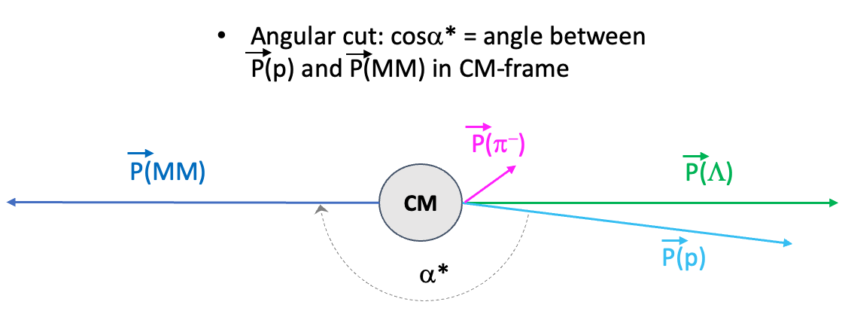
Λ Candidate Analysis Selection Criteria
Selection applied on skimmed events
RGK
RGA
cosα* > -0.99
Require cosα* < -0.98 for this dataset
  Cut optimized based on data set
    Physics reach (event kinematics), backgrounds, ... yielding different cut selections
cosα* > -0.98
cosα* > -0.99
With of vertex displacement cuts

Slide 7
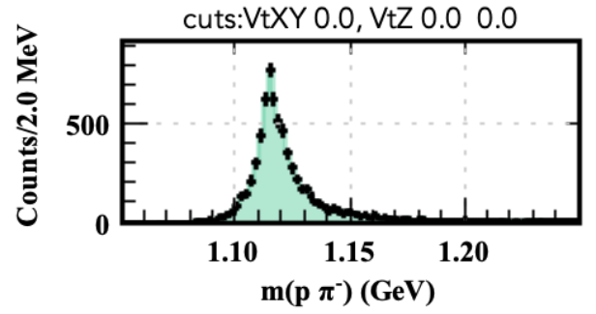
Λ Candidate Skim and Analysis Selection Criteria
Topology: p & π⁻ in FD: improved resolution and signal-to-background ratio
PID (|χ²_{PID}|<15) selection criteria for p and π⁻
Require the vertex between p and π⁻ to be reconstructed with doca<5 cm
Λ vertex to be downstream of the e- vertex (not @skim-level)
Require the cosine of the angle between the proton and pion computed assuming the Λ PDG mass between +/- 1 (@skim level)
cosα* < -0.98 (not @skim level)
~ no loss in number of signal events

Slide 8
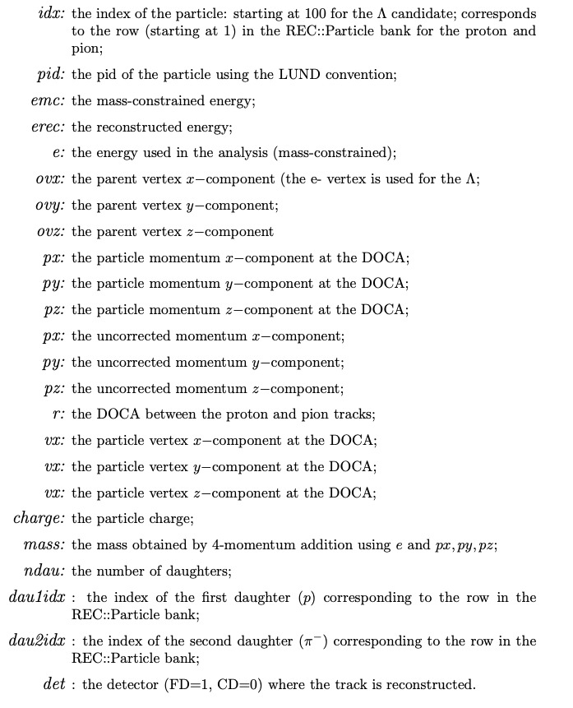
Skim Data Processing
Skim runs as a service on dst’s → output bank, YAML settings

Slide 9
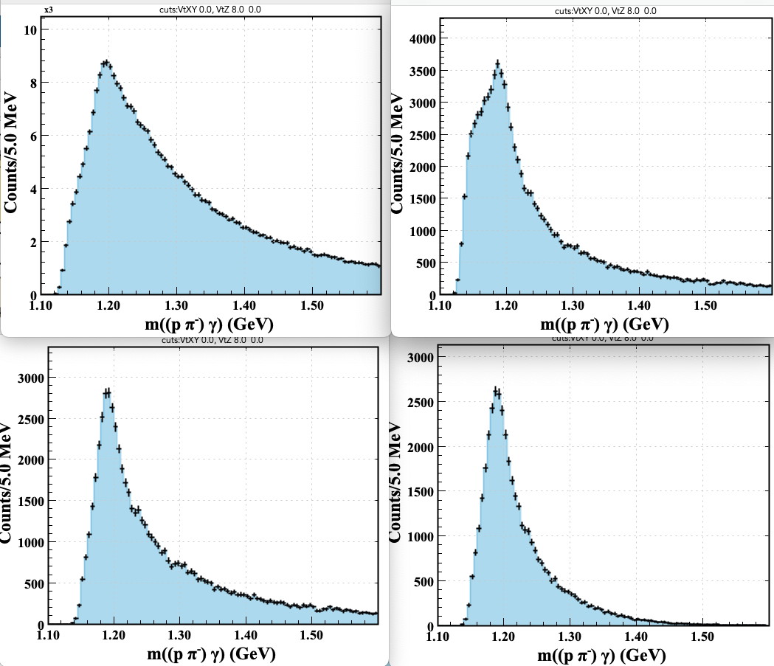
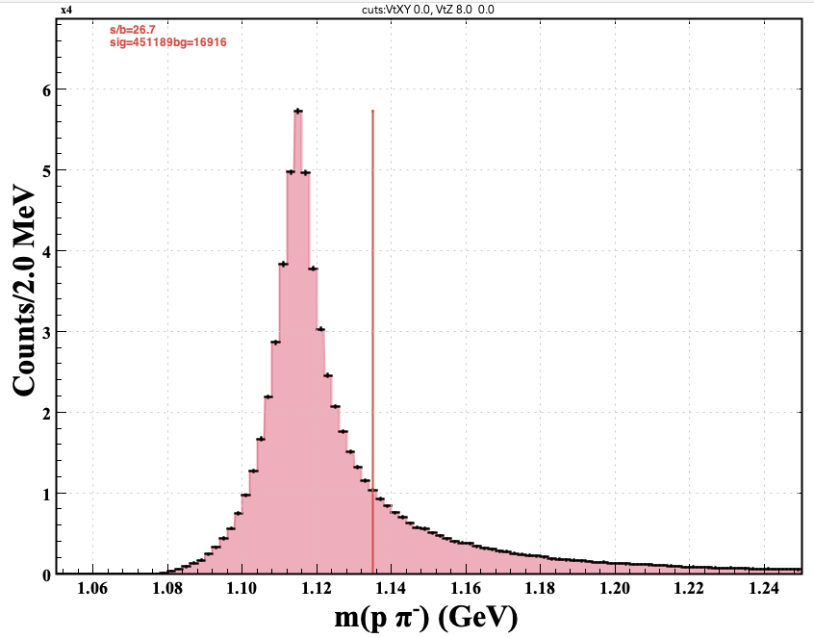
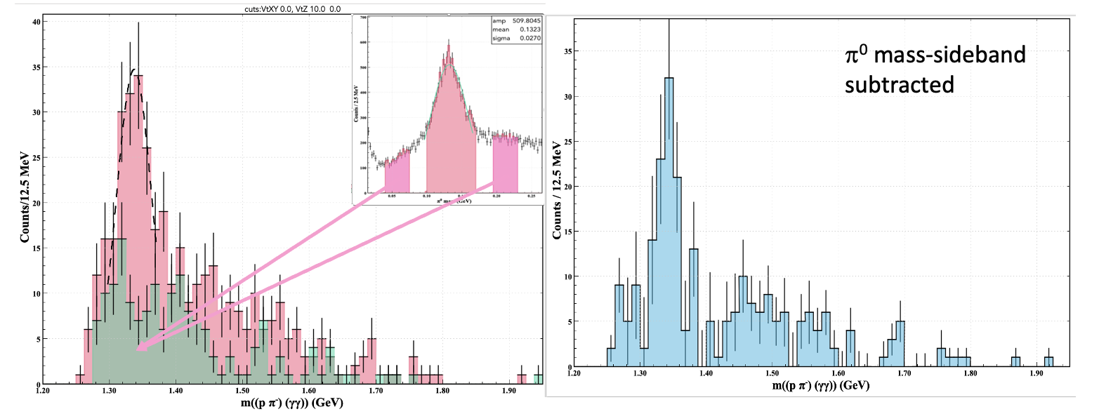
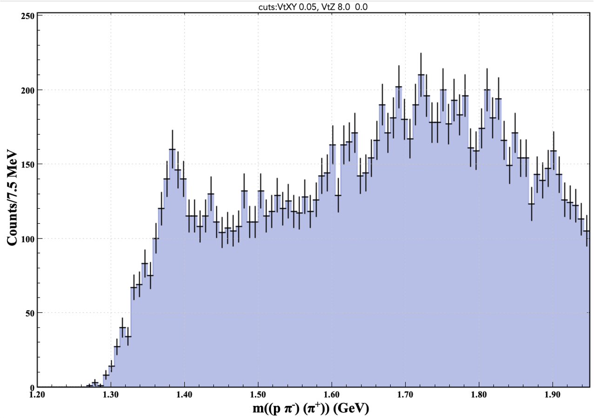
Combining Selected Λ with another Particle
RGA Pass-2 Data
Σ⁰
  m(pπ⁻)<1.135 GeV
  cos(Λγ)>0.6;
  γ ray w/in 5 cm of Λ vtx;
  250 <p(γ) MeV.
+ γ
π⁰ spectrum
Ξ⁰
π⁰ spectrum
+ π⁰
+ π⁺
Σ⁺
  No cuts on pion

Slide 10
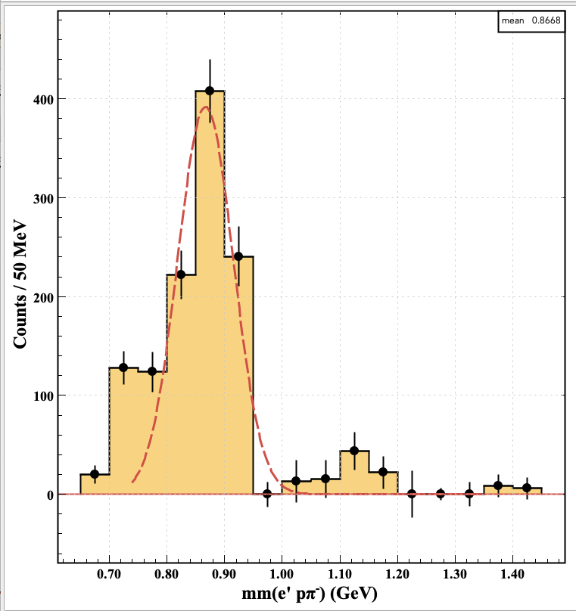
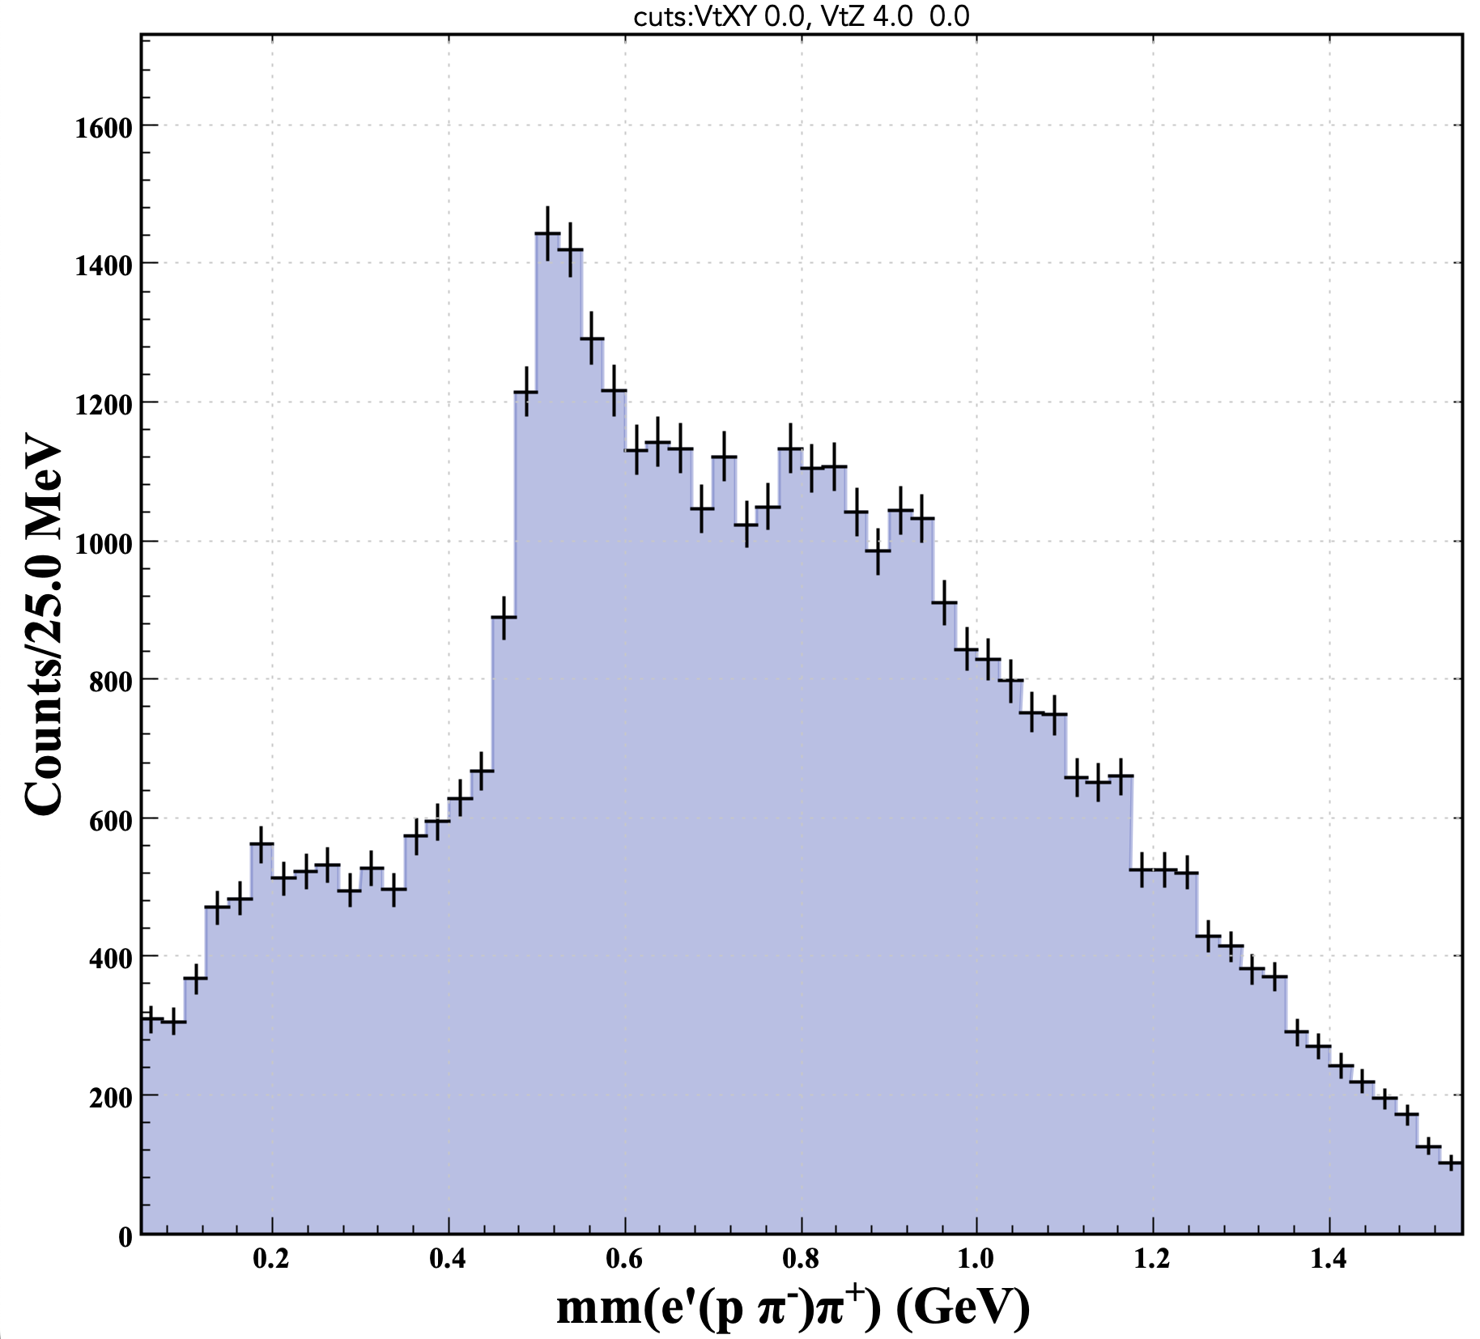
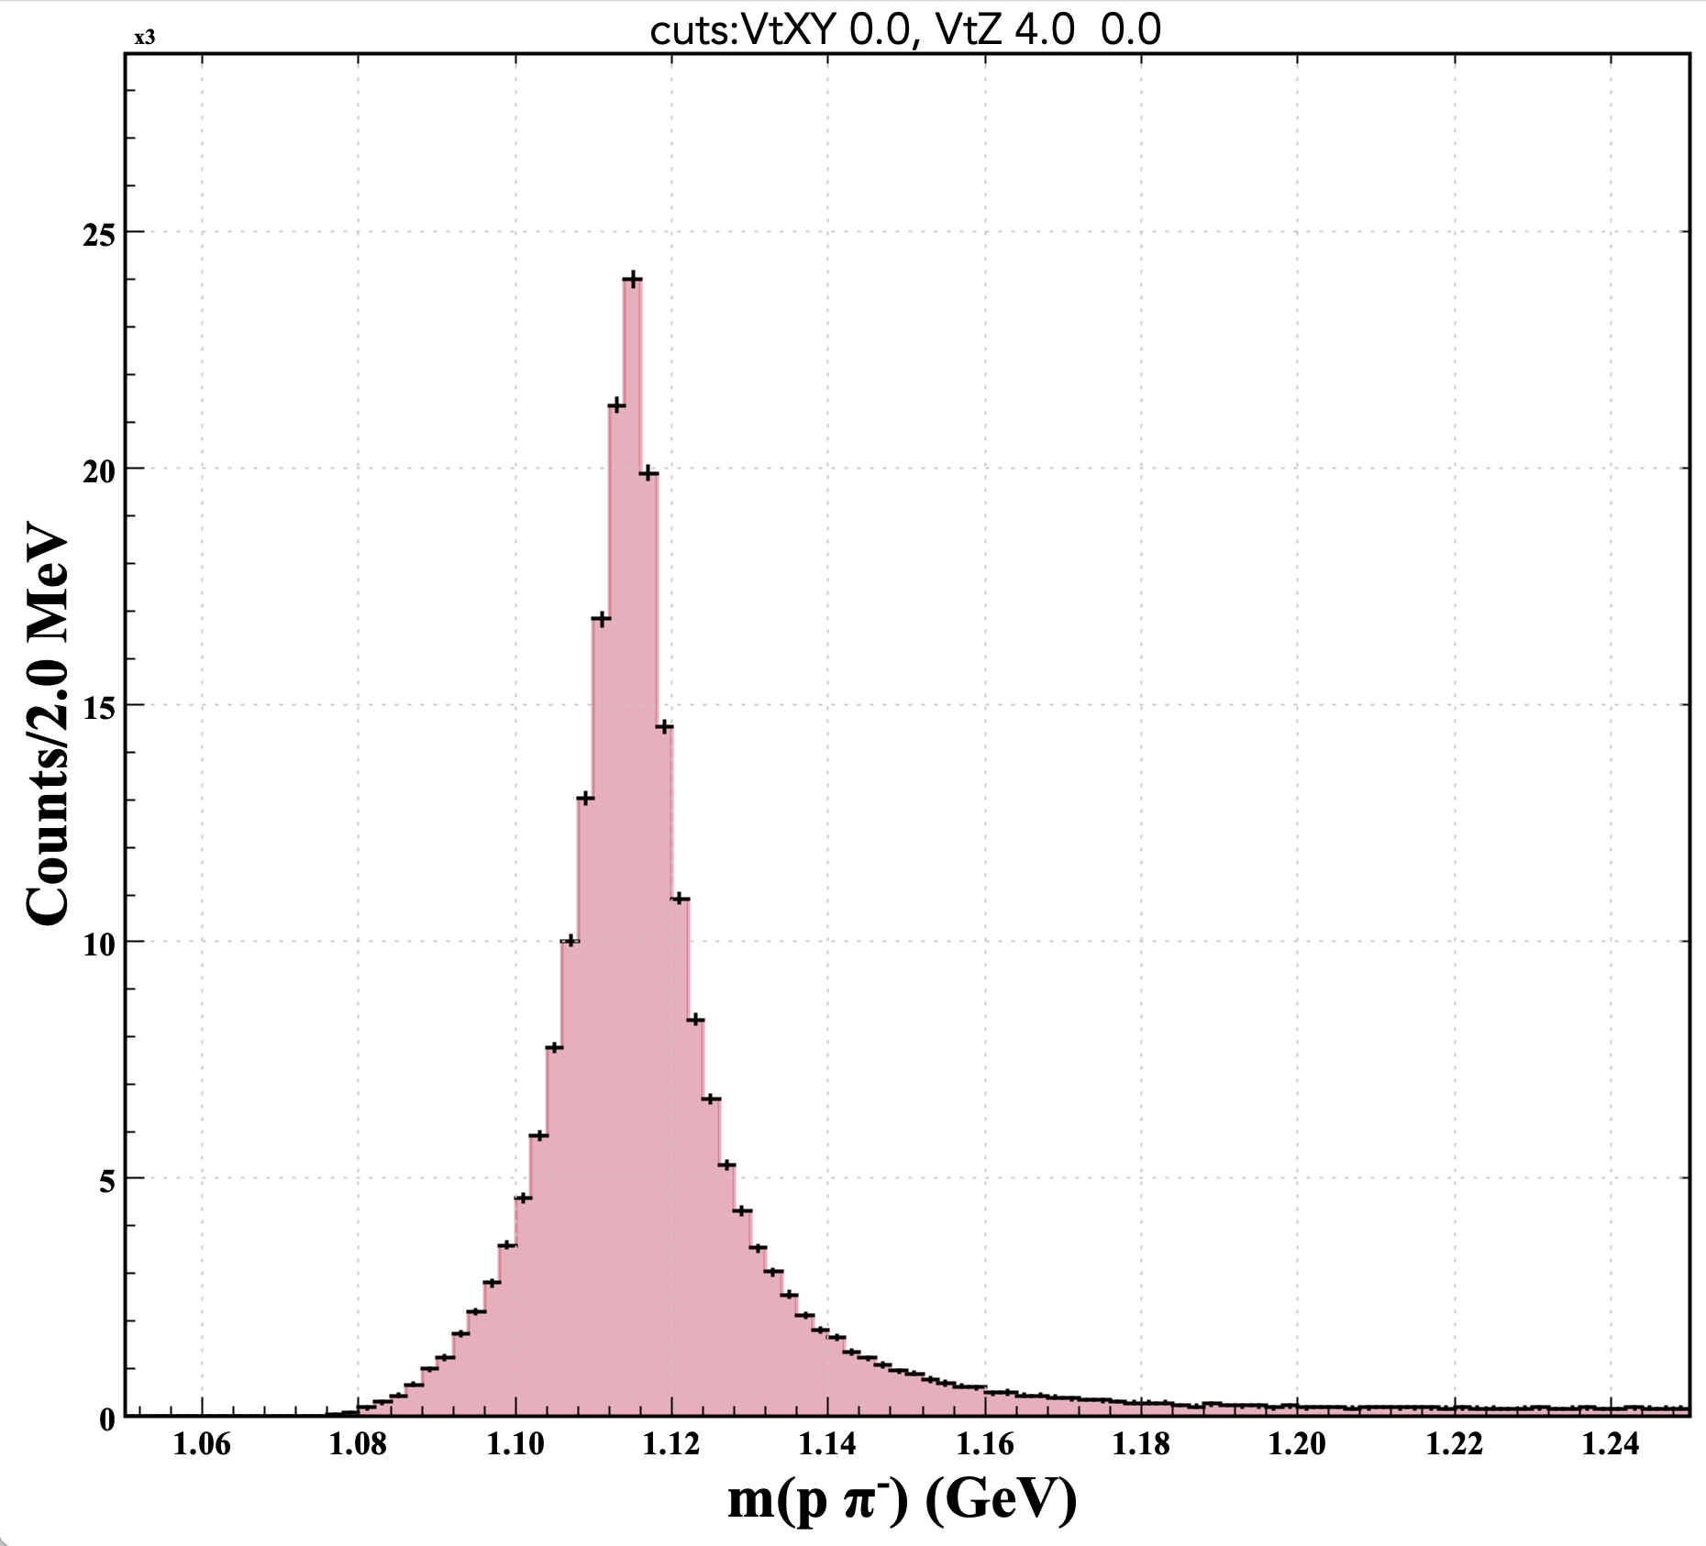
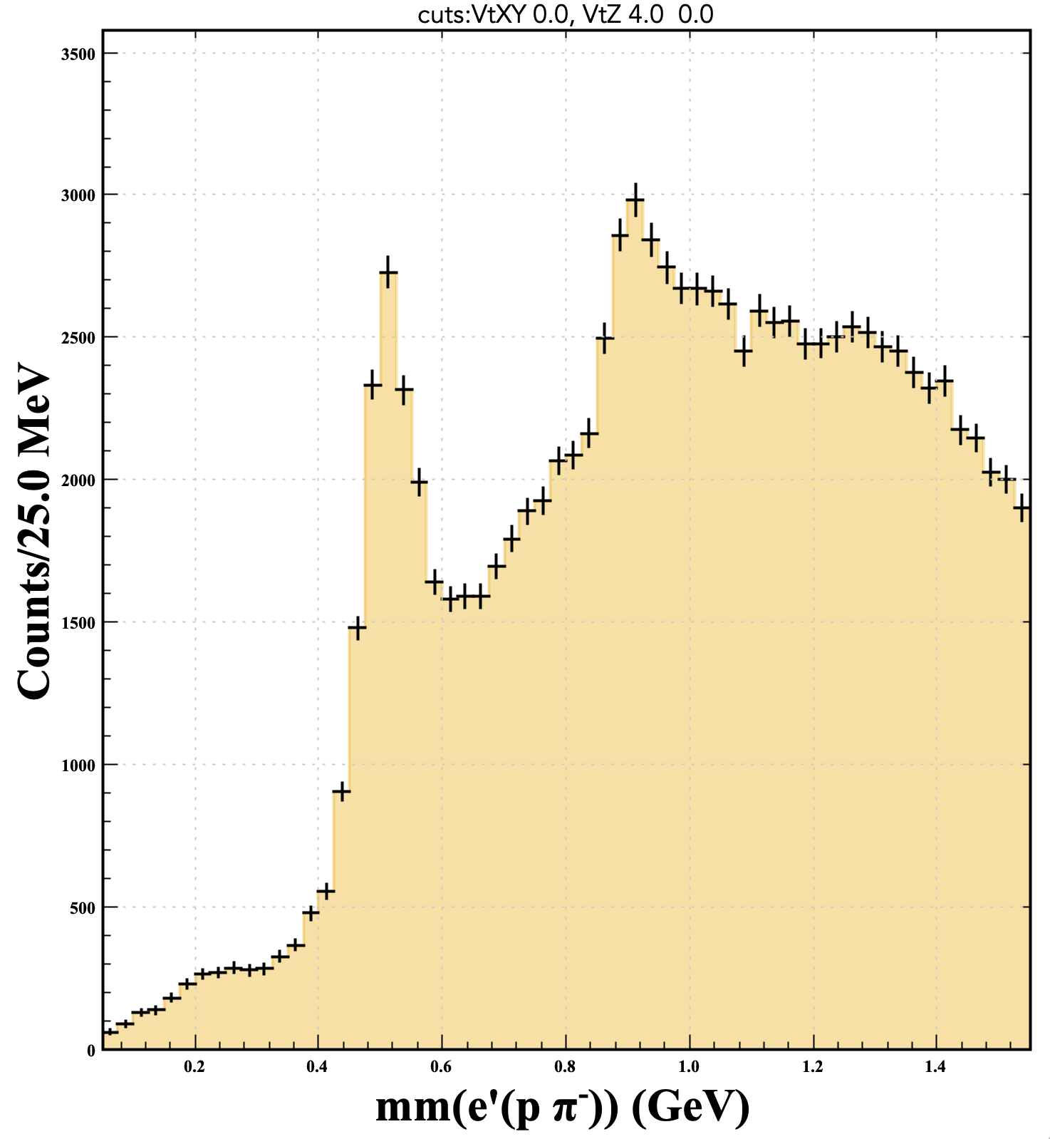
Preliminary Analyses Highlights (1)
First observation of ΛΚ∗(892) in electroproduction
using RGK Pass-2 Fall-18 Data
Clean Λ spectrum ➔ reduces background in extraction of physics observables from misreconstructed Λ candidates
K⁰ background-subtracted
Details → next talk

Slide 11
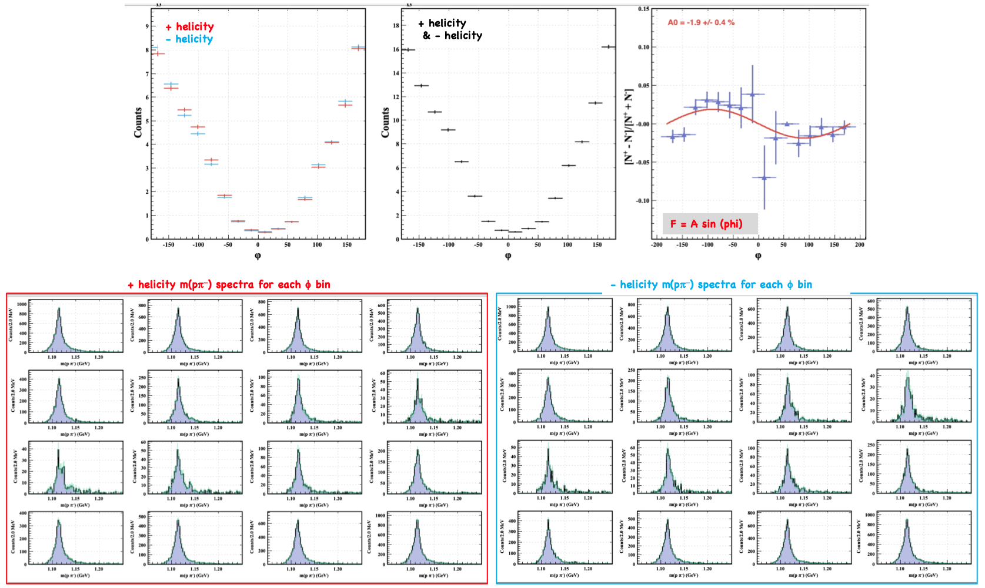
Preliminary Analyses Highlights (2)
BSA Studies using RGA Pass-2 Fall-18 Data
Very clean Λ distributions for all φ bins → no need for background subtraction
Details → talk at Deep Processes session yesterday

Slide 12
Summary
Λ skim in production
  Ongoing effort to include it in trains
Λ selection criteria yield very good signal purity
Λ skim used for several analysis
  Can do analyses too challenging to perform using the missing mass technique (e.g. ΛK* final state)
CLAS12 Note available
  https://misportal.jlab.org/mis/physics/clas12/viewFile.cfm/2024-008.pdf?documentId=174

Slide 13
Outlook
Semi-exclusive Λ skim allows analyses of multibody decays (e.g. ep→eΛΚ^{∗+}(→K⁺π⁻)) and sequential decays to a Λ with more precision than by the missing mass technique
Several analyses with Λ skim
  BSA
  Induced polarization studies
  Searches for strange baryons decaying to a Λ
  Study of the recoil against Ξ⁰◊Λπ⁰ ➔search for τ⁺ tetraquark state
  Λ SIDIS production off nuclei with RGE data(→Uditha Weerasinghe U. MISS)
Some analyses do not belong to a single working group (e.g. very strange+deep processes)
  Should we form a group dedicated to semi-exclusive Λ analyses ?
    What other analyses could be carried out using the Λ skim?
    Analyses techniques
    Simulations, trains for various Run Groups
    Momentum corrections (effect on Λ peak position)
    Data quality assessment for new runs
  Interest from different Run Groups?

Slide 14
BACKUP SLIDES

