Slide 1
AI-driven evaluation of $π^{+}n$ electroproduction cross sections and structure functions from the CLAS data
Andrey Golda
2024

Slide 2
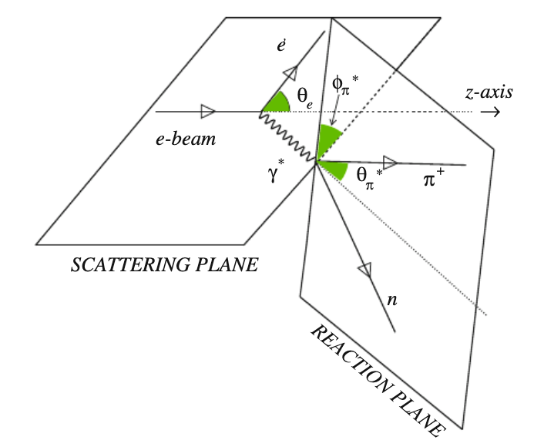
Kinematics of a single pion electroproduction
E – energy of the incoming electron beam
W - invariant mass of the final hadrons system
$Q^{2}$ - photon virtuality. (-1)*four momentum squared of virtual photon.
$θ$ – pion emission polar angle in the virtual-photon-target-proton CM frame
$φ$ - angle between the scattering plane and the reaction plane or azimuthal pion emission angle
$\frac{dσ}{dΩ}$ (W, $Q^{2}$, $θ$, $φ$,E)- differential cross-section

Slide 3
Objectives for AI/ML-driven Studies of the π⁺n Electroproduction Data
Explore AI/ML capabilities to evaluate two-fold differential π⁺n electroproduction cross section and to provide interpolation/extrapolation on the kinematics grid defined by the user. Validate the developed approach based on the accuracy of the experimental data description.
Explore AI/ML capabilities to establish the dynamics of π⁺n electroproduction reaction from the studies of multi-dimensional correlations in the measured observables, in particular, the ability to reproduce the dependence of π⁺n differential cross sections from angle φ (see Eq in slide #4) imposed by single photon exchange dynamics
Explore capabilities of AI/ML for extraction of π⁺n exclusive structure functions

Slide 4
The final π⁺ distribution over azimuthal angle ϕ
Rotational properties of the production amplitudes
Single photon exchange for $ep→e′π^{+}n$ reaction
Is AI/ML capable of reconstructing the ϕ−dependence from the studies of the measured two-fold differential cross sections?
Can the use of AI/ML improve knowledge of exclusive structure functions beyond the limitations imposed by restricted data coverage over azimuthal/polar angles?

Slide 5
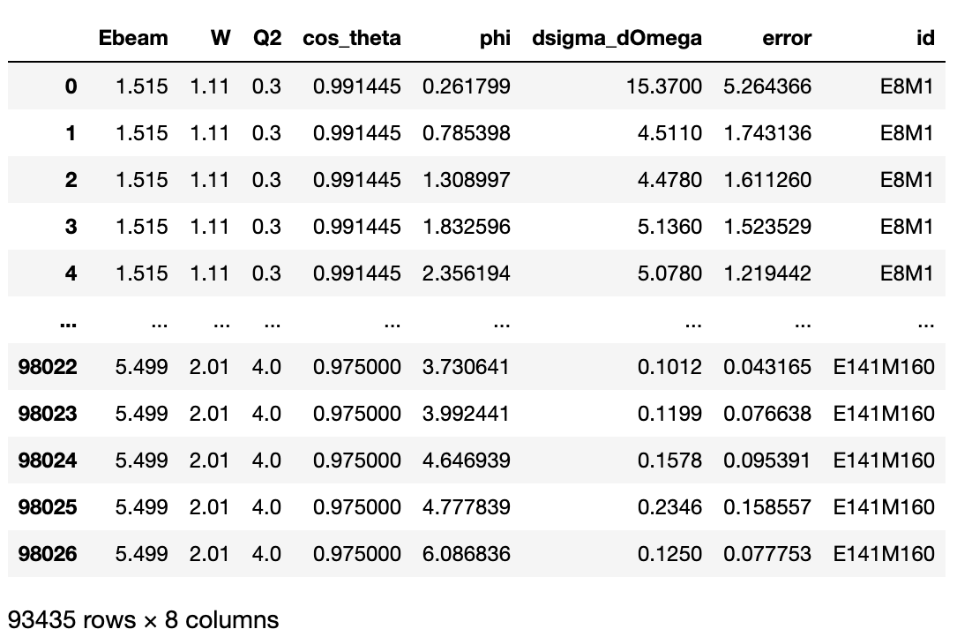
Input – Dataset from the Measurements with CLAS
The measured cross sections are storedCLAS Physics Database
created in collaboration between Hall B at Jefferson Lab and SINP MSU
https://clas.sinp.msu.ru/cgi-bin/jlab/db.cgi
Beam energies for the data included in AI/ML studies:
$$E, GeV ∈\{5.754, 5.499, 1.515\}$$

Slide 6
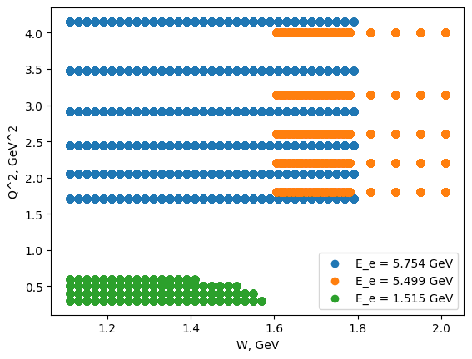
Input – Kinematic coverage of the measured with CLAS π⁺n cross sections

Slide 7
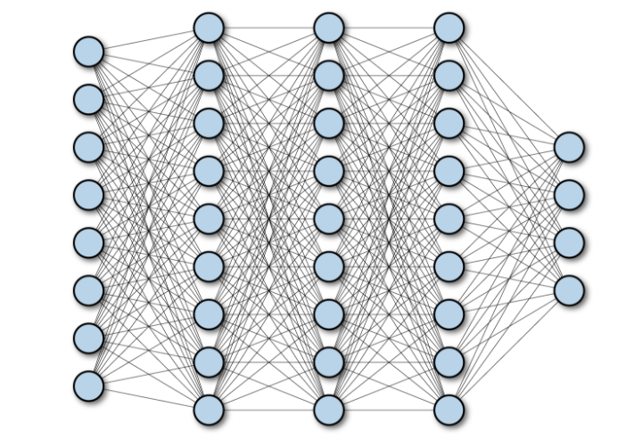
The neural Network
Input – experimental data
Neural Network
Output – prediction of $\frac{dσ}{dΩ}$
This work consists of training a neural network based on the presented dataset to be able to predict differential cross sections on the user-defined grid of kinematic variables

Slide 8
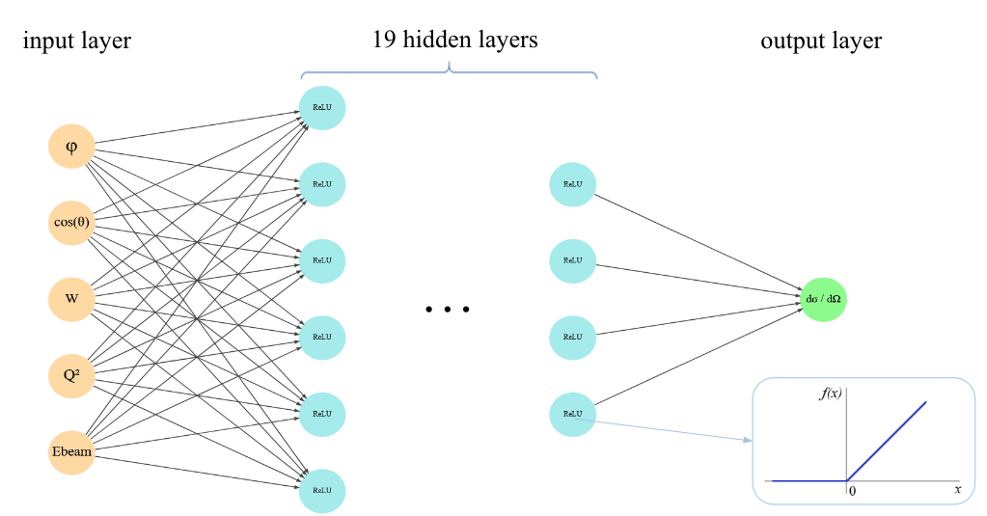
Network architecture
Rumelhart, D., Hinton, G. & Williams, R.
Learning representations by back-propagating errors. Nature 323, 533–536 (1986). https://doi.org/10.1038/323533a0

Slide 9
Validation – baseline: Quality of the training
$$MAE= \frac{1}{N} \sum_{i}^{i=N}{\left|{y_{i}}^{experimental}−{\hat{y_{i}}}^{predicted}\right|}$$
Average value and statistical error of cross sections (experimental):
Mean absolute error of cross-section prediction on a test sample:
MAE error is smaller than average error of differential cross-section.
Good quality of training!

Slide 10
Validation – examples
E = 5.754 $GeV$; $Q^{2}$ = 2.915 ${GeV}^{2}$
1st, 2nd, 3rd resonance regions
&
Structure functions

Slide 11
E = 5.754 $GeV$; $Q^{2}$ = 2.915 ${GeV}^{2}$ - 1st resonance maximum
Red dots with error bars – experimental data
Blue line – fit of the experimental data by Eq. in slide #4
Green line - Neural network predictions with uncertainties shown by green areas obtained from bootstrap
good description of the φ-dependence
AI/ML is capable of determining
φ-dependence of π⁺n differential cross sections from the multi-dimensional data analysis
AI/ML provides predictions for π⁺n differential cross sections within φ-ranges where the data are not available

Slide 12
E = 5.754 $GeV$; $Q^{2}$ = 2.915 ${GeV}^{2}$ - 2nd resonance maximum
Red dots with error bars – experimental data
Blue line – fit of the experimental data by Eq. in slide #4
Green line - Neural network predictions with uncertainties shown by green areas obtained from bootstrap.

Slide 13
E = 5.754 $GeV$; $Q^{2}$ = 2.915 ${GeV}^{2}$ - 3rd resonance maximum
Red dots with error bars – experimental data
Blue line – fit of the experimental data by Eq. in slide #4
Green line - Neural network predictions with uncertainties shown by green areas obtained from bootstrap

Slide 14
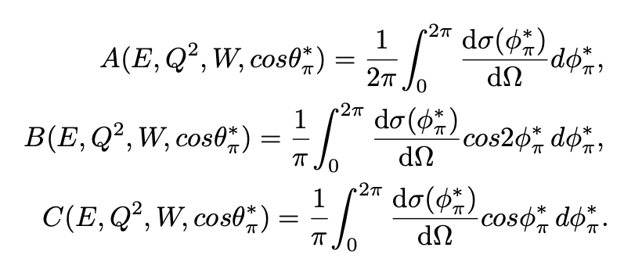
Structure functions from the moments over φ for the predicted cross-sections

Slide 15
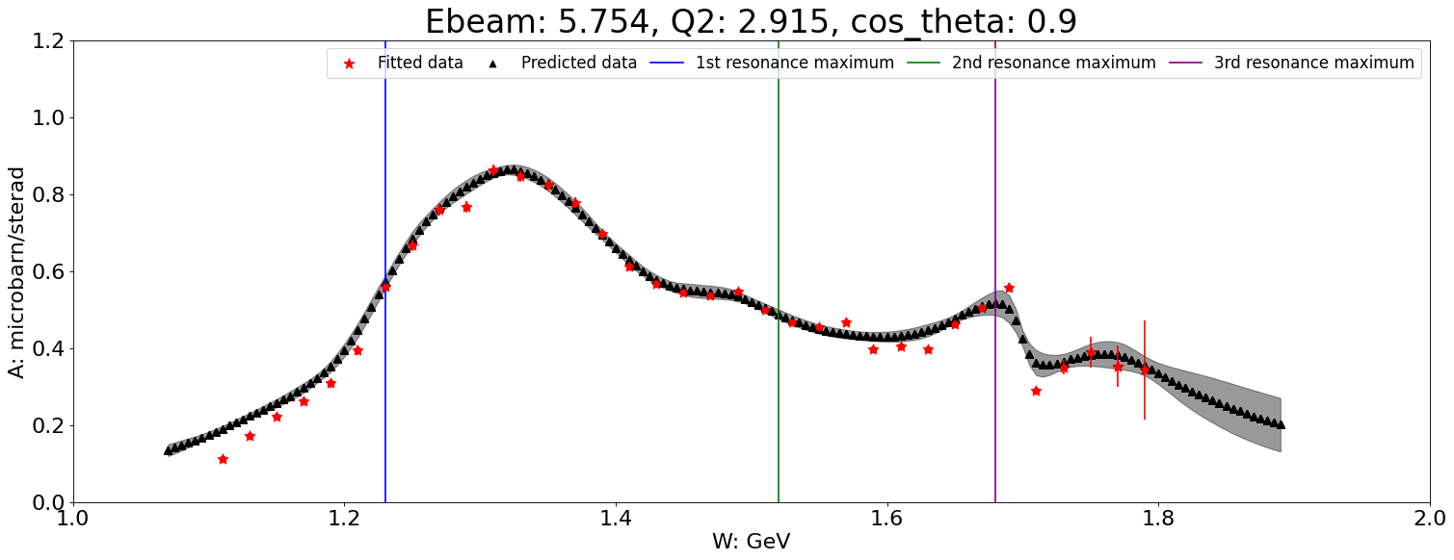
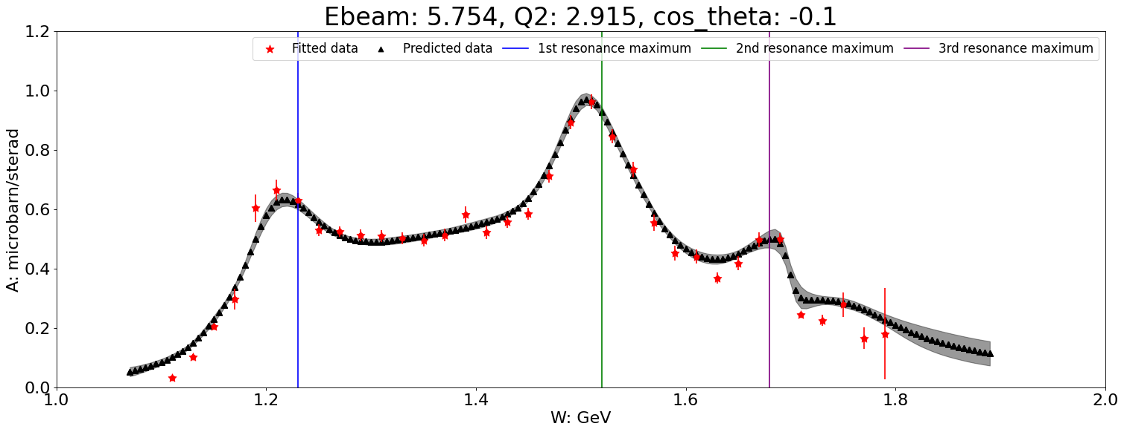
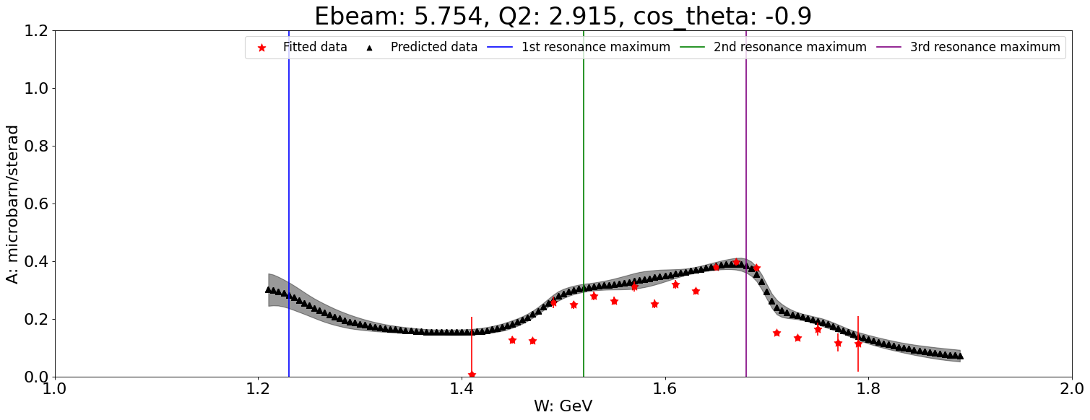
E = 5.754 $GeV$; $Q^{2}$ = 2.915 ${GeV}^{2}$ - A function defined in slide # 4
Red dots with error bars – structure functions from the experimental data fit by Eq in slide #4
Black line – predicted structure function obtained from the moments of the predicted within AI/ML cross sections with uncertainties from bootstrap
Blue line – the center of the 1st resonance region (W=1.23 GeV)
Green line – the center of the 2nd resonance region (W=1.52 GeV)
Purple line – the center of 3rd resonance region for π⁺n (W=1.68 GeV)

Slide 16
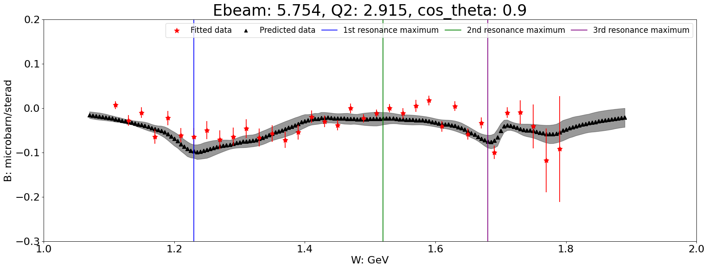
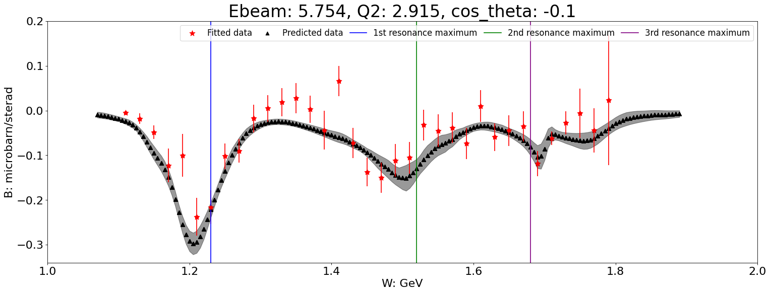
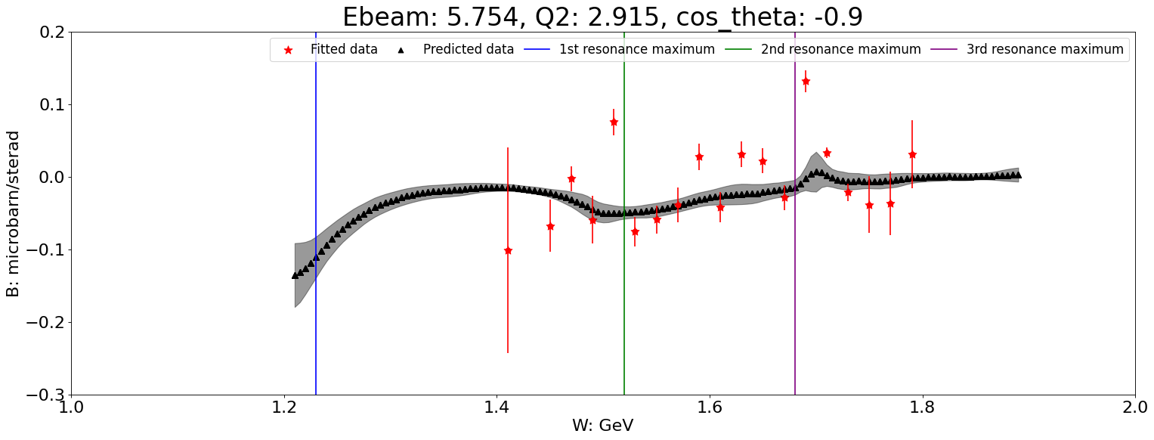
E = 5.754 $GeV$; $Q^{2}$ = 2.915 ${GeV}^{2}$ - B function
Red dots with error bars – structure functions from the experimental data fit by Eq in slide #4
Black line – predicted structure function obtained from the moments of the predicted within AI/ML cross sections with uncertainties from bootstrap
Blue line – the center of the 1st resonance region (W=1.23 GeV)
Green line – the center of the 2nd resonance region (W=1.52 GeV)
Purple line – the center of 3rd resonance region for π⁺n (W=1.68 GeV)

Slide 17
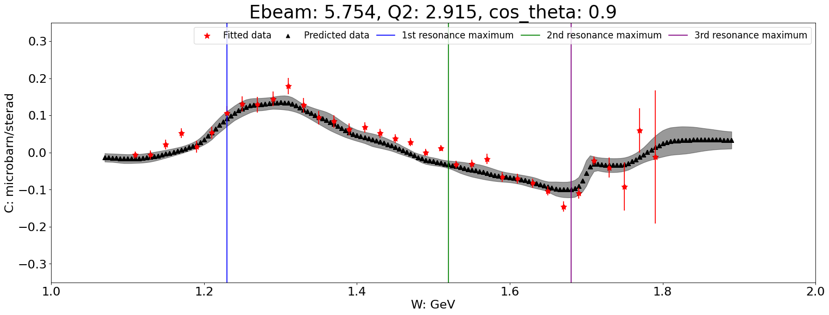
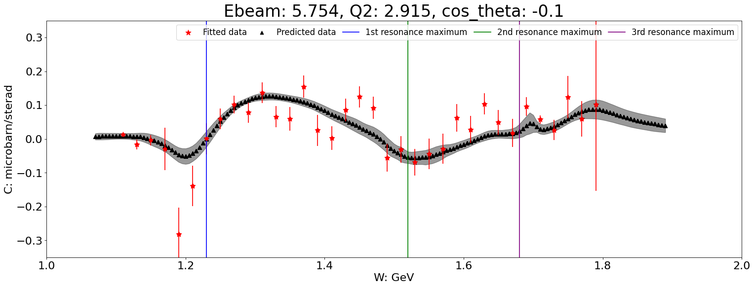
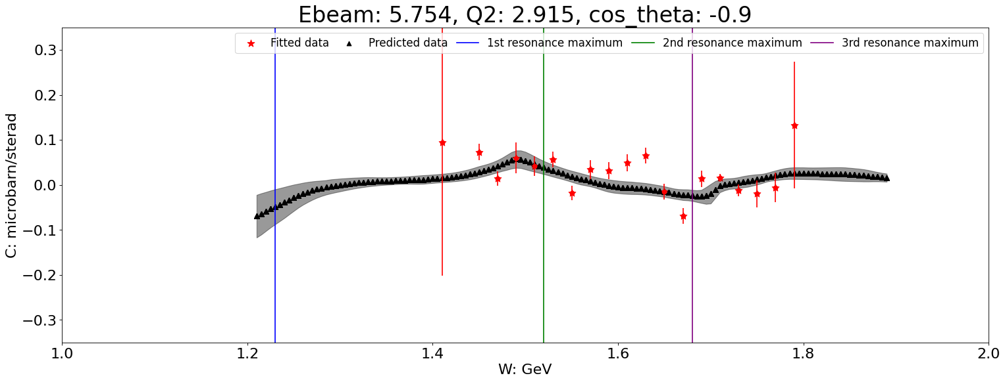
E = 5.754 $GeV$; $Q^{2}$ = 2.915 ${GeV}^{2}$ - C function
Red dots with error bars – structure functions from the experimental data fit by Eq in slide #4
Black line – predicted structure function obtained from the moments of the predicted within AI/ML cross sections with uncertainties from bootstrap
Blue line – the center of the 1st resonance region (W=1.23 GeV)
Green line – the center of the 2nd resonance region (W=1.52 GeV)
Purple line – the center of 3rd resonance region for π⁺n (W=1.68 GeV)

Slide 18
Conclusions
The AI/ML-driven approach for evaluations of the $π^{+}n$ differential cross sections and structure functions from the data measured with CLAS has been developed. The approach reproduces the available experimental results with good accuracy and offers predictions for $π^{+}n$electroproduction observables within the area of $1.1 GeV<W< 2 GeV and 0.5{ GeV}^{2}<Q2<4 {GeV}^{2}.$
AI/ML algorithms establish the φ-dependence of $π^{+}n$ cross sections from multi-dimensional data analysis without prior knowledge.
AI/ML algorithms allow us to evaluate $π^{+}n$ differential cross section within the angular areas where the experimental data are not available from multi-dimensional data analysis
The structure functions for $π^{+}n$electroproduction have been deduced from the CLAS data at $1.1 GeV<W< 2 GeV and 0.5{ GeV}^{2}<Q2<4 {GeV}^{2}$

Slide 19
Thank you for your attention!

