Slide 1
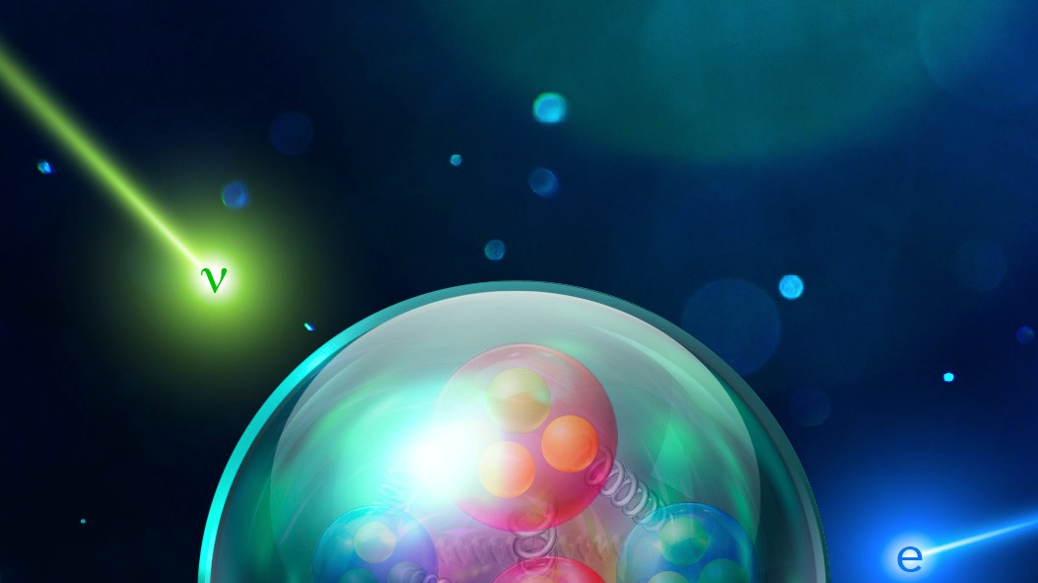




Unveiling neutrino interactions with new data from CLAS
Julia Tena Vidal at Tel Aviv University
on behalf of the e4nu and CLAS collaborations

Slide 2
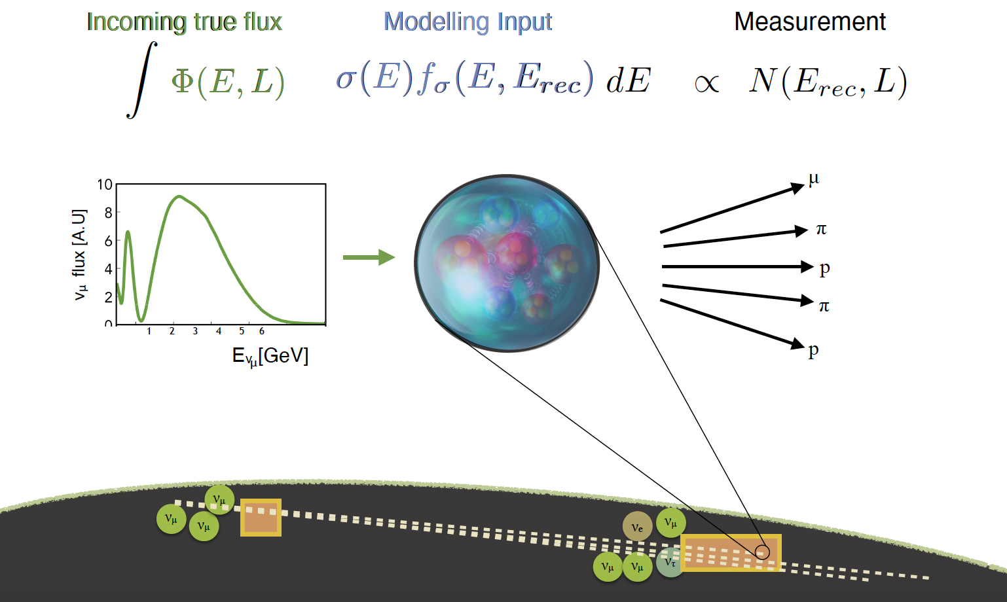
The next generation of neutrino experiments challenge

Slide 3
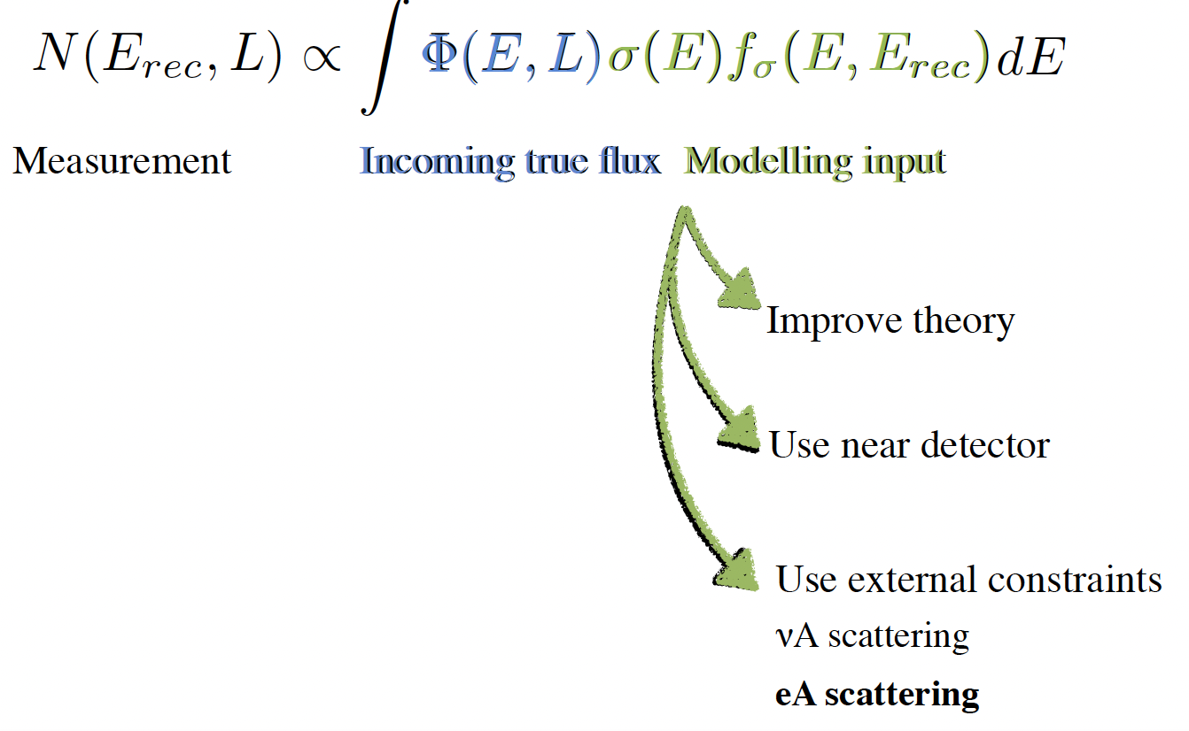
The next generation of neutrino experiments challenge

Slide 4
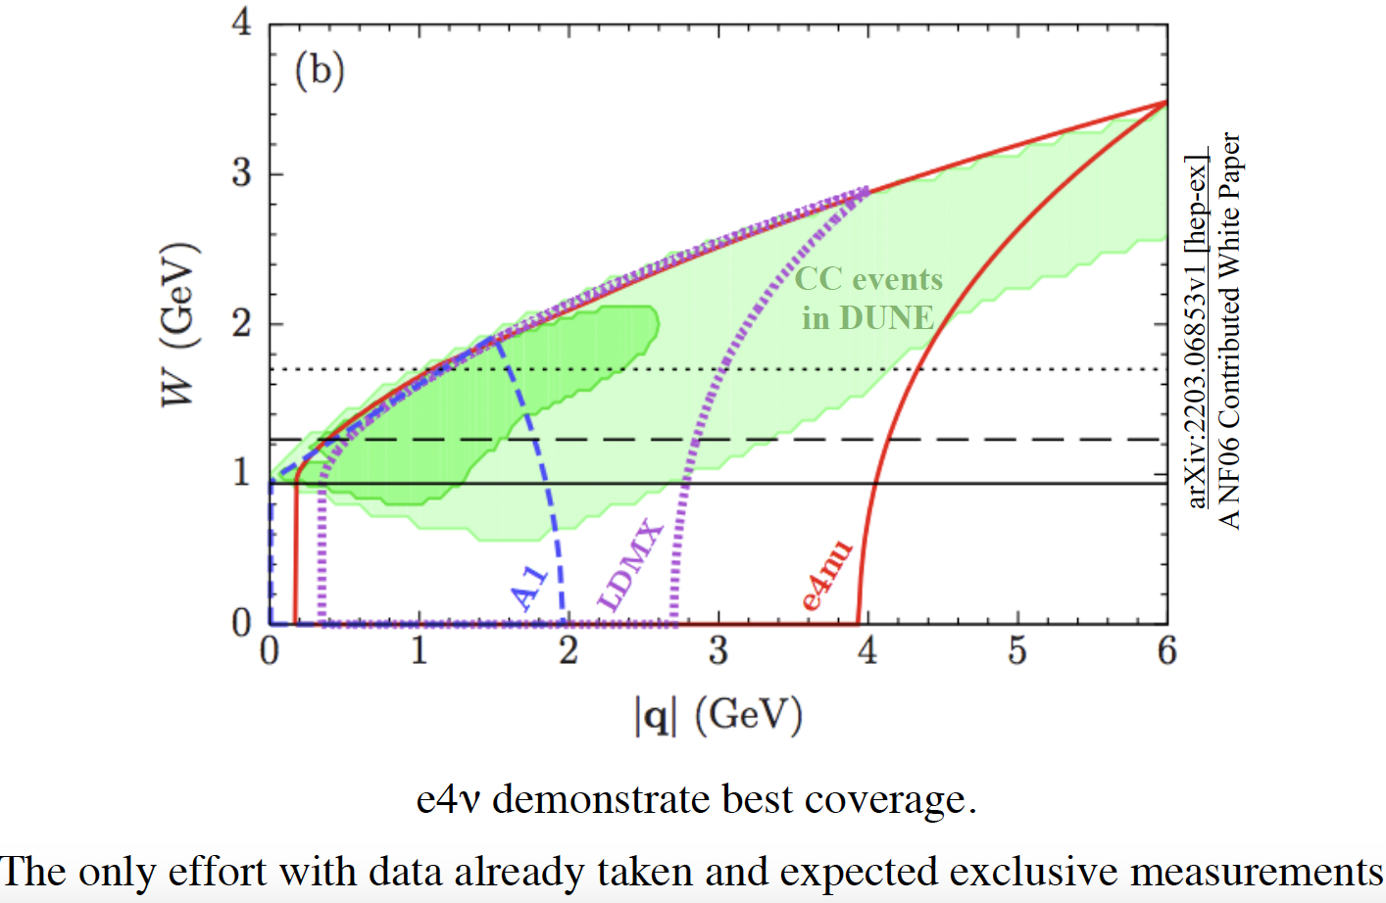
Phase space of interest for neutrino experiments
/CLAS

Slide 5
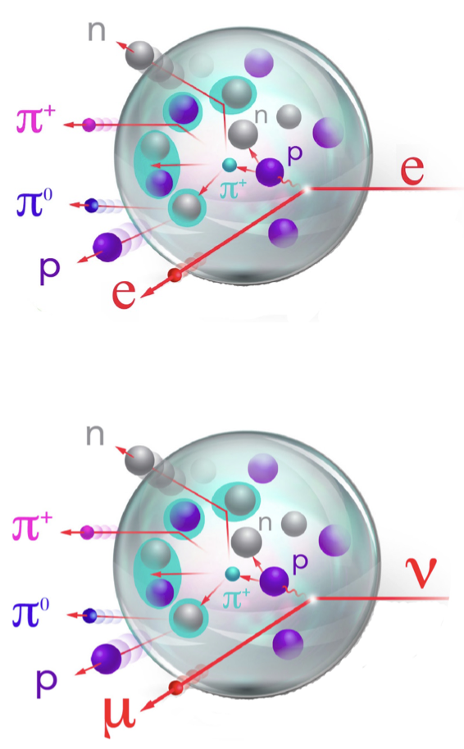
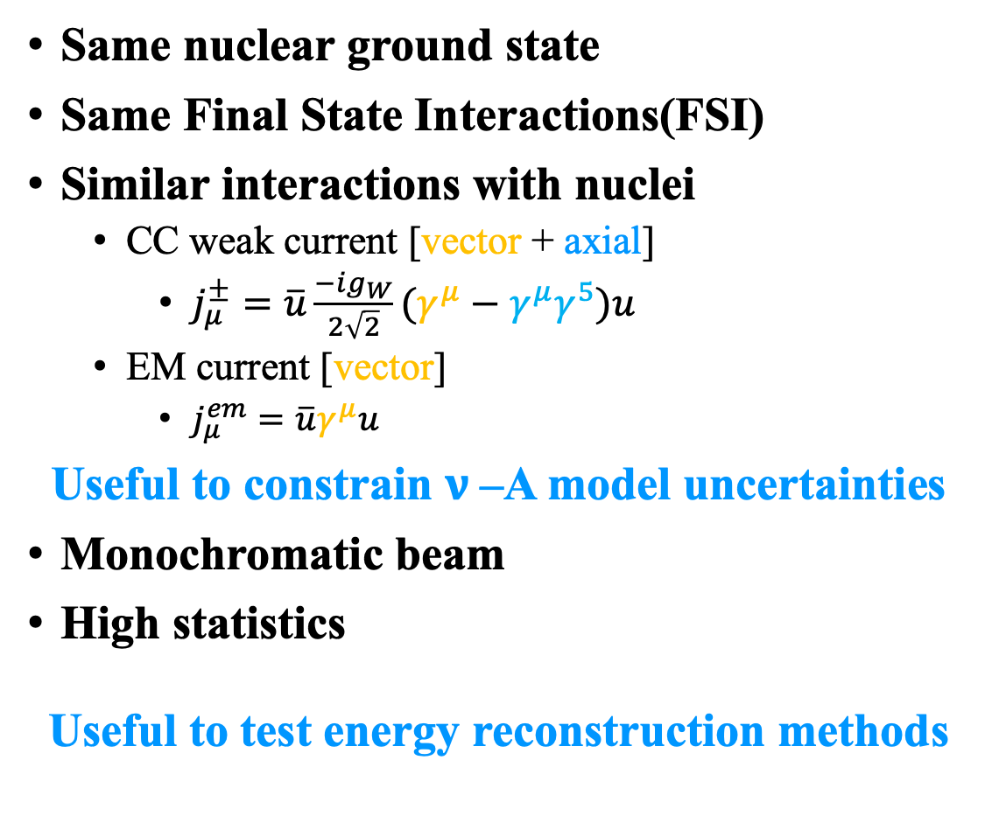
Electrons for neutrinos
Same nuclear ground state
Same Final State Interactions(FSI)
Similar interactions with nuclei
  CC weak current [vector + axial]
    $j_{μ}^{±}=\overline{u}\frac{−ig_{W}}{2\sqrt{2}}(γ^{μ}−γ^{μ}γ^{5})u$
  EM current [vector]
    $j_{μ}^{em}=\overline{u}γ^{μ}u$
Useful to constrain $ν$–A model uncertainties
Monochromatic beam
High statistics
Useful to test energy reconstruction methods

Slide 6

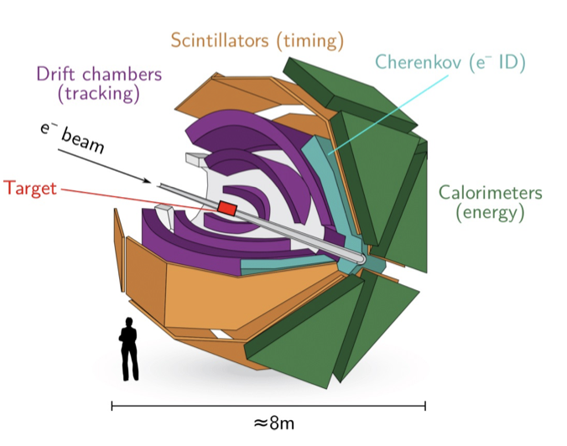
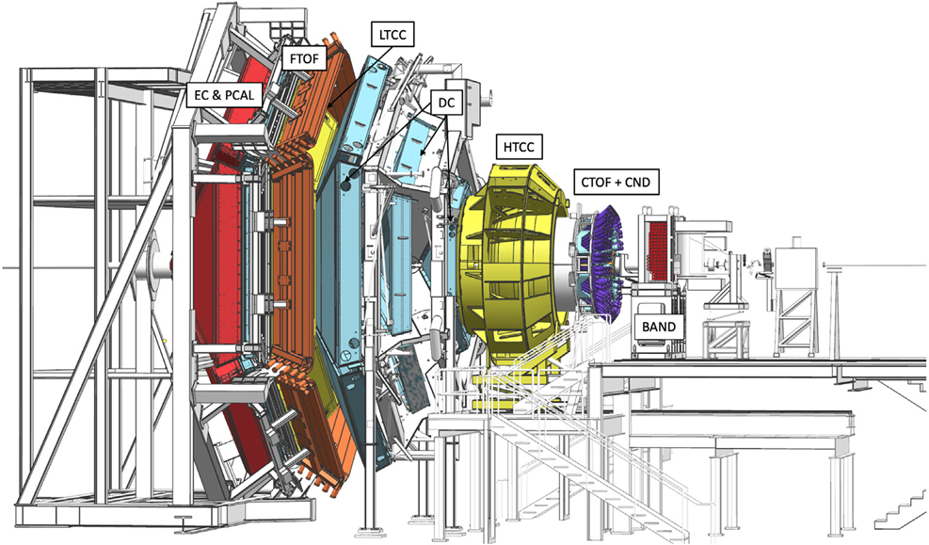
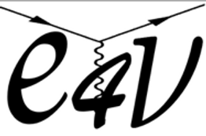
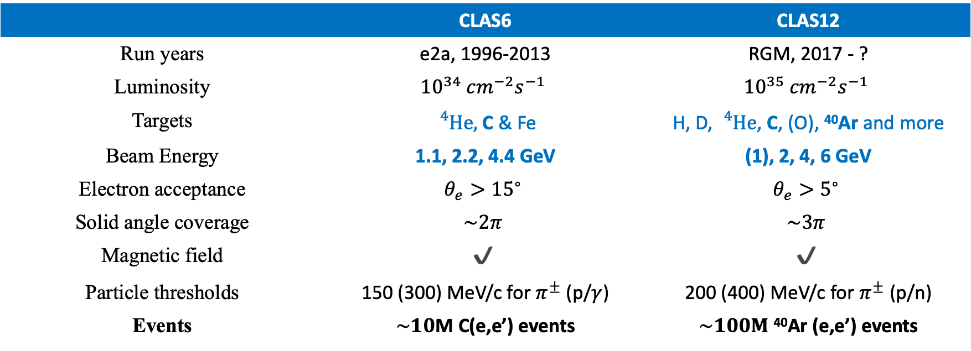
Hadron production with CLAS
 | CLAS6 | CLAS12
Run years | e2a, 1996-2013 | RGM, 2017 - ?
Luminosity | $${10}^{34} {cm}^{−2}s^{−1}$$ | $${10}^{35} {cm}^{−2}s^{−1}$$
Targets | ${}_{}^{4}{He},$ C & Fe | H, D, ${}_{}^{4}{He}$, C, (O), ⁴⁰Ar and more
Beam Energy | 1.1, 2.2, 4.4 GeV | (1), 2, 4, 6 GeV
Electron acceptance | $$θ_{e}>{15}^{∘}$$ | $$θ_{e}>5^{∘}$$
Solid angle coverage | $$\sim 2π$$ | $$\sim 3π$$
Magnetic field | $$✔️$$ | $$✔️$$
Particle thresholds | 150 (300) MeV/c for $π^{±}$ (p/$γ$) | 200 (400) MeV/c for $π^{±}$ (p/n)
Events | $\sim 10$M C(e,e’) events | $\sim 100M$ ⁴⁰Ar (e,e’) events

Slide 7


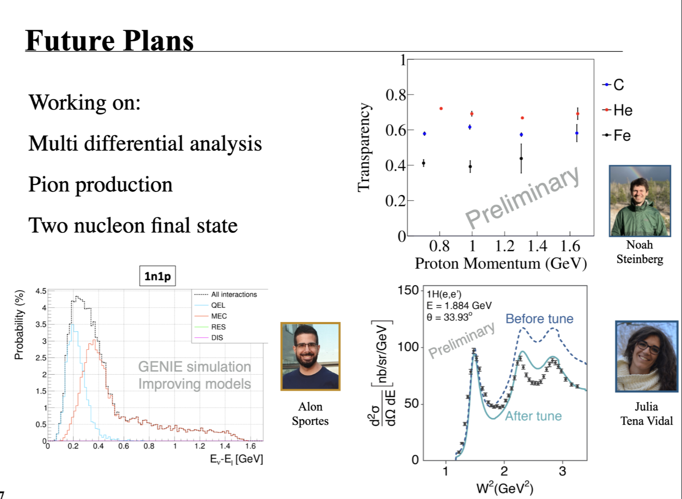













New electron-scattering data
(I) Inclusive
(I) Proton transparency
(III) Two nucleon
CLAS12
CLAS6
Next talk!
CLAS12
$$e^{−}$$
$$e^{−}$$
$$e^{−}$$
p
Steven Dytman
Sportes
p
$$e^{−}$$
Ar
$$e^{−}$$
C
$$e^{−}$$
CLAS Approved
Publication under review
N
Nearing completion
Nearing completion
(IV) Pion production
CLAS12
CLAS6
CLAS6
$$e^{−}$$
$$e^{−}$$
$$e^{−}$$
$$Nπ$$
1$π$
by J. Tena Vidal
$$π$$
by Caleb Fogler
D
$$e^{−}$$
C
C
$$e^{−}$$
$$e^{−}$$
X
p
Nearing completion
Nearing completion
1-6 GeV electrons for many targets (e.g. carbon, argon)

Slide 8
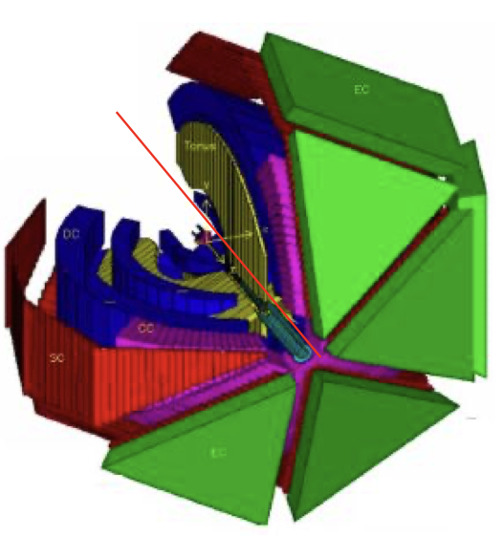
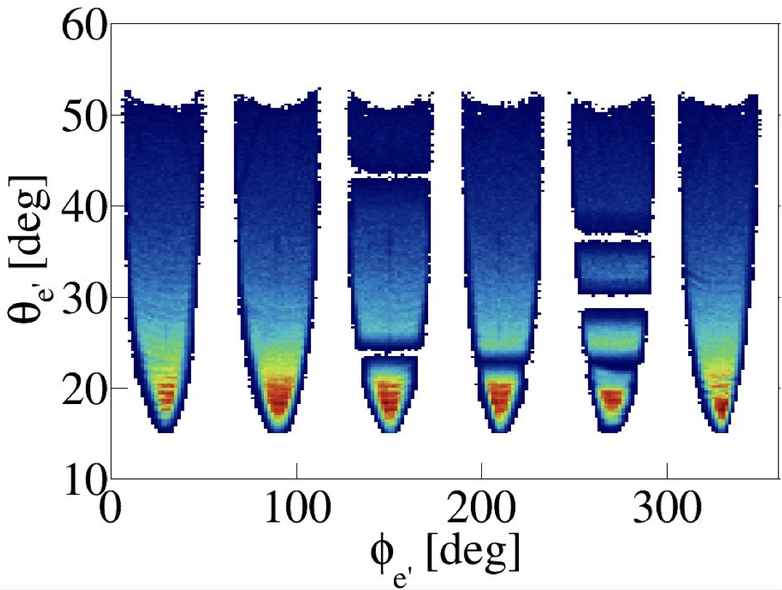

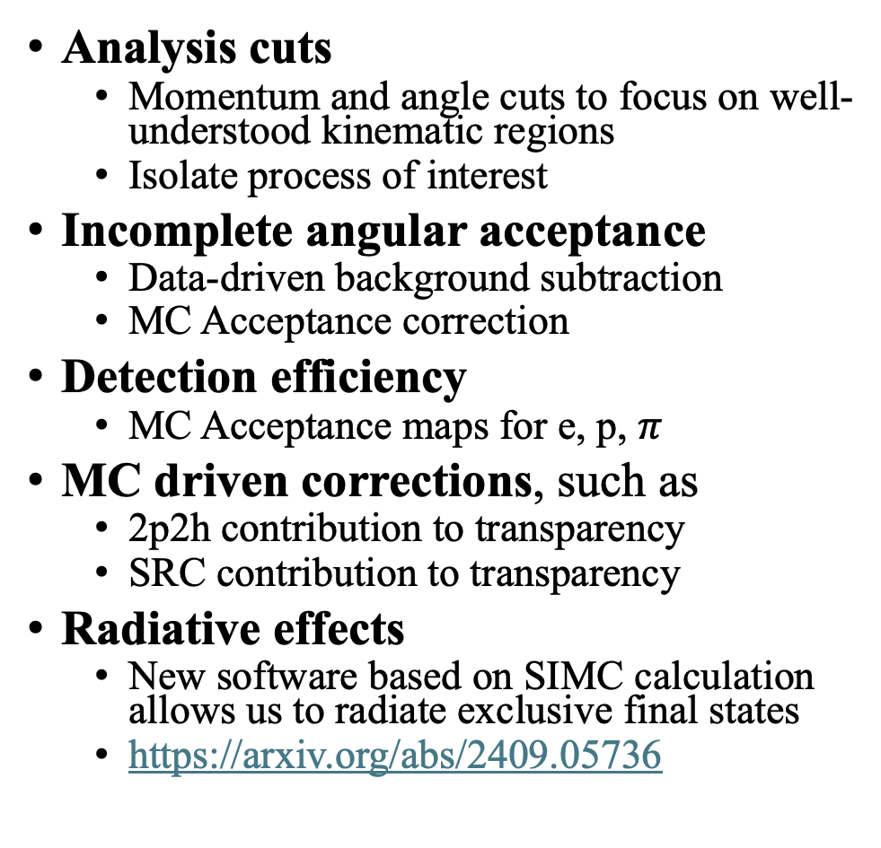


Analysis challenges
Analysis cuts
  Momentum and angle cuts to focus on well-understood kinematic regions
  Isolate process of interest
Incomplete angular acceptance
  Data-driven background subtraction
  MC Acceptance correction
Detection efficiency
  MC Acceptance maps for e, p, $π$
MC driven corrections, such as
  2p2h contribution to transparency
  SRC contribution to transparency
Radiative effects
  New software based on SIMC calculation allows us to radiate exclusive final states
  https://arxiv.org/abs/2409.05736
~50% of “4π” coverage
  Data-driven background subtraction
$$π^{−}$$
$$p$$
$$π^{+}$$

Slide 9
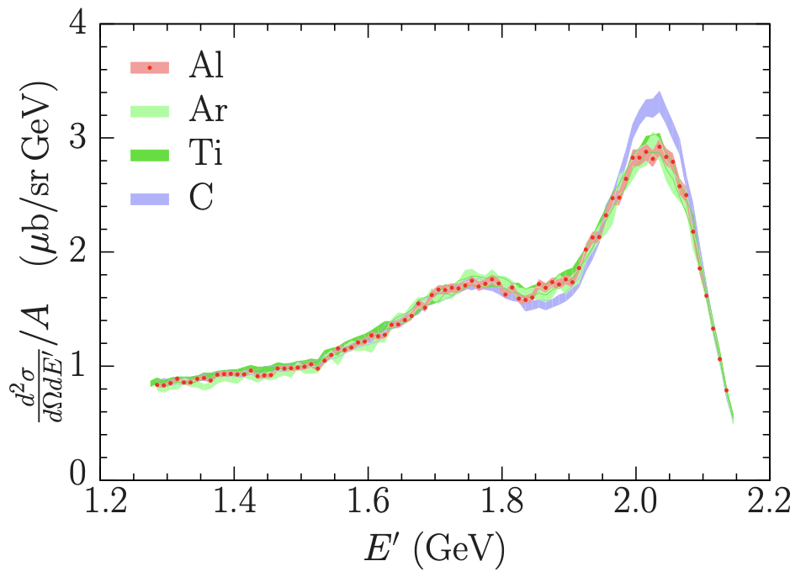

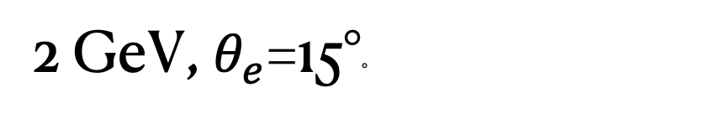


New Inclusive on C and Ar
CLAS12
$$e^{−}$$
$$e^{−}$$
Ar
2 GeV, $θ_{e}$=15°◦
@ PhysRevC.100.054606 (2019)
@ PhysRevC.99.054608 (2019)
@ PhysRevC.98.014617 (2018)
@ PhysRevC.98.014617 (2018)
Consistent with previous measurements from JLab Hall A
Different nuclear structure!
2.222 GeV, $θ_{e}$=15.54°◦
PRELIMINARY
CLAS12 data
Carbon
Argon

Slide 10

New Inclusive on C and Ar
CLAS12
$$e^{−}$$
$$e^{−}$$
Ar
2 GeV, $θ_{e}$=15°◦
@ PhysRevC.100.054606 (2019)
@ PhysRevC.99.054608 (2019)
@ PhysRevC.98.014617 (2018)
@ PhysRevC.98.014617 (2018)
Consistent with previous measurements
Different nuclear structure!
2.222 GeV, $θ_{e}$=15.54°◦
PRELIMINARY
Carbon
Argon

Slide 11















Unprecedented angular coverage
CLAS12
$$e^{−}$$
$$e^{−}$$
Ar
2 GeV on C & Ar
250
$θ_{e}$=10°
$θ_{e}$=11°
$θ_{e}$=12°
$θ_{e}$=13°
$θ_{e}$=14°
150
CLAS12 data
Carbon
Argon
PRELIMINARY
PRELIMINARY
PRELIMINARY
PRELIMINARY
PRELIMINARY
50
250
$θ_{e}$=15°
$θ_{e}$=16°
$θ_{e}$=17°
$θ_{e}$=18°
$θ_{e}$=19°
Cross Section / Mott / A
PRELIMINARY
150
PRELIMINARY
PRELIMINARY
PRELIMINARY
PRELIMINARY
50
250
$θ_{e}$=20°
$θ_{e}$=21°
$θ_{e}$=22°
$θ_{e}$=23°
$θ_{e}$=24°
150
PRELIMINARY
PRELIMINARY
PRELIMINARY
PRELIMINARY
PRELIMINARY
50
0
0.6
1.2
0
0.6
1.2
0
0.6
1.2
0
0.6
1.2
0
0.6
1.2
Energy Transfer [GeV]

Slide 12



Unprecedented angular coverage
CLAS12
$$e^{−}$$
$$e^{−}$$
Ar
2 GeV on C & ⁴⁰Ar
Dominated by
250
QEL
$θ_{e}$=12°
$θ_{e}$=10°
$θ_{e}$=11°
$θ_{e}$=13°
$θ_{e}$=14°
150
CLAS12 data
Carbon
Argon
PRELIMINARY
PRELIMINARY
PRELIMINARY
PRELIMINARY
PRELIMINARY
50
250
$θ_{e}$=15°
$θ_{e}$=16°
$θ_{e}$=17°
$θ_{e}$=18°
RES
$θ_{e}$=19°
Cross Section / Mott / A
PRELIMINARY
150
PRELIMINARY
PRELIMINARY
PRELIMINARY
PRELIMINARY
50
250
$θ_{e}$=20°
$θ_{e}$=22°
$θ_{e}$=23°
DIS
$θ_{e}$=21°
$θ_{e}$=24°
150
PRELIMINARY
PRELIMINARY
PRELIMINARY
PRELIMINARY
PRELIMINARY
50
0
0.6
1.2
0
0.6
1.2
0
0.6
1.2
0
0.6
1.2
0
0.6
1.2
Energy Transfer [GeV]

Slide 13


Proton transparency
CLAS Approved
Publication under review
CLAS6
$$e^{−}$$
p
Steven Dytman
$$e^{−}$$
p
p
Transparency
h-A data
Probability that a struck proton leaves the nucleus without significant re-scattering
Complement to hadron nucleus interaction
Study proton FSI similarly to neutrino scattering
Sensitive to both FSI and nuclear structure (PRD 104 053006 (2021))
Strong need for new data, especially at low proton momentum

Slide 14

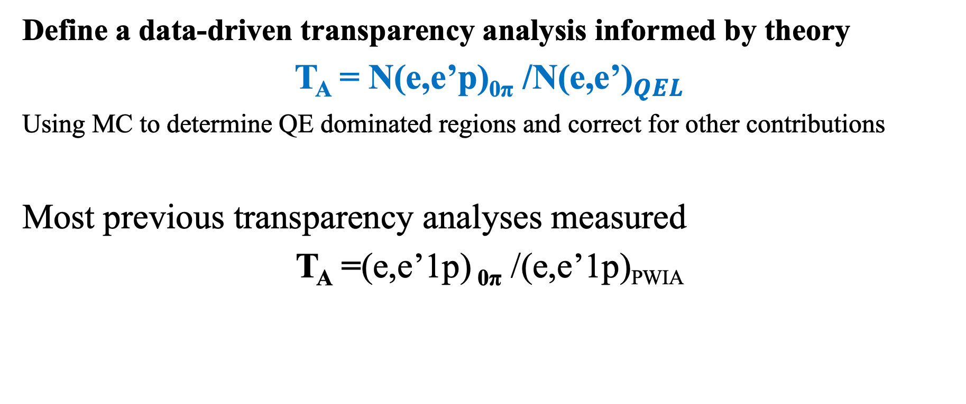
Measuring proton transparency
CLAS6
$$e^{−}$$
p
$$e^{−}$$
Steven Dytman
Define a data-driven transparency analysis informed by theory
T_{A} = N(e,e’p)_{0π} /${\text{N}\text{(}\text{e}\text{,}\text{e}\text{’)}}_{QEL}$
Using MC to determine QE dominated regions and correct for other contributions
Most previous transparency analyses measured
T_{A} =(e,e’1p) _{0π} /(e,e’1p)_{PWIA}

Slide 15
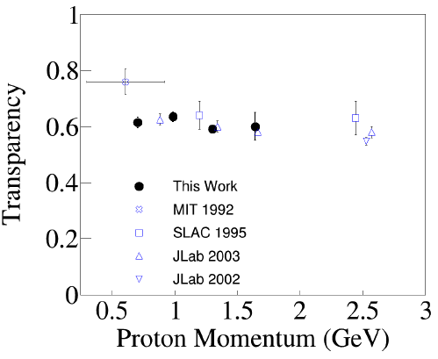
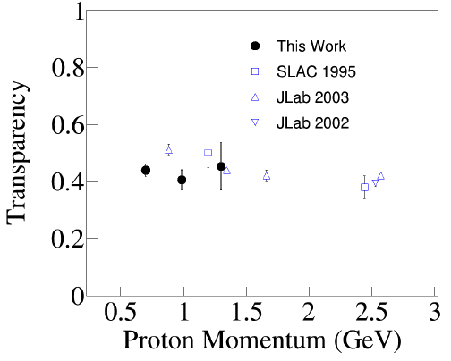
Compatible with previous data
CLAS6
$$e^{−}$$
p
$$e^{−}$$
Steven Dytman
¹²C
⁵⁶Fe
PRELIMINARY
PRELIMINARY

Slide 16
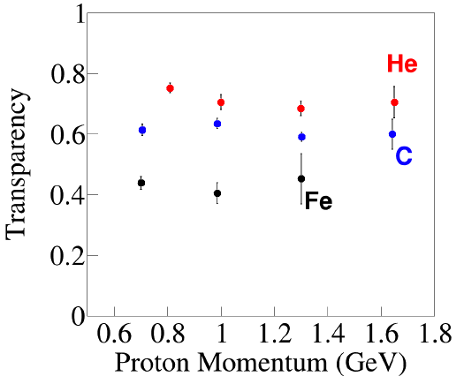
Transparency dependency with A
CLAS6
$$e^{−}$$
p
$$e^{−}$$
Steven Dytman
First ⁴He measurement
PRELIMINARY
Transparency flat in p_{p}
Decreases with A

Slide 17
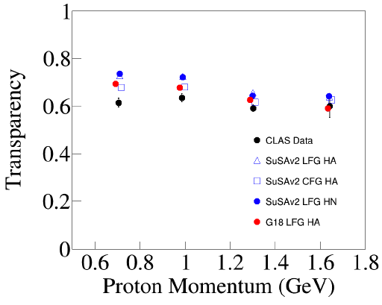
Data not described by GENIE
CLAS6
$$e^{−}$$
p
$$e^{−}$$
Steven Dytman
Larger discrepancies at small p_{p}
PRELIMINARY

Slide 18
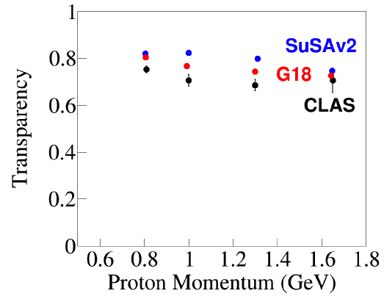
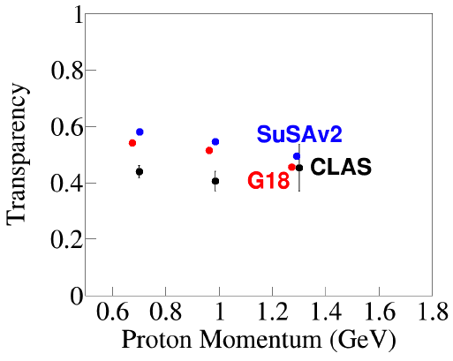
Data not described by GENIE
CLAS6
$$e^{−}$$
p
$$e^{−}$$
Steven Dytman
⁴He
¹²C
⁵⁶Fe
PRELIMINARY
PRELIMINARY
PRELIMINARY
PRELIMINARY
First ⁴He measurement
Simple nuclear models don’t describe data – Spectral Function preferred
No evidence of problems with GENIE FSI

Slide 19
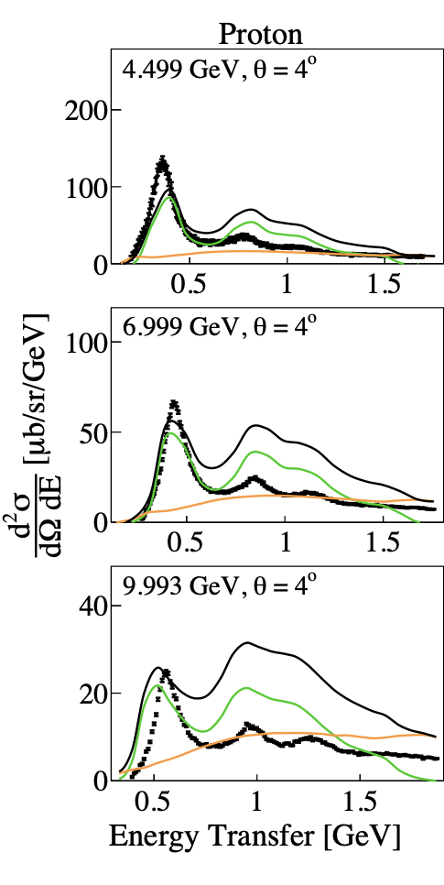
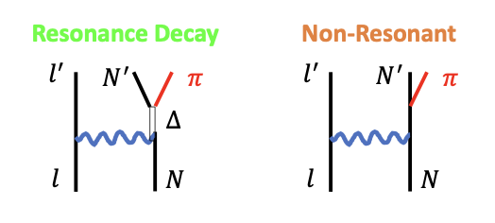
Pion production in GENIE
Proton (e,e’)
GENIE RES model
Berger-Sehgal to model each resonance
  Model predicts momentum transfer
  Resonance decayed into hadrons
No interference between RES (& Non-RES)
GENIE Non-RES model
DIS model (Bodek-Yang) @ W<1.7 GeV
Scaled with ad-hoc free parameters
Not tuned to electron data
GENIE G18_10a
RES
Non-RES/DIS
Over-predicting data
PhysRevD.103.113003

Slide 20
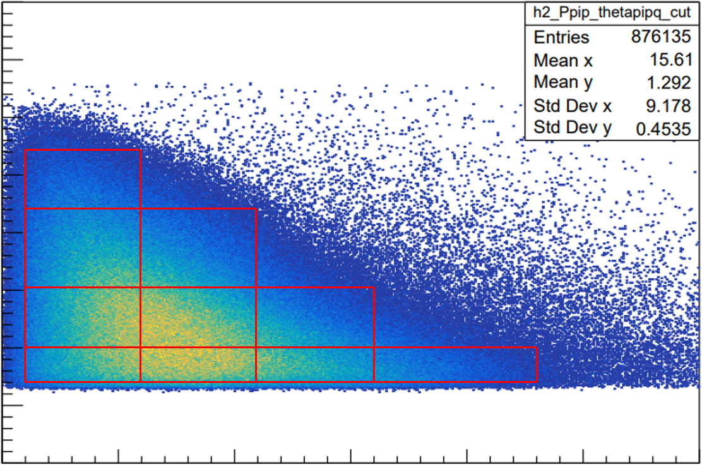

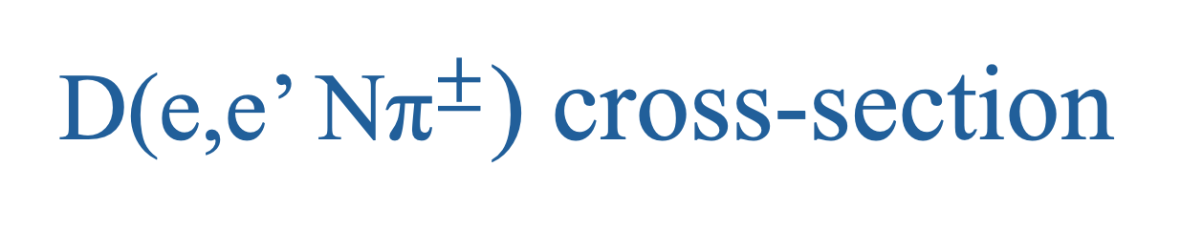

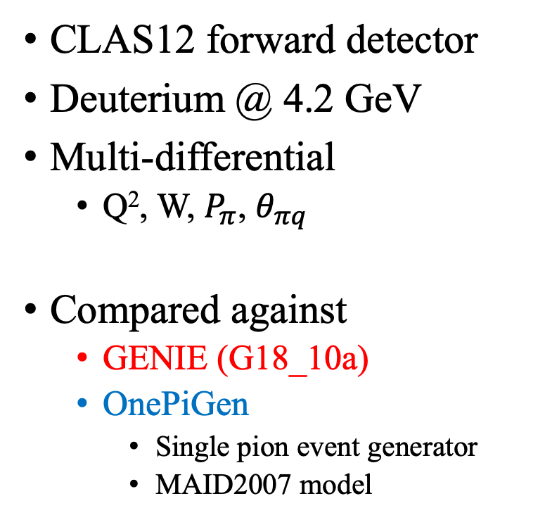

D(e,e’ N${\text{π}}^{±}$) cross-section
CLAS12
$$e^{−}$$
$$Nπ$$
$$e^{−}$$
D
by Caleb Fogler
CLAS12 forward detector
Deuterium @ 4.2 GeV
Multi-differential
  Q², W, $P_{π}$, $θ_{πq}$
Compared against
  GENIE (G18_10a)
  OnePiGen
    Single pion event generator
    MAID2007 model
0.7 ≤ Q² < 1.0 GeV²
4
P_{π} vs. θ_{π q}
+
+
3
10
P_{π} (GeV/c)
2
8
9
5
6
7
1
1
2
3
4
0
0
20
40
60
θ_{πq} (deg)

Slide 21
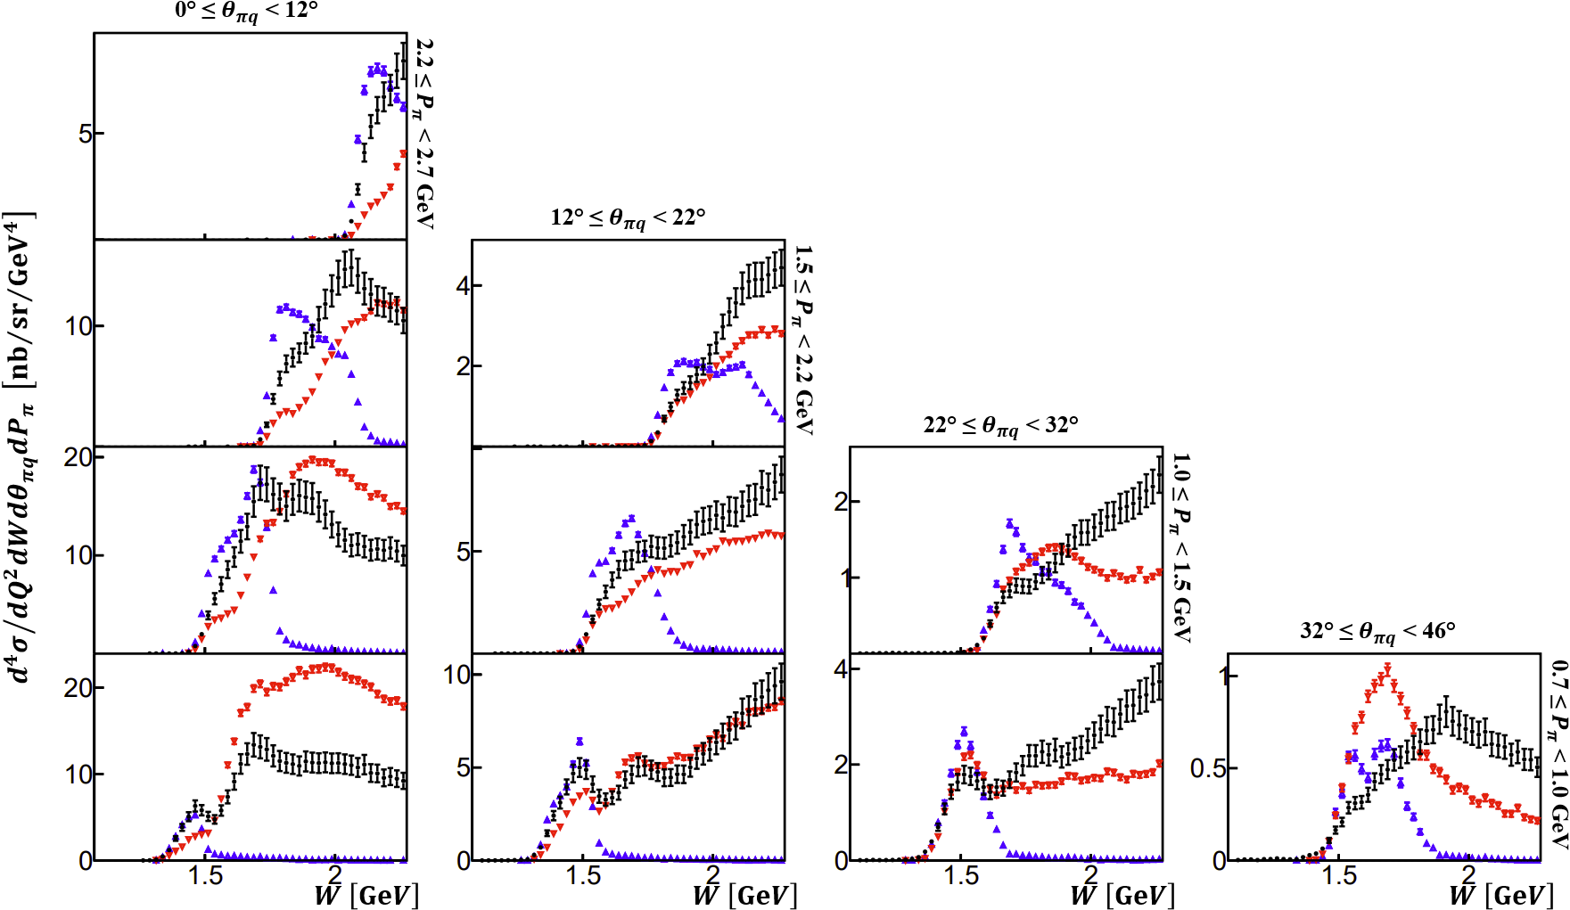


D(e,e’Nπ⁺)
CLAS12
$$e^{−}$$
PRELIMINARY
0.7 ≤ Q² < 1.0 GeV²
$$Nπ$$
$$e^{−}$$
D
Higher $P_{π^{+}}$
by Caleb Fogler
PRELIMINARY
PRELIMINARY
PRELIMINARY
PRELIMINARY
PRELIMINARY
PRELIMINARY
PRELIMINARY
PRELIMINARY
PRELIMINARY
Higher $θ_{πq}$

Slide 22

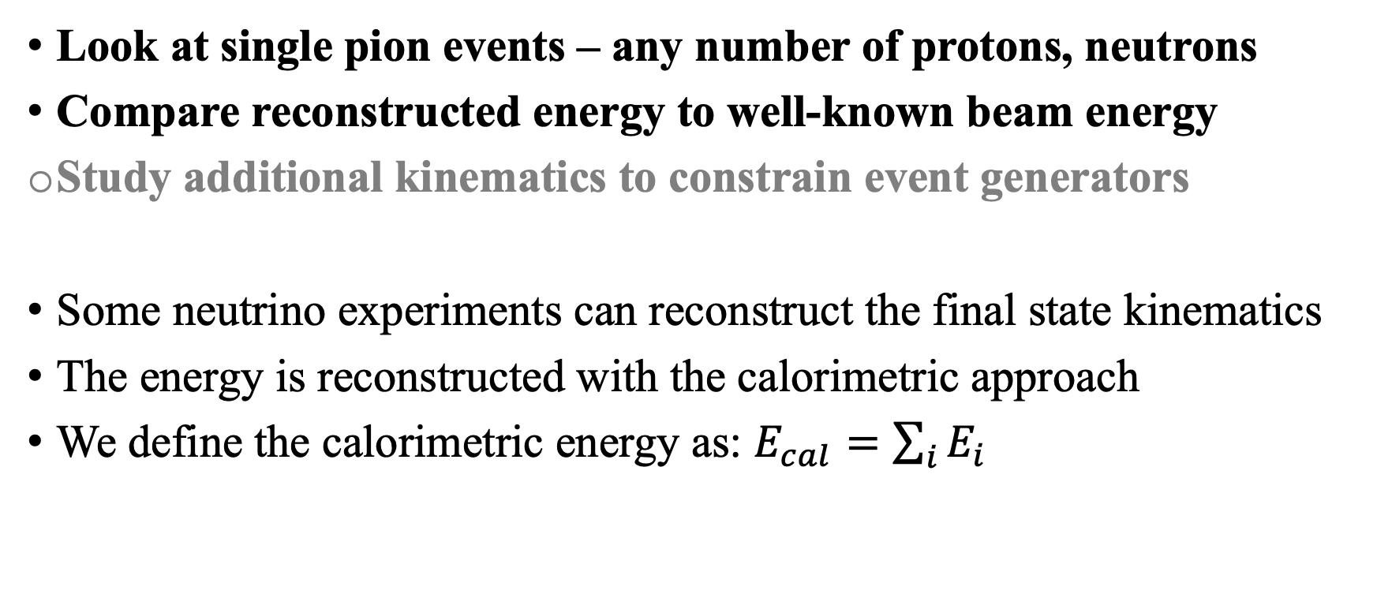
Energy bias in pion production events
MiniBooNE approach
CLAS6
$$e^{−}$$
1$π$
$$e^{−}$$
C
X
Look at single pion events – any number of protons, neutrons
Compare reconstructed energy to well-known beam energy
Study additional kinematics to constrain event generators
Some neutrino experiments can reconstruct the final state kinematics
The energy is reconstructed with the calorimetric approach
We define the calorimetric energy as: $E_{cal}=\sum_{i}{E_{i}}$

Slide 23
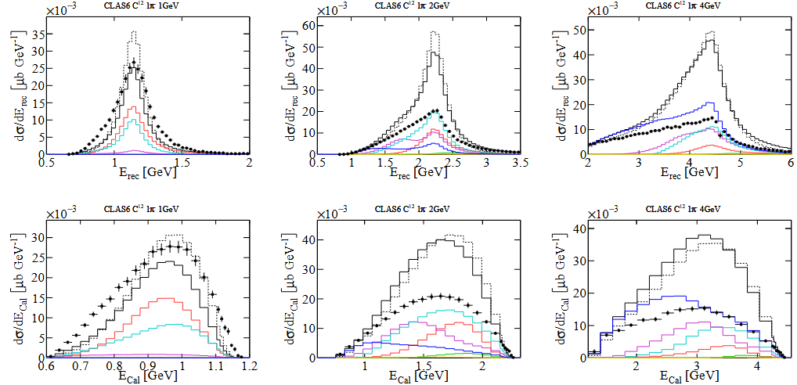
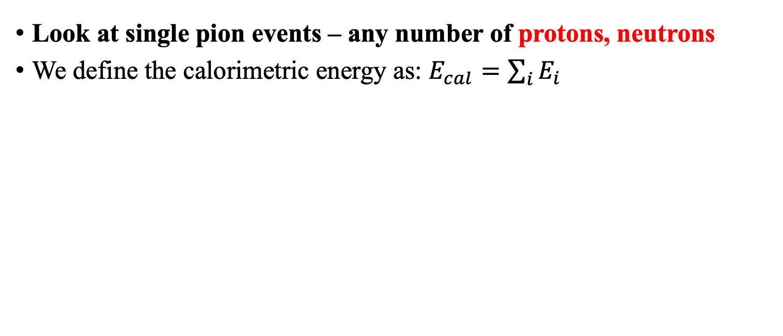
Energy bias in pion production events
MiniBooNE approach
CLAS6
$$e^{−}$$
1$π$
$$e^{−}$$
C
X
Look at single pion events – any number of protons, neutrons
We define the calorimetric energy as: $E_{cal}=\sum_{i}{E_{i}}$
GEM21_11a
QEL
Delta
Other RES
MEC
SIS
DIS
PRELIMINARY
PRELIMINARY
PRELIMINARY
This method fails to reconstruct the correct beam energy

Slide 24

Energy bias in pion production events
MiniBooNE approach
CLAS6
$$e^{−}$$
1$π$
$$e^{−}$$
C
X
Given that we detect the pion and the outgoing electron kinematics, we can reconstruct the initial energy assuming there is an undetected nucleon
$$E_{rec}=\frac{2m_{e′}^{2}+m_{π}^{2}−2M_{N}\left(E_{e^{′}}+E_{π}\right)+2p_{e^{′}}^{μ}∙p_{π,μ}}{2\left(E_{e^{′}}+E_{π}−\left|p_{e^{′}}\right|\cos{Θ_{e′}}−\left|p_{π}\right|\cos{Θ_{π}}−M_{N}\right)}$$
GEM21_11a
QEL
Delta
Other RES
NoFSI
MEC
SIS
DIS
PRELIMINARY
PRELIMINARY
PRELIMINARY
This method can reconstruct the correct energy, but with large bias

Slide 25



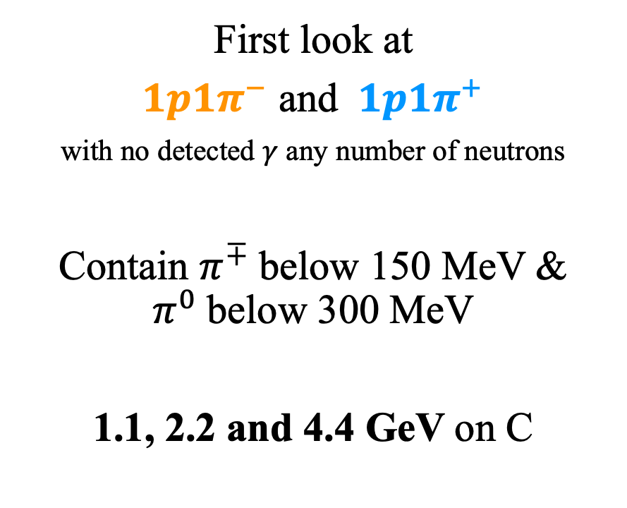









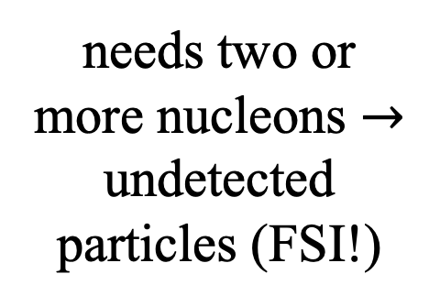


C(e,e’1p1$π^{∓}$) cross-section
Focus on nuclear effects
CLAS6
$$e^{−}$$
$$π$$
$$e^{−}$$
C
p
by Julia Tena Vidal
First look at
$1p1π^{−}$ and $1p1π^{+}$
with no detected $γ$ any number of neutrons
Contain $π^{∓}$below 150 MeV & $π^{0}$below 300 MeV
1.1, 2.2 and 4.4 GeV on C
$$π^{−}$$
possible at the free nucleon level
$$∆^{0}$$
$$e^{−}$$
$$γ$$
$$p$$
$$π^{+}$$
needs two or more nucleons $→$ undetected particles (FSI!)
$$∆^{0}$$
$$π^{−}$$
$$e^{−}$$
$$γ$$
$$p$$

Slide 26
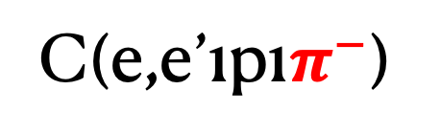

Hadron kinematics
CLAS6
$$e^{−}$$
$$π$$
$$e^{−}$$
C
2.2 GeV
1.1 GeV
p
No FSI
by Julia Tena Vidal
PRELIMINARY
PRELIMINARY
Testing (e,e’) models made exclusive
Wrong normalization
  Due to untuned non-RES
Pion momentum shape agrees with GENIE
  FSI essential
Incorrect low proton momentum shape
GENIE
Data
C(e,e’1p1$π^{−}$)
PRELIMINARY
PRELIMINARY
$∆$-RES
Non-RES
DIS
Other RES

Slide 27
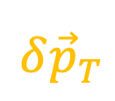

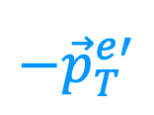



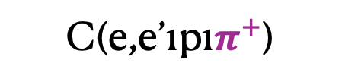

Nuclear effects
CLAS6
$$e^{−}$$
$$π$$
$$e^{−}$$
C
p
C(e,e’1p1$π^{+}$)
Transverse Kinematic Invariance (TKI), Boosting angle:
Most sensitive to FSI
Excellent shape description at all energies
1.1 GeV
by Julia Tena Vidal
$$−{\vec{p}}_{T}^{e′}$$
PRELIMINARY
$∆$-RES
$$=\cos^{−1}\left(\frac{−{\vec{p}}_{T}^{e′}⋅δ{\vec{p}}_{T}}{\left|{\vec{p}}_{e′}^{T}\right|\left|δ{\vec{p}}_{T}\right|}\right)$$
$$δφ_{T}$$
$$δα_{T}$$
Non-RES
$${\vec{p}}_{T}^{∆}$$
$$δ{\vec{p}}_{T}$$
x10³
2.2 GeV
GENIE
(normalized to data)
PRELIMINARY
No FSI
Other RES
DIS

Slide 28
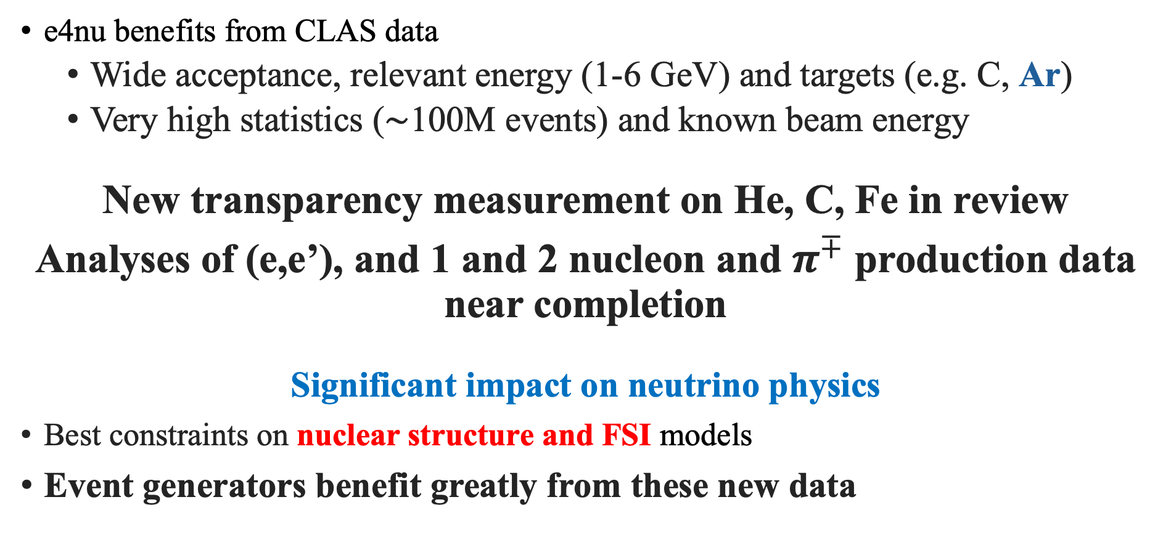
Next directions
e4nu benefits from CLAS data
  Wide acceptance, relevant energy (1-6 GeV) and targets (e.g. C, Ar)
  Very high statistics ($\sim$100M events) and known beam energy
New transparency measurement on He, C, Fe in review
Analyses of (e,e’), and 1 and 2 nucleon and $π^{∓}$ production data near completion
Significant impact on neutrino physics
Best constraints on nuclear structure and FSI models
Event generators benefit greatly from these new data

Slide 29








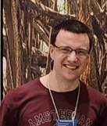
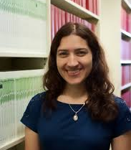
Thank you for your attention!
Adi Ashkenazi
Alon Sportes
Julia Tena Vidal
Larry Weinstein
Caleb Fogler
A.Papadopoulou
Cheryl Patrick
Matan Goldelberg
Noah Steinberg
Steven Dytman
Josh Barrow
Brandon Eberly
Steven Gardiner
Minerva Betancourt
More data on the way…
New collaborators welcome to maximize impact!

Slide 30

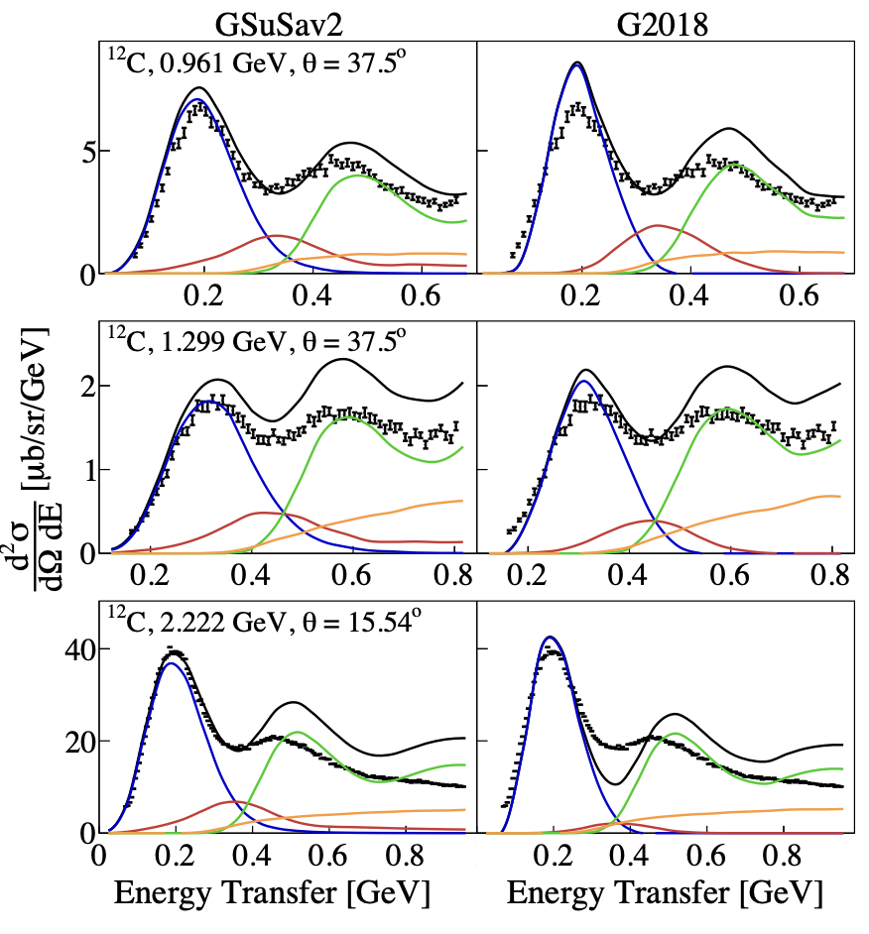
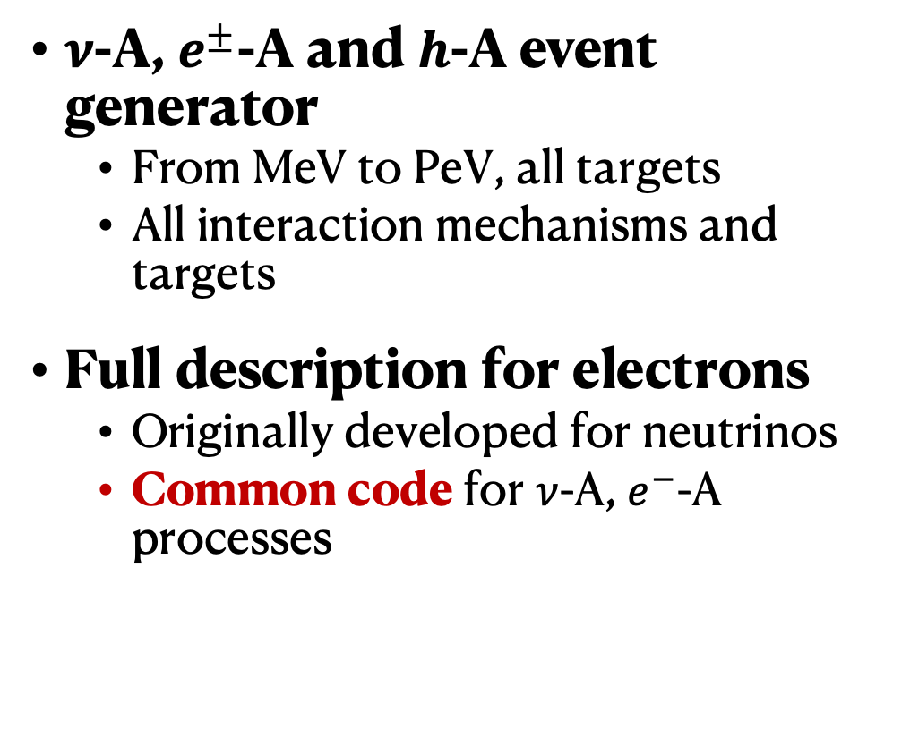
The GENIE event generator
http://tunes.genie-mc.org
$ν$-A, $e^{±}$-A and $h$-A event generator
  From MeV to PeV, all targets
  All interaction mechanisms and targets
Full description for electrons
  Originally developed for neutrinos
  Common code for $ν$-A, $e^{−}$-A processes
  GEM21_11a (SuSAv2), e-¹²C data
PhysRevC.98.014617
QE
RES
MEC
DIS

Slide 31
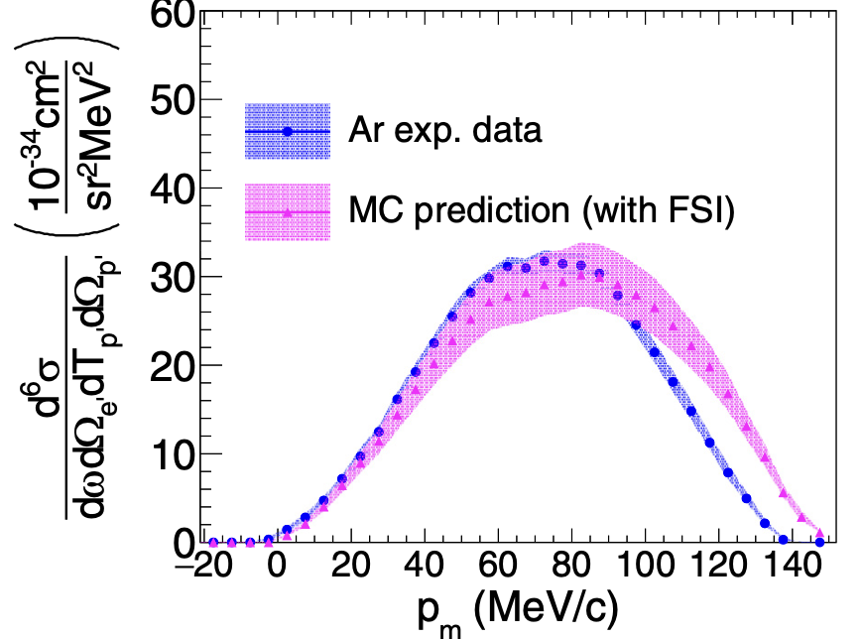
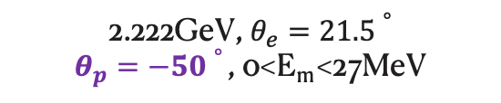
Generators need hadron production data
Many assumptions from (e,e’) to (e,e’X) – description not guaranteed
  Common with neutrinos
Lacking exclusive hadron production measurements!
  Growing interest in the electron community
    limited to specific kinematics
  Big effort in the neutrino community
    But more difficult
(e,e’p)
@ PhysRevC.103.034604 (2021)
2.222GeV, $θ_{e}=21.5∘$
$θ_{p}=−50∘$, 0<E_{m} <27MeV
High quality new data gives additional constraints to simulation

Slide 32
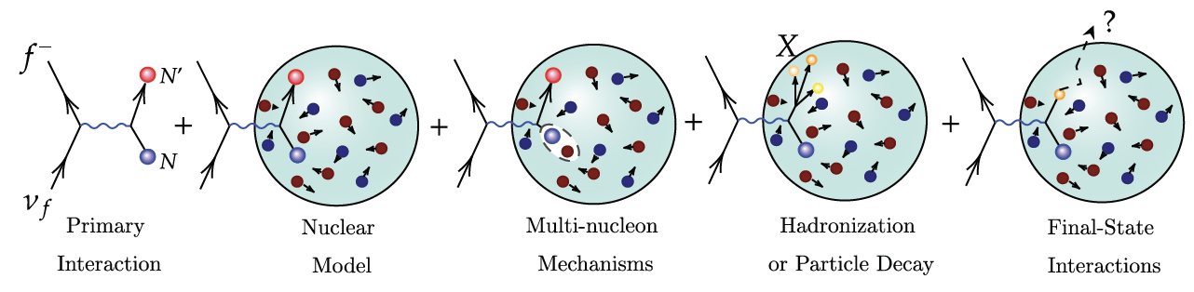
Neutrino event generators need constraints
Factorization approach
  Nuclear cross section from free nucleon

Slide 33
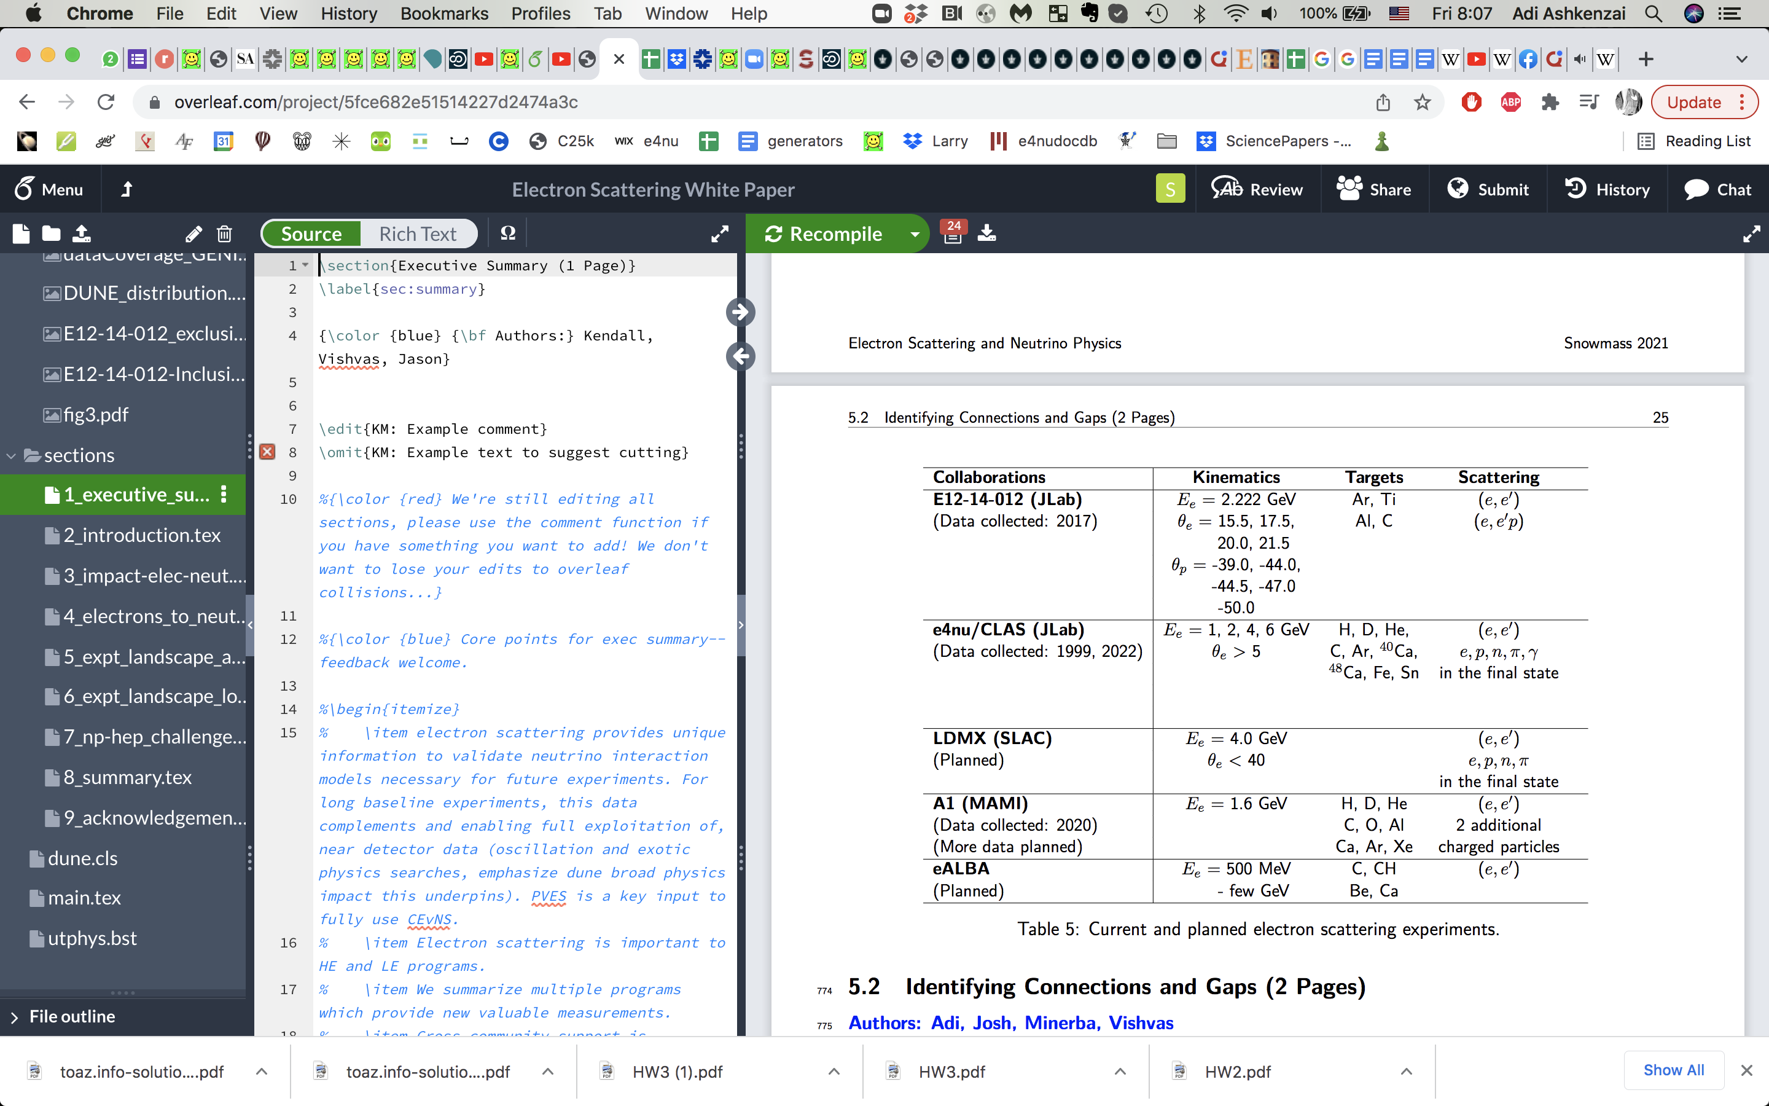




Complementary efforts
Publications
Phys. Rev. C 99, 054608
Phys.Rev.D 105 112002
Nature 599, 565
Phys.Rev.D 103 113003
Only effort with data already taken and expected exclusive measurements, best coverage
Adaptation from Proceedings of the US Community Snowmass2021 arXiv:2203.06853v1 [hep-ex]

Slide 34
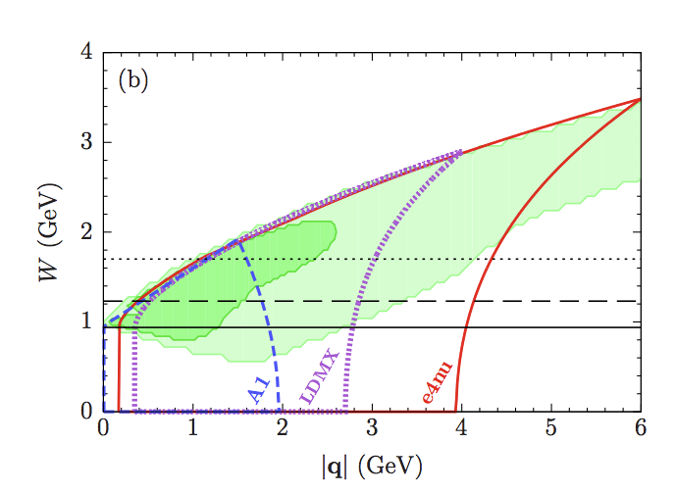
e4nu and DUNE
arXiv:2203.06853v1 [hep-ex] A NF06 Contributed White Paper

Slide 35
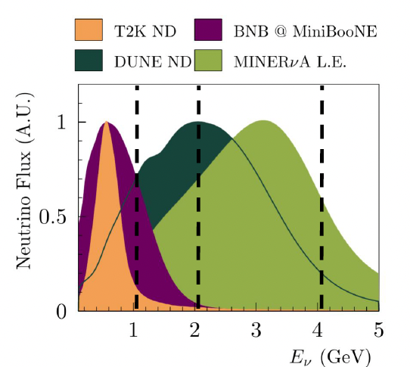
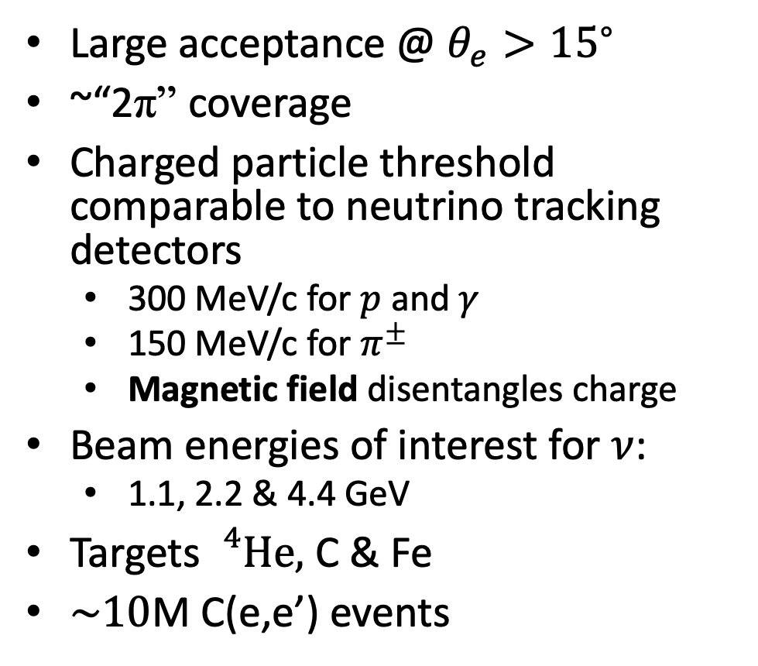
CLAS6
Large acceptance @ $θ_{e}>{15}^{∘}$
~“2π” coverage
Charged particle threshold comparable to neutrino tracking detectors
  300 MeV/c for $p$ and $γ$
  150 MeV/c for $π^{±}$
  Magnetic field disentangles charge
Beam energies of interest for $ν$:
  1.1, 2.2 & 4.4 GeV
Targets${}_{}^{4}{He},$ C & Fe
$\sim 10$M C(e,e’) events

Slide 36

CLAS12 – sub-systems in the FD and CD
36
Forward Detector (FD):
High Threshold Cherenkov Counter (HTCC)
Drift Chambers (DC)
Low Threshold Cherenkov Counter (LTCC)
Forward Time-Of-Flight detector (FTOF)
Ring Imaging Cherenkov detector (RICH)
Electromagnetic Calorimeters (EC & PCAL)
Central Detector (CD):
Central Vertex Tracker (CVT)
Central Time-Of-Flight (CTOF)
Central Neutron Detector (CND)
Back Angle Neutron Detector (BAND)
https://doi.org/10.1016/j.nima.2020.163419

Slide 37


Generalizing Background Subtraction
~50% of “4π” coverage
Not full “4π” coverage
Gaps between the sectors
Gaps within a sector
“Data driven” background subtraction
Multi-particle correction
$$π^{−}$$
$$p$$
$$π^{+}$$

Slide 38

Data Driven Background Subtraction
‘
Using measured (e,e’1p1π) events
Rotate p,π around q
Determine event acceptance
Subtract (e,e’1p1π) contribution
Julia
Tena Vidal

Slide 39
e4nu 1p0π Event Selection
Focus on Quasi Elastic events:
1 proton above 300 MeV/c
no additional hadrons above detection threshold:
150 MeV/c for Pπ^{+/-}
500 MeV/c for Pπ⁰
e
e

Slide 40




Incoming (e,e’)0π Energy Reconstruction
Cherenkov detectors:
Assuming QE interaction
Using lepton only
Tracking detectors:
Calorimetric sum
Using All detected particles
is the nucleon separation energy ~ 20 MeV

Slide 41


Incoming Energy Reconstruction
E = 1.159 GeV
E = 1.159 GeV
Afroditi
Papadopoulou
Mariana
Khachatryan
Nature 599, 565 (2021)

Slide 42

Incoming Energy Reconstruction
E = 1.159 GeV
Afroditi
Papadopoulou
Mariana
Khachatryan
C(e,e’p)0π Ecal [GeV]
Nature 599, 565 (2021)

Slide 43
Reconstructed (e,e’p)1p0π Calorimetric Energy
1.159 GeV
2.257 GeV
4.453 GeV
Nature 599, 565 (2021)

Slide 44

Reconstructed (e,e’p)1p0π Calorimetric Energy
1.159 GeV
2.257 GeV
4.453 GeV
Nature 599, 565 (2021)

Slide 45
Reconstructed (e,e’p)1p0π Calorimetric Energy
1.159 GeV
2.257 GeV
4.453 GeV
Nature 599, 565 (2021)

Slide 46



Focusing on different reaction mechanisms
Standard Transverse Variables
δαΤ
Sensitive to
hit nucleon momentum
Sensitive to
Final State Interactions

Slide 47

Transverse missing momentum
Nature 599, 565 (2021)

Slide 48
pT sensitivity to interaction mechanisms
Nature 599, 565 (2021)

Slide 49

MC vs. (e,e’p) Transverse Variables
Afroditi
Papadopoulou
@ ΑNL
arXiv:2301.03700 [hep-ex]

Slide 50










Beam energy reconstruction
$$e^{−}$$
$$e^{−}$$
$$π$$
C
$$e^{−}$$
C
$$e^{−}$$
2.2 GeV on Carbon
p
p
[Nature 599, 565-590 (2021)]
1p$0π$
1p${1π}^{−}$
1p${1π}^{+}$
PRELIMINARY
PRELIMINARY
  $E_{Cal}=E_{e′}$+ $T_{p}$+$ε_{p}$
  $E_{Cal}=E_{e′}$+ $E_{π}$ + $T_{p}$+$ε_{p}$
  $E_{Cal}=E_{e′}$+ $E_{π}$ + $T_{p}$+$ε_{p}$
Peak reconstructed if measured particles are full final state
Tail due to missing particles, not well described

Slide 51



Mott Cross section
$$e^{−}$$
$$e^{−}$$
$${\left(\frac{dσ}{dΩ}\right)}_{Mott}=\frac{α^{2}}{4E_{e}^{2}\sin^{4}{θ_{e′}}/2}\cos^{2}{θ_{e′}/2}$$
$α$: fine-structure constant
$E_{e}^{}:$ beam energy
$θ_{e′}$: outgoing electron scattering angle

Slide 52

2N analysis – goal and event selection
11/11/24
52
Goal: comparing 2p and 1n1p
Full signal selection (based on detector constraints!):
Particles |  | Sub-detector | Momentum thresholds* [GeV/c] | 2p | 1n1p
$$e^{−}$$ |  | FD | None | One electron
$$π^{±}$$ |  | CD & FD | 0.2 | No charged pions
$$γ$$ |  | FD | 0.3 | No photons
Nucleons | $$p$$ | FD | 0.4 | One proton ($≡pFD$) | None
 |  | CD |  | One proton ($≡pCD$) | One proton ($≡pCD$)
 | $$n$$ | FD | 0.4 lower & ${E_{beam}}/c$ upper | Any number of neutrons; all of them are ignored | Any number of neutrons; considering only the leading ($≡nFD$)
Anything else |  | CD & FD | None | Ignored; no constraints
*Refined thresholds will be used in future analyses

Slide 53




FD nucleon momenta
11/11/24
53
FD neutron momentum in 1n1p
FD proton momentum in 2p
FD nucleon momentum ratio
Preliminary
Preliminary
Preliminary
$nFD$ = FD neutron | $pFD$ = FD proton | $nucFD$ = FD nucleon
¹²C simulation and data at $E_{beam}≃6$ GeV
Notes:
Includes nFD in 1n1p and pFD in 2p
organization of figures!
Ratio definition!
Larger neutron momentum tail in both simulation and data – trend is stronger in data!

Slide 54







Opening angle between $q$ and $P_{nucFD}$ ($θ_{q,P_{nucFD}}$)
11/11/24
54
$θ_{q,P_{nFD}}$ in 1n1p
$θ_{q,P_{pFD}}$ in 2p
$θ_{q,P_{nucFD}}$ distribution ratio
Preliminary
Preliminary
Preliminary
$θ_{q,P_{nucFD}}$ – inversely related to $\left|P_{nucFD}\right|$
$nFD$ = FD neutron | $pFD$ = FD proton | $nucFD$ = FD nucleon
¹²C simulation and data at $E_{beam}≃6$ GeV
Notes:
organization of figures!
$θ_{q,P_{nucFD}}$ – inversely related to the magnitude of $\left|P_{nucFD}\right|$
Simulation:
1n1p in much wider than 2p, especially in the 20° ≤ θ_{q,PnucFD} ≤ 40° range, with a sharper drop in the 2p distribution.
This might indicate that, in 2p, we have fewer high-momentum protons escaping the nucleus.
Data:
the distributions are much wider than simulation
1n1p is also wider than 2p, yet the differences between the final states are less pronounced
Ratio:
Simulation and data differences are apparent, with a larger slope in simulation in comparison to the data
This result might be linked to different FSI effects on forward-going protons or neutrons and could be used to improve FSI modeling
the distributions of both final states are predominantly in the range of small θ_{q,PnucFD}

Slide 55


Opening angle between $q$ and $P_{nucFD}$ ($θ_{q,P_{nucFD}}$) – zoom-out
11/11/24
55
$θ_{q,P_{nFD}}$ in 1n1p
$θ_{q,P_{pFD}}$ in 2p
$θ_{q,P_{nucFD}}$ distribution ratio
Preliminary
Preliminary
Preliminary
$θ_{q,P_{nucFD}}$ – inversely related to $\left|P_{nucFD}\right|$
$nFD$ = FD neutron | $pFD$ = FD proton | $nucFD$ = FD nucleon
¹²C simulation and data at $E_{beam}≃6$ GeV
Notes:
organization of figures!
$θ_{q,P_{nucFD}}$ – inversely related to the magnitude of $\left|P_{nucFD}\right|$
Simulation:
the distributions of both final states are predominantly in the range of small θ_{q,PnucFD}
1n1p in much wider than 2p, especially in the 20° ≤ θ_{q,PnucFD} ≤ 40° range, with a sharper drop in the 2p distribution.
data:
the distributions are much wider than simulation
1n1p is also wider than 2p, yet the differences between the final states are less pronounced
Ratio:
Simulation and data differences are apparent, with a larger slope in simulation in comparison to the data
This result might be linked to different FSI effects on forward-going protons or neutrons and could be used to improve FSI modeling

Slide 56

New Results – Nuclear Transparency
C @ 2.261 GeV
Take advantage of lepton-hadron correlations in QEL scattering
Slice data in θ_{e} to pick out regions of Pp

Slide 57


New Results – Nuclear Transparency
C @ 2.261 GeV
C @ 4.4261 GeV

Slide 58

New Results – Nuclear Transparency
2.261 e-¹²C
37 deg < θ_{e} < 40 deg
Take advantage of lepton-hadron correlations in QEL scattering
Slice data in θ_{e} to pick out regions of Pp
  Cut on ω to pick QE dominated regions

Slide 59


New Results – Nuclear Transparency
(e,e’p) is a subset of (e,e’) cut on θ_{pq} and P_{p} to isolate QE and minimal FSI regions

Slide 60
Where is the acceptance correction working? Proton theta distributions
Black: Uncorrected Data
Blue: Acceptance Corrected Data
Red: Acceptance Correction Factor

Slide 61

Proton Transparency - Systematics

Slide 62

Proton Transparency

Slide 63

Proton Transparency – Spectral Function

Slide 64

1p1$π$ systematics
Not yet included (*)
Systematic Error | 1.1 GeV | 2.2 GeV | 4.4 GeV
Acceptance correction | <3 % | <2 % | <2 %
Bkg. Closure Test | <6 % (*) | <10 % (*) | <15 % (*)
Geometrical Acceptance | (*) | (*) | (*)
XSec Angular dependence | 1 % | 1 % | 1 %
Photon identification cuts | 0.5 % | 0.5 % | 2 %
Sector-to-Sector | <1 % | <5 % | <6 %
Normalization | 1 % | 1 % | 1 %
Radiative correction | 5 % | 5 % | 5 %
Total | <7 % | < 15 % | < 17 %

Slide 65

Radiative Correction
Accounts for [PhysRevC.64.054610]:
Incident electron radiation
  changes the incident flux
Outgoing electron radiation
  changes the observed energy transfer
Vertex corrections
  change the cross section (i.e., the weight) of the event
Peaking approximation
  Radiation emitted in the direction of travel
Internal & external bremsstrahlung effects
Neglects radiation by the emitted hadrons
emMCRadCorr

Slide 66




Radiative Correction – 1p$1π^{−}$
1.1 GeV
2.2 GeV
4.4 GeV
PRELIMINARY
PRELIMINARY
PRELIMINARY
Includes a 5 % systematic from pion radiation
Propagated to the data systematics
Using smooth distributions

Slide 67






Pion production nuclear effects
$${\vec{p}}_{e′}^{T}$$
$${\vec{p}}_{e′}^{}$$
Free nucleon
No missing transverse momentum!
$$δ{\vec{p}}_{T}=\left|{\vec{p}}_{T}^{e′}+{\vec{p}}_{T}^{∆}\right|=0$$
$${\vec{p}}_{e}$$
$${\vec{p}}_{∆}^{T}$$
$${\vec{p}}_{∆}$$
$$({\vec{p}}_{p}+{\vec{p}}_{π})$$

Slide 68






Pion production nuclear effects
$${\vec{p}}_{T}^{e′}$$
$${\vec{p}}_{}^{e′}$$
Nucleus $δ{\vec{p}}_{T}>0$
Nuclear structure
Final state interactions
$${\vec{p}}^{e}$$
$${\vec{p}}_{T}^{∆}$$
$${\vec{p}}_{}^{∆}$$
$$({\vec{p}}^{p}+{\vec{p}}^{π})$$

Slide 69




Hadron kinematics
$$e^{−}$$
$$π$$
$$e^{−}$$
C
Good angular description for pions and protons
p
C(e,e’1p1$π^{−}$) @ 2.2 GeV
C(e,e’1p1$π^{+}$) @ 2.2 GeV
by Julia Tena Vidal
$∆$-RES
No FSI
Other RES
Non-RES
PRELIMINARY
DIS
PRELIMINARY
High $θ_{p}$ possible only due to FSI
(e,e’1p1$π^{+}$) more sensitive to dynamics $→$ more shape change due to FSI

Slide 70



Nuclear effects
$$e^{−}$$
$$π$$
$$e^{−}$$
C
p
C(e,e’1p1$π^{−}$) @ 2.2 GeV
by Julia Tena Vidal
Free nucleon
$$δ{\vec{p}}_{T}=\left|{\vec{p}}_{T}^{e′}+{\vec{p}}_{p}+{\vec{p}}_{π}\right|=0$$
Nucleus $δ{\vec{p}}_{T}>0$
Nuclear structure
Reaction mechanisms
Final state interactions
$∆$-RES
Other RES
Non-RES
DIS
PRELIMINARY

Slide 71

Pion production analysis
For each data event,
Apply momentum and angle thresholds to detected particles
Select signal events (i.e. $1p1π^{−}$events)
Correct for detector acceptance ( * with MC )
Remove background ( * data-driven )
Correct for radiative effects ( * with MC )
Apply systematic uncertainties ( * with MC or data )
Convert from event-rate to cross-section
Same procedure for the $1p1π^{−}$ and $1p1π^{+}$ analyses

Slide 72
1- Momentum and angle thresholds

Slide 73



1p$1π^{±}$analysis: background contamination
Removing particles below threshold
  $p_{p}$ and $p_{γ}$ $>300 MeV$
  $p_{π^{±}}>150 MeV$
  Data not corrected for this
  Same cuts applied to simulation
  ${θ }_{p}>12 deg$
  ${θ }_{γ}>8 deg$
  ${θ }_{π^{±}}>12 deg$

Slide 74
3- Acceptance correction
We correct for particle efficiency detection and geometric acceptance with the “acceptance correction”

Slide 75

Acceptance correction
The acceptance is defined as
$$α_{acc.i}=\frac{True (e,e^{′}1p1π^{±})}{True Reconstructed (e,e^{′}1p1π^{±})}$$
The averaged acceptance is used to correct the data for eff. and detector geometry effects
  Per bin correction
We consider N models to compute the average acceptance correction
  Two models in my example (different FSI)
The MC might not be sufficient showing fluctuations in the acceptance
  We compute the smoothed acceptance, $α_{smooth.i}$, for systematics characterization
MC with detector effects

Slide 76

Acceptance correction systematic
Each model can give a different acceptance
  No model preference, using uniform uncertainty
Fluctuations also add an uncertanty:
$$σ_{i}^{acc.corr}=\sqrt{\frac{{(M_{max,i}−M_{min,i})}^{2}}{12}+\frac{{(α_{acc,i}−α_{smooth,i})}^{2}}{2}+{\overline{σ}}_{acc.stat,i}^{2}}$$
M_{max} and M_{min} are the maximum and minimum acceptances in each bin
$α_{smooth,i} is$ the smoothed acceptance
${\overline{σ}}_{acc.stat,i}^{2}$ is the average acceptance systematic error
This is added in quadrature to the data

Slide 77



Acceptance correction with systematics
Average Acceptance
Error driven by MC!
Propagated to data
Max
PRELIMINARY
PRELIMINARY
PRELIMINARY
Min
PRELIMINARY
PRELIMINARY
PRELIMINARY

Slide 78






Acceptance correction with systematics
Raw data
Acceptance correction
Cross Section
PRELIMINARY
PRELIMINARY
PRELIMINARY
PRELIMINARY
PRELIMINARY
PRELIMINARY
PRELIMINARY
The smoothing uncertainty is only relevant for angular variables
due to detector gaps

Slide 79


Sector-to-sector variation
If the acceptance correction worked as expected, we should see a small sector-to-sector variation
We compute the sector-to-sector variance as:
where,
i: bin id and j: sector id
$\overline{X}$ is the weighted average of the predicted event rate
N: number of valid sectors
For the calculation, we use the uncorrected event rate
We subtract the stat error and other sources of sys. uncertainties
$$σ_{Sectors,i}^{2}=\frac{{(X_{ij}^{}−{\overline{X}}_{ij})}^{2}}{N} −σ_{stat,i}^{2}$$

Slide 80

Sector-to-sector variation
The error is computed for each bin and added in quadrature
NOT USED
Bad e-acceptance
PRELIMINARY
PRELIMINARY
1.1 GeV | 2.2 GeV | 4.4 GeV
<1 % | <5% | <6 %
NOT USED
Bad e-acceptance
PRELIMINARY
PRELIMINARY

Slide 81
4- Background removal

Slide 82

1p$1π^{±}$analysis:
multi-particle background
~50% of “4π” coverage
Not full “4π” coverage
  Gaps between the sectors
  Gaps within a sector
  “Data driven” background subtraction
    Multi-particle correction
$$π^{−}$$
$$p$$
$$π^{+}$$

Slide 83

New background subtraction method
The new code classifies the events in “multiplicity” groups
  Signal multiplicity, Min. Multiplicity N_{min}
  Background multiplicity
    Mult N: $Nπ$ (max. mult. is configurable)
Starting from the higher multiplicity events, calculate probability to have a smaller multiplicity ($m_{f}$ ${<m}_{i}$)
  Store pseudo-event in new “multiplicity” group
  The new event has a weight $ω_{f}={−ω}_{i}\frac{N^{mf}}{N^{mi}}$
Repeat for lower multiplicity groups
  These contain real background events and pseudo-events

Slide 84

Validation with closure test
Compute true background using MC information
  Store background events which contribute to the signal after fiducials
Compute estimated background using rotation method in MC sample
  Using MC background events contained in the fiducial
Estimate systematic uncertainty:
$$σ_{Bkg,i}^{2}=\frac{{(x_{i}^{True}−{\overline{x}}_{i})}^{2}+{(x_{i}^{Est.}−{\overline{x}}_{i})}^{2}}{2} −σ_{stat,i}^{2}$$

Slide 85

Closure test – 1p$1π^{−}$@ 1.1 GeV
PRELIMINARY

Slide 86

Closure test – 1p$1π^{−}$@ 4.4 GeV
PRELIMINARY

Slide 87

Systematics from maximum multiplicity
$$σ_{Mult,i}^{2}=\frac{{(x_{i}^{max.5}−{\overline{x}}_{i})}^{2}+{(x_{i}^{max.6.}−{\overline{x}}_{i})}^{2}}{2} −σ_{stat,i}^{2}$$
Uncertainty depends on maximum event multiplicity for subtraction
Can neglect this uncertainty
Demonstrates algorithm convergence
Max Mult | 1.1 GeV | 2.2 GeV | 4.4 GeV
3 vs 4 | 0 % | <5% | <16 %
4 vs 5 | 0 % | 0 % | 0 %
5 vs 6 | 0 % | 0 % | 0 %

Slide 88
5- Radiative correction
And systematics

Slide 89
Radiative Correction
Accounts for [PhysRevC.64.054610]:
Incident electron radiation
  changes the incident flux
Outgoing electron radiation
  changes the observed energy transfer
Vertex corrections
  change the cross section (i.e., the weight) of the event
Peaking approximation
  Radiation emitted in the direction of travel
Internal & external bremsstrahlung effects
Neglects radiation by the emitted hadrons
emMCRadCorr

Slide 90


Radiative Correction - Validation
Validated against H(e,e’p) data
Radiation tail describes data
Same implementation extended to non-QEL processes
Implemented in analysis using per-bin acceptance weight
$$r_{i}=\frac{Unradiated (e,e^{′}1p1π^{±})}{Radiated (e,e^{′}1p1π^{±})}$$

Slide 91

Radiative Correction – 1p$1π^{−}$
1.1 GeV
2.2 GeV
4.4 GeV
PRELIMINARY
PRELIMINARY
PRELIMINARY
Includes a 5 % systematic from pion radiation
Propagated to the data systematics
Using smooth distributions

Slide 92
6 - Final systematics

Slide 93
Final systematics
Not yet included (*)
Systematic Error | 1.1 GeV | 2.2 GeV | 4.4 GeV
Acceptance correction | <3 % | <2 % | <2 %
Bkg. Closure Test | <6 % (*) | <10 % (*) | <15 % (*)
Maximum Multiplicity | 0 % | 0 % | 0 %
Geometrical Acceptance | (*) | (*) | (*)
XSec Angular dependence | 1 % | 1 % | 1 %
Photon identification cuts | 0.5 % | 0.5 % | 2 %
Number of rotations | 0 % | 0 % | 0 %
Sector-to-Sector | <1 % | <5 % | <6 %
Normalization | 1 % | 1 % | 1 %
Radiative correction | 5 % | 5 % | 5 %
Total | <7 % | < 15 % | < 17 %

Slide 94


