Slide 1
Current Status of the PRad-II and X17 Search Experiments
Ashot Gasparian
NC A&T SU
For the PRad-II/X17 collaboration
CLAS collaboration meeting, November 12, 2024, JLab
Outline
  PRad-II, physics goals
  X17 Search experiment, the goals
  upgrades to PRad experimental setup
  preparation status
  summary and outlook

Slide 2

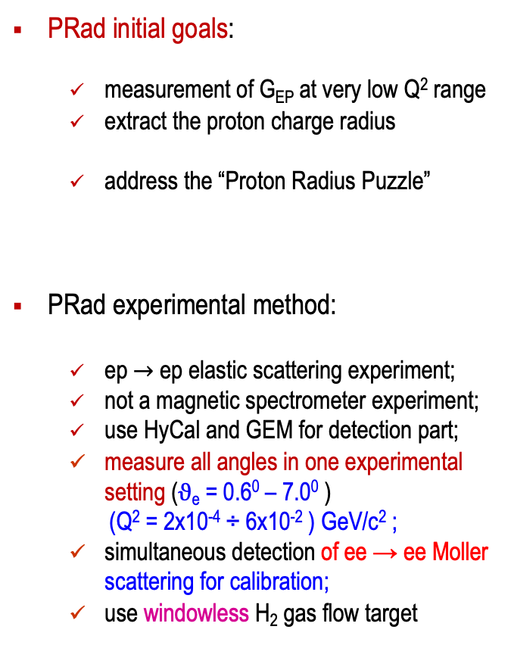
The PRad Experiment in Hall B
(Performed in May-June 2016)
PRad initial goals:
  measurement of G_{EP} at very low Q² range
  extract the proton charge radius
  address the “Proton Radius Puzzle”
PRad experimental method:
  ep$→$ ep elastic scattering experiment;
  not a magnetic spectrometer experiment;
  use HyCal and GEM for detection part;
  measure all angles in one experimental setting ($ϑ$_{e} = 0.6⁰ – 7.0⁰ )
  (Q² = 2x10⁻⁴ ÷ 6x10⁻² ) GeV/c² ;
  simultaneous detection of ee → ee Moller scattering for calibration;
  use windowless H₂ gas flow target
New York Times
Regular hydrogen average (CODATA): 0.8751 ± 0.0061 fm
Muonic hydrogen (CREMA coll. 2013): 0.8409 ± 0.0004 fm
  Muonic hydrogen (CREMA coll. 2010): 0.84184 ± 0.00067 fm

Slide 3
PRad Result on the Radius
PRad final result: R_{p} = 0.831 ± 0.007 (stat.) ± 0.012 (syst.) fm

Slide 4
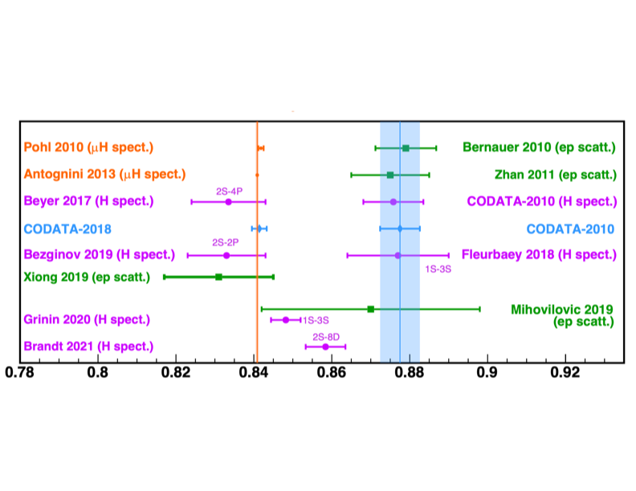
Today’s Status of the Proton Radius Puzzle
Arguably, the “Puzzle” is still not fully resolved! New high accuracy experiments are needed.
For the scattering sector: difference between PRad and all other ep scattering experiments is on 3$σ$ level only.

Slide 5
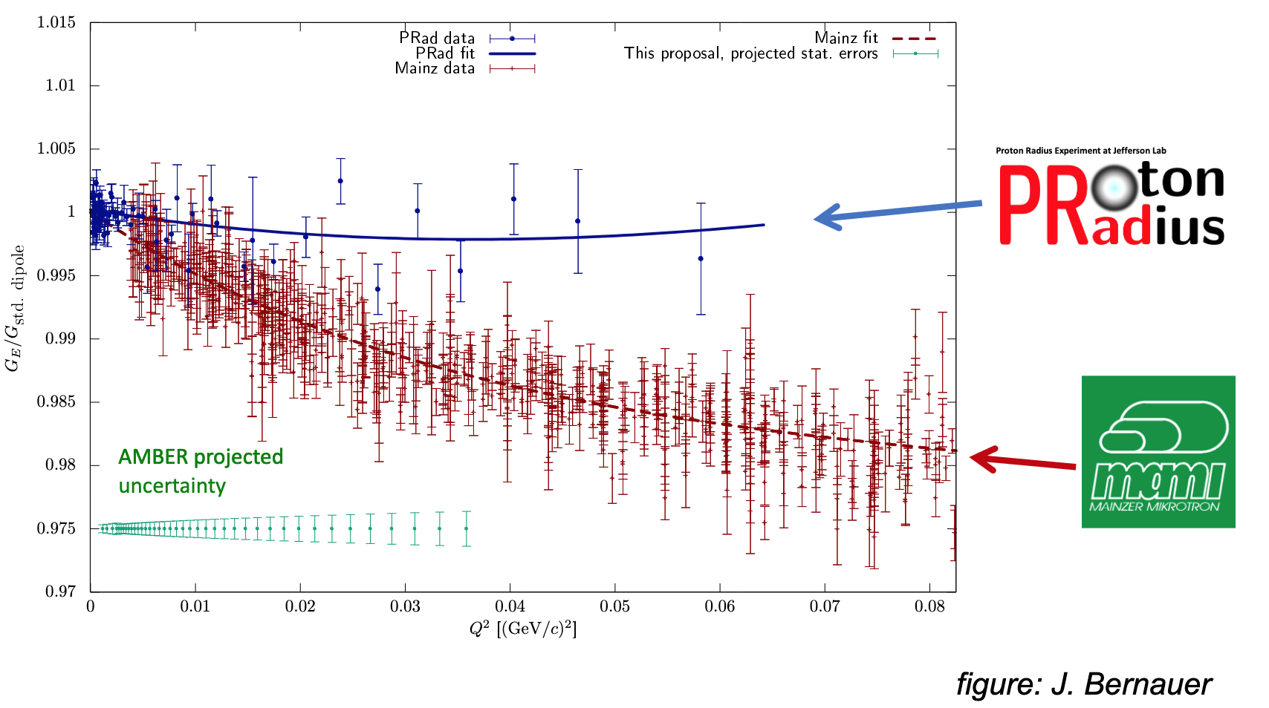
Goals for the PRad-II Experiment (E12-20-004)
There is certain discrepancy between two very recent Form Factor precision measurements.
New high accuracy ep-scattering measurements are needed.
PRad-II goals:
  high accuracy Gep measurement in a wide Q² range (Q² = 10⁻⁵ – 10⁻² GeV²);
  reach the Q² = 10⁻⁵ GeV² range
  a factor of 4 improvement on Rp

Slide 6
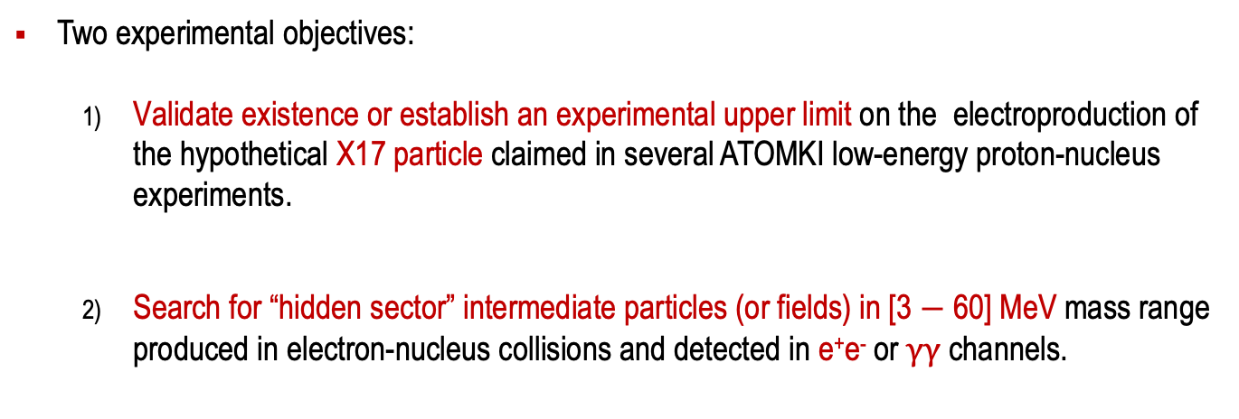
X17 Search Experiment, Physics Goals
(approved by PAC50 in 2022, E12-21-003)
Two experimental objectives:
  Validate existence or establish an experimental upper limit on the electroproduction of the hypothetical X17 particle claimed in several ATOMKI low-energy proton-nucleus experiments.
  Search for “hidden sector” intermediate particles (or fields) in [3 $−$ 60] MeV mass range produced in electron-nucleus collisions and detected in e⁺e⁻ or $γγ$ channels.

Slide 7
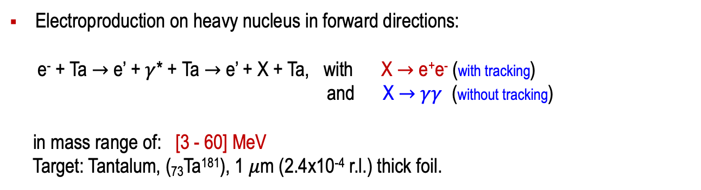
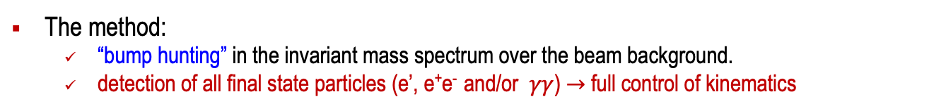
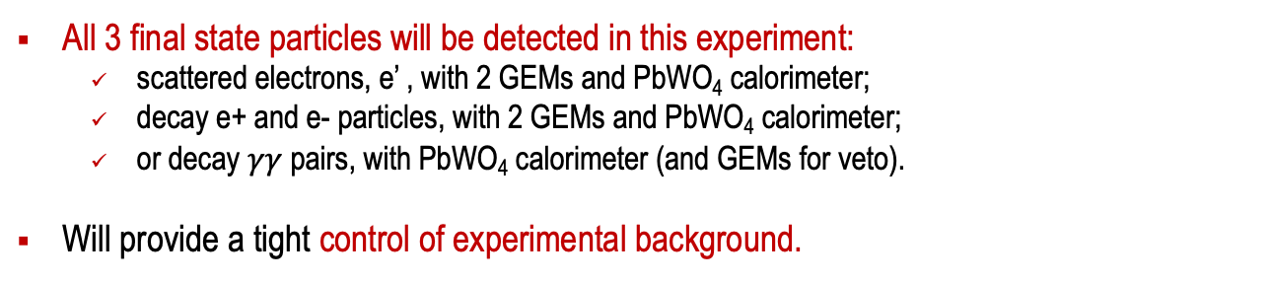
X17 Search Experiment: Experimental Method
Electroproduction on heavy nucleus in forward directions:
e⁻ + Ta $→$ e’ + $γ$* + Ta $→$ e’ + X + Ta, with X $→$ e⁺e⁻ (with tracking)
and X $→$ $γγ$ (without tracking)
in mass range of: [3 - 60] MeV
Target: Tantalum, (₇₃Ta¹⁸¹), 1 $μ$m (2.4x10⁻⁴ r.l.) thick foil.
The method:
  “bump hunting” in the invariant mass spectrum over the beam background.
  detection of all final state particles (e’, e⁺e⁻ and/or $γγ$) $→$ full control of kinematics
All 3 final state particles will be detected in this experiment:
  scattered electrons, e’ , with 2 GEMs and PbWO₄ calorimeter;
  decay e+ and e- particles, with 2 GEMs and PbWO₄ calorimeter;
  or decay $γγ$ pairs, with PbWO₄ calorimeter (and GEMs for veto).
Will provide a tight control of experimental background.

Slide 8
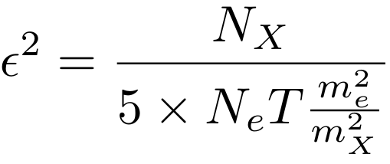
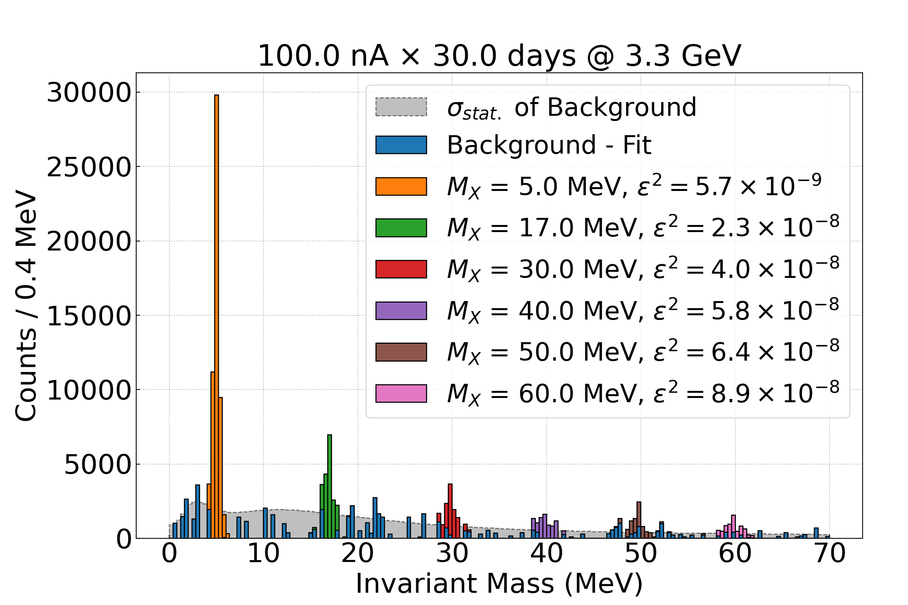
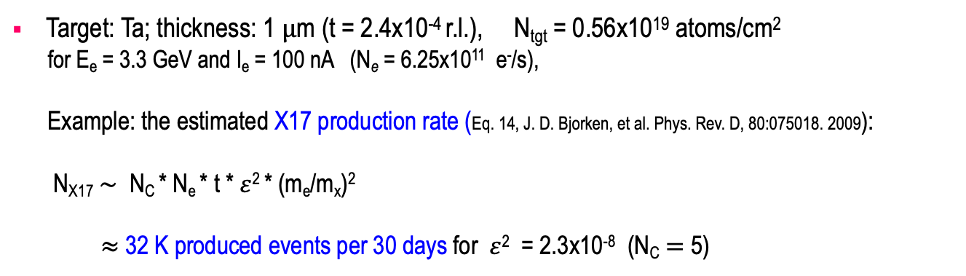
X17 Search Experiment: Beam Time and Statistics
Target: Ta; thickness: 1 $μ$m (t = 2.4x10⁻⁴ r.l.), N_{tgt} = 0.56x10¹⁹ atoms/cm²
for E_{e} = 3.3 GeV and I_{e} = 100 nA (N_{e} = 6.25x10¹¹ e⁻/s),
Example: the estimated X17 production rate (Eq. 14, J. D. Bjorken, et al. Phys. Rev. D, 80:075018. 2009):
N_{X17} $\sim$ N_{C} * N_{e} * t * $ε$² * (m_{e}/m_{x})²
$≈$ 32 K produced events per 30 days for $ε$² = 2.3x10⁻⁸ (N_{C} $=$ 5)
 | Time (days)
Setup checkout, calibration | 4.0
Production at 2.2 GeV, 50 nA | 20.0
Production at 3.3 GeV, 100 nA | 30.0
Energy change | 0.5
Empty target runs | 5.5
Total | 60

Slide 9
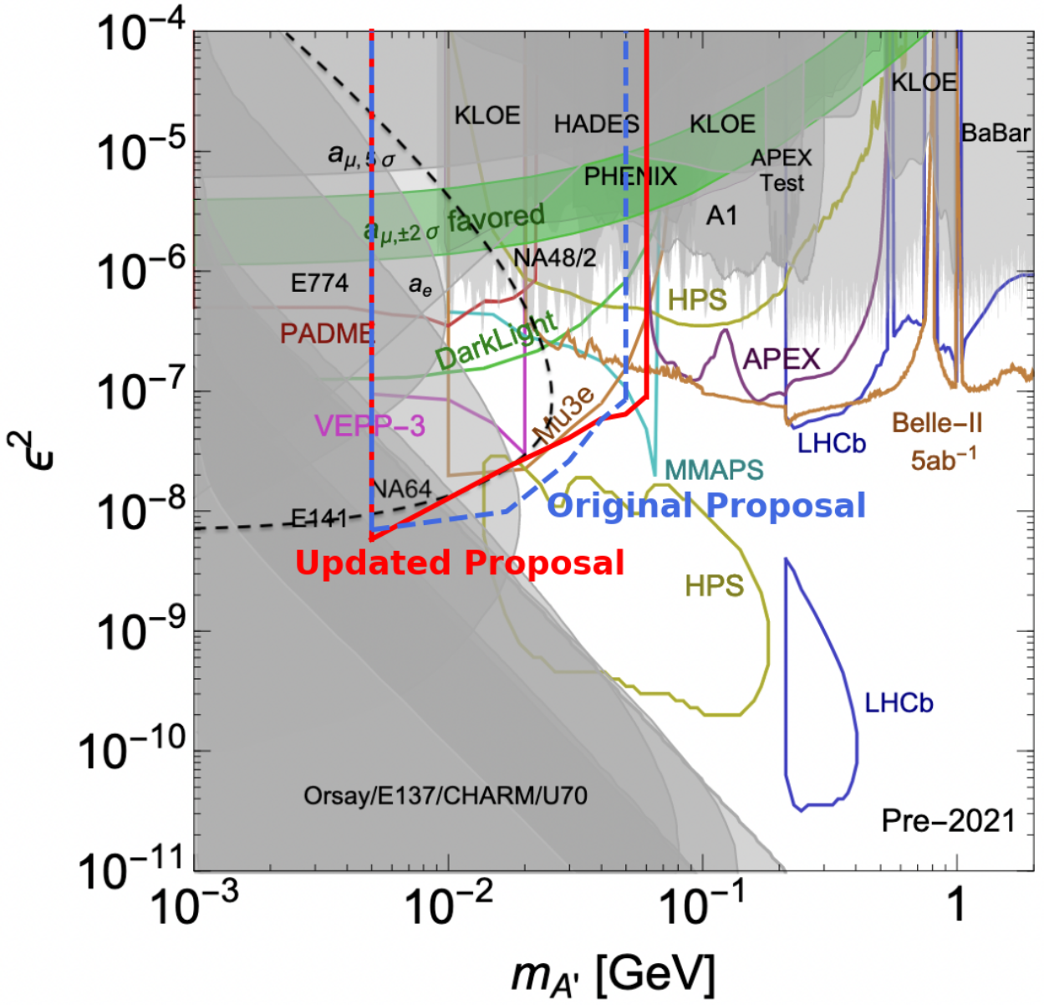
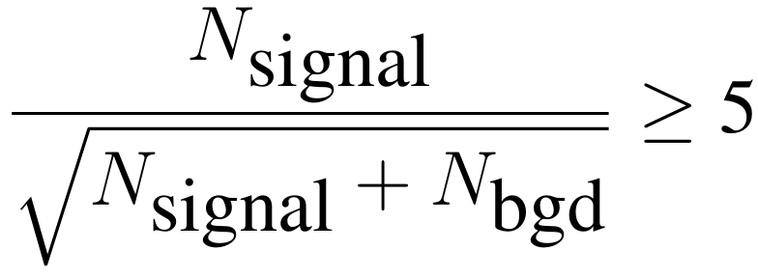
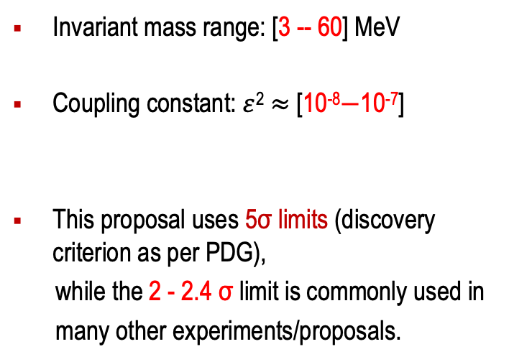
Parameter Space ($ε$² vs. Mass), Physics Reach
Invariant mass range: [3 -- 60] MeV
Coupling constant: $ε$² $≈$ [10⁻⁸$−$10⁻⁷]
This proposal uses 5σ limits (discovery criterion as per PDG),
while the 2 - 2.4 σ limit is commonly used in
many other experiments/proposals.

Slide 10
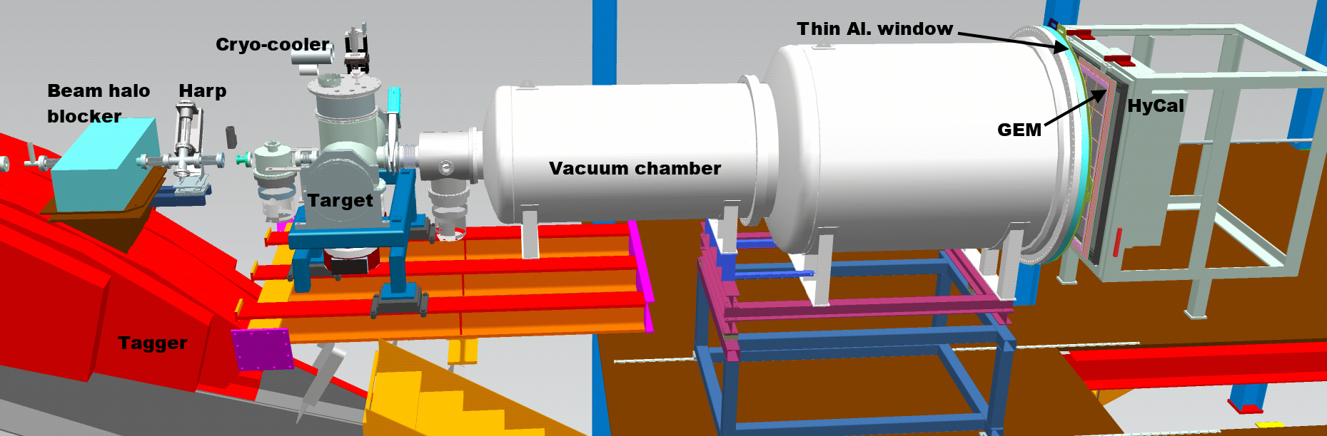
Both Experiments will Use the PRad Experimental Setup
Main detector elements:
  windowless H₂ gas flow target
  PrimEx HyCal calorimeter
  vacuum box with one thin window at HyCal end
  X,Y – GEM detectors on front of HyCal
Beam line equipment:
  standard beam line elements (0.1 – 50 nA)
  photon tagger for HyCal calibration
  collimator box (6.4 mm collimator for photon beam, 12.7 mm for e⁻ beam halo “cleanup”)
  Harp 2H00 l
e - beam

Slide 11
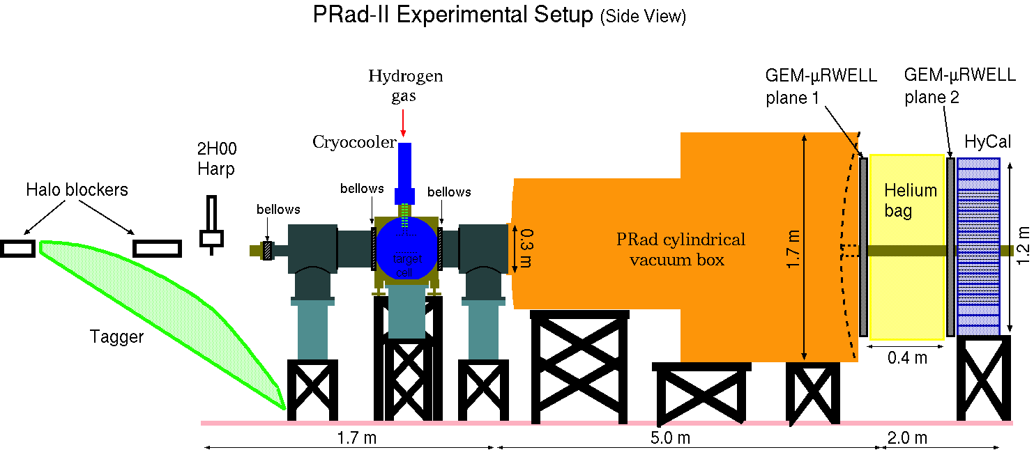
PRad-II Experimental Setup and Experimental Goals
Significantly improved statistics (4 times less statistical uncertainties, also helps systematics uncertainties).
Upgrade PRad experimental setup (improving the systematics):
  adding full tracking capability (second plane of GEM detectors).
  upgrade DAQ/electronics to fADC based system (new trigger and readout).
  small-size scintillator detectors just downstream the target to veto Moller electrons to reach the 10⁻⁵ GeV² Q² range.
  adding new “beam halo blacker” just before the Tagger for less beam background.
  use the PbWO₄ crystal part only (high energy and position resolutions).
Beam energies: Ee = 0.7, 2.1, 3.5 GeV
Total beam time: 40 days
e - beam

Slide 12
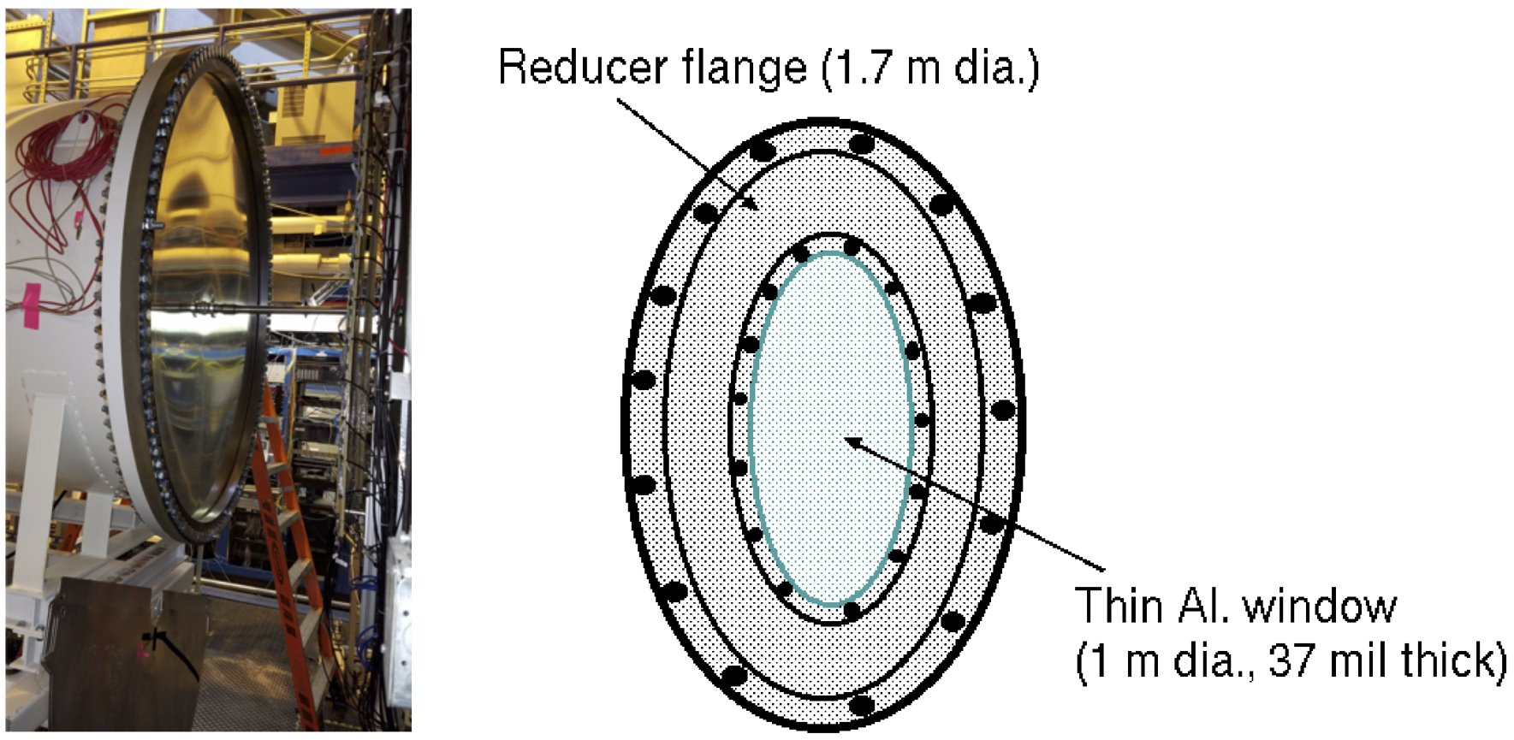
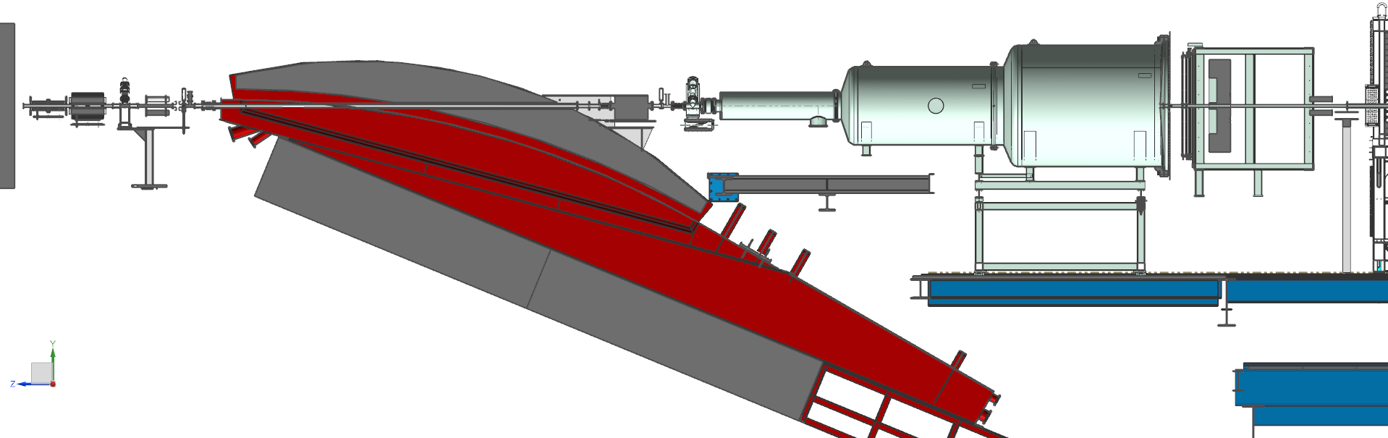
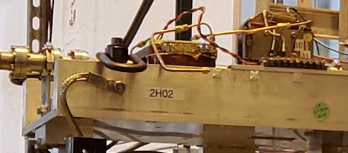
X17 Search Experiment: Beam Line Elements
New parts to be manufactured
New tube: 30 cm dia., 1.7m long
New reducer flange
1 m dia Aluminum window
2H01 girder to be placed after the HyCal
Collimator w/ radiator
Target w/ Harp wires
2 layer of GEMs
Modifications are discussed w/ Bob Miller
Vacuum chamber
Design and manufacturing: 4 months
Beamline installation ~2 weeks
Slide is from Rafo

Slide 13
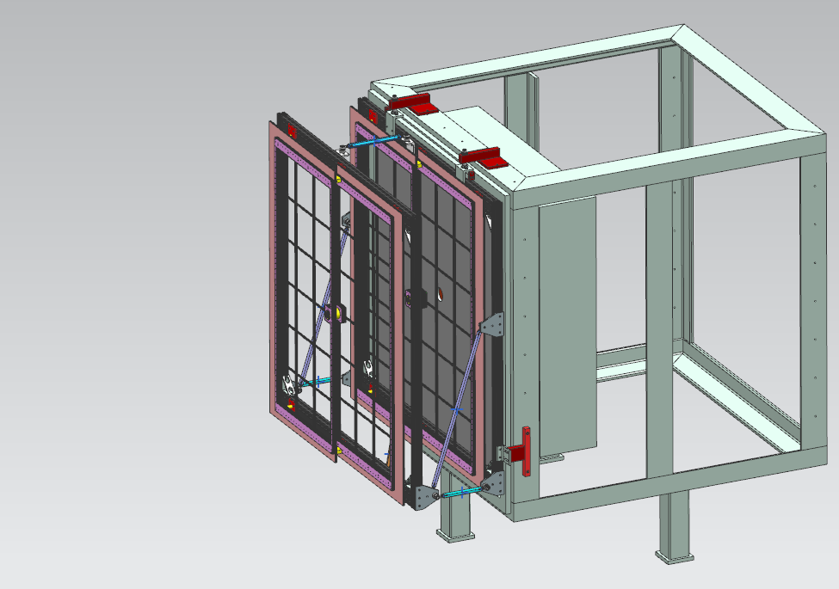
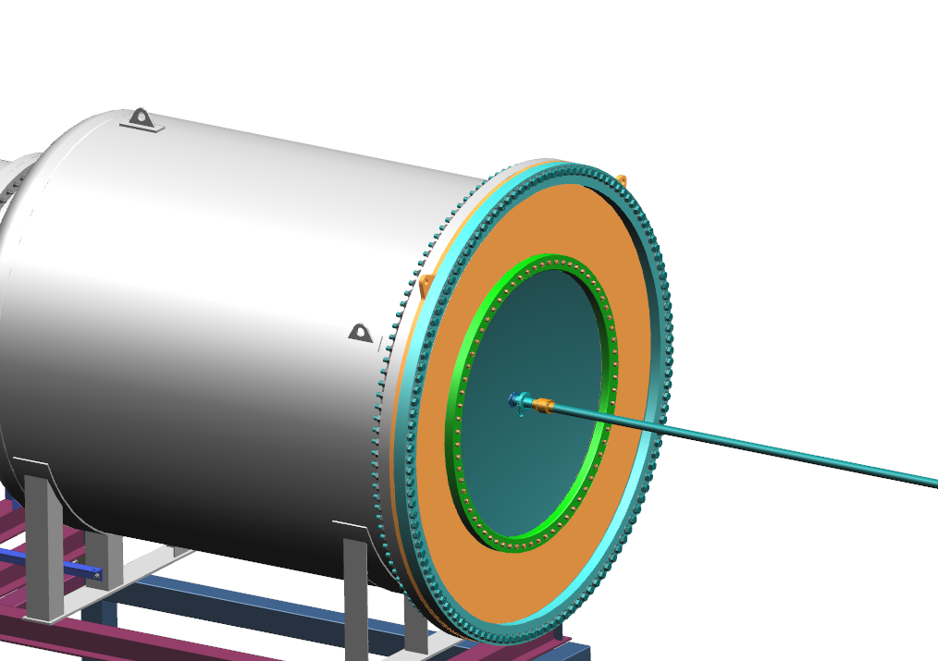
Experimental Setup Preparation Status:
Beam Line Elements
All new beam line elements for both PRad-II and X17 experiments are
identified, optimized conceptual design part is completed.
Engineering design work is nearly completed.

Slide 14
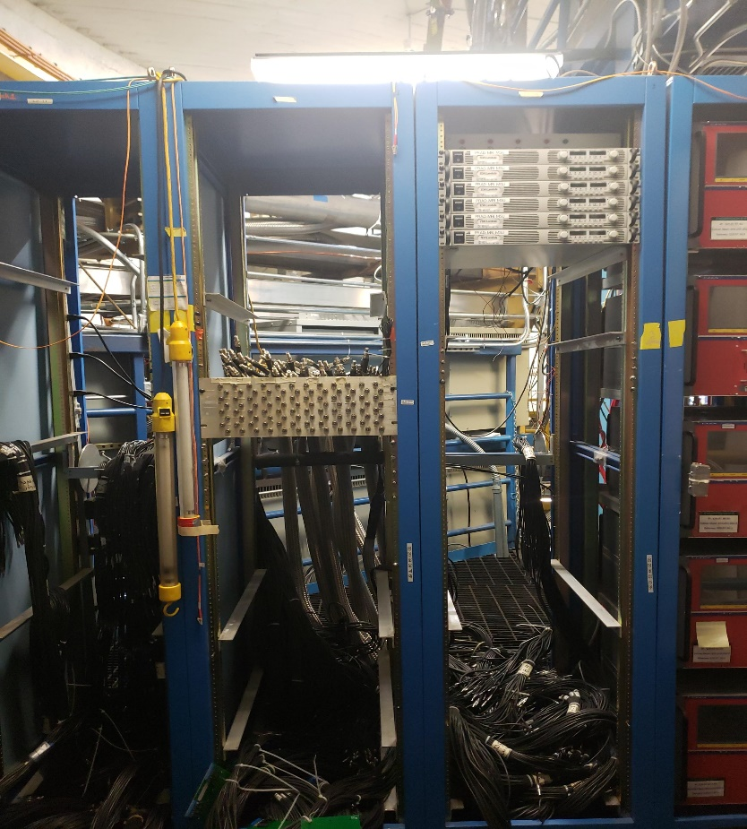
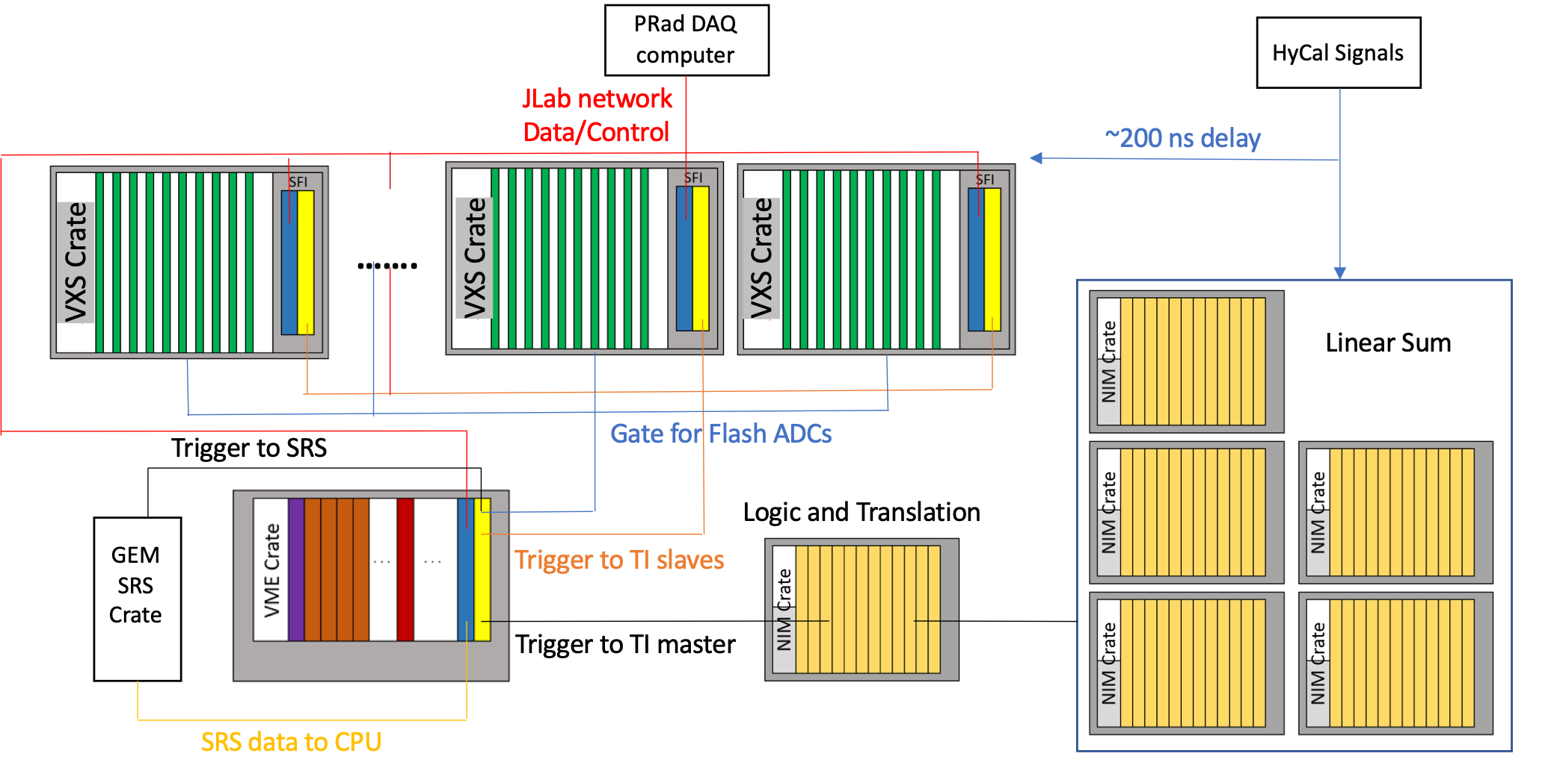
PRad-II Experimental Setup Preparation Status:
DAQ and Readout Electronics
5+ VXS crates are onsite (PbWO₄ part only)
72 fADC250 modules (1152 channels) are procured, most of them are onsite
Modern flash ADC-based pipelined DAQ with robust trigger efficiency monitoring.
Yesterday’s statement form Chris Cuevas:
  Old equipment removal performed safely and without issues
  Original coaxial cable cards re-terminated with Lemos
  Many Hall activities remain but we have DAQ equipment on site
  Do not anticipate any significant issues with new FADC250 boards
  Supporting VXS DAQ boards are on site and tested
  Network and Trigger fiber cables should be installed before end of SAD

Slide 15
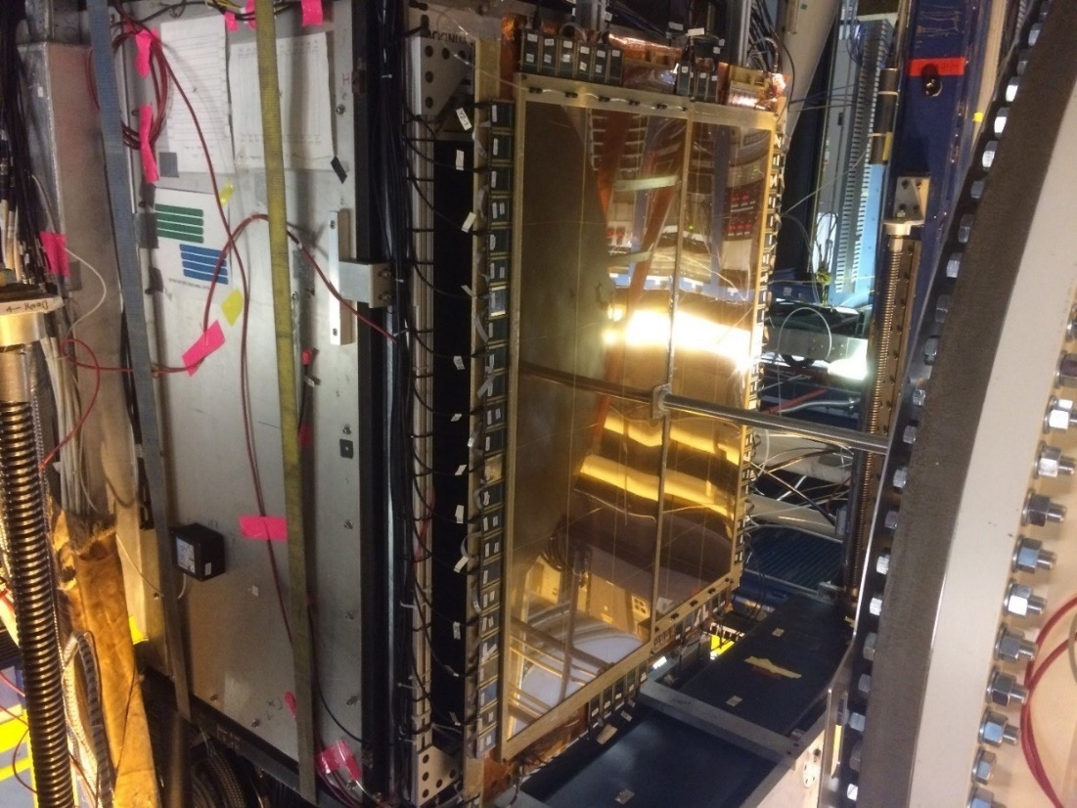
PRad-II Experimental Setup Preparation Status:
Two Planes of New GEM Detectors
4 new GEM modules to assemble 2 tracking layers.
Size: 120 x 55 cm2, similar to PRad GEMs.
GEM and readout foils: delivery from CERN
in December 2024
GEM holding frames: design optimized, order being placed, available in January 2025
GEMs construction will start from January 2025
New readout electronics ordered, expected from
February 2025
Cosmic ray tests at Jlab from April 2025
Ready for installation in Hall B from August 2025
PRad GEM on front of HyCal
Optimized and updated GEM frame design for PRad-II
Slide is from Nilanga

Slide 16
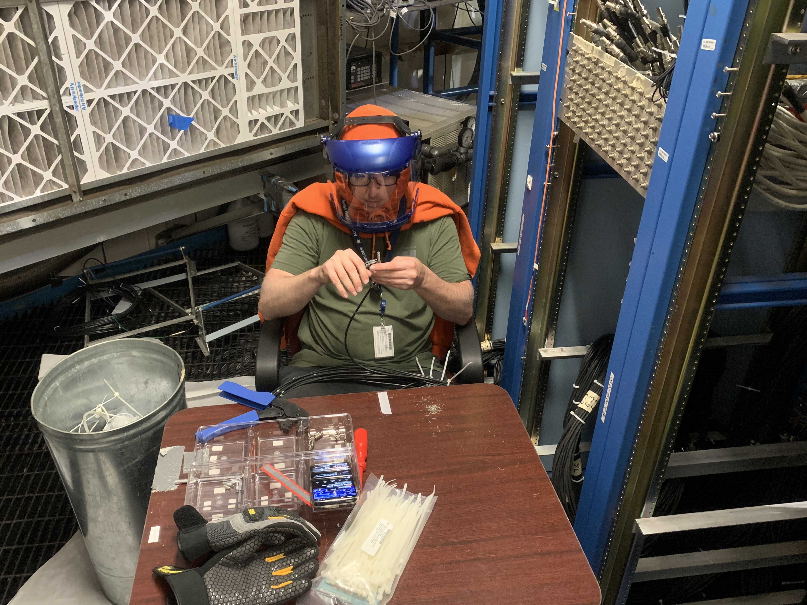
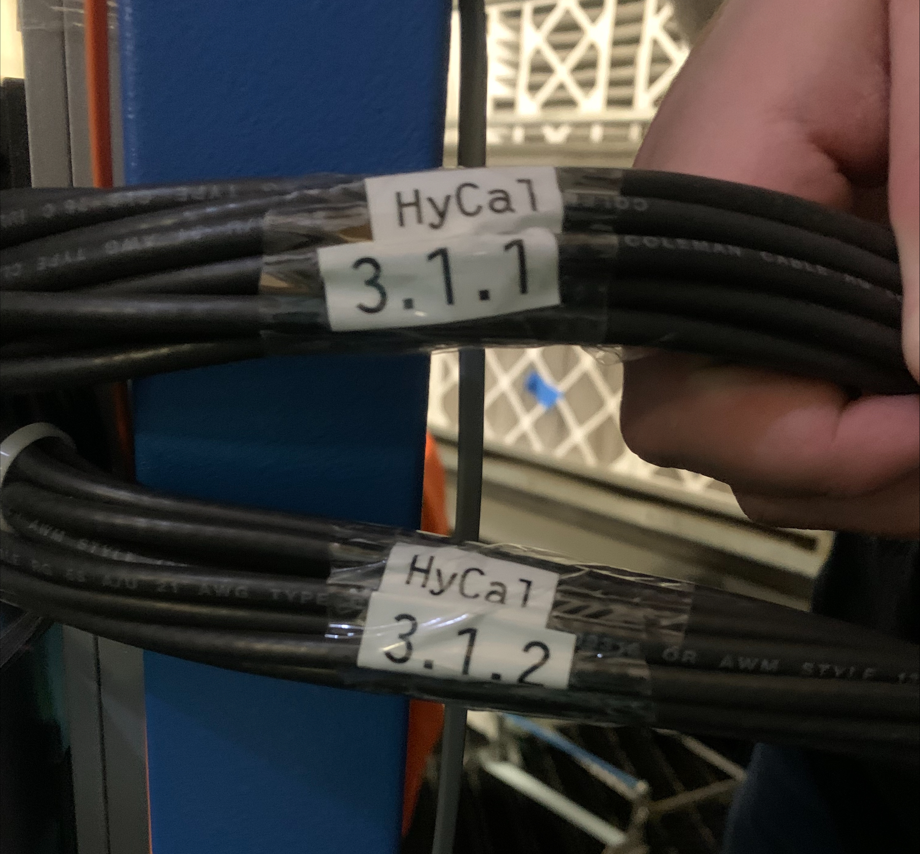
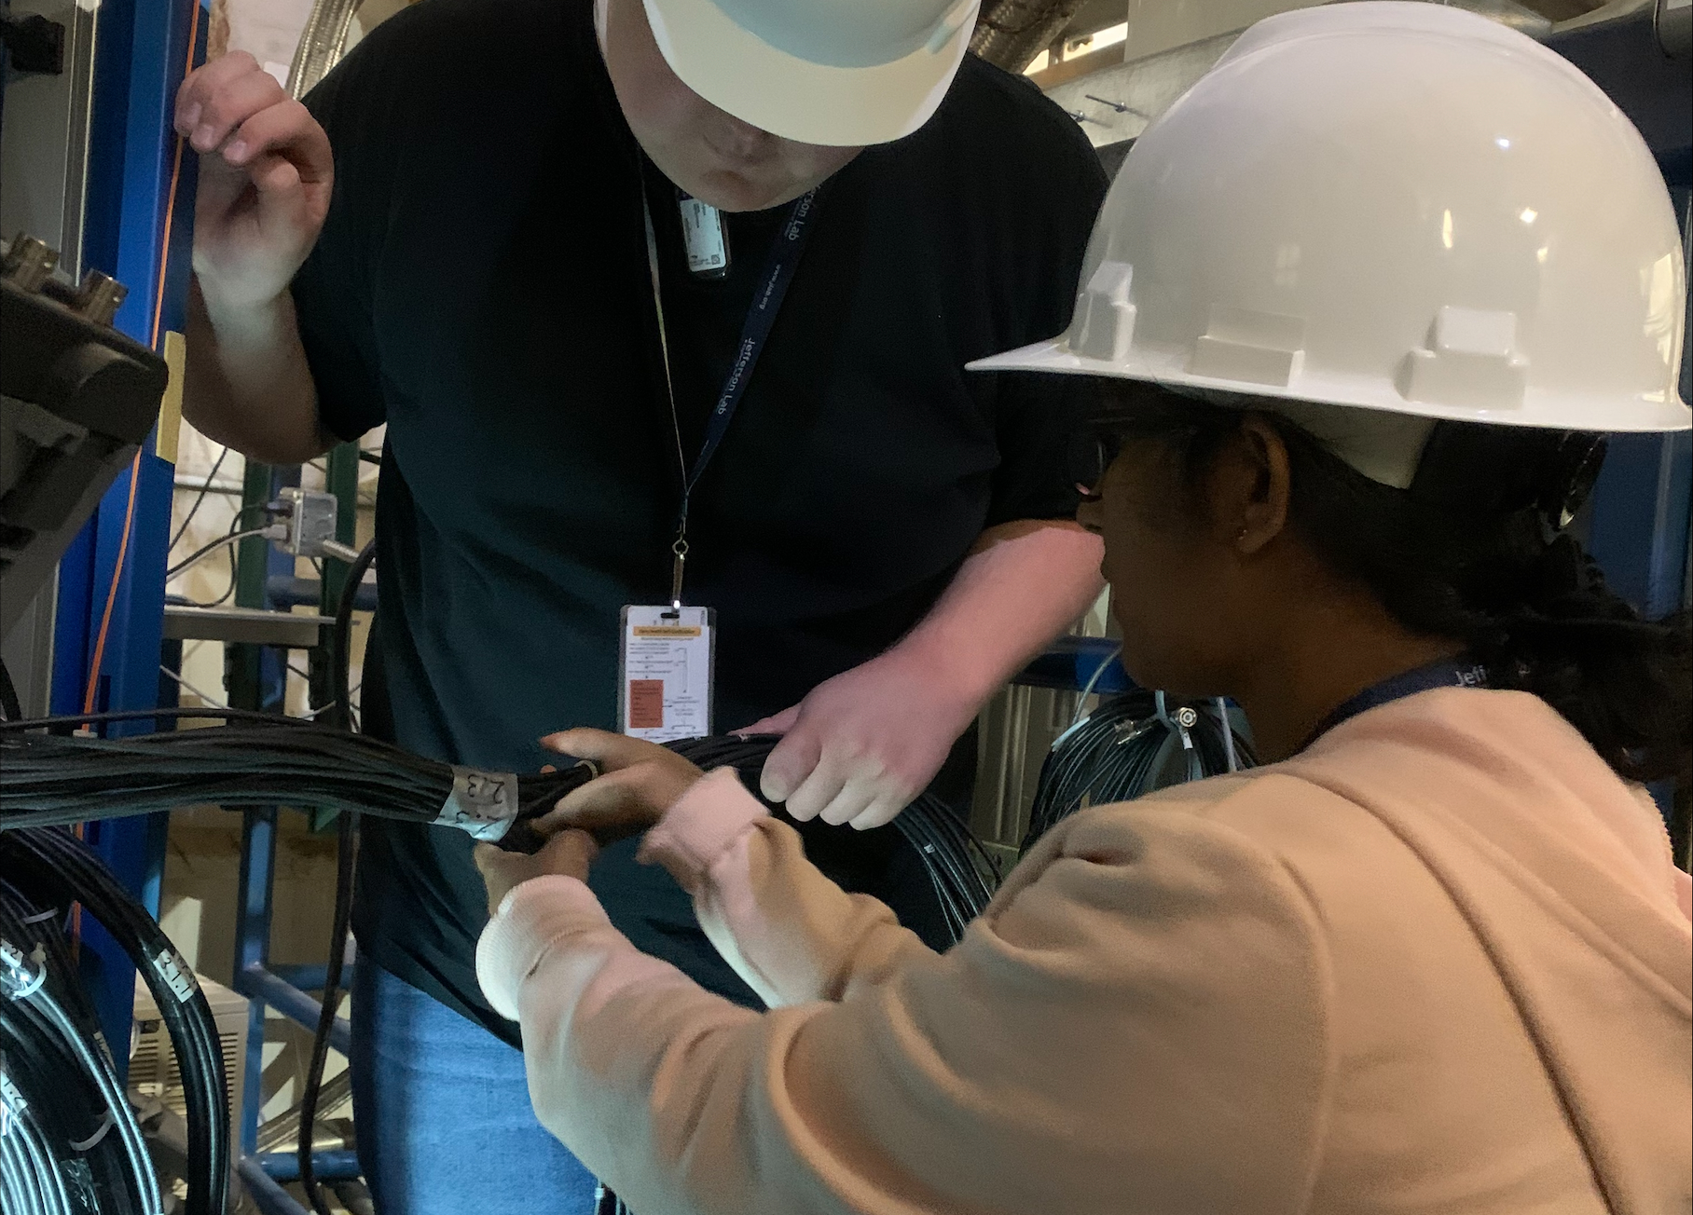
PRad-II Experimental Setup Preparation Status:
DAQ and Readout Electronics, re-cabling and installation
All FASTBUS crates with power supplies are removed from electronics rocks.
Re-termination of HyCal signal cables (RG58) with lemo connectors in nearly completed.
Channel-by-channel testing is in progress.
Test of HV channels and cables is in progress.

Slide 17
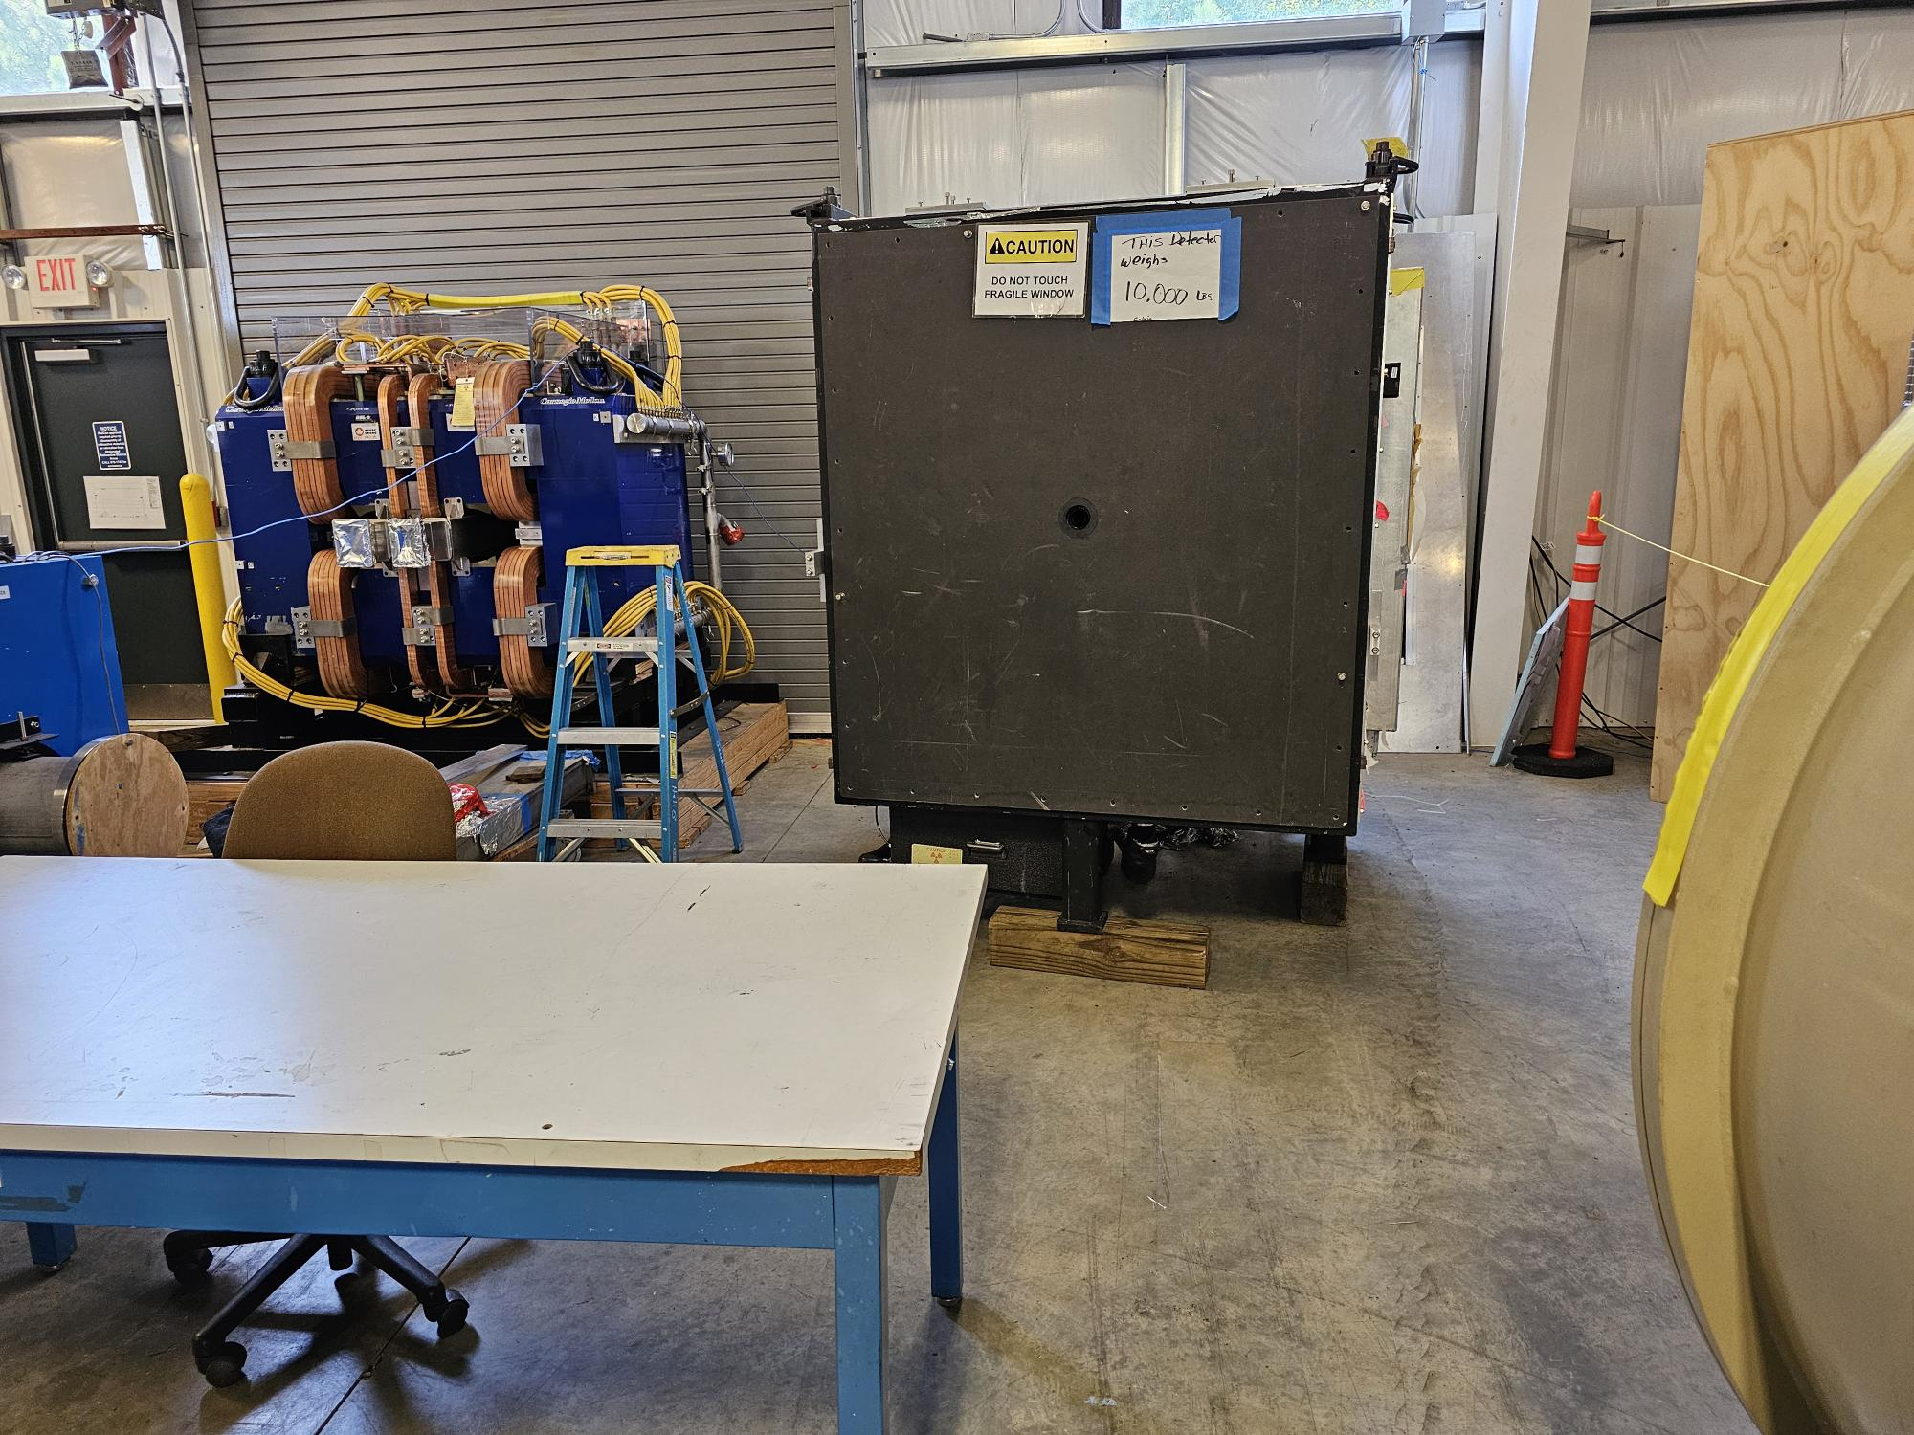
PRad-II Experimental Setup Preparation Status:
HyCal Tests in ESB Building
HyCal was recently re-positioned in ESB, the area was cleared, tests are in progress.
We are testing and repairing all HyCal channels (~1600)
  with cosmic rays (PbWO4 part is completed);
  with Light Monitoring System (in preparation)
  check optical contacts (completed)
Planned to finish all tests by January 2025..

Slide 18
The CLAS collaboration is Invited to Participate
in these Experiments
For your initial information, the PRad-II/X17 collaboration Charter together with the two proposals can be found at:
https://wiki.jlab.org/pcrewiki/index.php/Main_Page
The minimum number of shifts per person to be a co-author in any upcoming publication related to these experiments is 8 shifts for any one experiment and 12 for both experiments.
Shifts will be conducted in blocks of 4 shifts per institution which is common practice in Hall B.
You are welcomed to participate in these experiments!

Slide 19
Summary and Outlook
Conceptual design of all beamline elements for both PRad-II and X17 Search experiments is finalized.
Engineering design is nearly completed.
Construction of four GEM detectors is on track to be ready by mid-spring 2025:
  cosmic ray tests in Hall B beam line, starting from August of 2025
New DAQ equipment is on site.
Work on cables in Hall B is nearly completed.
HyCal tests are in progress, the PbWO₄ part is completed.
Start installation in Hall B beamline from August 2025
Experiments ready from November 2025.
We are inviting the CLAS collaboration to be a big part in these experiments
Thankful to Hall B administration, engineering group, technicians and Fast Electronics Group for their strong support and help to these experiments.

Slide 20
Backup Slides

Slide 21
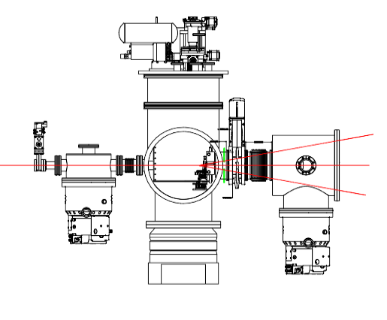
PRad-II Experimental Setup Preparation Status:
4 New Scintillator Detectors to Reach the Q²=10⁻⁵ GeV² Range
4 small scintillator detectors placed next to the H2 gas flow target chamber.
Size: 4 x 6 x 0.3 cm³
Remotely movable perpendicular to the beam direction.
Conceptual design by Y. Sharabian: completed.
Engineering design by C. Guthrie: in progress.
Manufacturing: by Spring, 2025
Estimated time for test in beamline: Summer, 2025.

Slide 22
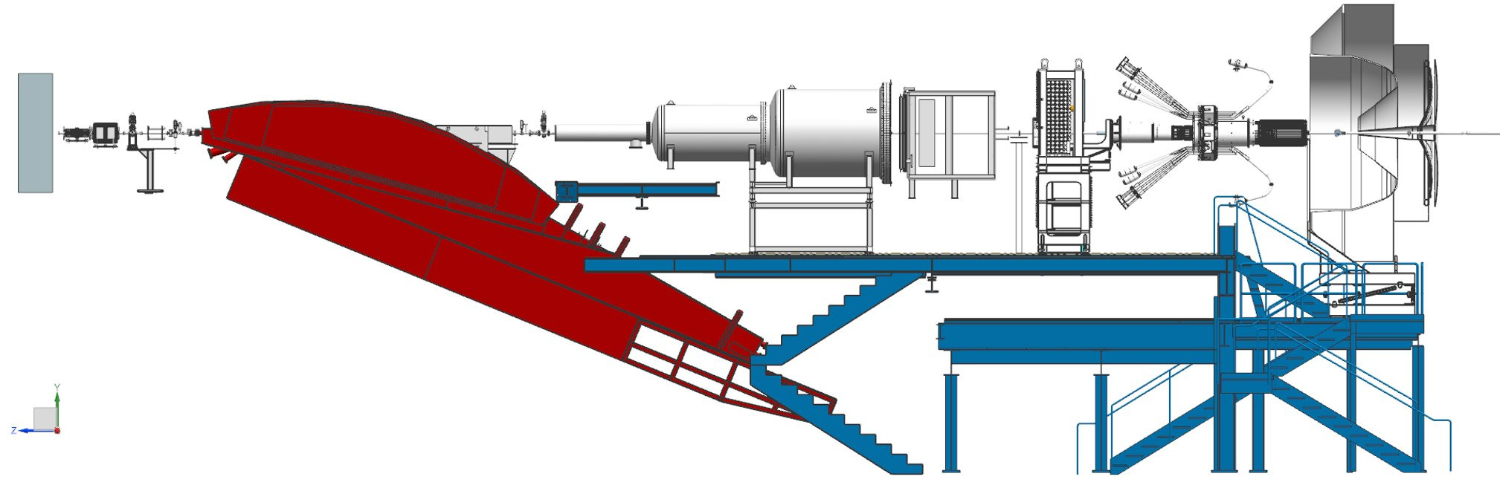
More than 4m available

Slide 23
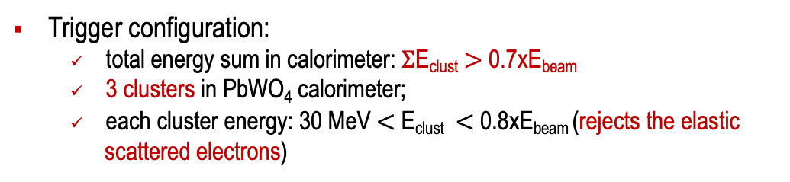
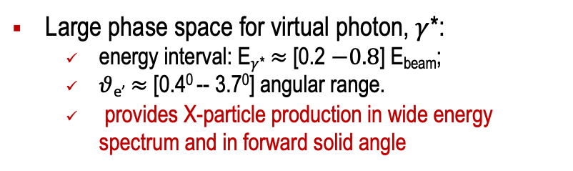
Detection Efficiency (Geometrical Acceptance)
Trigger configuration:
  total energy sum in calorimeter: $Σ$E_{clust} $>$ 0.7xE_{beam}
  3 clusters in PbWO₄ calorimeter;
  each cluster energy: 30 MeV $<$ E_{clust} $<$ 0.8xE_{beam} (rejects the elastic
  scattered electrons)
Large phase space for virtual photon, $γ$*:
  energy interval: E$γ$* $≈$ [0.2 $−0.8$] E_{beam};
  $θ$_{e’}$≈$ [0.4⁰ -- 3.7⁰] angular range.
  provides X-particle production in wide energy spectrum and in forward solid angle
Target to detector distance: L = 7.5 m provides good (integrated) detection efficiency in [3 - 60] MeV mass range for
E_{e} = 2.2, 3.3 and 4.4 GeV.
E_{e} = 2.2 and 3.3 GeV were chosen for relative ease of scheduling during CEBAF low-energy runs.

Slide 24
Suggested New Beam Time Distribution:
Original proposal:
E (GeV) Inten. (nA) Time (days)
0.7 20 4 (Intensity was limited by DAQ)
1.4 70 5
2.1 70 15
Suggested Run:
0.7 20 4
2.1 150 5
3.5 150 15
Setup checkout, tests and calibration 7 days (Intensity is limited by central crystals)
Beam energy change 1 day
Empty target runs 8 days
Total: 40 days (no change)

Slide 25
PRad Result on Proton Charge Radius
PRad final result: R_{p} = 0.831 ± 0.007 (stat.) ± 0.012 (syst.) fm (± 1.67%)
published in: Nature 575, 145–150 (2019)

Slide 26
PRad-II Expected Result on the Proton Radius
(PAC48, 2020, E12-20-004)
PRad-II projected result: R_{p} = 0.831 ± 0.0014 (stat.) ± 0.0041 (syst.) fm (± 0.43%)

Slide 27
