Slide 1
Jefferson Laboratory Science Programs
David J. Dean
Deputy Director for Science and Technology
Presented To:
CLAS meeting
November 12, 2024

Slide 2
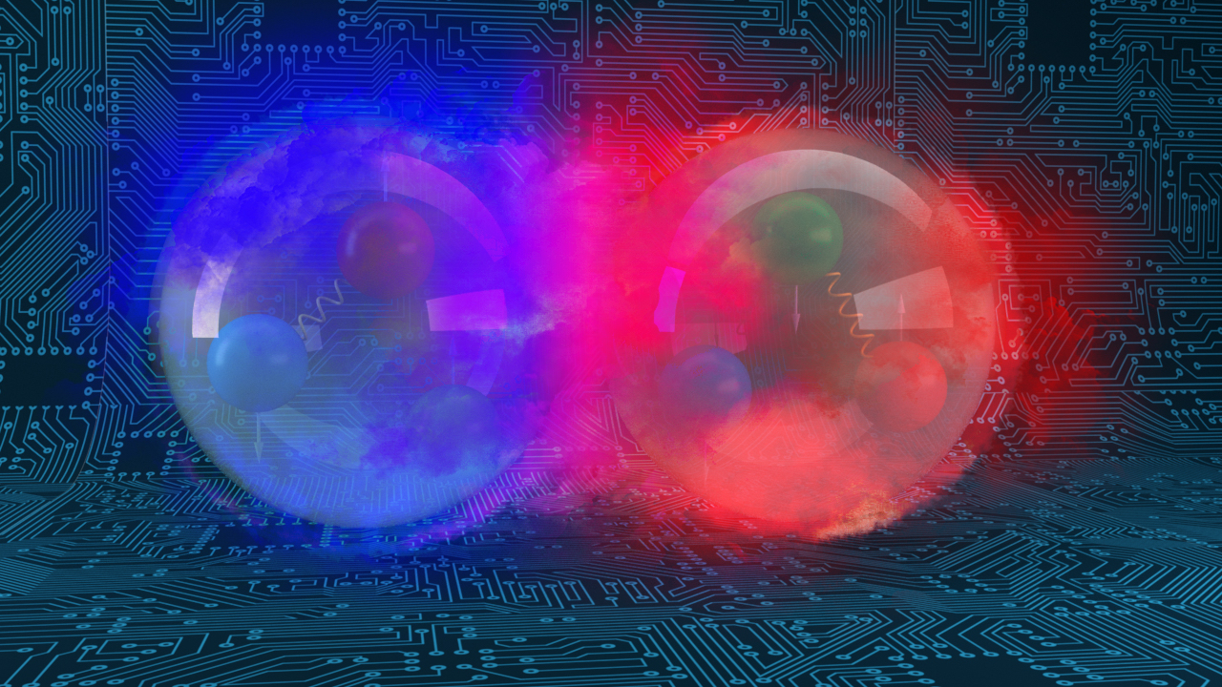
Outline…
A bit of science strategy
FY24 S&T accomplishments
Getting ready for the future

Slide 3
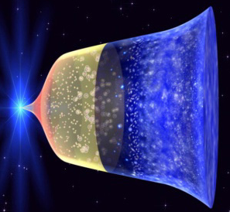
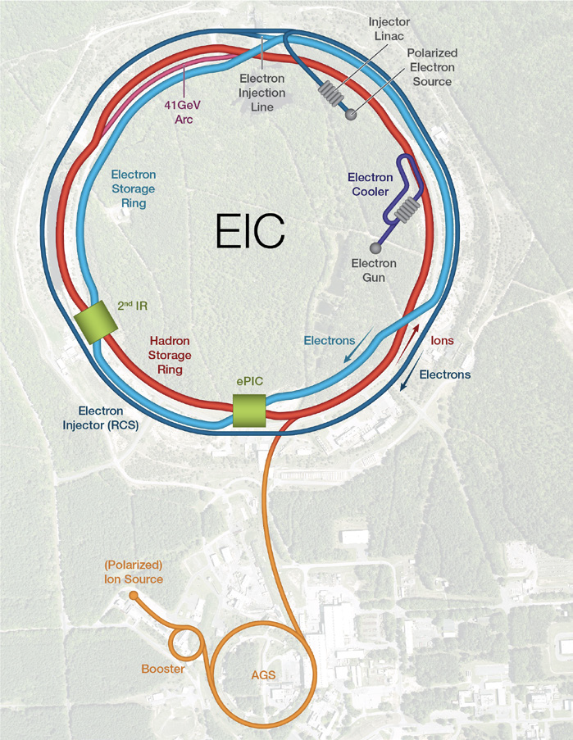
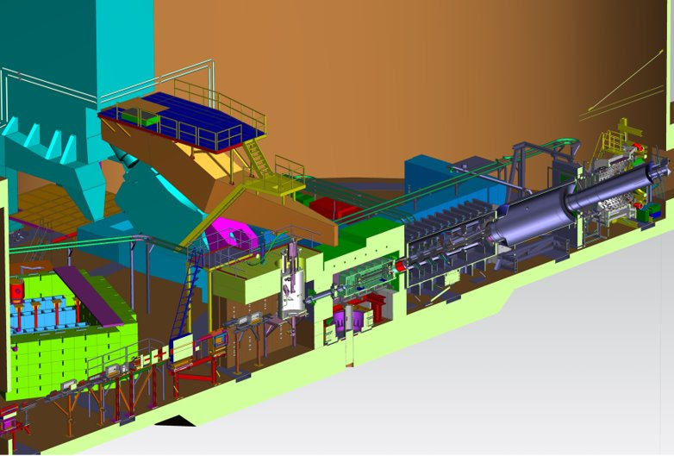
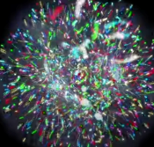
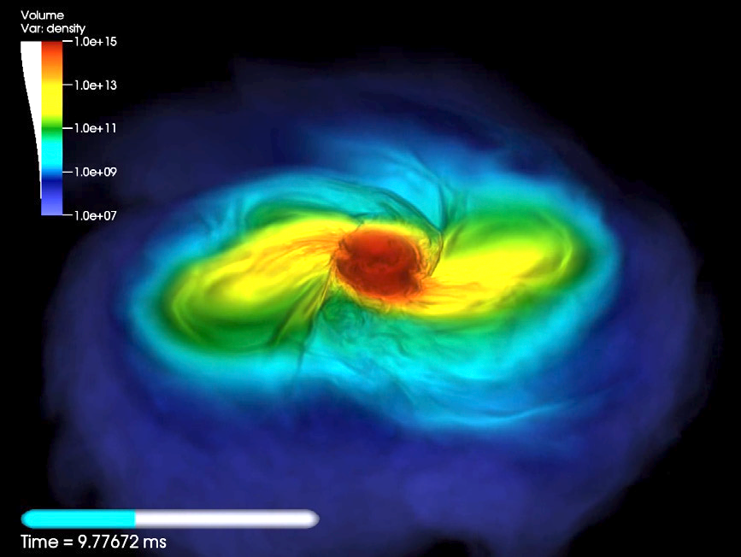
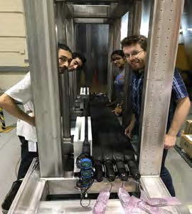
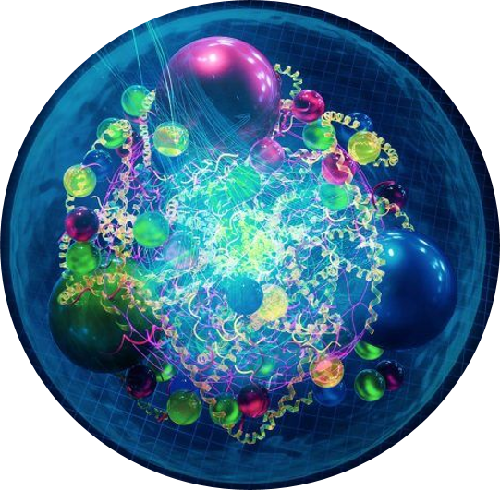
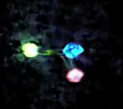
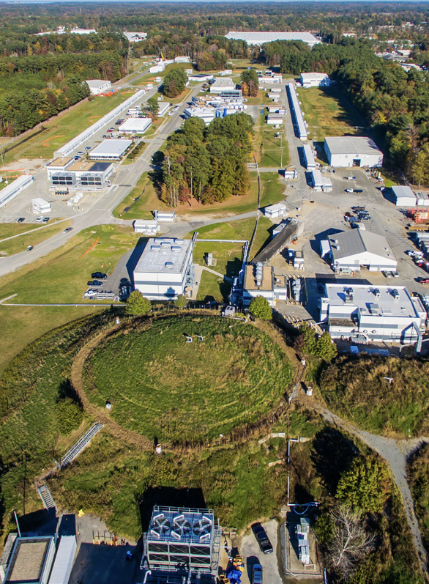
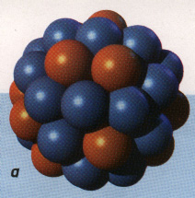
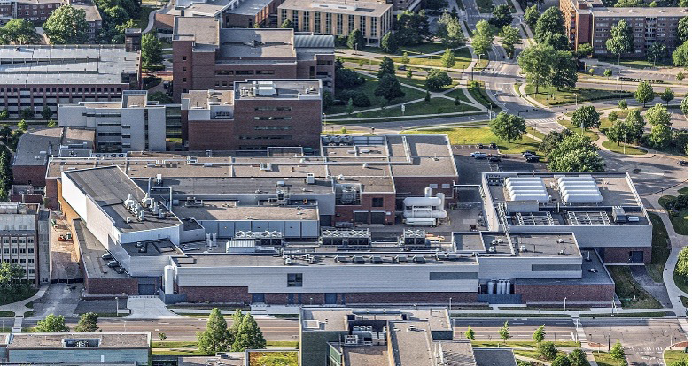
Nuclear Physics across the Universe
2023 LRP Science Questions
How do quarks and gluons make up protons, neutrons, and, ultimately, atomic nuclei?
How do the rich patterns observed in the structure and reactions of nuclei emerge from the interactions between neutrons and protons?
What are the nuclear processes that drive the birth, life, and death of stars?
How do we use atomic nuclei to uncover physics beyond the Standard Model?
Gluons
Fundamental Symmetries
Neutron Star Mergers
Quarks
Nuclear Physics & Astrophysics
10⁻¹⁰ –10⁻³ sec
The world of QCD
Notes:
<10⁻⁴³ seconds…Planck epoch
<10⁻³⁶ seconds…Grand Unification Epoch
<10⁻³² seconds…inflation epoch
10⁻¹² seconds…electroweak epoch
10-¹² – 10⁻⁶ seconds quark epoch (think QGP)
10⁻⁶ – 1 second the hadron epoch
1 second – neutrino decoupling
1 second – 10 seconds, lepton epoch…(lepton nonconservation…neutrinoless bb decay…)
10 seconds to 3 minutes – BBN
Recombination (electron capture on light nuclei) 370,000 years
150 million years later…first stars and galaxies form…
And they collide!!

Slide 4
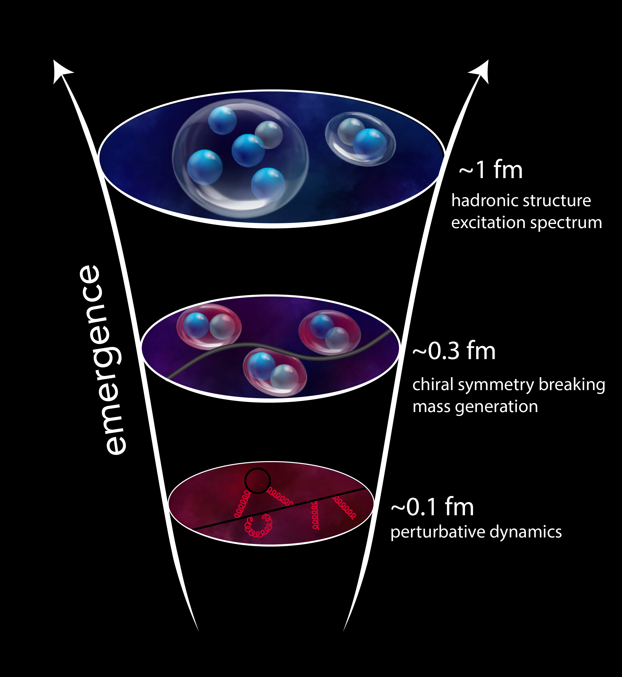
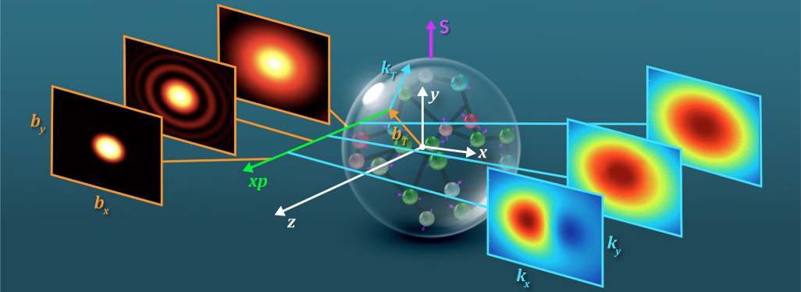
QCD Describes Quark Gluon Interactions
Position
Momentum
Direction of Proton
How do quarks and gluons make up protons, neutrons, and, ultimately, atomic nuclei?
The ability to reduce everything to simple fundamental laws does not imply the ability to start from those laws and reconstruct the universe. -- More is different, P. W. Anderson [Sci 177, 393 (1972)]

Slide 5
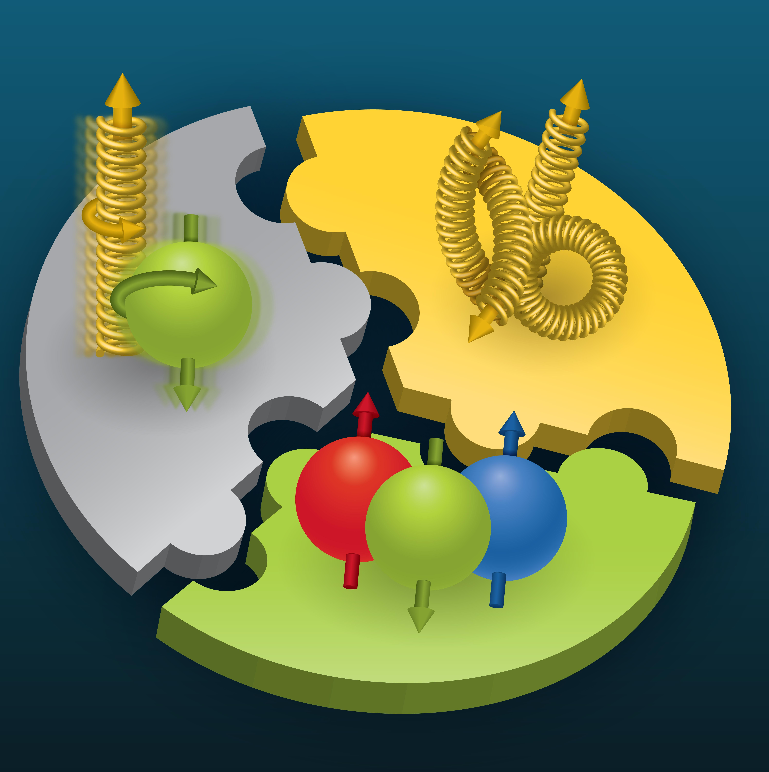

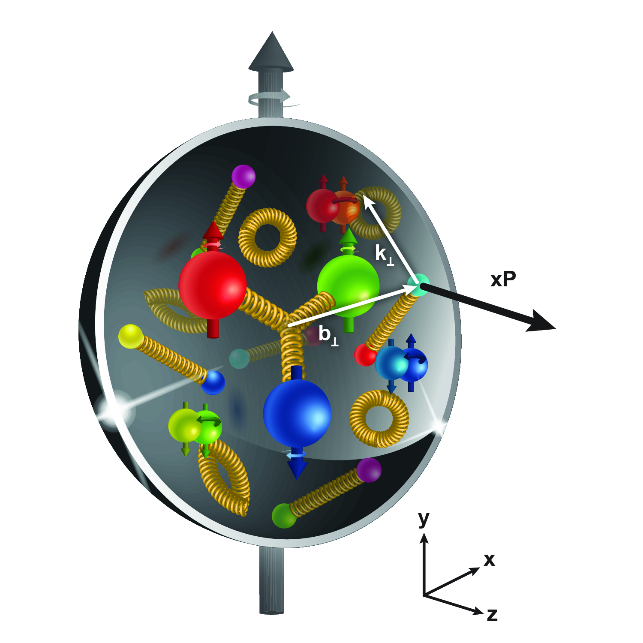
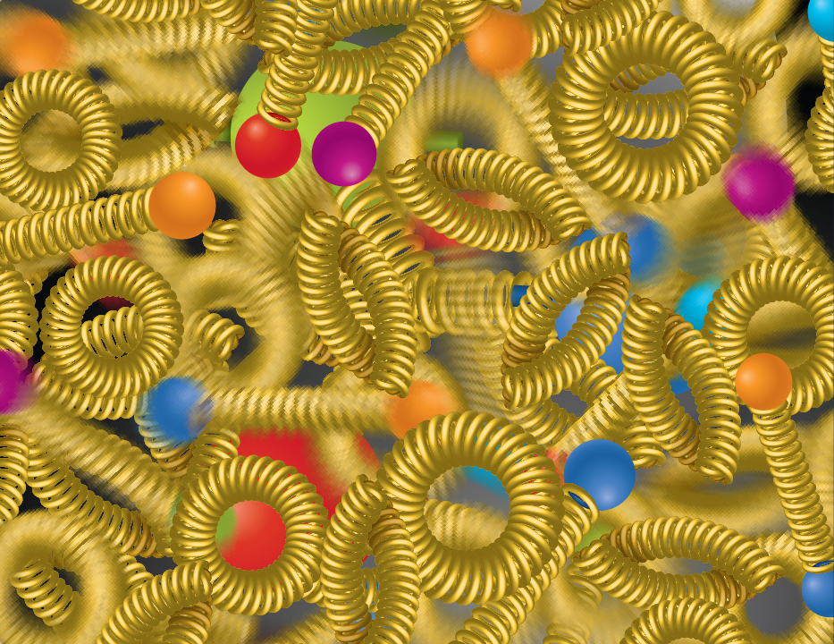
The Strong Force Science Questions
SPIN is one of the fundamental properties of matter.
All elementary particles, but the Higgs carry spin.
Spin cannot be explained by a static picture of the proton
It is the interplay between the intrinsic properties and interactions of quarks and gluons
Does the mass of visible matter emerge from quark-gluon interactions?
Atom: Binding/Mass =0.00000001
Nucleus: Binding/Mass = 0.01
Proton: Binding/Mass = 100
The so-called “QCD trace anomaly determines the proton mass. EIC measurements will determine the gluon term in the anomaly.
How are the quarks and gluon distributed in space and momentum inside the nucleon & nuclei?
How do the nucleon properties emerge from them and their interactions?
How can we understand their dynamical origin in QCD?
What is the relation to Confinement
How many gluons can fit in a proton?
How does a dense nuclear environment affect the quarks and gluons, their correlations, and their interactions?
What happens to the gluon density in nuclei? Does it saturate at high energy?
Is the structure of a free and bound nucleon the same?
How do quarks and gluons, interact with a nuclear medium?
How do the confined hadronic states emerge from these quarks and gluons?
How do the quark-gluon interactions create nuclear binding?
gluon
splitting
=
gluon
recombination

Slide 6
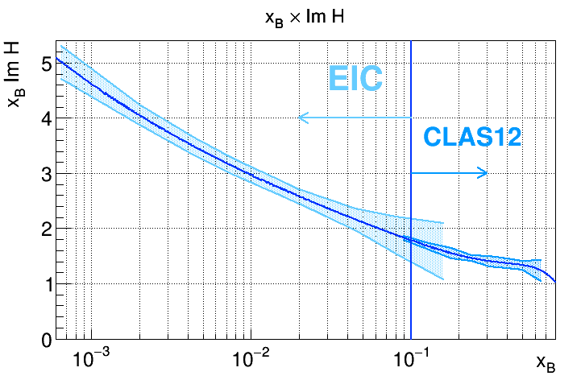
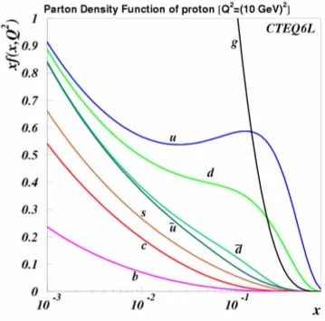
Jefferson Lab and the EIC
JLAB 12
CEBAF: ideal for the quark region (down to x~0.1) (studies of threshold charm production)
EIC: ideal for the gluon region (below 0.1)

Slide 7
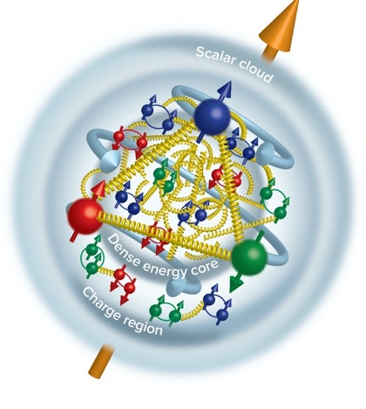
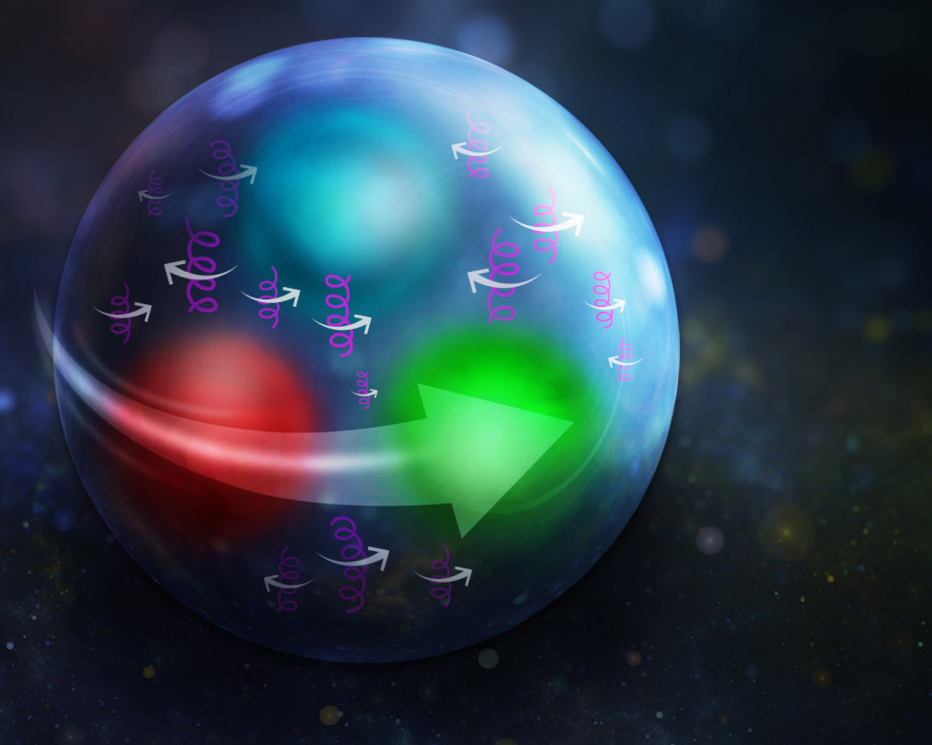
Highlights from Strong force exploration
Closing in on proton spin The Glue is in the middle Proton stress-energy tensor
Tangential stress force inside the proton changes direction near r ~ 0.45 fm
Peak : 38,000 N (4 metric tons)
Karpie et al., Gluon helicity from global analysis of experimental data and lattice QCD Ioffe time distributions, Phys. Rev. D 109, 036031 (2024)
Duran et al “Determining the gluonic gravitational form factors of the proton," Duran et al, Nature 615, 813 (2023)
Burkert, et al., Colloquium: Gravitational form factors of the proton. Reviews of Modern Physics 95, 041002 (2023)

Slide 8
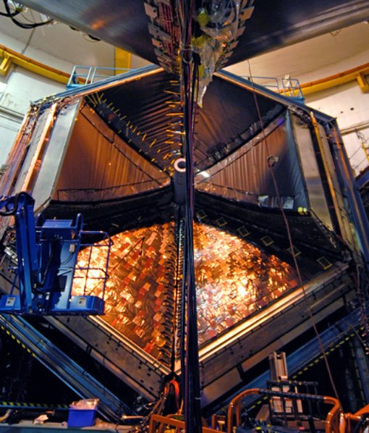
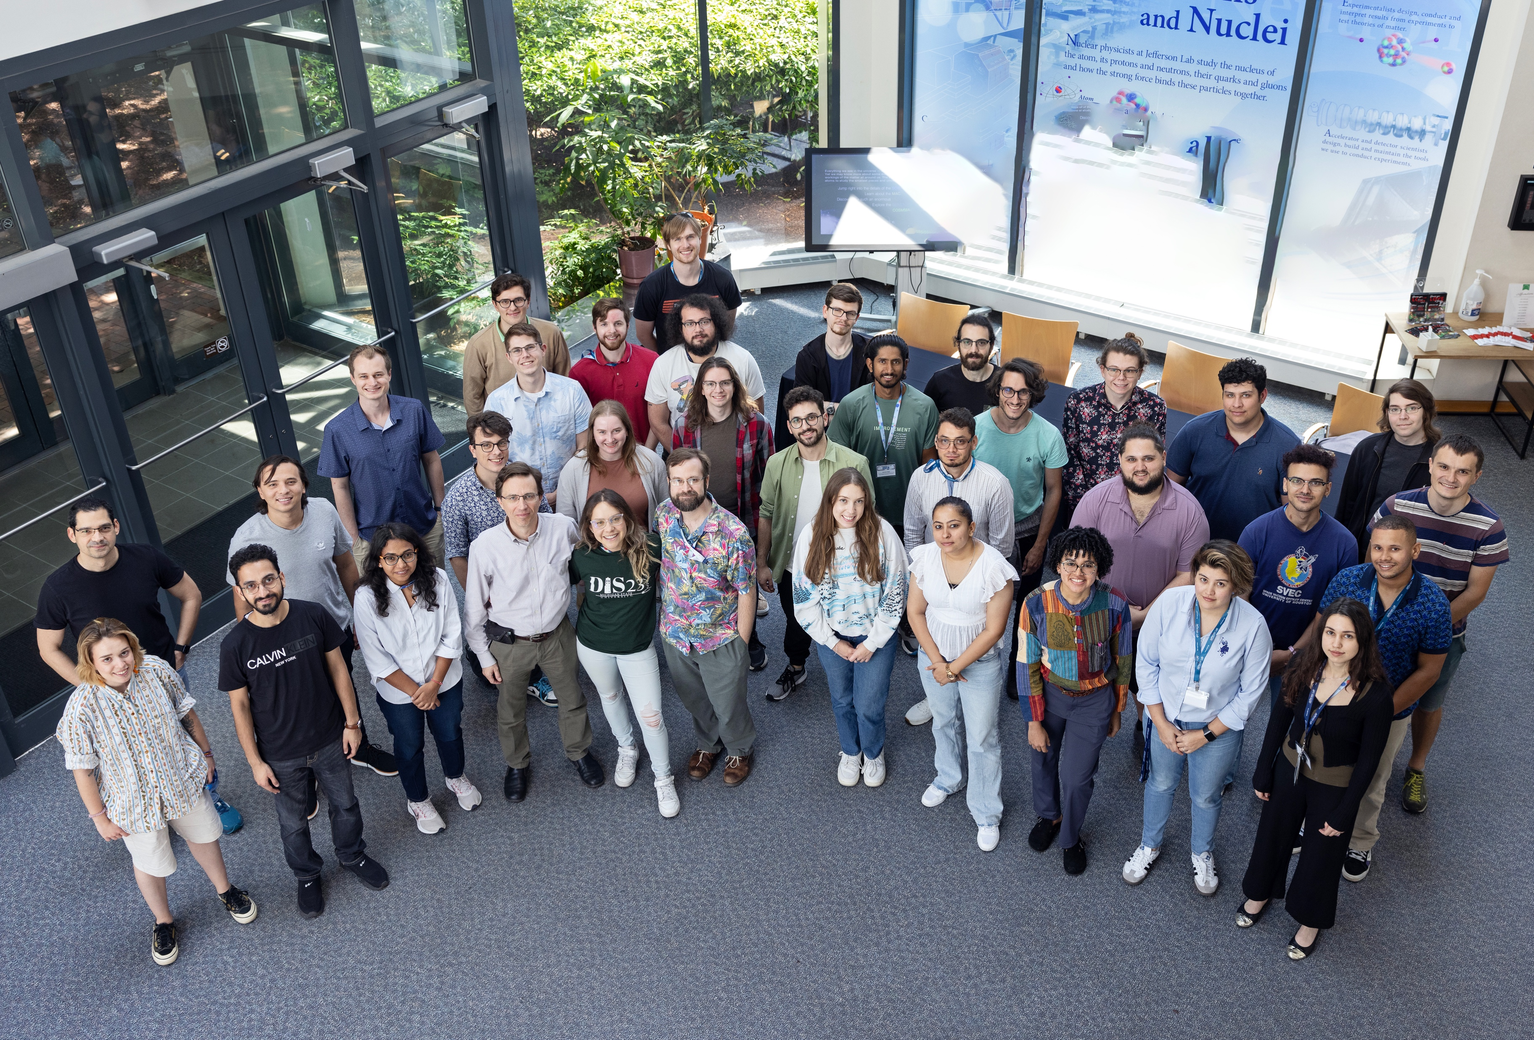
FY24 was a good physics year
30 weeks of Physics (9/5/23 – 5/19/24)​
  3 weeks more than planned to complete high-priority experiments​
  Reliability at 76% (vs. planned 77%)​
259 ’PAC’ days run: 5 Experiments Completed and 8 Experiments Partially Completed ​
(in Halls A, B, and C, with D installing new GlueX detector capability)​
98 journal publications; 27 PhD thesis produced; 185 invited talks​
Workforce of the future: 66 undergrad 177 grad, and 55 post-docs in residence at the laboratory in FY24​
R&D effort resulted in 3 patents; 10 invention disclosures during FY24​
  $437K from the Office of State and Community Energy Programs​
  $285k from Technology Commercialization Fund ​
  Projects in collaboration with Sandia and PNNL
Numerous new R&D funding from: NP, HEP/ARDAP, ASCR with new research in accelerator applications, superconducting electronics, AI/ML​
HUGS, 2024

Slide 9
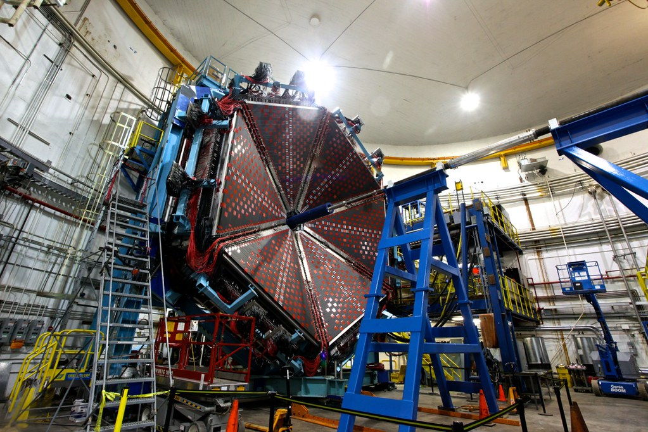
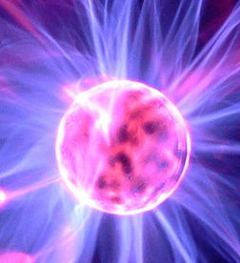
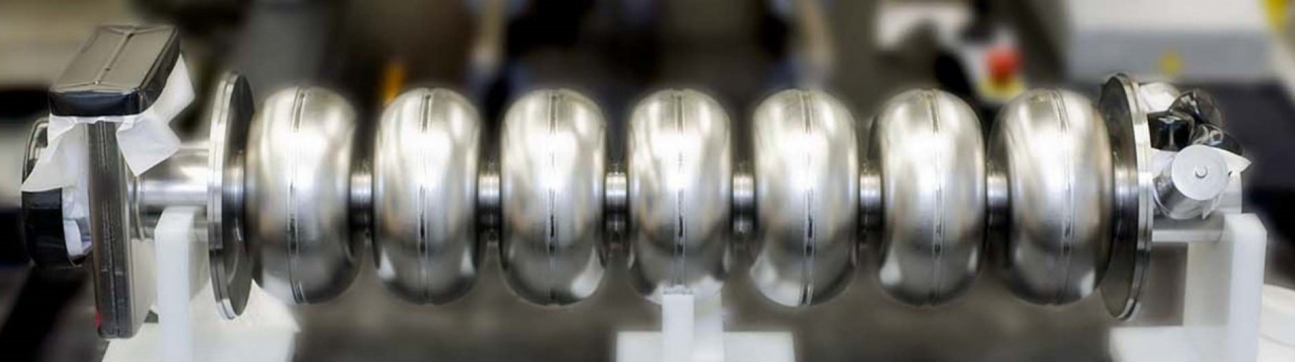
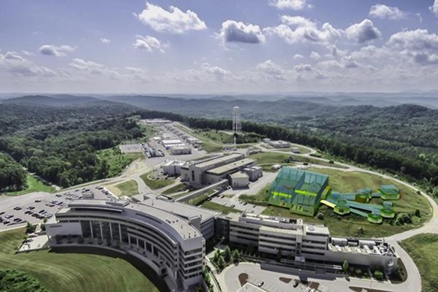
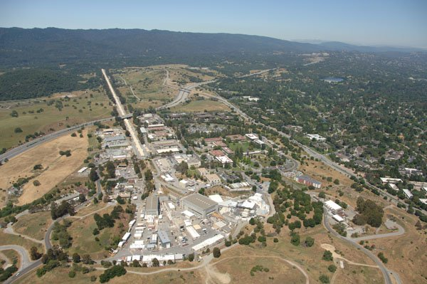
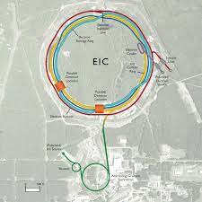

Advanced Detectors and accelerators make our quest possible
Theorists guide experiments & interpret results
SRF R&D makes accelerators better
e
H
SRF Capability enables research in chemistry, materials, medical research, isotope production
US-based MicroPattern Gaseous Detector Facility - A proposed User Resource

Slide 10
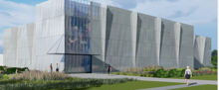
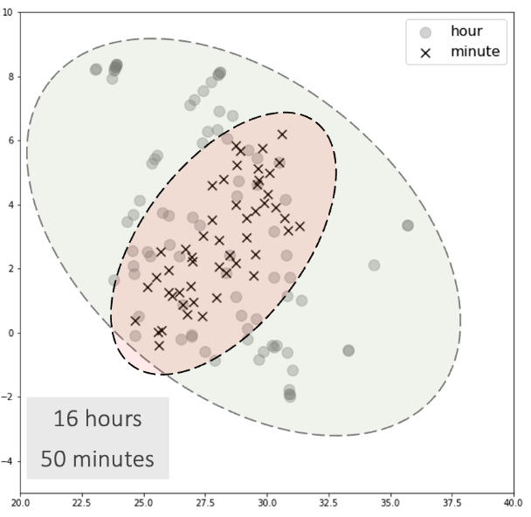
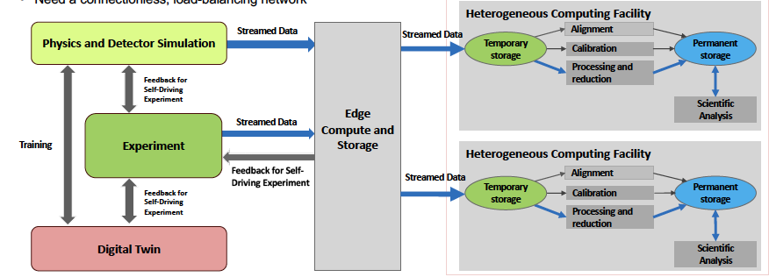
The data strategy extends from a new facility through R&D and application: High Performance Data Facility
Establish HPDF as the premier Data Science facility for SC and DOE
Generate foundational research and prototype computing systems to inform pathways for the integrated ecosystem.
Drive and enable AI/ML applications across the sciences. Grow in traditional computer science and applied math. Integrate facilities, workflows, algorithms, software and application tools.
Position HPDF as an integral component of a single, larger computational ecosystem that bolsters national S&T capabilities
Lead the NP engagements for IRI and an HPDF spoke. How: hold workshops, build on current research (EJfat, streaming grand challenge), and influence EIC computing model
JLDC
Application: AL/ML improve integrating into CEBAF Ops
HPDF hardware concepts

Slide 11
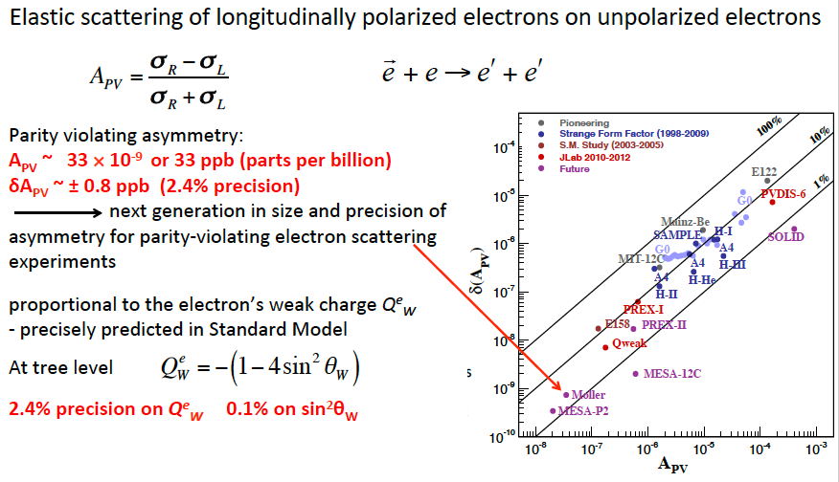
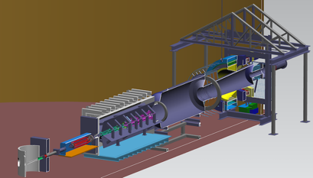
Moller: Testing the Standard Model to 27 TeV
MOLLER will probe energy regions for Beyond Standard Model Physics to ~27 TeV in this Q-weak sector
LHC energies: 13 TeV
Excellent technical progress.
CD-2/3 achieved in May FY24.

Slide 12
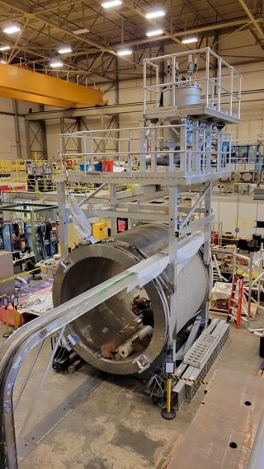
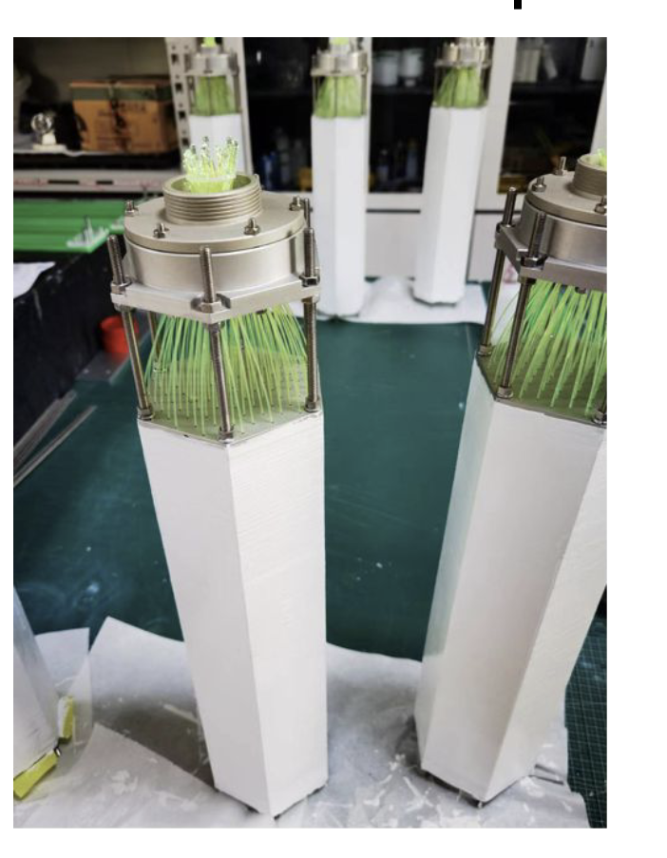
SoLID Fully Enables CEBAF 12 GeV at the Intensity Frontier
The SoLID science program was endorsed by the 2023 NSAC Long Range Plan (Recommendation #4) as one of the projects "that lay the foundation for the discovery science of tomorrow". SoLID is mentioned positively over 25 times in the Plan.
Nucleon spin, proton mass, BSM experiments require precision measurements of small cross sections and asymmetries, combined with multiple particle detection
There is a critical need for a high luminosity 10³⁷-10³⁹ cm⁻²s⁻¹ and large acceptance working in tandem – takes full advantage of Jefferson Lab capabilities
SoLID Whitepaper Published in: J.Phys.G 50 (2023)
Highlights of SoLID scientific programs and instrumentation
Risk-reducing R&D continues!
SoLID cost updated FY2023 (TPC = ~$92M)
Experimental operations and CE, with some sacrifice, could support ~$24M dependencies
Electromagnetic Calorimeter Prototype for the SoLID Project at Jefferson Lab
TIPP, SPRINGER NATURE (2018)
Magnet testing

Slide 13
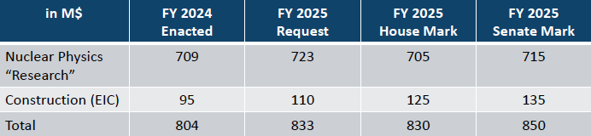
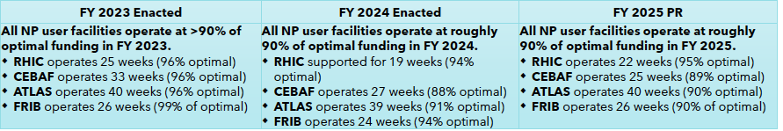
Working Through FY25 uncertainties
FY25 Budget does affect weeks of CEBAF Operations: from Linda Horton presentation at NSAC, September 12, 2024
DOE, Office of Science,
Office of Nuclear Physics

Slide 14
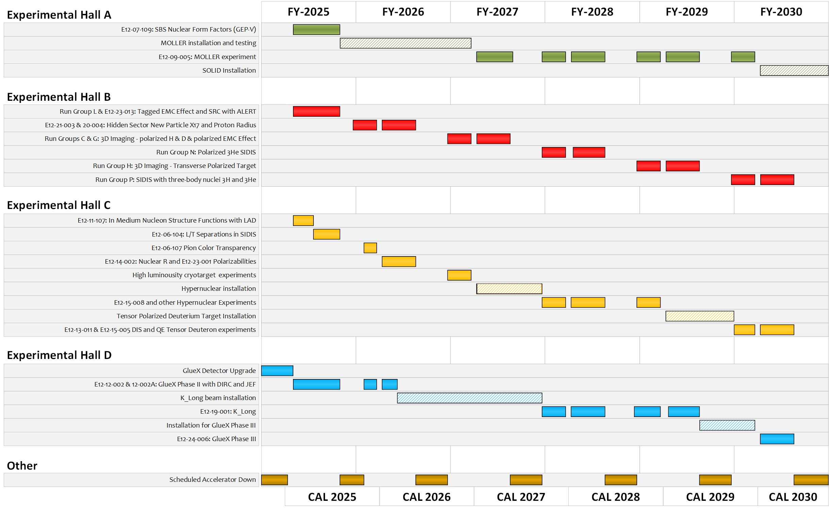
TENTATIVE Long-Term Schedule
Shown with 25 weeks of physics running in FY25 and FY26 and our optimal 32 weeks of physics running in the out years.
Optimizing the science output
  During MOLLER running, modest current experiments planned for Hall C to keep total machine power under 1.1 MW.
  During MOLLER installation, non-standard energy experiments in Halls B, C.
By FY31 ~80% complete without SoLID and ~70% complete with SoLID.
Approved positron experiments require an additional several years.

Slide 15

Discussion

