Slide 1


Covariant Formulation of the Deuteron
J. W. Van Orden
ODU/Jlab
Collaborators:
W. P. Ford
University of Southern Mississippi
S. Jeschennek
OSU-Lima

Slide 2
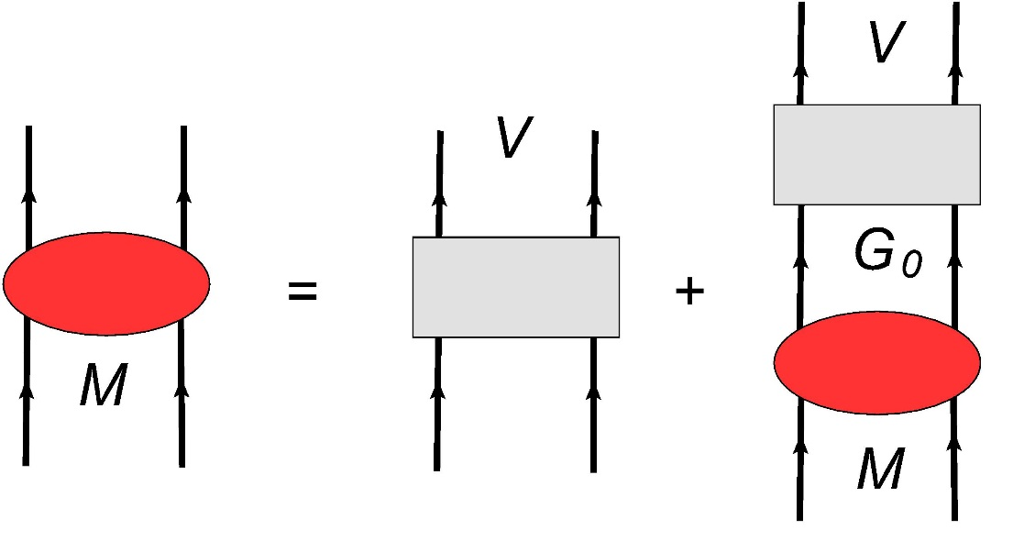

The Bethe-Salpeter Equation

Slide 3
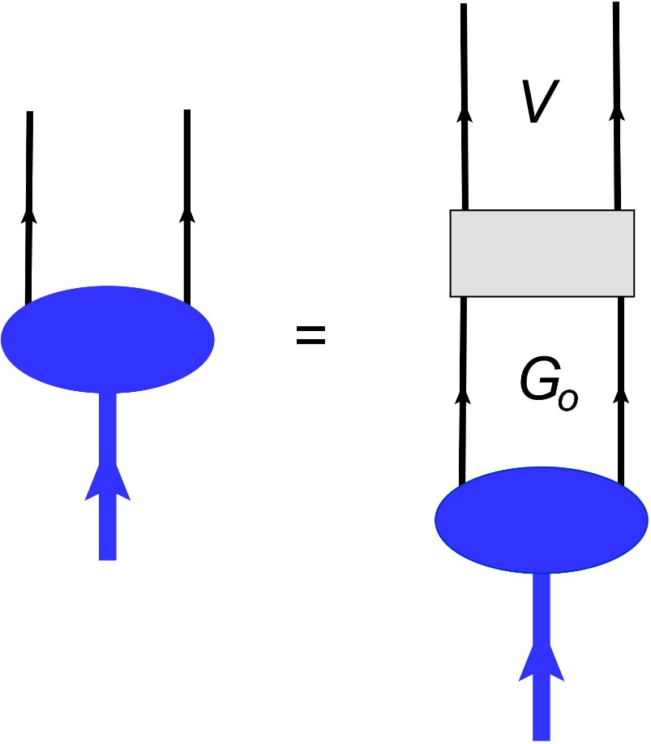
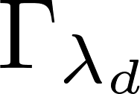
The Deuteron Vertex Function

Slide 4
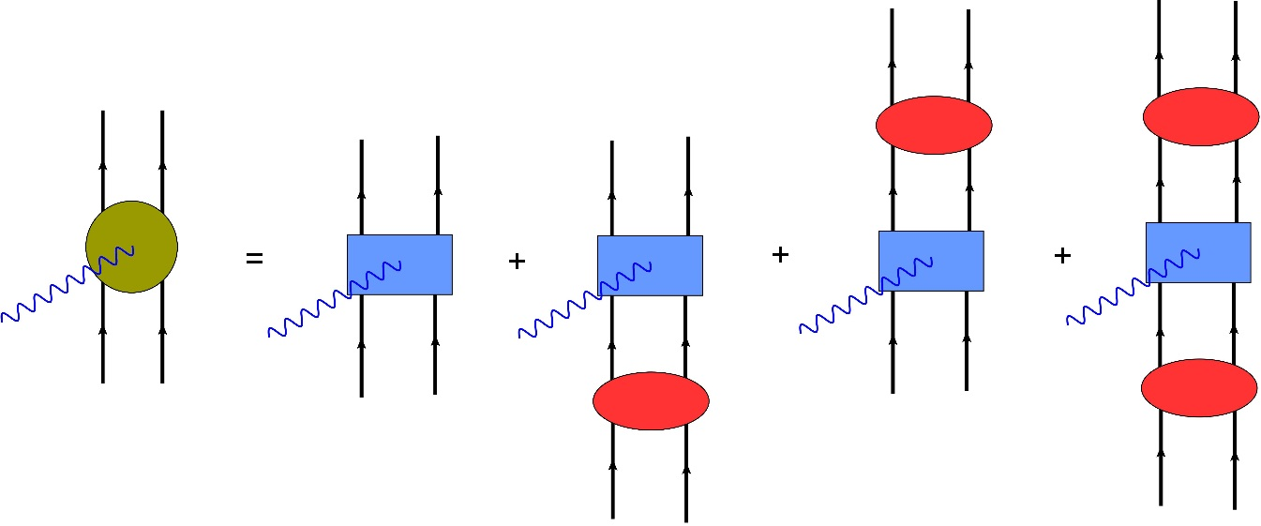

The Electromagnetic Current Operator

Slide 5

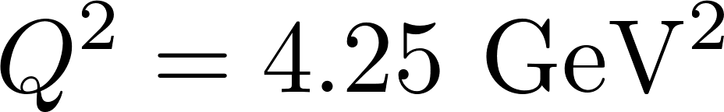
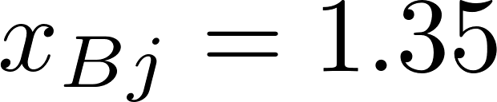
Experimental Determination of the Deuteron Momentum Distribution using d(e,e’p)
The usual procedure for extracting the momentum distribution for the deuteron is:
Choose kinematics that are predicted by theory to minimize the contribution of final state interactions, etc., to the cross section. For example for the approved experiment E1210003
These kinematics will be used for all calculations shown in this talk.

Slide 6
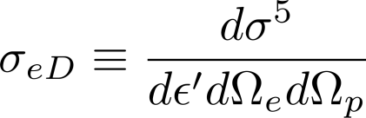
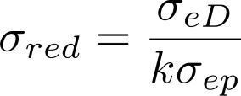

Representing the differential cross section as
the reduced cross section is defined as
where k represents an appropriate combination of kinematic factors and
is an off-shell electron-proton cross section. This is usually one of the deForest prescriptions.
The reduced cross section is then assumed to approximate the deuteron momentum distribution.

Slide 7
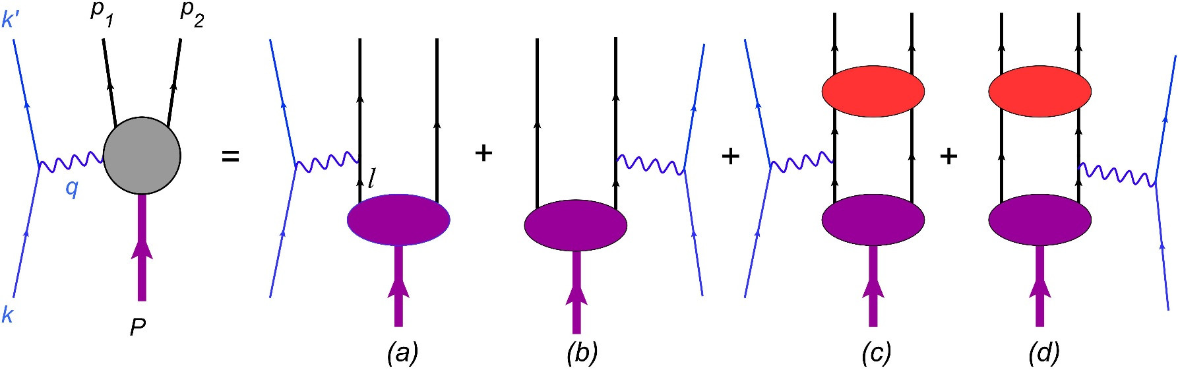
The Impulse Approximation
The impulse approximation to deuteron electrodisintegration is defined by the Feynman diagrams:
proton
neutron
Note: Impulse approximation calculations do not conserve current.

Slide 8
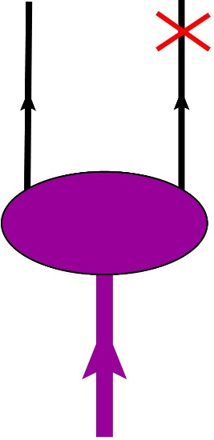
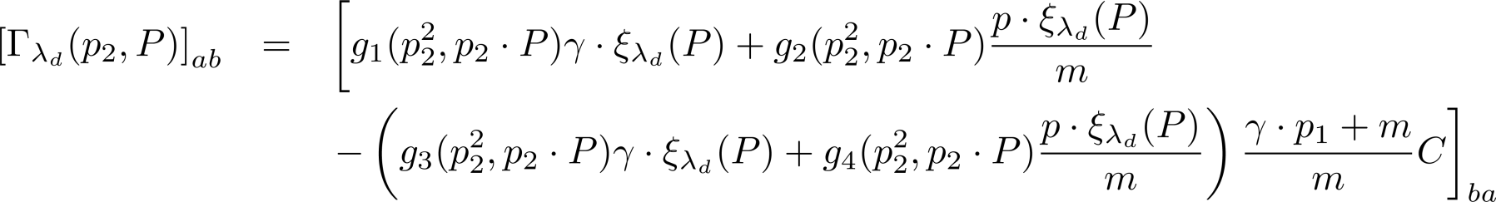
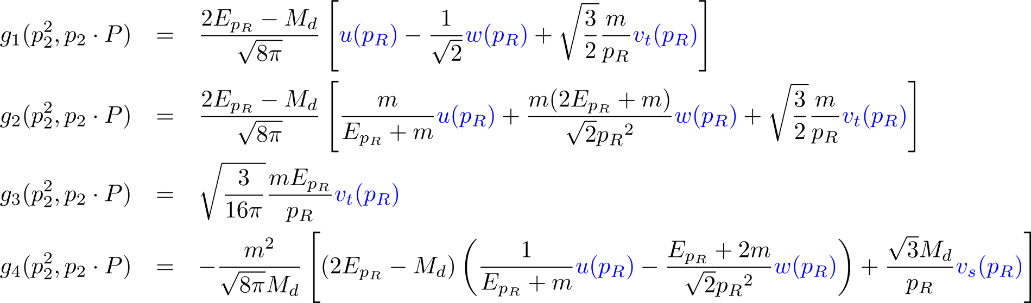
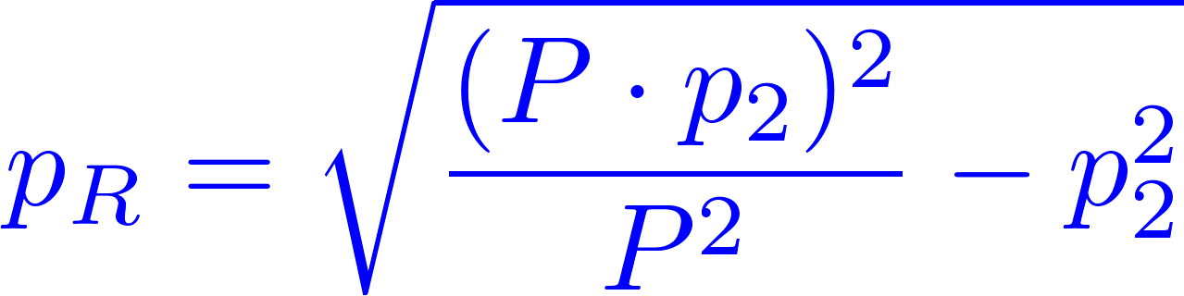
Deuteron Vertex Function
a
b
The invariant functions g_{i} are given by
Charge conjugation matrix
where
is the magnitude of the three-momentum in the deuteron rest frame.

Slide 9
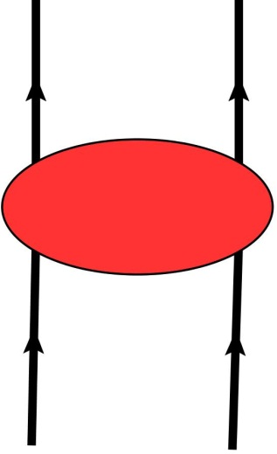
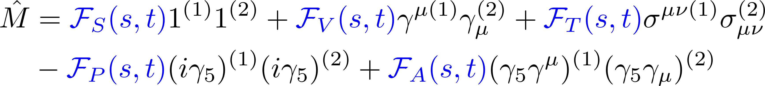
Final State Interactions
There are no reliable meson-exchange models of NN scattering for the invariant masses where pions production channels are open.
The scattering amplitudes must be obtained from data.
The scattering amplitudes are represented by a parameterization in terms of five Fermi invariants.
A complete description of on-shell NN scattering.
Lorentz invariant.
Has complete spin dependence.

Slide 10

We use two approaches:
The invariant functions are constucted from the SAID helicity amplitudes. np amplitudes are available for s<5.98 GeV²
We have recently performed a fit of the available NN data from s=5.4 GeV² to s=4000 GeV² based on a Regge model.*
In the calculations shown here, only on-shell contributions from the np amplitudes are used.
* W. P. Ford and J. W. Van Orden, Phys. Rev. C 87, 014004 (2013).
W. P. Ford, Ph.D. Dissertation, http://arxiv.org/abs/1310.0871

Slide 12

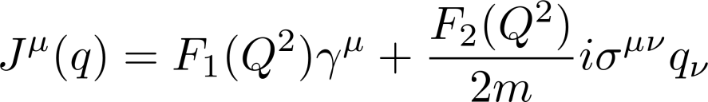
The Plane Wave Impulse Approximation (PWIA)
Defining the half-off-shell “wave function” as
the PWIA matrix element is given as
where the single nucleon current operator is taken to be

Slide 13
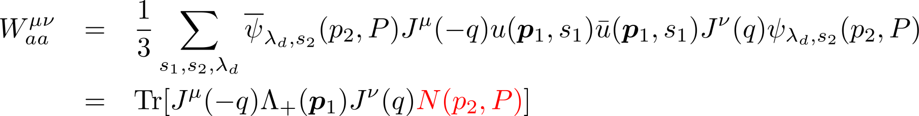
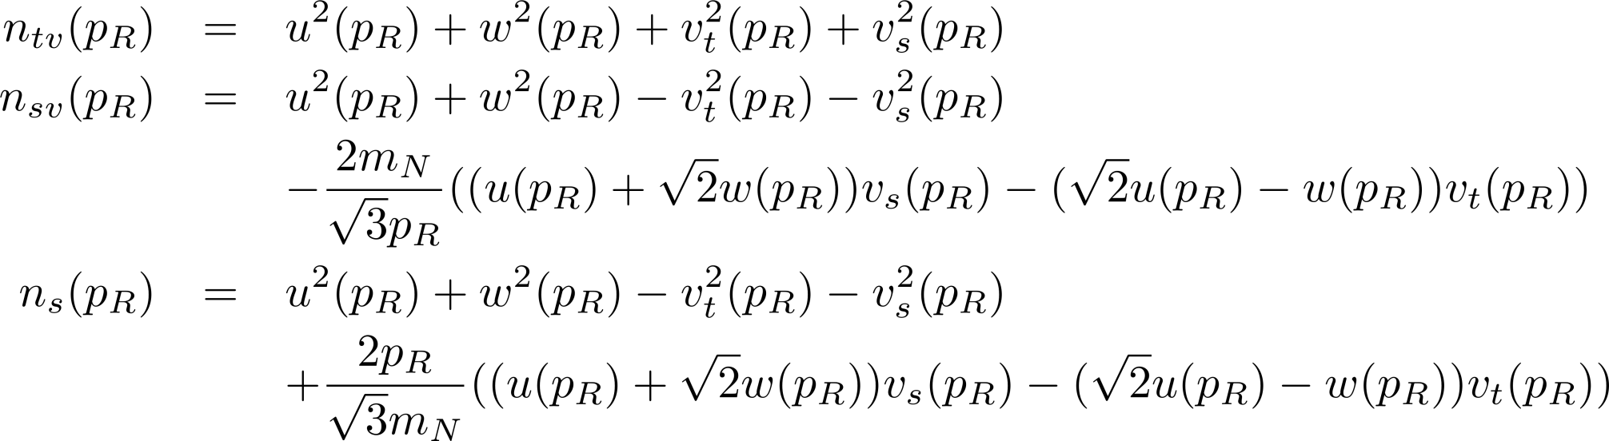
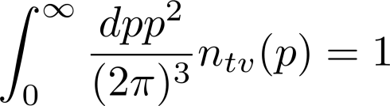
The deuteron response tensor is then
where
and
Normalization

Slide 14
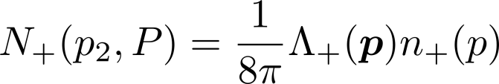
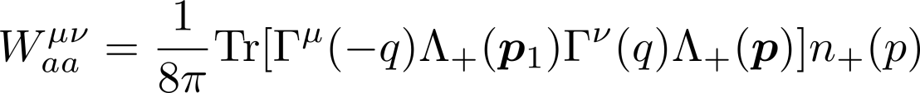
If the p-wave contributions are taken to be zero, then
The momentum distribution operator simplifies to
And the response tensor factors to give

Slide 15


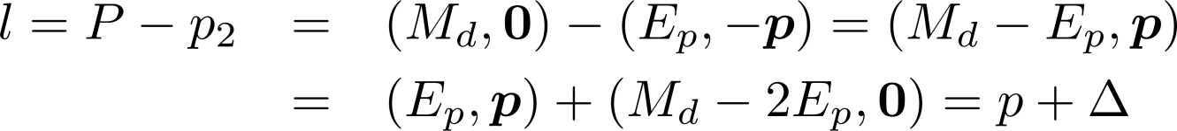
Note that for the PWIA diagram
then
Using this to calculate the factorized PWIA cross section and dividing by n₊(p) gives
Which is equivalent to the deForest CC2 prescription.

Slide 16
P-wave Contributions

Slide 17

Momentum Distributions
We have chosen a set of 8 wave functions, all but one of which corresponds to a fit with per degree of freedom.
The corresponding momentum distributions are

Slide 18
Single-Nucleon Form Factors
We use three single-nucleon electromagnetic form factors.

Slide 19
FSI Effects

Slide 20


With 8 possible wave functions, 3 electromagnetic form factors and 2 FSI parameterizations we have:
possible PWIA calculations
possible IA calculations

Slide 21
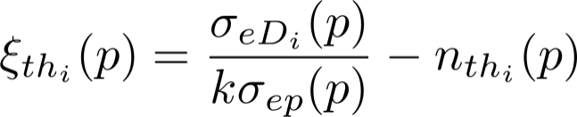
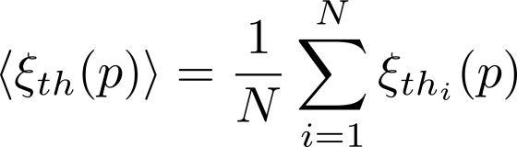
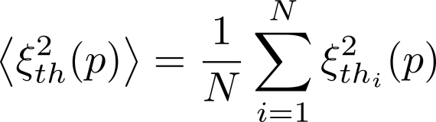

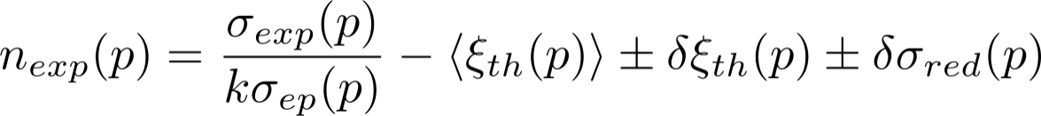
Method for Extracting the Approximate Deuteron Momentum Distribution with Estimates of the Theoretical Error
For each calculation find the difference between the reduced cross section and the momentum distribution for the wave functions used in the calculation
Calculate the average and the average of the square of this quantity for all calculations
The standard deviation is then
The experimental momentum distribution is then

Slide 22
The method can be tested by using one of the calculations a pseudo-data and then performing the procedure described on the previous slide.
WJC-2
GKex05
Regge

Slide 23
AV18
GKex05
Regge

Slide 24
CD Bonn
GKex05
Regge

Slide 25
Summary
A manifestly covariant model of the d(e,e’p) reaction has been constructed.
The model is not dynamically consistent and does not conserve current.
A number of roughly equivalent ingredients such as “wave function”, single-nucleon electromagnetic form factors and final state interactions are available.
A combination of all of the cross sections constructed for all possible combinations of the ingredients has been used to provide an improved approach to extracting the momentum distribution of the deuteron.

