Slide 1
The eRHIC Interaction Region

Slide 2
The eRHIC Interaction Region
Try to Envision a Viable Future Layout
Give Overview of Technical Challenges
Finally Look for Feedback/Discussion
Try to Envision a Viable Future Layout
Give Overview of Technical Challenges
Finally Look for Feedback/Discussion
Your Guide:
B. Parker,
BNL-SMD
Your Guide:
B. Parker,
BNL-SMD
Time Tunnel

Slide 3
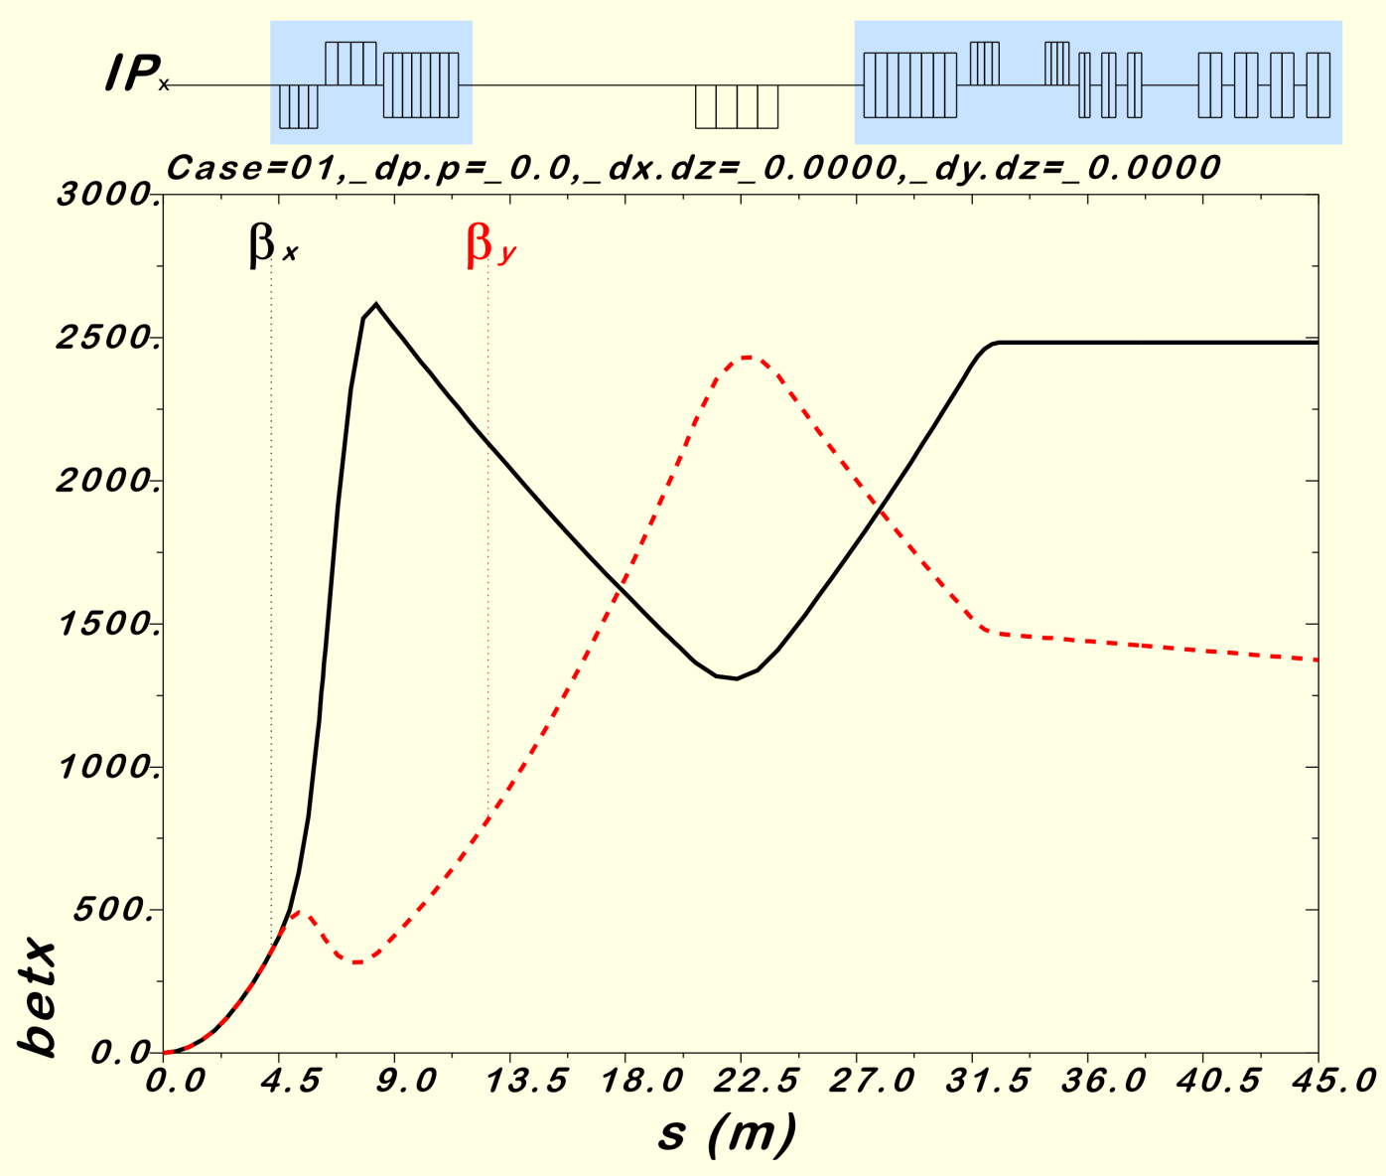
eRHIC IR, Version 2.5, Optics Summary
16 mrad “Dogleg Dipoles”
Cold Region
Cold Region
Warm Region
The Version 2.5 hadron beta function peaks are lower with respect to earlier optics in order to reduce the hadron beam chromaticity.
Neutrals and some forward off-momentum particles are detected within the first warm region shown here.
These optics are designed to be favorable for Crab Cavities.
We could look to design a secondary focus beyond 45 m.
Detection of forward particles after Crab Cavities seems ok.
90⁰ phase advance and large b for Crab Cavities
Smaller peak betas to reduce the chromaticity
While magnet apertures differ, the optics are the same for the forward and rear sides.

Slide 4
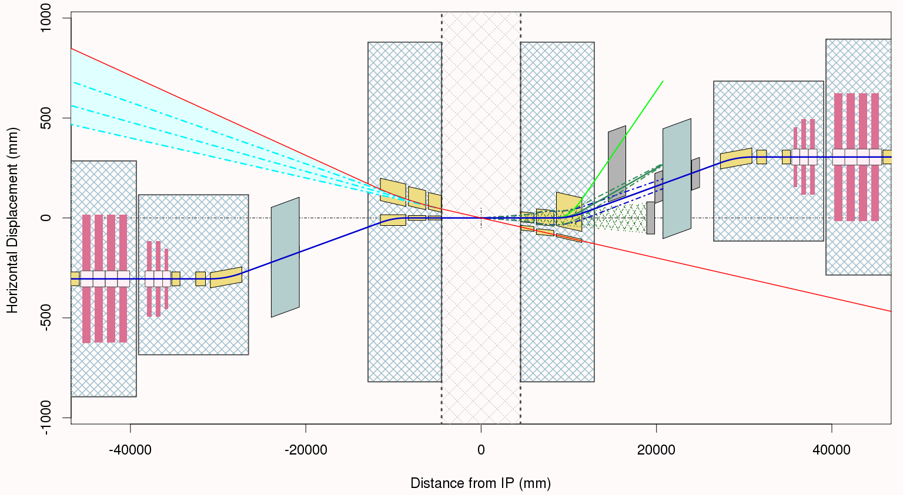
eRHIC IR, Version 2.5, Layout Summary
10 mrad additional electron bending
16 mrad hadron dogleg has spectrometer function for forward going particles
Crab Cavities
Yellow boxes outline the cold beam tube apertures.
Warm Quad
Crab Cavities
Cryostat
Cryostat
Synrad
Cryostat
±4.5m Region
Cryostat
Cryostat
IP
ZDC
Cryostat
Hadrons
Electrons
Crab Cavities
Warm Quad
10 mrad total crossing angle
Crab Cavities
16 mrad hadron dogleg
The hadron beta functions are symmetric but the bending is antisymmetric.
Electron bending comes after the IP in order to avoid synrad background.

Slide 5
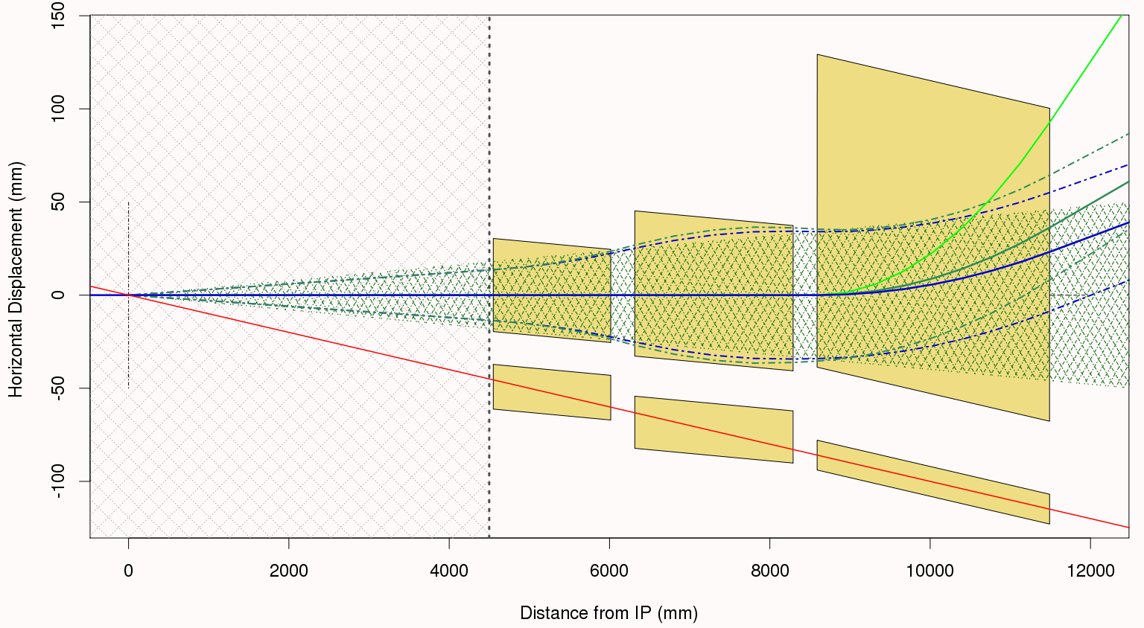
eRHIC IR, Version 2.5, Forward Layout Details
Strong dipole bending in this B1 aperture
Strong quadrupole focusing takes place in these, Q1 & Q2 apertures
4 mrad neutron cone acceptance
Low field “sweet spot” shielded
regions for incoming electrons in these apertures.
Note that the coordinate system in these figures is aligned with the center of the 4 mrad neutron cone (neutral vector) indicated by the hatched region on the plot.

Slide 6
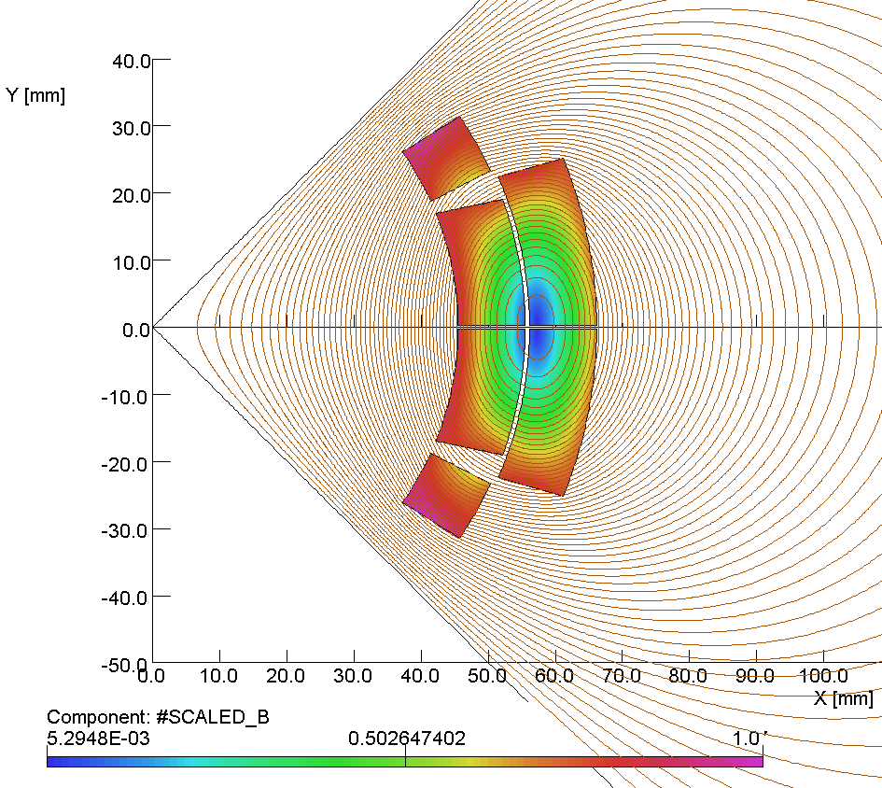
Public Service Spot: Magnets & Maxwell Tutorial
¼ Symmetry Bare Quadrupole Coil
The longest range field external field component from a quadrupole falls off as (R_{coil}/R)³.
So the external field “remembers” the size of the coil structure.
Higher order harmonics cause the field magnitude in the vicinity of the coil to be even larger.
The quadrupole coil thickness grows according to ln(R_{outer}/R_{inner}) gradient dependence (high field = thick coil).
For yoke fields more than say 2 T, the yoke saturates and field will leak into cutout regions (cannot hide there).
However, note that there is a zero in the coil field distribution close to the middle of the coil structure.
By0 Region
Average R = 55.5 mm
R = 100 mm
For this figure we plot #Scaled_B, the field distribution in the coil structure divided by the maximum field in the coil. At the 100 mm indicated spot #Scaled_B is about -0.2.

Slide 7
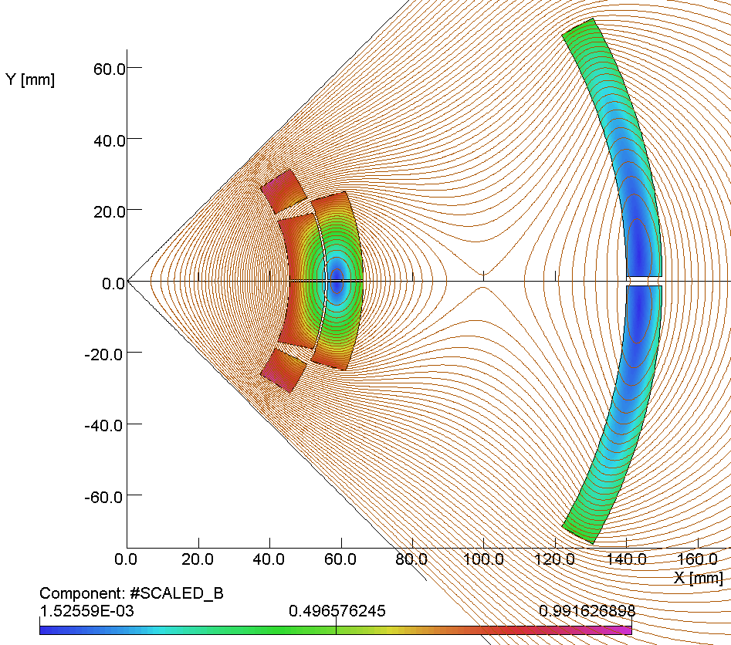
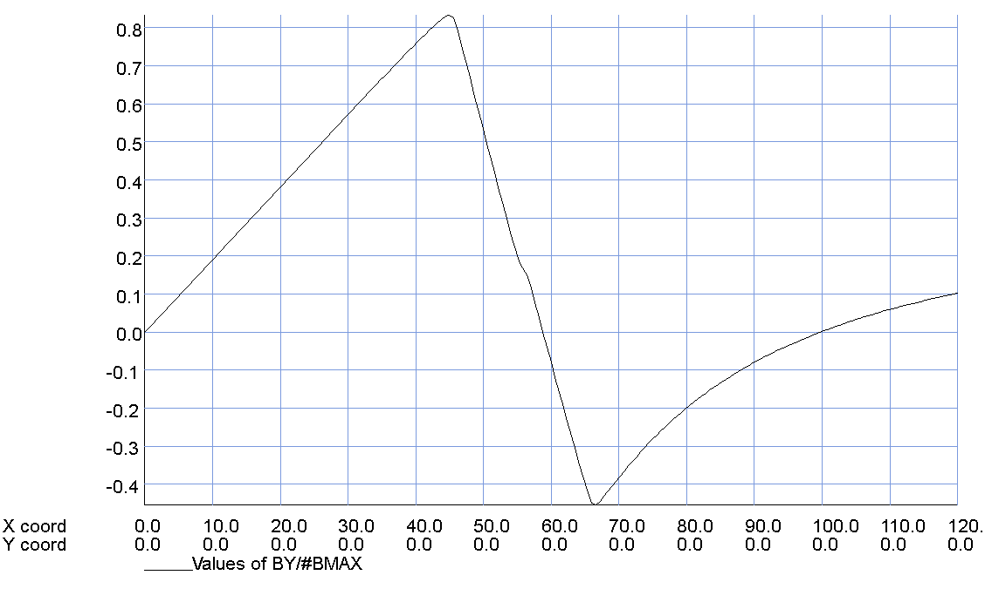
Public Service Spot: Magnets & Maxwell Tutorial
¼ Symmetry Simple Sweet Spot Coil
Adding the second outer quadrupole coil show here contributes an additional 11% to overall magnetic field efficiency and slightly decreases the peak field.
But now we have created a field reversal “sweet spot” at the desired, X = 100 mm, location.
R = 100 mm
Scaled Vertical Field at Coil Midplane
Linear on the
inside
By/B_{MAX}
Now have zero at X=100 mm
The field magnitude grows with distance from the zero crossing sweet spot point. It depends on how large the electron region we must shield whether or not we can use a passive iron shield for the final bit of field reduction.
Reverses in the coil
X, Y (mm)

Slide 8
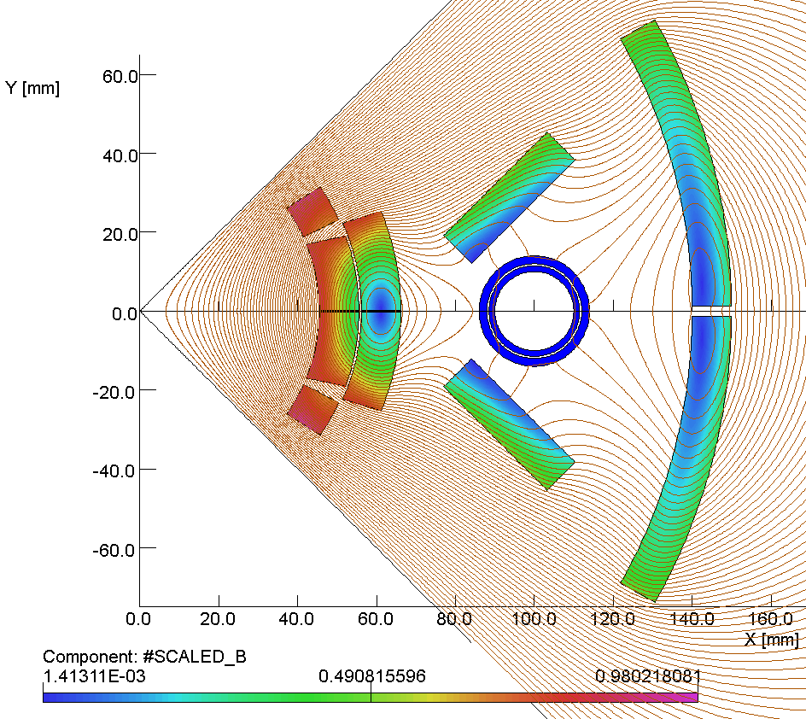
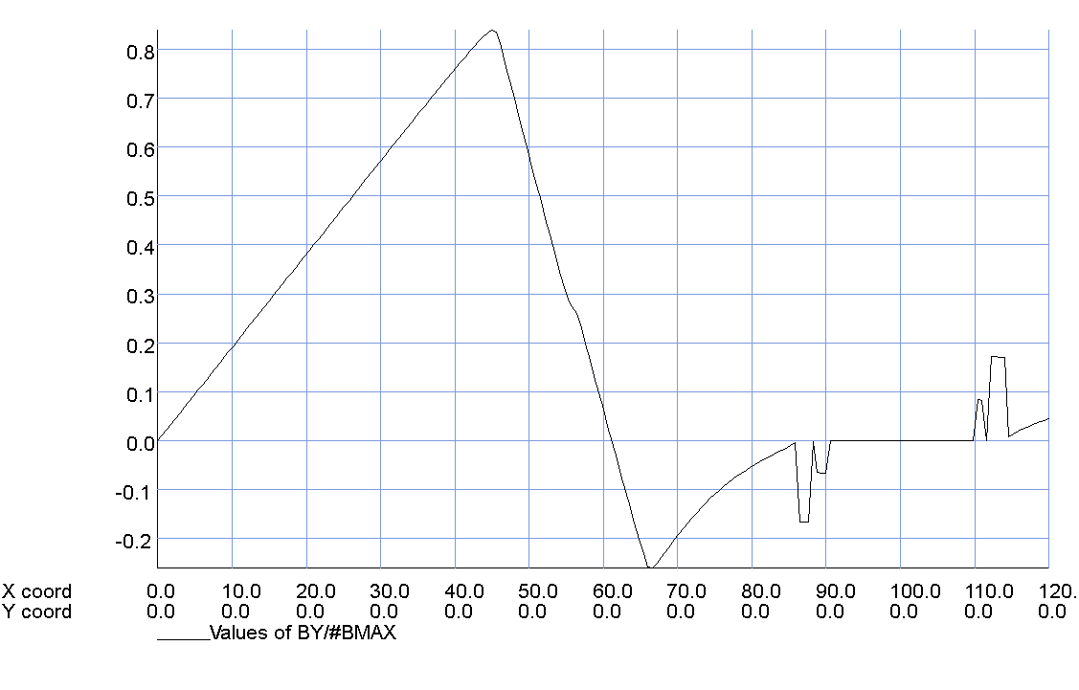
Public Service Spot: Magnets & Maxwell Tutorial
¼ Symmetry Final Sweet Spot Coil
Adding racetrack coils above and below the desired sweet spot region further enhances magnetic field efficiency and decreases the coil peak field.
But having conductor above/below the region of interest can dramatically reduce local field non-linearities and expand the size of the low-field sweet spot region.
Racetrack Coil
Racetrack Coil
Scaled Vertical Field at Coil Midplane
By/B_{MAX}
Zero field inside the passive iron shield
This coil configuration has good field quality with little influence from the passive iron shield. Unlike active shielding, these sweet spot coils have the same polarity yielding better efficiency. Optimizing the coil end turn positions is the major remaining challenge.
X, Y (mm)

Slide 9
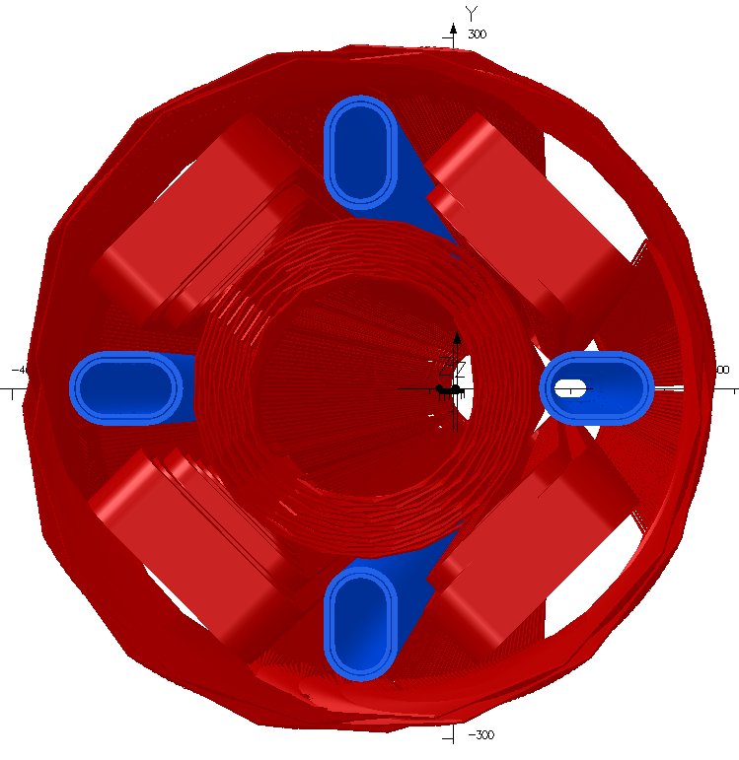
eRHIC IR, Version 2.5, Q1 Forward Details
Q1, Version 2.5 Optics, Full Model
Q1 Version 2.5 Parameters
Magnetic Length = 1.975 m
Main Gradient = 136.9 T/m
Field @ e-Beam < Few Gauss
The Version 2.5 Q1 magnet is longer than before and its aperture had to be increased to maintain desired forward experimental acceptance.
Note that the Q1 sweet spot region comes much closer to the main coil than the previous generic solution.
The Q1 outer coils contribute y36% of the total gradient and the peak field now reaches 6.2 T on the main coil
Field quality is close to 1 x 10⁻⁴ at R_{ref}=20mm (i.e. about 1 Unit).
Field inside elongated shielded region is less than 1 gauss in the main body.
Coil ends do not preserve the body cross section, so we must carefully optimize end turns. Combining magnetic and superconducting materials, “magnetic cloaking,” may be helpful. https://wiki.bnl.gov/eic/index.php/Magnetic_Cloak

Slide 10
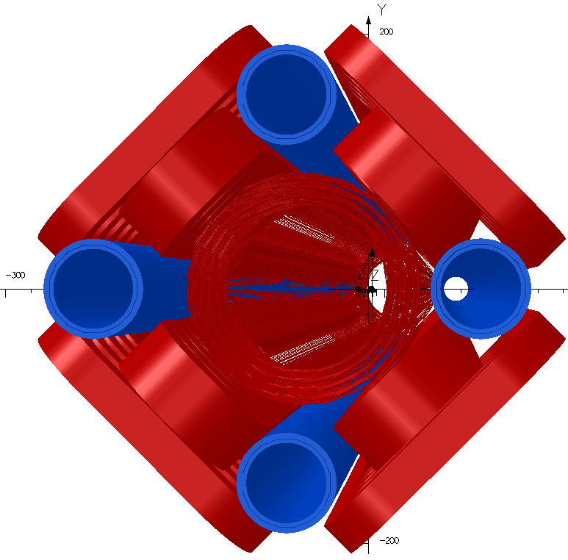
eRHIC IR Q0 Forward: New Parameters Comparison
Q0, Version 2.1 Optics, Full Model
Q0 Version 2.5 New Parameters
Magnetic Length = 1.465 m
Main Gradient = -213.0 T/m
Field @ e-Beam < Few Gauss
Q0 Version 2.1 Old Parameters
Magnetic Length = 1.400 m
Main Gradient = -170.0 T/m
Field @ e-Beam < 10 Gauss
An aggressive re-design is in progress in order to support the new, optics Version 2.5, Q0 magnet goals (that is based upon the latest Q1 design work).

Slide 11
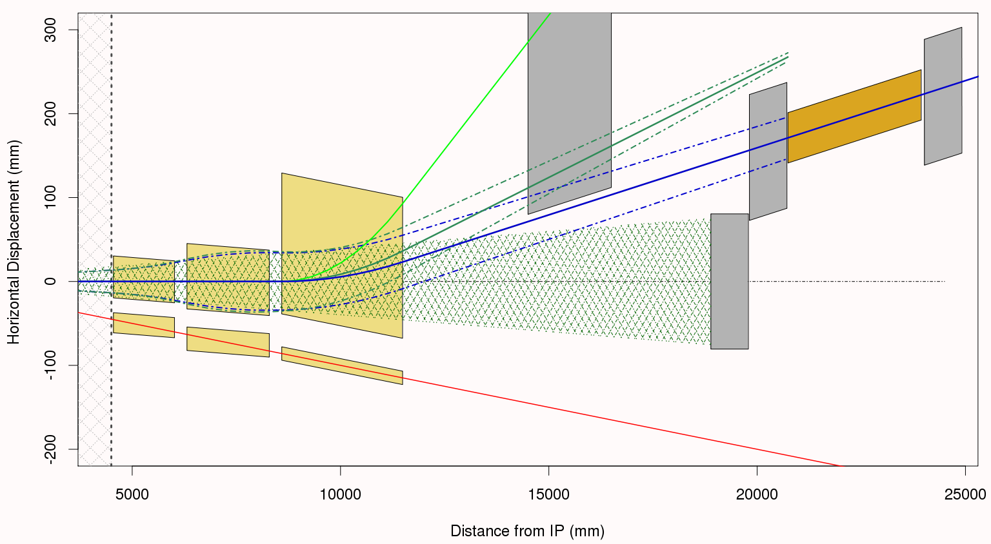
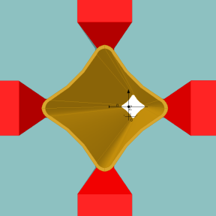
eRHIC IR, Version 2.5, Forward Layout Details
Dp/p = 20% P_{o}
±3.5 mrad
Forward
Detector
Roman
Pots
Dp/p = 50% P_{o}
Q2, has HERA style “butterfly shape chamber”
B1
Q1
Q0
4 mrad neutron cone
ZDC
Main Beam ±3.5 mrad
Q2 Front
Measure as much as possible before the next cold accelerator region.
Note that the coordinate system in these figures is aligned with the center of the 4 mrad neutron cone (neutral vector) indicated by the hatched region on the plot.

Slide 12
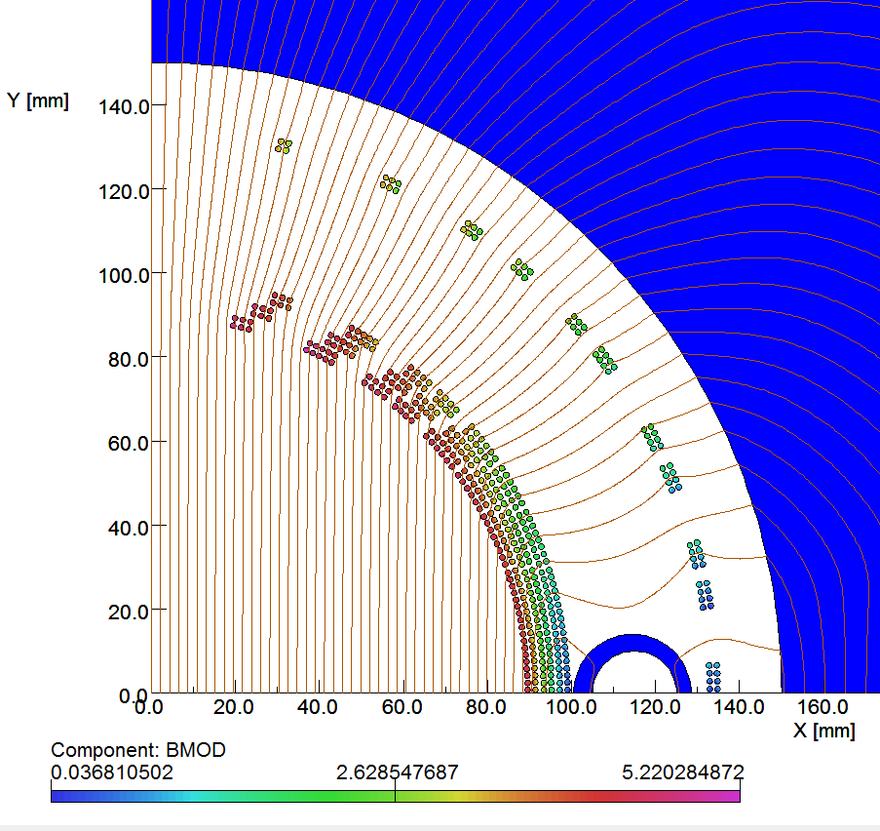
eRHIC IR, Version 2.5, B1 Forward Details
B1, Version 2.5 Optics, ¼ Symmetry Model
B1 Version 2.5 Parameters
Magnetic Length = 2.9 m
Dipole Field = 4.6 T
Field @ e-Beam < Few Gauss
For those already familiar with the RHIC DX magnet, this is in effect a septum version of that magnet.
Since the external field for a dipole falls off more slowly than from quad, (R_{coil}/R)², and the B1 coil radius is so large, expected that it would be hard to make a sweet spot close to the coil.
But the slower fall-off led to smaller residual field non-linearity over the sweet spot region and there is no need for any Q1-style racetrack coils.
We are constructing a 1 m long Direct Wind version of the inner coil now in FY’15 using LDRD funds.
Passive, sweet spot shield is located just outside the main coil
Field Magnitude, |B|, Mapping at the coil in Tesla
With a full 3d model we find that because the B1 end-fields change much less rapidly than for Q1, it is much easier to preserve the sweet spot throughout the magnet ends.

Slide 13
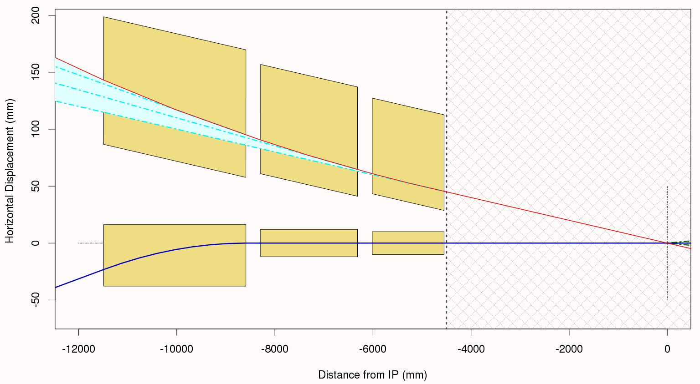
eRHIC IR, Version 2.5, Rear Side Layout Details
On the rear side we provide additional aperture for increased acceptance around the e-beam direction
Design provides a small field in these cutout regions in order to give outbound electrons an additional 10 mrad deflection
Synrad
Detector Space
Electrons
Rear B1
Rear Q1
Rear Q0
Hadrons
Avoid large coil fields by keeping hadron apertures small as possible
IP

Slide 14
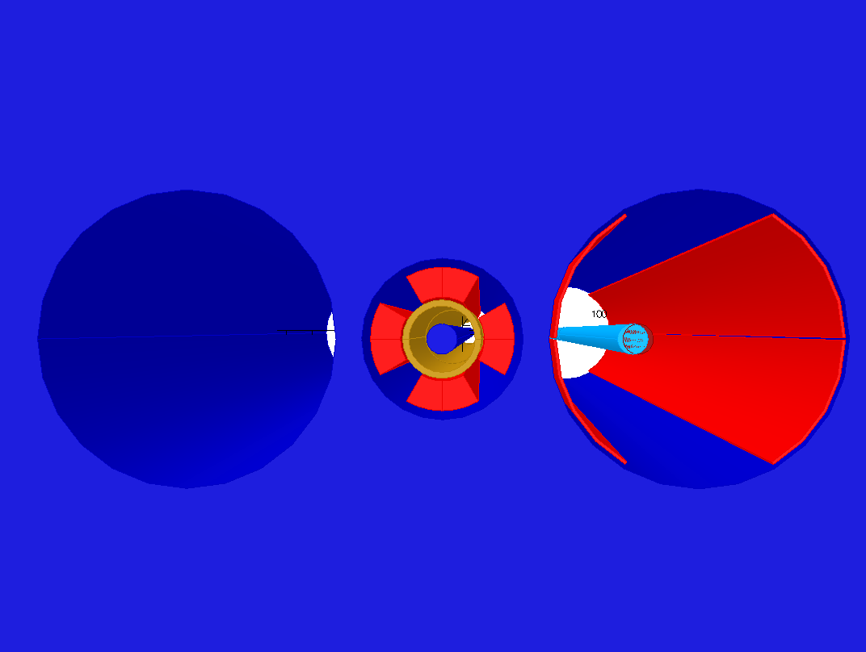
eRHIC IR, Version 2.5, Q1 Rear Side Details
Rear Side: Q1 Yoke Cutaway View
Weak dipole coil to deflect outbound electrons and off-momentum particles
Main coil and aperture for the incoming hadron beam
Magnetic “septum”
Outbound electron and synchrotron radiation beams
Outbound electron and synchrotron radiation beams
Cold yoke cutouts at ±10 mrad

Slide 15
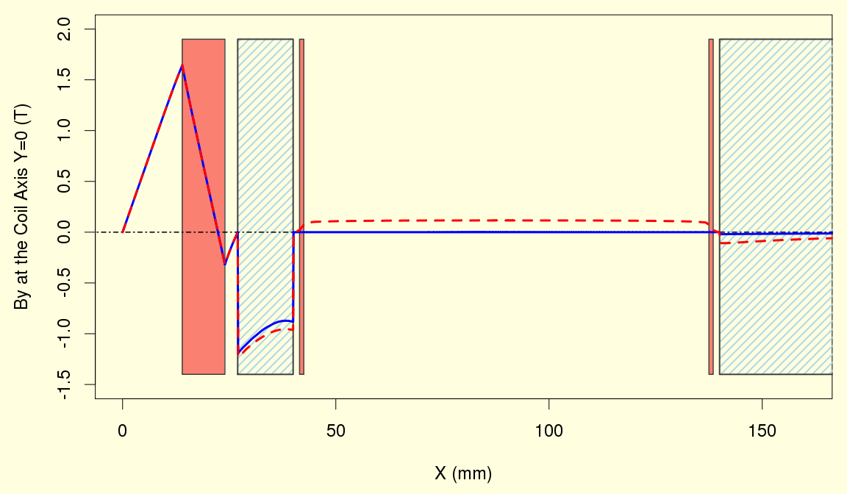
eRHIC IR, Version 2.5, Q1 Rear Design Details
Plot of By at Q1 Magnet Midplane with Coil & Yoke Structure Overlay
Weak dipole coil to deflect electrons
B_{y} Dipole Coil On
Yoke
Yoke
B_{y} Dipole Coil Off
Main Q1 Coil
Weak Dipole Coil
Field in this “septum” is ~1 T
On the rear side we can shrink the hadron aperture and avoid large coil peak fields. So our thin yoke section remains unsaturated and can shield the cutout region.

Slide 16
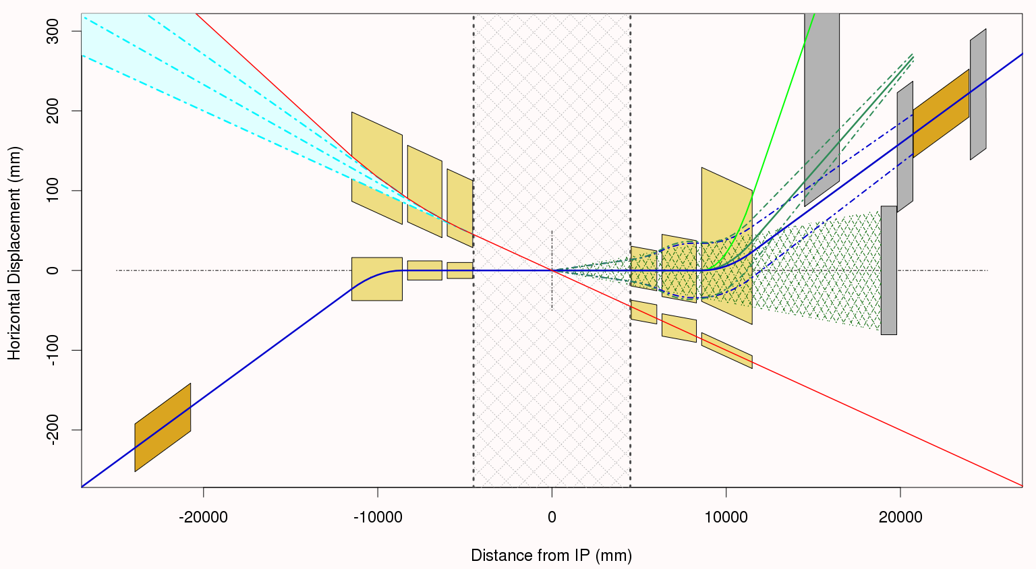
eRHIC IR, Version 2.5, Continued
Need different e-beam magnet designs for the rear & forward sides
Space for electron triplets
Q2
B1
Challenges: cleanly pass the synrad and provide useful rear acceptance
Q0
Q1
Q1
Q0
B1
Q2
Space for electron triplets
Challenge: space for forward detectors

Slide 17
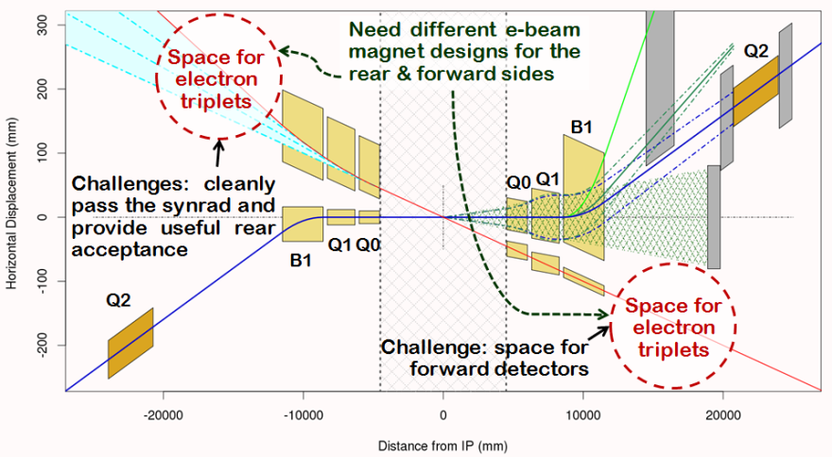
eRHIC IR, Version 2.X Optics, Options and Opportunities
The eRHIC optics and layout shown is optimized for clean forward separation between neutrals and off-momentum charged particles @ 0.8P_{O} in a dedicated warm beam line section.
Do you anticipate any scenario where detecting forward particles with momenta closer to P_{O} becomes important?
With the production of prototype magnets we are exploring the limits of superconducting magnet technology (e.g. the work with Dejan Trbojevic on optics to reduce peak betas).
Even for conventional (warm) magnets we need to continue iterating the IR layout an magnet parameters with feedback from experiments in order to ensure that everything works (e.g. here are rear side e-beam magnet apertures etc.).
Is the 10 mrad downstream bending useful or does it cause more problems than it solves?
X
This quad is almost off.
Shift Crab Cavities closer.
Create a secondary focus?
Redo the matching to arcs.

