Slide 1


Tensor Polarized Deuteron Experiments
Elena Long
High Energy Nuclear Physics With
Spectator Tagging, ODU
March 11th, 2015

Slide 2
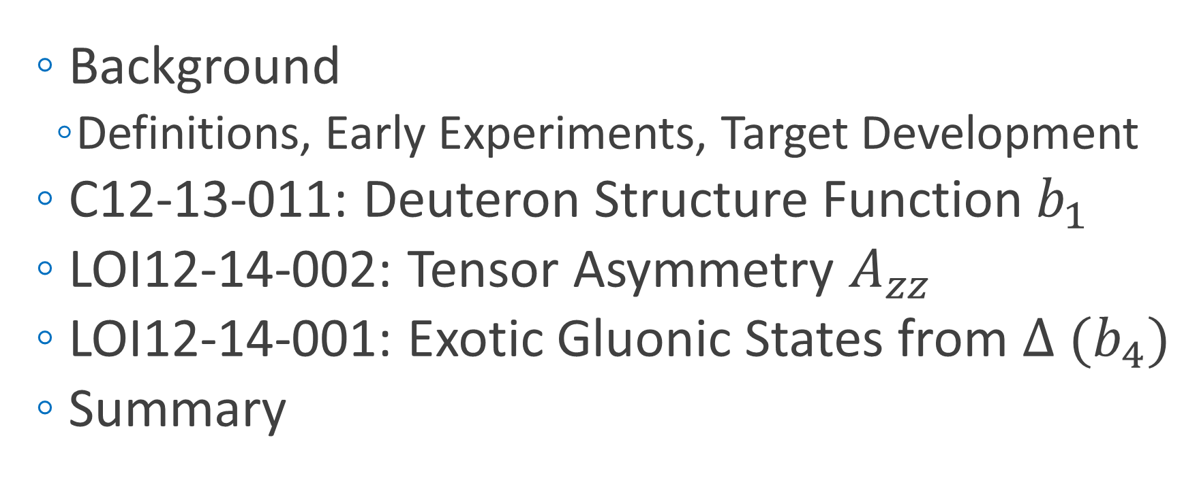
Today’s Discussion
  Background
    Definitions, Early Experiments, Target Development
  C12-13-011: Deuteron Structure Function $b_{1}$
  LOI12-14-002: Tensor Asymmetry $A_{zz}$
  LOI12-14-001: Exotic Gluonic States from $∆ {(b}_{4})$
  Summary

Slide 3
Background

Slide 4
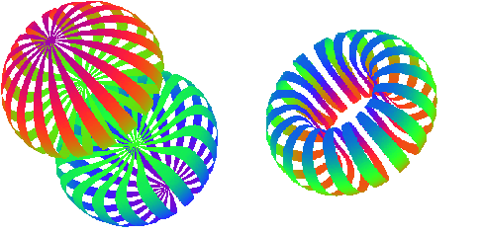
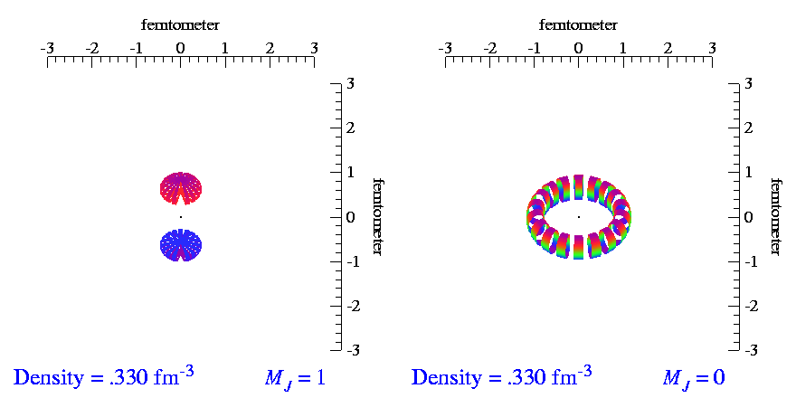


Tensor Polarization
$$m_{J}=±1$$
$$m_{J}=0$$
For tensor polarization, need spin-1 particles
Spin-1
System
Spin-½
System
m = +1
m = +½
m = 0
m = -½
m = -1
Animations by SC Pieper, et al, http://www.phy.anl.gov/theory/movie-run.html
J Forest, et al, PRC 54 646 (1996)

Slide 5
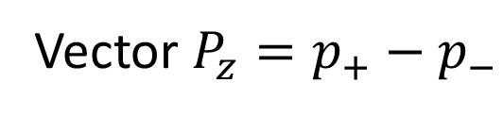

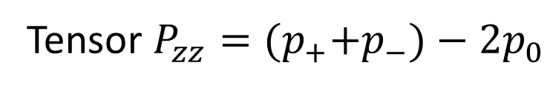
Tensor Polarization
$$m_{J}=±1$$
$$m_{J}=0$$
Vector $P_{z}=p_{+}−p_{−}$
-
$${(p}_{+}+p_{−})=1, { p}_{0}=0, { P}_{zz}=+1$$
$$\left(p_{+}+p_{−}\right)=2/3,{ p}_{0}=1/3, { P}_{zz}=0$$
$${(p}_{+}+p_{−})=0.5, { p}_{0}=0.5, { P}_{zz}=−1$$
Tensor $P_{zz}={(p}_{+}+p_{−})−2p_{0}$
( + )-2
$${(p}_{+}+p_{−})=0, { p}_{0}=1, { P}_{zz}=−2$$

Slide 6
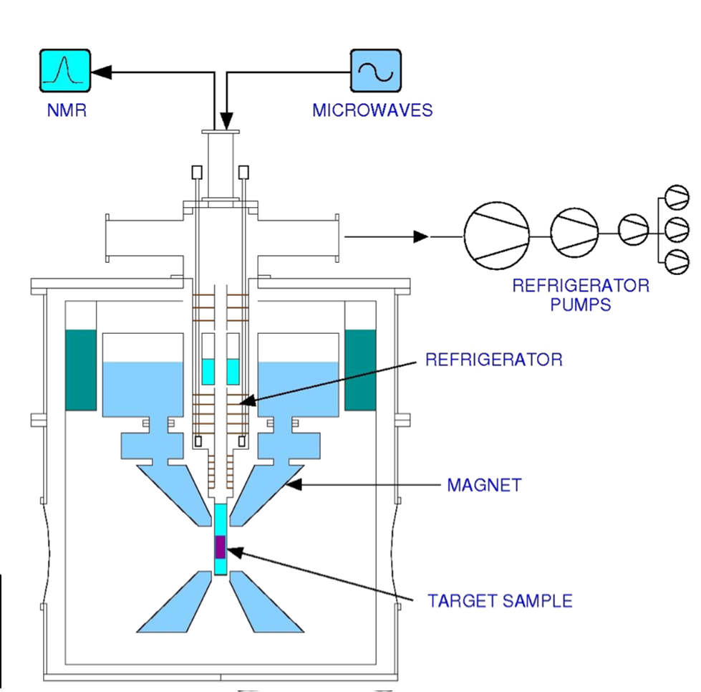
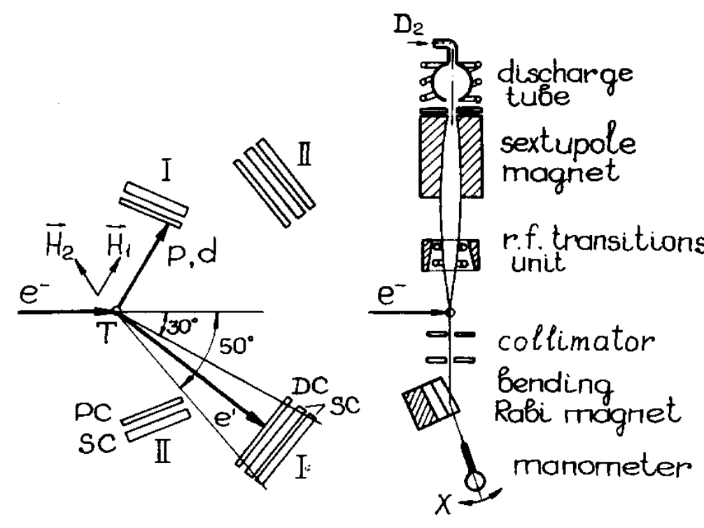
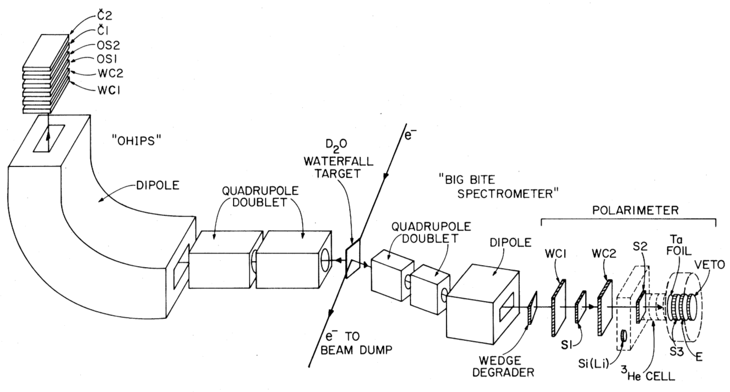
Tensor Polarization Experiments
  Unpolarized Target + Polarimeter
    D₂O waterfall^{[1]}
    Liquid D₂^{[2]}
    Medium-high luminosity, no polarization enhancement
  Gas Jet/Storage Cell Target^{[3]}
    Low luminosity, very high tensor polarization
  Solid Polarized DNP Target^{[4]}
    High luminosity, polarization enhancement, large dilution at high x
^{[1]} ME Schulze, et al, PRL 52 597 (1984)
^{[2]} D Abbot, et al, PRL 84 5053 (2000)
^{[3]} AV Evstugneev, et al, NIM A 238 12 (1985)
^{[4]} B Boden, et al, Z. Phys. C 49 175 (1991)

Slide 7
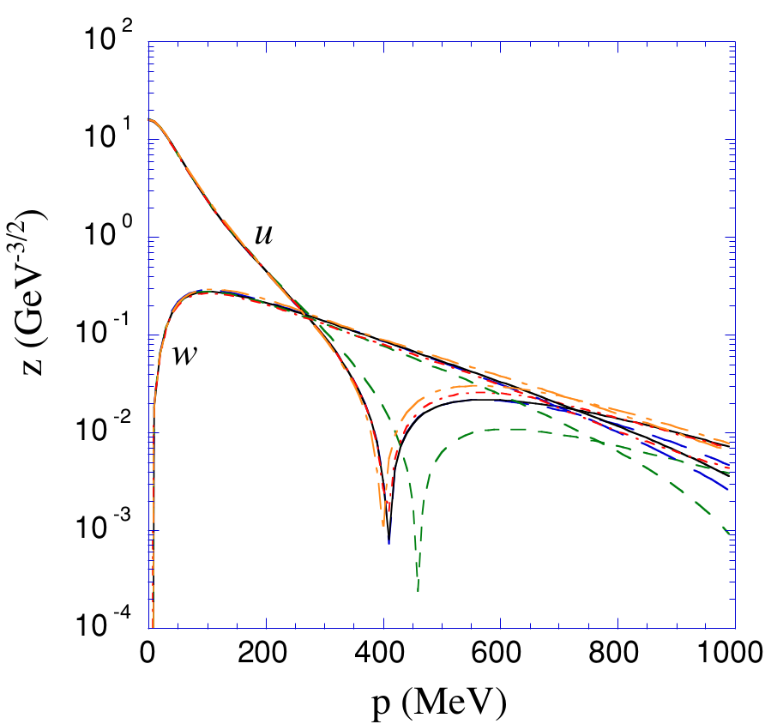
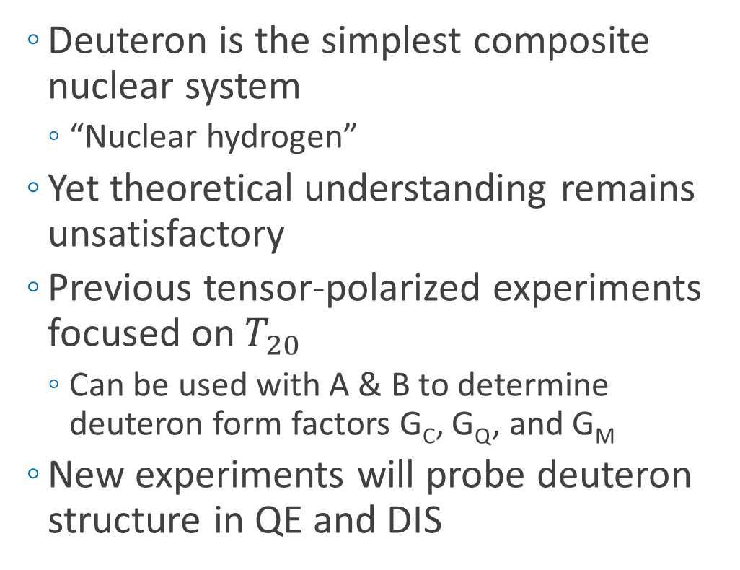
Deuteron Wave Function
  Deuteron is the simplest composite nuclear system
    “Nuclear hydrogen”
  Yet theoretical understanding remains unsatisfactory
  Previous tensor-polarized experiments focused on $T_{20}$
    Can be used with A & B to determine deuteron form factors G_{C}, G_{Q}, and G_{M}
  New experiments will probe deuteron structure in QE and DIS
R Gilman, F Gross, J. Phys. G 28 R37 (2002)

Slide 8
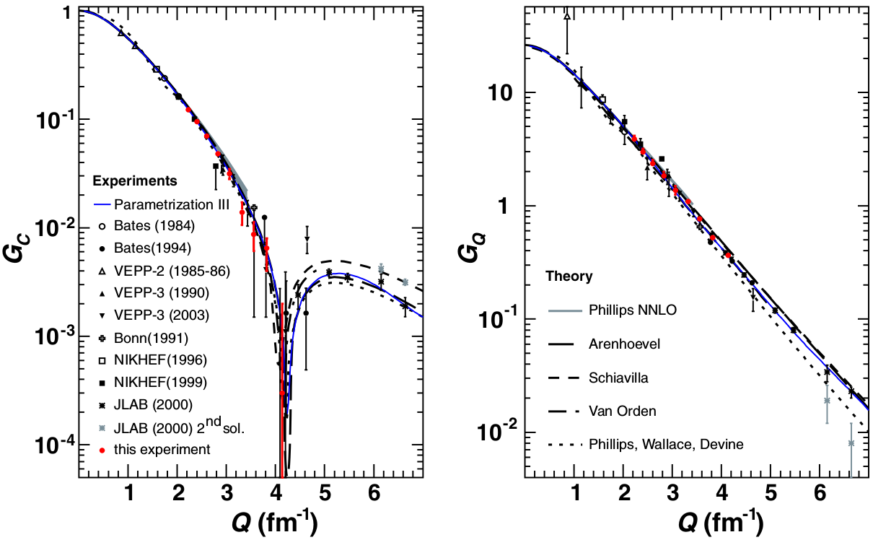
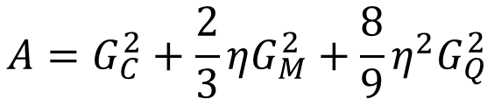

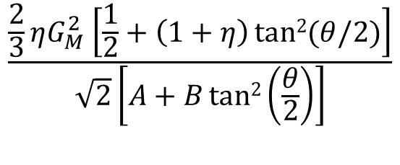
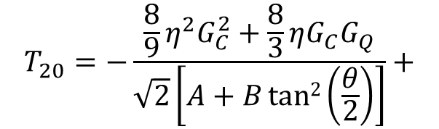
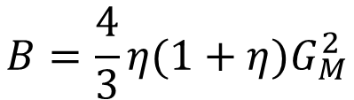
Elastic Tensor Observables
$$Q=7 {fm}^{−1}→Q^{2}=1.9{ GeV}^{2}$$
$$A=G_{C}^{2}+\frac{2}{3}ηG_{M}^{2}+\frac{8}{9}η^{2}G_{Q}^{2}$$
$$B=\frac{4}{3}η(1+η)G_{M}^{2}$$
$$T_{20}=−\frac{{\frac{8}{9}η^{2}G}_{C}^{2}+\frac{8}{3}ηG_{C}G_{Q}}{\sqrt{2}\left[A+Btan2\left(\frac{θ}{2}\right)\right]}+$$
$$\frac{\frac{2}{3}ηG_{M}^{2}\left[\frac{1}{2}+\left(1+η\right)tan2{(θ/2)}\right]}{\sqrt{2}\left[A+Btan2\left(\frac{θ}{2}\right)\right]}$$
RJ Holt, R Gilman, Rep. Prog. Phys. 75 086301 (2012)

Slide 9
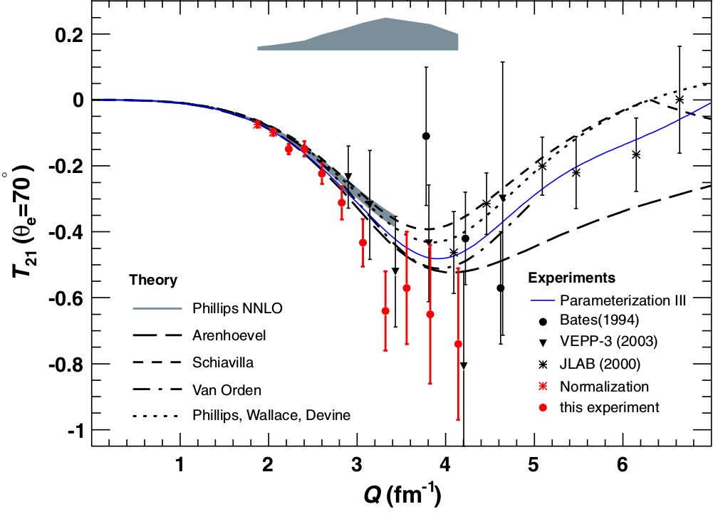
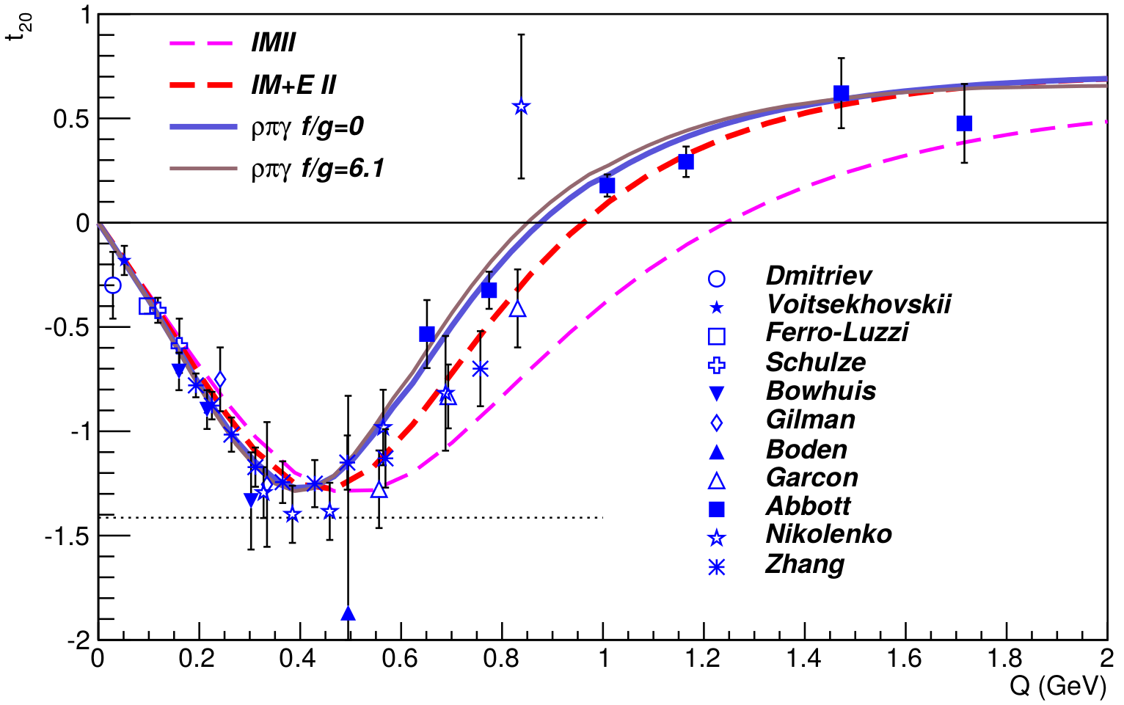
Elastic Tensor Observables
0.20
0.39
0.59
0.79
0.99
1.18
Q (GeV)
RJ Holt, R Gilman, Rep. Prog. Phys. 75 086301 (2012)
C Zhang, et al, PRL 107 252501 (2011)

Slide 10
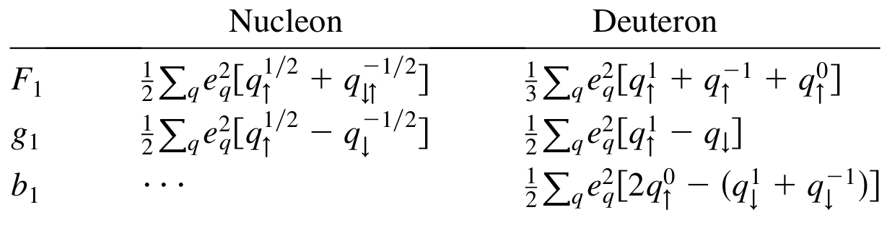



DIS Tensor Observables
$$W_{μν}=−{αF}_{1}+{βF}_{2}$$
Scattering on Unpolarized Targets
$$+iγg_{1}+iδg_{2}$$
Scattering on Vector Polarized Targets
$$−εb_{1}+ζb_{2}+ηb_{3}+κb_{4}$$
Scattering on Tensor-Polarized Targets
P Hoodbhoy et al, Nucl. Phys. B312, 571 (1989)
A Airapetian, et al, PRL 95 242001 (2005)

Slide 11
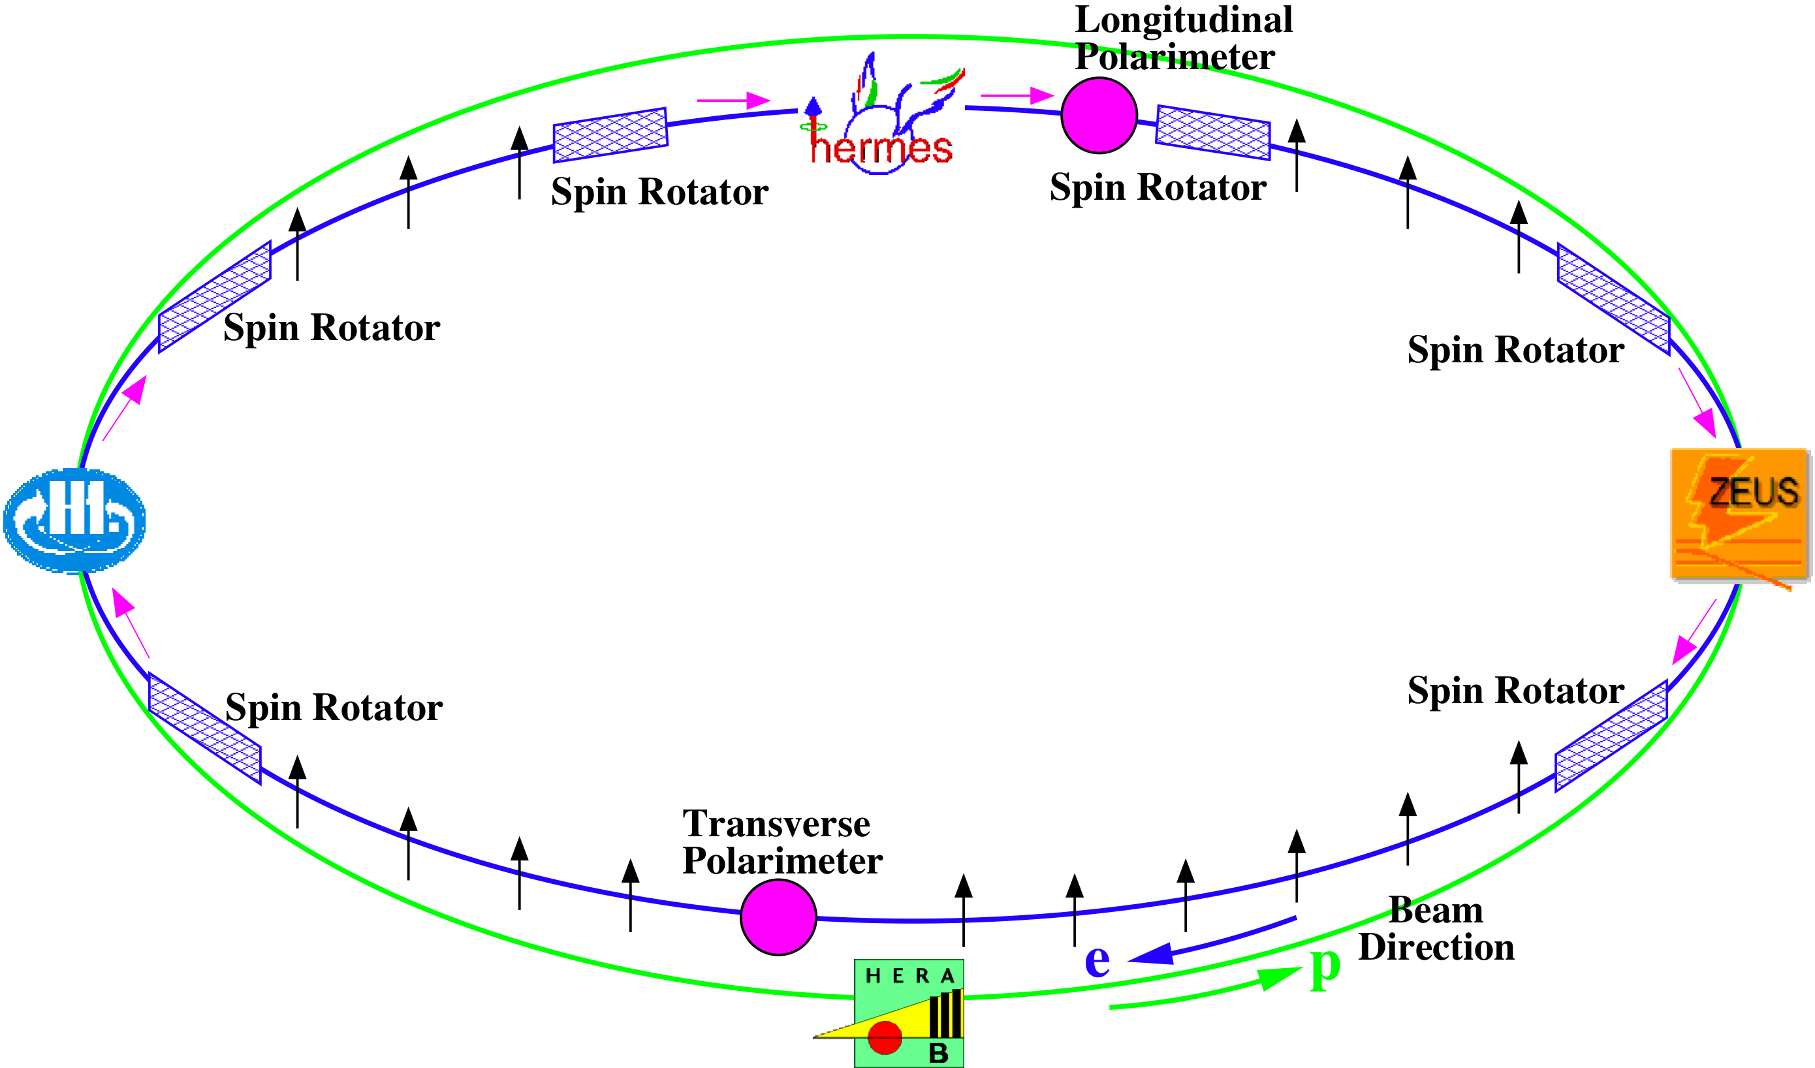
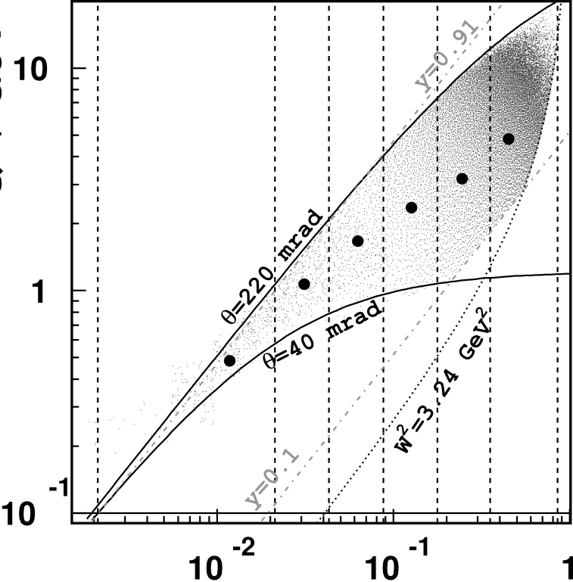
DIS Tensor Observables
  HERMES $b_{1}$ -- First tensor structure function measurement
Q² (GeV/c)²
27.6 GeV Positron Beam
Internal Gas Tensor-Polarized Target
x
A Airapetian, et al, PRL 95 242001 (2005)

Slide 12
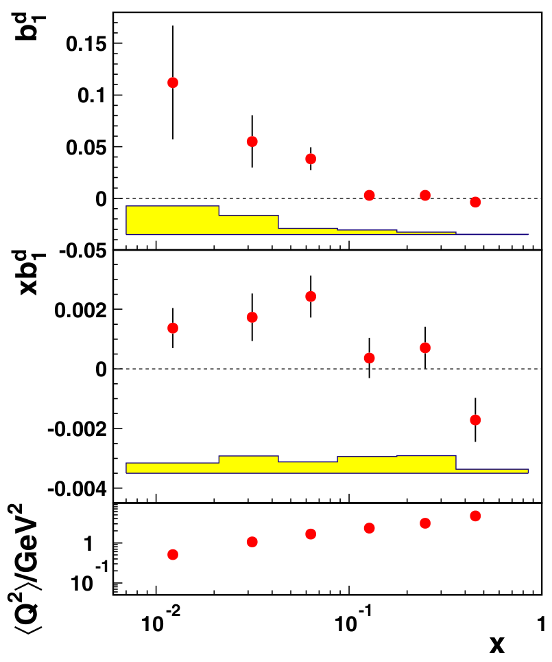
DIS Tensor Observables
  HERMES $b_{1}$ -- First tensor structure function measurement
A Airapetian, et al, PRL 95 242001 (2005)

Slide 13
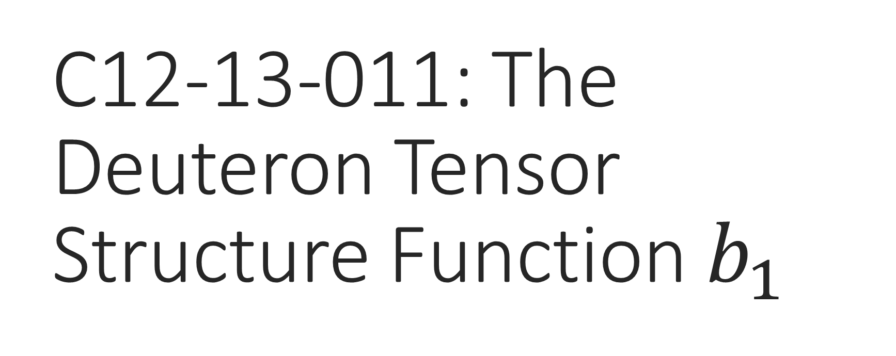
C12-13-011: The Deuteron Tensor Structure Function $b_{1}$
Spokespeople:
K. Slifer*, O.R. Aramayo, J.P. Chen, N. Kalatarians, D. Keller, E. Long, P. Solvignon,

Slide 14
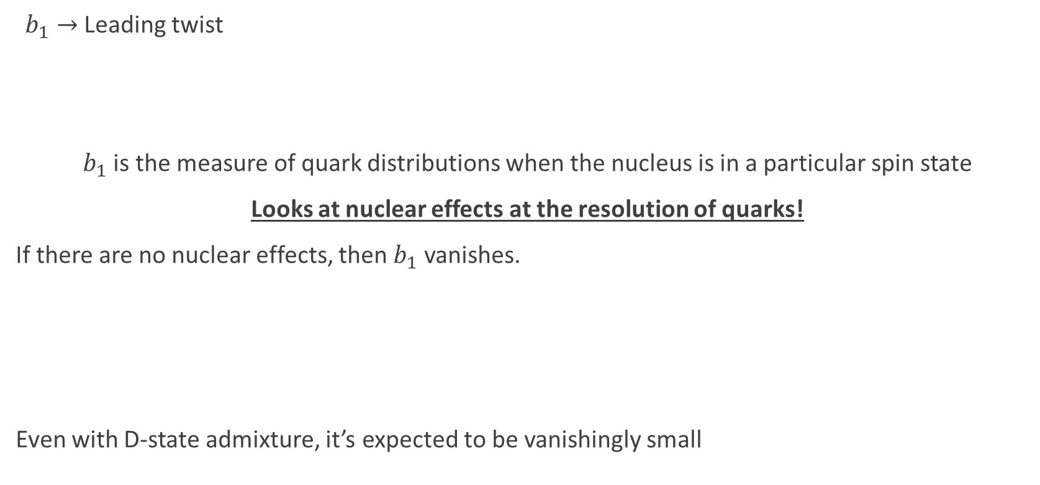


Tensor Structure Function, $b_{1}$
$b_{1}→$ Leading twist
$b_{1}$ is the measure of quark distributions when the nucleus is in a particular spin state
Looks at nuclear effects at the resolution of quarks!
If there are no nuclear effects, then $b_{1}$ vanishes.
Even with D-state admixture, it’s expected to be vanishingly small
Deuteron
=
n
+
p
$$b_{1}=0$$
Khan & Hoodbhoy, PRC 44 1219 (1991)
Umnikov, Phys. Lett. B 391 177 (1997)

Slide 15
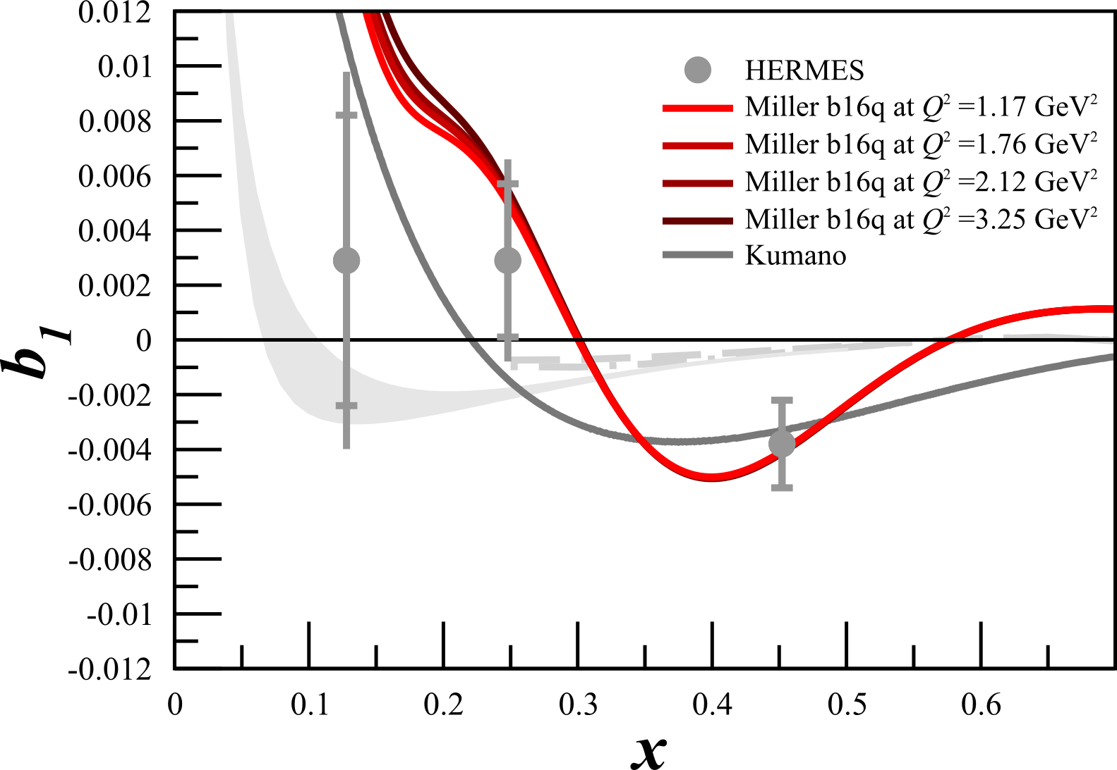
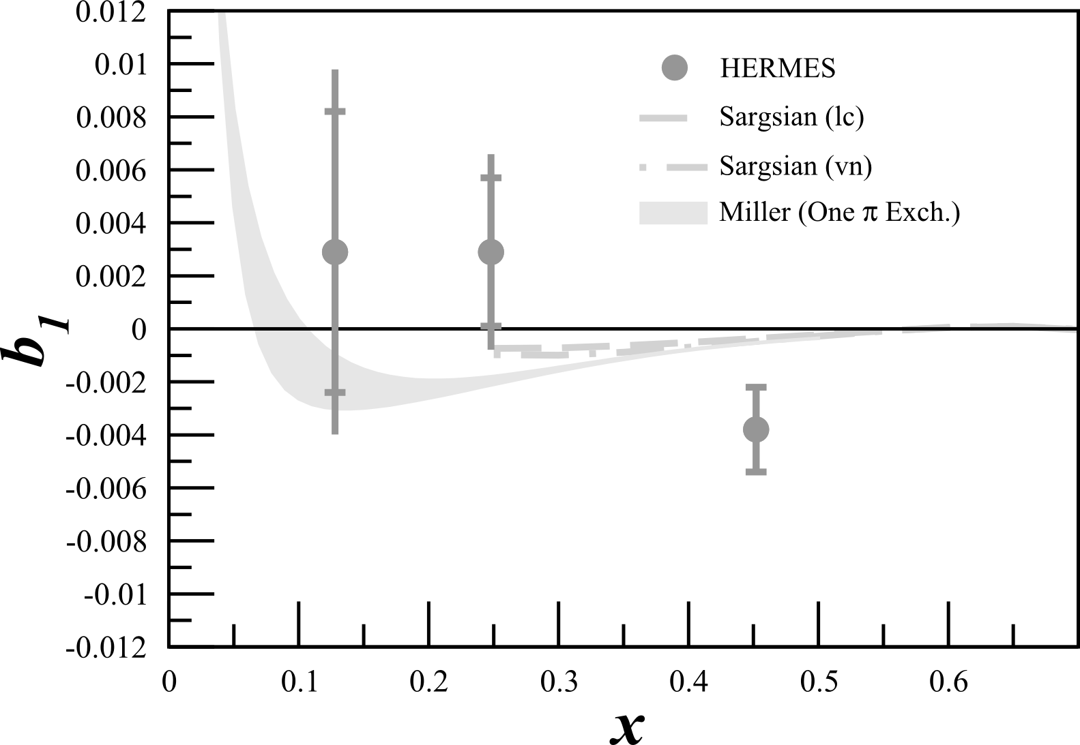
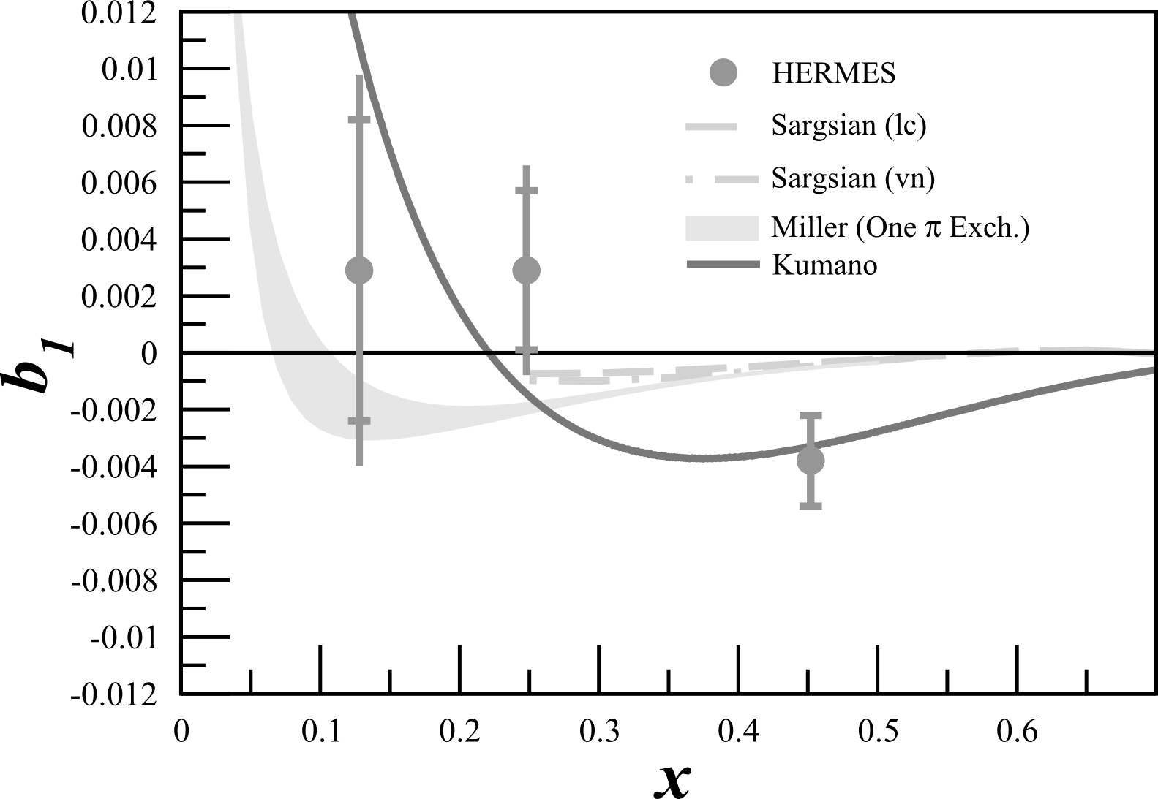
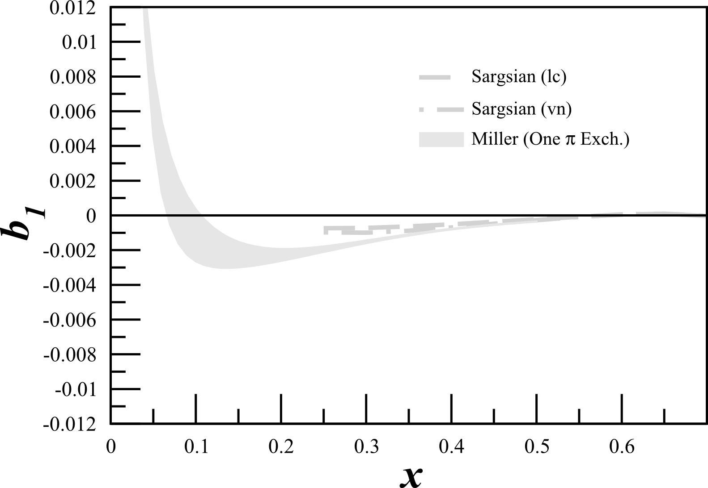
Tensor Structure Function, $b_{1}$
All conventional models predict small or vanishing values of b₁ in contrast with the HERMES data
All conventional models predict small or vanishing values of b₁ in contrast with the HERMES data
Any measurement of a b₁<0 indicates exotic physics
K Slifer et al, JLab E12-13-011

Slide 16
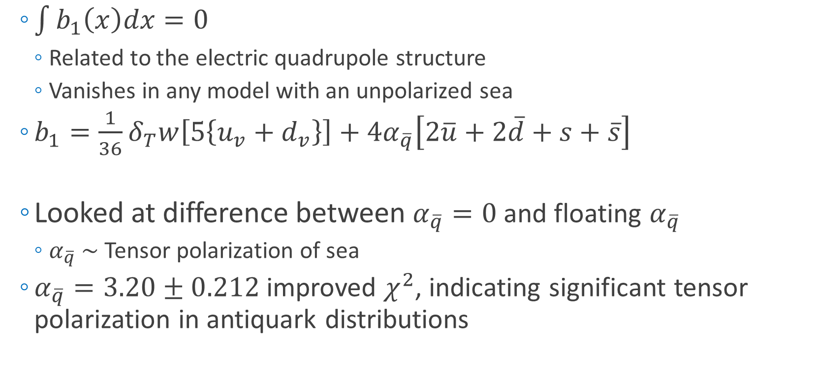
Close-Kumano Sum Rule
  $\int{b_{1}\left(x\right)dx=0}$
    Related to the electric quadrupole structure
    Vanishes in any model with an unpolarized sea
  $b_{1}=\frac{1}{36}δ_{T}w\left[5\left\{u_{v}+d_{v}\right\}\right]+4α_{\overline{q}}\left[2\overline{u}+2\overline{d}+s+\overline{s}\right]$
  Looked at difference between $α_{\overline{q}}=0$ and floating $α_{\overline{q}}$
    $α_{\overline{q}} \sim$ Tensor polarization of sea
  $α_{\overline{q}}=3.20±0.212$ improved $χ^{2}$, indicating significant tensor polarization in antiquark distributions
Quarks
Sea Strange and Anti-Quarks
S Kumano, PRD 82 017501 (2010)

Slide 17
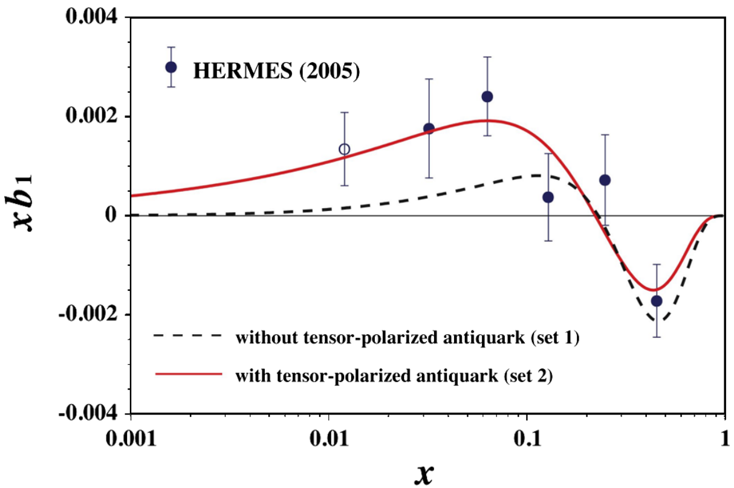


Close-Kumano Sum Rule
$$χ^{2}/dof=1.57$$
$$χ^{2}/dof=2.83$$
S Kumano, PRD 82 017501 (2010)

Slide 18
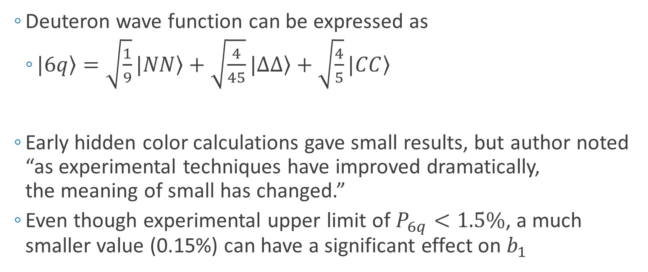
6-Quark, Hidden Color
  Deuteron wave function can be expressed as
    $\left.|6q\right\rangle =\sqrt{\frac{1}{9}}\left.|NN\right\rangle +\sqrt{\frac{4}{45}}\left.|∆∆\right\rangle +\sqrt{\frac{4}{5}}\left.|CC\right\rangle$
  Early hidden color calculations gave small results, but author noted “as experimental techniques have improved dramatically,
  the meaning of small has changed.”
  Even though experimental upper limit of $P_{6q}<1.5\%$, a much smaller value (0.15%) can have a significant effect on $b_{1}$
Nucleon-
Nucleon
Delta-Delta
Hidden Color
Probability of Hidden-Color Effects
G Miller, PRC 89 045203 (2014)

Slide 19
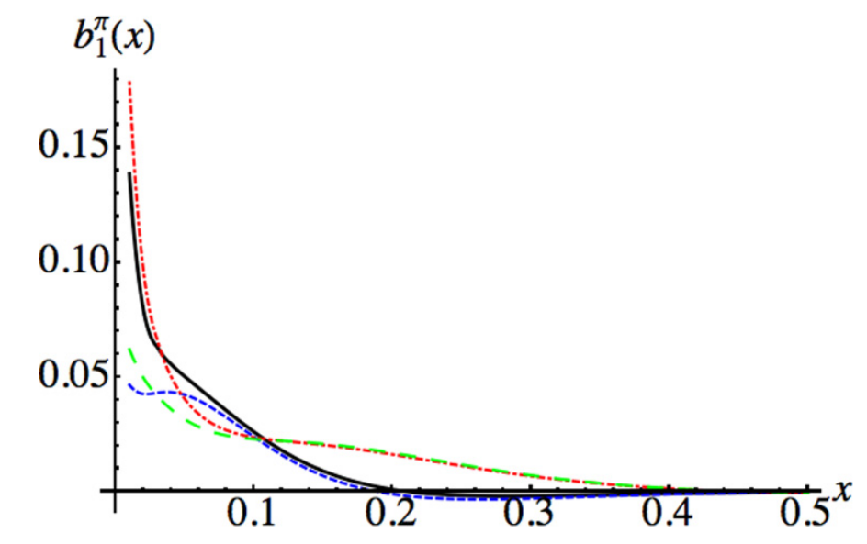

6-Quark, Hidden Color
  Pionic effects alone would violate Close-Kumano Sum Rule $\int{b_{1}\left(x\right)dx=0}$
G Miller, PRC 89 045203 (2014)

Slide 20
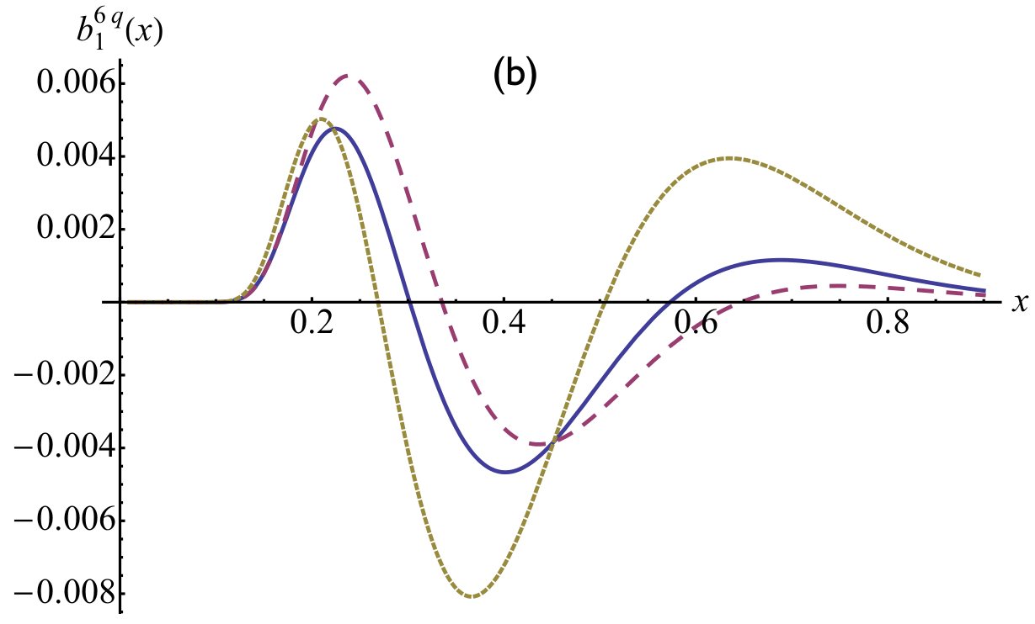
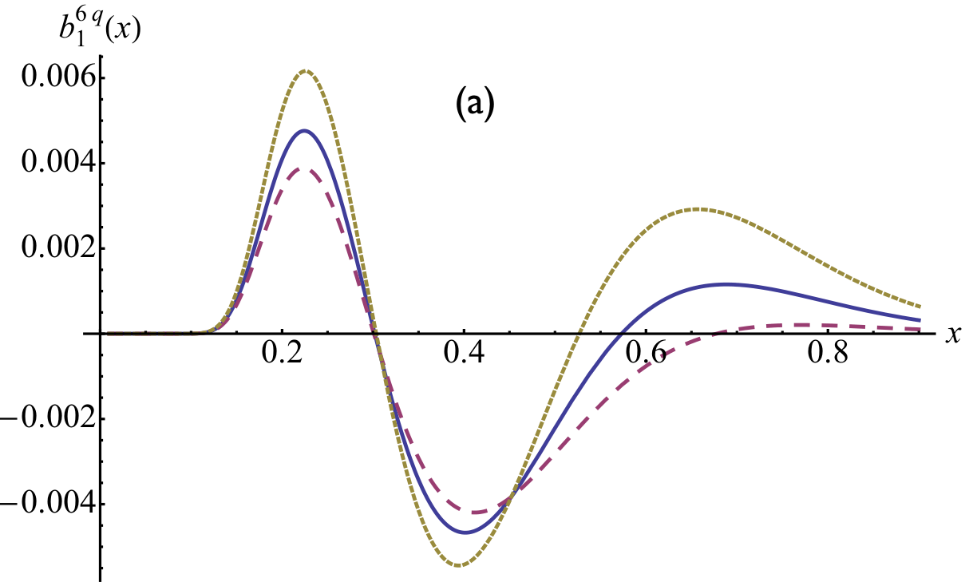

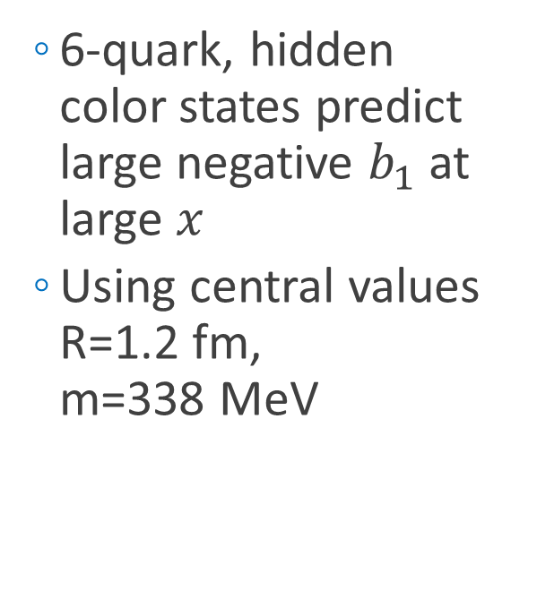

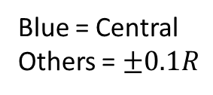
6-Quark, Hidden Color
  6-quark, hidden color states predict large negative $b_{1}$ at large $x$
  Using central values R=1.2 fm,
  m=338 MeV
Blue = Central
Others = $±0.1M$
Blue = Central
Others = $±0.1R$
G Miller, PRC 89 045203 (2014)

Slide 21
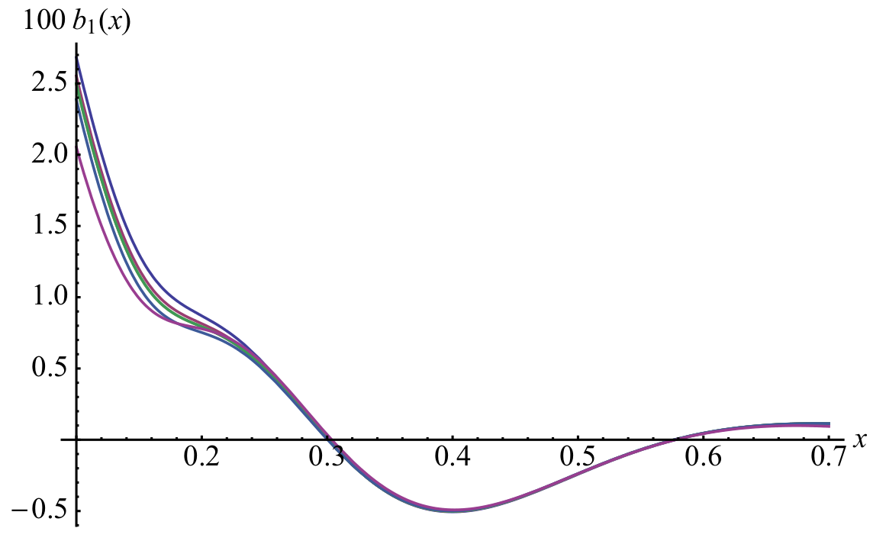
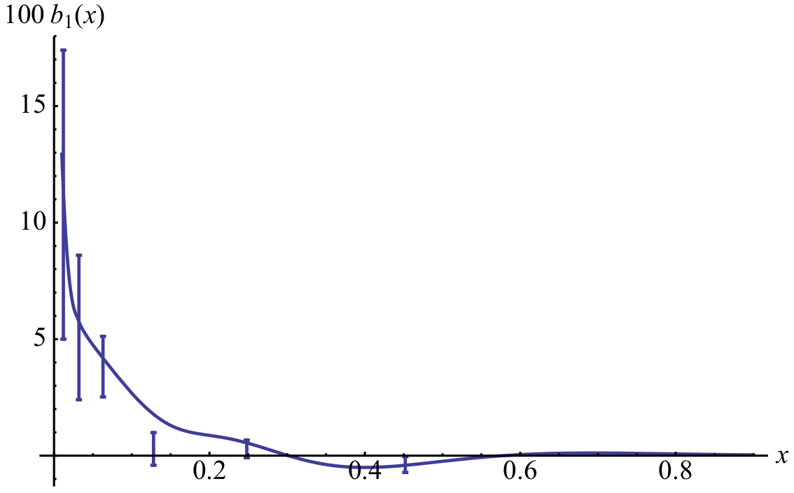
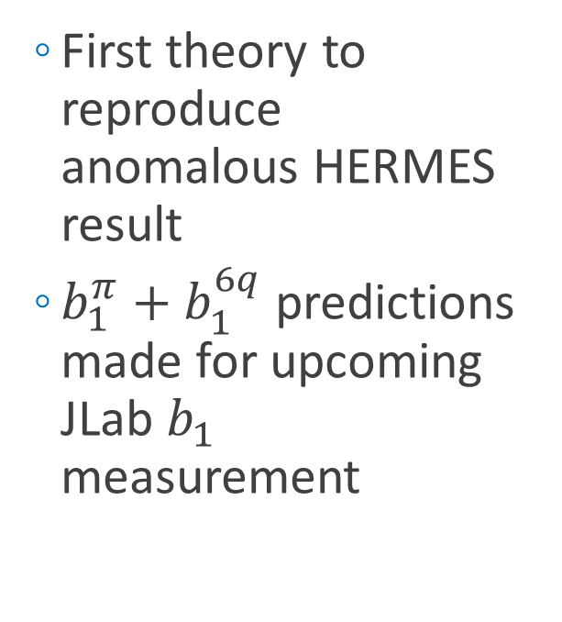
6-Quark, Hidden Color
  First theory to reproduce anomalous HERMES result
  $b_{1}^{π}+b_{1}^{6q}$predictions made for upcoming JLab $b_{1}$ measurement
G Miller, PRC 89 045203 (2014)

Slide 22
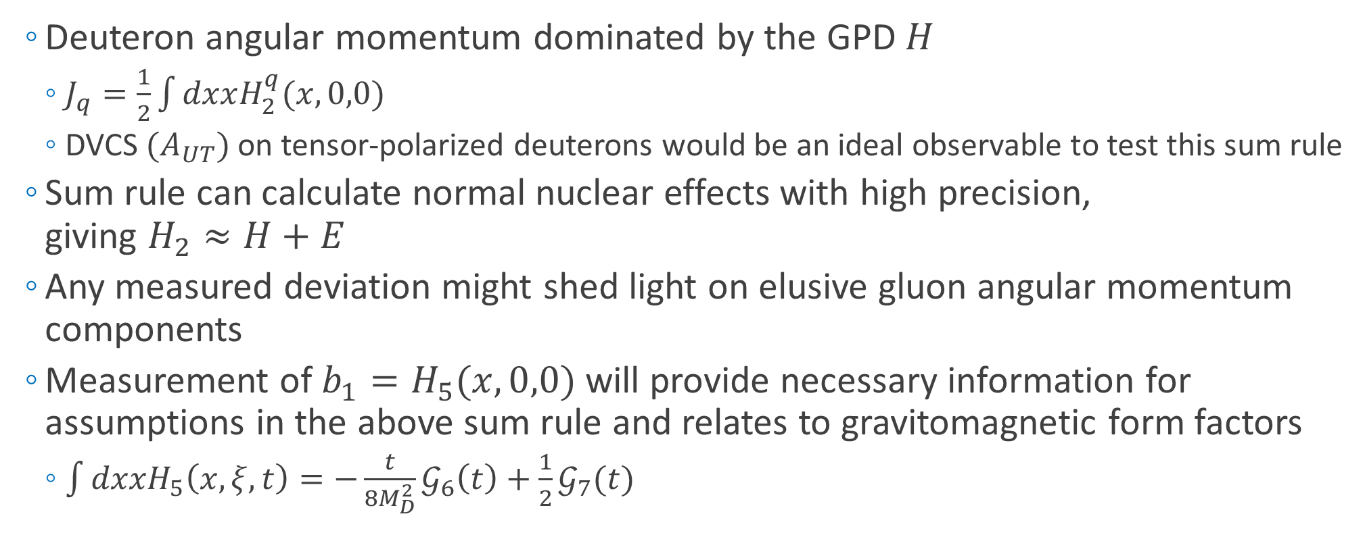
OAM and Angular Momentum Sum Rule
  Deuteron angular momentum dominated by the GPD $H$
    $J_{q}=\frac{1}{2}\int{dxxH_{2}^{q}(x,0,0)}$
    DVCS ${(A}_{UT})$ on tensor-polarized deuterons would be an ideal observable to test this sum rule
  Sum rule can calculate normal nuclear effects with high precision,
  giving $H_{2}≈H+E$
  Any measured deviation might shed light on elusive gluon angular momentum components
  Measurement of $b_{1}=H_{5}(x,0,0)$ will provide necessary information for assumptions in the above sum rule and relates to gravitomagnetic form factors
    $\int{dxxH_{5}\left(x,ξ,t\right)=−\frac{t}{8M_{D}^{2}}𝒢_{6}\left(t\right)+\frac{1}{2}𝒢_{7}(t)}$
SK Taneja, et al, PRD 86 036008 (2012)

Slide 23
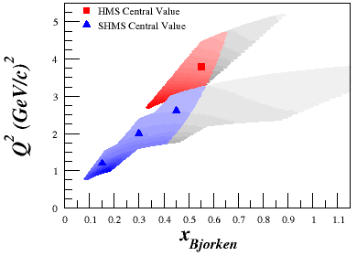

Tensor Structure Function, $b_{1}$
Measured by ratio method
$$=−\frac{3}{2}F_{1}A_{zz}$$

Slide 24
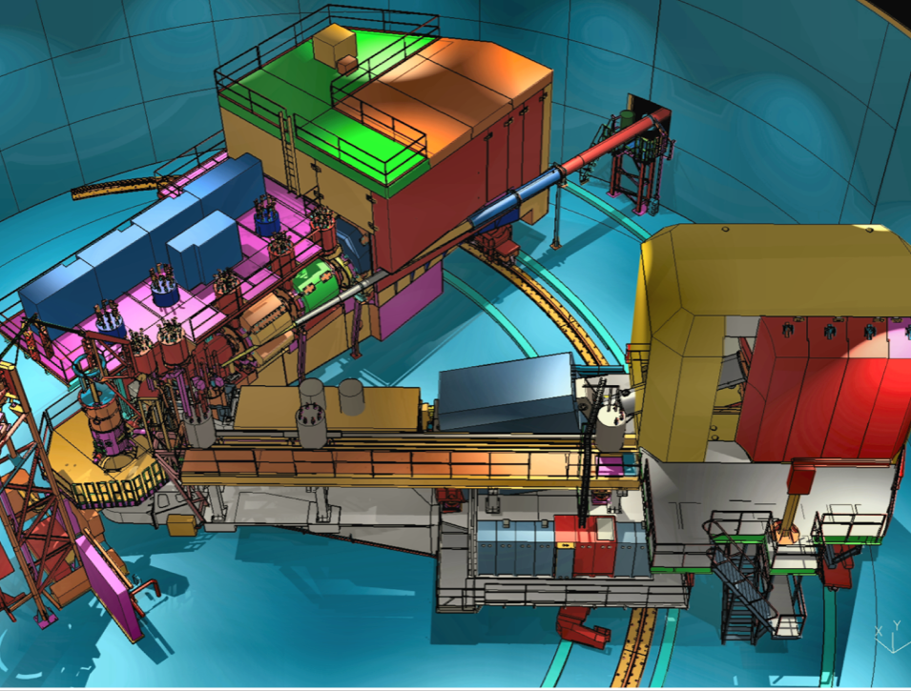
Tensor Structure Function, $b_{1}$
  Jefferson Lab’s Hall C
  Unpolarized beam, tensor polarized target (longitudinal alignment)
SHMS
SHMS
Slow
Raster
Faraday
Cup
Lumi
Unpolarized
Beam
Fast
Raster
Polarized
Target
HMS

Slide 25
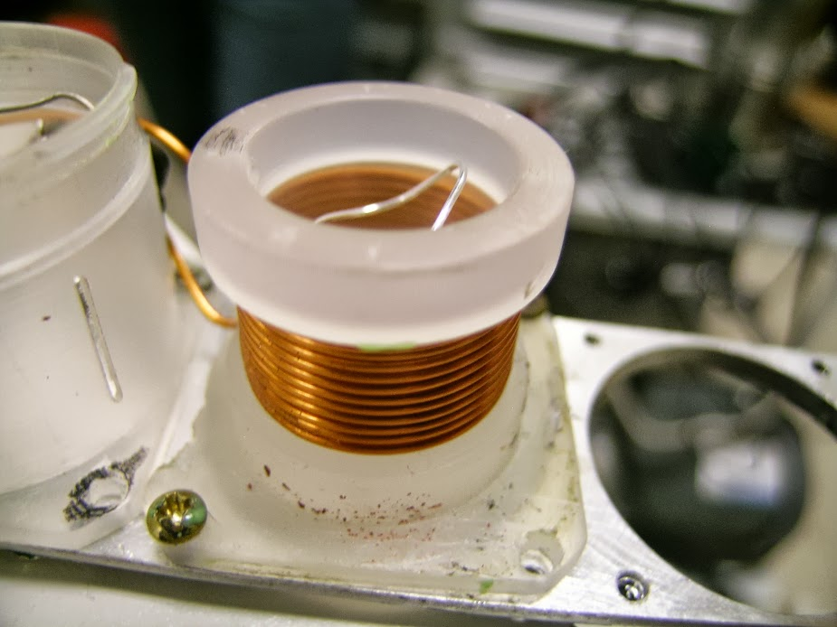
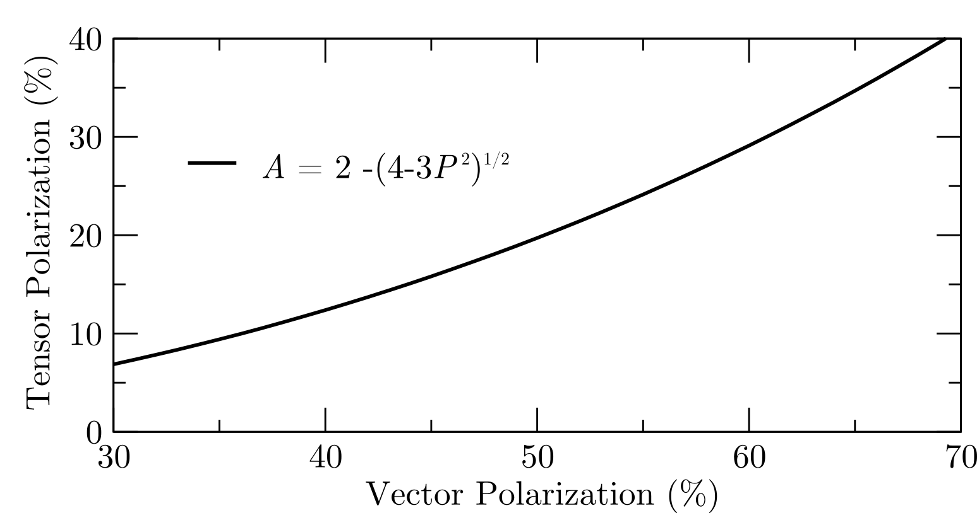

Tensor Structure Function, $b_{1}$
  Dynamic Nuclear Polarization of ND₃
  PAC Condition: $P_{zz} \sim 30\%$
  5 Tesla at 1 K
  3cm Target Length
  $p_{f} \sim 0.65$
  $f_{dil} \sim 0.27$
“Brute Force” Tensor Polarization

Slide 26
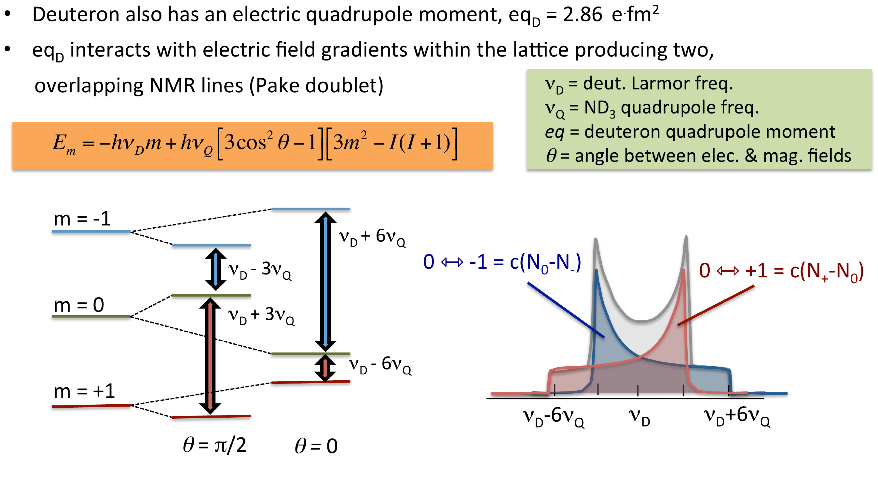
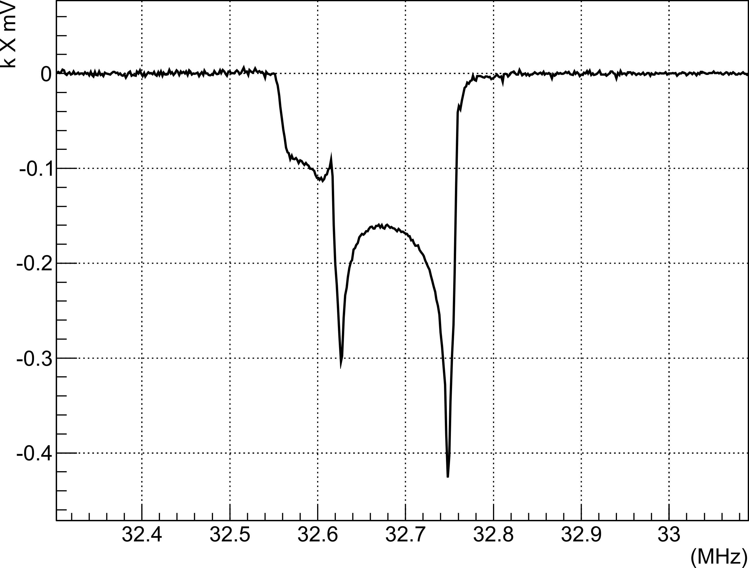



Tensor Structure Function, $b_{1}$
  Dynamic Nuclear Polarization of ND₃
  PAC Condition: $P_{zz} \sim 30\%$
  5 Tesla at 1 K
  3cm Target Length
  $p_{f} \sim 0.65$
  $f_{dil} \sim 0.27$
“Hole Burning” Tensor Enhancement
32.4
32.5
32.6
32.7
32.8
32.9
MHz
-0.4
-0.3
-0.2
-0.1
$k∙$ mV
0.0
D Keller, HiX Workshop (2014)
UVA Tensor Enhancement on Butanol (2014)
$$υ_{D}−3υ_{D}$$
$$υ_{D}+3υ_{D}$$

Slide 27

Tensor Structure Function, $b_{1}$

Slide 28


Tensor Structure Function, $b_{1}$
Measuring $b_{1}$ will give insight into:
Close-Kumano sum rule^{[1]}
6-quark hidden color^{[2]}
OAM and spin crisis^{[3]}
Pionic effects^{[2,4]}
Polarized sea quarks^{[4]}
Approved JLab Experiment C12-13-011
Spokespersons: K. Slifer, E. Long, D. Keller, P. Solvignon, J.P. Chen, O.R. Aramayo, N. Kalantarians
^{[1]} FE Close, S Kumano, Phys. Rev. D42, 2377 (1990)
^{[2]} G Miller, Phys. Rev. C89, 045203 (2014)
^{[3]} SK Taneja et al, Phys. Rev. D86, 036008 (2012)
^{[4]} S Kumano, Phys. Rev. D82, 017501 (2010)

Slide 29

LOI12-14-002: Tensor Asymmetry $A_{zz}$ in the $x>1$ Region
Spokespeople:
E. Long*, K. Slifer, P. Solvignon, D. Day, D. Keller,
D. Higinbotham

Slide 30





Quasi-Elastic $A_{zz}$
  Repeat same experiment, only look at $A_{zz}$ in the quasi-elastic region
    DIS ${→b}_{1}∝F_{1}A_{zz}$; QE ${→A}_{zz}$; Elastic $→T_{20}∝A_{zz}$
  Can give insight to short range deuteron structure
AV18
Light
Cone
AV18
Virtual
Nucleon
cdBonn
  $$A_{zz}∝\frac{\frac{1}{2}w^{2}−uw\sqrt{2}}{u^{2}+w^{2}}$$
cdBonn
M Sargsian, M Strikman, J. Phys.: Conf. Ser. 543, 012099 (2014)
R Gilman, F Gross, J. Phys. G 28 R37 (2002)
$$x$$
L. Frankfurt, M. Strikman, Phys. Rept. 160 235 (1988)

Slide 31



Quasi-Elastic $A_{zz}$ Experimental Set-Up
  Hall C
  Identical equipment as $b_{1}$ (E12-13-011)
  (Mostly??)
SHMS
SHMS
Polarized
Target
???
???
???
???
???
???
???
???
???
???
???
???
???
???
???
???
???
???
???
???
Slow
Raster
Faraday
Cup
Unpolarized
Beam
Lumi
Fast
Raster
?
?
?
LAD?
HMS
?
?
?
L. Frankfurt, M. Strikman, Phys. Rept. 160 235 (1988)

Slide 32



Kinematics
A
B
{
C
$I=90 nA$
$ℒ_{D}=1.3×{10}^{35} {cm}^{−1}s^{−1}$
1.5 (GeV/c)²
0.7
0.3
E. Long, et al, JLab LOI12-14-002

Slide 33



Quasi-Elastic $A_{zz}$
E. Long, et al, JLab LOI12-14-002

Slide 34

Quasi-Elastic $A_{zz}$
  Very large asymmetry
  Identical equipment as $b_{1}$ (?? + tagging??), less dependent on systematics
  Direct access to the tensor component of the deuteron, which is necessary to understand SRC
  Potential for parasitic $T_{20}$ measurement
    Can also be used to calibrate target polarization at low $Q^{2}$
E. Long, et al, JLab LOI12-14-002
RJ Holt, R Gilman, Rep. Prog. Phys. 75 086301 (2012)

Slide 35


Quasi-Elastic $A_{zz}$
First measurement of quasi-elastic $A_{zz}$ will give insight into:
SRCs & pn dominance^{[3]}
Differentiate light cone and VN models^{[1,2]}
Better understanding of deuteron wf^{[4]}
Final state interaction models^{[5]}
^{[1]} E. Long, et al, JLab LOI12-14-002
^{[2]} Sargsian, Strikman, J. Phys.: Conf. Ser. 543, 012099 (2014)
^{[4]} L Frankfurt, M Strikman, Phys. Rept. 160, 235
^{[5]} W Cosyn, M Sargsian, arXiv:1407.1653
^{[3]} J Arrington et al, Prog. Part. Nucl. Phys. 67, 898 (2012)

Slide 36
Quasi-Elastic $A_{zz}$
Encouraged for full submission by PAC42
“The measurement proposed here arises from a well-developed context, presents a clear objective, and enjoys strong theory support. It would further explore the nature of short-range pn correlations in nuclei, the discovery of which has been one of the most important results of the JLab 6 GeV nuclear program.”
-JLab PAC42 Theory Advisory Committee
E. Long, et al, JLab LOI12-14-002
Sargsian, Strikman, J. Phys.: Conf. Ser. 543, 012099 (2014)

Slide 37
LOI12-14-001: Search for Exotic Gluonic States in the Nucleus
Authors:
J. Maxwell*, W. Detmold, R. Jaffe, R. Milner, D. Crabb, D. Day, D. Keller, O.A. Rondon, M. Jones, C. Keith, J. Pierce

Slide 38



Tensor Structure Function, $b_{4}$ (or $∆$)
Hadronic double helicity flip structure function, $Δ\left(x,Q^{2}\right)=b_{4}$
Unpolarized electron beam on transversely-aligned tensor polarized target
Insensitive to bound nucleons or pions
Any non-zero value indicates exotic gluonic components
Encouraged for full submission by PAC42
R Jaffe, A Manohar, Phys. Lett. B 223,218 (1989)
J. Maxwell, et al, JLab LOI-14-001

Slide 39

Summary
  Previous tensor-polarized measurements focused on low $Q^{2}$ elastic $T_{20}$
  Expanding tensor measurements into quasi-elastic $\left(A_{zz}\right)$ and DIS $(b_{1},b_{4})$ will provide important information in a variety of topics
    Deuteron wave function
    (“Nuclear Hydrogen”)
    Close-Kumano Sum Rule
    Orbital Angular Momentum
    & Spin Crisis
    6-Quark, Hidden Color
    Pionic Effects
  …and we’re just getting started!
    Polarized Sea Quarks
    Short Range Correlations and p-n Dominance
    Differentiate Light Cone and Virtual Nucleon Models
    Final State Interactions
    Gluonic Effects

Slide 40
Thank you

Slide 42
Backup Slides

Slide 43

Quasi-Elastic $A_{zz}$
Encouraged for full submission by PAC42
“The measurement proposed here arises from a well-developed context, presents a clear objective, and enjoys strong theory support. It would further explore the nature of short-range pn correlations in nuclei, the discovery of which has been one of the most important results of the JLab 6 GeV nuclear program.”
-JLab PAC42 Theory Advisory Committee
E. Long, et al, JLab LOI12-14-002
Sargsian, Strikman, J. Phys.: Conf. Ser. 543, 012099 (2014)

Slide 44

Elastic Tensor Observables
VEPP-3 Internal gas 1.65-4.26 $T_{20}, T_{21}$ 6 2003
Bates Internal gas 0.42-0.89 $T_{20}, T_{21}$ 9 2011
R Gilman, F Gross, J. Phys. G 28 R37 (2002)

Slide 45


Frankfurt and Strikman Light Cone Calculations
  $A_{zz}=\left(3\frac{\frac{1}{2}k_{⊥}^{2}−k_{z}^{2}}{k^{2}}\right)\frac{\frac{1}{2}w^{2}\left(k\right)−u\left(k\right)w(k)\sqrt{2}}{u^{2}\left(k\right)+w^{2}(k)}$
    $u(k)$ is the momentum-dependent S state
    $w(k)$ is the momentum-dependent D state
  Recent study indicates dependence on choice of NN potential
L.L. Frankfurt, M.I. Strikman, Phys. Rept. 76 (1981) 215

Slide 46


Connection to
Short Range Correlations
Short range correlations caused by tensor force – why not probe it through tensor polarization?
N. Fomin et al., Phys. Rev. Lett. 108 (2012) 092505
L.L. Frankfurt et al., Int. J. Mod. Phys. A23 (2008) 2991-3055

Slide 47

Connection to
Short Range Correlations
Short range correlations caused by tensor force – why not probe it through tensor polarization?
L.L. Frankfurt et al., Int. J. Mod. Phys. A23 (2008) 2991-3055

Slide 48


Tensor Polarization Measurement
Vector optimize with microwaves
Fit peaks with convolution
Tensor optimize with RF
Measure change in peaks using Riemann Sum segments
Ratio of instantaneous
to initial NMR signal area
Percentage of initial peak
shifted any time
(from reduced side)
Available tensor
enhancement

Slide 49
Brute Force Tensor Polarization
When vector polarizing deuterium, some amount of tensor polarization occurs
Higher vector polarization → Higher tensor polarization

Slide 50


Systematics Estimate for $A_{zz}$

Slide 51

Interest from Theorists
M. Strikman and M. Sargsian have already been involved in providing $A_{zz}$ calculations
“This is an important measurement. Accessing the large x region will provide insights on the partonic structure of the D-wave dominated deuteron tensor structure function, $b_{1}$. This process should be calculated more thoroughly.” – S. Liuti
“This measurement was a highlighted need early at Jlab. A new measurement at higher $Q^{2}$ would be very interesting. In principle such could test my model. I could calculate the influence of my 6-quark configurations on elastic scattering.” – G. Miller
“I hope to do some calculations soon and could easily do them for the kinematics in your proposal.” – W. Cosyn
W. Van Orden has agreed to look into tensor polarization observables at low $Q^{2}$ using a variety of NN potentials

Slide 52




Rates for D(e,e’)X
Assumptions:
$$P_{zz}=30\%$$
$$p_{f}=65\%$$
$$z_{tgt}=3 cm$$
P.E. Bosted, V. Mamyan, arXiv:1203.2262
M. Sargsian, Private Communication
N. Fomin, et al., Phys. Rev. Lett. 108 (2012) 092502
N. Fomin, et al., Phys. Rev. Lett. 105 (2010) 212502
$R_{Pol}=𝒜\left[ℒ_{He}σ_{He}^{u}+ℒ_{N}σ_{N}^{u}+ℒ_{D}σ_{D}^{u}\left(1+\frac{1}{2}P_{zz}A_{zz}\right)\right]$
$R_{Unpol}=𝒜\left[ℒ_{He}σ_{He}^{u}+ℒ_{N}σ_{N}^{u}+ℒ_{D}σ_{D}^{u}\right]$
$N=Rt$
$A_{zz}=\frac{2}{f_{dil}P_{zz}}\left(\frac{N_{Pol}}{N_{Unpol}}−1\right)$
$δA_{zz}^{stat}=\frac{2}{f_{dil}P_{zz}}\sqrt{{\left(\frac{1}{N_{Unpol}}\sqrt{N_{Pol}}\right)}^{2}+{\left(\frac{N_{Pol}}{N_{Unpol}^{2}}\sqrt{N_{Unpol}}\right)}^{2}}$
  Used combination of P. Bosted and M. Sargsian code to calculate unpolarized cross sections
Compared with data similar to Azz range
  $E_{0}=5.766 GeV$
  $E′=4.8 GeV$
  $θ_{e′}={18.0}^{∘}$
E. Long, Technical Note, JLAB-TN-13-029

Slide 53


Dilution Factor
“…the background from interaction with nuclei increases as $α(x)$ increases. For example, for a D¹²C target the ratio of the cross sections $σ_{A}$ for A=¹²C and A=D is of the order of 40 for $x\sim 1.3$ and increases with $x$.”
- L.L. Frankfurt, M.I. Strikman,
Phys. Rept. 160 (1988) 235
$f_{dil}=\frac{ℒ_{D}σ_{D}}{ℒ_{N}σ_{N}+ℒ_{He}σ_{He}+ℒ_{D}σ_{D}+\sum{ℒ_{A}σ_{A}}}$
With the 12 GeV upgrade and the new SHMS, this measurement becomes possible even with the low dilution factor at high $x$

Slide 54



Target Development in Progress
  UVa Target Lab has successfully polarized deuterated butanol in April
  UNH Target Lab is ramping up, first cool-down in January, successfully reached 7T
Courtesy of D. Keller

Slide 55


Experimental Details
  D(e,e’)X with 90nA beam current
  Same equipment as C1-approved $b_{1}$ (E12-13-011) experiment

