Slide 1


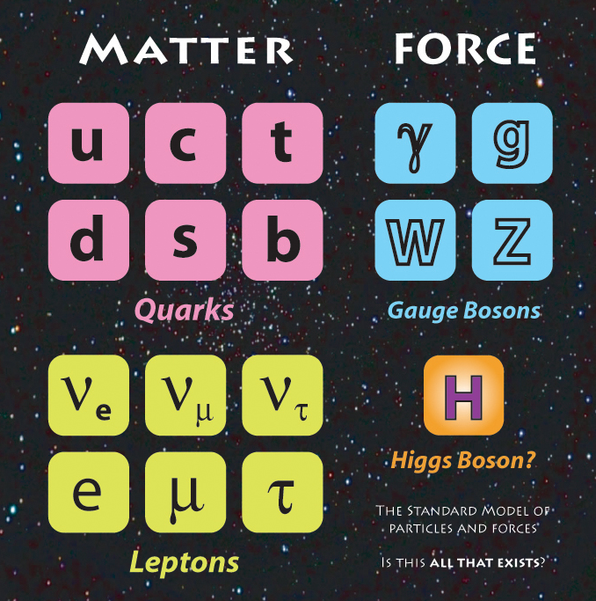

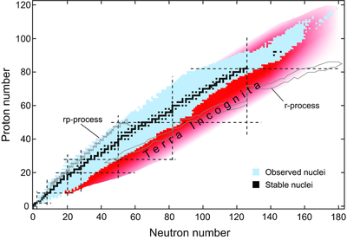
Electron Ion Collider:
The next QCD frontier
Understanding the Glue that Binds Us All
Why the EIC?
To understand the role of gluons & sea quarks
in binding quarks into Nucleons and Nuclei

Slide 2
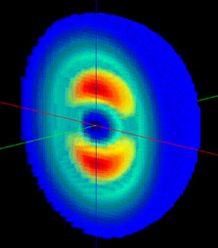
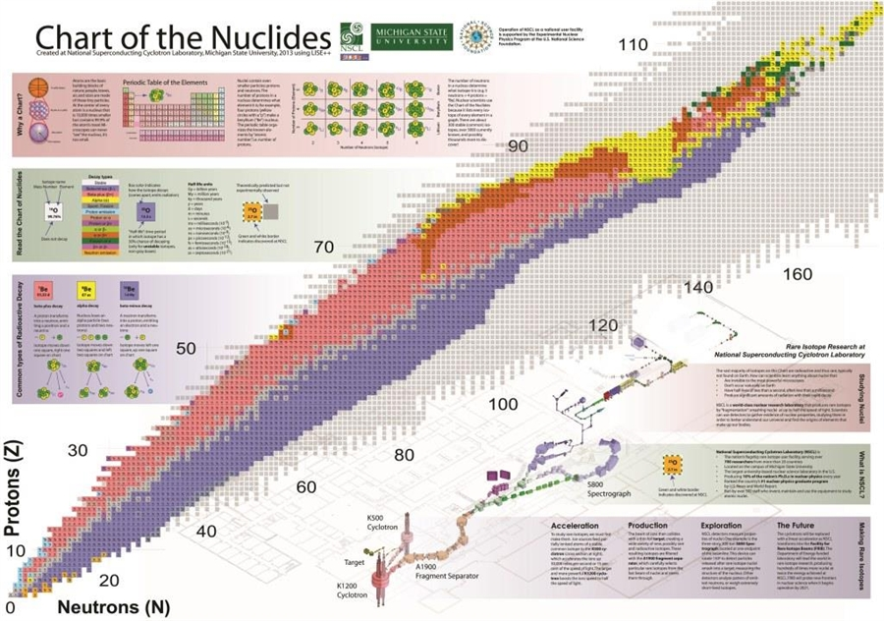
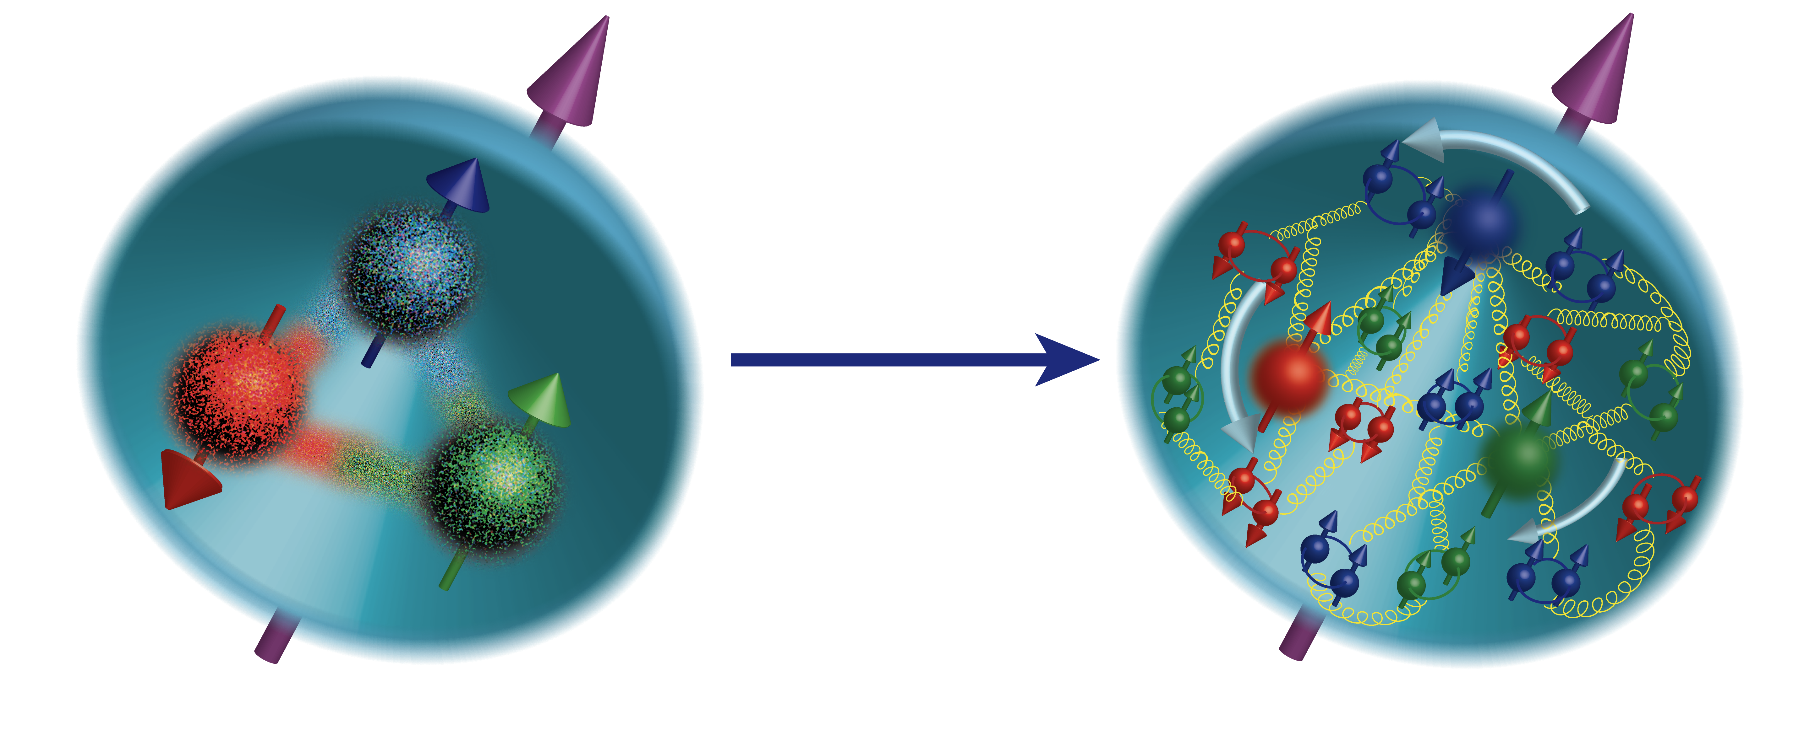
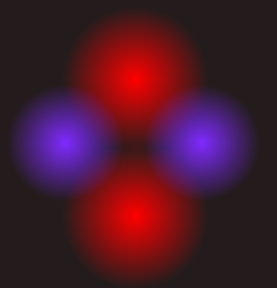
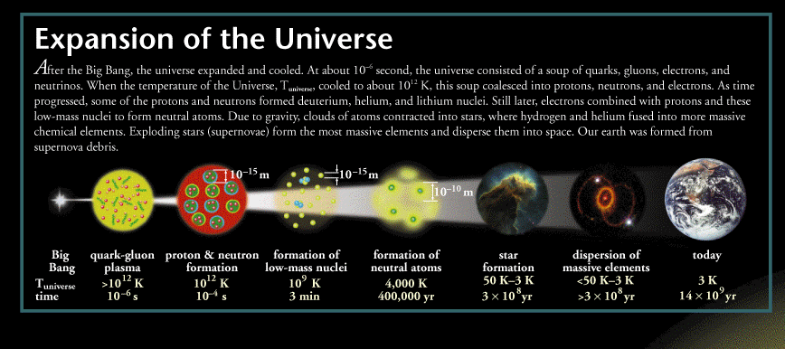
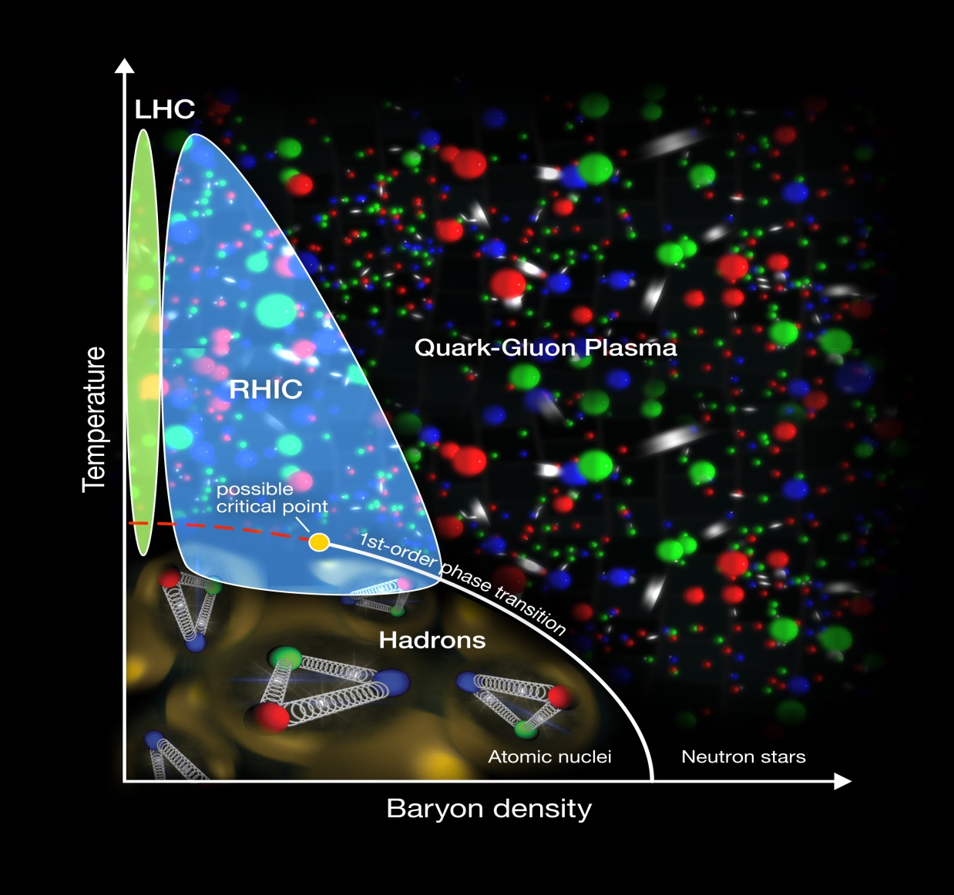
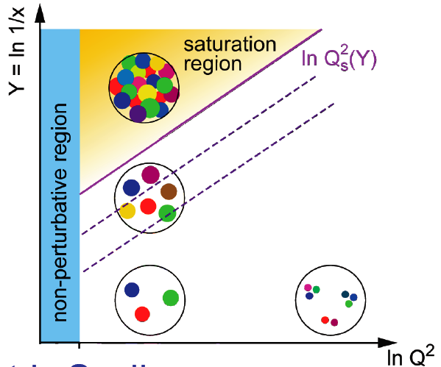
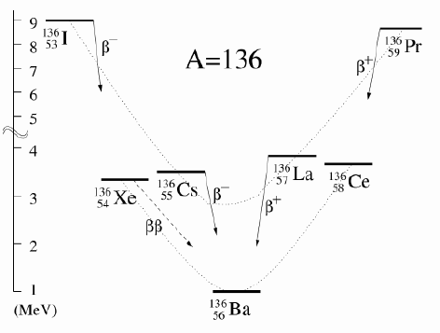
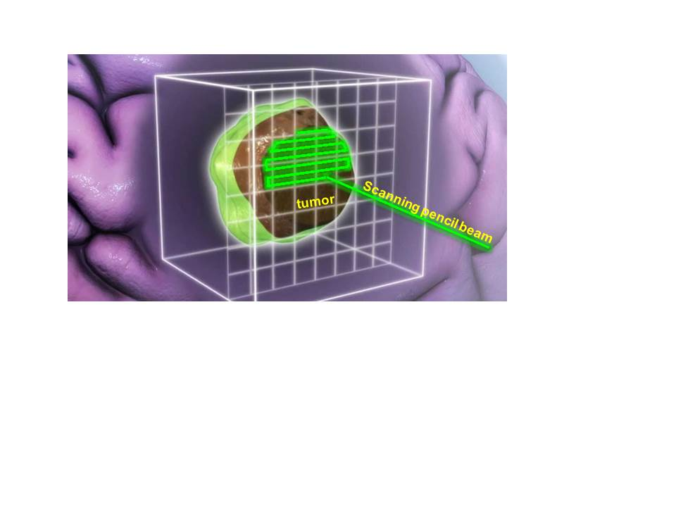

21st Century Nuclear Science:
Probing nuclear matter in all Its forms & exploring their potential for applications
Where in the universe, and how, were the heavy elements formed? How do supernovae explode?
How are the properties of protons and neutrons, and the force between them, built up from quarks, antiquarks and gluons? What is the mechanism by which these fundamental particles materialize as hadrons?
Where are the limits of nuclear existence, and what is the structure of nuclei near those limits?
What is the nature of the different phases of nuclear matter through which the universe has evolved?
Do nucleons and all nuclei, viewed at near light speed, appear as walls of gluons with universal properties?
How can the properties of nuclei be used to reveal the fundamental processes that produced an imbalance between matter and antimatter in our universe?
How are the nuclear building blocks manifested in the internal structure of compact stellar objects, like neutron stars?
How can technologies developed for basic nuclear physics research be adapted to address society’s needs?

Slide 3
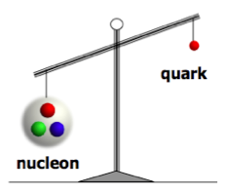

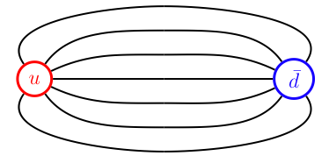
Emergence of nucleons and nuclei from the many body QCD dynamics
LQCD now treating NN forces, light nuclear magnetic moments
How do massless gluons and nearly massless quarks interact in the many body environment to give finite mass to hadrons?
Role of self-interacting colored gluons crucial!
“….resulting in a self-catalyzing enhancement that leads to a runaway growth …having only finite amount of energy to work with nature finds a way to short cut the ultimate [color] thundercloud ”
F. Wilczek, Origin of Mass, Nature Reference
What limits the ultimate thundercloud? → What are the relative roles played by color-confinement vs. saturation of soft gluon densities via gg-g recombination?
flux tube
recombination

Slide 4
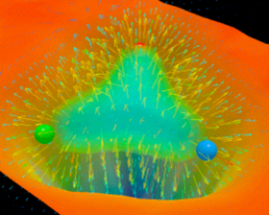
Role of gluons in hadron structure
Dynamical generation of hadron masses
Gluons generate more than 98% of the mass of the proton.
Because of their ability to self-interact, “virtual” gluons play a much more central role in the structure of hadrons than virtual photons do in the structure of atoms.
Roughly half the longitudinal momentum of a moving proton is carried by gluons.
Gluons determine the transverse motion of valence quarks in a moving proton.
Gluons carry a part of the proton spin (possibly up to 50%).
Lattice QCD cannot at present quantitatively address observables on the light cone, but there is hope that future developments will enable LQCD to help us to understand these issues.
Experimental insight and guidance are crucial to making progress towards a complete understanding of how hadrons emerge from quarks and gluons!
Notes:
EMERGENT PHENOMENA …. Mentioned, need to find way to incorporate “Many body systems” in the second half of this slide.
Will work on it.

Slide 5


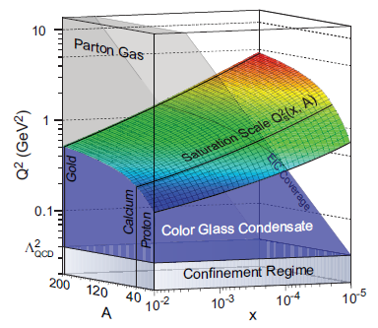
EIC addresses the puzzles & challenges of this emergent dynamics
How are sea quarks/gluons and their spins distributed in space and momentum inside the nucleon?
  How are these quark and gluon distributions correlated with the over all nucleon properties, such as spin direction?
  What is the role of the motion of sea quarks and gluons in building the nucleon spin?
Where does the saturation of gluon density set in?
  Is there a simple boundary that separates the region from the more dilute quark gluon matter? If so how do the distributions of quarks and gluons change as one crosses the boundary?
  Does saturation produce matter of universal properties
  in the nucleon and all nuclei viewed at nearly the
  speed of light?

Slide 6
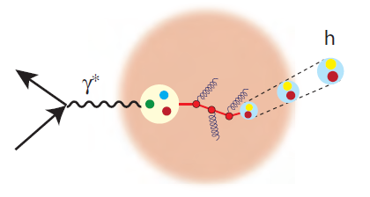
EIC addresses the puzzles & challenges of this emergent dynamics
How does the nuclear environment affect the distribution of quarks and gluons and their interaction in nuclei?
  How does the transverse spatial distribution of gluons compare to that in the nucleon?
  How does matter respond to fast moving color charge passing through it? Is this response different for light and heavy quarks?
Electro-Weak Physics and possible searches for physics beyond the SM:
  Precision measurement of evolution of the Sin²Θ_{W}
  Limits on charged lepton flavor violation (e→τ)(?)
  Will need the highest energy and luminosity of the collider.

Slide 7
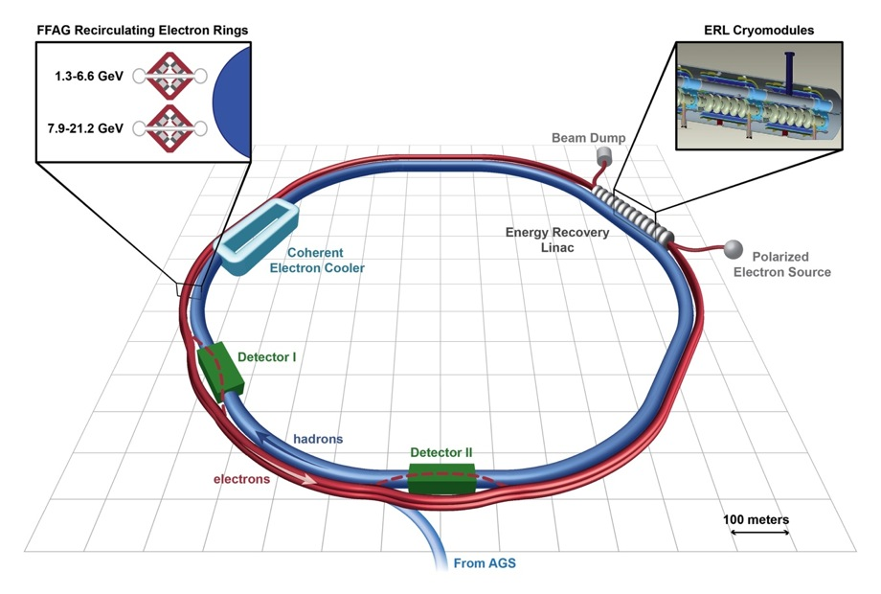
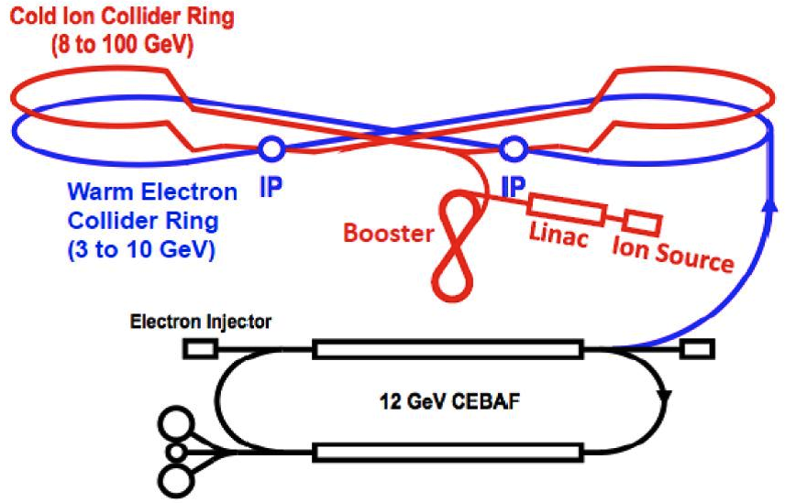
The Electron Ion Collider
Two proposals for realization of the Physics Case
1212.1701.v3
A. Accardi et al
For e-N collisions at the EIC:
Polarized beams: e, p, d/³He
e beam 5-10(20) GeV
Luminosity L_{ep} ~ 10³³⁻³⁴ cm⁻²sec⁻¹
  100-1000 times HERA
Variable center of mass energy
For e-A collisions at the EIC:
Wide range in nuclei
Luminosity per nucleon same as e-p
Variable center of mass energy
AGS
World’s first
Polarized electron-proton/light ion
and electron-Nucleus collider
Both designs use DOE’s significant investments in infrastructure
Notes:
Contrast with HERA could be made more explicit. Table/column presentation.

Slide 8
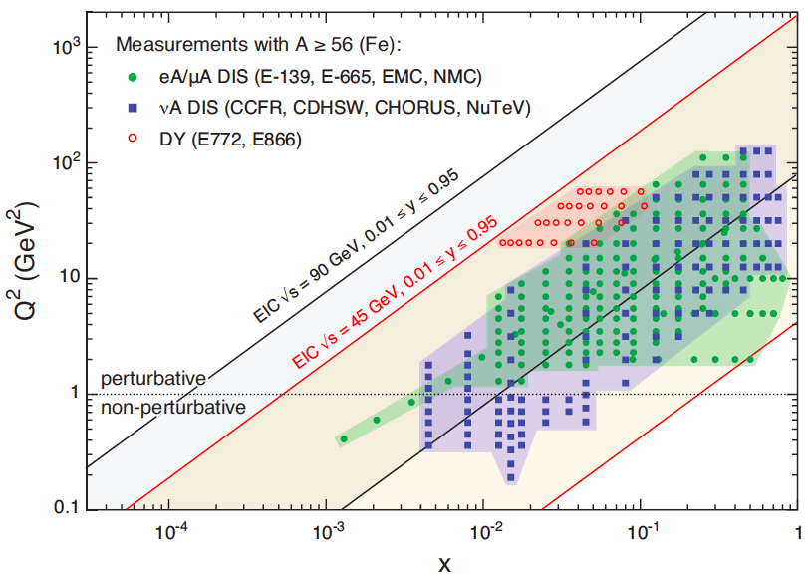
US EIC: Kinematic reach & properties
For e-N collisions at the EIC:
Polarized beams: e, p, d/³He
e beam 5-10(20) GeV
Luminosity L_{ep} ~ 10³³⁻³⁴ cm⁻²sec⁻¹
  100-1000 times HERA
Variable center of mass energy
For e-A collisions at the EIC:
Wide range in nuclei
Luminosity per nucleon same as e-p
Variable center of mass energy
Notes:
Minimize words, keep and enhance the figures….

Slide 9
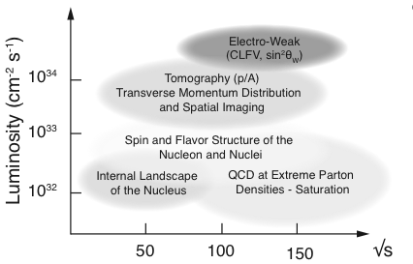
Physics @ EIC vs. luminosity & energy
Future beyond
Core capability
Current topics in gluonic and sea quarks
In nuclei and nucleons
Luminosity > 10³³ cm⁻²sec⁻¹
Binning of data
Study of distributions
Decision in close collaboration with theorist
Notes:
Colored version

Slide 10
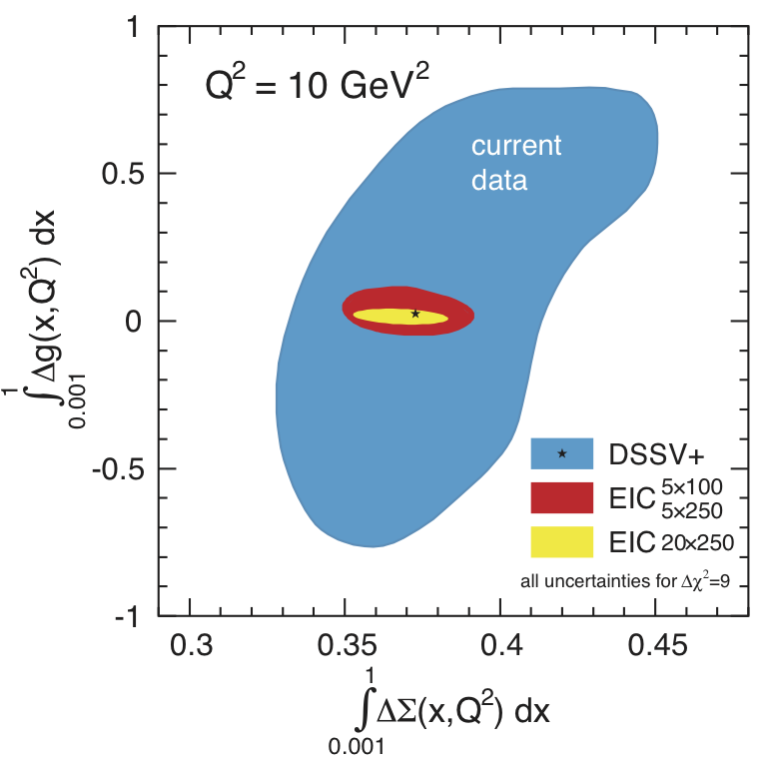
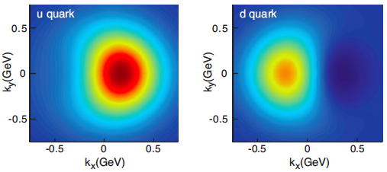
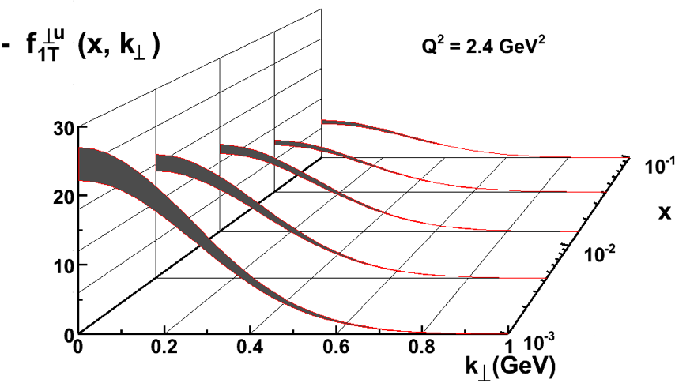
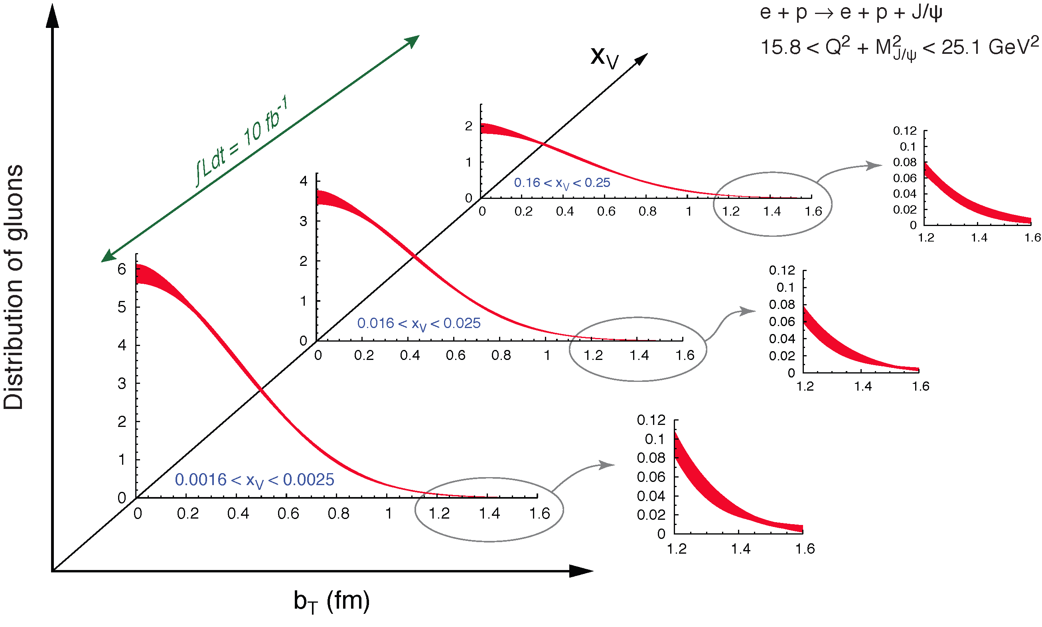
3D structure of the proton: momentum and position imaging
Helicity Distributions: ΔG and ΔΣ
Transverse Momentum Distributions
Transverse Position Distributions

Slide 11
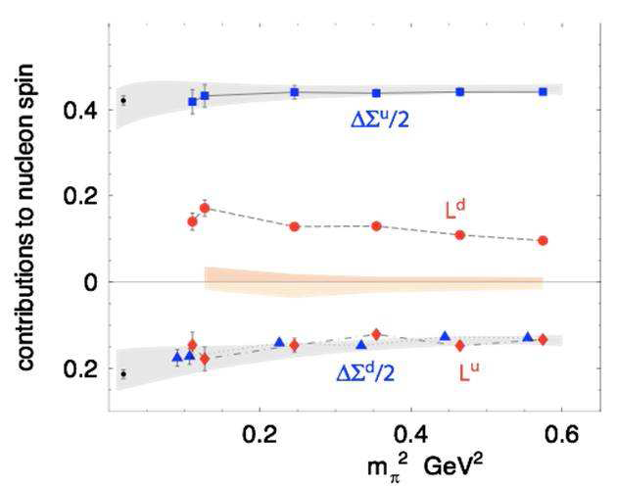
A direct consequence!
Quark GPDs and its orbital contribution to the proton spin:
The first meaningful constraint on quark orbital contribution to proton spin
by combining the sea from the EIC and valence region from JLab 12
This can be checked by Lattice QCD.
L_{u}+L_{d}~0
Rapid developments on ideas
of calculating parton distribution functions on Lattice:
X. Ji et al. arXiv 1310.4263; 1310.7471; 1402.1462
& Y.-Q. Ma, J.-W. Qiu 1404.6860
Notes:
Figure right bottom to be updated

Slide 12
Nucleus:
A laboratory for QCD
What do we know about the gluons in nuclei? Very little!
Parton propagation and interaction in nuclei (vs. protons)
Does gluon density saturate? Does it produce a unique and universal state of matter?

Slide 13
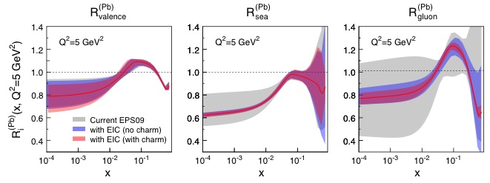
EIC: impact on the knowledge of nPDFs
Ratio of PDF(Pb)/PDF(p)
Without EIC, large uncertainties in nuclear sea quarks and gluons
With EIC (pseudo-data) significantly reduces the uncertainties, particularly low-x
Fitting F₂^{Charm} dramatically impacts the knowledge of nPDFs at high x
Impossible for current and future pA data at RHIC & LHC data to achieve
Notes:
Box around sea quarks and gluons rihght two figures.

Slide 14
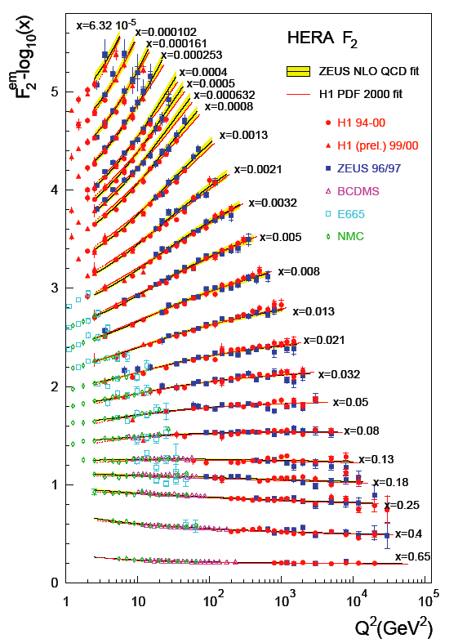
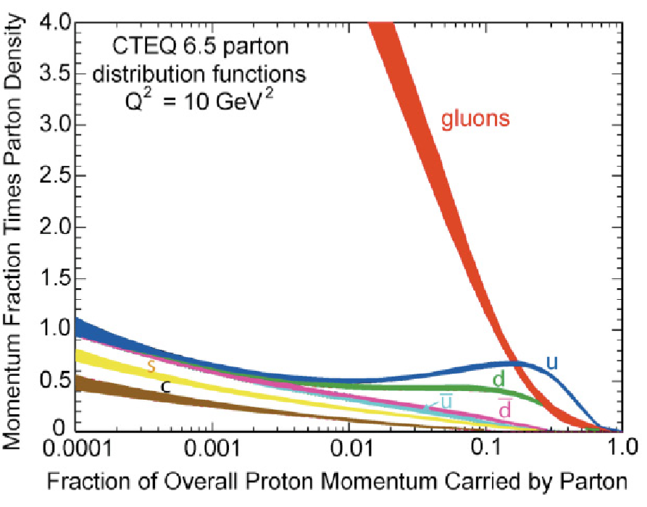
Gluons in proton (puzzle):
Notes:
Top: The same F2 structure function measured and fitted from HERA Data (that works so well in the calculation of jet cross sections across energy and species: RHIC, Tevatron, LHC) also suggests this “almost infinite rise of gluon number distribution at low x”

Slide 15
What do we learnt from low-x studies?
Ann. Rev. Nucl Part (60) 2010 F. Gelis et al., , arXiv:1002.0333)
What could tame the low-x rise?
New evolution eqn.s @ low x & moderate Q²
Small coupling, high gluon densities
Saturation Scale Q_{S}(x) where gluon emission and recombination comparable
gluon
emission
gluon recombination
=
At Q_{S}
First observation of gluon recombination!
➔leading to a strongly correlated gluonic system!
First observation of g-g recombination in different nuclei
→ Is this a universal property?

Slide 16
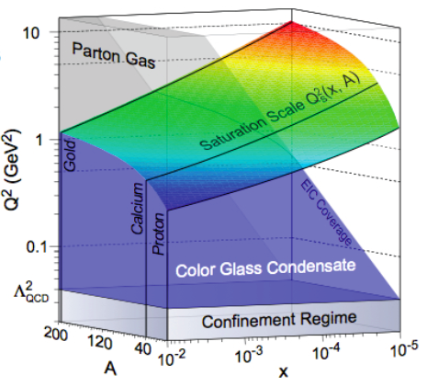
How to explore/study this new phase of matter?
Extreme high energy e-p collider OR an e-A collider
Probe NUCLEI with the: Electron Ion Collider (EIC)
Advantage of nucleus →
Kowalski, Teany
PRD 68:114005
Enhancement of Q_{S} with A:
Saturation regime reached at significantly lower energy (read: “cost”) in nuclei

Slide 17
Why we need the Electron Ion Collider?
Twenty years ago HERA discovered a vary large abundance of soft gluons inside the proton, however, the role of gluons in nucleon structure and dynamics is still unclear
The origin of nucleon spin and the distribution of quarks and gluons in nuclei remain mysteries after decades of study
We now have new phenomenology to explore nucleon structure: Generalized Parton Distributions (GPDs) and Transverse Momentum Dependent (TMDs) distributions that provide the means to powerfully “image” the quarks and gluons and access to orbital angular momentum. These studies will require high luminosity and polarized beams.
It’s the cleanest and the only way to be able to understand the initial state of the heavy ion collisions at RHIC and LHC, that result in a QGP with surprising properties

Slide 18
Why we need an EIC?
A new facility, EIC, with a versatile range of kinematics, beam polarizations and beam species, is required to precisely image the sea quarks and gluons in nucleons and nuclei, to explore the new QCD frontier of strong color fields in nuclei, and to resolve outstanding issues in understanding nucleons and nuclei in terms of fundamental building blocks of QCD
EIC
Partons
Nuclei

Slide 19
Why now?
A set of compelling physics questions has been formulated.
A set of measurements has been identified that can provide answers to many of the open questions about the gluon structure of the proton and of nuclei.
A powerful formalism has been developed over the past decade that connects measurable observables to rigorously defined properties of the QCD structure of nucleons and nuclei.
Accelerator technology has reached a state where a capable EIC can be constructed at an affordable cost.
World wide interest in collaborating with us on science of EIC
EIC White Paper
(arXiv:1212.1701v3)
Nuclear Science needs an EIC.
The U.S. must lead the way.

Slide 20
Remarks:
The EIC will profoundly impact our understanding of QCD with its energy variability , high luminosity (e-A) and polarized e-p/D collisions
It will lead to a 2+1 D view of nucleons and nuclei: Color distributions! And study the transition from low to high density QCD matter
EIC: 1st polarized DIS collider, 1st nuclear DIS collider, Focus: QCD
  Precision studies of the role of sea quarks and gluons in QCD
  Precision always leads to discoveries…
Development of the Standard model needed: p-p/p-bar, e-e, e-p collisions →complimentary but essential role
EIC’s will add “spin” and “nuclei” to this list: A-A, p/d-A, e-A
Currently two designs: JLab & BNL both use upgrades of existing facilities.
The hot & cold QCD community requests NSAC’s support for the EIC as the next NP facility to be built after the FRIB.

Slide 21

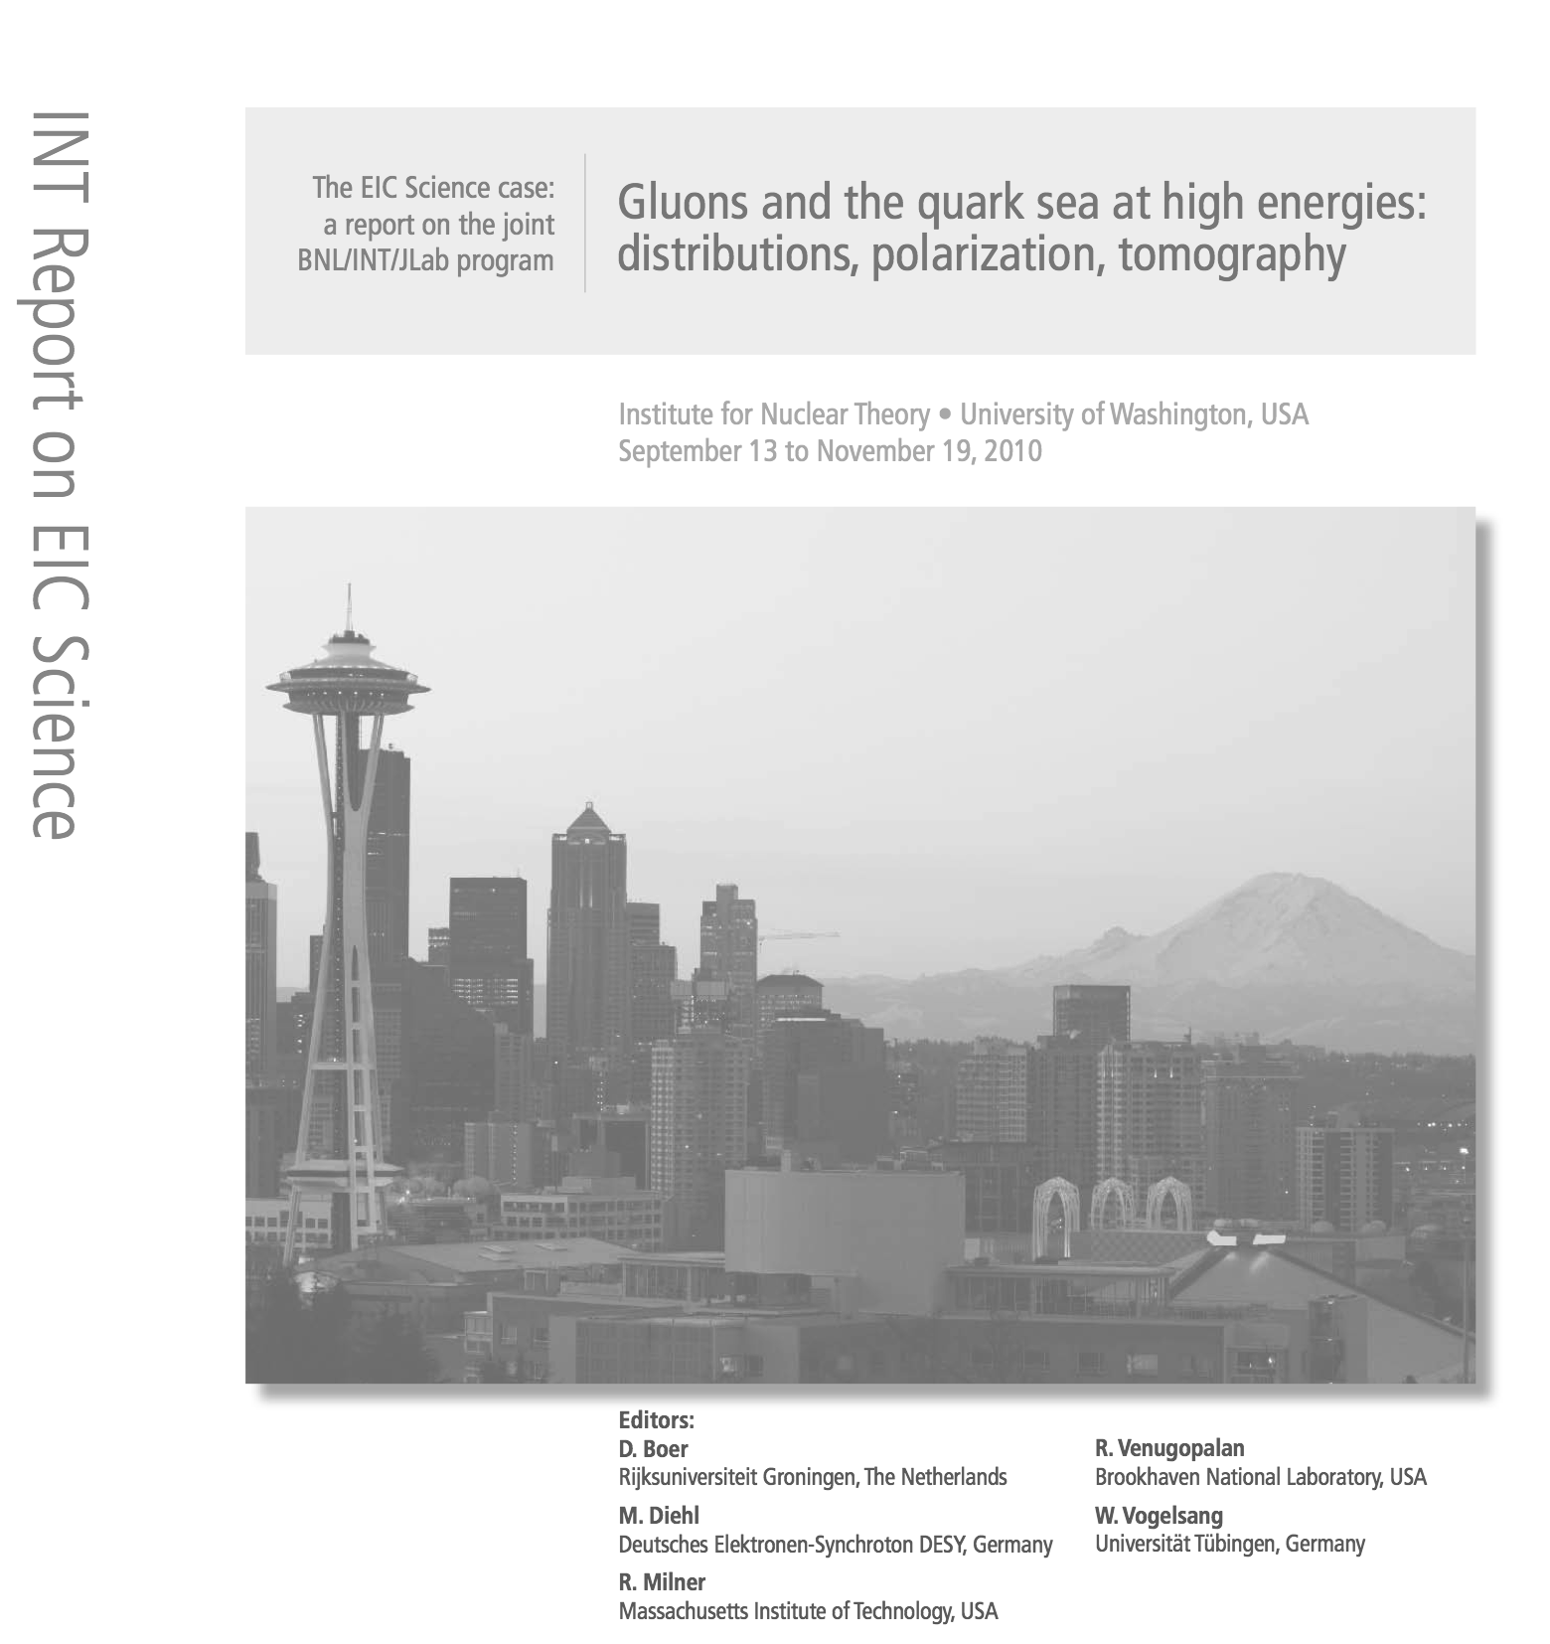
Evolving status of EIC in the US:
NSAC 2007 Long-Range Plan:
“An Electron-Ion Collider (EIC) with polarized beams has been embraced by the U.S. nuclear science community as embodying the vision for reaching the next QCD frontier. EIC would provide unique capabilities for the study of QCD well beyond those available at existing facilities worldwide and complementary to those planned for the next generation of accelerators in Europe and Asia.”
NSAC Facilities Subcommittee (2013):
The Subcommittee ranks an EIC as Absolutely Central in its ability to contribute to world-leading science in the next decade.”
DNP Organized town meeting for LRP (2014-15):
Both hot and cold QCD communites identified the Electron Ion Collider
As the highest priority for new construction in the NP feild..
NSAC Long-Range Process 2015:
EIC needs to be a high recommendation in this report!

Slide 22
Very Critical: (2 months!)
EIC Preparatory Meeting: March 30-31, 2015
  SURA Headquarters in Washington DC
  http://skipper.physics.sunysb.edu/~eicug/eiclrp/eicprep.html
  Attend in person or on BlueJeans
  All EIC associated Talks and Discussions (agenda coming soon)
NSAC Meeting April 3, 2015
  EIC Cost review presentation to NSAC
NSAC Resolution Meeting: April 16-20, 2015
  Kitty Hawk, North Carolina
  Presentations, discussion on vote on the Resolution to “Construct the Electron Ion Collider, as the next major NP experimental facility beyond FRIB”.

