Slide 1
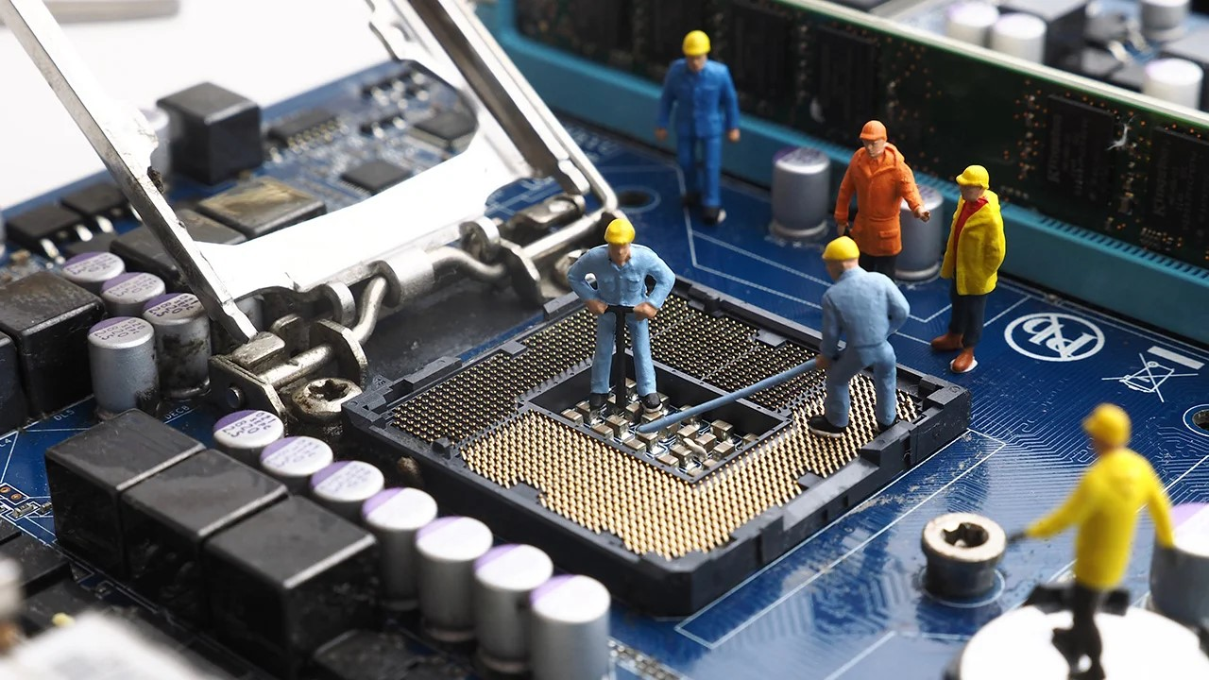
Experimental Nuclear Physics Division Support Group Report
Fast Electronics & Data Acquisition
‘FEDAQ’

Slide 2
Status Report Overview
Activity list in Hall B
DAQ Readout Boards
Trigger
Discussion & Summary

Slide 3
Mark Taylor
Armen Stepanyan
Jim Sheperd [Temp]
FEDAQ
Hall B Activities
Original FastBus crates/modules removed and excessed
Over a thousand RG58 coaxial connectors re-terminated with Lemo plugs after removal of old circuit boards used with the 1872 FastBus ADC
New VXS crates have been received and tested.
Installation in the hall by next week 17-Nov
New Trigger Fiber Optic cable has been ordered and patch panels received
New single mode network fiber optic cable is being installed now. Should be complete before Thanksgiving break.
Hall B Deck 2 North rack layout documentation started
128 channels
Base board
VMM
To GEM
FPGA
VTRx
(rad hard)
VMM
MGT power mezzanine
FPGA power mezzanine
VMM power mezzanine
50 mm x 215 mm

Slide 4
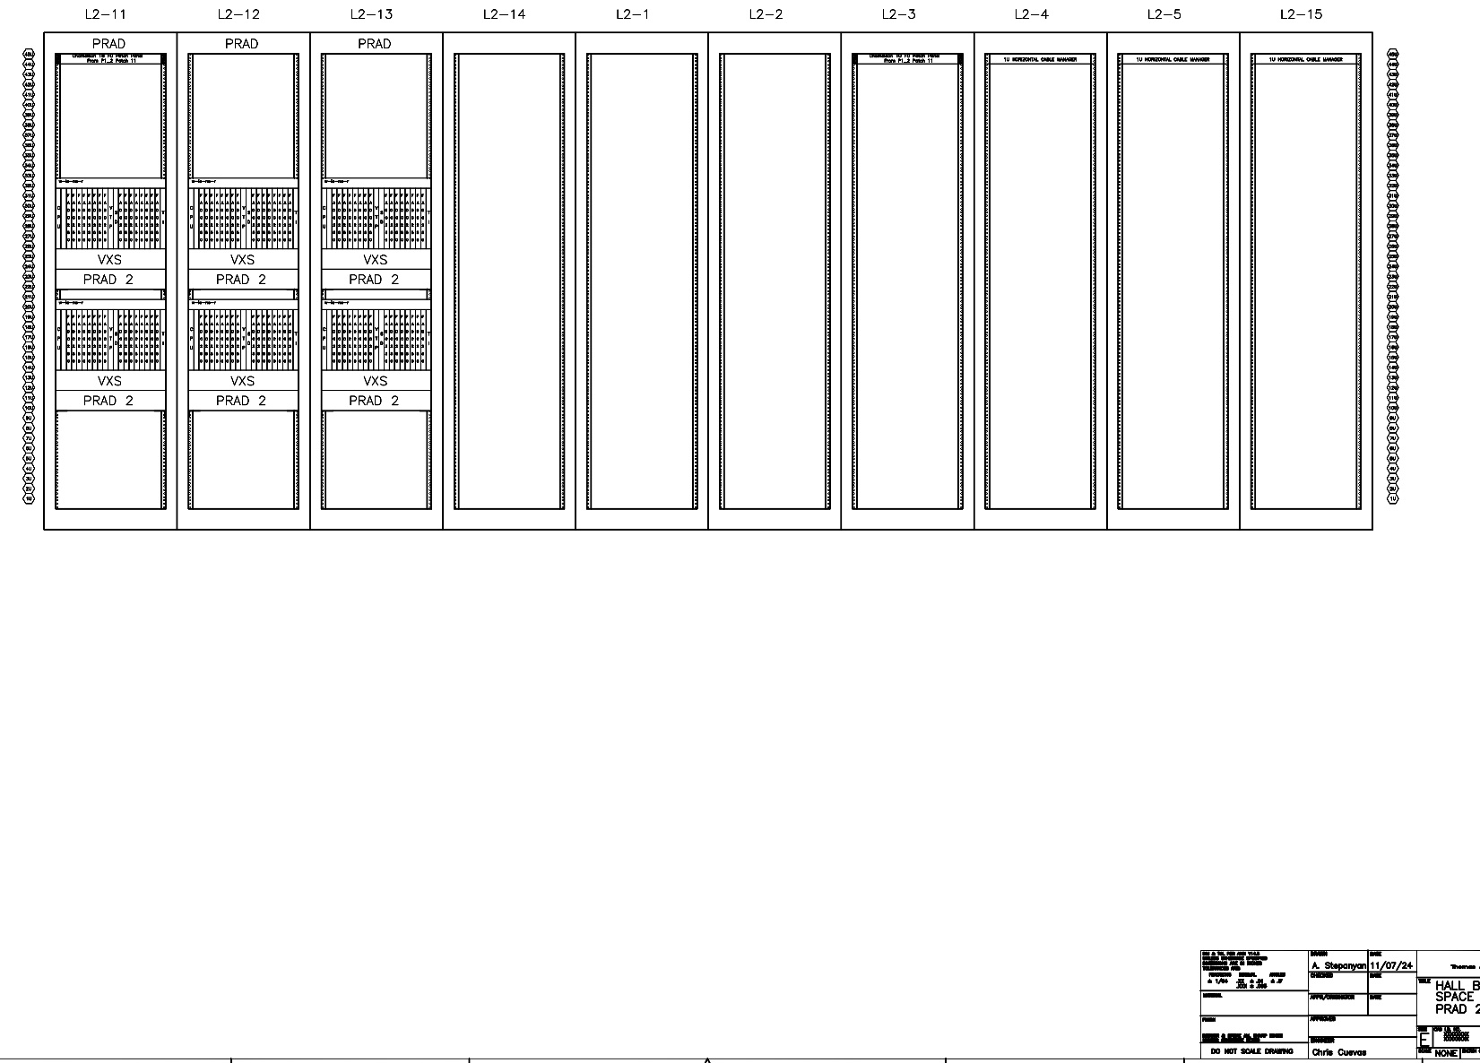
Mark Taylor
Armen Stepanyan
Jim Sheperd [Temp]
FEDAQ
Hall B Activities
Hall B – Space Frame – Deck 2 North – Rack layout
128 channels
Base board
VMM
To GEM
FPGA
VTRx
(rad hard)
VMM
MGT power mezzanine
VMM power mezzanine
50 mm x 215 mm
VXS Crates
DAQ Modules
Cables from
HCAL in the floor
7th VXS crate not shown
Network Gear and Trigger Fiber Panels in L2-1
CAEN HV equipment

Slide 5
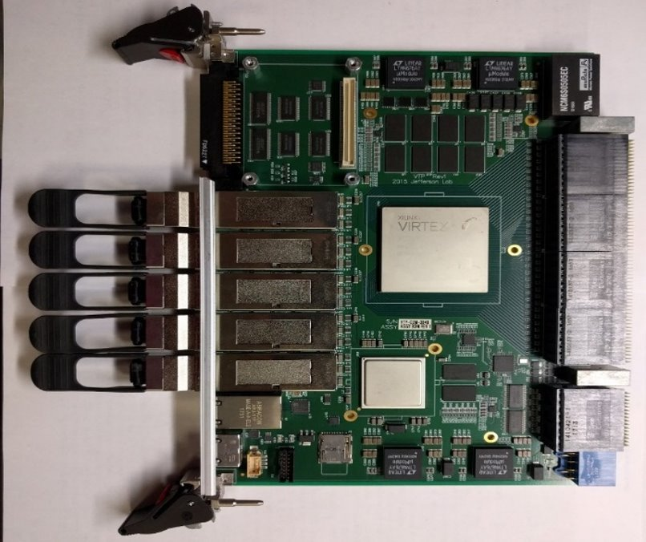
VXS Crate Configuration
Common configuration used at Jlab
21 Slot VXS crate
Up to 16 FADCs (256 channels/crate)
CPU for readout/config/monitor
TI and SD synchronize & distribute clocks, triggers, sync to front-end
VTP used to create trigger from FADC
Typical VXS Crate Setup: FADCs, VTP, SD, TI, CPU:
VTP receives integrated pulses from all FADC channels in crate to create trigger. Optical connections used to share information with other crates.

Slide 6
Mark Taylor
Armen Stepanyan
Jim Sheperd [Temp]
FEDAQ
Hall B Activities
25 New Abaco VME64x CPU modules ordered
2eSST firmware verified to work with JLAB DAQ modules
Will need to verify delivery date
New VTP boards received and tested
New Trigger Interface boards received and tested
New Signal Distribution [SD] boards received and tested
New Trigger Fiber Optic cable has been ordered and patch panels received
New network fiber links will need to be tested
New Trigger fiber will have to be tested to Pie Tower and Trigger Supervisor
Configure 7 new VXS crates and test with CLAS12 DAQ
128 channels
Base board
VMM
To GEM
FPGA
VTRx
(rad hard)
VMM
MGT power mezzanine
FPGA power mezzanine
VMM power mezzanine
50 mm x 215 mm

Slide 7
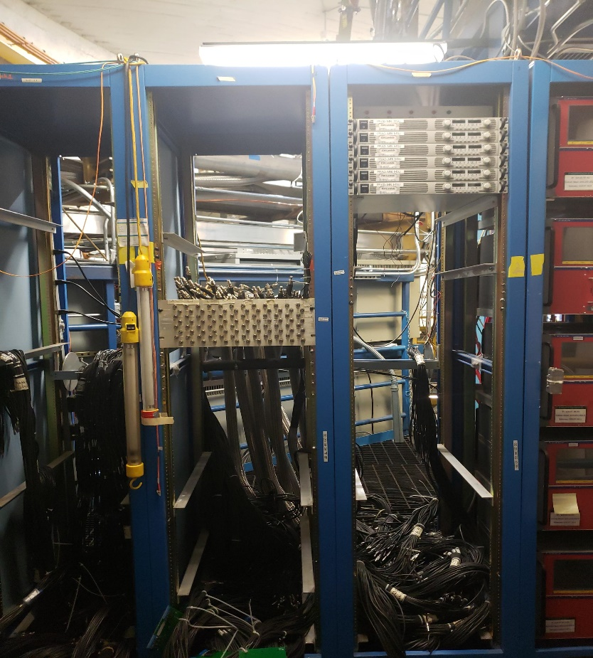
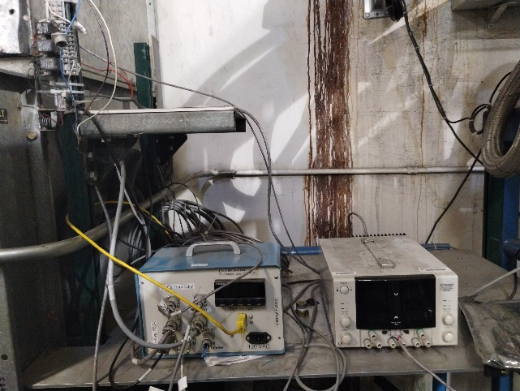
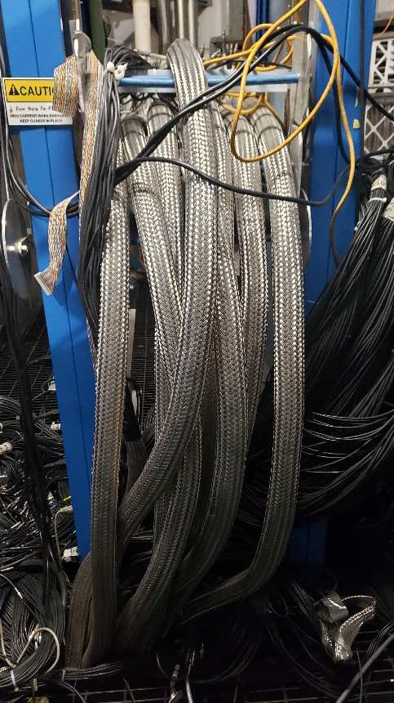
Mark Taylor
Armen Stepanyan
Jim Sheperd [Temp]
FEDAQ
Hall B Activities
Hall B – Space Frame – Deck 2 North – Rack Photos
128 channels
Base board
VMM
To GEM
FPGA
VTRx
(rad hard)
VMM
MGT power mezzanine
VMM power mezzanine
What is this equipment used for?
Will need to identify and document system function.
50 mm x 215 mm
Will these cables be used?
RG213? RG6?
Large Coax cable
6 VXS Crates & DAQ Modules
Will reside here
CAEN HV equipment

Slide 8
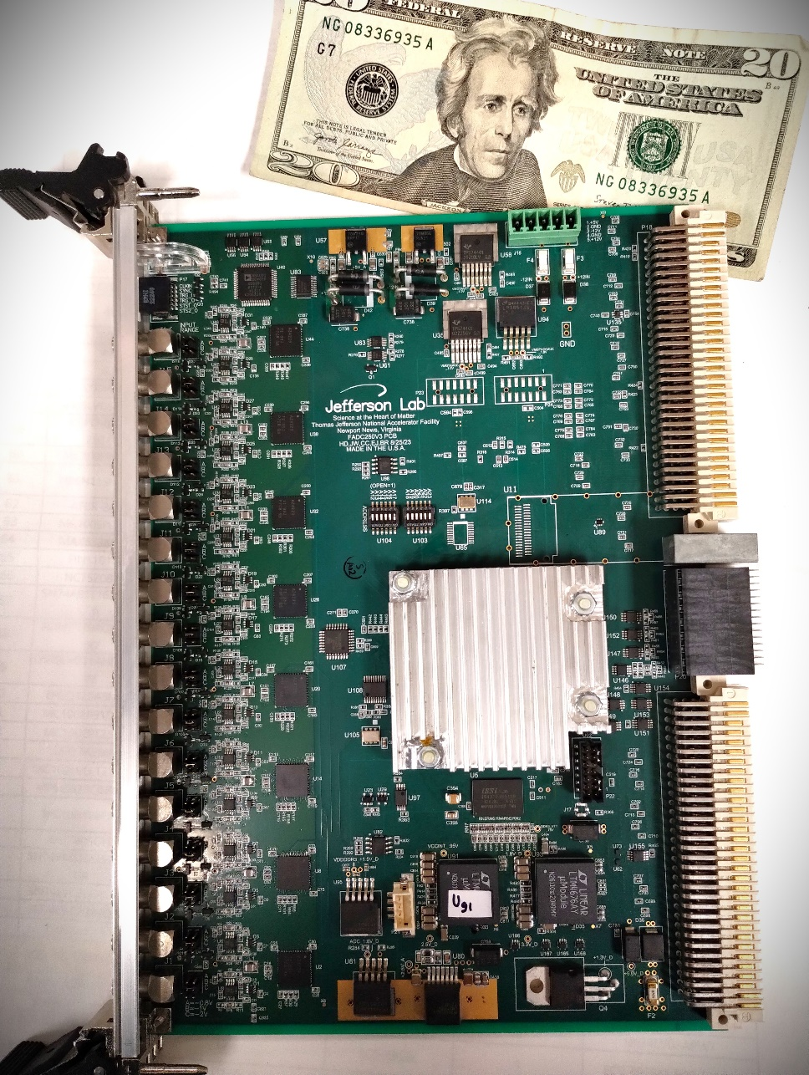
FADC250-v3 Board Status
FEDAQ
H. Dong
E. Jastrzembski
J. Wilson
Ben Raydo
FADC250_V3
Production boards have arrived!!
Inspection/Sub-Assembly and Acceptance testing has started
2nd vendor order due by end of November
We will have over 1600 channels available
for PRADII application
Aggressive schedule to install these into the Hall before SAD period ends
Not required but driven by schedule
Optical Port – NOT populated
Used in Stand-Alone mode only
Xilinx Kintex Ultrascale FPGA
Single FPGA solution!
Significantly lower power than previous version
Reduced part count and same price as 2012

Slide 9
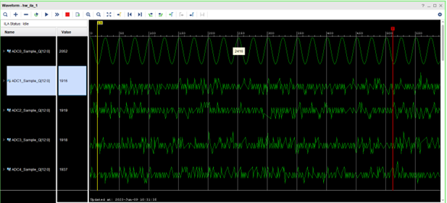
FADC250-v3 Board Modernization
FEDAQ
H. Dong
E. Jastrzembski
J. Wilson
Ben Raydo
FADC250_V3
Acceptance testing of the new modules is extensive
Resolution at 4.88mV; Full scale range is 2V; 12bit; 250Msps
VME/VME2eSST
Gigabit serial data transfer to VTP – Will experiment need Streaming Redout Option?
VME Eprom programming
SDRAM testing
Low level and Full Crate Acceptance Test [FCAT] software is close to final version
Activities for testing production assemblies is progressing nicely and will be ready!

Slide 10
Summary
Old equipment removal performed safely and without issues
Original coaxial cable cards re-terminated with Lemos
Many Hall activities remain but we have DAQ equipment on site
Do not anticipate any significant issues with new FADC250 boards
Supporting VXS DAQ boards are on site and tested
Network and Trigger fiber cables should be installed before end of SAD
Topics not covered:
Trigger setup for HyCAL and other detectors
GEM DAQ configuration and integration with new VXS readout
CAEN HV equipment testing and contingent plan for any issues
Tagger electronics? What devices need to be verified?
What are your questions?

Slide 11
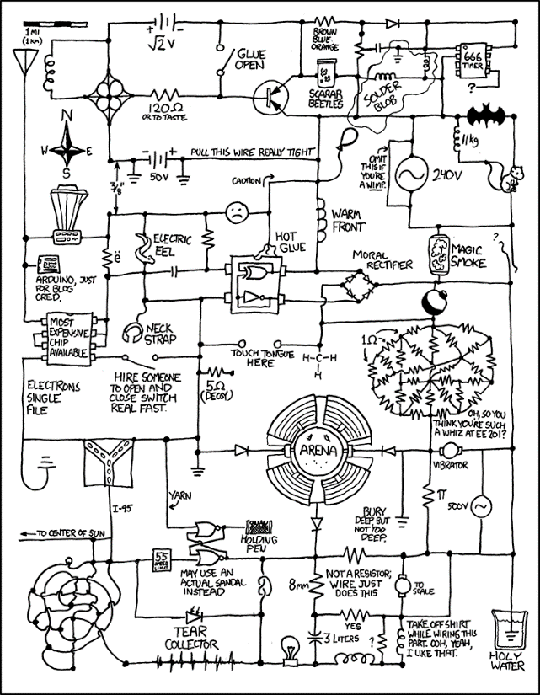
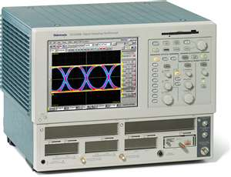
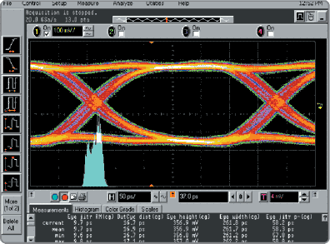
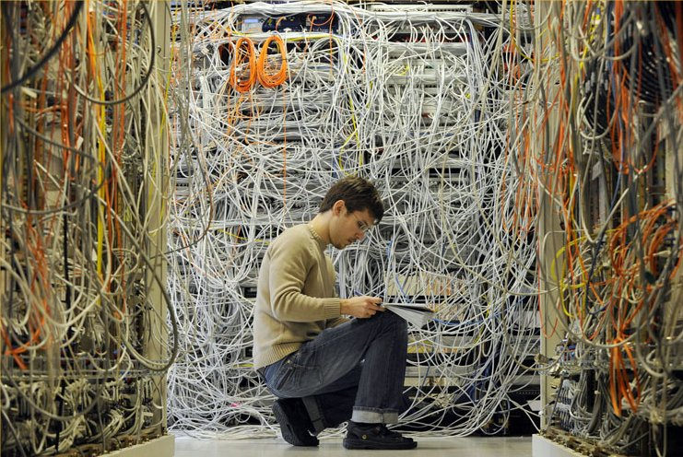
Backup slides
They said we were going “wireless”,,,

Slide 12
More Examples of VXS Readout/Control of ASIC
C. Dickover
B. Raydo
CEA Saclay** INFN*
2.5Gbps line rate 16bit bus @ 125MHz for transmit and receive
RICH 25,000 pixels
2.5Gbps line rate 16bit bus @ 125MHz for transmit and receive
SBS GEM
+40K pads
APV25
FPGA MPD*
2.5Gbps line rate 16bit bus @ 125MHz for transmit and receive
DREAM
FPGA FEC**
MicroMegas
+20K strips
Forward Tracker
+3300 uMegas Strips
VME64x Readout Bandwidth [~200MBs]
OK Because Detector occupancy Is low (~1%)
Thomas Jefferson National Accelerator Facility

Slide 13
This Design will carry JLAB DAQ for another decade!!
Amazing Electronic Device!
Thomas Jefferson National Accelerator Facility

Slide 14
Fast Electronics Streaming ReadOut Mode
FEDAQ
Streaming Read-Out – Experience
Augment existing pipelined hardware developed for the 12GeV experiment program. ( Flash ADC – 12bit/250Msps, High speed Gigabit backplanes)
Demonstrated high speed serial transmission that eliminates VME 200MByte/sec limitation
VXS uses multiple Giga-bit serial links on back-plane for data transfer
VXS Serial back-plane limit is 8GByte/sec
VXS Trigger_Processor[VTP] data transfer limit presently: ~2GByte/sec
VXS Trigger Processor with fADC250 boards on CLAS12 sub-detector used successfully during beam operations. [Forward Tagger]
16 fADC250 Modules ReadOut with serial mode to VTP
150MBytes peak data rates from Forward Tagger operated with beam
VTP uses 10GbitEthernet links to DAq network system

Slide 15
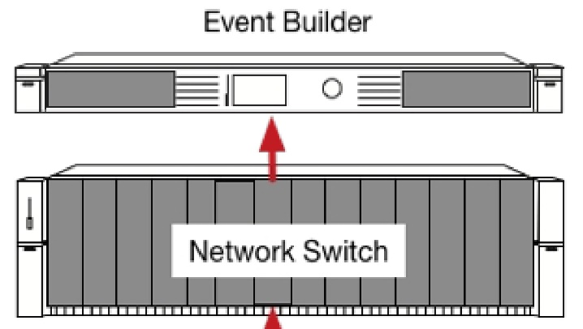
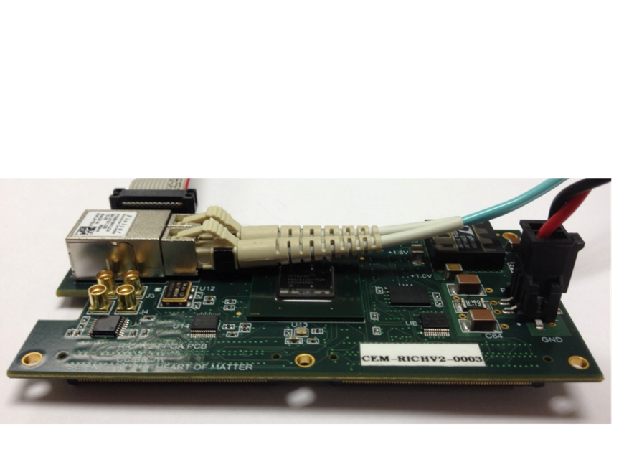
Streaming Without ‘Crates’
Readout/Control of ASIC <-->Network
FEDAQ Group
FPGA ReadOut & Control[ROC]
Develop interfaces with new ASIC:
Used MAROC3 for CLAS12 RICH and GlueX DIRC detectors
Petiroc 2A -> 32 Channel SiPM with Q and T conversion {10 bit ADC; 18ps timing[Prototype in development]
Xilinx Artix7
Fiber Optic
Aritsta Network Switch
Uses Xilinx FPGA
Innovation in Nuclear Data Readout and Analysis
INDRA Test Lab in CEBAF Center
Readout R&D lab for future 12GeV experiments
- TDIS
- SoLID
- Moeller
Development of new Software for managing streaming data storage
Developing Software Framework for processing tasks. i.e.) Calibration, monitoring, reconstruction.
Use new COTS {Aritsta} network gear that includes high level FPGA for control of data stream
Development of High Level Synthesis code for creating ‘virtual triggers’ from streaming data
JLAB FPGA Readout/Control Board
192 Channel Interface
Algorithms
1ns TDC
Scaler
Fixed Latency up to 8us
Optical Ethernet – Use Commercial 1Gbe
Finisar Transceiver capable of 10Gbps
Artix could run @3.125Gpbs
Mates to ASIC
+5VDC @1A

