Slide 1
HyCal Signal Cable Testing
Buddhiman Tamang
PRad Collaboration meeting
November 11, 2024

Slide 2
Outline
Introduction
Signal Cable Testing
High Voltage Cable Testing
Current Status
Summary

Slide 3
Introduction: HyCal Upgrade
Replace FastBUS Read Out by FADC
Add a second GEM plane between HyCal and vacuum chamber to further reduce the backgrounds and improve vertex resolution.

Slide 4
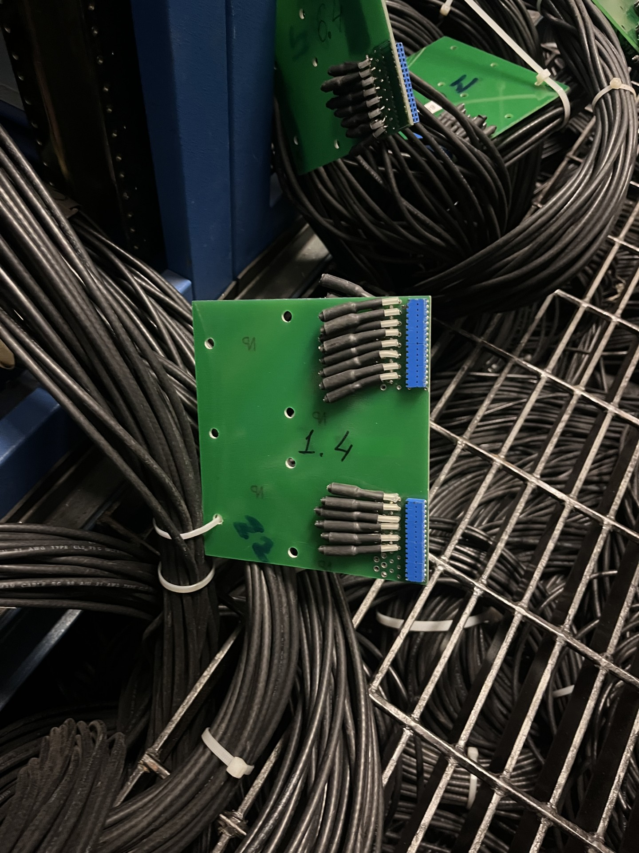
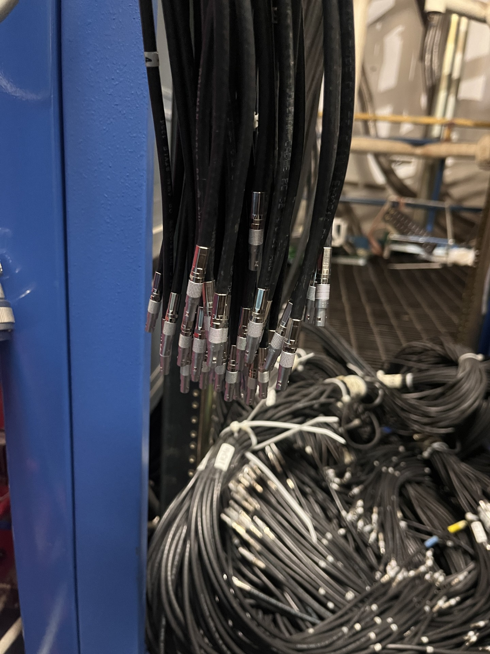
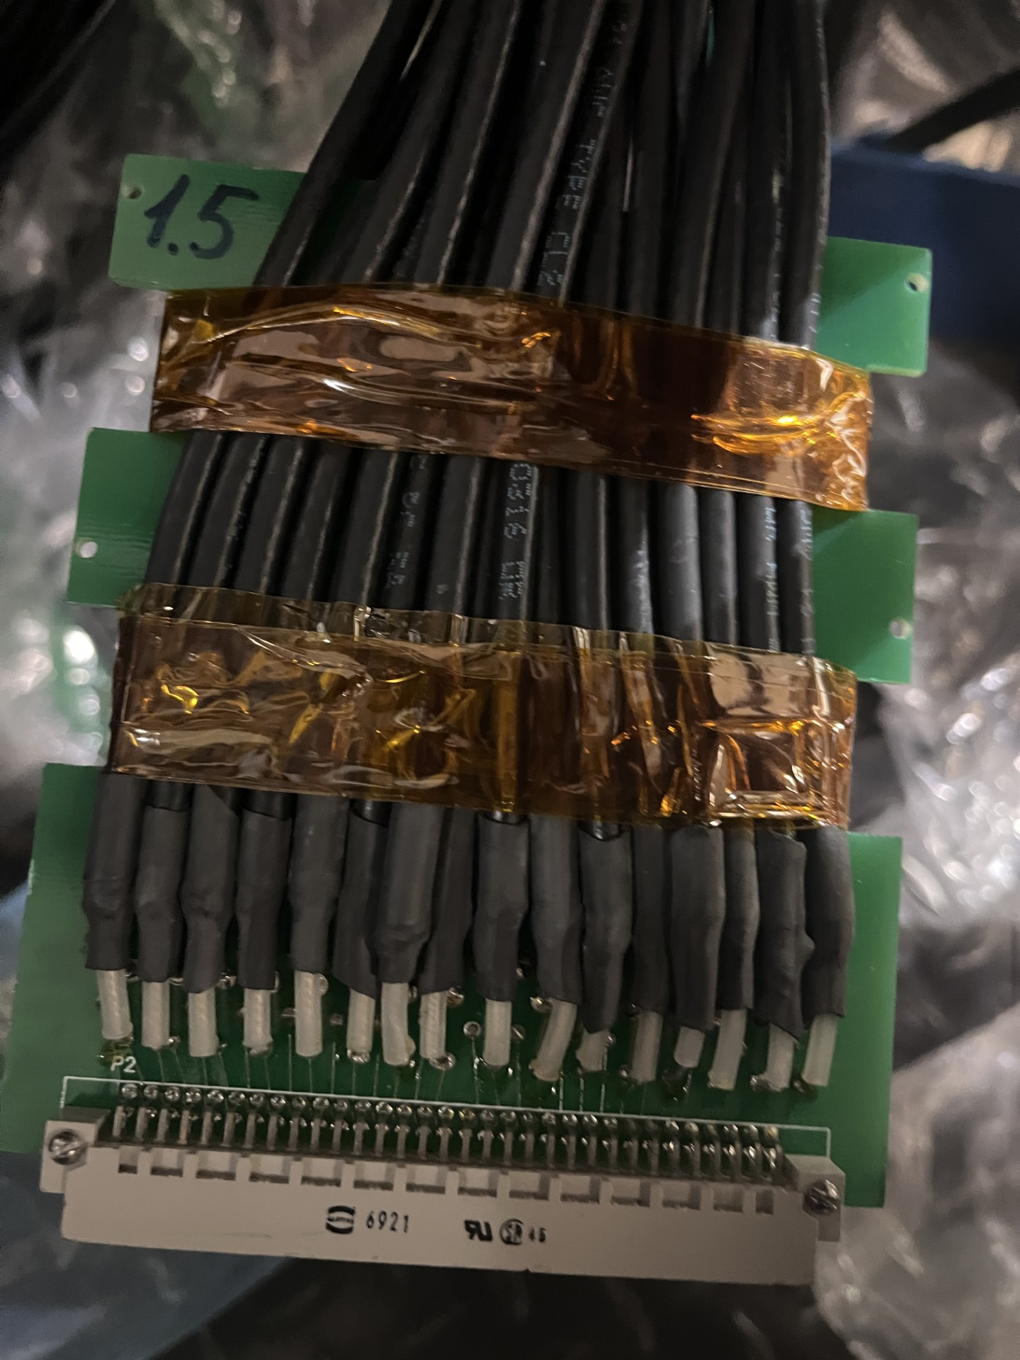
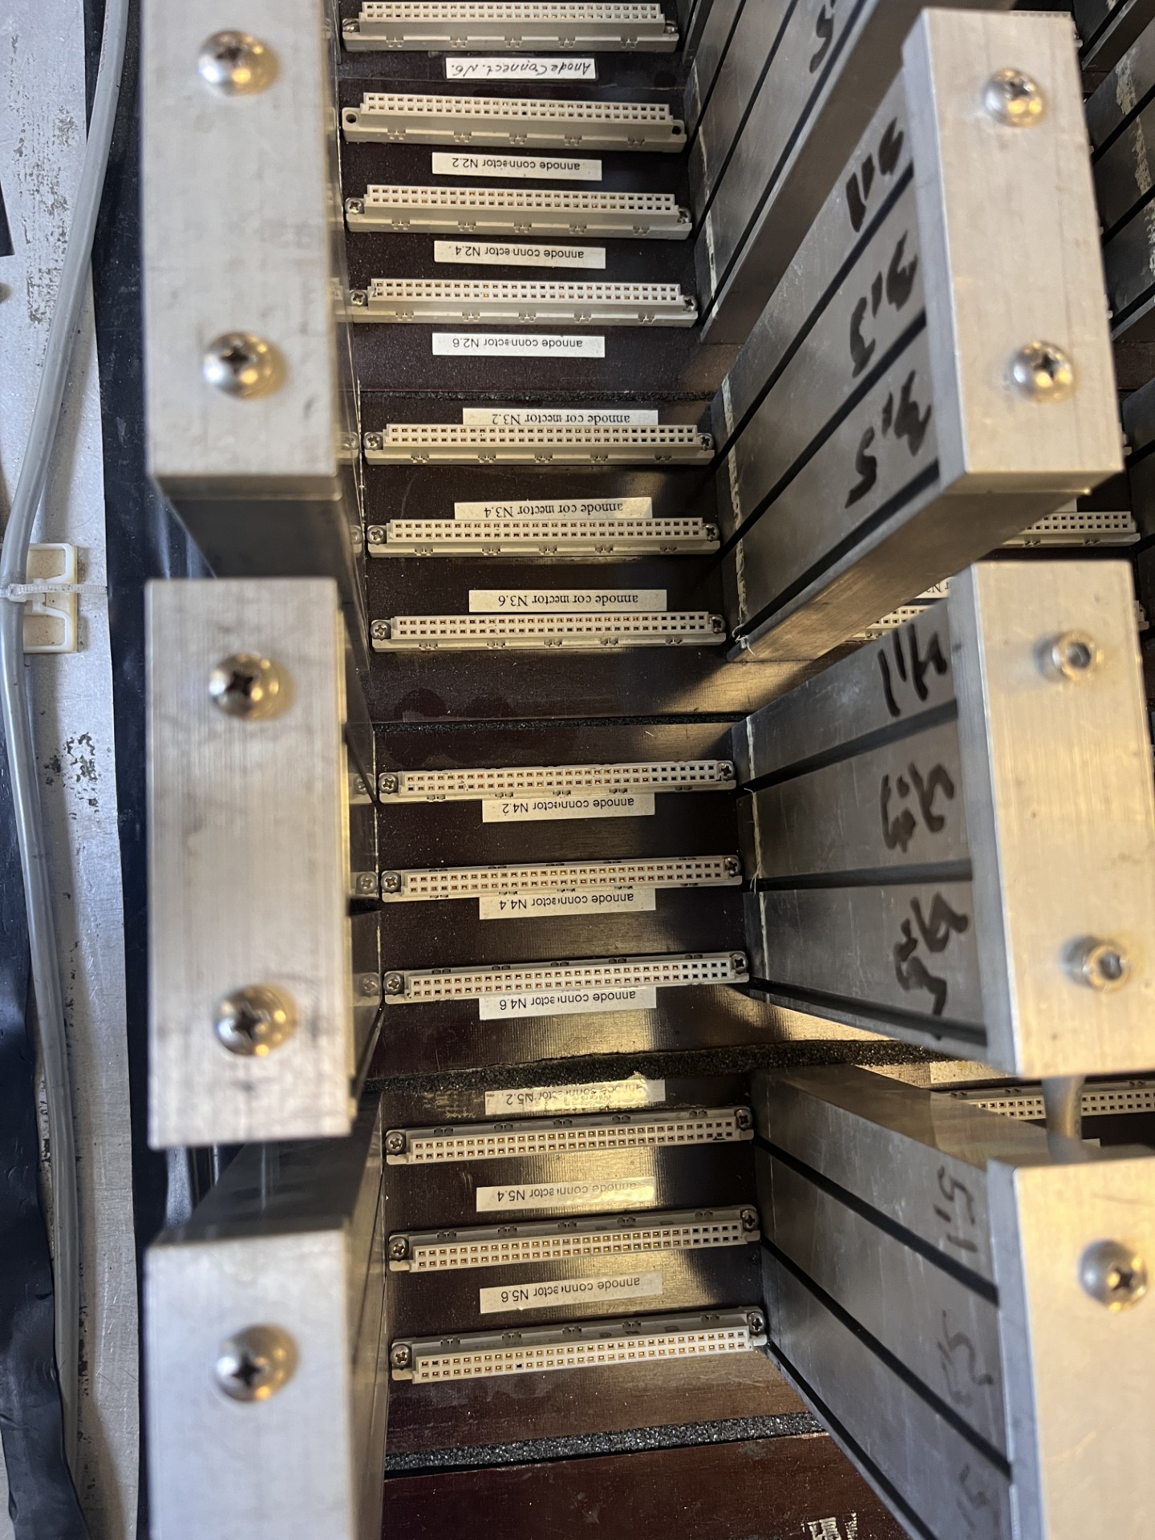
Signal Cable
Cables converted from pin connectors to the LEMO connectors
Signal cables previously used in the Prad experiment
Pin connector
LEMO connector
Signal board
HyCal top signal board connector

Slide 5
Signal Cable Bundle Types -3
32-Cable Bundles:
27-Cable Bundles:
25-Cable Bundles:

Slide 6
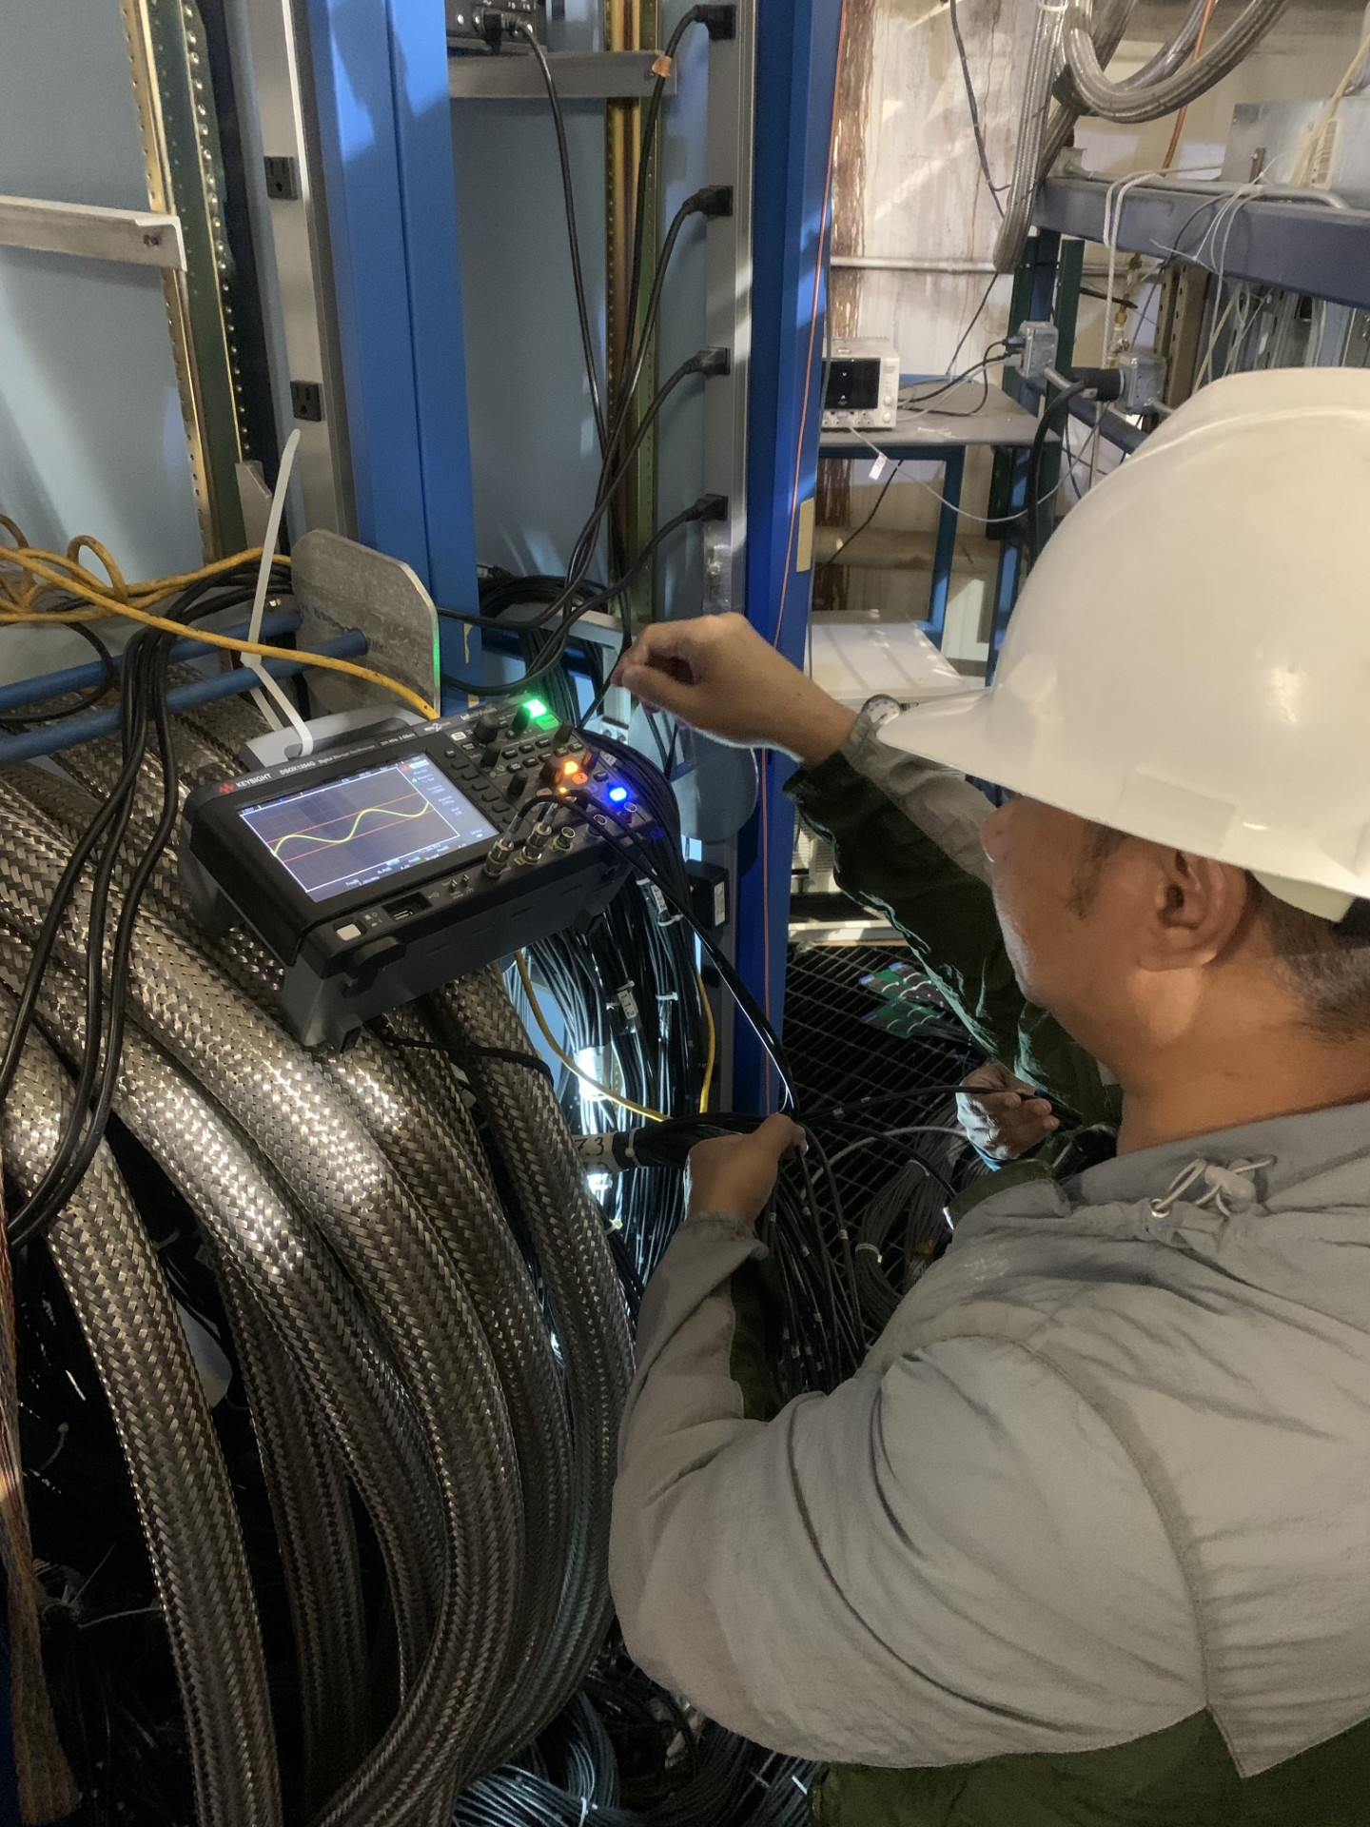
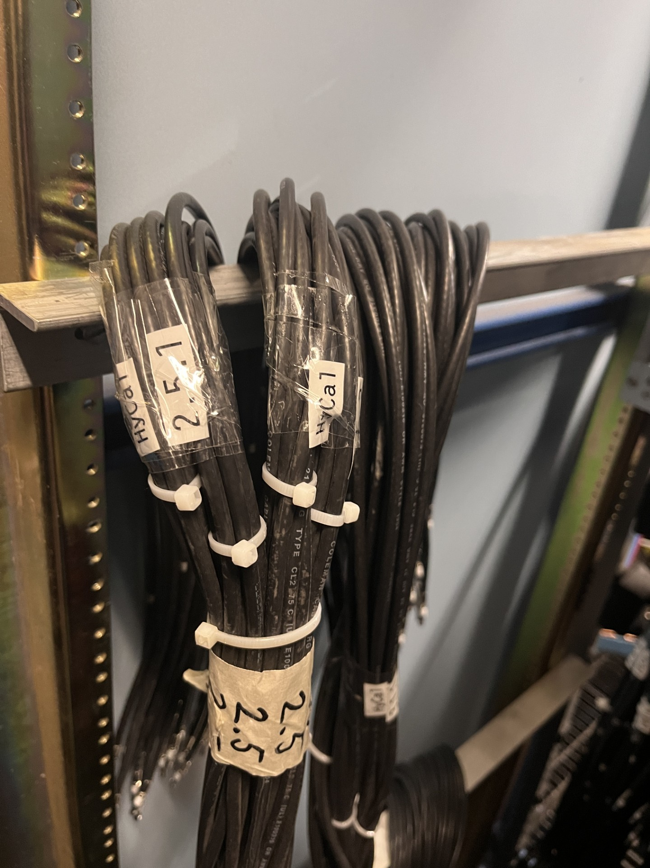
Cable Testing Procedure
32 pin end connector was connected to complete the circuit
5V-AC signal from scope was fed into one of the cable
Next cable was plugged into the input of scope
We observed around 4.4V signal on the scope
For lone cables, a terminator was connected to one end
Resistance was measured on the other end
Resistance was measured to be around 50 ohms
Re-bundled the cables after the test
Each bundle is sub-bundled into a group of 16 cables and the rest into another group
The labeling was done to preserve the previous numbering scheme and adding an extra identifier

Slide 7
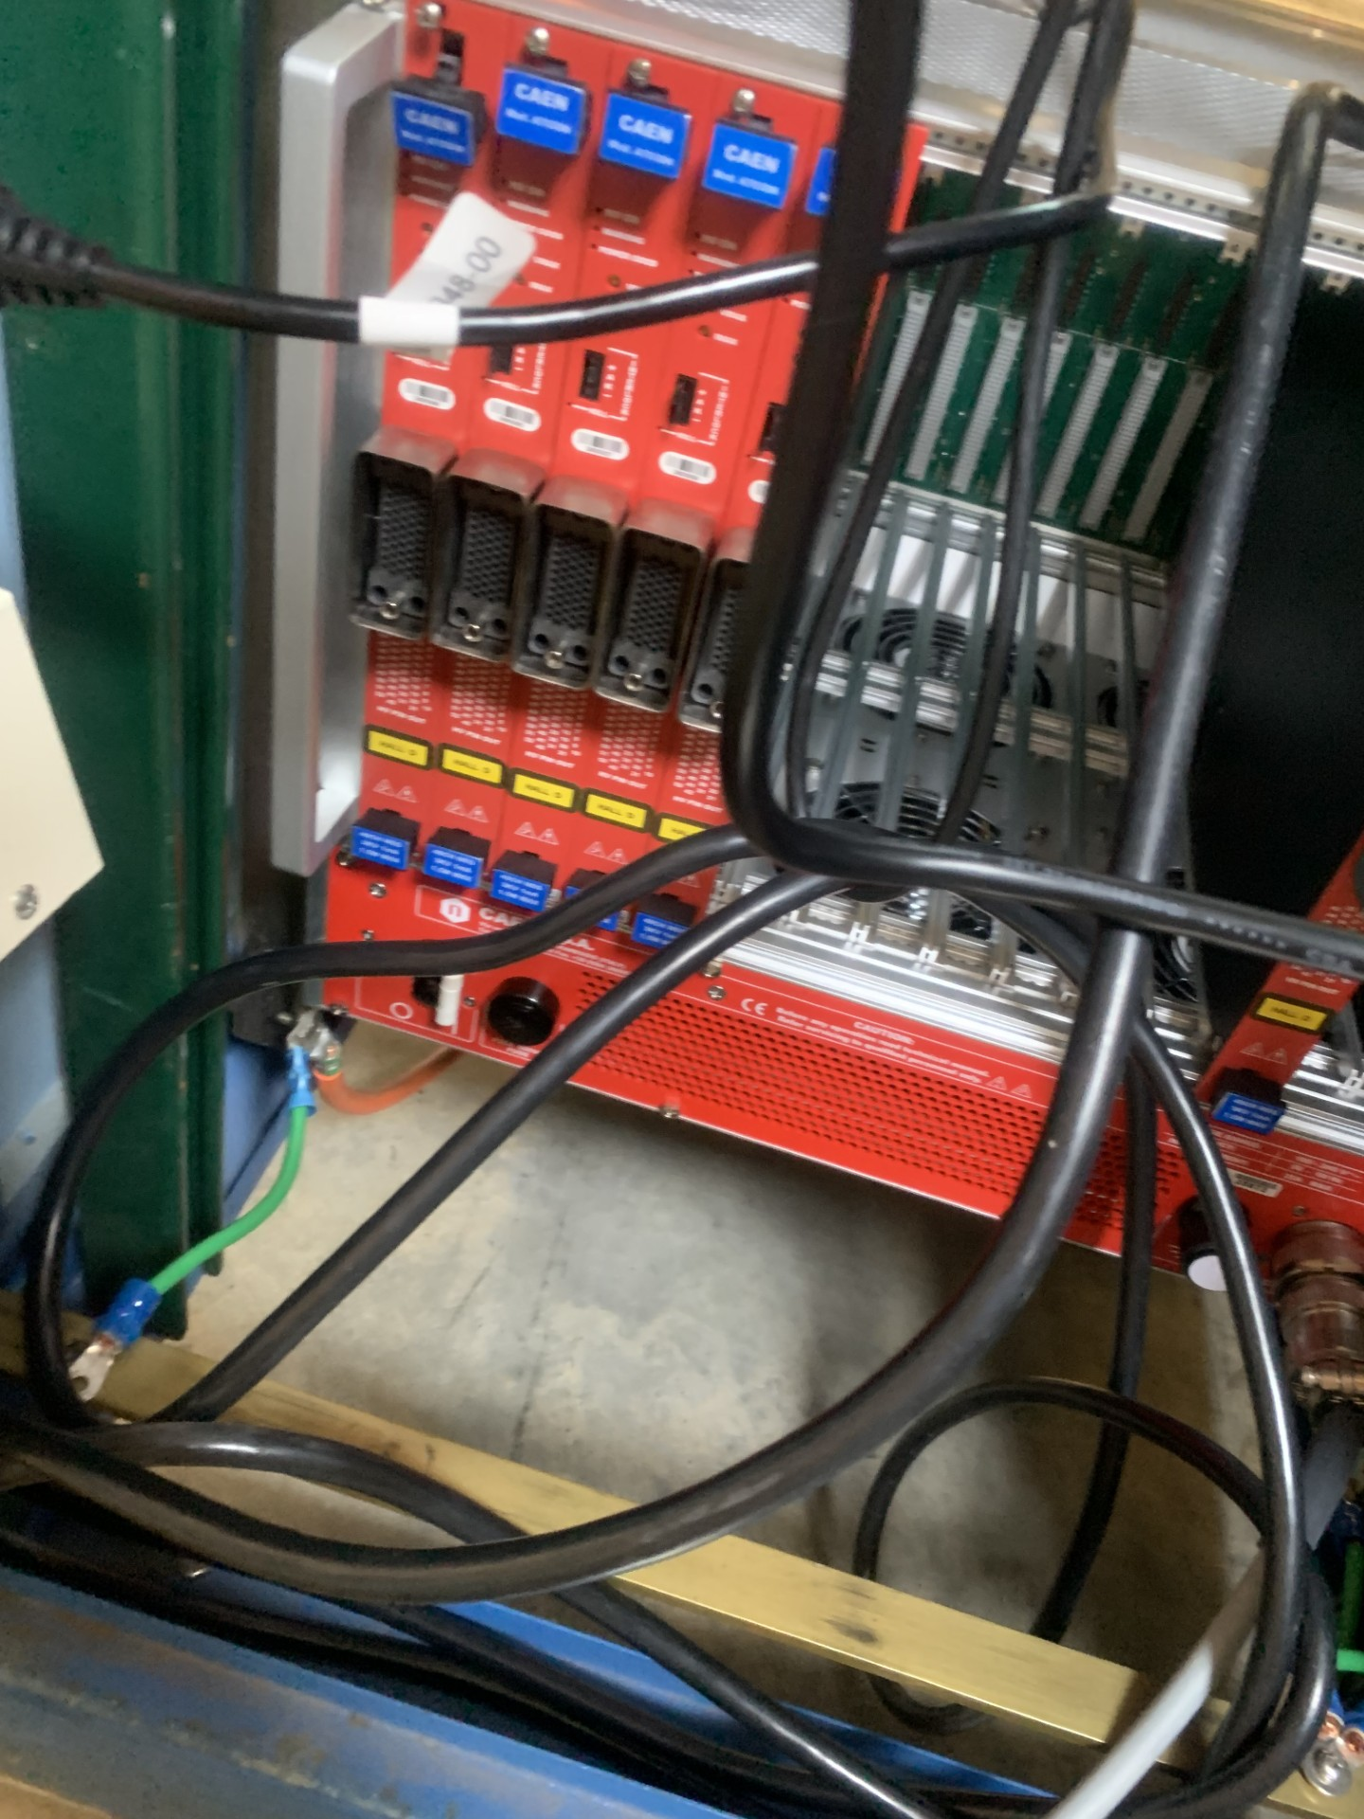
High Voltage Cable Test
We are waiting for dummy load setup so that we can conduct it in a safe manner
This test will be setup with the help of Mark Taylor from the fast electronics group
We expect this to be done before the upcoming run period

Slide 8
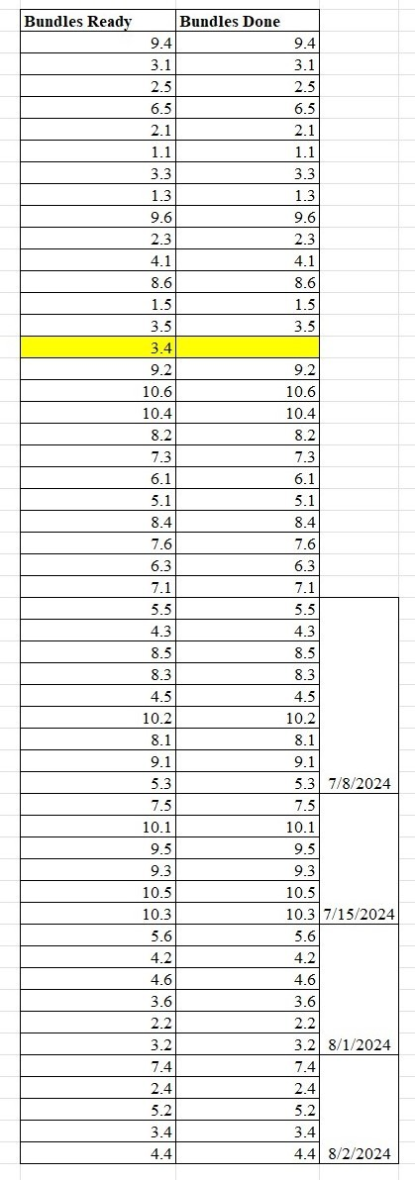
Current Status
Signal cables
Out of 60 bundles, 52 bundles are tested and found good
3 bundles had broken connectors which are fixed
5 bundles need to be converted to LEMO connectors
8 bundles remain

Slide 9
Summary
We tested 52 bundles of signal cables and 8 more need to be tested
We should start testing high voltage cables soon
If you want to see day by day progress, feel free to check PRad logbook
We will make sure that all these pending work will be done prior to ERR

Slide 10
Acknowledgements
US Dept. Of Energy under contract #DE-FG02-07ER41528​
My Advisor : Dr.Dipangkar Dutta, Mississippi State University
Dr. Aruni Naadeshani, Mississippi State University [conducted all testing]​
Erik Wrightson, Mississippi State University [conducted all testing]​
Dr. Eugene Pasyuk, JLab [Supervised our work]
Mark Taylor, JLab (Fast Electronics Group) [Arranged the setup for the test]
Jim, Contractor[Pin connector replaced with LEMO]
Hall B staff who helped with moving the floor grates to give better access to the cables
Current and future Prad collaborators

Slide 11
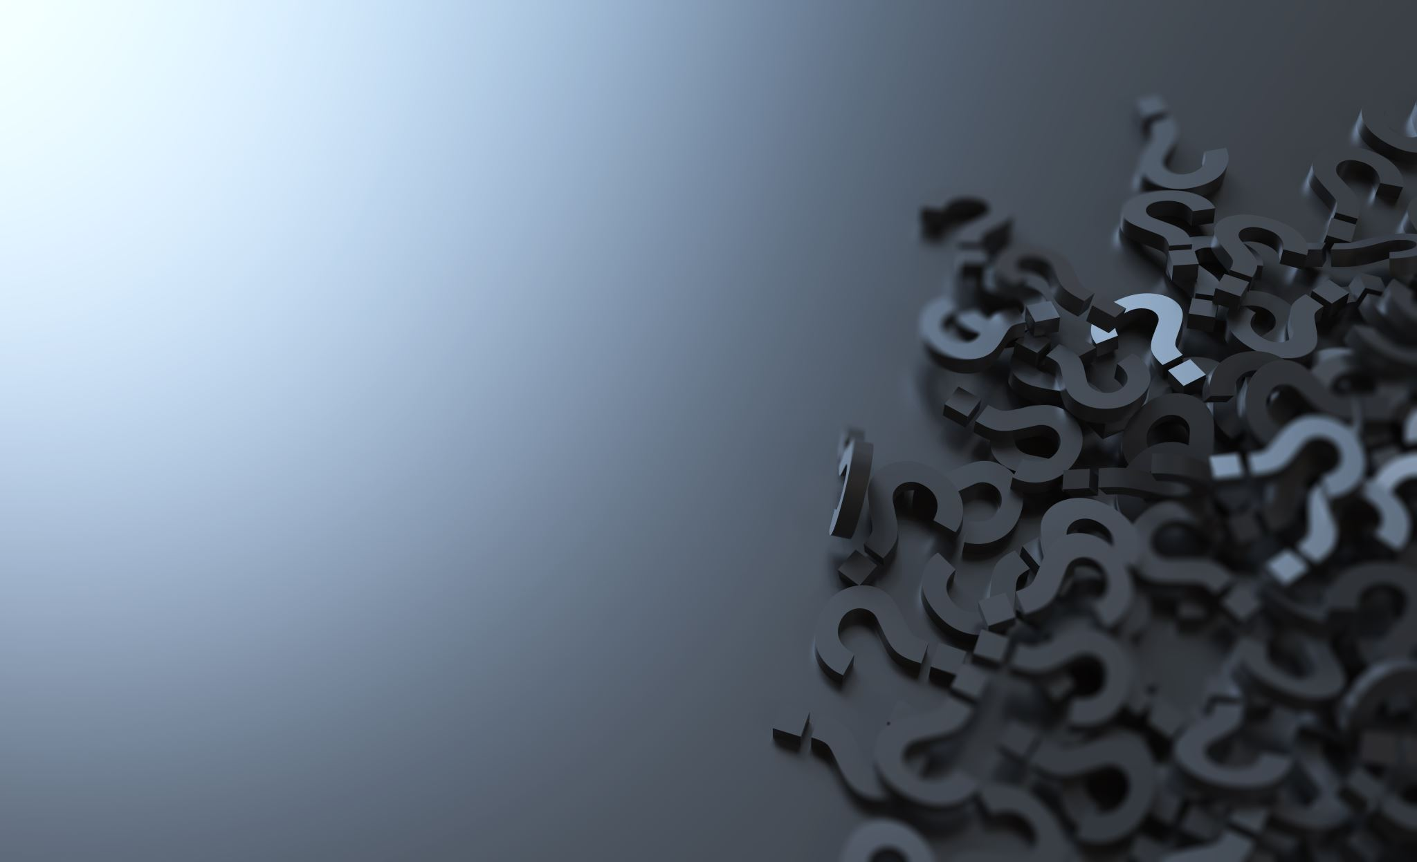
Questions ?

