Slide 1
JLab Hall B PRad II and X17 Beam Line Layout
November 2024
Bob Miller
Chris Guthrie

Slide 2
Outline
Beam Line Drawings at:
wiki.jlab.org/Hall-B/engineering/hallb_eng_wiki/index.php/Main_Page
Hall-B engineering
Prad II and X17 Upstream of the Tagger Magnet
Prad II from Tagger Magnet to Hycal
Prad II Scintillator Tagger
Prad II Scintillator Tagger Positions
X17 from Tagger Magnet to Hycal
X17 Vacuum Tank Window
GEM Detectors
Hycal to Beam Dump
A1
A2
B1
B1

Slide 3
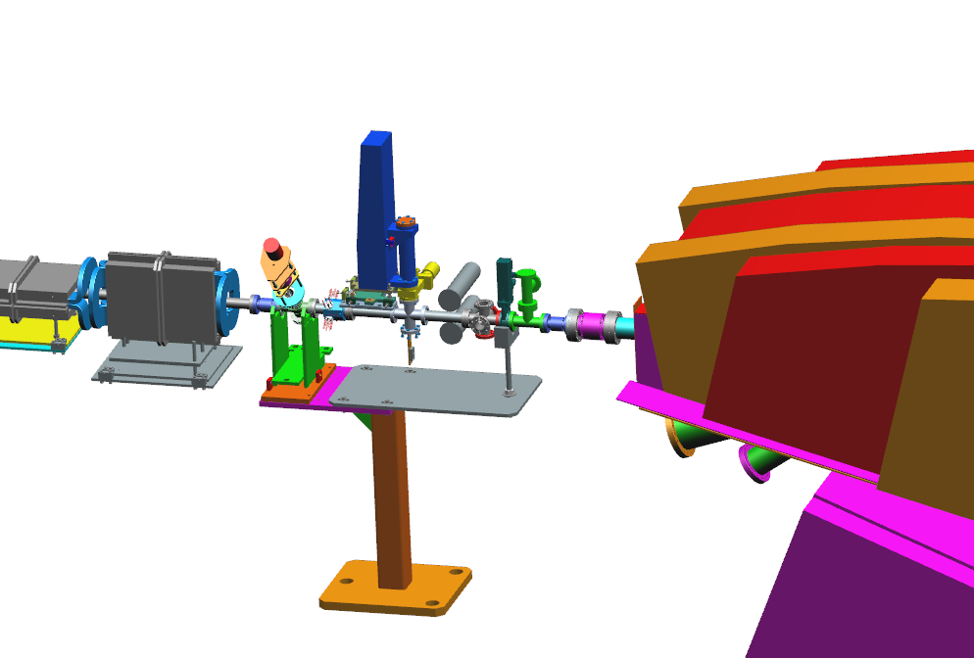
PRad II and X17 Upstream of the Tagger Magnet
Collimator Block
Halo
Counters
Harp and Radiator Foils
Valve and Gauges
A1
A2
B1
B1
Raster Magnets
Tagger Magnet

Slide 4
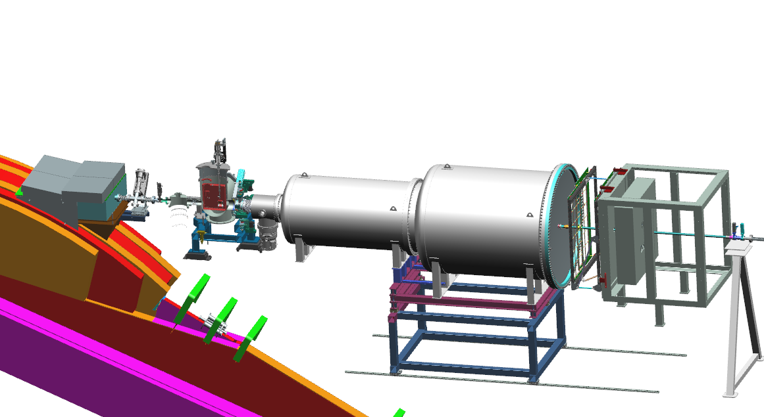
PRad II from Tagger Magnet to Hycal
Collimator Box
Harp
PRad Target
Scintillator Assembly
Vacuum Tanks
GEM Detectors
Hycal
PRad II Target to Hycal Lead Tungstate Counters is 6.2 Meters
A1
A2
B1
B1

Slide 5
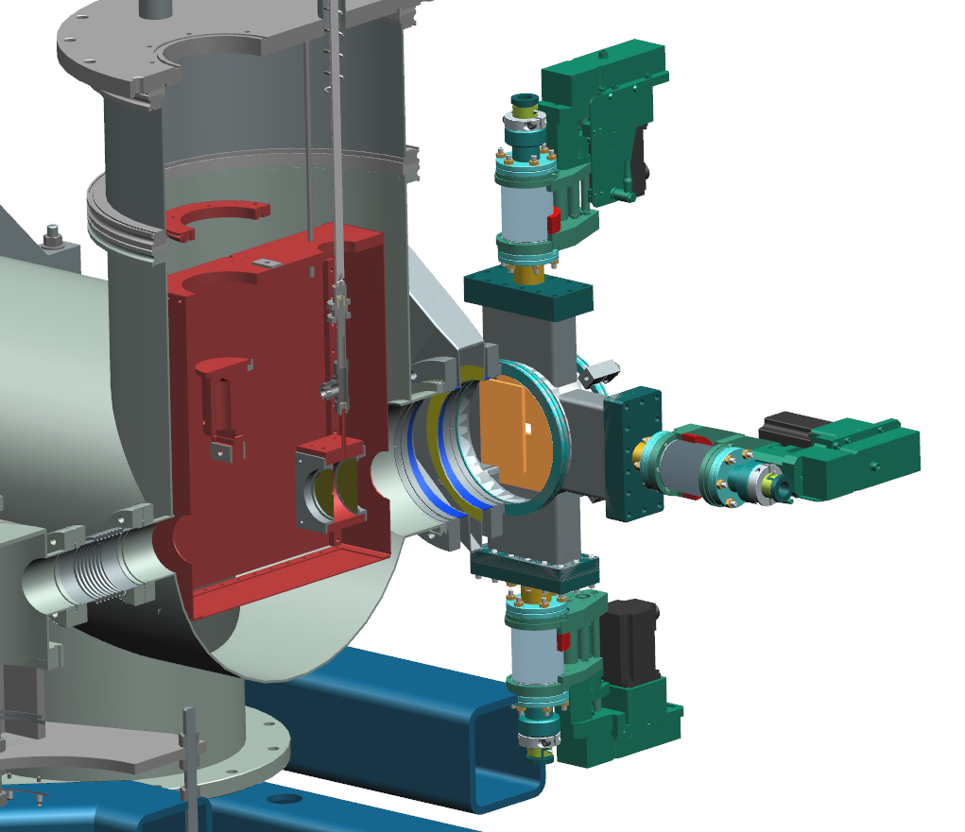
PRad II Scintillator Tagger
Four scintillator paddles
Mounted to the downstream side of the target
Each paddle can move in and out independently
A1
A2
B1
B1

Slide 6
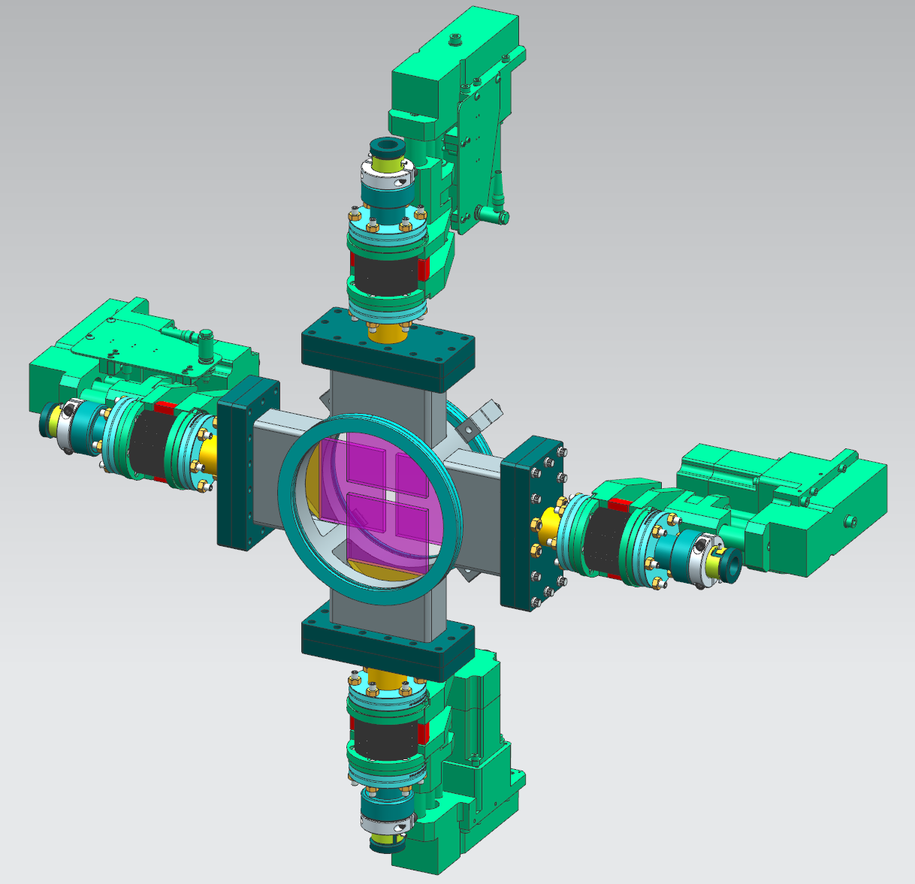
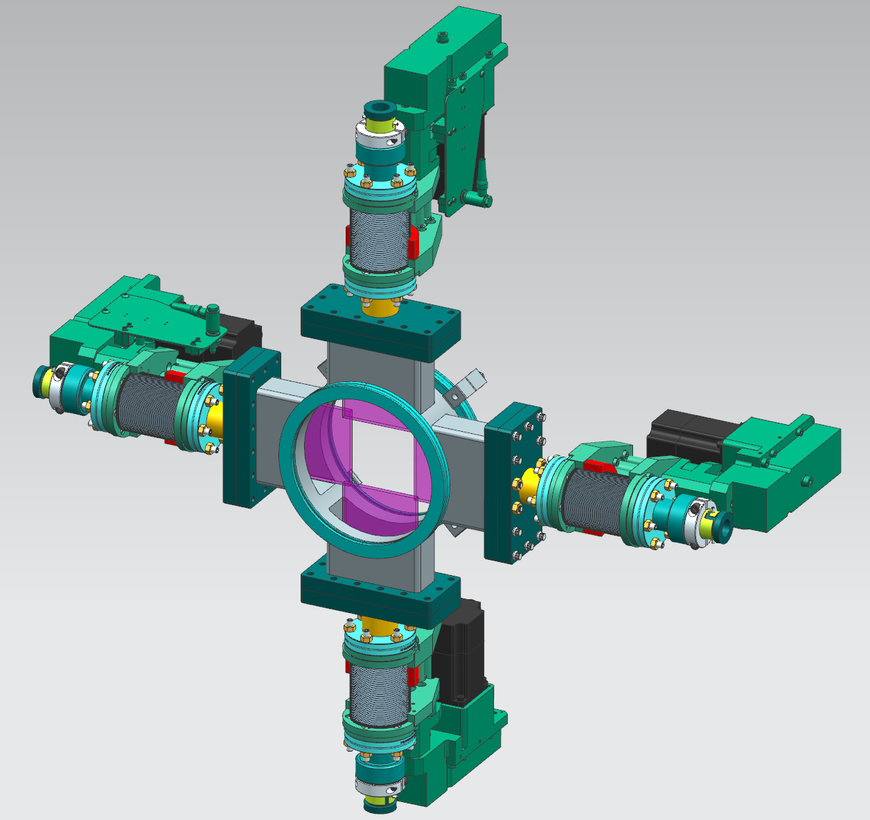
PRad II Scintillator Tagger Positions
A1
A2
B1
B1
Scintillators in for Hycal Calibration
Scintillators Retracted for PRad II Operation

Slide 7
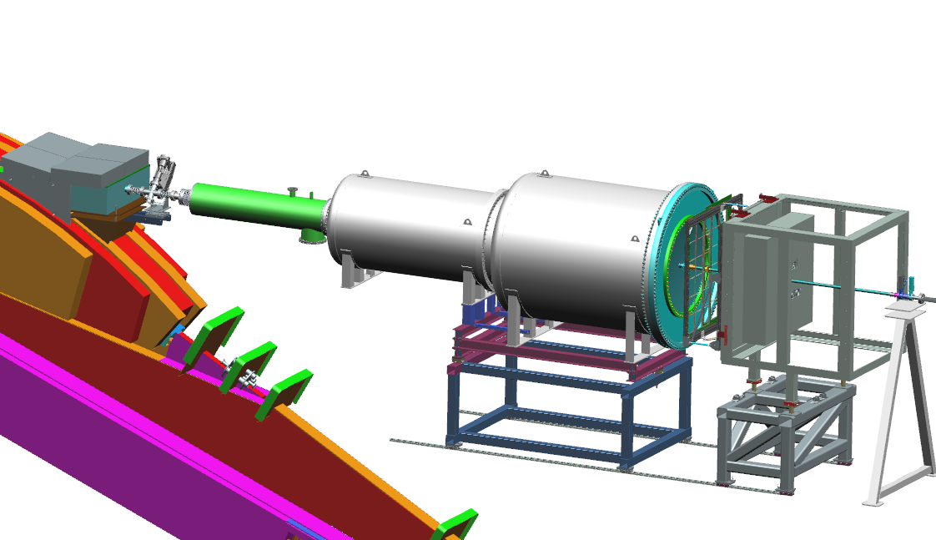
X17 from Tagger Magnet to Hycal
Collimator Box
Target
Vacuum Tube
Vacuum Tanks
1 Meter Window
GEM Detectors
Hycal
X17 Target to Hycal Lead Tungstate Counters is 7.5 Meters
A1
A2
B1
B1

Slide 8
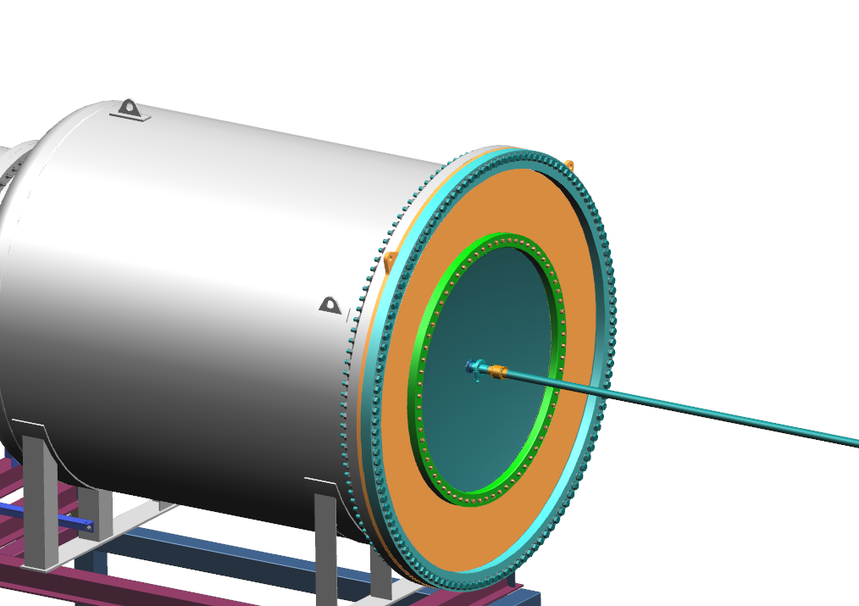
X17 Vacuum Tank Window
Window Adapter in Orange
1 Meter Diameter Window
0.020” Thick Aluminum
Aluminum Beam Tube Adapter
SST Bellows
Aluminum Beam Tube Through Hycal
A1
A2
B1
B1

Slide 9
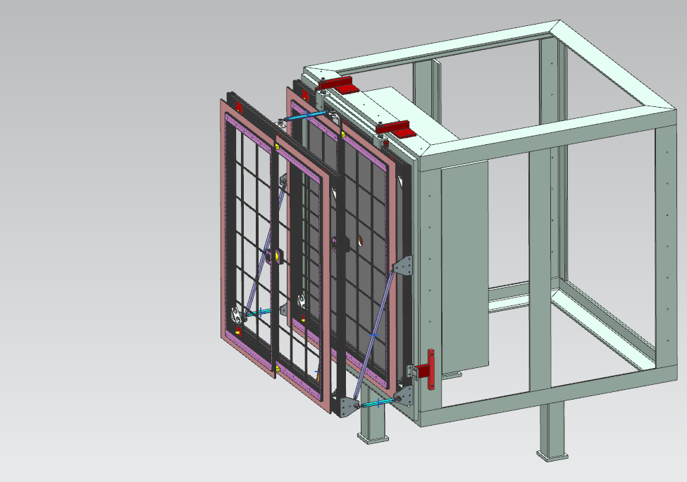
GEM Detectors
Downstream GEM Mounted to Hycal as in PRad I
Upstream GEM Mounted to Downstream GEM via Links
GEMs are Spaced 40 cm Apart – Upstream Plane to Upstream Plane

Slide 10
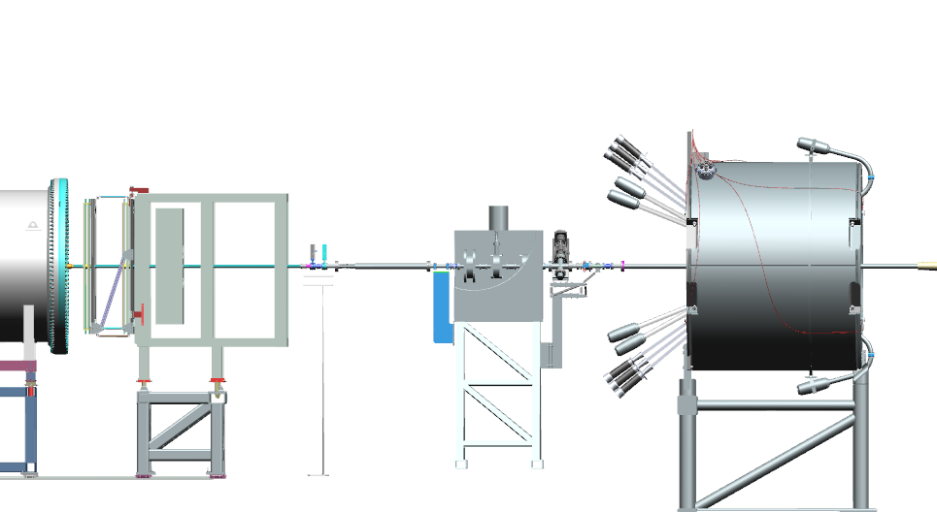
Hycal to Beam Dump
Hycal
Beamline Valves
Beam Position Monitor
Harp
Vacuum Tubes to Beam Dump

