Slide 1
Update on the Jefferson Lab Experimental Schedule
by
Douglas Higinbotham
Division Operations Director and Liasson to Accelerator Division

Slide 2
CEBAF Accomplishments During Last Run Period
Hall A
39 PAC Days Completed with major reconfirmation from pol. ³He to cryo-target during run
Completed Polarized ³He GEN Experiment (E12-09-016)
Completed GEN Recoil Polarization Experiment (E12-17-004)
Completed K_{LL} Experiment (E12-20-008)
Unfortunately due to beam dump problems the short, A_{LL} experiment (E12-20-008) was canceled.
Hall B
104 PAC Days Completed
Completed Run Group D (E12-06-106 and A)
Partially Completed Run Groups K (E12-16-010, A, and B) and E (E12-06-117)
Hall C
116 PAC Days Completed
Partially Completed Neutral Particle Spectrometer (NPS) Run Group (E12-13-010, E12-13-007, E12-22-006, E12-23-014)
Hall D
4 opportunistic calendar days
Installation of new calorimeter during most of the run period
Opportunistically extracted beam to Hall D for short beam test in March ‘24
Test went very smoothly, checking out beamline and detector performance
TOTAL OF 259 PAC DAYS RUN, 5 Experiments Completed and 8 Experiments Partially Completed
HUGE THANK YOU TO LEADERSHIP FOR RUNNING 30 WEEKS INSTEAD of 27 WEEKS

Slide 3
Upcoming Schedule
CEBAF has now run at an energy of 1047 MeV/linac for two run periods; with lower trips this year with more gradient overhead: ~10.5 GeV max to Hall’s A,B,C and ~11.6 GeV to D
Many discussions about how far to push CEBAF for the next run.
Goal to push up to an energy that is within Moller’s required energy ( 10.6 to 11 GeV).
Hall D is now requesting (this PAC) linear polarization; so we have considered that too.
This has pushed us to picked 1060 MeV/linac plus the ~100 MeV from the injector
10.7 GeV to Halls A, B, C
11.8 GeV to Hall D
Present budget expectation is for ~25 weeks of physics running in FY25&F26.
Peer-Review Found Deficiencies In JLab’s Lock-out Tag-out Program; near time items are address and accelerator work is proceeding.
Looking to get beam for physics in late January, though we don’t have any continency left in the updated Scheduled Accelerator Down (SAD) plans.
Draft FY25 schedule posted online: https://www.jlab.org/physics/experiments/schedule

Slide 4
Coming Experiments By Hall
Hall A
Run the high impact GEP-V Experiment until mid-July 2025
Next start reconfiguration pf the Hall for the Moller experiment
Hall B
FY25 run the ALERT and SRC-ALERT experiments
FY26 run PRad-II and X17 experiment ( with special lower energies )
Hall C
FY25 Large Acceptance Device SRC experiment and SIDIS LT measurement
FY26 Color Transparency, Nuclear R, and Polarizability with special lower energies
Hall D
FY25 run GlueX-II
FY26 finish the GlueX-II run and start transition to next major experiment ( K-Long / GlueX-III)
NOTE: Hall D is interested in making use of the low energy in late FY26 ( ~3.6 GeV )

Slide 5
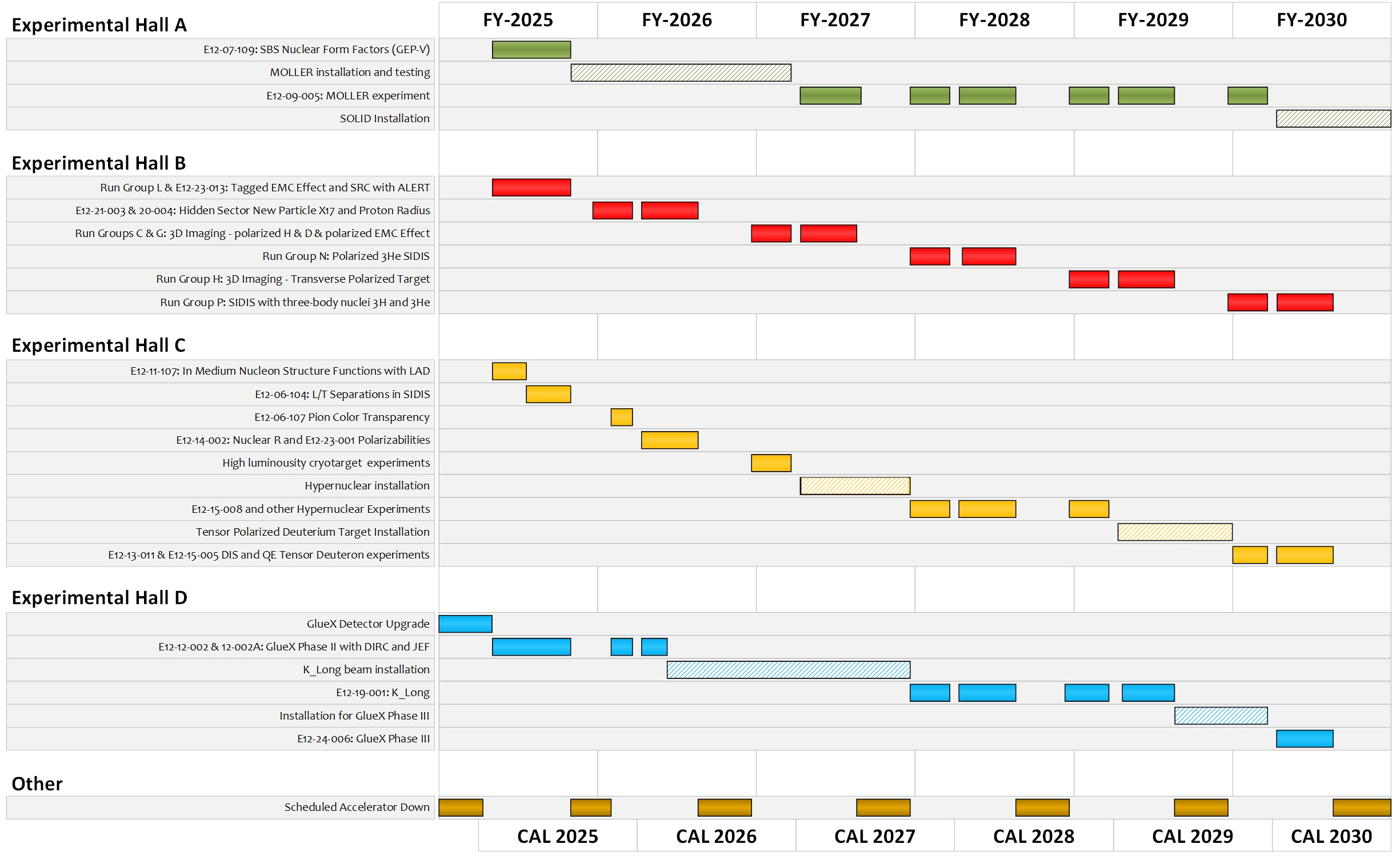
Likely Insert RG-E & HPS in FY28

Slide 6
Detailed Break-Down Of One Week of CEBAF Operations
Category | Restore Days (hours/week) | Research Days (hours/week)
Scheduled Maintenance | 40 | 12
Scheduled Beam Studies | 64 | 12
Planned Average Tune Time | 64 | 8
Hall Down When Beam Available (BANU) * | - | 16
Trips ** | - | 8
Down Time Events *** | - | 24
Planned Configuration Changes **** | - | 4
Actual Beam Used By Exp. Hall (ABU) | - | 84
Total Hours Per Week | 168 | 168
136 Research hours
* Some events, such as a cryo-event, can bring all the halls down together, typically individual downs are due to DAQ or detector problems.
** Currently trips cause ~1 hour per shift and in the past, prior to recent CPP improvement, we needed to limit current to the high-power halls to keep the trip rate reasonable.
*** The number one source of lost time in the accelerator is down time events. These are any equipment problem that stops beam from accelerator to the halls. Depending on when an event happens, the planned weekly maintenance can be done in parallel, also, when possible, beam studies are done during this time.
**** Planned changes, such as a pass change, will stop beam to all the halls while the accelerator configuration is changed.

