Slide 1
Theoretical Nuclear Physics Program
Robert Edwards
Deputy Director, JLab Theory Center
Jianwei Qiu
Associate Director, Theoretical & Computational Physics
Presented to:
JSA S&T Mission Committee
December 10, 2024

Slide 2
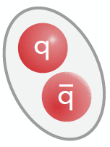
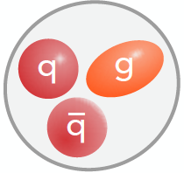
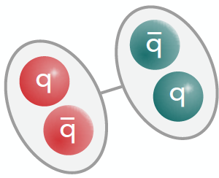
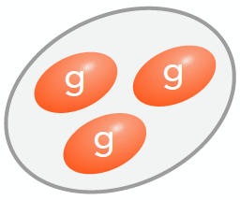
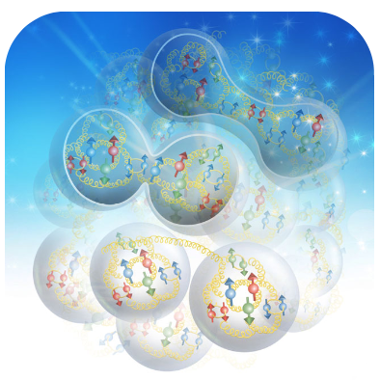
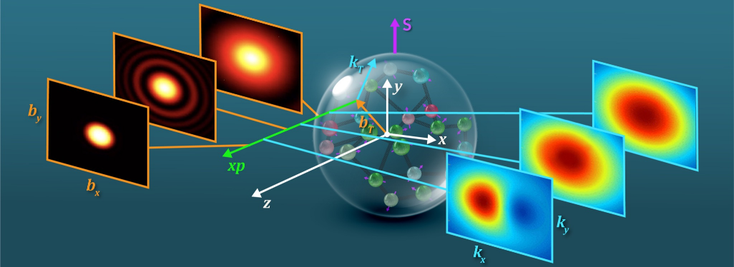
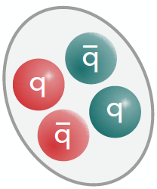
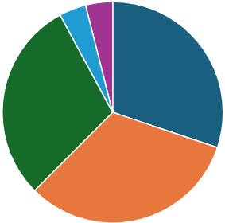
Division of Theoretical & Computational Physics @ JLab
Primary Objectives:
Motivate, stimulate, justify, promote, and support CEBAF experimental program and the future EIC
A comprehensive theoretical effort with leadership across nuclear physics community
Recruit and nurture young researchers, providing the best workforce training
The Challenge:
CEBAF has an extremely broad science program, largest users’ group, covering all aspects of Nuclear Physics!
Hadron spectroscopy:
Hadron properties &
Emergence of hadrons
Nuclear structure & properties
dual description: hadron/parton
GPDs
TMDs
Hadron 3D structure at a femtoscale
JLab Theory Program:
Isgur Fellow 0.5
Bridged staff (0.5)
Highly cost effective, great access to students, and commitment of universities & local communities
Small core of Lab staff + 1 Isgur Fellow
Fully committed joint and bridged staff
Young postdocs & Students
Postdocs
JLab Staff
Theory FTE
Distribution
FY2025
Joint Staff

Slide 3
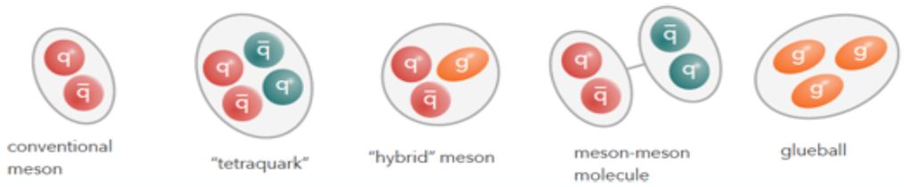
Research at Division of Theoretical & Computational Physics
Research focuses – organized in thrust areas:
Thrust area 1:
Hadron Spectroscopy - LQCD
Resonances & Exotic/hybrid hadrons
Data
Thrust area 2:
Hadron Spectroscopy - JPAC
Thrust area 3:
Hadron Structure - LQCD
3D partonic structure
& QCD dynamics
PDFs, TMDs, GPDs, …
Thrust area 4:
Hadron Structure - Partonic analysis
AI/ML and QC for NP
Initiatives:
Thrust area 5:
Hadron & Nuclear Structure
Effective Field Theories (EFTs)
Low energy nuclear properties & Structure
Low energy hadron properties
Mass, spin, …
Thrust area 6:
Nuclear Few Body Systems
Hadron Spectroscopy:
JLab is strong at every key step of the workflow
JLAB
COMPASS
BESIII
LHCb
…
Lattice QCD
Experimental
data
Amplitude
Analysis
Amplitude
Analysis
Hadronic amplitudes
& resonance poles
Joint Physics Analysis Center (JPAC)
Hadron Spectrum (HadSpec) Collaboration (LQCD)
Impact JLab program in Hall B and Hall D!

Slide 4
Research at Division of Theoretical & Computational Physics
Research focuses – organized in thrust areas:
Thrust area 1:
Hadron Spectroscopy - LQCD
Resonances & Exotic/hybrid hadrons
Data
Thrust area 2:
Hadron Spectroscopy - JPAC
Thrust area 3:
Hadron Structure - LQCD
3D partonic structure
& QCD dynamics
PDFs, TMDs, GPDs, …
Thrust area 4:
Hadron Structure - Partonic analysis
AI/ML and QC for NP
Initiatives:
Thrust area 5:
Hadron & nuclear Structure
Effective Field Theories (EFTs)
Low energy nuclear properties & Structure
Low energy hadron properties
Mass, spin, …
Thrust area 6:
Nuclear Few Body Systems
Hadron/Nuclear Structure:
JLab is strong at every key step of the workflow
JLAB
COMPASS
RHIC
LHC
EIC
…
Lattice QCD
Experimental
data
Factorization
Factorization
Quantum correlation
functions
JLab Angular Momentum (JAM) Collaboration
CTEQ-JLab (CJ) Collaboration
Hadron Structure (HadStruc) Collaboration (LQCD)
Impact JLab program in all Halls!
PDFs, TMDs, GPDs, Transversity, Polarized PDFs, …
– 3D hadron tomography!

Slide 5
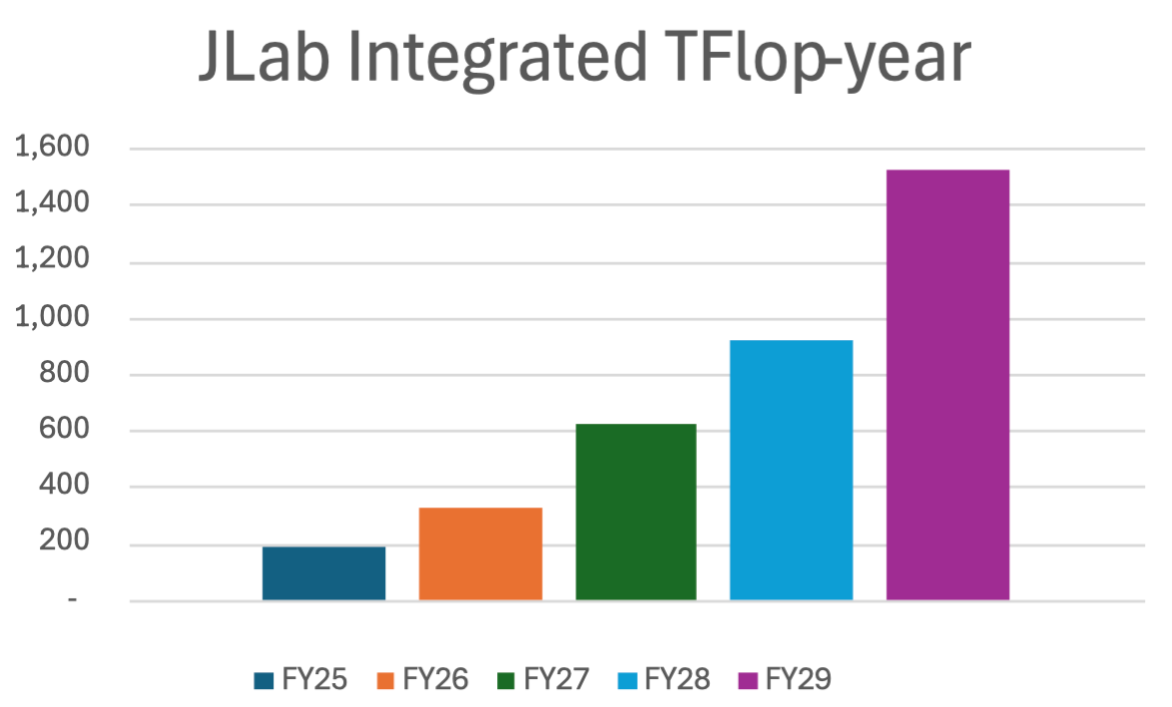






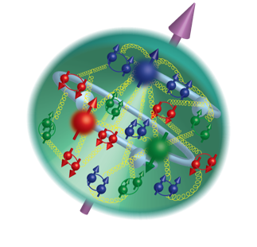
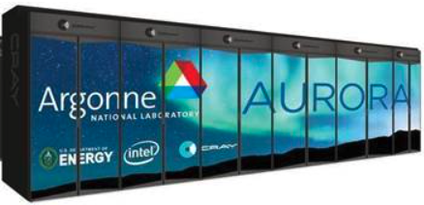
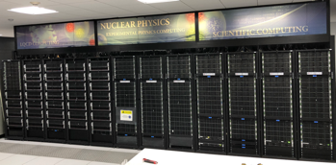
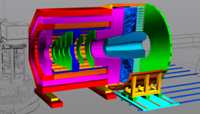
Samples of Major on-going Collaborative Theory Efforts
Help discover new exotic hadrons at GlueX/CLAS12 at JLab & future EIC:
LQCD capability
LQCD calculation of decay branching ratios of exotics & Dalitz plots – where to look!
Develop AI/ML tools for searching Exotics from data of JLab & future EIC (JPAC)
Develop the most advanced tools to “see” quarks & gluons from data:
Experiment
detectors
Theory
Pheno.
SciDAC
QuantOm
3D Hadron Structure
at Femtoscale
AI
ML
Pixelated images of proton
Data
Science
Exascale
HPC
Unique capability & synergy at JLab
EW & BSM at JLab & future EIC:
Intensity Frontier
Treating QCD and QED equally with all-order factorizations for lepton-hadron DIS and SIDIS at JLab & future EIC!
Precision NLO PVDIS (EW+QCD+SoLID) & explore BSM signatures at SoLID-JLab & future EIC, …

Slide 6
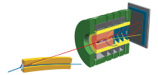


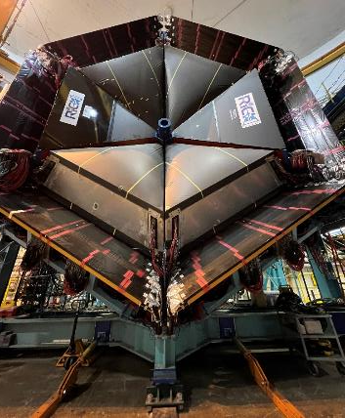
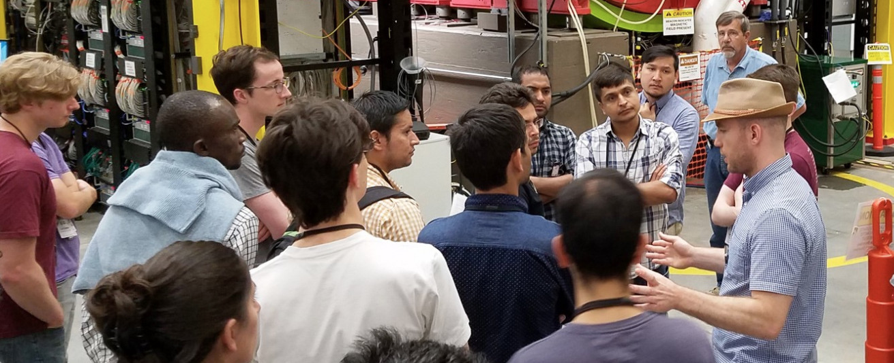
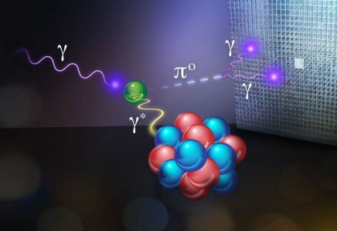
Joint Faculty Program for Theory & Computation
Joint Faculty/Staff leads or plays key role – Spectroscopy:
Led by A. Szczepaniak (Director) to support the spectroscopy analysis at
Locally led by J. Dudek + A. Rodas to provide LQCD predictions
for spectroscopy and search for exotics, …
Directed/organized by A. Accardi, supported by JLab postdocs, provided training to hundreds of students in nuclear physics
Many former students now hold prestigious faculty or staff positions!
HUGS
Joint Faculty/Staff leads or plays key role – Hadron/Nuclear Structure:
A. Radyushkin (4/1992)
Theory - Matching
R. Schiavilla
(8/1993-1/2024)
Nuclear structure (A>1)
K. Orginos (8/2005)
LQCD
GPDs
TMDs
PrimEX-II
I. Balitsky (9/1996) , T. Rogers (1/2015) - TMD - Theory
Program Uncertainty: R. Briceno to UC-Berkeley/LBNL (2023)
Major Risk F. Ringer to Stony Brook U. (2024)
J. Goity (1993) - EFTs

Slide 7
Joint Faculty Program for Theory & Computation – Uncertainty
Uncertainty of the Joint Faculty/Staff program:
3/2023: DOE/NP intended to terminate JLab’s Theory joint faculty/staff program
7/2023: DOE/NP’s effort was put on hold – waiting for a new policy (not available yet)
2/2024: DOE/NP PM asked JLab/Thy to cut its budget by $200K/yr for 4 years starting FY25 on top of a Flat/Flat base
Budget impact on the JLab/Theory program:
JLab Theory DOE/NP base budget has been Flat-Flat since FY2021: $4,222K for FY2021-2024
Resulted in a reduction of bridge faculty staff from 4 to 1 and a loss of 1 post-doc
Further $200K reduction for FY2025 and the future: $4,022K for FY2025
Reduction of 1 more post-doc (from Flat/Flat – inflation)
Not be able to replace R. Schiavilla (phased retired) and F. Ringer (to Stony Brook U)
FY2026: DOE/NP/PM asked JLab/Thy not to search for any replacement hire
Not even postdocs who are leaving (3) – 1st year we did not have any search for over 10 years!
Expected to lose 3 more PDs & 4-5 more Joint Staff/Faculty members by FY2028!
Major risks:
Not be able to provide the needed theory support to CEBAF program (PAC, T.E.D., …)
Losing good young staff: R. Briceno to UC Berkely/LBNL as a joint, F. Ringer to Stony Brook U, …
Hurting our ability to recruit good people (all young staff/joint staff received DOE ECAs so far!)

Slide 8
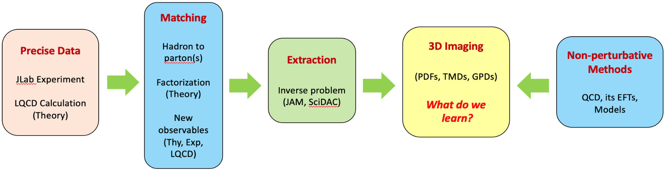
Joint Faculty Program for Theory & Computation – Mitigation Efforts
Writing proposals in response to LDRD, DOE/NSF Funding Opportunities:
FY2024: Received more than $3.2M beyond DOE/NP Theory base funding
(SciDACs, Topical Groups, HEP, NSF, QIS/QC, AI/ML, LDRD, …)
Continue making efforts to get more supports – But, Not stable & less FTEs to support CEBAF programs!
Developing/updating our 5-year Strategic Plan – Priority and Focuses (on-going):
How should the Theory Center and its physics focuses look like in FY2028?
NP Science (LRP) – identify what is relevant to us?
Our strength – QCD and hadron physics, …
Our role for the future of JLab and NP community?
Realistic goals, milestones, priority, and the need for achieving them?
Center for 3D hadron tomography:
DOE 2022 S&T
Recommendation
Synergies between thy, exp, data scientists, …, plus data from JLab
Workflow for delivering 3D nucleon tomography
CNF: Visitors, Sabbatical leaves, Topical workshops, …

Slide 9
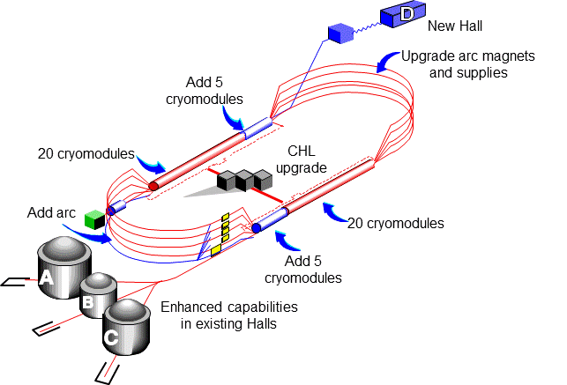
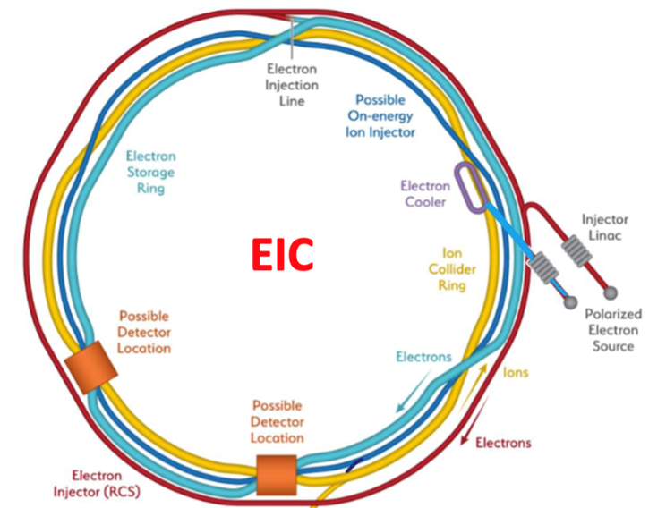
Division of Theoretical & Computational Physics @ JLab
Continue to engage in a range of outreach activities
Deliver the physics results from the JLab 12 GeV experimental and theoretical program, especially in the meson spectrum (GlueX), and nucleon structure (partonic structure, spin, 3D imaging, energy-momentum tensor)
Disseminate the specific knowledge and research to the broader academic community, attract and train future generations of scientists, and promote awareness and understanding of science in society at large
Develop and help strengthen the EIC physics program, especially in jet physics, heavy flavor physics, and nuclear processes
Provide intellectual and programmatic leadership in a range of areas in nuclear theory, and in future programs at JLab (SoLID, positron beam, CEBAF energy upgrade)
Explore opportunities in artificial intelligence/machine learning (AI/ML) and quantum computing for nuclear physics.
Recruit and nurture the best young researchers, providing the best workforce training
AL/ML: & QC for Nuclear Physics

