Slide 1
CEBAF Operations Review Outcomes
David J. Dean
Deputy Director for Science and Technology
Presented To:
S&T Mission Committee
December 10, 2024

Slide 2
Outline…
A brief recap
DOE Office of Nuclear Physics CEBAF Operations Review

Slide 3
Laboratory strategy incorporates three key areas
Nuclear Physics
CEBAF serving our user community in the quark sector (the review covered this)
EIC serving our user community in the gluon sector
Computational and Data Science
Delivering HPDF to accelerate scientific discovery and innovation
Accelerator Science and Technology
Innovation for reliable SRF accelerators, and training the next generation of accelerator scientists (the review covered part of this)

Slide 4
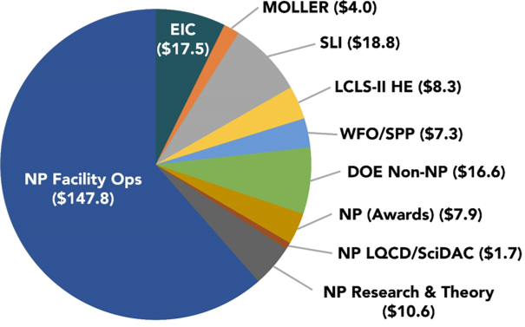
FY23 Lab Funding: All Sources ($240.5M Total)
The review covers the $147.8M

Slide 5
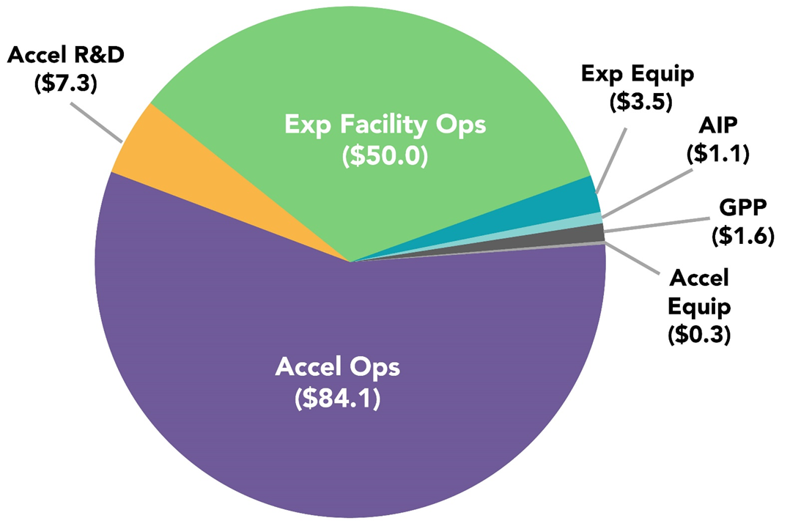
FY23 Facility Operations Funding by B&R Code: $147.8M Total
Accelerator Operations
Effort and M&S for CEBAF accelerator operations, including all technical systems, engineering support, cryogens, electrical power
Effort and M&S for Accelerator R&D activities, including SRF, Source/Injectors, CEBAF future
Accelerator Improvement Projects
Targeted projects to improve CEBAF performance
Accelerator Capital Equipment
Experimental Operations
Effort and M&S for experimental Hall operations, including all technical systems
Experimental Capital Equipment
Capital equipment to mount experiments in accordance with the approved schedule
General Plant Projects (GPP)
Jefferson Lab Facility infrastructure and site improvements

Slide 6
What does the Operations Budget Cover? (FY25 PBR)
The Operations activity provides accelerator operations funding for CEBAF, which boasts unique features of continuous wave polarized beam to four experimental halls and serves over 1,800 U.S. and international users.
Funding for this activity supports a team of accelerator physicists at TJNAF that operate CEBAF, as well as for power costs of operations and maintenance of the 12 GeV CEBAF.
The highest priority investments in cryomodule refurbishment, spares and critical maintenance are supported to address and improve machine performance and reliability.
The Request supports high priority accelerator improvements, and high priority capital equipment for research and facility instrumentation.
Targeted efforts in developing advances in SRF technology to improve operations of the existing machine continue.
The core competency in SRF technology plays a crucial role in supporting DOE projects and facility operations outside of nuclear physics and has broad applications from medicine to homeland security.
TJNAF also has developed award-winning cryogenics techniques that have led to more cost-effective operations at TJNAF and several other SC facilities; their cryogenics expertise benefitted several SC superconducting accelerator projects.
TJNAF accelerator physicists help train the next generation of accelerator physicists, enabled in part by a close partnership with nearby universities and other institutions with accelerator physics expertise.
Accelerator scientists play critical roles in the design development of the EIC.
The subprogram provides Experimental Support for scientific and technical staff, as well as for critical materials and supplies needed for the implementation, integration, assembly, and operation of the large and complex CEBAF experiments.
Essential
Highest Priority
High Priority
Targeted Effort
Maintain Core competency
A call out
Experimental Support

Slide 7
Review Charges Addressed and Indicated in Presentations and Prebriefs
Review questions (brief form)
Were CEBAF Operations effective in FY23 and the first half of FY24?
Are resources currently used to conduct the major activities in the various facility budget categories well justified?
Are plans to improve performance, enhance capabilities, and promote cost effectiveness of operations through AIP, and research and facility CE investments robust and appropriate?
Is the CEBAF operations organization effective?
Are the environmental, health, safety, and quality aspects of operations being effectively managed?
Are external investments and activities leveraging TJNAF core capabilities posing a risk to CEBAF supporting the NP mission?
Charge 1
Charge 2
Charge 3
Charge 4
Charge 5
Charge 6
Held at JLab 25-27 June 2024

Slide 8
CEBAF Operations Review Committee
Mei Bai, SLAC
Bob Zwaska, Fermilab
Ting Xu, MSU
Wolfram Fischer, BNL
Janet Bivens, ORNL
Bernd Surrow, Temple University
Fulvia Pilaf, ORNL
Olga Kuchar, ORNL
Oliver Kester, TRIUMF
Eric Brown, LANL
Peter Denes, LBNL
Paul Rossi, ANL
Michael Kelly, ANL
DOE: Paul Mantica (chair), Sharon Stevenson, Gulshan Rai, Spyridon Margetis, Manouchehr Farkhondeh, David Cinabro, Linda Horton
This review is held every 5-7 years, and is comprehensive

Slide 9
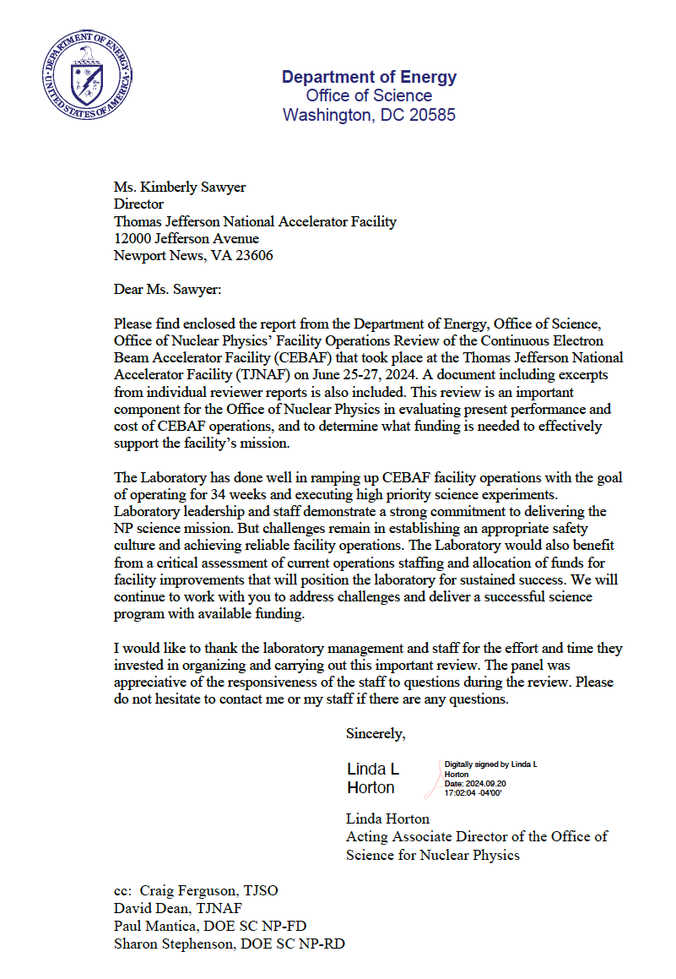
Cover Letter
The Laboratory has done well in ramping up CEBAF facility operations with the goal of operating for 34 weeks and executing high priority science experiments. Laboratory leadership and staff demonstrate a strong commitment to delivering the NP science mission. But challenges remain in establishing an appropriate safety culture and achieving reliable facility operations. The Laboratory would also benefit from a critical assessment of current operations staffing and allocation of funds for facility improvements that will position the laboratory for sustained success.
Good Marks
Strong commitment to delivering the mission
Challenges
Reliability
Safety culture
Need a critical assessment of current operations staffing and allocation of funds for facility improvements that will position the laboratory for sustained success.

Slide 10
Recommendations
Develop a beam energy requirement document for the approved experiments in the experimental halls, complete with physics justifications. This document must be distinctly separate from issues pertaining to reliability. Submit to NP by December 31, 2024.
Update the CEBAF Performance Plan (CPP) by December 1, 2024 and submit to the Office of Nuclear Physics (NP). Conduct annual reviews of CPP progress and share review outcomes with NP.
Adopt a proactive multi-year approach to accelerator improvement projects (AIP) planning and share the AIP plan with NP by December 31, 2024.
Complete the comprehensive Accelerator Management Plan as outlined in the comments by December 31, 2024, and submit it to NP.
Develop a revised staffing plan for CEBAF facility operations and present to NP at the next Laboratory Management Budget Briefing.
Produce a common set of comparable availability statistics for the experimental facilities and accelerator in terms of operating hours, uptime, etc. Deliver to NP by December 31, 2024.
Update the JLab Data Management Plan and associated experimental hall Data Management Plans by October 1, 2024.
Complete development and issuance of the LERF Operations Directives (LOD) and UITF Operations Directives (UOD) by July 15, 2024 to facilitate a timely review of the facility safety assessment document (FSAD) and get the DOE O 420.2D implementation back on schedule [Postscriptum. This recommendation was satisfied July 16, 2024].

Slide 11
Executive Summary: CPP and reliability
An understanding of the sustainability of effective operations in the outyears given a constant effort scenario based on the FY 2023 funding level is difficult to judge. While the risks associated with CEBAF operations have been captured, JLab leadership did not provide an introspective assessment of current staffing with anticipated future needs that would align with the goals of increasing facility reliability.
[A] thorough in-depth evaluation of the scientific benefits for remaining experiment(s) that strongly support the need for a marginal increase in beam energy was not evident. As a result, achieving the CPP energy reach goal may be less critical compared to the importance of providing optimal weeks of high-quality stable beam. A specific recommendation is to update the CPP that should be approached independently without assuming the outcome must align with the current CPP energy reach strategy. The cost and effort required to achieve this marginal increase in energy by pushing CEBAF to its limits might not be worth the potential scientific gains.

Slide 12
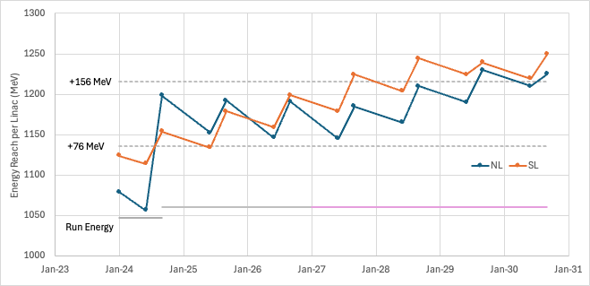
The experimental energy recommendation and the CPP recommendation
Experimental Energy: For FY25 CEBAF plans to run at 1060 MeV/linac which, along with the injection energy, will provide an energy of 10.7 GeV to Hall A. While the experiment would like to be able to increase the energy by 0.14 GeV to further precess the spin 180 degrees to do systematic checks, this doesn’t need to be done immediately, so a short-term focus on reliability running at 1060 MeV/linac meets the needs of the program, while the longer-term goal of achieving 1075 MeV/linac will improve the Moller experiment systematics.

Slide 13
Executive Summary: ESH
With regards to environment, health and safety, JLab continues to struggle with establishing an appropriate safety culture. Processes are in place whereby hazards are identified, analyzed, and appropriately mitigated, but the effectiveness of these processes is questionable. Recent shortfalls in hazardous energy control points to a need for the Laboratory to develop a program to continually assess the effectiveness of corrective actions as well as follow up on any subsequent preventative actions that result from safety stand downs to prevent recurrence in the future. Implementation of the new work planning system was seen by Laboratory management as an answer to address past safety shortfalls. However, implementation of the Electronic Permit Administration System (ePAS) has not gone smoothly. Utilizing proper change management techniques with appropriate support and established milestones would have better served the laboratory by ensuring stakeholders found value in the system at the start of implementation.

Slide 14
Executive Summary: Budget and staffing
With respect to the CEBAF operations budget planning and execution, JLab’s use of resources to conduct the major activities in the various facility budget categories is well justified. The current resource distribution is aimed to deliver the most productive program, however, the process JLab uses to optimize operations is not transparent. It is recommended that JLab develop a revised staffing plan for CEBAF facility operations based on a critical assessment of the existing skill set compared to that needed to deliver science safely and with high reliability and efficacy.

Slide 15
Alternate View of CEBAF Operations
CEBAF Operations (53)
Accelerator Engineering Systems (64)
Cryogenic Systems (44)
Experimental Support (49)
Hall A/C (44)
Hall B (30)
Hall D (21)
Run accelerator
Cryo and support
Experimental Ops
Mission Ready SRF (69)
Mech Sys Eng (71)
Challenging Question: What is the funding level and what are the critical skills (positions) necessary to accelerate one electron (or run one shift) of CEBAF? This is a ‘mission readiness’ approach to the question.

Slide 16
Building a priority driven 5-year plan (Accelerator, prioritized)
 | FY25 |  | FY26 |  | FY27 |  | FY28 |  | FY29 |  | FY30 |  | FY31
 | $k | FTE | $k | FTE | $k | FTE | $k | FTE | $k | FTE | $k | FTE | $k | FTE
Team that operates CEBAF
Power/cryogen costs
Maintenance of CEBAF (during run and SAD)
Address and improve CEBAF performance and reliability
AIP | 312
Accelerator CE | 1074
Developing advances in SRF tech for existing machine (R&D)
Maintenance of Core Competency in SRF (Mission Readiness)
Train Next Generation
GPP | 1658 |  | 1708 |  | 1759 |  | 1812 |  | 1866 |  | 1922 |  | 1980
Total (Funding and FTE | 95335 |  | 90768 |  | 93491 |  | 96296 |  | 99185 |  | 102161 |  | 102225

Slide 17
Assumptions for exercise
Build the staffing from the bottom up; not from what we have today.
Prioritize and rethink how we do things. Mission driven outlook
Allow for fungibility between Ops, Accelerator CE, AIP, R&D
Creative tension in the portfolio…

Slide 18
Executive Summary: EIC
One area of resource allocation needs attention. The committee was told CEBAF operations funds were re-directed to support the creation of a scientific research group focused on the Electron-Ion Collider (EIC). This is an inappropriate stewardship of operations funds that undermines transparency and accounting for facility operations budget. The JLab medium energy science programs and its research proposal, which included EIC scope, was reviewed in 2023 by a different committee. While JLab management was aware of the outcome, it has proceeded without approval from the cognizant NP research program.
This one is difficult. Strategically we know we must have an EIC science group (theory and experiment) and they must be active today to prepare for the future.

Slide 19
Executive Summary: Plans for the future
Plans to improve performance, enhance capabilities, and promote cost effectiveness of operations through accelerator improvement projects, and research and facility capital equipment investments are mostly appropriate, but would benefit from a more coordinated planning process. It is recommended to complete a comprehensive Accelerator Management Plan.
The physics programs carried out in the CEBAF experimental halls align closely with the recommendations outlined in the 2023 NSAC Long Range Plan. It remains important to understand the physics drivers for operating CEBAF at its highest energies. It is recommended that a beam energy requirement plan is developed for approved experiments to justify the allocation of significant resources to increase the beam energy to 12 GeV.
Accelerator Management Plan has started

Slide 20
Executive Summary: Plans for the future
Plans for computing resources meet the needs of the CEBAF operations and planned experimental program regarding the scientific computing platforms the capabilities in the experimental halls for capturing and archiving the experimental raw data is not clear. More information on the latter is needed. JLab should review the CEBAF data architecture (how data flows through the different systems), assess potential security issues, and appropriately capture identified risks in the CEBAF operations risk register.
New Staff Member: Laura Biven (Chief Data Officer), is working this (and is part of HPDF)

Slide 21
Executive Summary: JLab Management
In terms of JLab management, roles and responsibilities for CEBAF facility operations are well defined at the department leader level (Level 3), although the tie to CEBAF facility operations is sometimes implied rather than explicitly stated.
The accountability for CEBAF facility operations is not clear from the high-level organizational chart, and the reporting lines of the division directors to the directorate are not clear. Operations communications are well established and effective via schedule communication, program meetings to coordinate progress and provide feedback, and electronic tools to communicate and record operational and other important information, including downtime and failure tracking.
JLab is supportive of equity and inclusion and uses survey results to provide the basis for further commitments to diversity, equity and inclusion related programs.
This is a major change…will be executed within months

Slide 22
Executive Summary: Conduct of Operations
Conduct of operations for CEBAF has been established with clearly defined roles and responsibilities for accelerator activities including those for training and procedures. It is important that JLab complete the development and issuance of Operations Directives for the Low Energy Recirculation Facility and Upgraded Injector Test Facility to meet the schedule for DOE Order 420.2D implementation.
The Lab is working toward full implementation of 420.2D

Slide 23
Executive Summary: External Investments
There are external investments and activities leveraging JLab core capabilities which pose a risk to CEBAF supporting the NP mission. In most cases appropriate mitigations are in place. Clear presentations and responses to questions as provided in the breakout session on other activities outside of facility operations contained convincing examples for most of these mitigations.
We continue to develop external business for DOE (core capability)

Slide 24
Discussion

