Slide 1
High Performance Data Facility (HPDF) Project update
Kathryn (Kate) Mace
HPDF Project Director
Presented To:
JSA S&T Mission Committee Meeting
December 10, 2024

Slide 2
Outline
HPDF Project: Brief overview
Timeline to DOE Order 413 Critical Decision 1 (CD-1)
Current HPDF Project staff (FTEs)
Performance/Current Activities: HPDF
HPDF Risks
Current Funding + Preliminary Forecast
Performance/Current Activities: JLDC
Summary and Outlook

Slide 3
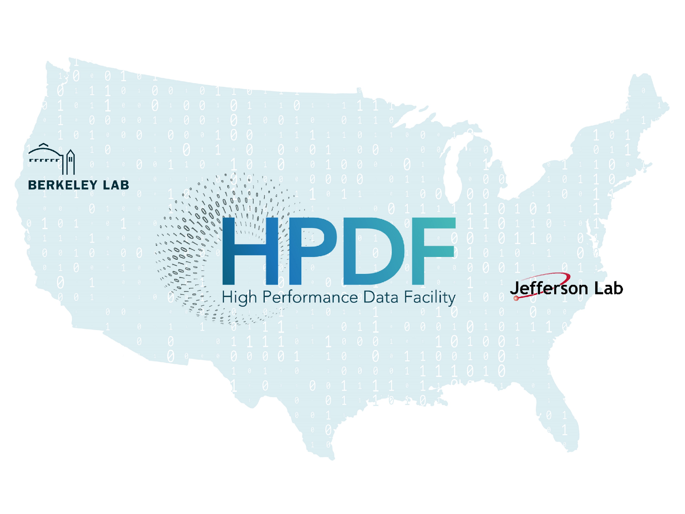
Innovation Through Partnership
Our mission: To enable and accelerate scientific discovery by delivering state-of-the-art data management infrastructure, capabilities, and tools
HPDF is a DOE 413 Project announced in Oct. 2023
The HPDF will be a first-of-its-kind SC user facility:
A data-centric facility with a distributed operations model, essential to long-term success and required performance levels
Project structure is integrated with JLab and LBNL staff
The HPDF Project team leverages the strengths and complementarity of both labs:
Decades of experience with scientific missions and user communities
A shared understanding of resilient, distributed infrastructure that supports the data life cycle
A shared commitment to the Integrated Research Infrastructure (IRI) initiative and ASCR ecosystem
IRI = Integrated Research Infrastructure (https://iri.science)

Slide 4
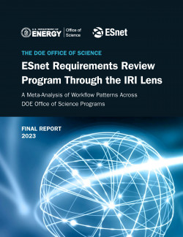
HPDF Will Address SC Priority IRI Science Patterns
Drivers | IRI Patterns
Supporting data curation, repositories, and archives
Supporting data processing and analysis pipelines
Data federation, sharing, and collaboration
Real-time streaming and processing
Time-Sensitive
Data Integration-intensive
Long-Term Campaign
These patterns are seen widely in the larger community, in other parts of DOE, and outside

Slide 5
Timeline to DOE Order 413 Critical Decision 1 (CD-1)
Summary: Preparing for CD-1 Energy System Acquisition Advisory Board (ESAAB) Approval at the end of CY2025
Next steps: Conceptual Design, refine Project Cost range & preliminary Schedule, required CD-1 documentation
HPDF
Analysis of Alternatives complete: January 2025
Conceptual Design Review (peer review): June 2025
Required documentation (Master Schedule, Funding profile, Cost range, Risk Register, Preliminary Project Execution Plan, Project Management Plan, etc.): Ongoing
CD-1 Director’s Review: July/Aug 2025
CD-1 IPR: September 2025
CD-1 ESAAB: December 2025
JLDC
A&E/CM Firms are refining the design and costs (more info follows)
Integrating P6 schedules (JLDC + HPDF)
JLDC delivery date is currently 2029 due to long approval cycles

Slide 6
DRAFT WBS: HPDF (FTE)
HPDF 1.0
Project Management 1.01
User Experience, Workflows, & Policy 1.02
Hardware 1.03
Software 1.04
Data Management 1.05
Integration & Testing 1.06
JLDC 1.07
B59 LBNL 1.08
Spokes (1.09)
Total
JLab on Project
4.4 | .4 | 2.15 | 3.25 | .4 | 1.15 | 1.0 |  | .65
1.85 | 1.5 | 1.2 | .5
13.4*
5.05
LBNL on Project
*= Note: Majority of Project Team members are matrixed from other Lab Divisions
Planning for future Facility staff will begin in earnest later, during Project execution

Slide 7
Performance/Current Activities: HPDF
Current activities: Significant work & progress in the technical & project management realms
Next steps: Conceptual Design, Preparation for CD-1 (Approve Alternative Selection & Cost Range)
Technical
Requirements gathering from the scientific user community
Integration into the existing DOE-SC ecosystem
Define models for partnerships & interfaces between HPDF Hubs & Spokes
Development of a phased project execution approach to address urgent needs of the science community
Formal Analysis of Alternatives
Project Management
Funding, Cost range development, schedule development = strong collaborative effort between Labs + ASCR
Staffing plans
Risk Register, Project Management Plan, Preliminary Project Execution Plan, and other required documentation

Slide 8
HPDF Risks
Risk Register nearing “finalization”
Risk Workshop: January 13-14, 2025
In draft form now; will finalize the living Risk Register following the Workshop
JLDC project integration with HPDF Project
Timeline, Milestones
Mitigation: JLDC/HPDF Liaison role, JLab hiring a Manager of Conventional Facilities Project Management
Staffing
Lean team, based on current funding
Serious risk of oversubscription (need to “protect” Project team to meet CD-1 deadlines)
Evaluating the use of contractors to fill immediate needs for CD-1
Funding (DOE-SC)
Awaiting FY25 funding (ASCR Program Office is aware/working)
Scope development and funding profile in progress with ASCR Program Manager

Slide 9
Current Funding + Preliminary Forecast
DOE-SC ASCR HPDF Costs to date (October 2024)
Laboratory | Funded ($K) | % Spent
JLAB | $6400 | 36.4%
LBNL | $2530 | 22.5%
DOE-SC ASCR HPDF Funding to date (Jefferson Lab + Berkeley Lab)
The HPDF Funding profile is under development with DOE SC, as planned/expected as this phase.
To date, the Project has received the following funding to support effort required to reach CD-1:
FY2023: $1.9M
FY2024: $7.0M
FY2025: In progress
​
Jefferson Lab Data Center (JLDC)
Funding source | FY2023 | FY2024 | FY2025 | FY2026 | FY2027 | FY2028
Commonwealth of Virginia | $3.0M | $0.0M | $33.0M | $10.3M | $0.0M | $0.0M

Slide 10
Performance/Current Activities: Jefferson Lab Data Center (JLDC)
Summary: Updated concept drawings complete
Next steps: Preliminary design, rough cost estimates, CD-1 prep to support HPDF
Activity | Status
Architect/Engineering (AE) + Construction Manager (CM) + Project Team kickoff | Complete: 9/30/24
AE + CM + Project Team design Charette | Complete: 10/2-3/24
Initial drawings for JLDC (site plan, floor plan, site security, structural foundations & loading, utility yard, geotechnical requirements SOW, etc.) | Complete: 10/21/24
Purchase request for Geotechnical survey of building site | PO in progress
Initial/rough cost estimate for “shell” costs | In progress
Planning & Management documentation, in preparation for HPDF CD-1 DOE Review | In progress

Slide 11
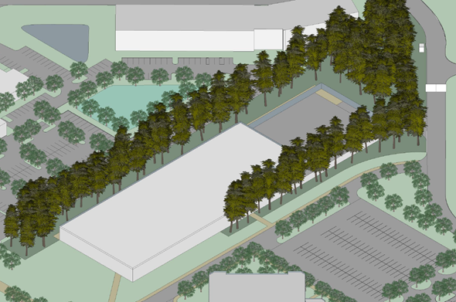
JLDC Site Plan (Currently 2 Options)
JLDC data points
Warm lit shell cost not to exceed $43M (VA Commonwealth funding)
Square Footage: ~60,000 sq ft total/ 21,000 - 24,000 sq ft data center floor
LEED Gold
Redundant, diverse paths for utilities (power, water, fiber, etc.)
Raised data center floor
JLDC building useful lifespan: 50 years

Slide 12
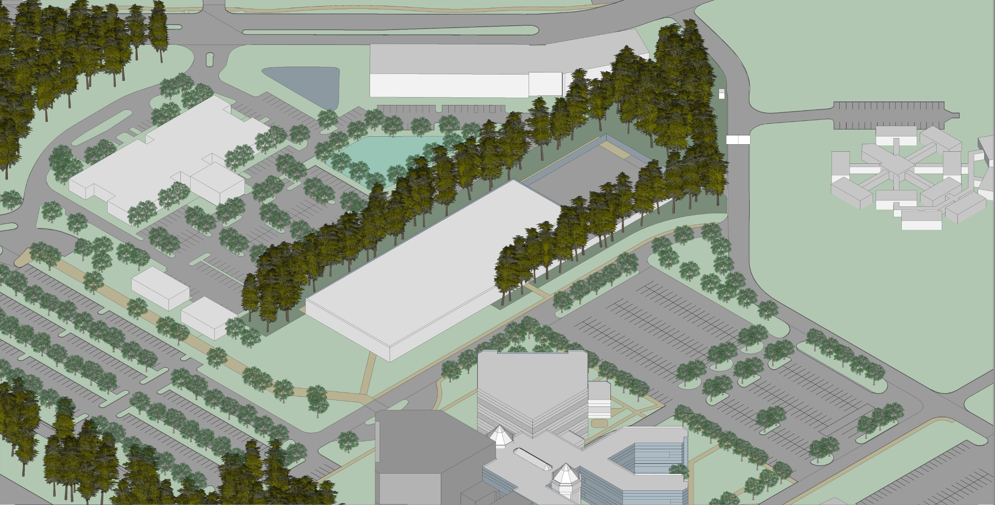
JLDC Site Location
SSC (Bldg. #28)
SURA Residence Facility (Bldg. #6)
Future JLDC
(Bldg. #14)
CEBAF (Bldg. #12)

Slide 13
Summary and Outlook
Identifying individual team scope & deliverables in the context of CD-1 achievement
Currently: Lean team (per budget)
Much work to do – we must be efficient, with Lab Leadership support
HPDF Project guided by the IPT, by design & intention
"Studies indicate a positive correlation between the level of performance of an IPT and the degree of success in project execution. This is especially true for large, complex, and technically challenging projects that involve multiple stakeholders, tight budgets and schedules. In all cases, DOE capital asset projects have a much better chance of succeeding when an FPD works together with a competent and committed IPT."*
Quantified asks of JLab to support the success of the HPDF Project in progress
Plan resources needed to achieve: Conceptual Design, JLDC Design reviews, HPDF CD-1
Staffing plan post-CD-1 in progress
Forward looking plans for HPDF Facility (in parallel)
*= https://www.directives.doe.gov/directives-documents/400-series/0413.3-EGuide-18A-admchg1/@@images/file

