Slide 1
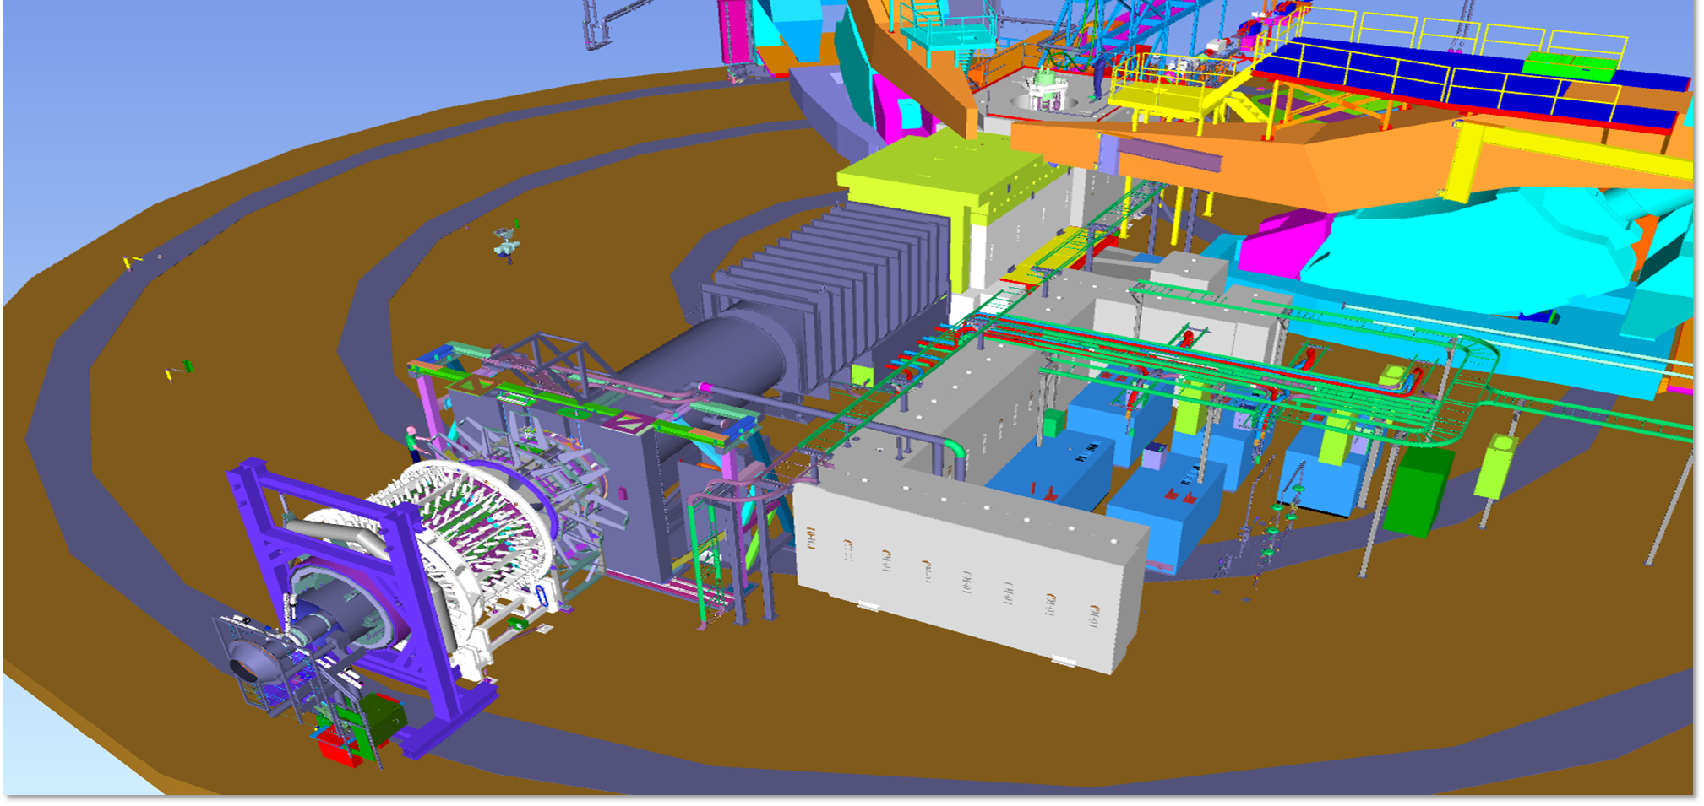
Measurement of Lepton-Lepton Electroweak Reactions (MOLLER)
Name of Presenter
Mark Jones (Hall A Leader)
Ruben Fair (MOLLER Project Manager)
Presented To:
JSA S & T Mission Committee
Date of presentation
Dec 10th 2024

Slide 2

Outline…
Measurement of Lepton-Lepton Electroweak Reactions (MOLLER)
The MOLLER MIE, in conjunction with the NSF and CFI/RM grants, will provide JLab with the equipment and systems needed to perform the most precise measurement to date of the parity violating asymmetry, APV, in electron-electron scattering, and thus the weak charge of the electron, Q^{e}_{W}.
Such a measurement would constitute more than a factor of five improvement in fractional precision.
The experiment will essentially utilize electron-electron interactions as a very sensitive test for physics beyond the standard model , including possible electron-structure

Slide 3
Contents
Physics – Mark Jones
DOE MIE Updates – Ruben Fair
  Status Table
  Installation in Hall A
    Project Approach, KPPs, Scope, Program Integration
  FY2024 Highlights
  Project Performance
  Quality Assurance
  Environment, Safety and Health
  Staffing
  Risks
  Summary and Outlook

Slide 4

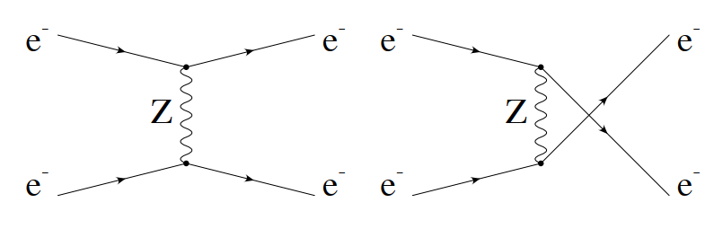
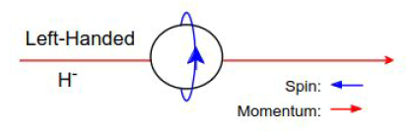
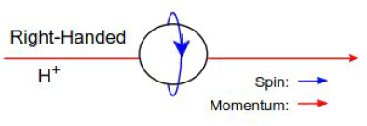
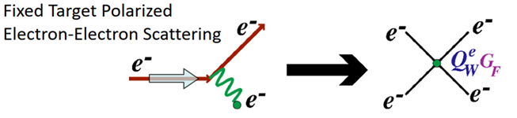


Physics: Ultra-precise Measurement of Weak Mixing Angle
Measure Parity Violating Asymmetry in Moller scattering with polarized beam
γ,
γ,
Parity Violating Asymmetry gives access to the weak charge of the electron
Experiment conditions
      Beam: Energy ~11 GeV, I= 65uA, Pol = 90%
Beam helicity flipped at 2kHz
125cm liquid hydrogen target
Moller scattering angles 60-120 COM
                Scattered electron energy = 2 - 8 GeV
                Q² = 0.0056 GeV²
Theoretical prediction accurately calculable with negligible hadronic uncertainty
A_{PV} ~ 32 +/- 0.8 ppb
HUGS, 2024

Slide 5
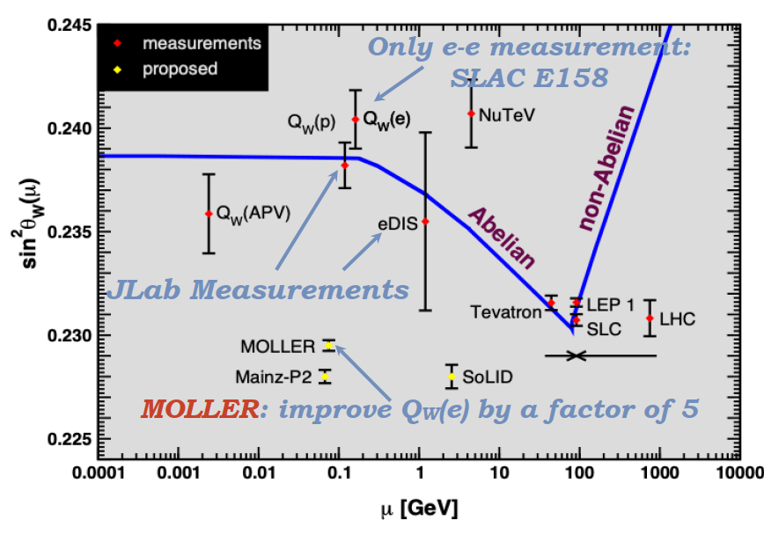
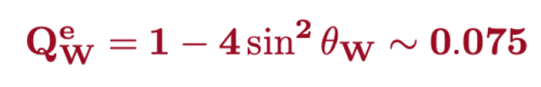
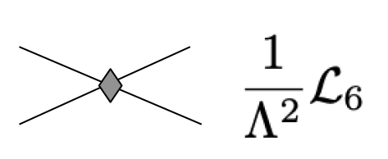
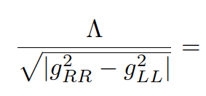

Physics: Sensitive to Physics Beyond the Standard Model
ΔQ^{e}_{W} = +/- 2.1% (stat) +/- 1.1% (syst)
Δ(sin²Θ_{W}) = +/- 0.00023 (stat)
+/- 0.00012 (syst)
Unique sensitivity to TeV scale physics coupling more to leptons than to quarks
HUGS, 2024

Slide 6
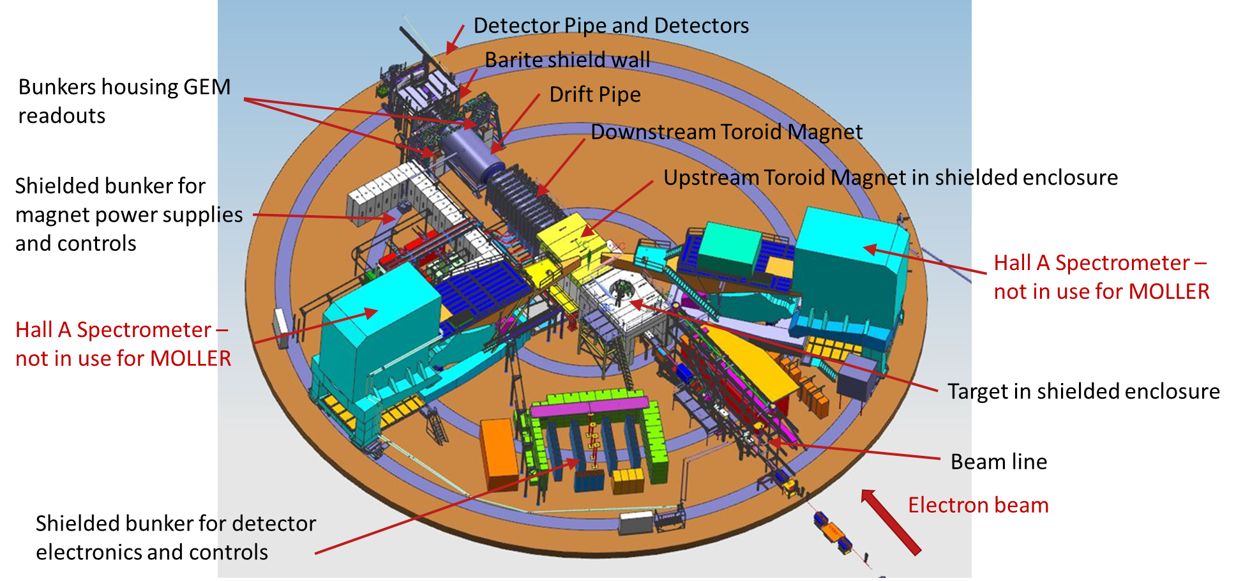
MOLLER Installation in Hall A

Slide 7
MOLLER Project Approach
MOLLER has a Project Execution Plan (PEP) and Program Management Plan (PMP) which,
  Establish policies and procedures to manage and control project planning, initiation, definition, execution, and transition/closeout
  Use the outcomes and outputs from all project planning processes, integrating them into a formally approved document
  Includes an accurate reflection of how the project is to be accomplished, resource requirements, technical considerations, risk management, configuration management, and roles and responsibilities
  → MOLLER is a DOE O413.3b MIE project which is baselined (CD-2/3 Approval obtained in May 2024))

Slide 8
Key Performance Parameters
The KPPs remain unchanged since CD-1
CD-4 Approval requires demonstration of Threshold KPPs.
The KPPs are defined in such a way that they can be demonstrated with
cosmic rays and/or low current beam prior to the transition to operations.
The Objective KPP criteria represent performance stretch goals and the basis for the baseline scope, schedule and budget.
The Ultimate Performance Parameters (UPPs) describe the performance required to achieve the science outcome upon which the mission need was based. The UPPs will be able to be verified after several months of operations.

Slide 9
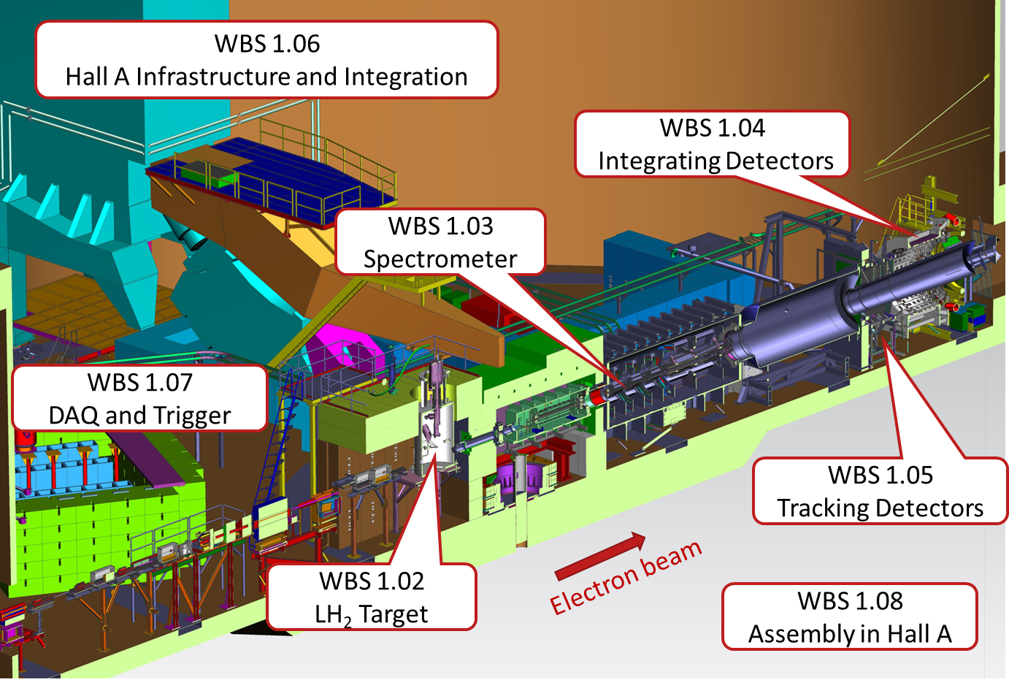
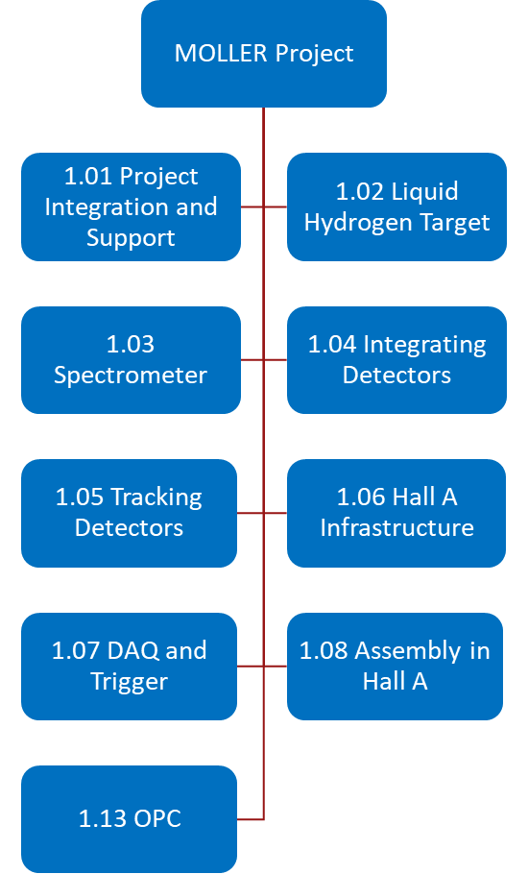
DOE MIE Project Scope

Slide 10
MOLLER Program Scope (DOE, NSF and CFI/RM)
Targets
  LH₂ target (1.25m length, 3.7KW)
  Solid (C, Al) targets and motion system
Spectrometer
  7-fold symmetry upstream & downstream toroids in vacuum enclosures
  Tungsten/copper beam collimators and lintels to sculpt spectrometer acceptance
  Beam pipes, windows and bellows from the target vessel to the beam dump
Integrating Detectors
  Quartz integrating detector modules and readout electronics (224+28 thin quartz and 28+7 ShowerMax)
  Lead donut and pion detectors (28)
  Scattered beam monitors
Tracking Detectors (GEMs)
  Four tracking stations upstream of integrating detectors (16+12 modules)
  One layer integrated with pion detectors
  Moller polarimeter electron detectors
Infrastructure
  Reconfiguration of incoming beam line to accommodate target moved 4.5m upstream from normal location
  Shielding bunkers around target, first beam collimators, electronics & DAQ
  HV and LV power supplies and cables
DAQ and Trigger
  Co-design between DOE/NSF/CFI
  Integrating mode preamplifiers and ADC boards
  Flash ADCs, VETROC, and trigger decision modules for both integrating and counting mode operations
  Online computing and networking
Assembly in Hall A
  Assembly of all sub-systems
  Survey and Alignment
  Validation of KPPs

Slide 11
Project Dependencies
The MOLLER experiment will require the completion of several enhancements of JLab facilities, currently being developed for general use, but that are outside the scope included in the MIE. Note that the MOLLER KPPs only rely on completion of two of these dependencies.
Hall A Power/Water Upgrade: An upgrade of the Hall A power and Low Conductivity Water (LCW) capabilities has been completed as of FY22. → COMPLETED in FY22. Required to demonstrate Spectrometer KPPs (Required for CD-4)
End Station Refrigerator Upgrade: The JLab End Station Refrigerator (ESR-2) project will replace the aging End Station Refrigerator for efficient four-hall operations. → COMPLETED in FY24/Q3 (required to demonstrate Objective KPP for target performance (Not required for CD-4)
Polarimetry: A common approach to high-precision polarimetry in Halls A and C is being implemented. → This includes the ongoing operations upgrades to the Halls A and C high-field MOLLER polarimeters towards improved consistency, and the work to make the Halls A and C Compton polarimeters near-equivalent.
MOLLER Quality Beam: JLab injector, accelerator, and beam delivery diagnostics are being developed and implemented. → The injector upgrade is proceeding, with the collaboration verifying that beam quality meets expectation at each stage
Hall A Beam Line: Hall A beam line diagnostic cavities and instrumentation will be installed and operational, capable of ensuring the needed helicity-dependent beam position measurements and helicity-dependent beam charge measurements. → The beam current calibration instrumentation for the Hall A beamline has been purchased and is ready for assembly into the MOLLER beamline, which is otherwise part of the project under WBS 1.06 Hall A Infrastructure
Offline Software and Computing: → Physics analysis software is a research contribution from the user community.

Slide 12
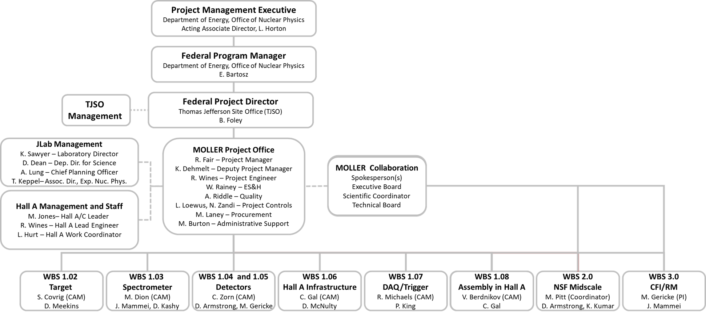
MOLLER Program Integration

Slide 13
Status Table [Oct 2024]

Slide 14
FY2024 Highlights
Independent Project Review (IPR) in Oct 2023
  All recommendations closed.
Received CD-2 / CD-3 Approval in May 2024
  Approve Performance Baseline/Start of Construction
Completed DOE Surveillance Review of JSA’s EVMS in Sep 2024
  Corrective Action Plan in place
88% ($6.3M) of CD-3A procurements have been awarded
  Remainder ($726K) still to be awarded
To date we have taken delivery of $7M worth of procurements
  We have another $6M of procurements to go
Technician team of 3 FTEs assigned to Spectrometer build in Test Lab
11 of the 13 technicians needed for assembly in the hall in FY25/26/27 have been identified
  Any shortfalls to be addressed via hiring strategy in conjunction with the EIC project

Slide 15
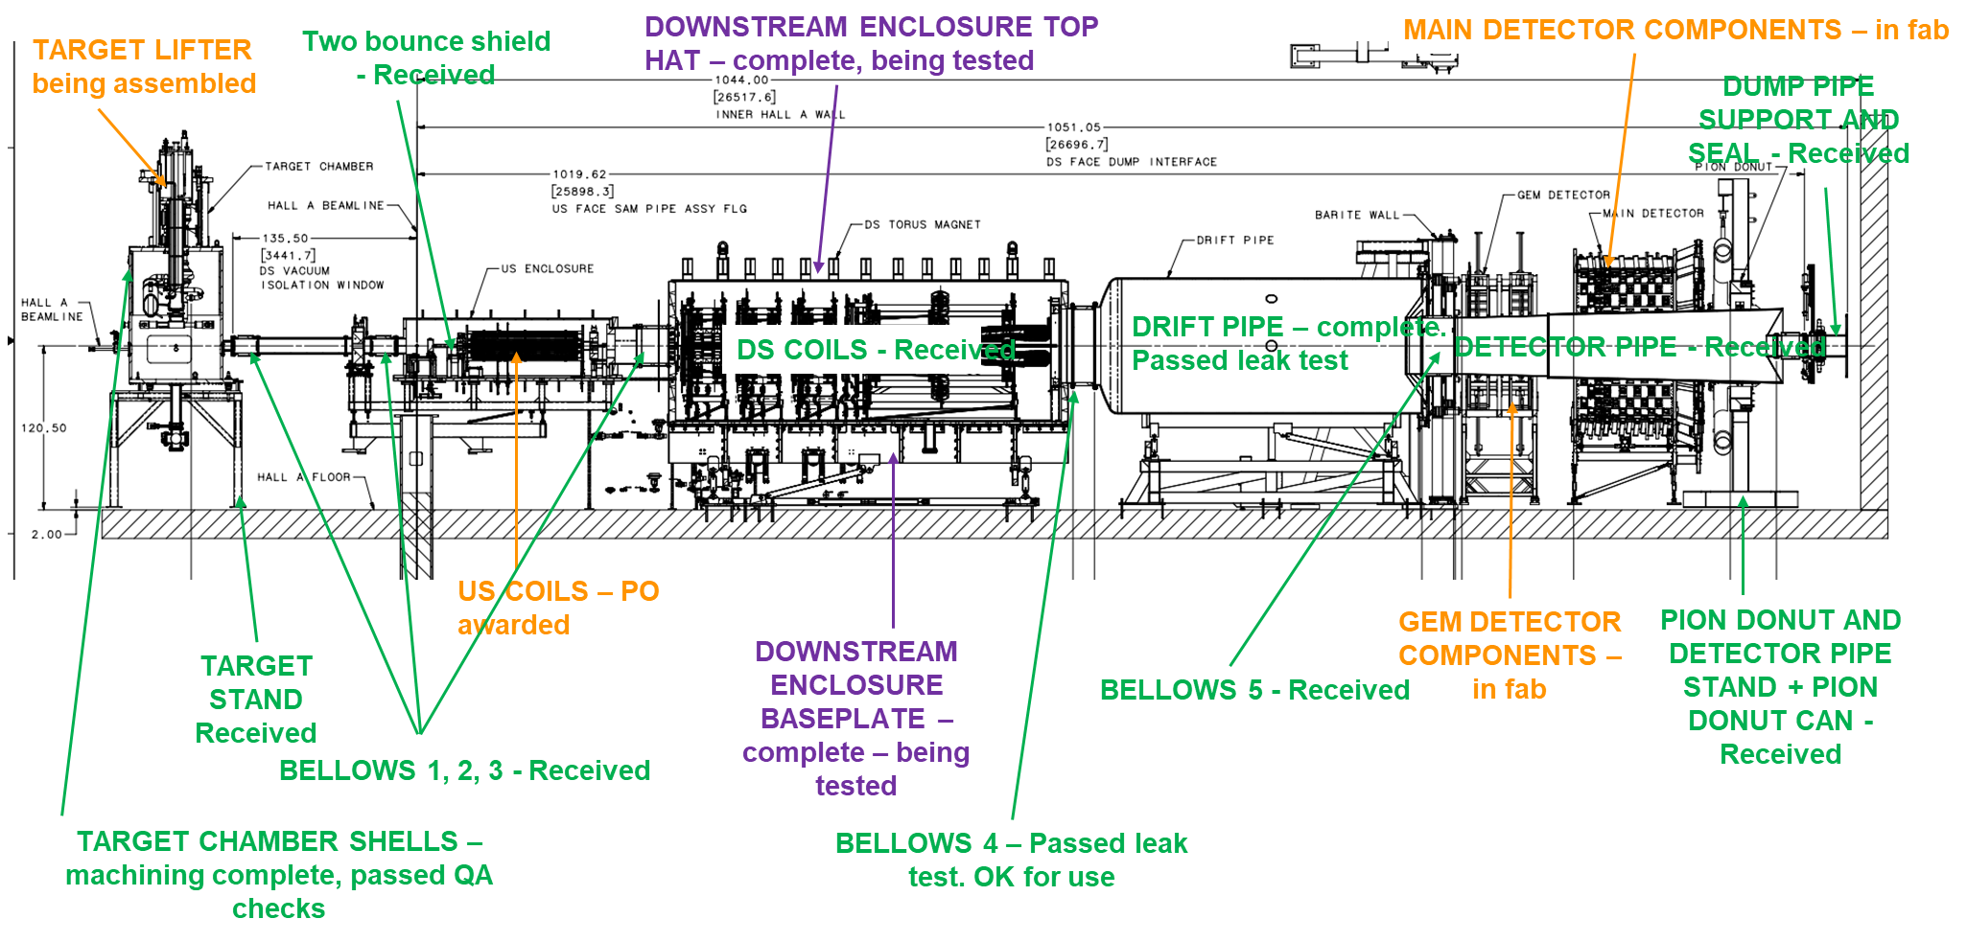
FY2024 Highlights

Slide 16
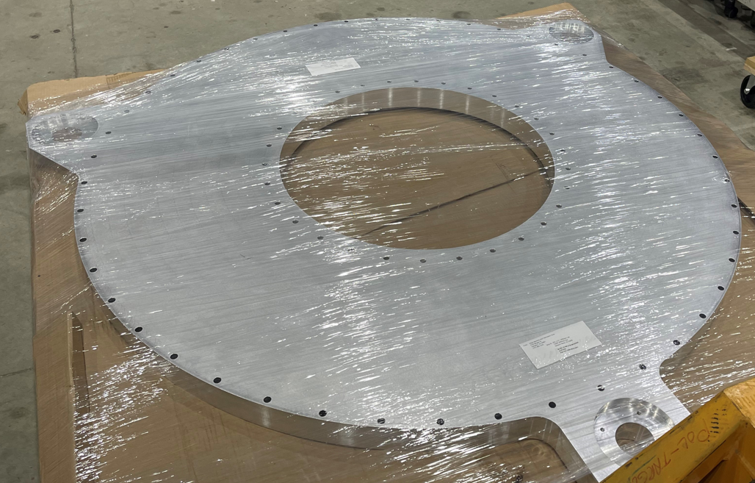
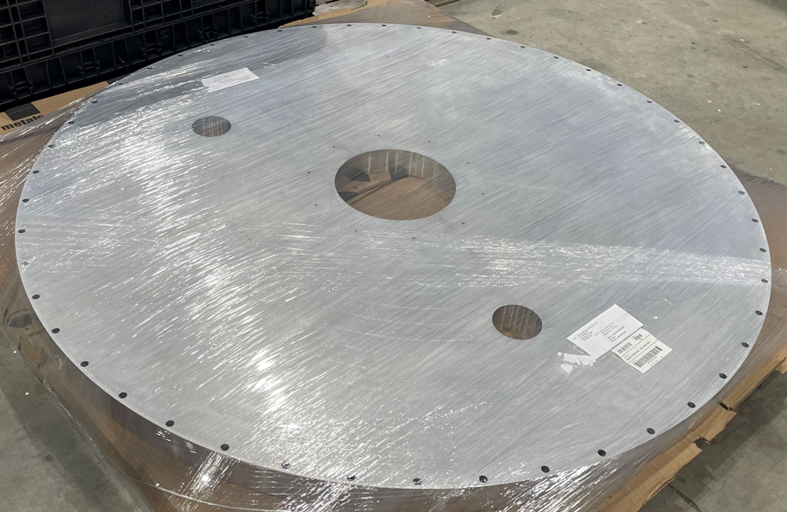
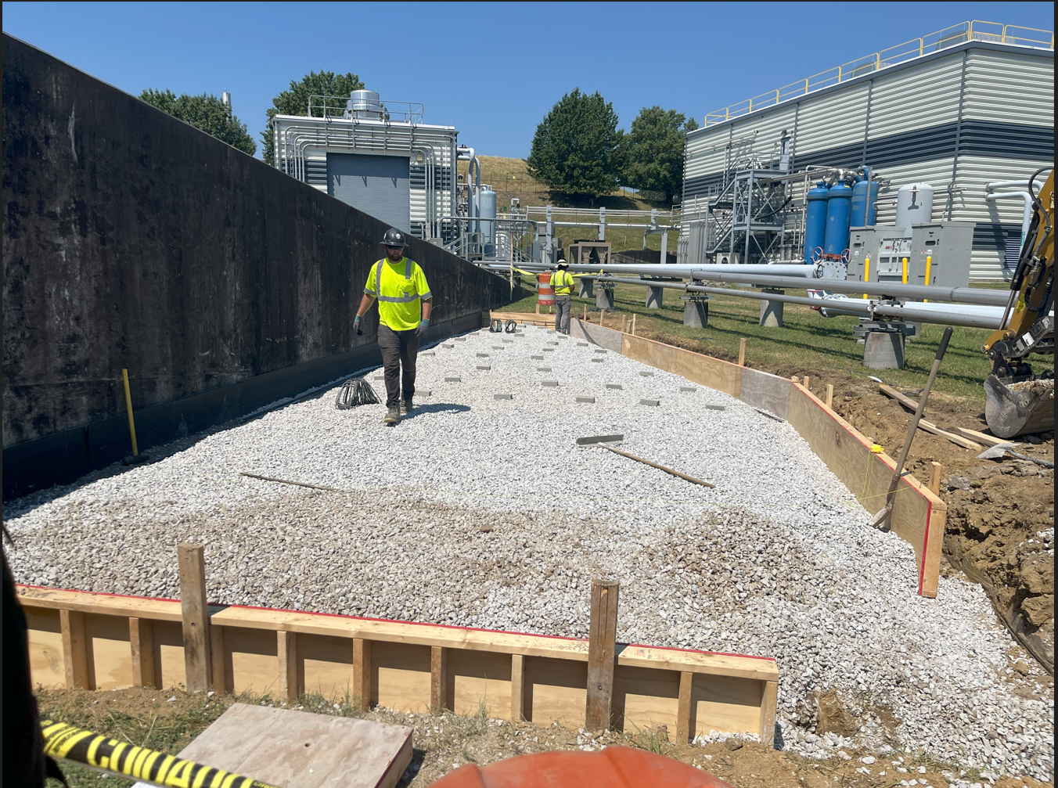
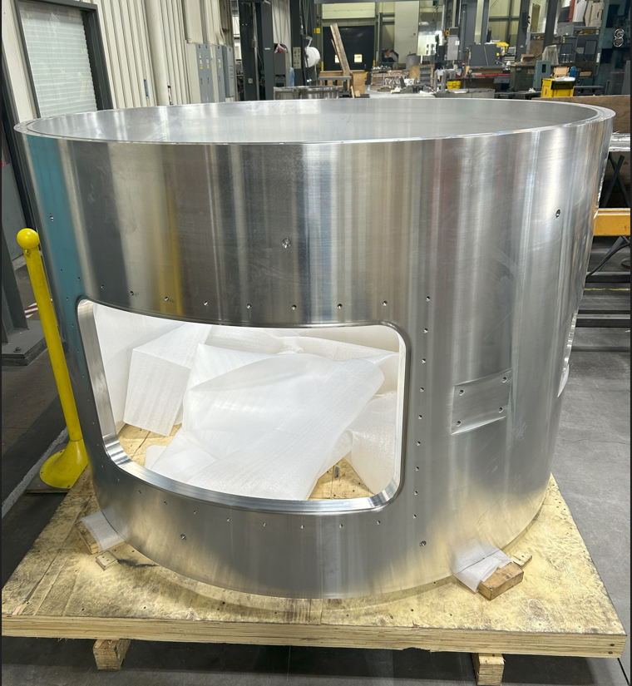
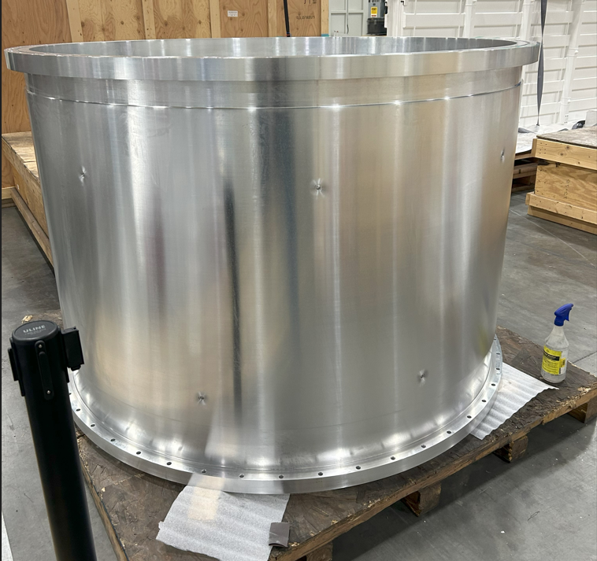
FY2024 Highlights – WBS 1.02 Target
Jan 2024 – Chamber shell endplates received
June 2024 – Concrete pad being poured (for hydrogen tanks)
Nov 2024 – Chamber shells – machining complete

Slide 17
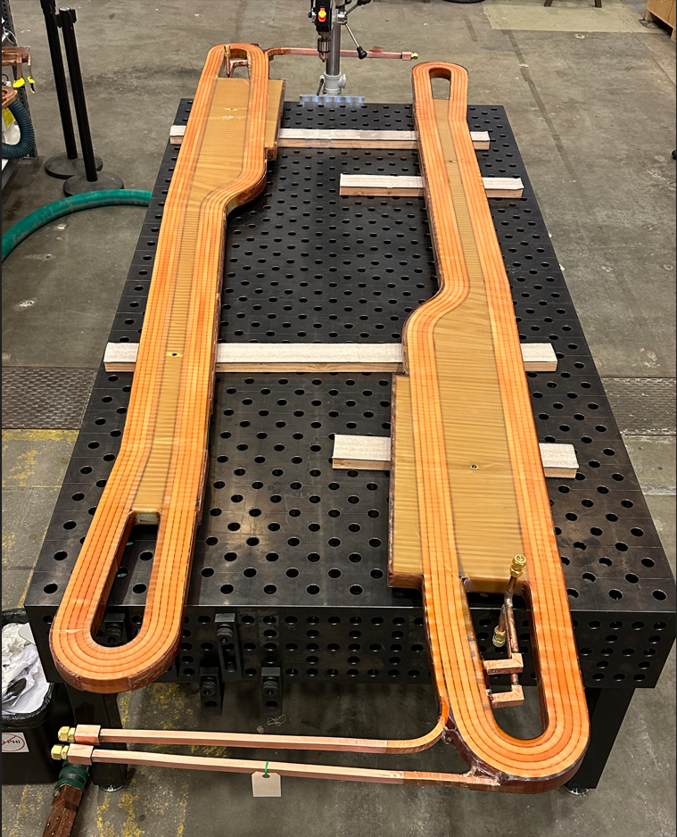
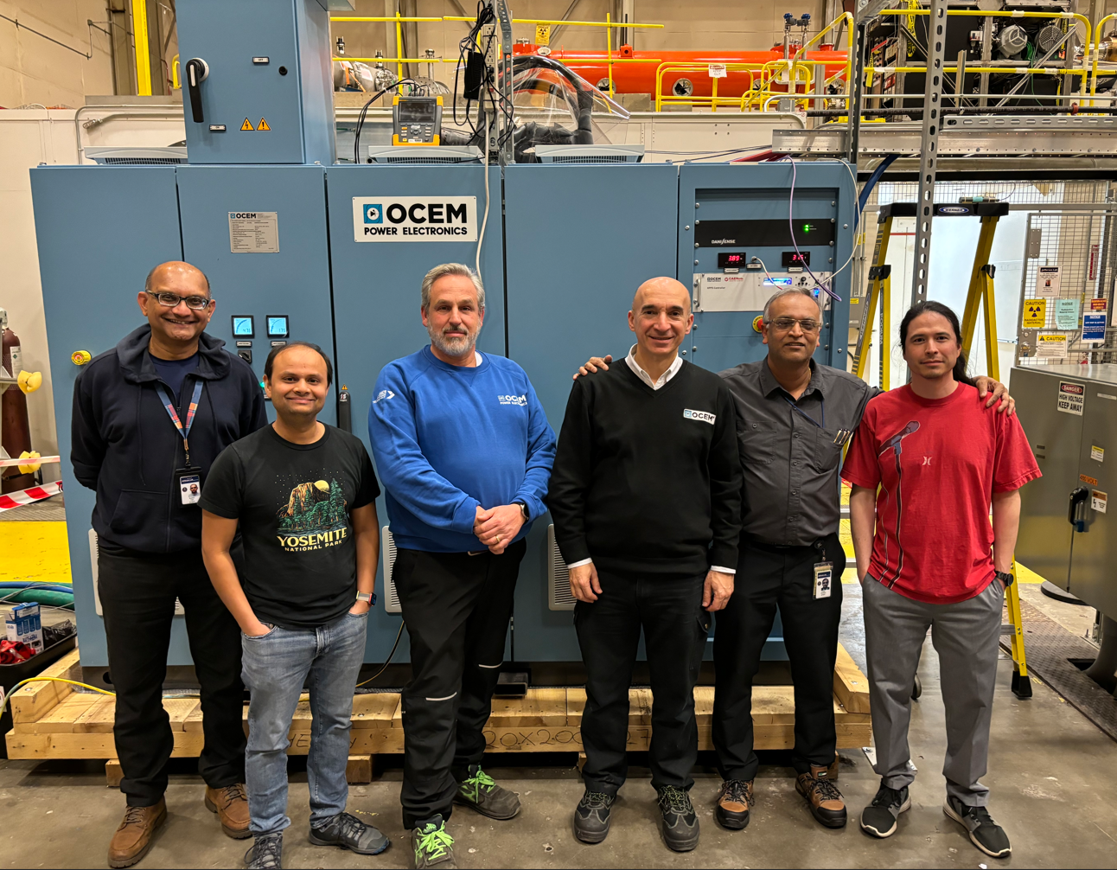
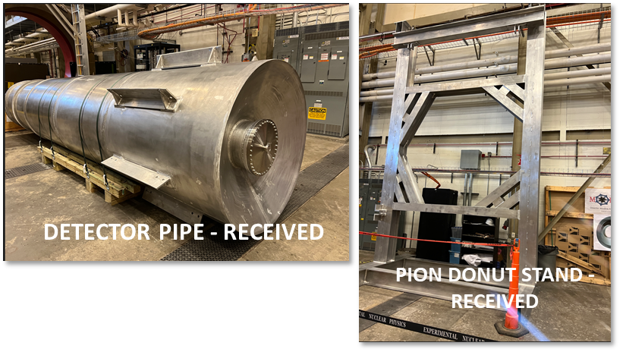
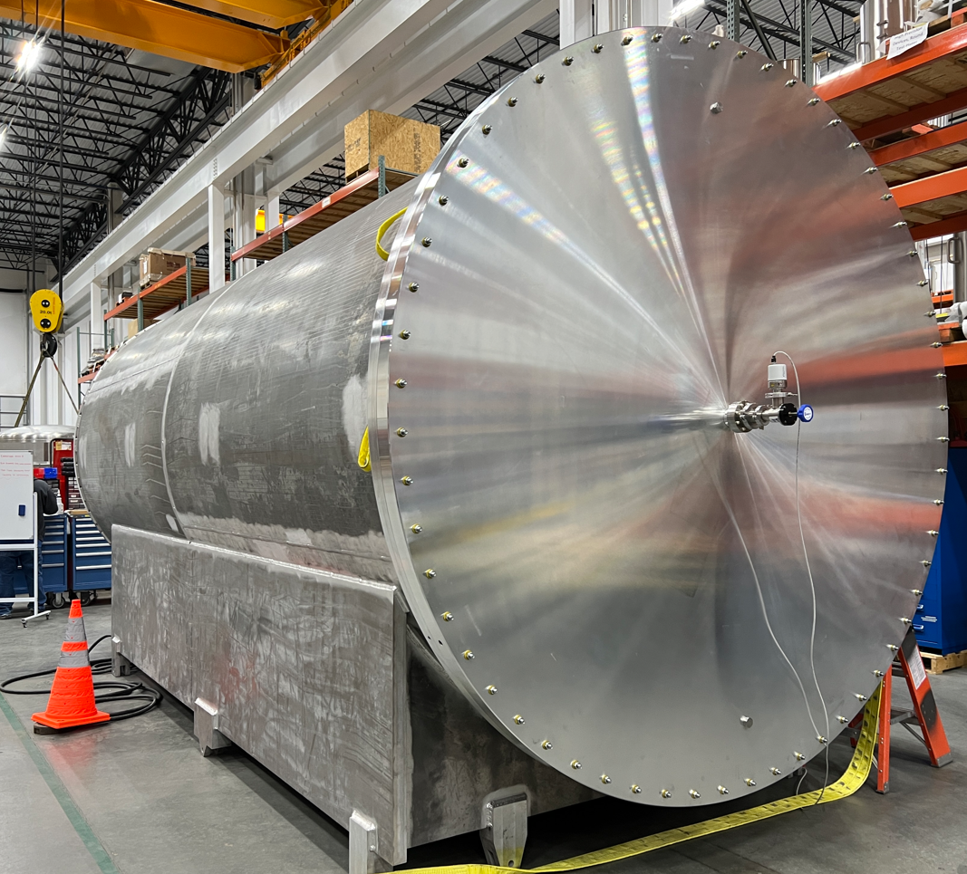
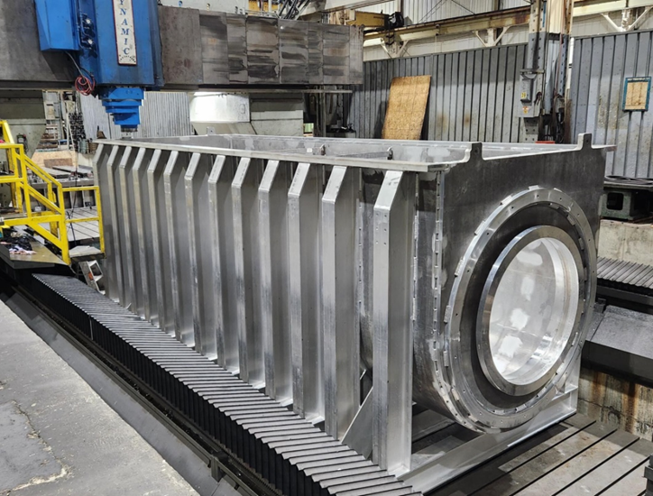
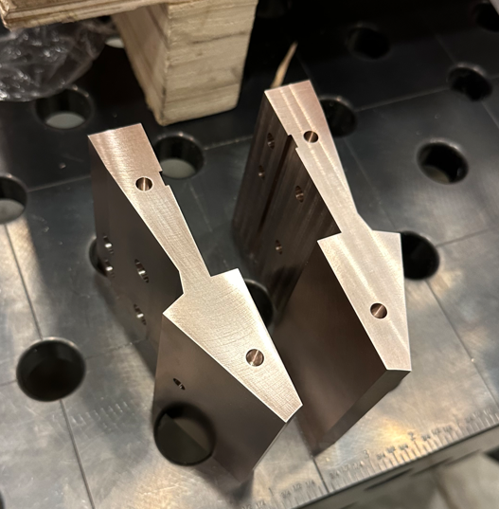
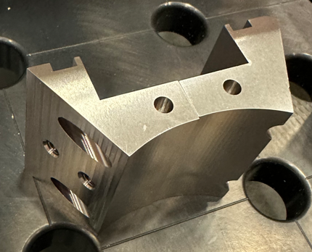
FY2024 Highlights – WBS 1.03 Spectrometer
Successful Site Acceptance Test of prototype power supply at JLab
All downstream toroid coils received
Drift pipe passed leak test
Collimators for coils received
DS enclosure fabrication complete – to be tested

Slide 18
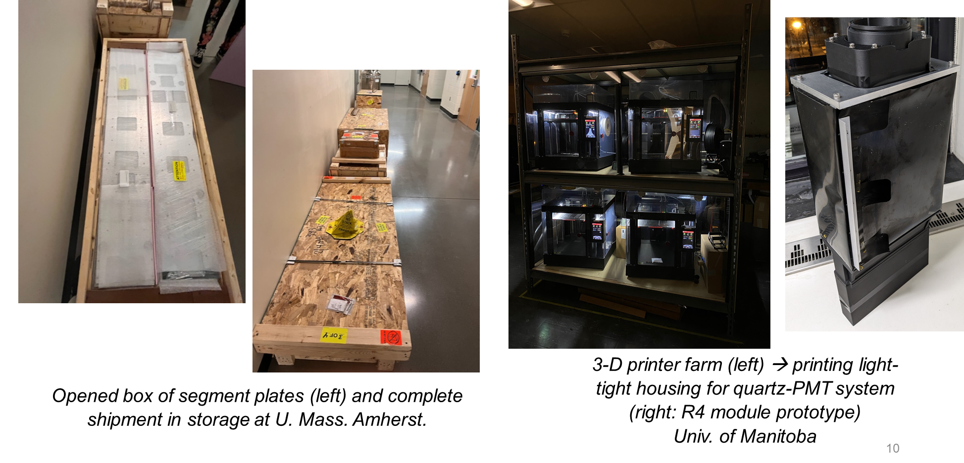
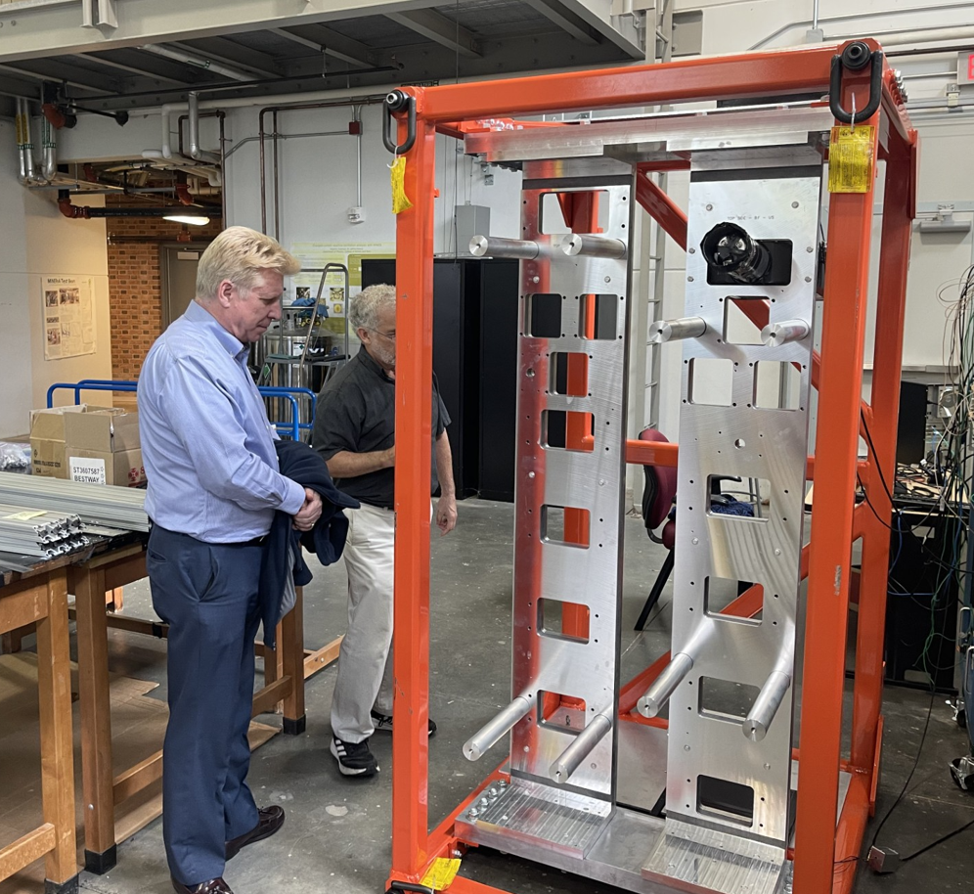
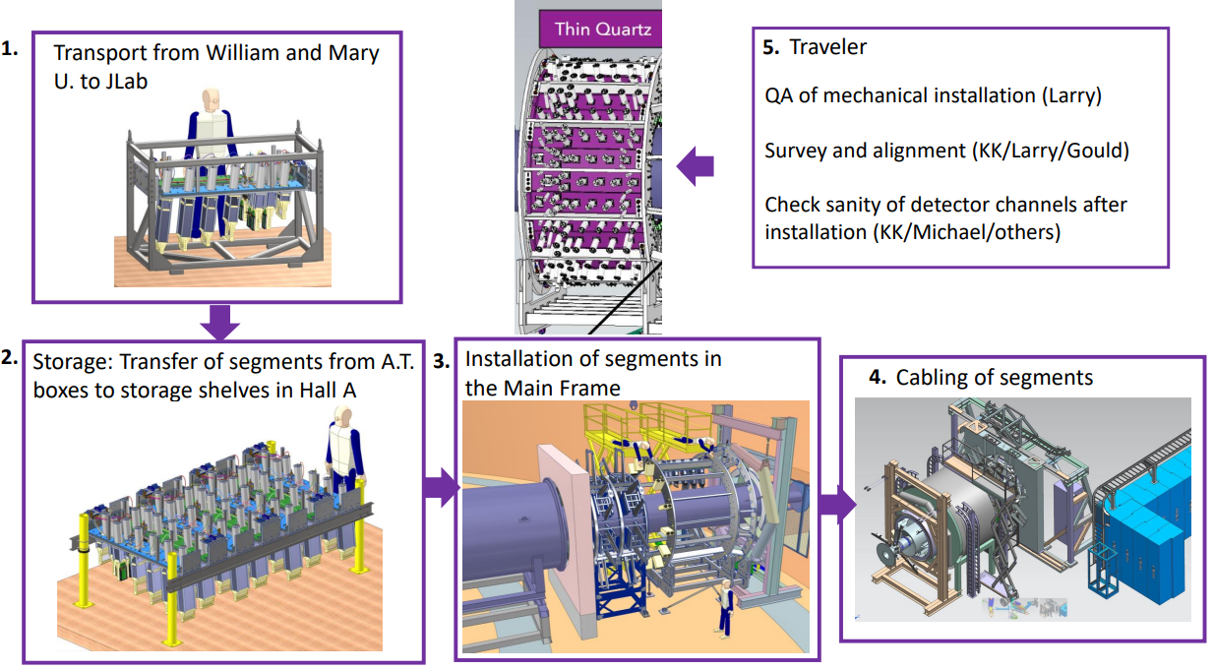
FY2024 Highlights – WBS 1.04 / 1.05 Detectors
MOLLER Federal Project Director visiting the high bay at William and Mary.
Assembly and Test stand for main detector components
Draft installation instructions being developed

Slide 19
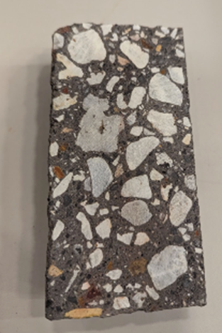
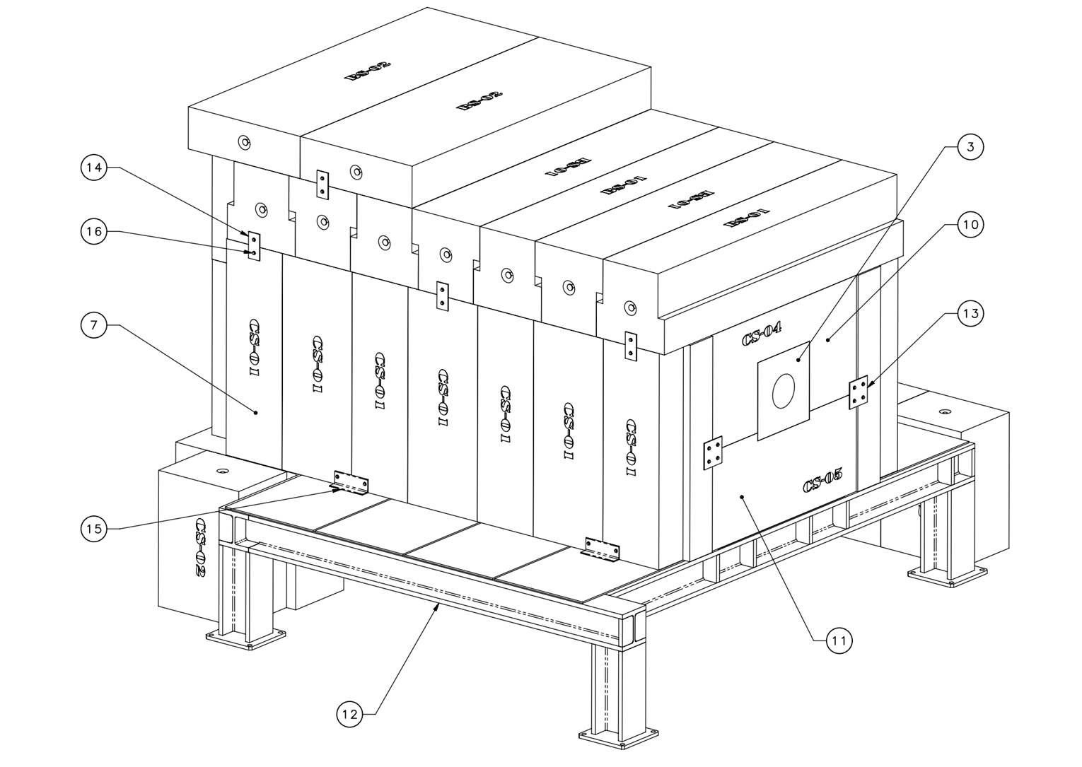
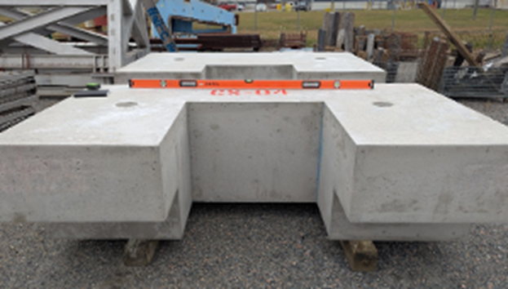
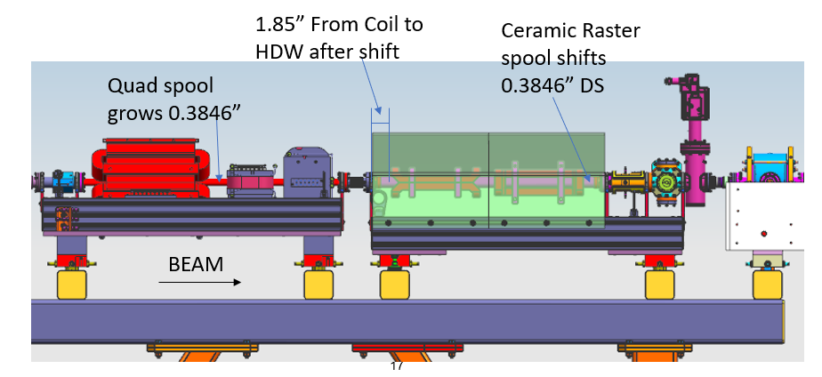
FY2024 Highlights – WBS 1.06 Infrastructure
Shielding Blocks
Left: High density concrete sample; Right: Prototype standard concrete blocks
Upstream beamline modifications

Slide 20
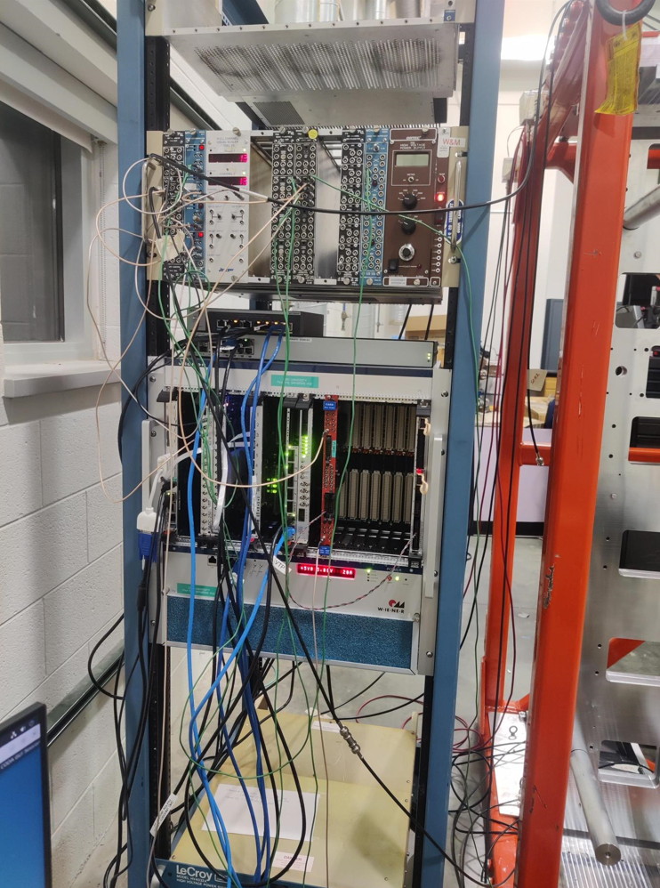
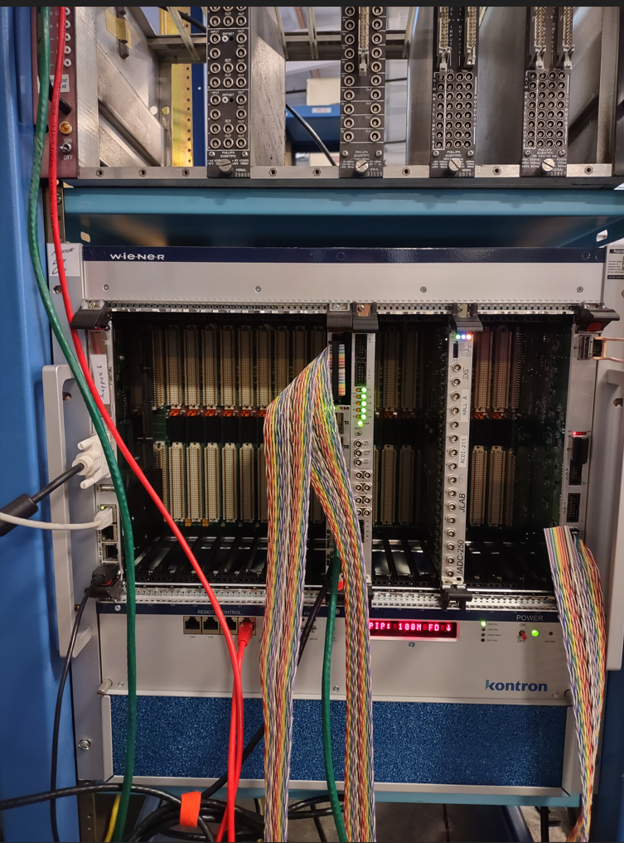
FY2024 Highlights – WBS 1.07 DAQ and Trigger
DAQ VXS crate (center of the rack) at William and Mary with a NIM-based trigger (top of the rack) for detector checkout.
The VXS instrumentation includes 32 channels of FADC readout (2 modules) for 8 scintillators and 16 thin quartz detectors, as well as the CODA Trigger Interface, Signal Distribution, and VXS Trigger Processor cards.
VXS crate with a CPU, VTP, SD, FADC and TI at JLab.
This setup will be used to develop the MOLLER experiment counting DAQ trigger.
TI: Trigger Interface --- Interfaces between crates and coordinates the entire data acquisition system
SD: Signal Distribution --- Communicates with the TI over the crate backplane, and sends the trigger and clock from it to the front-end modules
VTP: VXS Trigger Processor --- FPGA module which receives data from the front-end modules to be able to form a trigger decision. The front-end modules are streaming data to the VTP, which generates a potential trigger; this trigger goes to a master-TI which ensures the DAQ is ready to process an event then issues a trigger to all of the client TI modules in all the crates.

Slide 21
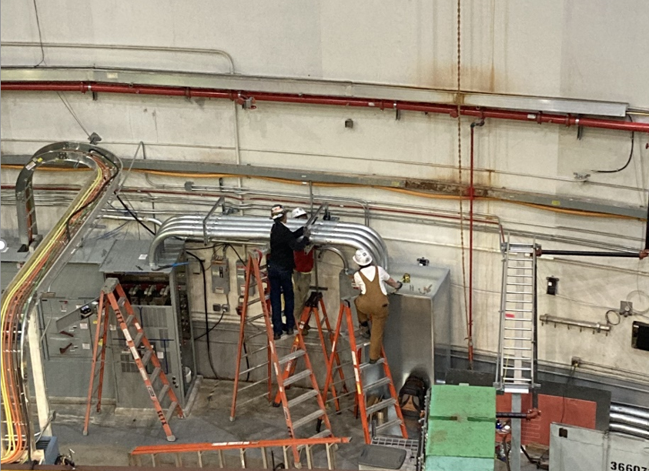
FY2024 Highlights – WBS 1.08 Assembly in the Hall
Other work completed in the hall early
  Jib crane installation (75% complete)
  Dump pipe support installation (75% complete)
  → will be completed in CY2025
Electrical switchgear and conduit work completed in the hall (for Spectrometer toroid magnets power supplies) – completed one year early

Slide 22
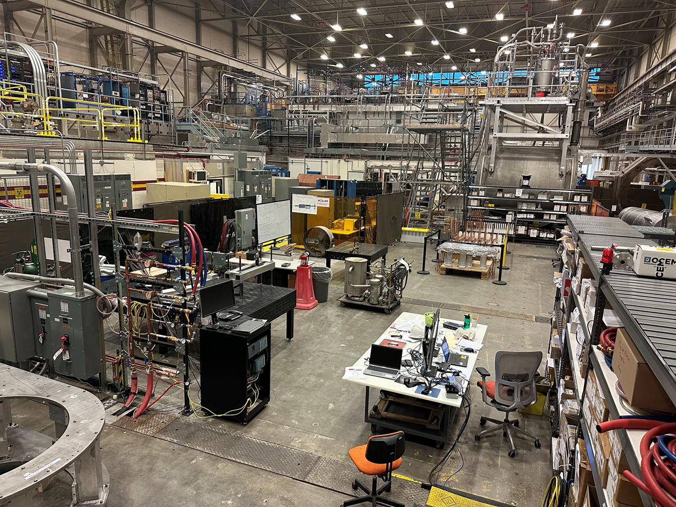
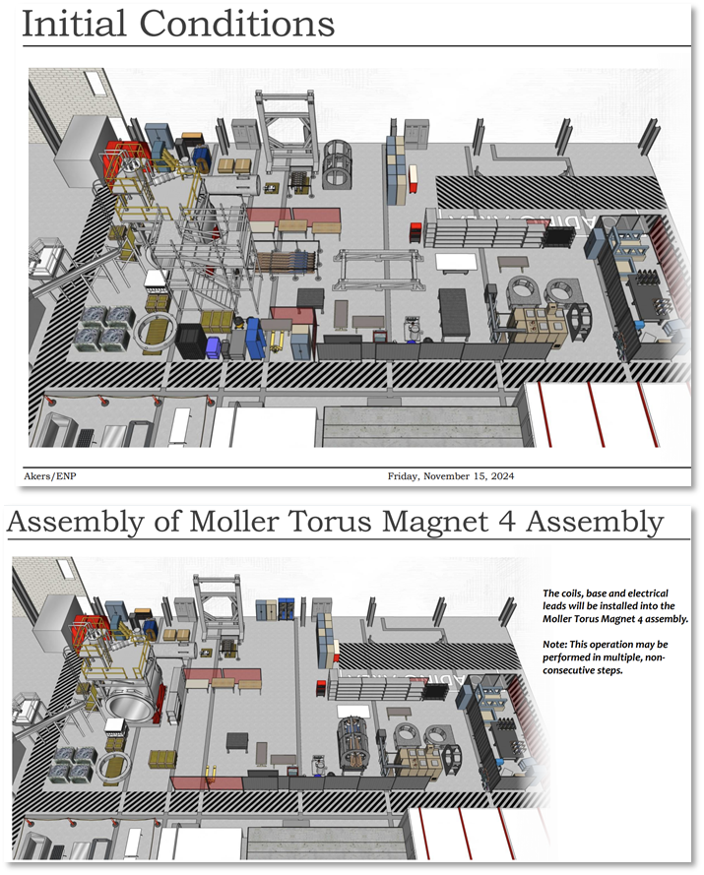
JLab Test Lab – Spectrometer Assembly Area / Space Planning

Slide 23
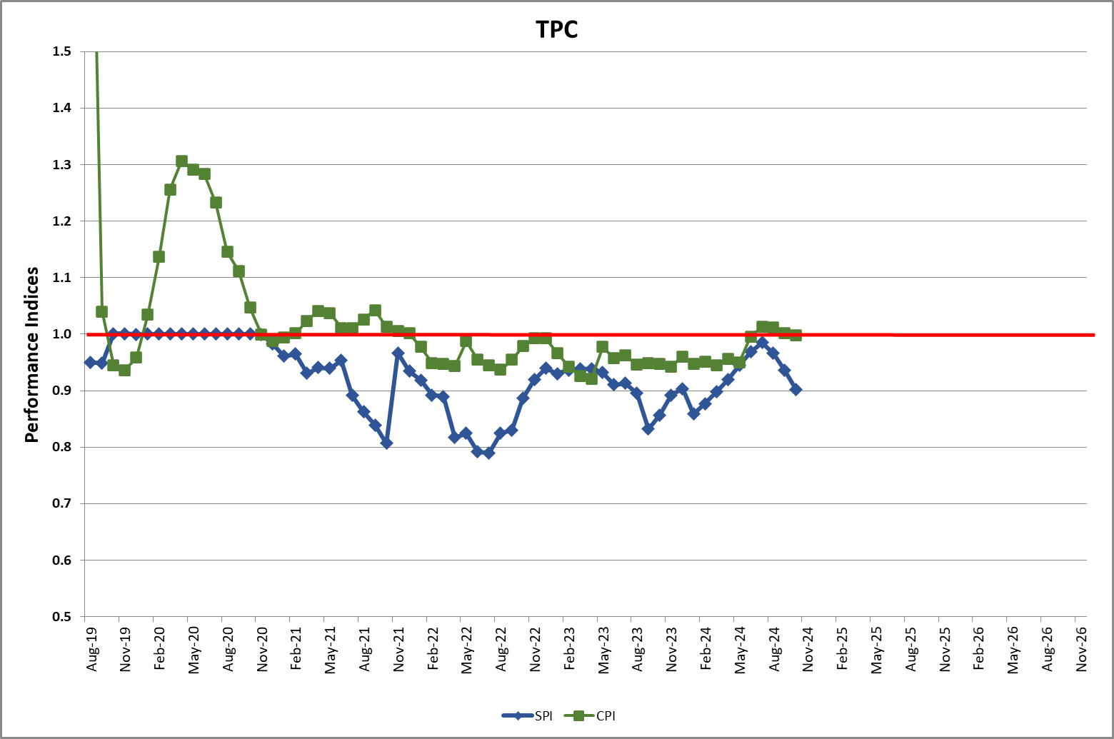
Project Performance [Oct 2024]
Budget at Completion (BAC) = $42.5M
Project is approx. 53.9% complete
Performance - Overall Project: SPI = 0.9, CPI = 1.00 ; CD-3A Procurements: SPI = 0.79, CPI = 1.06
See later slide for contributory factors and mitigations to improve schedule performance

Slide 24
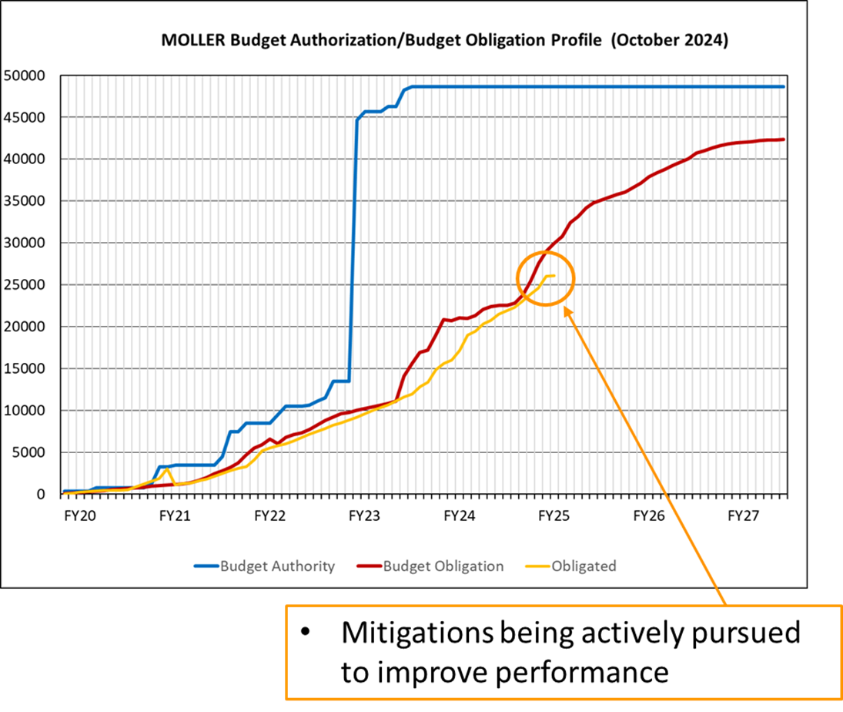
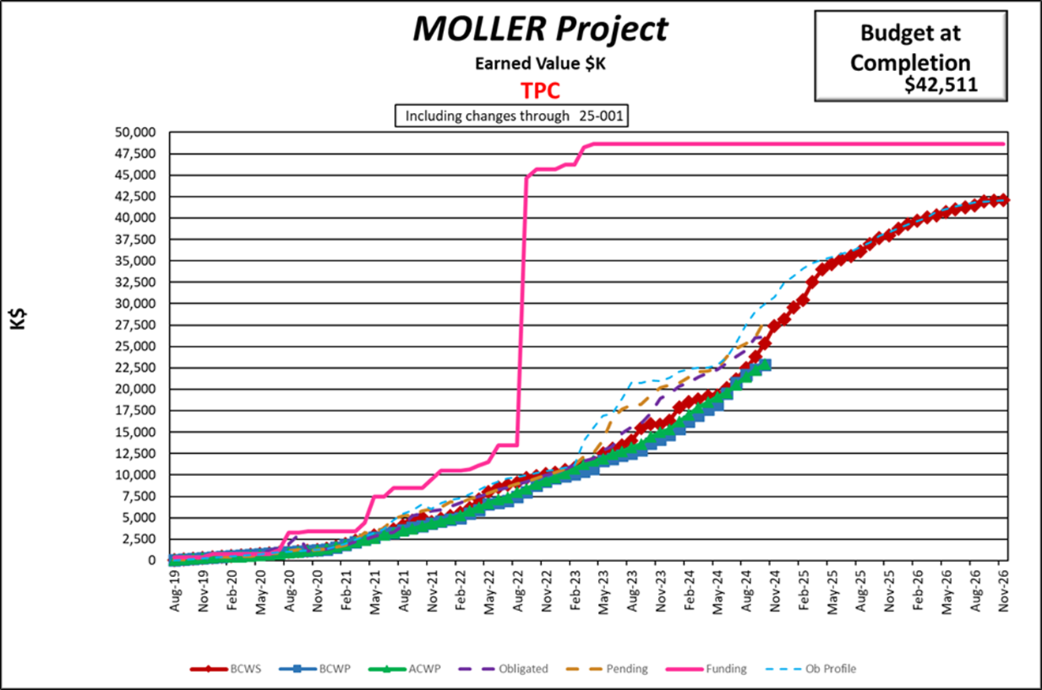
Project Performance [Oct 2024]

Slide 25
Project Performance [Oct 2024]
There are 5 contributory factors that have led to the deteriorating schedule performance between the months of June (when the project was baselined) and November 2024.
  Continuing poor CD-3A performance in particular for the upstream torus (Baselined in March 2023)
    Decision was made in Feb 2024 to use another organization (not MIT BATES) to complete upstream torus CD-3A and CD-2/3 work.
    Main delay between June and Oct was the lengthy University of Wisconsin (Physical Sciences Laboratory) contract negotiation which was eventually stopped, and contract switched to an independent engineering company who are proving to be more agile and responsive
  Access to stable resources: 60% impact (see back-up slide)
  Safety pause and notable event: 20% impact (see back-up slide)
  Supply Chain: 15% impact (see back-up slide)
  Purchasing Changes: 5% impact (see back-up slide)
  Mitigation efforts being actively pursued to improve schedule performance:
    Efforts are focused on awarding remaining CD-3A procurements by end of CY2024, but this is dependent on receiving bids from capable vendors.
    Job postings prioritized for Target and Magnet Groups
    Employing dedicated (non-matrixed) technician resources for Spectrometer Test Lab work (in place as of Nov 2024)
    Streamlining purchasing procedures e.g. the use of Blanket Order Arrangements to speed up purchasing using P-Cards.
    Lab Director and Deputy Director engagement in prioritizing resource needs in support of MOLLER
    PM is developing a recovery plan - which primarily includes obtaining additional resources and resequencing of activities

Slide 26
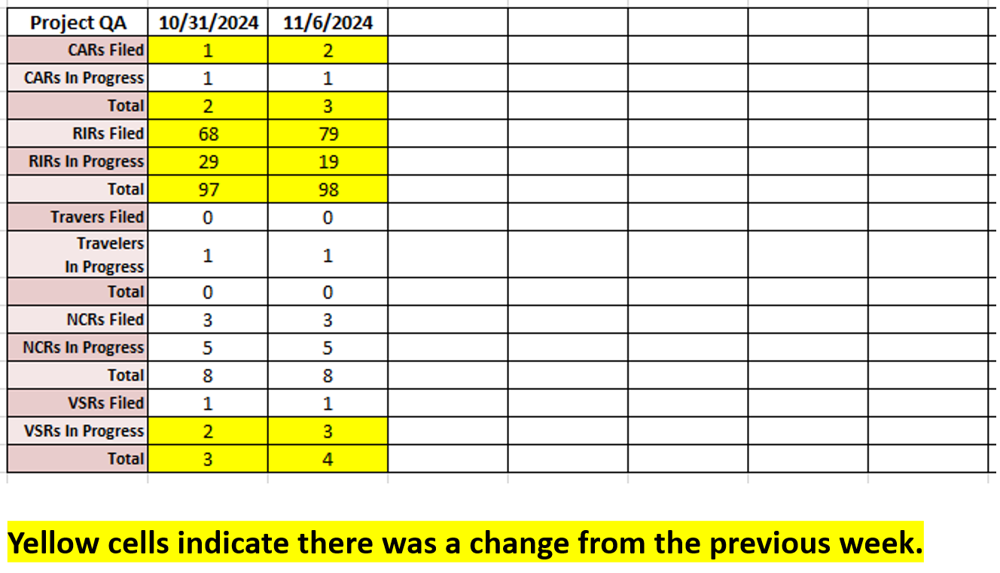
MOLLER Quality Assurance
Record of QA documents in use
We have a Quality Engineer matrixed to the project
We have developed Quality Assurance procedures and processes for the project
  CARs – Corrective Action Requests
  RIRs – Receipt Inspection Reports
  Travelers
  NCRs – Non-Conformance Reports
  VSRs – Vendor Surveillance Reports
HUGS, 2024

Slide 27
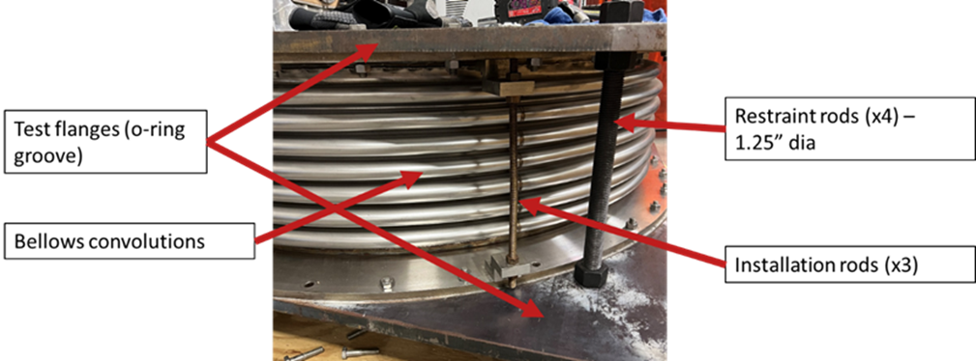
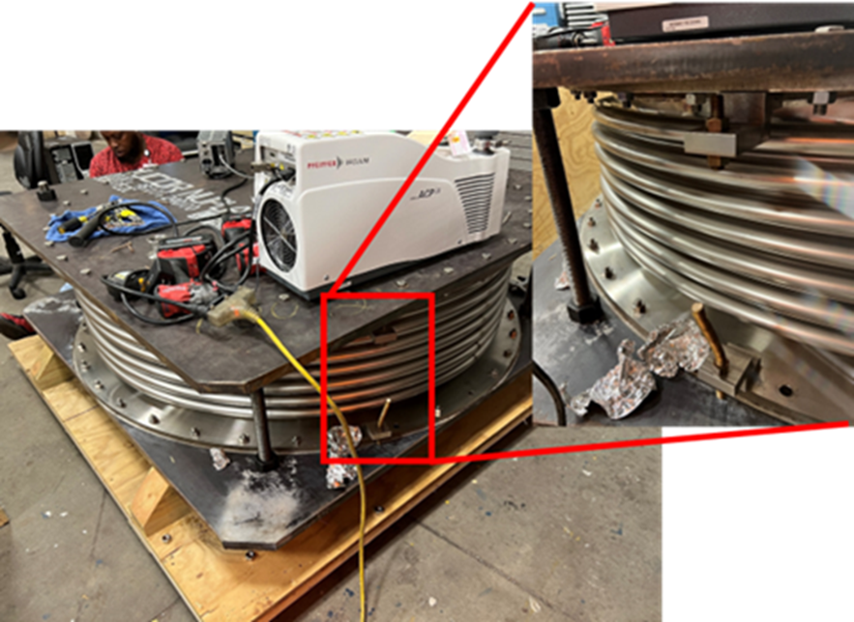
MOLLER Environment, Safety and Health
We have a ES&H Engineer matrixed to the project
We have had one notable event on the project (August 2024)
  Bellows vacuum incident during pump down
    Broken installation rods
  Work was stopped and ES&H and management informed
  No one was injured
  Causal analysis investigation was carried out and completed in October
    5 corrective actions: 3 completed, 2 to start (due for completion in Mar 2025)
  Bellows was retested and found to be undamaged, therefore suitable for use on the project
  The team reacted correctly when the incident occurred.
  Lessons learned have been disseminated to the rest of the team, other projects and the lab
HUGS, 2024

Slide 28
MOLLER Staffing [Nov 2024]
Project Controls Analyst​
    1.25 FTE on the project
    Additional support from two other PCAs – as required​
Technicians​
Spectrometer Assembly in Test Lab (FY25) – 3 FTEs assigned (1 FTE already on-board, 1 FTE started on Nov 18th, 1 lead FTE to join team in Dec 2024)​
Assembly in Hall A (FY25/26/27) – 11 out of 13 mech techs identified. Remainder to be identified internally by end Dec 2024 or a decision will be made to hire.​
All resources will be secured via the laboratory’s Annual Work Planning (AWP) system.​
Risk Analyst​
Contract to be set up with the Data Science group at PNNL to provide quantitative risk analyses for projects like MOLLER with a mature P6 file, as well as qualitative risk analyses for less mature projects - Quotation received and reviewed, contact being finalized​
Engineers and Designers​
Job postings out, recruitment underway
HUGS, 2024

Slide 29
3 High Risks
LATE DELIVERY OF MAGNET POWER SUPPLIES - R3.12 The vendor has received 95% of all critical items and 98% of all long lead items for the remaining power supplies.
  → They are still on schedule to deliver to JLab by May 2025
  → On target to reduce risk to MEDIUM once fabrication is complete in Dec 2024.
UNAVAILABILITY OF BARITE SHIELDING - R6.05a The team has partially mitigated this by reducing the number of barite shielding blocks needed and are also working with a local vendor to develop the manufacturing process for these blocks.
  → The team now has a path forward – local vendor (ideal option) + backup vendor (potentially higher cost option)
  → On target to reduce risk to MEDIUM by end Jan 2025 – alternative ilmenite mix option may be acceptable.
INSUFFICIENT TECHNICIAN RESOURCE - R8.02 Sufficient workforce might not be available for the installation in Hall A. This risk will be mitigated by setting up a formal written agreement with the laboratory to secure this resource.
  → Project management is finalizing the agreement with resource providers throughout the laboratory and aiming to secure this resource by end December 2024; 11 out of the 13 required staff members have already been identified. MOLLER will work the EIC project team to ensure resources can be identified and shared
  → On target to reduce risk to MEDIUM by end Dec 2024.
HUGS, 2024

Slide 30
Summary and Outlook
Project received CD-2/3 in May 2024 – Approval of Performance Baseline and Start of Construction
Project is 54% complete
The three remaining high risks are on target to be downgraded over the next few months
Contingency at 30% of ‘To-Go’ work is adequate for this stage of the project
Mitigation efforts are actively being pursued to improve project schedule performance

