Slide 1
BioMedical Research and Innovation Center (BRIC)
Cynthia Keppel
Associate Director for Physics
Presented To:
JSA S&T Mission Committee
December 11, 2024

Slide 2
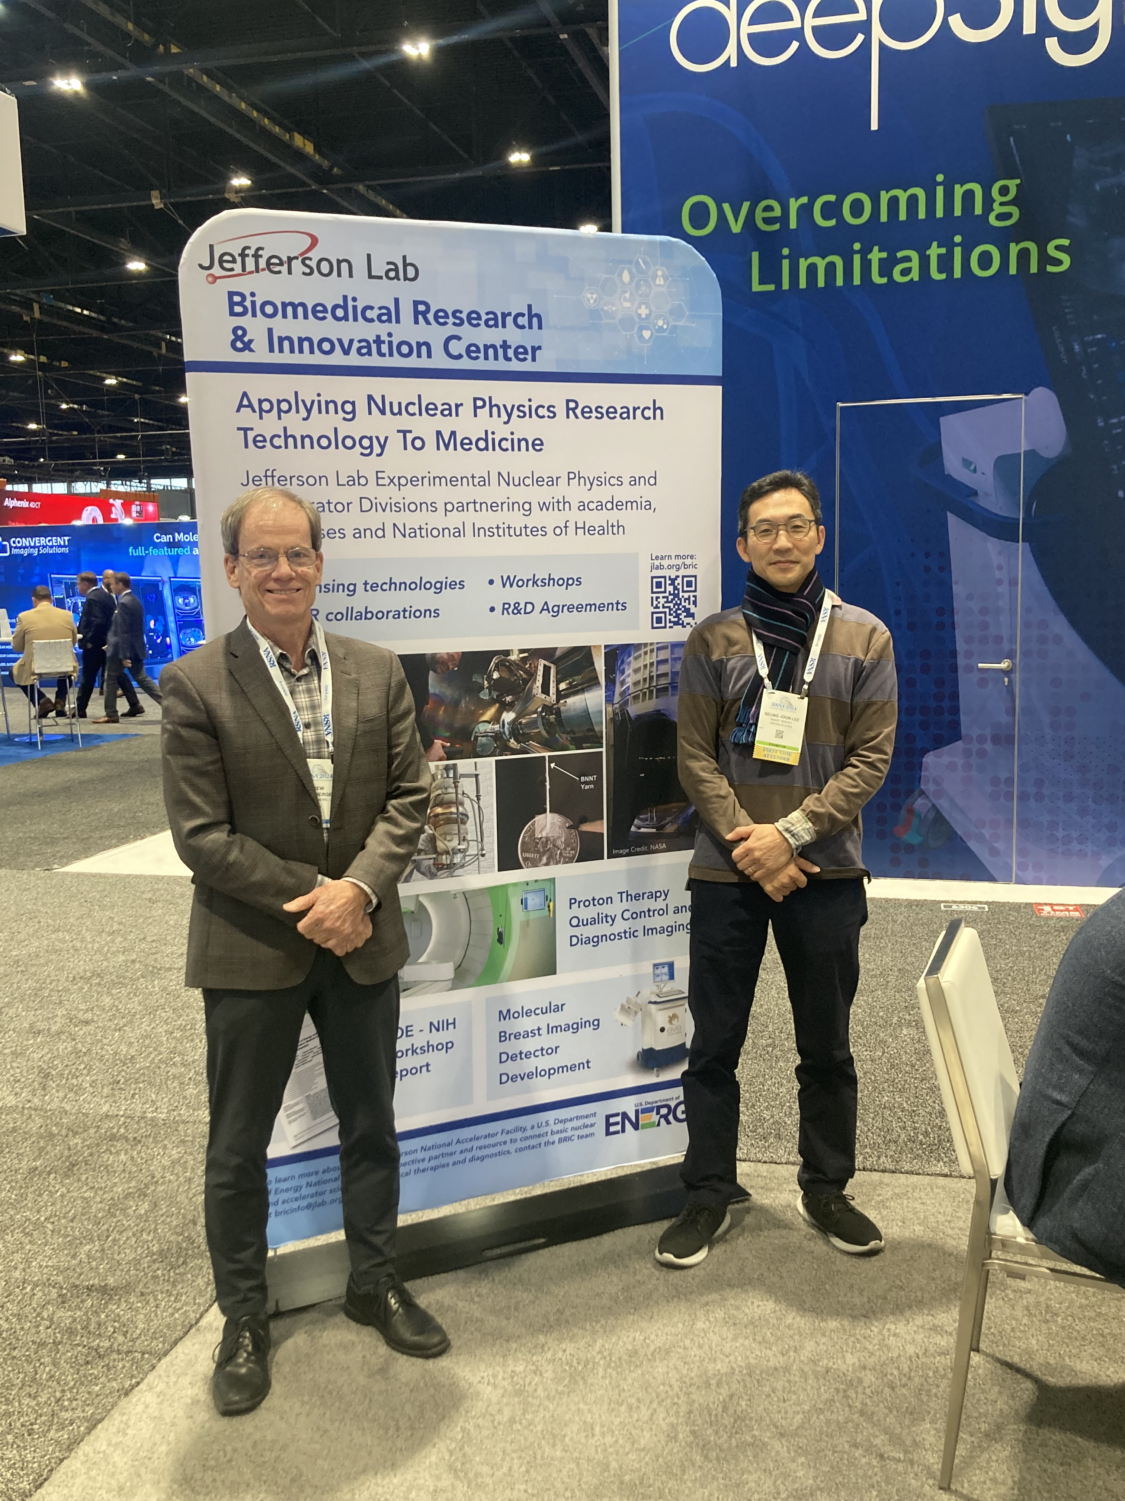

Biomedical Research and Innovation Center
The JLab Biomedical Research and Innovation Center (BRIC) is established:
to be a central hub to highlight to both internal and external stakeholders the health, biological and medical related applications of Jefferson Lab’s technical expertise and
to provide a supportive, collaborative environment in which existing and future biomedical efforts can thrive and expand.
BRIC Poster at RSNA 2024

Slide 3
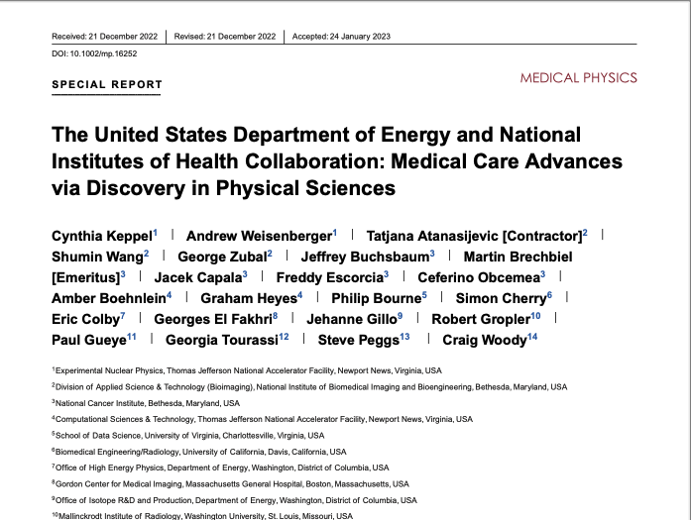
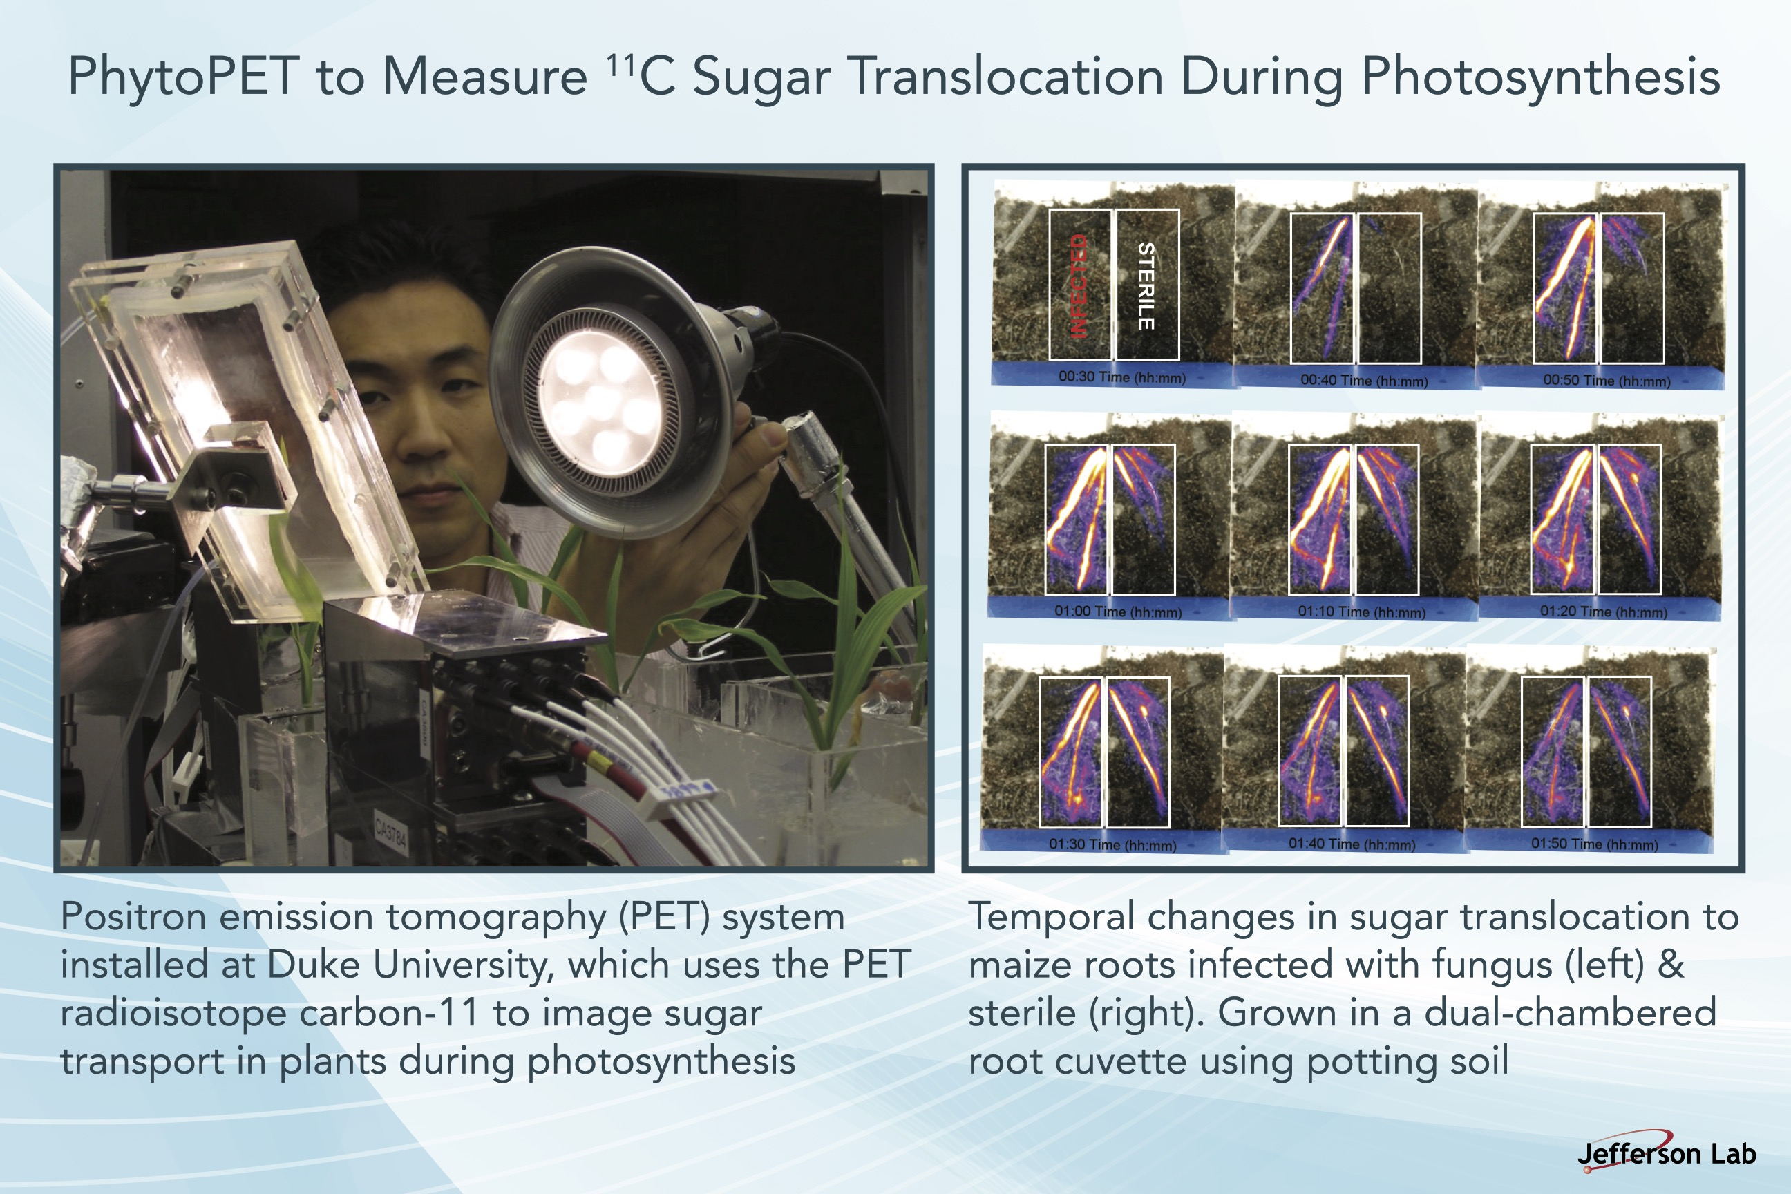
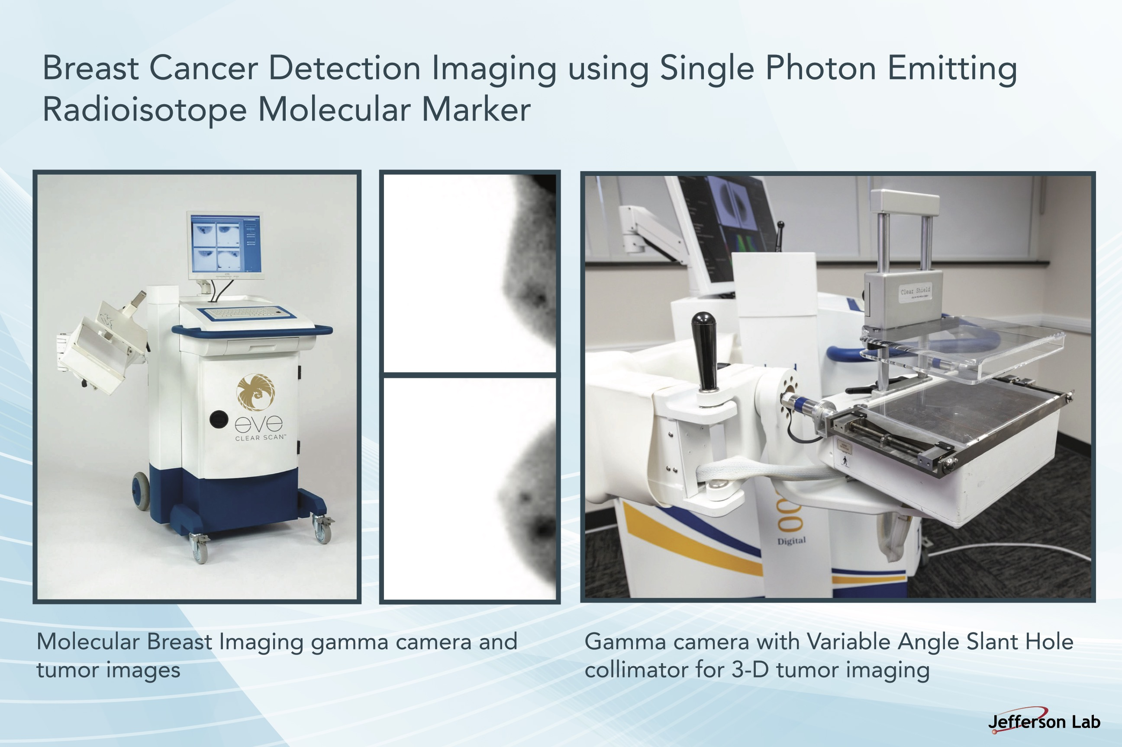
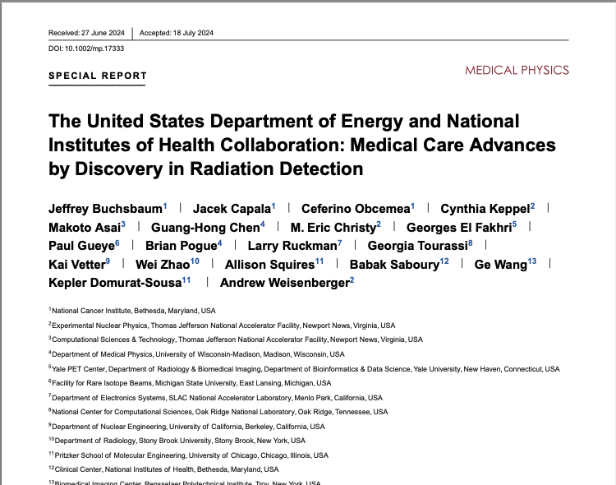
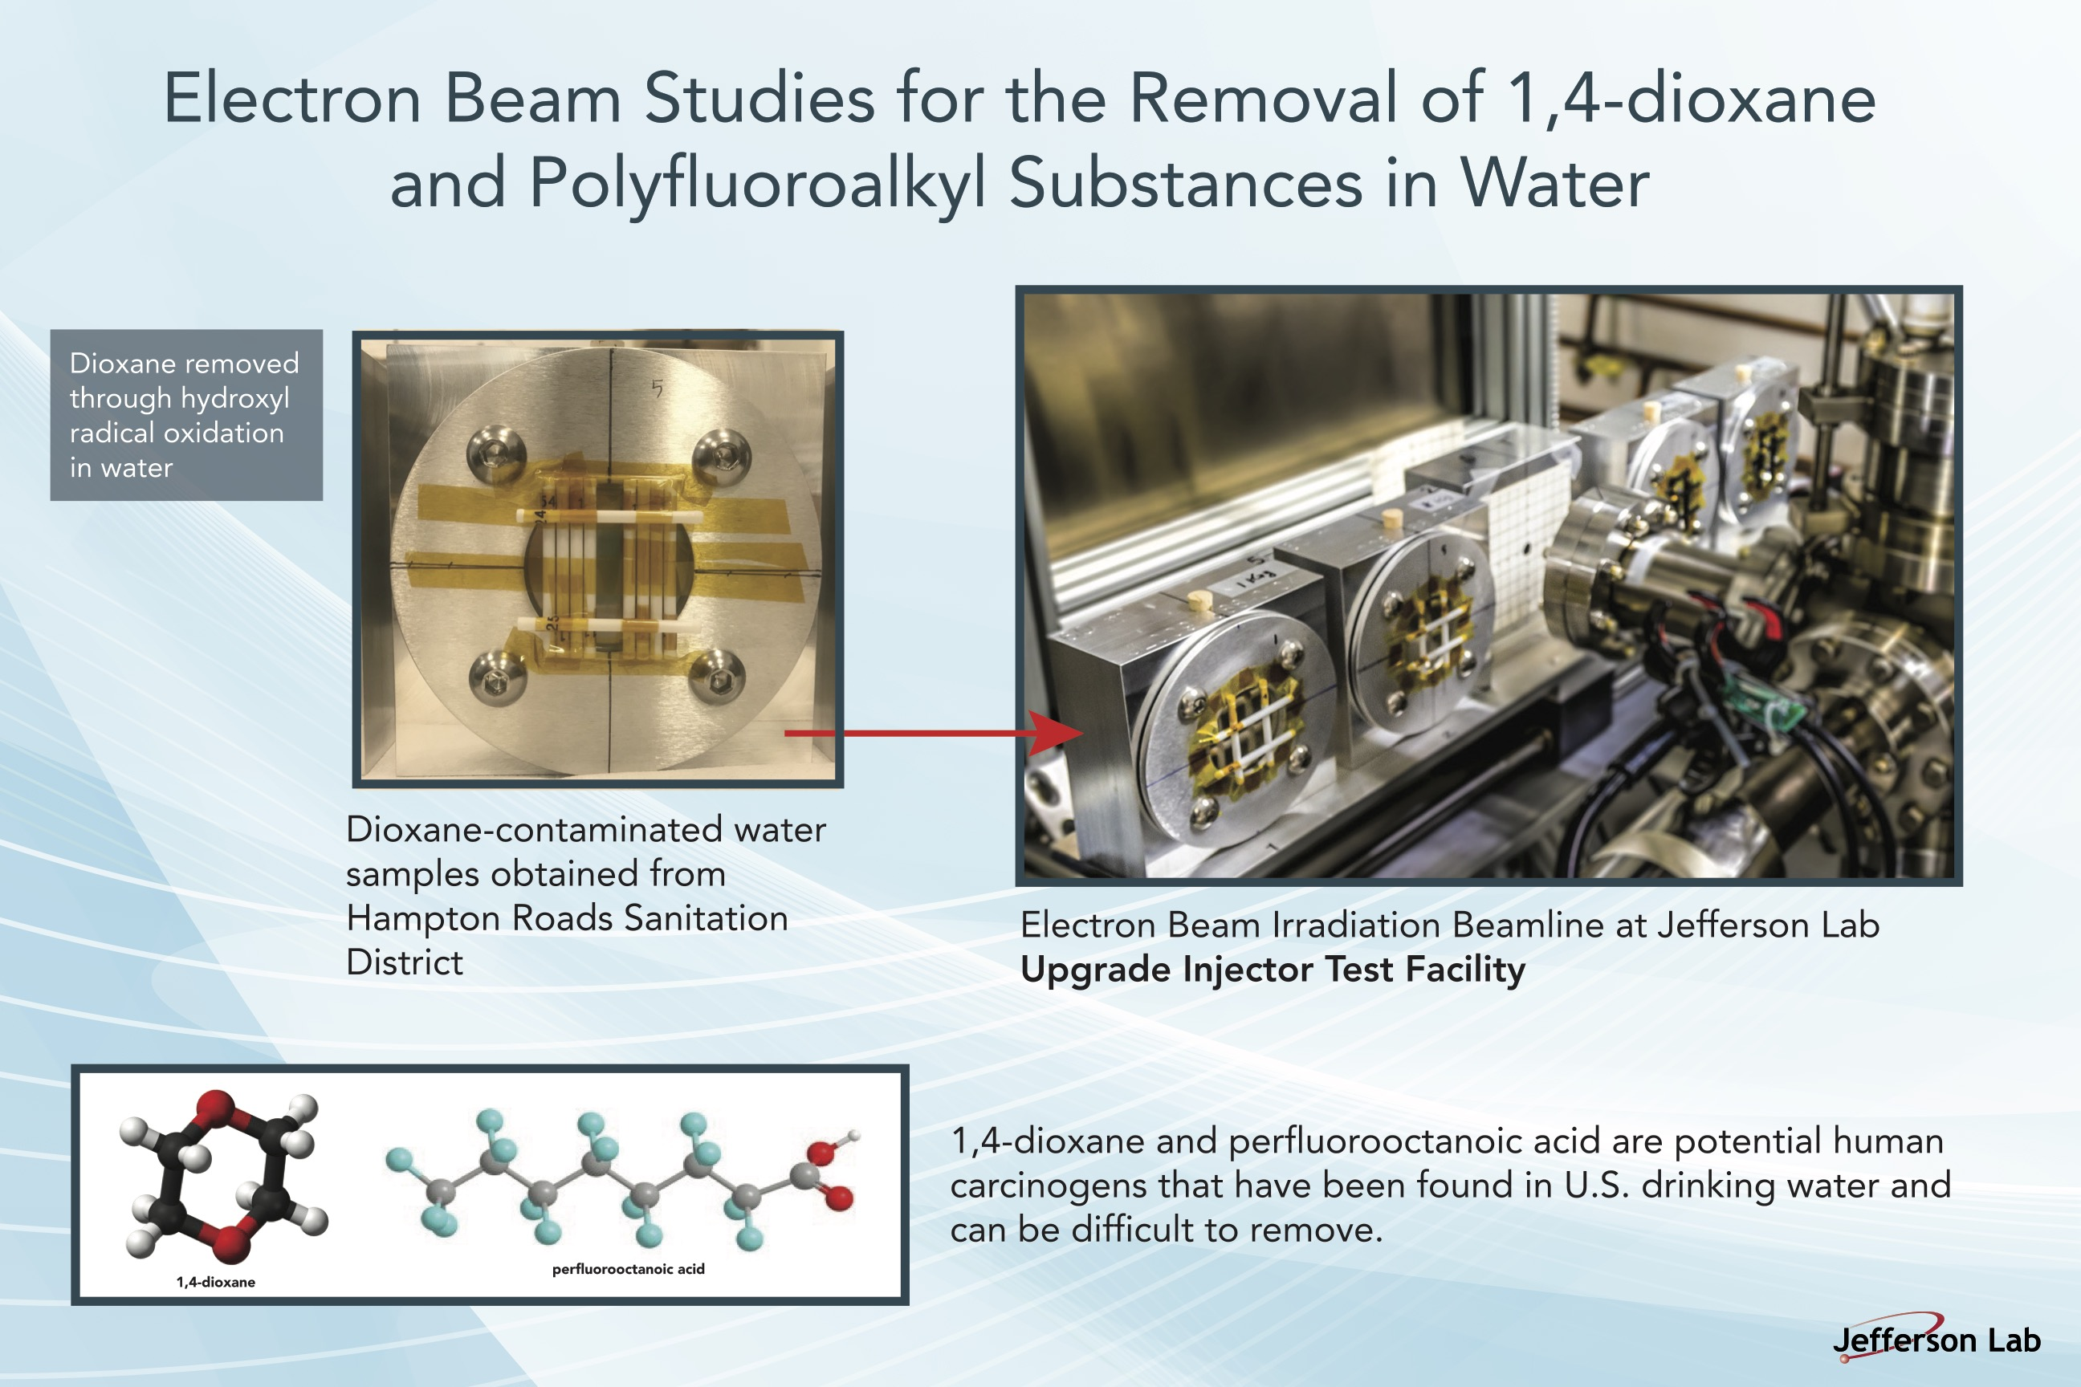
BRIC Affiliated Jefferson Lab Technical Organizations
  Center for Advanced Studies of Accelerators (Accelerator Division)
  Data Science Department (Computational Sciences and Technology Division)
  Radiation Detector and Imaging Group (Experimental Nuclear Physics Division)
  Radiation Control Group (Environmental Health and Safety)
Highlights & promotes bio-medical applications of JLab technical expertise
Provides a collaborative internal & external facing environment
Sponsored NIH-DOE Workshops
Facilitates Collaborations

Slide 4
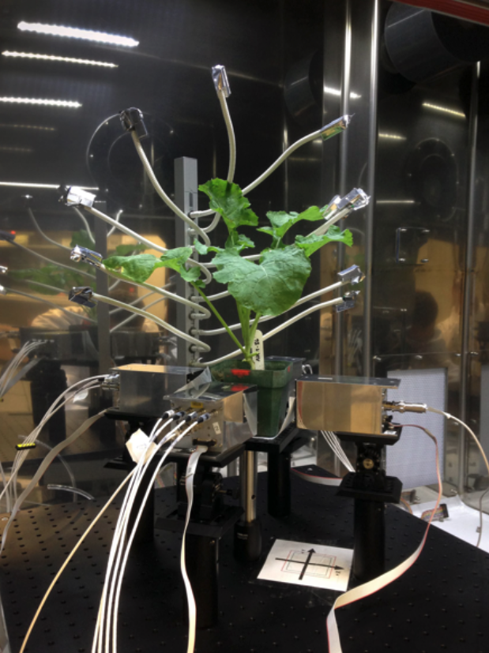
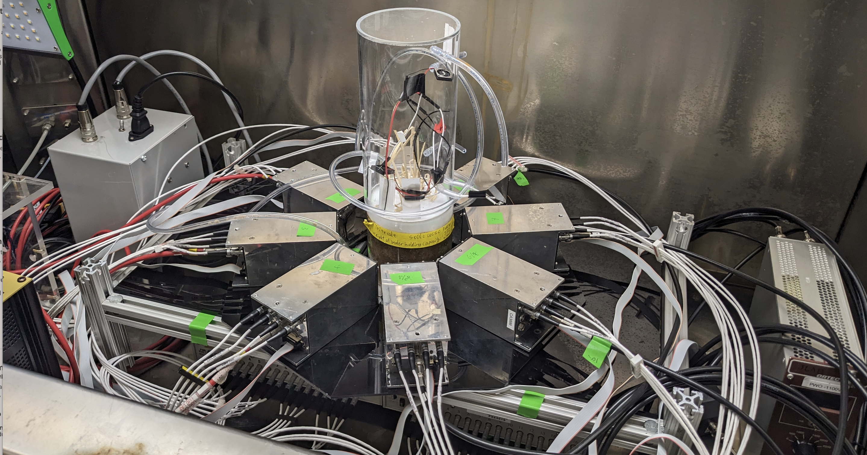
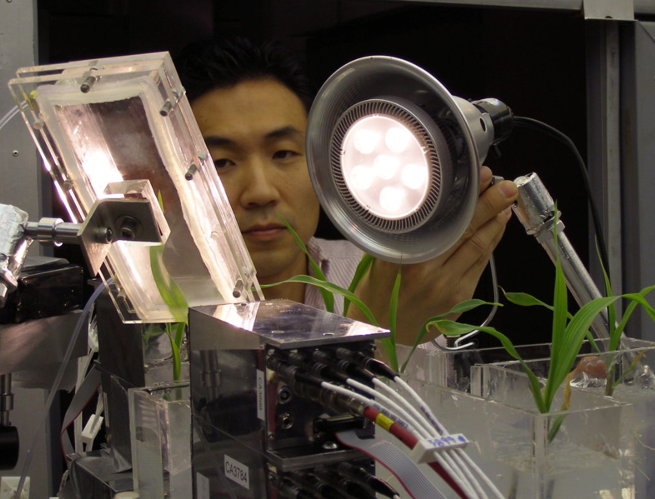
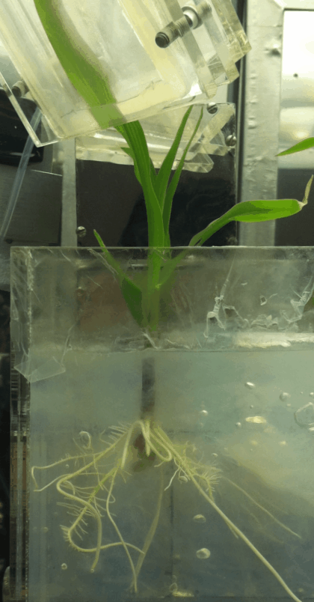
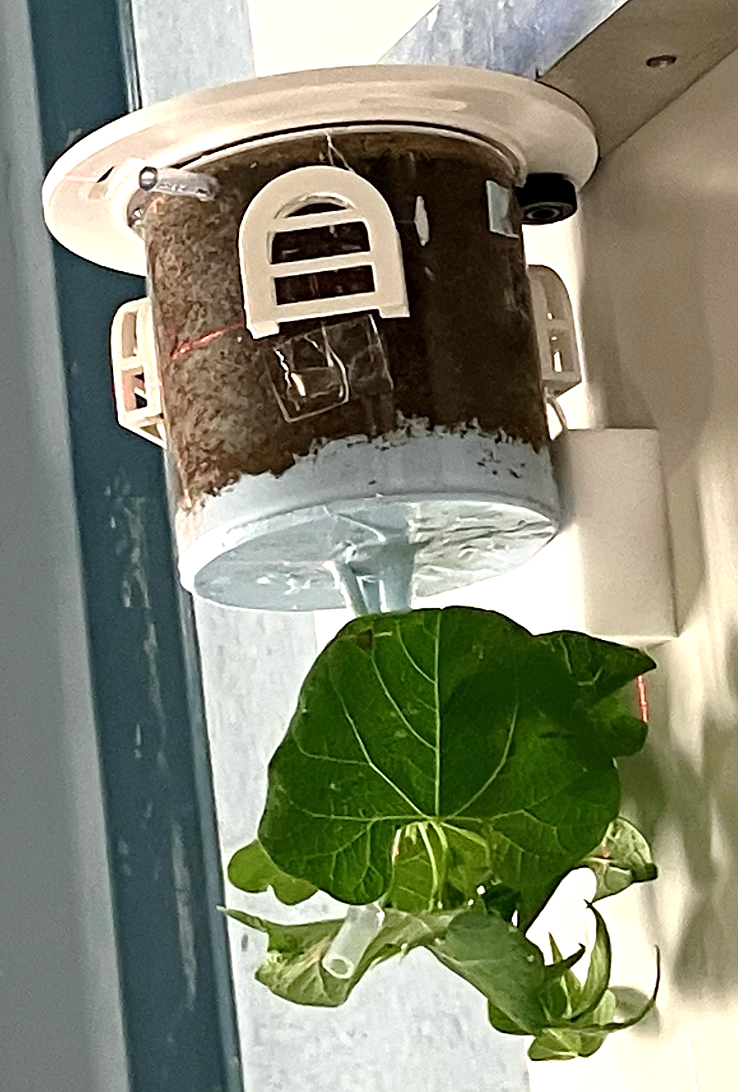
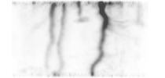
Environmental Research
PhytoPET: PSPMT based positron emission tomography (PET) imaging system for [carbon-11] CO₂ plant physiology research exploring in vivo carbon transport for carbon sequestering
2010-2022 collaboration with Duke University
2015-2021 CRADA with University of Regina
2023- present collaboration with UC Santa Cruz & Stanford University
DOE-BER had designated the JLab Detector Group a Radiochemistry and Instrumentation Science Focus Area (SFA).

Slide 5
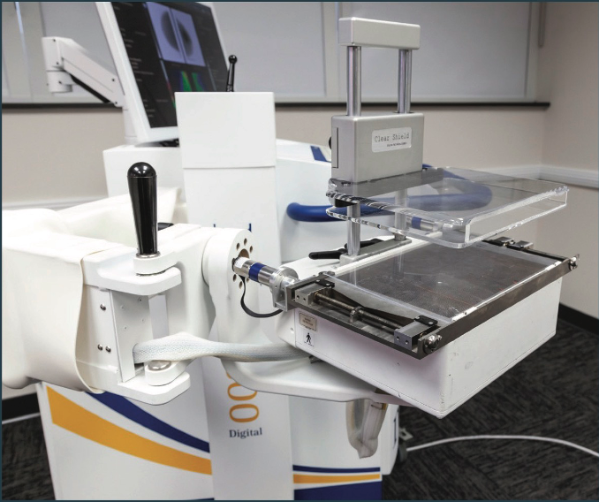
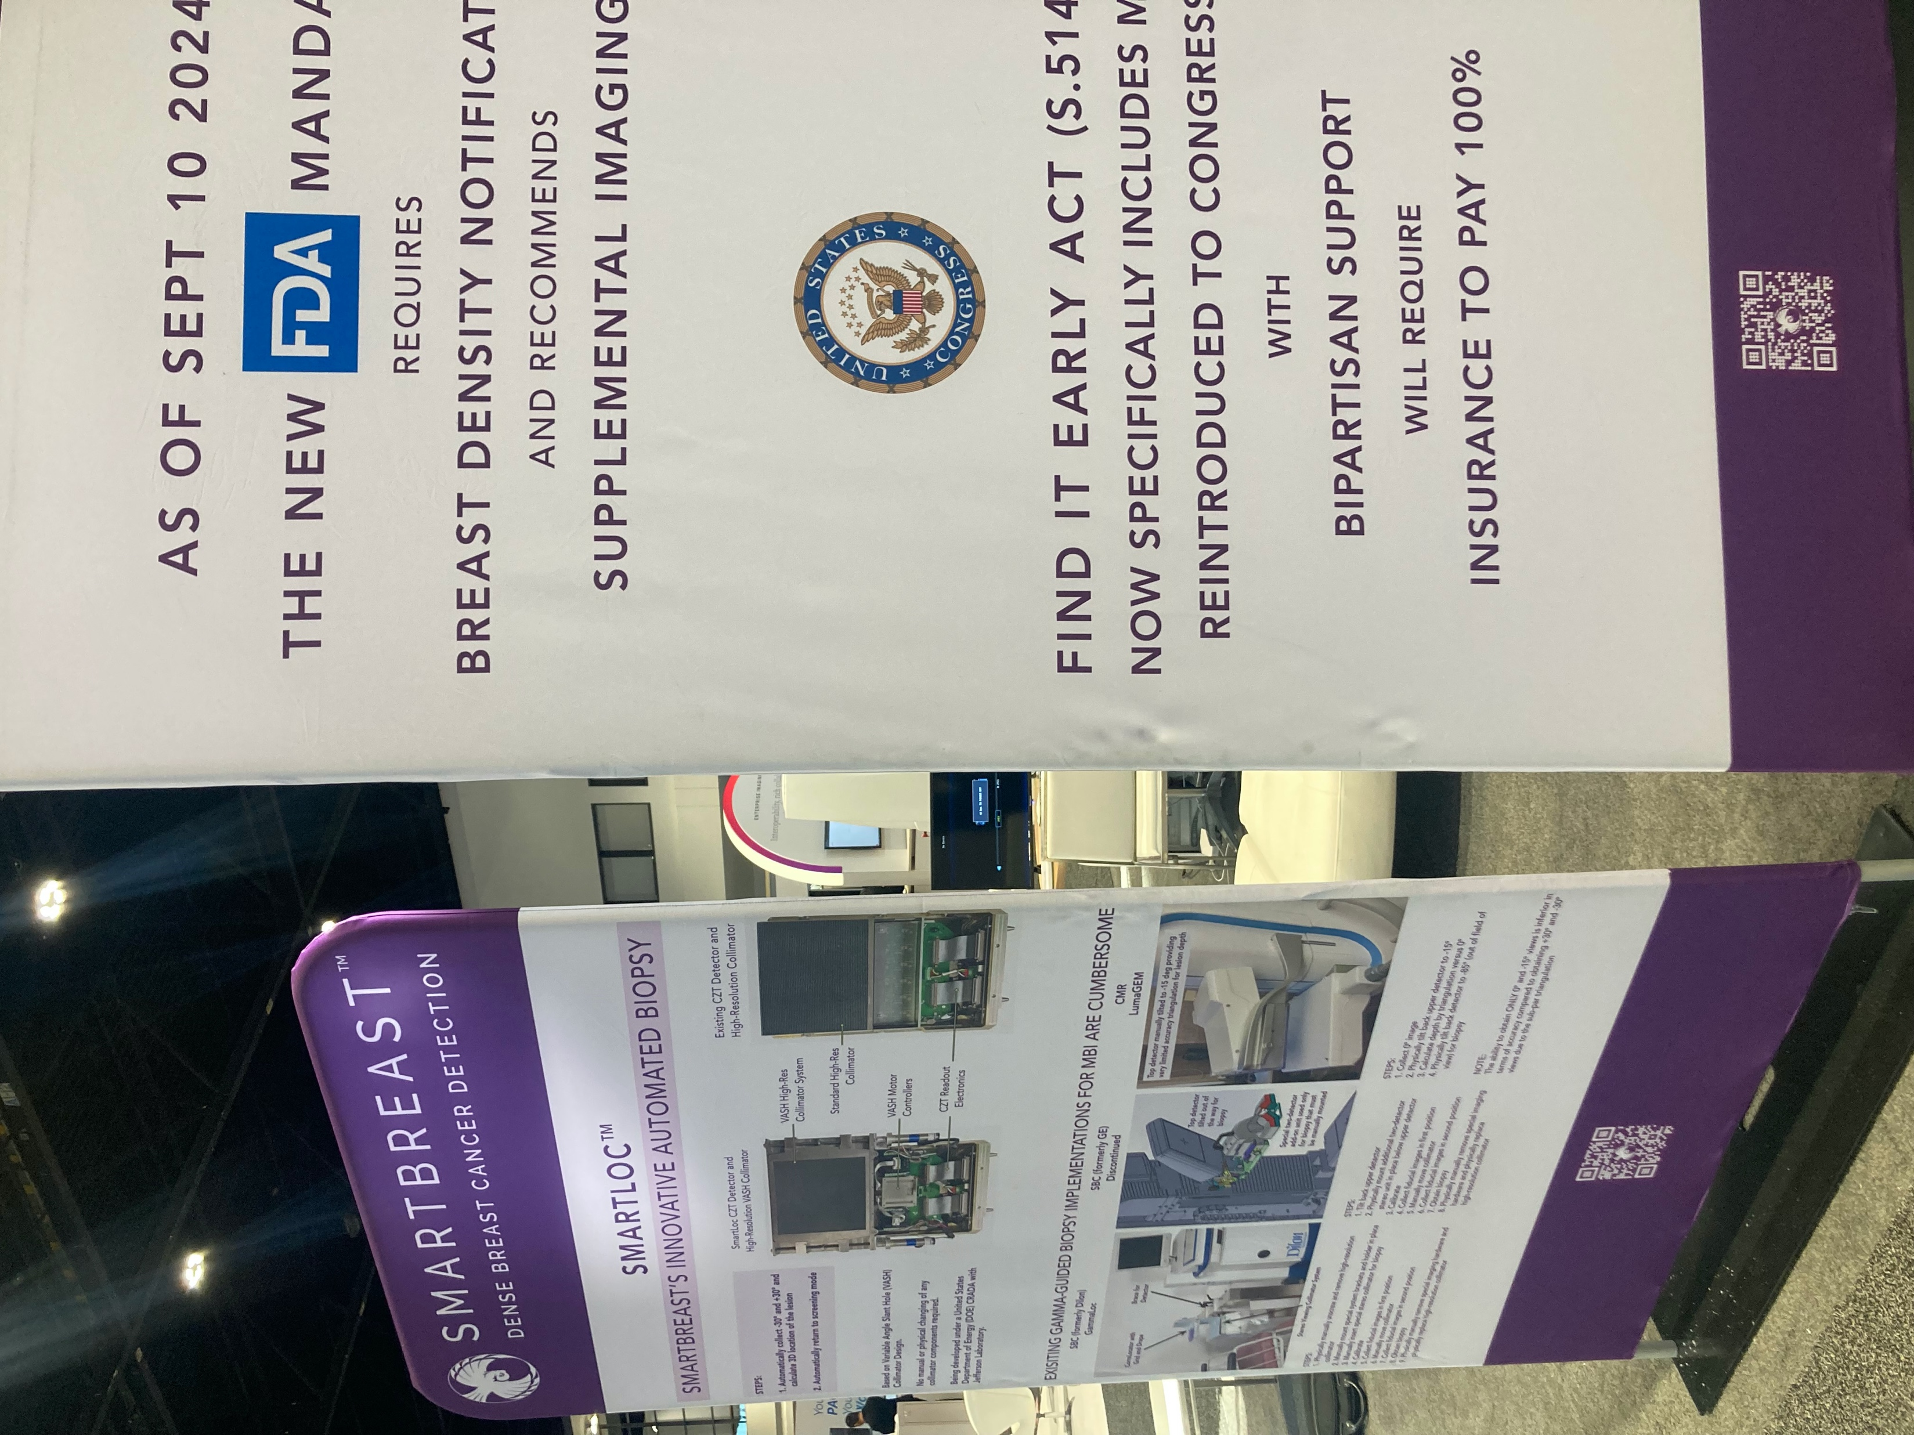
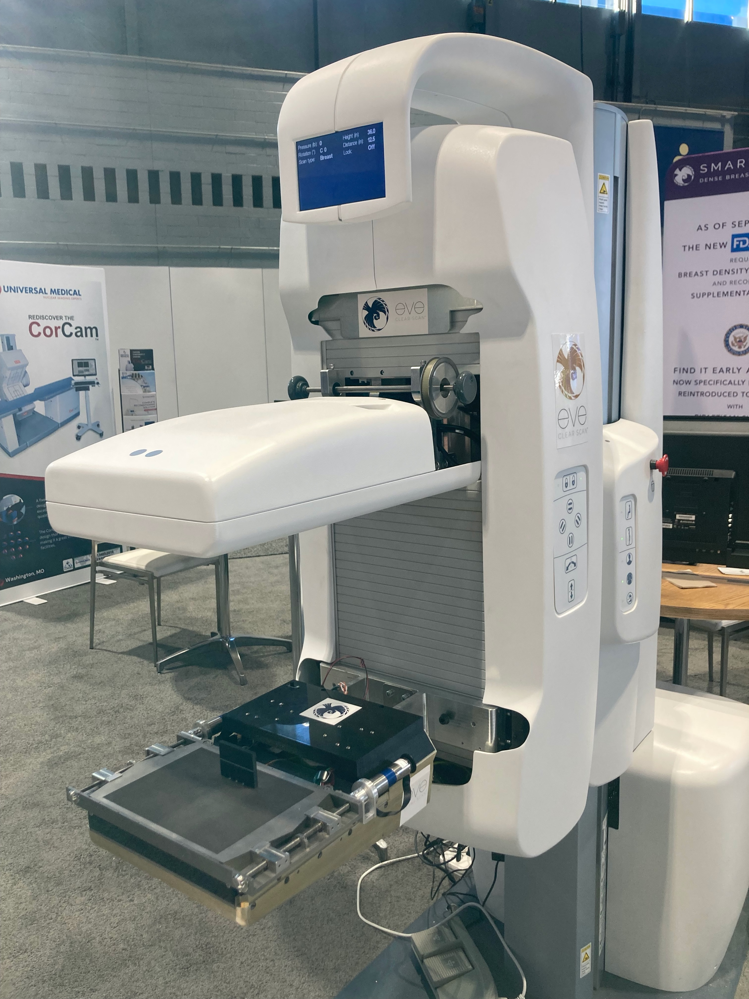
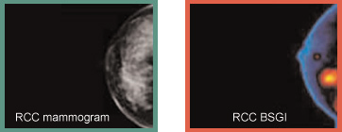
Nuclear Medicine Imaging
CRADA with SmartBreast LLC to adapt variable angle slant hole (VASH) collimator to a two headed breast cancer diagnostic imaging system
- Builds on previous JLab technology and partnerships

Slide 6
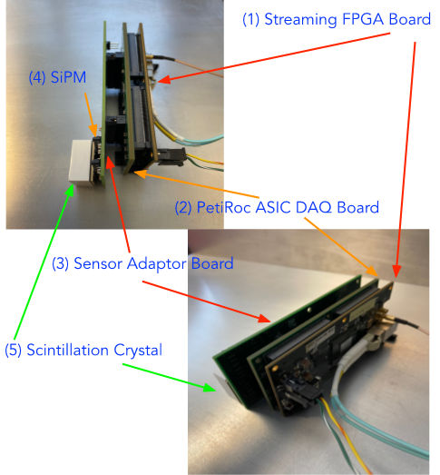
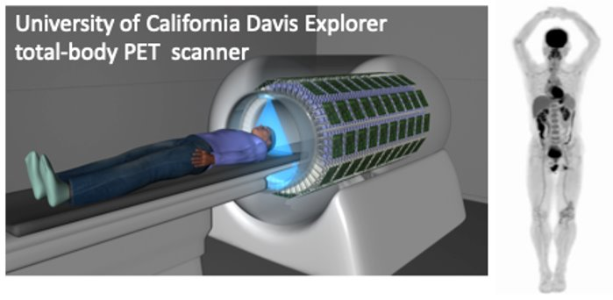
Streaming Read Out (SRO) PET
Foundation:
Positron Emission Tomography (PET) utilizes scintillators to measure coincident e⁺ annihilation 511keV photons
Project Goal: Streaming Readout (SRO) DAQ and parallelized PET analysis implementation, scaling performance metrics
Facilitate total body PET, reduced patient radiation and imaging time
June 2024 –deployed with a new prototype PET detector system
  Based on ALERT TOF detector from Hall B, designed by Ben Raydo and Wenze Xi
LYSO Pixel
F-18
LYSO Pixel
Cartoon of positron annihilation and two 511 keV gammas coincident in crystal scintillator measurements for tomography
Rendering of UC Davis EXPLORER system (left) and a representative total-body PET scan (right)
LYSO, SiPM, PETIROC ASIC, and FPGA based PET detector prototype developed for RD&I group's SRO PET prototype system

Slide 7
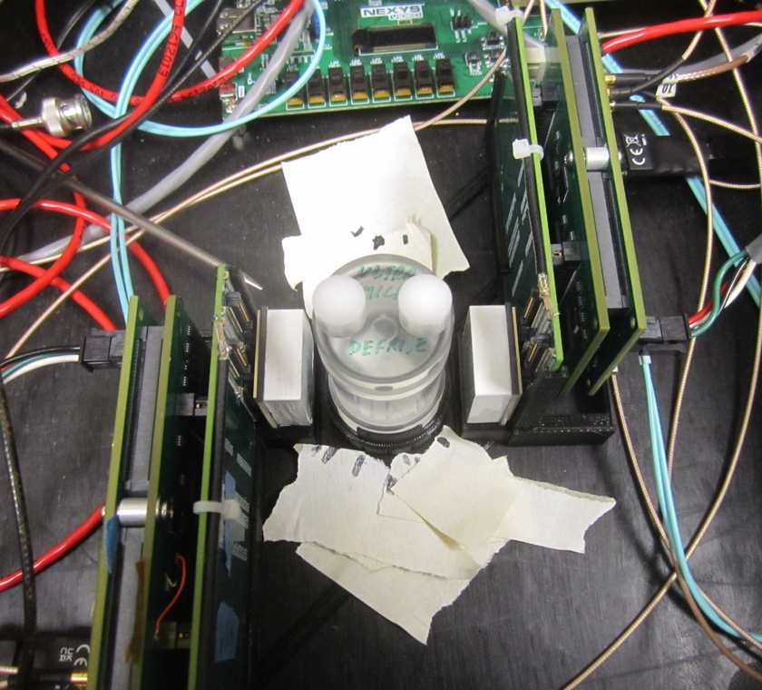
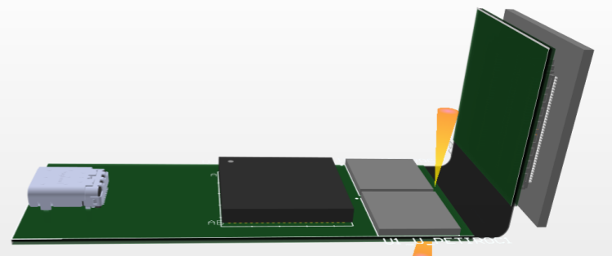
SRO PET LDRD
FY 2025 LDRD Project funding awarded:
To develop an improved prototype detector and pre-clinical array
To utilize EPSCI group's ERSAP SRO analysis platform for high performance computing
FY26 goal: Constructed array, imaging tests, performance scalability study -> Total Body PET
Current progress:
New modular detector prototype printed circuit board design with FEDAQ, purchasing parts
Designing ERSAP implementation architecture with EPSCI, improving existing software & firmware
New PCB concept – USB-C, FPGA, ASICs, Flex connector, SiPM
Two SiPM based detectors for PET coincidence measurements at University of Maryland Medical Center

Slide 8
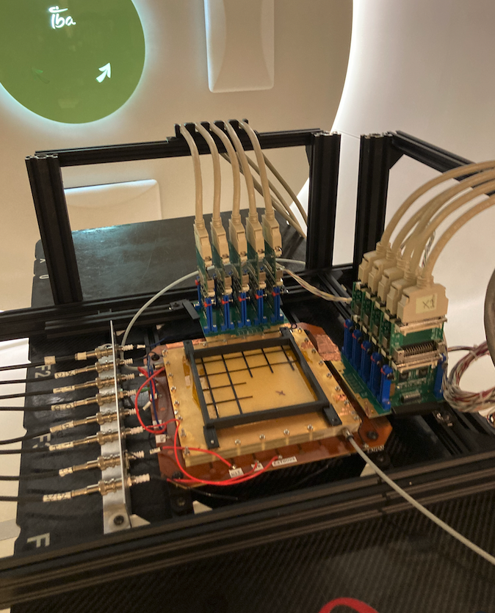
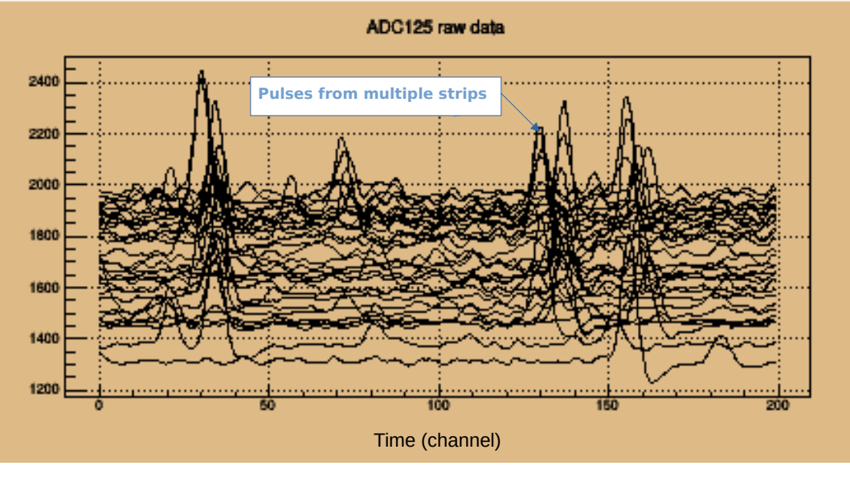
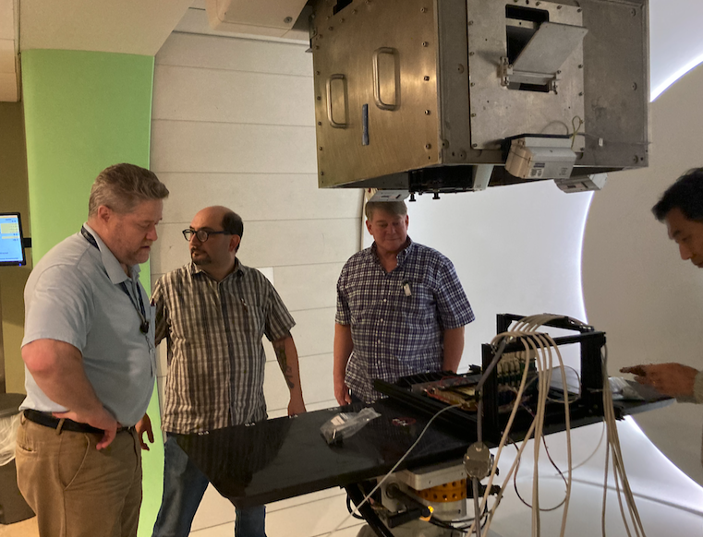
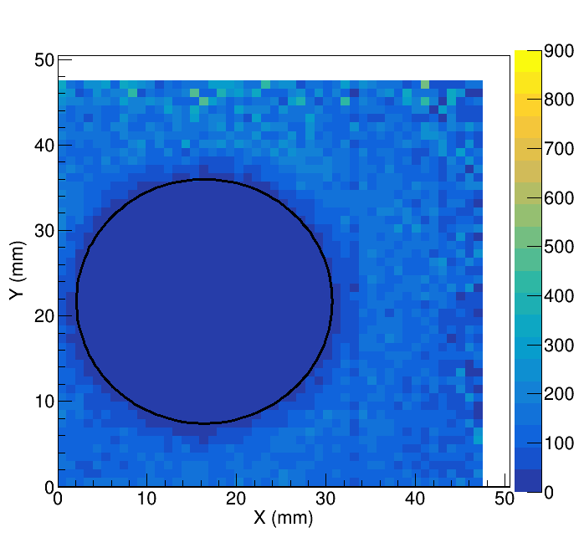
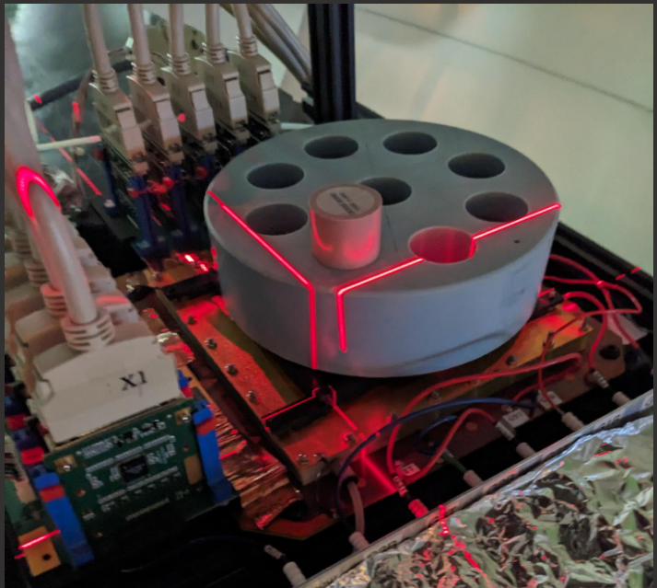
Cancer Treatment
20 nA double scattered beam (~10⁷ cm⁻² s⁻¹)
→ X-Y Strip readout (0.4 mm pitch)
→ Sort proton signals based on peak time.
→ Demonstrated ability to separate proton hits within at least 4 time bins (32 ns).
→ Record peak amplitude and time.
→ Tested up to 40 kHz event rate (pulser trigger)
with nearly 100% live time.
→ Test to higher data rates in future.
→ Plans to improve detector for higher beam flux
Time bin (8 ns / bin)
Imaging of Solid Water Phantom with dense bone insert (9.5 cm DoP beam)
→ Only rough correction using uniform illumination map.
→ Expect to improve noise reduction and strip-strip gain calibrations in future.
Testing of Beam QA Device at HUPCI

Slide 9
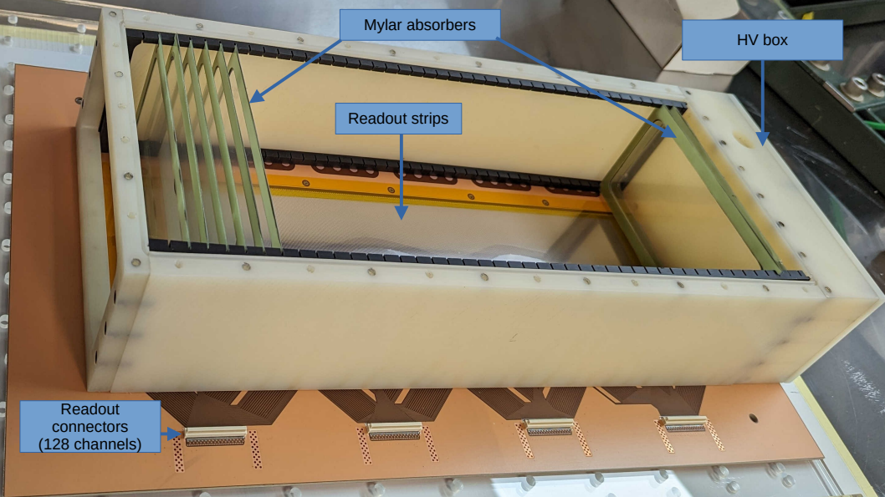
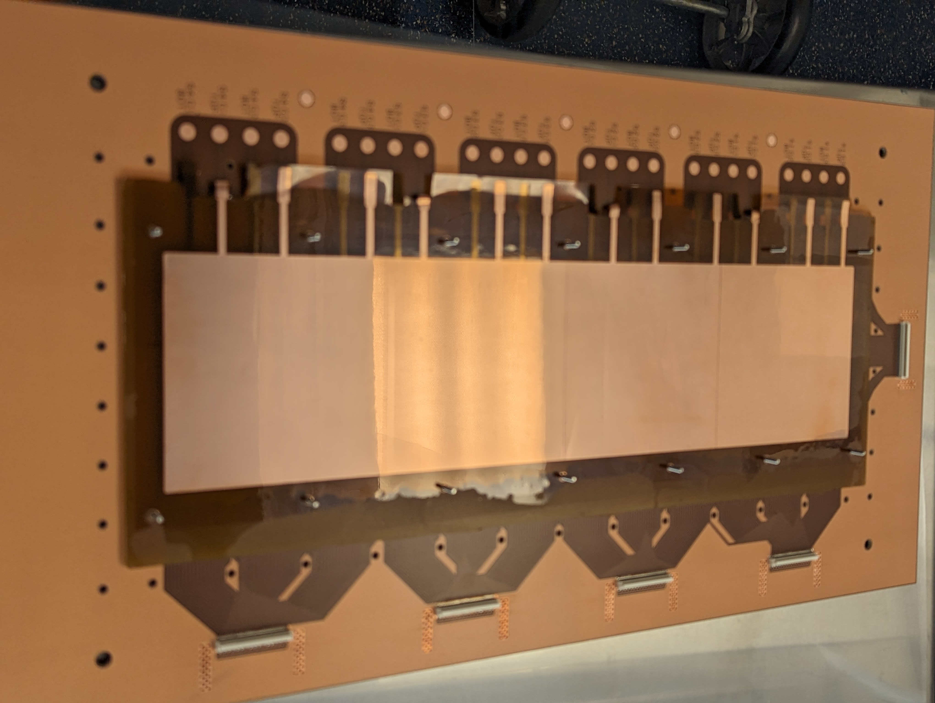
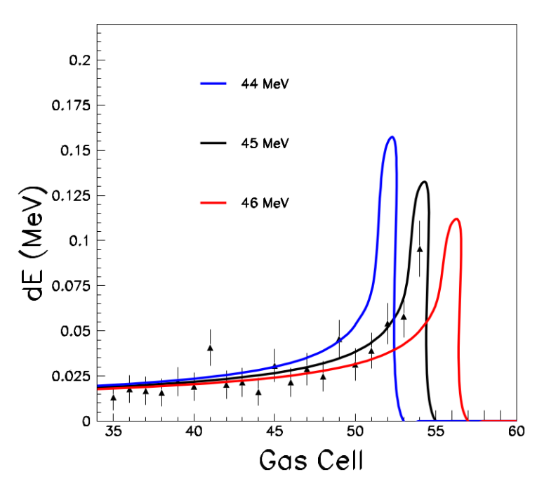
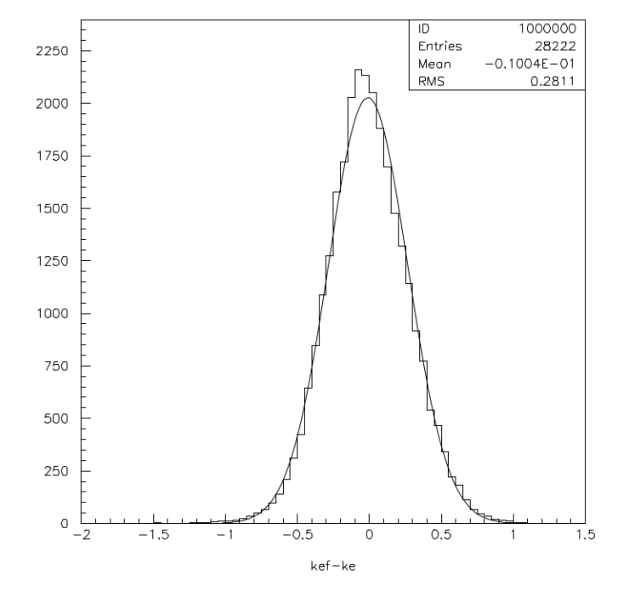
Proton Radiography/Computed Tomography
Patent pending
Current focus on ETPC development
Pre -Tracker
Post -Tracker
Energy measurement device
phantom
Standard GEM chambers
GEM based vertical TPC with thin film aborbers for
Range / dE/dx fitting
Energy degrader
Shutter box
(multiple degraders)
Simulated results for energy
reconstruction from dE/dx fits
dE Fit residuals
10 < KE < 45 MeV
s < 300 keV
KEfit – KEtrue (MeV)
GEM layer Readout board

Slide 10
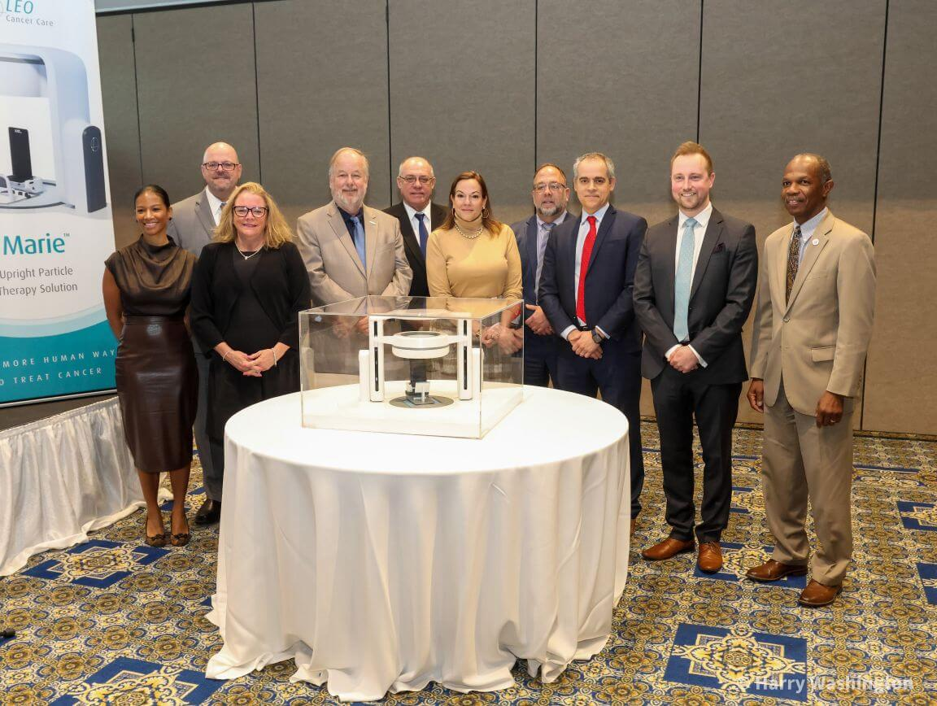

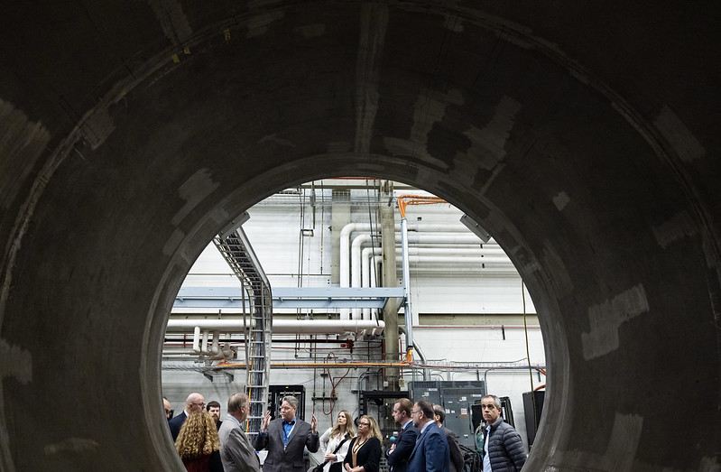
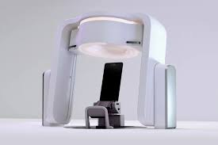
Industry Partnerships
Leo Cancer Care, Hampton University Proton Cancer Institute, Jefferson Lab partnership to install upright patient positioning and advanced imaging in an existing fixed proton beam treatment room.
JLab: Gas Electron Multiplier-based proton radiography

Slide 11

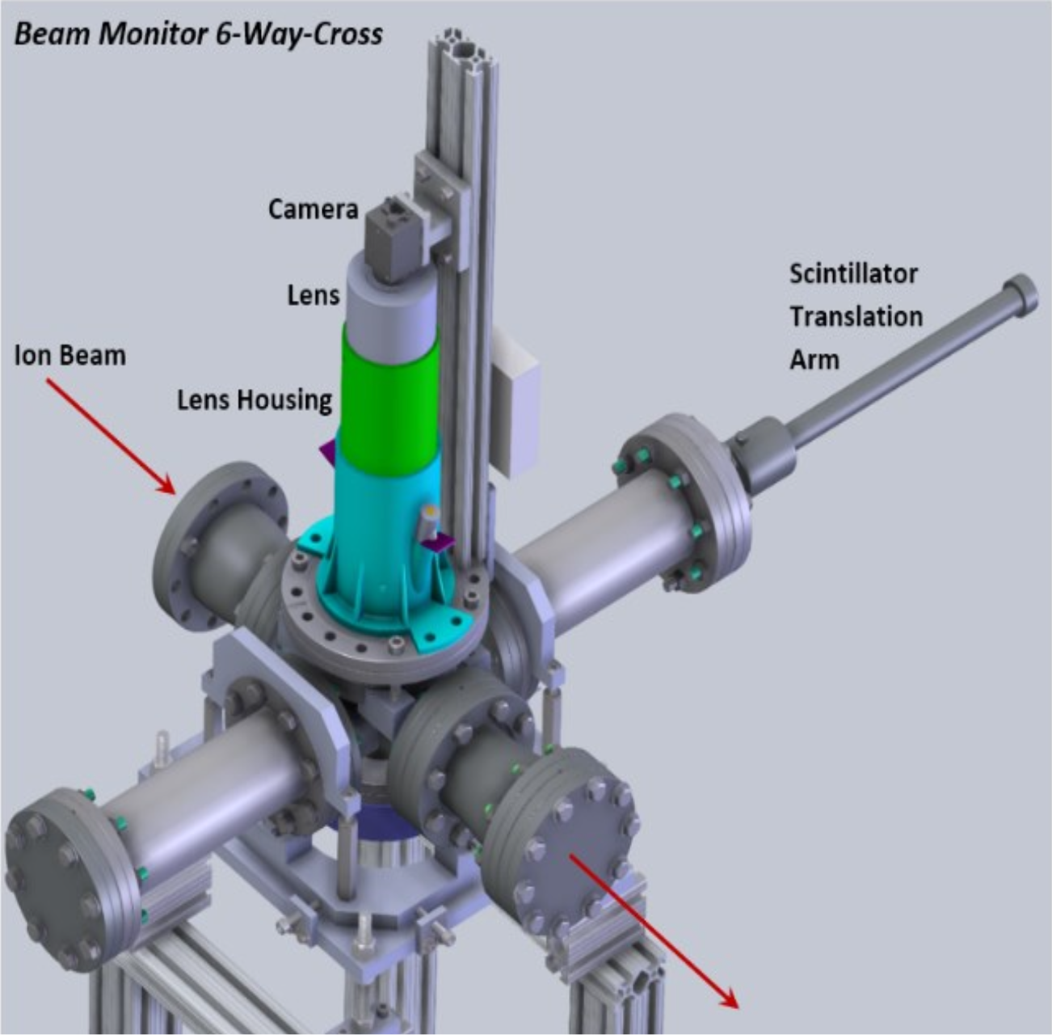
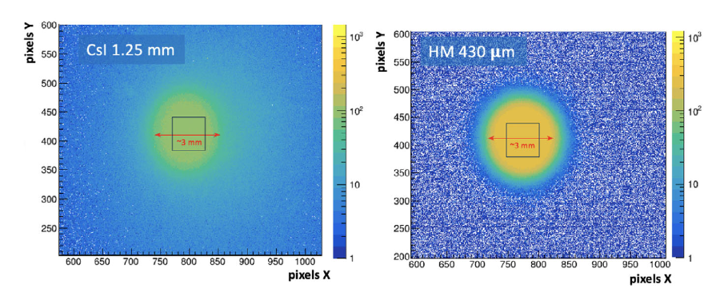
Beam Tests
Integrated Sensors LLC
Assisting small business with possible use of JLab test beams for proposed work with National Institute of Health potentially supporting FLASH
A High-Performance Multifunction Scintillator Beam Monitor
Background subtracted images of a 3 mm collimated β− particles on 1.25 mm thick CsI(Tl) crystal (left) and 0.43 mm thick HM scintillator (right)

Slide 12

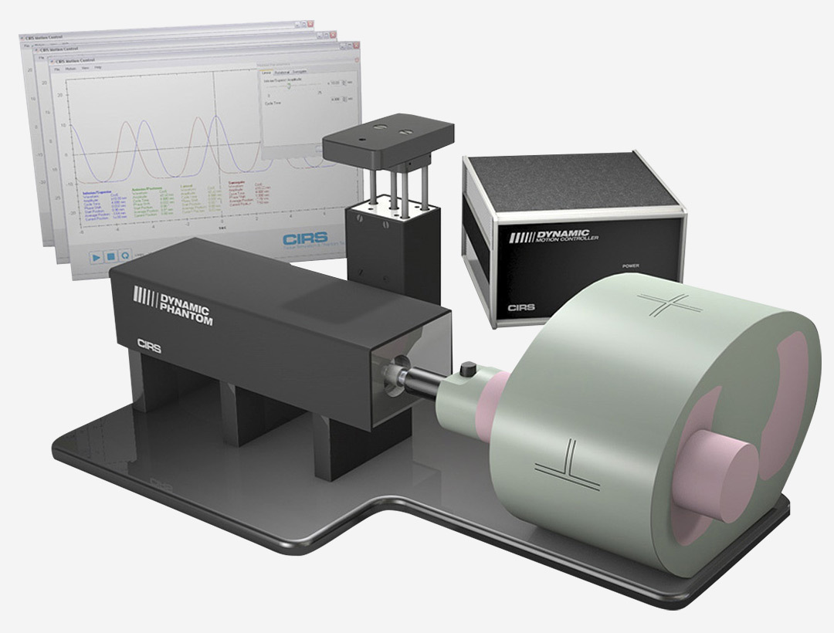
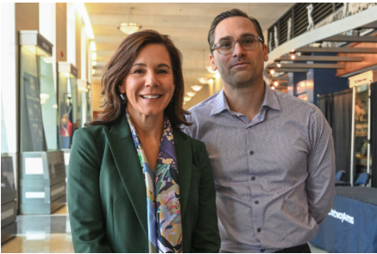


Other
APS Joint March/April Meeting GMED Focus Sessions
Fortnightly meeting for JLab BRIC and Joint Institute on Advanced Computing for Environmental Studies (ACES) collaborations
NIH-DOE Workshop Planning
Adaptive proton therapy: Dynamic motion phantom- 3 degrees of insert motion

Slide 13
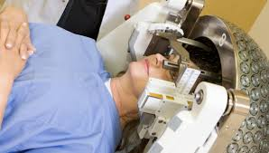
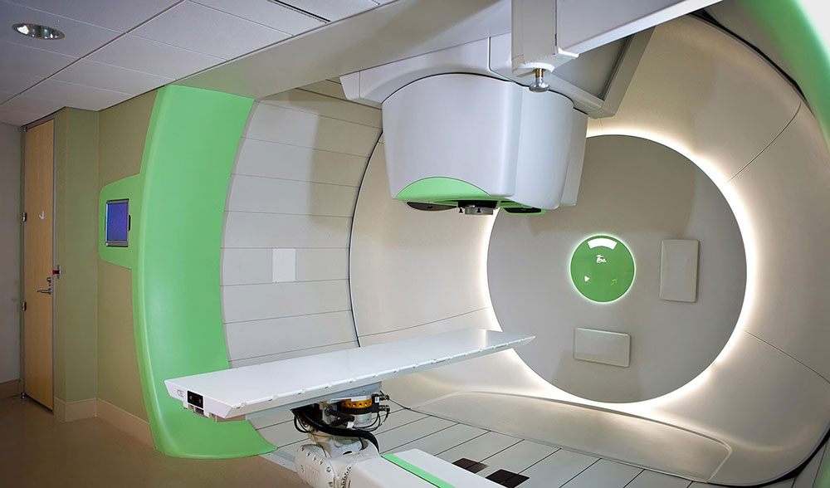
NNSA ORS Radiosurgery Landscape Survey
Office of Radiological Security:
Seeks to understand avenues for reducing reliance on radioisotopes for cancer treatment
Accelerator-based alternatives, like Proton Therapy (PT)?
PT pros: localized dose deposition
PT cons: uncertainties in delivery may have much worse impact
Goals of the study:
Evaluate the landscape of radiosurgery
Compare treatment plans from beam and fixed source treatments
Identify options, pros and cons, to radioisotopes
Photo of Gamma Knife Radiosurgery at Michigan Head and Spine Institute
– Gamma Knife is a technology that uses radiation from 192 cobalt-60 radiation sources to stop tumor growth or repair lesions inside the brain.
Photo of a treatment room at the Hampton University Proton Cancer Institute (HUPCI) down the road from JLab

Slide 14
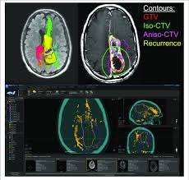
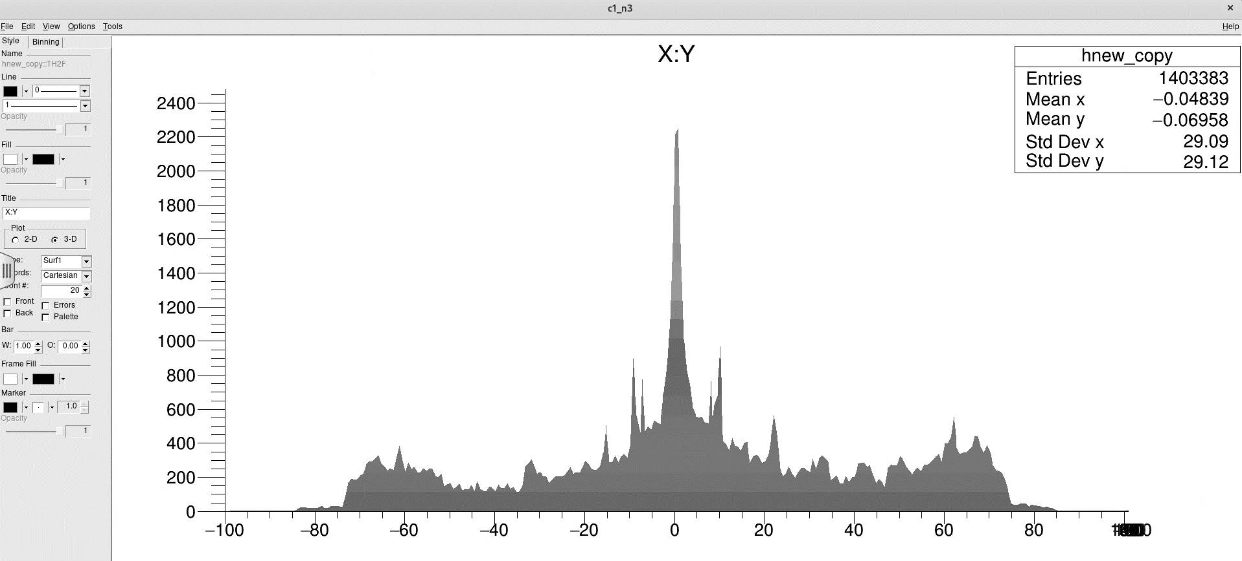

NNSA ORS Radiosurgery Landscape Survey
Work plan for 2025:
Survey the state of the art
Visit multiple sites with accelerator or radioisotope-based treatment modalities
Learn from experts in the research and clinical fields
Purchase a treatment planning system to get hands on experience
  RayStation: clinical calculation framework for reading CT scans, planning dose, and controlling dose delivery
Report to NNSA ORS with actionable recommendations for reducing reliance on isotopes
Radio-therapy treatment from protons (color) vs. 60-Co gamma rays (grey)

Slide 15
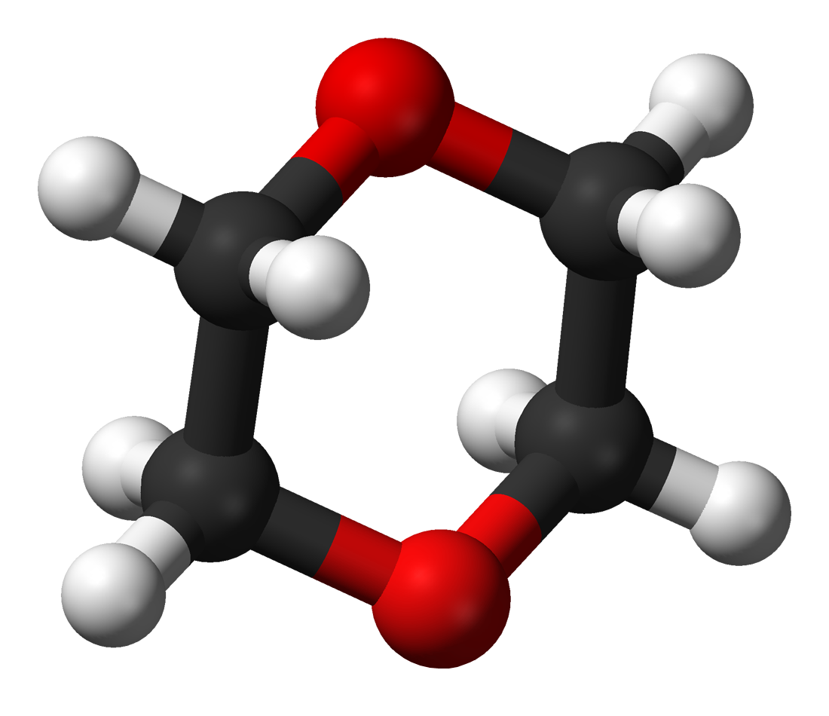
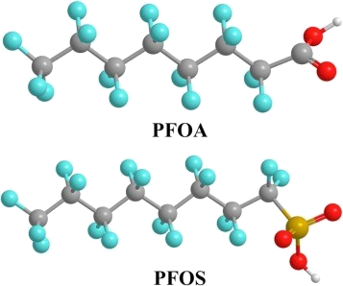
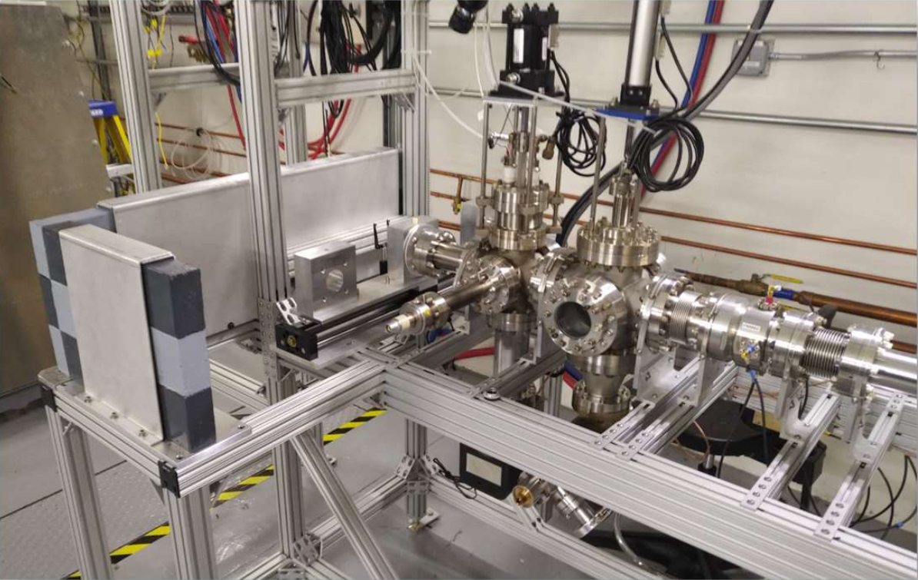
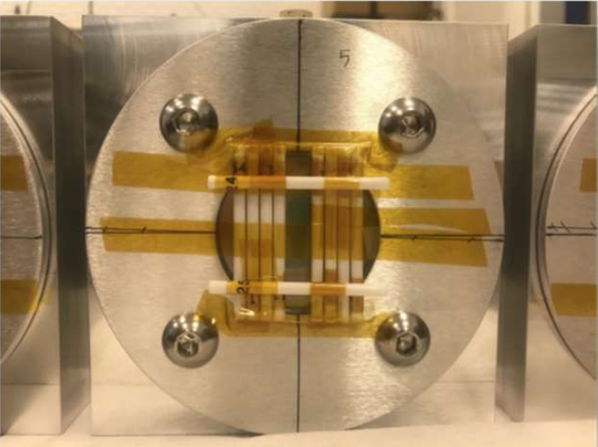
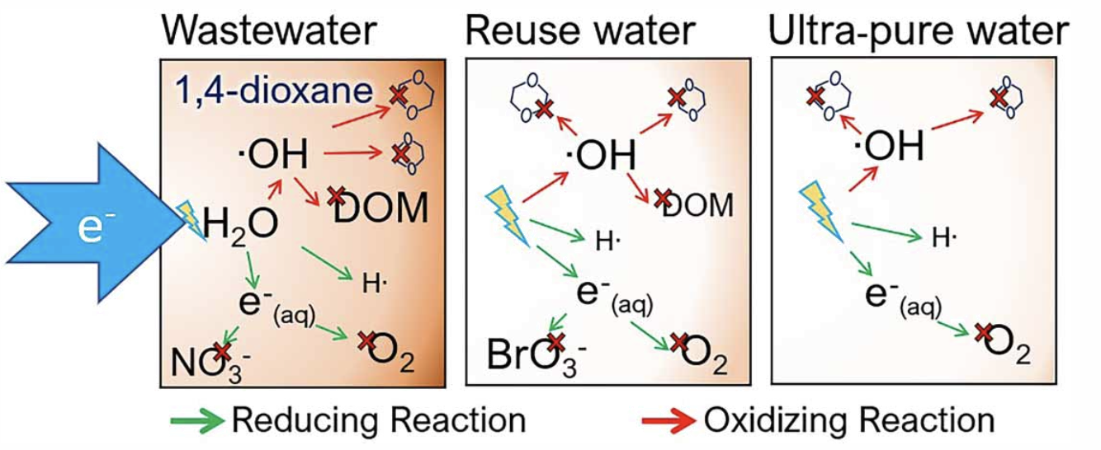
Wastewater Treatment
Electron Beam Studies for the Removal of 1,4-dioxane and Polyfluoroalkyl Substances in Water
Dioxane contaminated water samples to treat with electron beam obtained from Hampton Roads Sanitation District.

Slide 16
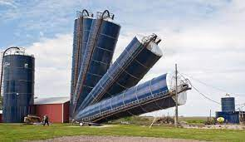

Summary
Jefferson Lab has multiple facilities spanning a broad range of expertise – user resources to be leveraged
There is increased recognition that technology overlap with the biomedical community may be mutually beneficial
There are MANY exciting opportunities!
Attempting to remove barriers, increase partnerships
  Agency to agency (direct collaboration and academic grant partnerships)
  Lab to industry (technology transfer)
Thank You!
Notes:
Wish list. Jlab is supposed to collaborate with BNL

Slide 17
Thank you!
HUGS, 2024

Slide 18
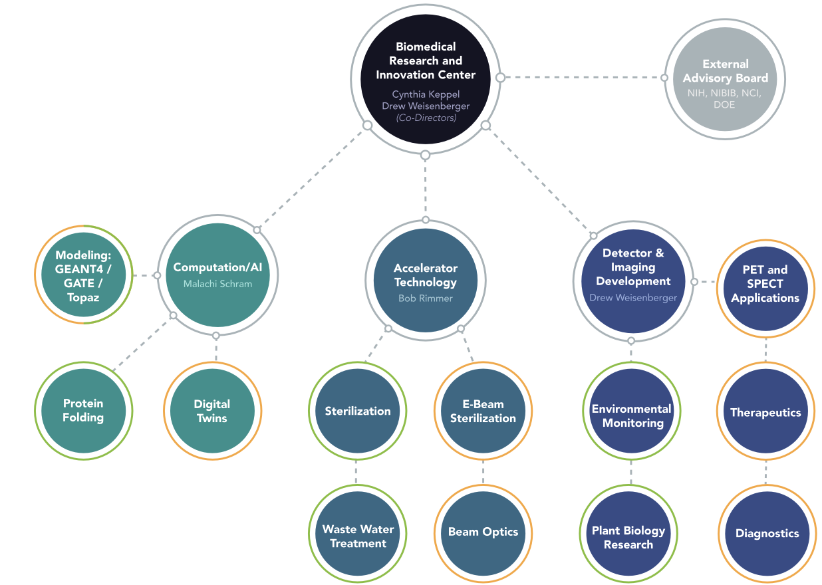
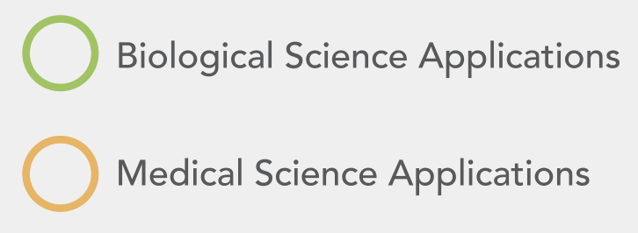
Biomedical Research and Innovation Center

