Slide 1
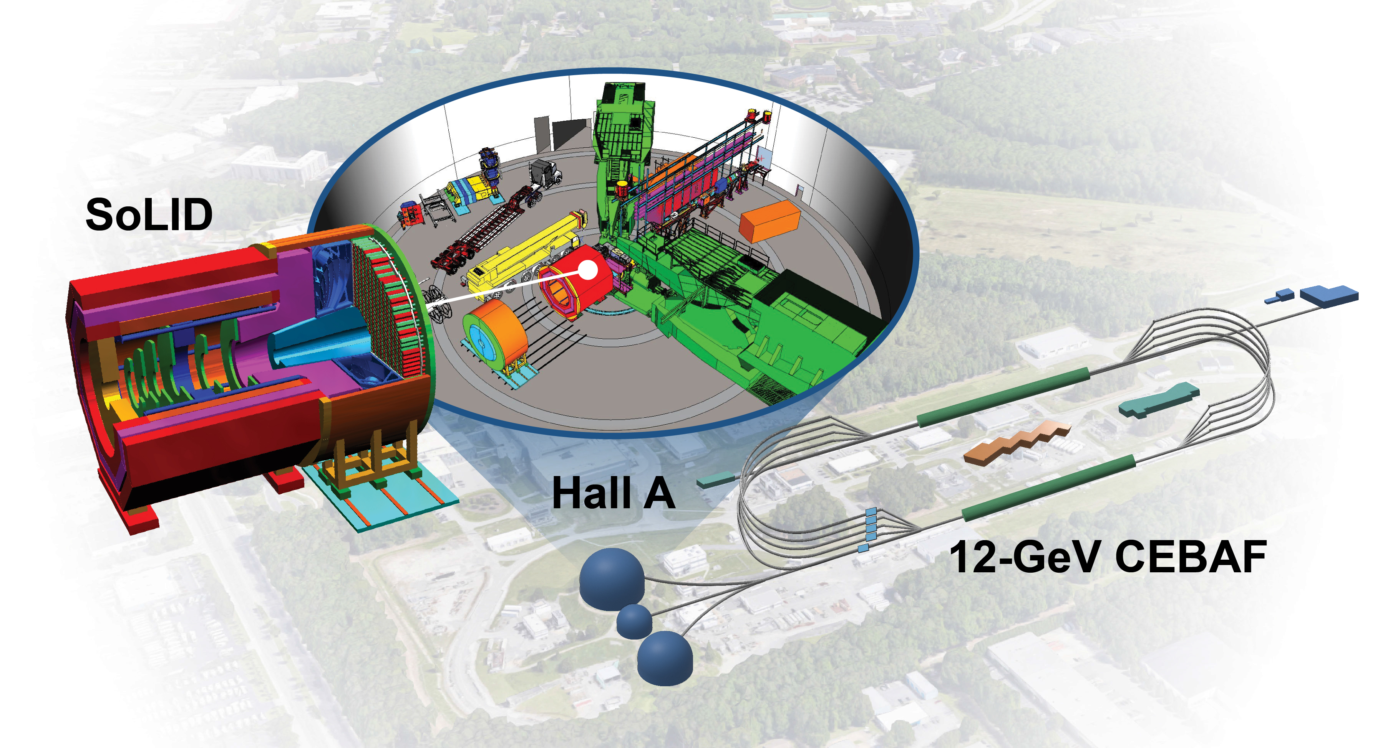
Overview of SoLID and Strategy Update
Haiyan Gao
Duke University
(For the SoLID Collaboration)
Presented To:
JSA S&T Mission Committee
December 10, 2024
https://www.innovationnewsnetwork.com/quantum-chromodynamics-at-the-intensity-frontier-with-a-precision-microscope/52920/

Slide 2

Outline
Brief introduction
The three science pillars of the SoLID program
The proposed SoLID apparatus
The SoLID Collaboration, Timeline, LRP and Broad Impact
Strategy to move SoLID forward
Summary and Outlook

Slide 3
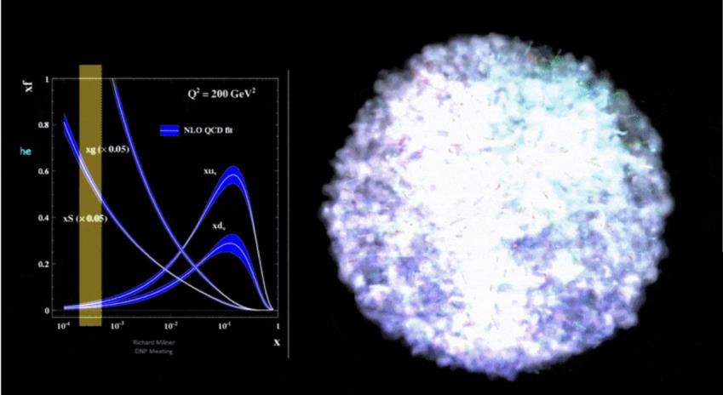
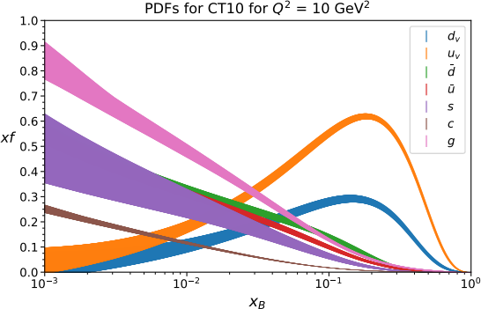
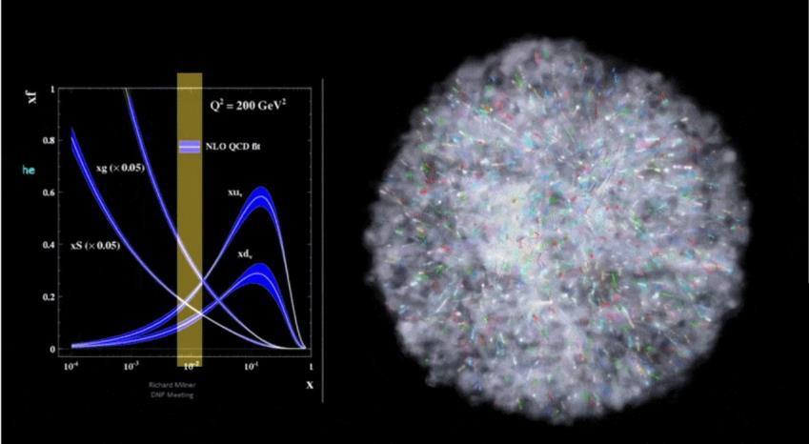
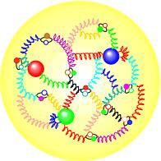
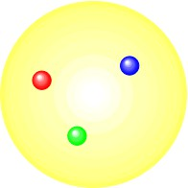
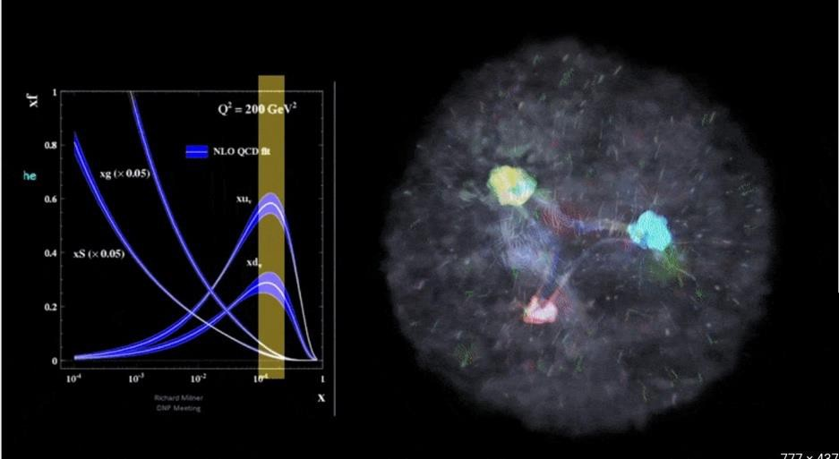
Experimental Frontier of QCD Studies of Nucleons & Nuclei
x https://www.youtube.com/watch?v=Dt8FZ4ksWiY
https://arts.mit.edu/visualizing-the-proton/

Slide 4

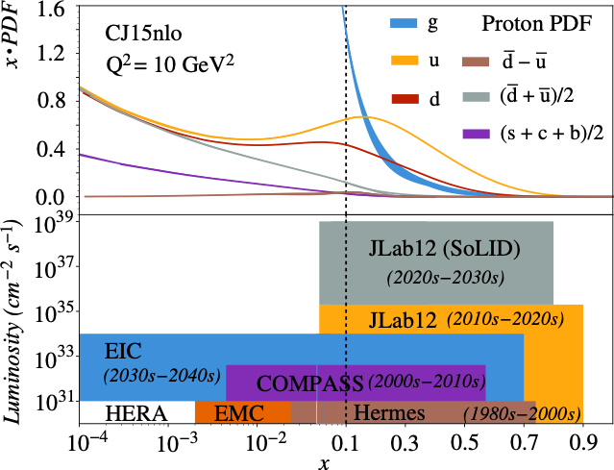
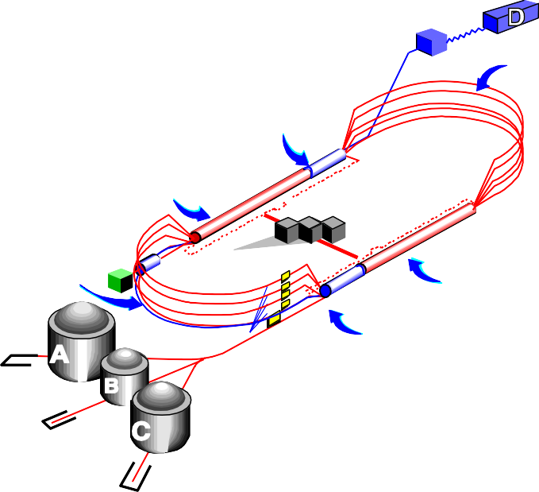
Interplay of Energy and Intensity
Structure of visible matter probed at JLab and the future EIC
Discoveries in Physics are often enabled by high-precision measurements
and that is where SoLID comes!
New Hall
Upgraded arc magnets
and supplies
Added 5
cryomodules
20 cryomodules
CHL
upgrade
Added arc
20 cryomodules
Added 5 cryomodules
Enhanced capabilities
in existing Halls

Slide 5
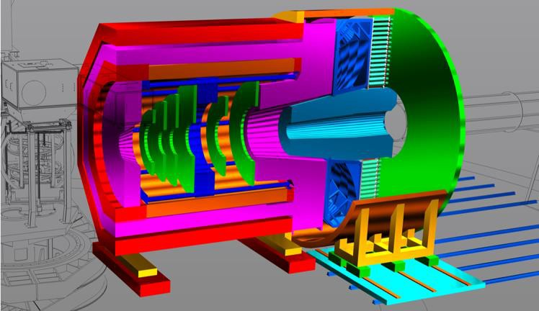

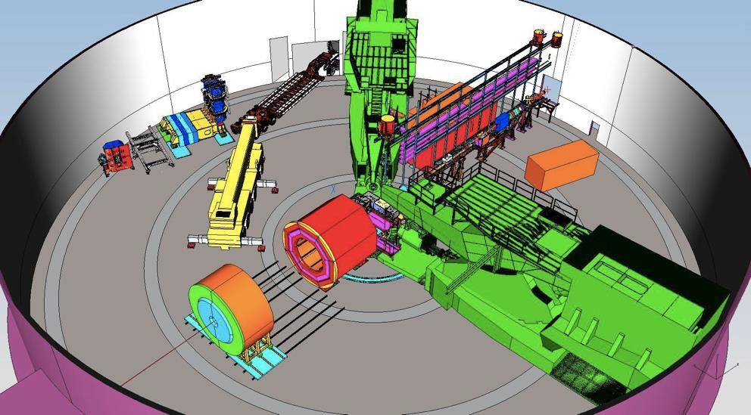
SoLID: How and Why?
SoLID will maximize the science return of the 12-GeV CEBAF upgrade by combining
High Luminosity
10³⁷⁻³⁹ /cm²/s
[ >100x CLAS12 ][ >1000x EIC ]
Large Acceptance
Full azimuthal 𝜙 coverage
Research at SoLID will have the unique capability to explore the QCD landscape while complementing the research of other key facilities
Two science pillars of the SoLID (proton spin and mass): high-luminosity valence quark tomography and precision J/𝜓 production near threshold (EIC in the sea/gluon region, both needed!)
PVDIS: test of Standard Model & search for new physics

Slide 6
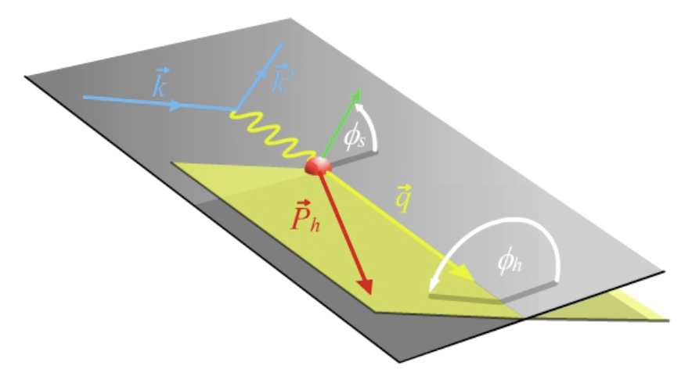
SoLID-SIDIS: precision tomography in 3D momentum space
u quark
d quark

Slide 7
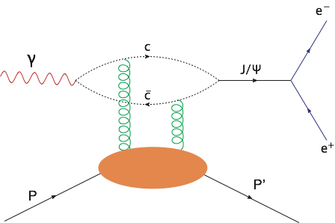
Proton mass, mass radius and gravitational form factor

Slide 8
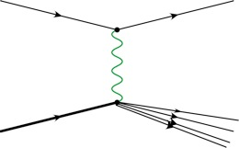
Standard Model test, New Physics, QCD via parity-violating DIS
e⁻
e⁻
Z*
γ*
N
X
Complementary to MOLLER for SM test; might be a better (unique) handle for BSM search by looking into quarks
Published data
Published data + P2
Published data + P2 + SoLID

Slide 9
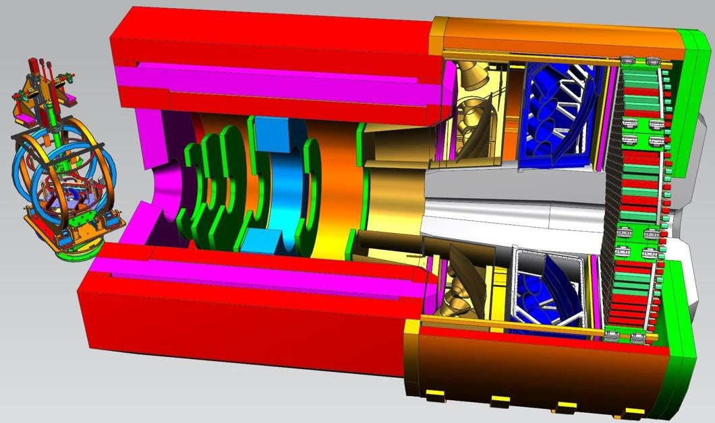

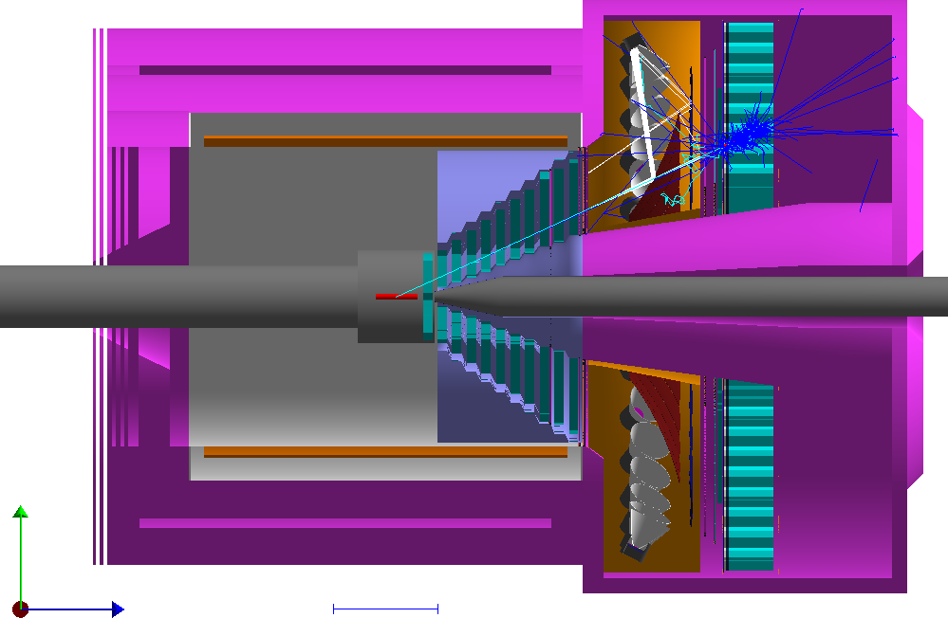

The proposed SoLID apparatus
Polarized ³He (``neutron”) & J/psi SoLID configuration
Challenging requirements
High Luminosity (10³⁷-10³⁹)
High data rate
High background
Low systematics
High Radiation
Large scale
Modern Technologies
Micro-pattern Gaseous tracking detectors
Shashlik electromagnetic calorimeter
High Performance Cherenkov detectors
Pipeline DAQ, streaming readout
Rapidly advancing computational capabilities
First test of a self-driving detector
Large scale deployment of AI/ML from the design up
PVDIS SoLID configuration
SoLID is the training, testing, proving ground for the EIC

Slide 10
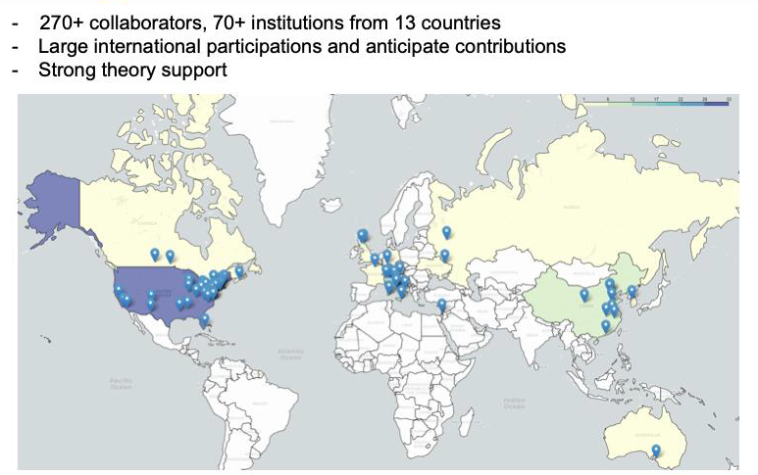
The SoLID Collaboration

Slide 11
SoLID Physics and Project Development
Rich physics program: (2010-now)
6 SoLID experiments approved by PAC with high rating ( 5 A, 1 A-)
    3 SIDIS (3d structure), 1 PVDIS (search for new physics),
    1 threshold J/𝜓 (gluon force), 1 A-n (new phenomena), +
1 conditional approval + 6 run-group experiments (3d/spin structure)
Pre-conceptual design, Pre-R&D, reviews and current status
2014: pCDR submitted to JLab with cost estimation, updated in 2017, 2019
Director’s Reviews in 2015, 2019 and 2021
2020: SoLID MIE (with updated pCDR/estimated cost) submitted to DOE 2020-now: DOE funded pre-R&D activities
2021: DOE Science Review for SoLID, positive feedback
2023: Long Range Plan, SoLID highlighted, one of the recommendations
2024: Facility Review: Ready to Launch

Slide 12
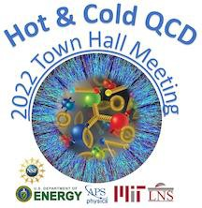
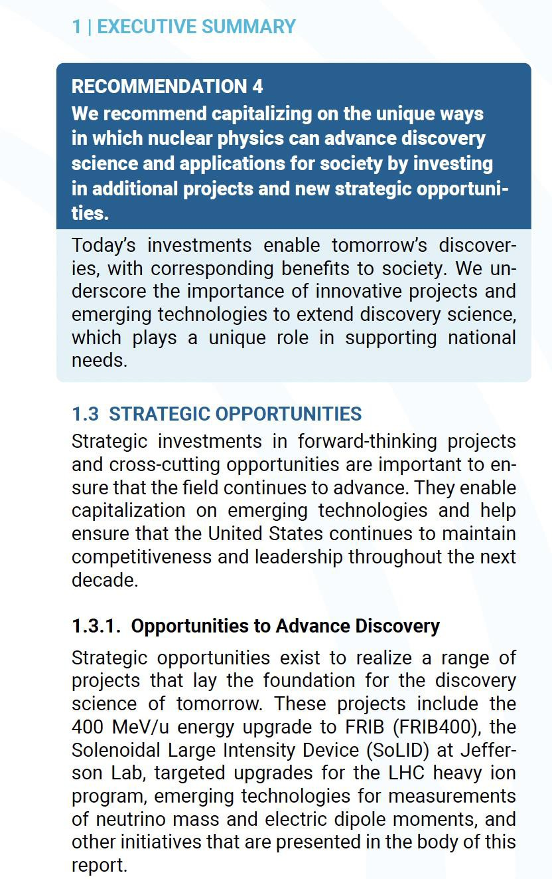

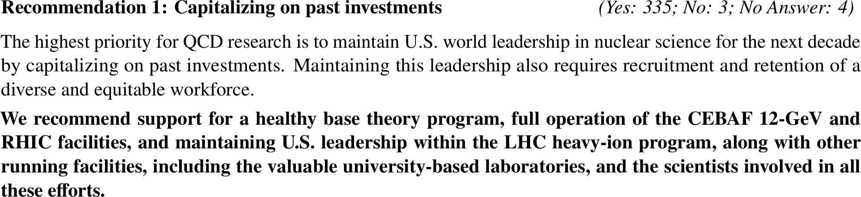
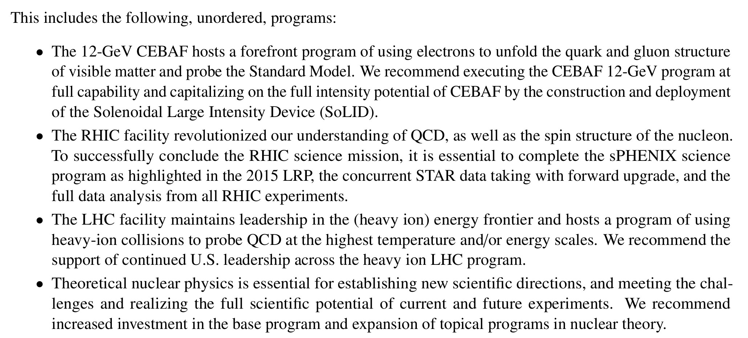
SoLID in 2023 NSAC Long Range Plan & strong community support
NSAC 2023 LRP Town
Meetings – QCD
https://science.osti.gov/-
/media/np/nsac/pdf/202310/NSAC-LRP- 2023-v12.pdf https://arxiv.org/abs/2303.02579
https://inspirehep.net/literature/2638645

Slide 13
Broad Impact of SoLID
Science Impact: valence- (SoLID) and sea-quark/gluon (EIC) regions required to fully unravel the structure of the nucleon and search for new physics
Technologies: testing grounds for advanced detector, DAQ and computing technologies including AI/ML, e.g., HPDF
Workforce development critical for future success of the EIC science
STEM Workforce development for energy, medicine, data science, and more

Slide 14
Strategy to move SoLID forward
SoLID science more compelling in the era of the EIC as demonstrated in the 2015 and 2023 NSAC LRPs; both valence and sea/gluon regions required
Robust and growing interest of international and theory communities
Successful Pre-R&D activities reduce cost and scheduling risks; robust and consistent cost estimates over the years
Broad impact, e.g., testing grounds for advanced and new technologies, HPDF, essential workforce for the EIC and more
Funding
  DOE/NP; JLab capital and repurpose possibilities
  NSF Mid-scale program
  International funding

Slide 15
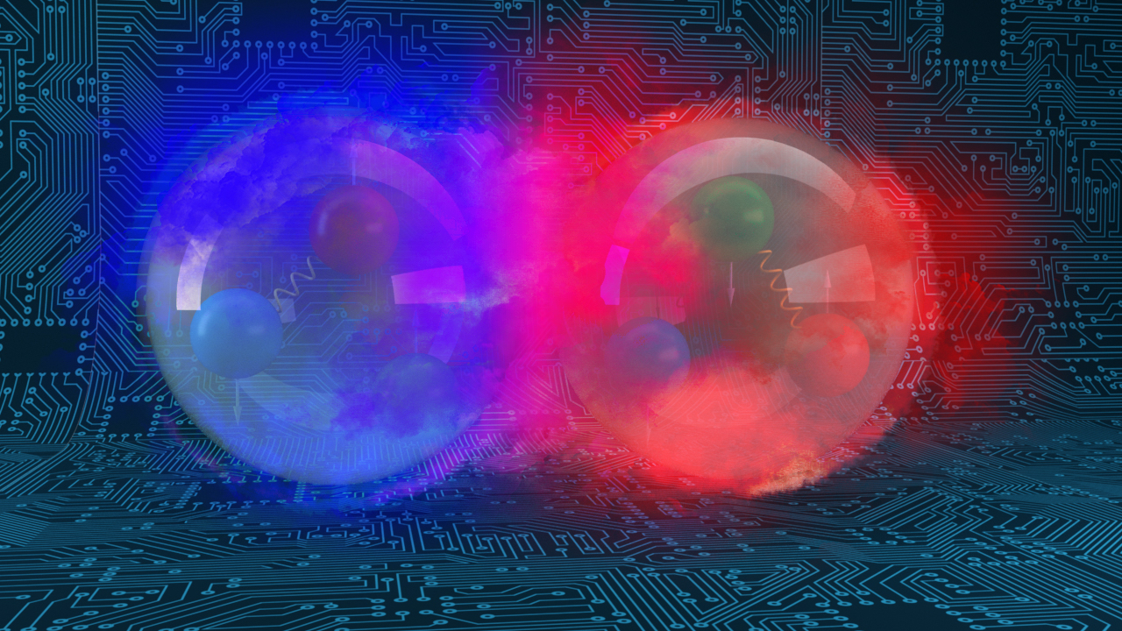
Summary and Outlook
SoLID: A large acceptance device which can handle very high luminosity to allow full exploitation of JLab12 potential
SoLID has rich and vibrant science programs complementary and synergistic to the proposed EIC science program, workforce development for the EIC
After a decade of hard work, we have a mature pre-conceptual design with expected performance meeting requirements for the three major science programs (DOE 2021 Science review and 2024 facilities review)
SoLID is a core part of JLab 12-GeV program, highlighted in 2023 NSAC LRP Recommendations; strong support of the lab to move SoLID forward
The collaboration formed more than 15 years ago, ready and eager to move onto the next stage

