Slide 1
EIC and JLab’s Continuing Role
Jim Fast, EIC Associate Project Manager/Deputy Project Director
Rolf Ent, EIC Co-Associate Director – Experimental Program
Presented to:
JSA S&T Mission Committee
December 10, 2024

Slide 2
EIC Project
JLab’s Continuing Role
Jim Fast
EIC Associate Project Manager
December 10, 2024

Slide 3
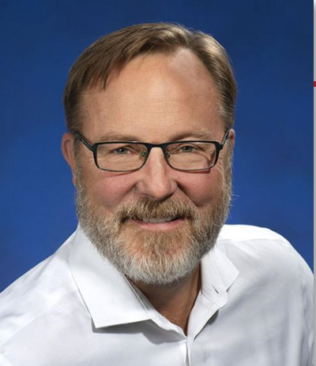



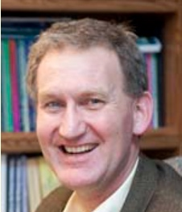
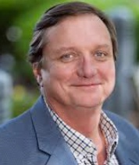
An Integrated BNL/JLab Leadership Team – FY2023
ELECTRON-ION COLLIDER PROJECT J. Yeck PROJECT DIRECTOR A. Petrone CHIEF OF STAFF
EIC PROJECT MANAGER | L. Lari
TECHNICAL DIRECTOR | S. Nagaitsev
ASSOCIATE PROJECT MANAGER | J. Fast
CO-ASSOCIATE DIRECTOR EXPERIMENTAL PGM | R. Ent
CO-ASSOCIATE DIRECTOR EXPERIMENTAL PGM | E. Aschenauer
SENIOR ADVISOR | F. Willeke
Associate Director for ACC. IntL. Partnerships | A. Seryi
Environmental, Safety and Health | C. Schaefer
 | W. Rainey
Jim Yeck
Project Director
Luisella Lari
Project Manager
Sergei Nagaitsev
Technical Director
Elke Aschenauer
Co-Associate. Director of Experimental Program
Rolf Ent, JLab
Co-Associate. Director of Experimental Program
Jim Fast, JLab
Ass. Project Manager
Integrated BNL/JLab organization established in 2020
Continues to evolve and strengthen with the support of the host labs
An effective framework for developing execution strategies and identifying and resolving issues
Executive Management Team meetings include additional participants
Technical Director, Sergei Nagaitsev, on leave from JLab to serve in that capacity at BNL

Slide 4
EIC Leadership Team Now – JLab is losing equity
ELECTRON-ION COLLIDER PROJECT J. Yeck PROJECT DIRECTOR
EIC PROJECT MANAGER | L. Lari
TECHNICAL DIRECTOR | S. Nagaitsev
DEPUTY TECHNICAL DIRECTOR | K. Smith
ASSOCIATE PROJECT MANAGER | J. Fast
CO-ASSOCIATE DIRECTOR EXPERIMENTAL PGM | R. Ent
CO-ASSOCIATE DIRECTOR EXPERIMENTAL PGM | E. Aschenauer
Associate Director for INFRASTRUCTURE | C. Folz
IR SC MAGNET PRODUCTION MANAGER | B. Wahl
Environmental, Safety and Health | C. Schaefer
CHIEF OF STAFF | A. Petrone
EXECUTIVE ADMINISTRATION | C. Hoffman
Jim Yeck
Project Director
Luisella Lari
Project Manager
Sergei Nagaitsev
Technical Director
Elke Aschenauer
Co-Associate. Director of Experimental Program
Rolf Ent, JLab
Co-Associate. Director of Experimental Program
Jim Fast, JLab
Ass. Project Manager
Integrated BNL/JLab organization established in 2020
Continues to evolve and strengthen with the support of the host labs
An effective framework for developing execution strategies and identifying and resolving issues
Executive Management Team meetings include additional participants

Slide 5
EIC Leadership Team Now – JLab is losing equity
ELECTRON-ION COLLIDER PROJECT J. Yeck PROJECT DIRECTOR
EIC PROJECT MANAGER | L. Lari
TECHNICAL DIRECTOR | S. Nagaitsev
DEPUTY TECHNICAL DIRECTOR | K. Smith
ASSOCIATE PROJECT MANAGER | J. Fast
CO-ASSOCIATE DIRECTOR EXPERIMENTAL PGM | R. Ent
CO-ASSOCIATE DIRECTOR EXPERIMENTAL PGM | E. Aschenauer
SP1 Lead SP2 Lead SP3 Lead SP4 Lead | TBD (BNL) TBD (JLab) TBD (BNL) TBD (JLab)
Associate Director for INFRASTRUCTURE | C. Folz
IR SC MAGNET PRODUCTION MANAGER | B. Wahl
Environmental, Safety and Health | C. Schaefer
CHIEF OF STAFF | A. Petrone
EXECUTIVE ADMINISTRATION | C. Hoffman
The project is headed in the direction of using subproject
At present there are 4 subprojects envisioned, each with their own lead
  SP1: HSR/ESR Rings
  SP2: Detector and IR
  SP3: Electron Injector
  SP4: RF power upgrades and 41 GeV p/h
One mechanism to restore balance would be to have JLab staff lead one or two of these subprojects [SP2, SP4?]

Slide 6
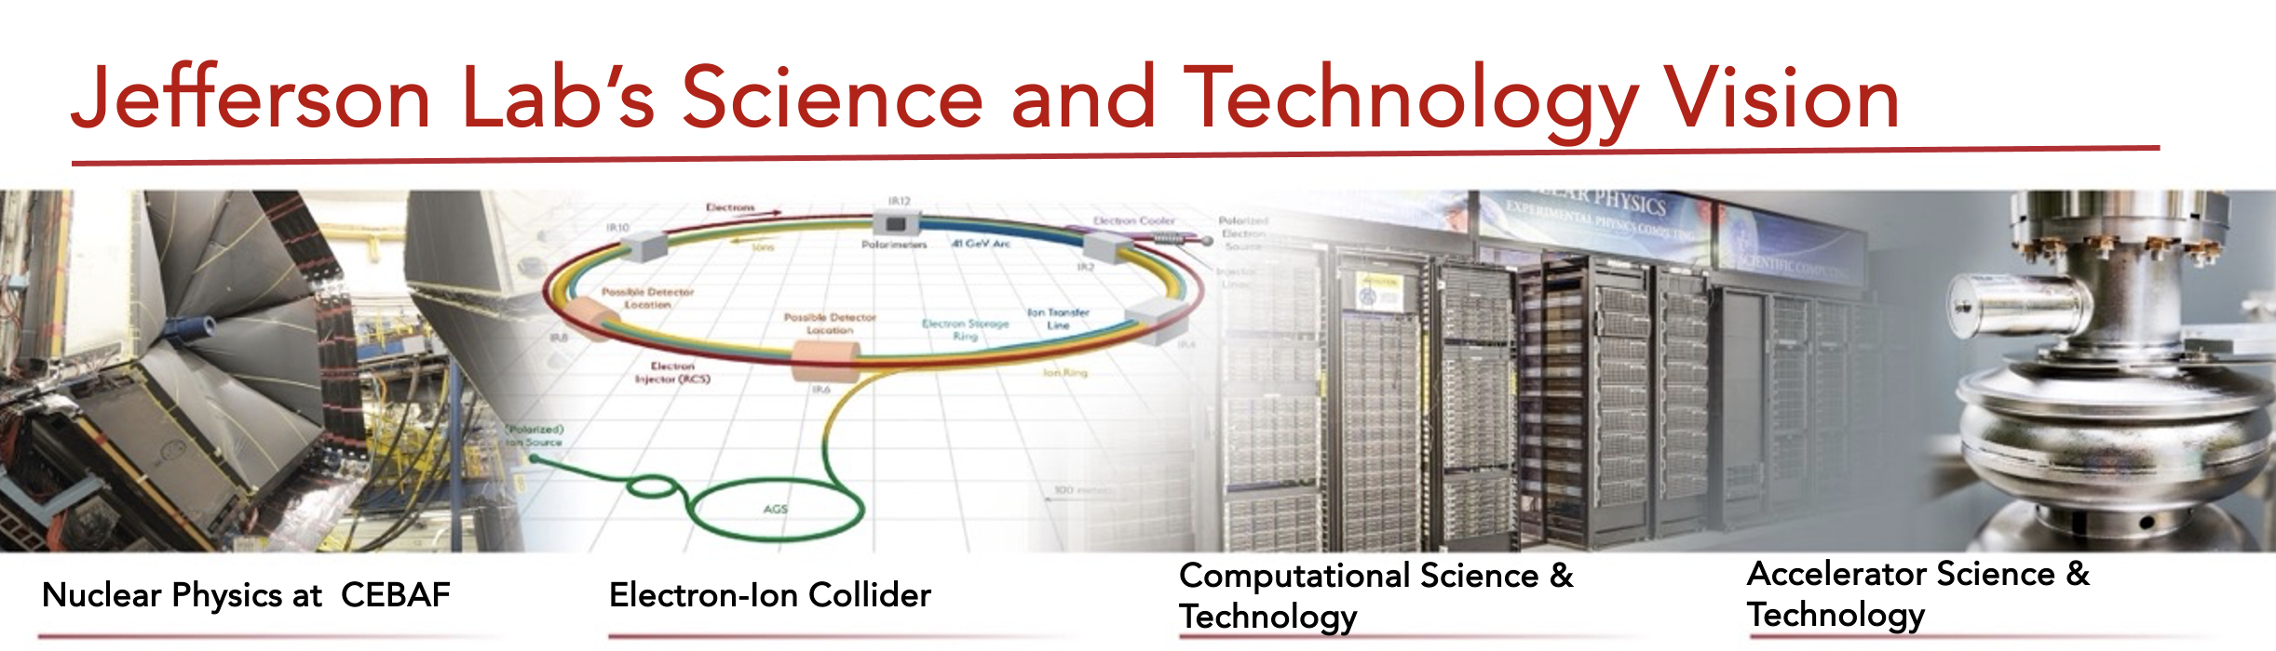
JLab’s Technical Roles on EIC
JLab is committed to the success of the EIC Project and the Science Program
  EIC is one of four pillars of the JLab S&T Vision and is tightly linked to Accelerator S&T thrust
JLab Project scope is aligned with lab technical expertise and strategic interests
  Maintain worldwide leadership in SRF technology from RF design to manufacturing
  Maintain excellence in cryogenic engineering, notably 2K helium systems
  Rebuild waning normal conducting magnet expertise and test equipment
  Build on expertise in detector systems

Slide 7
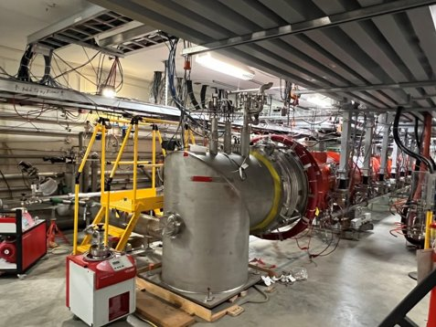
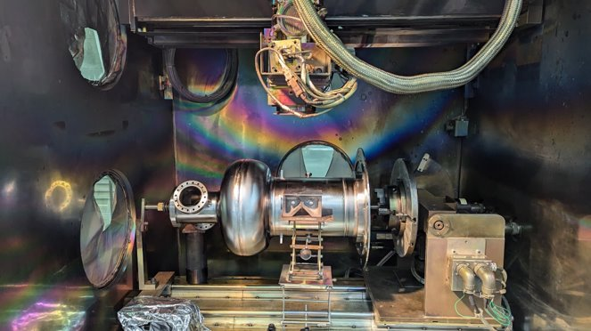
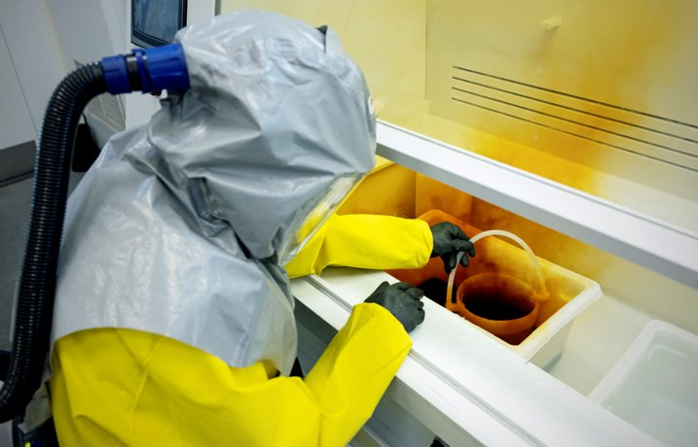
Superconducting Radiofrequency (SRF)
Long-standing expertise at JLab – it’s what put CEBAF on the map
History of partner projects (LCLS-II, SNS PPU, LCLS-II-HE)
  In addition to being a provider to host labs, partnered with other DOE labs to execute work
Three pillars of SRF technology at JLab
  SRF R&D – RF physics design through R&D prototypes
  SRF Engineering – Significant experience with engineering SRF cryomodule systems
  SRF Operations – Manufacturing and testing of cryomodules
LCLS-II Cryomodule Testing
EIC 591 MHz Design Verification Cavity
SRF Chemical Processing

Slide 8
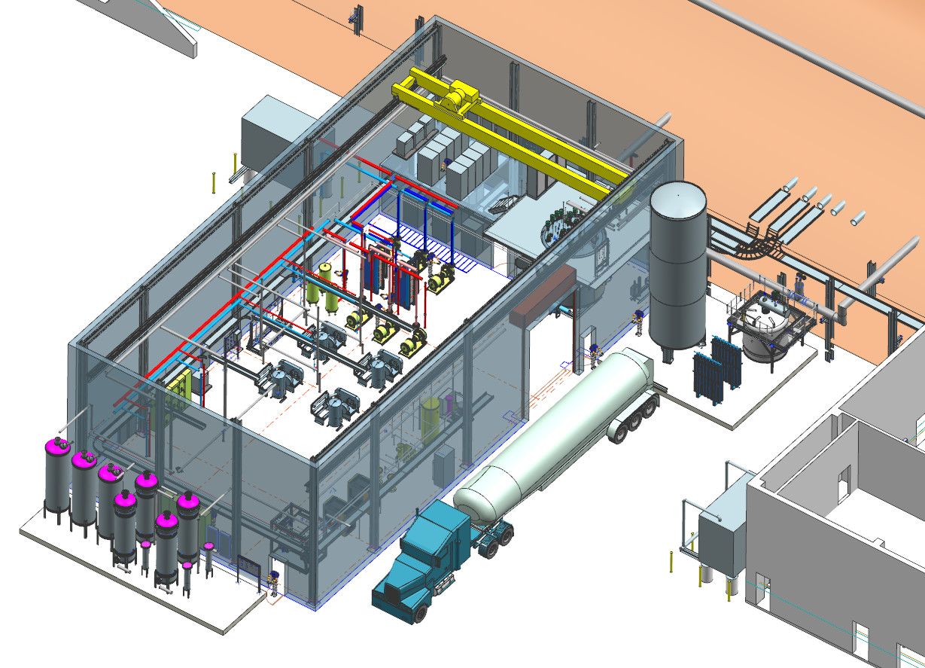
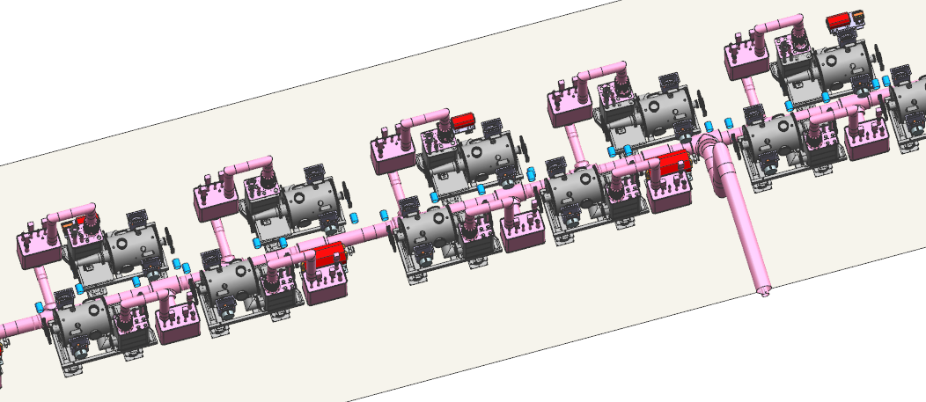
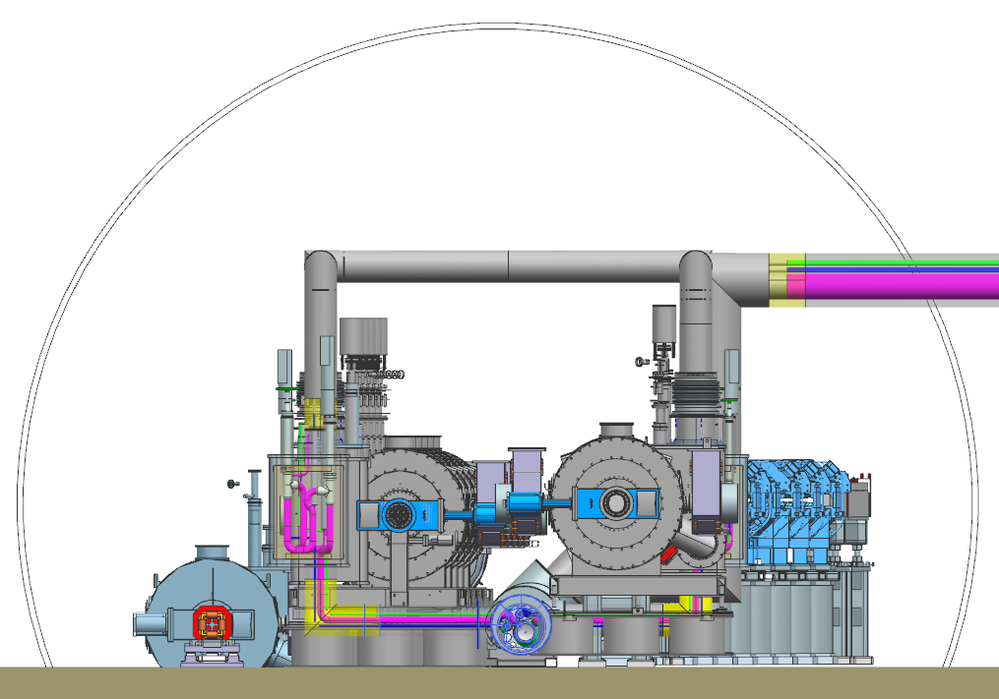
Cryogenic Engineering
JLab’s cryogenics expertise paralleled the SRF development for CEBAF
End Station Refrigerator-II recently completed at JLab (feeds Hall A for MOLLER)
  Utilized cold box and compressors salvaged from the SSC 30 years ago!
JLab is designing the 2K Satellite Refrigerator Plants and 2K distribution systems for the EIC while BNL is handling the 4K systems
IR-10 Satellite plant (CD-3A)
IR-10 2K cryogeneic distribution system

Slide 9
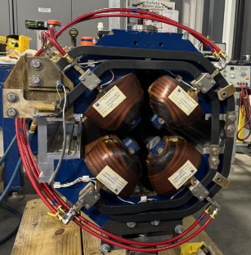
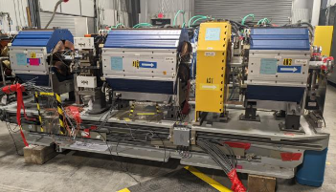
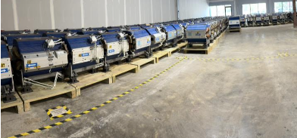
Normal Conducting Magnets
JLab’s interest is rebuilding expertise in magnet design and testing
  EIC offers opportunities to refresh engineering talent and test stands
  Leveraging JLab assets such as magnet power supplies for tests, granite tables etc.
Repurposing of APS magnets
  122 magnet girders received at JLab from APS
    All disassembled to recover quadrupoles (blue) and sextupoles (yellow)
    Radioactive waste stream <1000 lbs vs 60,000 lbs planned for
  First set of 6 magnets have been refurbished/rebuilt (one of each flavor)

Slide 10
EIC Detector – Synergy with CEBAF Operations
JLab has known responsibility in:
CAMs for R&D, tracking, particle id, far-forward/-backward, magnet, electronics, DAQ/computing
Detector Solenoid Magnet
Computing and Software – synergy with streaming/advanced computing grand challenge
Electronics and DAQ/Computing coordination – synergy with streaming/advanced computing
Electron Polarimetry – synergy with high-precision polarimetry for MOLLER
E&D for pfRICH, dRICH and far-forward/far-backward as part of EIC Project work
Ongoing JLab interest areas – together with Jefferson Lab/EIC users:
muRWell and E&D for GEM-based trackers (outer MPGD, Disks) – synergy with MPGD Center
High-performance DIRC – E&D, assembly, synergy with GlueX/DIRC work and infrastructure
Backward EM Calorimeter (backup for EEEmCAL group) – synergy with earlier NPS, FCAL-II
dRICH (backup for INFN-led project) – synergy with earlier CLAS12 RICH work
HRPPD evaluation – synergy with ongoing work with/interest in LAPPDs for PID detectors

Slide 11
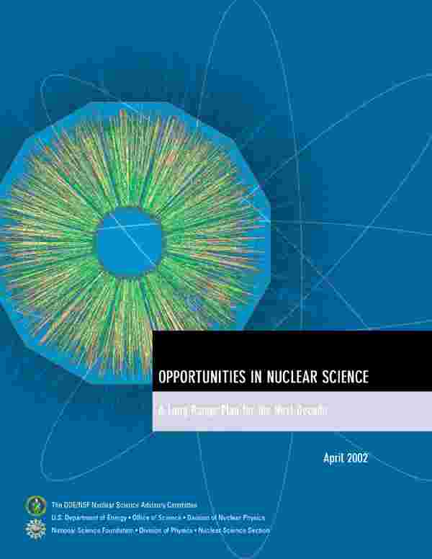
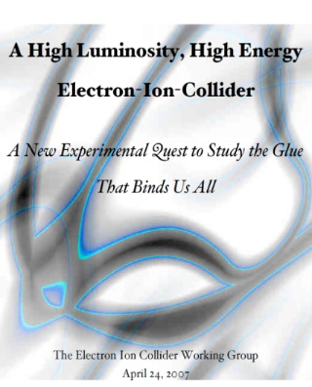
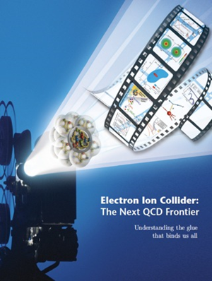

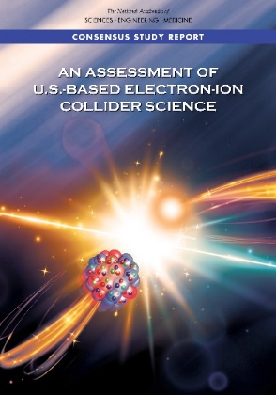

EIC Scientific Case Built Over Decades
More on EIC Science in Rolf Ent’s presentation
2002
2007
2009
“We recommend the expeditious completion of the EIC as the highest priority for facility construction.” (2023)
2010
2012
Gluons and the Quark Sea at High Energies
2013
NSAC
2015
Major Nuclear Physics Facilities for the Next Decade
2018
2021
2023
March 14, 2013
“The science questions that an EIC will answer are central to completing an understanding of atoms as well as being integral to the agenda of nuclear physics today.” (2018)
arXiv:2103.05419
11

Slide 12
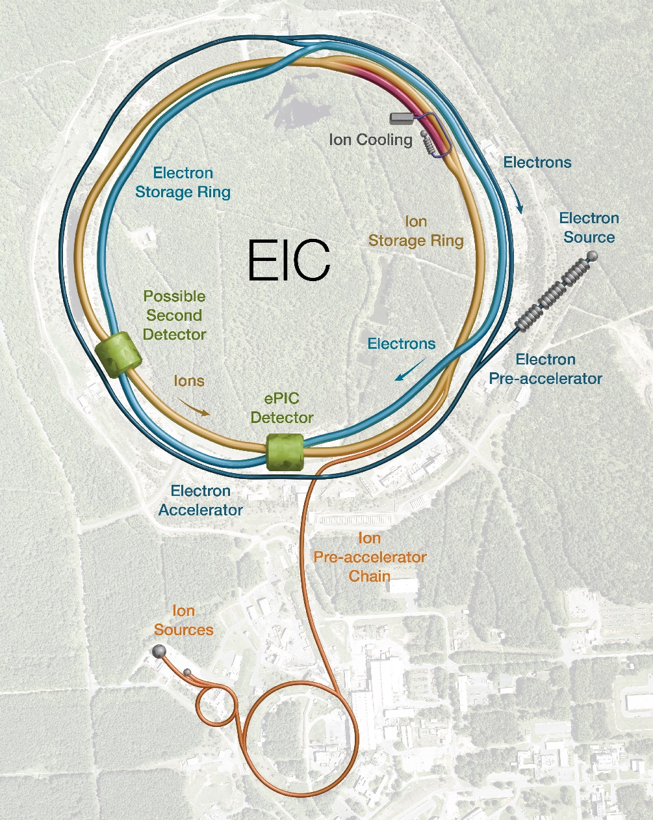
Facility Requirements
High Luminosity: L= 10³³ – 10³⁴cm⁻²sec⁻¹
Highly Polarized Beams: 70%
Large Center of Mass Energy Range: E_{cm} = 20 – 140 GeV
Large Ion Species Range: protons – Uranium
Large Detector Acceptance and Good Background Conditions
Possibility to implement a Second Interaction Region (IR)
Conceptual design scope and expected performance satisfy the U.S. Nuclear Science Advisory Committee (NSAC) Long Range Plan (2015 & 2023) and the requirements endorsed by the U.S. National Academy of Sciences (2018).
Full capabilities are not compatible with $3B TPC so trade studies are underway to reduce project scope with acceptable impacts on the physics reach of the accelerator complex:
No strong hadron cooling – replaced with low energy cooler
Alternative approach for electron injector complex
41 GeV hadrons and 18 GeV electrons after early science Ops

Slide 13
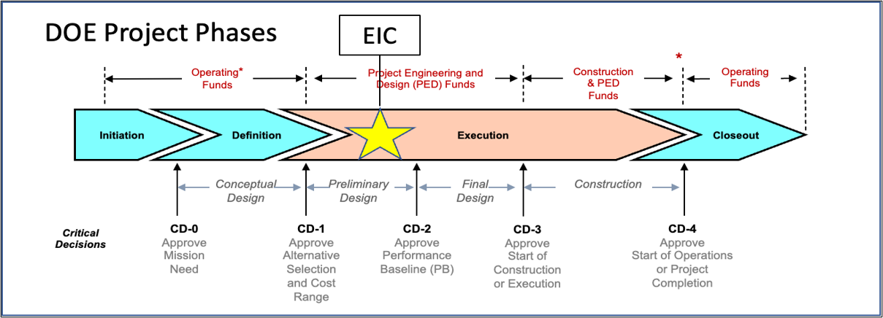
EIC Project Critical Decisions and Plans
2019
2021
2026-2027
2027-2028
~2034
CD-3A, Long Lead Procurement, approved March 2024. Excellent use of IRA funding.
CD-3B, Long Lead Procurement, approval planned for March 2025.
CD-2 and CD-3 will be split into subprojects based on technical readiness and funding.
  Earliest CD-2 or CD-2/3 anticipated in late 2026.

Slide 14
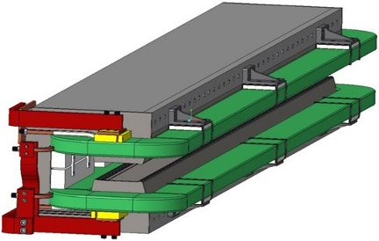
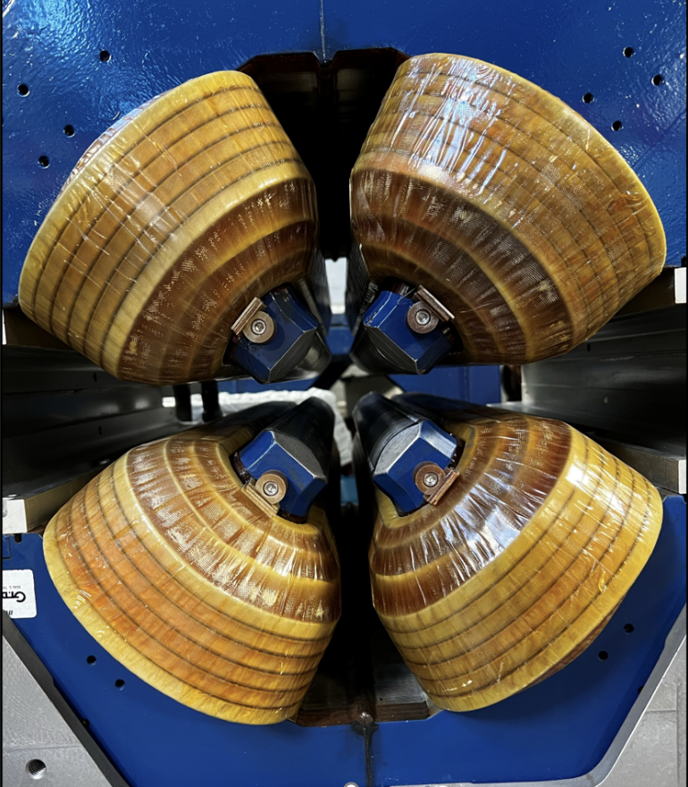
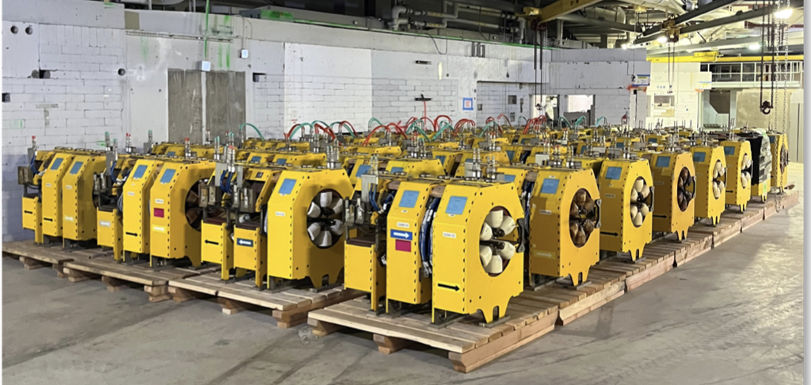
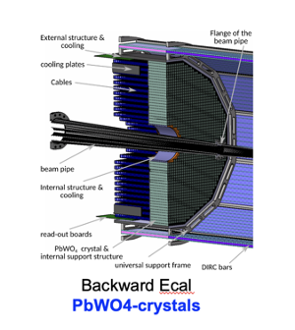
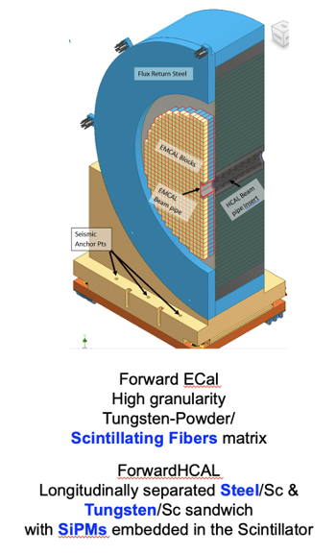
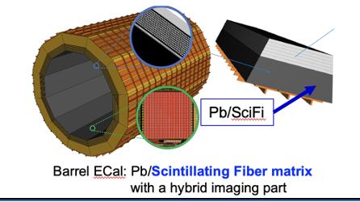
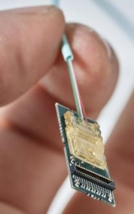
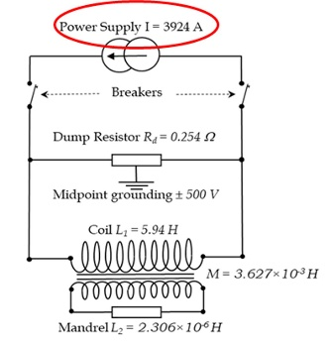
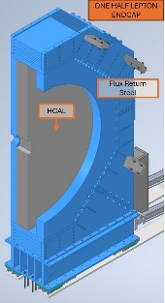
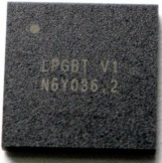
CD-3B Request Overview
The EIC Project requests authority to execute ~ $50M in LLPs, including 35% contingency.
Electron Storage Ring (ESR) Dipole Magnets
Advanced Photon Source (APS) Sextupole Magnet Refurbishment, Testing, and Measurement
ESR Magnetic Measurement Bench
APS Quadrupole Magnet Refurbishment, Testing & Measurement
ESR APS Quadrupole Magnetic Measurement Stand
* Lead Tungstate Crystals for the Detector Backward Electro-Magnetic (EM) Calorimeter - Batch 3 and Batch 4
* Scintillating Fibers for the Detector Barrel - Bath 2 and Forward - Batch 2 EM Calorimeters
* Steel for the Detector Forward Hadronic Calorimeter
Detector Solenoid Magnet Power Supply
Detector Electronics Versatile Link Plus Transceiver (VRTX+) and low Power Giga-bit transceiver (1pGBT)
Detector Endcap Structures – Flux Return Steel
Accelerator
Detector
* Continuation of CD-3A contracts

Slide 15
EIC Comprehensive Scope Identification
On-Project Scope and Dependencies
DOE EIC Line-Item Project ~$3B |  | DOE Order 413.3B, Resource Loaded Schedule (P6), Earned Value Management System (EVMS), Reporting, etc. Contingency included to cover the risks associated with In-Kind Contributions and the NYS ESD Grant.
In-Kind Contributions Accelerator/Detector ~$150M |  | Deliverables/specifications agreed with Partners and Partners secure funding. Milestones in P6 with schedule tracking and technical integration.
NYS $100M |  | P6, EVMS, NYS ESD Grant Compliance.
Off-Project Scope and Dependencies
Accelerator & Infrastructure |  | BNL accelerators and infrastructure and lifetime extension needed for EIC.
Detector |  | BNL and JLab facilities and resources required for the success of the EIC experimental program.
Host Laboratory |  | BNL support for the EIC project, guests, and users.
$3.5-3.7B is my guestimate
Several $100Ms at BNL
Few M$ at JLab

Slide 16
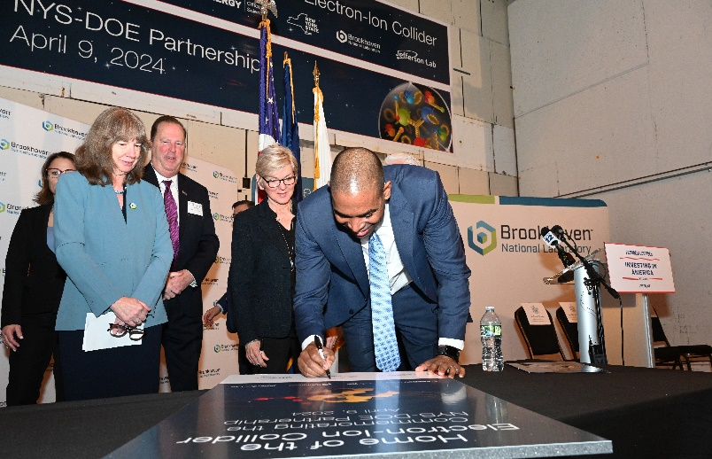
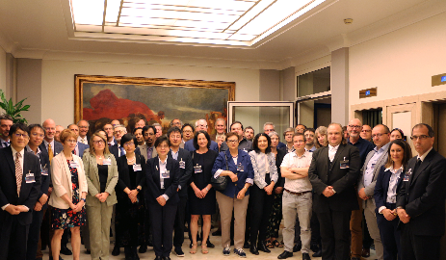

Strong Support from Partners & Collaborators
New York State committed $100M toward construction of EIC buildings and infrastructure.
EIC Accelerator Collaboration Kick-Off at the International Particle Accelerator Conference with over 150 participants expressing interest in contributing to the global EIC effort.
UK announced £58 million ($75M) for the EIC.
EIC Resource Review Board Meeting in Rome in May 2024. Strong participation from Canada, Czech Republic, France, India, Israel, Italy, Japan, South Korea, United Kingdom, and Taiwan. Next meeting to held in Nov 2024 at BNL.
16
16

Slide 17
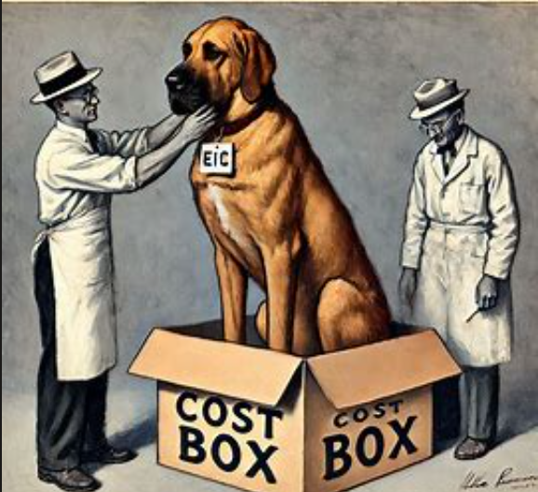
Challenges facing EIC and JLab’s Role in EIC
The project is not making sufficient progress on
developing a coherent scope/schedule/cost
performance baseline.
It is clear ~$3B will not deliver all of the scope
  Some features such as 41 GeV bypass, RF power could
  potentially be funded on operations in parallel with the early science program
Leadership is not in synch on how to get to a resolution
  This is driving my decision to step down from my role on EIC and retire
JLab’s roles in the L1 management box have weakened over the past two years and are now being tangibly reduced in the Org Chart
  This does not bode well for maintaining a “Special Partnership” status

Slide 18
EIC Project
JLab’s Continuing Role
Rolf Ent
EIC Co-Associate Director – Experimental Program
December 10, 2024

Slide 19
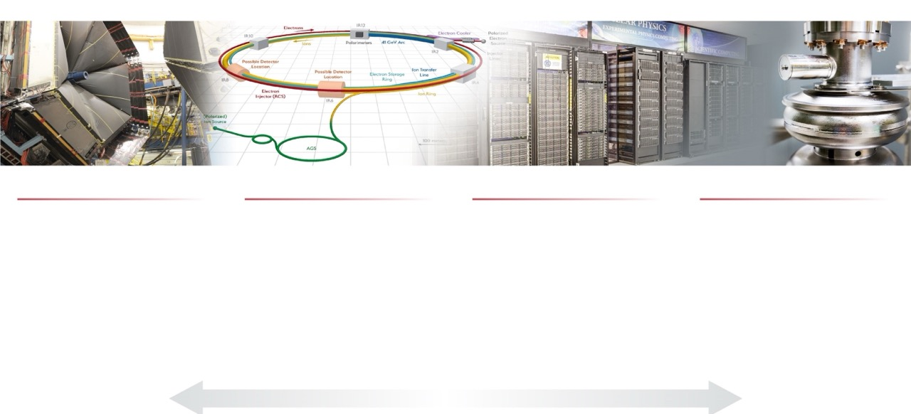
Jefferson Lab’s Science and Technology Vision
Nuclear Physics at CEBAF
Electron-Ion Collider
Computational Science &
Technology
Accelerator Science & Technology
Vibrant nuclear physics research program at CEBAF supporting ~1,900 annual users
MOLLER Project
Future opportunities complementary to EIC
Theory and computation supporting NP goals
Partnering with BNL in the management, design, and construction of the Electron-Ion Collider Project
Leadership in EIC scientific program
Leadership of the Generic EIC–related Detector R&D Program
Design, construction, operation of first-of-its-kind data-intensive computing facility: High Performance Data Facility
Building out data science, domain science capabilities in support of HPDF and to take advantage of HPDF
Accelerator component production for DOE construction projects partnering across the National Lab complex.
Develop CEBAF upgrade concepts
R&D in accelerator, detectors and applications in nuclear imaging and medicine
S&T thrusts are synergistic and mutually supportive
From: Annual Lab Plan Presentation 2024

Slide 20
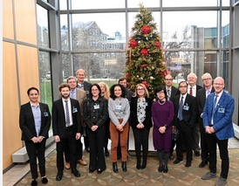
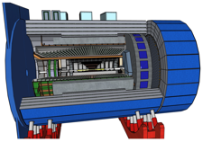

Ensure Excellence in Delivering on the EIC Partnership
Vision
Strategy
Apply our extensive decades-long expertise in electron scattering science and technology in partnership with BNL to ensure the success of both the EIC Project and its scientific program, in both experiment and theory
Priority areas
Demonstrate leadership in the EIC scientific program and deliver on TJNAF Project Partnership responsibilities
Develop a strong R&D effort that encompasses the physics covered by the EIC in both theory and experiment
Recent achievements
Execute TJNAF CD-3A scope
Develop with BNL project plans for CD-3B and CD-2
Promote scientific community support for the EIC detector
Establish key scientific roles in the EIC in computing and femtography
Strong partnership with BNL
CD-3A approval in March, 2024
International Resource Review Board Established (3rd meeting completed)
Completed many technical reviews for aspects of the detector and accelerator
JLab led (!): the formation of the EIC User Group, the science correlated with 3D imaging of protons and mesons and the origin of mass, the initiation of the streaming readout consortium, the initiation of the modern EIC computing & software, the initiation and the steering of the Yellow Report activity, the formation of the EIC partnership, the development of the Resource Review Board meetings, etc., …
EIC FPD Status Update Meeting @ BNL June 28-30, 2022
From: Annual Lab Plan Presentation 2024
EIC Collaboration Statement of Interest signing France CNRS and DOE Nov. 13, 2023
DOE EIC CD-3A/Status Independent Project Review Nov. 14-16, 2023

Slide 21
EIC Science – Context and EIC Group Mission
Context: The EIC is a natural outgrowth of the Jefferson Lab CEBAF science program. At the same time, it would be an outgrowth of the BNL RHIC program. Both lab’s have a vested interest in the science
Both labs began developing EIC concepts and exploring the science case beginning in the early 2000s.
JLab and BNL are co-hosting the EIC experimental program.
EIC Group Mission: Advance the science capabilities of the EIC, support the EIC project, and provide a regional hub for analyzing future EIC data.
  Leverage the synergy between nuclear science at Jefferson Lab and the EIC.
  Develop novel or improved detector technologies to enhance opportunities for nuclear science and technology transfer.
  Facilitate detector R&D in test setups and parasitic beam tests using Jefferson Lab’s facilities.
  Create a modular simulation, reconstruction and analysis toolkit for the fully integrated EIC detector and interaction region, which is fully compatible with the envisioned compute-detector integration using streaming readout, AI/ML, and heterogeneous computing.
  Mentor the future nuclear physics workforce towards the co-hosted EIC science program.
  Foster a collaborative and inclusive scientific community to advance cutting-edge research at EIC.

Slide 22
EIC Detector - Summary
Vision: Be the place to go for AI-empowered near-real time analysis of EIC science with an emphasis on 3D imaging and understanding emergent mass and structure.
  The Jefferson Lab 12-GeV science is the place to start.
  Jefferson Lab leads the computing and software efforts in EIC.
  Natural synergy with streaming readout grand challenge, SciDAC project on 3D imaging, and HPDF.
EIC Detector responsibilities and areas of Jefferson Lab interest provide natural synergy with the ongoing 12-GeV science program, JLab user expertise, and tech transfer opportunities.
  TJNAF has responsibilities for Detector SC magnet, Particle Identification (hpDIRC, dRICH), PbWO4 precision calorimetry, GEM-based MPGDs, large-area photosensors, electron polarimetry, (streaming readout) electronics and data acquisition, and computing and software.
The EIC group is a hybrid of ~4 FTE scientists supported by NP OPS, matrixed staff that works as Control Account Managers, and direct EIC project hires.
  This also provides natural synergy, like the EIC tech work group is predominantly available for MOLLER fabrication and installation work in 2024 and 2025.
EIC detector activities leverage TJNAF core capabilities; as such they pose risk for CEBAF operations by conflicting needs of skilled labor. We mitigated by adding dedicated new hires. EIC detector activities provide also synergy with Hall operations and user expertise; as such they provide opportunity.
From: CEBAF Operations Review Presentation 2024

Slide 23
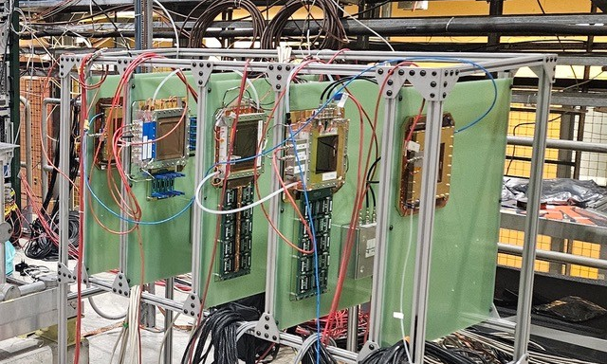
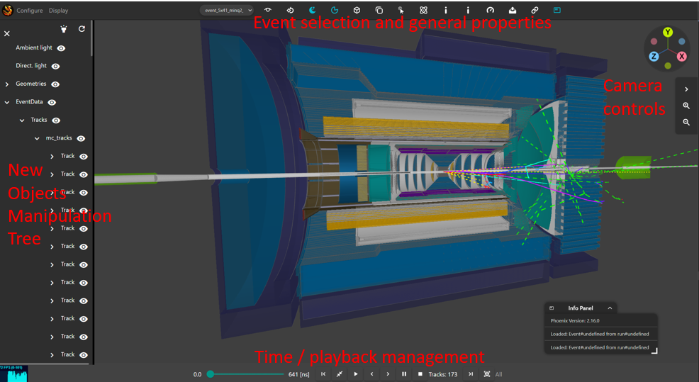
EIC Group Staff – 12 GeV Program & EIC Synergies
Markus Diefenthaler (~0.15 RES, ~0.10 SciDAC, ~0.75 OPS)
  Transverse-Momentum Parton Distributions (EIC & Hall C), QuantOm JLab contact.
  ePIC Software & Computing Coordinator; Streaming Readout and AI/ML applications
Rolf Ent (~0.3 OPS, ~0.7 EIC)
  Strategic Lab Planning
  Streaming Readout Grand Challenge
Yulia Furletova (~0.2 RES, ~0.3 OPS, ~0.5 EIC)
  Lepton Flavor Violation (EIC & SoLID), Meson Structure (EIC & 12 GeV)
  Detector R&D, notably the idea and development of the GEM-TRD for GlueX-III
Francois-Xavier Girod (~0.25 RES, ~0.75 OPS)
  GPDs & Pressure Distribution (Nature article, 243 citations)
  Monte Carlo Development for Deep Exclusive Scattering Processes (EIC & 12 GeV)
Dmitry Romanov (~0.25 RES, ~0.75 OPS)
  Streaming readout development & AI
  Modern software development, web-based one-event display compatible with streaming, phones, tablets; ACTS tracking (EIC & Tagged DIS)
Two detector scientists are hired for EIC project work, but have a small ops component through an MOU for lab demands, training, etc.
Arshak Asaturyan (~0.85 EIC, ~0.15 OPS)
Sourav Tarafdar (~0.85 EIC, ~0.15 OPS)
(numbers are FY25 projection)

Slide 24
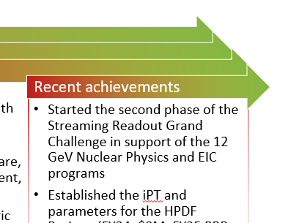
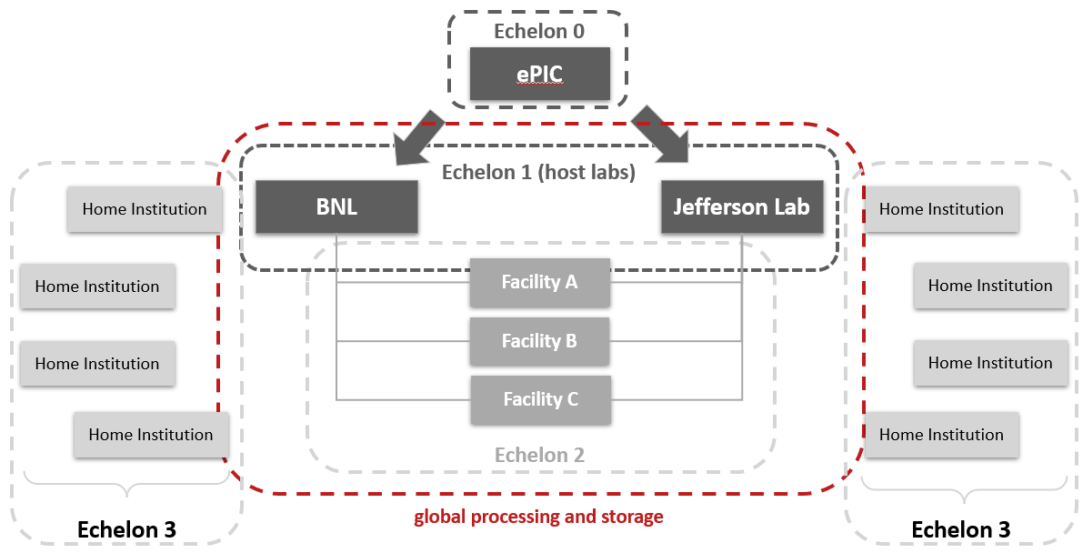
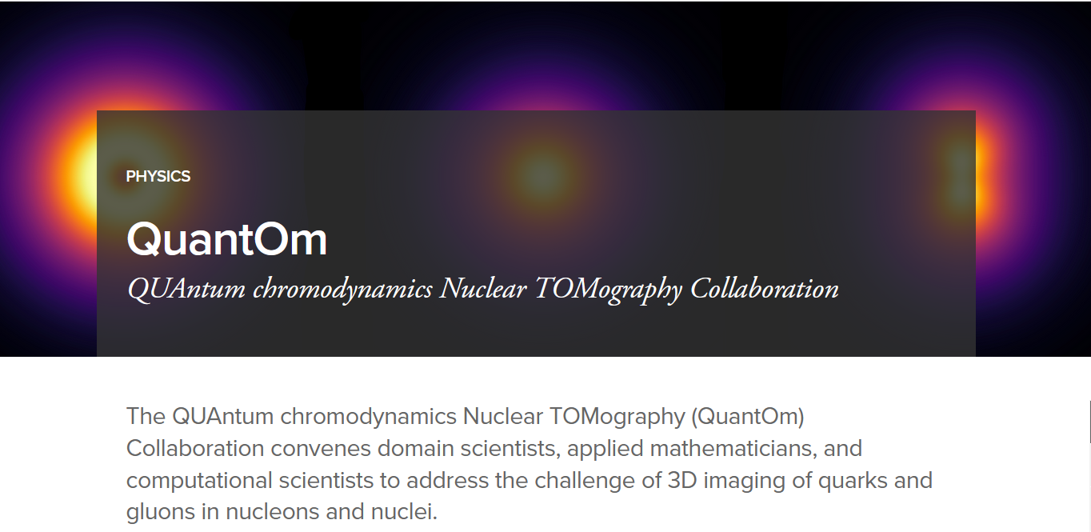
EIC Detector – Computing Synergy
Vision: Be the place to go for AI-empowered near-real time analysis of EIC science with an emphasis on 3D imaging and understanding emergent mass and structure.
  The Jefferson Lab 12-GeV science is the place to start.
  Jefferson Lab leads the computing and software efforts in EIC.
  Natural synergy with streaming readout grand challenge, SciDAC project on 3D imaging, and HPDF.
From Annual Lab Plan slide on “Deploy HPDF and Develop an Associated R&D Program”
Adapted from the “The ePIC Streaming Computing Model” and the 3rd ePIC computing & software review
From QUAntum chromodynamics Nuclear TOMography (QuantOm) Collaboration web pages at ANL

Slide 25
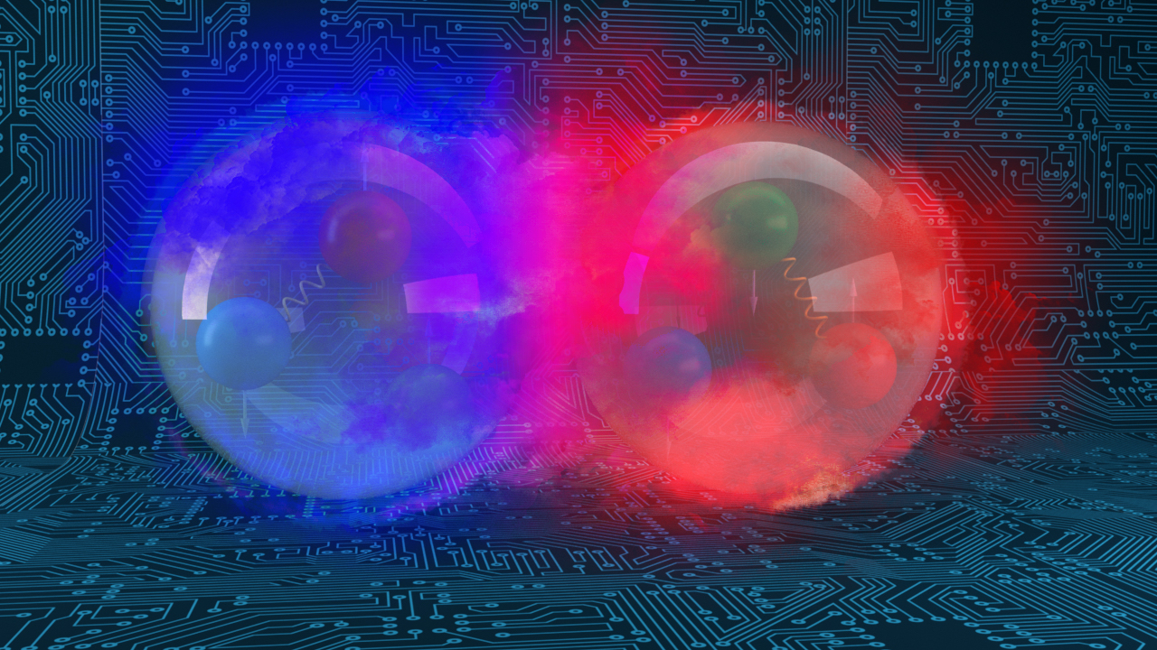
Summary and Outlook
The EIC is a natural outgrowth of the Jefferson Lab CEBAF science program and accelerator S&T interests.
The EIC Partnership serves the Project and the Community well by leveraging skills and strengths at both Labs.
The EIC Computing and Software are unique in a number of important respects: globally distributed computing, streaming computing model, two host Labs are symmetric peers for post-echelon-0 processing.
Vision: Be the place to go for AI-empowered near-real time analysis of EIC science with an emphasis on 3D imaging and understanding emergent mass and structure.

Slide 26
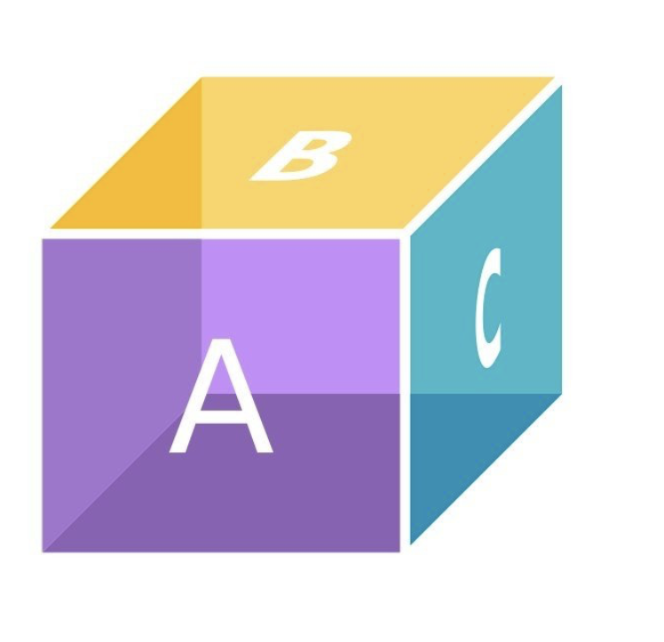
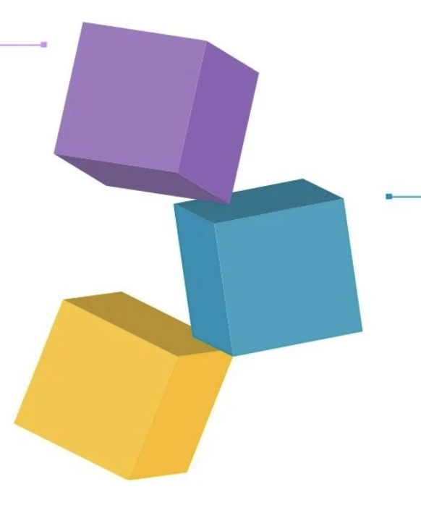





EIC Computing Challenges
The EIC Computing and Software are unique in a number of important respects*
globally distributed computing, streaming computing model, two host Labs are symmetric peers for post-E0 processing, …
processing,…)
ePIC Collaboration
EIC computing components
are independent and
inconsistent
Effectively elaborates streaming model. Needs computing for simulation and services (today)
EIC Computing & Software Joint Institute (ECSJI) aims to provide efficient support for EIC computing and proposes an organisation that ensures robust support for EIC experiments, accelerator simulations and theorists in computing and software, while recognising organisational differences at host laboratories.
Two Host Labs
EIC computing components are coherent, but with grey areas
Need to support Echelon0 & Echelon1/2
Computing and Users
EIC Project
Computing is not part of the EIC project.
But it needs simulations (e.g. , computing) for its detector (and accelerator) optimization.
It is needed today.
The EIC Project: machine and the detector will be ready on time
DAQ is part of the project, Computing and Software (services) are not
EIC computing
components evolve
independently
ePIC Collaboration : Organize collaboration effort and requirements, define
a computing model, work in close contact with ECSJI and international partners
* Markus talk

Slide 27

Questions?

