Slide 1
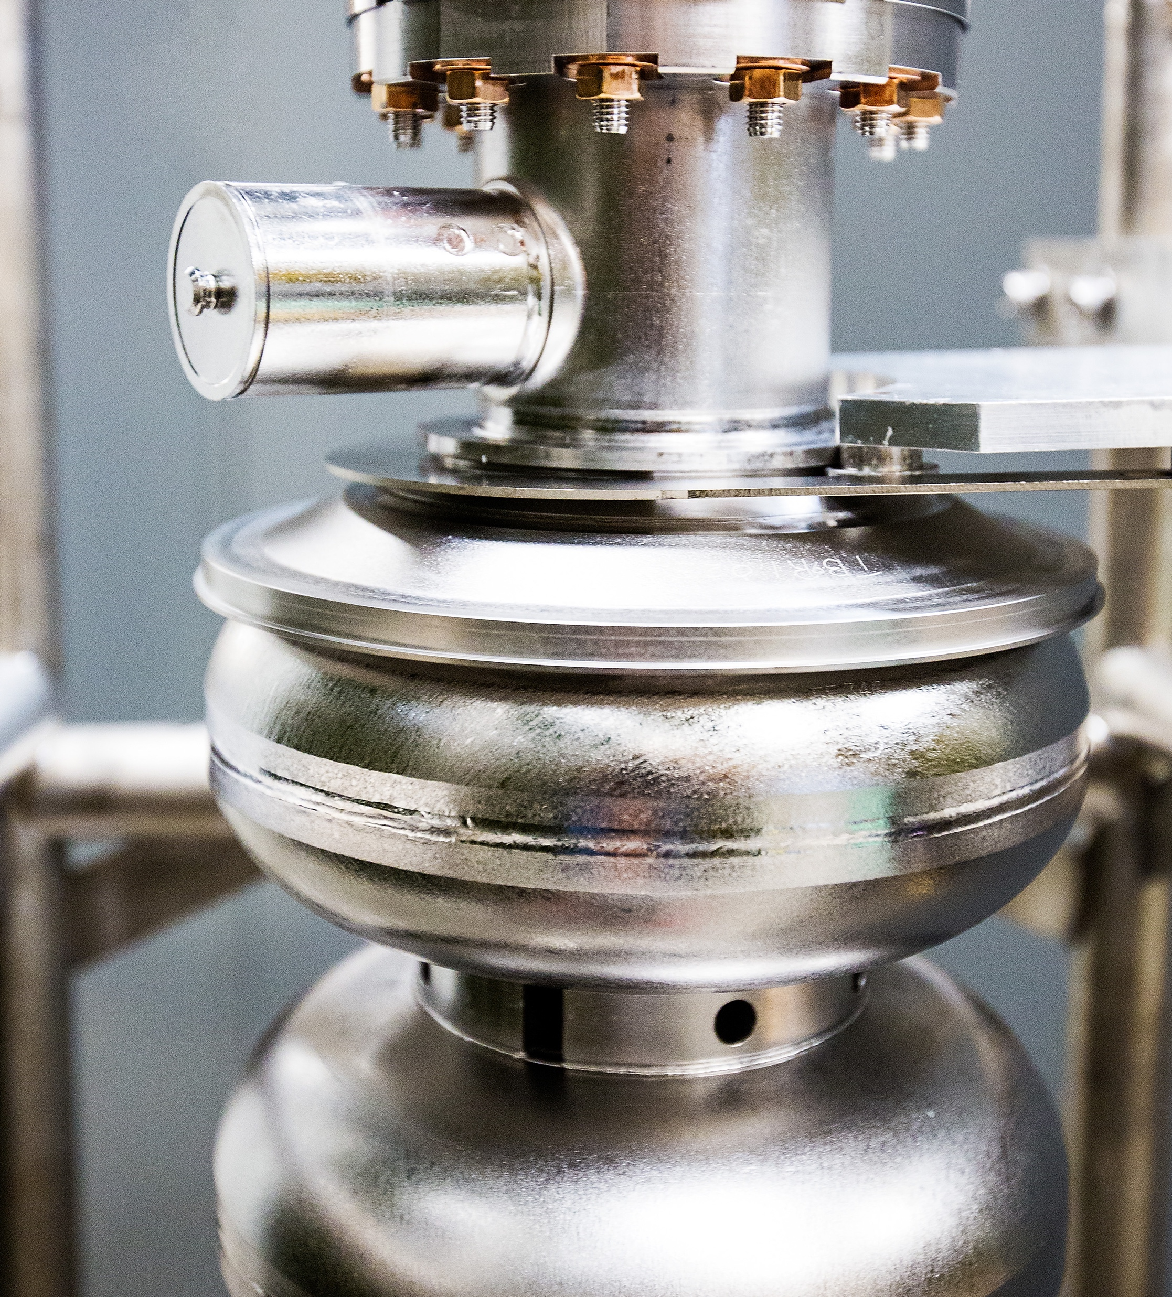
Jefferson Lab Status
Kimberly Sawyer, Lab Director
Presented to:
S&T Mission Committee
December 10, 2024
Notes:
Let me introduce myself, I am Kim Sawyer, the new Director of Jefferson Lab. I am excited to meet with you today. Ultimately, our user community is what Jefferson Lab is all about - collaboration, cooperation, and innovation across institutions, across state and national boundaries – to deliver the best science in our field in a safe and efficient way.

Slide 2
1080
668
588
2
Notes:
Jefferson lab has the largest community of nuclear physicist in the world.
We have a total of 1904 scientific users worldwide: 1238 domestic users and 666 international scientific users as of October 2024.

Slide 3
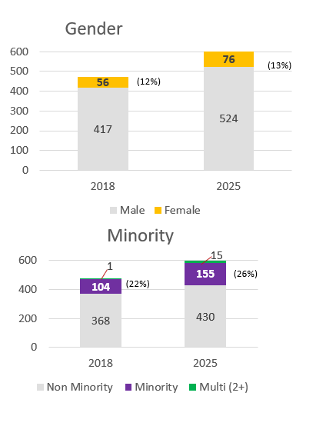
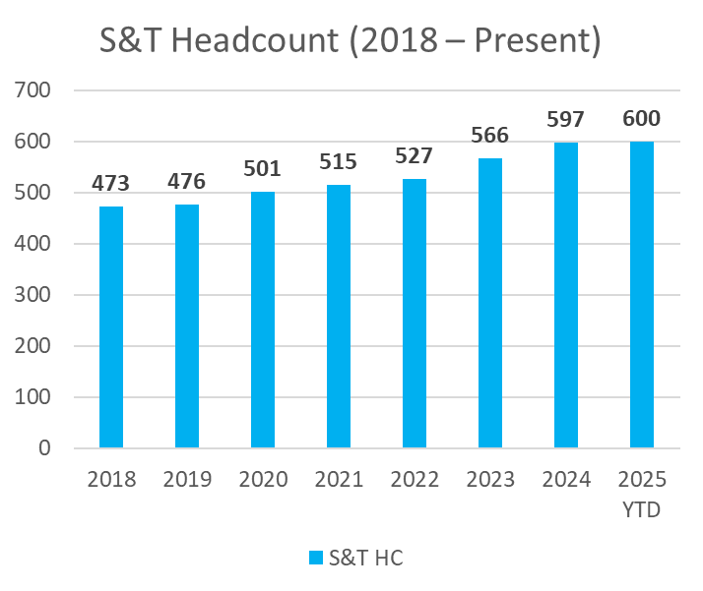
Science & Technology Growth
3
Notes:
Lab is growing, 166 new staff in FY24
Demographic profile is also changing: Female and minority population are on the rise as you can see the increase in percentage in 2024 compared to 2018.

Slide 4
Deputy Chief Operating Officer
Natalie Carter
General Counsel
Rhonda Scales
Quality & Performance Assurance Director
Steve Smith
Chief Communications Officer
Lauren Hansen
Chief Audit Executive
Daniel Caldwell
JEFFERSON SCIENCE ASSOCIATES
EIC Project Director
James Fast
HPDF Project Director
Kate Mace
Project Assurance
Officer
Allison Lung
Chief Innovation Officer
Marla Schuchman
Sean Hearne, JSA Board Chair
THOMAS JEFFERSON NATIONAL ACCELERATOR FACILITY
Laboratory Director
Kimberly Sawyer
Deputy Laboratory Director
for Science and Technology
David Dean
Deputy Laboratory Director
for Operations/COO
Johnathon Huff
COMPUTATIONAL
SCIENCES AND
TECHNOLOGY
Amber Boehnlein
THEORETICAL AND
COMPUTATIONAL
PHYSICS
Jianwei Qiu
EXPERIMENTAL
NUCLEAR PHYSICS
Cynthia Keppel
ENGINEERING
Tim Michalski
ACCELERATOR
Andrei Seryi
PROCUREMENT AND
PRIME CONTRACTS
Tisca Dorsey
Procurement Dir./Prime Contract Mgr.
ENVIRONMENT, SAFETY
AND HEALTH
Natalie Carter
Interim ES&H Director
FINANCIAL
MANAGEMENT
Gail Frayne
Chief Financial Officer
HUMAN RESOURCES
Rhonda Barbosa
Chief Human Resources Officer
FACILITIES MGMT AND
LOGISTICS
Kent Hammack
FM&L Director
PROJECT MANAGEMENT
OFFICE
Steve Smith
Interim PMO Director
4
Notes:
In our efforts to shift toward becoming a high-performing multi-purpose laboratory, we have set a goal to streamline operations and improve services across Jefferson Lab to deliver world-leading science.
Aligning our budget and finance offices
Created a Project Assurance Office
Created a Project Management Office
CPO taking on a new role (CPO office functions re-assigned)
ES&H Director taking on a new role (Interim in place Oct. 16)
Assessing centrally managed, field deployed model to provide safety professionals for divisions

Slide 5
Continuing Recognition of our Employees and Users
2024 APS Fellow: Jozef J. Dudek
2024 APS Fellow: Patrizia Rossi
2024 APS Fellow: S. Alex Bogacz
2024 APS Fellow: Mark Kevin Jones
Tom W. Bonner Prize in Nuclear Physics: Volker Burkert
Stuart Jay Freedman Award in Experimental Nuclear Physics: Caryn Palatchi (JLab User/Indiana Univ.)
Guido Altarelli Award for Experimental Physics: Holly Szumila-Vance
J.J. & Noriko Sakurai Dissertation Award in Theoretical Particle Physics: Zhite Yu
DOE Oppenheimer Science & Energy Leadership Program: Mike Spata
DOE Oppenheimer Science & Energy Leadership Program: Doug Higinbotham
DOE Early Career Award: Whitney Armstrong (JLab User/ANL)
DOE Early Career Award: Marie Boer (Bridge Faculty/VA. Tech )
DOE Early Career Award: Miguel Arratia (Bridge Faculty/UC Riverside)
5
Notes:
You might all be aware that the 2024 APS fellows has been just announced: Jozef, Patrizia, Alex, and Mark are the JLab staff that has been selected. I am very proud that the accomplishments and contributions of these four Jefferson Lab staff members to the field of physics are being recognized by their peers with this honor.
APS Stuart Jay Freedman Award in Experimental Nuclear Physics
Caryn A. Palatchi, Indiana University – JLab user
“For contributions to the measurement of the weak nuclear form factors, including the development of improved systems for controlling polarized electron beams.”
Congratulations to Holly, and Zhite on their prestigious awards in Experimental Physics and Theoretical Particle Physics and the Alexandre being named an American Physical Society Fellow.
I'm pleased to recognize three who won the DOE early career award in 2024. Whitney our JLab User, Miguel and Marie who are our JLab bridge faculty as well as users.
DOE has been interested in developing leadership across the Lab Complex. It's great to see Doug and Mike in the program this year. They still have busy day jobs and have to do a lot of outside work in the program. Welcome to executive leadership!
I know there have been other recognition and awards that are not named here so congratulations to all of you as well.
**The APS announced its 2024 Fellows on Oct. 4. These newly minted fellows join the ranks of an elite cadre of physicists employed in academia, national laboratories and industry worldwide. The APS has more than 50,000 members, and each year, no more than one half of one percent of APS membership may be elected to fellowship status. Click here for the full list of APS Fellows.
Jozef J. Dudek, jointly appointed with William & Mary For contributions to the spectroscopy of hadrons under the strong nuclear force and their impact on experimental programs worldwide.
Patrizia Rossi For leading a scientific program to study the nucleon’s transverse momentum dependent parton distribution functions, including the development of a major particle detection system, and for visionary leadership in promoting the science of an energy-upgraded CEBAF accelerator at 22 GeV beam energy.
S. Alex Bogacz For the development of a broadly adopted novel coupling formalism for accelerators, its application to innovative recirculating linac designs, and leadership in high-energy recirculating linac design for ERLs, muon colliders, and CEBAF upgrades.
Mark Kevin Jones For scientific leadership in experimental studies of the fundamental nucleon electromagnetic form factors, including the surprising discovery of significant variation in the large momentum behavior of the proton electric form factor, and for developing new detection systems enabling the studies
*The Guido Altarelli Award honours the memory of the late Guido Altarelli, one of the founding fathers of QCD, an outstanding communicator of particle physics, and a mentor and strong supporter of Junior Scientists. The Guido Altarelli Award consists of a certificate and prize money. It is awarded to Junior Scientists for outstanding scientific contributions to the fields covered by the DIS Conference series.
*J.J and Noriko Skurai Dissertation award recognizes exceptional early-career scientists who have performed original doctoral thesis work of outstanding scientific quality and achievement in the area of theoretical particle physics.

Slide 6
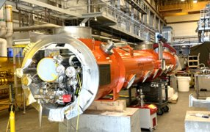
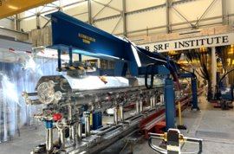
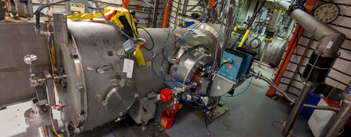
S&T Performance Summary
FY24 delivered 30 weeks with 76% reliability
FY25 plan restarts on January 31 for 25 weeks
Nobium-tin (Nb3Sn) Cryomodule – achieved milestone
LCLS-II-HE delivery on time and on track
EIC Project is organizing into sub-projects
New HPDF Project Director Kate Mace started on October 28
J30 Installing warm couplers
J31 Cavity tuners being installed
CEBAF style quarter cryomodule with two 5-cell Nb3Sn cavities
6
Notes:
​
Nobium-tin (Nb3Sn) Cryomodule Background: With the investment of DOE Office of Science Nuclear Physics (DOE SC-NP) on Superconducting Radio-Frequency (SRF) R&D and Early Career Award to an early career SRF investigator, Jefferson Lab has been committed to developing the next generation SRF accelerator technology based on the new material niobium-tin (Nb3Sn) since 2010 (see attached timeline and references). After decades of hard work, a milestone has finally been achieved: the first prototype niobium-tin cryomodule with two CEBAF-style SRF Nb3Sn cavities completed its qualification test in the CMTF facility at Jefferson Lab. The cryomodule is now ready for beam test at Jefferson Lab. This once-in-half-a-century milestone represents the beginning of a new era of SRF technology for particle accelerators and potentially many other scientific instruments.
Proposal: Jefferson Lab to organize an event to dedicate the historic niobium-tin cryomodule for the beginning or a new era of SRF. Following the tradition of CEBAF, world’s first large-scale SRF linear accelerator, the niobium-tin cryomodule will be named (story to be told at the event). Lab leadership will invite DOE NP officials for this event. Representatives from partners and contributing institutions, Fermi National Accelerator Laboratory and College of William Mary will be also invited. SRF pioneers formerly worked at Jefferson Lab will be also invited.

Slide 7
Risk Summary
MOLLER schedule performance is below 0.9 - We are actively working on a recovery plan
Planning for outyear budget and operations under constrained budget
Accelerator Safety Order 420.2C and 420.2D status
TJSO has extended authorization to operate (CEBAF, LERF, GTS, UITF, VTA, CMTF) from 12/1 to 12/17. Jefferson Lab must demonstrate compliance with DOE Order 420.2C Safety of Accelerator Facilities by 12/17. If demonstrated, TJSO will reissue authorization to operate until March 1 (or later if required) under the new order 420.2D.
7
Notes:
​
Nobium-tin (Nb3Sn) Cryomodule Background: With the investment of DOE Office of Science Nuclear Physics (DOE SC-NP) on Superconducting Radio-Frequency (SRF) R&D and Early Career Award to an early career SRF investigator, Jefferson Lab has been committed to developing the next generation SRF accelerator technology based on the new material niobium-tin (Nb3Sn) since 2010 (see attached timeline and references). After decades of hard work, a milestone has finally been achieved: the first prototype niobium-tin cryomodule with two CEBAF-style SRF Nb3Sn cavities completed its qualification test in the CMTF facility at Jefferson Lab. The cryomodule is now ready for beam test at Jefferson Lab. This once-in-half-a-century milestone represents the beginning of a new era of SRF technology for particle accelerators and potentially many other scientific instruments.
Proposal: Jefferson Lab to organize an event to dedicate the historic niobium-tin cryomodule for the beginning or a new era of SRF. Following the tradition of CEBAF, world’s first large-scale SRF linear accelerator, the niobium-tin cryomodule will be named (story to be told at the event). Lab leadership will invite DOE NP officials for this event. Representatives from partners and contributing institutions, Fermi National Accelerator Laboratory and College of William Mary will be also invited. SRF pioneers formerly worked at Jefferson Lab will be also invited.

Slide 8
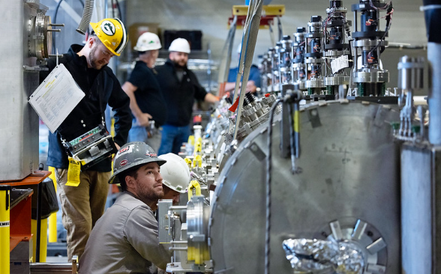
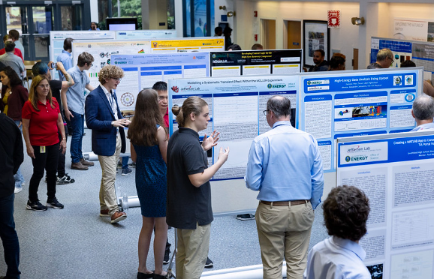
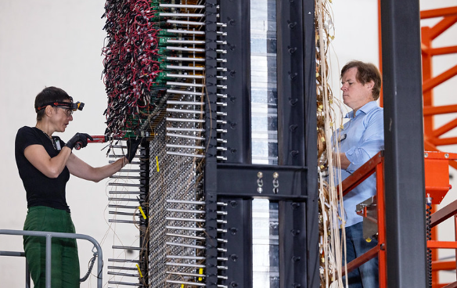
Thank you for your …
Continued support to Jefferson Lab
Insights and advices on our S&T programs
Guidance in strategic S&T plan towards our mission
8

Slide 9
Questions?

Slide 10
Thank you!

