Slide 1

SIDIS Studies with CLAS12
Harut Avakian (JLab)
May 22, 2025
  Semi-Inclusive DIS: Experiment
  Final states (π0, π+, π+π− ,…)
  What we can learn from longitudinal target measurements
  Dissecting SIDIS
  Evolution studies as validation test
  Comparing ALU with AUL
  Summary

Slide 2
Observables with longitudinally pol. target
λ and Λ→ helicities of e- and proton (normalizing lumi of positive and negative targets
N⁺⁺+N⁻⁺ = sum of events (with +/- helicities of e-) for positive target polarization
N⁺⁻+N⁻⁻ = sum of events (with +/- helicities of e-) for negative target polarization
N⁺⁺+N⁺⁻ = sum of events (with +/- helicities of p) for positive e- helicity
N⁻⁺+N⁻⁻ = sum of events (with +/- helicities of p) for negative e- helicity
Observables
beam SSA (N⁺⁺ + N⁺⁻ - N⁻⁺-N⁻⁻)/(N⁺⁺ + N⁺⁻ + N⁻⁺+N⁻⁻)= (a_{lu}sinφ)/(1+b_{uu}cosφ)
use the (1+b_{uu}cosφ) containing cos from acceptance and Cahn for others
target SSA
(N⁺⁺ + N⁻⁺ - N⁺⁻-N⁻⁻)/(N⁺⁺ + N⁺⁻ + N⁻⁺+N⁻⁻)= (a_{ul}sinφ+b_{ul}sin2φ)/(1+b_{uu}cosφ)
Target double spin asymmetries
(N⁺⁺ - N⁻⁺)/(N⁺⁺ + N⁻⁺) =(a_{ul}sinφ+b_{ul}sin2φ+a_{LL}+b_{LL}cosφ)/(1+b_{uu}cosφ)
(N⁻⁻ - N⁺⁻)/(N⁻⁻ + N⁺⁻) =(-a_{ul}sinφ−b_{ul}sin2φ+a_{LL}+b_{LL}cosφ)/(1+b_{uu}cosφ)
use the same helicity
(N⁺⁺ - N⁺⁻)/(N⁺⁺ + N⁺⁻) =(a_{lu}sinφ+a_{LL}+b_{LL}cosφ)/(1+b_{uu}cosφ)
(N⁻⁻ - N⁻⁺)/(N⁻⁻ + N⁻⁺) =(-a_{lu}sinφ+a_{LL}+b_{LL}cosφ)/(1+b_{uu}cosφ)
Longitudinally polarized target offers several observables critical for test

Slide 3
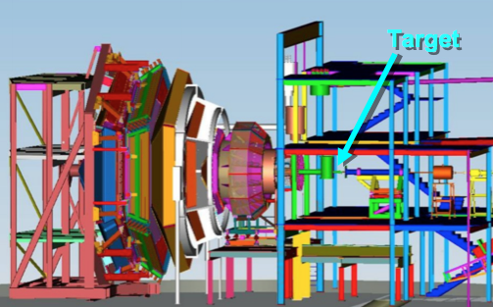
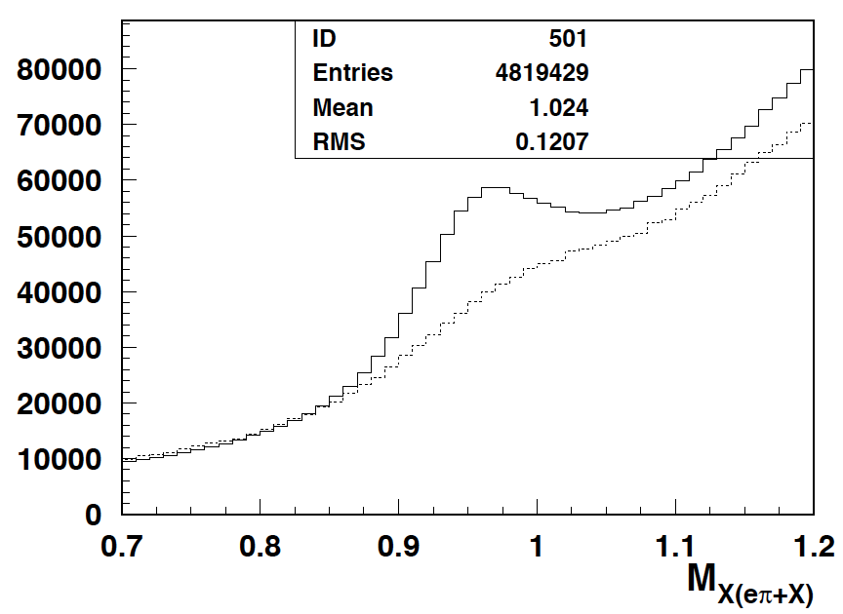
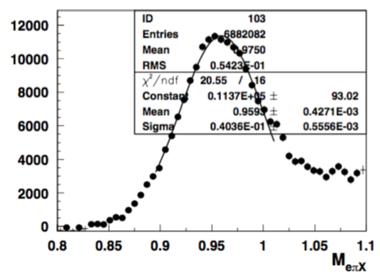
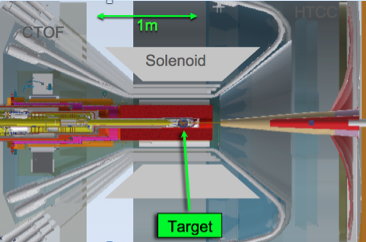
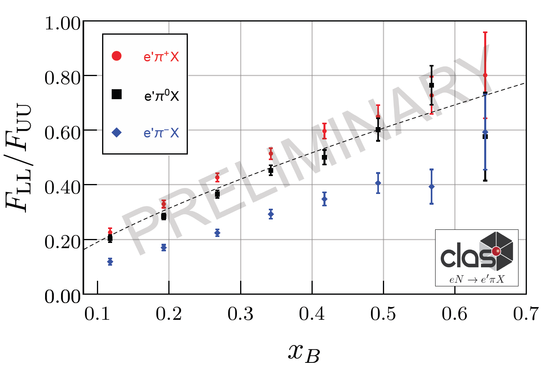
CLAS12 RGC experiment with longitudinally polarized target
CLAS12
Electroproduction on longitudinally polarized NH3 and ND3
NH3
C
E12-06-109, E12-06-119, E12-07-107, E12-09-009
Subtracting carbon data from NH3 (nice neutron peak)
Dynamic Nuclear Polarization (DNP)
Notes:
5 mm Radial Clearance inside the SVT
The actual time for swapping the Target Cell is ~15 min
The Target Cell is comprised of a 50 mm long perforated PCTFE (polytetrefluoroethylene) cylinder with a wall thickness of 0.5 mm and sealed with 20 μm thick Al foil beam windows upstream and downstream. These cells are made in two diameters, 15 and 20 mm. The cell is supported in the bath my an Al frame with a removable foil window upstream and fixed foil down stream.
NH₃, ND₃, CH₂, CD₂, C, Empty and Optical Targets

Slide 4
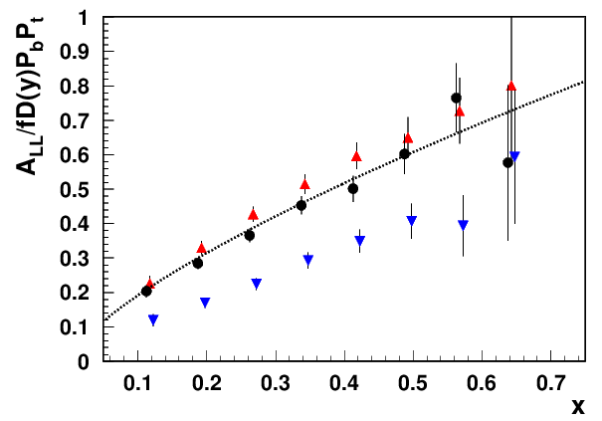
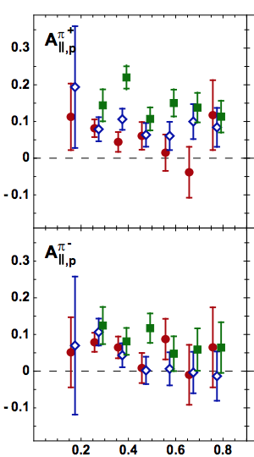

Single pion DSAs
1810.07054
NH3: ep→e’πX
HERMES(p)
π+
π0
π-
CLAS12 PRELIMINARY
z
Double spin asymmetries for ep→eπ+X seem to decrease at large z and effect more significant at low x
The ep→eπ+X drops faster at low x than ep→eπ0X (consistent with DIS fit)
Note: →exclusive rho contributions more significant at large z and low x

Slide 5
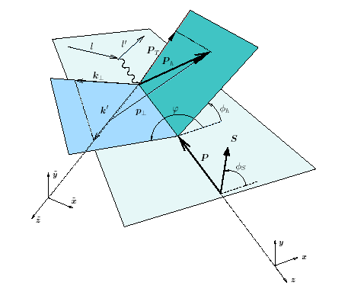
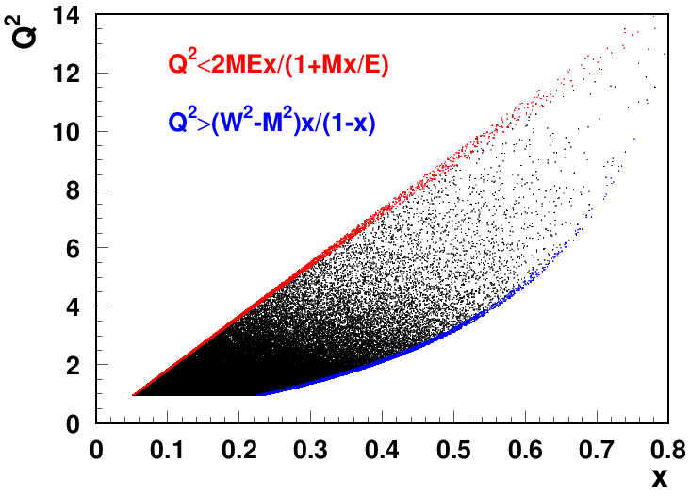
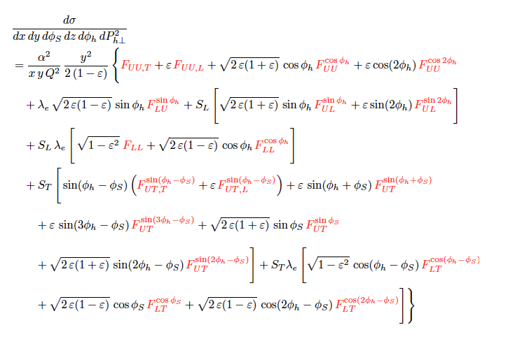
DIS kinematical coverage and observables
ν=E-E’
z=E_{h}/ν
CLAS12
p┴
P_{hT} = p┴ +z k┴
EIC
x-slices to study Q²-dependence

Slide 6
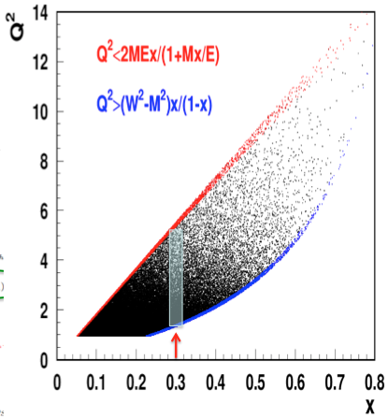
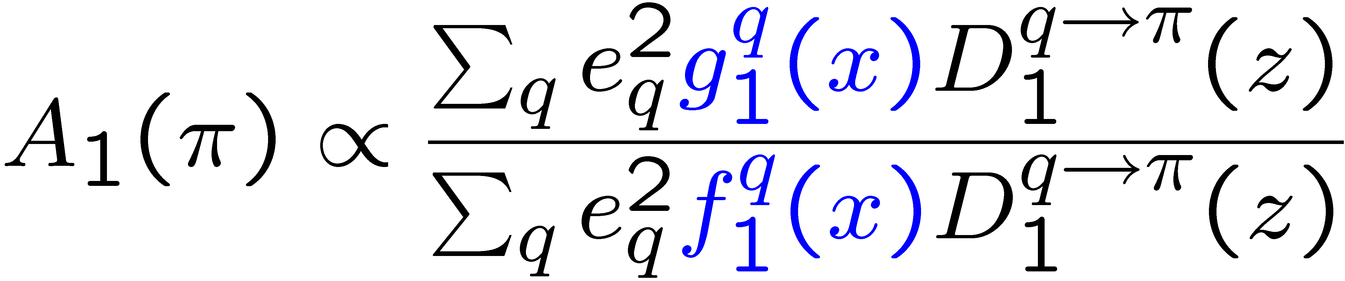
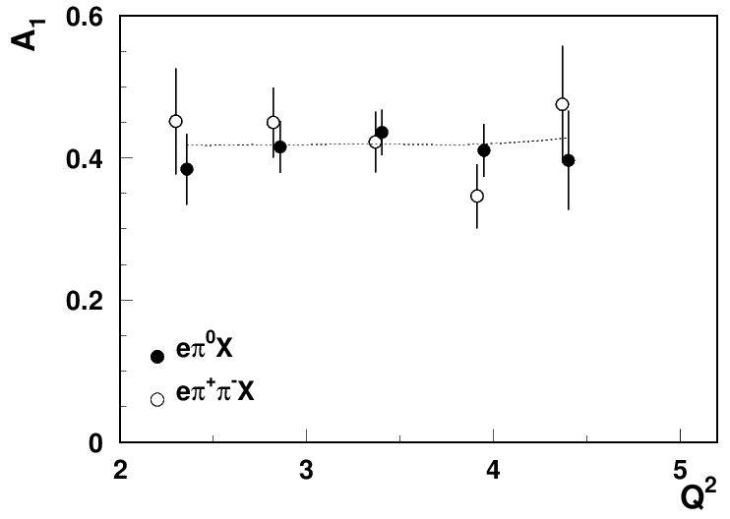
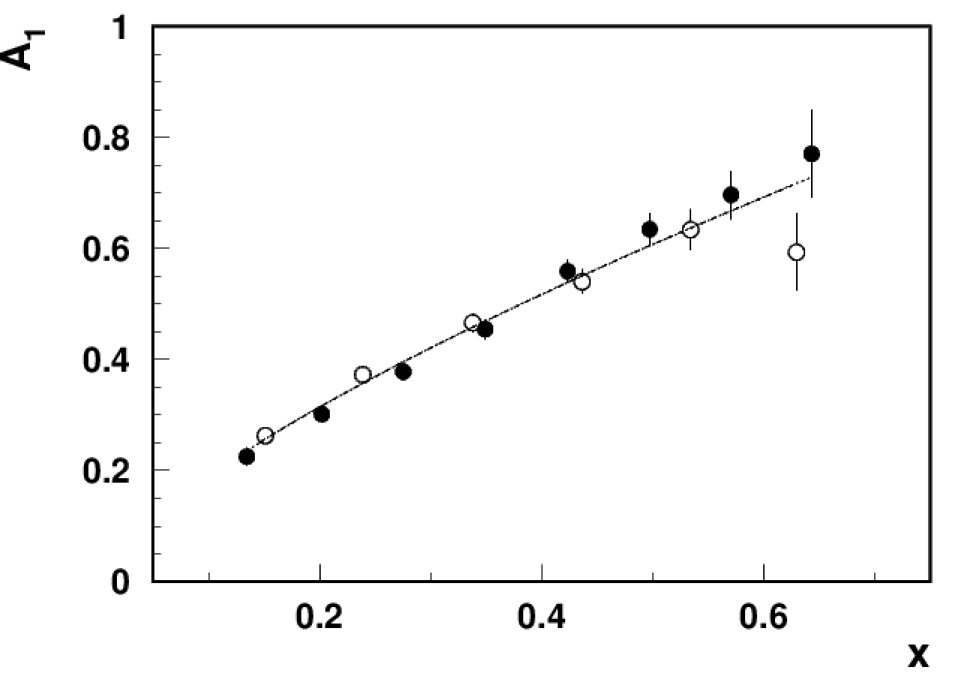
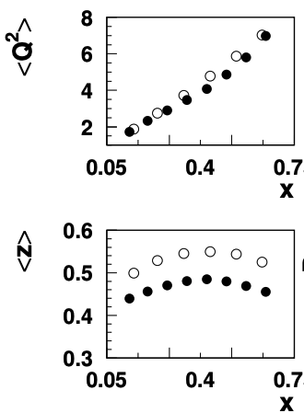
A₁ x-dependence for ep→e’π⁰X vs ep→e’π+π−X
0.3<z<0.8, y<0.75
CLAS12 PRELIMINARY
CLAS12 PRELIMINARY
the line x^{0.72}(DIS)
DSA extracted for ep→e’π⁰X (filled) and ep→e’π+π−X for 0.3<z<0.8(empty circles) consistent
No contributions from exclusive ep→e’ρ⁰X
Consistent with simple fit to world data (no major Q²-dependence)

Slide 7
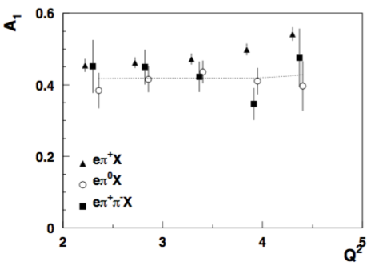
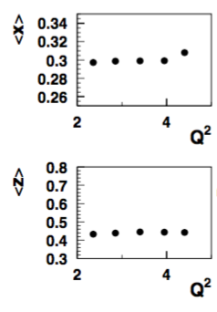
DSAs: comparing different processes
0.28<x<0.32, 0.3<z<0.8, y<0.75
A. Bongallino(ep→e’π+X)
ep→e’π+X
the DIS line x^{0.72}
CLAS12 PRELIMINARY
DSA for ep→e’π+X vs ep→e’π0X and ep→e’π−π+X consistent
No major Q²-dependence apart from for ep→e’π+X

Slide 8
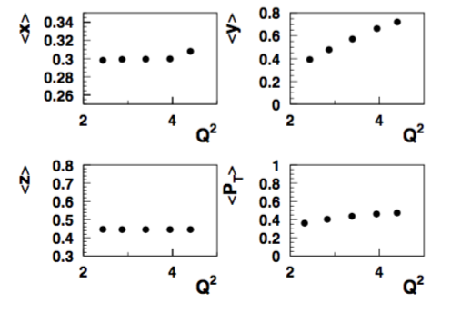
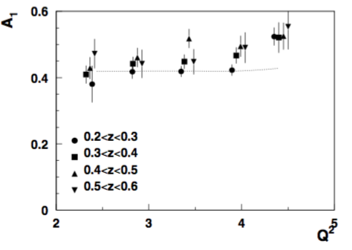
DSAs: Q²-dependence in z-bins
0.28<x<0.32, y<0.75
ep→eπ+X
the line x^{0.72}
CLAS12 PRELIMINARY
DSA for ep→e’π+X for z-bins
Tendency to increase with Q² stays for bins in z

Slide 9
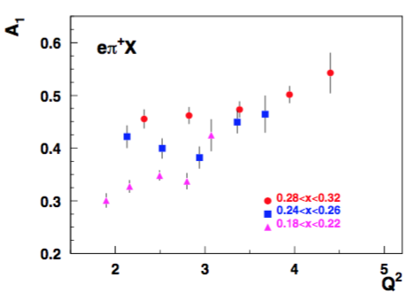
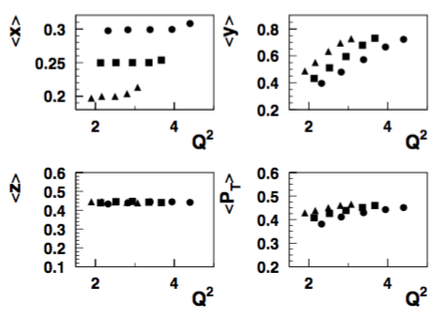
DSA ep→e’π+X: more bins in x
0.28<x<0.32, 0.3<z<0.8, y<0.75
CLAS12 PRELIMINARY
Inclusive (in progress) and π+ samples may have significant contributions from longitudinal photons (VMs)
Behavior of the double spin asymmetry for π+ is consistent with increase with Q²

Slide 10
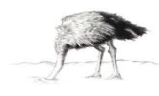
Theory-Experiment Dialogue
…........
Fragmentation Function
→ probability to produce π+
…........
theory
most significant
increases at higher energies
γ*_{L} and γ*_{T} → different dynamics
Notes:
lN\rightarrow l^\prime \omegaX

Slide 11
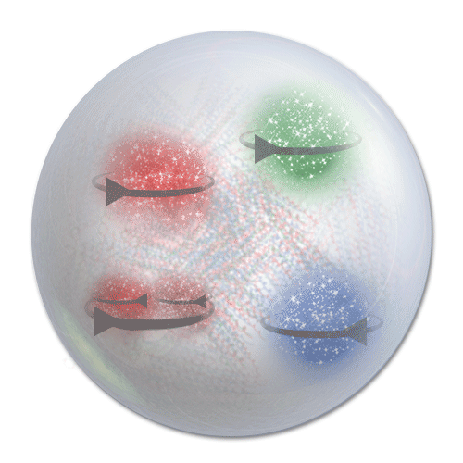
Theory-Experiment Dialogue: How to proceed
Keeping the formalism the same, including the input data where it works well, and try to get a better description using more sophisticated TMD models for TMD PDFs, and TMD FFs.
Try to extend the theory adding contributions assumed irrelevant in existing phenomenology, including also accounting of NLO terms. Note that all kinds of perturbative calculations for azimuthal moments (sin,cos, F_UU,L,...) in perturbative approaches were order of magnitude less than non-perturbative quantities (ex. Cahn)
Try to extend the theory coverage by eliminating from the input data set the contributions that are not accounted for in the phenomenology, most importantly the longitudinal photon contributions
Measurements of Q²-dependence of observables is key for validation!!!
Notes:
lN\rightarrow l^\prime \omegaX

Slide 12
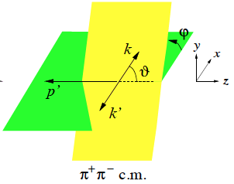
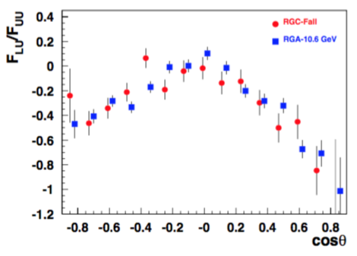
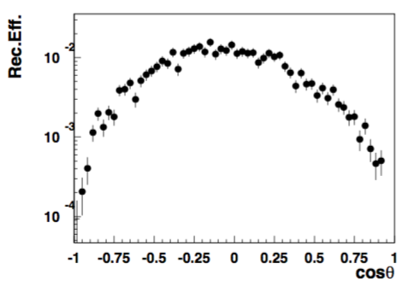
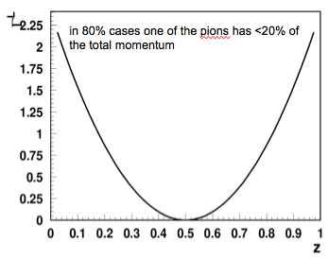

What we know about the longitudinal rho
longitudinal ρ→ source of info on γ∗_{L}
Has huge SSAs (negative for beam SSA)
CLAS12
ρ⁰_{T}
ρ⁰_{L}
CLAS12 PRELIMINARY
CLAS12 PRELIMINARY
Very challenging to measure
asymmetric decays hard to detect and identify
Interference of γ_{T}*→ρ_{L} and γ_{L}*→ρ_{L}
← measured 0 at HERMES/COMPASS

Slide 13
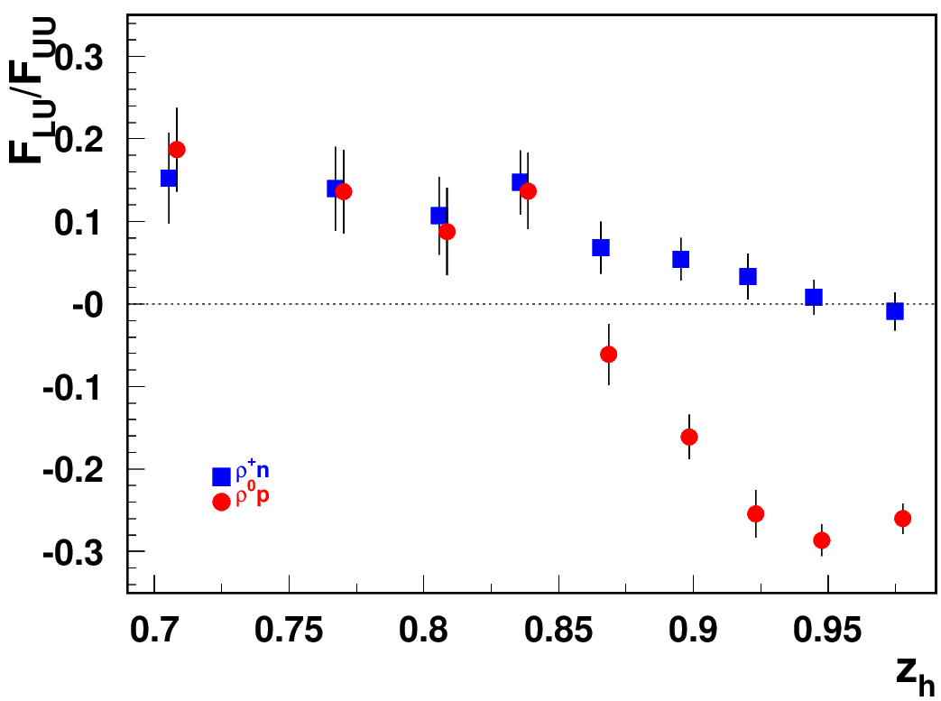
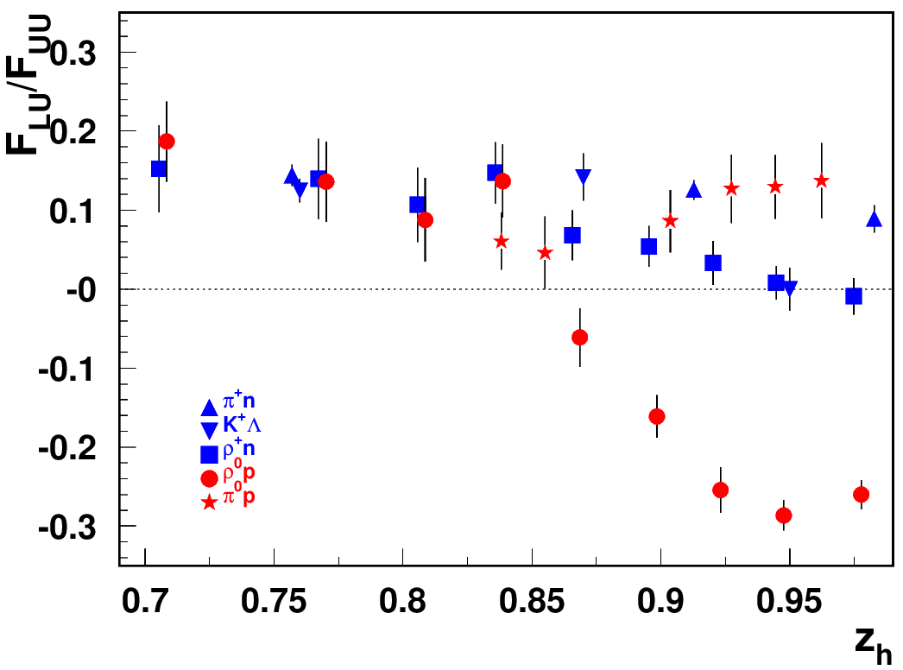
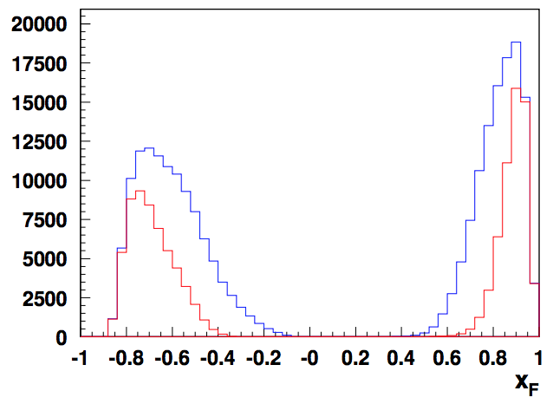
“diffractive” VMs: rapidity gap
Beam SSA for exclusive states
ep→e’pρ⁰
ρ⁰
p
t<1
ρ⁰_{T}
t<0.5
ρ⁰_{L}
Significant rapidity gap between protons (backward) and rho (forward)
What is the fraction of VMs in DDIS?
What is the relative fraction of VMs as a function of W and Q²?
Identify kinematics of “diffractive” ρ⁰ by comparison with ρ⁺
ρ⁰_{L} and ρ⁰_{T} →2 different particles!!!

Slide 14
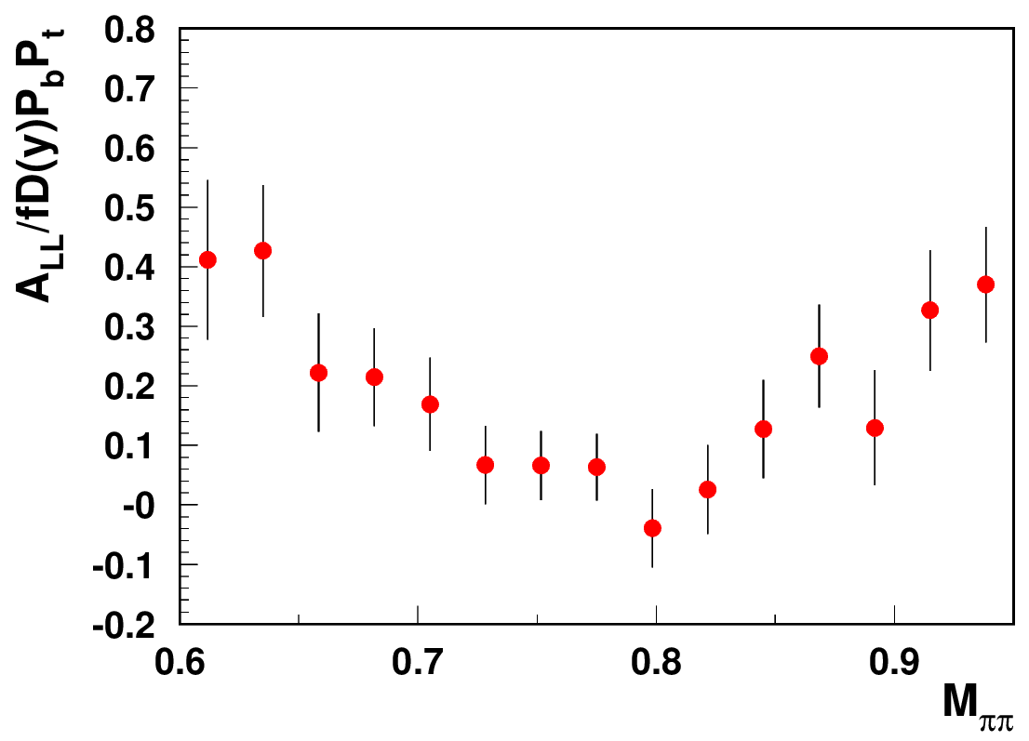
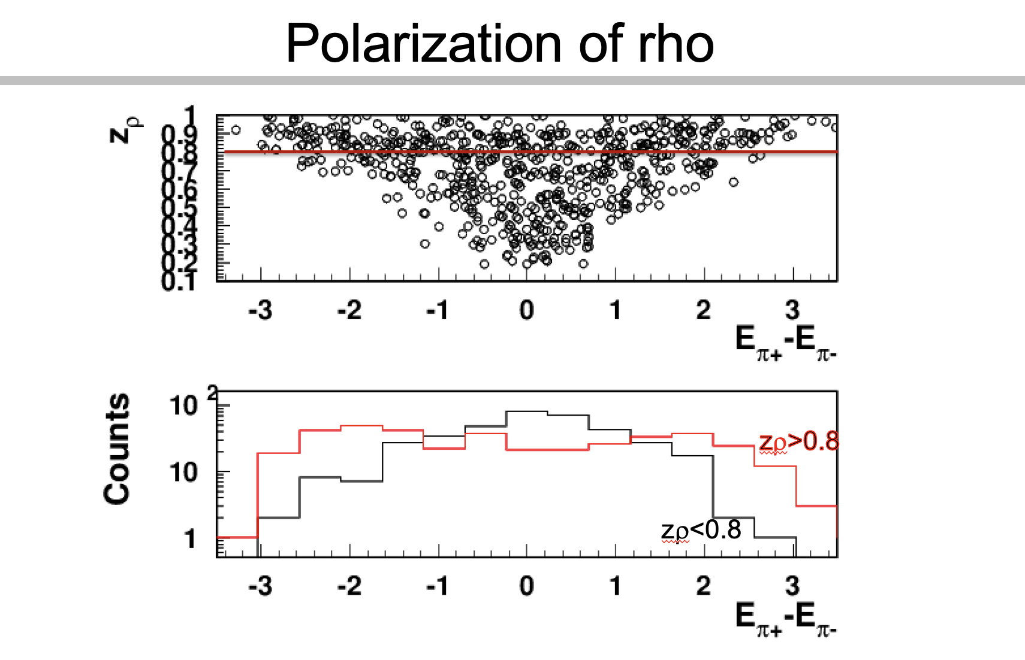
Studies of ρ⁰ impact with longitudinally polarized NH₃ target
CLAS12 Preliminary
ep->e’p’π⁺π⁻
Need clear separation of hydrogen from NH₃
and “diffractive” exclusive ρ0s from exclusive π+π−
DSA is P-even, SSA is P-odd
longitudinal photon cross section is P-odd
→ contribution appears only in the SSA, a P-odd observable, and does not appear in DSA(→significant dilution in DSA)
At large z (small t) the shapes of distributions (getting asymmetric) clearly indicate dominance of longitudinal rho

Slide 15
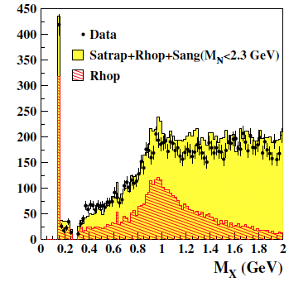
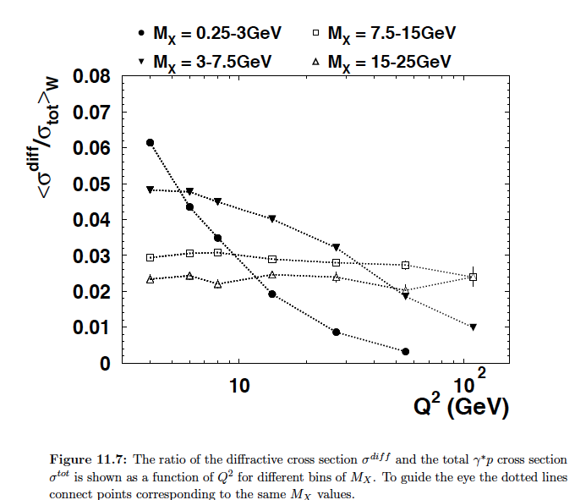
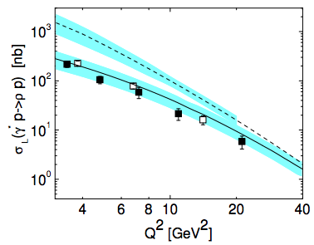
What we know about longitudinal rho: ZEUS
ZEUS diffraction 1/Q⁶ at low M_X
~20-30% of DDIS comes from rho
What about the Q²~4GeV²?
1/Q⁶ theory misses ~70-80% at low Q²
Kroll&Goloskokov
hep-ph/0611290
What are the other ~70-80% contributions to DDIS in the low MX bin, at low Q², in particular?

Slide 16
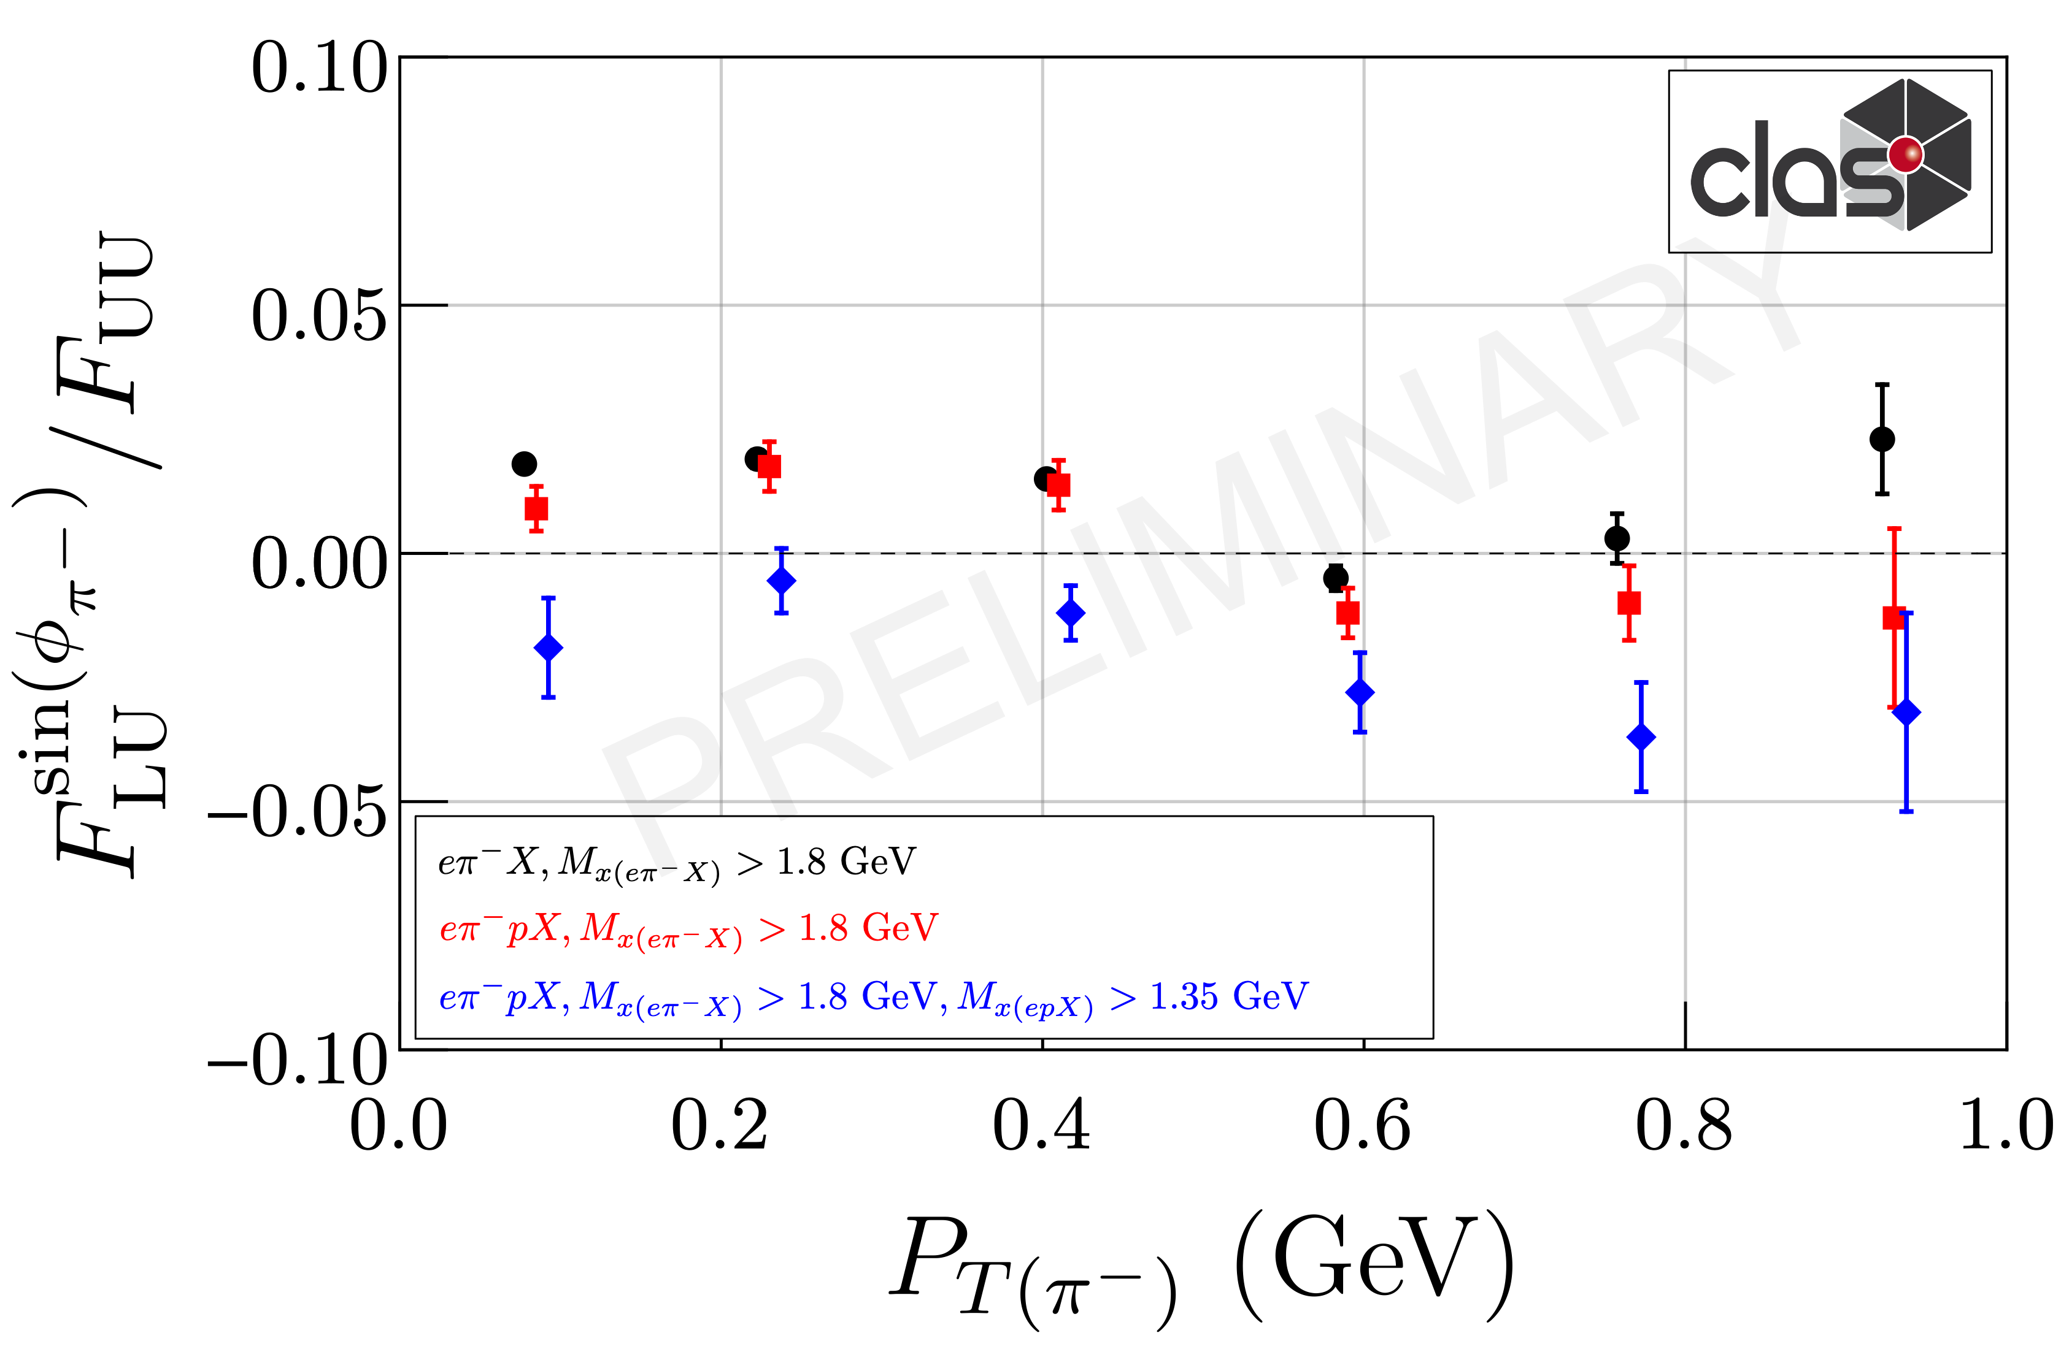
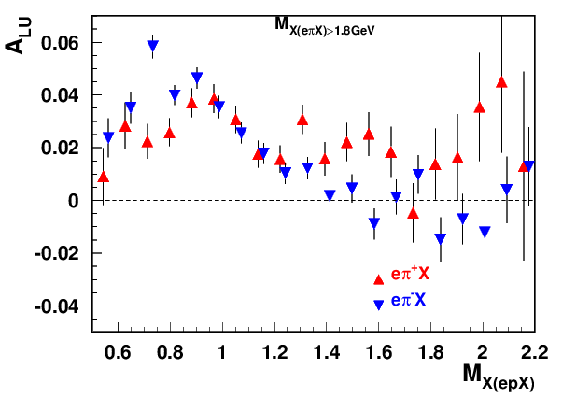
Exclusive ρ contributions to π: P_{T}-dependence
“ρ-free” SIDIS
0.1<P_{T}<0.3, 0.4<z<0.6
Can change the pion SSAs, in particular at small PT
The same sign and size of π+ and π- SSA indicates the rho0 may not be properly subtracted(require detailed MC studies, which require proper SDMEs)
While VM contributions are ~20% in multiplicities in SSA they can be >100%
Detection of the target proton introduces much smaller bias on the inclusive charged pion SSA, than the exclusive rho contributions

Slide 17
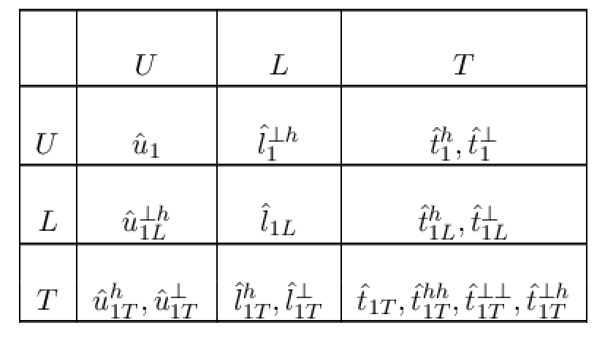
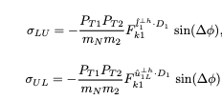
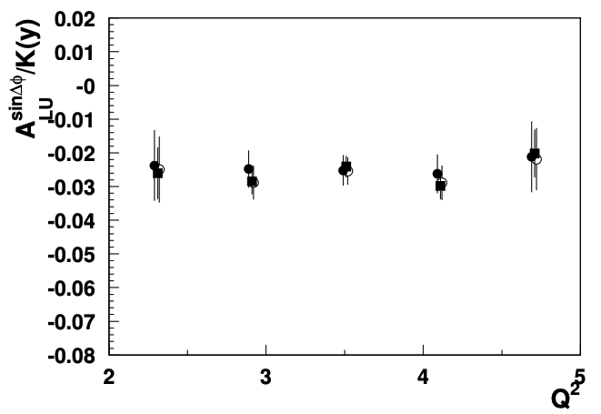
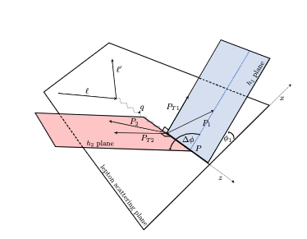
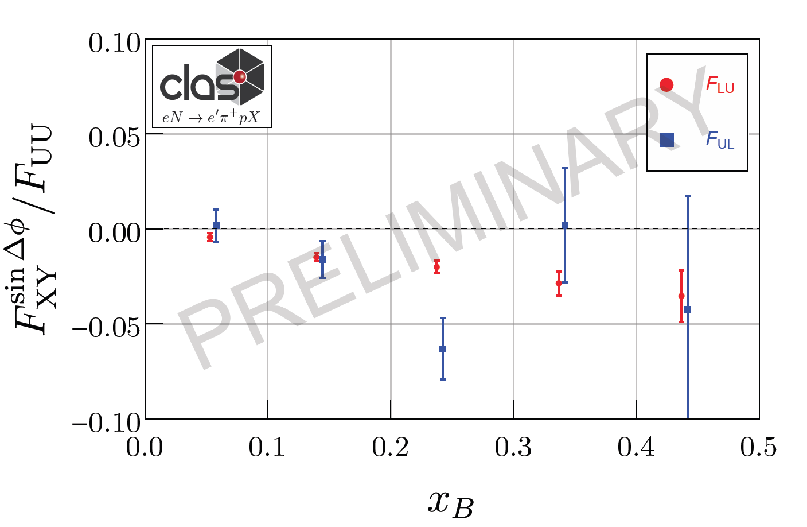
Azimuthal modulations in B2B production
N/q
→checked Q² dependence for F_{LU}
3 independent methods used
pion in CFR
F_{UL} and F_{LU} comparable (consistent with epX))
No suppression at higher energies for F_{UL}
proton in TFR
Full CLAS12 longitudinally polarized target set (x4) will provide a significant measurement of the target single spin asymmetry A_{UL} ^{sinΔφ} , which has no suppression at higher energies and can be measured at colliders!

Slide 18
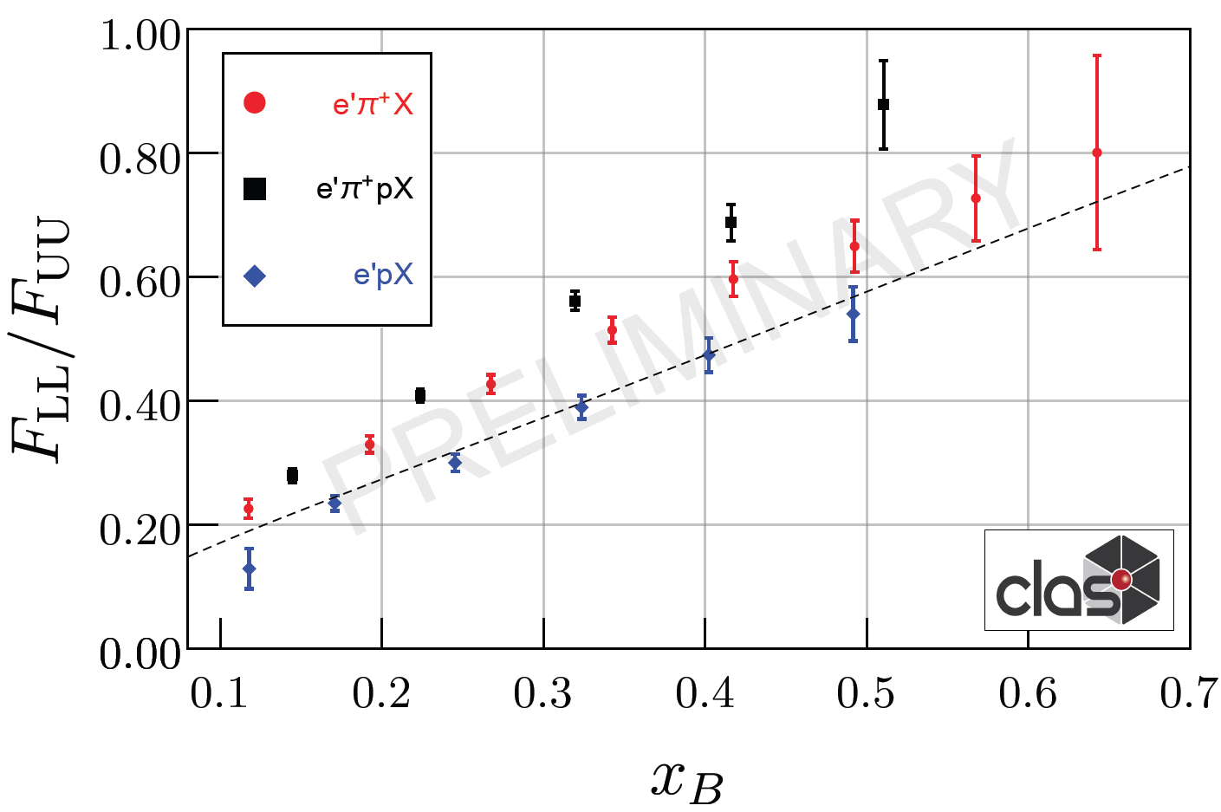
B2B production: exclusive baryon in TFR
N/q
pion in CFR
Exclusive proton in TFR
Detection of proton allows implementation of the “rho free” SIDIS. The same DSA ep→eπ+X with detection of proton, allowing to cut out the exclusive rho is higher.
theory
Semi-exclusive processes, involving GPDs/GTMDs on proton side (TFR) and FFs on pion side (CFR) Yuan and Guo

Slide 19
summary
Huge amount of semi-inclusive and exclusive hadron production data accumulated by CLAS12 allowing detailed studies of variety of contributions, critical for providing adequate data for QCD phenomenology for 3D studies (TMDs and GPDs/GTMDs?)
First data from longitudinally polarized target, confirms importance of sorting out longitudinal photon contributions in general, and longitudinal rho0s, in particular
Studies of evolution properties of all relevant observables has been shown to be a critical validation test
The SIDIS data on neutral pions, free of VM contributions, is ready for phenomenological studies!!!
Looking forward for Theory-Experiment Dialog on most efficient way for using JLab data in 3D phenomenology

Slide 20
Support slides

Slide 21
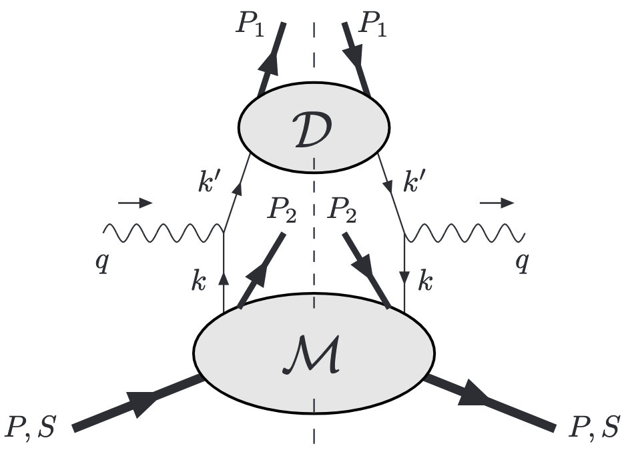
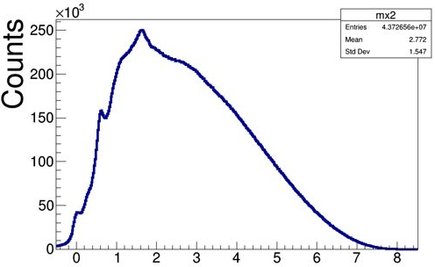
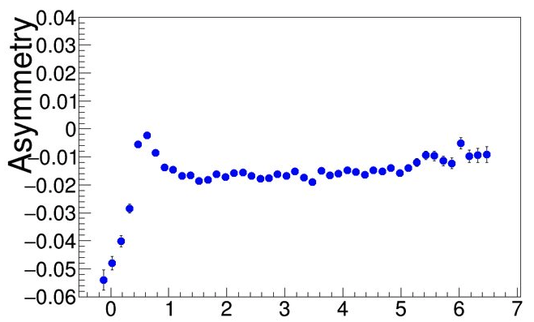
Longitudinally polarized quarks in B2B SIDIS
ep→e’pπX
N/q
Detection of proton allows elimination of exclusive rho!
φ
f₂
Possible theory formalisms:
Formalism based on fracture functions (Anselmino, Barone, Kotzinian (back-to-back, b2b, hadron production, DSIDIS)
Semi-exclusive processes, involving GPDs/GTMDs on proton side (TFR) and FFs on pion side (CFR) Yuan and Guo
HEMP
SIDIS (“ρ free”)
ep→e’pρ⁰ /ω
x_{F}<0
Differences in A_{LL} , due to different weights on PDFs can provide additional info on impact of possible ingredients
Measurements of A_{LL} for ρ⁰ indicate very small values, and can be one of the reasons for higher A_{LL} with protons with a M_{X} cuts above 1.5 GeV (excluding exclusive ρ⁰ )
Beam SSA
M_{X}²(ep→e’pX)
ep→e’pπ⁰

Slide 22
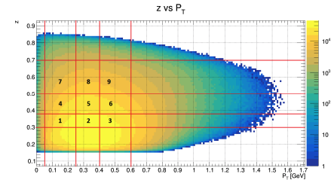
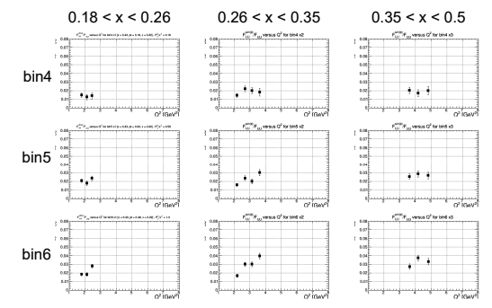


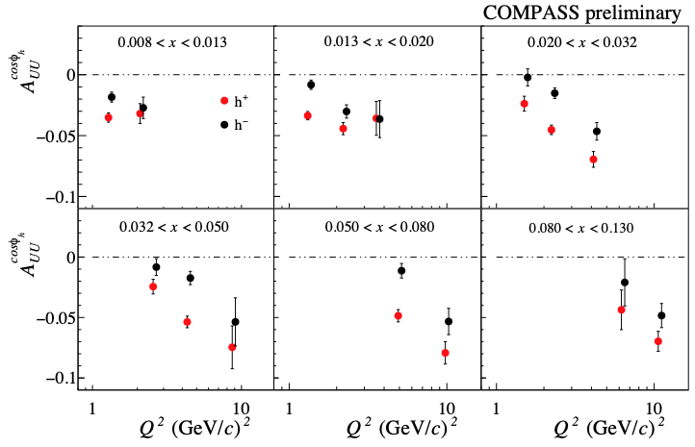
Attempts to understand Q²-dependence of HT
CLAS12(preliminary)
J. Matousek COMPASS
We always measure ratio to
The moments defined as a ratio to φ-independent x-section(to F_{UU,T}), are not decreasing with Q!!!
The HT observables, don’t look much like HT observables, something missing in understanding
Understanding of these behavior can be a key to understanding of other inconsistencies
Checking the Q² and P_{T}-dependences of the F_{UU,L} may provide crucial input for validation

Slide 23
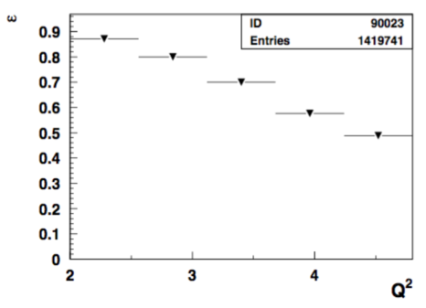


SSAs for dihadrons: kinematics
0.28<x<0.32, 0.3<z<0.8, y<0.75
Depolarization factors
Hadronic variables, z also have some variations in x-bins and P_{T}

Slide 24



Addressing PAC/theory comments
What exactly are identified so far sources of “factorization breakdown” in SIDIS and where is the evidence that “few GeV” matters?
COMPASS 2h
CLAS12
Q²=2 GeV²
x=0.2
2) Diffractive VMs (ρ⁰)
CLAS12 measurements indicate the 2hadron exclusive sample is dominated by “diffractive rho0”produced at very small t
JLab provides possibility of detailed studies of those rhos, crucial for interpretation in terms of TMDs of SIDIS data in general, and for EIC in particular.
Estimated ~20% contributions from rho to charged pion SIDIS, consistent with ~10% of diffractive DIS in inclusive DIS
indication: most longitudinally polarized ρ⁰
note: higher the Q² lower is ε
Studies of exclusive processes require high resolution and multidimensional measurements !!!

Slide 25




SSAs for ep→e’π⁺π⁻X
0.09<x<0.69 bin-2, <x>=0.24, 0.3<z<0.8, y<0.75

Slide 26





CLAS12 Experiments involved: Exclusive rhos
Exclusivity condition defined by the missing Energy:
CLAS12 (width <0.1GeV)
HERMES(width ~0.6GeV)
COMPASS(width ~2GeV)
~20% of data
Guarantying the “exclusivity” requires good resolutions (get worse at higher energies)
Subtraction procedure relays on normalization, based on exclusive limit of LUND-MC
All distributions have tails, indicating the RC may not be negligible
Extraction of SDMEs, will require validation in the multi-D space (significant samples)

Slide 27











Exclusive dihadrons from CLAS12
all exclusive ρ
Q²=2 GeV²
Q²=3 GeV²
Q²=4 GeV²
x=0.2
longitudinal ρ
Q²=2 GeV²
Q²=3 GeV²
Q²=4 GeV²
Q²=5 GeV²
GK: arXiv:0708.3569
x=0.3
Q²=2 GeV²
Q²=3 GeV²
Q²=4 GeV²
Q²=5 GeV²
x=0.4
at lower x need higher z
The exclusive rho contributions in SIDIS (multiplicity) drop with Q² (~1/Q²)
At large z=z₁+z₂ the transverse photon contributions to ρ_{L} suppressed
Notes:
Lorenz invariant amplitudes

Slide 28



QCD fundamentals for TMD extraction
https://wiki.jlab.org/sidiswiki/index.php/Main_Page
TMD factorization theorem separates a transversely differential cross section into a perturbatively calculable part and several well-defined universal factors
TMDs may in general contain a mixture of both perturbative and non-perturbative contributions
corrections for the region of large kT~Q
Aybat,Collins,Qiu,Rogers 2012
Collins&Rogers 2015
non perturbative
perturbatively calculable

Slide 29

semi-inclusive pi0 production
Study PT-dependence in bins in x
Average kinematics is changing within bins

Slide 30

CLAS12 exclusive pions from RGC
NH3
C
Normalizing carbon and NH3 for MX below 0.8 and subtracting to get the dilution factor as a function of the variable of interest

Slide 31





q_{T}-crisis or misinterpretation
Request to theory:
provide comparison with COMPASS with and without evolution to see the impact
3) Cuts not only most of the JLab data, but practically all accessible in polarized SIDIS large P_{T} samples , including ones from HERMES COMPASS, and even EIC.
https://arxiv.org/pdf/1709.07374.pdf
at higher Q² the slope in P_{T} changes, why?
possible reason → less diffractive rho at higher Q² filling the low P_{T} in pion SIDIS (what about π⁰?)
Challenging for theory to explain the correlation of P_{T} and Q
need experimental subtraction of rhos (proton detection will help)
P_{T}²
Notes:
Some impact of the limitation on the experimental data you can see from the two plots for JLab and COMPASS at lower and higher energy ranges. The cut excludes practically all PTs starting from ~1GeV the region, where the effects are large and measurable

Slide 32









“ρ-free SIDIS” free: target proton bias
ep→e’ππX
ep→e’pππX
+ x_{Fproton}<0
ep→e’pππX
+ x_{Fproton}<0
+ M_{X}(epX)>1.05 GeV
x=0.3(0.25<x<0.35)
Q²=2 GeV²
Q²=3 GeV²
Q²=4 GeV²
While the detected proton introduces slight difference in the kinematic distributions, the cut on the proton missing mass makes significant impact (clear at large z).
Notes:
Lorenz invariant amplitudes

Slide 33
CLAS12 Experiments involved: RGA superiority
Exclusivity condition defined by the missing Energy:
CLAS12 (width <0.1GeV)
HERMES(width ~0.6GeV)
COMPASS(width ~2GeV)
~20% of data
Guarantying the “exclusivity” requires good resolutions (get worse at higher energies)
Subtraction procedure relays on normalization, based on exclusive limit of LUND-MC
All distributions have have tails, indicating the RC may not be negligible
Extraction of SDMEs, will require validation in the multi-D space (significant samples)

Slide 34

“diffractive rho0s” in SIDIS multiplicities
G.Matousek (Duke) & N.Trotta (UCONN)
0.18<x<0.22
0.5<z0.7
Q²=2 GeV²
total eπ+X
Estimated ~20% contributions from rho, mainly show up at low P_{T} in SIDIS
The “diffractive” rho will bias extractions of TMDs, unless properly subtracted in multidimensional space of SIDIS measurements.
Notes:
Lorenz invariant amplitudes

Slide 35
RGC: Kinematical cuts for results and x-checks
Start with Fall22 Tpol+=0.7,Tpol-=-0.7
Kineamtics of e’ withing fiducial acceptance
W>2, Q²>1,y<0.75 (study dependence, mainly for y)
|Vz+Vz0|<5, Vz0= 2.2 for RGC-Fall 2.5 for RGA-spring19
Kinematics of single pions ep→e’πX
M_{X}>1.3 pi-/0, M_{X}>1.8 for pi+ (study dependence)
xF>0, 0.8>z>0.3 for integrated (study z-dependence from 0.1<z<1)
|Vz-Vz\pi+|<7, |Vz-Vz\pi-|<5 (study the Vz-dependence)
Kinematics for dihadrons ep→e’ππX
M_{X}(ep→e’πX)>1.3 pi-/0, M_{X}>1.8 for pi+ (study dependence, cut resonances)
z<0.85 (beam SSA negative)
MX(e’ππX)>1.3 (cut exclusive rho, should mainly overlap with z)

Slide 36


CLAS12 RGC experiment with longitudinally polarized target
CLAS12
E12-06-109, E12-06-119, E12-07-107, E12-09-009
A Dynamic Nuclear Polarized
Notes:
5 mm Radial Clearance inside the SVT
The actual time for swapping the Target Cell is ~15 min
The Target Cell is comprised of a 50 mm long perforated PCTFE (polytetrefluoroethylene) cylinder with a wall thickness of 0.5 mm and sealed with 20 μm thick Al foil beam windows upstream and downstream. These cells are made in two diameters, 15 and 20 mm. The cell is supported in the bath my an Al frame with a removable foil window upstream and fixed foil down stream.
NH₃, ND₃, CH₂, CD₂, C, Empty and Optical Targets

