Slide 1

Probing small-x helicity distributions in particle production at RHIC and EIC
Yuri Kovchegov
The Ohio state university

Slide 2
Credits
Based on work done with Dan Pitonyak and Matt Sievert (2015-2018, 2021-present), Florian Cougoulic (2019-present), Gabe Santiago (2020-present), Josh Tawabutr (2020-present), Andrey Tarasov (2021-present), Daniel Adamiak, Wally Melnitchouk, Nobuo Sato (2021-present), Jeremy Borden (2023-present), Ming Li (2023-present), Brandon Manley (2023-present), Nick Baldonado (2022-present), Zardo Becker (2024-present).

Slide 3
Outline: helicity-dependent observables as RHIC and EIC at small x
DIS: g₁ structure function at small x + sub-eikonal operators.
Helicity evolution at small x.
SIDIS: g₁^{h} structure function.
Polarized p+p collisions: gluon production at mid-rapidity.
Inclusive dijet production in polarized e+p collisions.
Elastic dijet production in polarized e+p collisions.

Slide 4
g₁ Structure Function

Slide 5
Dipole picture of DIS
x⁻
x⁺
Large q⁻ → large x⁻ separation
aka the “shock wave”

Slide 6
Polarized Dipole: non-eikonal small-x physics
All flavor-singlet small-x helicity observables depend on “polarized dipole amplitudes”:
Double brackets denote an object with energy suppression scaled out:
unpolarized quark
polarized quark: eikonal propagation,
non-eikonal spin-dependent interaction

Slide 7
Polarized fundamental “Wilson line”
To complete the definition of the polarized dipole amplitude, we need to construct the definition of the polarized “Wilson line” V^{pol}, which is the leading helicity-dependent contribution for the quark scattering amplitude on a longitudinally-polarized target proton.
At the leading order we can either exchange one non-eikonal t-channel gluon (with quark-gluon vertices denoted by blobs above) to transfer polarization between the projectile and the target, or two t-channel quarks, as shown above.
We employ a blend of Brodsky & Lepage’s LCPT and background field method-inspired operator treatment. We refer to the latter as the light-cone operator treatment (LCOT).

Slide 8
Notation
Fundamental light-cone Wilson line:
Adjoint light-cone Wilson line:
They sum multiple eikonal re-scatterings to all orders.

Slide 9
Sub-eikonal quark S-matrix in background gluon and quark fields
The full sub-eikonal S-matrix for massless quarks is (Balitsky&Tarasov ‘15; KPS ‘17; YK, Sievert, ‘18; Chirilli ’18; Altinoluk et al, ’20; YK, Santiago ‘21)
“helicity
independent”
“helicity
dependent”
“helicity
independent”
“helicity
dependent”

Slide 10
Gluon Helicity
A calculation gives
Here we defined a new dipole amplitude G₂ (cf. Hatta et al, 2016; KPS 2017)
What is this D-D operator? Turns
out it is related to the DD operator
from before.

Slide 11
Quark Helicity PDF and TMD
The flavor-singlet quark helicity PDF and TMD are
We have defined another operator:

Slide 12
g₁ structure function
g₁ structure function is obtained similarly, using DIS in the dipole picture:
One gets
G₂ was defined before. This is the gluon admixture to quark helicity distributions.
The dipole amplitude Q is due to F¹² & axial current.
The contribution of G₂ comes from the DD operator in the quark S-matrix.

Slide 13
Amplitude Q
The amplitude Q is defined by
with , where
U = adjoint light-cone Wilson line.

Slide 14
Evolution for Polarized Quark Dipole
One can construct an evolution equation for the polarized dipole:
Spin-dependent (non-eikonal) vertex
polarized
particle
similar to the
unpolarized
BK evolution
box =
target shock
wave (proton)

Slide 15
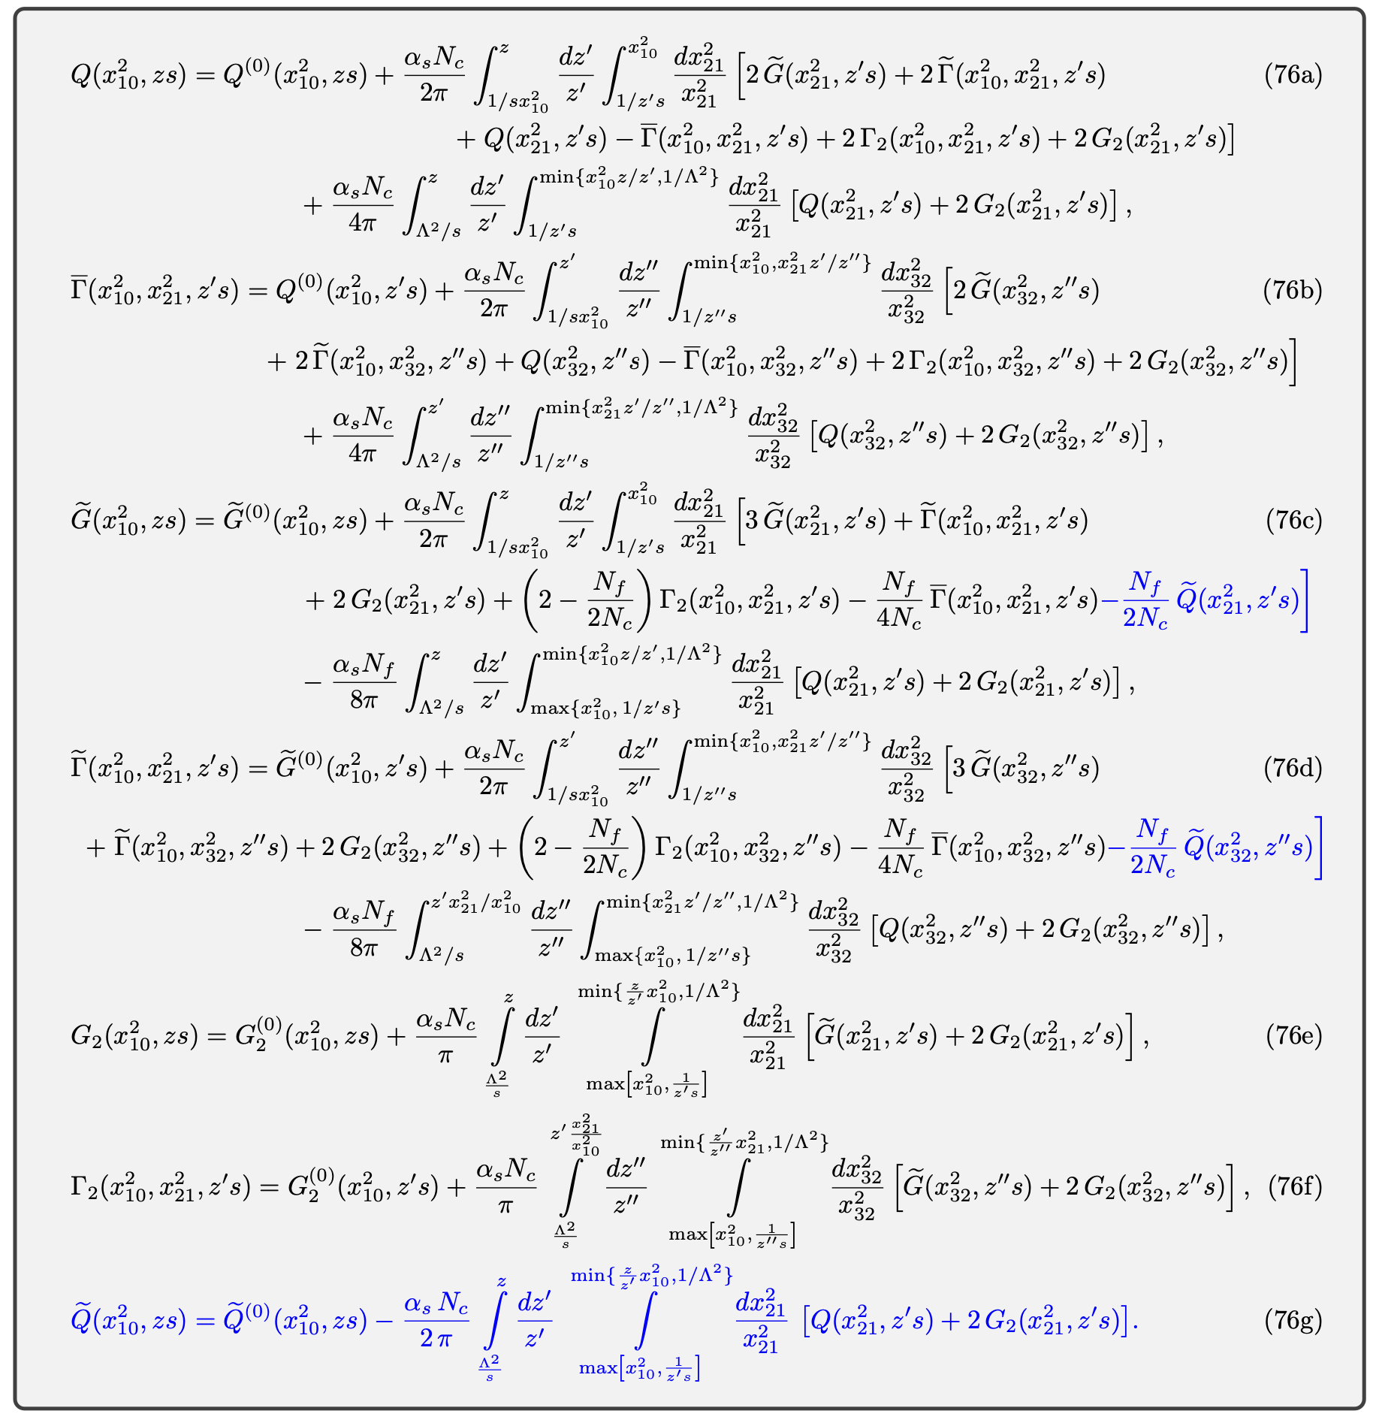
Evolution Equations
Initial version by YK, D. Pitonyak, M. Sievert
’15-’18 (KPS), modifications with subscript 2 due
to YK, F. Cougoulic, A. Tarasov, Y. Tawabutr ‘22.
Beyond large-N_{c}, one needs to add the
quark-to-gluon and gluon-to-quark transitions
(G. Chirilli, 2101.12744 [hep-ph];
J. Borden, YK, M. Li, 2406.11647 [hep-ph]):
This results in the large-N_{c}&N_{f} evolution
equations given here (transition terms are
in blue). Agrees with DGLAP anomalous
dimensions to 3 loops.

Slide 16
Polarized SIDIS
+ data analysis

Slide 17
Polarized SIDIS at small x
Consider (anti-)quark production in the current
fragmentation region in the polarized e+p
scattering at small x.
The process is similar to the g₁ structure
function calculation.
A straightforward calculation yields the SIDIS
structure function (D₁ = fragmentation function)

Slide 18
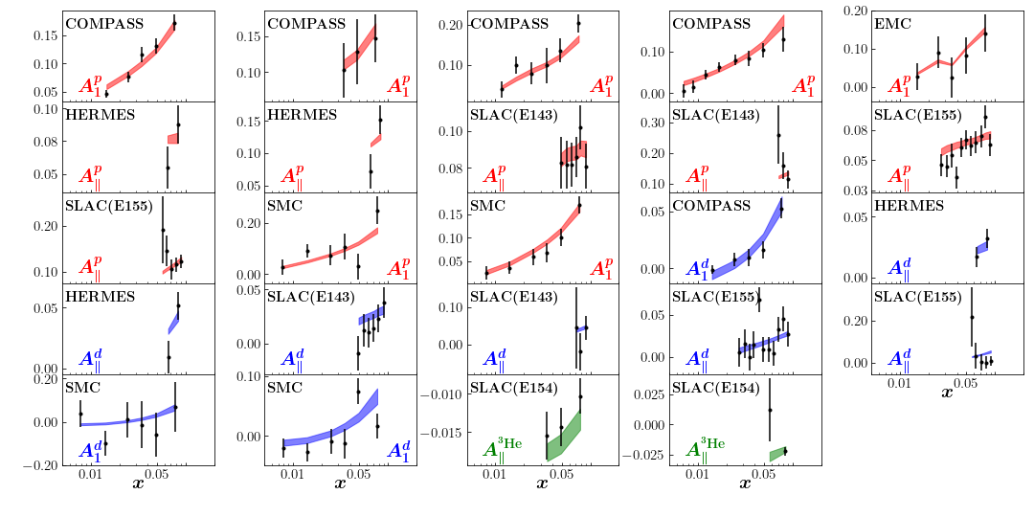
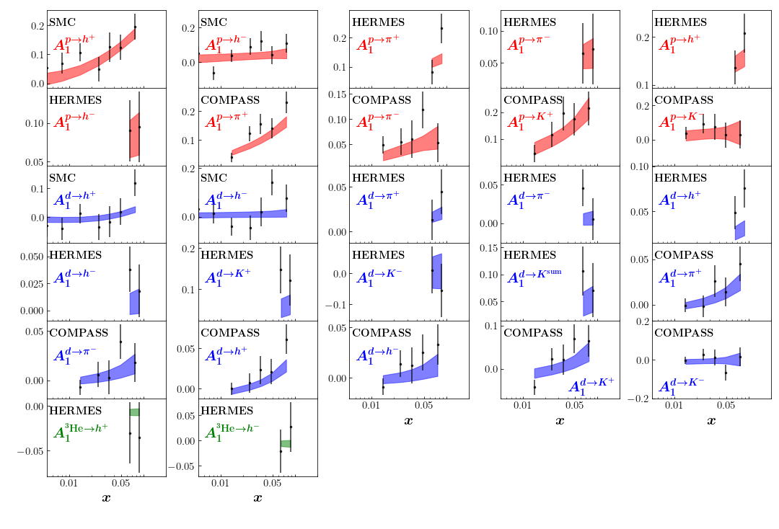
The analysis
JAMsmallx: Adamiak, Baldonado, YK, Melnitchouk, Pitonyak, Sato, Sievert, Tarasov, Tawabutr,
2308.07461 [hep-ph]
Initial conditions:
D= kinematic factor (known)
Running-coupling large-N_{c}&N_{f} evolution, 226 polarized
DIS and SIDIS data points.
Double-spin asymmetries for p, d, and ³He

Slide 19
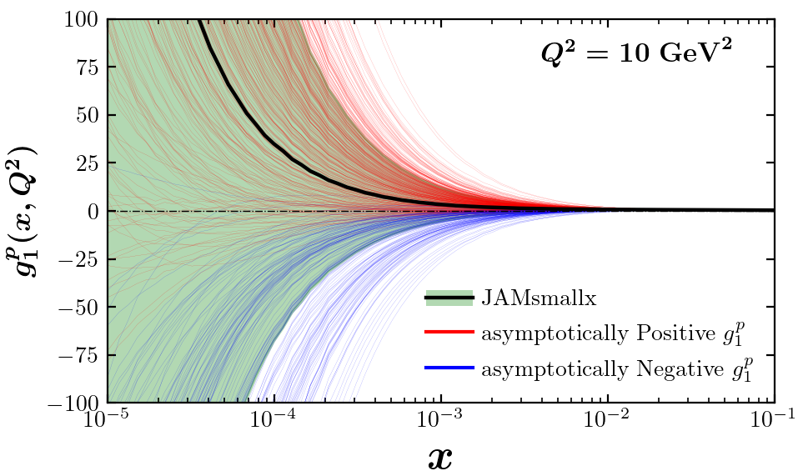
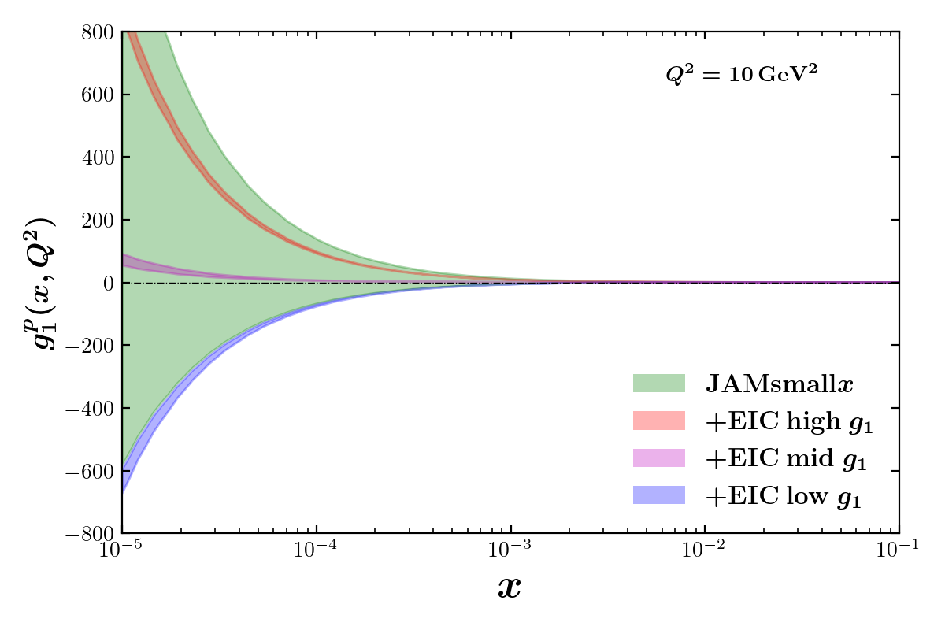
Proton g₁ structure function
JAM-smallx
g₁^{p} extracted from the existing data
EIC impact
JAM is based on a Bayesian Monte-Carlo: it uses replicas.
Due to the lack of constraints, the spread is large.
On the right, extraction using EIC pseudo-data (3 thin bands = 3 possible EIC data sets).

Slide 20
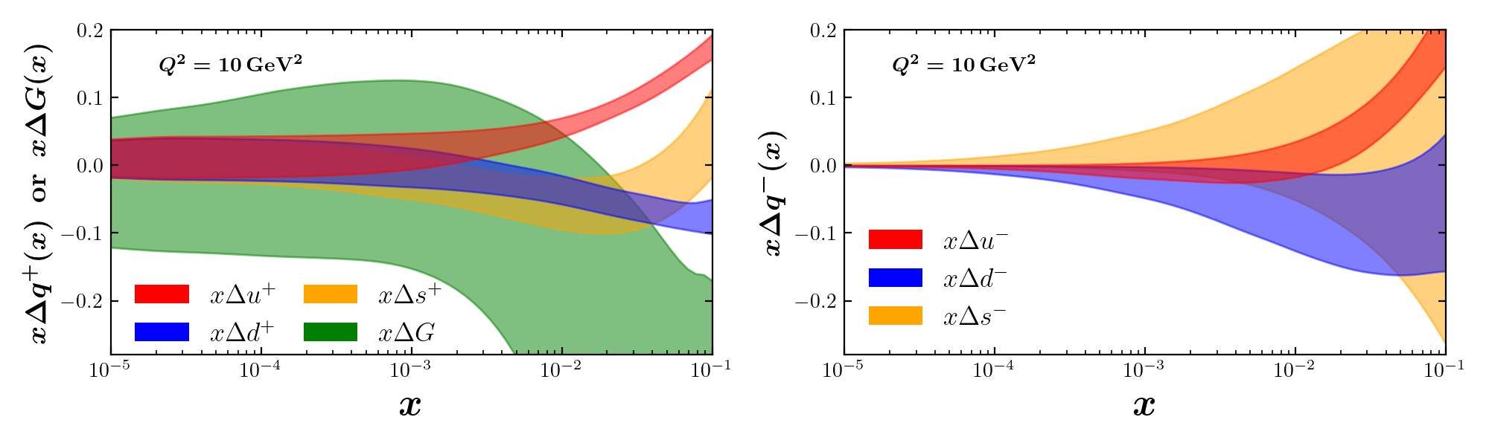
Helicity PDFs:
JAM-smallx
Uncertainties at small x seem to be driven
by our inability to constrain the dipole
amplitude G₂ and Gtilde using the current data.

Slide 21
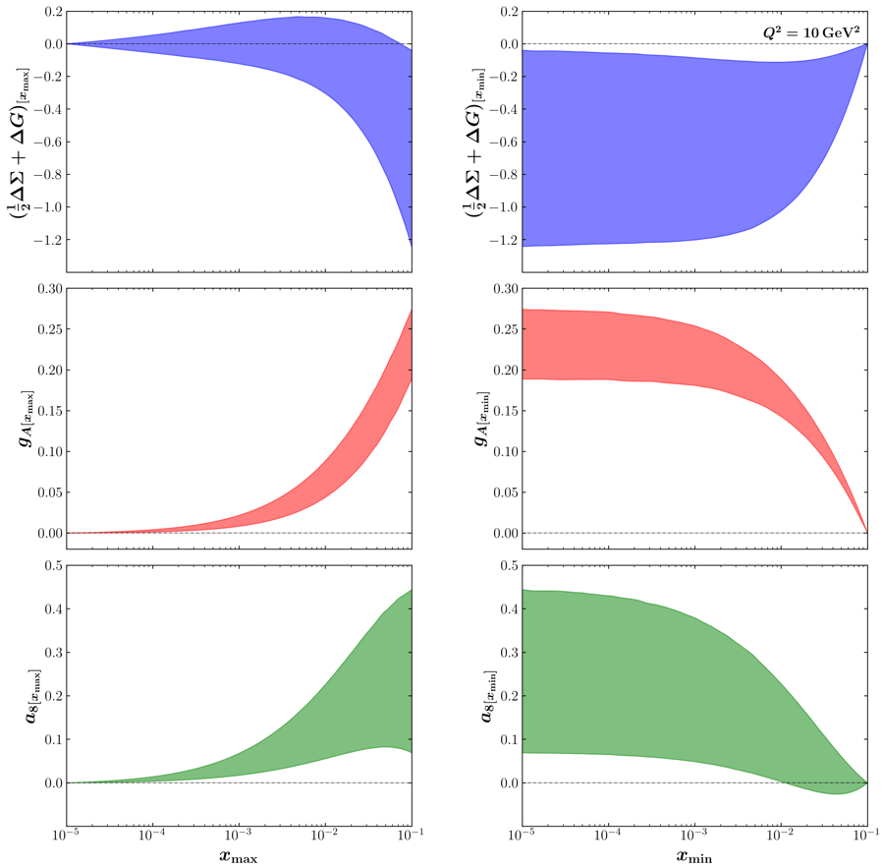
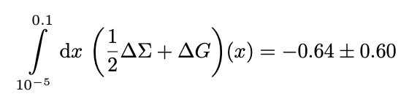
How much spin is there at small x?
JAMsmallx: Adamiak, Baldonado, YK, Melnitchouk, Pitonyak, Sato, Sievert, Tarasov, Tawabutr 2023
Negative
net spin at
small x!
Potentially a lot of spin at small x. However, the
uncertainties are large. Need a way to constrain the initial conditions. To do so, we will include the polarized p+p data from RHIC.

Slide 22
Particle production in polarized p+p collisions
YK, M. Li, 2403.06959 [hep-ph]

Slide 23
Gluon production at mid-rapidity
We want to calculate gluon production
cross section in polarized p+p collisions
at mid-rapidity, where the gluon is
small-x in both proton’s wave functions.

Slide 24
Gluon production in polarized p+p collisions
Working in the shock wave picture, we first
need to sum up the following diagrams
(emission inside shock wave is suppressed
by a log):
The result is shown below, and is cross-checked
against the existing lowest-order calculations.

Slide 25
Including small-x evolution
We need to include small-x evolution on the projectile and target sides.
This is simple on the target side, less so on the projectile side:
We symmetrize the above expression with respect to target—projectile interchange, after which we can include the evolution on the projectile side as well.

Slide 26

Gluon production in polarized p+p collisions at mid-rapidity: the final result
In the end we get the following expression for the cross section (at large N_{c}), where the dipole amplitudes Q and G₂ evolve via the above evolution equations (YK, M. Li, 2024):
Equivalently, in momentum space we obtain the following factorized expression in terms of TMDs (${∆H}_{3L}^{⊥}$ is a twist-3 helicity-flip TMD):

Slide 27
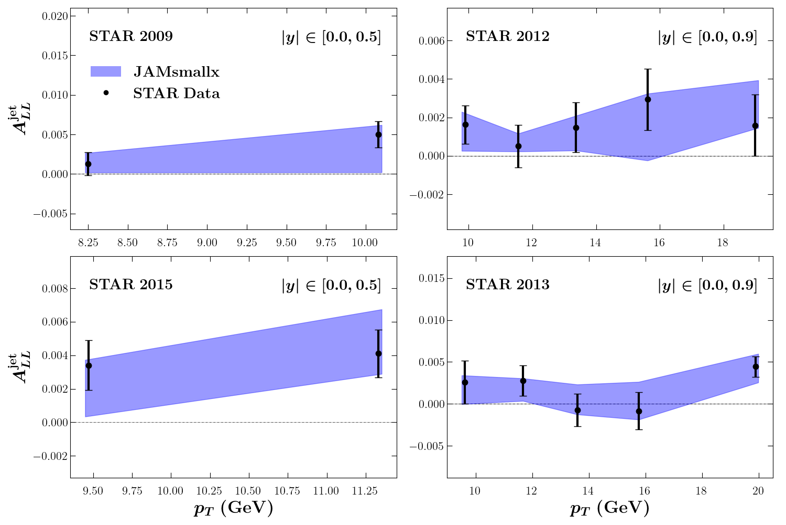
Polarized p+p collisions: small-x phenomenology
The above result can be applied
to RHIC data
(D. Adamiak, N. Baldonado, et al,
2503.21006 [hep-ph]):
Note that the calculation was for
gluons only, quarks need to be
included (in progress). Hence,
comparison with the data is
a proof-of-concept at this point.
Only large-N_{c} evolution (+external quarks) is employed.

Slide 28
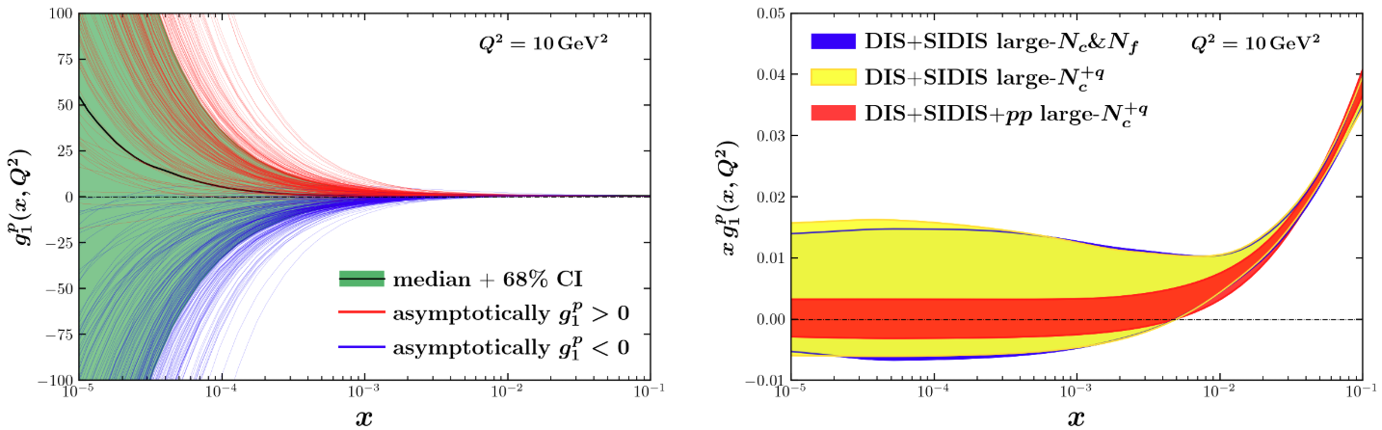
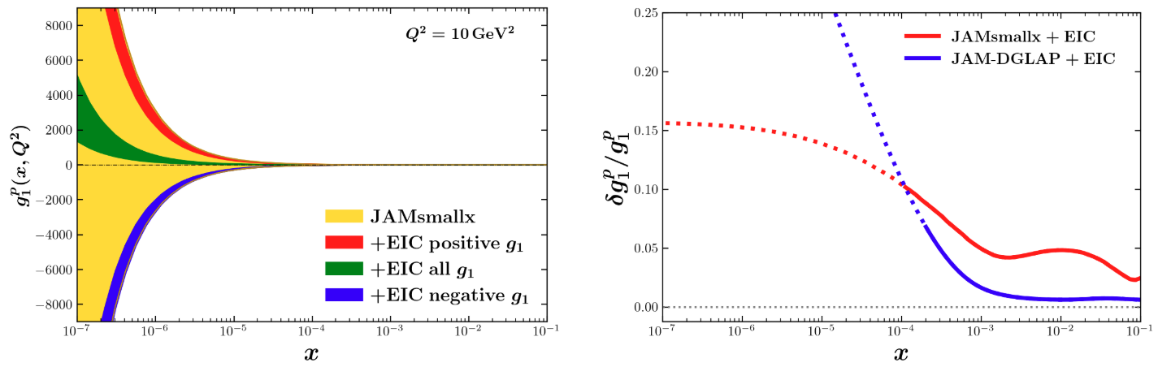
Longitudinal Spin: Small-x Evolution
Small-x evolution can predict
helicity distributions at small x.
But: hard to fix initial conditions
given the existing data (note: not
all polarized p+p data has been
analyzed yet).
End result: also a spread of
predictions for EIC.
EIC will provide constraints:
Plots are from JAMsmallx,
D. Adamiak, N. Baldonado,
et al, 2503.21006 [hep-ph]

Slide 29
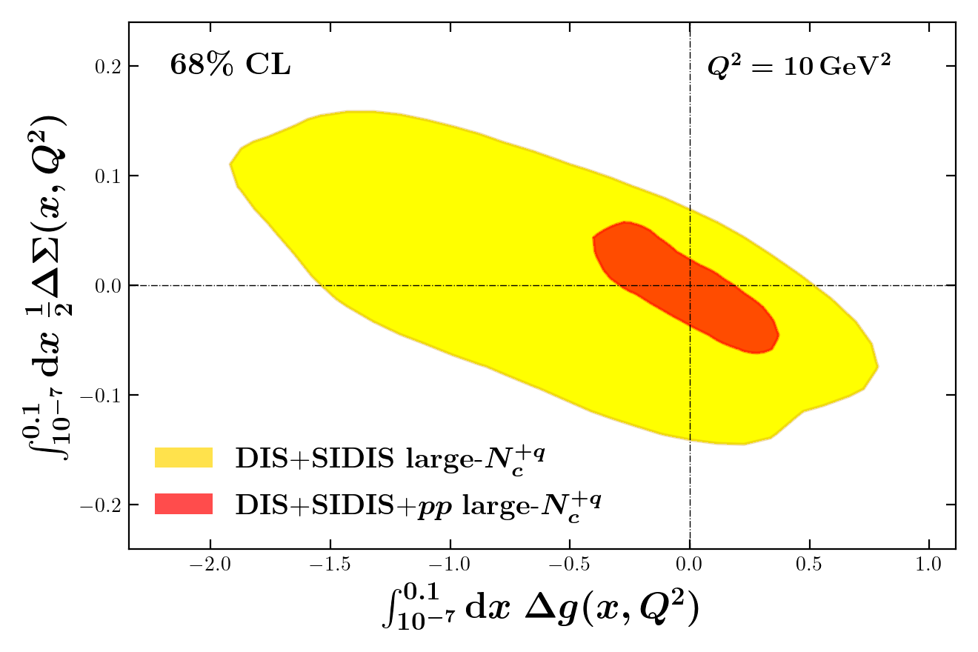
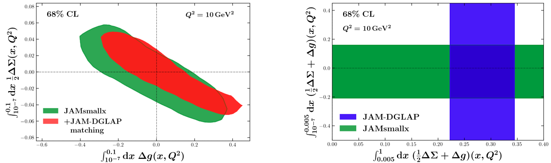
New constraints coming from polarized p+p data:
Including more data constrains the initial conditions for the dipole amplitudes involved, resulting in more precise EIC predictions for the proton g₁ structure function and estimates of spin at low x:
D. Adamiak, N. Baldonado,
et al, 2503.21006 [hep-ph]

Slide 30
Inclusive dijet production in polarized e+p collisions
YK, M. Li, 2504.12979 [hep-ph]

Slide 31
Inclusive dijet production in polarized e+p collisions
Consider double spin asymmetry (DSA) in inclusive dijet production in e+p collisions. In the b2b limit
(p_{T} ~ Q >> $∆_{⊥}\sim Λ_{QCD}$) the cross section probes the WW gluon helicity TMD (cf. F. Dominguez, B.-W. Xiao,
and F. Yuan, 2010; F. Dominguez, C. Marquet, B.-W. Xiao, and F. Yuan, 2011, for unpolarized TMDs):
Since, in the linear regime, the two TMDs are the same, , we can use the
future dijet data at EIC to further constrain gluon helicity distribution.

Slide 32
Elastic dijet production in polarized e+p collisions
YK, B. Manley, 2410.21260 [hep-ph]

Slide 33
OAM Distributions
Let us write the (Jaffe-Manohar) quark and gluon OAM in terms of the Wigner distribution as
After much algebra, we arrive at the quark and gluon OAM distributions at small x :

Slide 34

OAM Distributions and Moment Amplitudes
We now have the impact parameter moments of dipole amplitudes, labeled I₃, I₄, I₅ and $\tilde{I}$:

Slide 35
Evolution for Moment Dipole Amplitudes
Evolution equations for
the moment amplitudes
in DLA and at large N_{c}
are derived in
YK, B. Manley,
2310.18404 [hep-ph]
(see also YK, B. Manley,
2410.21260 [hep-ph]).
They can be solved
numerically (same ref)
and analytically (B. Manley,
2401.05508 [hep-ph]).

Slide 36
Elastic dijet production in e+p collisions
The process is similar to the one above,
except now the proton remains intact.
One considers two observables, double spin
asymmetry (DSA) and single spin asymmetry (SSA):
Hatta et al, 2016; S. Bhattacharya,
R. Boussarie and Y. Hatta, 2022 & 2024;
S. Bhattacharya, D. Zheng and J. Zhou, 2023;
YK, B. Manley, 2410.21260 [hep-ph]

Slide 37
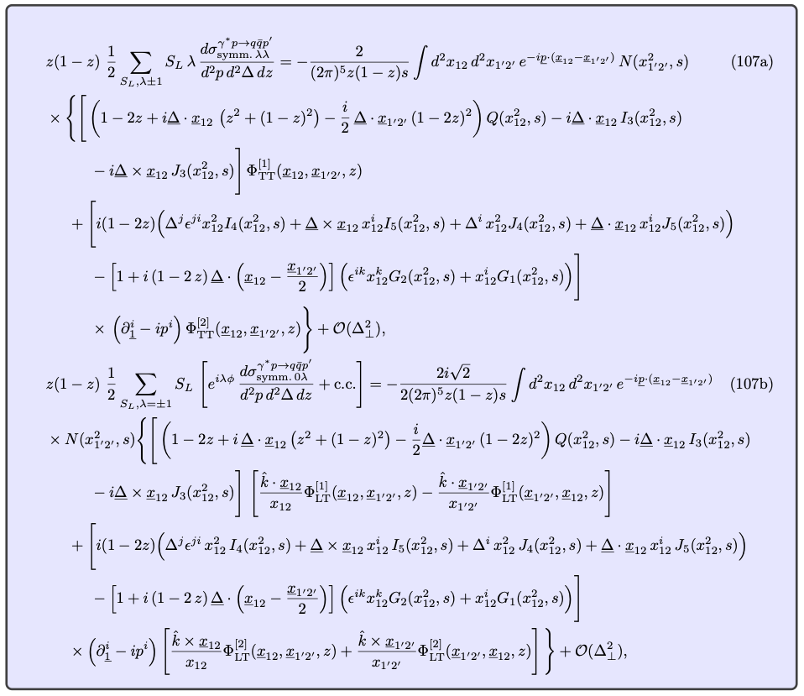
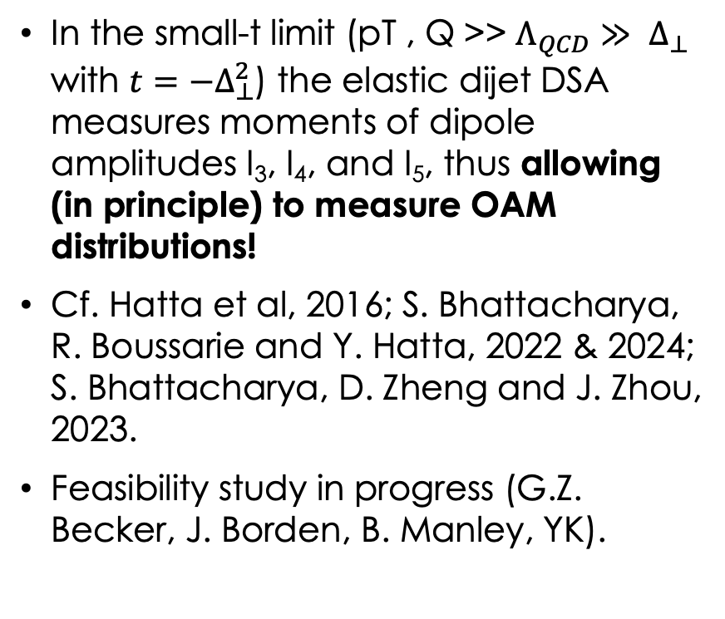
Measuring OAM distributions in elastic e+p collisions
In the small-t limit (pT , Q >> $Λ_{QCD}≫ Δ_{⊥}$ with $t=−Δ_{⊥}^{2}$) the elastic dijet DSA measures moments of dipole amplitudes I₃, I₄, and I₅, thus allowing (in principle) to measure OAM distributions!
Cf. Hatta et al, 2016; S. Bhattacharya, R. Boussarie and Y. Hatta, 2022 & 2024;
S. Bhattacharya, D. Zheng and J. Zhou,
2023.
Feasibility study in progress (G.Z. Becker, J. Borden, B. Manley, YK).

Slide 38

OAM measurement with elastic dijets: feasibility study (very preliminary!)
Vertical axis – cos $φ_{ΔpT}$
harmonic in elastic dijets A_{LL}.
pT = jets b2b momentum
Δ = momentum transfer
assumed int. luminosity = 100 fb⁻¹
JAMsmallx (Brandon Manley) – preliminary!

Slide 39
Conclusions
The small-x helicity formalism in the double logarithmic approximation (DLA) + running coupling allows to do successful polarized DIS + SIDIS phenomenology based on the existing small-x data.
However, the multitude of different dipole amplitudes in the formalism prevents precise EIC predictions: there are too many initial conditions to fix using the existing data.
Polarized p+p data on A_{LL} from RHIC, if properly included, may help. The first step in this direction is presented above.
When EIC comes online, DSA in inclusive dijet production would help constrain gluon helicity distributions.
Elastic dijets at EIC may help us measure the OAM distributions as well (and compare their x-dependence to theory).

Slide 40
Backup slides

Slide 41
Quark and Gluon OAM at Small x and Large N_{c}
YK, B. Manley, 2310.18404 [hep-ph]; B. Manley, 2401.05508 [hep-ph];
YK, B. Manley, 2410.21260 [hep-ph].

Slide 42
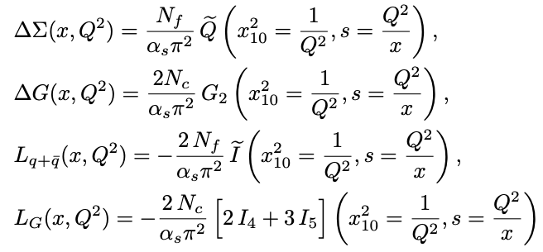
OAM Distributions
We begin by writing the (Jaffe-Manohar) quark and gluon OAM in terms of the Wigner distribution as
After much algebra, we arrive at the quark and gluon OAM distributions at small x :

Slide 43
Small-x asymptotics of OAM distributions
Solving the above evolution equations numerically, we arrive at
Consistent with Boussarie,
Hatta, Yuan, 2019 (based on
BER IREE from 1996) within
the numerical precision

Slide 44
Two intercepts, again
The evolution equations for moment dipole amplitudes have been solved analytically by B. Manley in 2401.05508 [hep-ph]. The solution was constructed using the double Laplace transform, similar to the solution for the impact-parameter integrated amplitudes.
The resulting small-x OAM asymptotics at large N_{c} is the same as for helicity PDFs,
with the intercept
This slightly disagrees with the work of Boussarie, Hatta, and Yuan (2019), which resulted in the same intercept as BER:

Slide 45
OAM Distribution to hPDF Ratios
Following Boussarie et al (2019), we consider the ratios of OAM distributions to helicity PDFs at small x.
For these ratios, Boussarie et al, predict, inspired by the Wandzura-Wilczek approximation:
Pure WW approximation predicts:

Slide 46
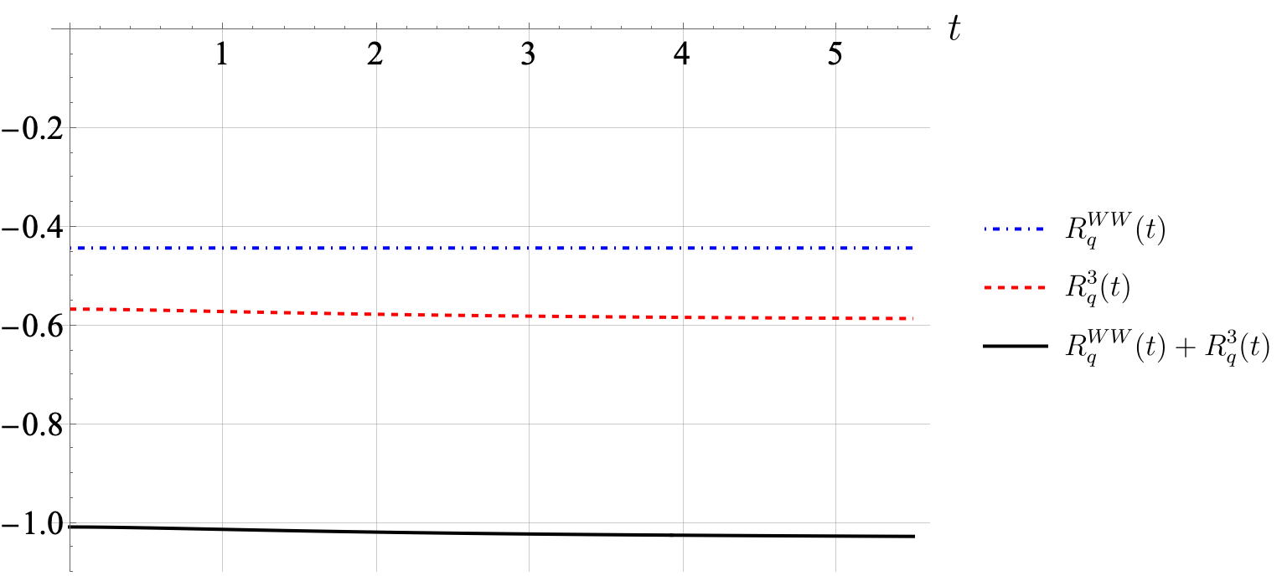
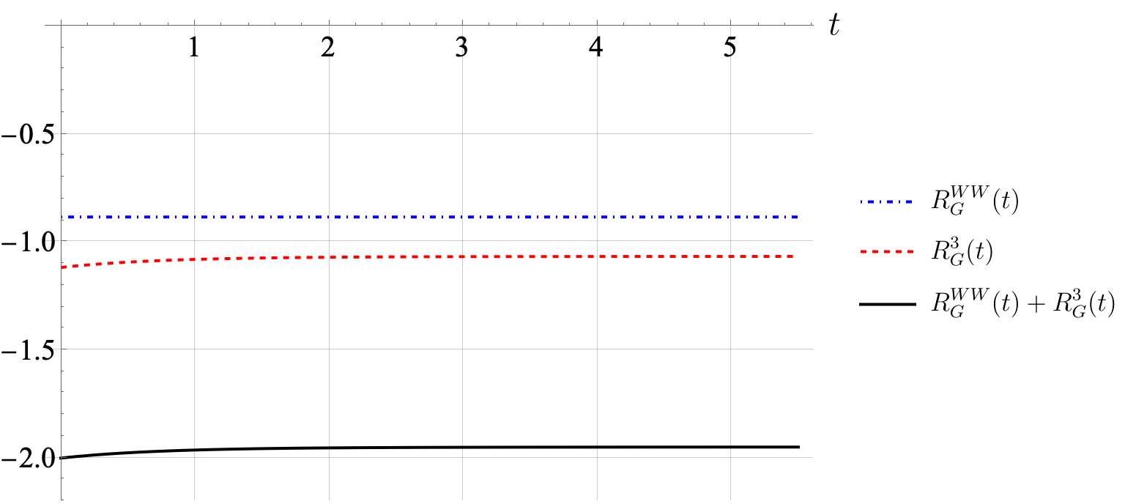
OAM Distribution to hPDF Ratios
Analytic solution from B. Manley,
2401.05508 [hep-ph], gives
Compares well with Boussarie et al:

