Slide 1
$$GPDs through$$
$$Universal$$
$$Moment$$
$$Parametrization$$
$$Quark and Gluon GPD Global Analysis$$
$$with DVCS and DVMP at NLO$$
$$Fatma Aslan$$
(with Yuxun Guo, Gabriel Santiago and Xiangdong Ji)

Slide 2
$$Outline$$
GPDs and Challenges of the GPD Pheno
Parametrization
Inverse problem
The GUMP Project
$Conformal wave expansion of GPDs$
$DVMP and DVCS$
$TFFs from ρ meson production$

Slide 3
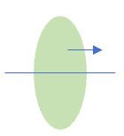
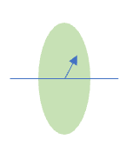
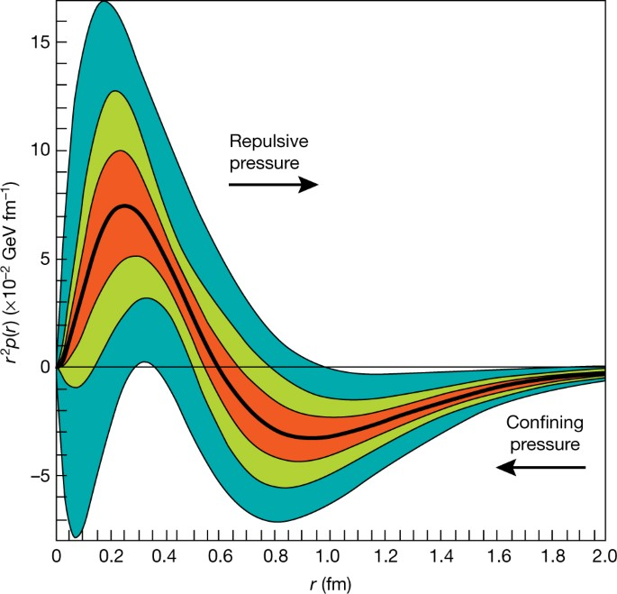
GPDs…
$$b_{⊥}$$
$$k^{+}$$
GPDs (x$,ξ$,t) → Gravitational form factors
GPDs (x$,ξ$,t)
$$ξ=0$$
$$\int{dx x GPDs\left(x,ξ,t\right)→gr FFs(t)}$$
Mass and energy distributions
Angular momentum distribution
Pressure distribution
Shear force distribution
FFs(t)
PDFs(x)
$$b_{⊥}$$
$$k^{+}$$
From GPDs we learned:
Impact parameter distributions
Charge and magnetization distributions:
Longitudinal momentum distribution:
Mass radius of the proton:
$$R_{m}=0. 55 fm$$
$$q\left(x,b_{⊥}\right)=FT\left({−∆}_{T}^{2}\right) GPD(x,ξ=0,{−∆}_{T}^{2})$$
$$Kharzeev \left(PhysRevD.104.0540151\right)$$
$Polyakov, Schweitzer (2018)$1805.06596
$$\int{dx GPD\left(x,ξ,t\right)→em FFs(t)}$$
Pressure distribution of the proton
V. D. Burkert, L. Elouadrhiri
& F. X. Girod 2018
https://doi.org/10.1038/s41586-018-0060-z
$$GPD\left(x,ξ=0,t=0\right)=PDF(x)$$

Slide 4
That much information comes at a cost!

Slide 5
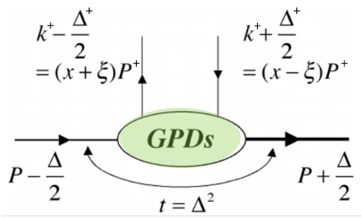
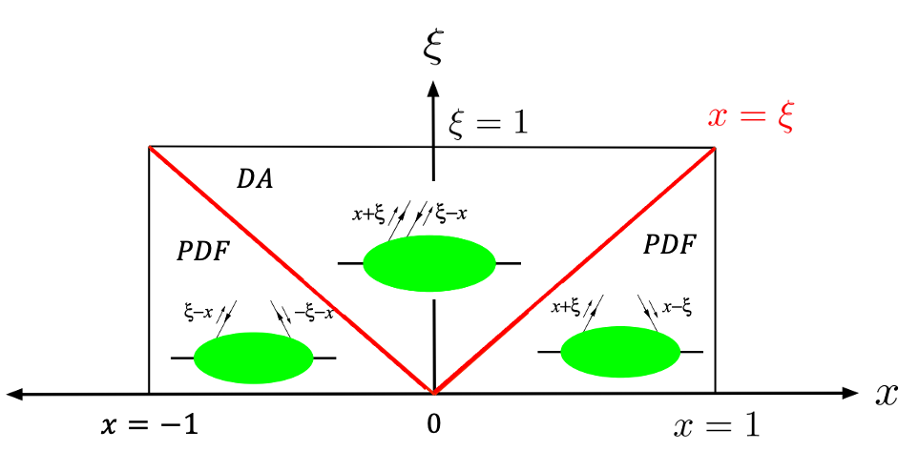
$$The Challenges of GPD pheno$$
$$Parametrizing the GPDs$$
$$3 variables at fixed scale:x,ξ ,t$$
$$Two kinematic regions:$$
$$DGLAP and ERBL (or PDF or DA)$$
$x:$Average longitudinal momentum fraction
$ξ:$Longitudinal momentum transfer fraction
$t:$ Momentum transfer squared
$$Constraints on GPDs\left(x,ξ,t\right)$$
We need to parametrize a multi dimensional function of three variables, $(x,ξ,t)$, that is defined in two kinematical regions and must obey certain theoretical constraints

Slide 6
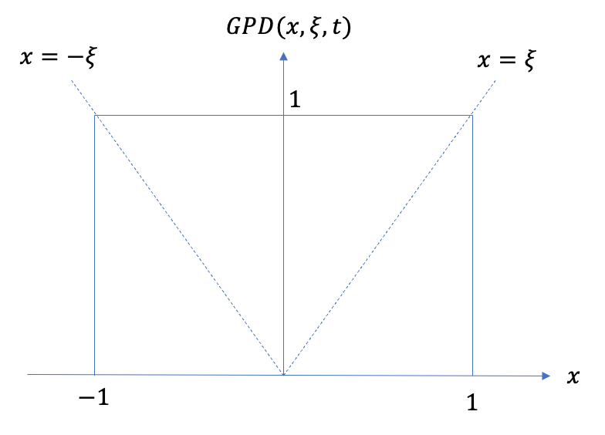
$$The Challenges of GPD pheno$$
$$The Inverse Problem$$
Lattice
Experiment+Lattice
$$+$$
$$=$$
DVCS
DVMP
Lattice matching has limitations on $x=±ξ$
Experimental data and lattice calculations are complementary!

Slide 7
$$The Challenges of GPD pheno$$
$$The Inverse Problem$$
THE GUMP PROJECT
Experiment
Lattice
Experiment+Lattice
$$=$$
PDFs
Lattice matching has limitations on $x=±ξ$
Experimental data and lattice calculations are complementary!

Slide 8
$$The Challenges of GPD pheno$$
$$The Inverse Problem$$
THE GUMP PROJECT
Experiment
Lattice
Experiment+Lattice
DVCS
DVMP
$$=$$
PDFs
Experimental data give information only on $x=±ξ$
Lattice matching has limitations on $x=±ξ$
Experimental data and lattice calculations are complementary!
$$∗ Neglecting the real parts of the CFFs and TFFs$$

Slide 9
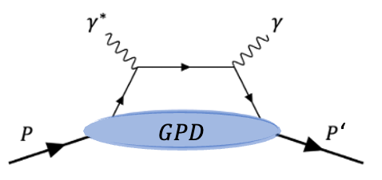
$$The Challenges of GPD pheno$$
$$The Inverse Problem$$
THE GUMP PROJECT
Experiment
Lattice
Experiment+Lattice
Why only $x=±ξ$ ?
DVCS
DVMP
$$=$$
PDFs
Experimental data give information only on $x=±ξ$
$$dx$$
Lattice matching has limitations on $x=±ξ$
Experimental data and lattice calculations are complementary!
$$∗ Neglecting the real parts of the CFFs and TFFs$$
$$GPD at x=ξ$$

Slide 10
$$The Challenges of GPD pheno$$
$$The Inverse Problem$$
THE GUMP PROJECT
Experiment
Lattice
Experiment+Lattice
Why only $x=±ξ$ ?
DVCS
DVMP
$$=$$
PDFs
Experimental data give information only on $x=±ξ$
$$dx$$
Lattice matching has limitations on $x=±ξ$
Experimental data and lattice calculations are complementary!
$$∗ Neglecting the real parts of the CFFs and TFFs$$
$$GPD at x=ξ$$
How to take the GPDs off the $x=±ξ$ line: Single diffractive hard exclusive processes. Qiu&Yu 2407.11304

Slide 11
$$The Challenges of GPD pheno$$
$$The Inverse Problem$$
THE GUMP PROJECT
Experiment
Lattice
Experiment+Lattice
DVCS
DVMP
$$=$$
PDFs
Experimental data give information only on $x=±ξ$
Lattice has limitations on $x=±ξ$
Experimental data and lattice calculations are complementary!
$Errors:$ $\frac{1}{{\left(x P^{z}\right)}^{2}}$, $\frac{1}{{\left((1−x) P^{z}\right)}^{2}}$, $\frac{1}{{ \left((ξ−x) P^{z}\right)}^{2}}$

Slide 12
$$The Challenges of GPD pheno$$
$$The Inverse Problem$$
THE GUMP PROJECT
Experiment
Lattice
Experiment+Lattice
DVCS
DVMP
$$+$$
$$=$$
PDFs
Experimental data give information only on $x=±ξ$
Lattice has limitations on $x=±ξ$
Experimental data and lattice calculations are complementary!
Combining all the possible constraints on GPDs, including both experimental and lattice calculations and parametrizing the t dependence of the conformal moments of valence and sea distributions

Slide 13
$$Conformal wave expansion of GPDs$$
$Consider we expand the GPD in terms of a complete set of polynomials:$
$Then the {expansion coeffcients,F}_{i}^{C}\left(ξ,t\right) are simply the moments of F\left(x,ξ,t\right):$

Slide 14
$$Conformal wave expansion of GPDs$$
$Consider we expand the GPD in terms of a complete set of polynomials:$
$Then the {expansion coeffcients,F}_{i}^{C}\left(ξ,t\right) are simply the moments of F\left(x,ξ,t\right):$
$There are infinitely many possible options for C_{i}\left(x\right); which choice is the most suitable one for GPDs?$

Slide 15
$$Conformal wave expansion of GPDs$$
$Consider we expand the GPD in terms of a complete set of polynomials:$
$Then the {expansion coeffcients,F}_{i}^{C}\left(ξ,t\right) are simply the moments of F\left(x,ξ,t\right):$
$There are infinitely many possible options for C_{i}\left(x\right); which choice is the most suitable one for GPDs?$
$The answer is motivated by the GPD evolution$

Slide 16
$$Conformal wave expansion of GPDs$$
$Consider we expand the GPD in terms of a complete set of polynomials:$
$Then the {expansion coeffcients,F}_{i}^{C}\left(ξ,t\right) are simply the moments of F\left(x,ξ,t\right):$
$There are infinitely many possible options for C_{i}\left(x\right); which choice is the most suitable one for GPDs?$
$The answer is motivated by the GPD evolution$

Slide 17
$$Conformal wave expansion of GPDs$$
$Consider we expand the GPD in terms of a complete set of polynomials:$
$Then the {expansion coeffcients,F}_{i}^{C}\left(ξ,t\right) are simply the moments of F\left(x,ξ,t\right):$
$There are infinitely many possible options for C_{i}\left(x\right); which choice is the most suitable one for GPDs?$
$Gegenbauer polynomials are the best choice because they simplify the evolution equations.$

Slide 18
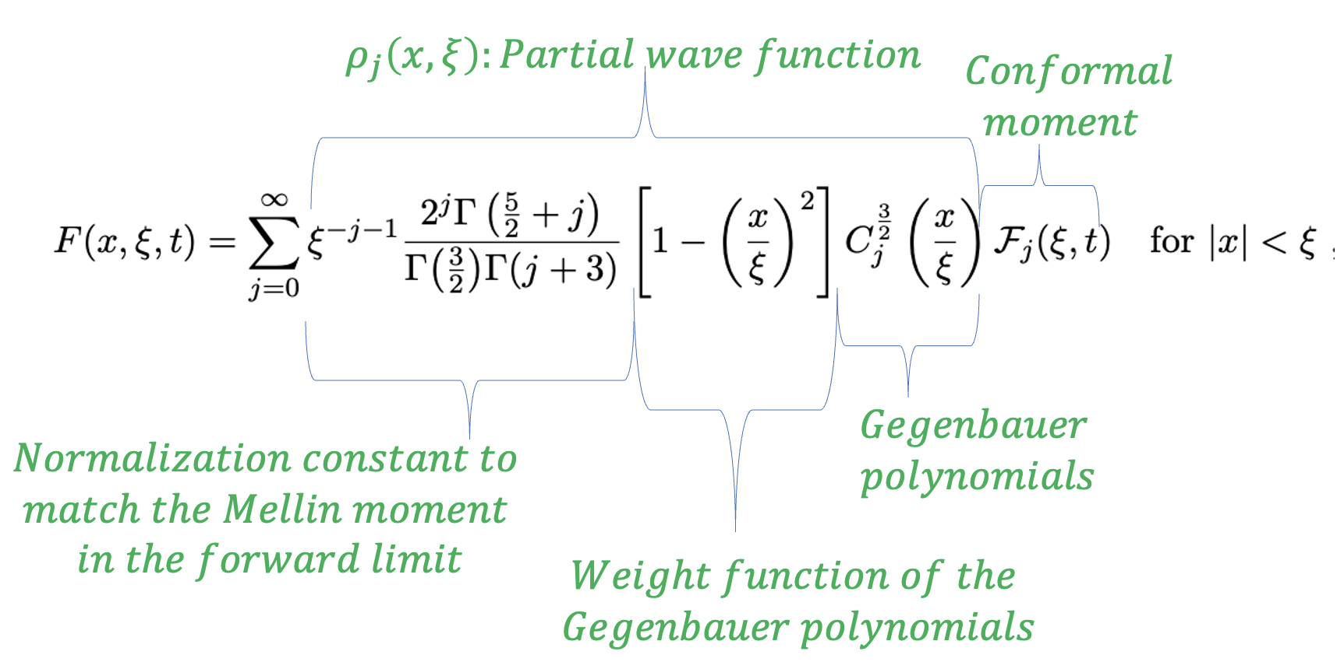
$$Conformal wave expansion of GPDs$$
$Consider we expand the GPD in terms of a complete set of polynomials:$
$Then the {expansion coeffcients,F}_{i}^{C}\left(ξ,t\right) are simply the moments of F\left(x,ξ,t\right):$
$There are infinitely many possible options for C_{i}\left(x\right); which choice is the most suitable one for GPDs?$
$Gegenbauer polynomials are the best choice because they simplify the evolution.$

Slide 19
$$Conformal wave expansion of GPDs$$
$Consider we expand the GPD in terms of a complete set of polynomials:$
$Then the {expansion coeffcients,F}_{i}^{C}\left(ξ,t\right) are simply the moments of F\left(x,ξ,t\right):$
$There are infinitely many possible options for C_{i}\left(x\right); which choice is the most suitable one for GPDs?$
$Gegenbauer polynomials are the best choice because they simplify the evolution.$
$This series diverges!$ $Cannot represent GPDs$
$$ξ$$
$$x=−ξ$$
$$1$$
$$x=ξ$$
$$ERBL$$
$$DGLAP$$
$$x$$
-1
$$1$$

Slide 20
$$Conformal wave expansion of GPDs$$
$Consider we expand the GPD in terms of a complete set of polynomials:$
$Then the {expansion coeffcients,F}_{i}^{C}\left(ξ,t\right) are simply the moments of F\left(x,ξ,t\right):$
$There are infinitely many possible options for C_{i}\left(x\right); which choice is the most suitable one for GPDs?$
$Gegenbauer polynomials are the best choice because they simplify the evolution.$
$This series diverges!$ $Cannot represent GPDs$
$$ξ$$
$$x=−ξ$$
$$1$$
$$x=ξ$$
$$ERBL$$
$$Analytic continuation$$
$$(Using asymptotic behaviour)$$
$$DGLAP$$
$$x$$
-1
$$1$$

Slide 21
$$Conformal wave expansion of GPDs$$
$Consider we expand the GPD in terms of a complete set of polynomials:$
$Then the {expansion coeffcients,F}_{i}^{C}\left(ξ,t\right) are simply the moments of F\left(x,ξ,t\right):$
$There are infinitely many possible options for C_{i}\left(x\right); which choice is the most suitable one for GPDs?$
$Gegenbauer polynomials are the best choice because they simplify the evolution.$
$This series diverges!$ $Cannot represent GPDs$
$$Analytic continuation$$
$$(Using asymptotic behaviour)$$
$$Mellin Barnes Integral:$$
Muller and Schafer hep-ph/0509204 (2005)

Slide 22
$$Parametrization of GPDs$$
$$Inverse conformal transform$$

Slide 23
$$Parametrization of GPDs$$
$$Inverse conformal transform$$
$$polynomiality$$

Slide 24
$$Parametrization of GPDs$$
$$Inverse conformal transform$$
$$polynomiality$$
$$Observed$$
$$exp. fall off$$
$$Common ansatz for PDFs$$
$$Regge Trajectory$$
$$α\left(t\right)=α_{0}+{α′}_{0}t$$
$$5 parameters in the semi−forward limit$$

Slide 25
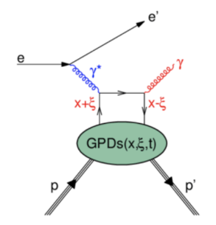
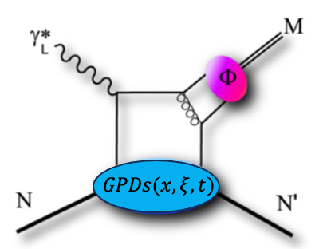
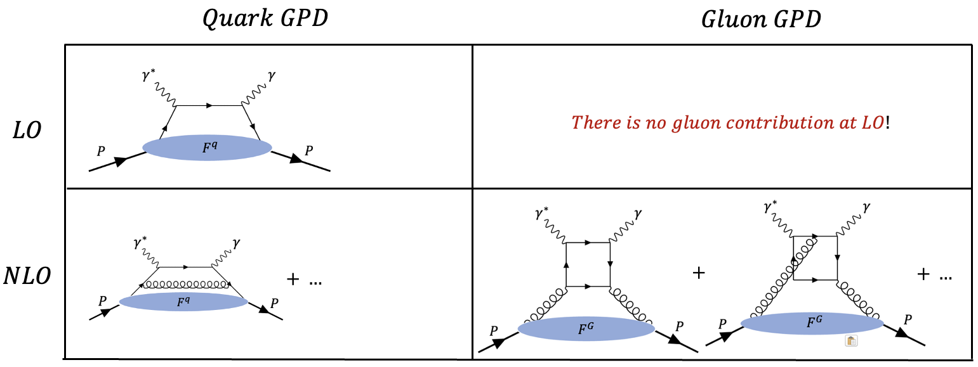
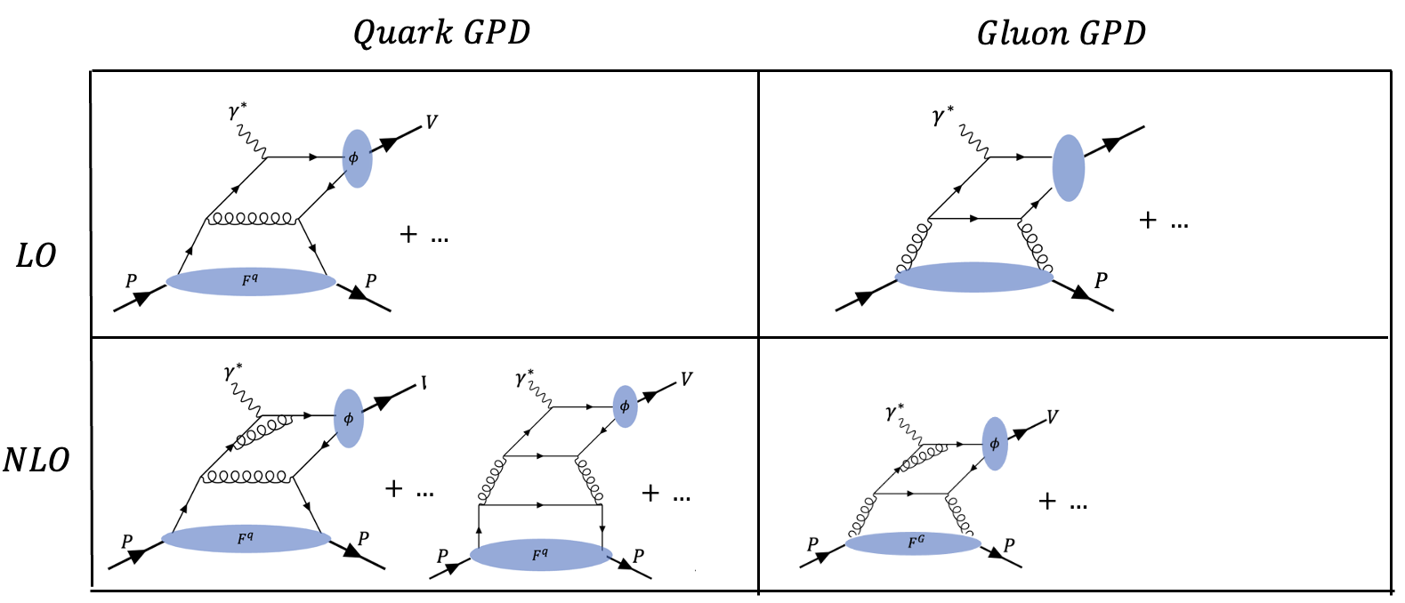
$$DVCS and DVMP; complementary rather than redundant$$
$$DVCS$$
$$DVV_{L}P$$
$$e p→e′ p′ γ$$
$$e p →e^{′}p^{′}M$$
$$A lepton scatters off the proton$$
$$by exchanging a virtual photon,$$
$$and in the final state, a real$$
$$photon is emitted$$
$$A lepton scatters off the proton$$
$$by exchanging a virtual photon,$$
$$and in the final state, a meson$$
$$is produced$$
$The gluons start contributing the hard part at NLO.$
$$Their impact at LO arises only through evolution.$$
$The gluons start contributing to the hard part at LO.$
$Contributions from vector GPDs H \& E and$
$$axial vector GPDs \tilde{H} \& \tilde{E}$$
$Vector GPDs H and E contribute to vector meson$
$$production.$$

Slide 26
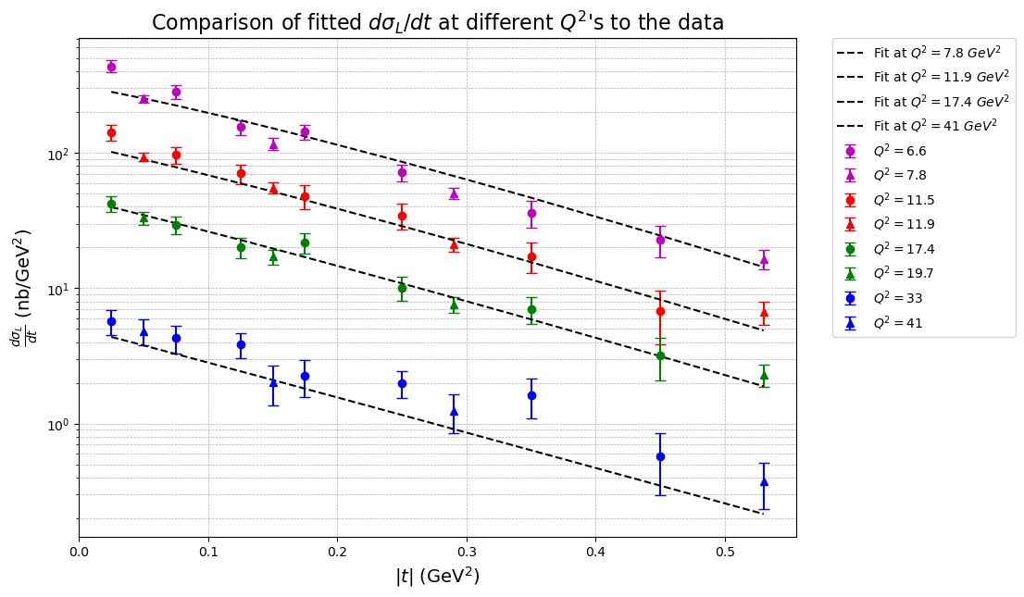
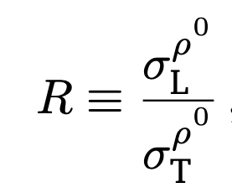
Fit with the longitudinal cross section
We are using only HERA data for DVMP (Jlab data is not at high enough $Q^{2}$ for DVMP)
We are making an L\T separation of the differential cross section
$$∆=ZEUS$$
$$Ο=H1$$

Slide 27
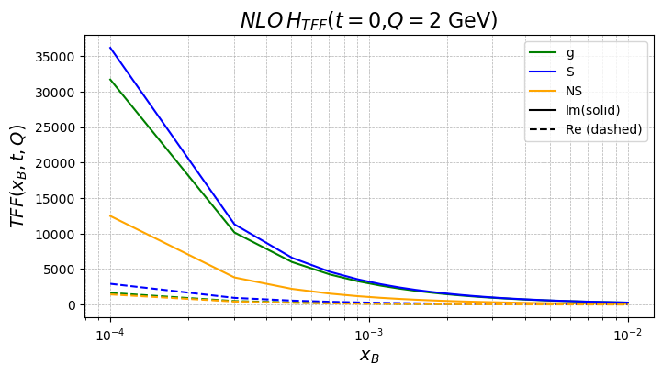
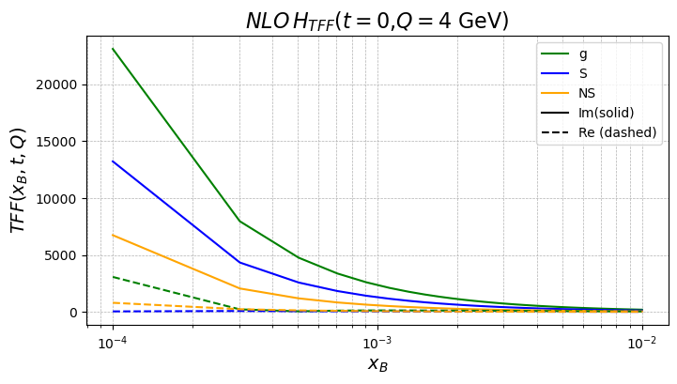
Singlet=$\left(u+\overline{u}\right)+\left(d+\overline{d}\right)$
Non-singlet= -$\left(u+\overline{u}\right)+\left(d+\overline{d}\right)$
The Real and Imaginary parts of the transition form factor at NLO
NLO $H_{TFF}$ (Q=2GeV)
NLO $H_{TFF}$ (Q=4GeV)
TFF = Hard part $⊗$ GPD (x,$ξ$)
TFF = Hard part $⊗$ Evolution $⊗$ GPD (x,$ξ$)
perturbative
perturbative
perturbative
(LO+NLO…)
(LO+NLO+…)
(LO+NLO+…)
At LO, real part is negligibly small:
This is also the case at NLO

Slide 28
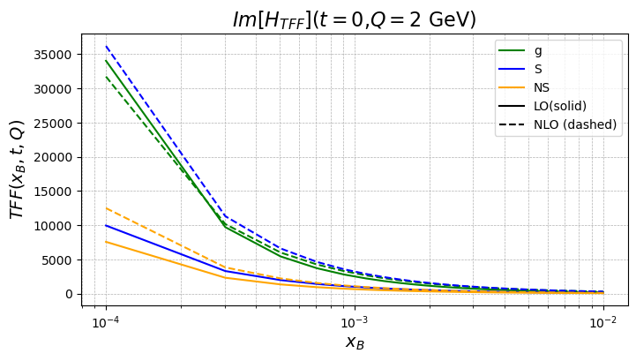
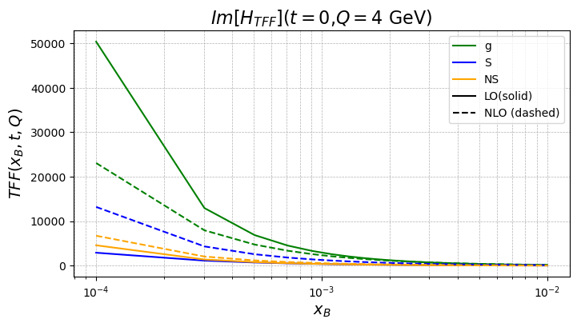
Imaginary part of the transition form factor at LO and NLO
Singlet=$\left(u+\overline{u}\right)+\left(d+\overline{d}\right)$
Non-singlet= -$\left(u+\overline{u}\right)+\left(d+\overline{d}\right)$
Im ($H_{TFF}$) (Q=2GeV)
Im ($H_{TFF}$) (Q=4GeV)
Significant contribution from NLO!

Slide 29
THE GUMP PROJECT
$$Challenges of GPD Pheno$$ | $$The GUMP project$$
Parametrization | $$Working with conformal moments of GPDs$$ $$(easy evolution, polynomiality,…)$$
$$Inverse problem$$ | $$Combining the experimental and lattice data$$
DV$ρ$P at NLO
The real part of the TFFs are negligible also at NLO
Significant contributions from NLO to the imaginary part of the TFFs
Global analysis combining DVCS and DVMP + lattice data
Improving the gluon parametrization
Full error and uncertainty analysis
Adding in strange quarks and the data that is sensitive to them
.
.
THANK YOU!

Slide 30
