Slide 1
Jefferson Laboratory Science Programs
David J. Dean
Deputy Director for Science and Technology
Presented To:
JLUO meeting at the DNP, Boston
October 8, 2024

Slide 2
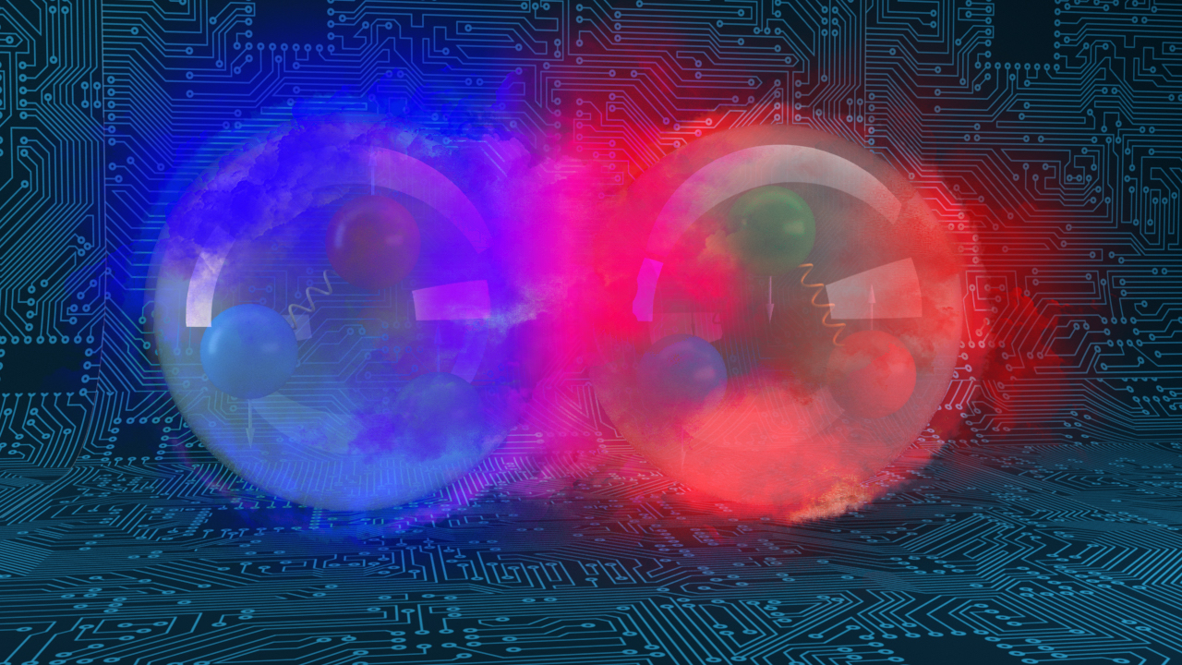
Outline…
A bit of science strategy
FY24 S&T accomplishments
Getting ready for the future

Slide 3
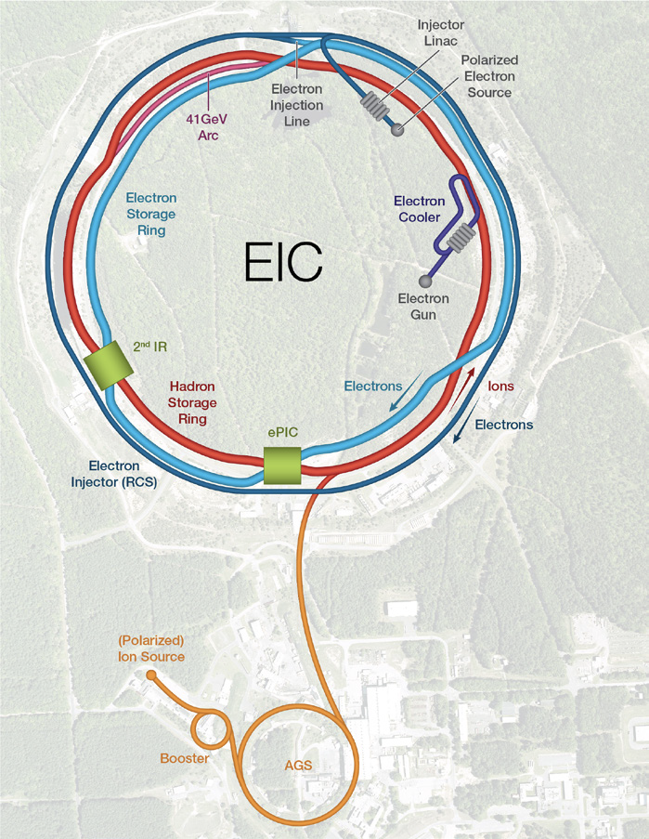
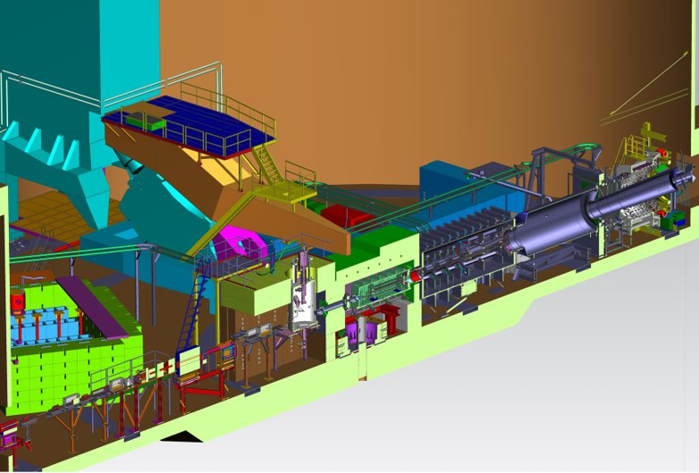
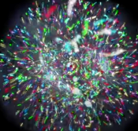
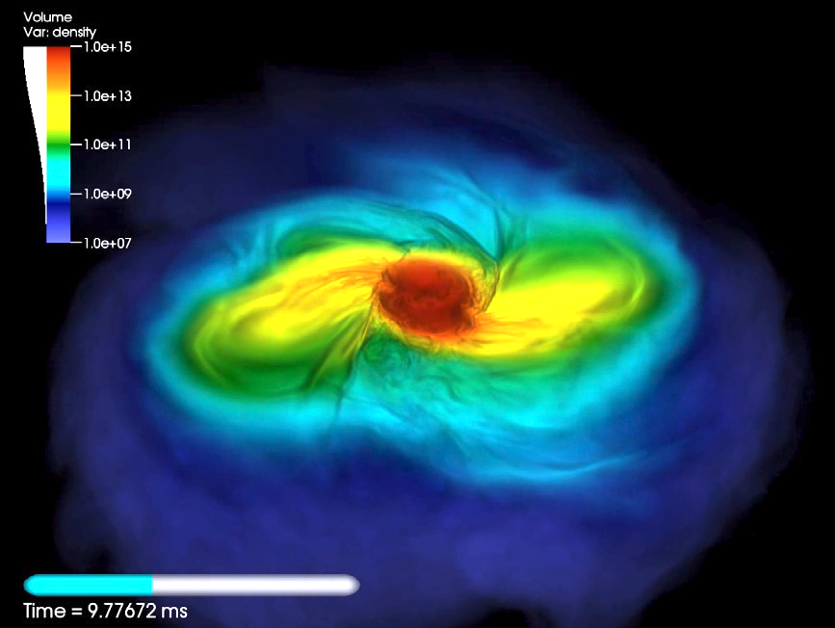
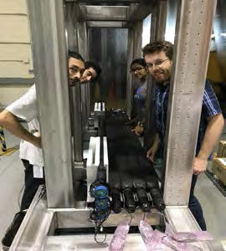
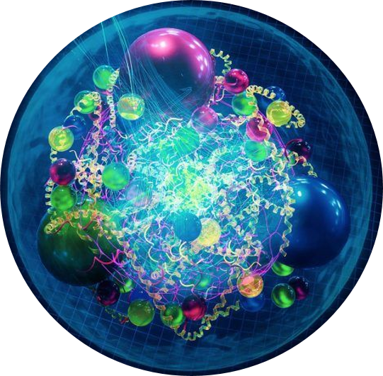
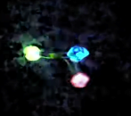
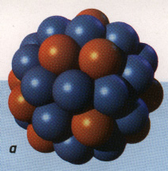
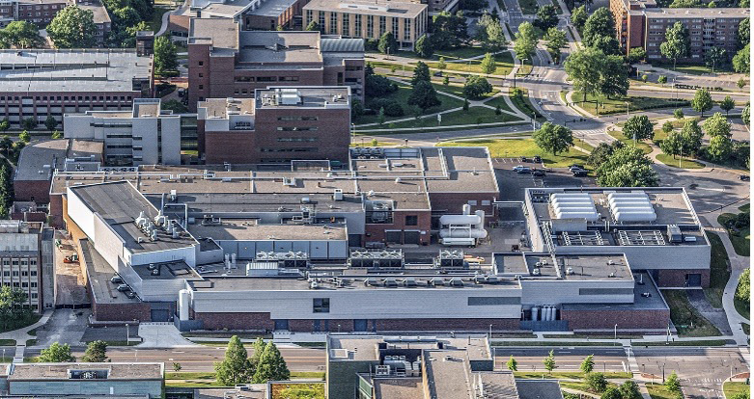
Nuclear Physics across the Universe
2023 LRP Science Questions
How do quarks and gluons make up protons, neutrons, and, ultimately, atomic nuclei?
How do the rich patterns observed in the structure and reactions of nuclei emerge from the interactions between neutrons and protons?
What are the nuclear processes that drive the birth, life, and death of stars?
How do we use atomic nuclei to uncover physics beyond the Standard Model?
Gluons
Fundamental Symmetries
Neutron Star Mergers
Quarks
Nuclear Physics & Astrophysics
10⁻¹⁰ –10⁻³ sec
The world of QCD
Notes:
<10⁻⁴³ seconds…Planck epoch
<10⁻³⁶ seconds…Grand Unification Epoch
<10⁻³² seconds…inflation epoch
10⁻¹² seconds…electroweak epoch
10-¹² – 10⁻⁶ seconds quark epoch (think QGP)
10⁻⁶ – 1 second the hadron epoch
1 second – neutrino decoupling
1 second – 10 seconds, lepton epoch…(lepton nonconservation…neutrinoless bb decay…)
10 seconds to 3 minutes – BBN
Recombination (electron capture on light nuclei) 370,000 years
150 million years later…first stars and galaxies form…
And they collide!!

Slide 4
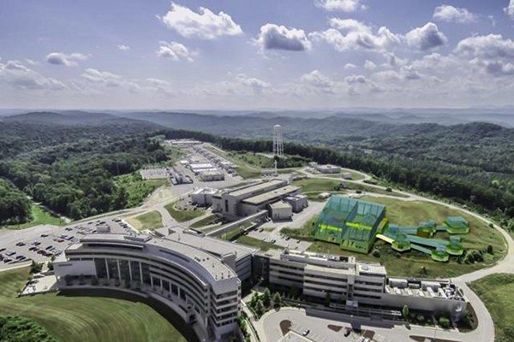
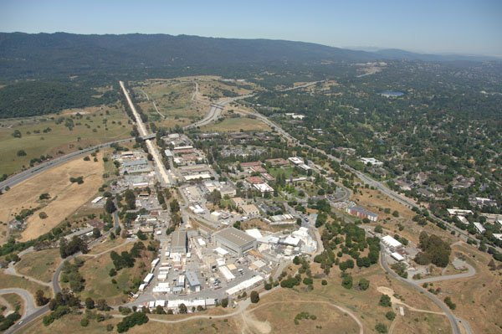
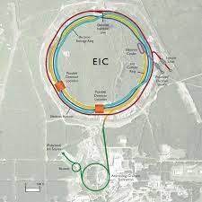
Advanced Detectors and accelerators make our quest possible
Theorists guide experiments & interpret results
SRF R&D makes accelerators better
e
H
SRF Capability enables research in chemistry, materials, medical research, isotope production
US-based MicroPattern Gaseous Detector Facility - A proposed User Resource

Slide 5
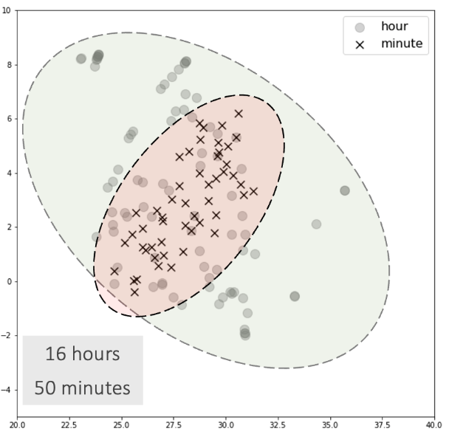
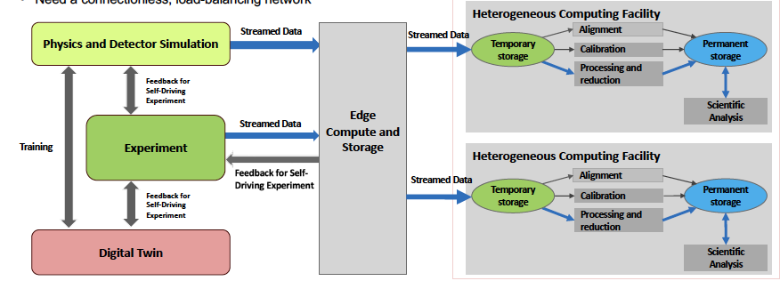
The data strategy extends from a new facility through R&D and application: High Performance Data Facility
Establish HPDF as the premier Data Science facility for SC and DOE
Generate foundational research and prototype computing systems to inform pathways for the integrated ecosystem.
Drive and enable AI/ML applications across the sciences. Grow in traditional computer science and applied math. Integrate facilities, workflows, algorithms, software and application tools.
Position HPDF as an integral component of a single, larger computational ecosystem that bolsters national S&T capabilities
Lead the NP engagements for IRI and an HPDF spoke. How: hold workshops, build on current research (EJfat, streaming grand challenge), and influence EIC computing model
JLDC
Application: AL/ML improve integrating into CEBAF Ops
HPDF hardware concepts

Slide 6
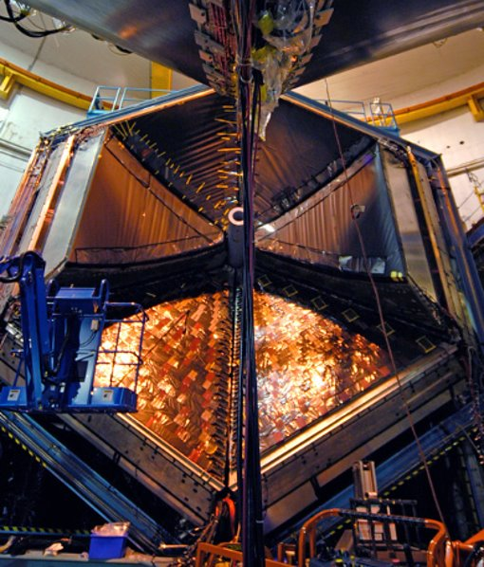
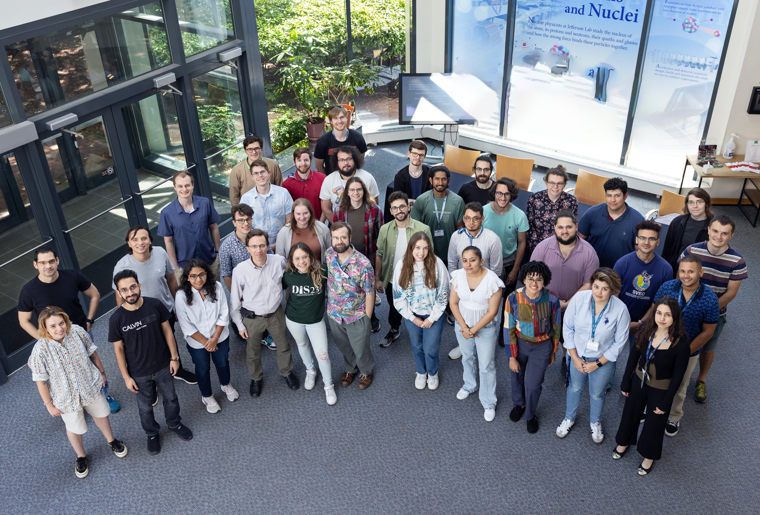
FY24 was a good physics year
30 weeks of Physics (9/5/23 – 5/19/24)​
3 weeks more than planned to complete high-priority experiments​
Reliability at 76% (vs. planned 77%)​
259 ’PAC’ days run: 5 Experiments Completed and 8 Experiments Partially Completed ​ (in Halls A, B, and C, with D installing new GlueX detector capability)​
98 journal publications; 27 PhD thesis produced; 185 invited talks​
Workforce of the future: 66 undergrad 177 grad, and 55 post-docs in residence at the laboratory in FY24​
R&D effort resulted in 3 patents; 10 invention disclosures during FY24​
$437K from the Office of State and Community Energy Programs​
$285k from Technology Commercialization Fund ​
Projects in collaboration with Sandia and PNNL
Numerous new R&D funding from: NP, HEP/ARDAP, ASCR with new research in accelerator applications, superconducting electronics, AI/ML​
HUGS, 2024

Slide 7
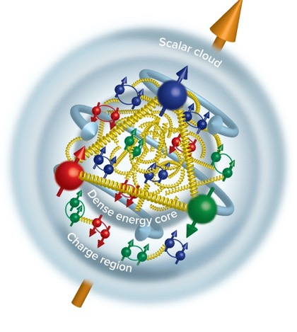
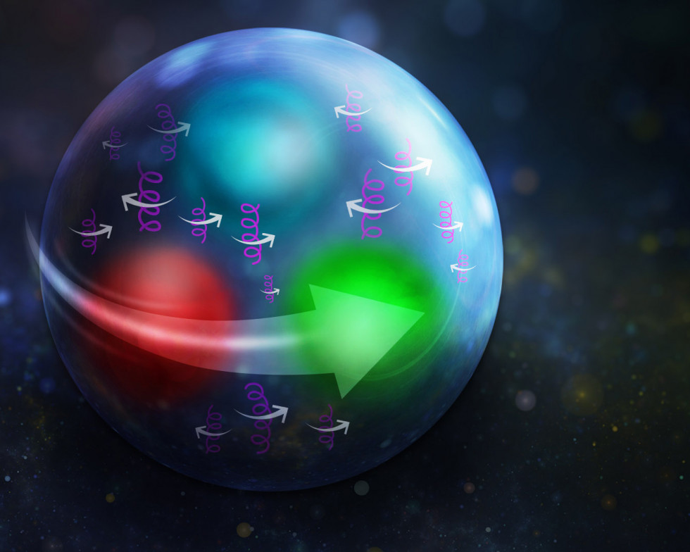
Highlights from Strong force exploration
Closing in on proton spin The Glue is in the middle Proton stress-energy tensor
Tangential stress force inside the proton changes direction near r ~ 0.45 fm
Peak : 38,000 N (4 metric tons)
Karpie et al., Gluon helicity from global analysis of experimental data and lattice QCD Ioffe time distributions, Phys. Rev. D 109, 036031 (2024)
Duran et al “Determining the gluonic gravitational form factors of the proton," Duran et al, Nature 615, 813 (2023)
Burkert, et al., Colloquium: Gravitational form factors of the proton. Reviews of Modern Physics 95, 041002 (2023)

Slide 8
Working Through FY25 uncertainties
FY25 Budget does affect weeks of CEBAF Operations: from Linda Horton presentation at NSAC, September 12, 2024
DOE, Office of Science,
Office of Nuclear Physics

Slide 9
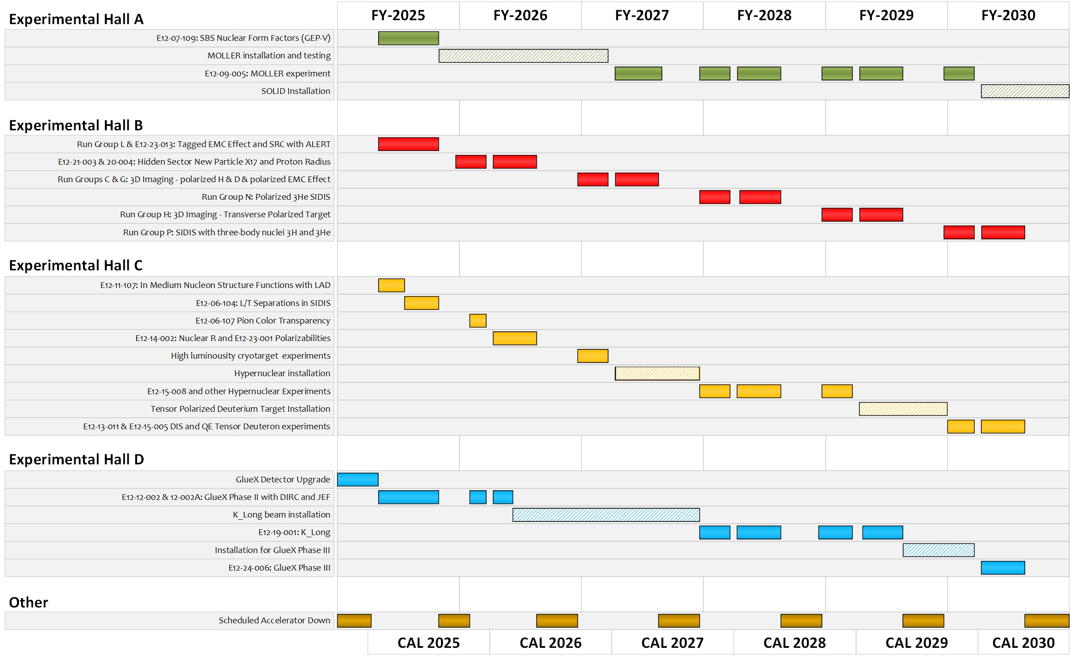
TENTATIVE Long-Term Schedule
Shown with 25 weeks of physics running in FY25 and FY26 and our optimal 32 weeks of physics running in the out years.
Optimizing the science output
During MOLLER running, modest current experiments planned for Hall C to keep total machine power under 1.1 MW.
During MOLLER installation, non-standard energy experiments in Halls B, C.
By FY31 ~80% complete without SoLID and ~70% complete with SoLID.
Approved positron experiments require an additional several years.

Slide 10
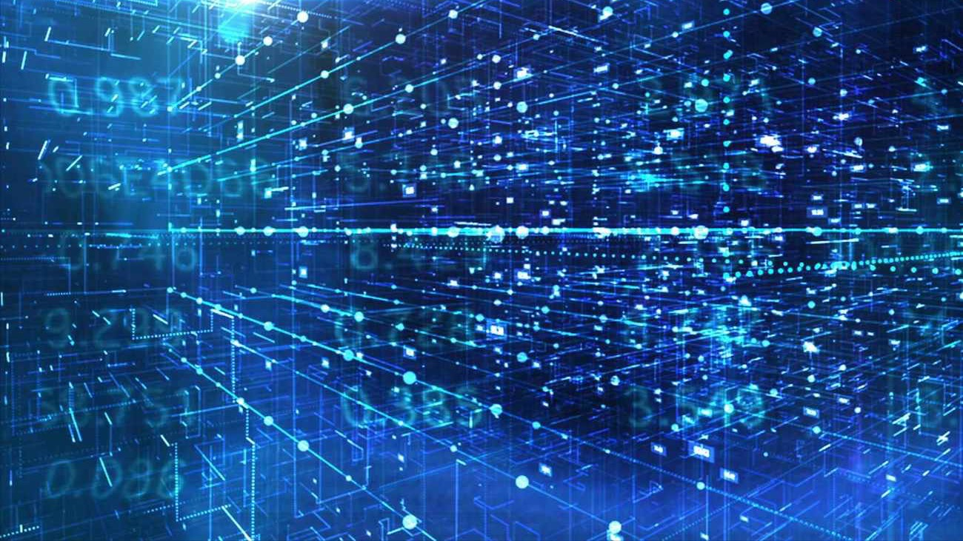
Discussion

