Slide 1
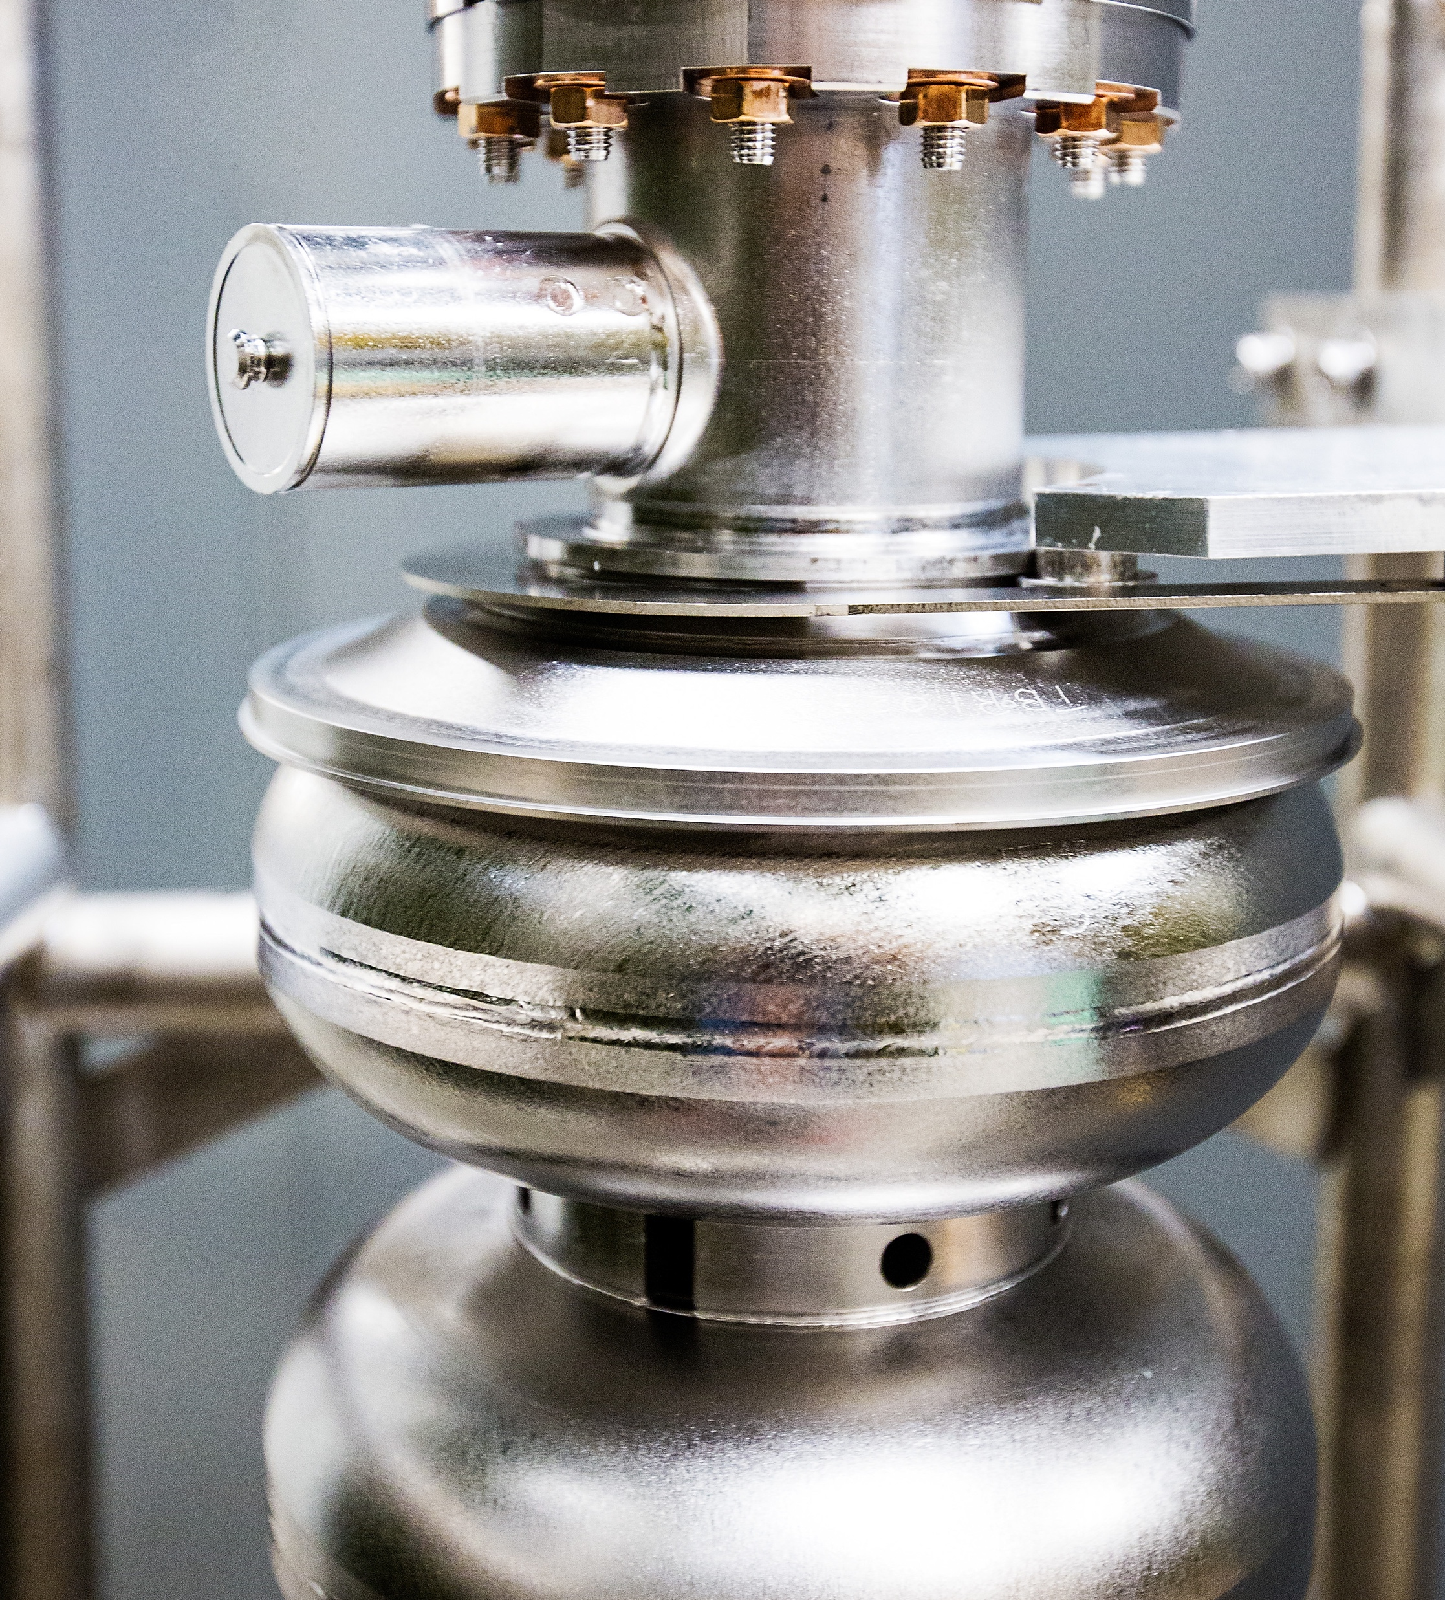
Jefferson Lab Status
Kimberly Sawyer, Lab Director
Thomas Jefferson National Accelerator Facility
October 8, 2024
Notes:
Let me introduce myself, I am Kim Sawyer, the new Director of Jefferson Lab. I am excited to meet with you today. Ultimately, our user community is what Jefferson Lab is all about - collaboration, cooperation, and innovation across institutions, across state and national boundaries – to deliver the best science in our field in a safe and efficient way.

Slide 2
2
Notes:
Jefferson lab has the largest community of nuclear physicist in the world.
We have a total of 1904 scientific users worldwide: 1238 domestic users and 666 international scientific users as of October 2024.

Slide 3
Lab Growth
3
Notes:
Lab is growing, 166 new staff in FY24
Demographic profile is also changing: Female and minority population are on the rise as you can see the increase in percentage in 2024 compared to 2018.

Slide 4
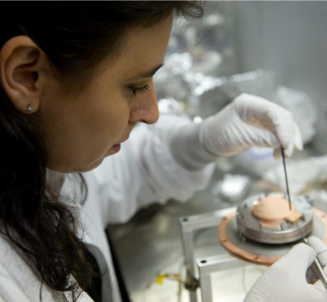
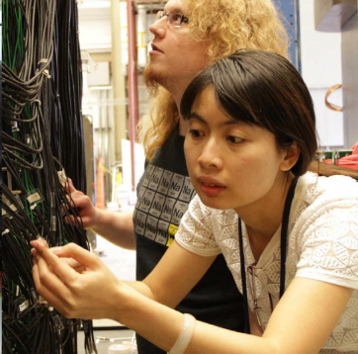
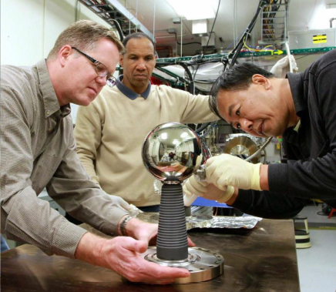
Agenda
Put simply, Jefferson Lab’s fundamental ethical principles are as follows:
Each of us is responsible for the propriety and consequences of our actions Each of us must conduct all aspects of Jefferson Lab business in an ethical and lawful manner
Each of us must hold ourselves to high standard of honesty, integrity, and fairness in relationship to others
Everyone at Jefferson Lab has a responsibility to foster an environment where all employees, users, students, guests, visitors, and subcontractors feel safe, welcomed and supported in advancing the Lab's mission.
Everyone is expected to embody the values of professionalism, respect, and diversity as well as cultivate a supportive and inclusive environment where the opinions of others are embraced.
Behaviors not aligned with the lab's values will not be tolerated.
If you or someone else feels uncomfortable in the workplace or believe you are subjected to a hostile or harassing environment, or have any other related concerns, please contact the Jefferson Lab Ethics Officer, Rhonda Barbosa, immediately at rbarbosa@jlab.org or via the Lab's Ethics Hotline at http://www.jsaecp.ethicspoint.com. Alternately, you may contact your sponsor or the DEIA Program Manager at dei@jlab.org.
4
Notes:
I want to, as a starting point, emphasize my commitment to the Community Standards that are essential to creating an environment where our very diverse community, including staff and users, can contribute to our mission with professionalism and respect. While things are changing at Jefferson Lab, these standards provide a foundation for all that we do.

Slide 5
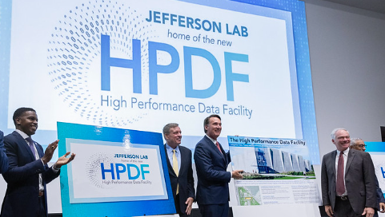
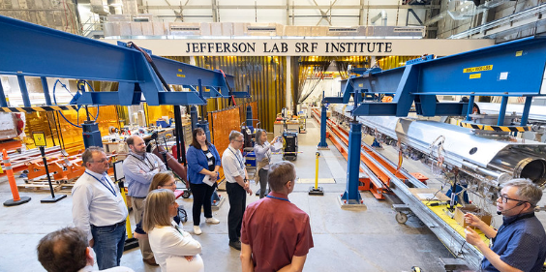
Managing Change – Creating the Jefferson Lab of the Future
Transitioning to a multi-purpose lab
We are positioning Jefferson Lab
Employee engagement
Functional realignment
Maturity of our safety culture
We are driving operational excellence
Quality customer satisfaction
Transparency
Accountability
Simplification
5
Notes:
We are managing change to creating the new Jefferson Lab of the Future.
JLab used to be a single program laboratory with a primary mission of delivering breakthrough science and technology in the area of Nuclear Physics.
We are expected to become a multi-purpose laboratory within the next few years with the award and siting of Office of Science’s Advanced Scientific Computing Research (ASCR) high performance data facility.​
We are positioning Jefferson Lab through employee engagement, functional realignment by reorganization. Project Management is teaming up with Quality Assurance. As part of re-enforcing a healthy safety culture, HEC LOTO pause has now established as a new norm.
Most importantly, my goals is to drive operational excellence through:
Delivering quality customer satisfaction
Transparent communication so that decisions and actions are made visible to all allowing openness and trust within our organization.
Fostering accountability through clear roles and responsibilities. In fact, the second thing I did after holding an all-hands meeting once I become the director, I had a leadership workshop on R2A2s.
Simplifying bureaucracy to make decision-making faster, improve efficiency and reduce frustration. We now have two Deputy Directors in stead of three and am streamlining process through Work Planning and Control Improvement.

Slide 6
Deputy Chief Operating Officer
Natalie Carter
General Counsel
Rhonda Scales
Quality & Performance Assurance Director
Steve Smith
Chief Communications Officer
Lauren Hansen
Chief Audit Executive
Daniel Caldwell
JEFFERSON SCIENCE ASSOCIATES
EIC Project Director
James Fast
HPDF Project Director
Kate Mace
Project Assurance
Officer
Allison Lung
Chief Innovation Officer
Marla Schuchman
Sean Hearne, JSA Board Chair
THOMAS JEFFERSON NATIONAL ACCELERATOR FACILITY
Laboratory Director
Kimberly Sawyer
Deputy Laboratory Director
for Science and Technology
David Dean
Deputy Laboratory Director
for Operations/COO
Johnathon Huff
COMPUTATIONAL
SCIENCES AND
TECHNOLOGY
Amber Boehnlein
THEORETICAL AND
COMPUTATIONAL
PHYSICS
Jianwei Qiu
EXPERIMENTAL
NUCLEAR PHYSICS
Cynthia Keppel
ENGINEERING
Tim Michalski
ACCELERATOR
Andrei Seryi
PROCUREMENT AND
PRIME CONTRACTS
Tisca Dorsey
Procurement Dir./Prime Contract Mgr.
ENVIRONMENT, SAFETY
AND HEALTH
Natalie Carter
Interim ES&H Director
FINANCIAL
MANAGEMENT
Gail Frayne
Chief Financial Officer
HUMAN RESOURCES
Rhonda Barbosa
Chief Human Resources Officer
FACILITIES MGMT AND
LOGISTICS
Kent Hammack
FM&L Director
PROJECT MANAGEMENT
OFFICE
Steve Smith
Interim PMO Director
6
Notes:
In our efforts to shift toward becoming a high-performing multi-purpose laboratory, we have set a goal to streamline operations and improve services across Jefferson Lab to deliver world-leading science.
Aligning our budget and finance offices
Created a Project Assurance Office
Created a Project Management Office
CPO taking on a new role (CPO office functions re-assigned)
ES&H Director taking on a new role (Interim in place Oct. 16)
Assessing centrally managed, field deployed model to provide safety professionals for divisions

Slide 7
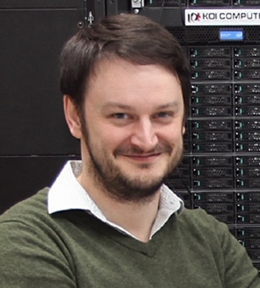
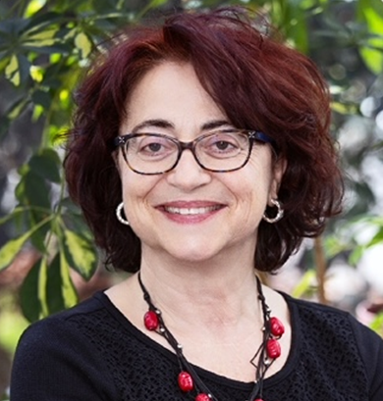
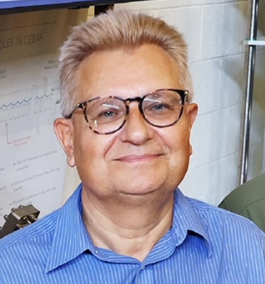
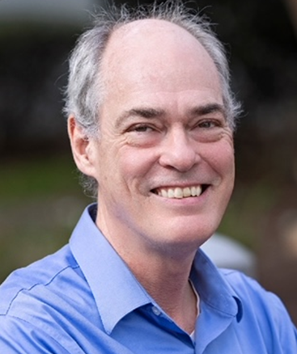
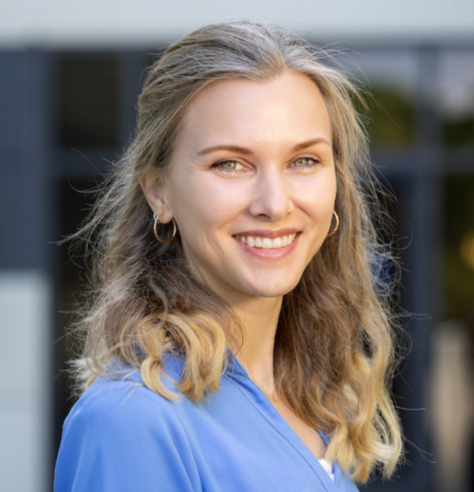
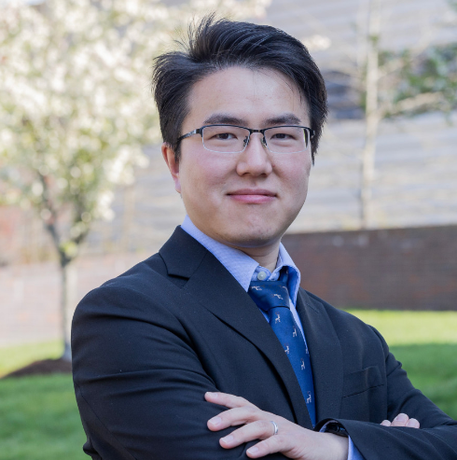
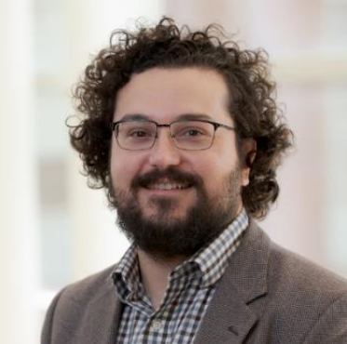
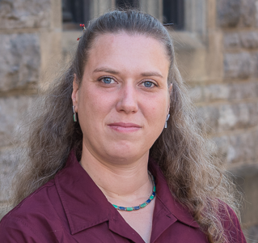
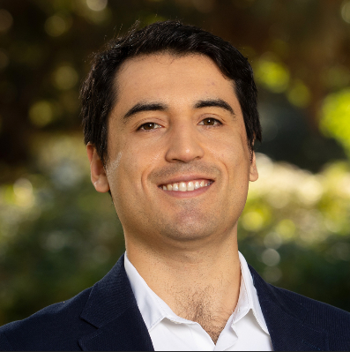
Continuing Recognition of our Employees and Users
2024 APS Fellow:
Jozef J. Dudek
2024 APS Fellow:
Patrizia Rossi
2024 APS Fellow:
S. Alex Bogacz
2024 APS Fellow:
Mark Kevin Jones
Guido Altarelli Award for Experimental Physics:
Holly Szumila-Vance
J.J. & Noriko Sakurai Dissertation Award in Theoretical Particle Physics: Zhite Yu
DOE Early Career Award:
Whitney Armstrong
(JLab User/ANL)
DOE Early Career Award:
Marie Boer
(JLab Bridge Faculty/VA. Tech )
DOE Early Career Award:
Miguel Arratia
(JLab Bridge Faculty/UC Riverside)
DOE Oppenheimer Science and Energy Leadership Program: Doug Higinbotham
DOE Oppenheimer Science and Energy Leadership Program: Mike Spata
DOE Early Career Award
7
Notes:
You might all be aware that the 2024 APS fellows has been just announced: Jozef, Patrizia, Alex, and Mark are the JLab staff that has been selected. I am very proud that the accomplishments and contributions of these four Jefferson Lab staff members to the field of physics are being recognized by their peers with this honor.
Hold until APS announcement Stuart Jay Freedman Award in Experimental Nuclear Physics
Caryn A. Palatchi, Indiana University – JLab user
“For contributions to the measurement of the weak nuclear form factors, including the development of improved systems for controlling polarized electron beams.”
Congratulations to Holly, and Zhite on their prestigious awards in Experimental Physics and Theoretical Particle Physics and the Alexandre being named an American Physical Society Fellow.
I'm pleased to recognize three who won the DOE early career award in 2024. Whitney our JLab User, Miguel and Marie who are our JLab bridge faculty as well as users.
DOE has been interested in developing leadership across the Lab Complex. It's great to see Doug and Mike in the program this year. They still have busy day jobs and have to do a lot of outside work in the program. Welcome to executive leadership!
I know there have been other recognition and awards that are not named here so congratulations to all of you as well.
**The APS announced its 2024 Fellows on Oct. 4. These newly minted fellows join the ranks of an elite cadre of physicists employed in academia, national laboratories and industry worldwide. The APS has more than 50,000 members, and each year, no more than one half of one percent of APS membership may be elected to fellowship status. Click here for the full list of APS Fellows.
Jozef J. Dudek, jointly appointed with William & Mary For contributions to the spectroscopy of hadrons under the strong nuclear force and their impact on experimental programs worldwide.
Patrizia Rossi For leading a scientific program to study the nucleon’s transverse momentum dependent parton distribution functions, including the development of a major particle detection system, and for visionary leadership in promoting the science of an energy-upgraded CEBAF accelerator at 22 GeV beam energy.
S. Alex Bogacz For the development of a broadly adopted novel coupling formalism for accelerators, its application to innovative recirculating linac designs, and leadership in high-energy recirculating linac design for ERLs, muon colliders, and CEBAF upgrades.
Mark Kevin Jones For scientific leadership in experimental studies of the fundamental nucleon electromagnetic form factors, including the surprising discovery of significant variation in the large momentum behavior of the proton electric form factor, and for developing new detection systems enabling the studies
*The Guido Altarelli Award honours the memory of the late Guido Altarelli, one of the founding fathers of QCD, an outstanding communicator of particle physics, and a mentor and strong supporter of Junior Scientists. The Guido Altarelli Award consists of a certificate and prize money. It is awarded to Junior Scientists for outstanding scientific contributions to the fields covered by the DIS Conference series.
*J.J and Noriko Skurai Dissertation award recognizes exceptional early-career scientists who have performed original doctoral thesis work of outstanding scientific quality and achievement in the area of theoretical particle physics.

Slide 8
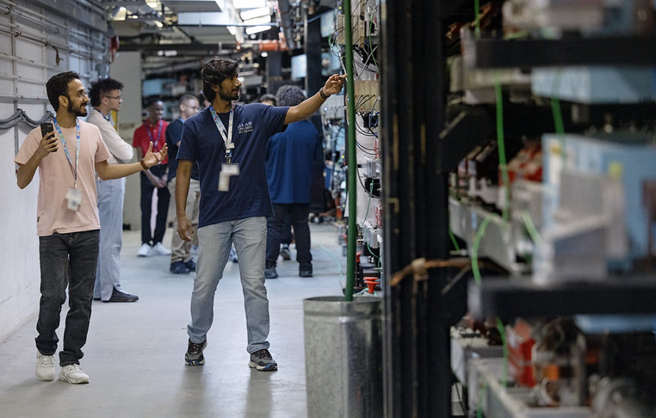
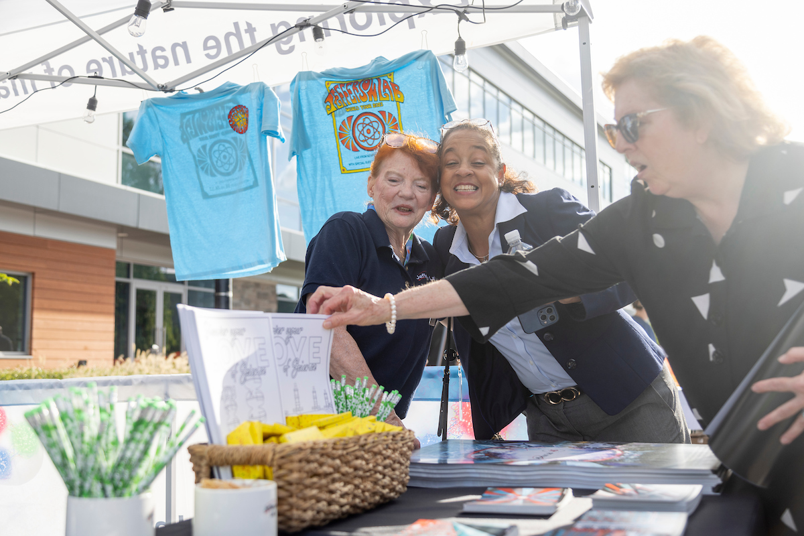
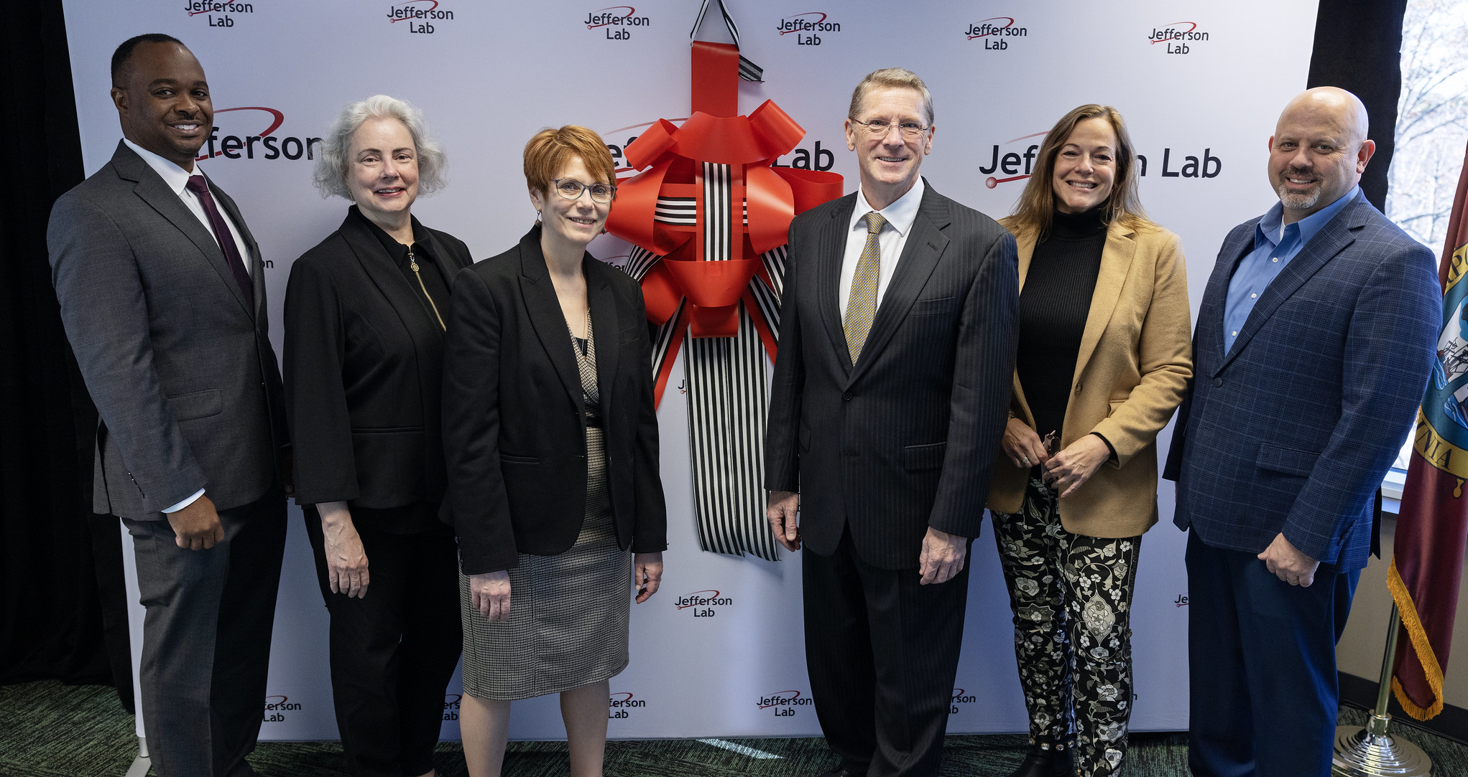
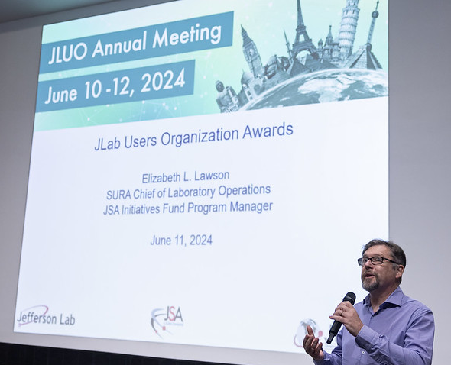
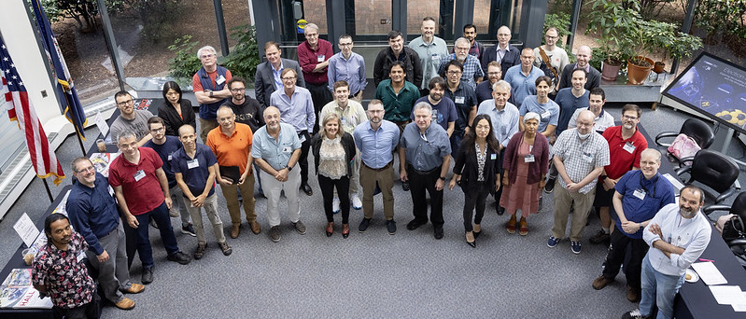
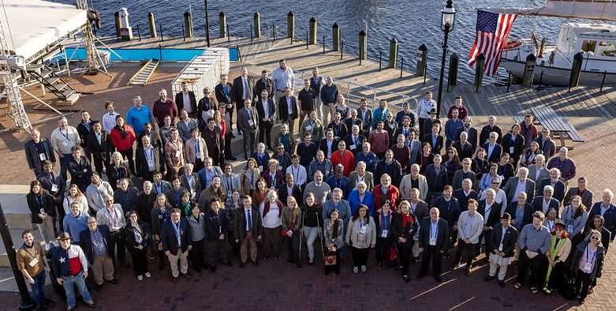
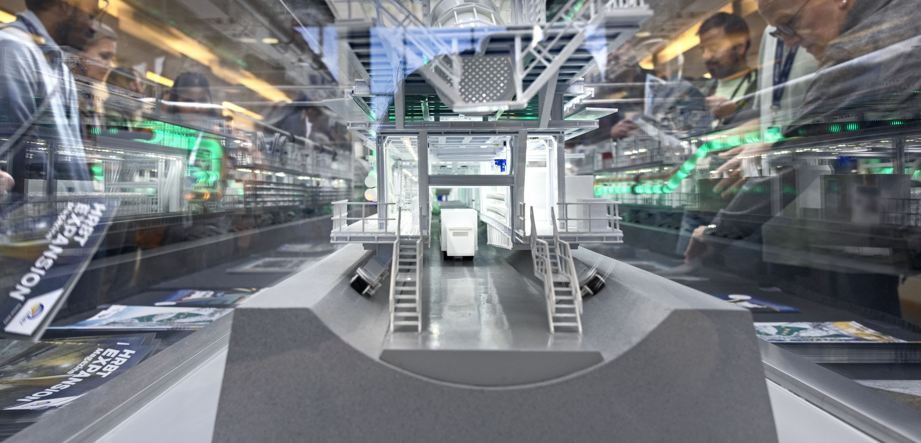
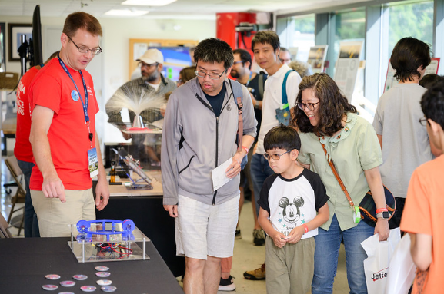
HUGS, June 2024
Tech Center Community Event, Sept. 2024
ARC Community Event, Nov. 2023
User Group Meeting, June 2024
AccelApp, Mar. 2024
HRBT Expansion Special Event, Feb. 2024
Sustainable Software Infrastructure for Advanced Nuclear Physics Computing (SANPC) Workshop, June 2024
2x
2x
Jefferson Lab hosted the number of conference and event visitors in 2024, compared to 2023.
Open House, June. 2024
Polarized Sources, Targets, and Polarimetry (PSTP) , Sept. 2024
8
Notes:
We continue to host the Hampton University Graduate Studies (HUGS) program. We had the Applied Research Center (ARC) ribbon tying event last November which means we have more office spaces for you all to do the research her.
We hosted numerous conferences and workshops at the lab, twice as many as the number from last year.
Our engagement with the universities, community, user group, DOE and scientific communities is noteworthy. Let's keep that going!

Slide 9
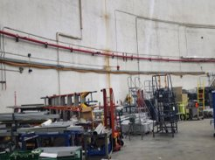
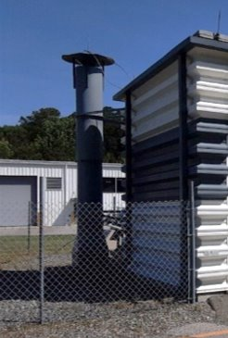
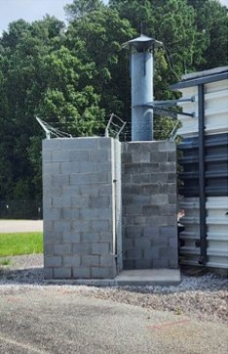
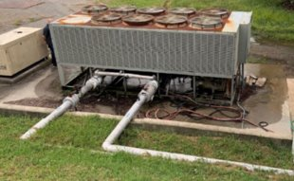
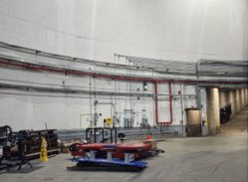
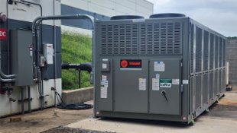
Safety – Back to Basics
Improve Work Planning and Control
Workspaces are kept free of hazards and excellence in housekeeping
Prioritize and execute addressing issues (on-going)
Checklists for walkthroughs and labs based on top issues
Lab wide opportunities for improvement
Hall A
Before
LERF Chiller
Before
Hall A
After
Building 21 Vent Shielding
Before
Building 21 Vent Shielding
After
LERF Chiller
After
9
Notes:
FY25 will focus on high quality planning and execution.
We want to ensure your safety through systems, controls and training.
The Best way to assure continued scientific results is to operate safely.
Here are a few pictures of the material condition improvement throughout the lab: Here you can see the before and after pictures of Hall A, building 21 vent shielding and the LERF Chiller.

Slide 10
Update on Future Transition
10
Notes:
The purpose of this contract competition is to solicit and award a new M&O contract that will result in improved contractor performance and cost efficiencies at the lab.
DOE expects that this competition will elicit new and innovative approaches for planning the Laboratory’s future.
The successful offeror will be expected to assume full responsibility for Laboratory operation on June 1, 2025.​
​

Slide 11
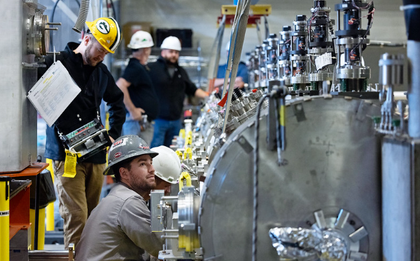
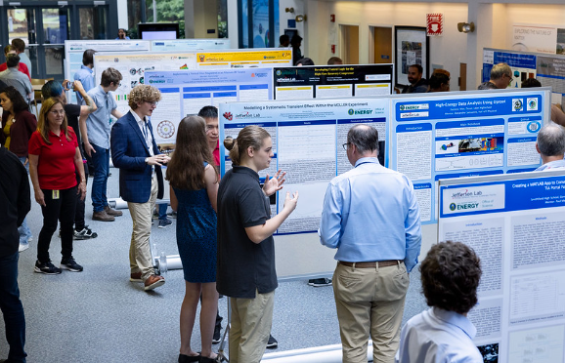
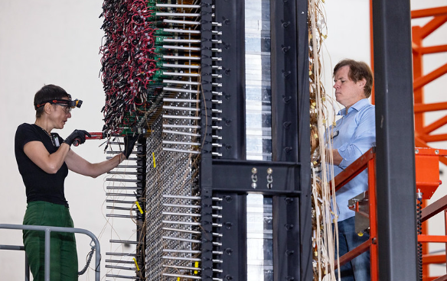
Thank you for your …
Continued enthusiasm
Engagement with Jefferson Lab and its programs
Partnership in delivering our present and ensuring our future
11

Slide 12
Questions?

Slide 13
Thank you!

