Slide 1
Safety and Operations
Presented to the Oppenheimer Science and Energy Leadership (OSELP) Program
Johnathon Huff, Ph.D.
Deputy Laboratory Director for Operations and Chief Operating Officer
October 15, 2024

Slide 2
Jefferson Lab Operational Excellence 2025
Leadership Development
& Engagement
Build Workforce/
Facilities Of The Future
Continuously Improve
Our Culture
Develop Missions
Of The Future
Digital Transformation
• Individual Career Profile
• Directors Safety Council Improvements
• Supervisor Fundamentals Program
• Management Safety Discussions
• Wellness Programs
• Job Structure and Compensation
• Hybrid Work Evolution
• CEBAF Renovation and Expansion
• Work Planning and Control Process and Tool Improvements
• Safety Culture Improvements: leadership accountability/ engagement, competency evaluations
• Inclusion Survey #2 Corrective Actions
• Carbon Pollution Free Electricity
• Jefferson Lab Data Center / High Performance Data Facility
• High Bay Space to support science mission
• DOE Integrated Contractor Project
• Human Capital Management Enterprise Software
• IT Governance Process
• Integration of AI into business operations
Operations Integration to support S&T Vision
2

Slide 3
Opportunities as we grow
​
Preparing our leaders
Preparing our leaders to lead in a hybrid R&D environment and accomplish the mission safely
Daily engagement with our workforce to drive safety culture
Effectively engaging a hybrid workforce to build relationships and understand where help is needed
Keeping a pulse on the culture in the face of rapid change
Learning about how our workforce prefers engagement allows us to develop the most effective approaches to engaging on safety topics
Actions: Use this information to drive how we engage when safety related events occur – clearly articulate the ‘Why’ and communicate often
Action: Management Safety Discussions
Actions: Supervisor training and reinvigorating human performance improvement program

Slide 4
Keeping a Pulse on the Culture
Completed our second inclusion survey in the last 3 years and integrated safety in our leadership actions
Recognition and Rewards
Bolster and Reintroduce Employee Recognition and Rewards Program (includes safety leadership award)
Communication & Voice
Hold regular All Hands meetings (lab wide safety topics and lessons learned discussed)
Growth/Career Development
Pilot "Just a Cup" mentoring program
JLab Supervisor Academy
The results of the survey indicated that transparency in decision making and engagement with leadership were valued – this is how we engage on safety topics with our workforce

Slide 5
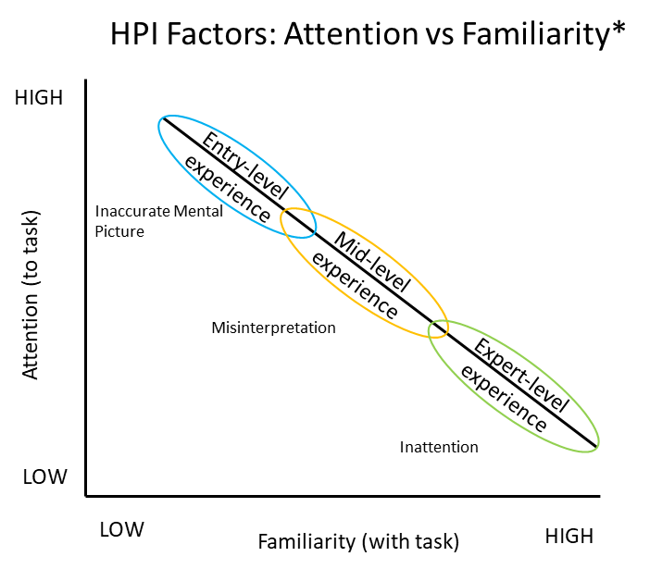
Keeping a Pulse on the Culture: Fostering a Learning Culture
Learning from our events
Near misses
New and experienced employees
Safety pause/restart
All High Hazard Work
Lockout/Tagout
In FY23, Weekly forum with lab leadership
7 forums to date: ~100 participants each session
Learning from others
Lab Director forums
HPI Factors: Familiarity vs Attention*
We have many new employees, users, and leaders in new roles; being able to review work in detail and hear directly from leadership has proven to be impactful
*Adapted from DOE-HDBK-1028-2009, Human Performance Improvement Handbook, Volume 1: Concepts and Principles

Slide 6
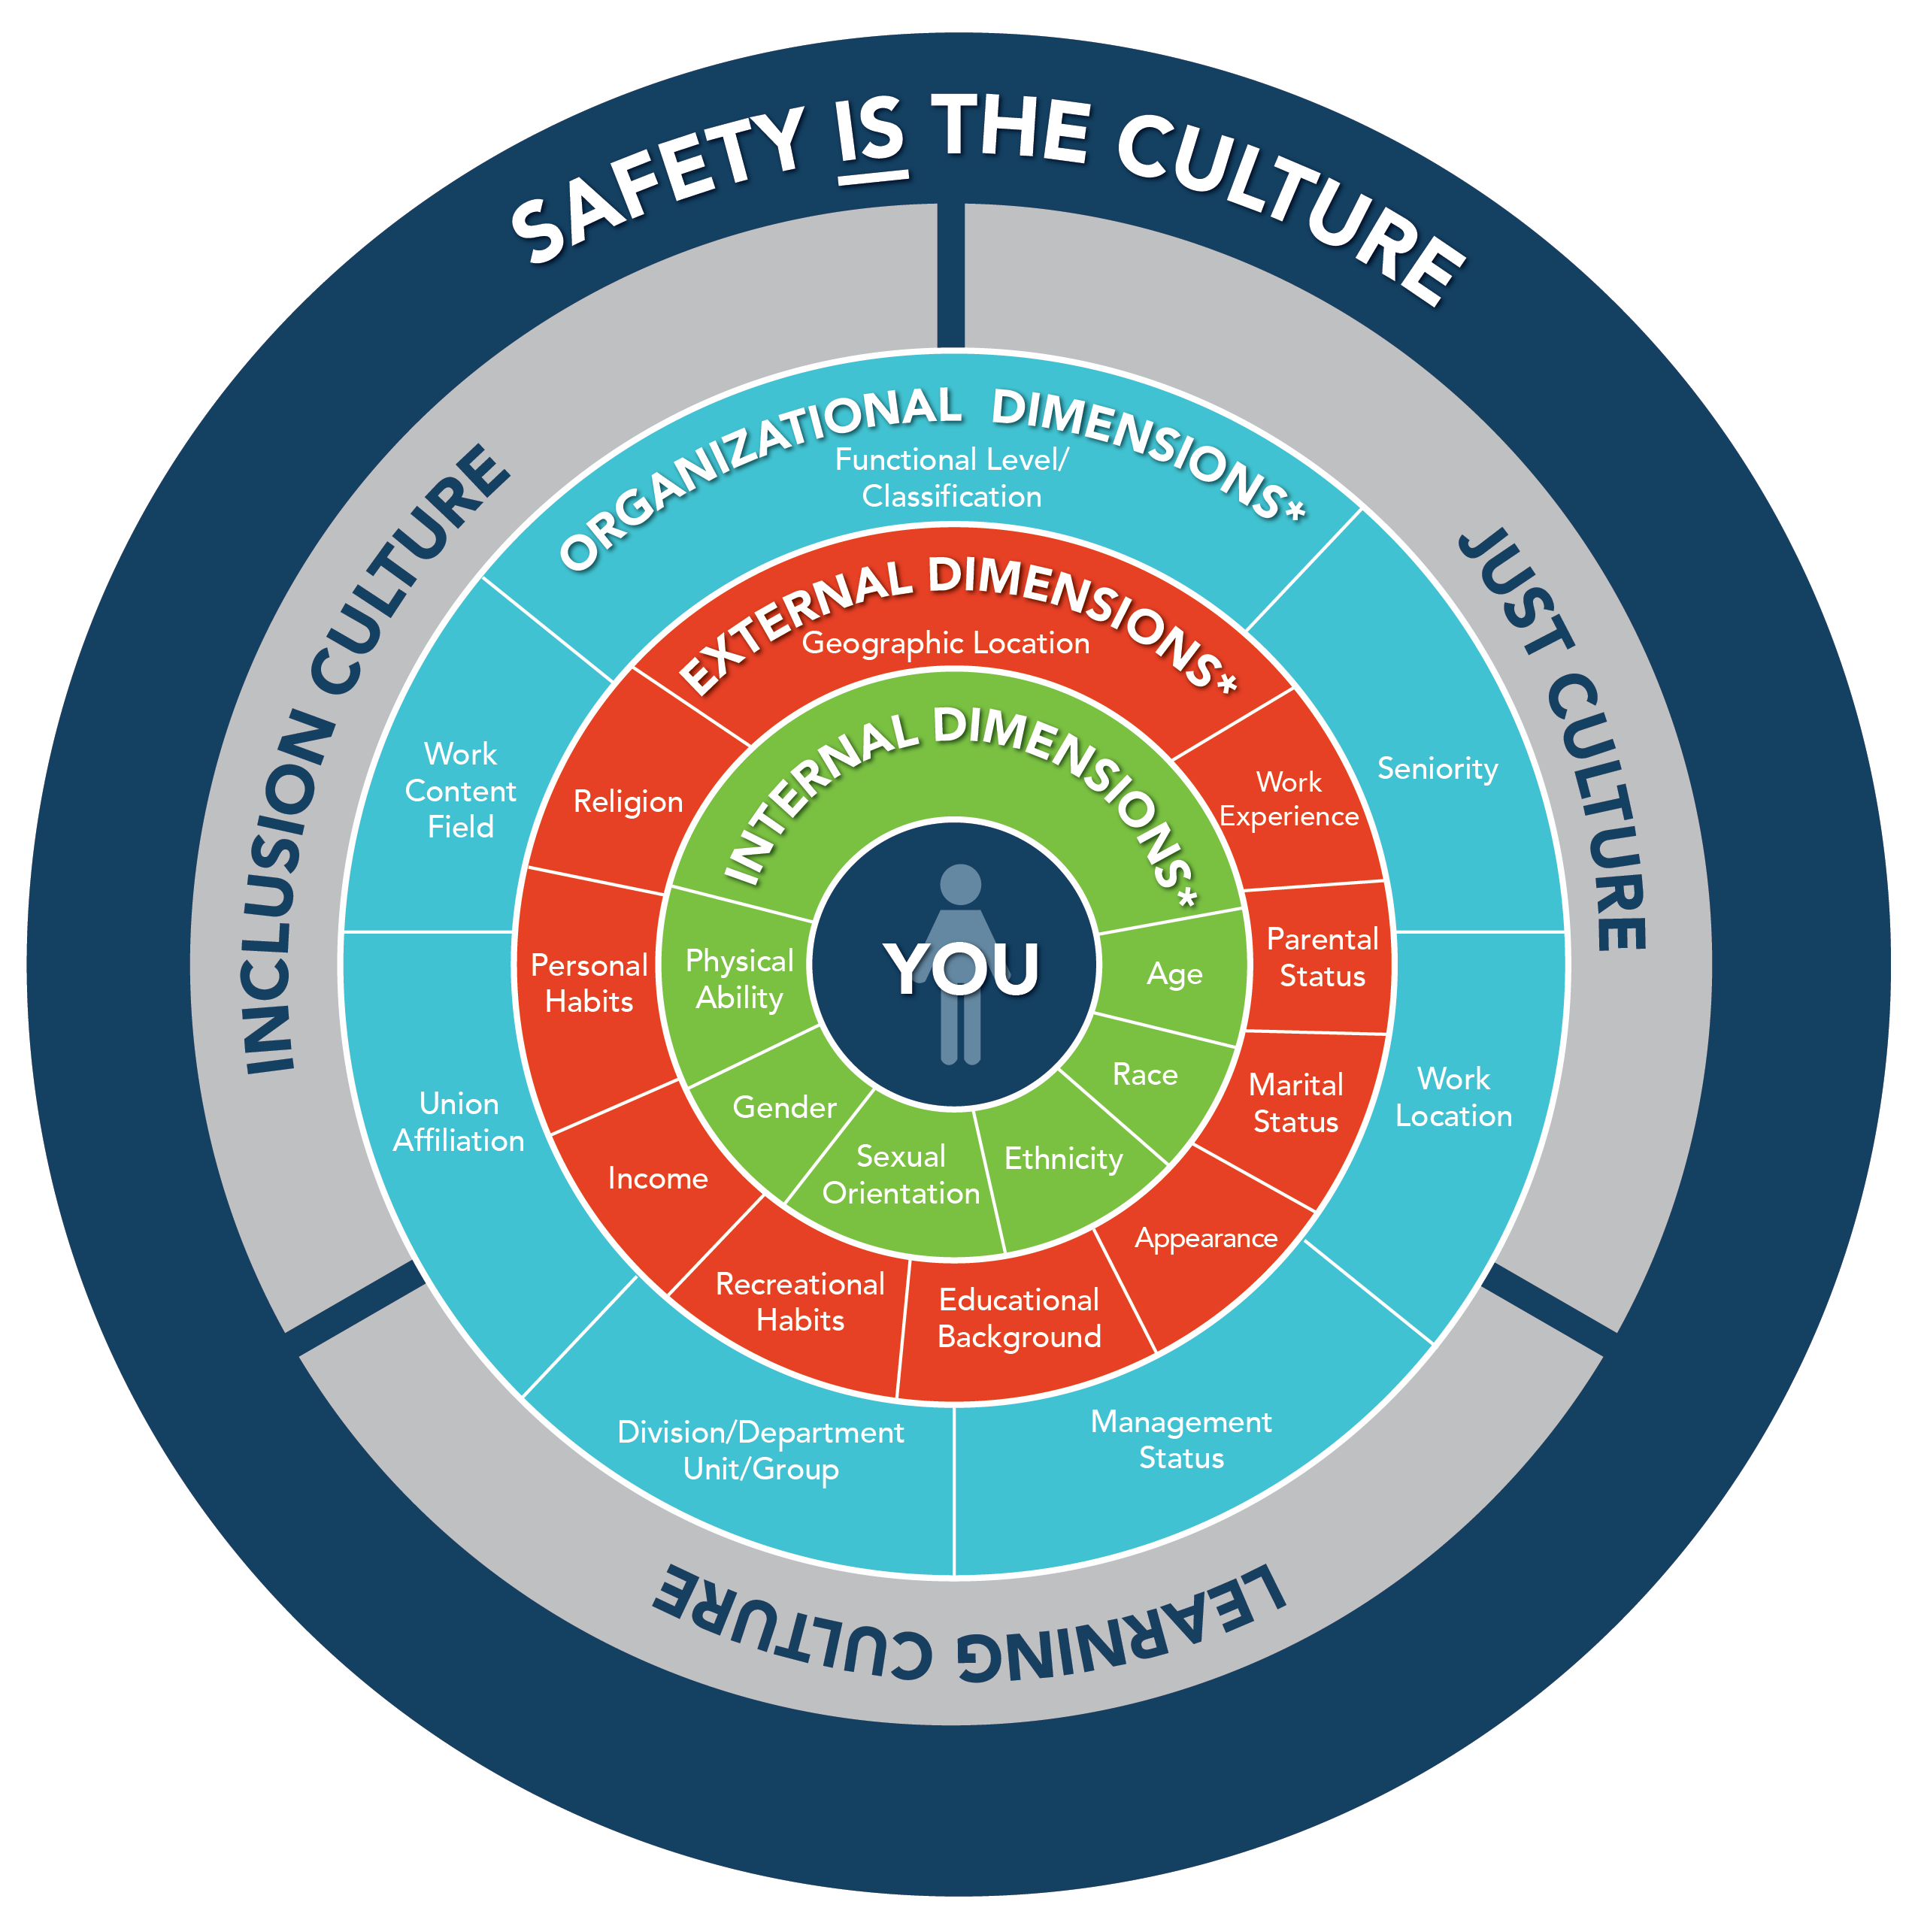
Keeping a pulse on the culture: Safety Culture
Reinvigorating Human Performance Improvement (HPI) program:
Safety events are evaluated from an HPI perspective considering error precursors: time pressure, high workload, lack of knowledge
We recognize organizational weaknesses contribute to a large portion of safety events
Continuing our training for all staff on HPI in FY24
Critical for new employees and supervisors/staff in new positions
* Chart adapted from Dimensions of Diversity: The Diversity Wheel
by Marilyn Loden and Judy Rosener, 1990

Slide 7
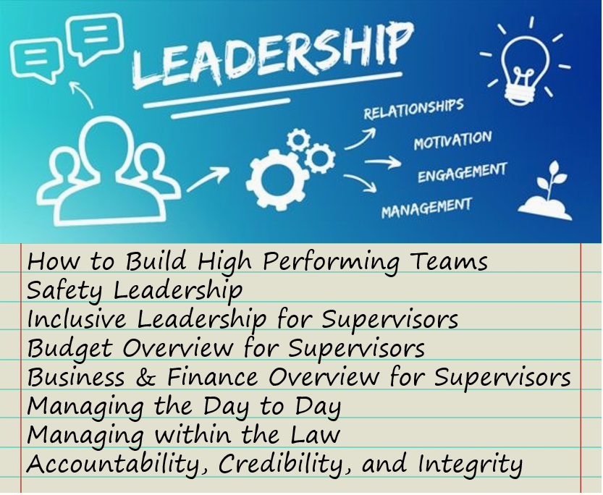
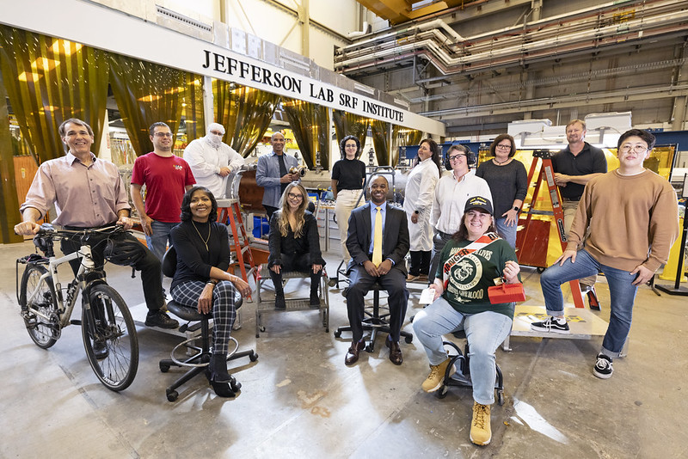
Preparing our leaders
JLab Supervisor Academy prepares new and experienced leaders with the skills to lead diverse, high performing teams to accomplish the mission safely (pilot completed July 2023)
Facilitated course: “Leading a Hybrid Team at Jefferson Lab”​
What’s different in the new normal: picking cohorts with supervisors that have teams with various types of remote work agreements

Slide 8
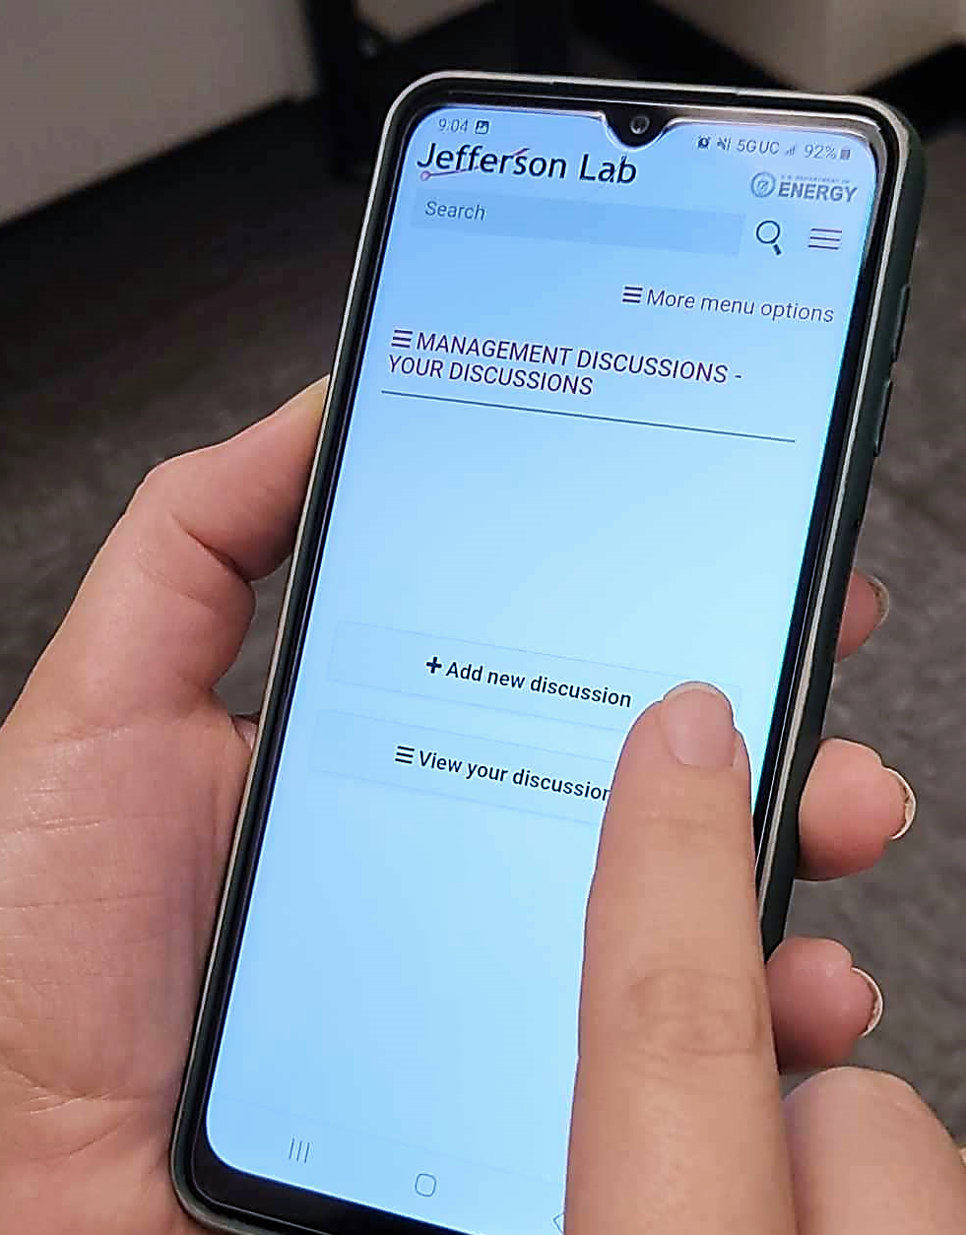
Management Safety Discussions
Reinforces leadership commitment to connecting with employees and understand the resources needed to help do work safely.
If running 24/7 operations, leaders visiting teams on off-regular hours shifts is impactful.
Check-ins with our Worker Safety Committee on effectiveness.
What’s different in the new normal: focus on both virtual and in-person walkthroughs.
Management Safety Discussions

Slide 9
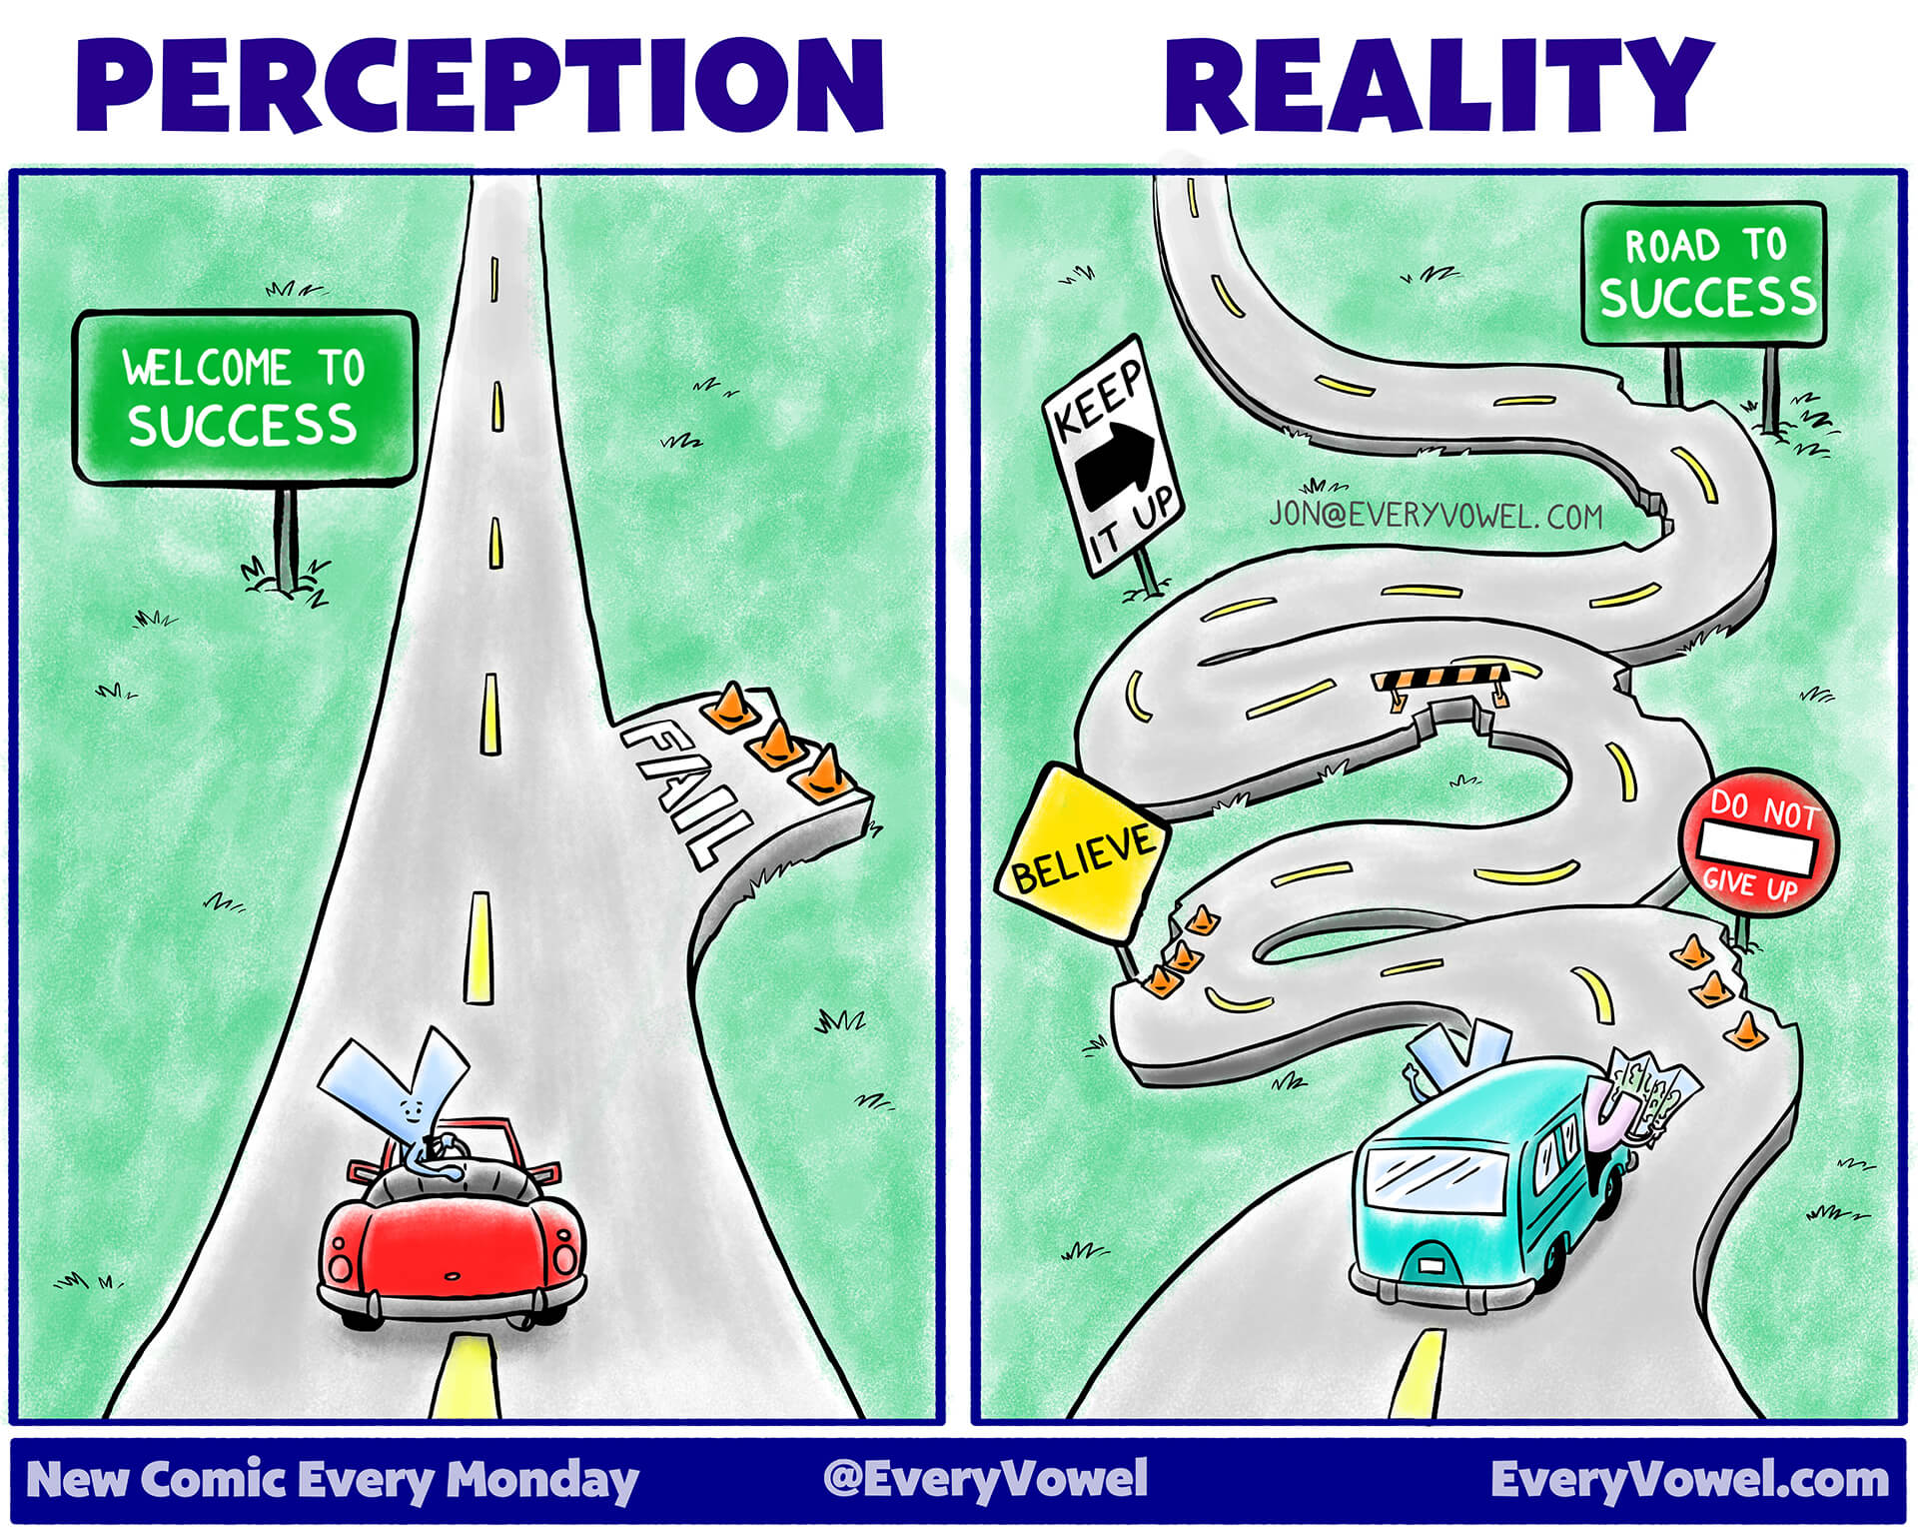
Transition and Change
Considerations
Mature our alignment of goals throughout the organization
Increased Integration
Focus on Quality of deliverables
Tremendous opportunity to learn from the talented staff we are hiring ("free consulting")
Develop business processes across the whole organization
What could it feel like?
Everything is different, uncomfortable
I am the only one with this issue
I am being asked more questions about what I am doing - am I trusted to do my job?
This is moving really fast
Let's have fun getting there together!
9
Notes:
Increased Integration - we will need to work together in an integrated way to accomplish our goals – a great example of cross org efforts is the integrated contractor project, HPDF, Green Buy Awards.
Focus on Quality of deliverables - we have had at least one quality miss in every organization this year. The question is how we evaluate those to get better. I know all of you have ideas of how to make your workspaces better, lets engage on those ideas to understand which ones will work.
We have approved many new positions and have the appropriate funding; if you are missing something you need, let your supervisor know or I would love to know.
Example: Tech editing of deliverables before they go to the site office or other external entities.
Mature our alignment of expectations throughout the organization
Performance Expectations are aligned so we can all understand the priorities.
Need methodology for ensuring the right issues are escalated for awareness.
Tremendous opportunity to learn from the talented staff we are hiring
We have a tremendous opportunity with all the new hires we are bringing on board to take advantage of their knowledge and experience as we grow.
Eliminate “It has been working for 30 years” or other forms of “We have always done it that way”
Develop business processes across the whole organization – lots of knowledge in our heads vs on paper, which causes efficiency and effectiveness issues.

