Slide 1
The Jefferson Lab
Biomedical Research and Innovation Center
Drew Weisenberger, Co-Director: Biomedical Research and Innovation Center Group Leader: Radiation Detector and Imaging Group
October 14-15, 2024

Slide 2
Biomedical Research and Innovation Center
The JLab Biomedical Research and Innovation Center (BRIC) is established:
to be a central hub to highlight to both internal and external stakeholders the health, biological and medical related applications of Jefferson Lab’s technical expertise and
to provide a supportive, collaborative environment in which existing and future biomedical efforts can thrive and expand.

Slide 3
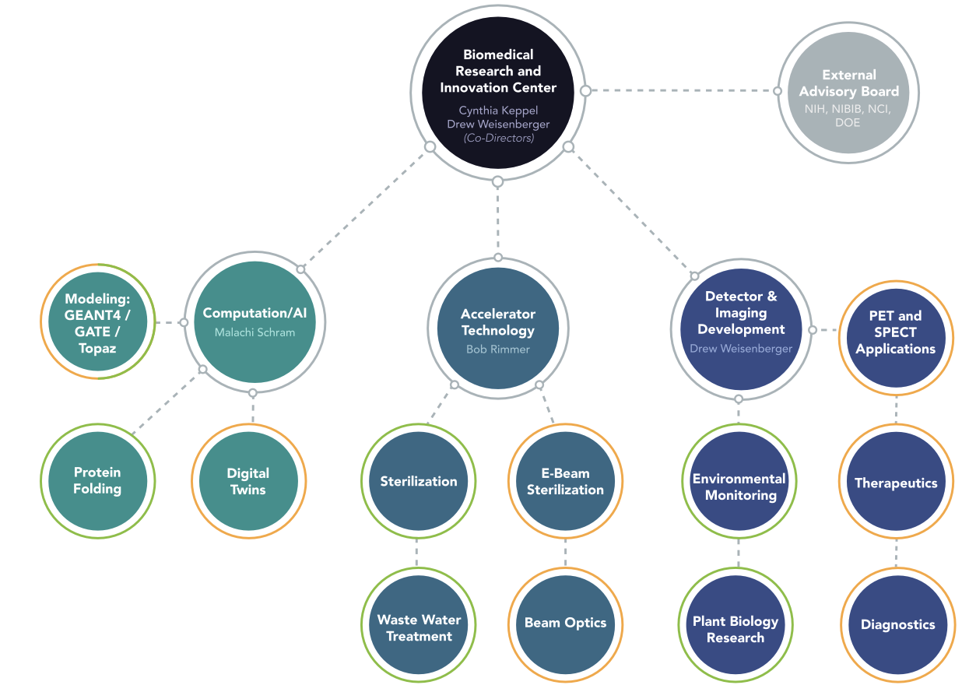
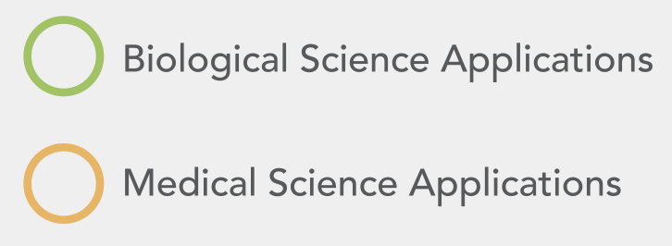
Biomedical Research and Innovation Center

Slide 4
Biomedical Research and Innovation Center
BRIC Affiliated Jefferson Lab Technical Organizations
Center for Advanced Studies of Accelerators (Accelerator Division)
Data Science Department (Computational Sciences and Technology Division)
Radiation Detector and Imaging Group (Experimental Nuclear Physics Division)
Radiation Control Group (Environmental Health and Safety)

Slide 5
Biomedical Research and Innovation Center
Background
JLab Radiation Detector and Imaging Group
Hampton University Center for Advance Medical Instrumentation
JLab Center for Advanced Studies of Accelerators

Slide 6
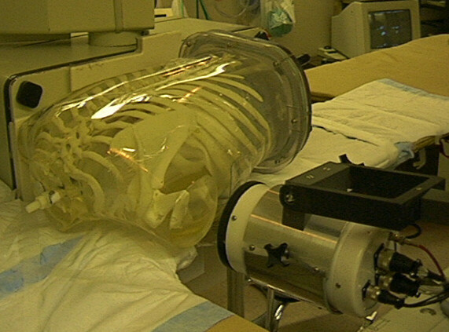
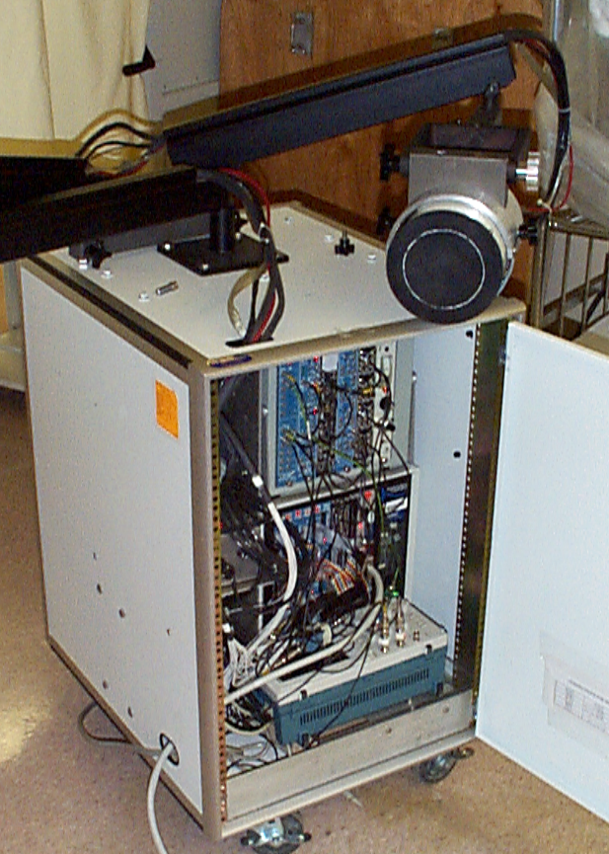
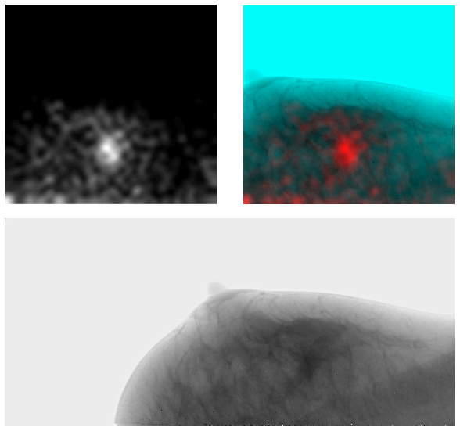
Biomedical Research and Innovation Center
Radiation Detector and Imaging Group
Experimental Nuclear Physics Division technical support group
1995 teams with University of Virginia Medical School in applications in nuclear medicine imaging that use radiopharmaceuticals
Collaborates with Hampton University Center for Advance Medical Instrumentation
Awarded several patents
Establish CRADAs with a commercial partner: Dilon Technologies Inc
Early clinical trials with JLab detector for breast cancer detection at the University of Virginia.

Slide 7
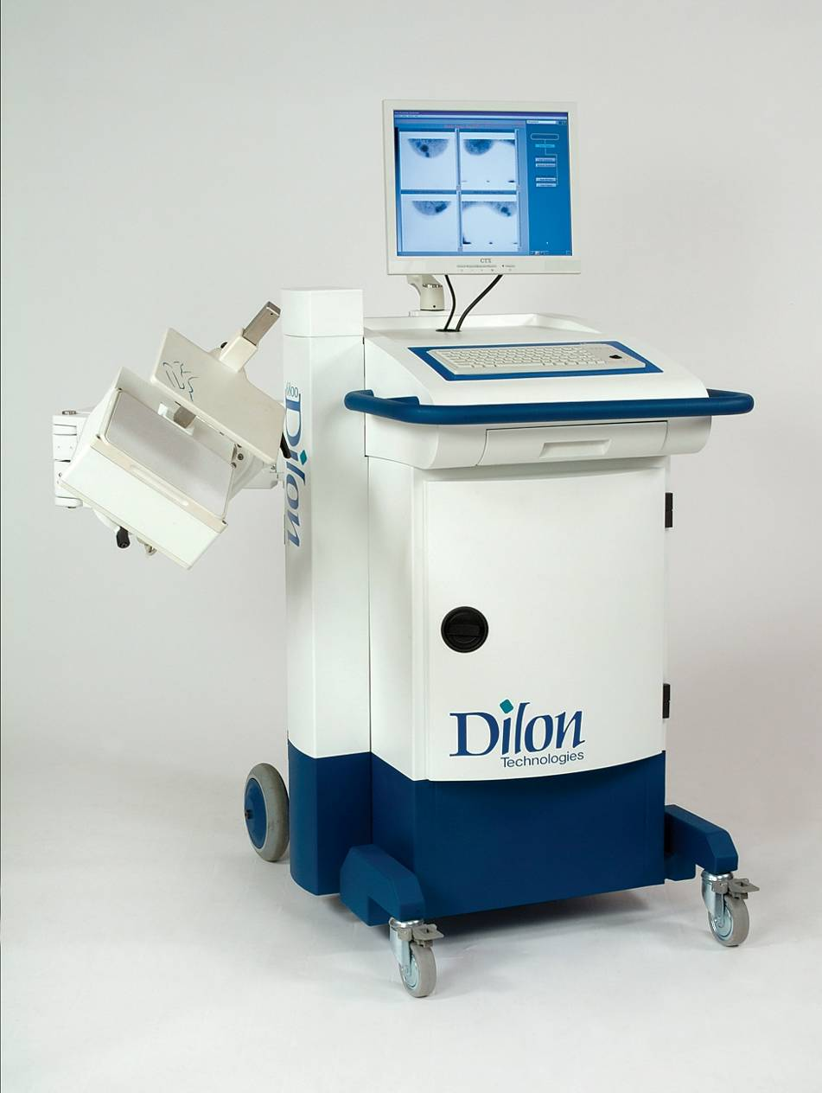
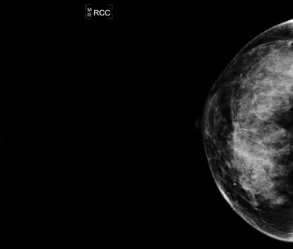
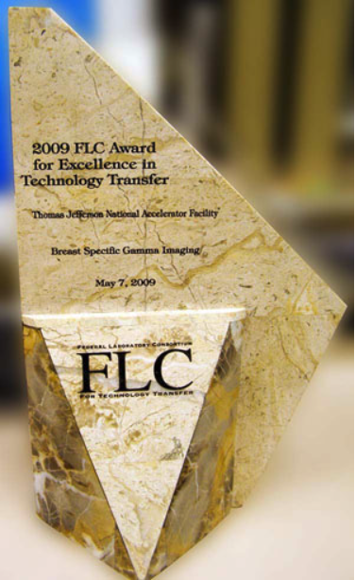
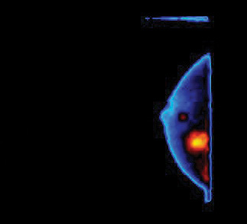
Biomedical Research and Innovation Center
Radiation Detector and Imaging Group
Radiation Detector and Imaging Group recognized with an award for “excellence in technology transfer” by the Federal Laboratory Consortium for Technology Transfer.
Dilon 6800 Gamma Camera
Several patents licensed from JLab

Slide 8
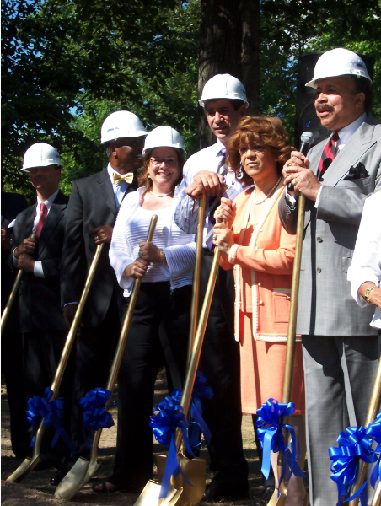
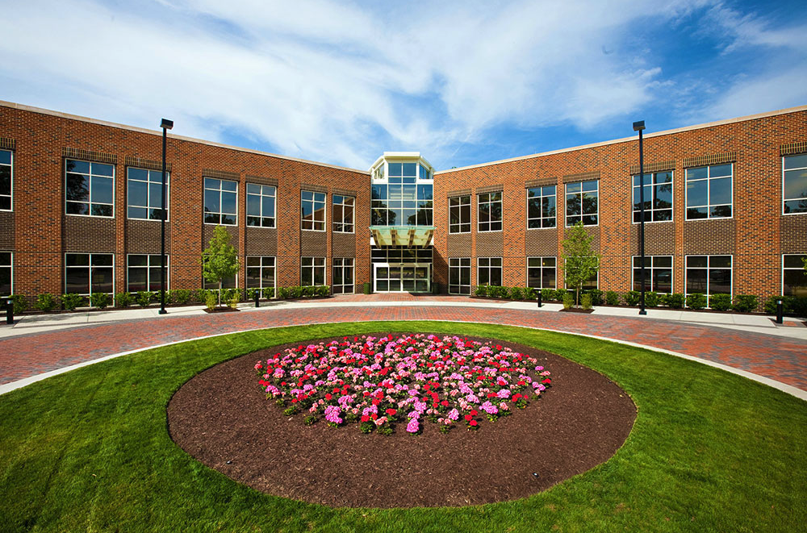
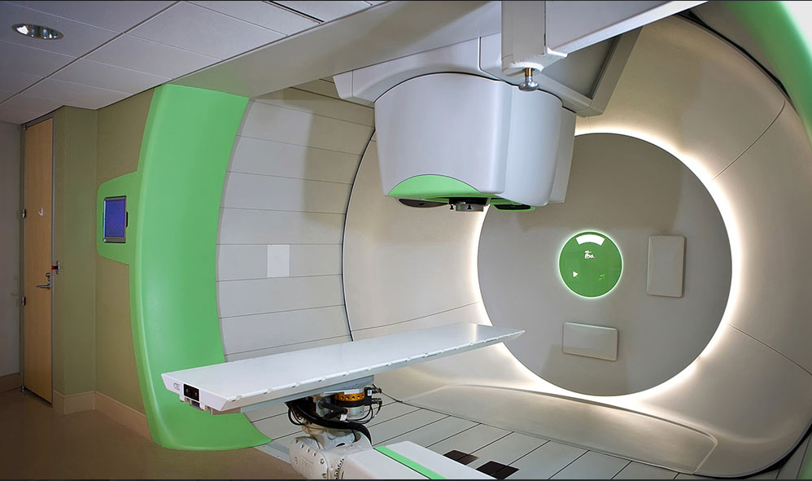
Biomedical Research and Innovation Center
Hampton University Center for Advance Medical Instrumentation
Dr. Cynthia Keppel -joint JLab physicist /Hampton University faculty
Hampton University Proton Therapy Institute (HUPTI)
Dr. Keppel - scientific and technical director
Broke ground 2007

Slide 9
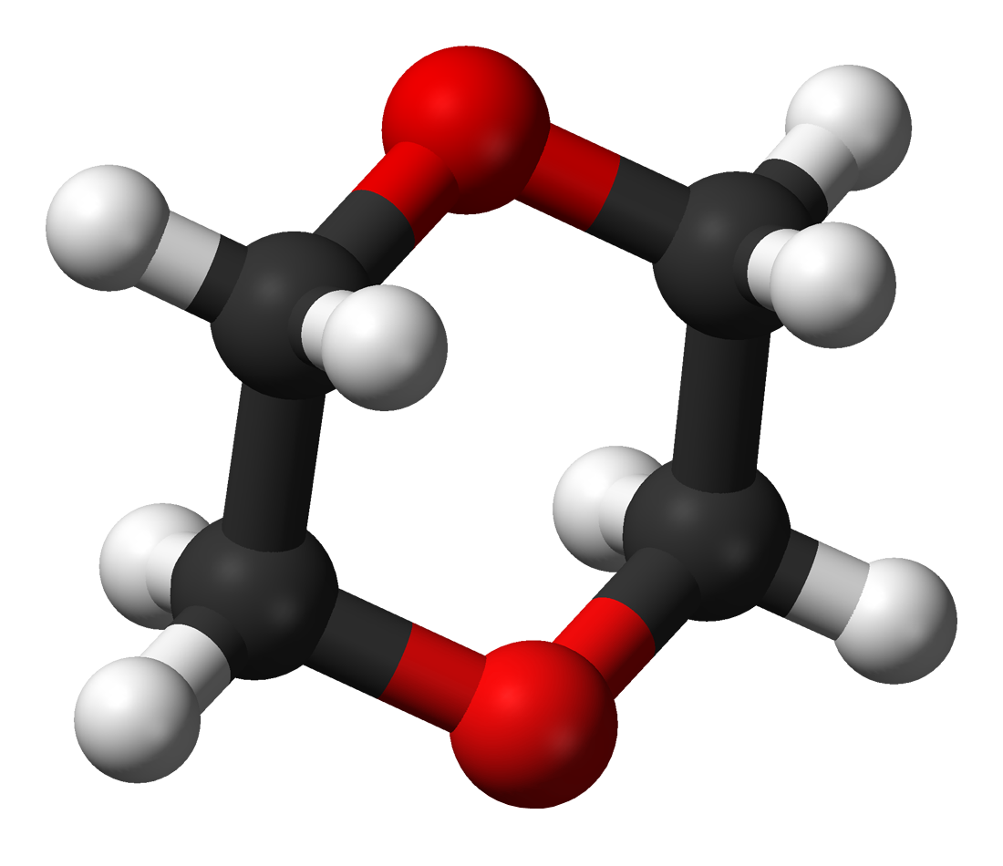
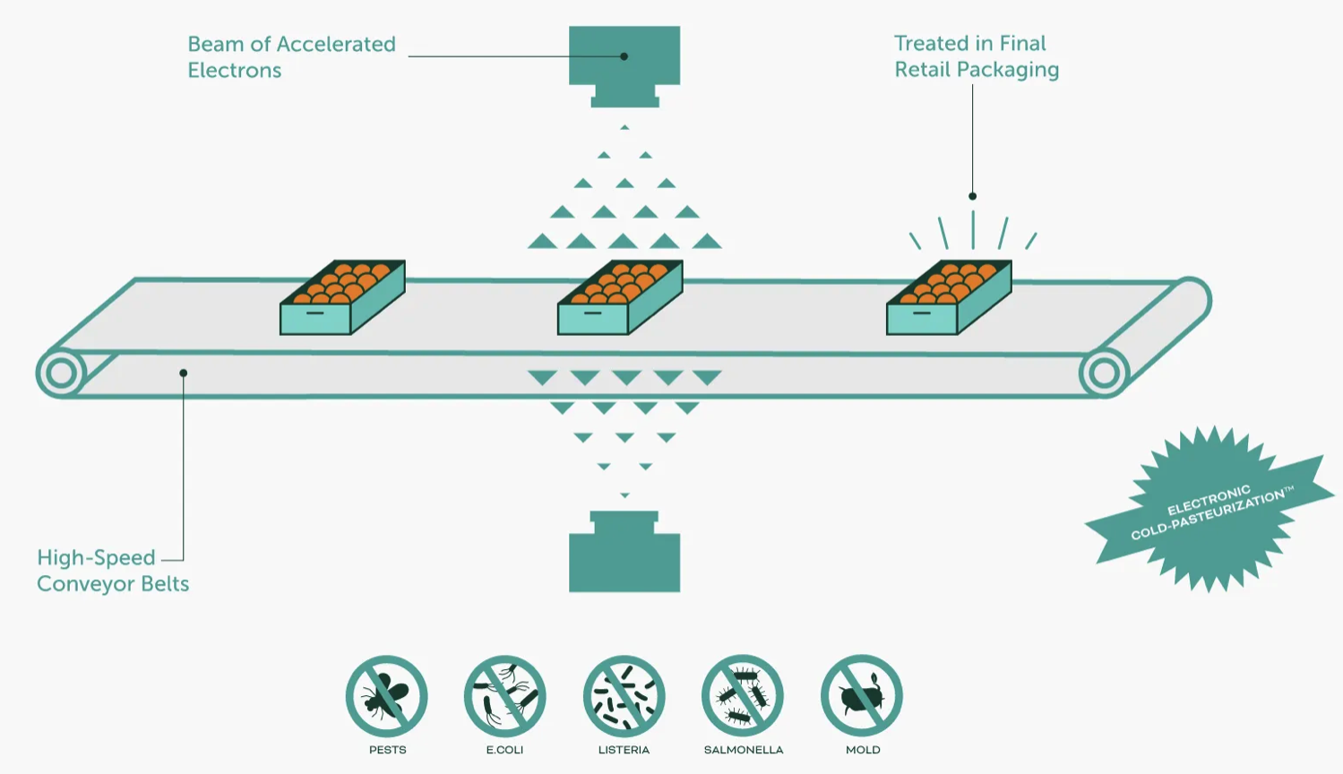
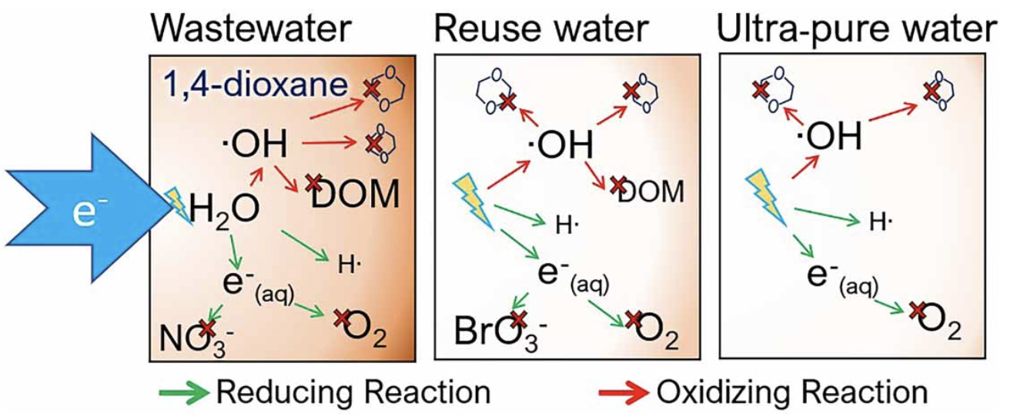
Biomedical Research and Innovation Center
Center for Advanced Studies of Accelerators
E-beam accelerator technology for food sterilization
Collaboration with Reveam (formerly ScanTech Sciences)
Water treatment research with Hampton Roads Sanitation District

Slide 10
Biomedical Research and Innovation Center
Cynthia Keppel received $1 million for research as a newly appointed U.S. Department of Energy Office of Science Distinguished Scientist Fellow

Slide 11
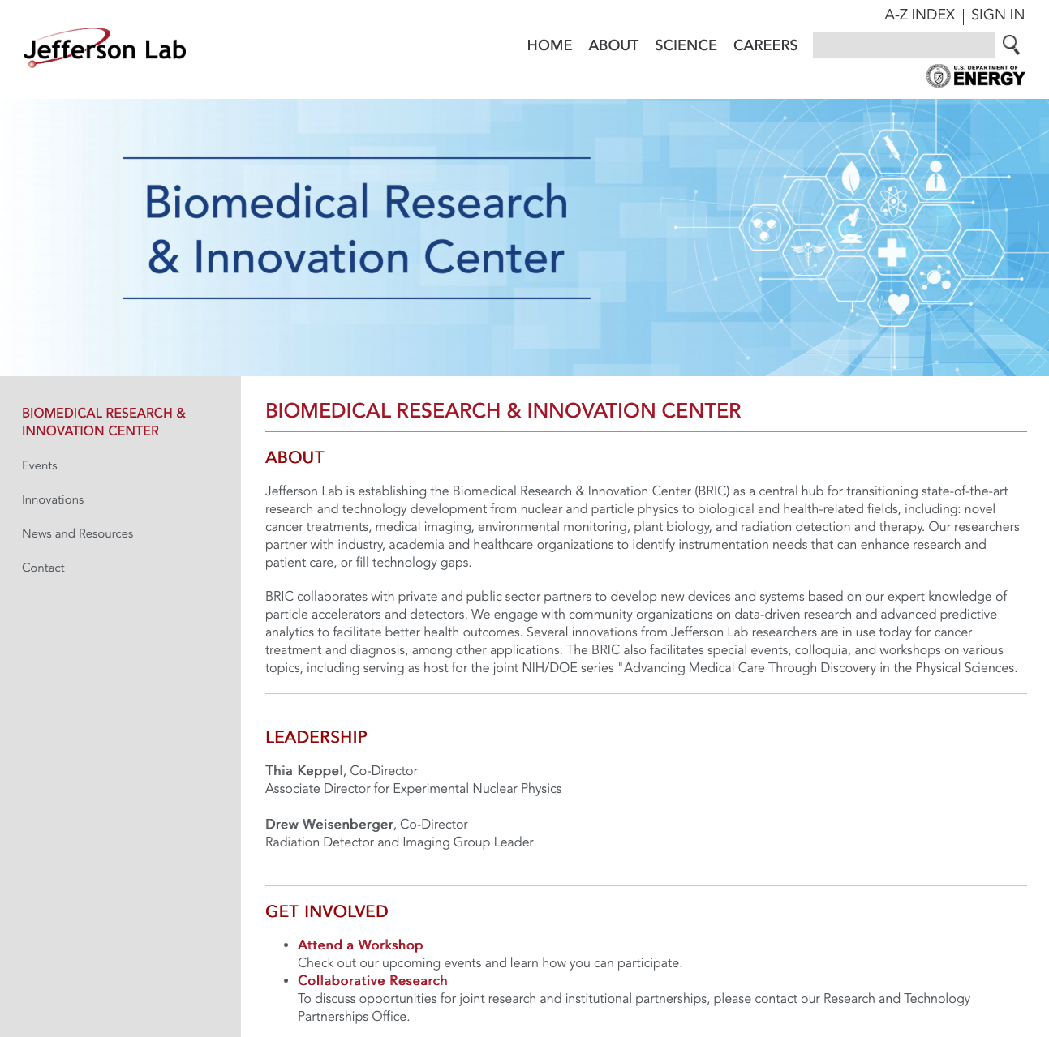
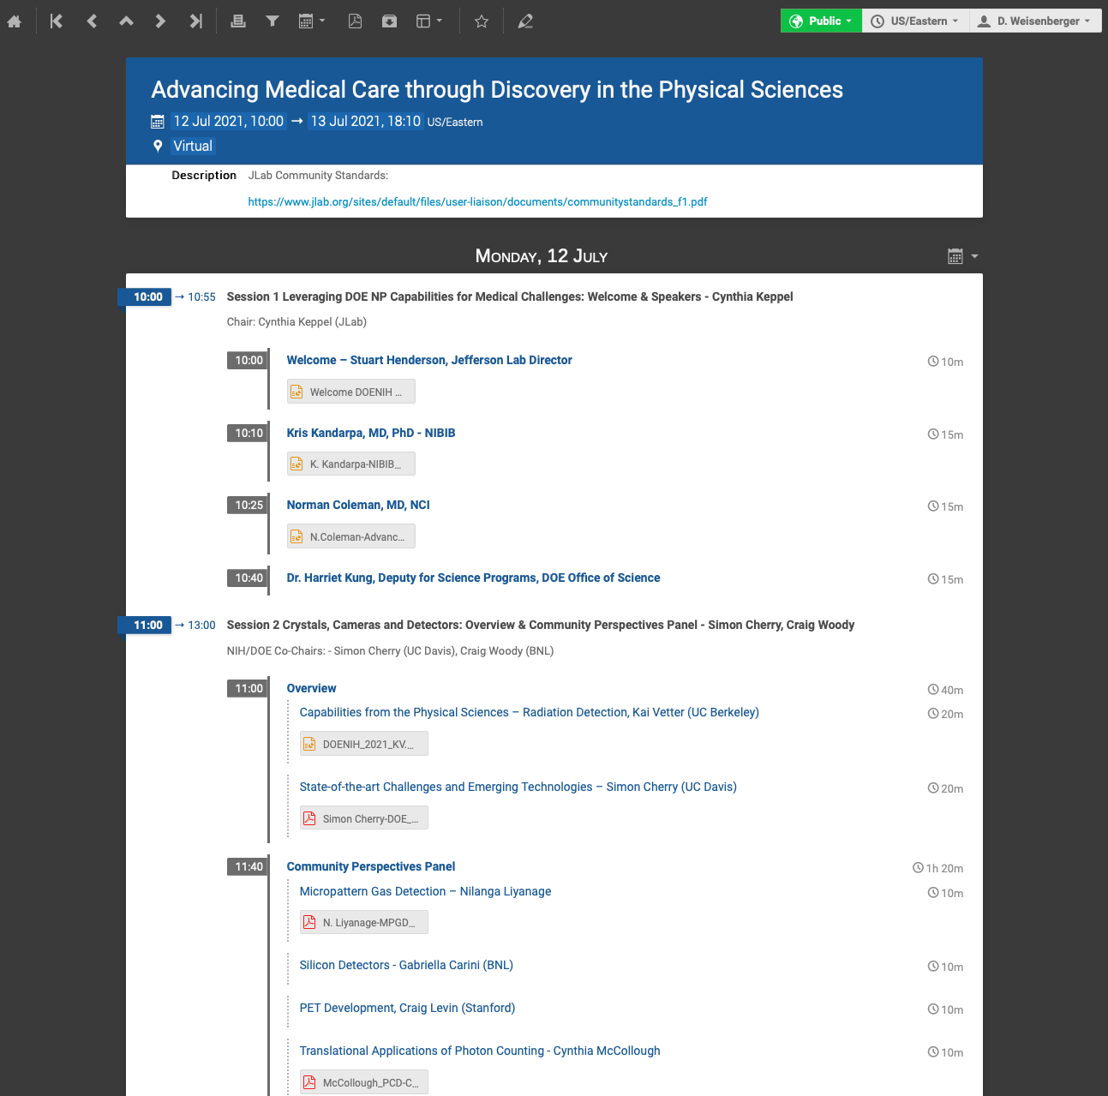
Opportunities
Website
Conferences/Workshops

Slide 12
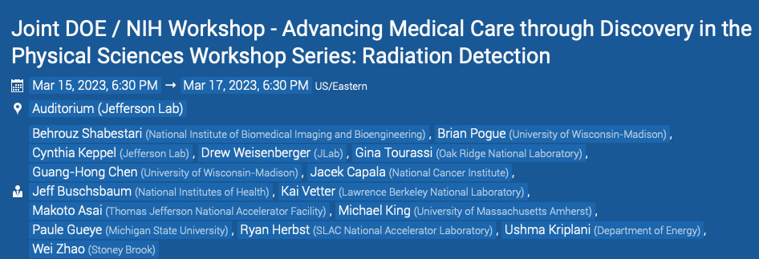
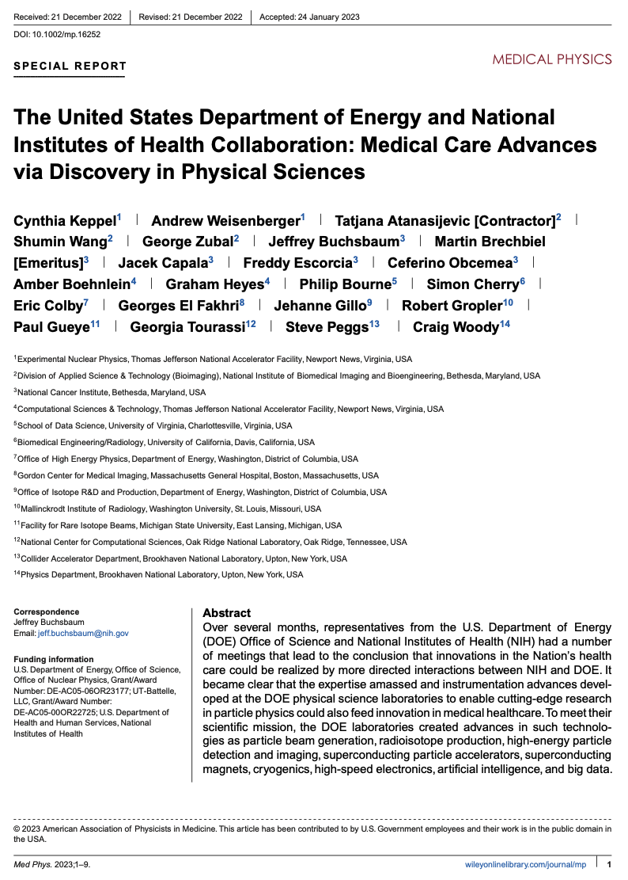
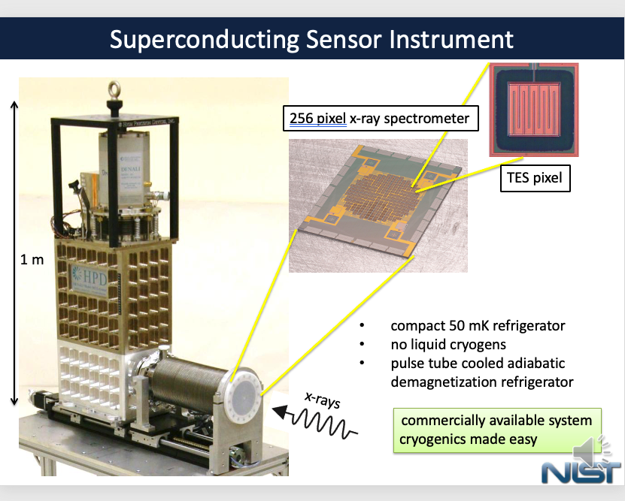
NIH – DOE Workshop Series
July 12-13, 2021 Virtual Workshop Report
Crystals, Cameras and Detectors
Advanced Magnetics
Radiopharmaceuticals for Diagnosis and Therapy
Electronics, Data Processing & Image Reconstruction
Radiotherapy Instrumentation
Data Science
March 16-17, 2023 Workshop at Jefferson Lab
Focus is on Radiation Detectors

Slide 13
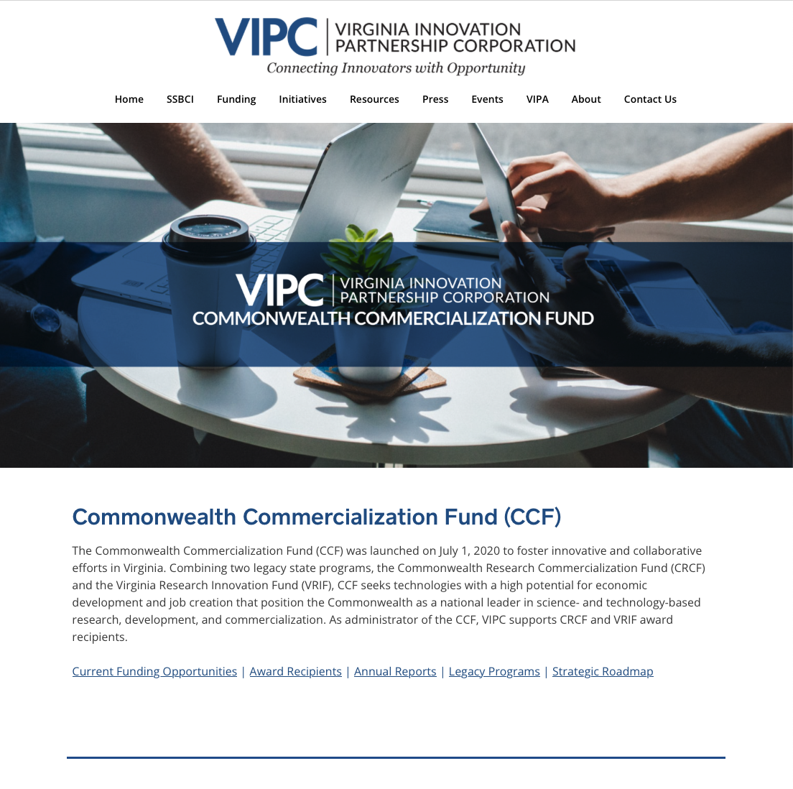
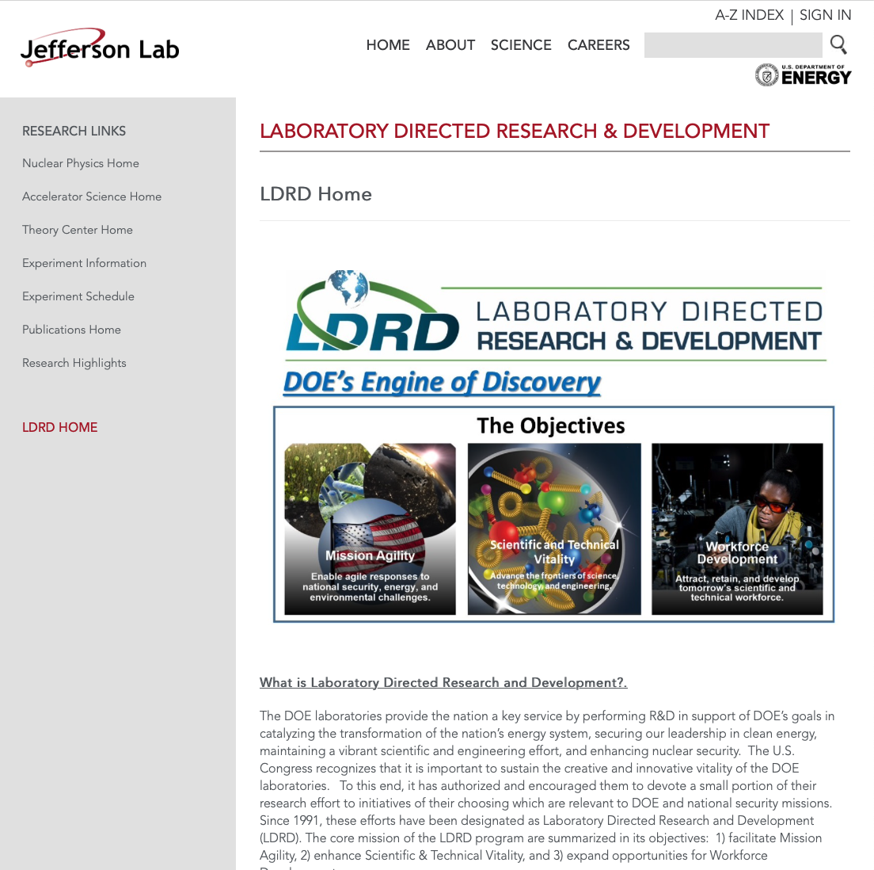
Opportunities
Industry Partners
Funding Sources

Slide 14
Biomedical Research and Innovation Center
External Collaborations Essential
Industry
Hampton Roads Sanitation District
Smart Breast LLC
Integrated Sensors LLC
DOE Facilities
FermiLab
Oak Ridge National Laboratory
Savannah River Site
Academia
NIH

Slide 15
Biomedical Research and Innovation Center

Slide 16
Biomedical Research and Innovation Center

Slide 17
Questions?

