Slide 1
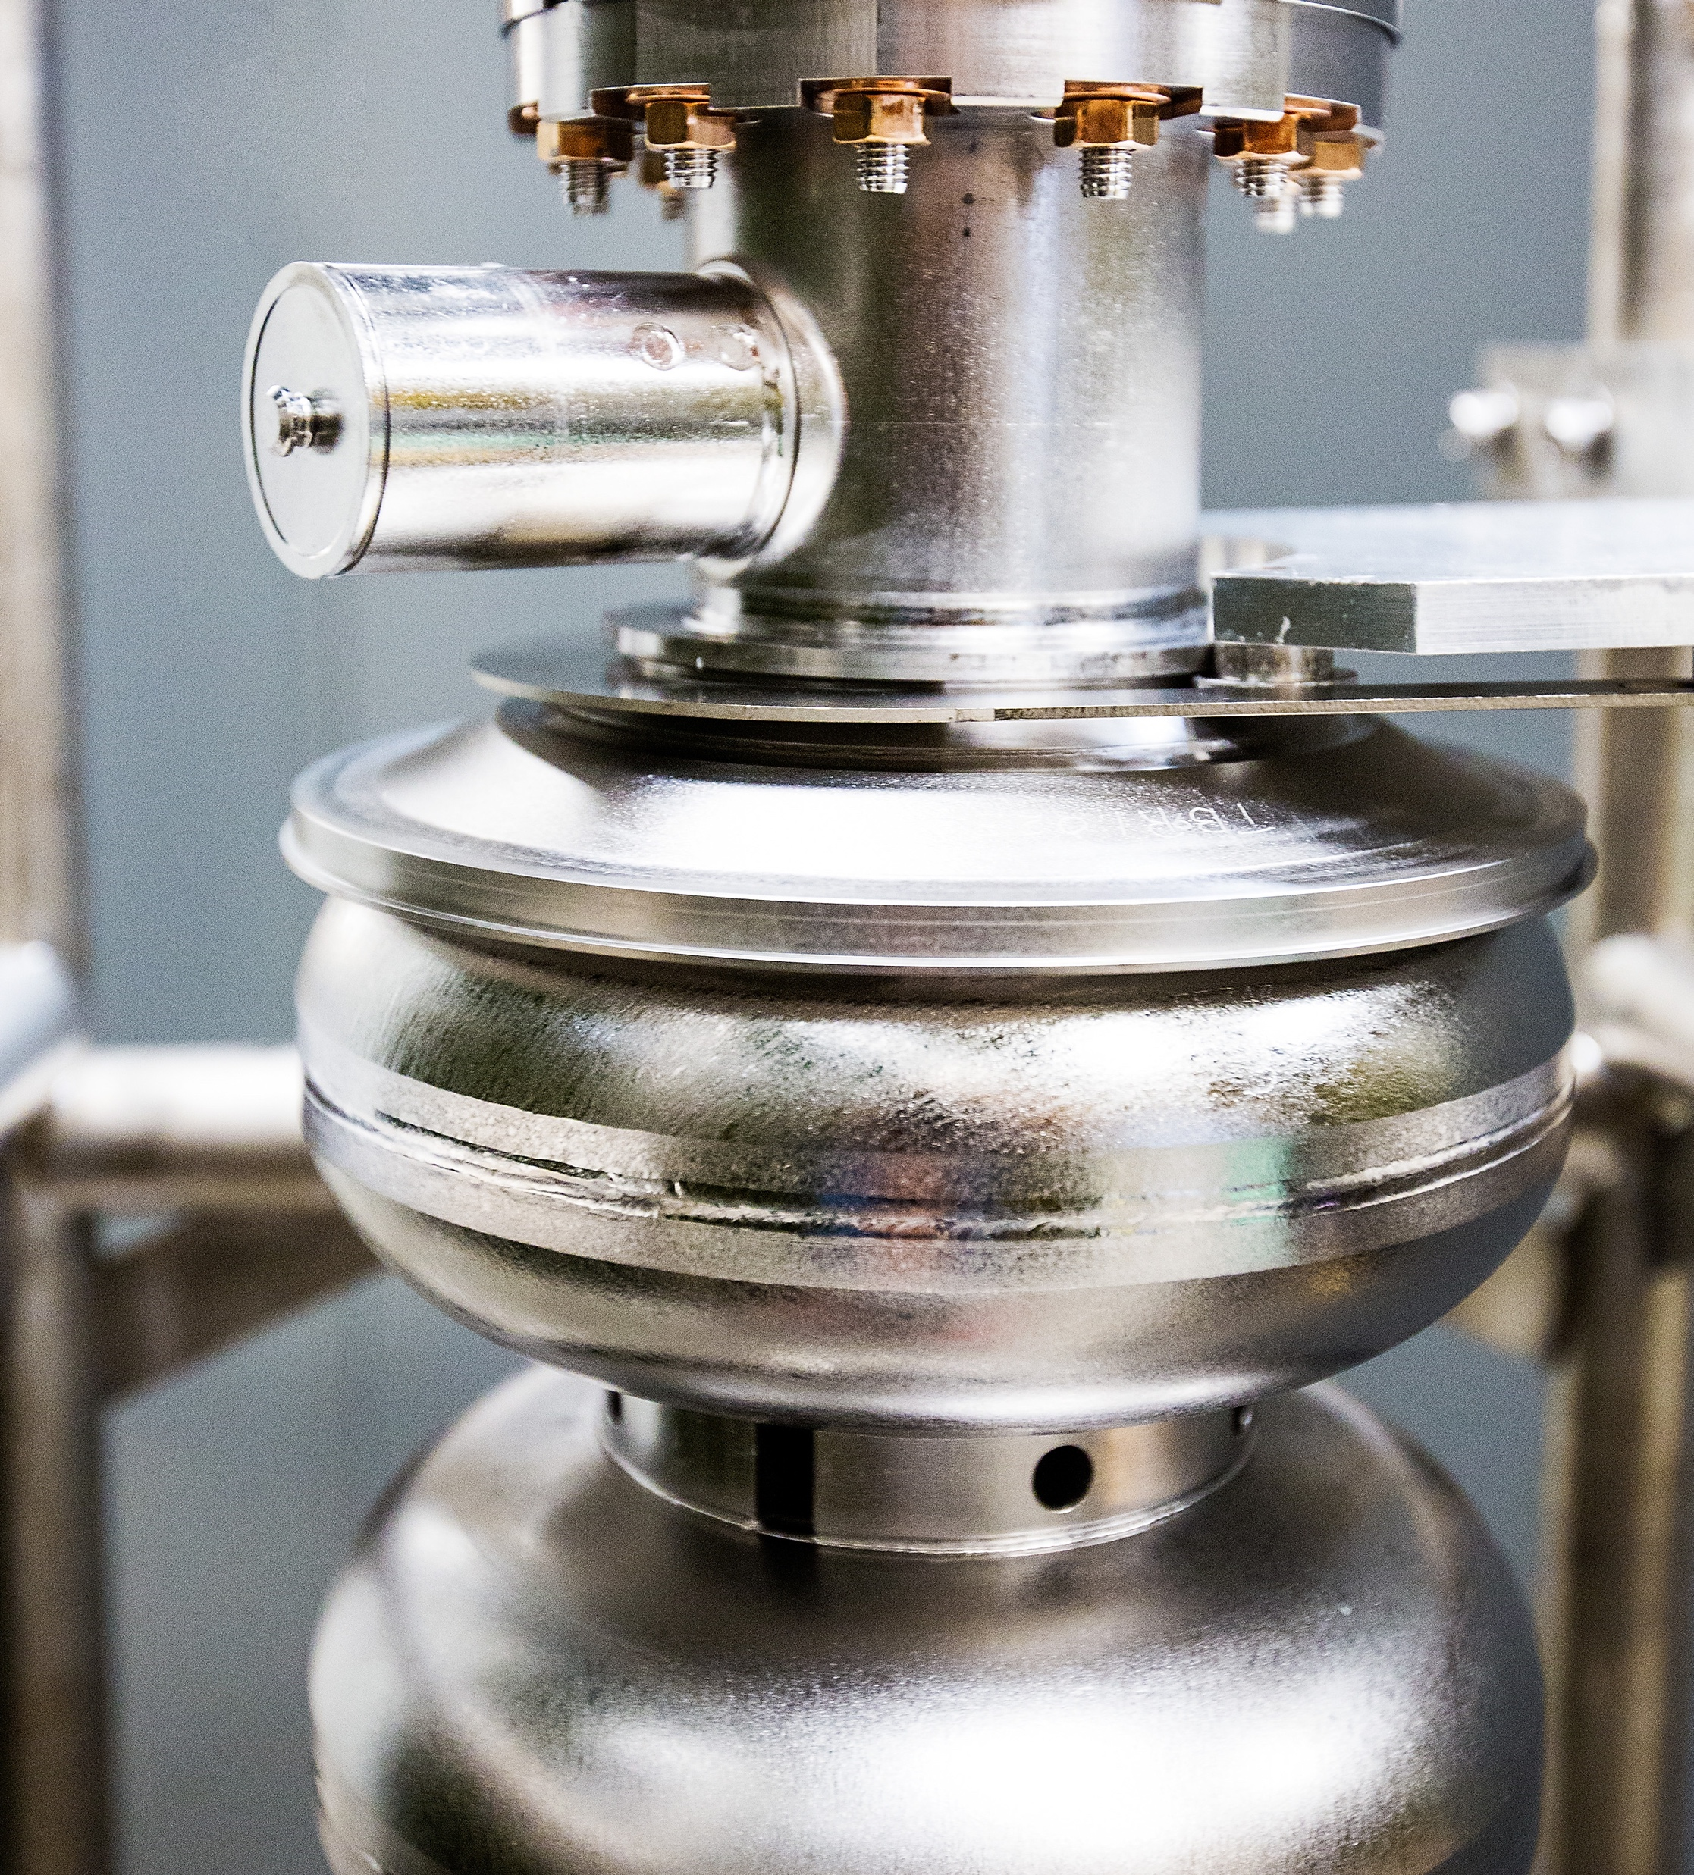
Oppenheimer Science & Energy Leadership Program Site Visit
Partnerships and Regional Engagement
October 14, 2024
Marla Schuchman, CINO

Slide 2
Setting the Stage for Fruitful Partnerships
Relationship Management is key:
Approach to strategic partnerships is about relationships
Institutional relationships ≠ LinkedIn
Lab is an entity with a reputation and lab staff are representatives
Working with the labs can be challenging and very rewarding
“What if you win the lottery?”
Lab relationships shouldn’t disappear when people move on
Who owns a lab’s relationship?
All partnerships are relationships, but not all relationships are partnerships. Grow both.
Notes:
What’s in a word – Partnerships?
Mentioned many times on your agenda
Partnerships are central to how our work a the labs benefits the nation and society as a whole
We can’t work with other external partners without formal agreements

Slide 3
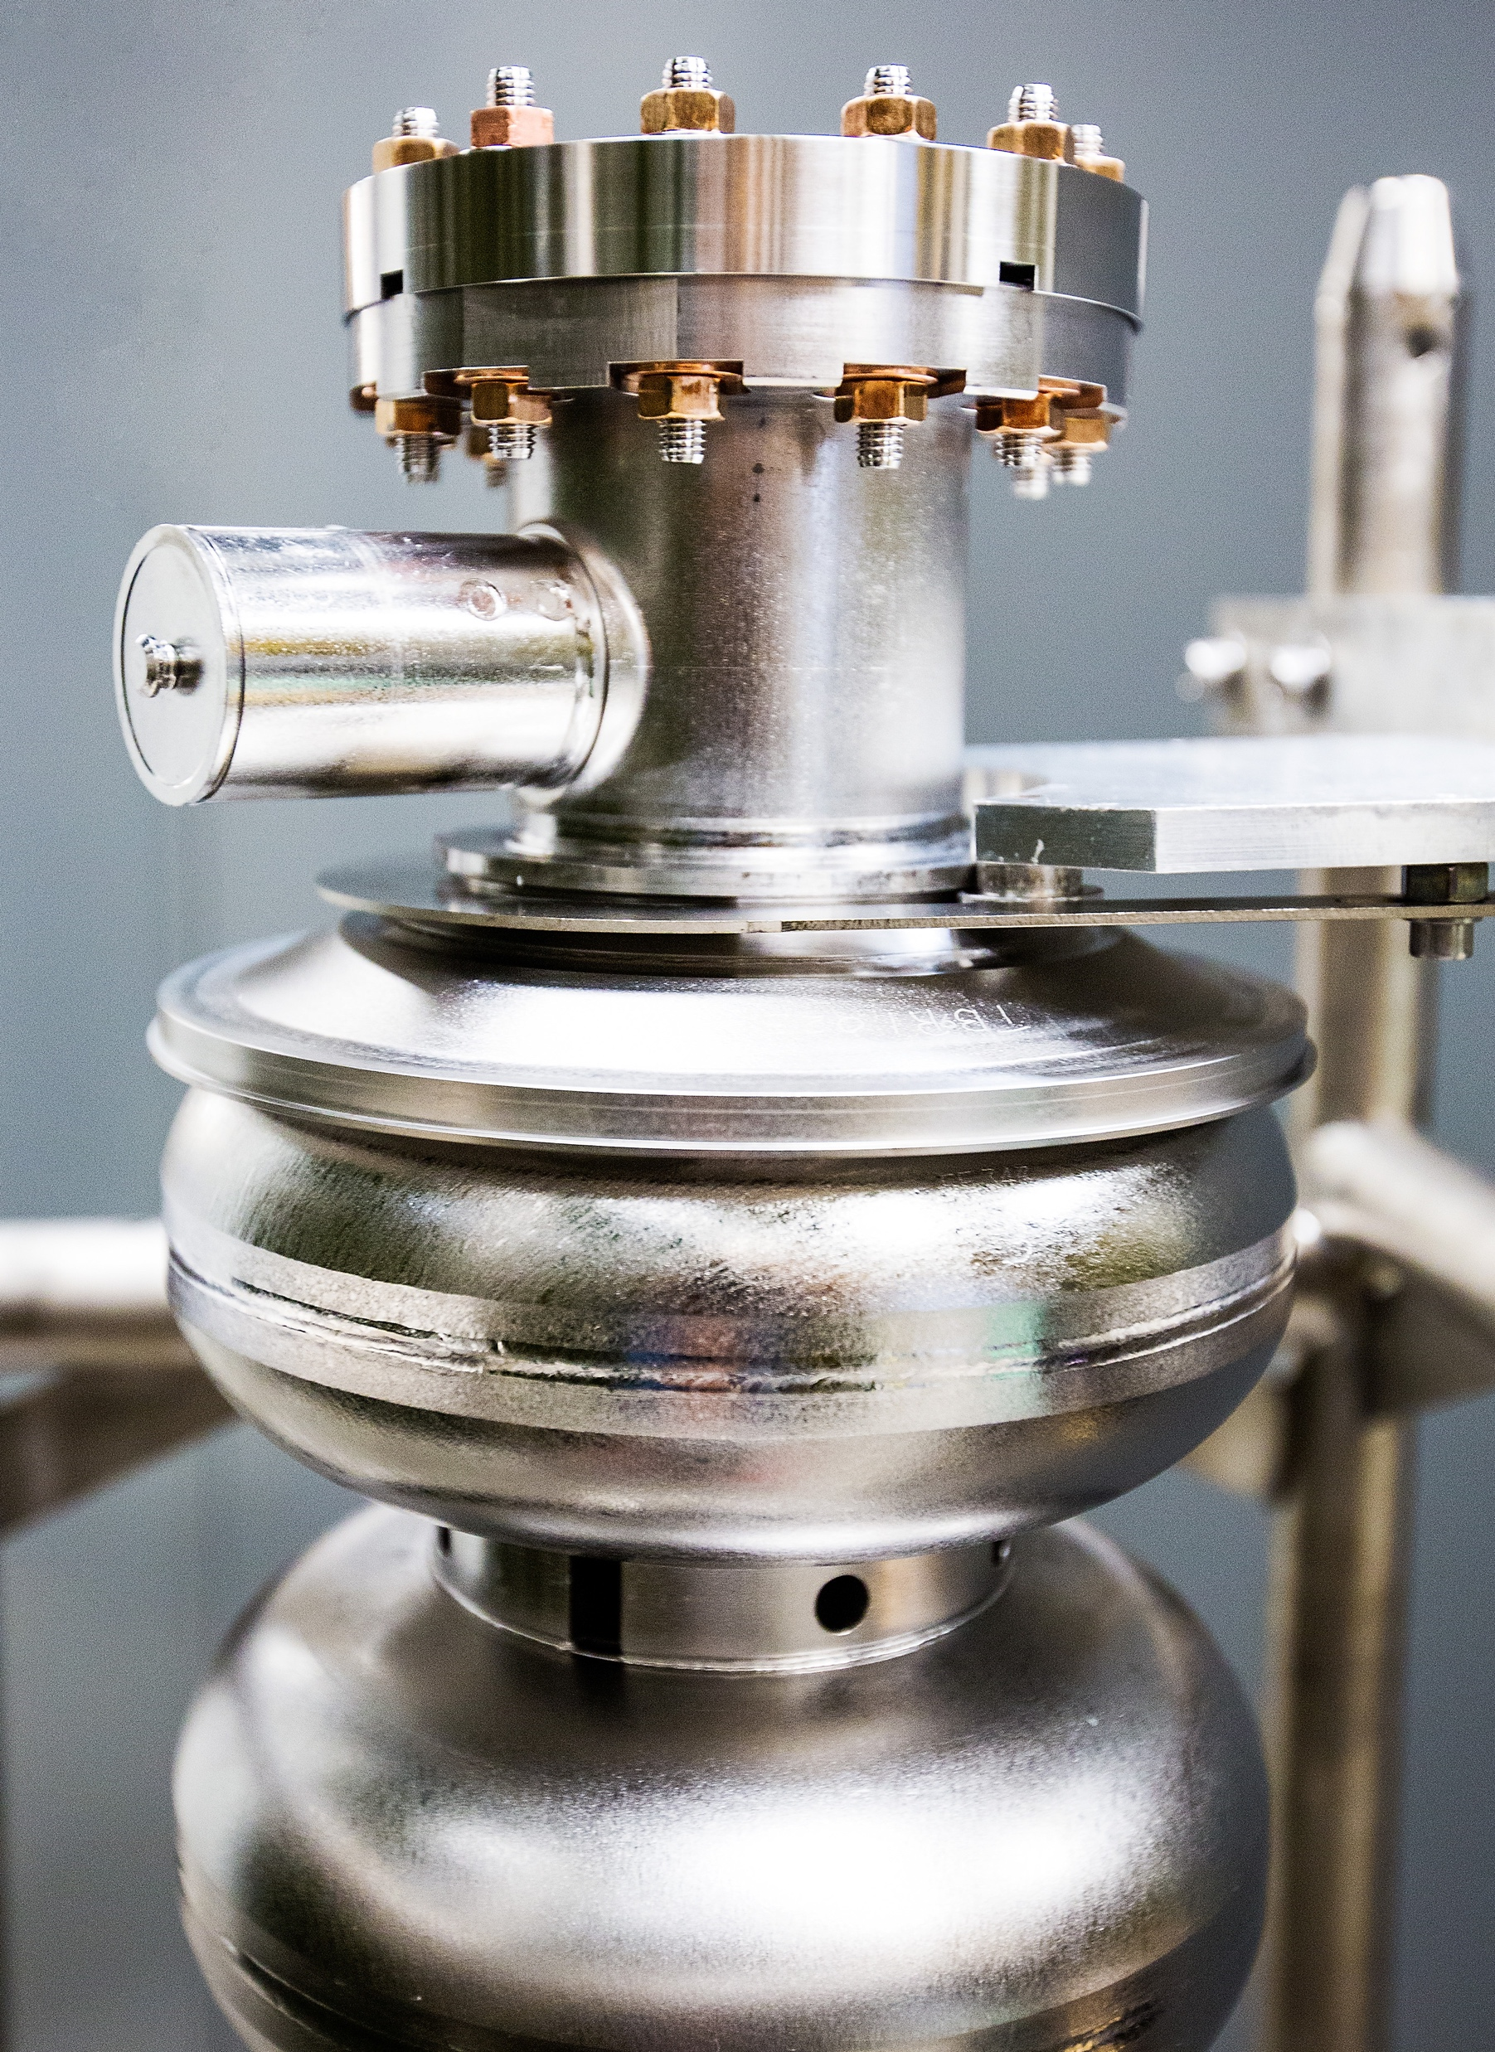
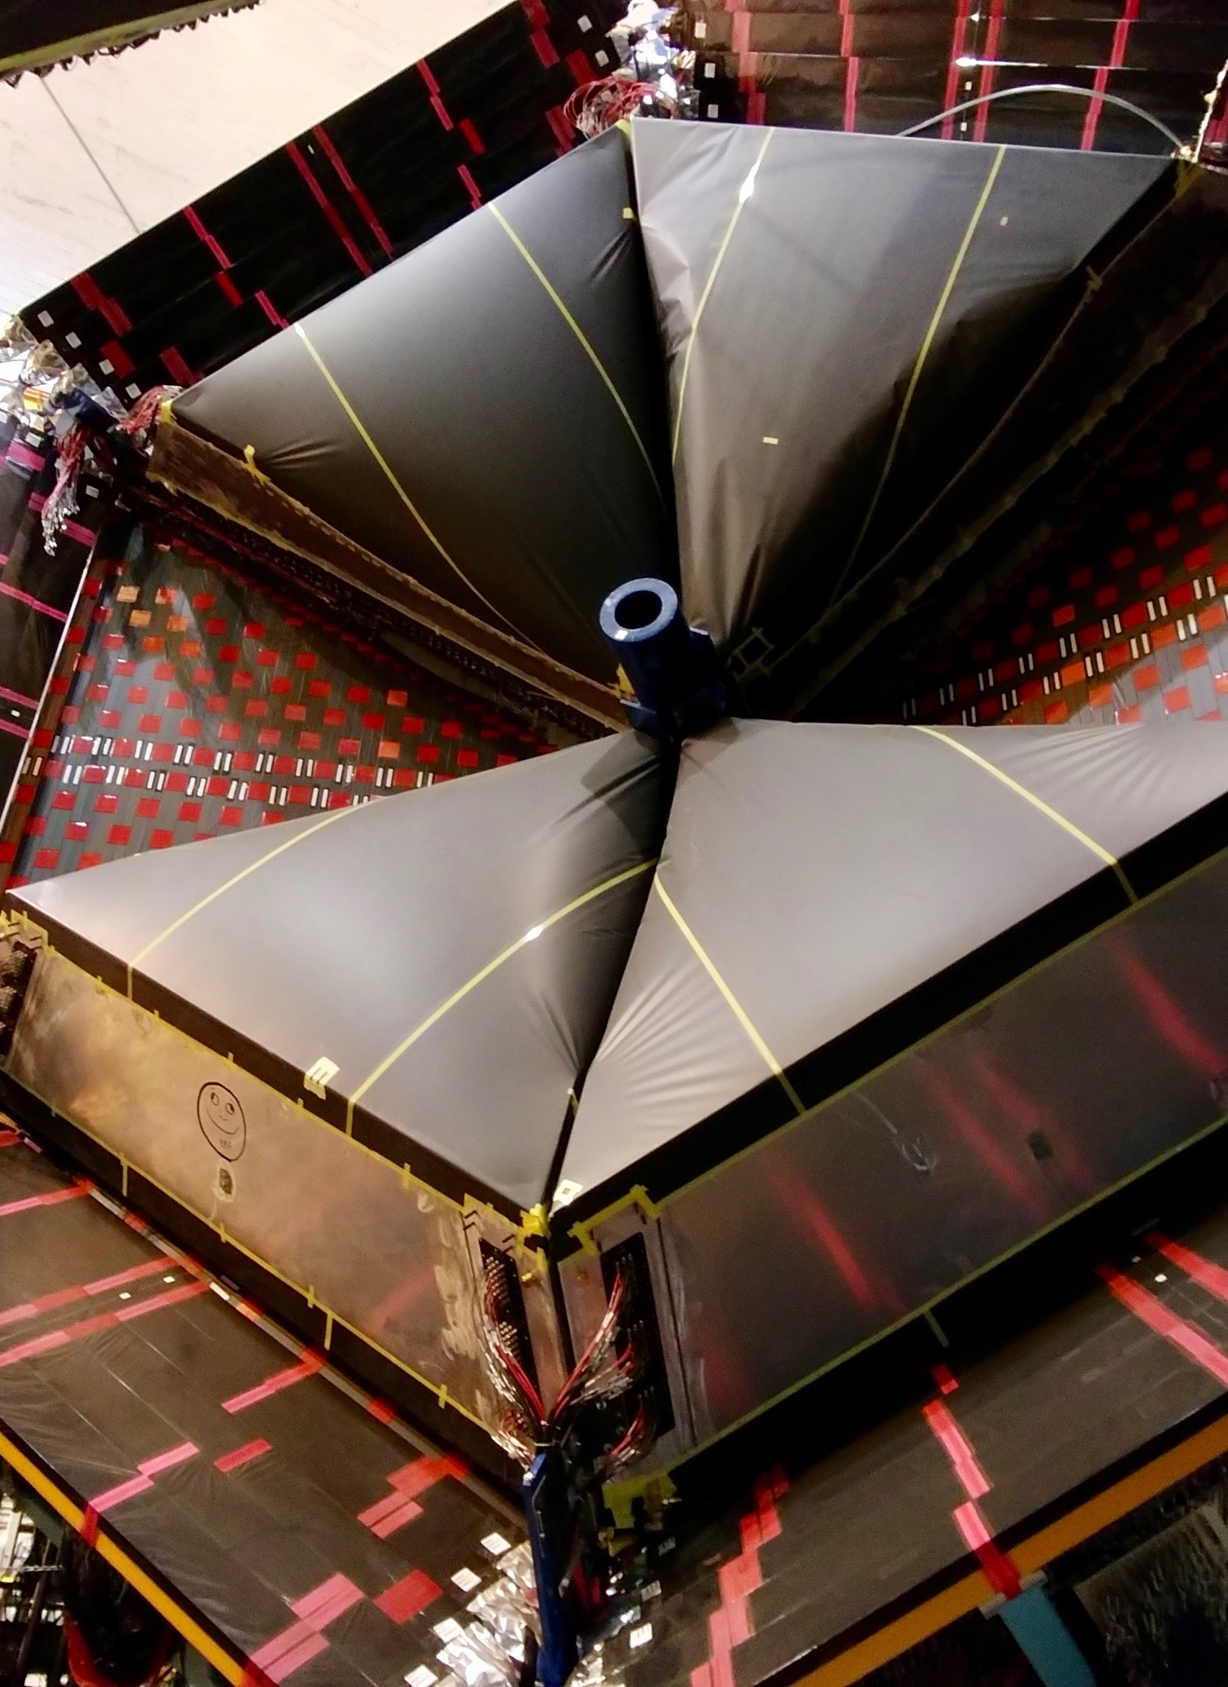
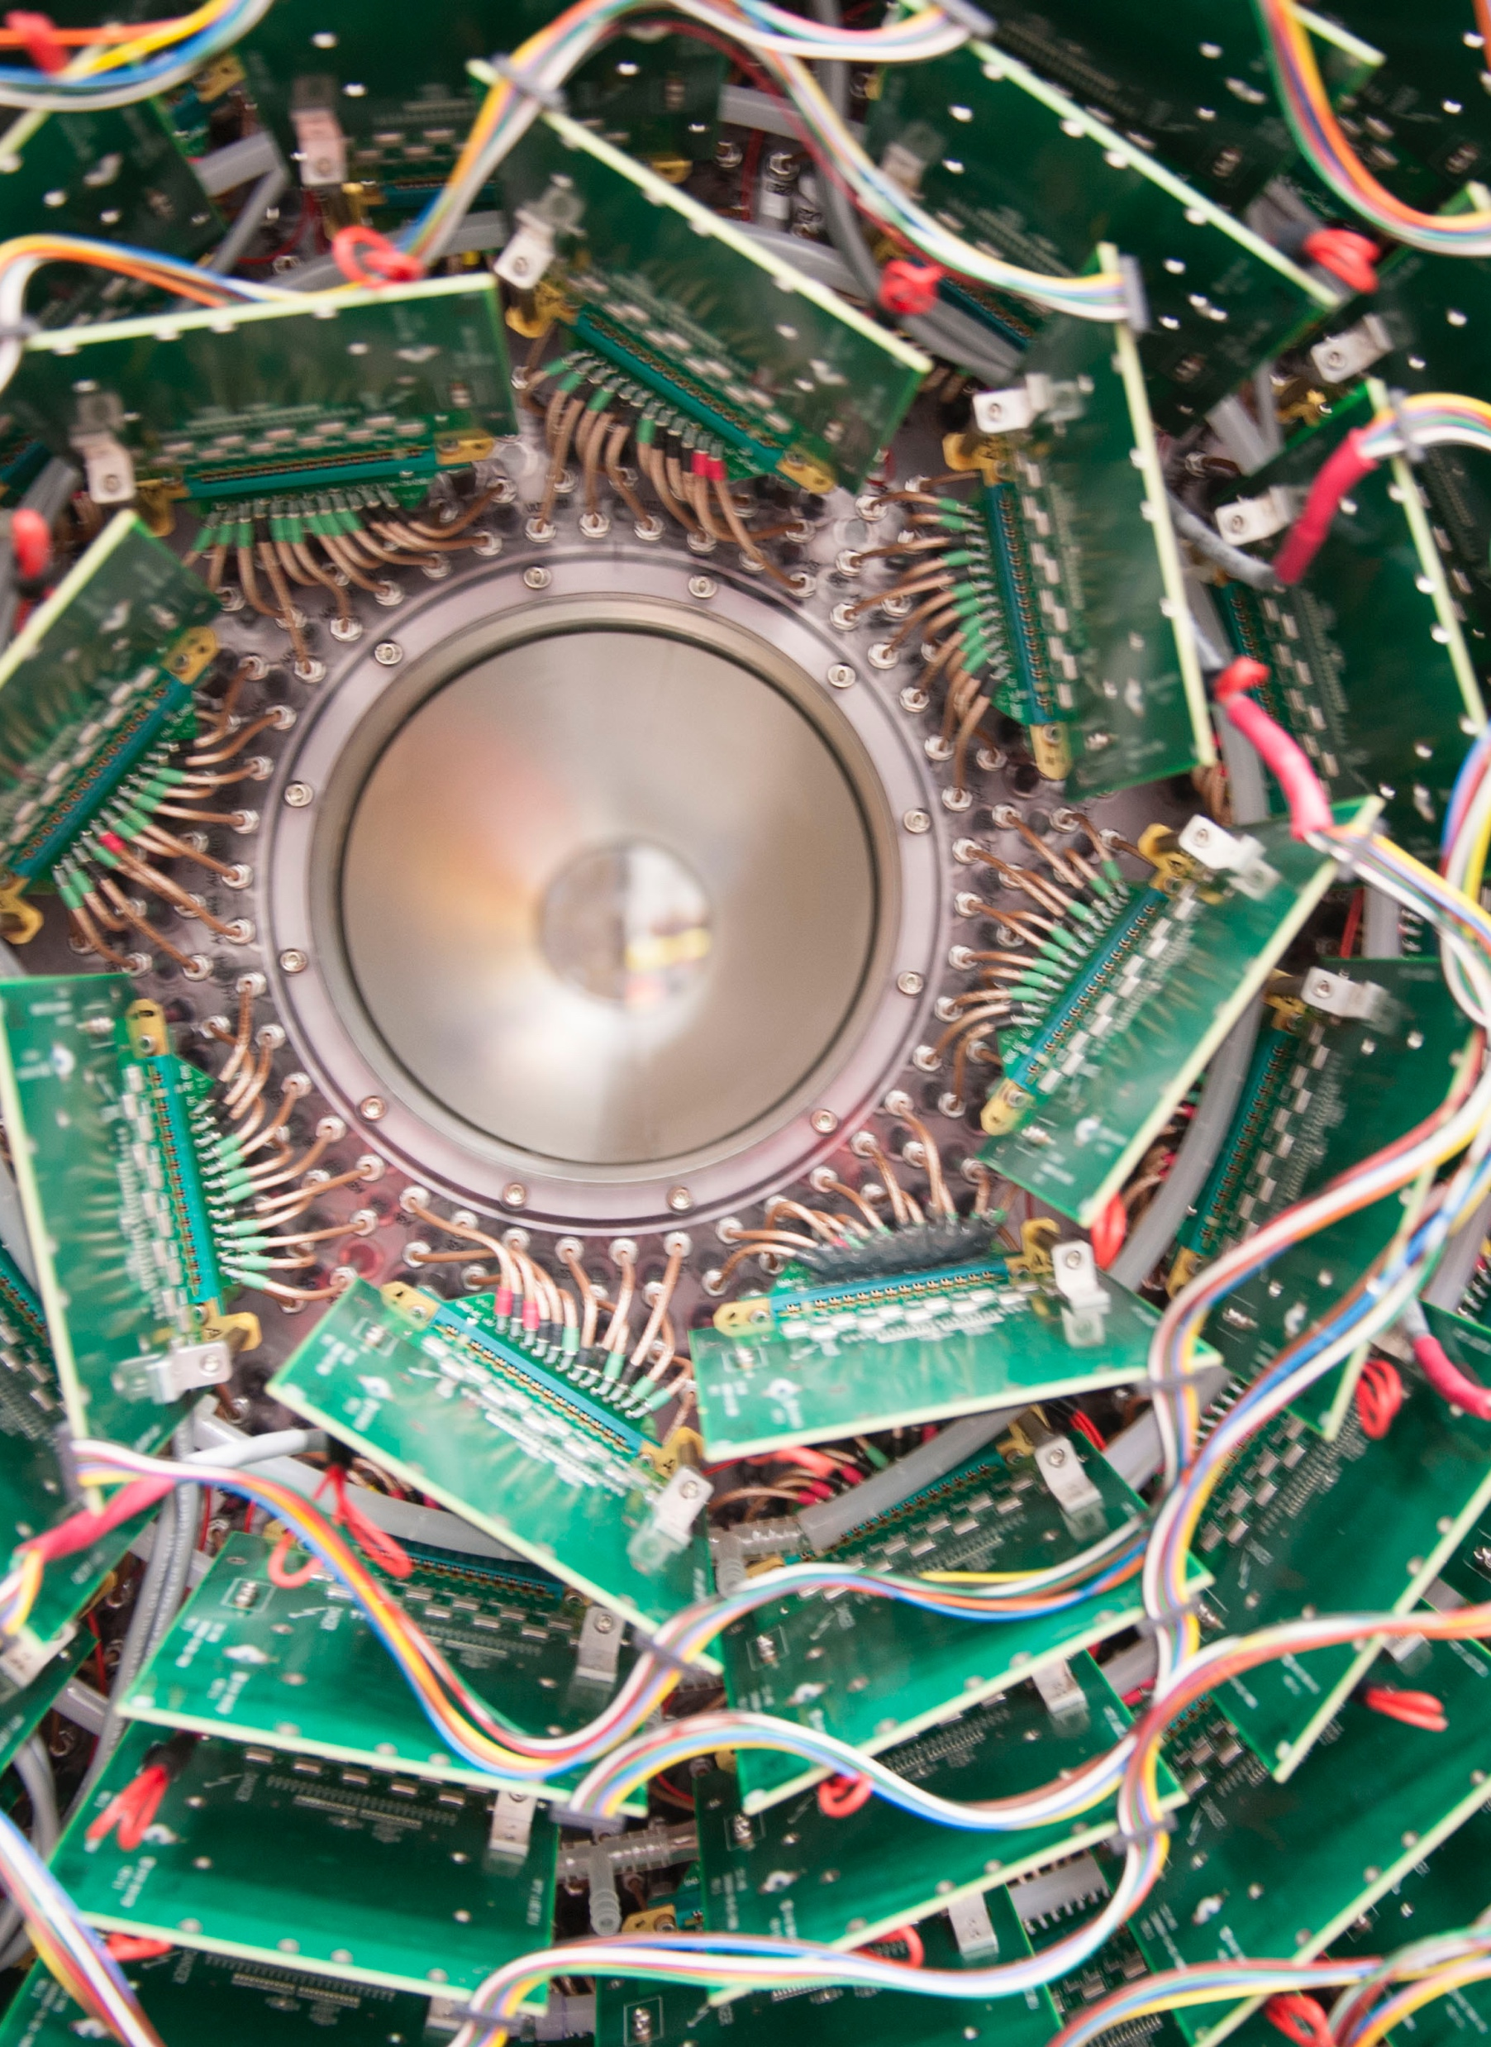
ABOUT RTPO

Slide 4
Research & Technology Partnerships Office Functions
TECH TRANSFER & INNOVATION
Industry engagement, strategic partnerships
IP cultivation, curation, lifecycle monitoring, licensing
Innovation programs (OTT administered & self-hosted)
PARTNERSHIP AGREEMENTS
CRADAs, SPPs, IAAs
Joint Appointments (Lab -> Uni via SPP)
MOUs, NDAs with Legal dept.
MTAs with Property dept.
CRM pilot implementation (TCF Streamlining Workflows)
SPONSORED RESEARCH
Pre & post-award management
SBIR/STTR Program
Relationship management
COMMUNITY OUTREACH & ECON DEV
Events in the community
Hosted tours, industry days
Entrepreneurial support organizations (startup accelerators, incubators, SBDCs)
Business schools

Slide 5
Research & Technology Partnerships Office Functions
TECH TRANSFER & INNOVATION
Industry engagement, strategic partnerships
IP cultivation, curation, lifecycle monitoring, licensing
Innovation programs (OTT administered & self-hosted)
PARTNERSHIP AGREEMENTS
CRADAs, SPPs, IAAs
Joint Appointments (Lab -> Uni via SPP)
MOUs, NDAs with Legal dept.
MTAs with Property dept.
CRM pilot implementation (TCF Streamlining Workflows)
SPONSORED RESEARCH
Pre & post-award management
SBIR/STTR Program
Relationship management
COMMUNITY OUTREACH & ECON DEV
Events in the community
Hosted tours, industry days
Entrepreneurial support organizations (startup accelerators, incubators, SBDCs)
Business schools

Slide 6
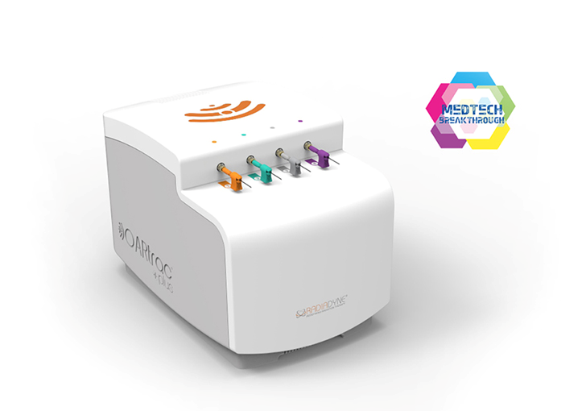
Technologies Transferred
2018 RadiaDyne licensed three technologies around novel uses for scintillating fibers to measure how much radiation cancer patients receive in real time at the tumor site.
2012 BNNT / NIA licensed a technique for synthesizing boron-nitride nanotubes, a novel material with exceptional qualities, developed via a joint effort by NASA scientists and Jefferson Lab researchers.
1997 Dillon Technologies licensed detector technology for medical imaging for diagnostics and research, now in widespread use. Work continues with SmartBreast.
OARtrac, a breakthrough radiation dose monitoring system allowing doctors to measure the amount of radiation therapy patients receive in real time.

Slide 8
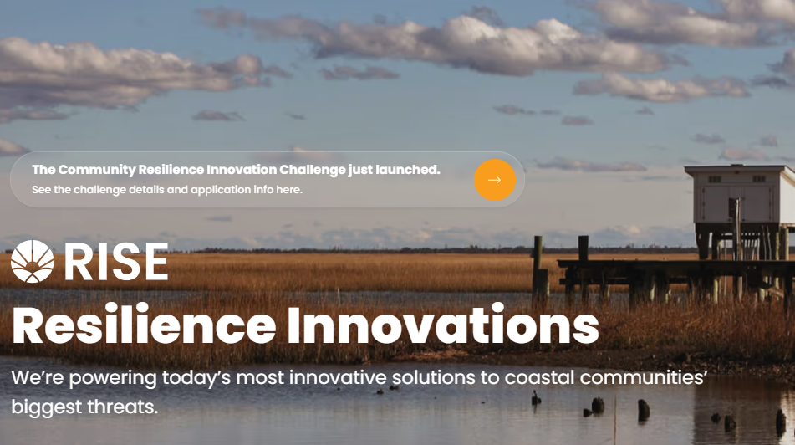
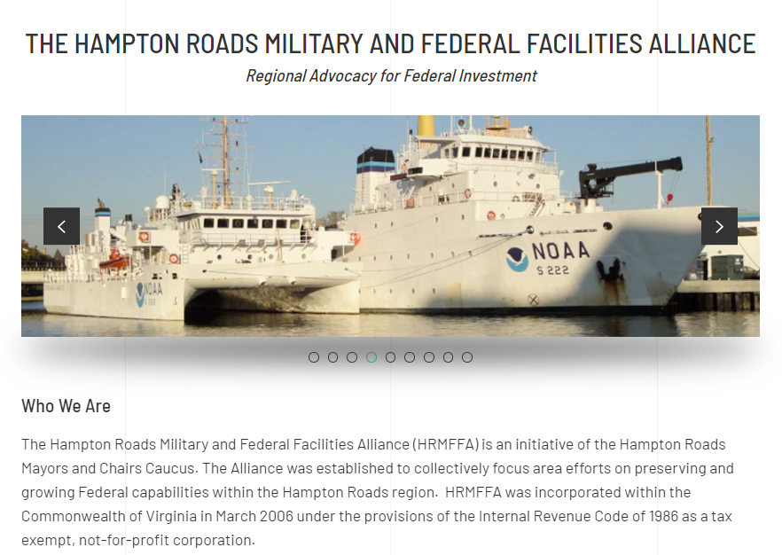
Our Place in the Region
Our Community Cares About:
Sea level rise, coastal resiliency
Federal investment
Energy security and future technologies (Nuclear, Hydrogen, Off-shore Wind)
Protecting military assets & families
Protecting vulnerable populations & disadvantaged communities/neighborhoods
Workforce upskilling and industries of the future
The Port of Virginia / strategic center of commerce
Overcoming fragmentation & encouraging collaboration (17 municipalities!)
Our coastal community’s many touchpoints for DOE and National Lab interest and involvement.

Slide 9
Only DOE Lab in Virginia, strategic location central in mega-region from RIC to Norfolk.
As our mission grows, so does our effort to be an employer of choice in the region.
CEBAF and HPDF user facilities are unique to Virginia and to DOE and the world.
OSELP – October 14, 2024

Slide 10
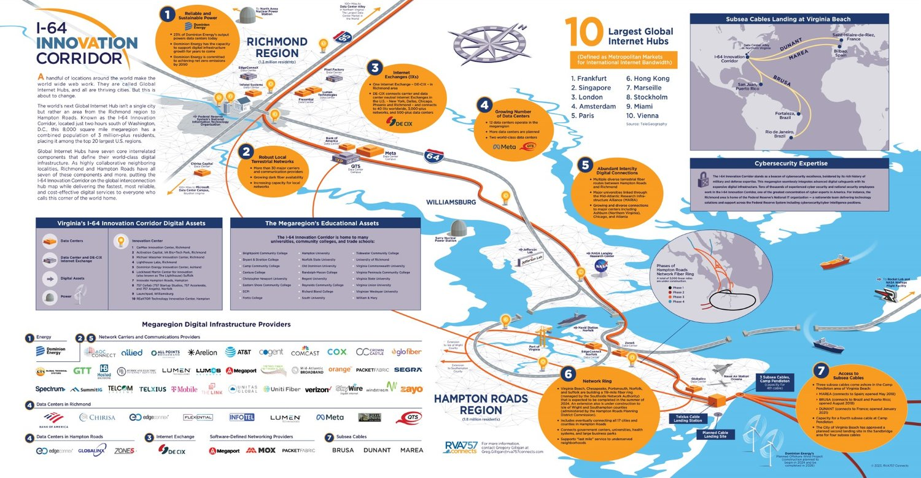
Where are we on the map?
RVA757 Connects “I-64 Innovation Corridor”
Centrally located in Hampton Roads (Virginia Beach–Norfolk–Newport News, VA–NC, MSA)
Other regional assets:
NASA Langley
Newport News Shipbuilding (HII)
Higher Ed (HU, CNU, W&M, VPCC, ODU, VT)
DoD (Ft. Eustis, Langley Air Force Base, Camp Peary, Yorktown NWS, Naval Station Norfolk)
Water / Coastal community
~3hr travel circumference to NW VA, DC metro & NC (Research Triangle, Raleigh-Durham-Chapel Hill)
Link to map
RVA757 Connects is a regional advocacy group focused on mega-region of Richmond/HRVA and is one of several organizations we work with on innovation ecosystem projects.

Slide 11
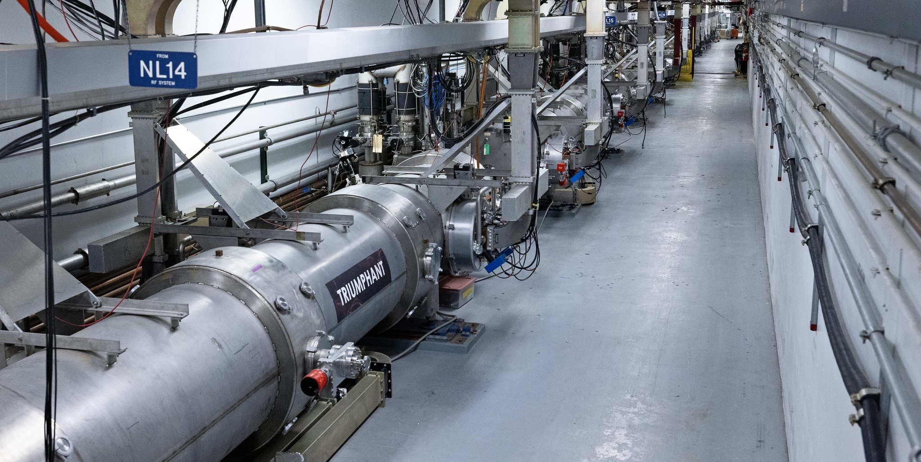
CURRENT EFFORTS

Slide 12
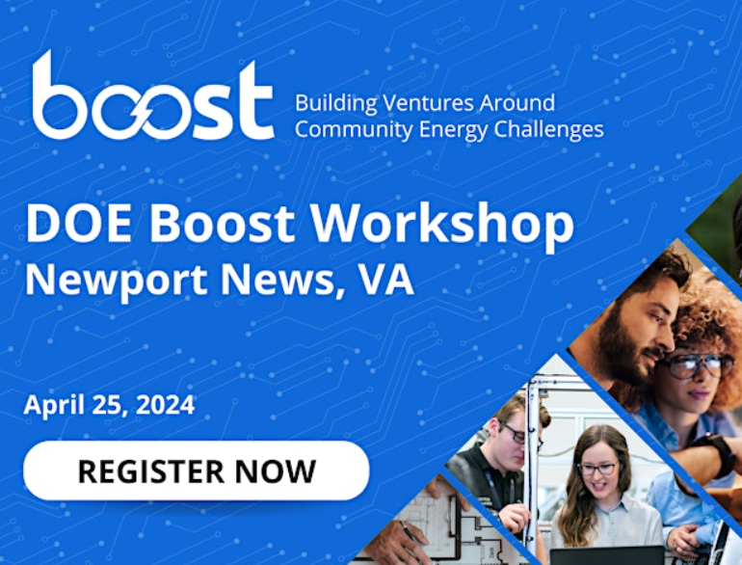
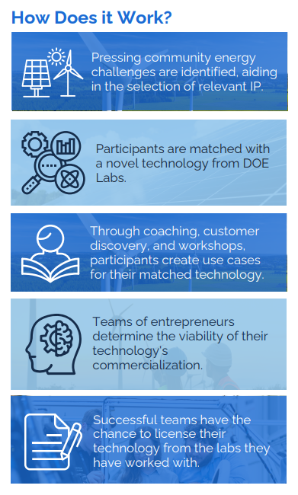
DOE Programs & Events
Boost: Sandia National Labs & Fedtech-led TCF with several labs
Match lab technology (IP) to community needs
Opportunity for teams to get mentorship & license technology
Hosted Newport News workshop to seek local challenges
C-4: Sandia National Labs TCF project with several labs
Hub & spokes for Manufacturing Demonstration Facility (ORNL), JLab looking into developing a spoke
Strong regional interest: NASA Langley, ODU, CNU, VT, Canon
Action Center for Community Energy Systems Solutions (ACCESS)
Enable more communities to harness technical expertise of the Labs and TA partners
Front door to DOE opportunities via lab relationships to the community
JLAB - Insights into SC labs and helping bridge to EERE mission space, how small labs can “do TA”.

Slide 13
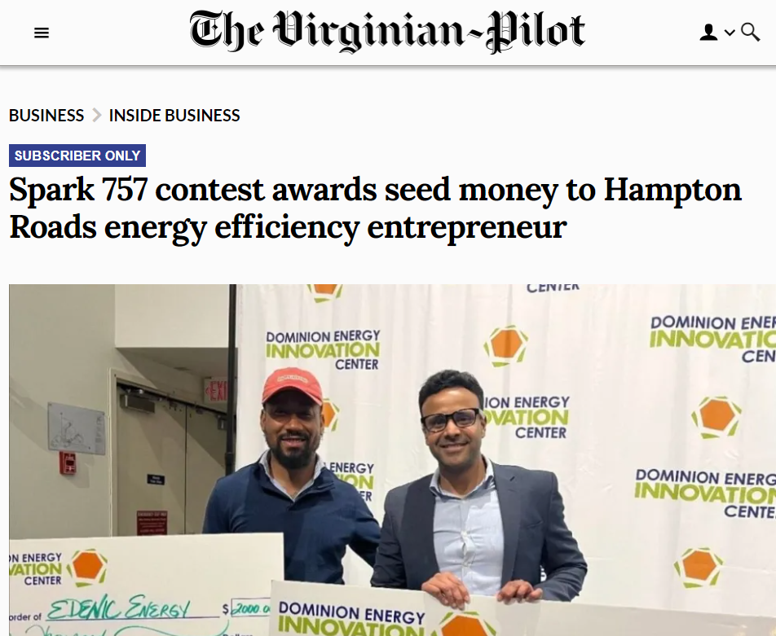
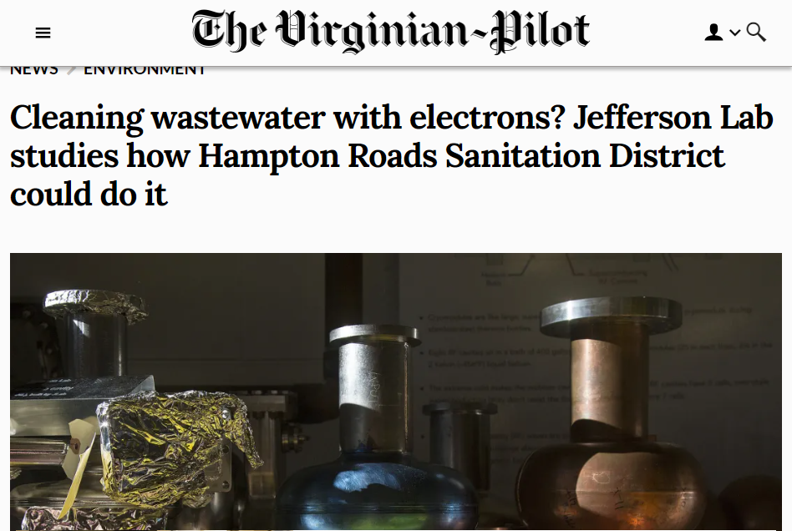
Community Efforts
Dominion Energy / DE Innovation Center
DEIC is an DOE EPIC prize winner x2
Hosted Spark 757 regional energy conference
Virginia Tech Corporate Research Center, Tech Center
Hydrogen test bed, looking for research synergies
Other opportunities due to proximity – seat on VA Tech Newport News advisory board
Newport News Innovation Manager located next door
Mid-Atlantic Tech Bridge, Department of the Navy
Collaboration on identifying lab-generated technologies of use to the Navy
Hampton Roads Sanitation
CRADA to explore utility of e-beam on hard to destroy chemicals
ACES Joint Institute at ODU
Modeling flooding for the City of Norfolk

Slide 14
Questions? Marla Schuchman Chief Innovation Officer marla@jlab.org

