Slide 1
High Performance Data Facility: Status and Plans
August 21, 2024

Slide 2
Outline
Overview of HPDF
Preliminary outcomes of user engagements
Summary and Next Steps

Slide 3
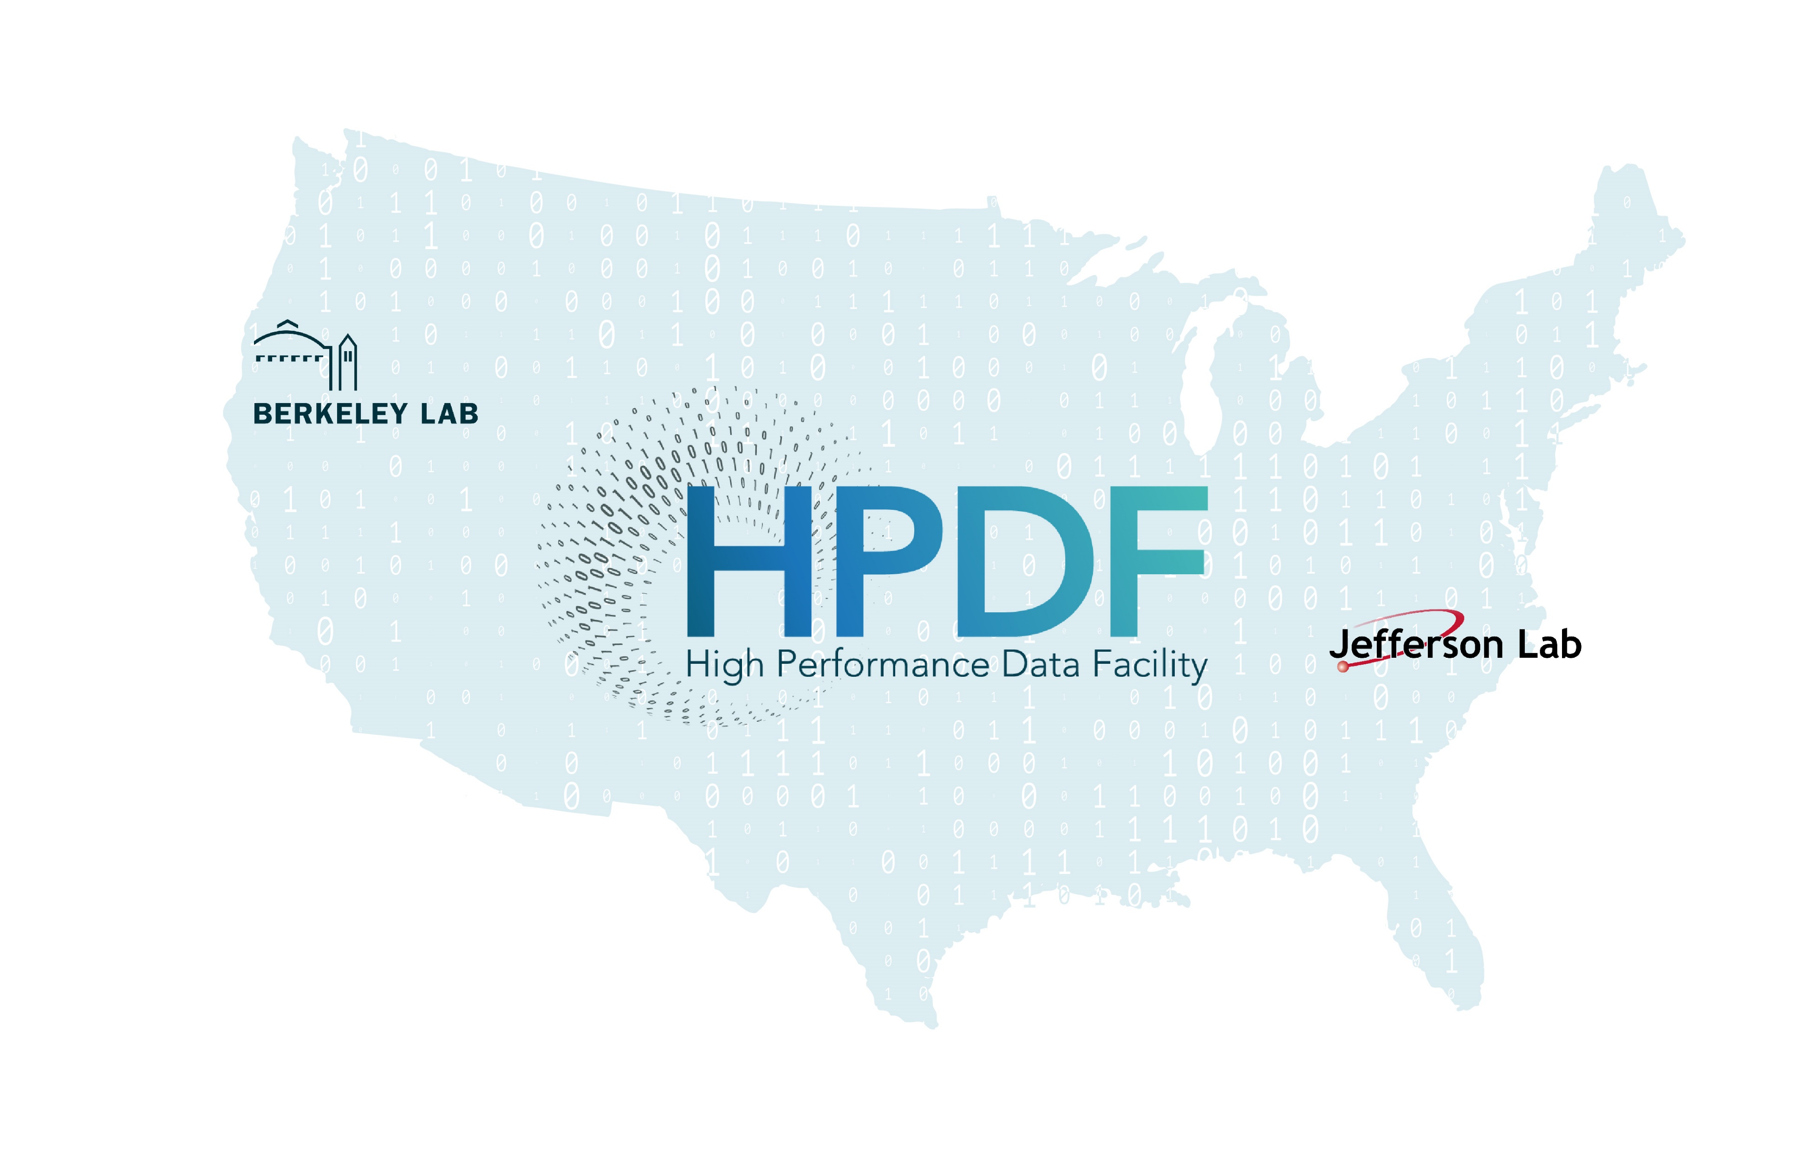
Innovation Through Partnership
Our mission: To enable and accelerate scientific discovery by delivering state-of-the-art data management infrastructure, capabilities, and tools
The HPDF Project team leverages the strengths
and complementarity of both labs:
Decades of experience with scientific missions
and user communities
A shared understanding of resilient, distributed infrastructure that supports
the data life cycle
A shared commitment to the IRI initiative
and ASCR ecosystem
The HPDF will be a first-of-its-kind SC user facility:
A distributed operations model will be essential to long-term success and required performance levels
Project structure is integrated with JLab and LBNL staff
HPDF is a DOE 413 Project announced in Oct. 2023

Slide 4




HPDF is essential to handle the staggering amounts of data
The DOE envisions a revolutionary ecosystem – the Integrated Research Infrastructure – to deliver seamless, secure interoperability across National Laboratory facilities
The 2023 IRI Architecture Blueprint Activity identified three broad science patterns that demand research infrastructure interoperability:
  Time-sensitive patterns
  Data-integration-intensive patterns
  Long-term campaign patterns
HPDF will enable analysis, preservation, and accessibility of the staggering amounts of experimental data produced by SC facilities
Our mission: To enable and accelerate scientific discovery by delivering
state-of-the-art data management infrastructure, capabilities, and tools

Slide 5
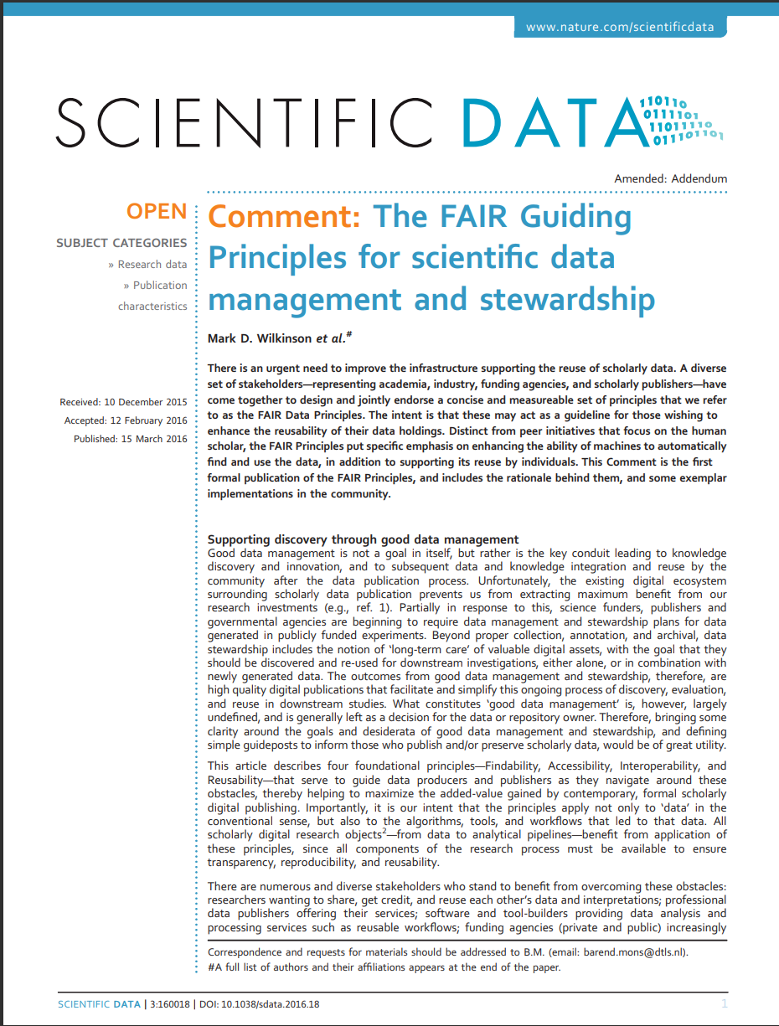
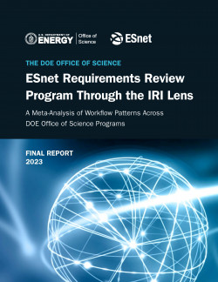




HPDF Will Address SC Priority IRI Science Patterns
Drivers | IRI Patterns
Supporting data curation, repositories, and archives
Supporting data processing and analysis pipelines
Data federation, sharing, and collaboration
Real-time streaming and processing
Time-Sensitive
Data Integration-intensive
Long-Term Campaign
These patterns are seen widely in the larger community, in other parts of DOE, and outside
Notes:
Mention we would like to get a prioritized list from DOE
Mention IRI Blueprint activity and ESnet requirements reviews
Make a forward reference to Lavanya's part

Slide 6

Key Facets of Data Requirements
Management – A dynamic and scalable data management infrastructure integrated with the DOE computing ecosystem
Capture – Dynamically allocatable data storage and edge computing at the point of generation
Staging – Dynamic placement of data in proximity to appropriate computing for reduction, analysis, and processing
Archiving – Extreme-scale distributed archiving and cataloging of data with FAIR principles
Processing – Resources for workflow and automation for processing and analyses of data at scale
Policy of data and providing collaborative environments around data are also critical

Slide 7
HPDF will Support Data Lifecycle Management
Data science requires curated and annotated data that adheres to FAIR principles, and data reuse will be a metric for HPDF. Office of Scientific and Technical Information (OSTI) services will complement HPDF to provide full life cycle coverage.
User Facilities
Science Gateways
Refine
Raw & Derived Data
Publish
Fulfill FAIR principles for scientific data
Share
Hub
Release
Acquire and Prepare
Ingest experimental, observational and reprocessed data using standard APIs
ESnet
Preserve
Long-term data curation and archival
Tiered
Storage
Analyze
Transfer
Move and manage data
and dynamic data streams
Clean and Process
Scalable scientific and
AI/ML workflows
Compute
July 2024

Slide 8
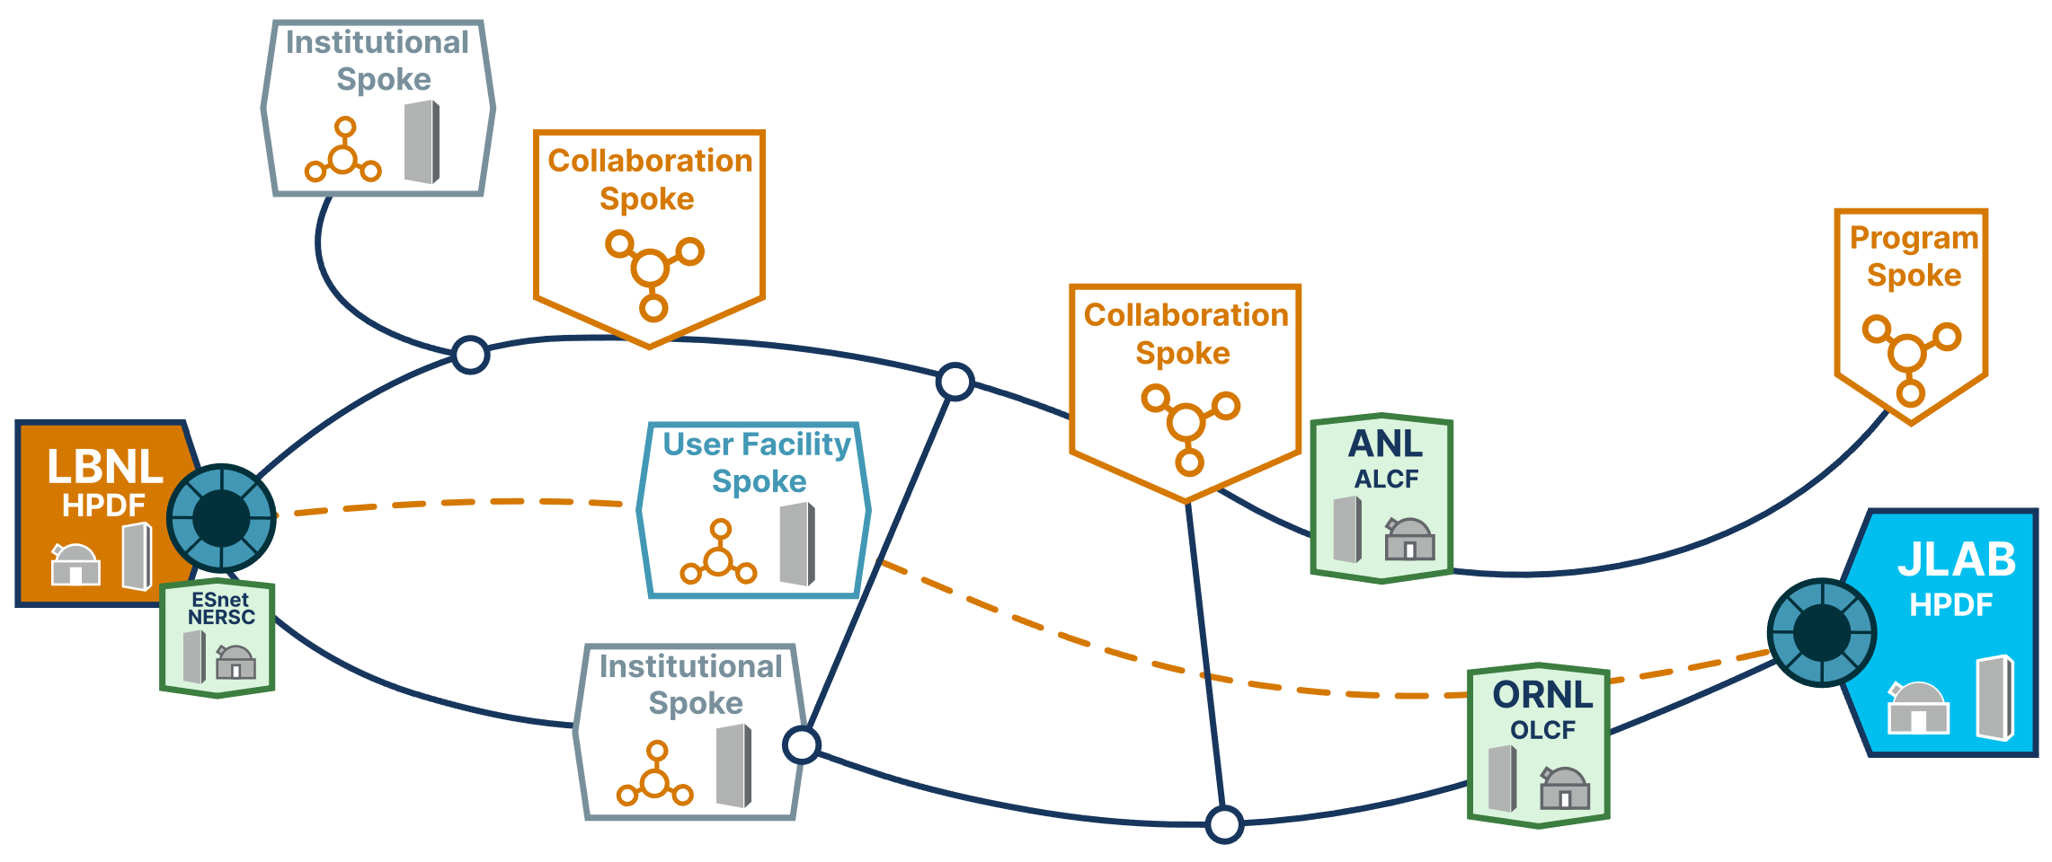
HPDF in the ASCR Ecosystem
Working with IRI and other ASCR facilities ensures a secure, high-performance mesh data fabric that enables data and workloads to flow freely
The HPDF distributed infrastructure
will be designed to maximize planned availability and resilience
Partnering with Spoke sites will provide seamless data life cycle services to scientific users worldwide
Pilot activities and partnerships will help refine the design as Hub software and hardware technology evolve and foster workforce development

Slide 9
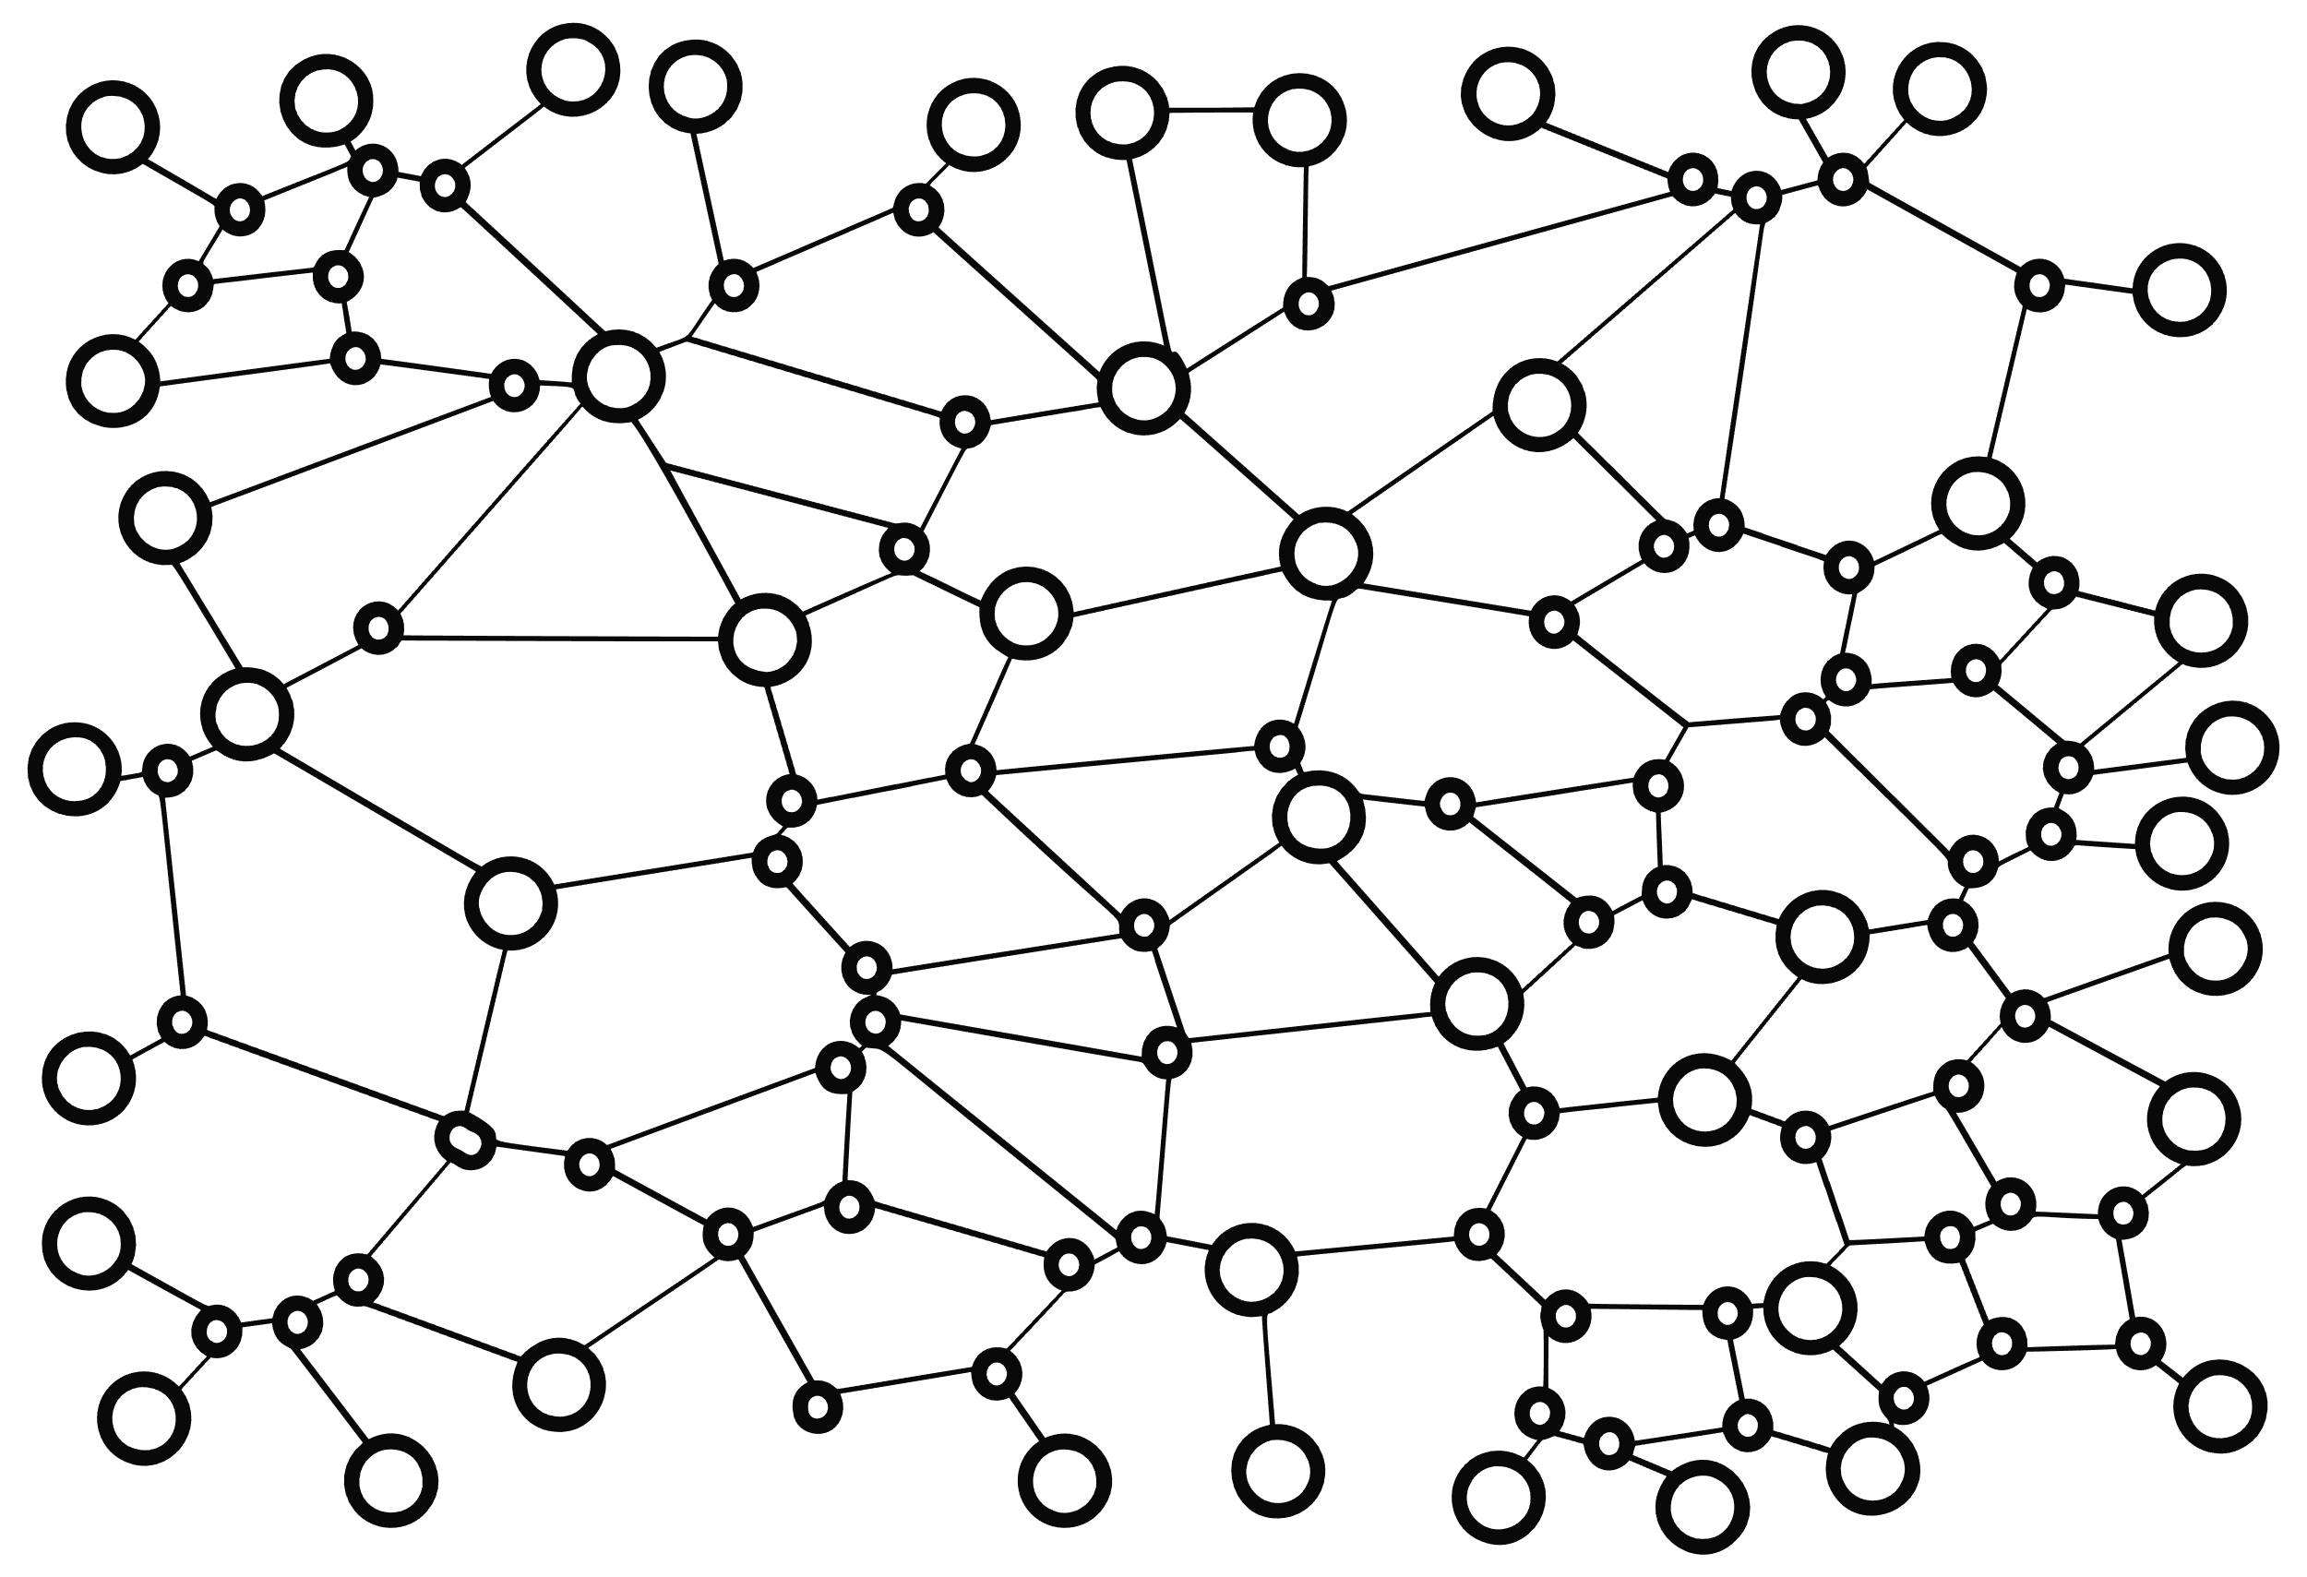
HPDF — A Distributed Facility
Spoke
Concept: HPDF is a distributed facility with a
hub and spoke architecture.
Hub. Data-centric infrastructure with high availability and performance, as well as geographically and operationally resilient active-active failover.
Spokes. Distributed data-centric infrastructure to enhance HPDF access and support for science users and integrate distributed computing or storage resources.
Integration and Services. Orchestration hardware, software, and services for data movement, storage and retrieval, and science workflow automation. These will use a mesh data fabric building on ESnet6 capabilities.
Coordination
Spoke
Coordination
Hub
HPDF data fabric
Coordination
Coordination
Spoke
Computational
Facility
July 2024

Slide 10
Technical Design — Core Capabilities
Hub Computing and
Data Infrastructure
Distributed Spoke Infrastructure
Data-centric Orchestration of Hardware, Software,
and Services
  High uptime
  Experiment-friendly availability
Data-driven agility
Support for new technologies
Data storage, management, and interoperability
Data preservation
  User support
  Scientific application tailoring
  Hardware resources that mirror, supplement, or complement Hub resources
  Low-latency or
  high-bandwidth coupling
  of HPDF services to edge compute
High availability
High-performance mesh data transport fabric
Secure data paths
Monitoring
Orchestration
July 2024

Slide 11
HPDF Architecture Stack
Common APIs and data services to facilitate portability
Distributed orchestration and execution layers
Data transport, caching, communication, and monitoring built on ESnet6 capabilities
Dynamic virtualized compute and storage ensuring portability between sites
Cross-cutting components for security and monitoring
Developed in partnership with IRI
Data Services
User Software Tools
Site-specific Stacks
Both sites will have similar storage & compute resources, possibly at differing scales, that complement existing ASCR HPC facilities and target
data-driven use cases
Databases
Storage Interfaces
APIs
Orchestration Framework
Security
Monitoring & Telemetry
Distributed Execution & Resource Management
Mesh data fabric (Building on ESnet6)
Compute
Storage
Compute
Storage
Compute
Storage
Hub
Future Spokes

Slide 12
Software & Data Services Strategy: Innovation & Stewardship
Identify
Evaluate
Integrate
Identify data services and software as part of DOE SC
user facilities and projects
Work closely with the community on identified software, ensuring it is usable and operational
Technical evaluation
by HPDF staff
Identify data services and software as part of DOE ASCR facilities and IRI
Evaluation of sustainability, usability, etc. by UX team
Identify stewardship path
Interaction with software stewardship organizations
Integration and
development efforts
Work closely with DOE PMs and advisory committees
Interaction with ASCR
research programs and Exascale Computing Project
Advanced data technologies
Innovate & Partner
Coordination and collaboration with the governance for IRI and ASCR scientific software
July 2024

Slide 13
Preliminary Results: Scalable Data Management Infrastructure Mapped to IRI Patterns
Data replication & tiering
FAIR data support, curate data with metadata
Streaming data core & edge services co-dev with ESnet
Robust & reliable distributed
data management layer
Data analysis tools/services:
user feedback, vendor/OSS engagement
Data Capture
& Storage
Data Life Cycle Services
Techniques for data filtering, data scheduling, parallel stream processing
Replication
APIs for schedulers
Publication QA/QC pipeline, search tools, AI/ML dataset tagging
Long-term storing, archiving, access, & discovery through
web interface, DOIs & APIs
Data Management
& Staging
Data
Repository
& Archiving
APIs to services across entire data lifecycle
Access through web-based APIs & Python/C++
Interface to SF-API
Connect data to clusters/ clouds/HPC
Integrated AI platform with uniform APIs
Re-use & reproduce previous results
Programmable APIs
Data Analysis
& AI
Time-Sensitive
Data Integration-intensive
Long-Term Campaign

Slide 14



User Experience Engagement: Core to Our Strategy & Plan
User research gives us a process to verify/validate our “intuition about what the user needs” (hypothesis) and convert it into action
Deep partnership model
to serve user needs, mature data stewardship across SC, and develop a workforce
User support and data stewards
will provide critical help to HPDF users to leverage resources effectively and efficiently, allowing us to address computation and data needs early
“Tale of caution; you get one shot at making things accessible. Simple, easy (Google-esque) interfaces. You get one shot at it, or you'll lose your PIs. Interface simplicity.”
– Dan Jacobsen, ORNL/UT
July 2024

Slide 15
Programmatic View of Spokes
User Facility Spokes. Supporting the data lifecycle needs of a given DOE scientific user facility, or one of its constituent parts.
Program Spokes. Supporting specific DOE program community with tailored resources necessary to advance that program’s mission and strategic goals.
Institutional Spokes. Supporting a specific DOE national laboratory to support its multi-mission scientific community.
Collaboration Spokes. Supporting a significant DOE-funded project that requires close partnership with Hub to collaboratively design and tailor solutions that can advance and sustain the data lifecycle.
Q: Does the programmatic view of Spokes capture the use cases you might have?

Slide 16
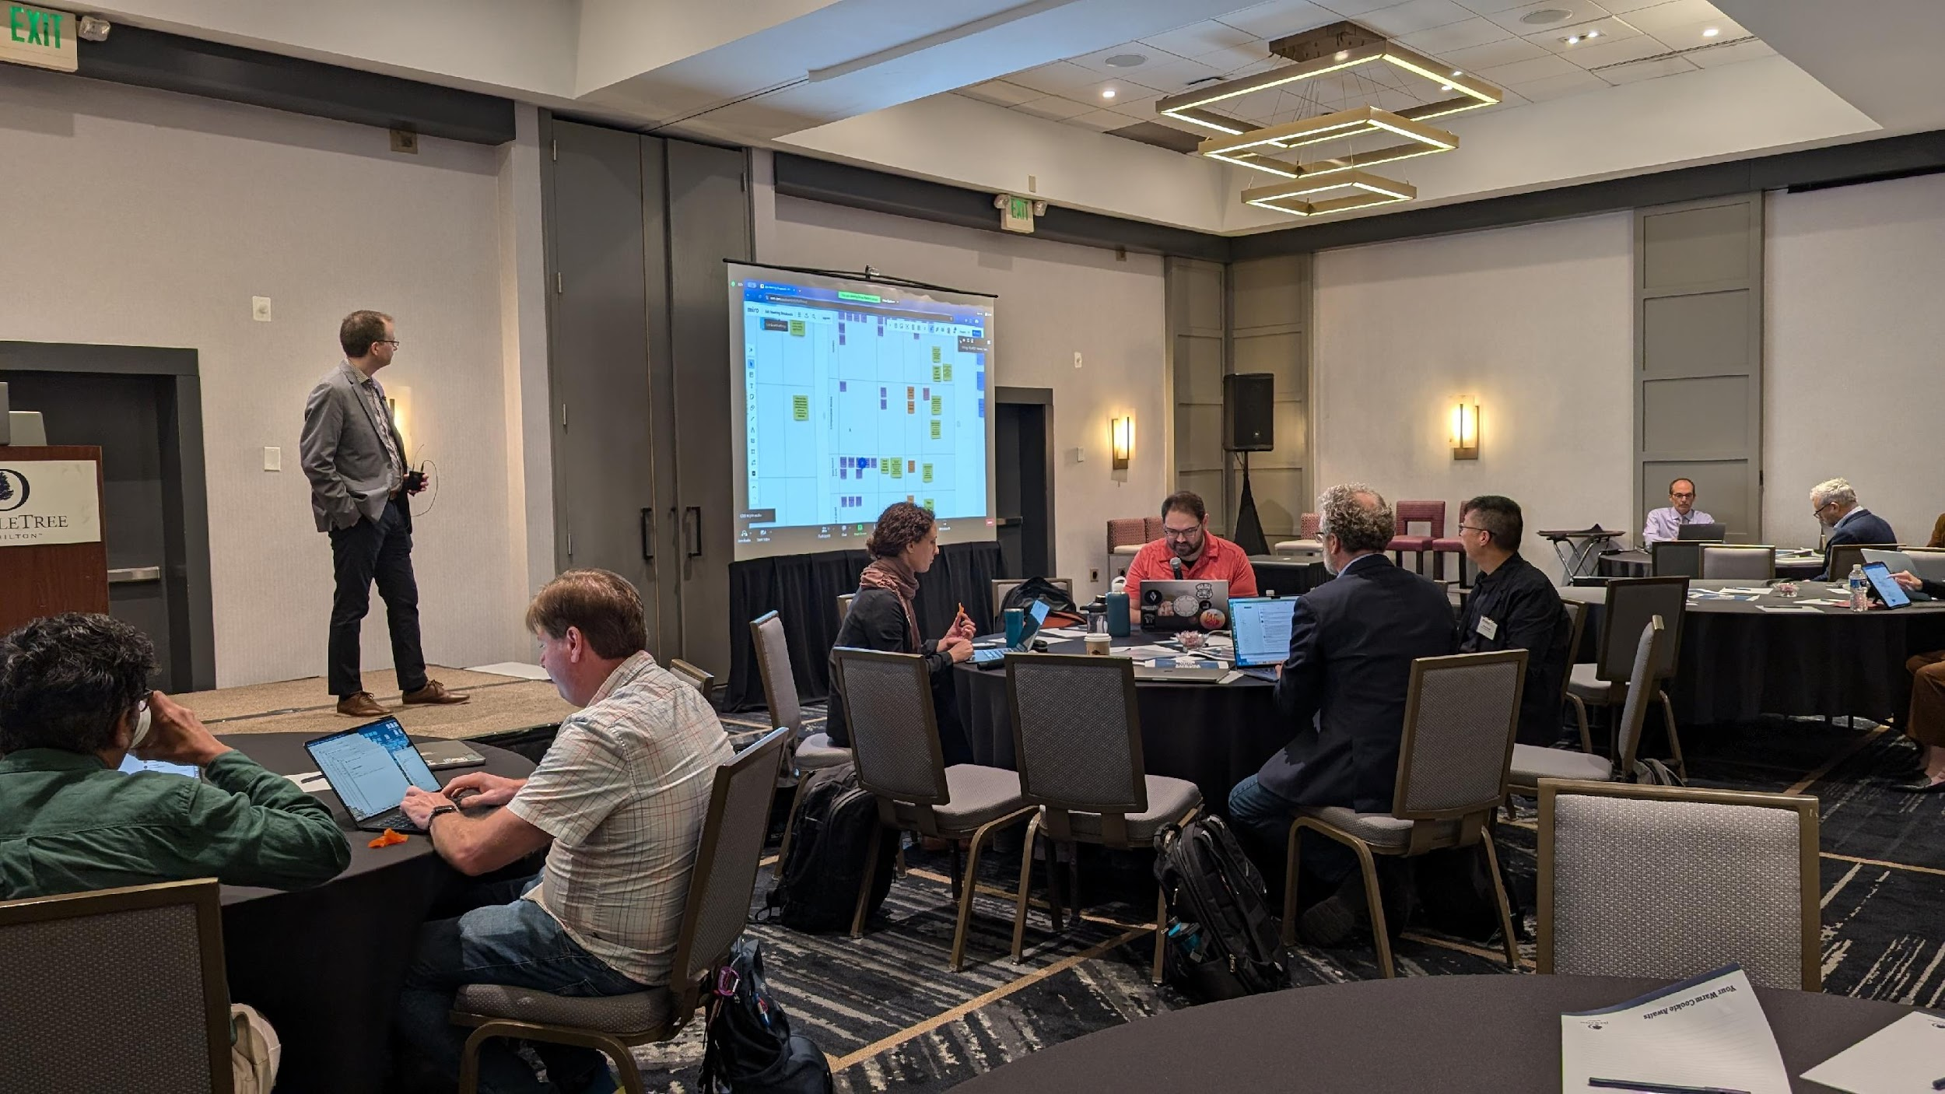
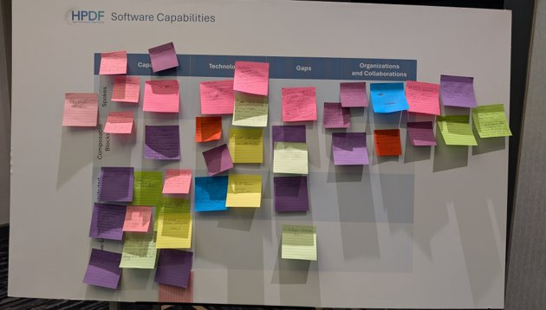
IRI/HPDF Meeting Impressions
July 11-13, 2024
Well-attended with around 80+ people
  A mix of program managers, lab people, ASCR facility directors and staff
Attendees were engaged and active, providing lots of feedback
Early Synthesis is approaching completion
The SC community expressed an Immediate and Urgent Need for HPDF Capabilities

Slide 17
Summary
Near-term Deliverables
User & Community Engagement
Working toward CD-1: Conceptual technical design and scope and alternative analyses
  Includes design of Hub and initial Spoke Capability
  Explore data policy and governance.
  Priorities/Timeline/Roadmap including phasing
  Vision for operational model
  Workflow archetypes
  Set up Advisory groups
Community outreach
  6-way Light Sources meeting (Jan, in-person)
  IRI Management Council (April, virtual)
  Community Webinar (June, virtual)
  FES PI Meetings (June, in-person)
  HPDF/IRI workshop (July, in-person)
  Monterey Data Conference (August, in-person)
  Community Webinar (Q4 FY24, virtual)
  Small-group interviews with groups identified through initial HPDF workshop (summer/fall, virtual)
  Supercomputing ’24 (November, in-person)
July 2024

Slide 18


Q&A
https://hpdf.science
Share thoughts & questions or request to be added to our mailing list via our form.
Answers will be provided via the website within a few weeks.

Slide 19
HPDF in the ASCR Ecosystem
Ingestion of simulation data from computational facilities
User Facilities
Leveraging OSTI
Science Gateways
Refine
Raw & Derived Data
Publish
Fulfill FAIR principles for scientific data
Share
Hub
Release
Acquire and Prepare
Ingest experimental, observational and reprocessed data using standard APIs
ESnet
Preserve
Long-term data curation and archival
Tiered
Storage
Analyze
Transfer
Move and manage data
and dynamic data streams
Using ESnet
Clean and Process
Scalable scientific and
AI/ML workflows
Compute
Leveraging LCF
and NERSC at scale

Slide 20
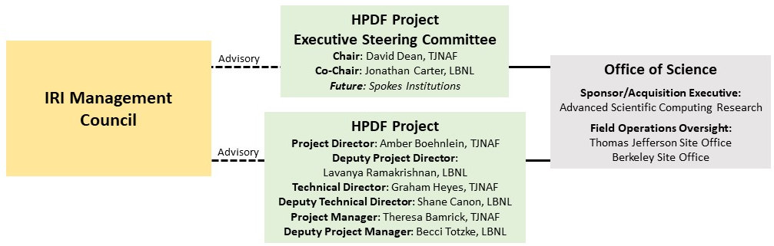
HPDF Governance & Execution

Slide 21
HPDF Engagement modes
Users
Partners
Spokes
Use HPDF hardware, software, and services to support their data lifecycle needs.
Store and retrieve data
Acquire, prepare, preserve, and publish
Process/analyze data
Leverage IRI capabilities to seamlessly use ASCR facilities
Partners provide software/services that contribute to the HPDF ecosystem.
Long-term partnerships that support the data lifecycle needs for specified communities
A mutual commitment to align the teams, resources, and policies users depend on for maximum productivity
Spokes provide first level of service for the communities they serve and provide enhanced user experience and customizations
Co-evolve with Hub infrastructure as computing and data technology and solutions advance
Add value by providing community-specific software and services, user support, and possibly hardware resources mirroring, supplementing, or complementing Hub resources

Slide 22
Spoke Exemplars — Tailoring to Science Needs
Names are work in progress.
Saturn
Venus
Exemplars begin to show range of potential Spokes which may be develop to support diverse community needs.
Spokes are likely to change over time, evolving from a narrower scope to larger as community needs and funding shift
Science Gateways
Refine
Raw & Derived Data
Publish
Fulfill FAIR principles for scientific data
Share
Hub
Release
Acquire
Ingest experimental, observational and reprocessed data using standard APIs
ESnet
Old | New
A | Saturn
B | Earth
C | Mercury
D | Mars
E | Jupiter
F | Venus
Preserve
Long-term data curation and archival
Tiered
Storage
Analyze
Transfer
Move and manage data
and dynamic data streams
Previously labeled Spoke Types A-F
Process
Scalable scientific and
AI/ML workflows
Compute
Jupiter
Earth
Mars
Mercury
These are rough categorizations and we anticipate more categories and a possible melding of categories for specific use cases.
High Performance Data Facility Project: Spokes Concepts

Slide 23
Spokes are the deepest HPDF partnerships
Spokes support the data lifecycle for specified user communities
  Establishing a mutual commitment to align the teams, resources, and policies users depend on for maximum productivity
Spokes provide first level of service for the communities they serve
  Provides enhanced user experience and customizations
  Co-evolve with Hub infrastructure as computing and data technology and solutions advance
Add value by providing community-specific software and services, user support, and possibly hardware resources
  Mirroring, supplementing, or complementing Hub resources
Success of the model will depend on the human, policy, and technical interfaces between the Hub and the Spokes
  Allowing scientific communities to achieve interoperability while developing specialized solutions
Spokes will add value to their scientific communities and the broader HPDF ecosystem.
High Performance Data Facility Project: Spokes Concepts
Notes:
Spoke staff will bring the domain & community specific knowledge necessary to forge successful partnerships

Slide 24
Hub and Spokes model allows for effective and efficient integration
Hub-and-Spoke infrastructure design and management framework
Will allow the scaling of resources and services
Support various strategic priorities, partnership contexts, and scientific communities
Hub — Provides core infrastructure, services, and generalized expertise to support the diverse communities across SC
Spokes — Resources will be tailored & localized for their data lifecycle needs depending on the scope identified.
Spoke
Spoke
Coordination
Coordination
Coordination
HPDF data fabric
Hub
Coordination
Coordination
Impact: Together the Hub and Spokes will enable and accelerate multi-disciplinary novel science discovery through support for all IRI patterns across the entire data lifecycle.
Computational
Facility
Spoke
High Performance Data Facility Project: Spokes Concepts
Notes:
Also
Early engagement between HPDF and its users will lead to creative thinking about how Spokes can help accelerate scientific discovery.
Spokes will be designed in partnership to address the needs of Office of Science communities & facilities who are producing and consuming data.
Spokes will require deep partnership and co-investment in resources from SC programs and their communities
Ongoing user outreach will foster the dialogue essential for shared governance and a coherent, seamless user experience.

Slide 25
Spoke design will be grounded in a multi-tiered science engagement process
Early engagement between HPDF and its users will lead to creative thinking about how Spokes can help accelerate scientific discovery.
Spokes will be designed in partnership to address the needs of Office of Science communities & facilities who are producing and consuming data.
Spokes will require deep partnership and co-investment in resources from SC programs and their communities
Ongoing user outreach will foster the dialogue essential for shared governance and a coherent, seamless user experience.
Spoke
Spoke
Coordination
Coordination
Coordination
HPDF data fabric
Hub
Coordination
Coordination
Computational
Facility
Spoke
Q: What would you like to gain and contribute to the HPDF partnership?
High Performance Data Facility Project: Spokes Concepts

Slide 26
The HPDF Hub: Unique Hardware Capabilities
Combines high availability, flexibility, and support of time-critical workflows
Composable storage will be configured to limit the need to modify existing code
A local archive will be available along with a federated data catalog of data archived elsewhere
The data processing design is based on the concept of
“standard units,” hardware elements following well-defined architectures targeting specific use cases
  Batch jobs, AI/ML intensive, streaming, real-time, and
  dynamic reconfiguration
  A mix of CPU/GPU flavors to run existing optimized code
The Hub will incorporate a range of standard units in a mix that meets the science needs yet can evolve over time
This is not a one-size-fits-all approach; it allows tailoring to needs and lowers the barrier to HPDF use
Hub Storage
Data access servers
Composable storage
Local archive
Hub Compute
CPU Standard Unit
GPU/AI/ML SU
Real-time SU
Future novel HW SU
July 2024

Slide 27
Key Spoke Activities: High-level View
  Collaborative Design: Work between Hub, Spoke, & focal communities on resources such as hardware, software, data policy, and data lifecycle needs.
  Systems Operations: Responsible for the management and support of different types of operational tasks & resources (hardware, software, etc.).
  Partnership Modalities: Spoke staff will contribute to HPDF partnership and governance model as part of systems and community operations activities.
Spoke Activities
  Data Policy in Practice: Spoke staff will ensure appropriate collaborative data policies are put into practice in concert with a community.
  Support: Spoke staff will offer front line user support that leverages their deep subject matter expertise in the scientific domains, instrumentation, or data products at hand.
  Training & Outreach: Leading training & outreach activities for community specific workflows, specific HPDF resources, and outreach to the Spoke's community, or general advocacy of Open Science.
High Performance Data Facility Project: Spokes Concepts
Notes:
Key Spoke Activities
Collaborative Design –
System Operations – Responsible for the management and support of different types of operational tasks & resources (hardware, software, etc.).
Data Policy in Practice – Spoke staff will ensure appropriate collaborative data policies are put into practice in concert with a community.
Partnership Modalites – Spoke staff will contribute to HPDF partnership and governance model as part of systems and community operations activities.
Support – Spoke staff will offer front line user support that leverages their deep subject matter expertise in the scientific domains, instrumentation, or data products at hand.
Training & Outreach – Leading training & outreach activities for community specific workflows, specific HPDF resources, and outreach to the Spoke's community, or general advocacy of Open Science.
https://thenounproject.com/icon/design-2123403/
https://thenounproject.com/icon/operations-6329466/
https://thenounproject.com/icon/policy-6924531/
https://thenounproject.com/icon/governance-6132988/
https://thenounproject.com/icon/support-6704050/
https://thenounproject.com/icon/training-6994612/

Slide 28
Factors Shaping Spoke Design
Team anticipates that Spokes will be various combination of hardware (compute, storage, and network), software, people, data policies, trainings, and user support depending on data lifecycle needs of the specific communities.
Community Structure
Organizational Structure
Scientific Scope
Planned Permanence
Size
Funding Model(s)
Infrastructure
IRI Patterns
Notes:
Community Structure — How strongly governed or united a community is around a set of policies or goals for its data products.
Organizational Structure — How the organization or institution is designed to support their user community’s full data life cycle.
Scientific Scope — Spectrum capturing the extent of domains & communities a Spoke is intended to support
Planned Permanence — Lifespan intended to exist in support of a defined user community
Size — Spoke size will be shaped by the confluence of anticipated user base, data volume and velocity, and resources (staff, compute)
Funding Model(s) — How the spoke is funded, for what lifespan, and how end users are supported (sub-awards, allocations, etc.) to leverage its resources.
Data/Compute Resources — The types and extent of technical functionality a spoke supports for its user community.
IRI Patterns — Type(s) of patterns expected to be supported at a given stage of a Spoke’s lifecycle.

