Slide 1
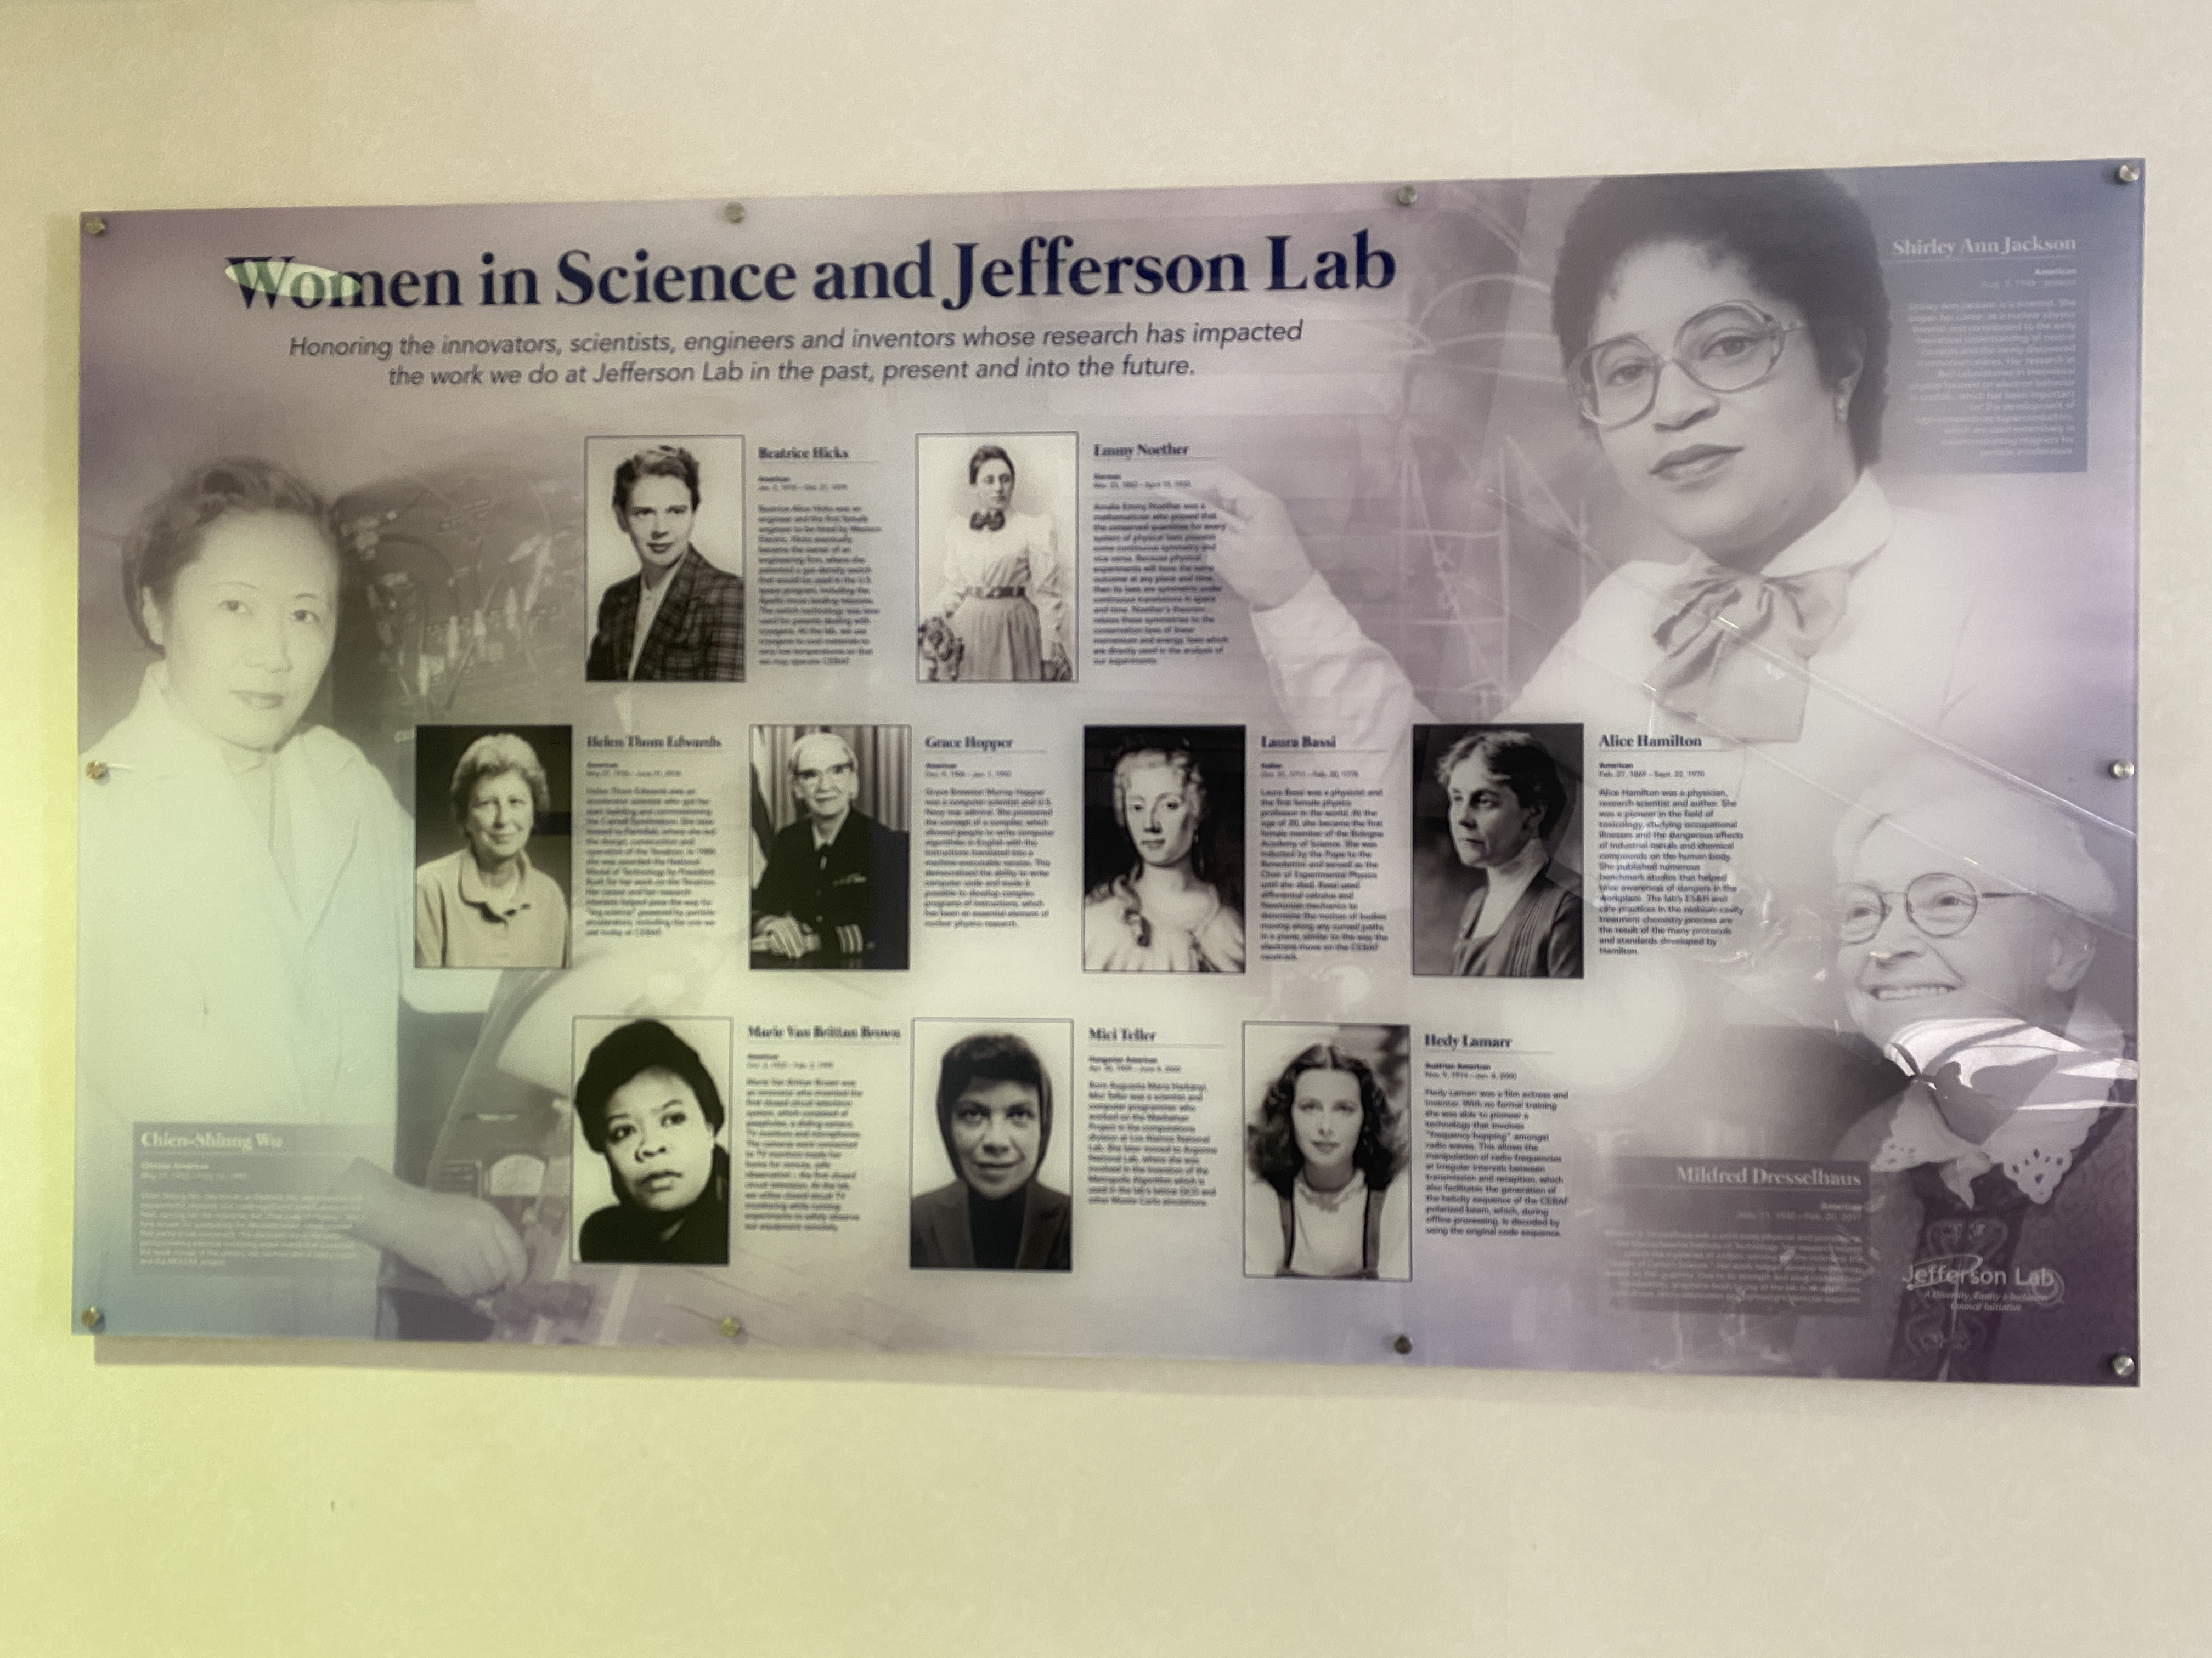
Jefferson Lab DEIA Strategy and Programming
Rhonda Barbosa, Human Resources Director & Ethics Officer
Jennifer Carter, Diversity, Equity, Inclusion and Accessibility (DEIA) Program Manager

Slide 2
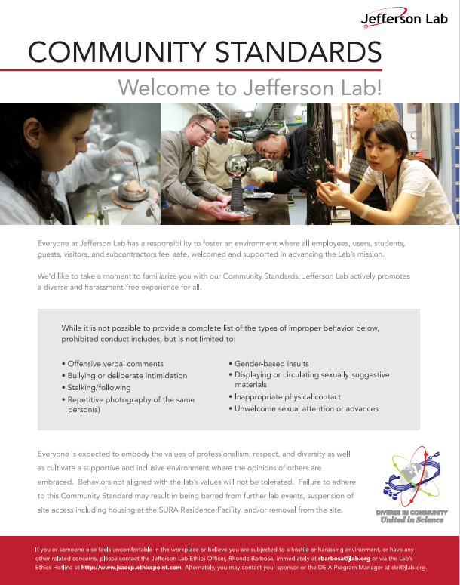
Cultivating a Respectful, Inclusive and Professional lab
The lab’s Community Standards reaffirms our commitment to providing everyone at the lab with an inclusive and welcoming environment
Our goal is to have a professional, ethical and respectful work environment where everyone can contribute to the lab’s mission.

Slide 3
Ground Rules
Remove distractions
Maintain confidentiality
Engage in a respectful and engaging discussion

Slide 4
DEIA is critical to the Jefferson Lab’s Mission and Culture
The foundation of our operations lies in our commitment to Diversity, Equity, Inclusion, and Accessibility (DEIA), guiding us towards creating a sustainable, positive, and productive work environment..
Black History Month with Dr. Chiles, 2024

Slide 5
Lab’s DEIA Strategy Promotes Respect and Innovation

Slide 6
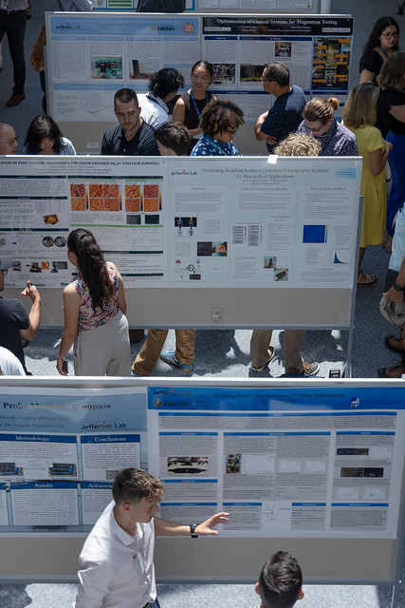
Jefferson Lab’s Multi-Year DEIA Plan Supports the Strategy
Feedback from multiple sources strengthens the connection, including the Inclusion Survey and DOE Peer Review Feedback.
Focus Areas
Outreach – Hired an Outreach Specialist
Strengthened outreach plan aimed at building deeper relationships with local HBCUs: Hampton University, Norfolk State University and Old Dominion University.
DEIA Training – Embed DEIA into Supervisor Academy, New Hire Orientation, performance appraisals and promotion processes. Offer DEIA training classes including LGBTQ+ Safe Zone, Psychological Safety and Allyship@JLab.
Communications – Increase targeted labwide communications through All Hands Meetings and Division and Department meetings, “Ask the Director” and DEIA website redesign.
WDTS Programming, 2024
6

Slide 7
DEIA Strategy Assessment and Looking to the Future
We continue to evaluate our DEIA strategy and look to the future of the lab by:
Focusing on change management as the lab moves to a multi-purpose lab and intensify our focus on safety, inclusion & belonging
Better understanding the needs of our staff as the demographics of the lab changes through increased hiring and retirements
Being ready for external changes such as an administration change and/or contractor change

Slide 8
College & University Partnerships Foster Outreach

Slide 9
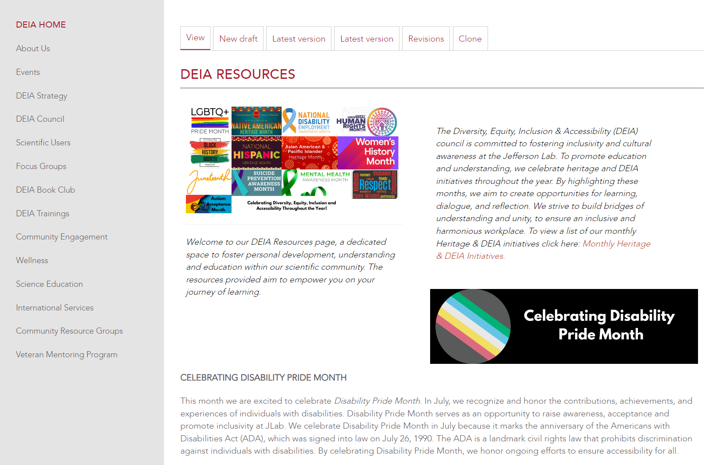
DEIA Website Provides Information to Support All Staff and Users

Slide 10
Questions?

