Slide 1
Jefferson Laboratory Science Programs
David J. Dean
Deputy Director for Science and Technology
Presented To:
OSELP
October 14, 2024

Slide 2
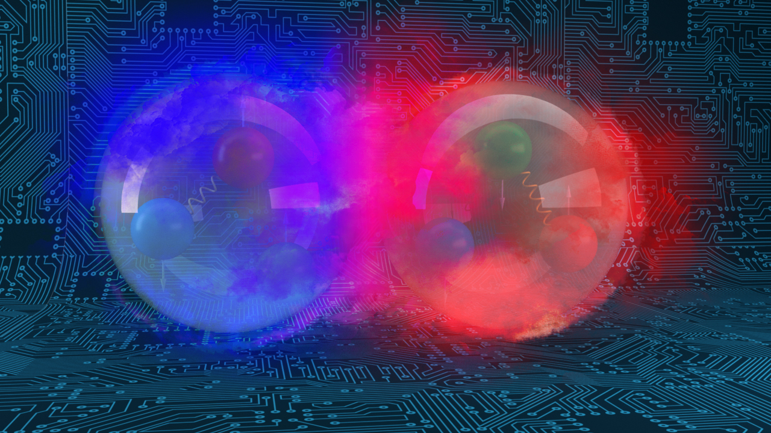
Outline…
Field of Nuclear Physics and Jefferson Lab
Scientific Advances Driven by Data

Slide 3
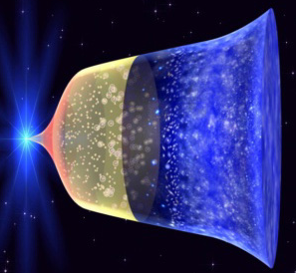
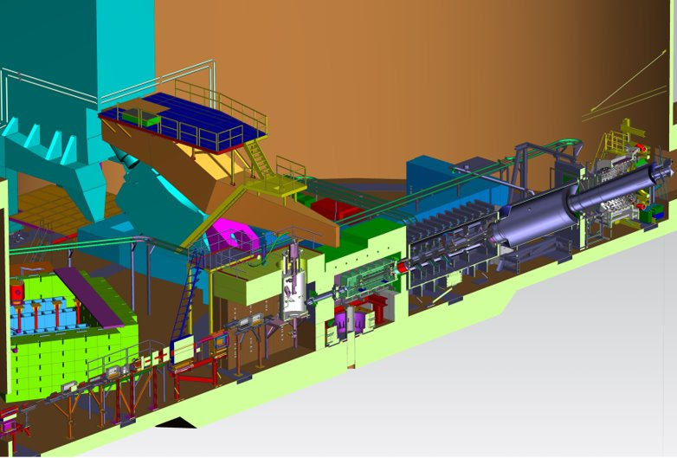

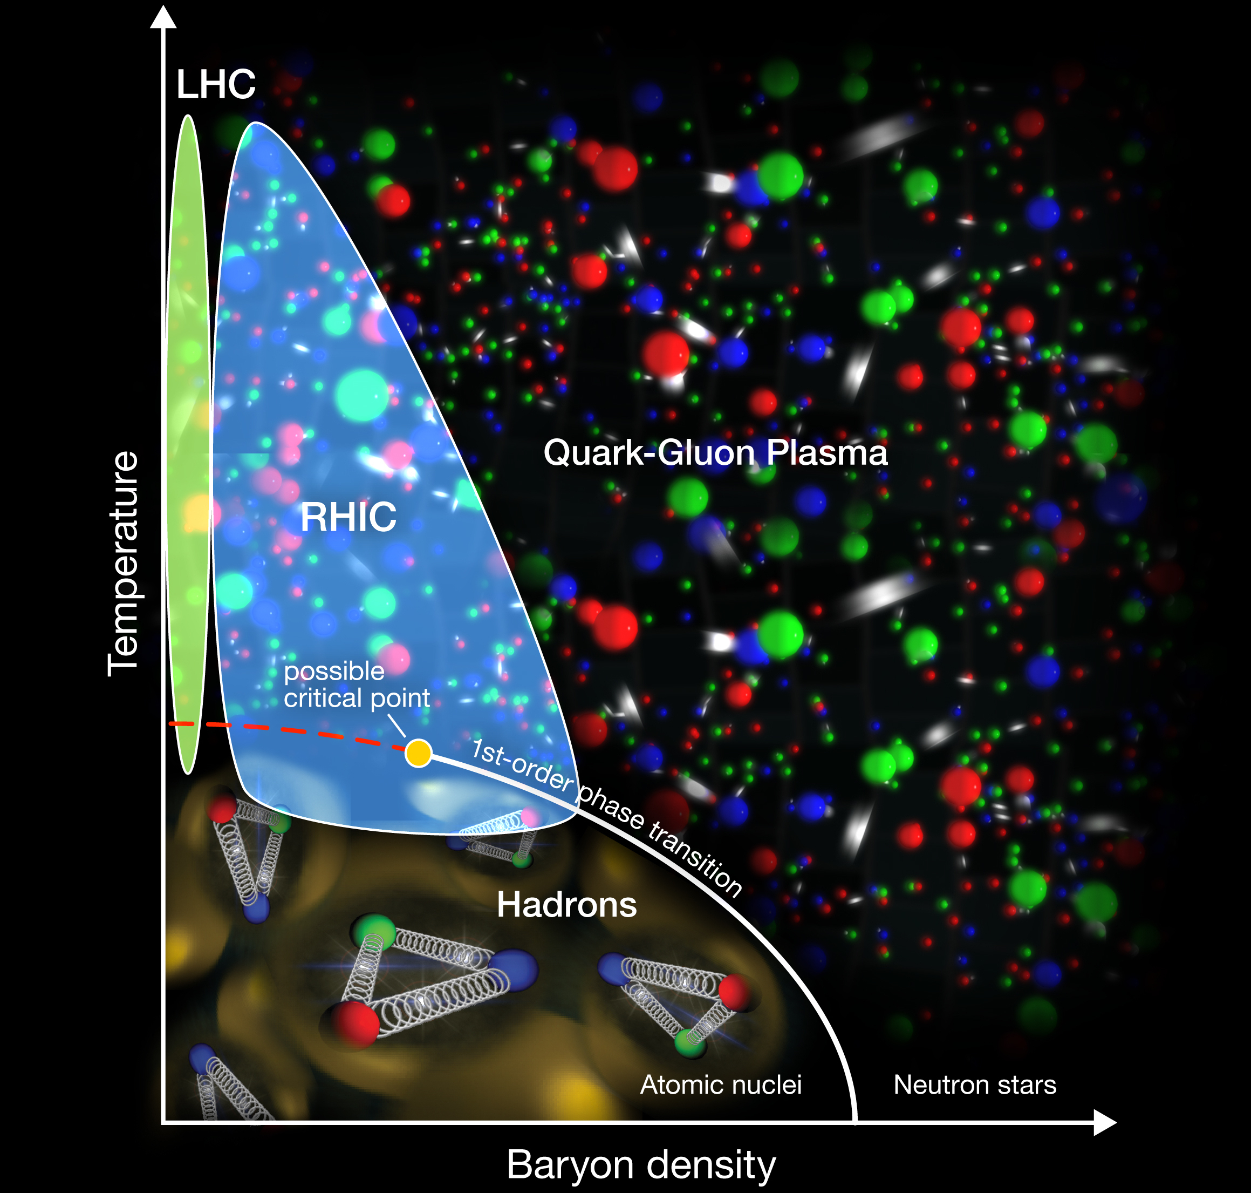
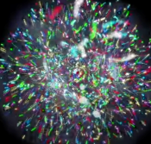
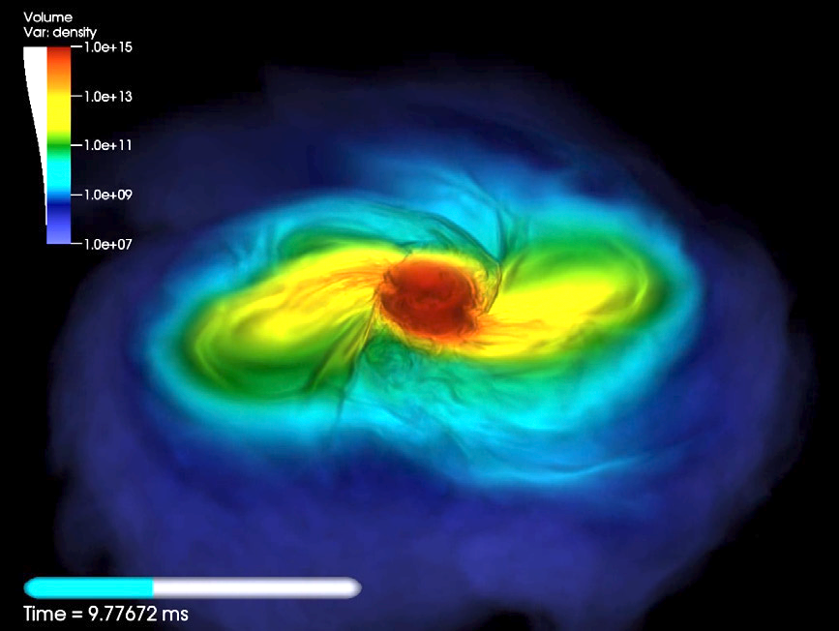
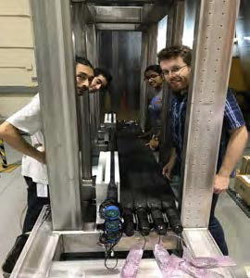
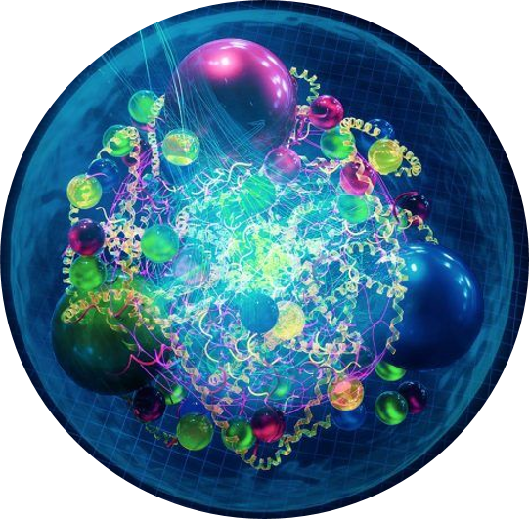
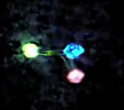
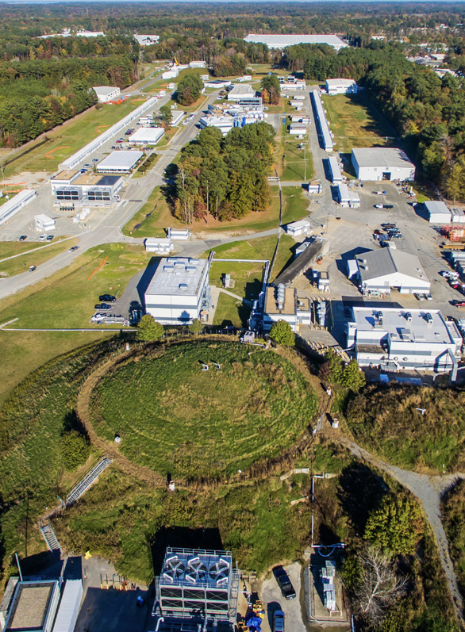
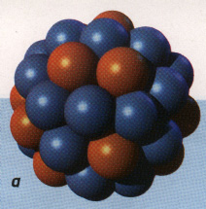
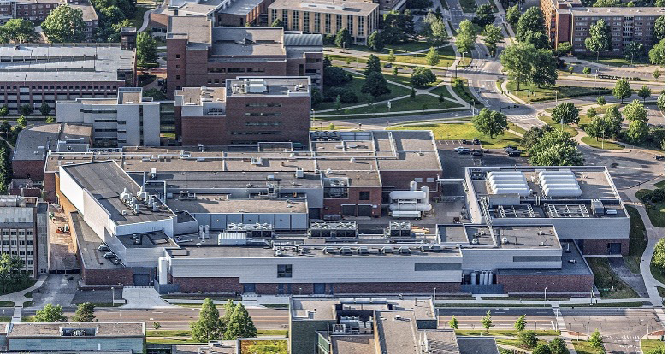
Nuclear Physics across the Universe
Gluons
Fundamental Symmetries (in search of Physics Beyond Standard Model)
Neutron Star Mergers
Credit: BNL
Quarks
Nuclear Physics & Astrophysics
10⁻¹⁰ –10⁻³ sec
The world of QCD
Notes:
<10⁻⁴³ seconds…Planck epoch
<10⁻³⁶ seconds…Grand Unification Epoch
<10⁻³² seconds…inflation epoch
10⁻¹² seconds…electroweak epoch
10-¹² – 10⁻⁶ seconds quark epoch (think QGP)
10⁻⁶ – 1 second the hadron epoch
1 second – neutrino decoupling
1 second – 10 seconds, lepton epoch…(lepton nonconservation…neutrinoless bb decay…)
10 seconds to 3 minutes – BBN
Recombination (electron capture on light nuclei) 370,000 years
150 million years later…first stars and galaxies form…
And they collide!!

Slide 4
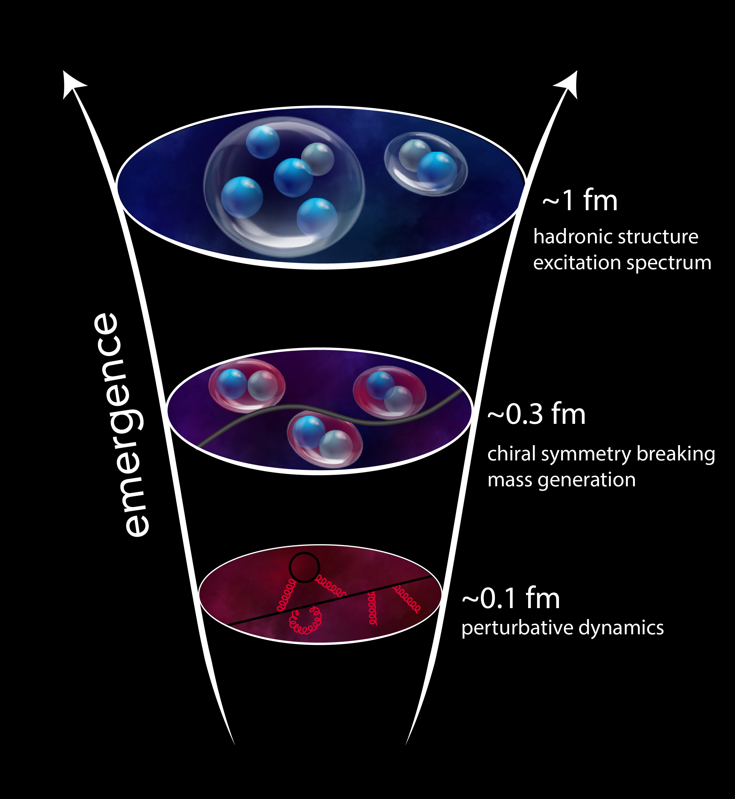
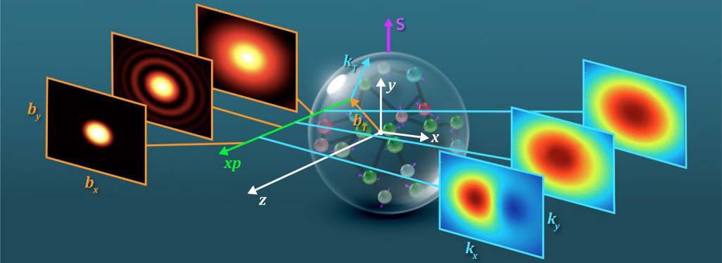
QCD Describes Quark Gluon Interactions
Position
Momentum
Direction of Proton
How do quarks and gluons make up protons, neutrons, and, ultimately, atomic nuclei?
The ability to reduce everything to simple fundamental laws does not imply the ability to start from those laws and reconstruct the universe. -- More is different, P. W. Anderson [Sci 177, 393 (1972)]

Slide 5
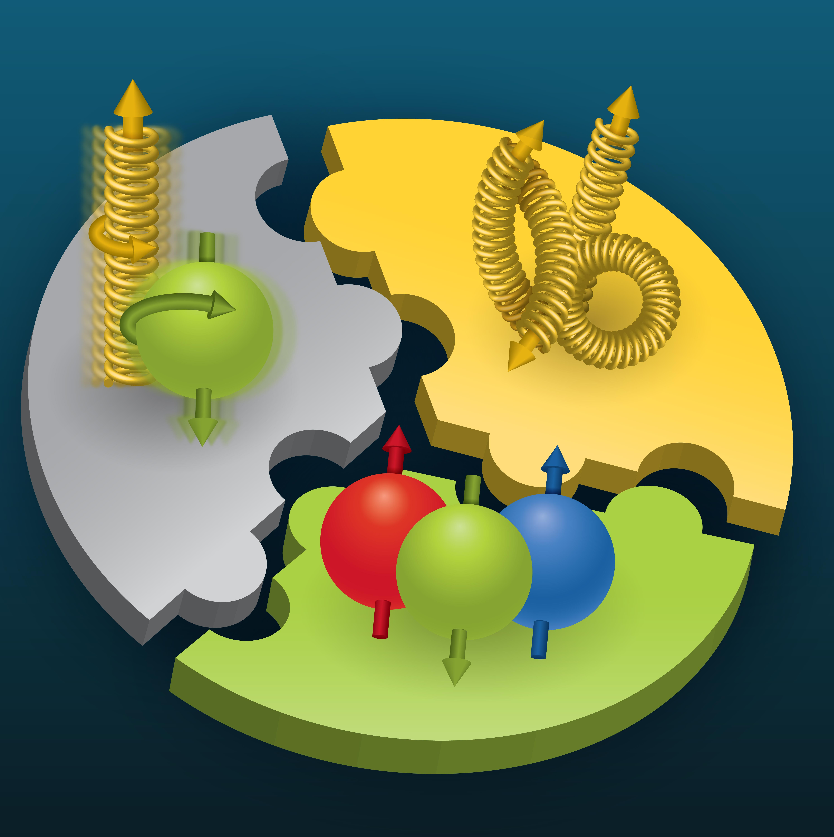
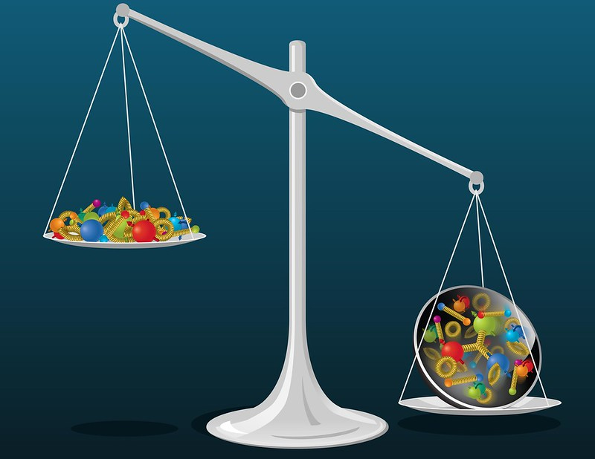
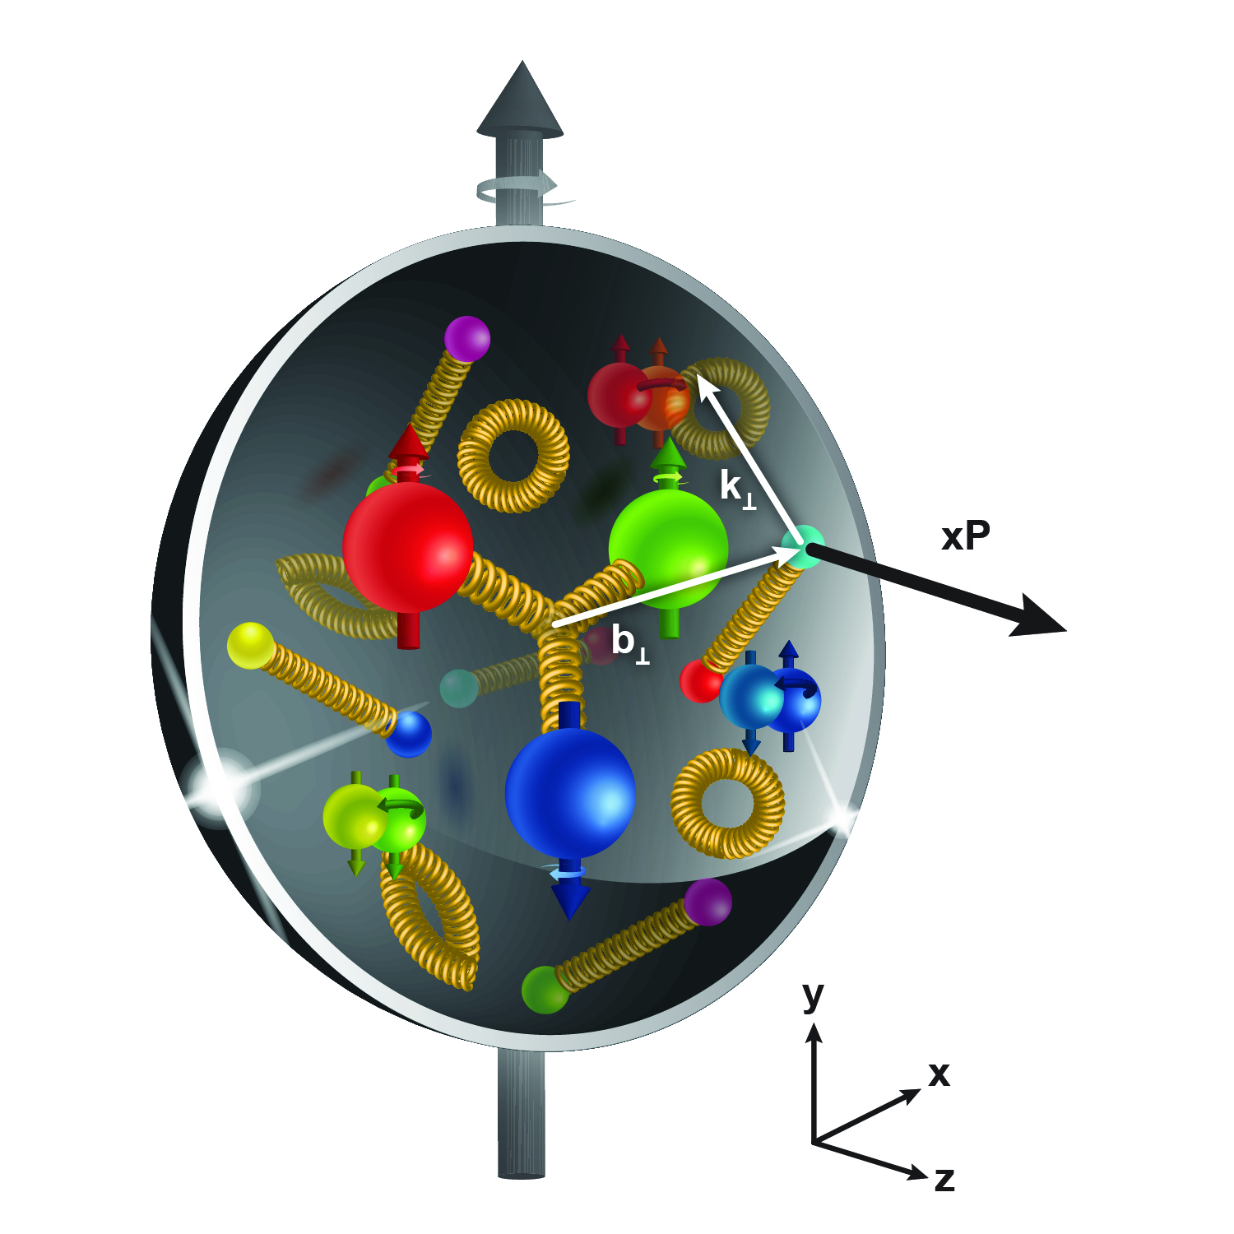
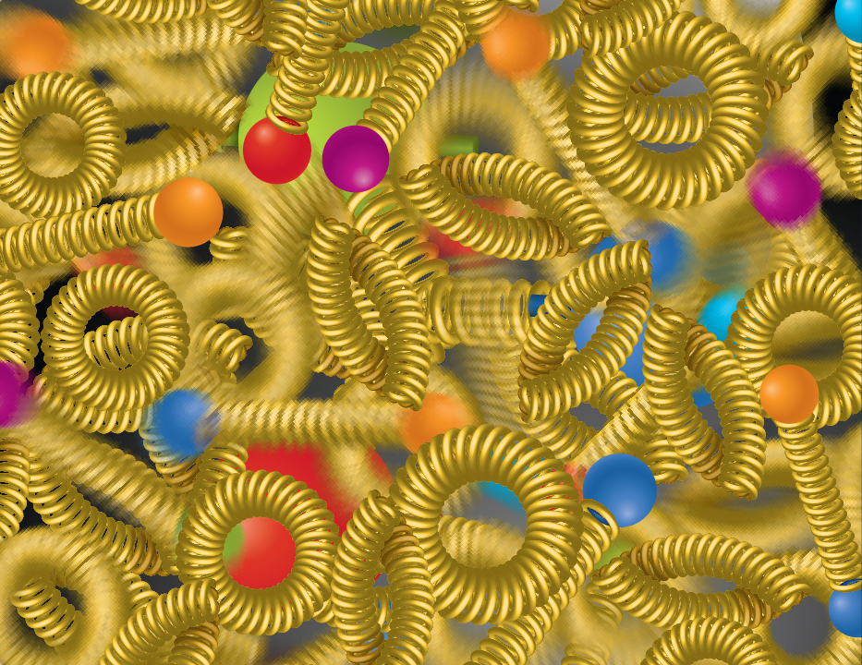
The Strong Force Science Questions
SPIN is one of the fundamental properties of matter.
All elementary particles, but the Higgs carry spin.
Spin cannot be explained by a static picture of the proton
It is the interplay between the intrinsic properties and interactions of quarks and gluons
Does the mass of visible matter emerge from quark-gluon interactions?
Atom: Binding/Mass =0.00000001
Nucleus: Binding/Mass = 0.01
Proton: Binding/Mass = 100
The so-called “QCD trace anomaly determines the proton mass. EIC measurements will determine the gluon term in the anomaly.
How are the quarks and gluon distributed in space and momentum inside the nucleon & nuclei?
How do the nucleon properties emerge from them and their interactions?
How can we understand their dynamical origin in QCD?
What is the relation to Confinement
How many gluons can fit in a proton?
How does a dense nuclear environment affect the quarks and gluons, their correlations, and their interactions?
What happens to the gluon density in nuclei? Does it saturate at high energy?
Is the structure of a free and bound nucleon the same?
How do quarks and gluons, interact with a nuclear medium?
How do the confined hadronic states emerge from these quarks and gluons?
How do the quark-gluon interactions create nuclear binding?
gluon
splitting
=
gluon
recombination

Slide 6
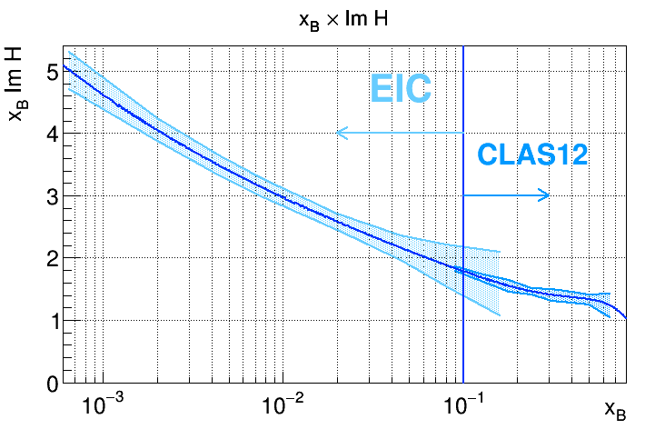
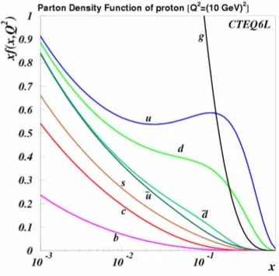
Jefferson Lab and the EIC
CEBAF: ideal for the quark region (down to x~0.1) (studies of threshold charm production)
EIC: ideal for the gluon region (below 0.1)

Slide 7
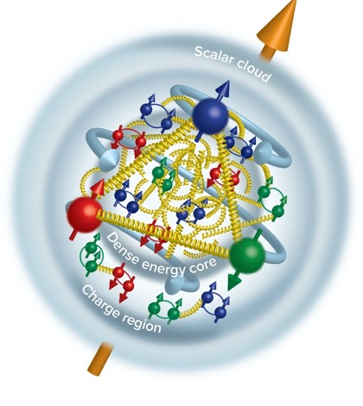
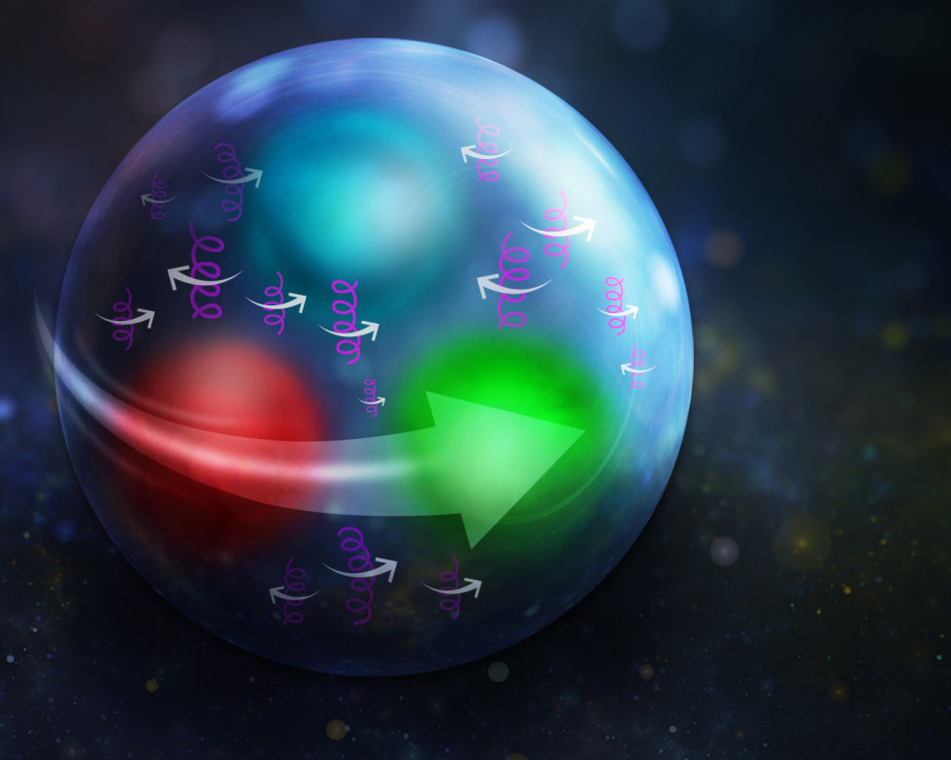
Highlights from Strong force exploration
Closing in on proton spin The Glue is in the middle Proton stress-energy tensor
Tangential stress force inside the proton changes direction near r ~ 0.45 fm
Peak : 38,000 N (4 metric tons)
Karpie et al., Gluon helicity from global analysis of experimental data and lattice QCD Ioffe time distributions, Phys. Rev. D 109, 036031 (2024)
Duran et al “Determining the gluonic gravitational form factors of the proton," Duran et al, Nature 615, 813 (2023)
Burkert, et al., Colloquium: Gravitational form factors of the proton. Reviews of Modern Physics 95, 041002 (2023)

Slide 8
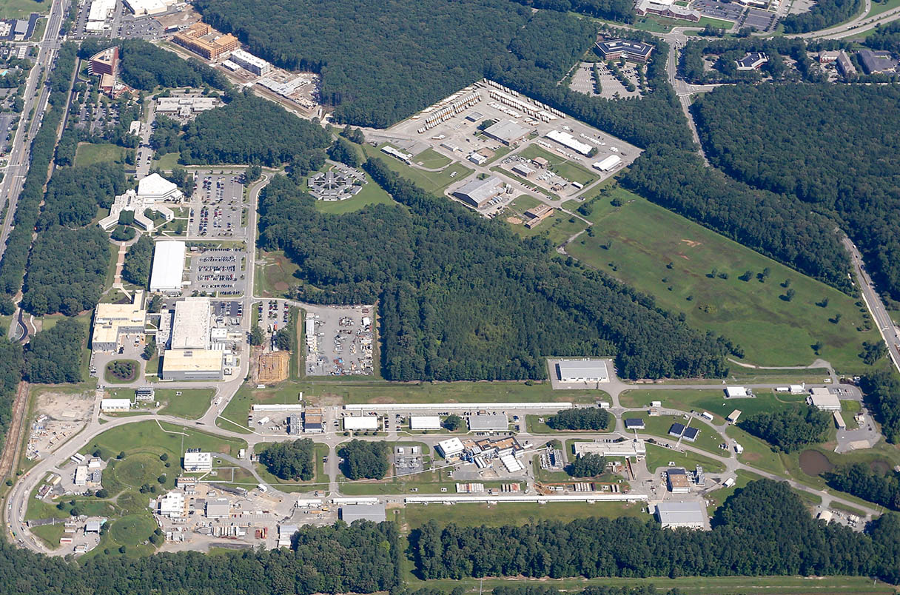
CEBAF: Race-track design to send polarized electrons at different energies and different currents to multiple halls simultaneously with up to 1.1 Megawatt of power.

Slide 9
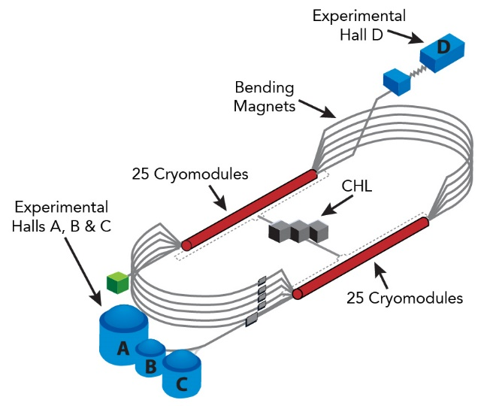
CEBAF: The Continuous Electron Beam Accelerator Facility
Accelerator
  Two 1 GeV Superconducting Linacs
  418 SRF cavities in 52 cryomodules with associated RF systems
  7 km of beamline
  > 2800 magnets
  > 500k channels in accelerator control system
  Independent beam delivery with tunable current from 100 uA to few nA
  1 MW beam power capable
Experimental Halls
  4 Halls, simultaneous operation
  23 Superconducting magnets in operation
  Two 1MW beam dumps
  Up to 2.5 kW cryogenic targets
  Well over 100k data channels
  1 nm position difference of beams with different helicity
Cryogenics
CEBAF is one of the largest and most complex accelerator-based scientific
facilities in the U.S. and the world
  5 Cryogenic plants
  Largest 2K cryoplant in the world; combined capacity of 9.4 kW@2K
  115,000 liquid liters He

Slide 10
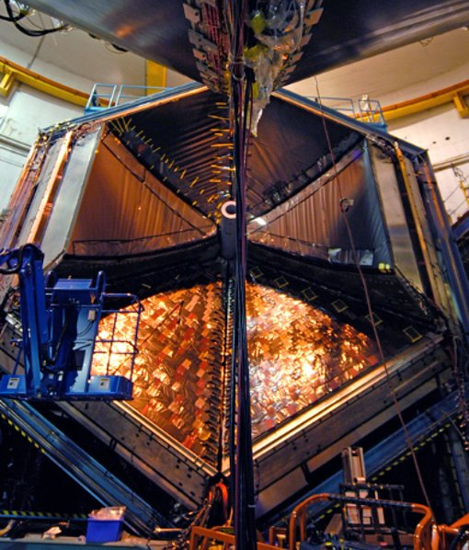
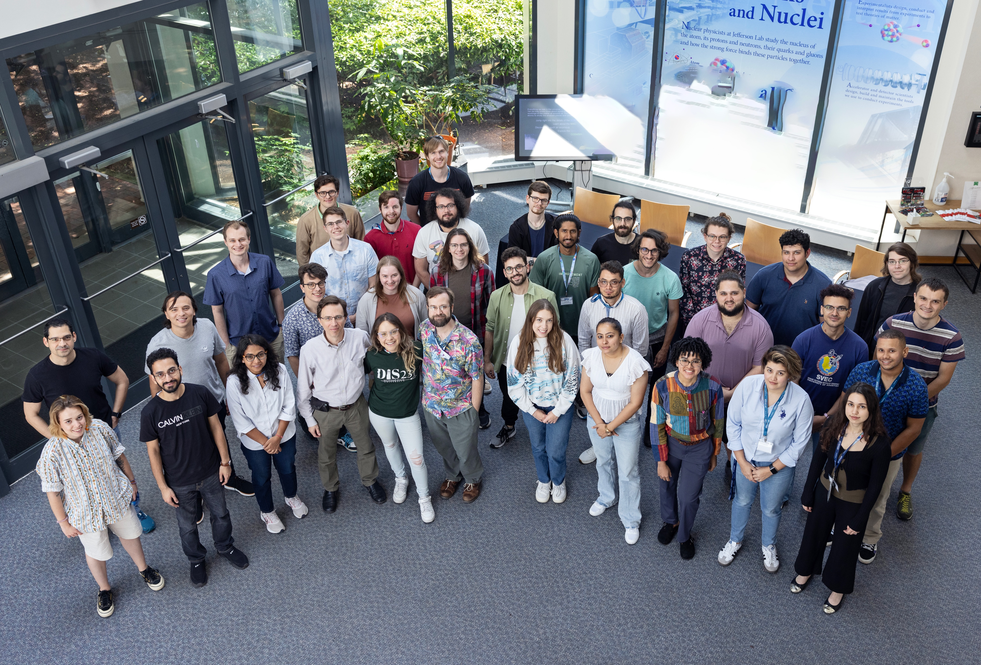
FY24 was a good physics year
30 weeks of Physics (9/5/23 – 5/19/24)​
  3 weeks more than planned to complete high-priority experiments​
  Reliability at 76% (vs. planned 77%)​
259 ’PAC’ days run: 5 Experiments Completed and 8 Experiments Partially Completed ​
(in Halls A, B, and C, with D installing new GlueX detector capability)​
98 journal publications; 27 PhD thesis produced; 185 invited talks​
Workforce of the future: 66 undergrad 177 grad, and 55 post-docs in residence at the laboratory in FY24​
R&D effort resulted in 3 patents; 10 invention disclosures during FY24​
  $437K from the Office of State and Community Energy Programs​
  $285k from Technology Commercialization Fund ​
  Projects in collaboration with Sandia and PNNL
Numerous new R&D funding from: NP, HEP/ARDAP, ASCR with new research in accelerator applications, superconducting electronics, AI/ML​
HUGS, 2024

Slide 11
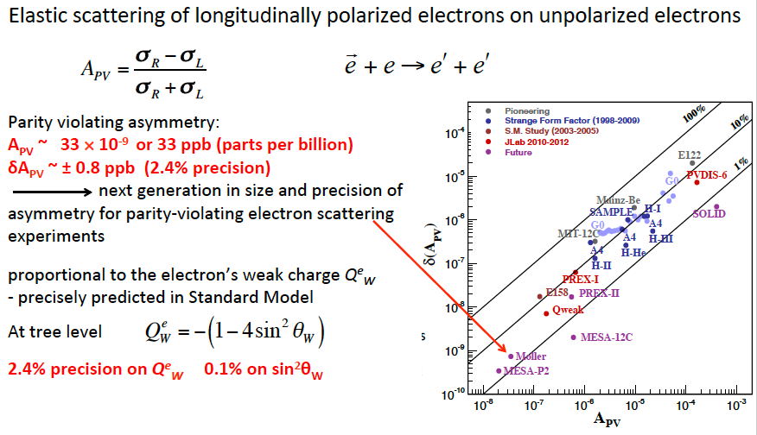
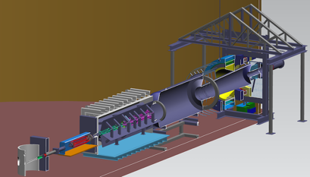
Moller: Testing the Standard Model to 27 TeV
MOLLER will probe energy regions for Beyond Standard Model Physics to ~27 TeV in this Q-weak sector
LHC energies: 13 TeV
Excellent technical work being accomplished.
CD-2/3 achieved in May FY24.

Slide 12
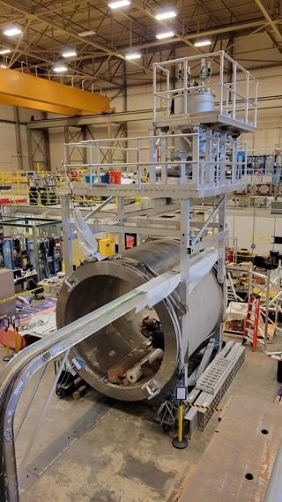
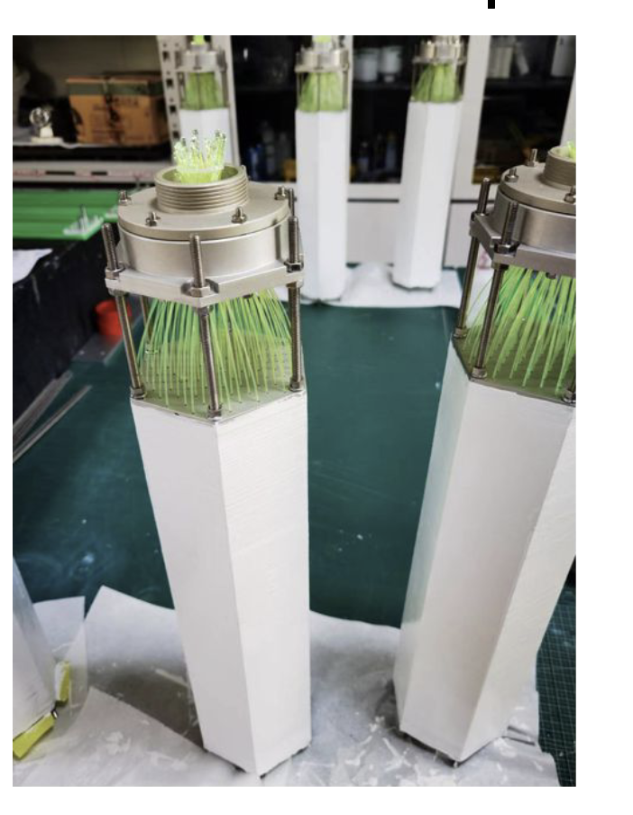
SoLID Fully Enables CEBAF 12 GeV at the Intensity Frontier
The SoLID science program was endorsed by the 2023 NSAC Long Range Plan (Recommendation #4) as one of the projects "that lay the foundation for the discovery science of tomorrow". SoLID is mentioned positively over 25 times in the Plan.
Nucleon spin, proton mass, BSM experiments require precision measurements of small cross sections and asymmetries, combined with multiple particle detection
There is a critical need for a high luminosity 10³⁷-10³⁹ cm⁻²s⁻¹ and large acceptance working in tandem – takes full advantage of Jefferson Lab capabilities
SoLID Whitepaper Published in: J.Phys.G 50 (2023)
Highlights of SoLID scientific programs and instrumentation
Risk-reducing R&D continues!
SoLID cost updated FY2023 (TPC = ~$92M)
Experimental operations and CE, with some sacrifice, could support ~$24M dependencies
Electromagnetic Calorimeter Prototype for the SoLID Project at Jefferson Lab
TIPP, SPRINGER NATURE (2018)
Magnet testing

Slide 13
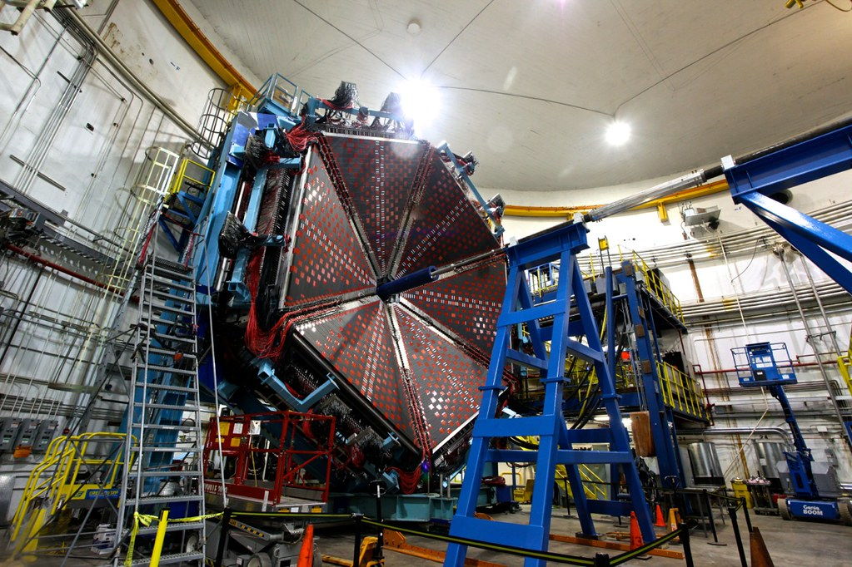
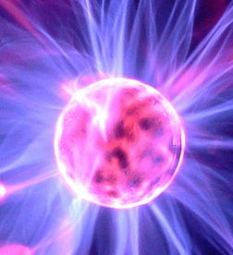
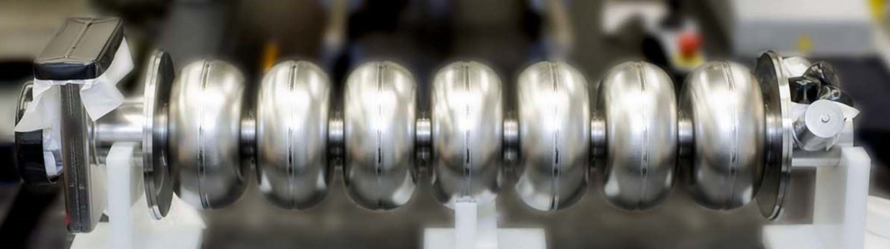
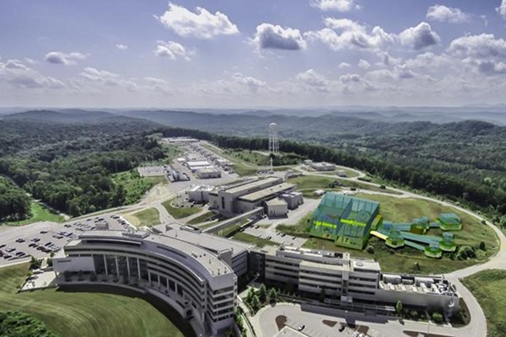
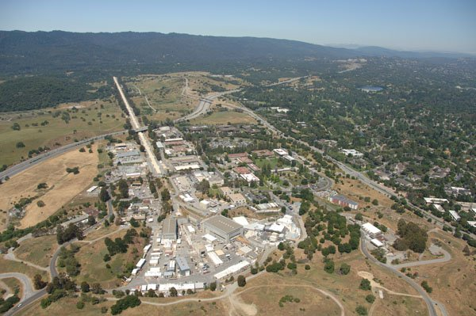
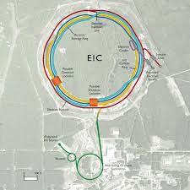

Advanced Detectors and accelerators make our quest possible
Theorists guide experiments & interpret results
SRF R&D makes accelerators better
e
H
SRF Capability enables research in chemistry, materials, medical research, isotope production
US-based MicroPattern Gaseous Detector Facility - A proposed User Resource

Slide 14
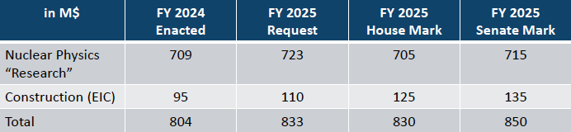
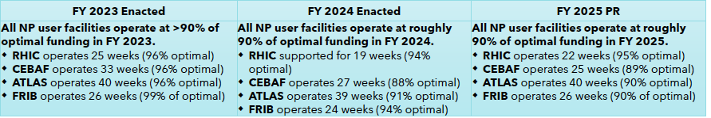
Working Through FY25 uncertainties
FY25 Budget does affect weeks of CEBAF Operations: from Linda Horton presentation at NSAC, September 12, 2024
DOE, Office of Science,
Office of Nuclear Physics

Slide 15
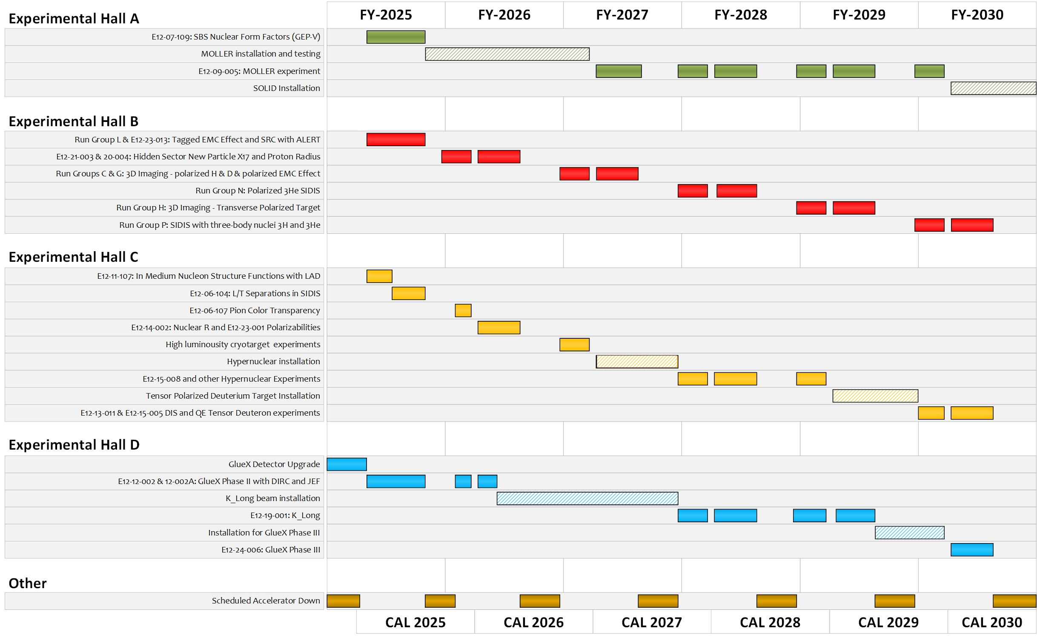
TENTATIVE Long-Term Schedule
Shown with 25 weeks of physics running in FY25 and FY26 and our optimal 32 weeks of physics running in the out years.
Optimizing the science output
  During MOLLER running, modest current experiments planned for Hall C to keep total machine power under 1.1 MW.
  During MOLLER installation, non-standard energy experiments in Halls B, C.
By FY31 ~80% complete without SoLID and ~70% complete with SoLID.
Approved positron experiments require an additional several years.

Slide 16
Summary and Outlook I
Nuclear physicists discover, explore, and understand all forms of nuclear matter. While we have a good understanding of quarks and gluons, how they interact inside matter remains to be explored. CEBAF and the EIC are exciting places to continue this quest for understanding.
Data, coming from both experiment and theory, will be a key driver in our quest to understand the proton…
Scientific Advances Driven by Data

Slide 17
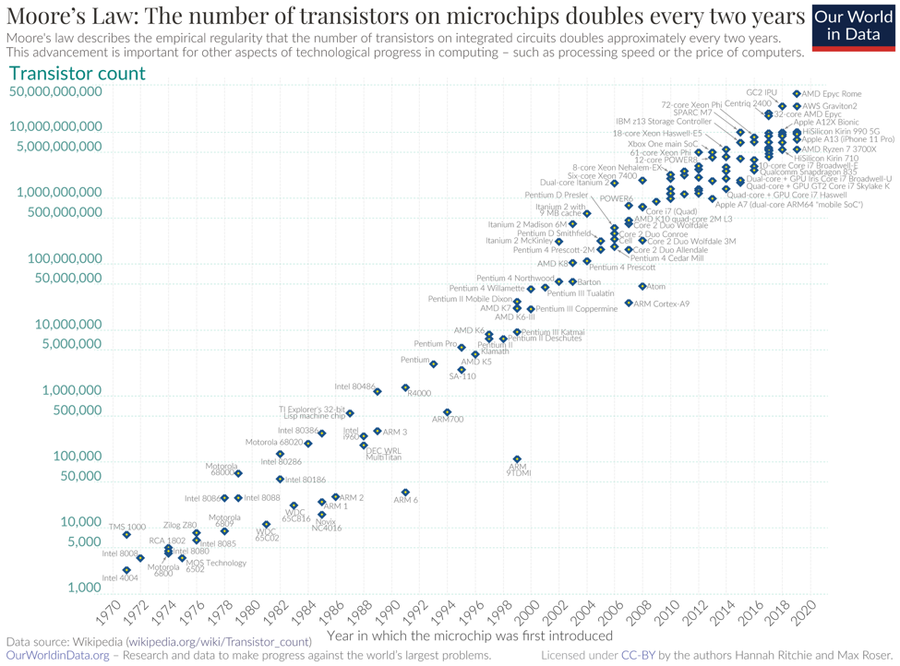
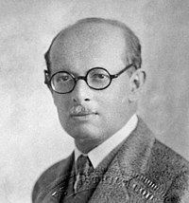
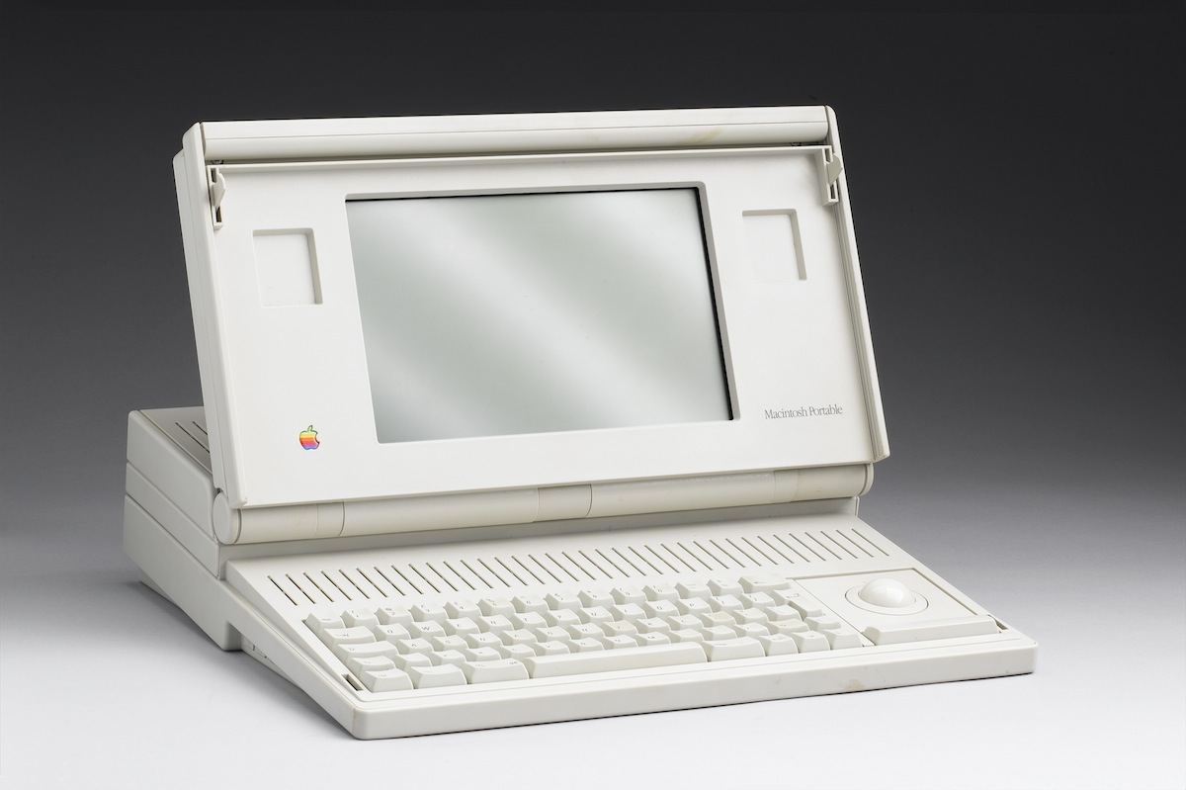
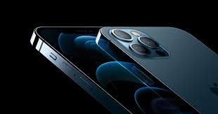
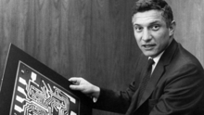
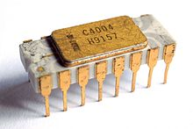
Lillenfeld
Transistor theory
1926
Bell labs
1947
16 MHz
200k transistors
9 MB ram
16 pounds
$15k (today)
Bardeen, Shockley, Brattain
First Si IC
Fairchild
A14, 3.1 GHz 6 core, neural engine; 11.8 billion transistors; 256 GB ram
4.76 ounces; ~$1,000.00
A16: 16 billion transistors; 5 nm; 16 core neural engine
Robert Noyce
1957
2,250 transistors

Slide 18
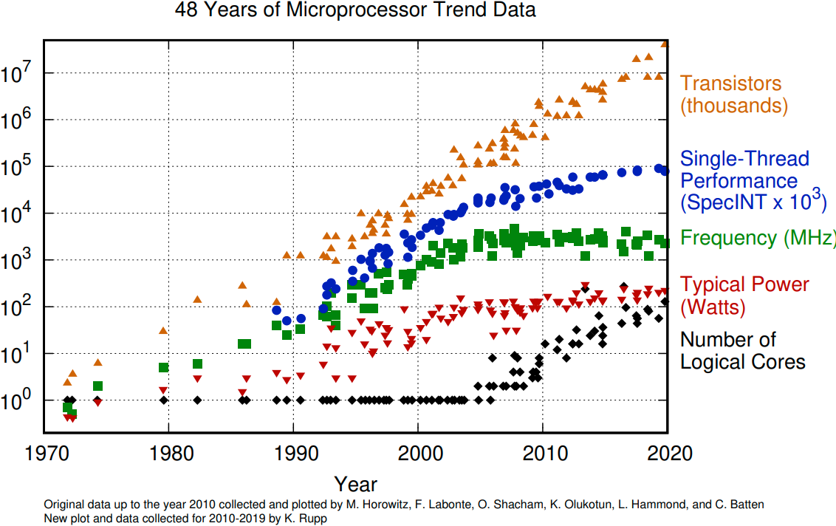
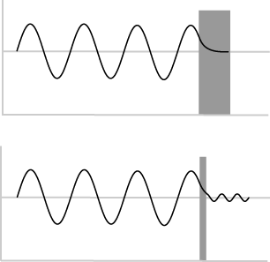
Moore’s Law and other trends
Moore’s Law must end…
free Si diameter is 0.2 nm
Quantum tunneling increasingly hampers transistor density below about 5 nm.
2020: 5nm
2025: 2nm
Dennard Scaling ends in the mid-2000s (as transistors get smaller their power density stays constant…)

Slide 19
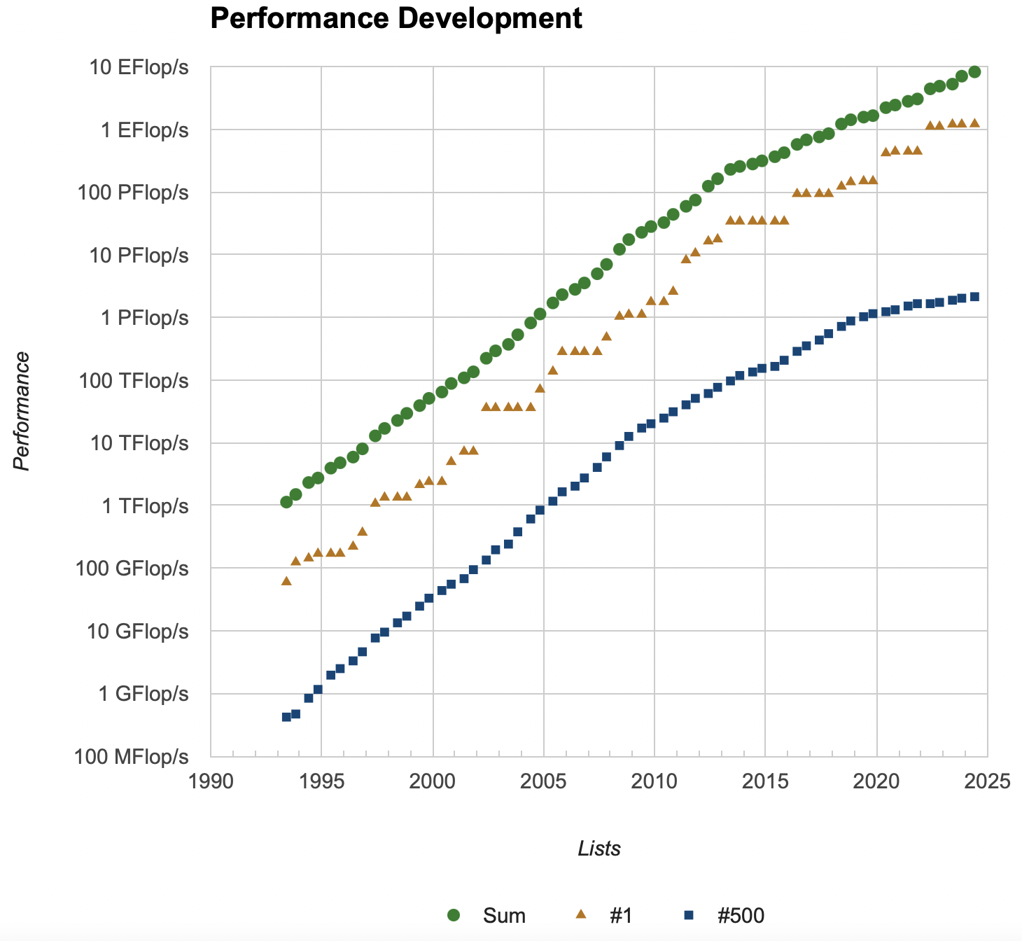
The world’s fastest computers do amazing work
Rank | System | Cores | Rmax (PFlop/s) | Rpeak (PFlop/s) | Power (kW)
1 | Frontier - ORNL | 8,699,904 | 1,206.00 | 1,714.81 | 22,786
2 | Aurora ANL | 9,264,128 | 1,012.00 | 1,980.01 | 38,698
3 | Eagle - Microsoft United States | 2,073,600 | 561.20 | 846.84
4 | Fugaku - Japan | 7,630,848 | 442.01 | 537.21 | 29,899
5 | LUMI Finland | 2,752,704 | 379.70 | 531.51 | 7,107
6 | Alps Switzerland | 1,305,600 | 270.00 | 353.75 | 5,194
7 | Leonardo - Italy | 1,824,768 | 241.20 | 306.31 | 7,494
8 | MareNostru Spain | 663,040 | 175.30 | 249.44 | 4,159
9 | Summit - ORNL | 2,414,592 | 148.60 | 200.79 | 10,096
10 | Eos NVIDIA Corporation United States | 485,888 | 121.40 | 188.65
Curves appear to go linear around position 100…
Compute intensive: solving PDEs (requires fast FLOPs)
Most of the execution time goes to floating-point operations

Slide 20
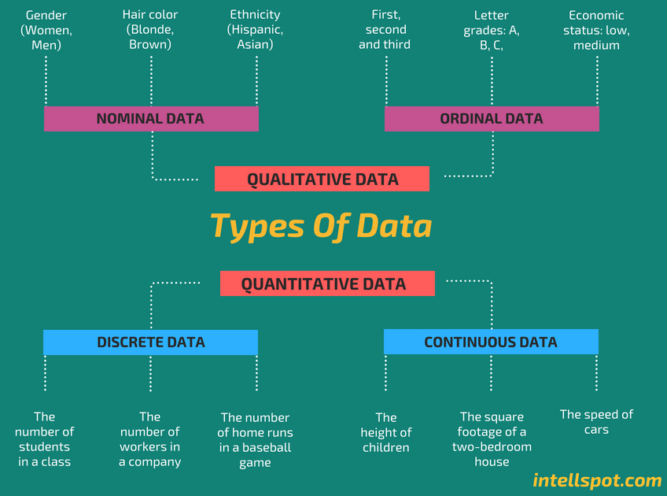
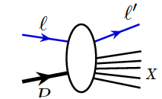

Data has become a commodity in life and physics
Scattering data is more or less discrete (digitized)
It is also similar (splat-on-splat, Venton Cerf)
It is usually not complete

Slide 21



The data strategy extends from a new facility through R&D and application: High Performance Data Facility
Establish HPDF as the premier Data Science facility for SC and DOE
Generate foundational research and prototype computing systems to inform pathways for the integrated ecosystem.
Drive and enable AI/ML applications across the sciences. Grow in traditional computer science and applied math. Integrate facilities, workflows, algorithms, software and application tools.
Position HPDF as an integral component of a single, larger computational ecosystem that bolsters national S&T capabilities
Lead the NP engagements for IRI and an HPDF spoke. How: hold workshops, build on current research (EJfat, streaming grand challenge), and influence EIC computing model
JLDC
Application: AL/ML improve integrating into CEBAF Ops
HPDF hardware concepts

Slide 22


HPDF will be at the Heart of Data and Computation in the Office of Science
The HPDF (data intensive), other HPC facilities (compute intensive),
User Facilities…coupled through ESNet represent components of the ‘Integrated Research Infrastructure’ connects all SC user facilities

Slide 23

Cost to train models (it takes many millions)
Training GPT-4 took ~ 3 months on an exascale equivalent computer

Slide 24

Big Data Equals Big Electricity Requirements
Source: Virginia Mercury, 28 May 2024
The utility has connected 94 data centers to date and expects to connect another 15 this year, Blue also told investors. Power Engineering reported on a Securities Exchange Commission annual filing that in 2023 and 2022, 24% and 21% of electricity sales from Dominion were to data centers, respectively.
Dominion projects its load growth, which includes data centers and vehicle electrification, to increase from 17 gigawatts in 2023 to 33 gigawatt in 2048.

Slide 25
Summary and Outlook II
Computing technology, built on silicon, has enabled a revolution in almost every facet of life and science; this 70-year trend will continue although the underlying technology is reaching maturity (linear growth)
Physics requires experiments, data, and theory…working hand in hand to explain phenomena…
  there is a valid, proven, way to practice science: ask a falsifiable question, construct a hypothesis, perform an experiment, refine hypothesis…repeat…
  There is also an incorrect way to practice science which leads to alchemy: collect data, find patterns magically, forget theory, repeat
Poincare’: Science is built of facts the way a house is built of bricks: but an accumulation of facts is no more science than a pile of bricks is a house.

