Slide 1
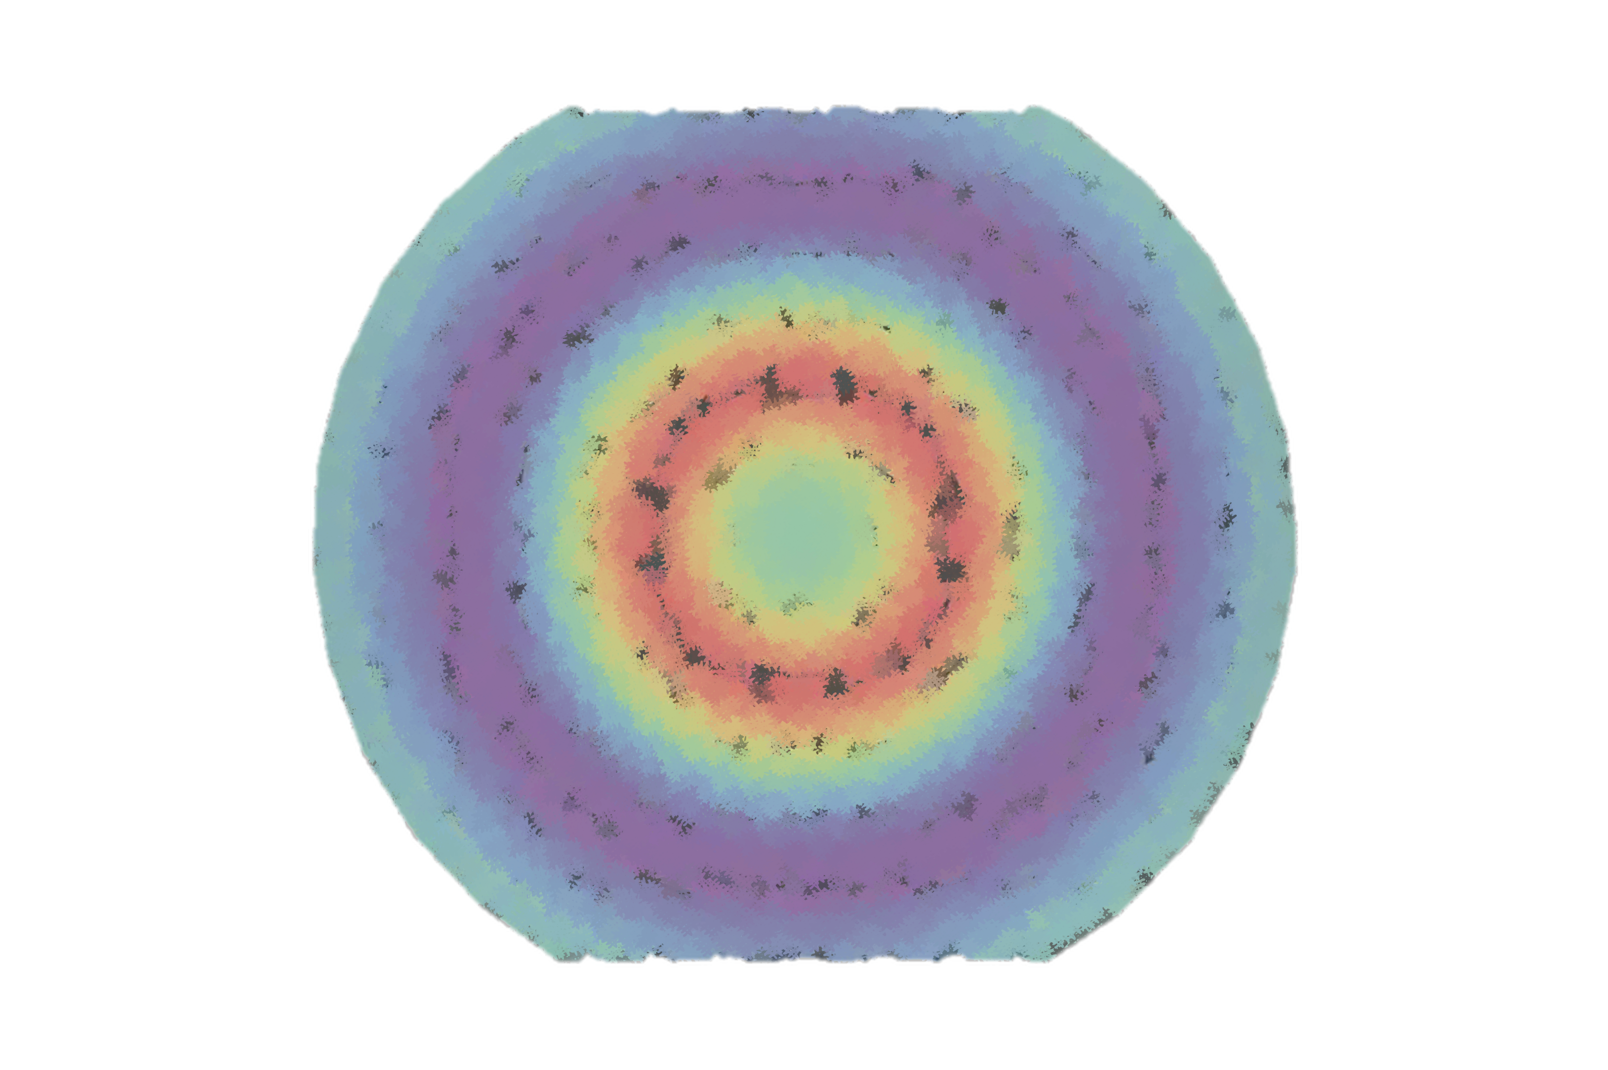
The Mechanical structure of the proton at solid
Henry Klest
Argonne National Laboratory
hklest@anl.gov
Hall A Winter Collaboration Meeting
January 16, 2025

Slide 2
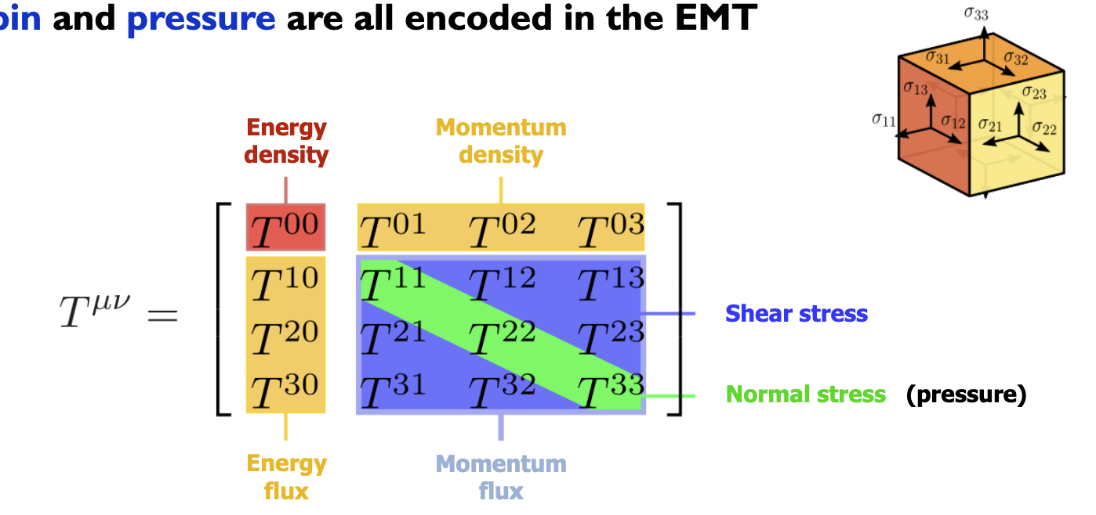
Proton mechanical structure
Proton mechanical structure is defined by analogy to GR via the QCD energy-momentum tensor (EMT)

Slide 3
Gravitational form factors
Proton gravitational form factors (GFFs) encode information about the matrix elements of the QCD energy-momentum tensor
EMT Matrix Elements

Slide 4
Gravitational form factors
Proton gravitational form factors (GFFs) encode information about the matrix elements of the QCD energy-momentum tensor
Form factors
Fourier transforms of spatial distributions

Slide 5
Gravitational form factors
Proton gravitational form factors (GFFs) encode information about the matrix elements of the QCD energy-momentum tensor
Form factors
Fourier transforms of spatial distributions
“Gravitational”
Describing the energy-momentum tensor
I.e. what would be seen from proton-graviton scattering

Slide 6
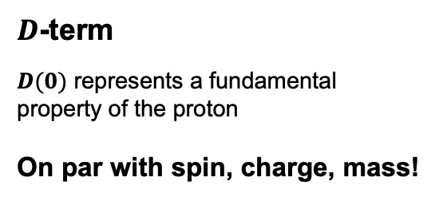
Gravitational form factors
Proton gravitational form factors (GFFs) encode information about the matrix elements of the QCD energy-momentum tensor
$D$-term
$D(0)$ represents a fundamental property of the proton
On par with spin, charge, mass!

Slide 7
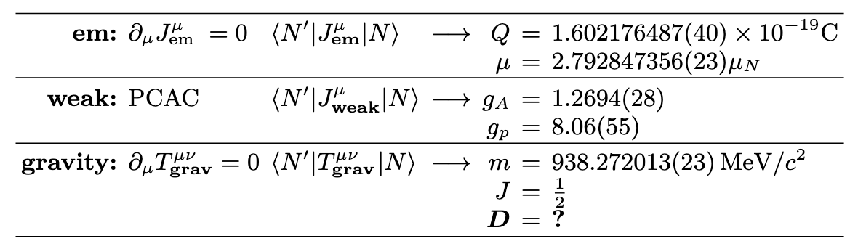

Gravitational form factors
Proton gravitational form factors (GFFs) encode information about the matrix elements of the QCD energy-momentum tensor
$D$-term
Often called the last global unknown property of the proton!

Slide 8
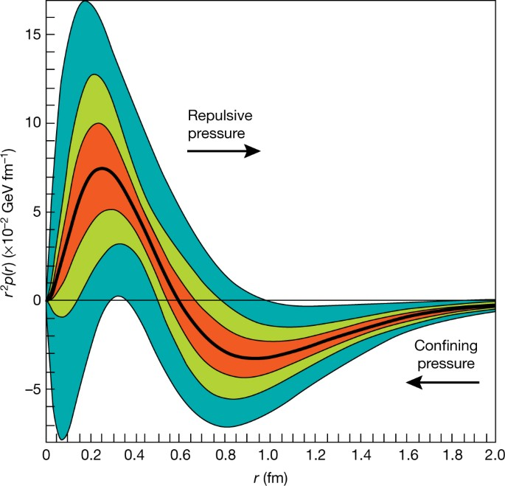
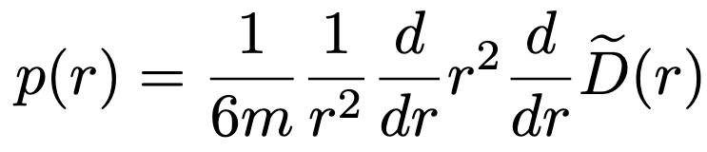
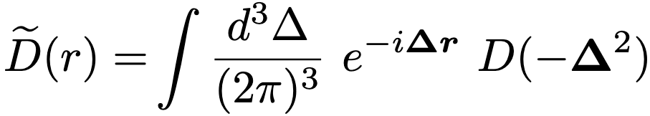
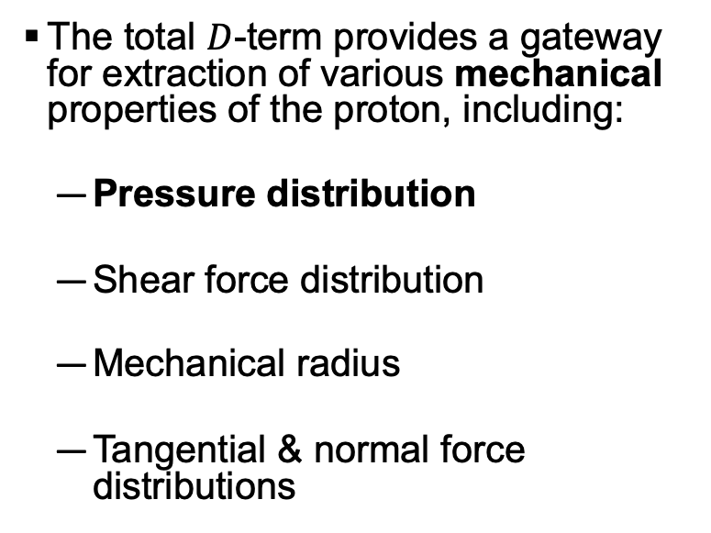
Mechanical properties
The total $D$-term provides a gateway for extraction of various mechanical properties of the proton, including:
  Pressure distribution
  Shear force distribution
  Mechanical radius
  Tangential & normal force distributions
Pre-Jlab 6 GeV Data
Jlab 6 GeV Data
Jlab 12 GeV Data (Projected)

Slide 9
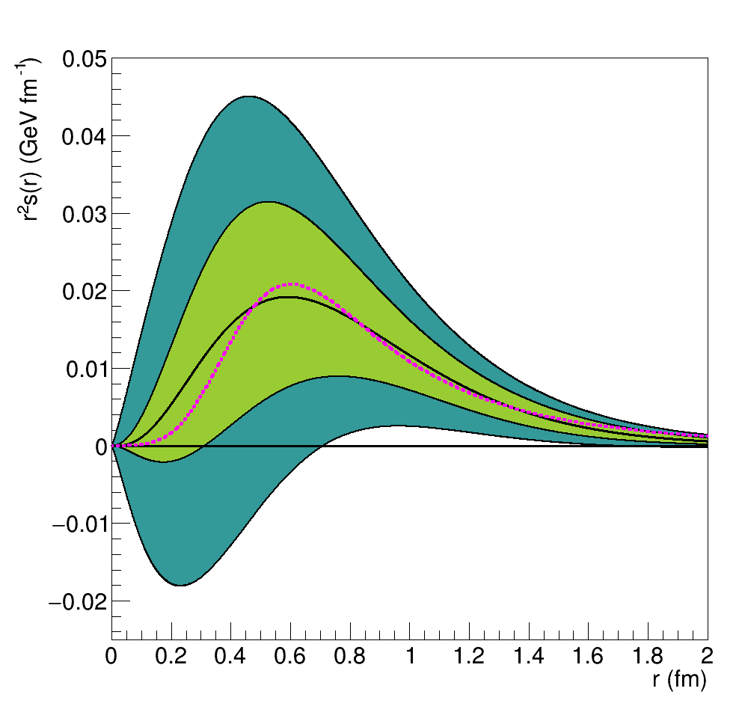
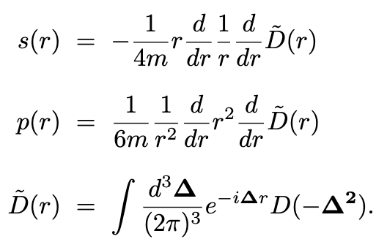
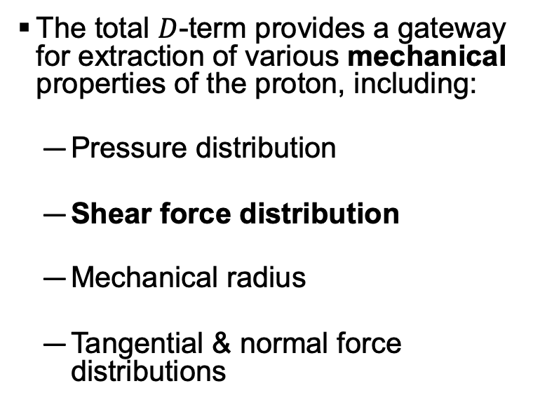

Mechanical properties
The total $D$-term provides a gateway for extraction of various mechanical properties of the proton, including:
  Pressure distribution
  Shear force distribution
  Mechanical radius
  Tangential & normal force distributions
Pre-Jlab Data
Jlab 6 GeV Data
$χQSM$ Prediction

Slide 10
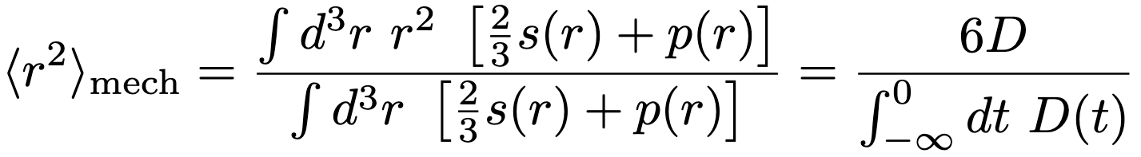
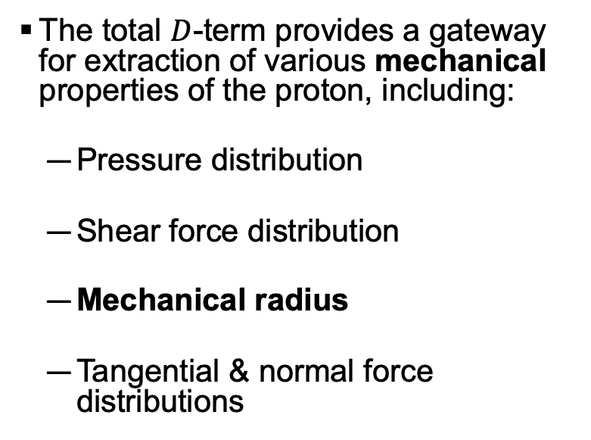
Mechanical properties
The total $D$-term provides a gateway for extraction of various mechanical properties of the proton, including:
  Pressure distribution
  Shear force distribution
  Mechanical radius
  Tangential & normal force distributions

Slide 11
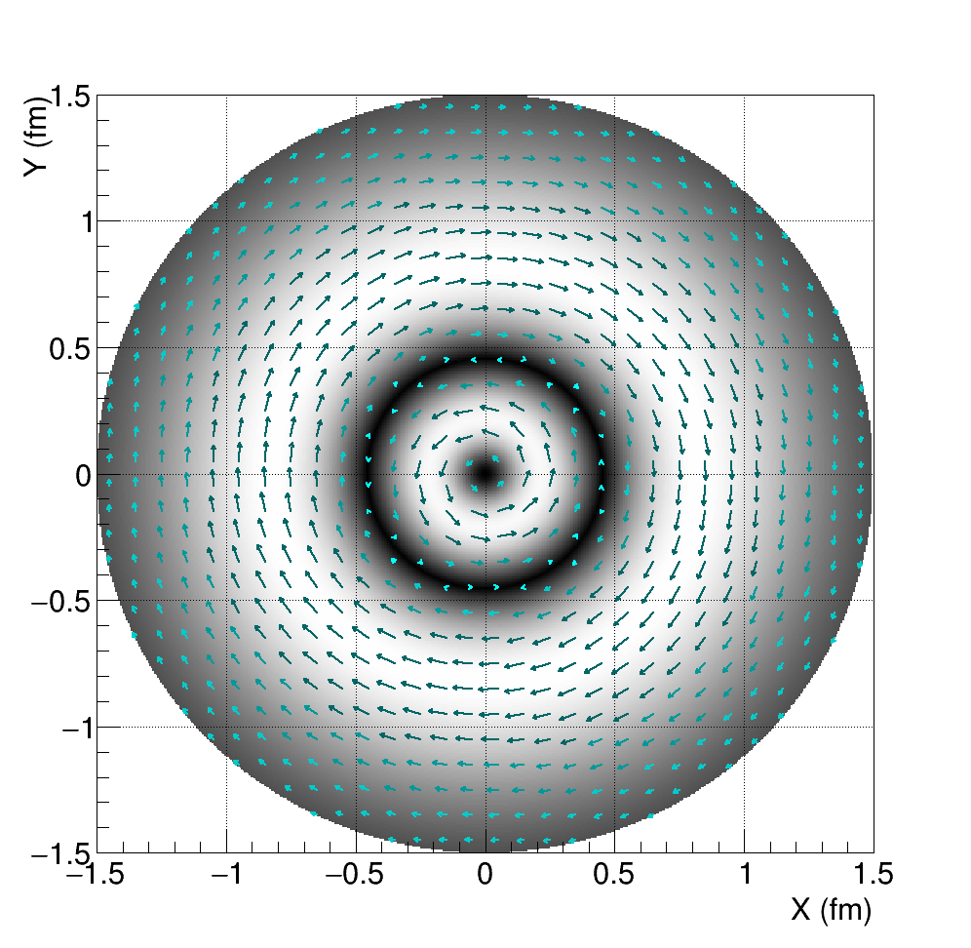
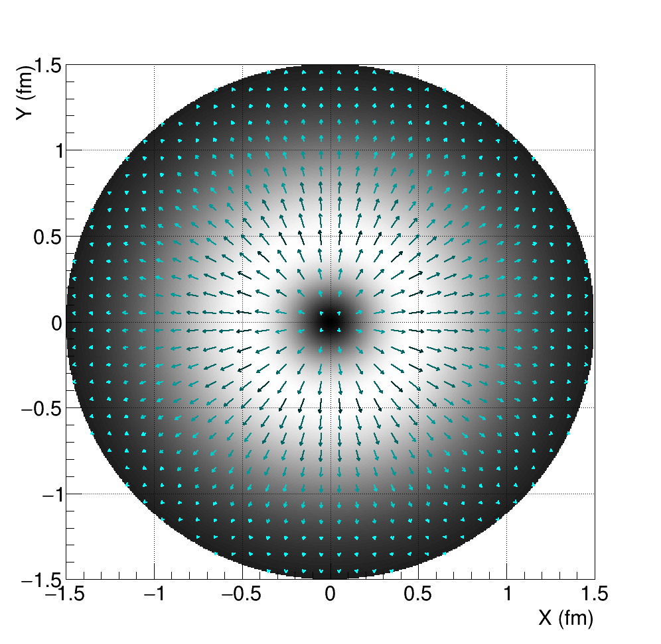
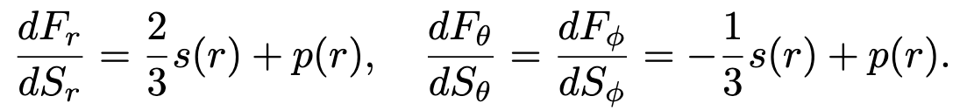
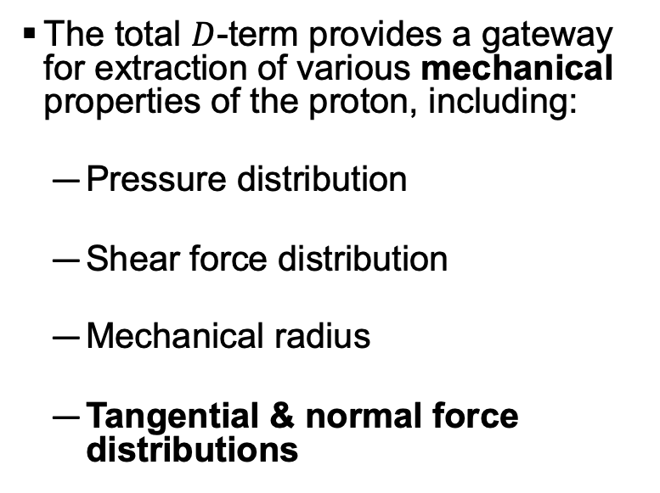
Mechanical properties
The total $D$-term provides a gateway for extraction of various mechanical properties of the proton, including:
  Pressure distribution
  Shear force distribution
  Mechanical radius
  Tangential & normal force distributions
Tangential force
Normal force

Slide 12
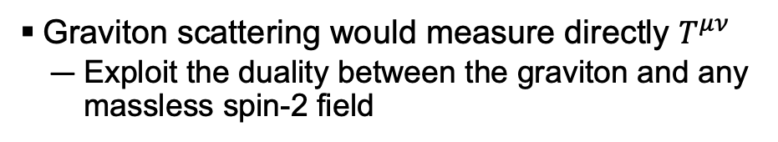

How do we measure this stuff?
Graviton scattering would measure directly $T^{μν}$
  Exploit the duality between the graviton and any massless spin-2 field
𝐷-term is a contribution to the generalized parton distributions (GPDs)
  Measured in hard exclusive reactions like Deeply Virtual Compton Scattering (DVCS), Deeply Virtual Meson Production (DVMP)
Extractions of 𝐷-term can go through GPDs, or use models to bypass them depending on the process
Deeply Virtual Compton Scattering
Graviton exchange $≈$

Slide 13
How do we measure this?
The total 𝐷-term is related to the partonic 𝐷-terms by a sum rule:
Different exclusive processes provide access to the different partonic 𝐷-terms!

Slide 14
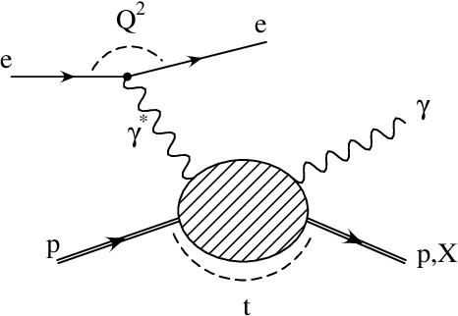
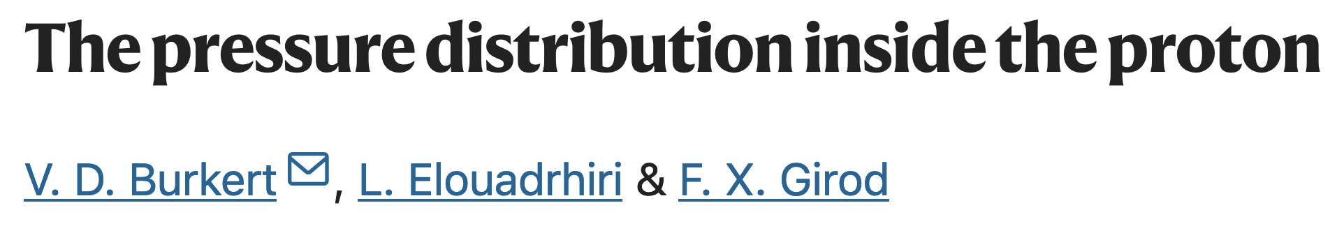
Up & Down quarks:
Accessible via DVCS cross section & beam-spin asymmetries

Slide 15
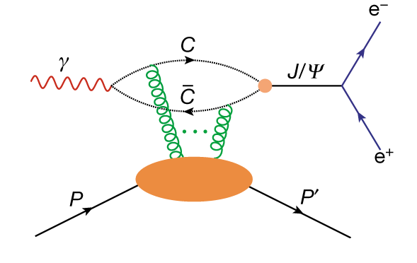
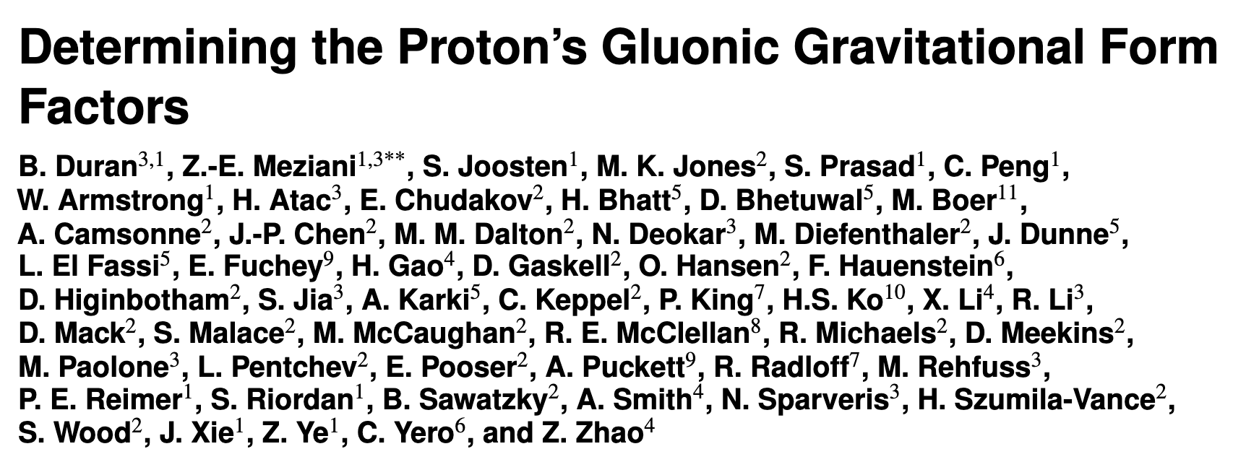
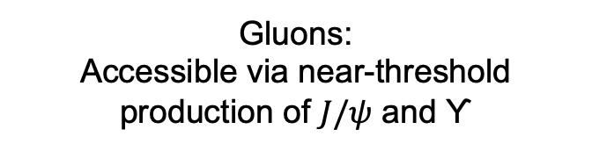

Gluons:
Accessible via near-threshold production of $J/ψ$ and ϒ
SoLID $J/ψ$!

Slide 16
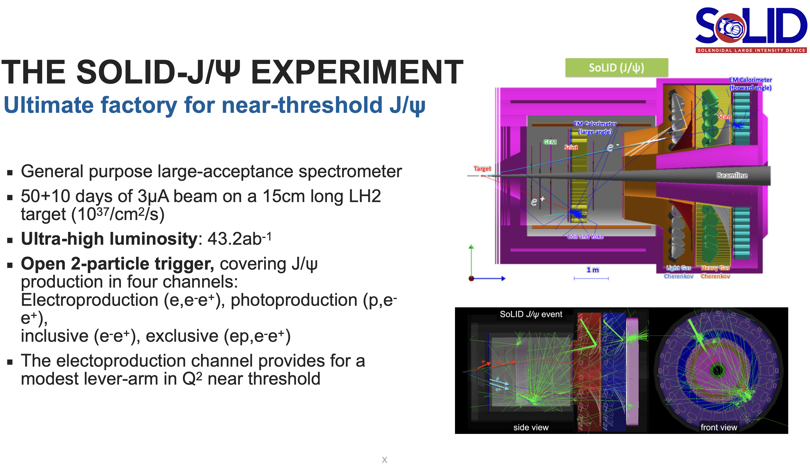

Slide 20
Highly multi-dimensional measurement!

Slide 21

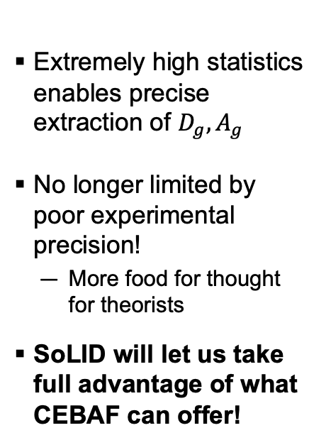



Gluon GFFs
Extremely high statistics enables precise extraction of $D_{g}, A_{g}$
No longer limited by poor experimental precision!
  More food for thought for theorists
SoLID will let us take full advantage of what CEBAF can offer!
$$|t|$$
$$|t|$$
$$|t|$$
$$|t|$$

Slide 22
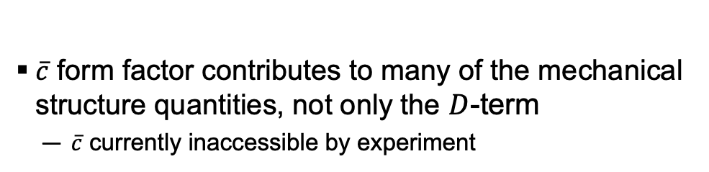
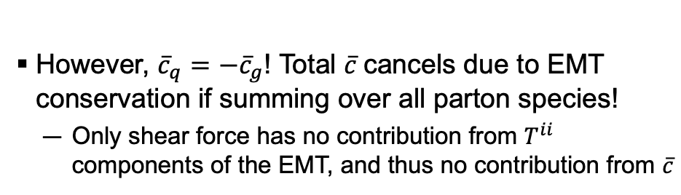
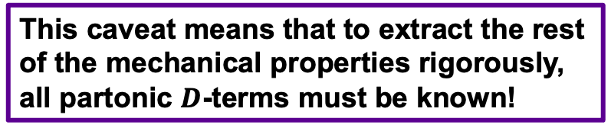
$\overline{c}$ Caveat
$\overline{c}$ form factor contributes to many of the mechanical structure quantities, not only the $D$-term
  $\overline{c}$ currently inaccessible by experiment
However, ${\overline{c}}_{q}=−{\overline{c}}_{g}$! Total $\overline{c}$cancels due to EMT conservation if summing over all parton species!
  Only shear force has no contribution from $T^{ii}$ components of the EMT, and thus no contribution from $\overline{c}$
Pre-Jlab 6 GeV Data
Jlab 6 GeV Data
Jlab 12 GeV Data (Projected)
This caveat means that to extract the rest of the mechanical properties rigorously, all partonic $D$-terms must be known!

Slide 23
Since we need all terms in the sum rule to extract pressure, mechanical radius, force distributions…
Strange quarks: Can we just neglect them…?

Slide 24
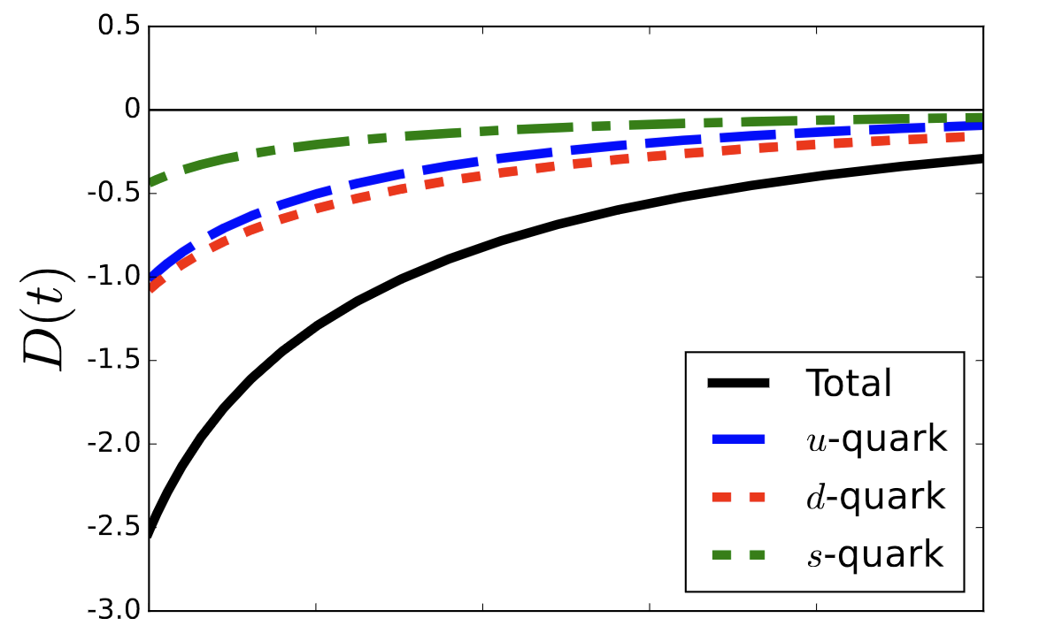
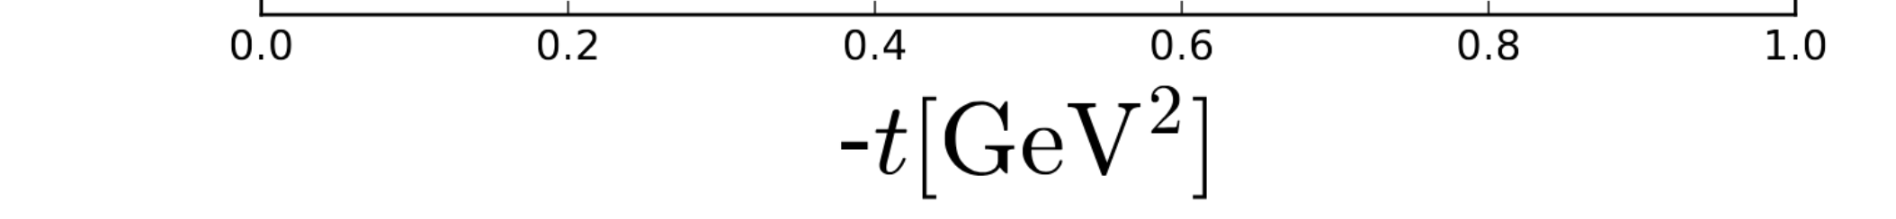
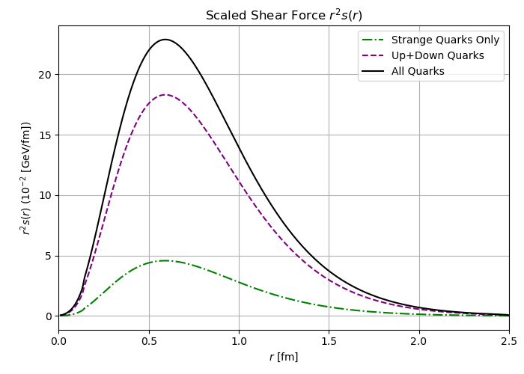
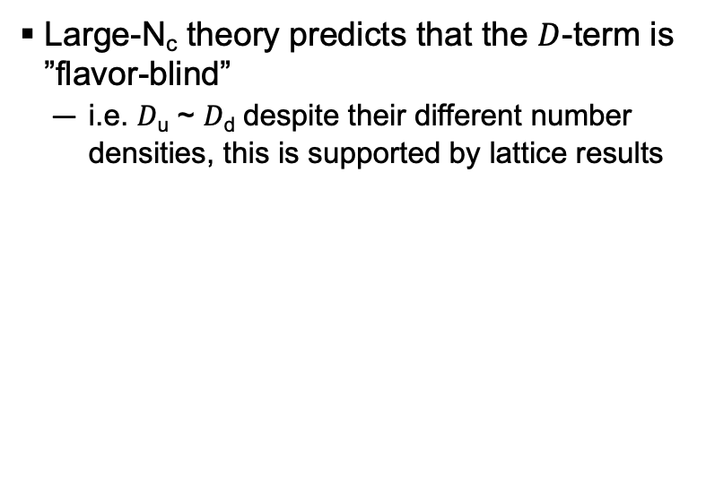

theory predictions
ArXiv: 2307.00740
Large-N_{c} theory predicts that the $D$-term is ”flavor-blind”
  i.e. 𝐷_{u} ~ 𝐷_{d} despite their different number densities, this is supported by lattice results
$$χQSM$$
Extending this argument, could 𝐷_{u} ~ 𝐷_{d} ~ 𝐷_{s}?
Chiral quark soliton model: 𝐷_{u} ~ 𝐷_{d} ~ 2𝐷_{s}
This would make 𝐷_{s} a non-negligible contributor to the total 𝐷-term, and thus necessary for a full extraction of many of the mechanical properties of the proton!

Slide 25
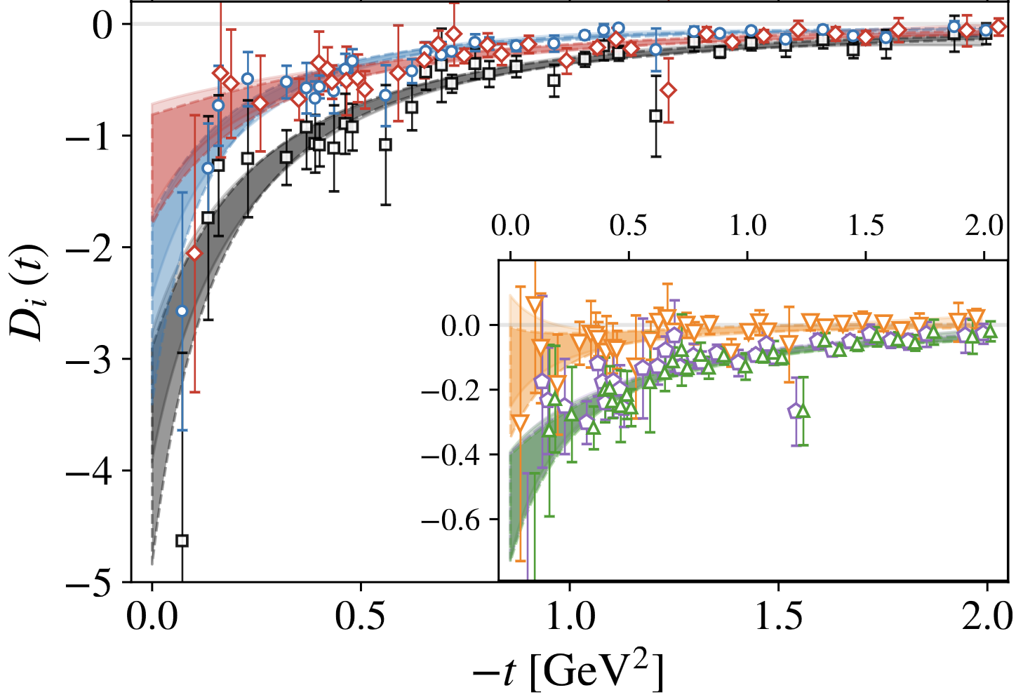
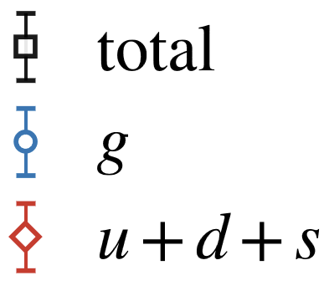
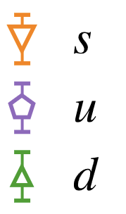
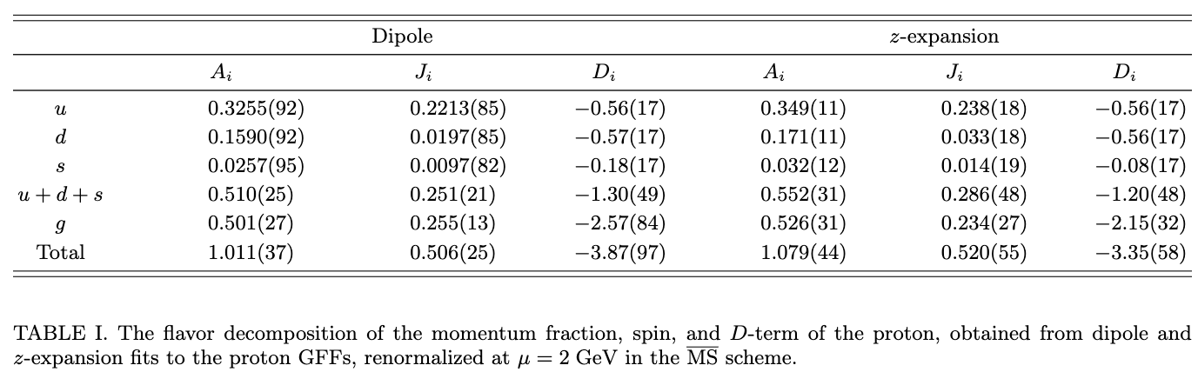
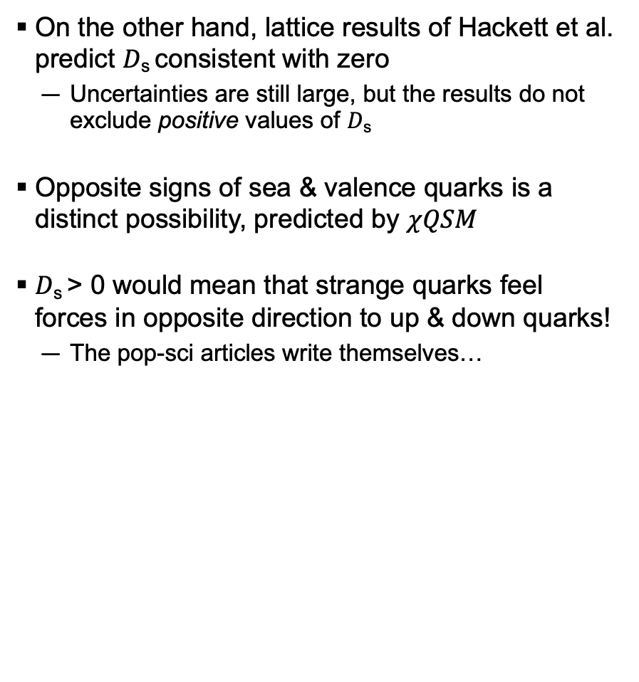
theory predictions
On the other hand, lattice results of Hackett et al. predict 𝐷_{s} consistent with zero
  Uncertainties are still large, but the results do not exclude positive values of 𝐷_{s}
Opposite signs of sea & valence quarks is a distinct possibility, predicted by $χQSM$
𝐷_{s} > 0 would mean that strange quarks feel forces in opposite direction to up & down quarks!
  The pop-sci articles write themselves…

Slide 26
Variety of theory predictions giving very different values for 𝐷_{s}, let’s measure it!
But how…?

Slide 27

Variety of theory predictions giving very different values for 𝐷_{s}, let’s measure it!
But how…?
SoLID $φ$!

Slide 28
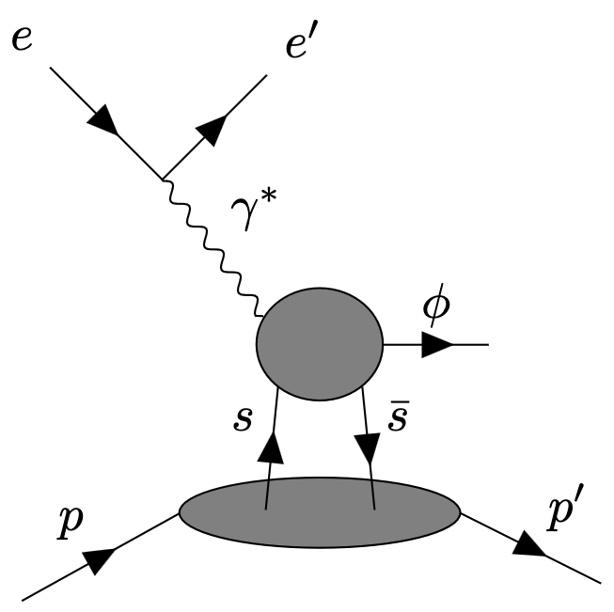
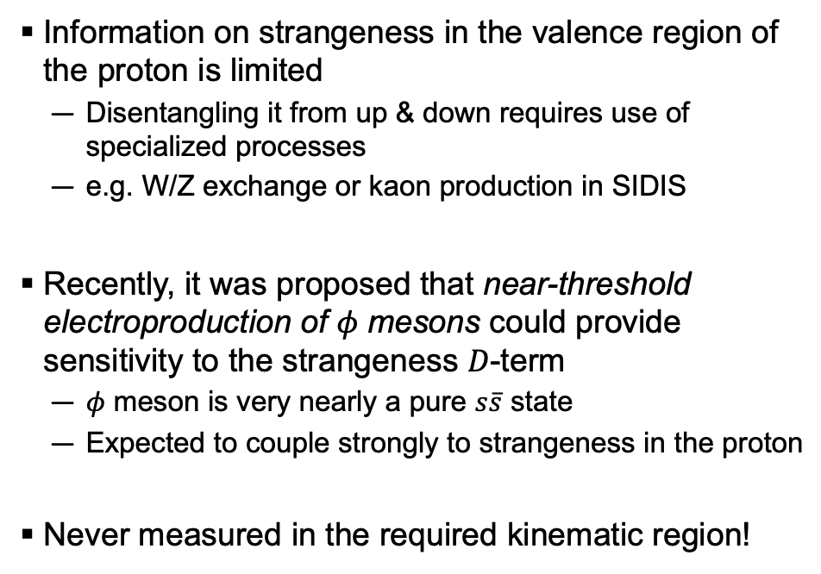
Accessing the strangeness d-term
Information on strangeness in the valence region of the proton is limited
  Disentangling it from up & down requires use of specialized processes
  e.g. W/Z exchange or kaon production in SIDIS
Recently, it was proposed that near-threshold electroproduction of 𝜙 mesons could provide sensitivity to the strangeness 𝐷-term
  𝜙 meson is very nearly a pure $s\overline{s}$ state
  Expected to couple strongly to strangeness in the proton
Never measured in the required kinematic region!

Slide 29
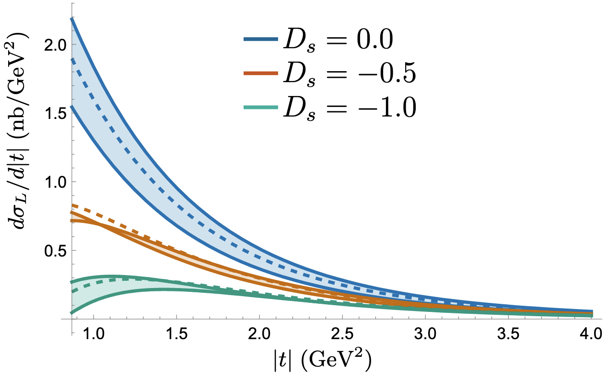
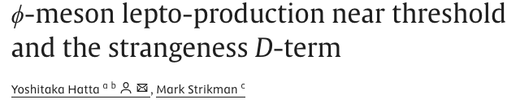
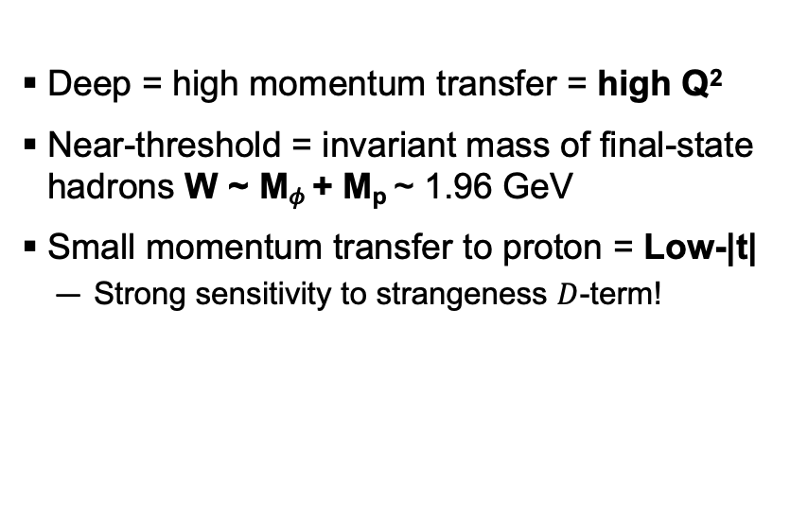

Deep near-threshold 𝜙 kinematics
Deep = high momentum transfer = high Q²
Near-threshold = invariant mass of final-state hadrons W ~ M_{𝜙} + M_{p} ~ 1.96 GeV
Small momentum transfer to proton = Low-|t|
  Strong sensitivity to strangeness $D$-term!
Q²
W
$Q^{2}=6.25$ GeV²
$W=2.5$ GeV
|t|

Slide 30
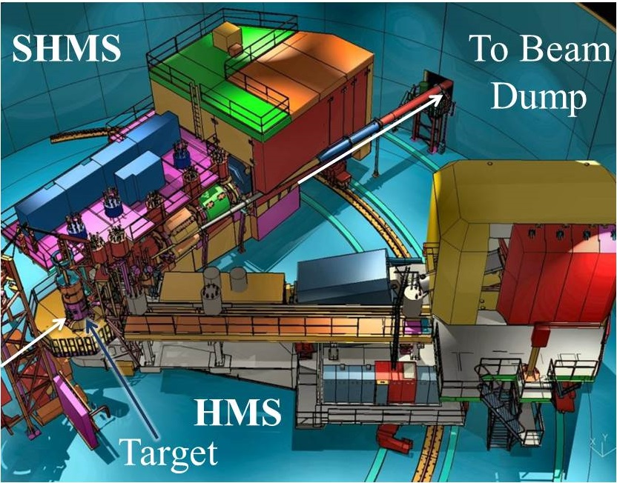
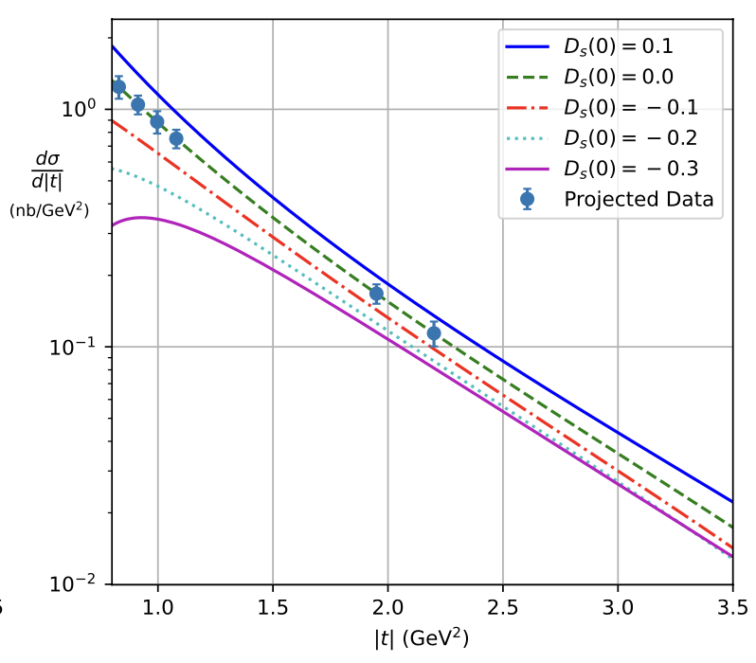
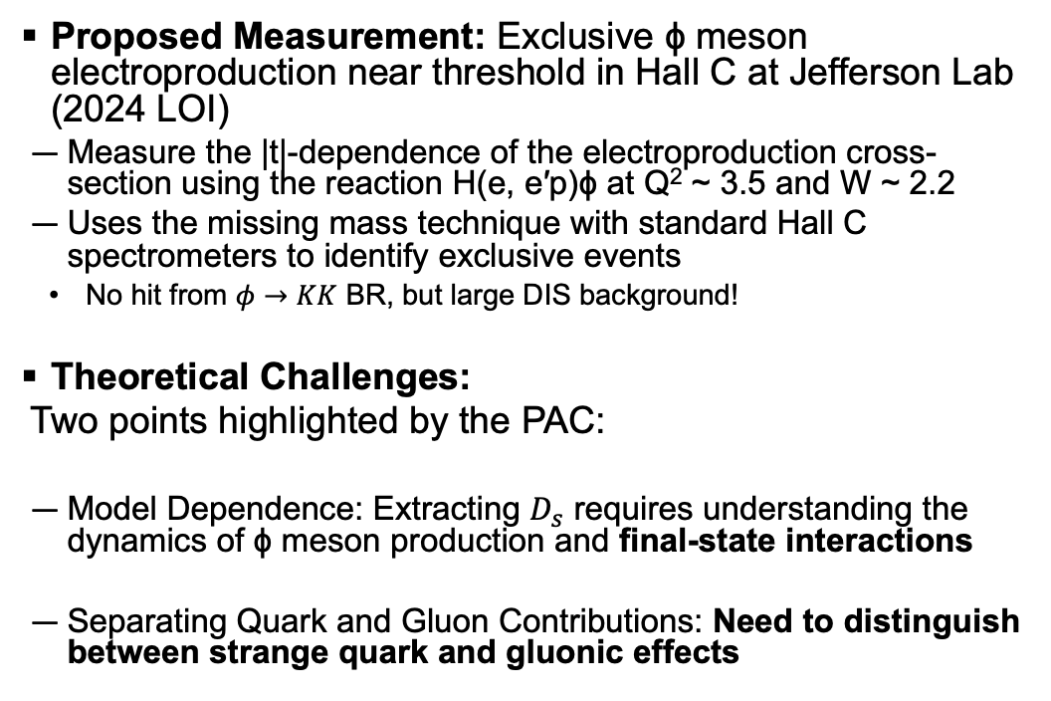
The strangeness d-term in hall c
2501.01582
Proposed Measurement: Exclusive ϕ meson electroproduction near threshold in Hall C at Jefferson Lab (2024 LOI)
  Measure the |t|-dependence of the electroproduction cross-section using the reaction H(e, e′p)ϕ at Q² ~ 3.5 and W ~ 2.2
  Uses the missing mass technique with standard Hall C spectrometers to identify exclusive events
    No hit from $φ→KK$ BR, but large DIS background!
Theoretical Challenges:
  Two points highlighted by the PAC:
  Model Dependence: Extracting $D_{s}$ requires understanding the dynamics of ϕ meson production and final-state interactions
  Separating Quark and Gluon Contributions: Need to distinguish between strange quark and gluonic effects
Scattered e⁻
Scattered proton
^{e-}
Hall C Phi Collaboration, "Studying the Strangeness D-Term in Hall C via Exclusive ϕ Electroproduction," JLab PAC 52 LOI (2024)

Slide 31
The strangeness d-term in hall c
2501.01582
Proposed Measurement: Exclusive ϕ meson electroproduction near threshold in Hall C at Jefferson Lab (2024 LOI)
  Measure the |t|-dependence of the electroproduction cross-section using the reaction H(e, e′p)ϕ at Q² ~ 3.5 and W ~ 2.2
  Uses the missing mass technique with standard Hall C spectrometers to identify exclusive events
    No hit from $φ→KK$ BR, but large DIS background!
Theoretical Challenges:
  Two points highlighted by the PAC:
  Model Dependence: Extracting $D_{s}$ requires understanding the dynamics of ϕ meson production and final-state interactions
  Separating Quark and Gluon Contributions: Need to distinguish between strange quark and gluonic effects
Scattered e⁻
Scattered proton
^{e-}
Jobs for theorists…
Hall C Phi Collaboration, "Studying the Strangeness D-Term in Hall C via Exclusive ϕ Electroproduction," JLab PAC 52 LOI (2024)

Slide 32
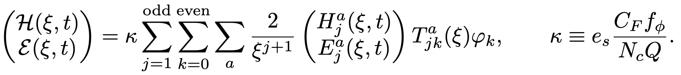
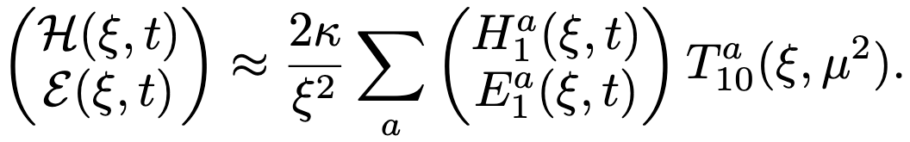
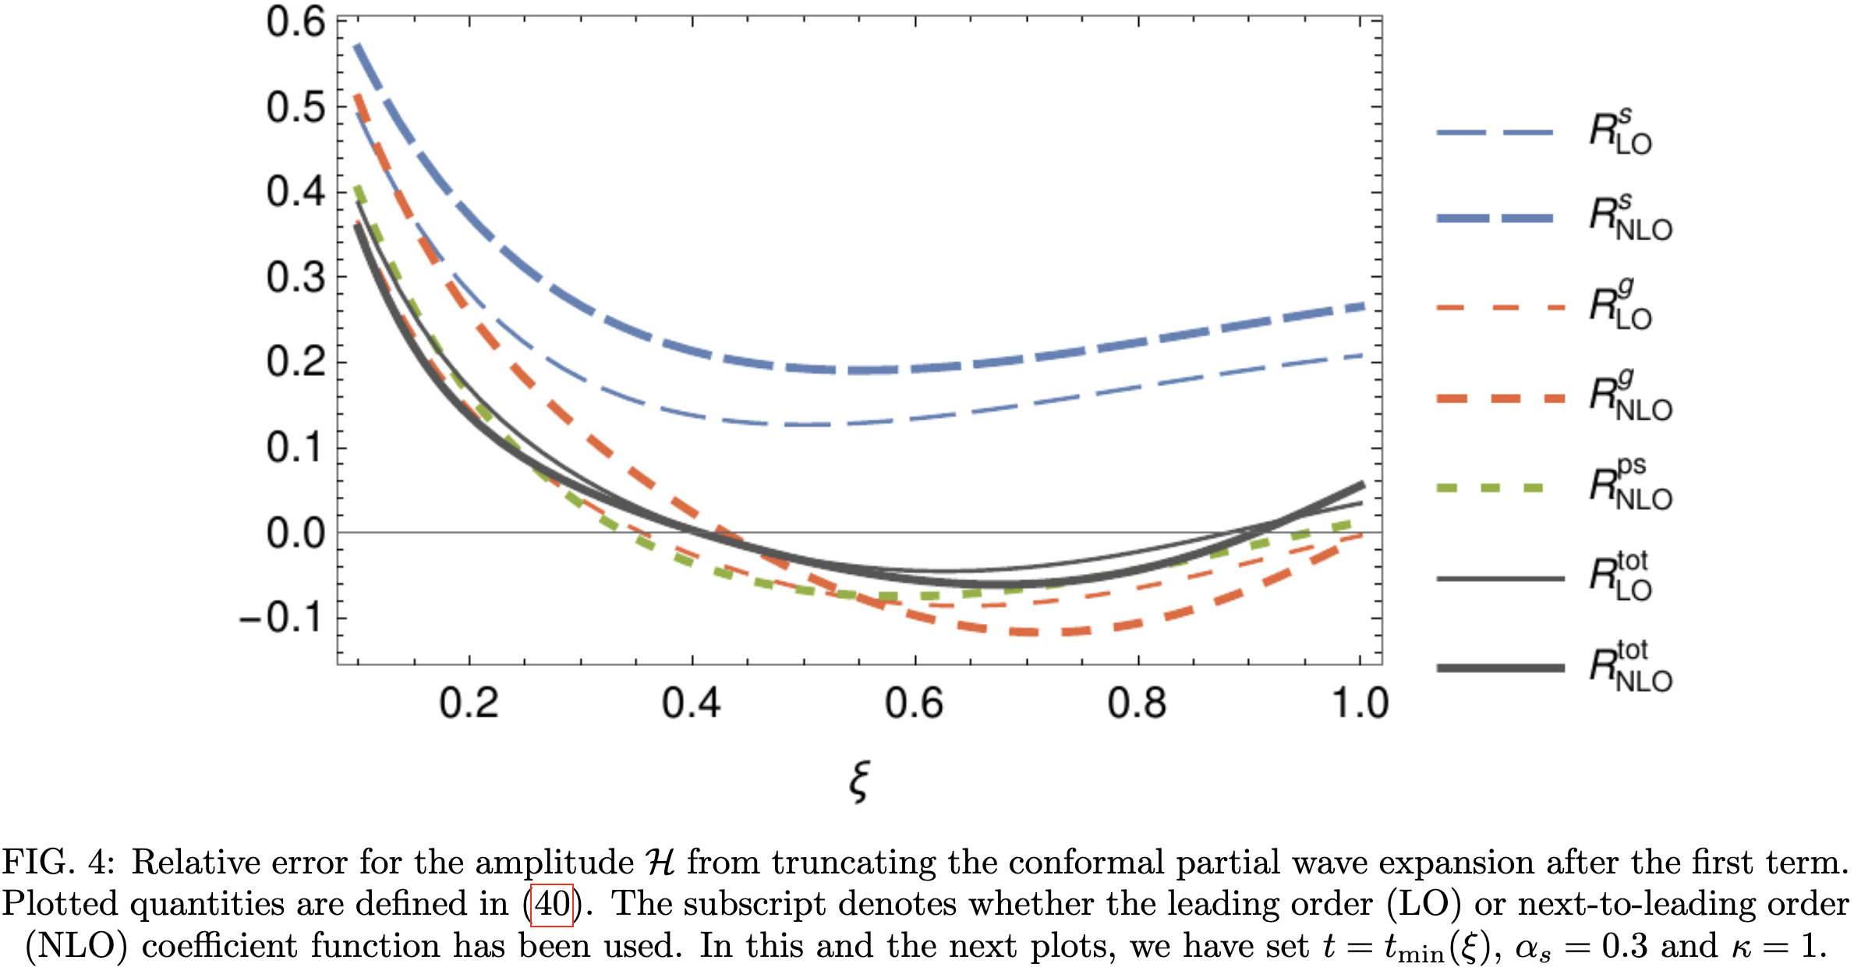
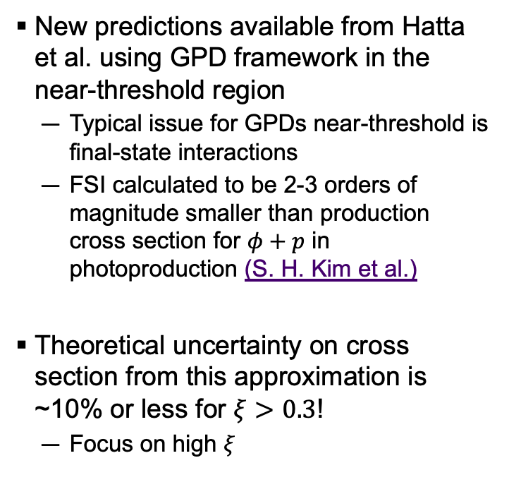
Theory predictions
Hatta, HK, Passek, Schoenleber (To be submitted)
New predictions available from Hatta et al. using GPD framework in the near-threshold region
  Typical issue for GPDs near-threshold is final-state interactions
  FSI calculated to be 2-3 orders of magnitude smaller than production cross section for $φ+p$ in photoproduction (S. H. Kim et al.)
Theoretical uncertainty on cross section from this approximation is ~10% or less for $ξ>0.3$!
  Focus on high $ξ$
“Threshold Approximation” – Keep only j = 1
Error < 5%

Slide 33

Theory predictions
Hatta, HK, Passek, Schoenleber (To be submitted)
Predictions available at NLO for $\frac{dσ_{L}}{d|t|}$!
  Requires our experiment to have an L/T separation (or modelling of $R$) for comparison

Slide 34



Hatta, HK, Passek, Schoenleber (To be submitted)
These predictions are valid for $ξ≳0.4$ and $Q^{2}≳3|t|$
Challenging to satisfy! Need high $Q^{2} \& W<3$

Slide 35



Theory predictions
Hatta, HK, Passek, Schoenleber (To be submitted)
Theory uncertainty from $\frac{Q}{2}<μ<2Q$ scale variation
Near-threshold $φ$ exhibits
factor ~ 4 greater sensitivity to $D_{s}$ compared to $D_{g}$!

Slide 36





Theory predictions
Hatta, HK, Passek, Schoenleber (To be submitted)
$$ξ\sim 0.5$$
$$A_{g}\sim A_{u,d}≫A_{s}$$
$$D_{g}\sim D_{u,d}\sim D_{s}?$$
Theory uncertainty from $\frac{Q}{2}<μ<2Q$ scale variation

Slide 37

Theory predictions
Hatta, HK, Passek, Schoenleber (To be submitted)
Near-threshold $φ$ exhibits
factor ~ 4 greater sensitivity to $D_{s}$ compared to $D_{g}$!
This is the green light for our experiments to measure $D_{s}$ , so let’s go!
Theory uncertainty from $\frac{Q}{2}<μ<2Q$ scale variation

Slide 38




Exclusive $φ$ in solid
Large acceptance & luminosity!
  𝜙 decay products can be measured directly
    Fully exclusive, low background
    Measure $R$ to extract $σ_{L}$
  PID from ToF, Cherenkovs
  High statistics & continuous kinematic coverage for multidimensional measurement

Slide 39



Projections
First look at projections for SoLID
  43.2 ab⁻¹ (existing $J/ψ$ proposal)
  Fully exclusive! - Detect all four final state particles: e’, p’, K⁺, K⁻
Require kaons, proton to be detected in forward angle detector
  Better TOF PID
Particle momenta nicely suited for the SoLID PID systems!
Particles in events with 4/4 reconstructed

Slide 40

Projections
Assumption of 10% systematic uncertainty still exhibits good sensitivity to 𝐷_{s}!

Slide 41




Slide 42
Conclusion
QCD EMT framework provides new insights into the structure of hadrons
  In particular, 𝐷-term accesses a new & exciting set of measurable quantities
If we ever want a complete experimental measurement of the total 𝐷-term of the proton, will need to measure the strangeness 𝐷-term
  Can be done at CEBAF, with the right tools
Scattered e⁻
Scattered proton
^{e-}
SoLID provides the opportunity to measure 𝐷_{g} and eventually 𝐷_{s}, bringing us into the precision era of proton mechanical structure!
Let me know if you’re interested in collaborating!

Slide 43



PID
Kaons from decay of ɸ should be PID’d to reduce background
Range of K^{+,-} momentum from ~1-4 GeV in forward detector
HGC will provide $π$ rejection above 2.5 GeV
150 ps TOF covers 3σ $π/K$ up to ~2.5 GeV
  MRPC would handle this better, reduce the reliance on HGC near its threshold
Scattered proton is low momentum, typically 1-2 GeV
  TOF should be able to handle it

Slide 44

Analysis strategy
Kaons:
  Forward detector has superior PID
    Longer TOF baseline + Cherenkovs to reject fast pions
    MRPC would handle PID over whole momentum range
    SPD TOF could handle it up to where the HGC turns on
  Require kaons to be in forward detector
Protons:
  Large-angle detector can PID protons up to ~ 2 GeV with SPD TOF
  Allow protons in forward or large angle detectors
Electrons:
  Acceptance for fully exclusive reconstruction is best when electron is at large angle
  Require electron in large angle

Slide 45


Slide 46


