Slide 1
Hall A Collaboration Meeting ’25 Status of SoLID and Pre-R&D Activities
January-16-2025
Klaus Dehmelt – TJNAF
On behalf of the SoLID Collaboration

Slide 2
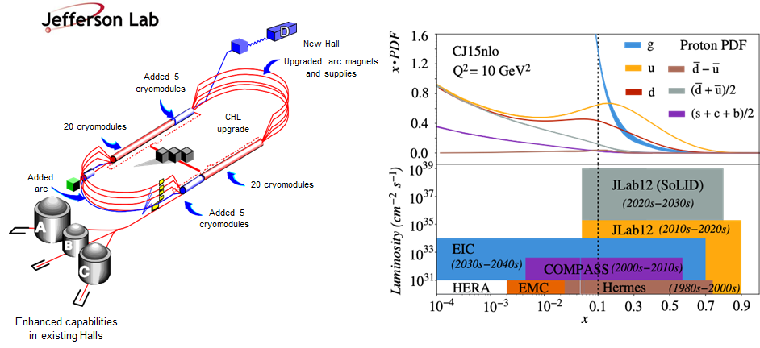
Solenoidal Large Intensity Device – SoLID Hall-A
SoLID will explore QCD landscape ⇨ Complementary to research at other facilities, e.g., EIC
SoLID will exploit CEBAF-12-GeV upgrade
SoLID will maximize science return
SoLID ⇨ core part of JLab 12-GeV program + future upgrades

Slide 3
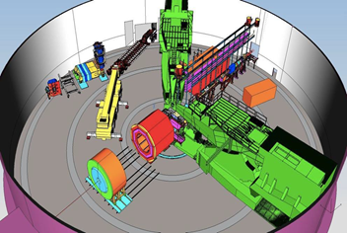
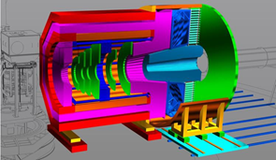
SoLID – The Apparatus
Proposed apparatus in Hall-A

Slide 4
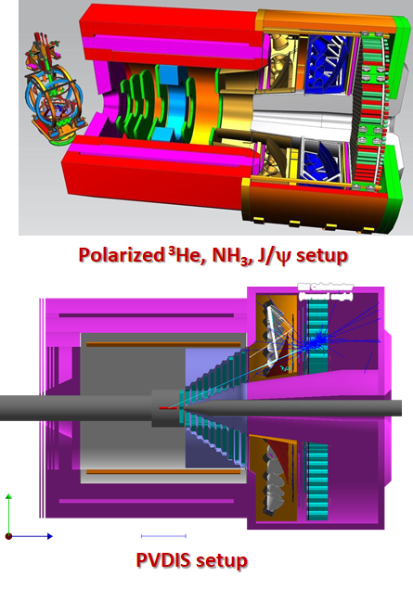
SoLID – The Apparatus
Two configurations
Precision tomography in 3-D momentum space
Proton mass, mass radius, gravitational form factors
Standard model test, BSM, QCD via
parity violating Deep Inelastic Scattering

Slide 5
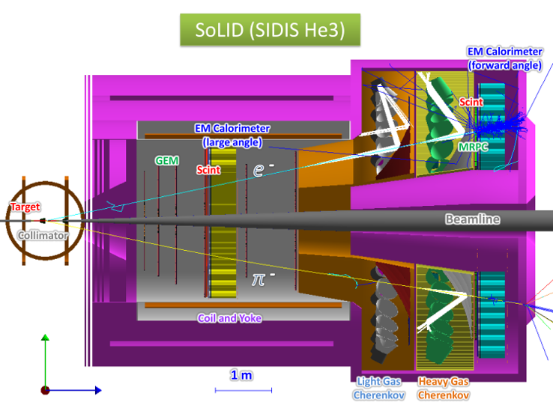
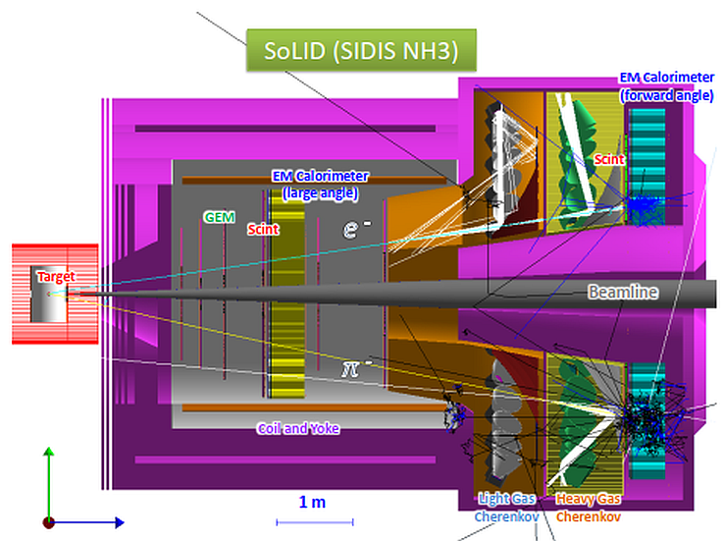
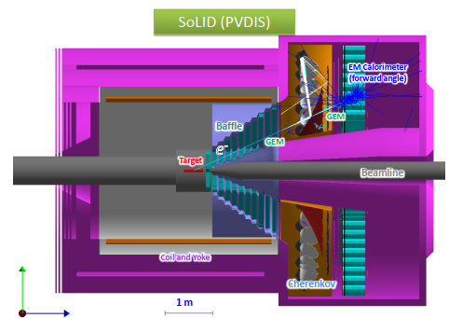
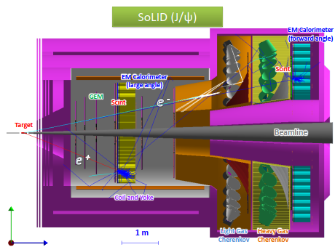
SoLID – The Apparatus
State of the Art Detectors
MPGD – GEM, μRWell/μRGroove tracker
Shashlik EMCal
HP Cherenkov detectors
Pipelined DAQ, streaming readout
Rapidly advancing computational
facilities
First implementation of
self-driving detector
Design considers large scale deployment of
ML/AI
Solenoid (CLEO magnet)

Slide 6
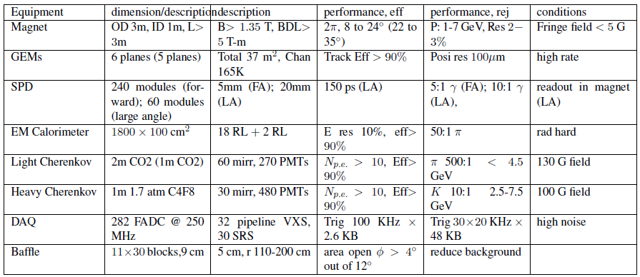
SoLID – The Apparatus

Slide 7
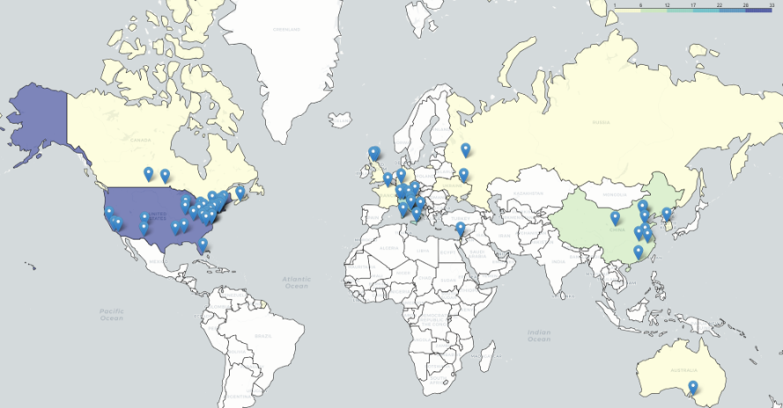
SoLID – The Collaboration
270+ collaborators
70+ institutions
13 countries
4 continents

Slide 8
SoLID – The Development
Rich and diverse physics program ⇨ started in 2010
Total of 6 PAC approved SoLID experiments
High Rating
5 A
1 A⁻
3 SIDIS (3-D structure)
1 PVDIS (BSM)
1 Threshold J/ψ (gluon force)
1 A-n (new phenomena)
Plus 1 conditional approval Plus 6 run-group experiments (3-D and spin structure)

Slide 9
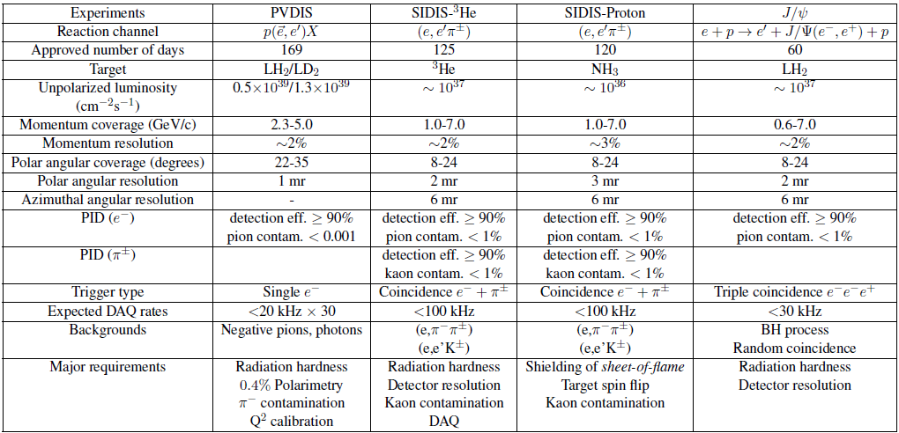
SoLID – The Development

Slide 10
SoLID – The Development
Pre-conceptual design, Pre-R&D, reviews, and current status
2014: pCDR submitted to JLab with cost estimation, updated in 2017, 2019
Director’s Reviews in 2015, 2019 and 2021
2020: SoLID MIE (with updated pCDR/estimated cost) submitted to DOE 2020-now: DOE funded pre-R&D activities
2021: DOE Science Review for SoLID, positive feedback
2023: Long Range Plan, SoLID highlighted, one of the recommendations
2024: Facility Review: Ready to Launch

Slide 11
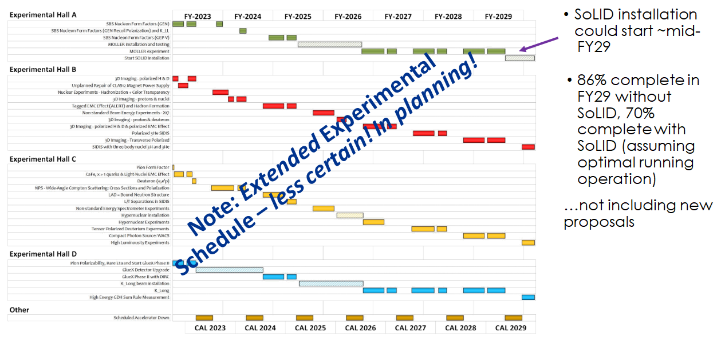
SoLID – The Development

Slide 12
Long Range Plan 2023

Slide 13
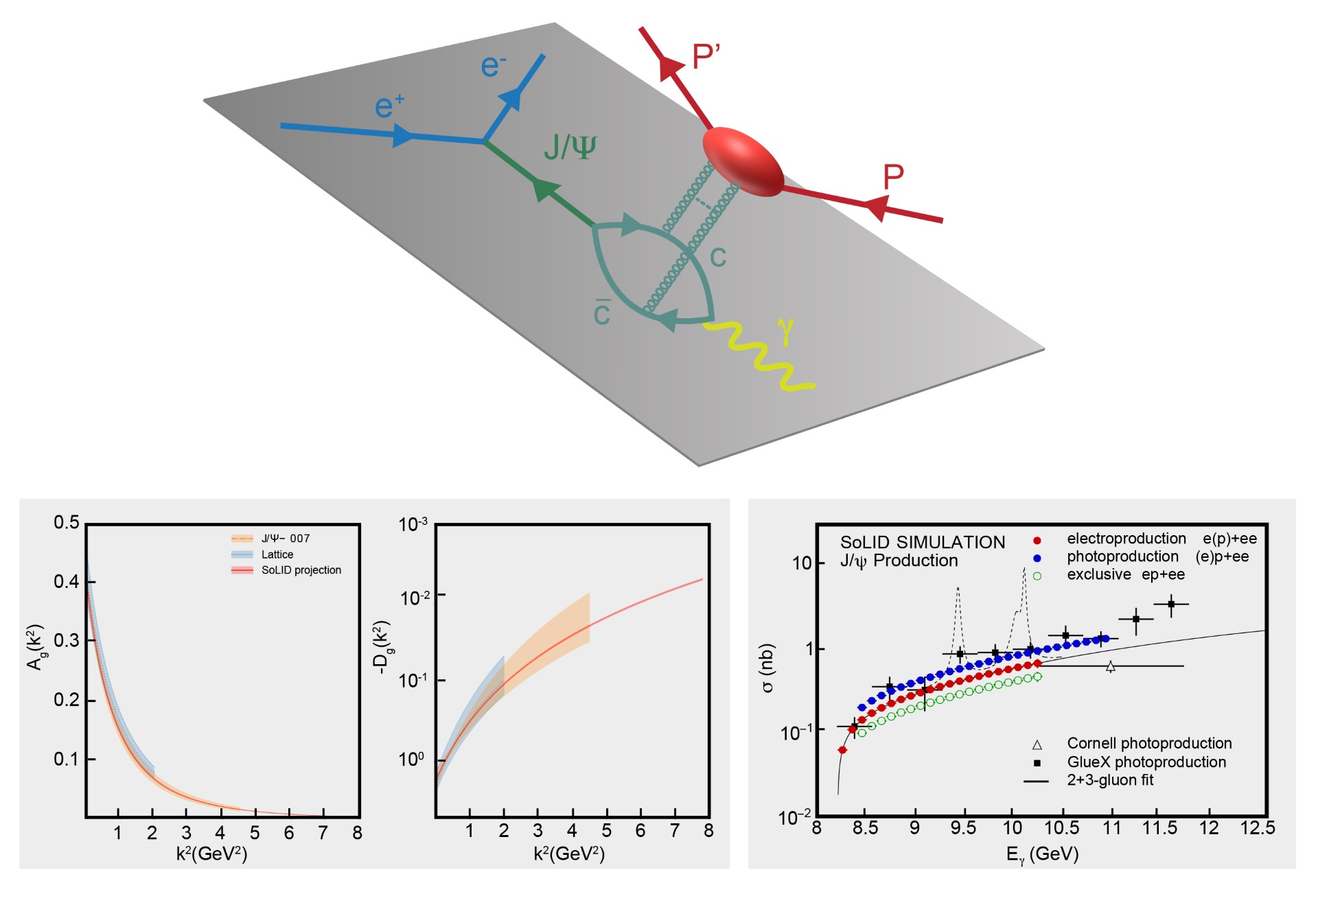
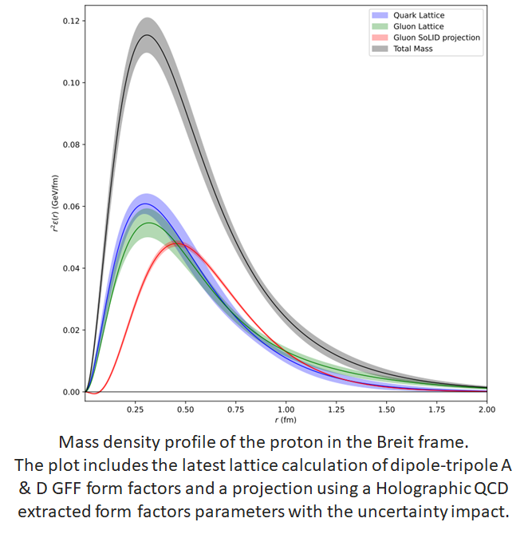
Proton Mass, Gravitational Form Factors, and Mass and Scalar Radii
The simulated total electro- (red) and photo- (blue) production of J/ψ on a proton (far right panel).
Each data point represents the integral of the measured differential cross section as a function of the Mandelstam variable ‘t’,
from which the A and D gluonic gravitational form factors would be extracted with the precision shown by the red band.
Also plotted is our present knowledge of these form factors from experiment J/ψ-007 (orange), together with the lattice QCD calculations (blue).

Slide 14
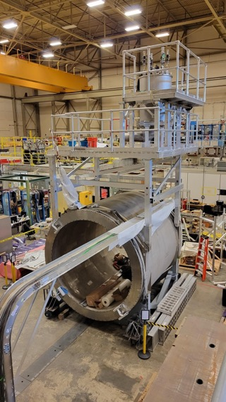
Realization of SoLID – Ongoing Activities at JLab Now
Proposed ~$30M “redirect” to support SoLID project (JLab Operations to take on more dependencies – magnet, some infrastructure,…)
Planning to put forward at March/April LMBB
Requires some strategy (MOLLER project issues now cause concern)
Two Capital Equipment projects already in place
Magnet refurbishment and testing
Data acquisition
Working with DOE research to identify preR&D opportunities
Supporting electronics testing and trigger development
Physics AD meets with DOE research (Gulshan Rai) monthly
Pre-R&D plan white paper to be submitted by the end of Jan. ’25
Encouraged to consider another white paper for MPGD ASIC
development
Staff continuing to assist in development

Slide 15
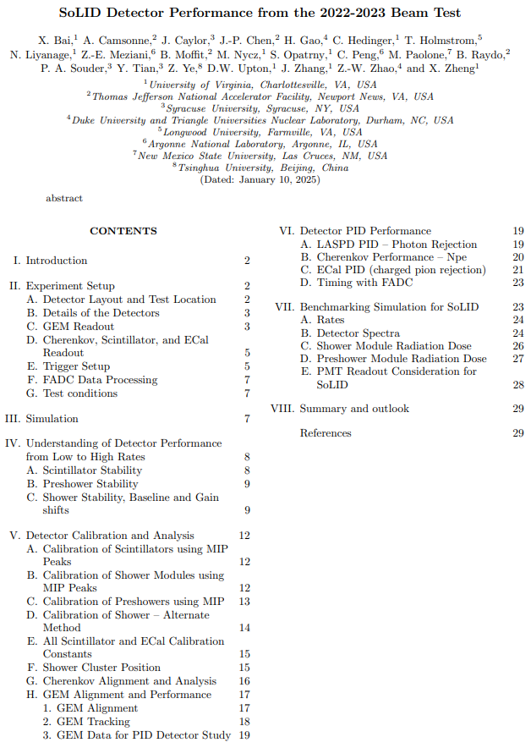
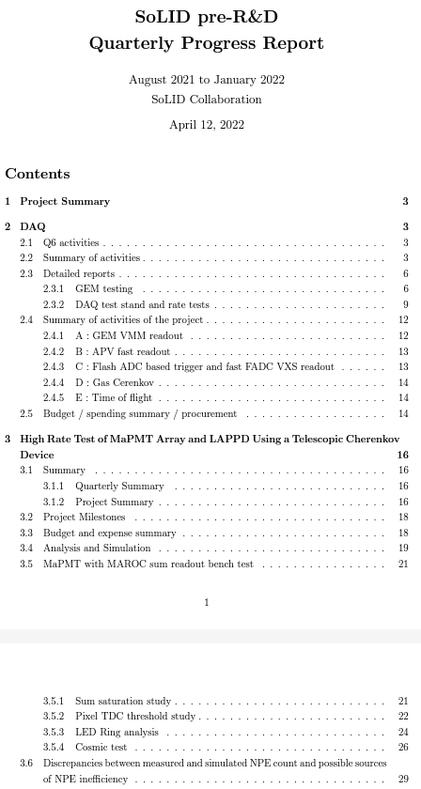
Pre-R&D Activities – Past Activities
Recent past activities were summarized
in reports

Slide 16
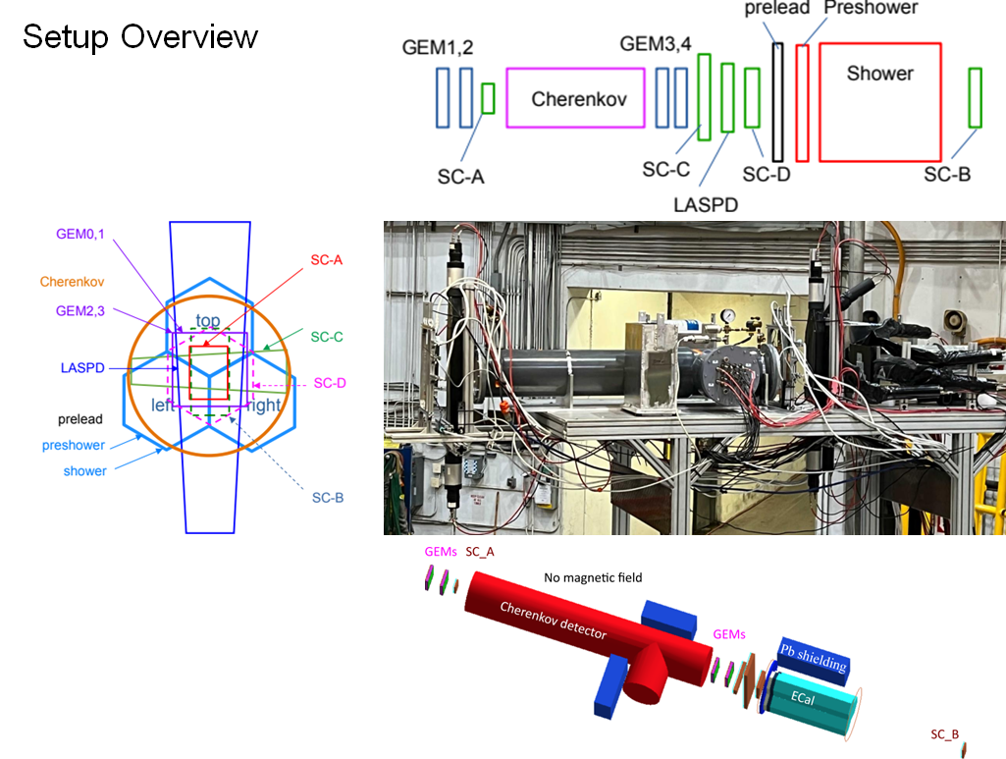
Pre-R&D Activities – Past Activities

Slide 17
Pre-R&D Activities – MPGD Readout
GEM readout → more general MPGD readout

Slide 18
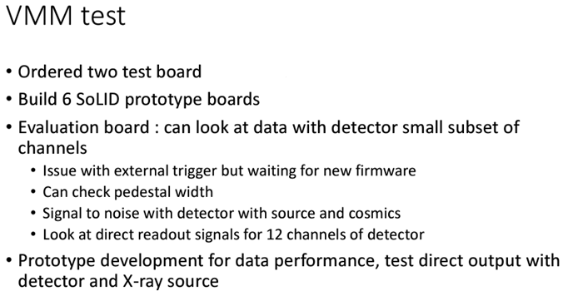
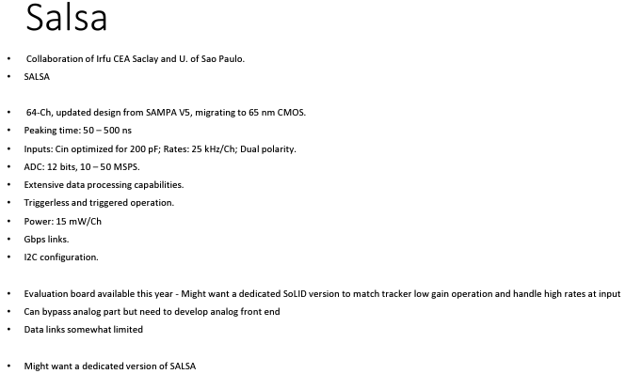
Pre-R&D Activities – MPGD Readout
GEM readout → more general MPGD readout

Slide 19
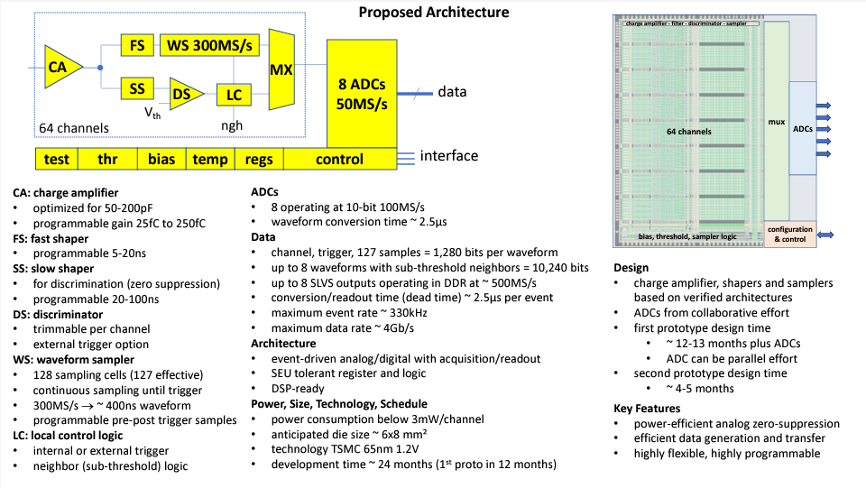
Pre-R&D Activities – MPGD Readout

Slide 20
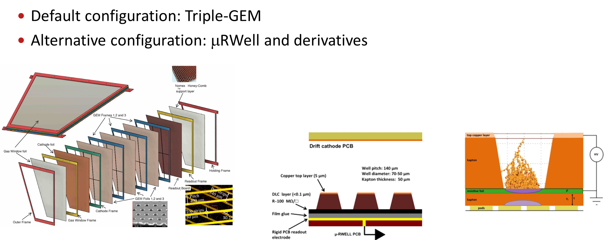
Pre-R&D Activities – Tracking Options
Tracking options

Slide 21
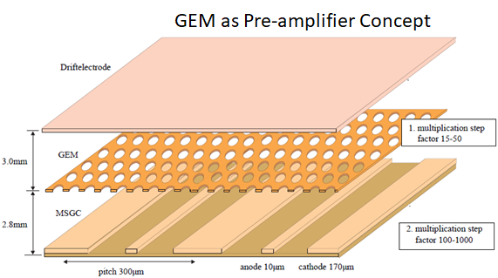
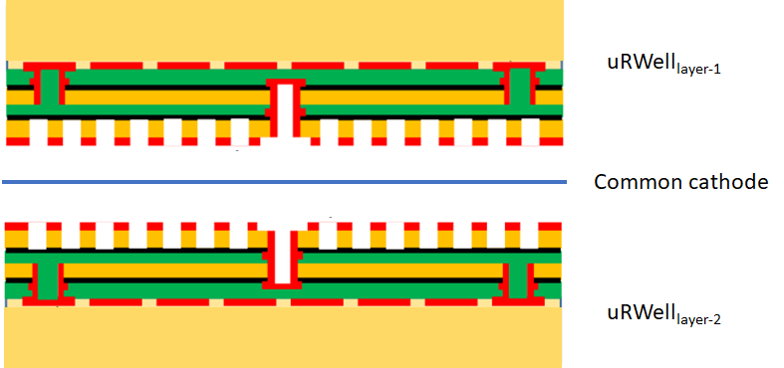
Pre-R&D Activities – Tracking Options
Alternative configuration: μRWell and derivatives

Slide 22
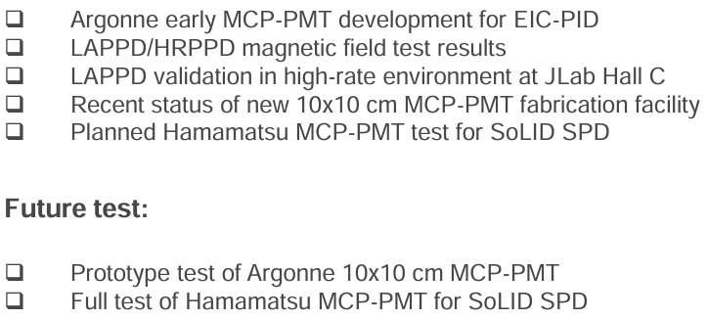
Pre-R&D Activities – MCP-PMT
MCP-PMT

Slide 23
Pre-R&D Activities
GEM readout → more general MPGD readout
Tracking options
MCP-PMT
SoLID_preRD_Fall2024 → Proposed Milestones and Budget

Slide 24
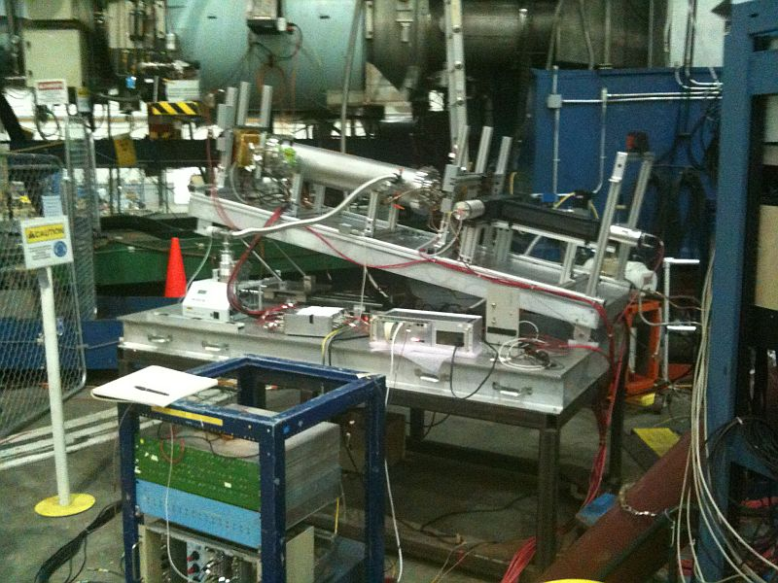
Pre-R&D Activities And Test Beam Plans – Hall C
Perform a sector test with SoLID
sub-detectors

Slide 25
Pre-R&D Activities And Test Beam Plans – Hall C

Slide 26
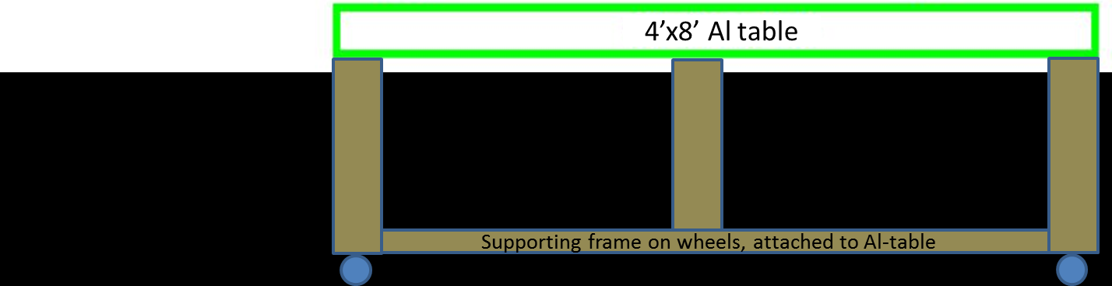
Pre-R&D Activities And Test Beam Plans – Hall C

Slide 27
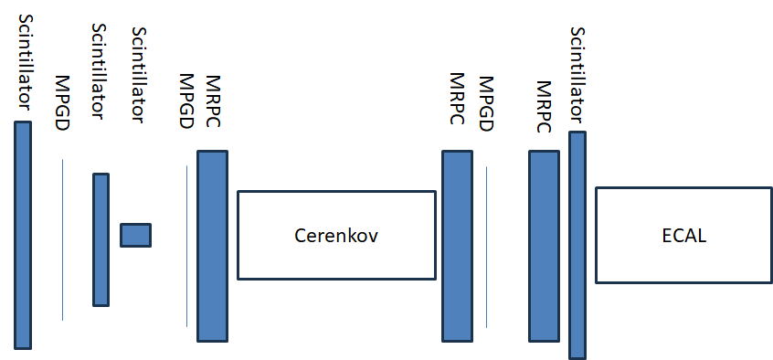
Pre-R&D Activities And Test Beam Plans – Hall C

Slide 28
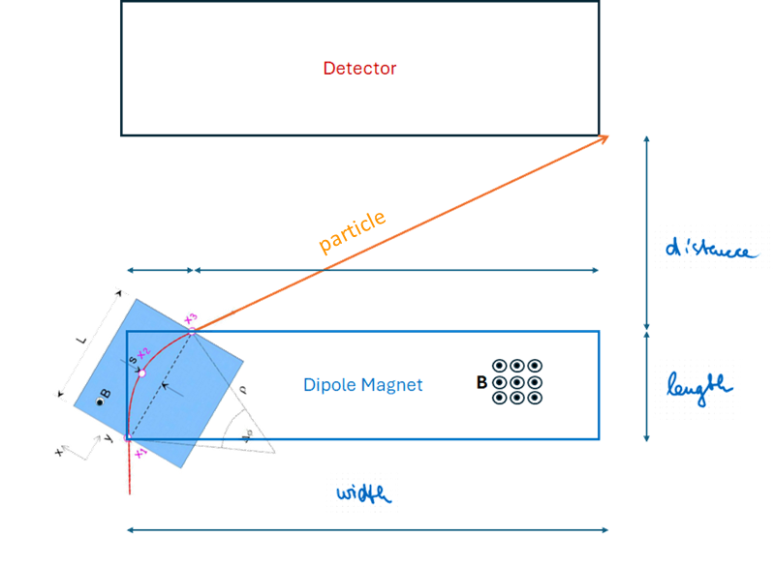
Pre-R&D Activities And Test Beam Plans – Hall C
Background reduction
Remove Møller electrons → sweeping magnet
Dipole magnet
Aperture, gap, field strength
Accommodated around detector setup

Slide 29
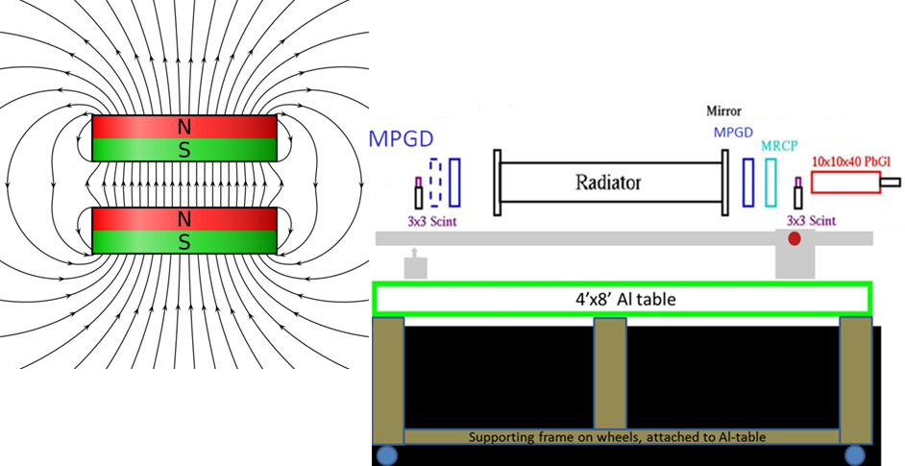
Pre-R&D Activities And Test Beam Plans – Hall C

Slide 30
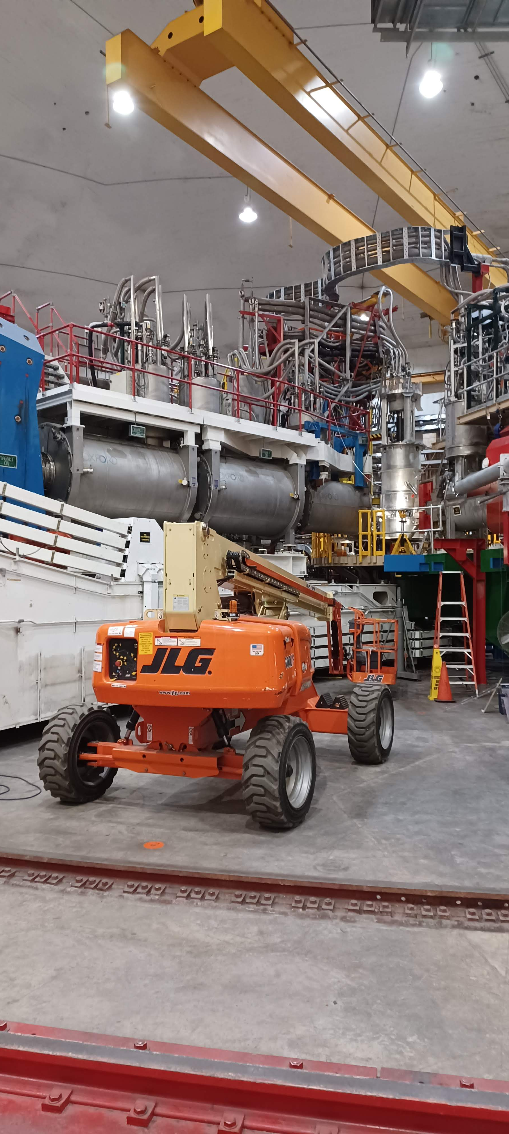
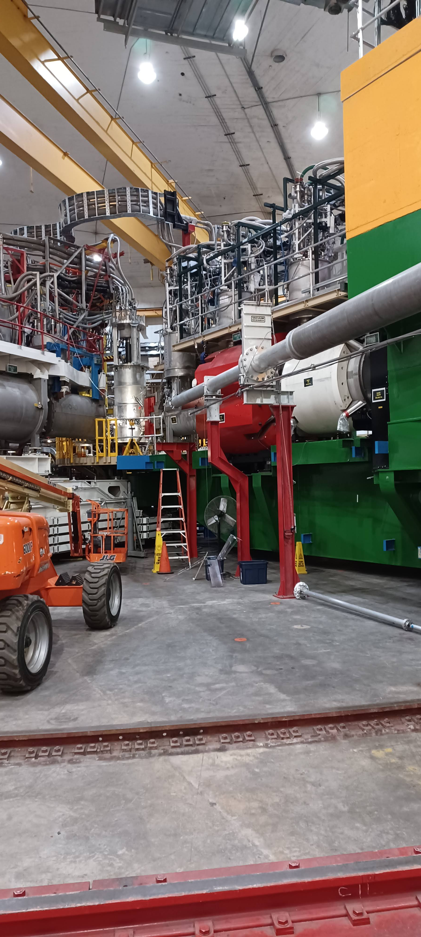
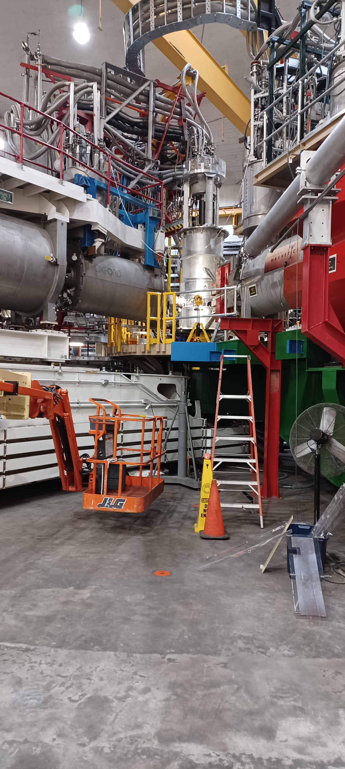
Pre-R&D Activities And Test Beam Plans – Hall C

Slide 31
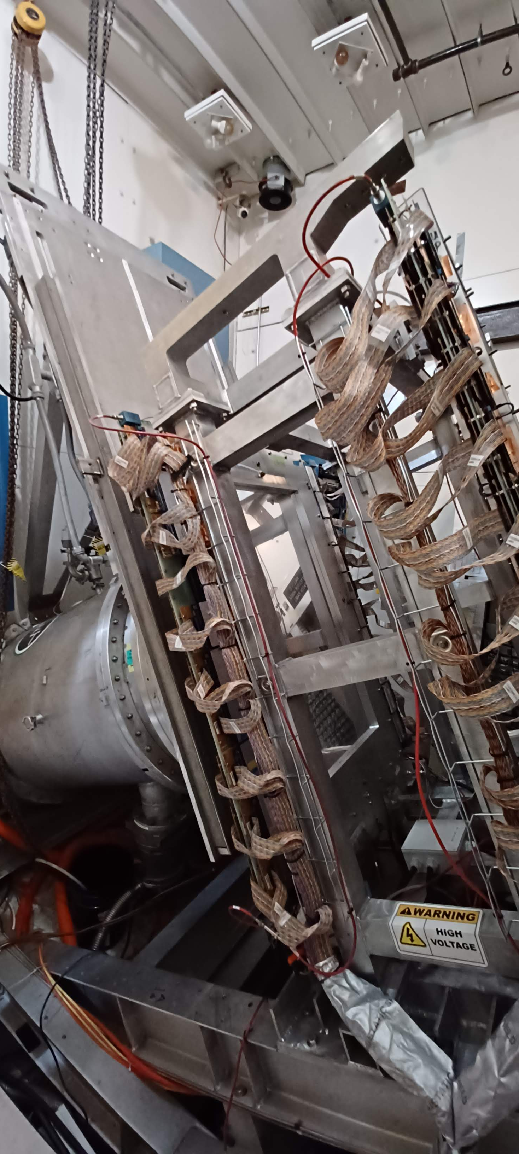
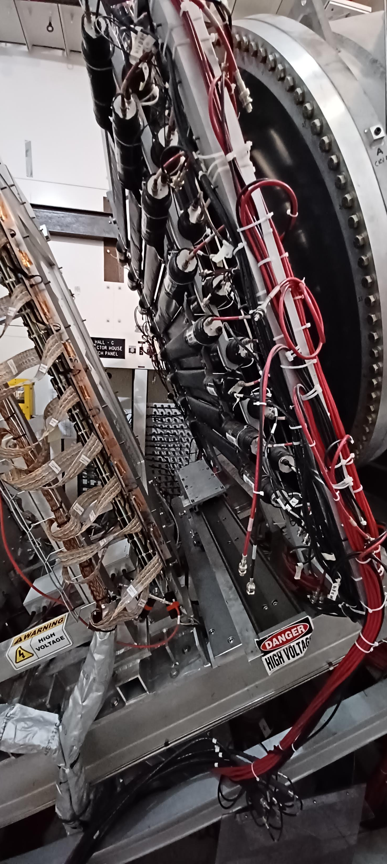
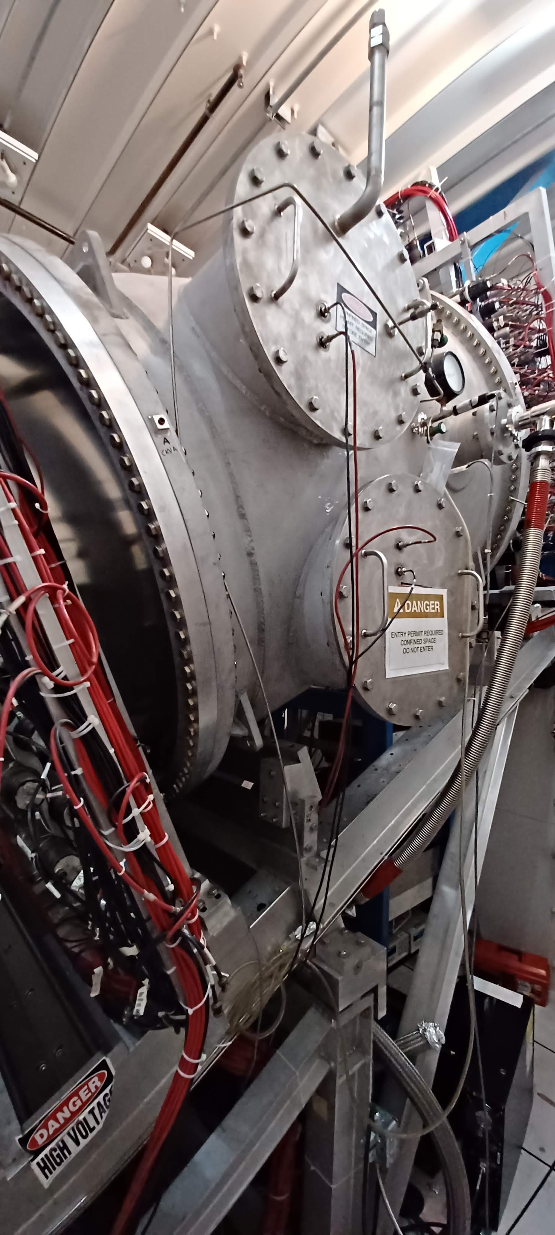
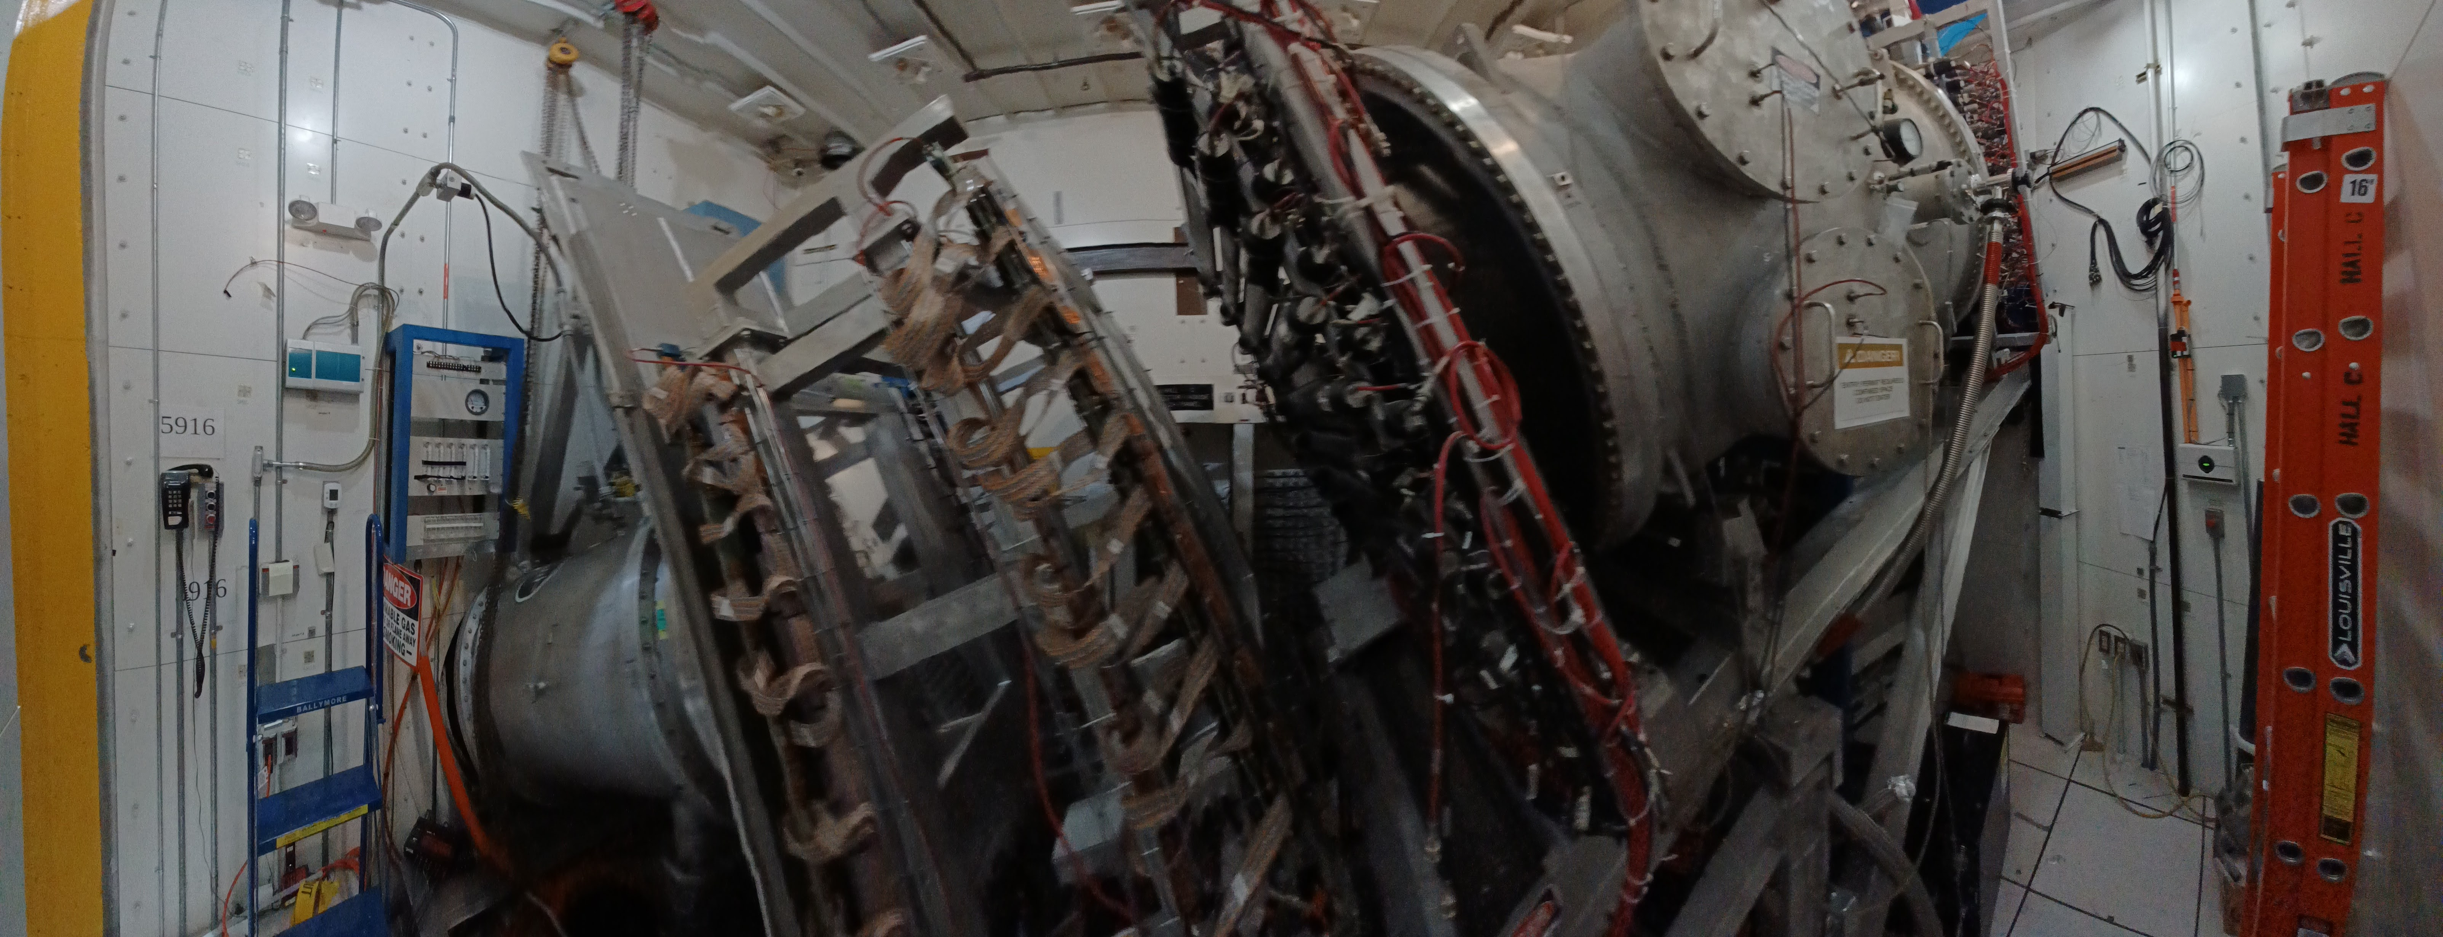
Pre-R&D Activities And Test Beam Plans – Hall C

Slide 32
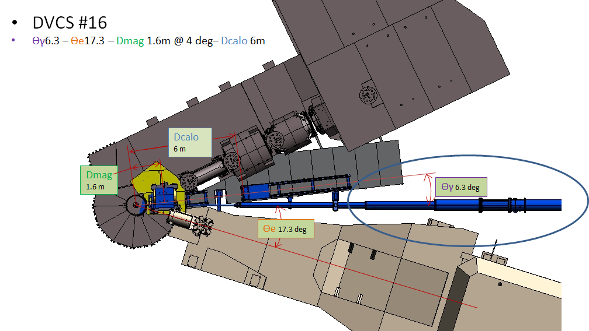
Pre-R&D Activities And Test Beam Plans – Hall C

Slide 33
Summary and Conclusion
SoLID collaboration looks back a decade of hard planning and executing activities
SoLID collaboration developed a mature pre-conceptual design
SoLID is a core part of JLab’s 12-GeV program and beyond
SoLID is prominently highlighted in the 2023 NSAC LRP
SoLID has strong support from Jefferson Lab
Pre-R&D topics
GEM readout → more general MPGD readout
Tracking options
MCP-PMT
Need to be finalized in document to be sent to G. Rai
Test beam plan
Concept available
Detailed requirements and requests to be worked out
Resources to be identified and finalized

Slide 35
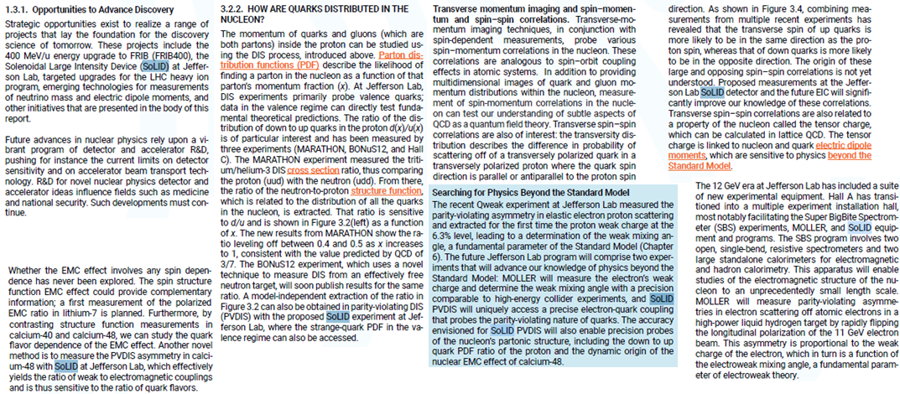
Long Range Plan 2023
SoLID mentioned 24 time in the LRP 2023

Slide 36
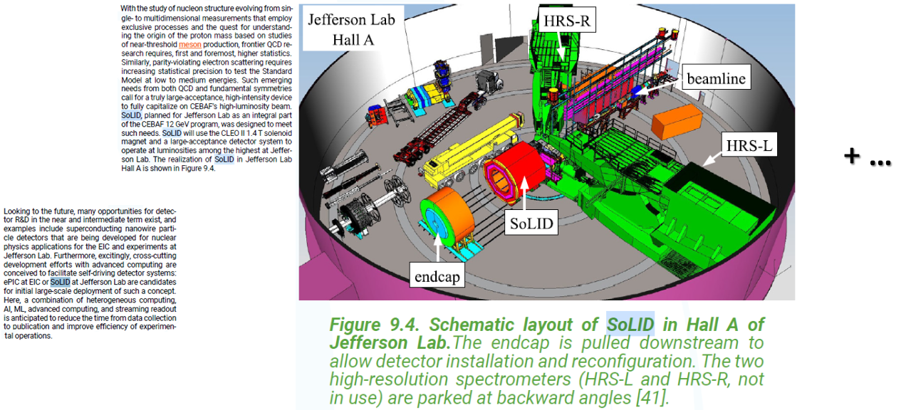
Long Range Plan 2023
SoLID mentioned 24 time in the LRP 2023

