Slide 1
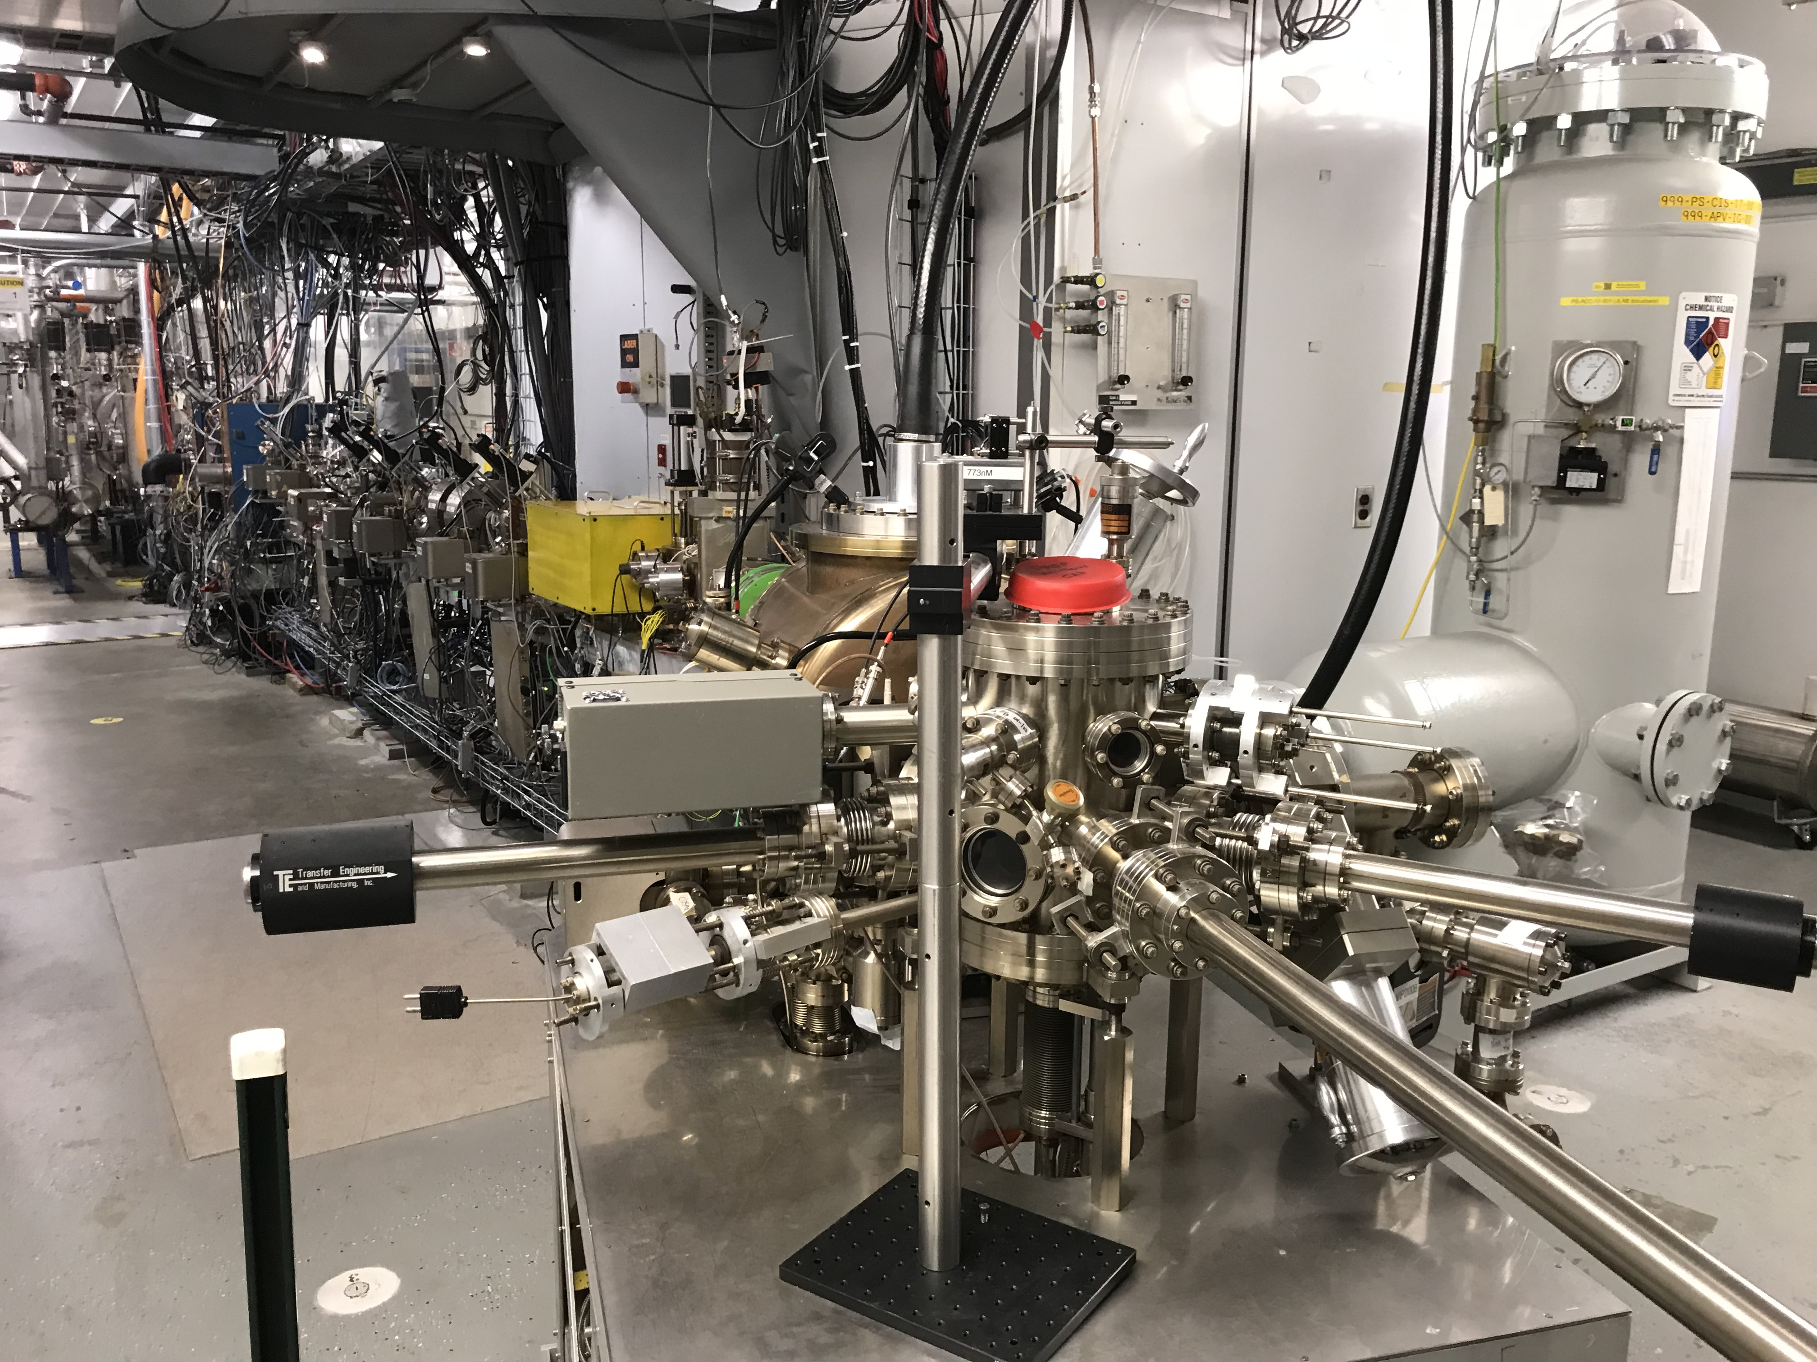
Injector Status and Upgrades for MOLLER
Hall A Collaboration Winter Meeting
January 15 – 16, 2025
Riad Suleiman

Slide 2
Outline
Parity Violation Experiments at CEBAF
MOLLER Requirements
Injector Status and Upgrades for MOLLER:
  Source: 200 kV Gun, Polarized Photocathodes
  Beamline: Solenoid Magnets, 200 keV Wien Filters, SRF Booster
  Helicity Controls: Helicity Generator Board, Helicity Decoder Board
  Parity-Quality Beam : RTP HV Driver, IA HV Driver, Helicity Magnets Control
Future Plans

Slide 3
Parity-Violating Experiments at CEBAF
PV Experiment | Energy (GeV) | Pol (%) | I (µA) | Target | A_{pv} (ppb) | Charge Asym (ppb) | Position Diff (nm) | Angle Diff (nrad) | Size Asym(δσ/σ)
HAPPEx-I 1998 – 1999 | 3.3 | 38.8 68.8 | 100 40 | ¹H (15 cm) | 15,050 | 200 | 12 | 3 | <10⁻³
G0-Forward 2003 – 2004 | 3.0 | 73.7 | 40 | ¹H (20 cm) | 3,000-40,000 | 300±300 | 7±4 | 3±1 | <10⁻³
HAPPEx-II 2004 – 2005 | 3.03 | 87.1 | 55 | ¹H, ⁴He (20 cm) | 1,580 | 400 | 2 | 0.25 | <10⁻³
G0-Backward 2006 – 2007 | 0.359, 0.688 | 85.8 | 60 | ¹H, ²H (20 cm) | 9,700-37,400 | -30±300 | 47±9 | 1.2±0.5 | <10⁻³
HAPPEx-III 2009 | 3.484 | 89.4 | 100 | ¹H (25 cm) | 23,800 | 200±10 | 3 | 0.5±0.1 | <10⁻³
PVDIS 2009 | 6.067 | 89.0 | 105 | ²H (20 cm) | 60,000-160,000 | 100 | 100 | 40 | <10⁻³
PREx-I 2010 | 1.056 | 89.2 | 70 | ²⁰⁸Pb (0.5 mm) | 657±60 | 85±1 | 4 | 1 | <10⁻⁴
QWeak 2010 – 2012 | 1.162 | 88.7 | 180 | ¹H (34 cm) | 226.5±9.3 | 20.5±1.7 | -4.6±0.2 | -0.07±0.01 | <10⁻⁴
PREx-II 2019 | 0.953 | 89.7 | 70 | ²⁰⁸Pb (0.5 mm) | 550±18 | 20.7±0.2 | 2.2±4 | 0.3±0.3 | <6x10⁻⁵
CREx 2019-2020 | 2.18 | 87.1 | 150 | ⁴⁸Ca (5 mm) | 2668±113 | -88±26 | -5.2±3.6 | -0.13±0.08 | <6x10⁻⁵
MOLLER 2027-2029 | 10.6 | 90 | 65 | ¹H (125 cm) | 35.6±0.74 | <10 | <0.6 | <0.12 | <10⁻⁵
An overview of how parity-violating electron scattering experiments are performed at CEBAF,
P.A. Adderley et al., Nuclear Inst. and Methods in Physics Research, A 1046 (2023) 167710 https://doi.org/10.1016/j.nima.2022.167710

Slide 4
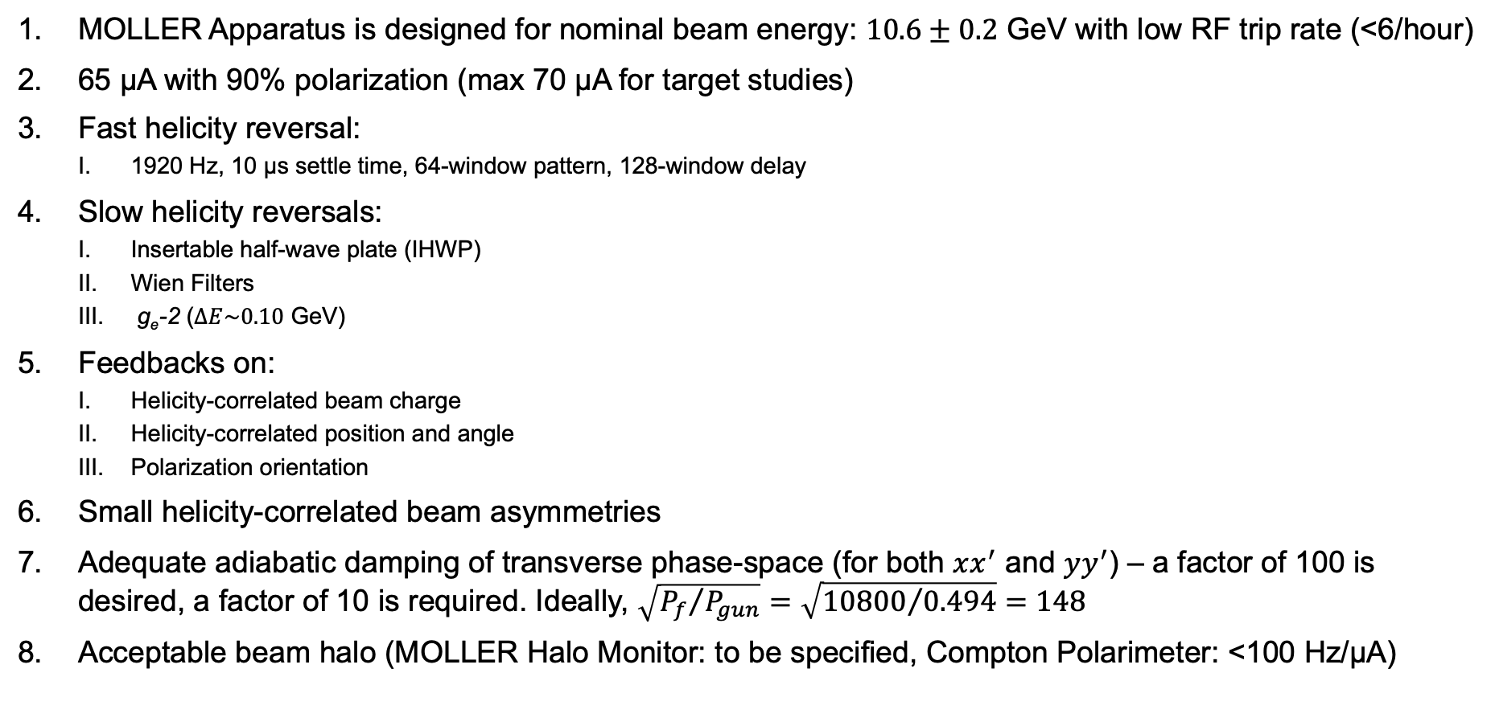
MOLLER Requirements
MOLLER Apparatus is designed for nominal beam energy: $10.6±0.2$ GeV with low RF trip rate (<6/hour)
65 µA with 90% polarization (max 70 µA for target studies)
Fast helicity reversal:
  1920 Hz, 10 µs settle time, 64-window pattern, 128-window delay
Slow helicity reversals:
  Insertable half-wave plate (IHWP)
  Wien Filters
  g_{e}-2 ($∆E\sim 0.10$ GeV)
Feedbacks on:
  Helicity-correlated beam charge
  Helicity-correlated position and angle
  Polarization orientation
Small helicity-correlated beam asymmetries
Adequate adiabatic damping of transverse phase-space (for both $xx^{′}$ and $yy^{′}$) – a factor of 100 is desired, a factor of 10 is required. Ideally, $\sqrt{{P_{f}}/{P_{gun}}}=\sqrt{{10800}/{0.494}}=148$
Acceptable beam halo (MOLLER Halo Monitor: to be specified, Compton Polarimeter: <100 Hz/µA)

Slide 5
From Beginning-to-End
Attenuator
IA
Gain-switched Diode Laser and Fiber Amplifier
Rotatable Strained
Superlattice GaAs
Photocathode
LP HWP LP
HWP PC LP
Laser
Electron Beam
Com. Fiber
Controls
HV Supply
(-105 – 105 V)
nHelicity
Fibers
Helicity Generator
15° Dipole Magnet
Delayed
Helicity Fiber
Helicity
Fibers
Vacuum
Window
T-Settle
Fiber
Hall
200 keV
Charge
Feedback
(IA)
RHWP
V-Wien Filter
Target
DAQ
Spin Solenoids
BCMs
H-Wien Filter
BPMs
Position
Feedback
Charge and Position
Feedbacks
RTP
Cell
HV Supply
(-2 kV – 2 kV)
10.6 GeV
CEBAF
6.8 MeV
Helicity Magnets
PSS
Shutters
IHWP
g_{e}-2 Reversal

Slide 6
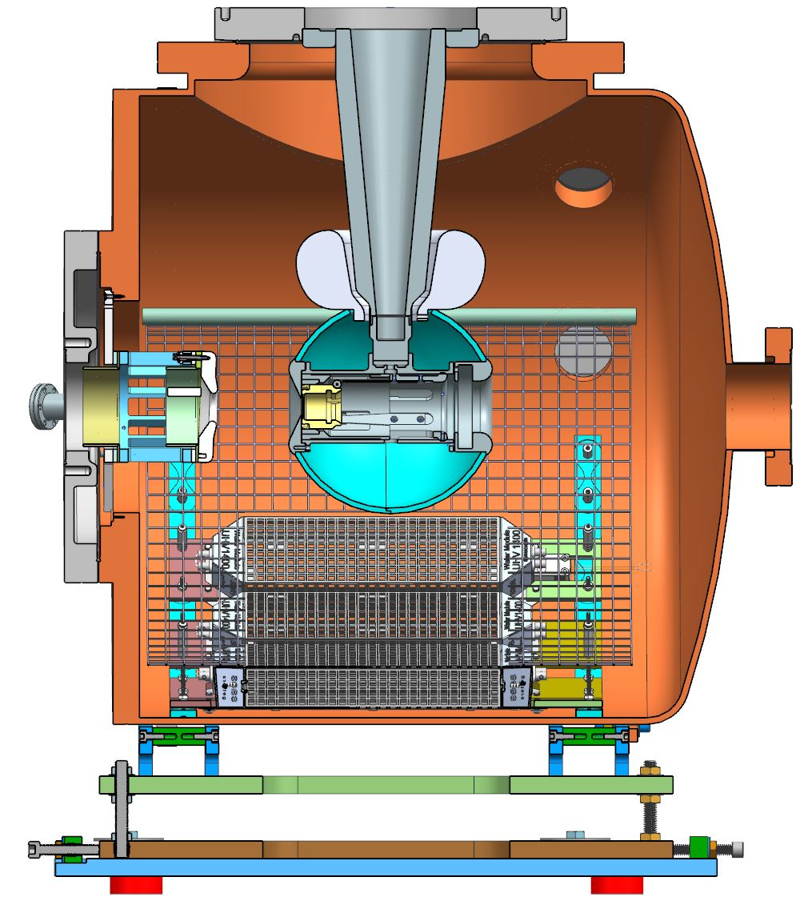
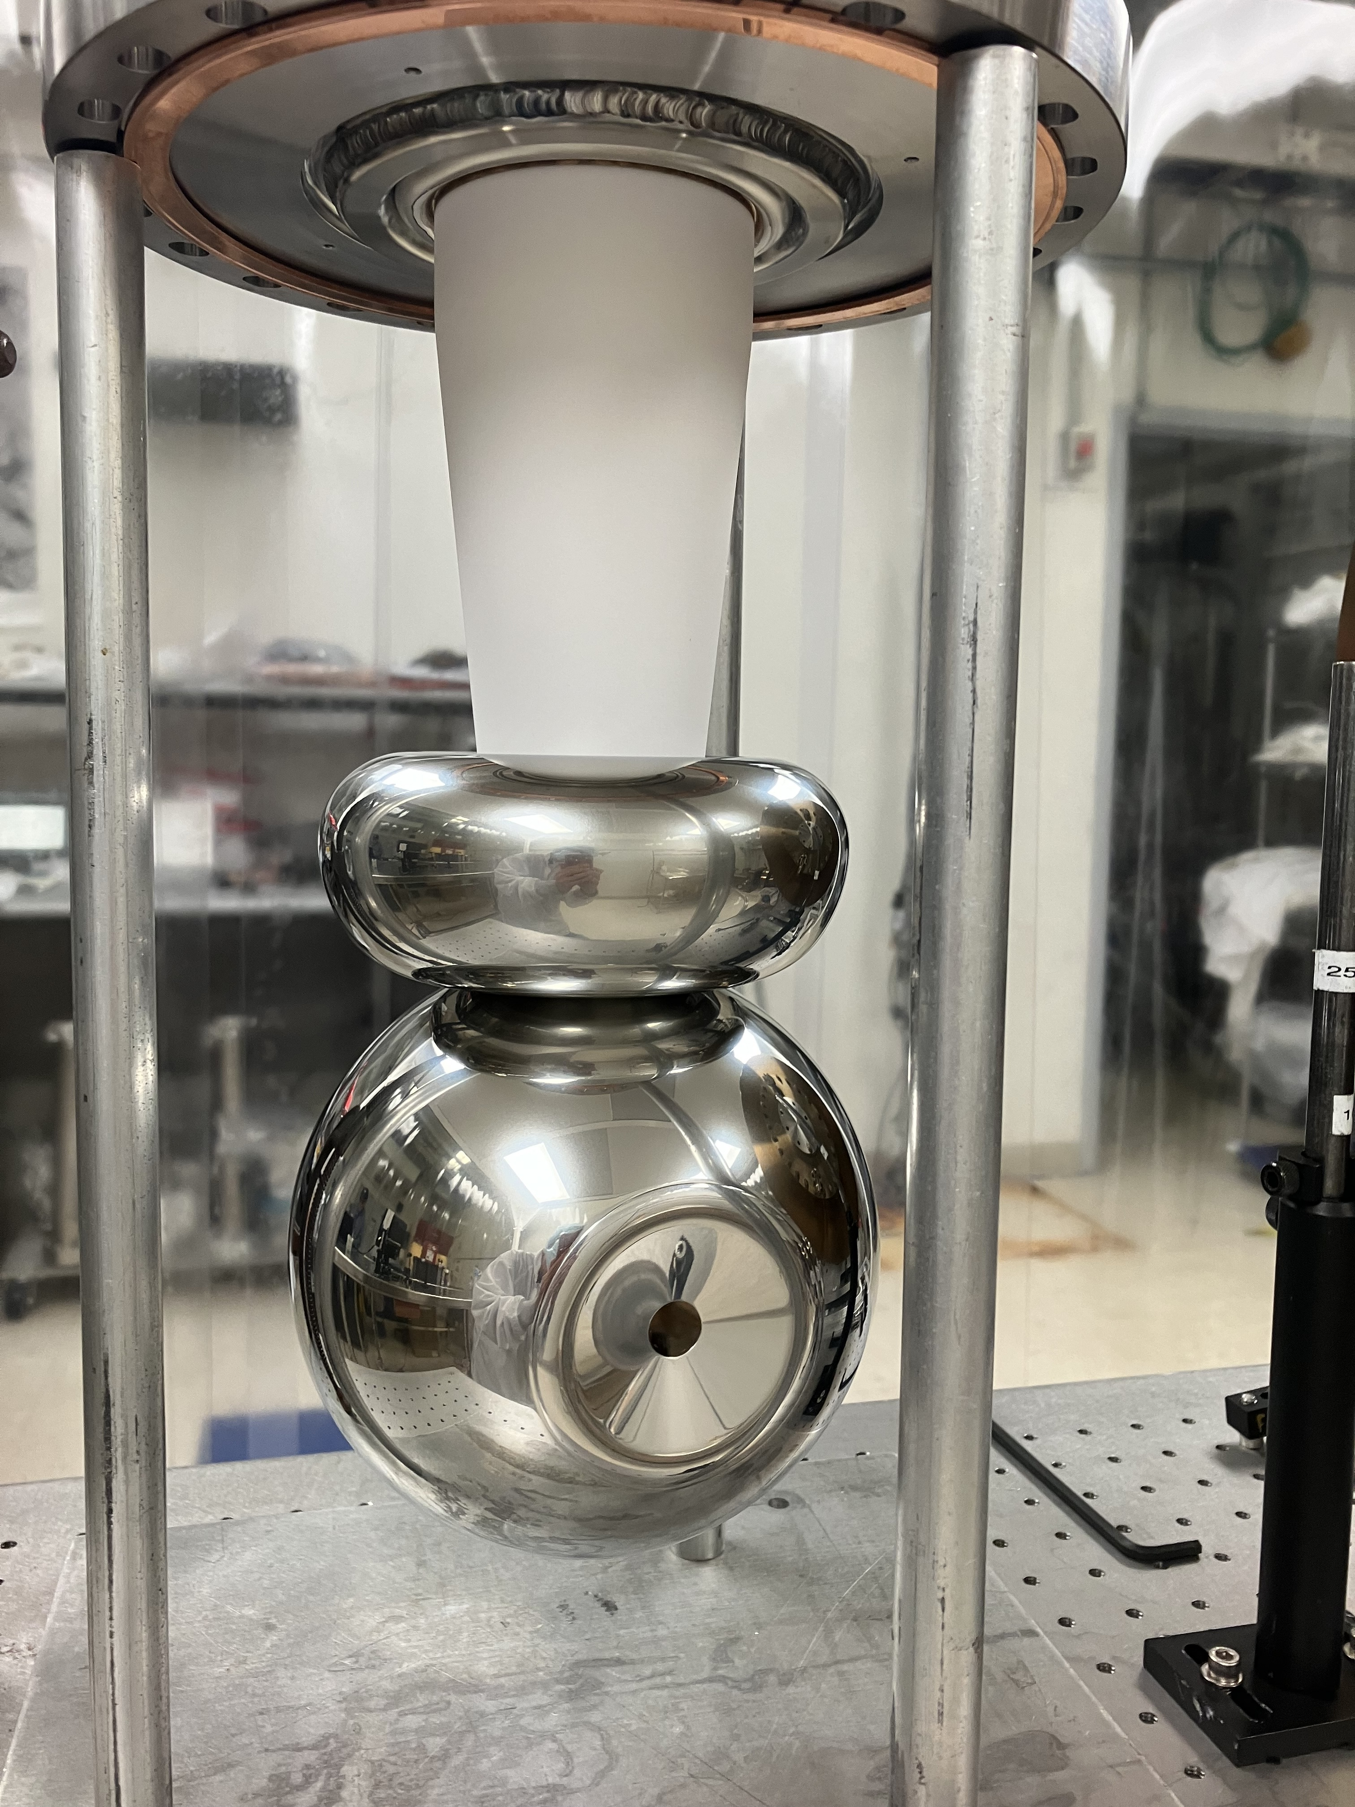
200 kV Gun – Spherical Electrode and 18" Chamber
Upgraded from 130 kV to 200 kV: less space-charge forces → higher transmission
Optimized beam optics and longer charge lifetime
Commissioned and delivering beam right now
Anode tilted by angle = 2.0 degrees
Cathode Pierce angle = 16 degrees
Biased Anode (+1kV)
https://doi.org/10.1103/
PhysRevAccelBeams.27.123401

Slide 7
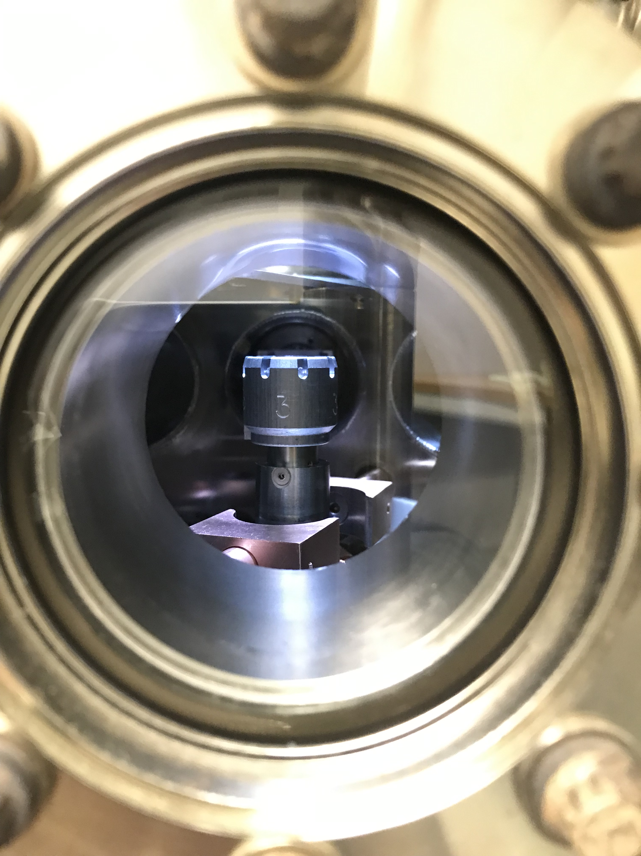
Polarized Photocathodes
Now running from Puck #3 (QWeak sibling)
Have extra two SLSP photocathodes in Preparation Chamber
Jefferson Lab, ODU, and UCSB collaborations are successfully prototyping new high-polarization high-QE photocathodes:
Puck # | Photocathode Material | Note
8 | SLSP-5247-1 | PREx-I, QWeak (July 2009 - January 2015)
9 | SLSP-5756-4 | PREx-II and CREx (January 2015 – July 2023)
3 | SLSP-5247-4 | (December 2023 – present)
10 | SLSP-5757-3 | Sibling of 5756 wafer
31 | SLSP-75104​-1 | Measured 0.7% QE and 90% polarization in micro-Mott
https://doi.org/10.1063/5.0170106
https://pos.sissa.it/456/215/pdf

Slide 8
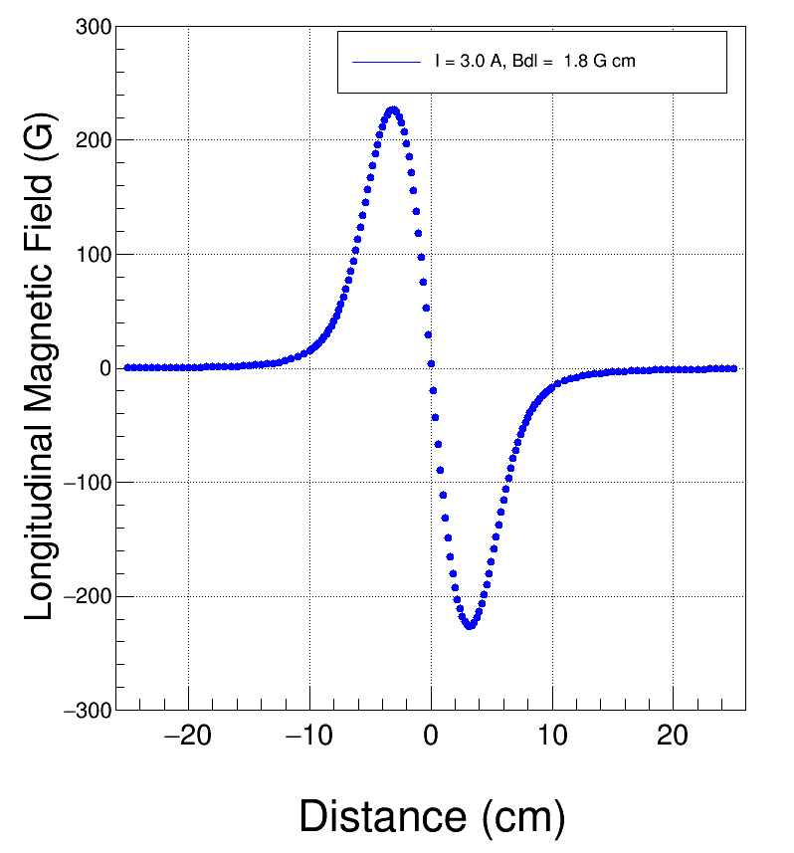
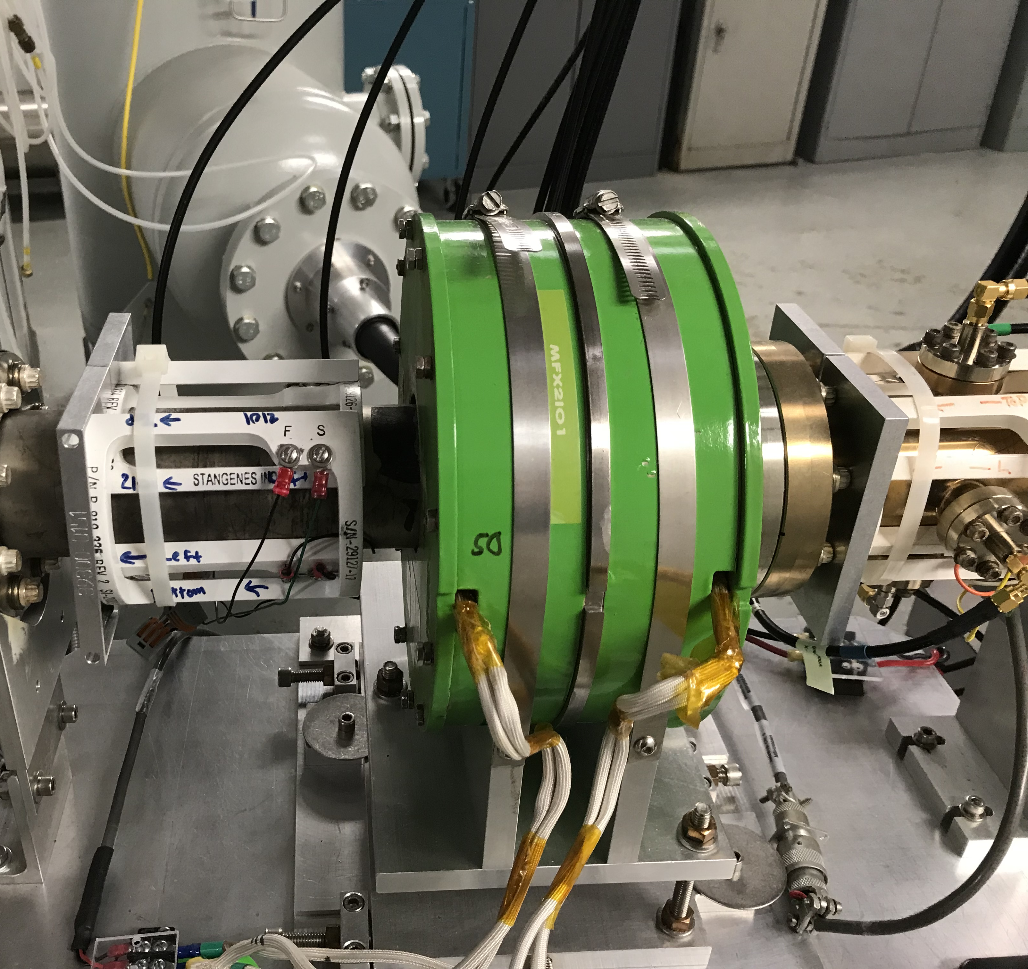
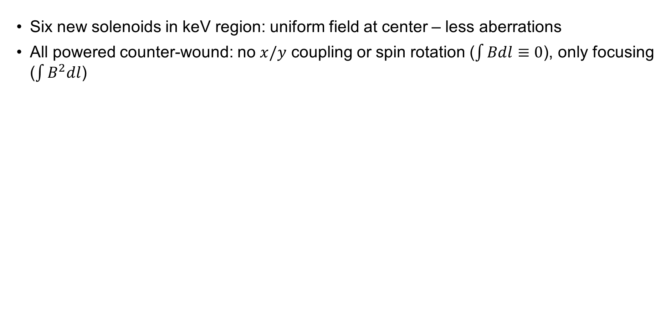
Solenoid Magnets
Six new solenoids in keV region: uniform field at center – less aberrations
All powered counter-wound: no $x/y$ coupling or spin rotation ($\int{Bdl}≡0$), only focusing ($\int{B^{2}dl}$)

Slide 9
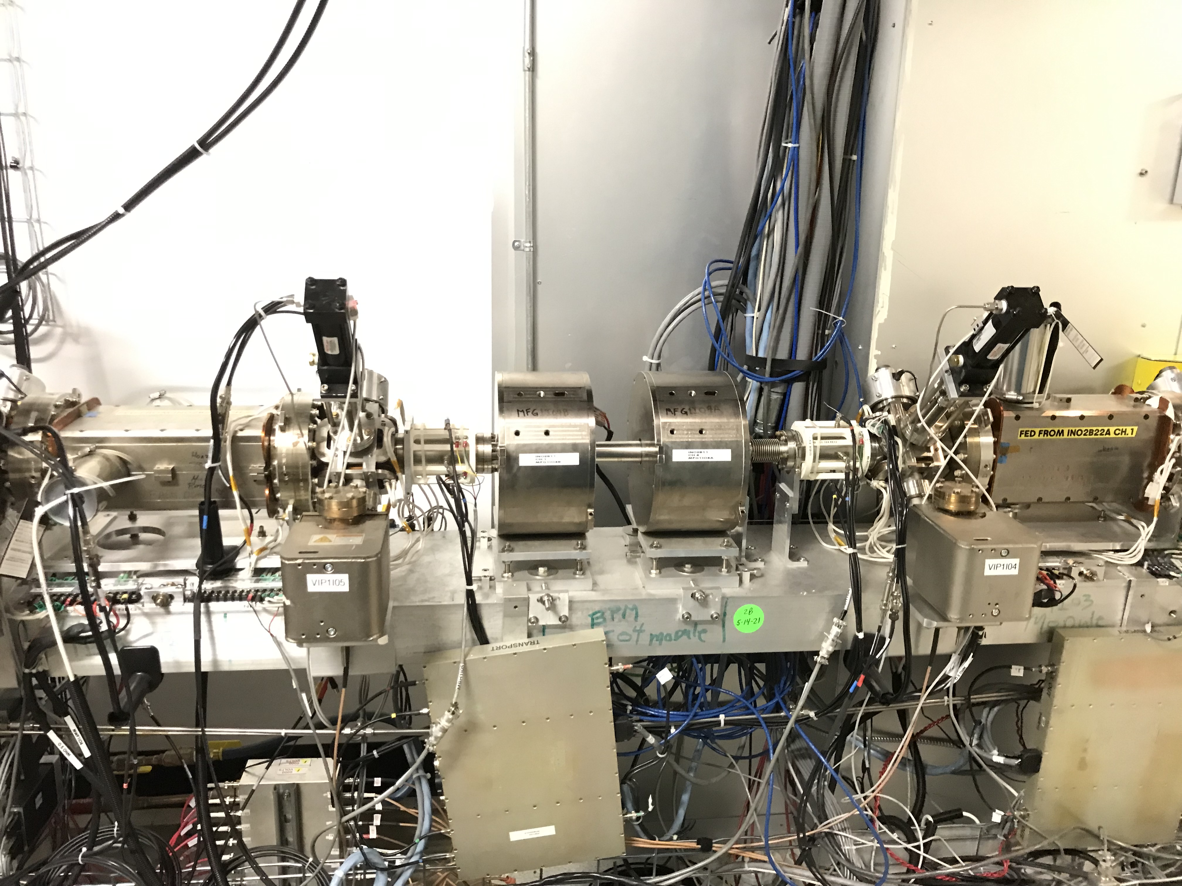
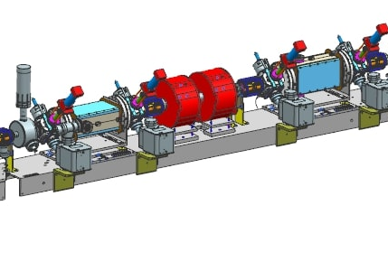
200 keV Wien Filters
Vertical Wien
Horizontal Wien
Spin Solenoids

Slide 10
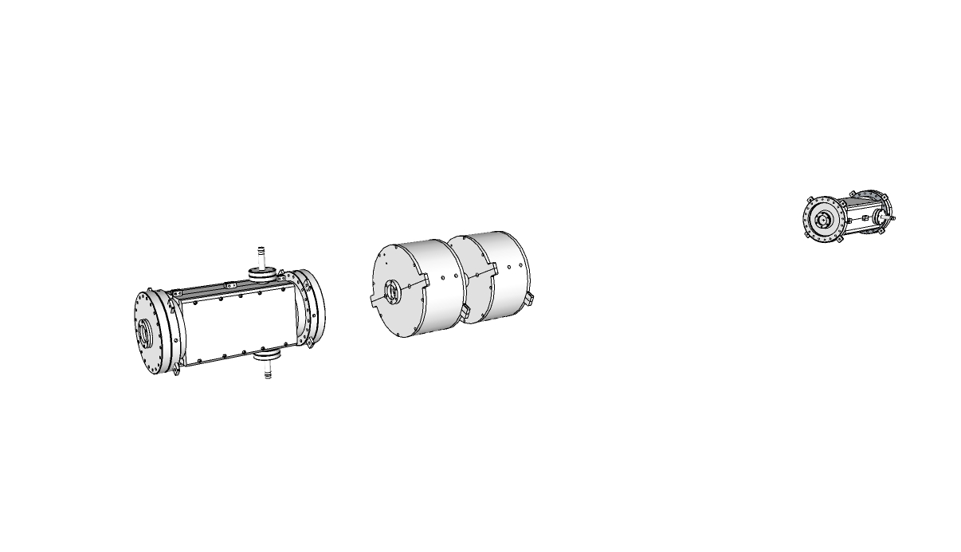
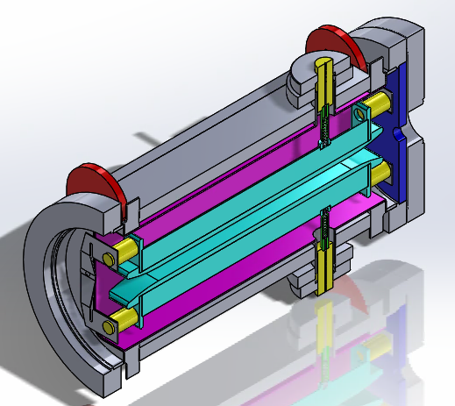
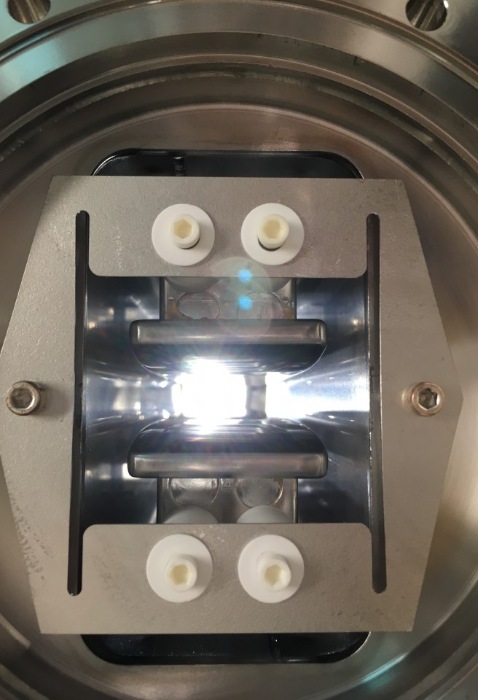
200 keV Electron Beam Spin Manipulation
Horizontal Wien
Spin Solenoids
LEFT
RIGHT
Vertical Wien
LEFT
Vertical
RIGHT
Use for Polarization Feedback
Polarized Electron Source
Long.
HV conditioned to 22 kV
Will be able to rotate spin to 110 degrees
https://jacow.org/napac2022/papers/wepa20.pdf

Slide 11
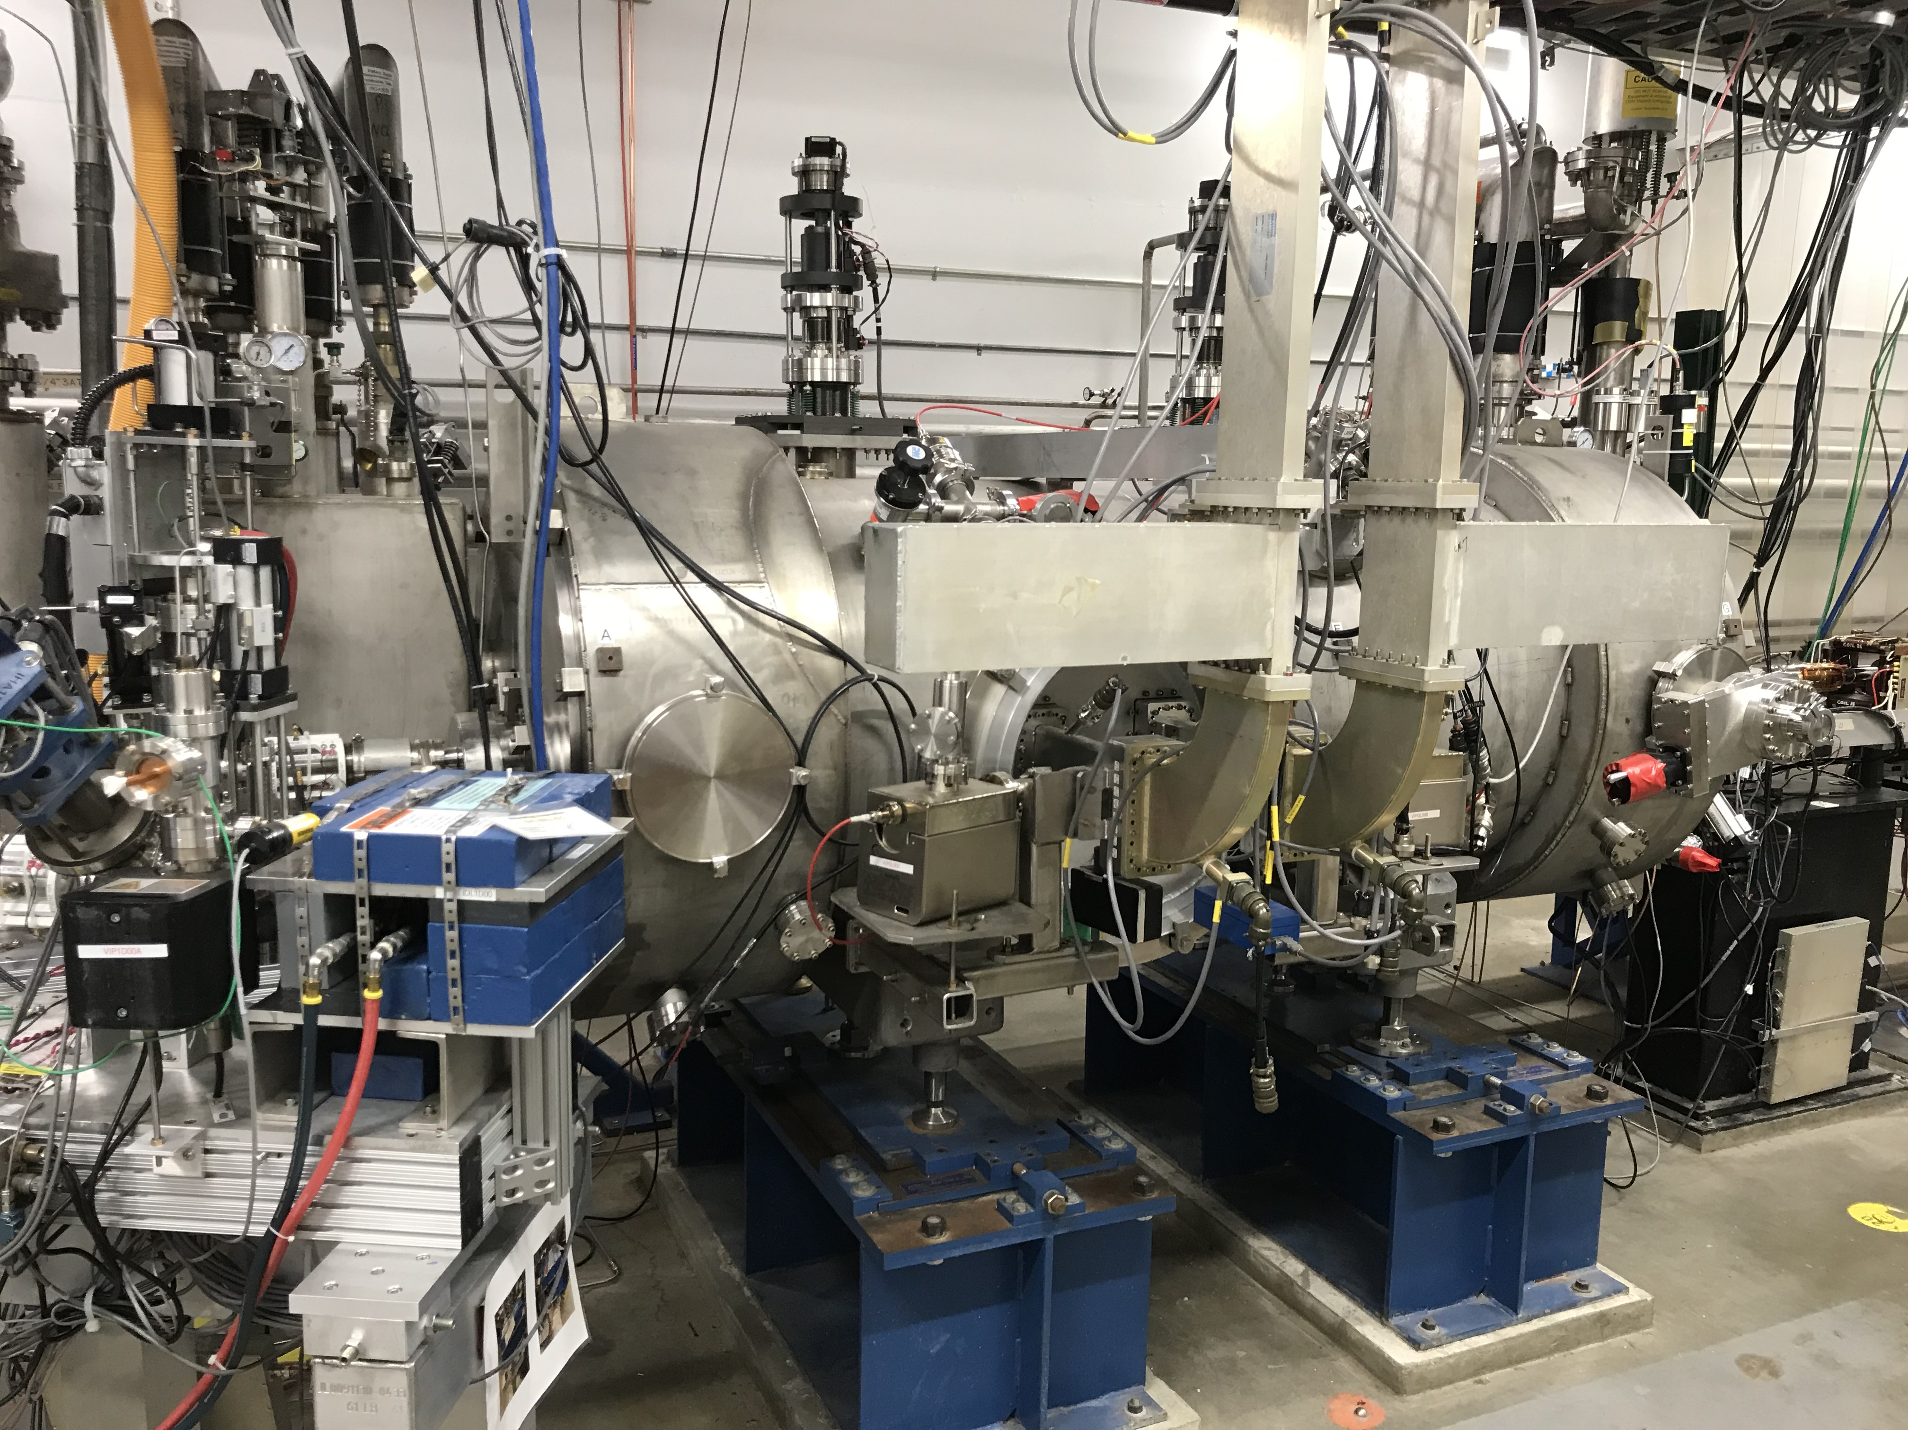
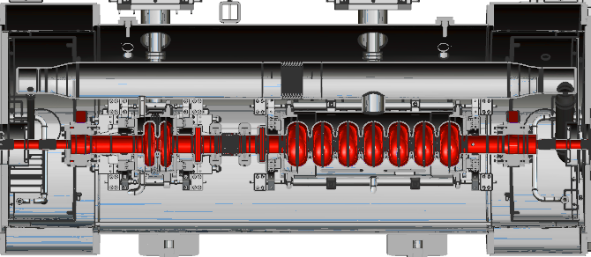
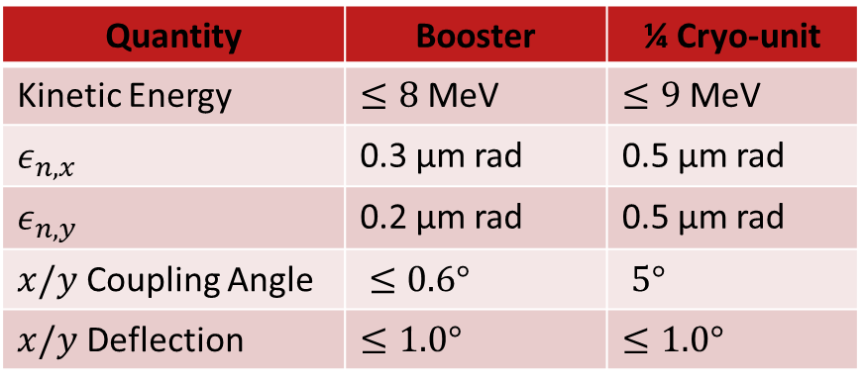
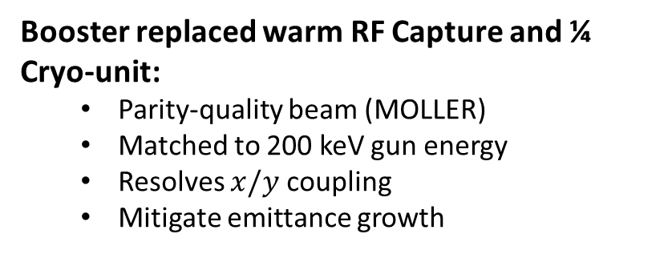
SRF Booster
Booster replaced warm RF Capture and ¼ Cryo-unit:
  Parity-quality beam (MOLLER)
  Matched to 200 keV gun energy
  Resolves $x/y$ coupling
  Mitigate emittance growth
Quantity | Booster | ¼ Cryo-unit
Kinetic Energy | $≤8$ MeV | $≤9$ MeV
$$ε_{n,x}$$ | 0.3 µm rad | 0.5 µm rad
$$ε_{n,y}$$ | 0.2 µm rad | 0.5 µm rad
$x/y$ Coupling Angle | $≤0.6°$ | $5°$
$x/y$ Deflection | $$≤1.0°$$ | $$≤1.0°$$
For more data:
• JLAB-TN-23-005
• https://doi.org/10.18429/ JACoW- NAPAC2022- WEPA12

Slide 12
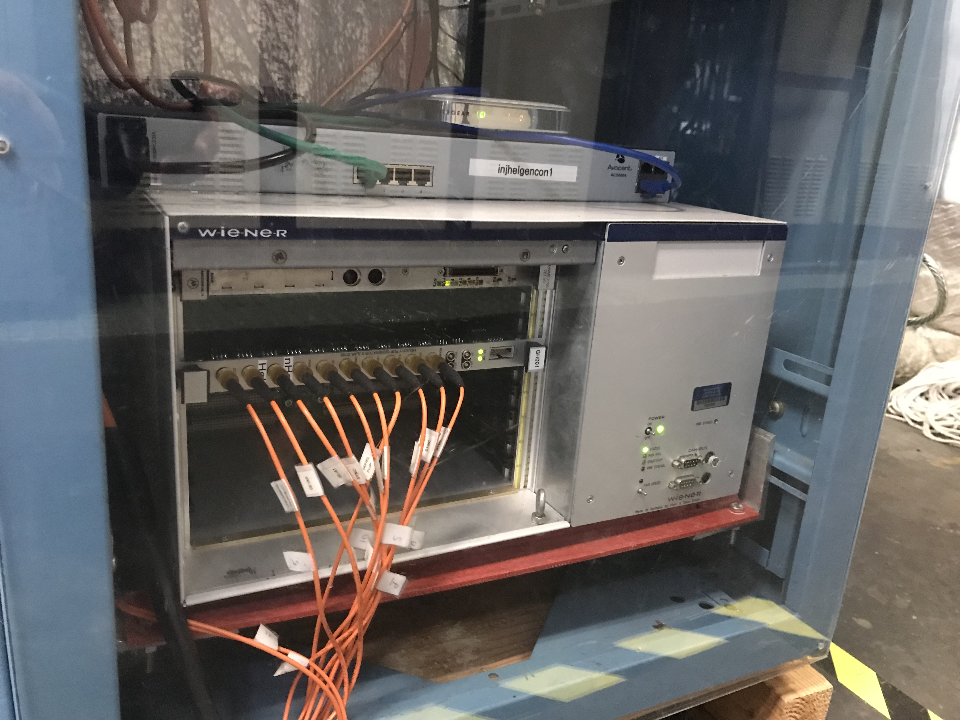
Helicity Generator Board
Built 13 boards and distributed to MOLLER
Recent firmware additions:
  New Helicity settings for MOLLER:
    Free Clock Mode at 1920 Hz, 10 µs T_Settle, 510.85 µs T_Stable
    64-window patterns: Thue-Morse-64, 16-Quad, 32-Pair
  Fixed Line-Sync Mode
  Added Soft Reset functionality
Recent hardware changes:
  Changed IA0 and IA1 fiber outputs to Helicity Flip and nHelicity Flip
Board is supported by Jefferson Lab Fast Electronics Group

Slide 13
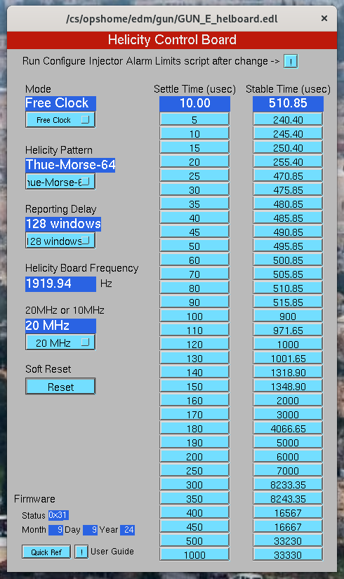
Helicity Generator Settings
Pseudo-random Bit out
30-Bit Shift Register
Shift Left
30
29
28
27
…
7
…
1
OR
XOR
XOR
Pseudo-random Bit
(0 or 1)
1
XOR
Switch
Open: Pseudo-random Patterns
Closed: Toggle Pattern

Slide 14
Helicity Decoder Board
MOLLER fast helicity reversal with delay reporting could cause mis-identification of real helicity of some of events in counting mode (these are random events), diluting measured asymmetry
Board developed by: MOLLER Collaboration (Ohio University), Jefferson Lab Fast Electronics Group and Accelerator Division
Will be used by all data acquisition systems using helicity signals
Board will not reconstruct real helicity or real 30-Bit Shift Register
Board has four input signals: T_Settle, Delayed Helicity, Helicity Pattern, and Pair Sync
For each counting event:
  Now: Delayed Helicity and Pattern are recorded in Rings of helicity-gated SIS3801 Scaler. Offline analysis then attempts to construct real helicity, a complicated process due to delay and randomness of events.
  New Board: board will keep records of helicities spanning last 30 patterns – to be able to construct 30-bit shift register seed of pseudo-random helicity generator – and position within pattern. And for each event, these records are read along with event. Offline analysis (anytime>n-patterns) will calculate real helicity using helicity predictor. Will be able to correctly identify helicity of every event.

Slide 15
Electron Beam Travel Time
With 10 µs T_Settle time, travel time from photocathode (Pockels Cell) to Hall target becomes relevant. Also, time it takes for helicity board signals to propagate to Laser Hut and to Halls.
It takes electron beam about 4.3 µs per pass to reach Hall.
Total distance at 5 passes is about 6.5 km
Fiber length from Injector Service Building (ISB) IN01B05 to Counting House was measured to be 1705 ft. With n=1.45, it takes 2.5 µs for helicity signals to travel in fibers to Hall DAQ
  All these travel times will be accounted for in this new Helicity Decoder Board such that recorded events have correct helicity at Physics Interaction Time
Built 20 Production Boards, tested and ready for distribution:
  Five in use: 2 MOLLER, 1 Hall B, 1 Hall D, 1 Injector Mott Polarimeter
  Contact Chris Cuevas to get your board

Slide 16
Decoder Board I/O and Features
Input:
  T_Settle
  Delayed Helicity
  Helicity Pattern
  Pair Sync
  External 250 MHz FADC Clock (ECL) – Board has 250 MHz internal clock
  Trigger and Sync Signals
Output:
  Four NIM helicity outputs: T_Settle, Delayed, Pattern and Pair Sync
  Data words for each trigger event
Add programable common delay (0-32 µs) for input helicity signals:
  To fix time delays due to beam travel time and helicity signal distribution to Hall
  Will be measured for each board in a specific DAQ
  Will sync helicity of beam at Physics Interaction Time in Hall
NIM or Fiber, programmable

Slide 17
Board Programmable Common Delay
How to set input common time delay:
  Helicity Board: 60 Hz Beam Sync (354 µs)
  Electron Beam: VL, 60 Hz Beam Sync, 50 ns pulses
  First, check relative timing of electron VL Generator and Helicity signal on laser table
  Adjust board common delay to match relative timing at laser table
60 Hz Beam Sync
Check relative timing
ISB
Helicity Decoder Board
Check relative timing
Delayed
Helicity
Fiber
Helicity Generator
VL
Generator
Real
Helicity
Fiber
DAQ
Trigger
HV Supply
RTP
Cell
Board Common Input Delay (0-32 µs)
Hall
CEBAF
Target

Slide 18
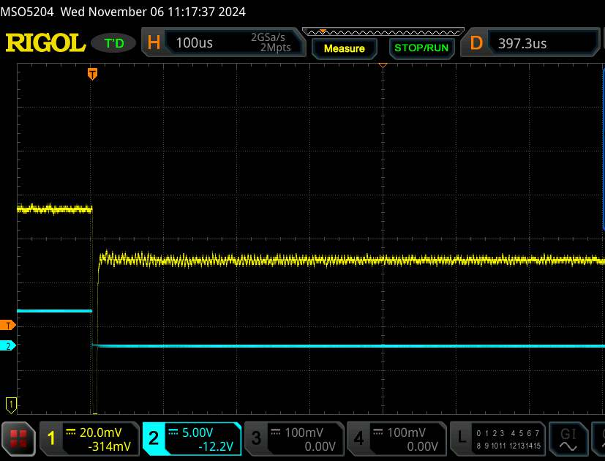
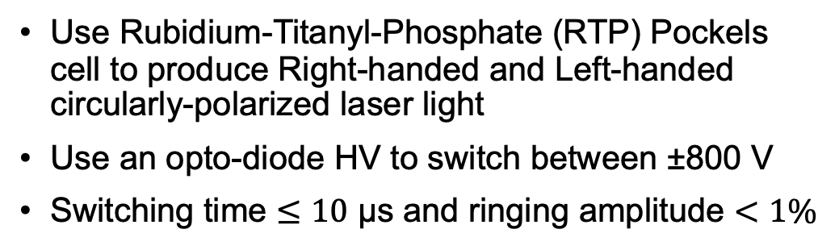
UVA Prototype RTP HV Driver
Use Rubidium-Titanyl-Phosphate (RTP) Pockels cell to produce Right-handed and Left-handed circularly-polarized laser light
Use an opto-diode HV to switch between ±800 V
Switching time $≤10$ µs and ringing amplitude $<1\%$
https://doi.org/10.48550/arXiv.2106.09546

Slide 19
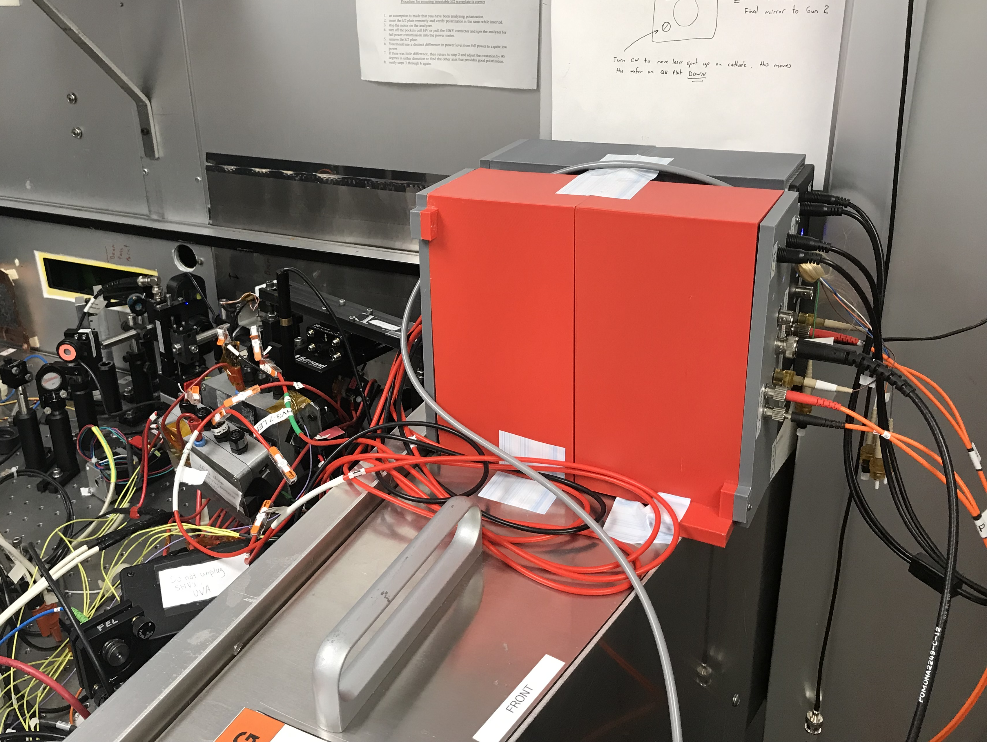
New JLab RTP HV Driver
Designed and built by Steven Covert and Jim Kortze
Use solid-state switch – MOSFET
Prototype under development and testing

Slide 20
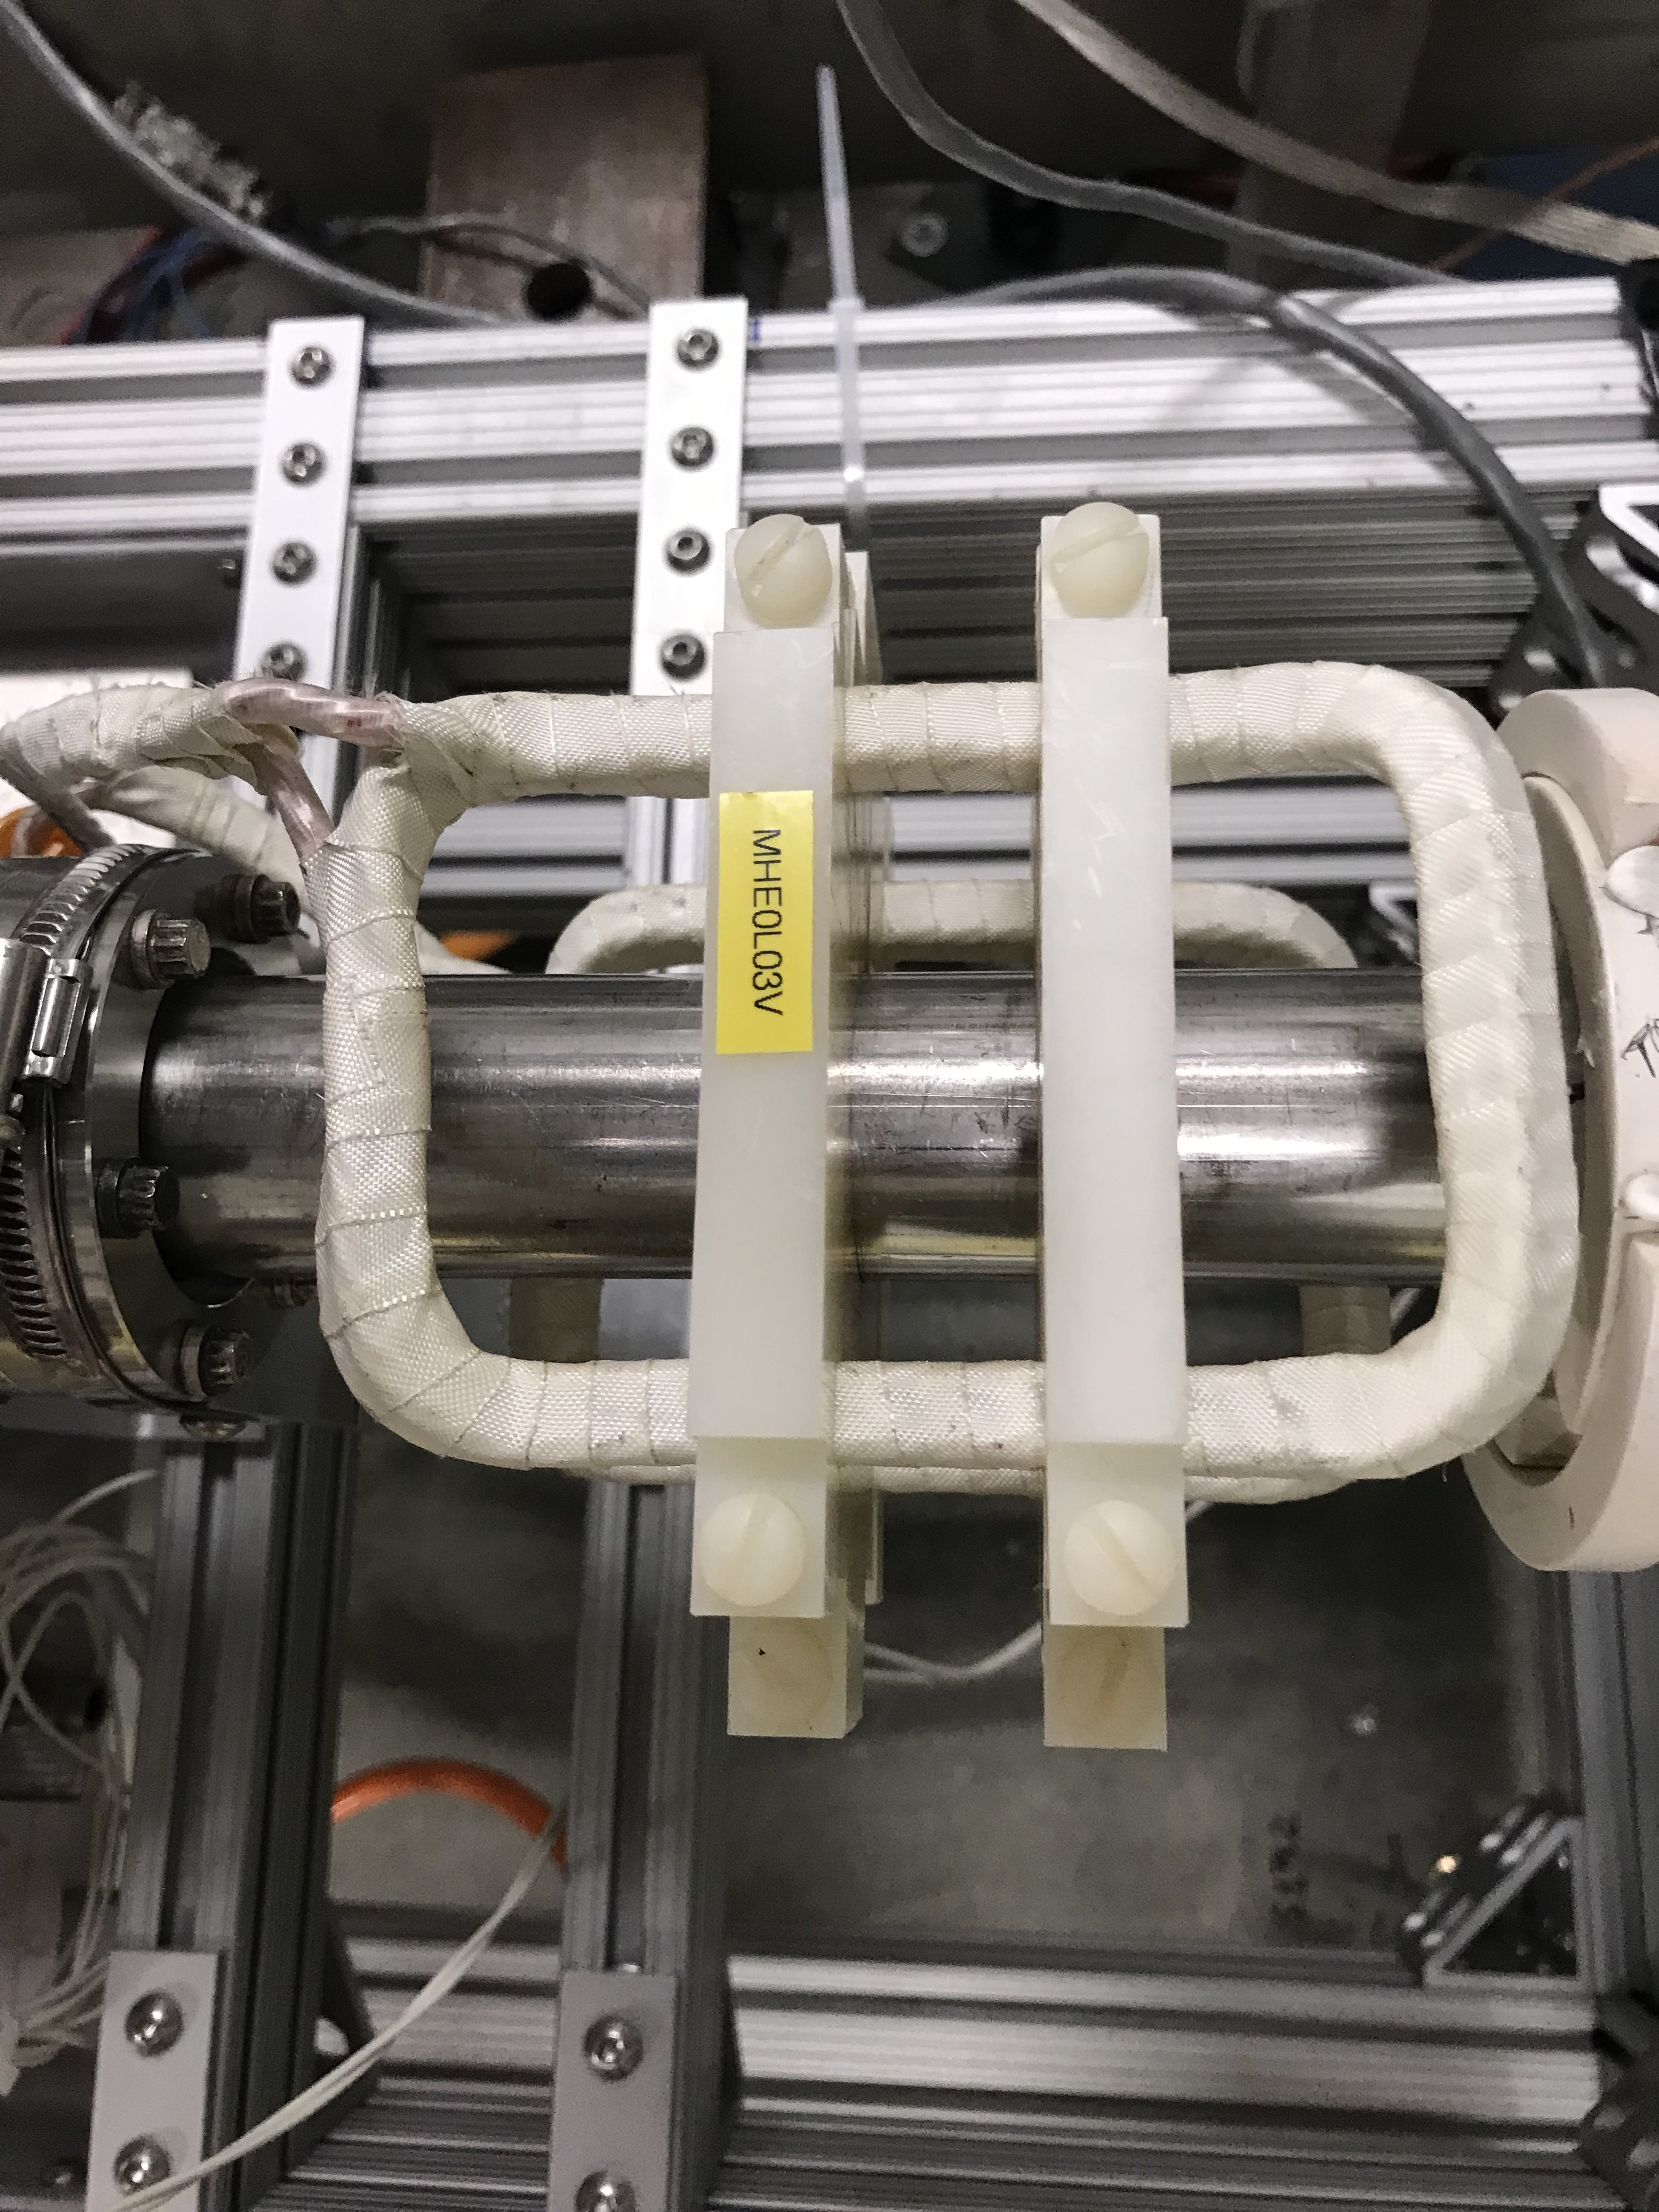
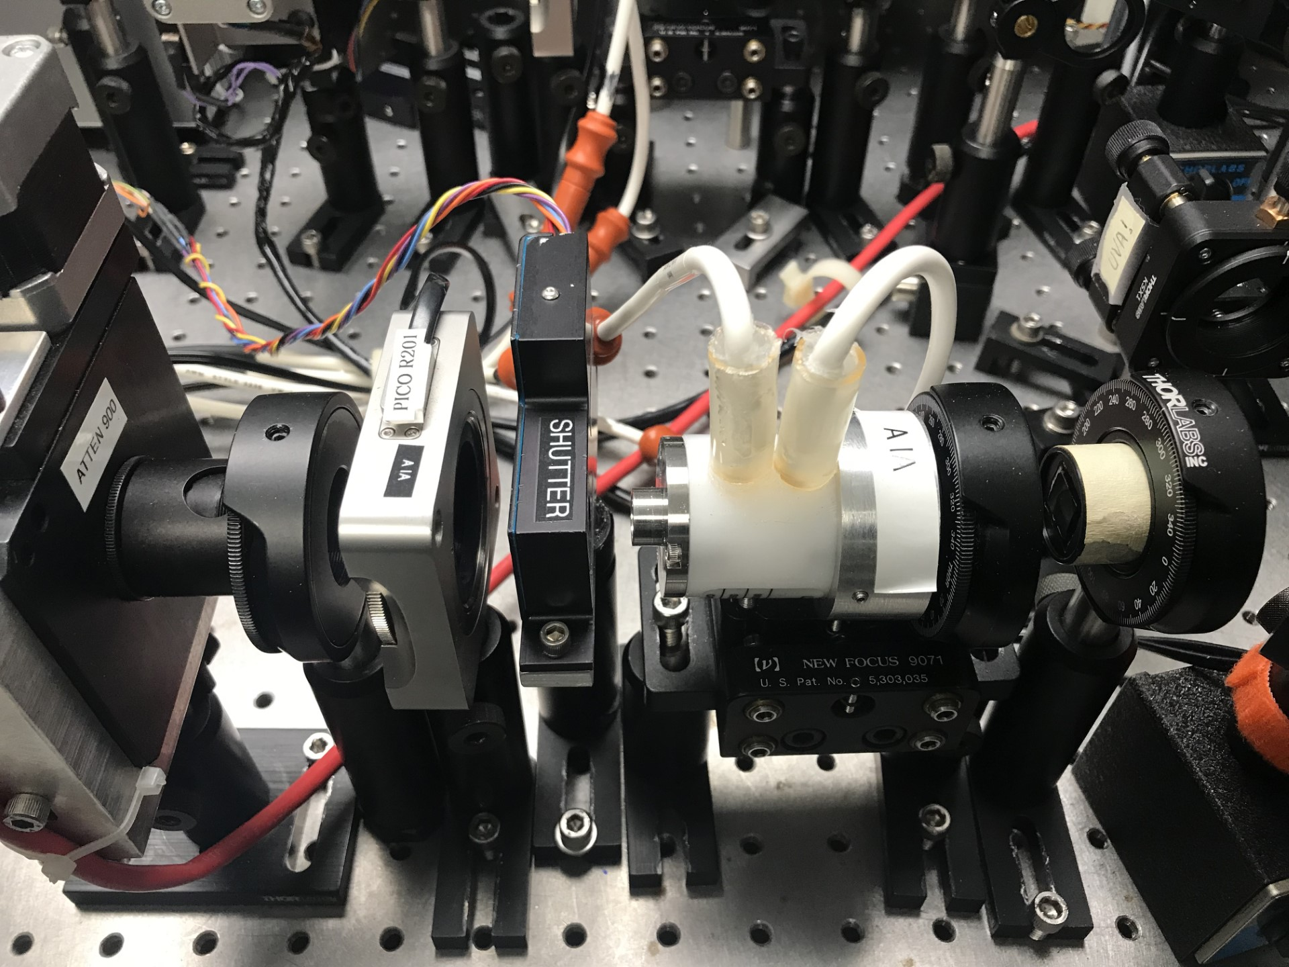


IA HV Driver and Helicity Magnets Control
New Intensity Attenuator (IA) HV Driver is planned in FY2025
Use ±105 V precision Operational Amplifier
Switching time $≤10$ µs
IA system for each Hall (A, B, C, and D)
New Helicity Magnets controller is planned in FY2025
Switching time $≤10$ µs
Four air-core magnets made of Litz wire are installed in Injector MeV region
LP
λ/2 WP
KD*P PC
LP

Slide 21
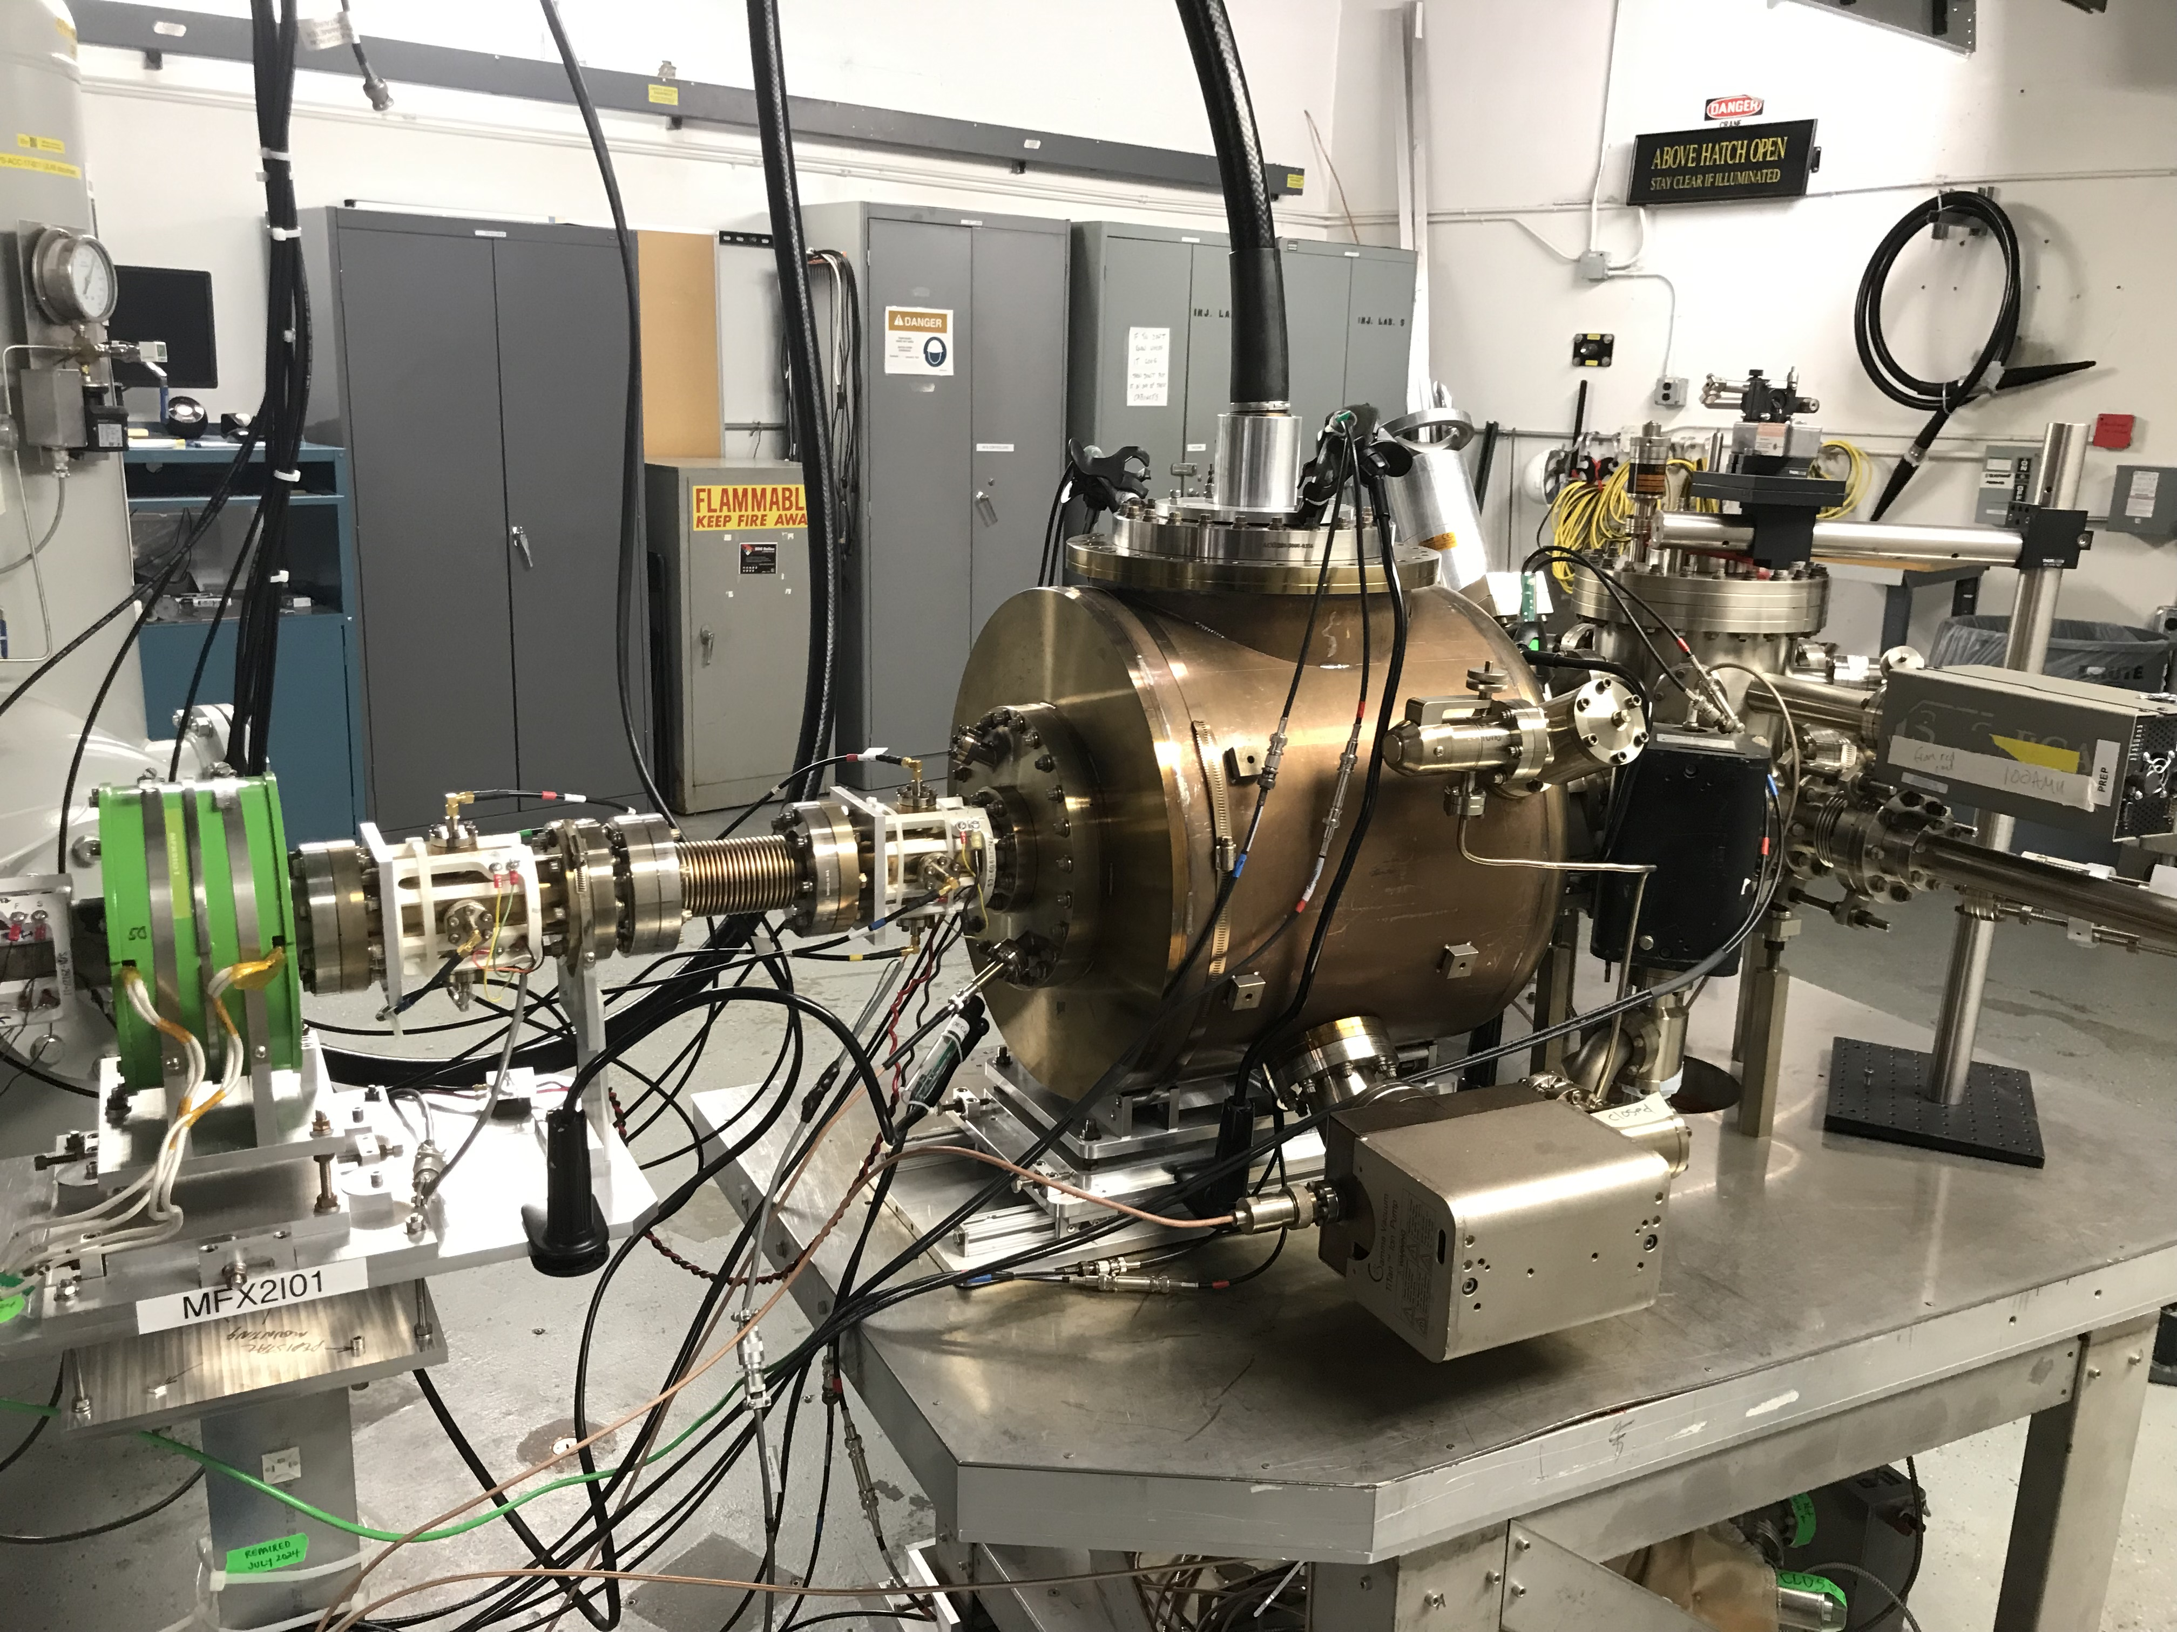
Future Plans
This Run Period:
  Parity-quality beam studies in Injector and Hall A
  Install RTP HV Driver
This coming Scheduled Accelerator Maintenance:
  Install IA HV Driver
  Install Helicity Magnets Control
  Upgrade Isolated Rack of Helicity Generator
  Laser Room Cleanup
Possibility of new 6.8 MeV Wien Filter for polarization feedback

