Slide 1
Single channel uRWELL PICOSEC prototypes
Analysis results (June 2024 test beam)

Slide 2
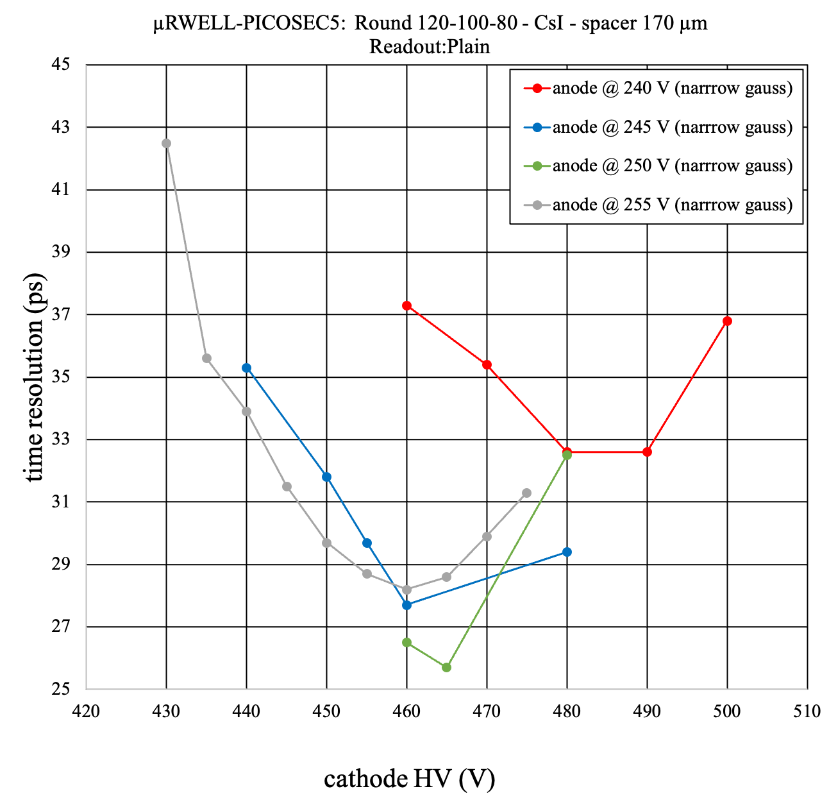
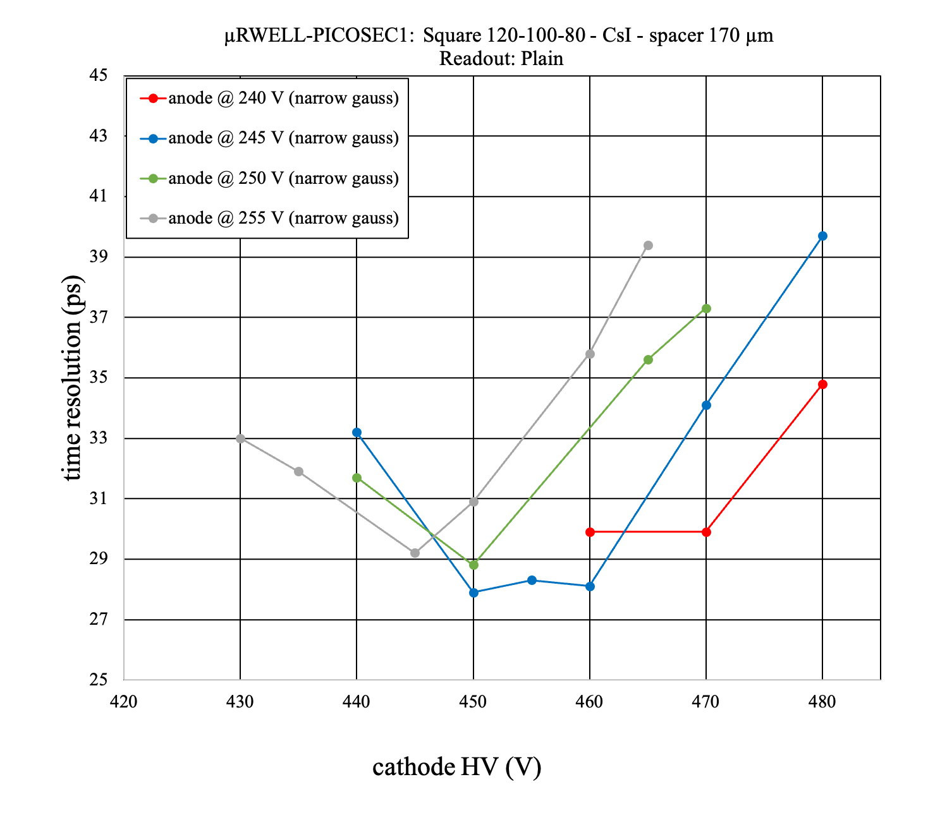
Hole shape: Round vs Square

Slide 3
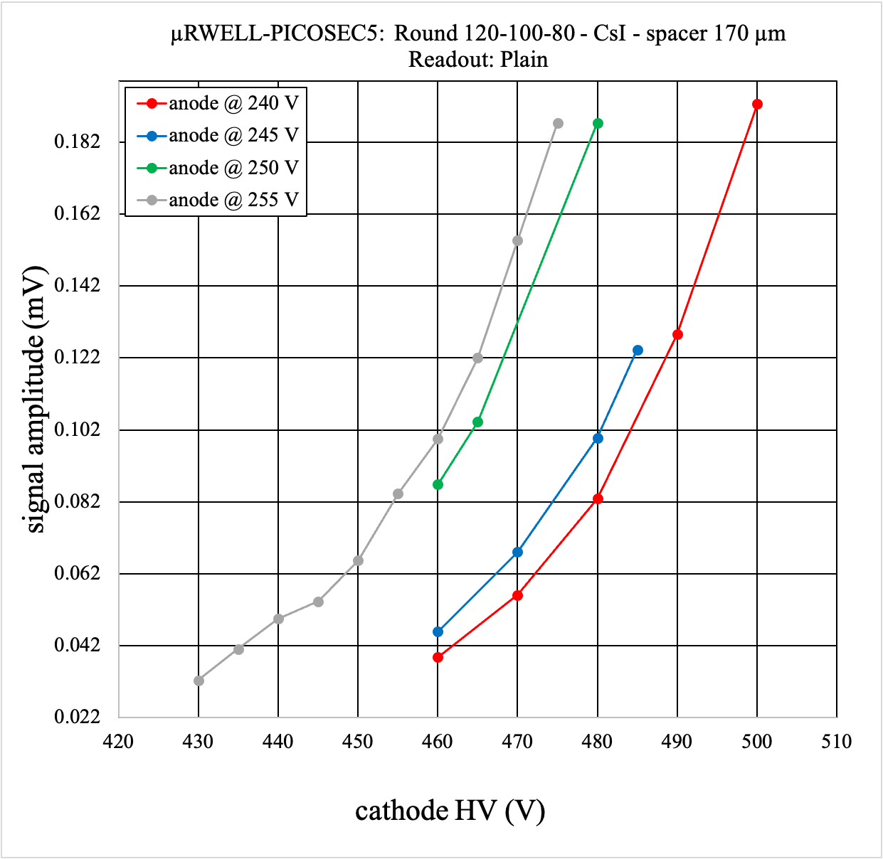
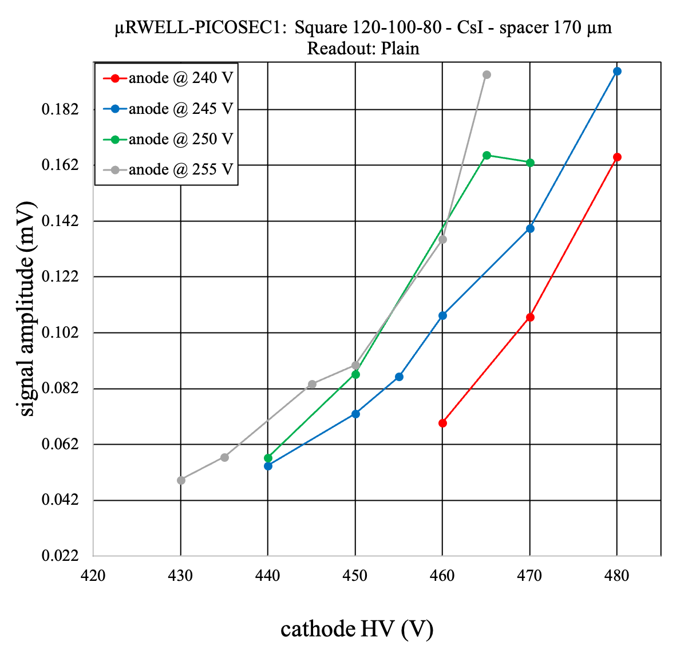
Hole shape: Round vs Square

Slide 4
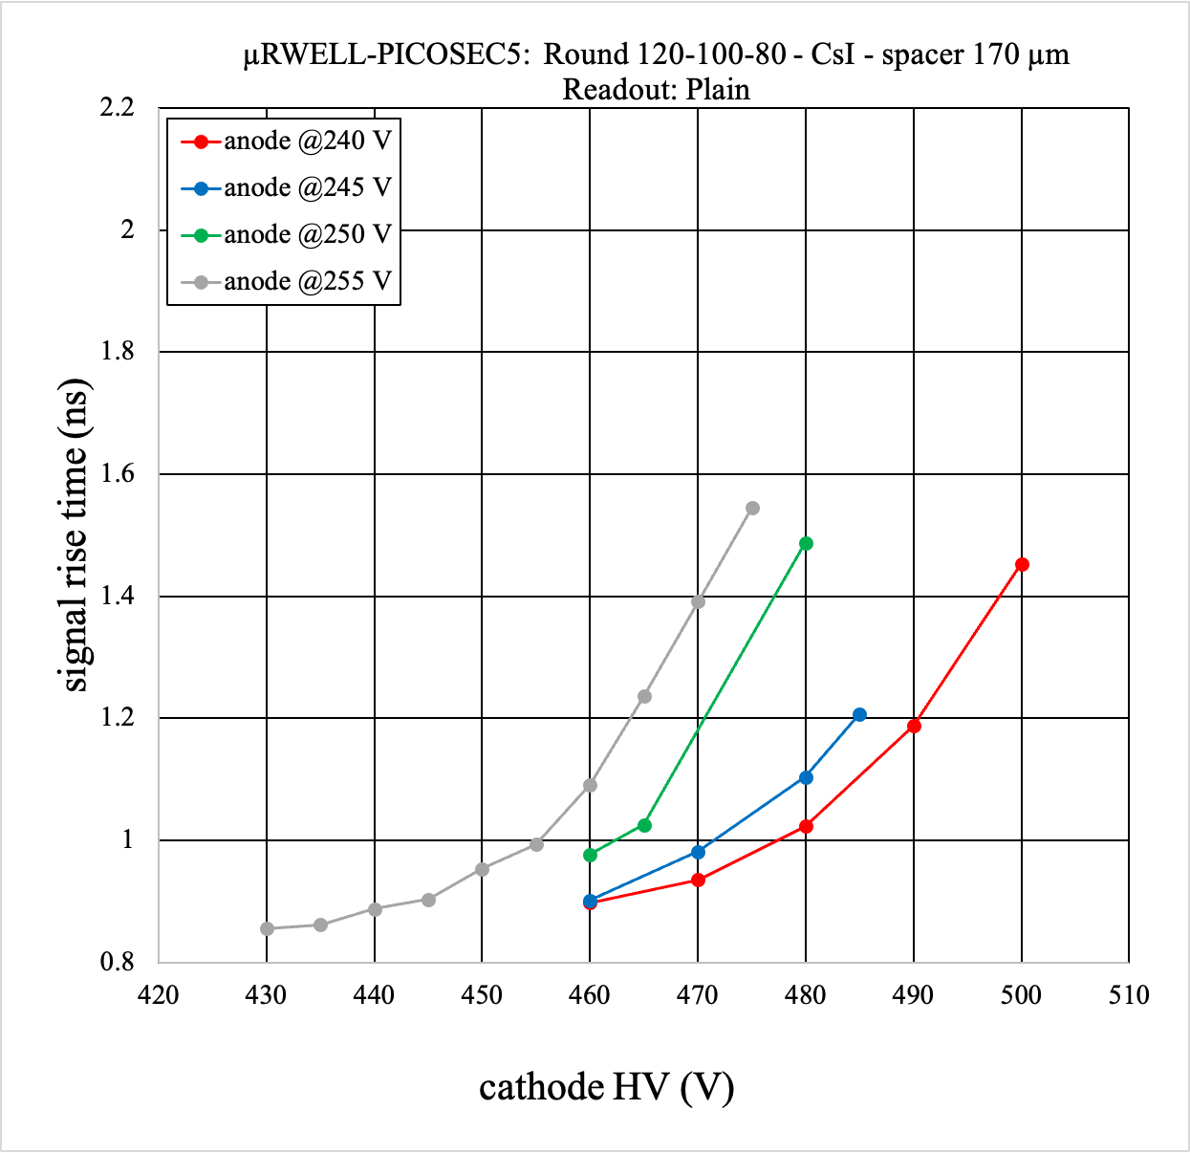
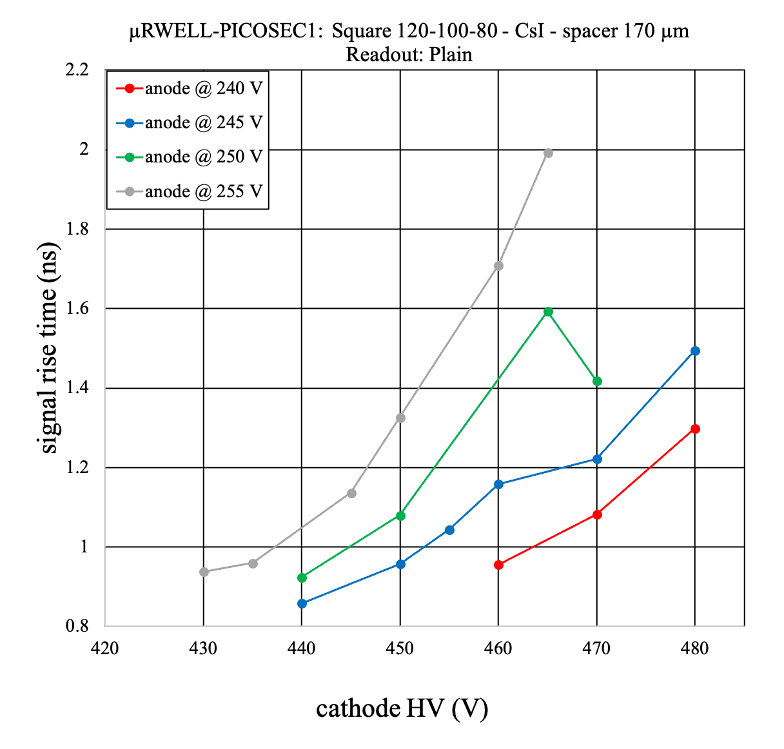
Hole shape: Round vs Square

Slide 5
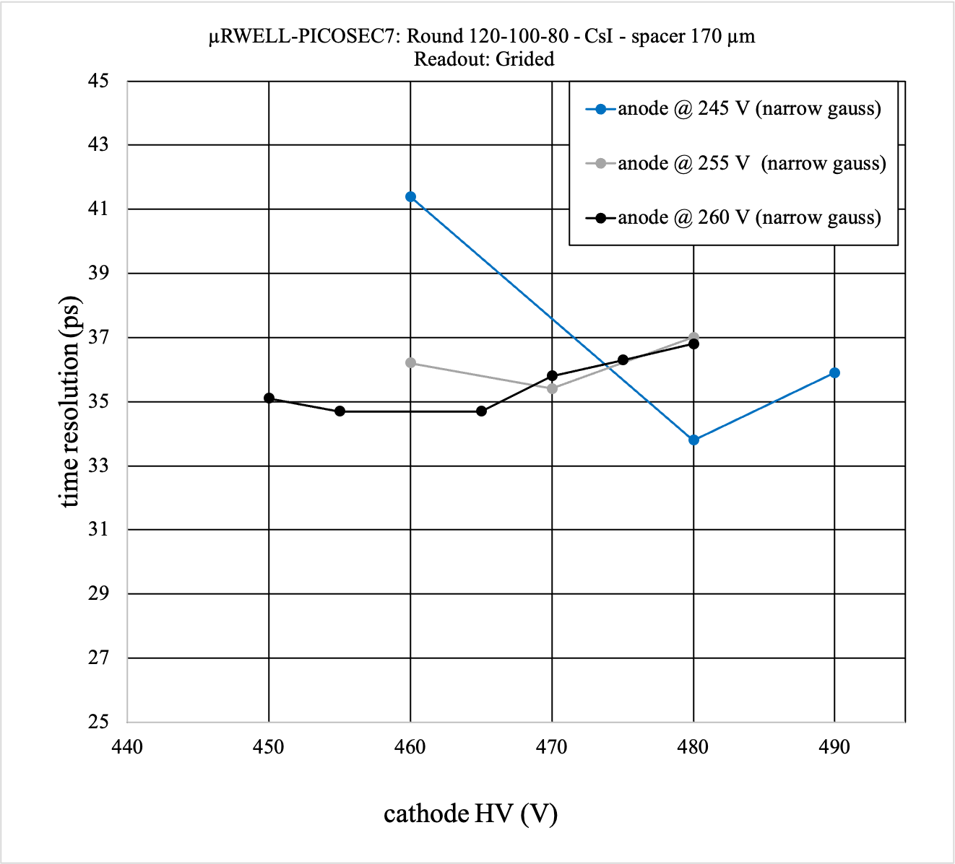
Readout: Plain vs Grided

Slide 6
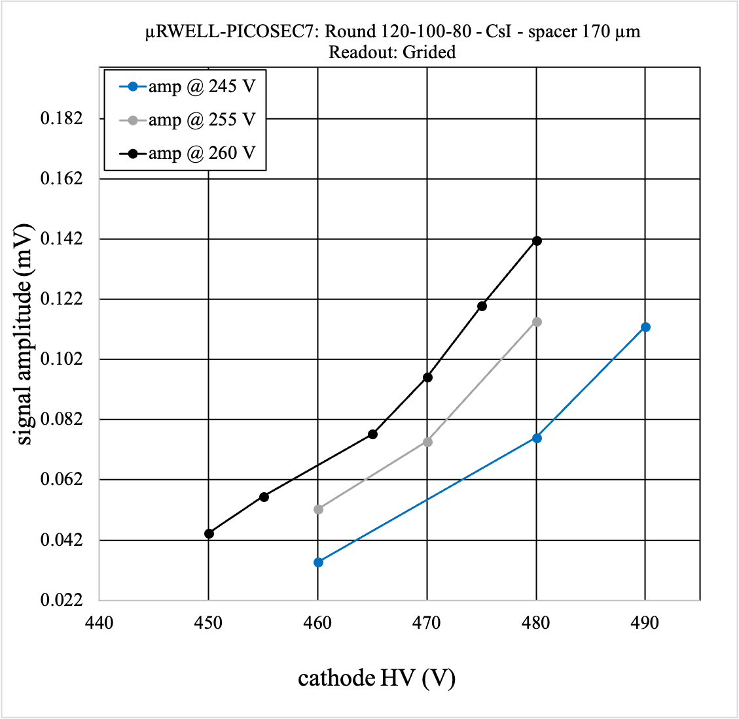
Readout: Plain vs Grided

Slide 7
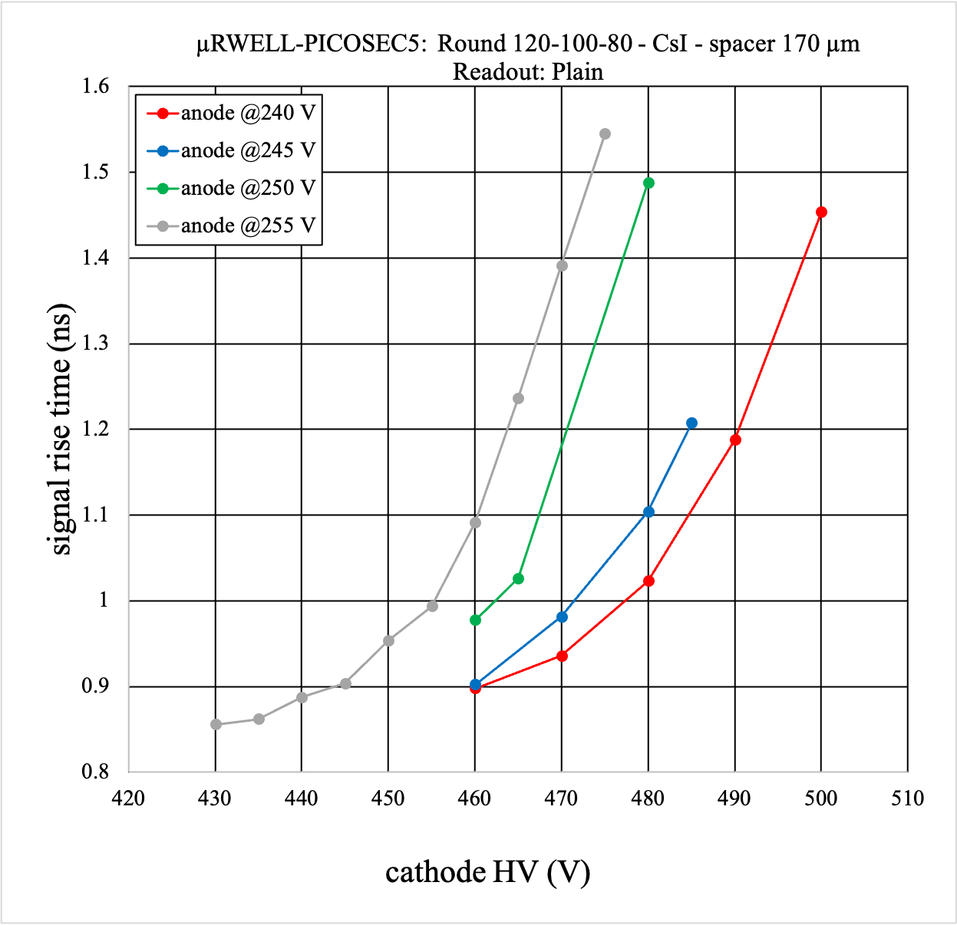
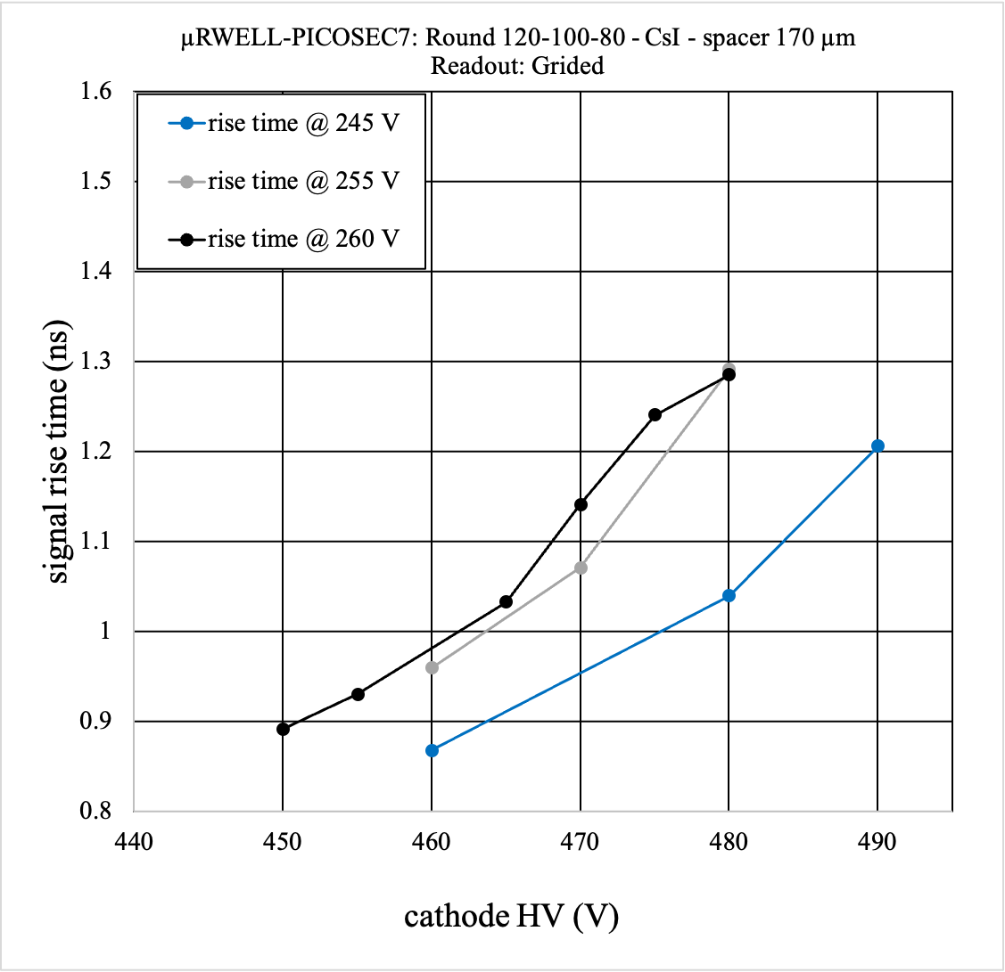
Readout: Plain vs Grided

Slide 8
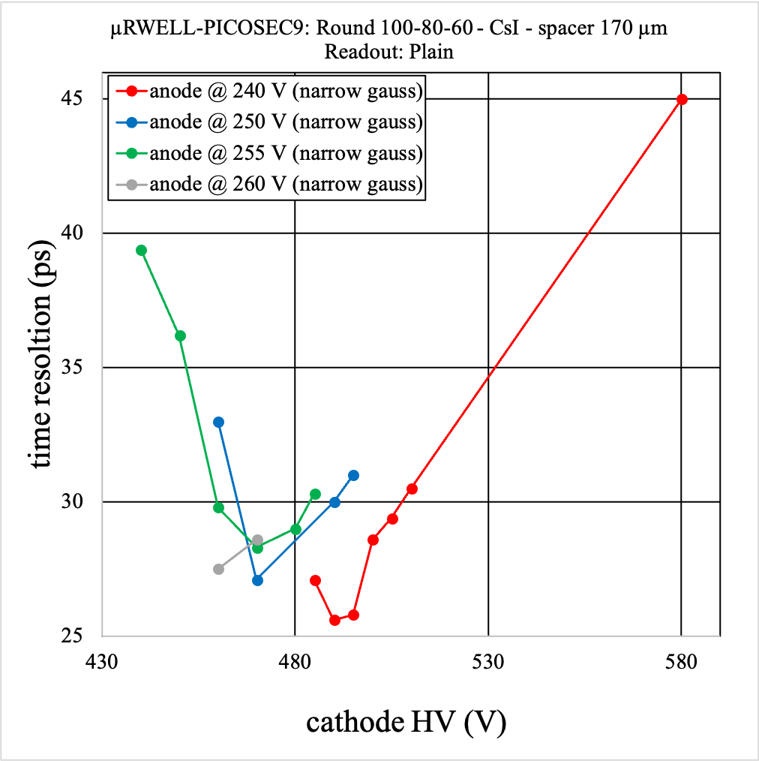
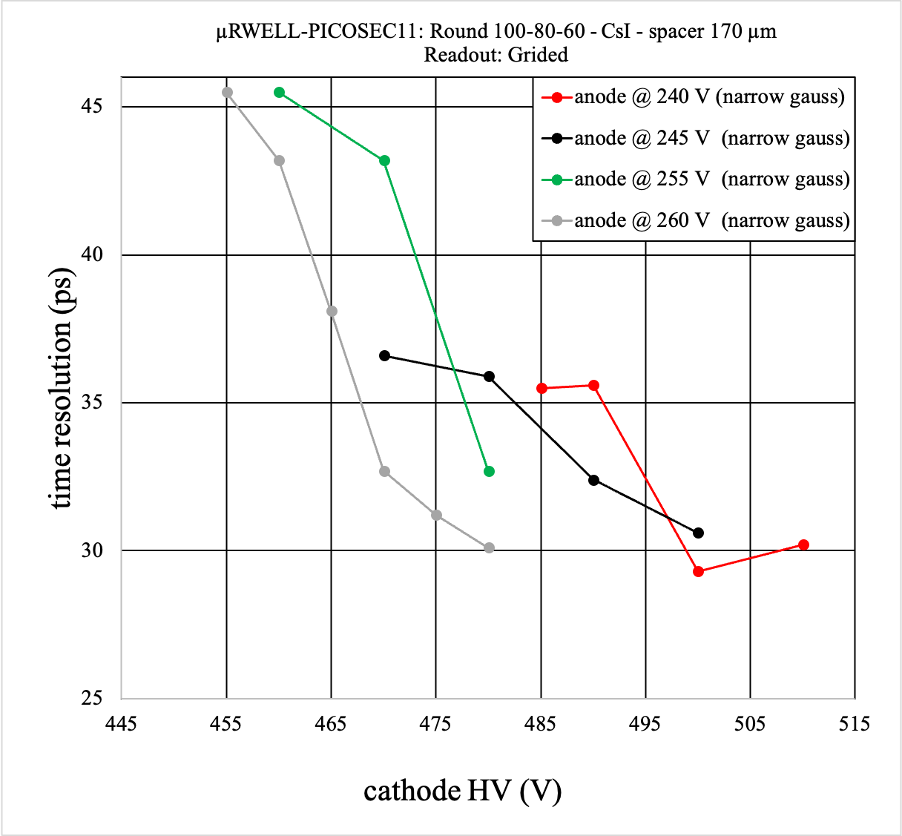
Readout: Plain vs Grided

Slide 9
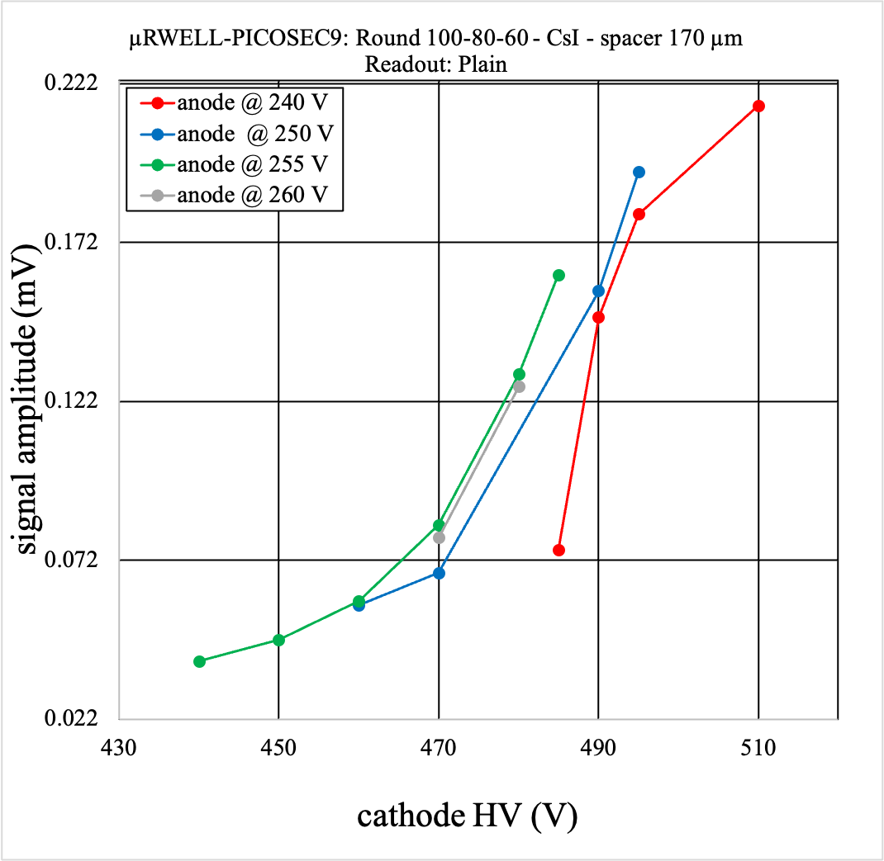
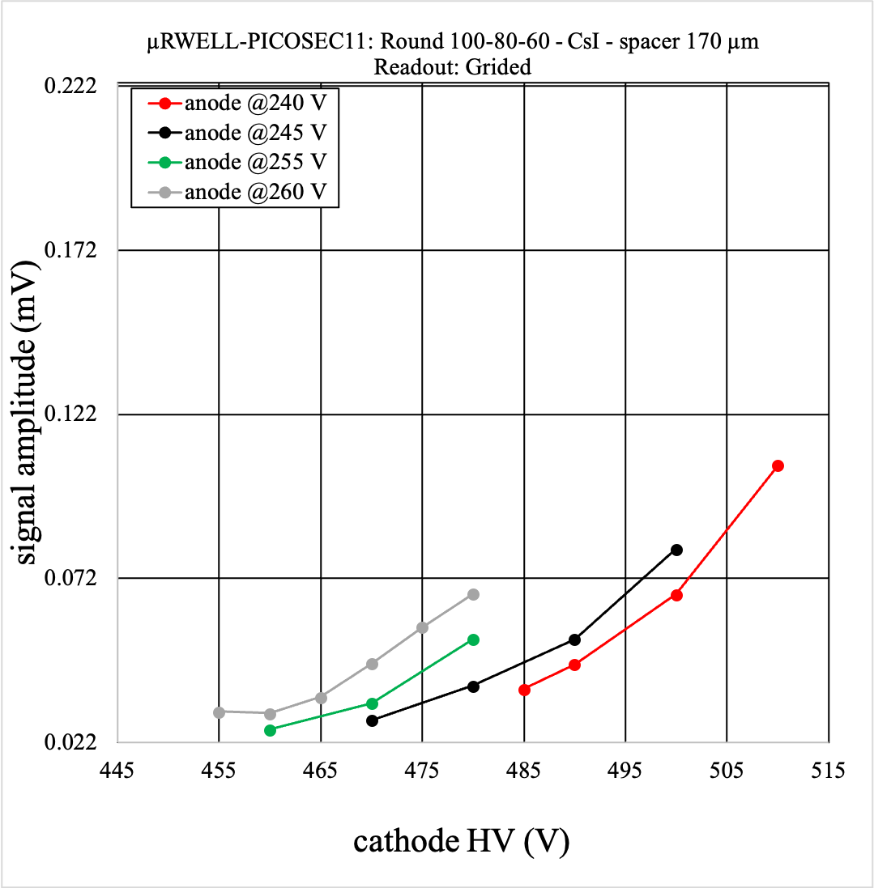
Readout: Plain vs Grided

Slide 10
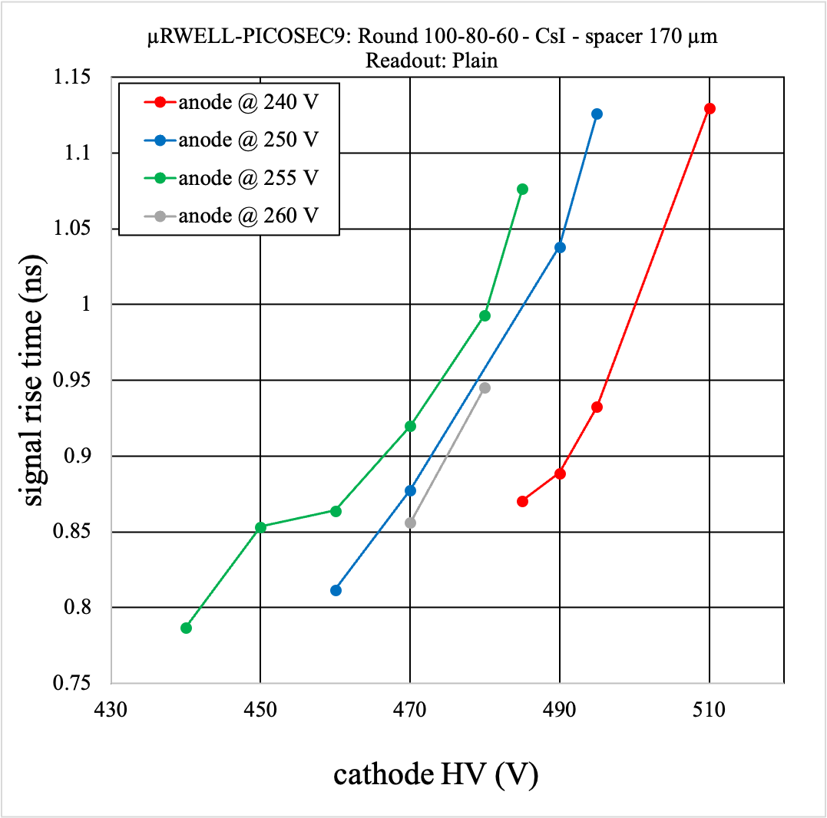
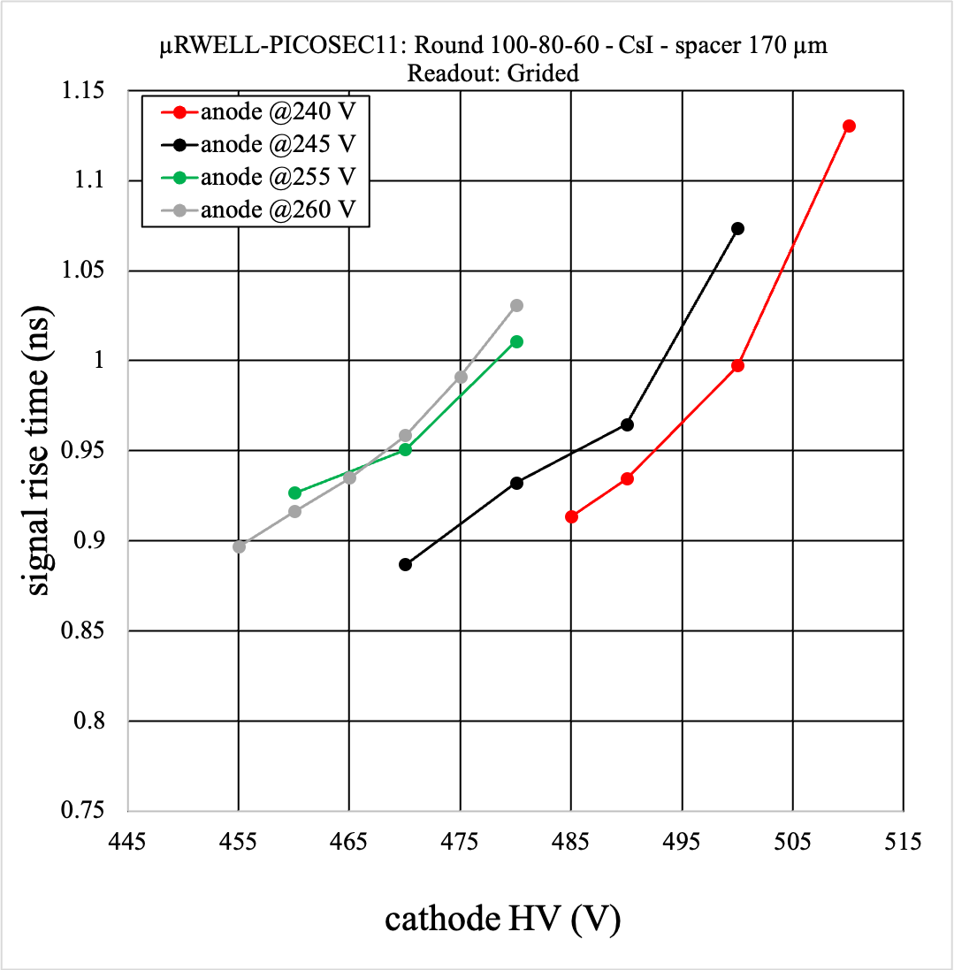
Readout: Plain vs Grided

Slide 11
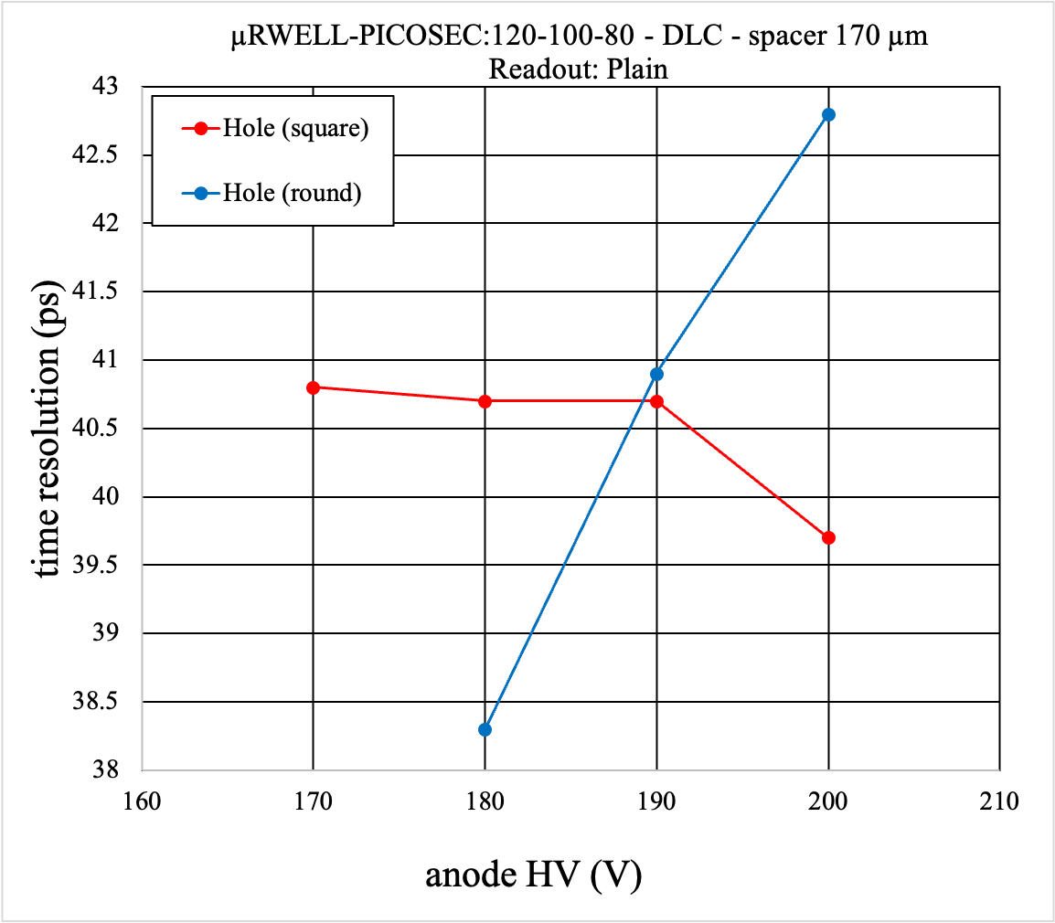
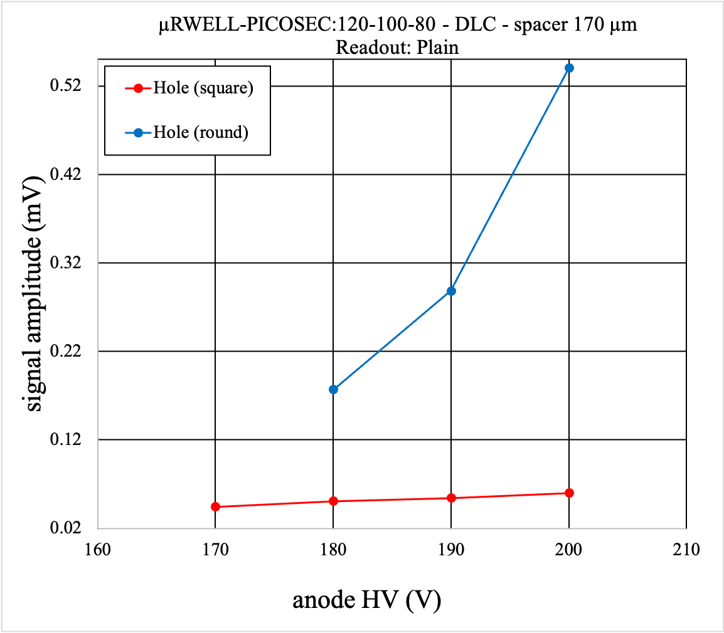
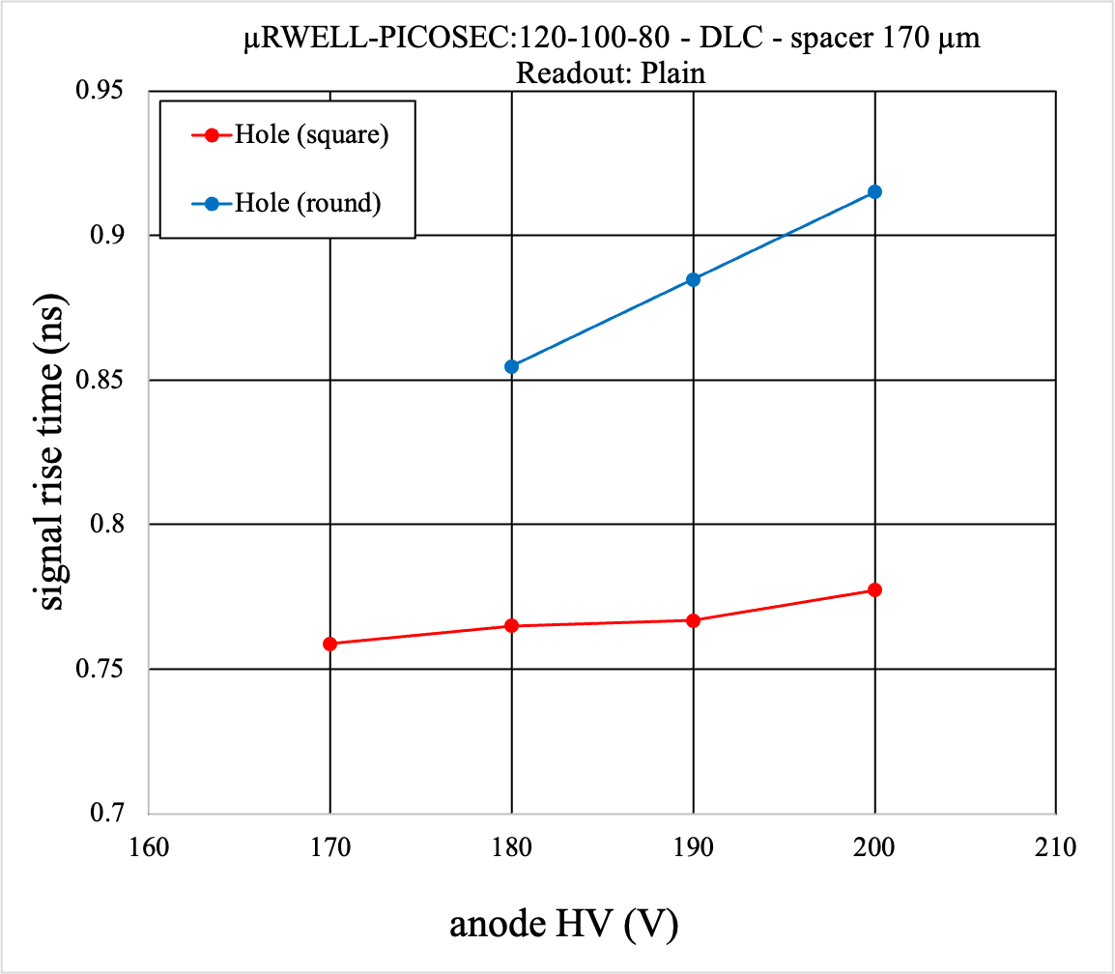
Hole shape: Round vs Square

Slide 12
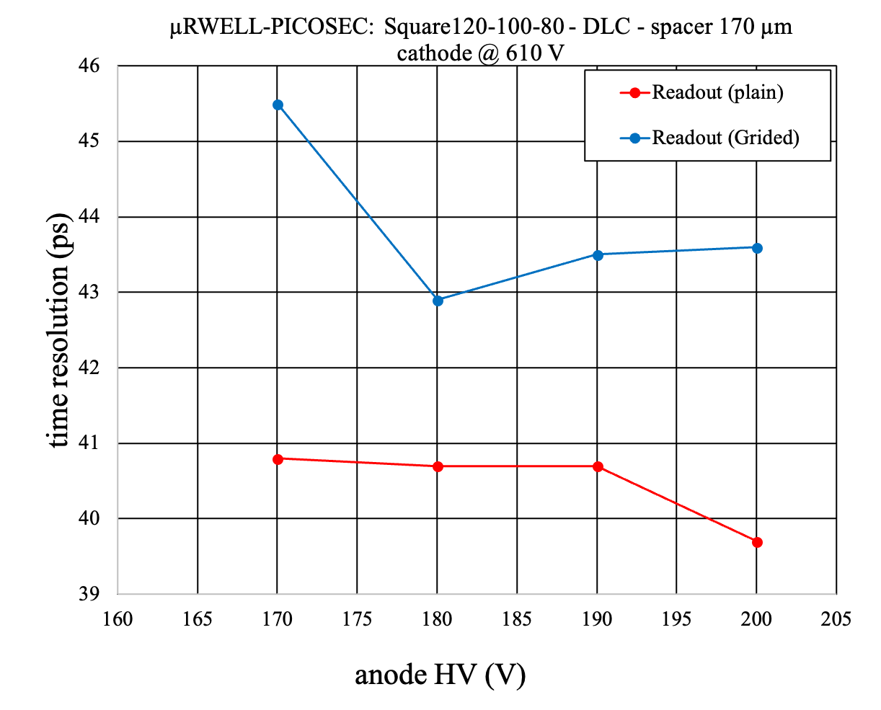
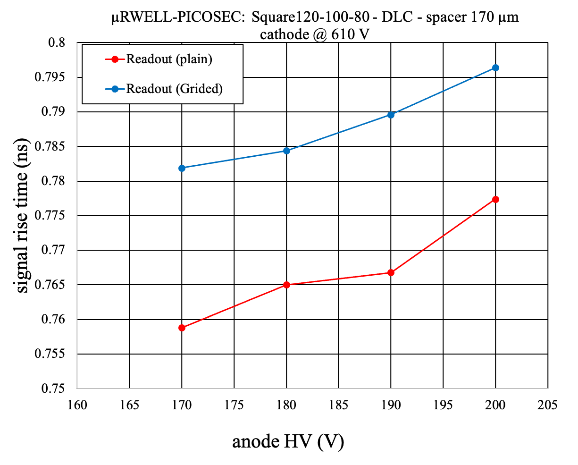
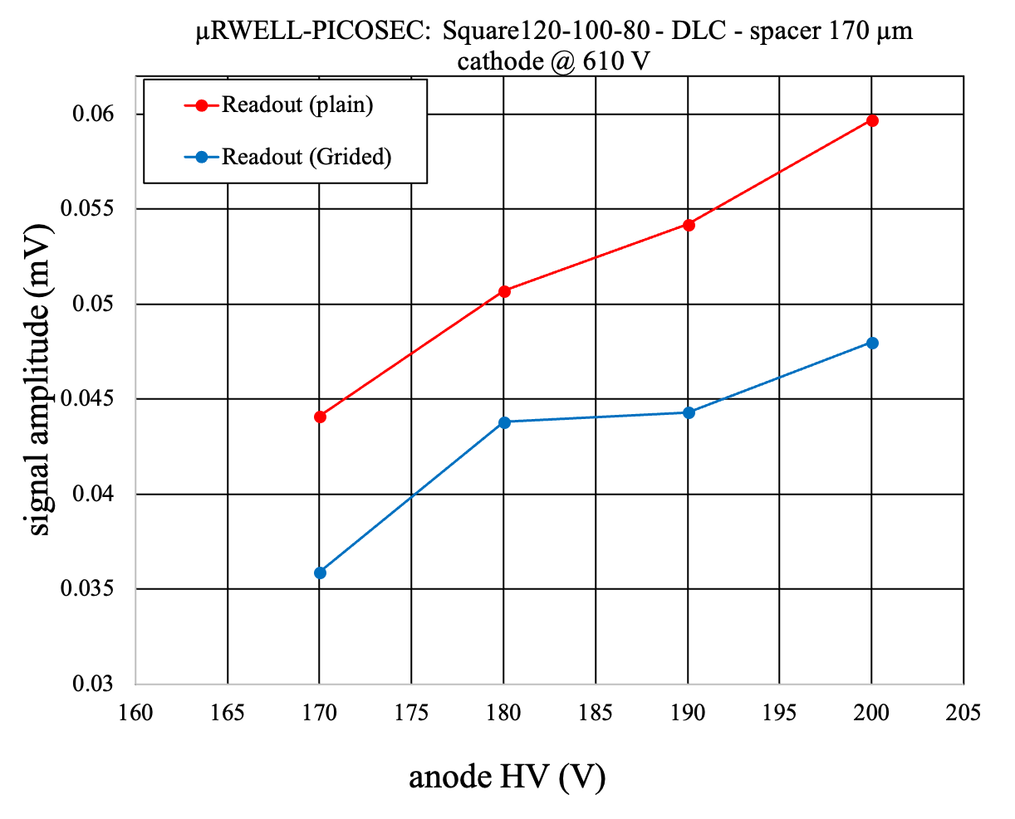
Readout: Plain vs Grided

Slide 13
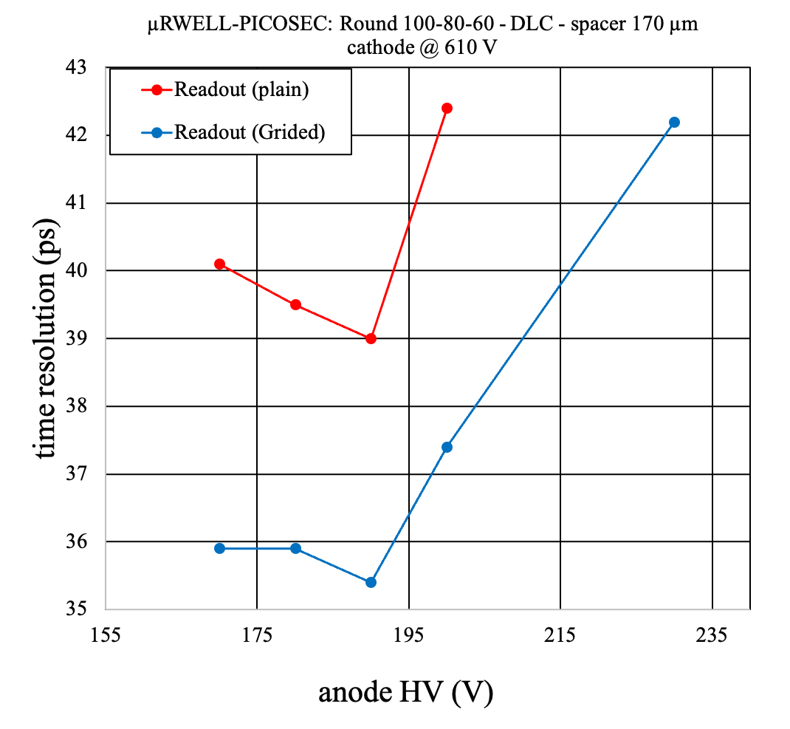
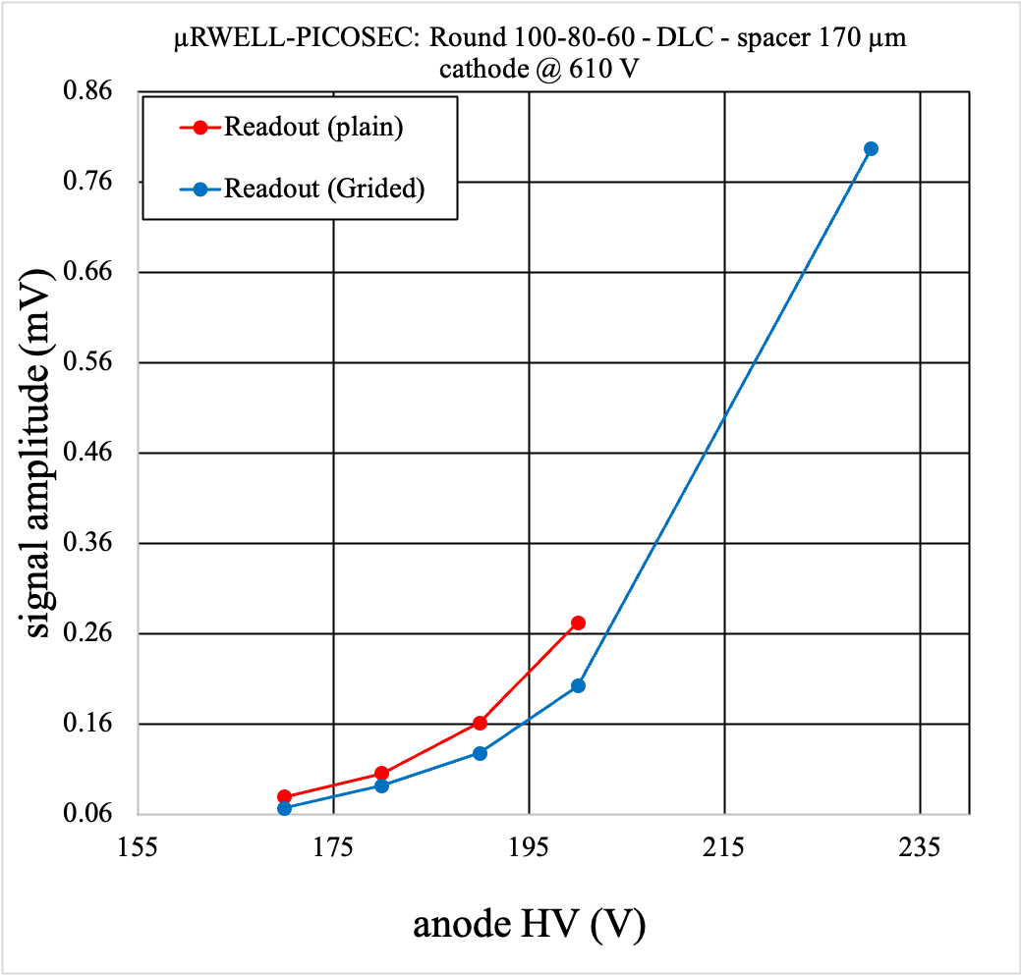
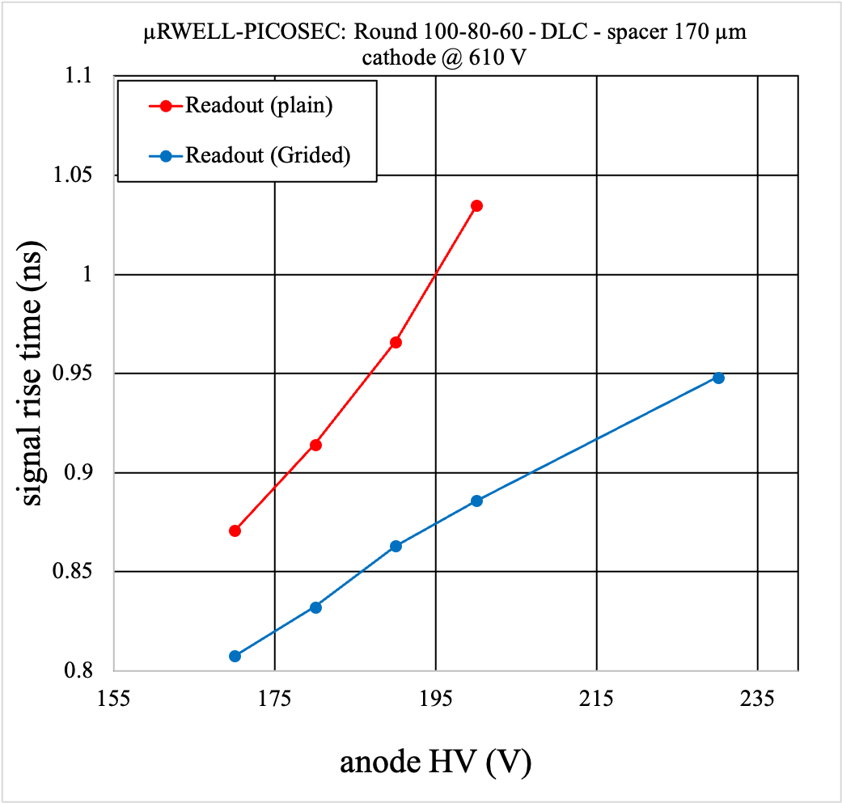
Readout: Plain vs Grided

Slide 14
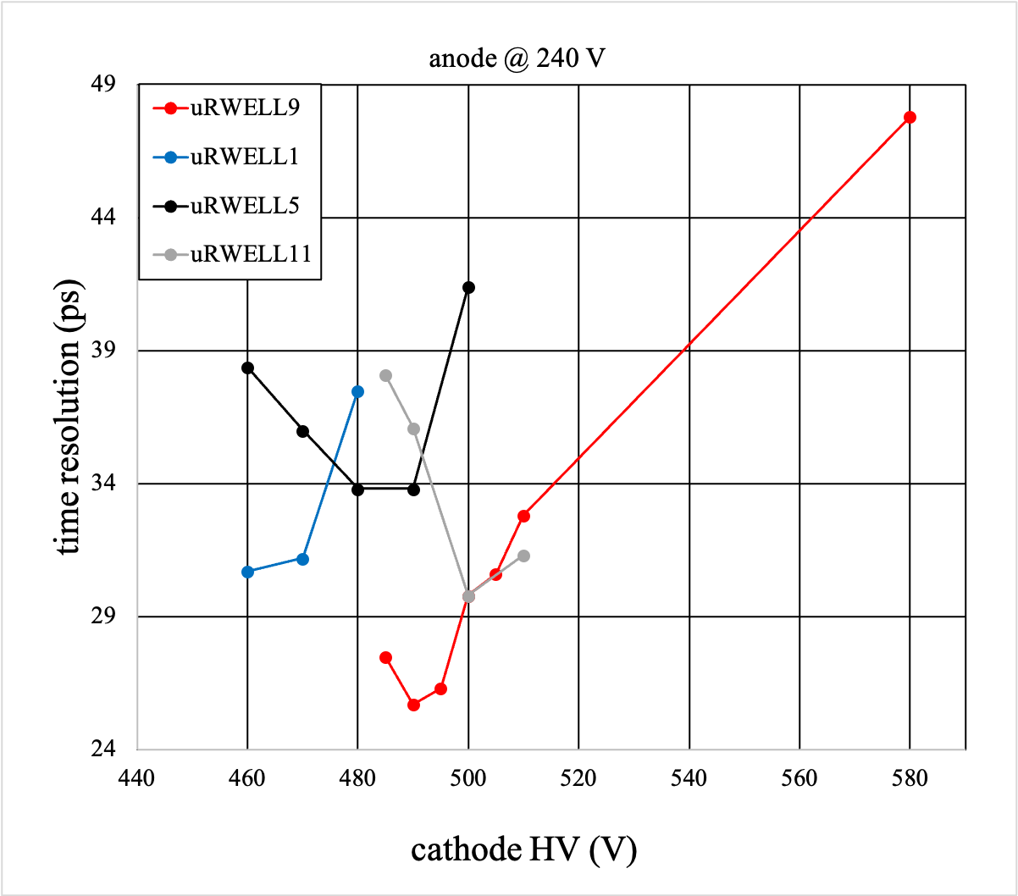
Time resolution performance for various single channel prototypes with a fixed anode voltage
uRWELL9
uRWELL1
uRWELL5
uRWELL11
Pitch (μm)
Hole(o) (μm)
Hole(i) (μm)
Hole shape
Readout
Spacer (μm)
Photocathode
100
80
60
Round
Plain
170
CsI
120
100
80
Square
Plain
170
CsI
120
100
80
Round
Plain
170
CsI
100
80
60
Round
Grided
170
CsI

Slide 15
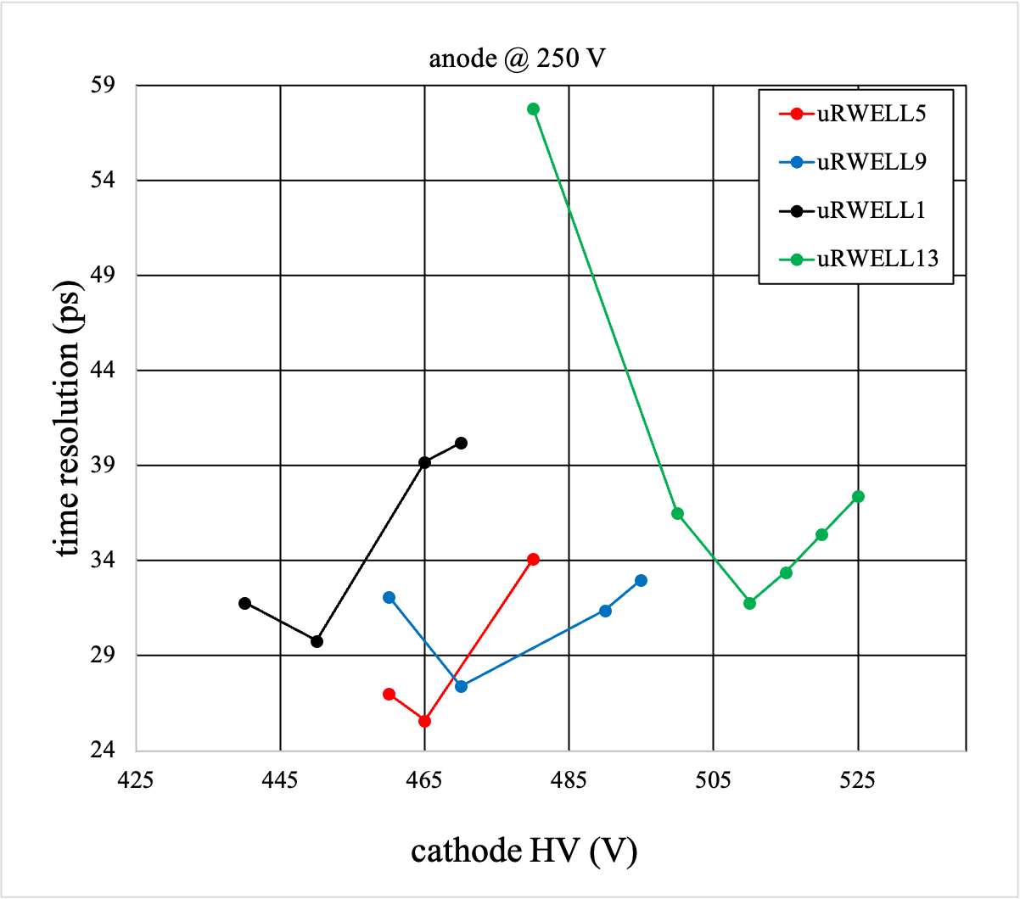
Time resolution performance for various single channel prototypes with a fixed anode voltage
uRWELL5
uRWELL9
uRWELL1
uRWELL13
Pitch (μm)
Hole(o) (μm)
Hole(i) (μm)
Hole shape
Readout
Spacer (μm)
Photocathode
120
100
80
Round
Plain
170
CsI
100
80
60
Round
Plain
170
CsI
120
100
80
Square
Plain
170
CsI
80
60
40
Square
Plain
170
CsI

Slide 16
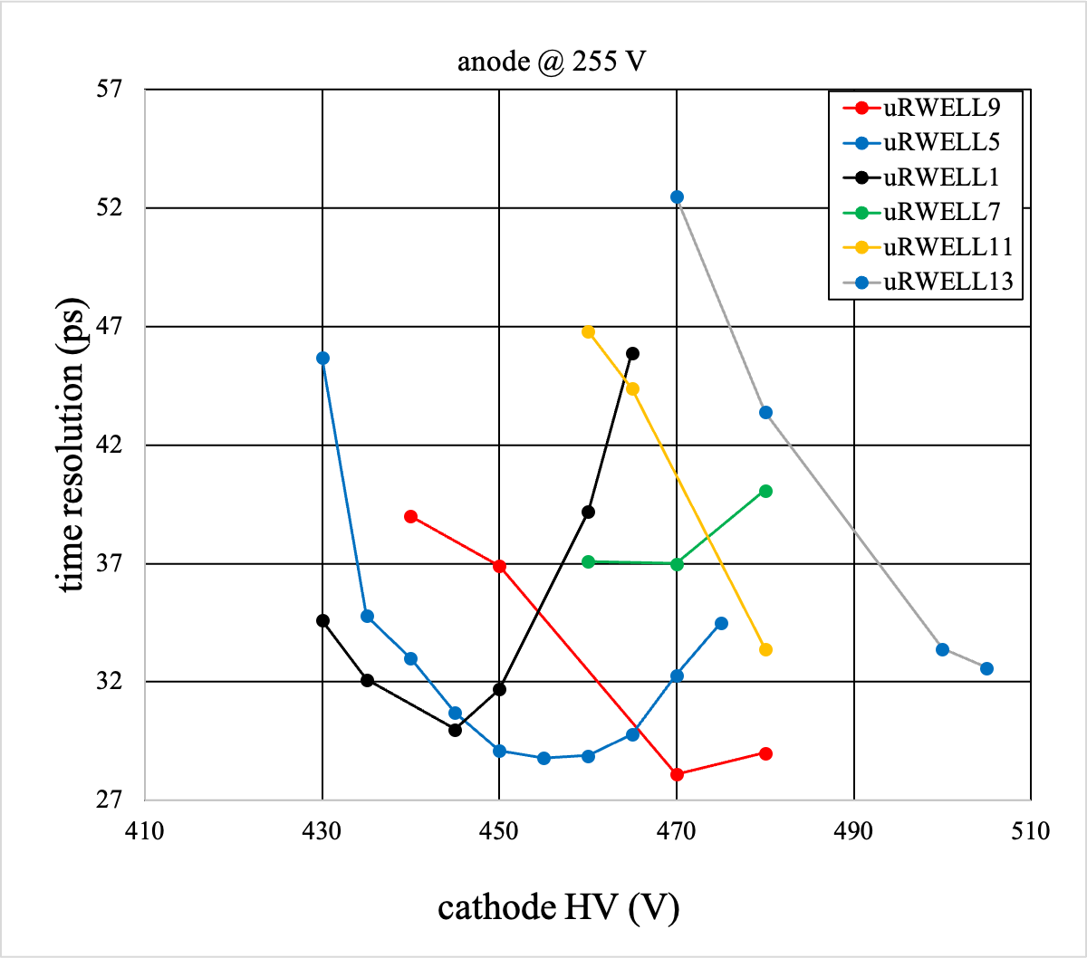
Time resolution performance for various single channel prototypes with a fixed anode voltage
uRWELL9
uRWELL5
uRWELL1
uRWELL7
uRWELL11
uRWELL13
Pitch (μm)
Hole(o) (μm)
Hole(i) (μm)
Hole shape
Readout
Spacer (μm)
Photocathode
100
80
60
Round
Plain
170
CsI
120
100
80
Round
Plain
170
CsI
120
100
80
Square
Plain
170
CsI
120
100
80
Round
Grided
170
CsI
100
80
60
Round
Grided
170
CsI
80
60
40
Square
Plain
170
CsI

Slide 17
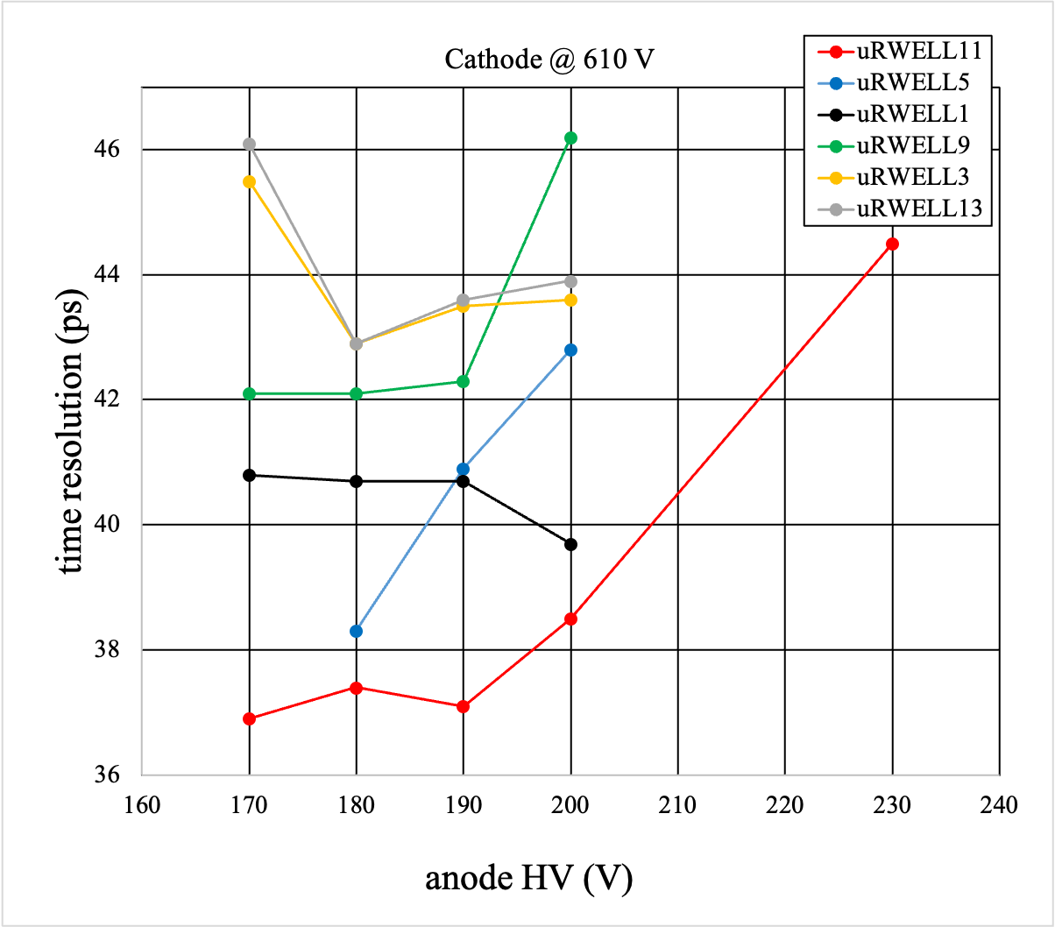
uRWELL11
uRWELL5
uRWELL1
uRWELL9
uRWELL3
uRWELL13
Pitch (μm)
Hole(o) (μm)
Hole(i) (μm)
Hole shape
Readout
Spacer (μm)
Photocathode
100
80
60
Round
Grided
170
DLC
120
100
80
Round
Plain
170
DLC
120
100
80
Square
Plain
170
DLC
100
80
60
Round
Plain
170
DLC
120
100
80
Square
Grided
170
DLC
80
60
40
Square
Plain
170
DLC

Slide 18
backup

Slide 19
In June test beam 2024, following prototypes have been tested:
Single channel uRWELL protypes with CsI photocathode
uRWELL13: Square P:80, H(o):60 H(i):40, Spacer 170 um, Readout: Plain
uRWELL9: Round P:100, H(o):80 H(i):60, Spacer 170 um, Readout: Plain
uRWELL5: Round P:120, H(o):100 H(i):80, Spacer: 170 um, Readout: Plain
uRWELL7: Round P:120, H(o):100 H(i):80, Spacer: 170 um, Readout: Grided
uRWELL11: Round P:100, H(o):80 H(i):60, Spacer 170 um, Readout: Grided
uRWELL1:Square P:120, H(o):100 H(i):80, Spacer 170 um, Readout: Plain
Single channel uRWELL protypes with DLC photocathode
uRWELL9: Round P:100, H(o):80 H(i):60, Spacer 170 um, Readout: Plain
uRWELL1:Square P:120, H(o):100 H(i):80, Spacer 170 um, Readout: Plain
uRWELL5: Round P:120, H(o):100 H(i):80, Spacer: 170 um, Readout: Plain
uRWELL13: Square P:80, H(o):60 H(i):40, Spacer 170 um, Readout: Plain
uRWELL11: Round P:100, H(o):80 H(i):60, Spacer 170 um, Readout: Grided
uRWELL3: Square P:120, H(o):100 H(i):80, Spacer 170 um, Readout: Grided

