Slide 1
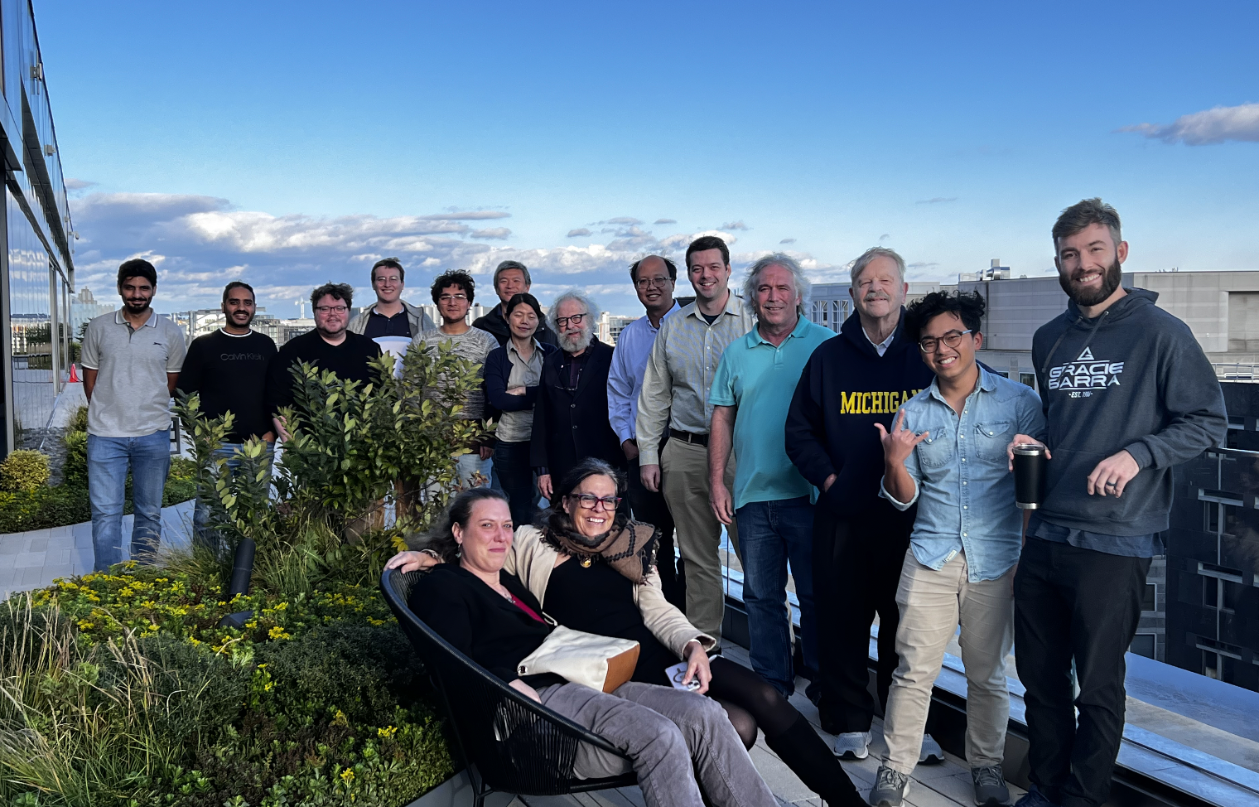
The EXCL(AI)M collaboration
https://willuhmjs.github.io/exclaim/
PIs: Prasanna Balachandran (UVA), Marie Boer (VT), Gia-Wei Chern (UVA) , Michael Engelhardt (NMSU), Gary Goldstein (Tufts), Yaohang Li (ODU), Huey-Wen Lin (MSU), SL (UVA), Matt Sievert (NMSU), (Dennis Sivers, UM)
Funded Postdocs: Douglas Adams, Marija Cuic, Liam Hockley, Saraswati Pandey, Emanuel Ortiz, Kemal Tezgin
Graduate Students: Andrew Dotson, Carter Gustin, Jang (Jason) Ho, Fayaz Hossen, Adil Khawaja, Zaki Panjsheeri, Anusha Singireddy, Jitao Xu
Undergraduate: Will Faircloth
Notes:
What does physics bring to AI? Apply physics to AI? Example: Alexnet, imaging with deep learning, This is what we are trying to do. Kepler and Newton, introduces dynamics in the picture, only a physicist can do that, so can we get institutionsl support to have a center like in MIT/Harvard or Santa Fe, or the Perimeter institute. What does it mean to abstract like Newton? Physics has a history of rewarding this behavior, and we are thinking of alternatives to LLM. SR autoencoder.

Slide 2
Twist three GPD Physical interpretation at the core of spin puzzle
A. Rajan, M. Engelhardt and S. Liuti, Phys. Rev. D98, 074022 (2018)
A. Rajan, A. Courtoy, M. Engelhardt and S. Liuti, Phys. Rev. D94, 034041 (2016)
M. Rodekamp, M. Engelhardt, J.R. Green, S. Krieg, S. Liuti, S. Meinel, J.W. Negele, A. Pochinsky and S. Syritsyn, Phys. Rev. D 109, 074508 (2024)
*Twist 3 GPD notation from Meissner, Metz and Schlegel, JHEP(2009)

Slide 3
Transverse Angular Momentum Sum Rule
O. Alkassasbeh, M. Engelhardt, SL and A. Rajan,
https://arxiv.org/abs/2410.21604

Slide 4
Extract Compton Form Factors from Leading order parametrization of DVCS cross section
Compton Form factors
Azimuthal angle φ dependent coefficients
spin non-flip
spin flip
mixed
B. Kriesten et al, Phys.Rev. D 101 (2020)
B. Kriesten and S. Liuti, Phys.Rev. D105 (2022), arXiv 2004.08890
B. Kriesten and S. Liuti, Phys. Lett. B829 (2022), arXiv:2011.04484
First Inverse Problem!

Slide 5
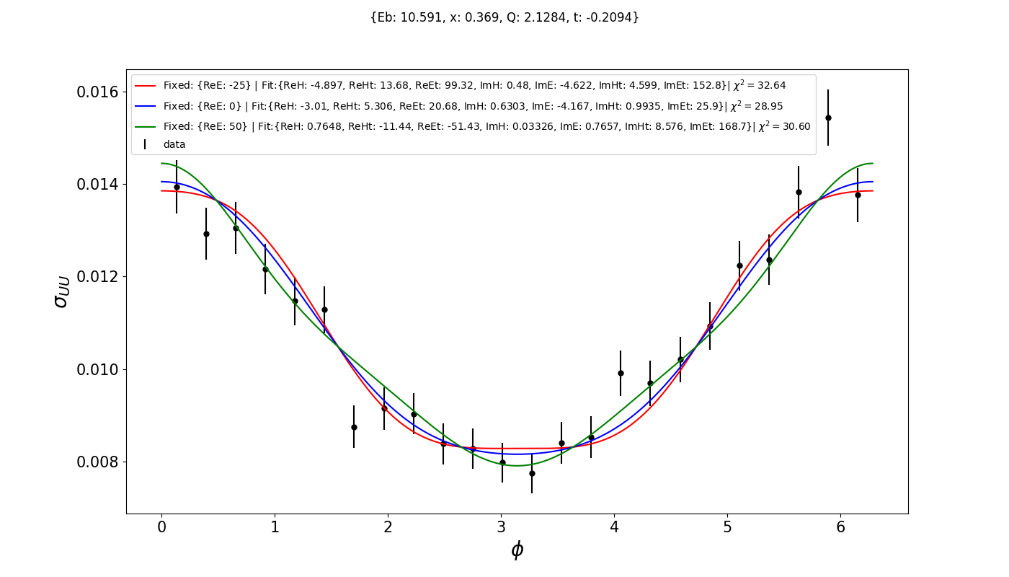
Degeneracy of Curve Fit Results

Slide 6
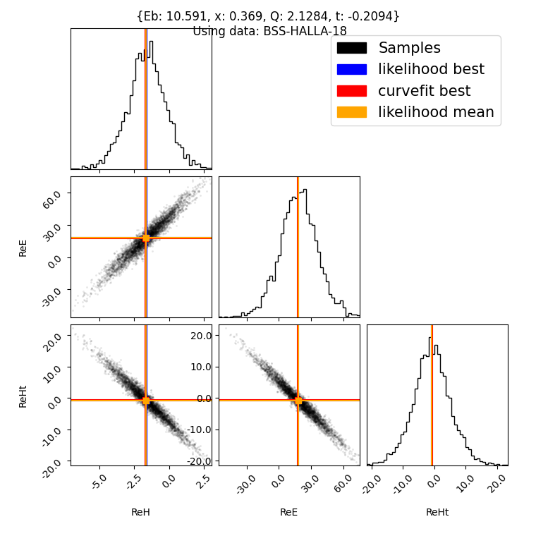
Covariance of CFF Results
Here the maximum likelihood is achieved allowing 3 CFFs to vary.
Only 23 combinations of 2 angles are used.
Notes:
Define Bayesian Likelihood

Slide 7
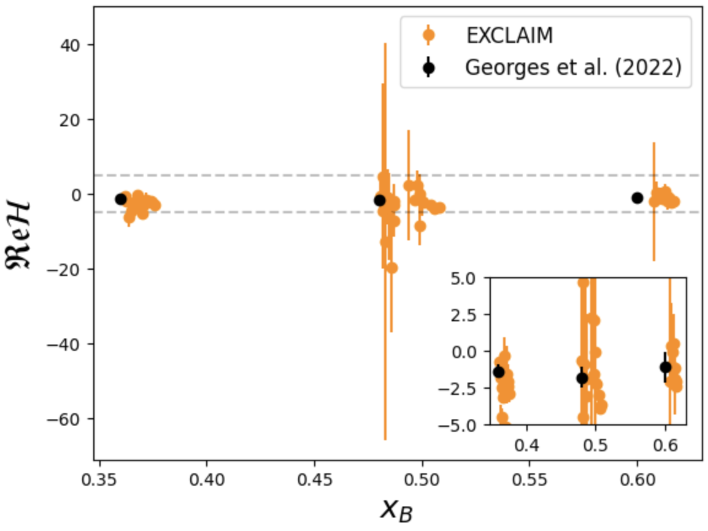
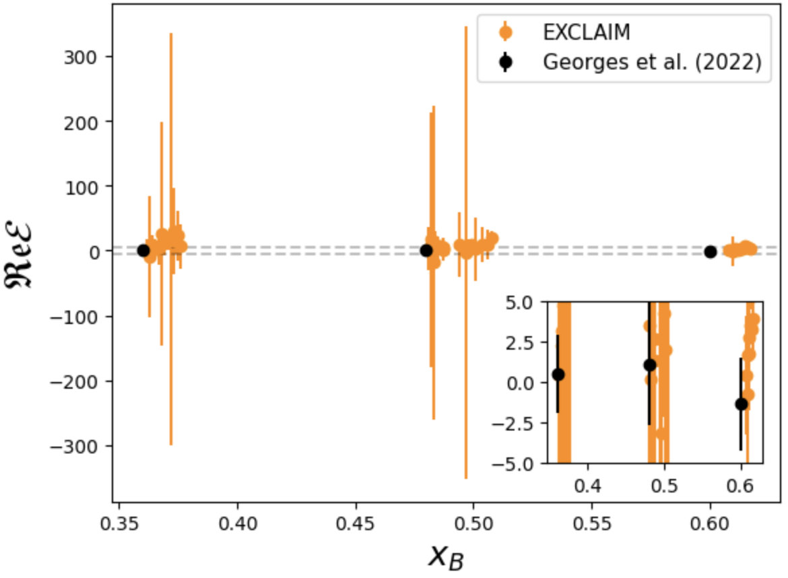
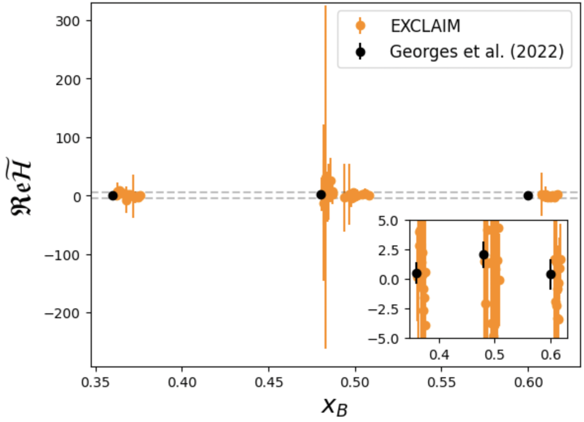
Marginal Posterior CFF Results
H
E
~
H

