Slide 1
Spin-1 TMDs and Structure Functions of the Deuteron
David Ruth
On Behalf of the Tensor Collaboration
Hall C Winter 2025 Meeting

Slide 2
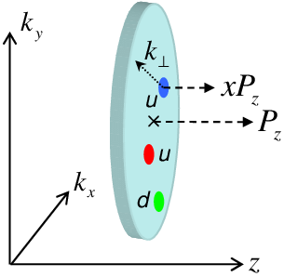
TMDs are essential for investigating nuclear structure
Transverse-Momentum-Dependent distribution functions: parton structure in terms of x and k_{T} (transverse momentum)
Unique Capabilities for:
Hadron Tomography
Color Degrees of Freedom
Understanding Transverse Momentum Structure
Extensive past and current studies on spin $\frac{1}{2}$ nucleon TMDs

Slide 3
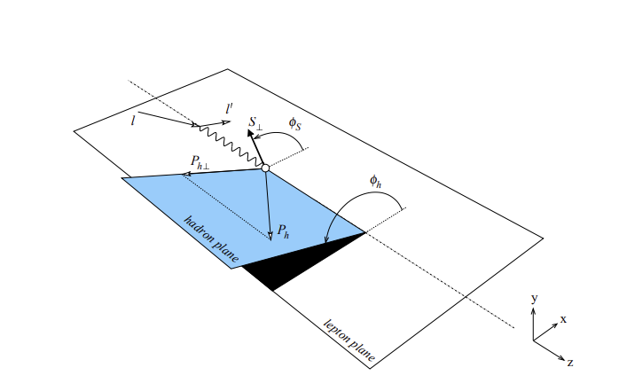
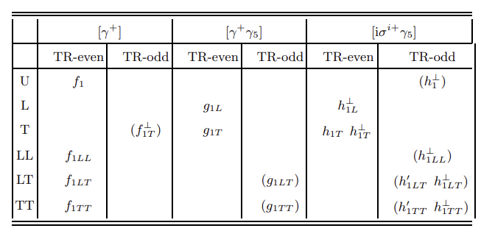
Spin-1 Deuteron TMDs Never Before Measured!
Suite of Tensor TMDs never before measured:
Needs Semi-Inclusive Deep-Inelastic Scattering (SIDIS)
Needs tensor polarized target: $P_{zz}=\frac{N_{1}+N_{−1}−2N_{0}}{N_{tot}}$
l
l'
q
H

Slide 4
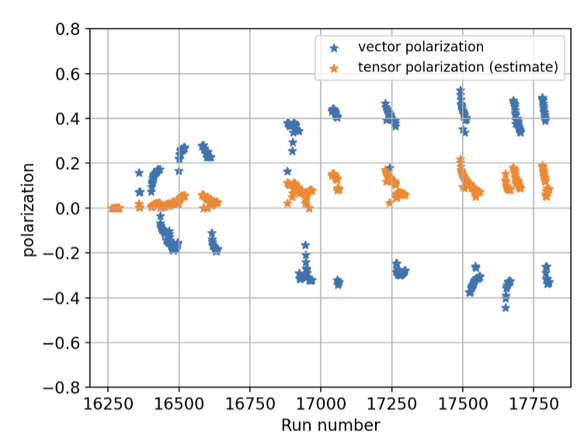
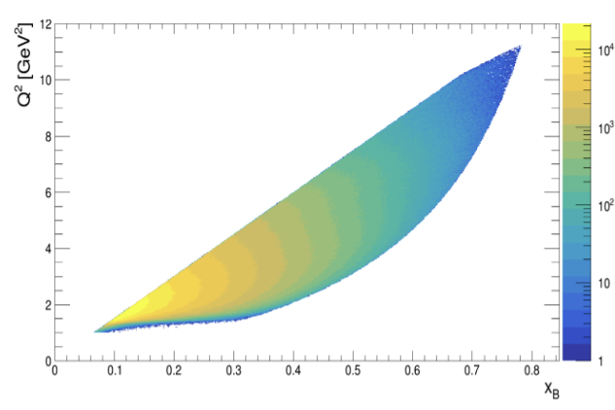
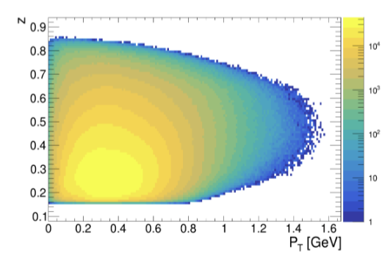
First, can we use any existing data?
Recently approved CLAS-Approved-Analysis (CAA) to use RG-C data from Hall B
Equilibrium tensor polarization (~10%) sufficient for a first extraction
Analysis is just getting going!
But we will get much better statistics from a dedicated measurement

Slide 5
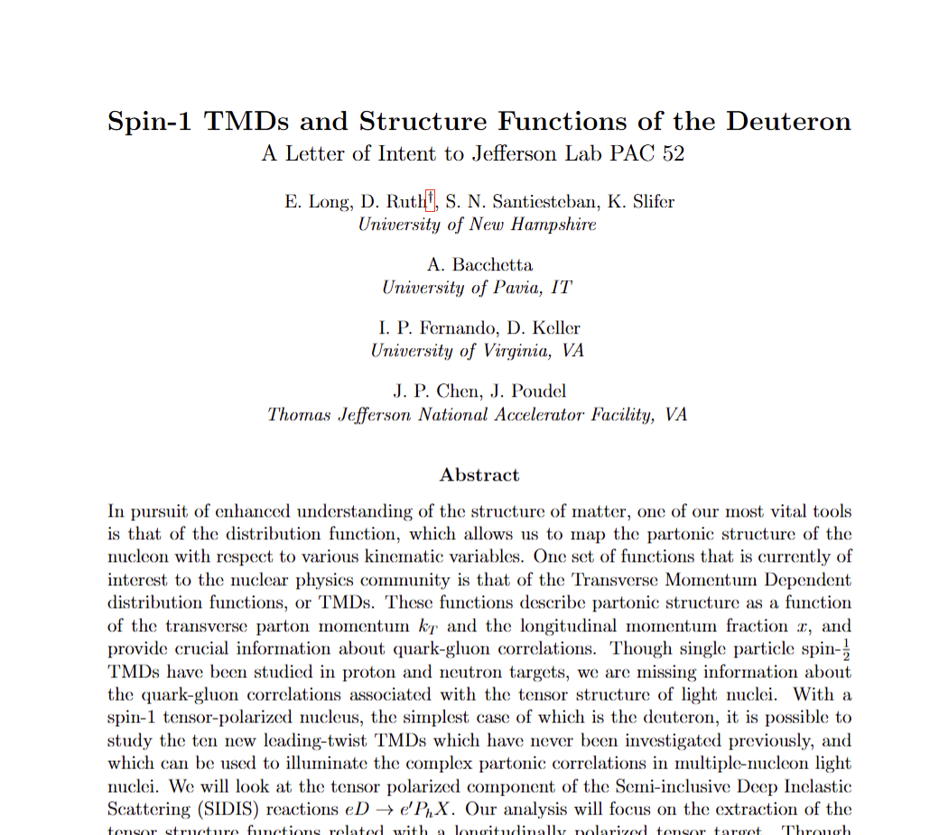
Hall C Proposed Setup + LOI
Use SBS (Hadron) and SHMS (Lepton) to do a SIDIS measurement in Hall C
Collect data over a range of vector polarization magnitudes and directions to isolate tensor part of XS
LOI12-24-002 Submitted to PAC52
Encouraged to submit a full proposal!

Slide 6
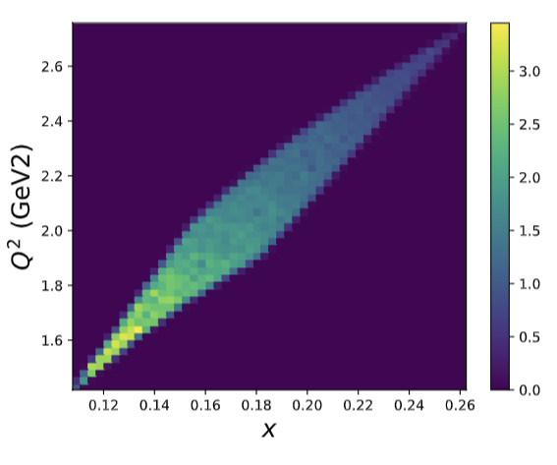
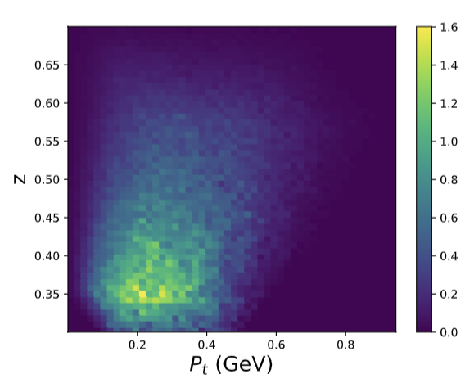
Expected Acceptances

Slide 7
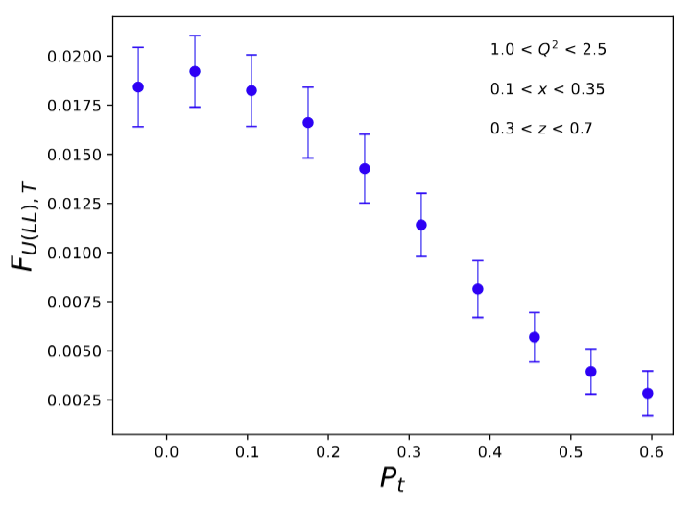
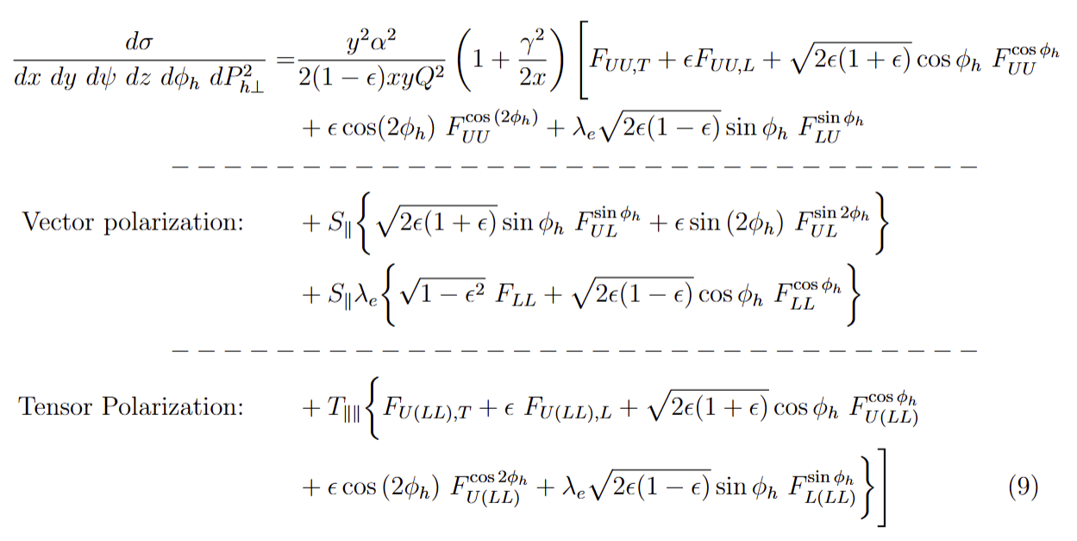
Structure Functions
TMDs are linked to set of tensor structure functions
Projected rate for 5 days @ 80 nA
A. Baccheta

Slide 8
Current Open Tasks
Theory support to better understand relation between F_{U(LL),T} and F_{UU,T} (A. Baccheta, I. Cloet)
Full simulation including SBS
Tensor-enhanced polarized target
CAA Analysis to better understand tensor contribution

Slide 9
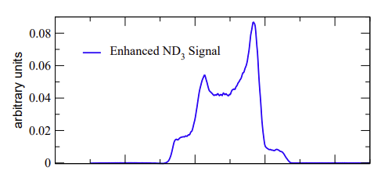
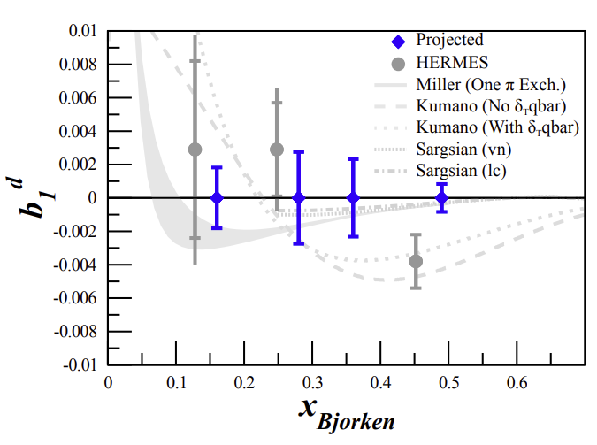
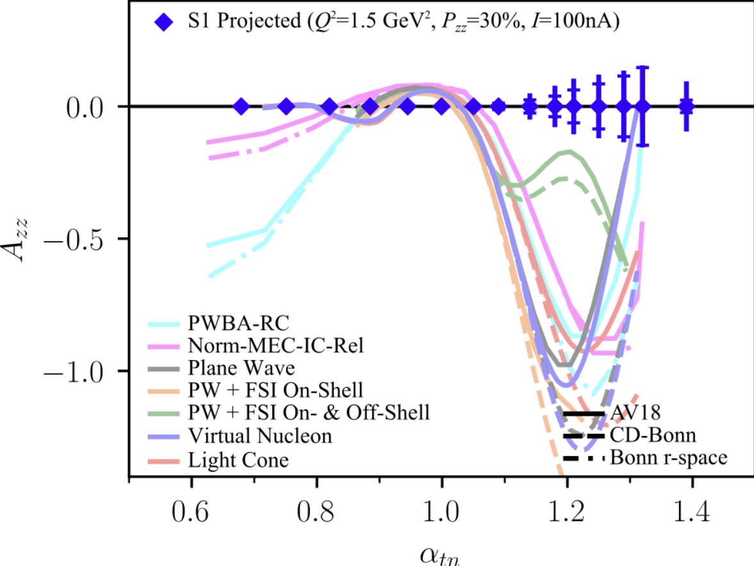
Other Tensor Experiments
This new SIDIS program joins 2 approved DIS experiments using tensor polarization
b₁ and A_{zz} collaborations preparing to run in Hall C, currently we are working on an ERR
Look for an update from these experiments at another meeting soon

Slide 10
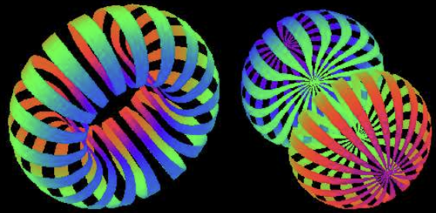
Meetings & Tensor Group
SIDIS Meetings: Thursdays at 2PM (TBD)
General Tensor Meetings: Every-other Friday at 1:30 PM
†: Contact († b₁, † A_{zz}, † SIDIS LOI)
Large and growing group (DIS, SIDIS... See previous talk by C. Yero on Exclusive too!)
All are welcome! Let us know if you are interested in Tensor spin physics and please join us!
Spokespeople:
Nathaly Santiesteban
Jian-Ping Chen
Karl Slifer†
Elena Long†
Dustin Keller
Oscar Rondon Aramayo
Narbe Kalantarians
Donal Day
Doug Higinbotham
Grad Students:
Anchit Arora
Hector Chinchay
Muhammad Farooq
Chhetra Lama
Michael McClellan
Postdocs:
David Ruth†
Jiwan Poudel
Ishara Fernando
Allison Zec

Slide 11
Next Steps + Full Proposal
Full Hall C SIDIS Proposal currently targeted for Summer 2026
CLAS-Approved Analysis underway, with preliminary results targeted for 2025
DIS Experiments preparing for an ERR
More Tensor physics is coming soon to Hall C!

