Slide 1
Deuteron Electro-Disintegration Experiment
(E12-10-003)
Hall C Winter Collaboration Meeting Jan 13-14 2025
Gema Villegas
Florida International University
Pramila Pokhrel
Catholic University of America
Ph.D. Advisor: Dr. Carlos Yero
Catholic University of America

Slide 2
OUTLINE
Motivation
Kinematics
SIMC/DATA Comparison
HMS Momentum Check
Summary

Slide 3
Motivation
Ideal system to study NN potential.
Study Deuteron at short ranges (< 1fm).
Extract D(e,e’p)n cross-section beyond 500 MeV/c missing momentum at high/low Q2
Extract momentum distributions (not an observable) from cross sections.

Slide 4
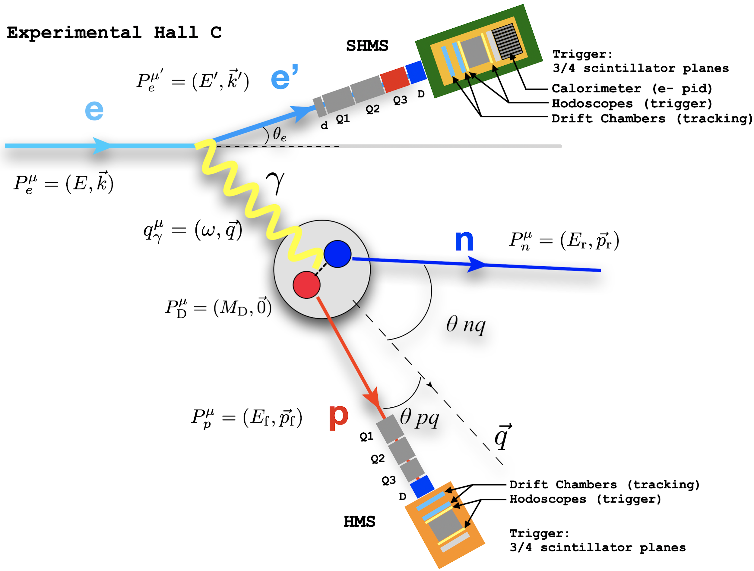
D(e,e’p)n Reaction Kinematics

Slide 5
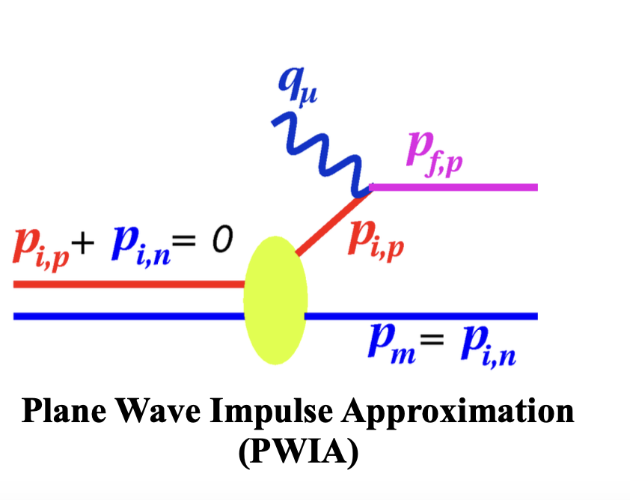
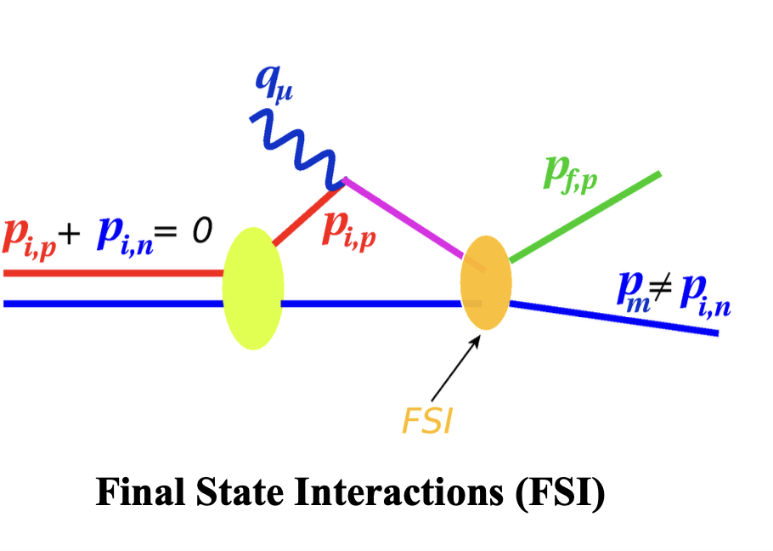
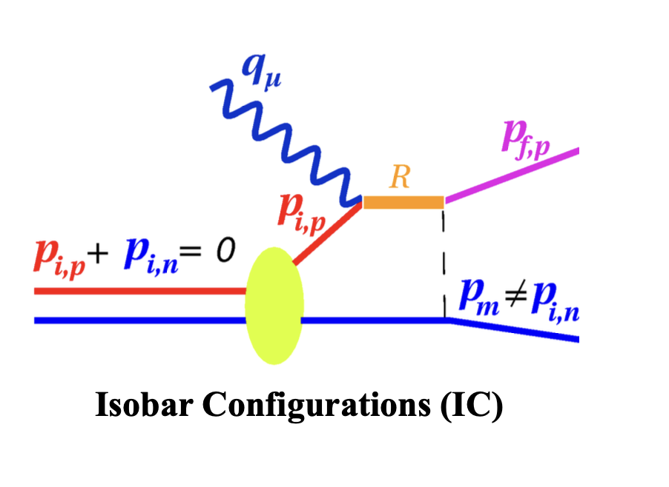
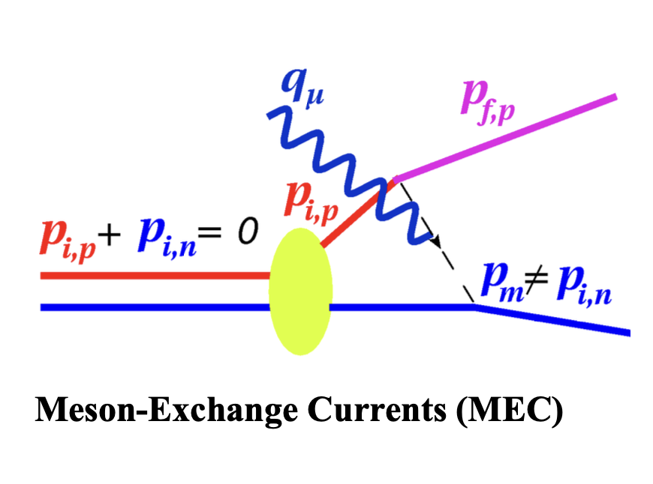
D(e,e’p)n Interactions

Slide 6
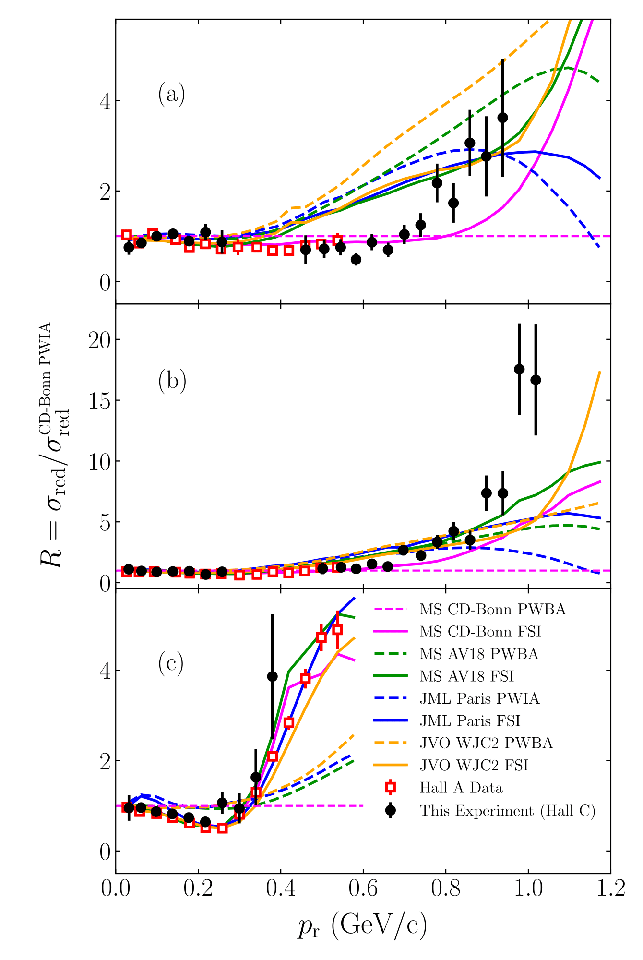
Hall A Experiment (E01-020)
Hall B Experiment (CLAS)
Hall C Experiment (E12-10-003)
200 < p_{r} < 300
θ_{nq} = 35°
400 < p_{r} < 600
θ_{nq} = 45°
75°
W. U. Boeglin et al. (2011) 10.1103/PhysRevLett.107.262501
K. S. Egiyan et al. (2007) 10.1103/PhysRevLett.98.262502
C. Yero et al. (2020) 10.1103/PhysRevLett.125.262501

Slide 7
E12-10-003
H(e,e’p) Analysis:
SIMC and Data Comparison

Slide 8
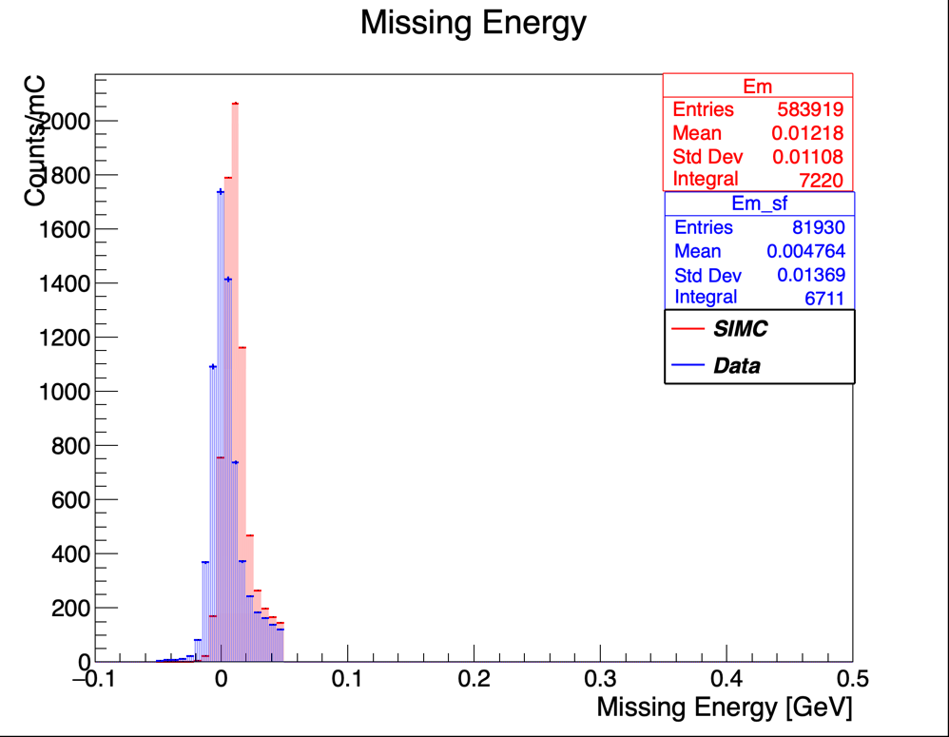
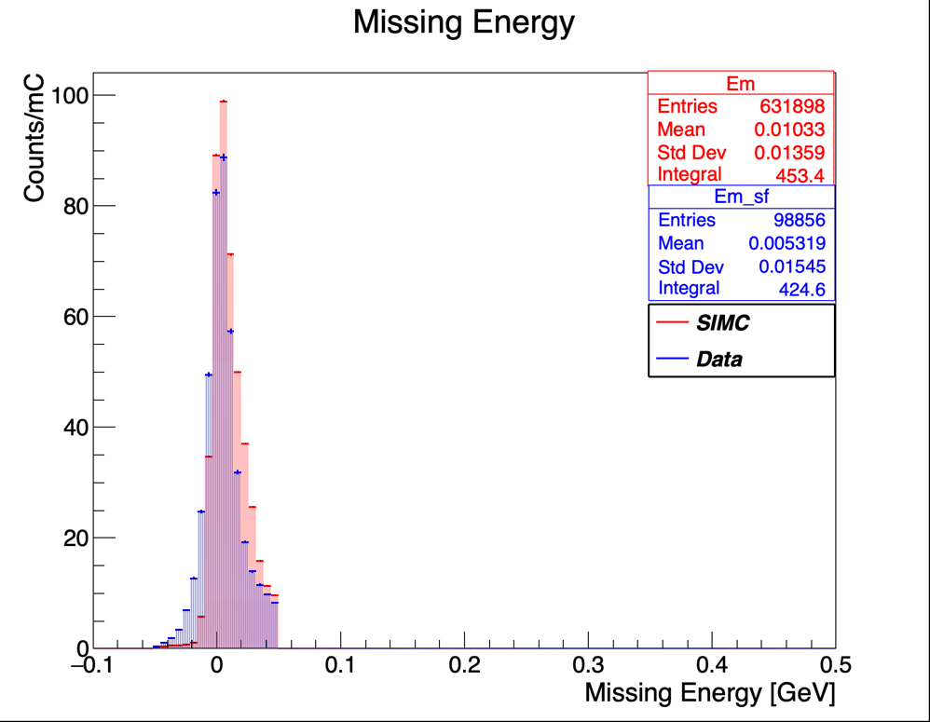
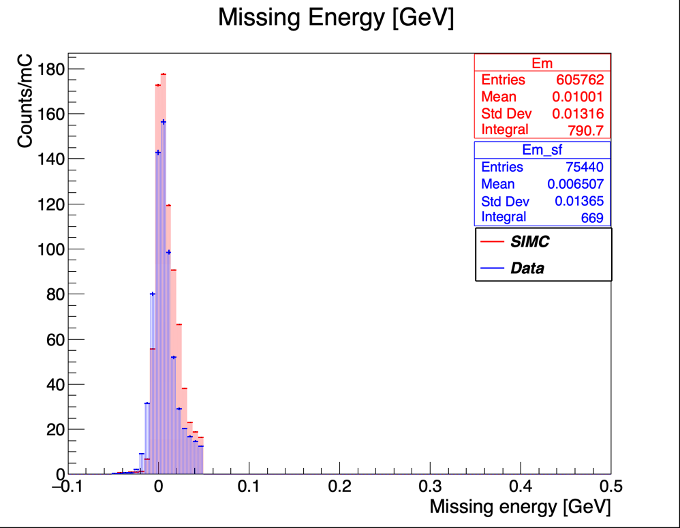
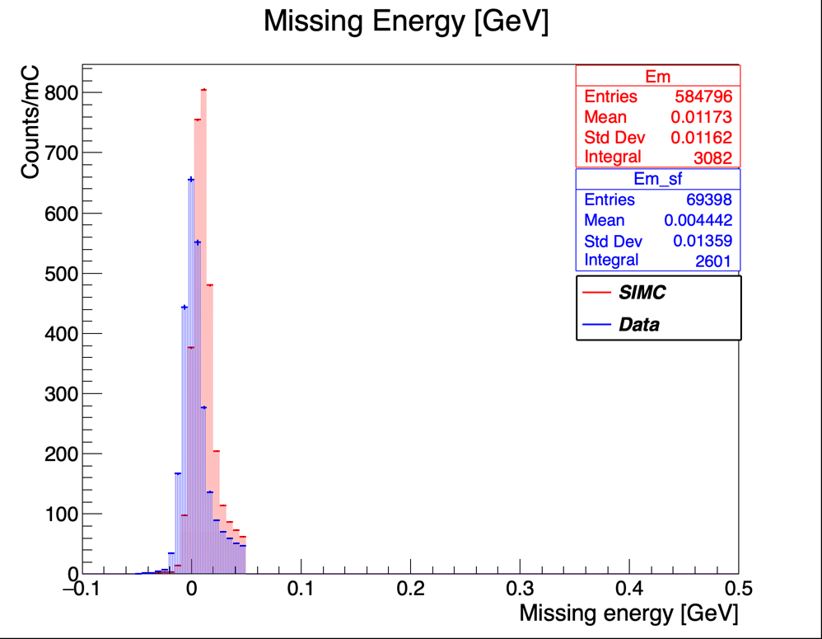
SIMC/DATA Comparison: CUTS APPLIED
Missing Energy cut, Emcut<0.05 and >-0.05
20861
20841
20846
20858
20851

Slide 9
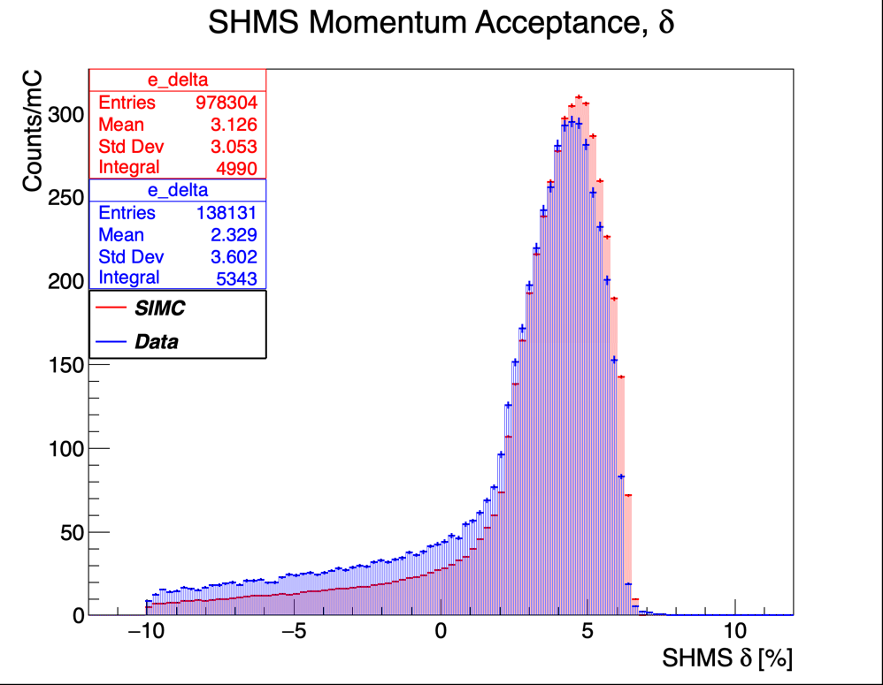
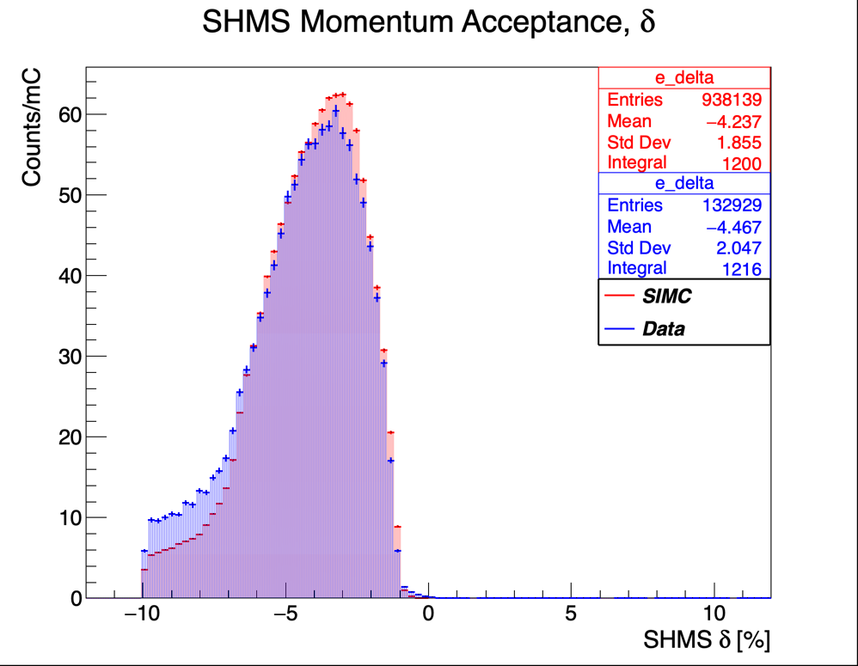
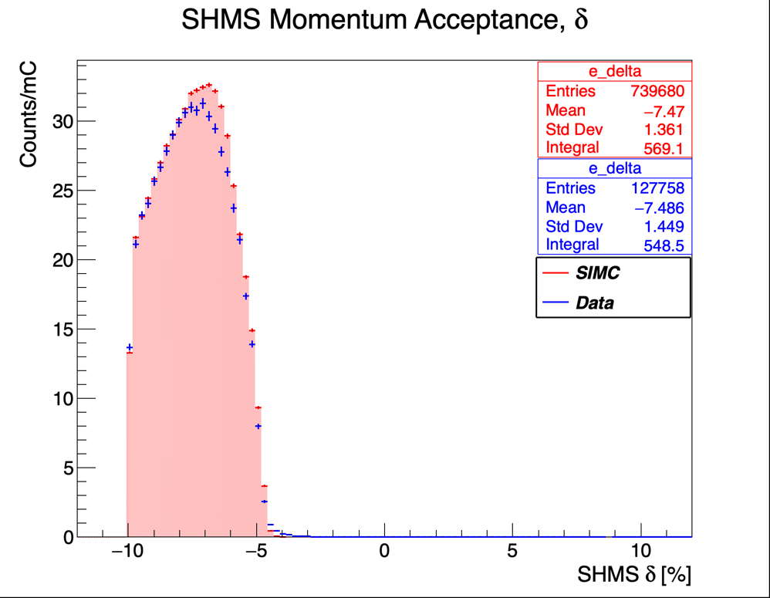
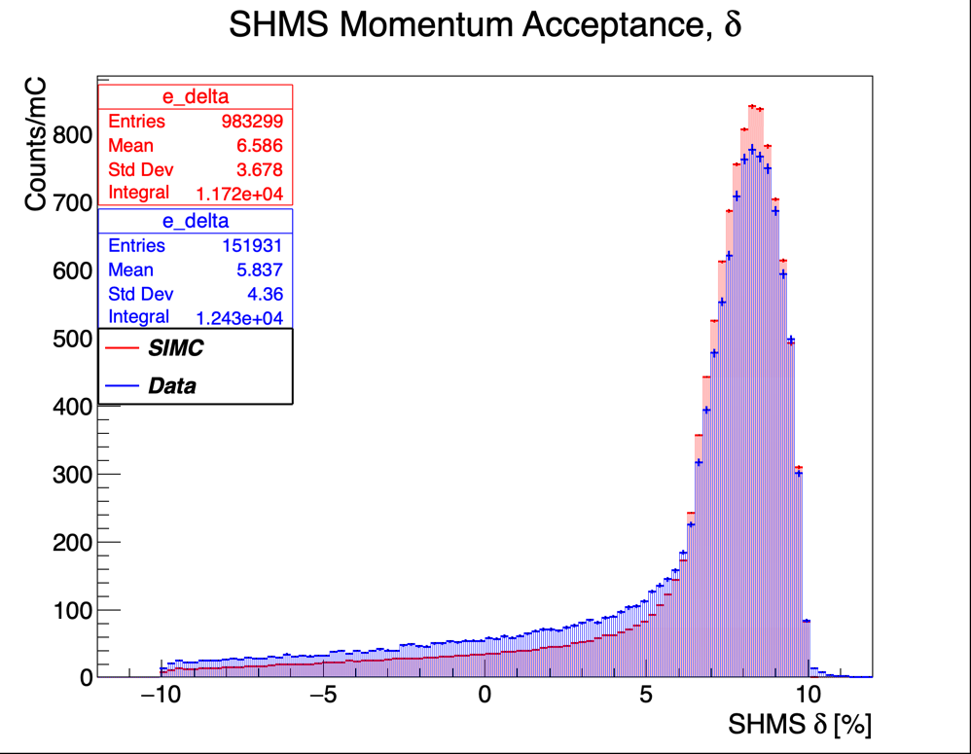
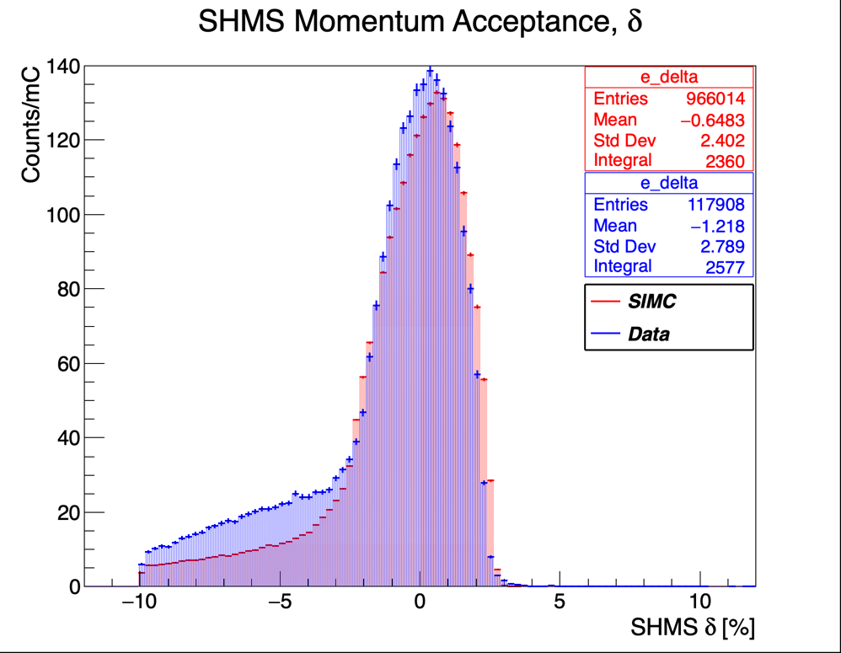
SIMC/DATA Comparison: CUTS APPLIED
SHMS Momentum Acceptance cut <22 and >-10
20858
20846
20841
20861
20851

Slide 10
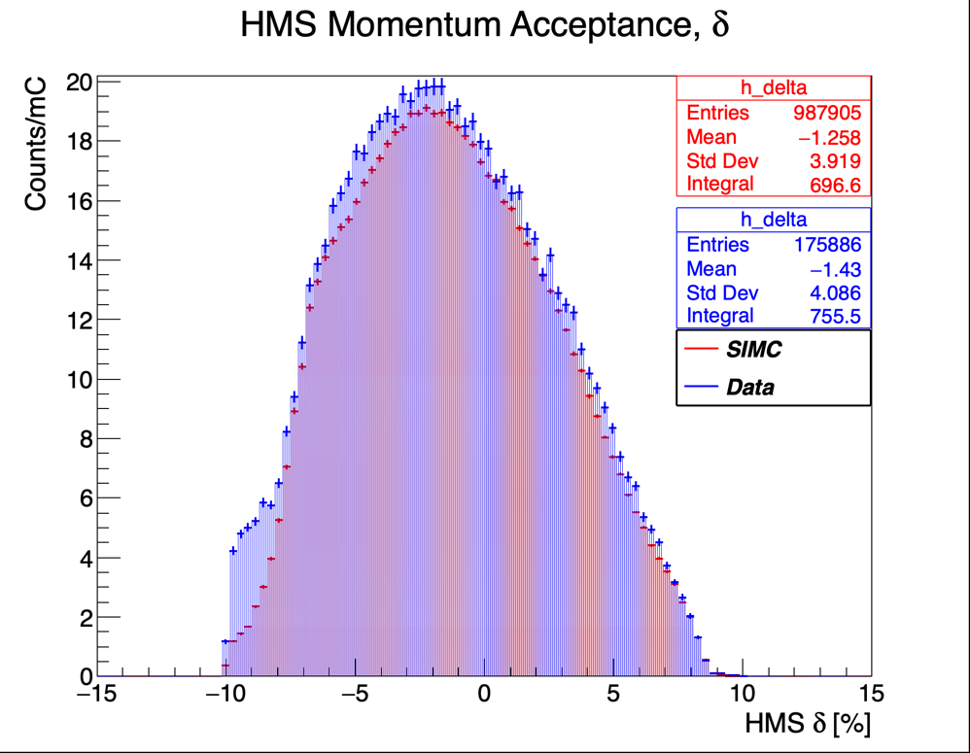
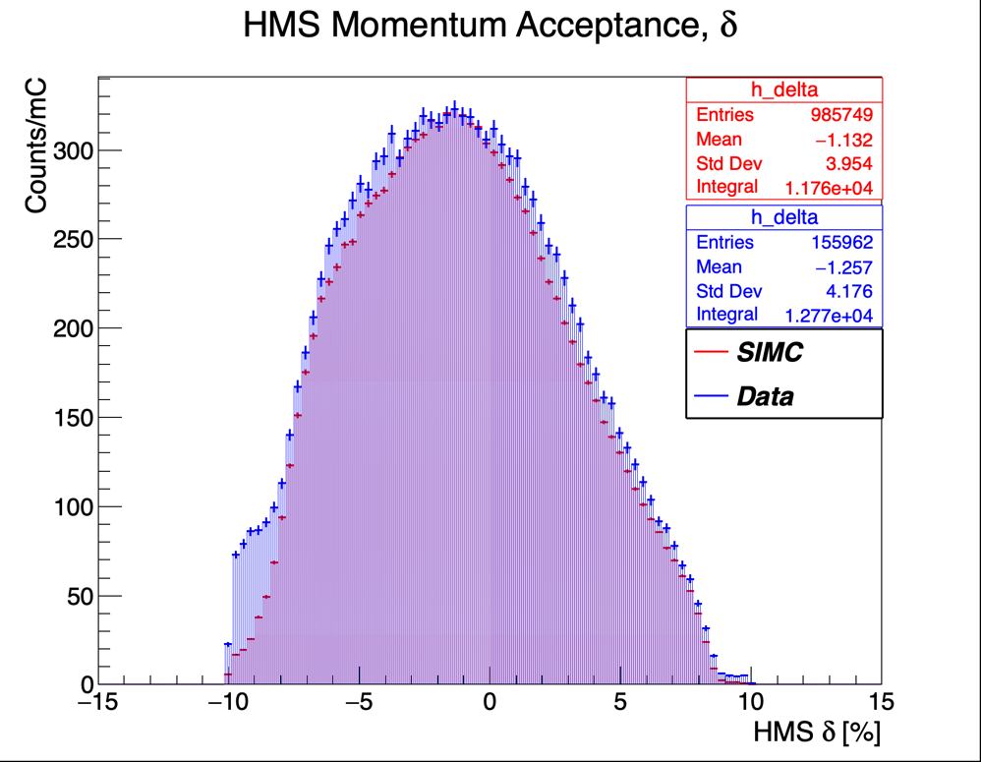
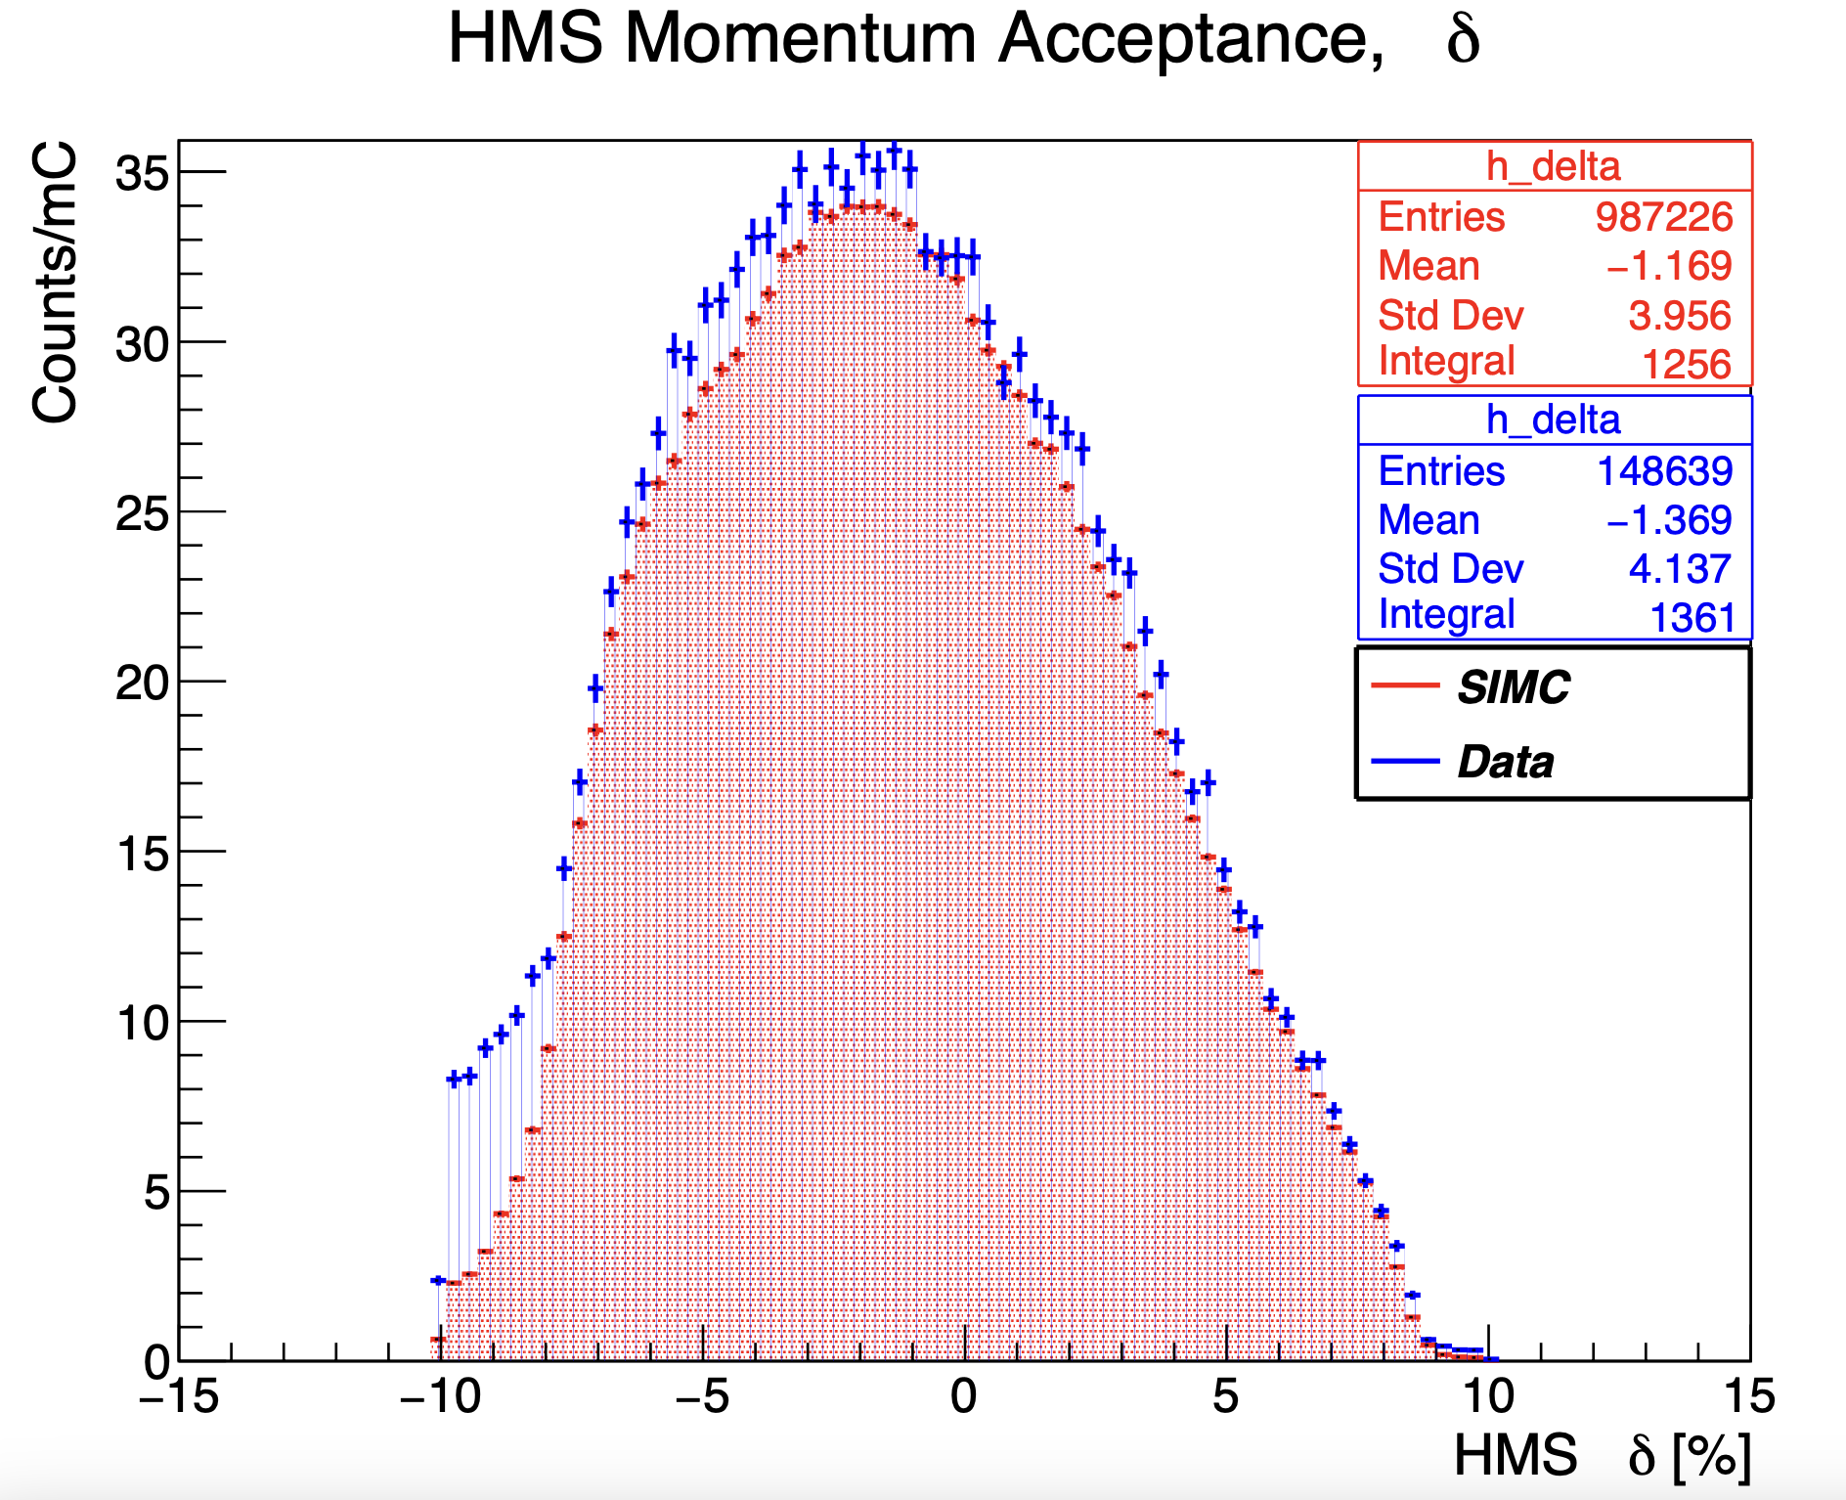
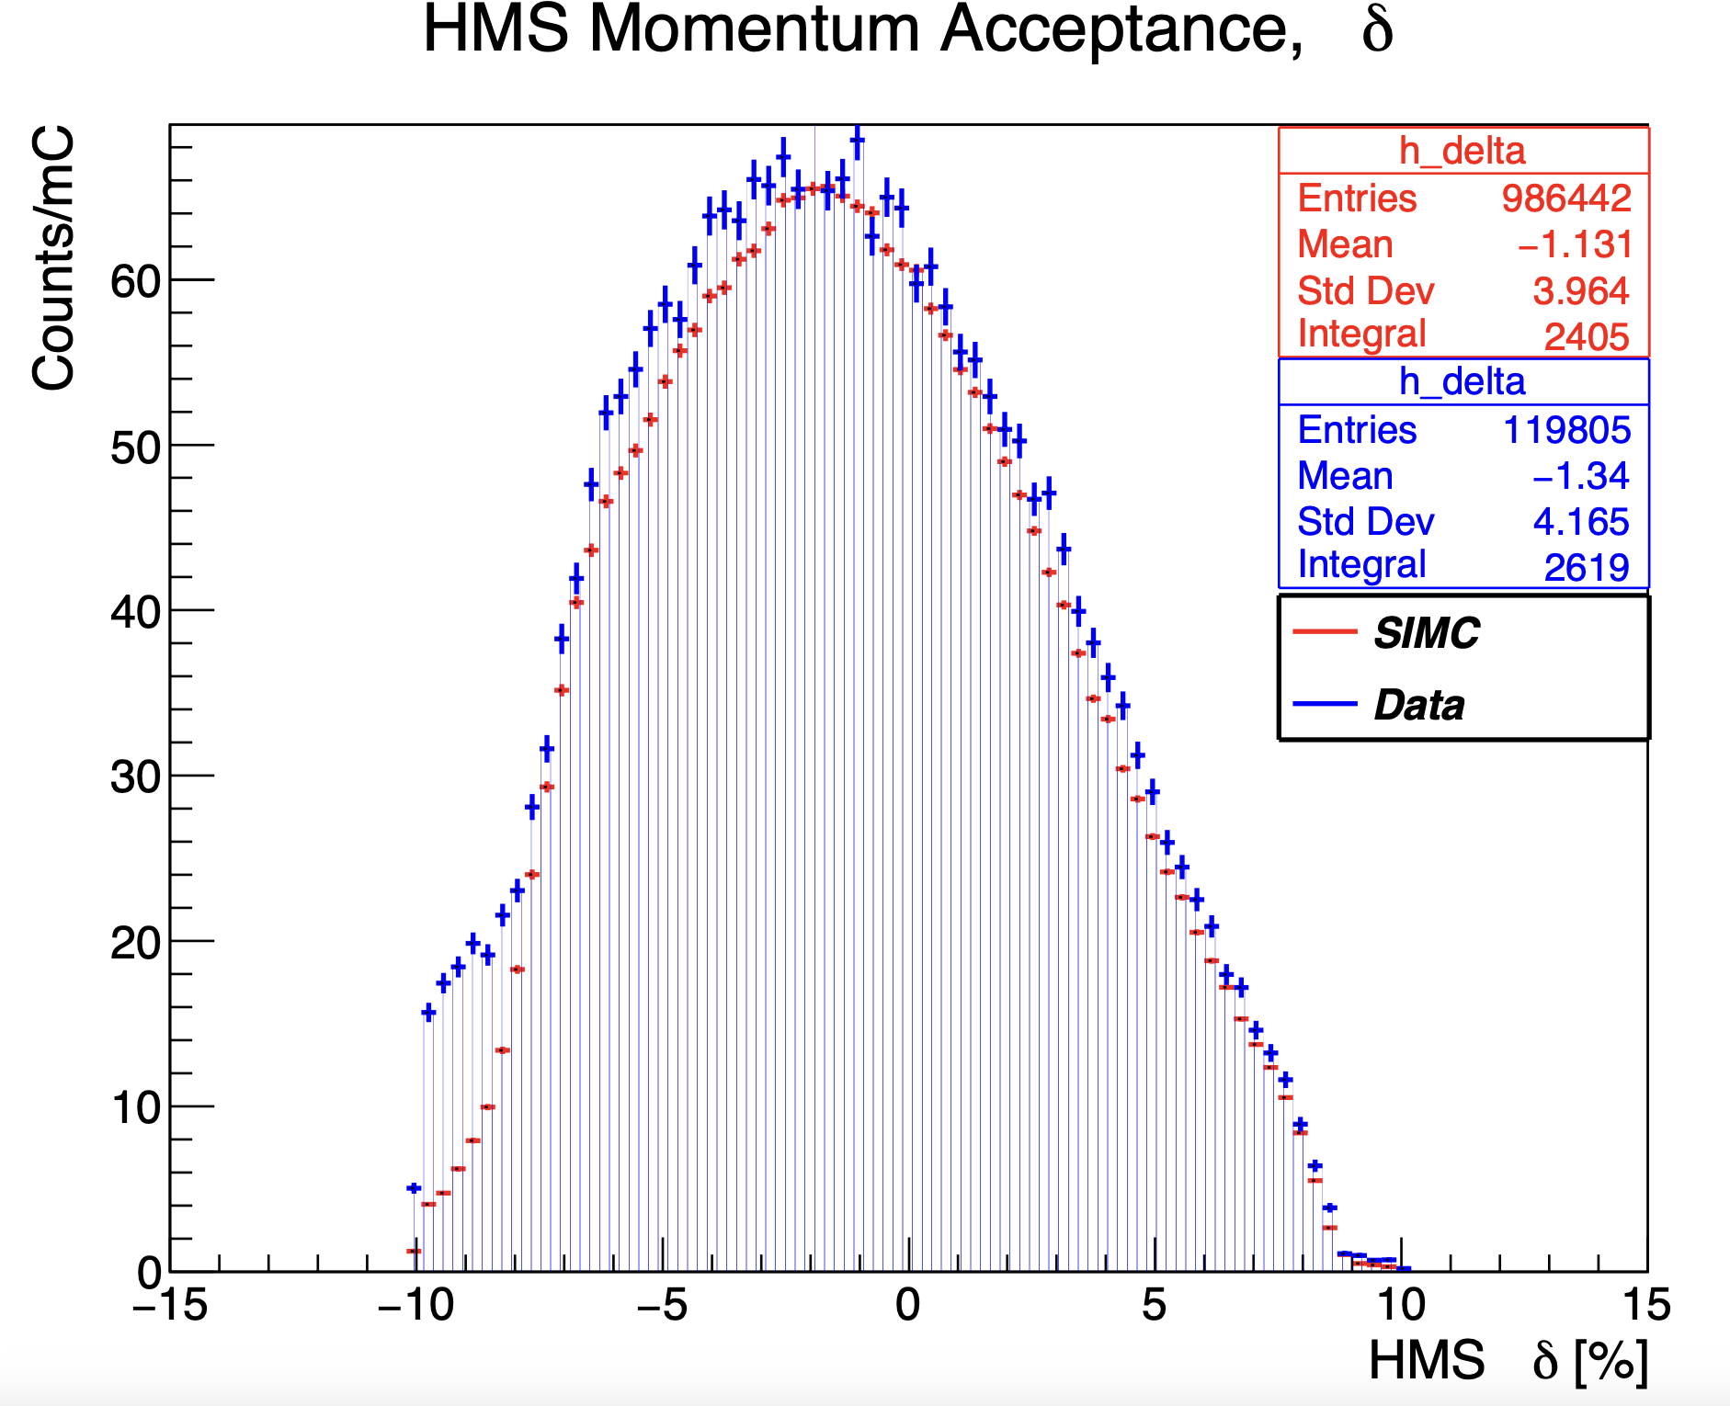
SIMC/DATA Comparison: CUTS APPLIED
HMS Momentum Acceptance cut <10 and >-10
20841
20858
20861
20846
20851

Slide 11
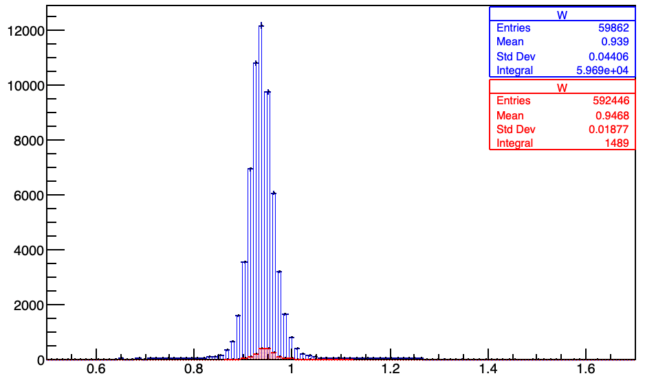
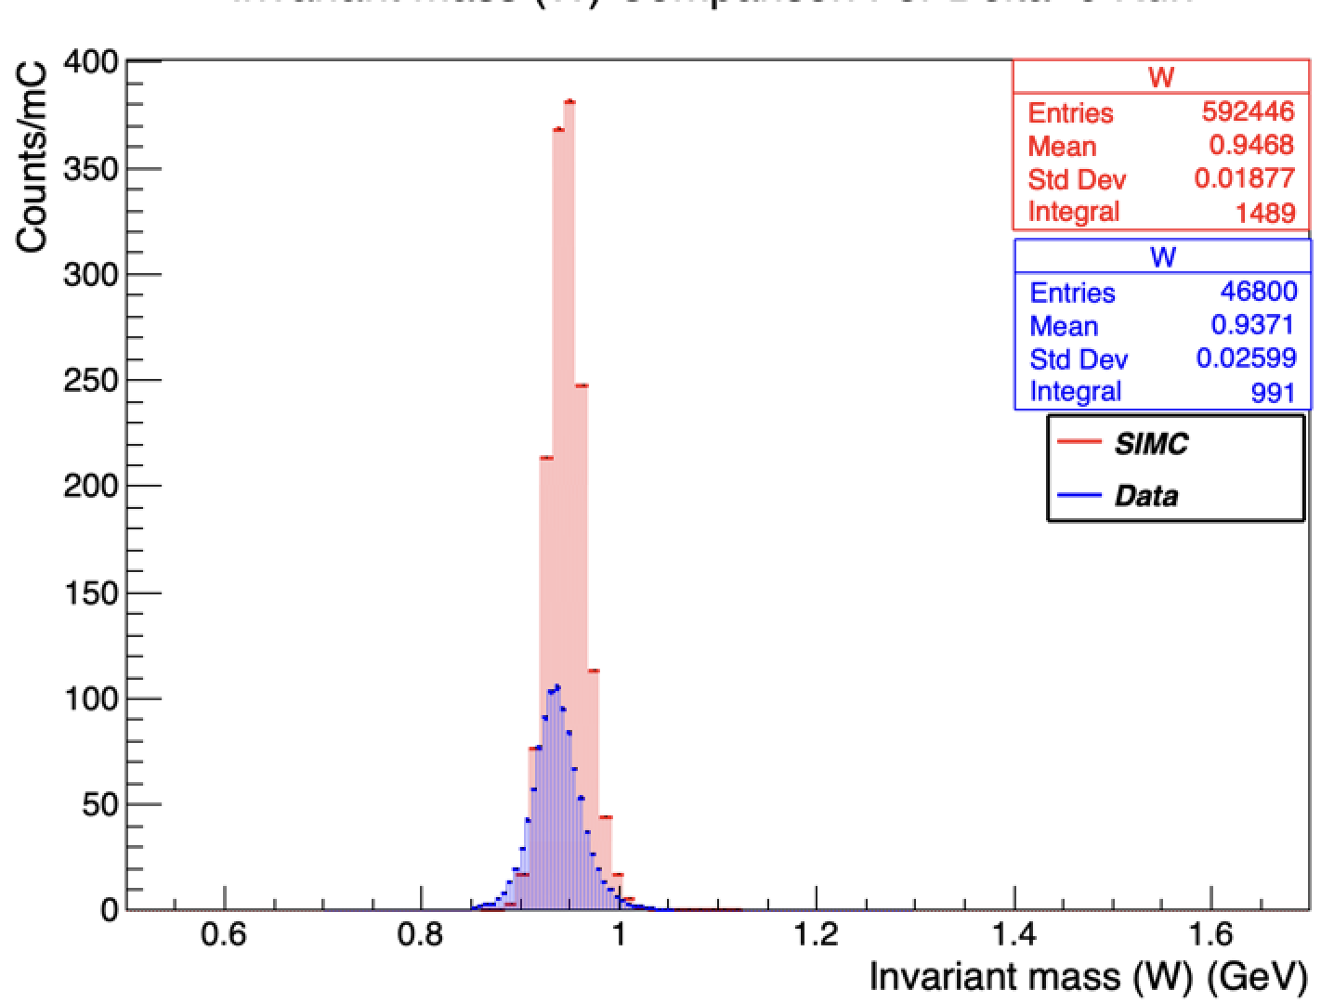
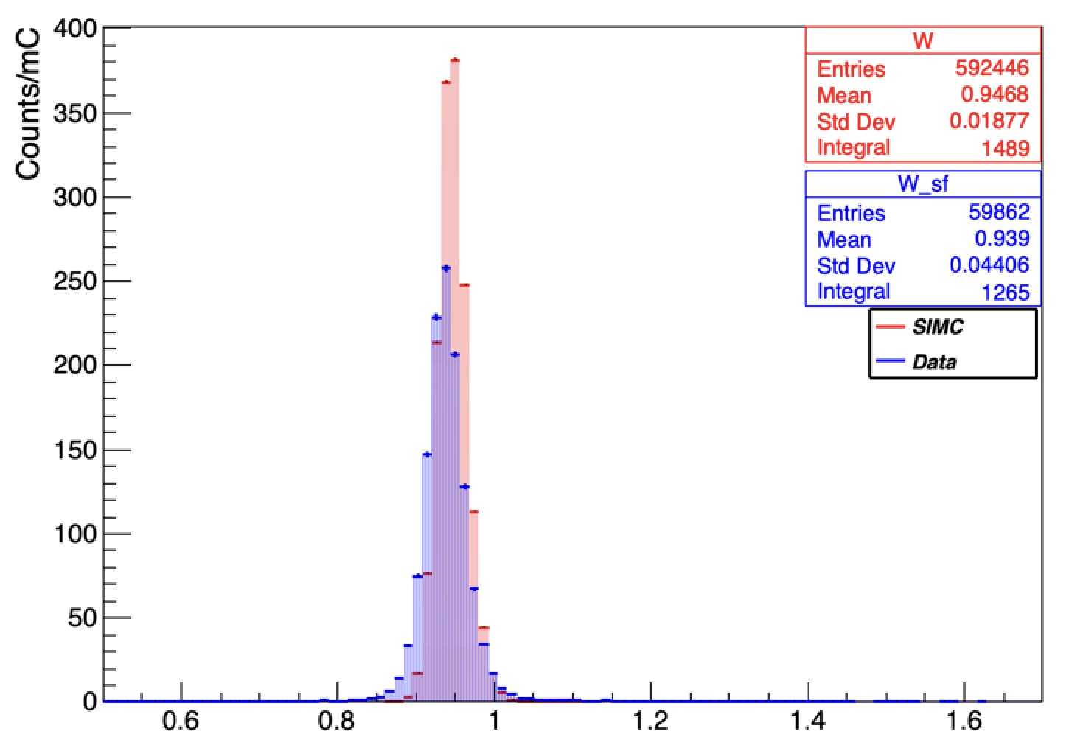
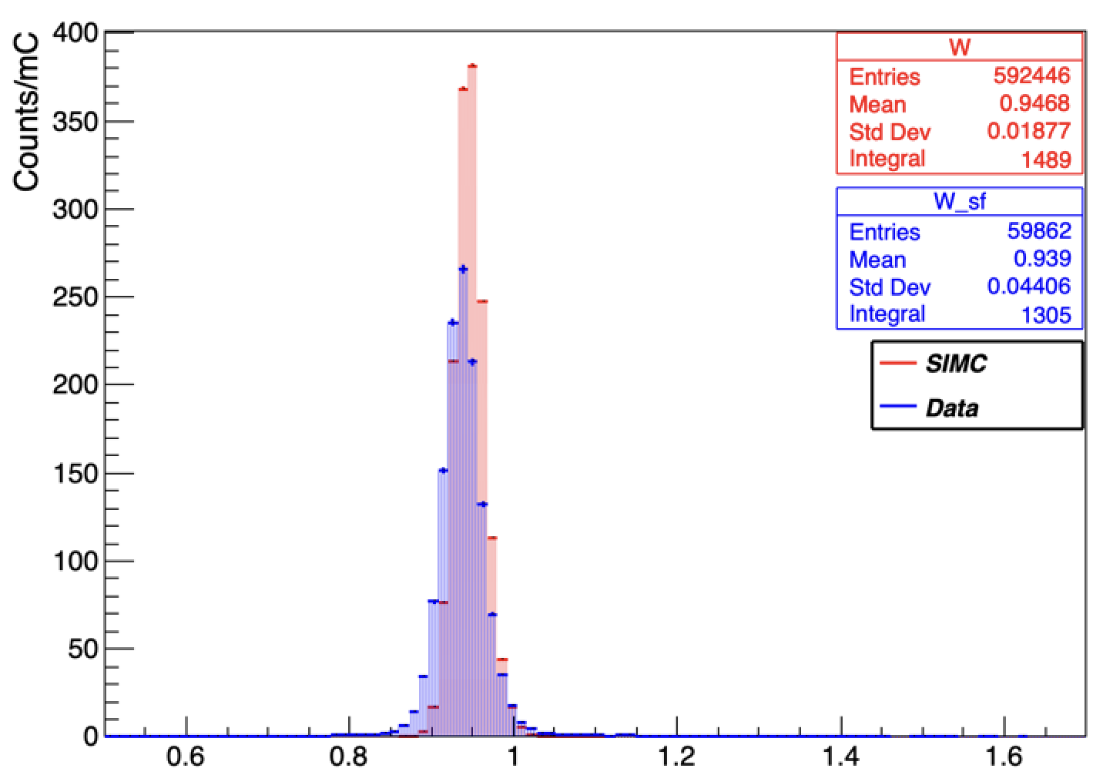
SIMC/DATA Comparison: CUTS APPLIED
20851
Invariant mass, W
Invariant Mass, W
Counts
Charge normalized
No normalizations applied
W[GeV/c^2]
Invariant mass, W
Invariant mass, W
Normalized by charge, live time and tracking efficiencies
Charge and live time normalized
W[GeV/c^2]
W[GeV/c^2]

Slide 12
E12-10-003
H(e,e’p) Analysis:
HMS Momentum Correction

Slide 13
Heep Analysis: HMS Momentum Corrections and Optimization
Fractional Momentum
H(e,e’p) Elastics Kinematics Used In Optimization Procedure
Run # | HMS Momentum [GeV/c] | HMS angle [deg] | SHMS Momentum [GeV/c] | SHMS angle [deg] | SHMS Delta | HMS Delta Range
20841 | 3.499 | 33.344 | 8.55 | 14.153 | Delta scan -8
20846 | 3.145 | 35.750 | 8.55 | 12.940 | Delta scan -4
20851 | 2.783 | 38.549 | 8.55 | 11.705 | Delta scan 0
20858 | 2.417 | 41.812 | 8.55 | 10.435 | Delta scan+4
20861 | 2.048 | 45.667 | 8.55 | 9.125 | Delta scan+8

Slide 14
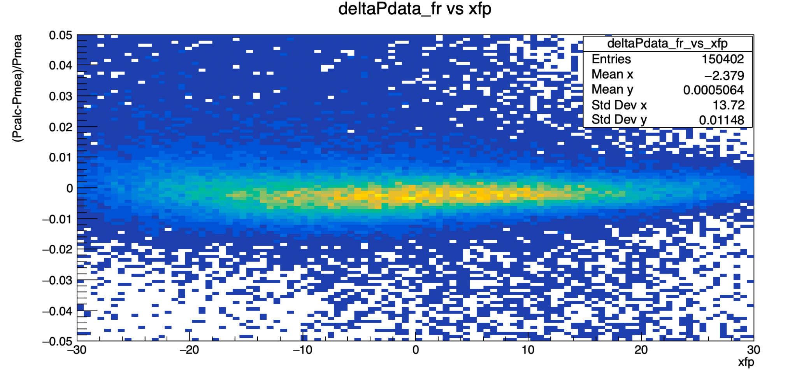
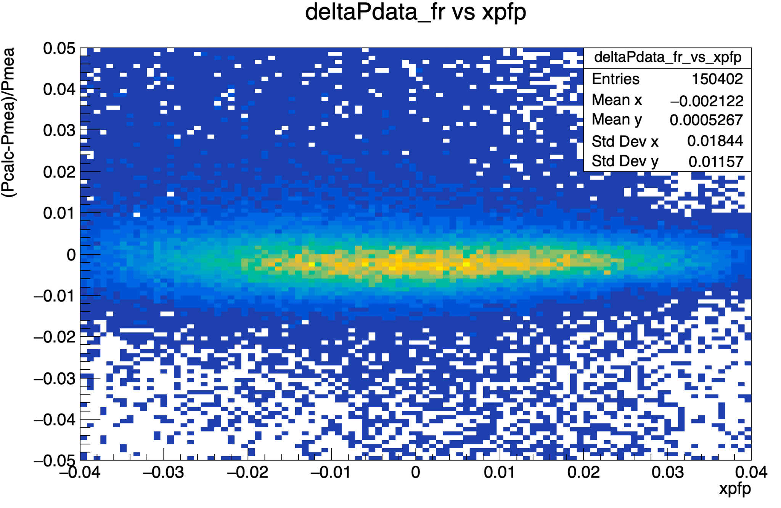
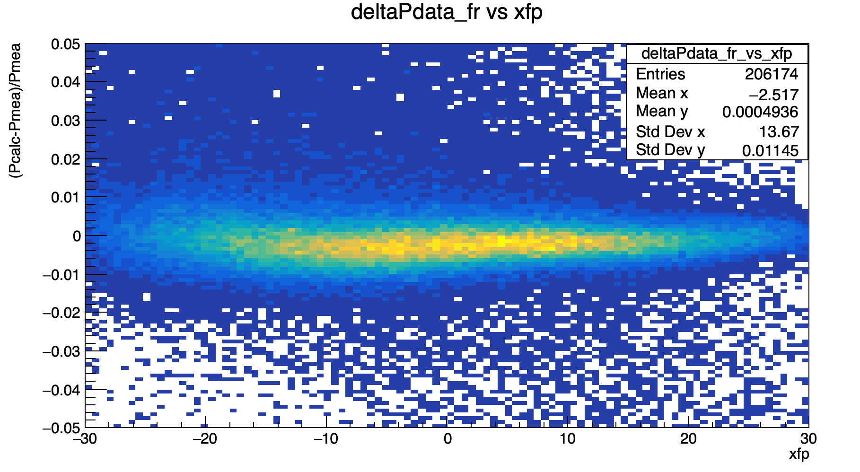
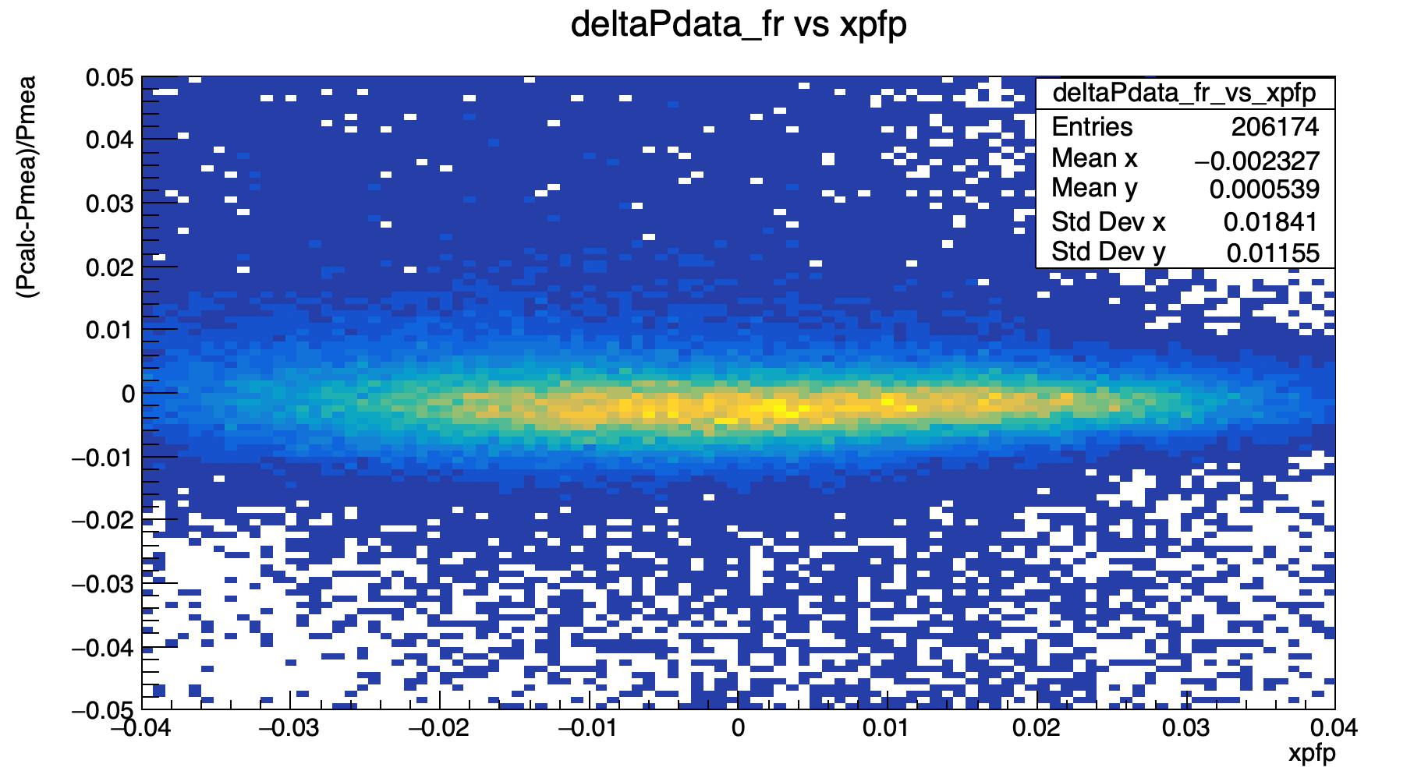
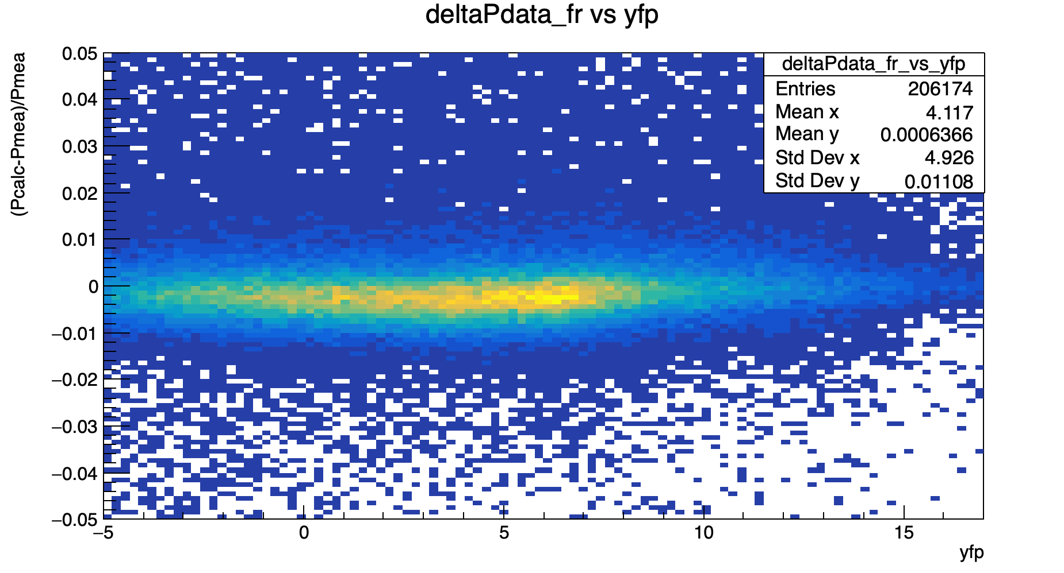
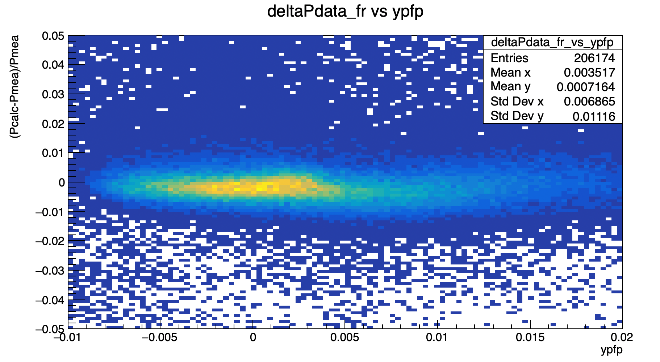
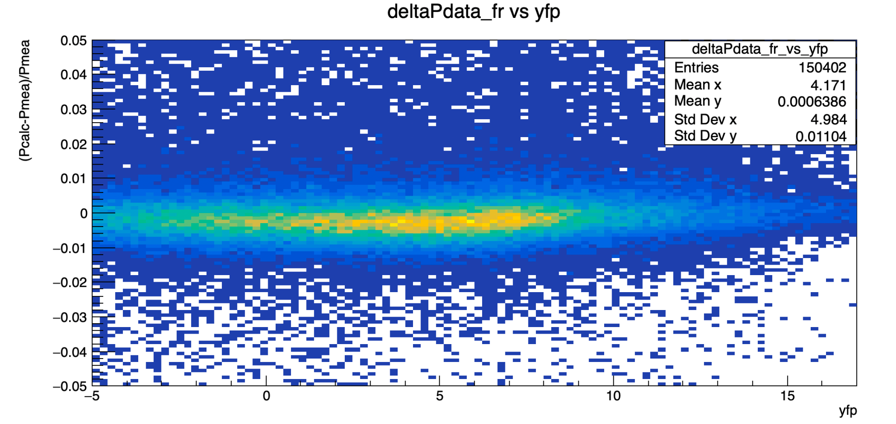
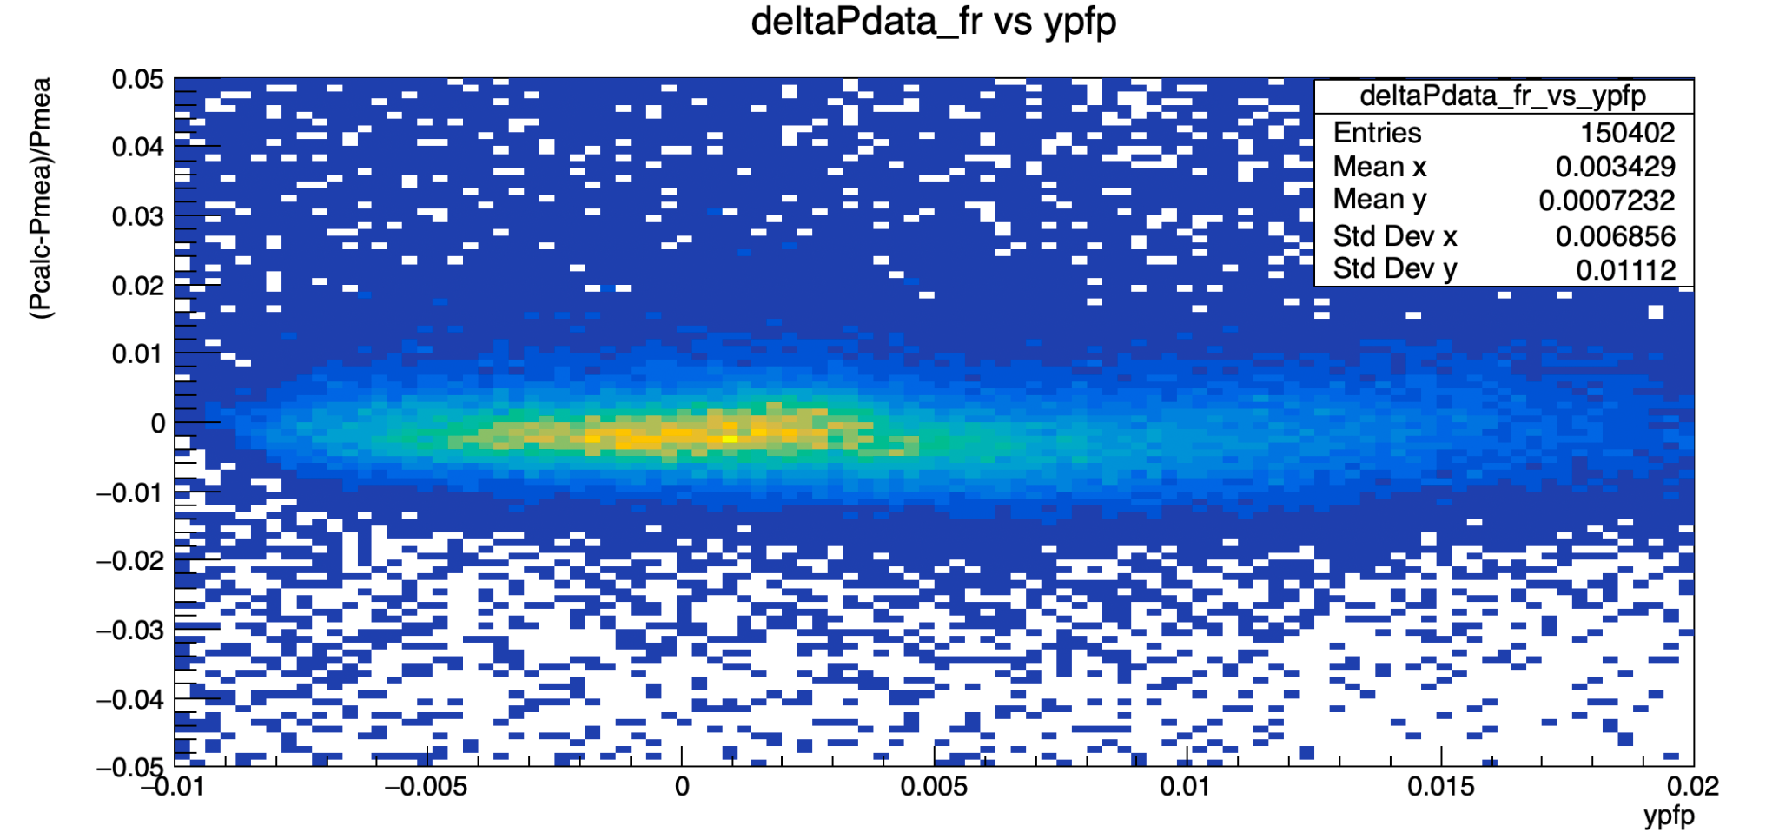
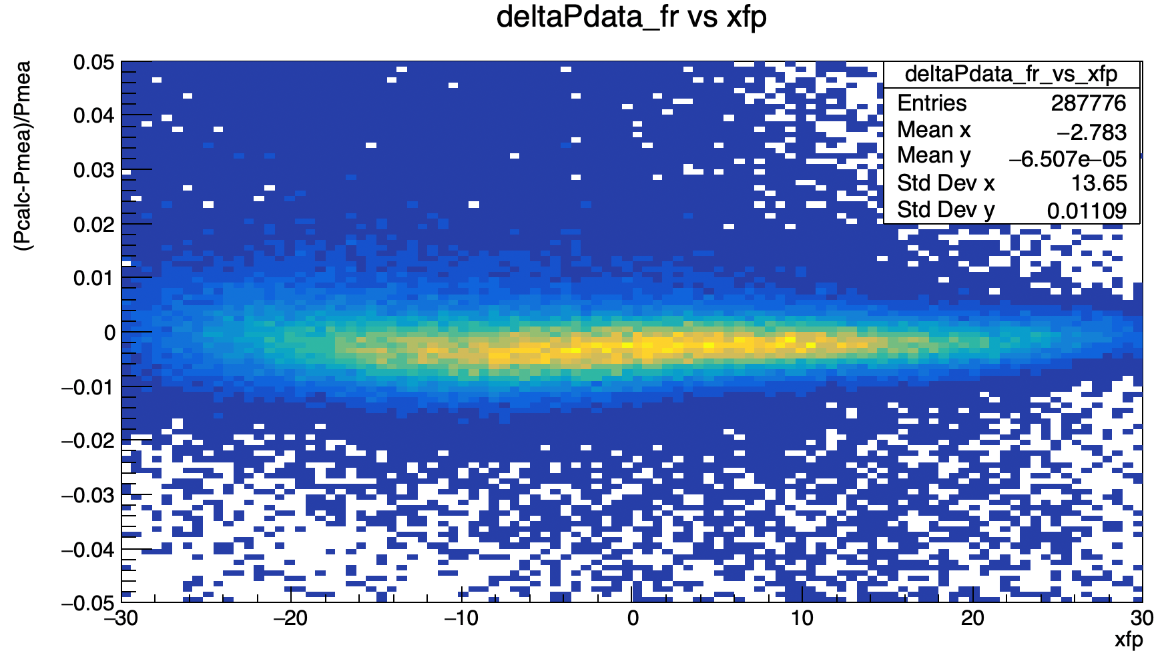
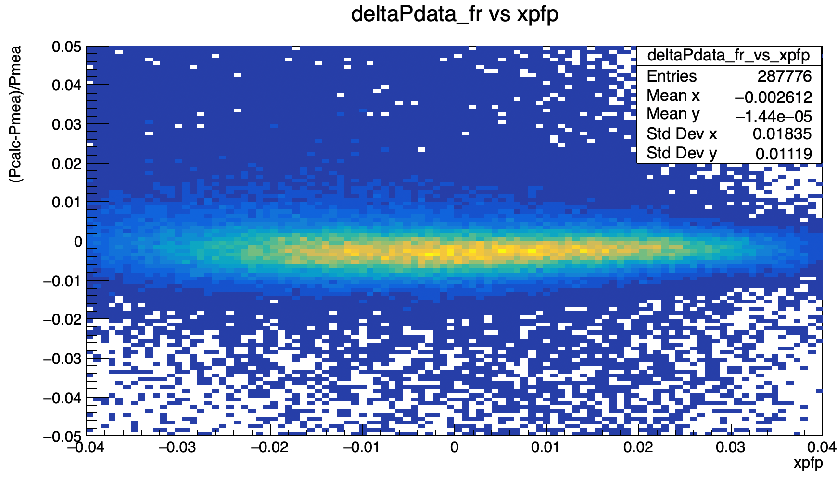
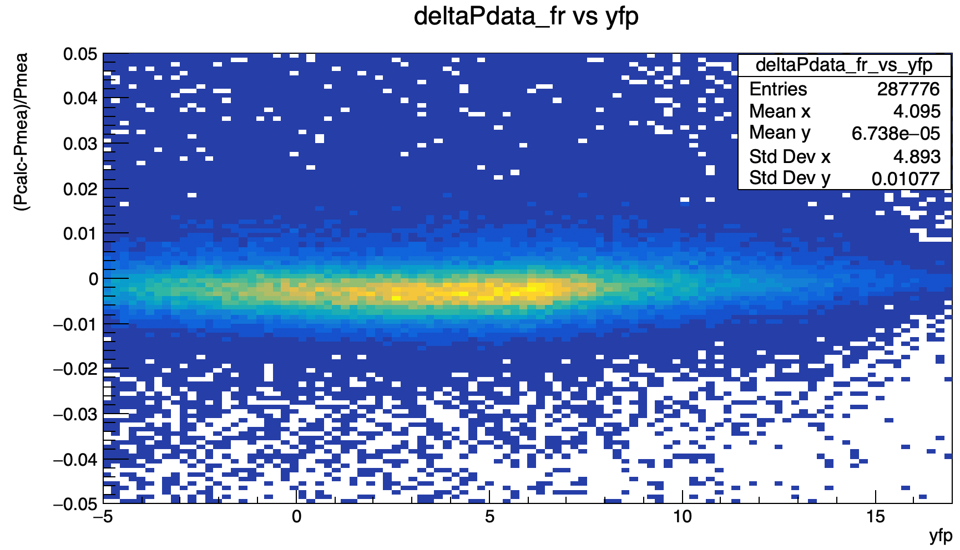
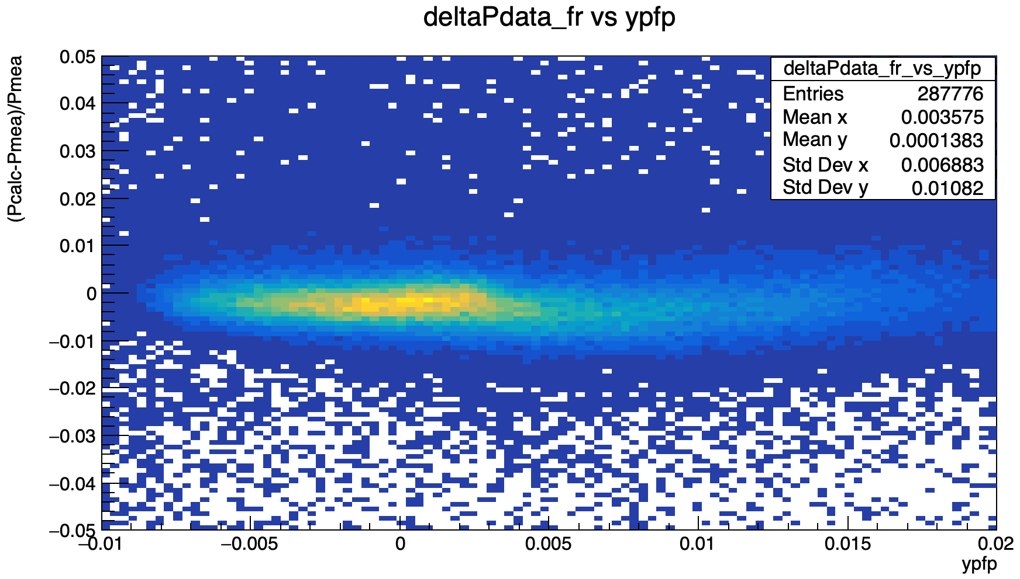
Correlation check
20846
20851
20841
20858

Slide 15
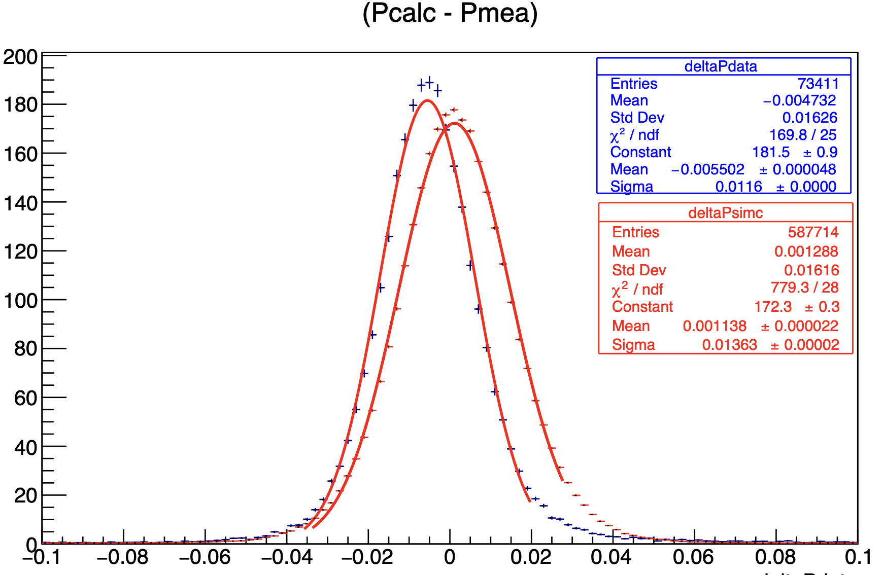
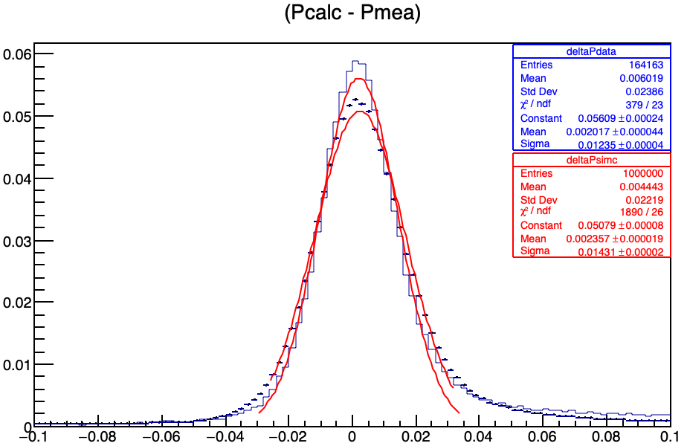
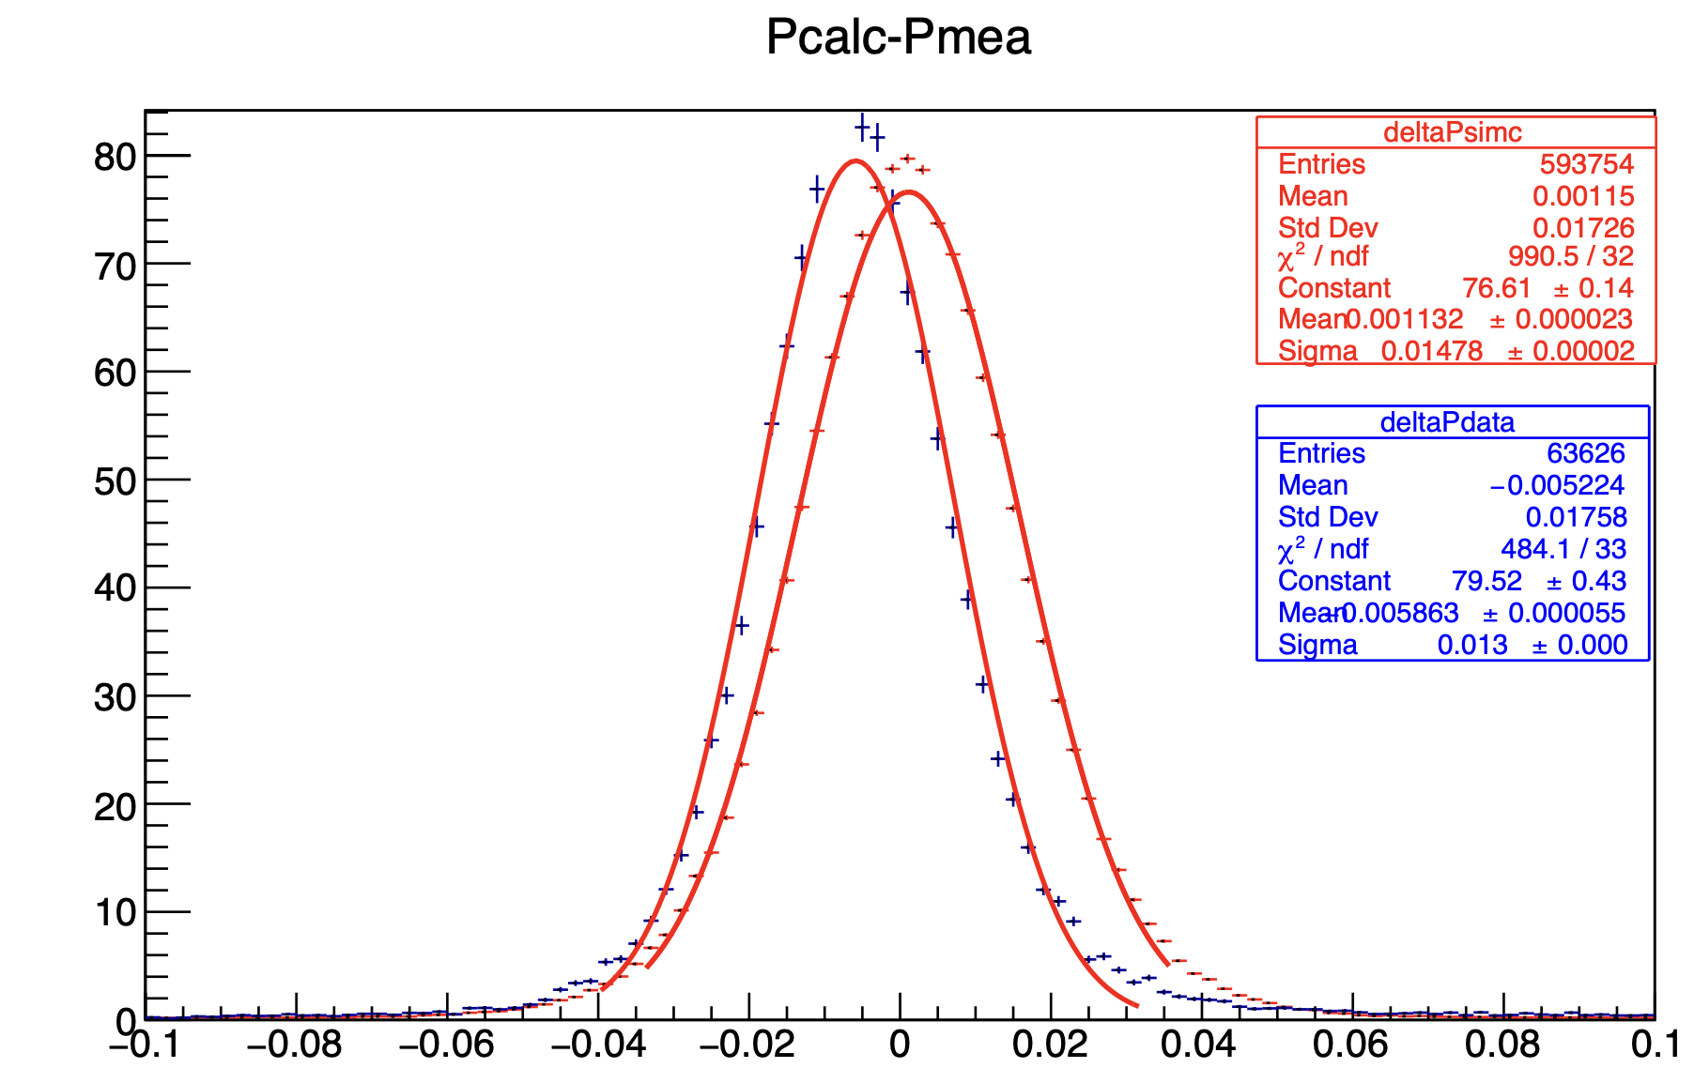
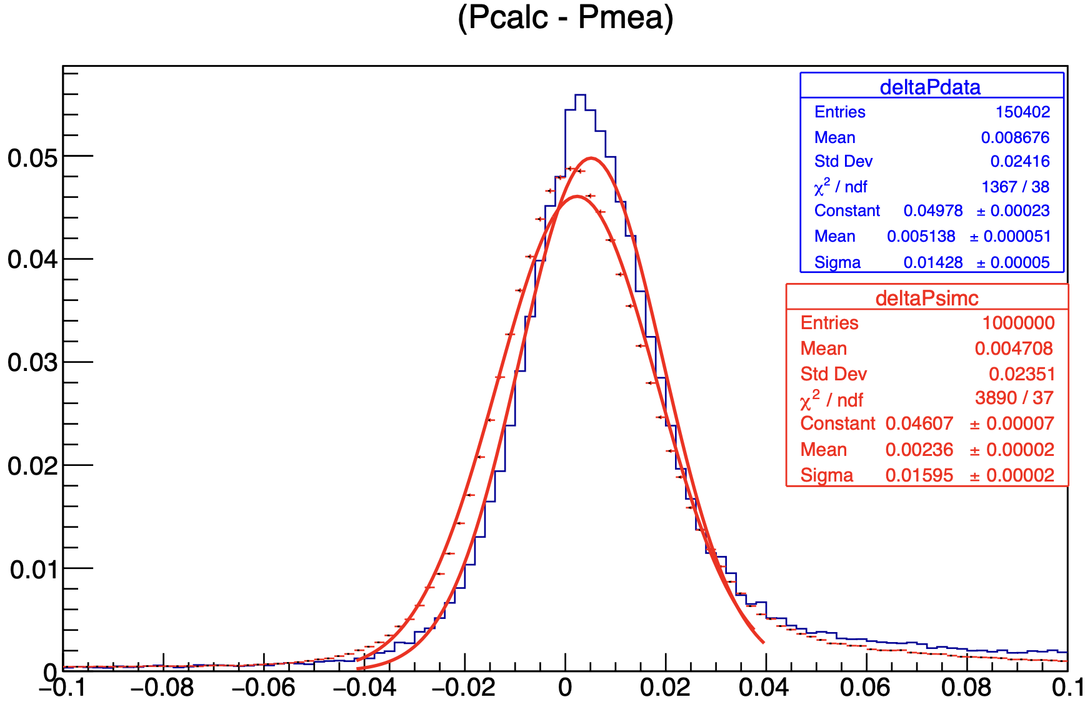
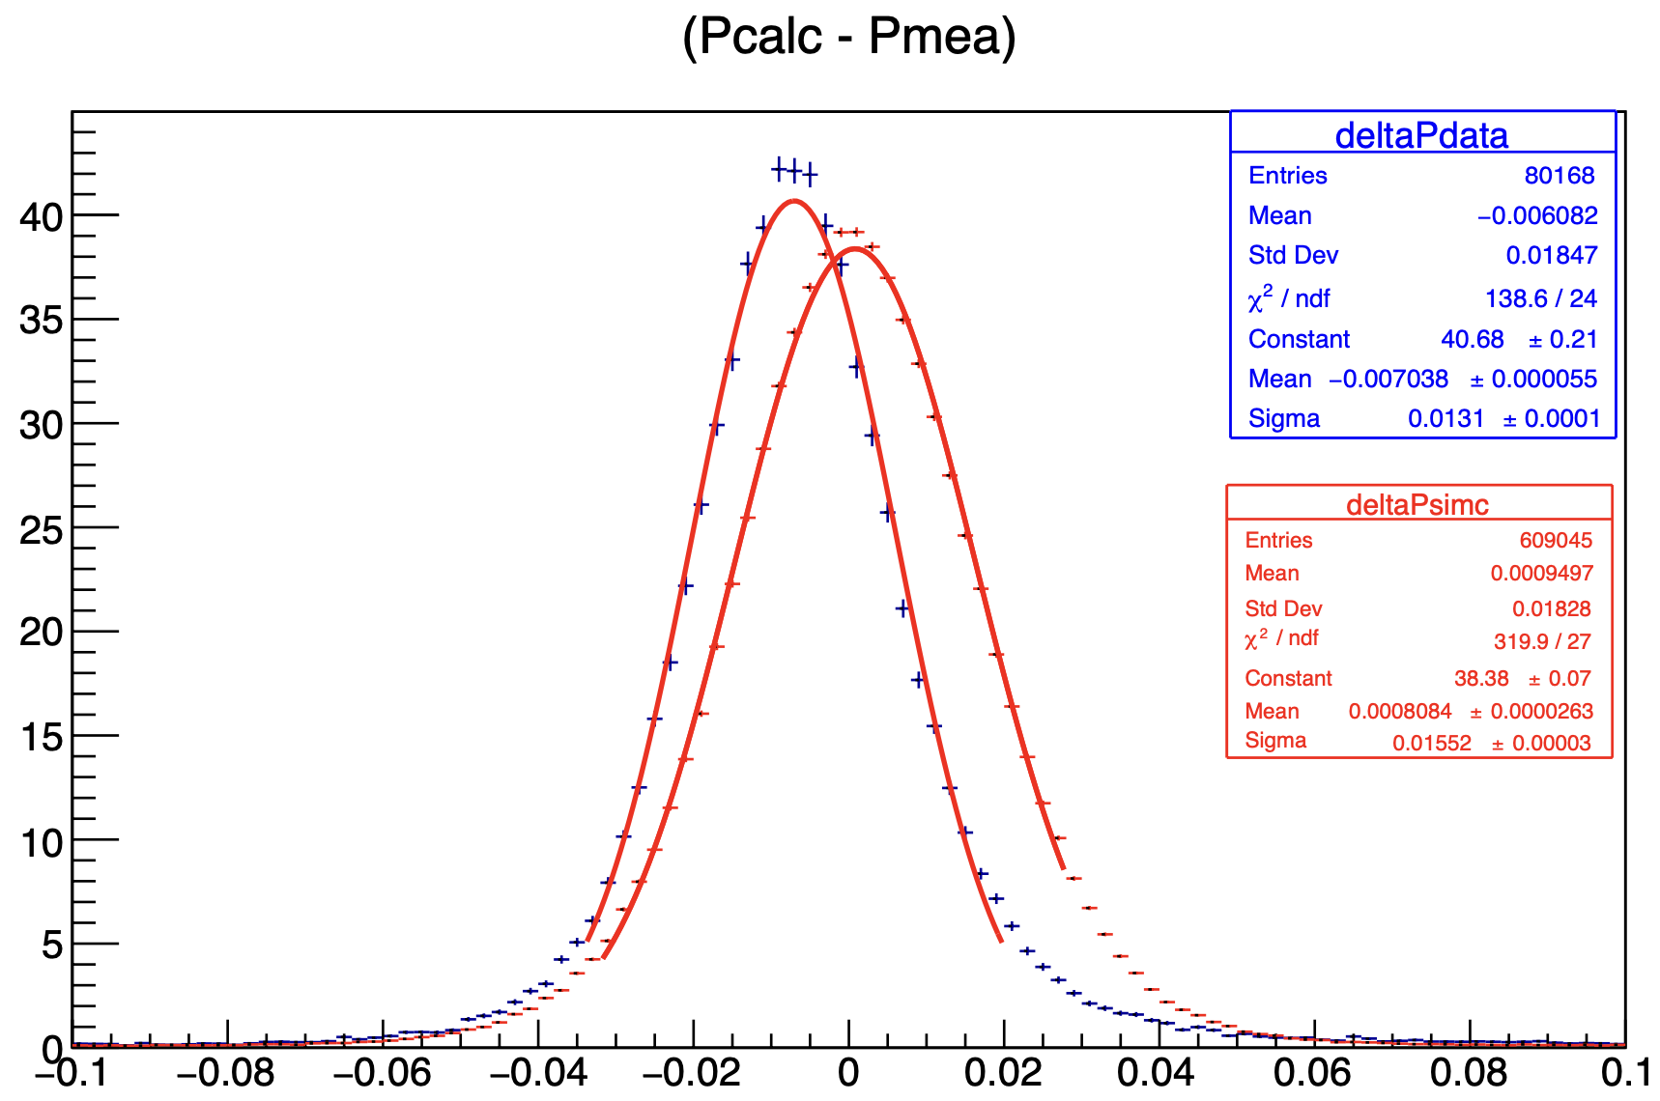
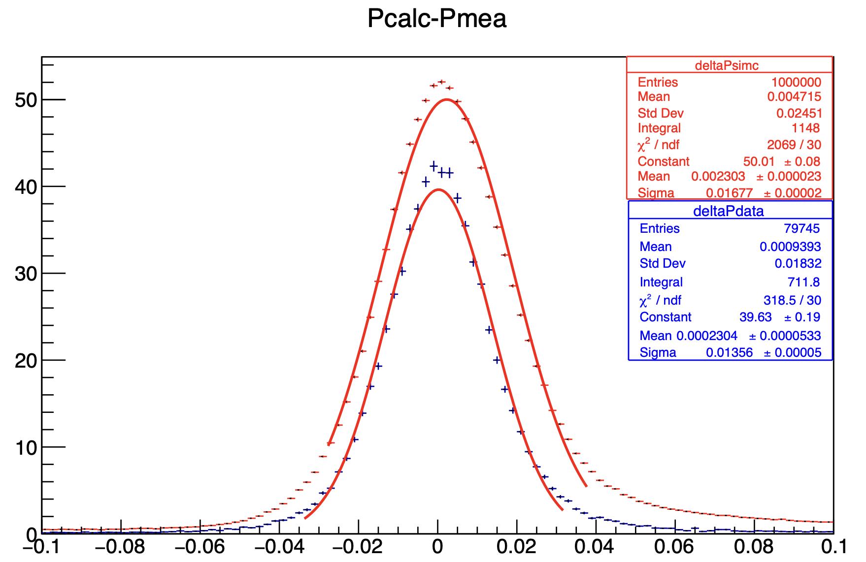
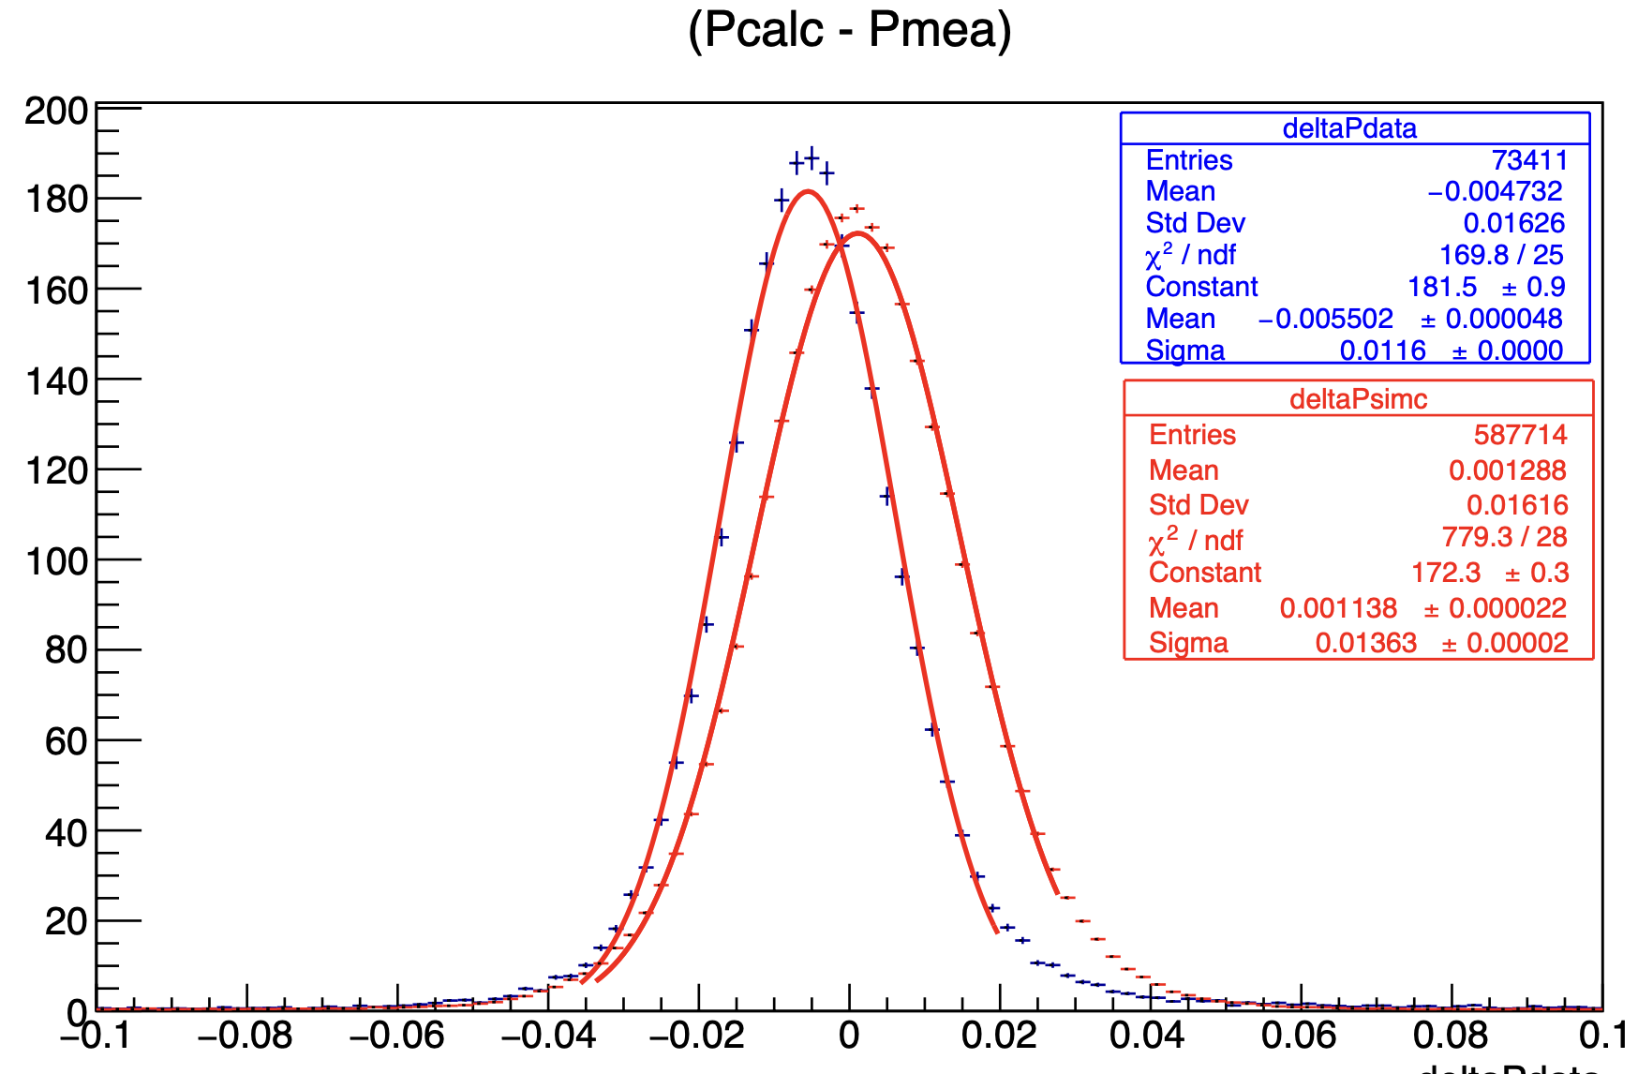
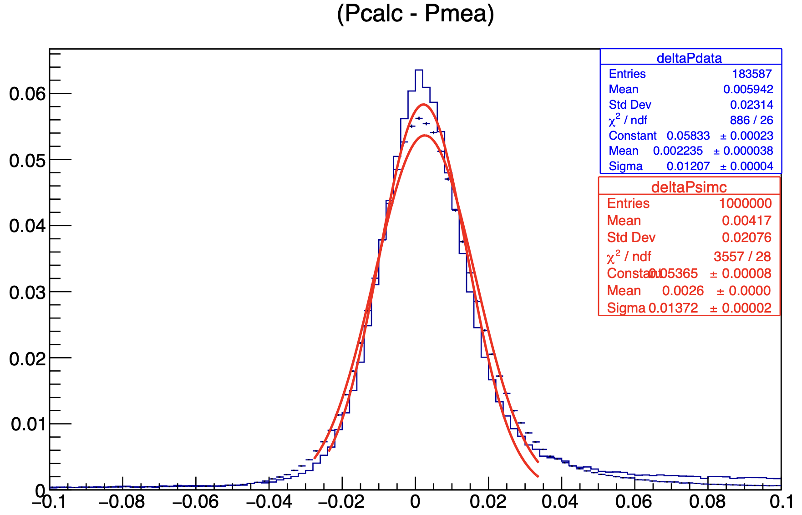
Normalized Counts
Before Correction After Correction
Normalized Counts
20858
Normalized Counts
Normalized Counts
ΔPsimc-ΔPdata [GeV]
ΔPsimc-ΔPdata [GeV]
20851
Normalized Counts
ΔPsimc-ΔPdata [GeV]
ΔPsimc-ΔPdata [GeV]
Normalized Counts
20846
Normalized Counts
Normalized Counts
ΔPsimc-ΔPdata [GeV]
ΔPsimc-ΔPdata [GeV]
20861
ΔPsimc-ΔPdata [GeV]
ΔPsimc-ΔPdata [GeV]

Slide 16
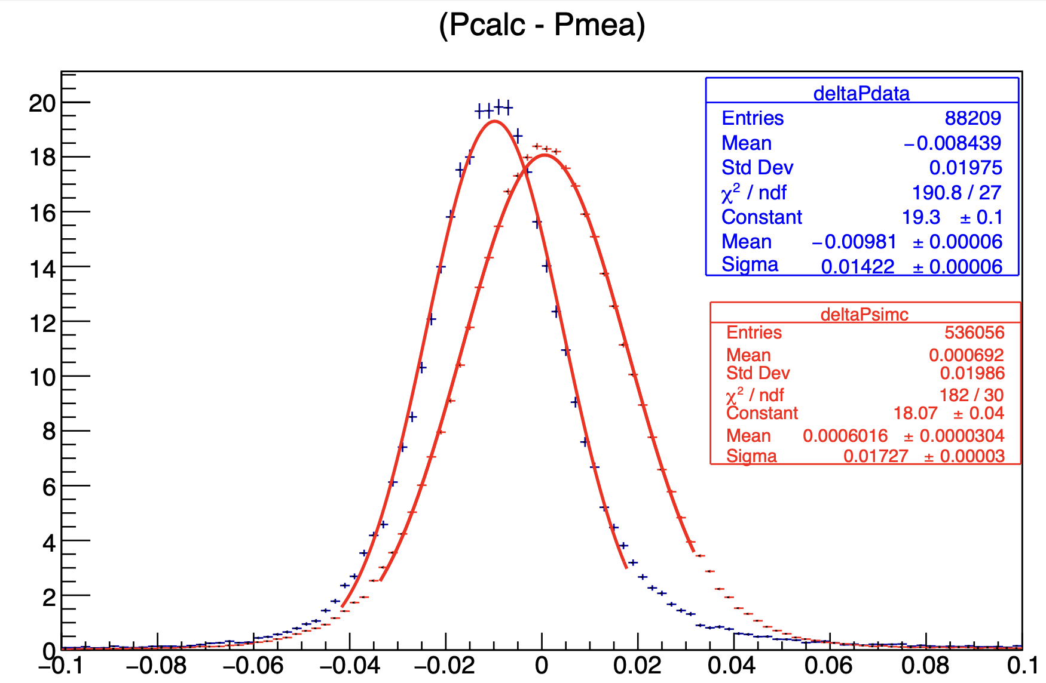
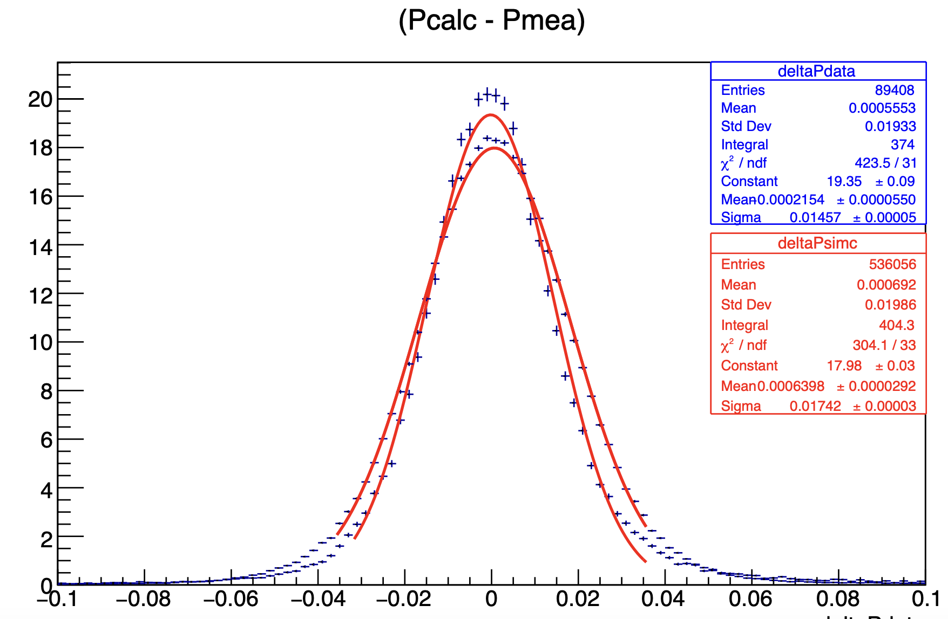
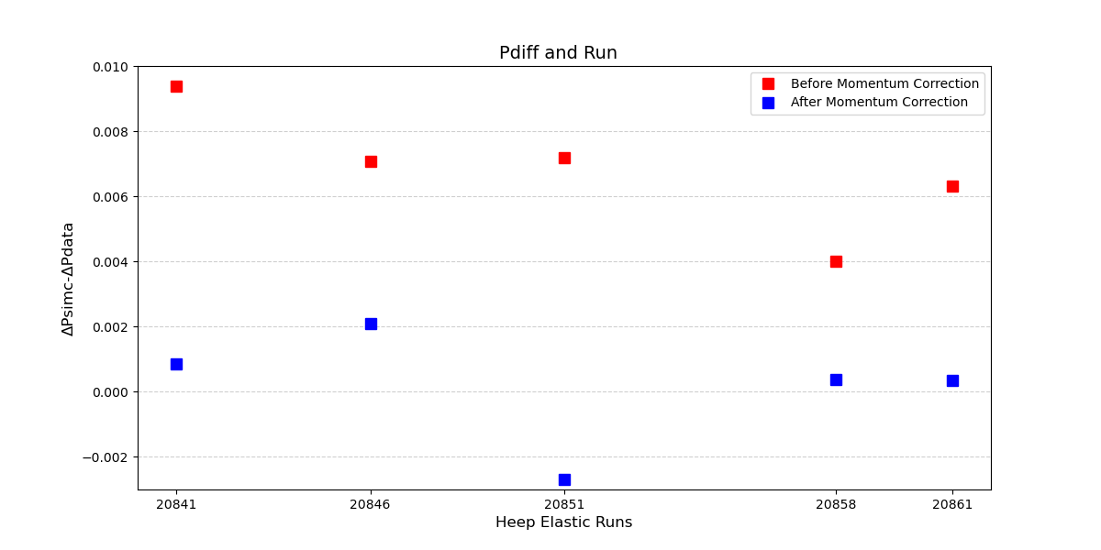
Normalized Counts
Normalized Counts
20841
ΔPsimc-ΔPdata [GeV]
ΔPsimc-ΔPdata [GeV]
HMS Momentum Before and After Correction

Slide 17
SUMMARY
HMS Momentum for Heep studied.
SIMC/DATA Yields currently being studied

Slide 18
Deuteron Electro-disintegration Analysis Update
Gema P. Villegas Minyety
Florida International University
Pramila Pokhrel
Catholic University of America
Hall C Collaboration Meeting
14 January 2025

Slide 19
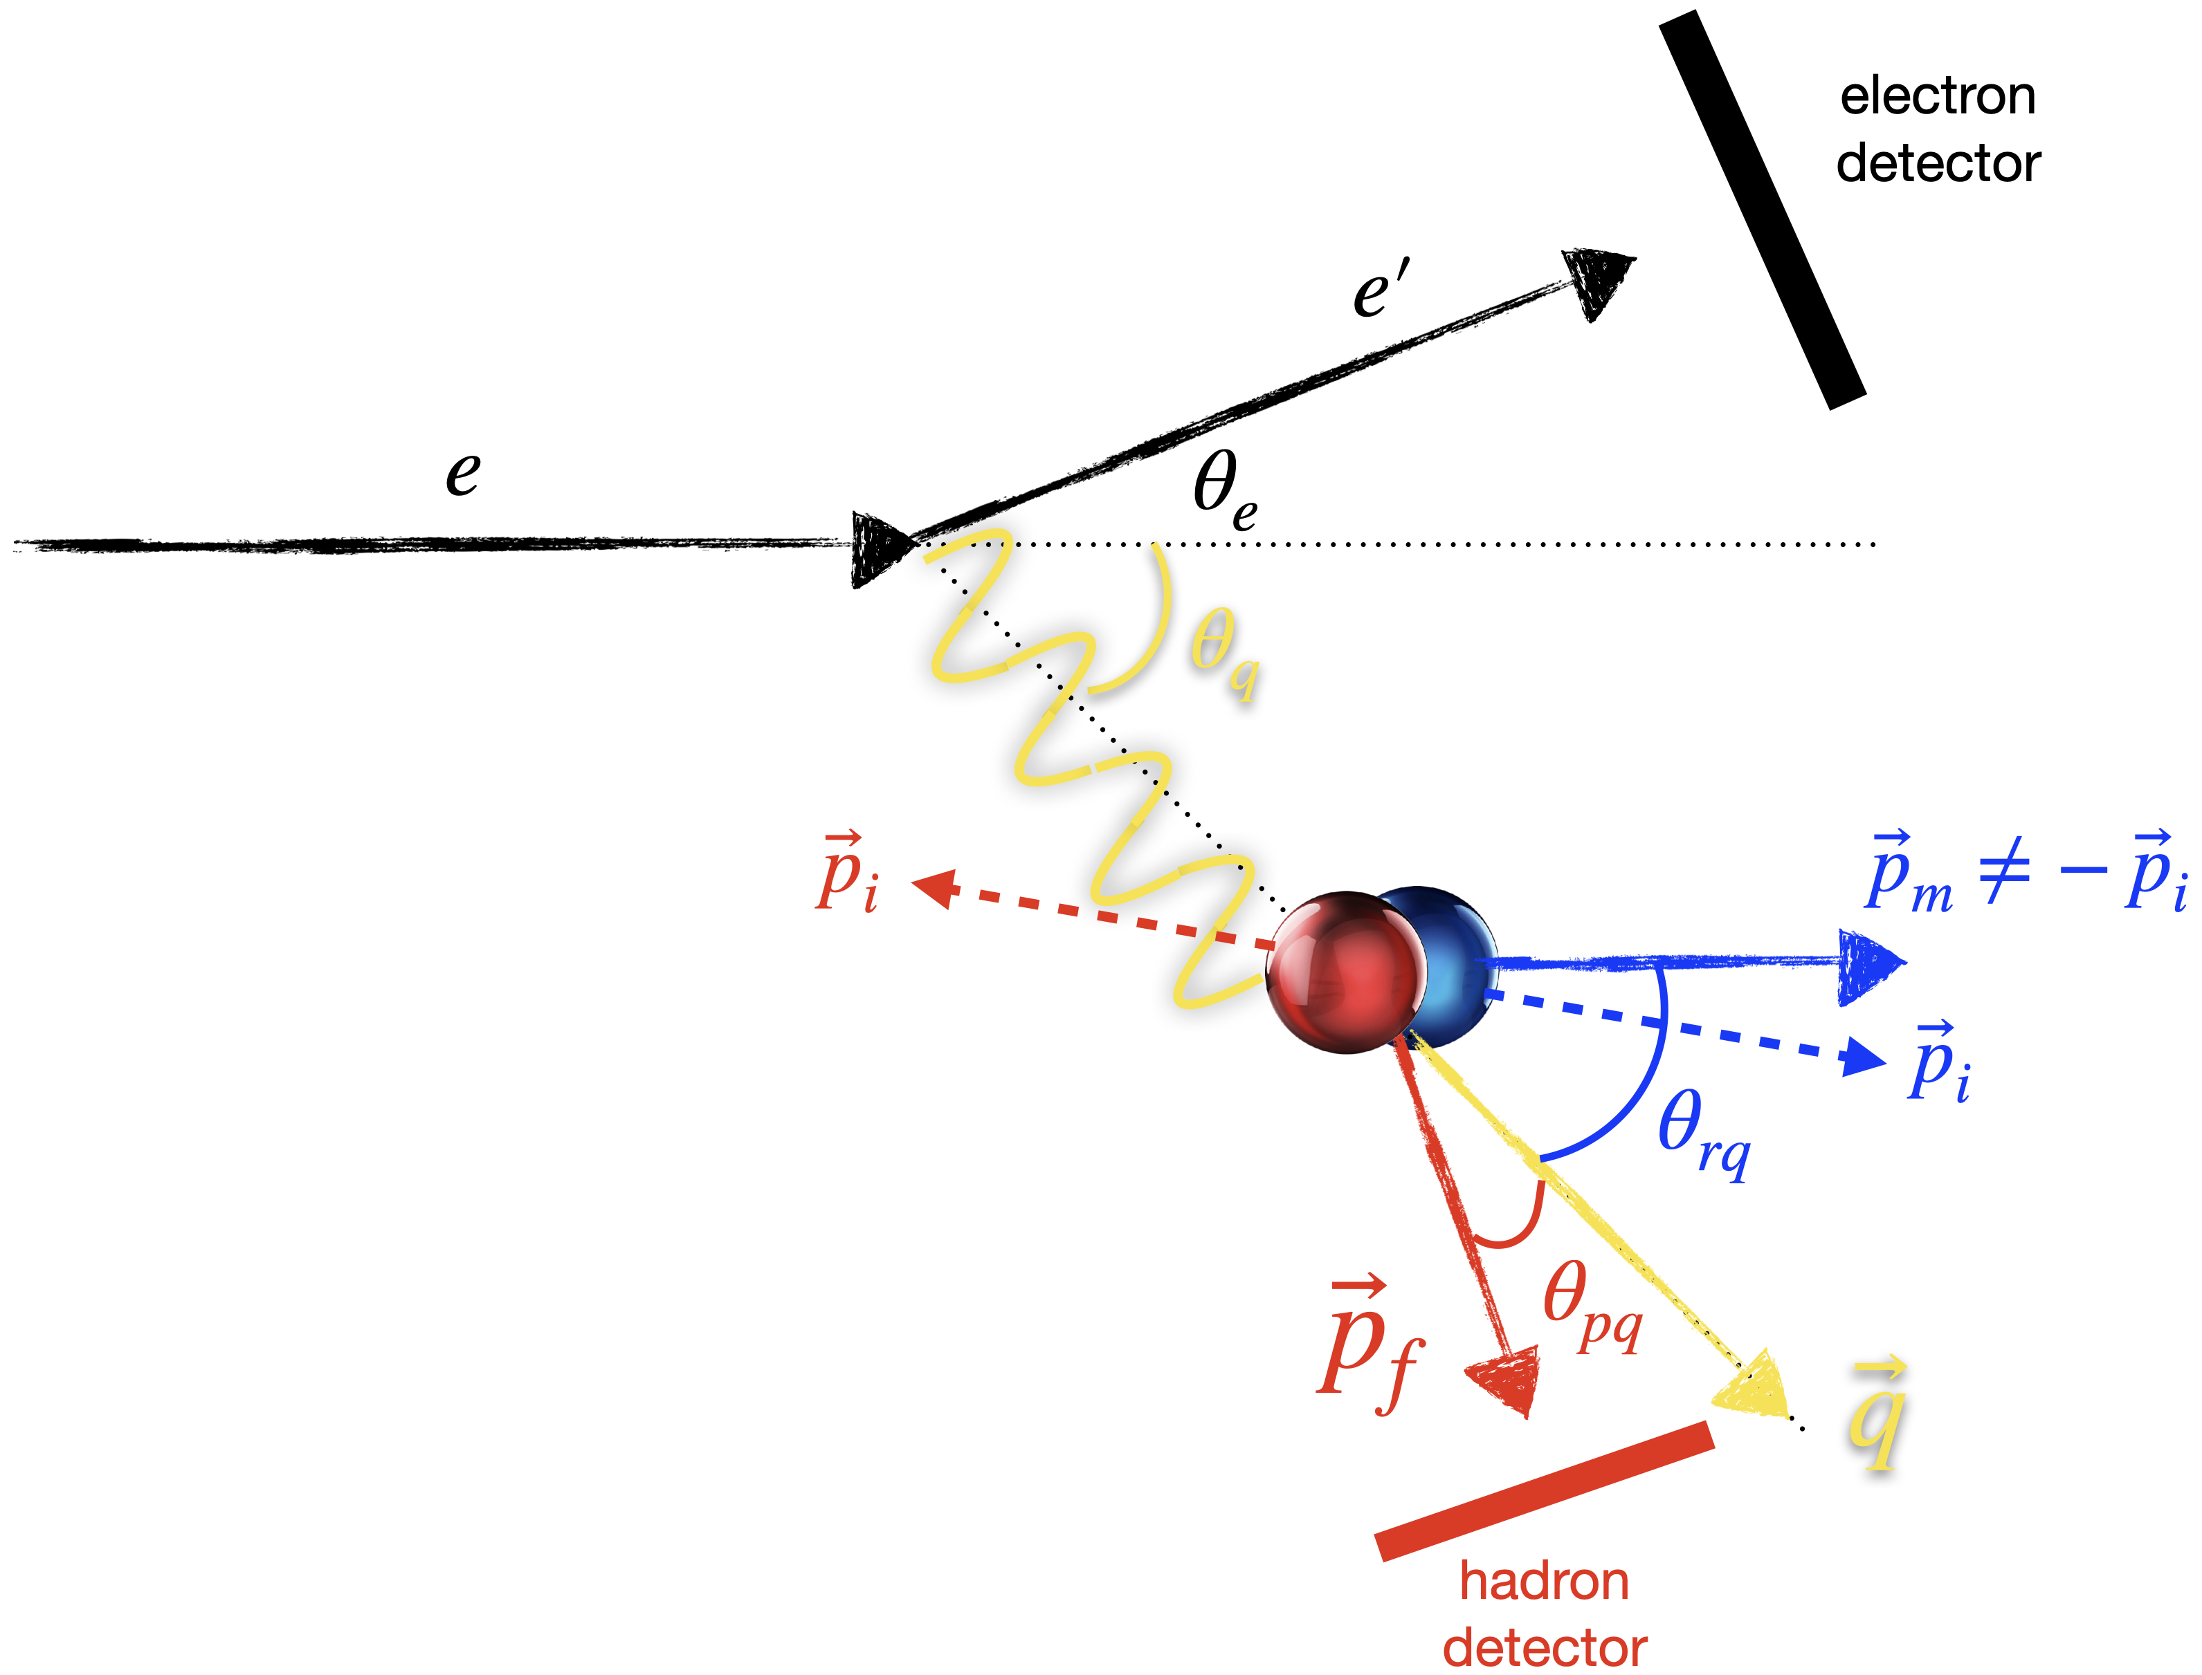
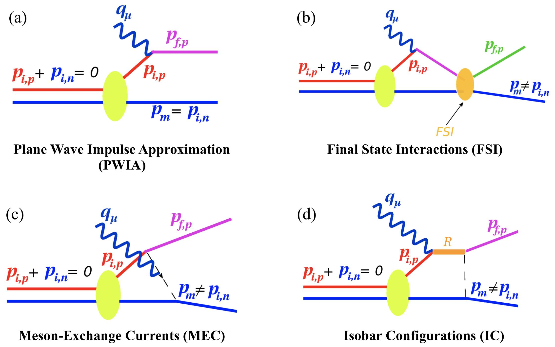
Brief Overview of D(e,e'p)n
C. Yero. (2020). Thesis
(b), (c), and (d) are suppressed in the kinematic window used
C. Yero, p. c.
Notes:
Here is an schematic of the reaction and where is detected. Describe where each particle is detected.
The goal is to isolate the kinematics in which the maximum recoil momentum of the neutron can be recovered.

Slide 20
Analysis Procedure
Set Reference Times & Time Window Cuts
Reference times have been set & Time Window cuts placed.
Detector calibrations mostly done, might need revisiting.
Detector Calibrations
Compare with Simulation (SIMC)
Determine Event Selection Cuts
Cross Section Extraction
SIMC comparison show there is further optics work.

Slide 21
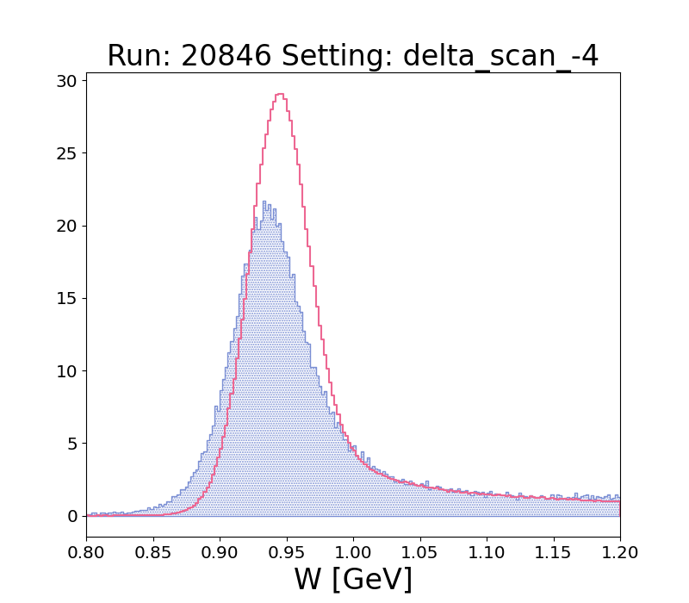
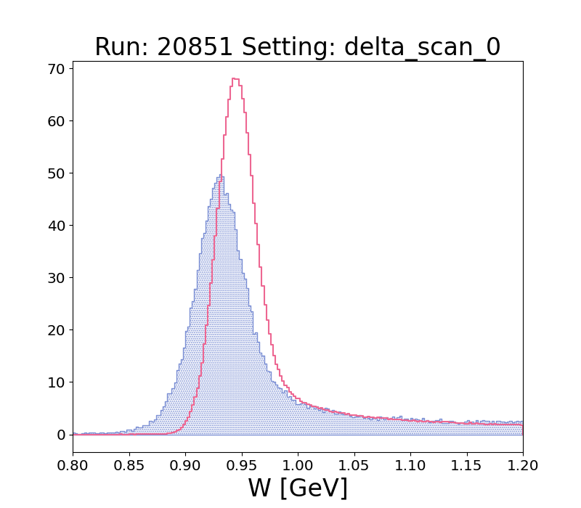
SIMC-H(e,e'p) Comparison
Hydrogen Elastics
Notes:
Here is an schematic of the reaction and where is detected. Describe where each particle is detected.
The goal is to isolate the kinematics in which the maximum recoil momentum of the neutron can be recovered.

Slide 22
Angle and Momentum Offset Determination
Determining offsets in angle then in momentum, based on SIMC comparison
Method was developed by C. Yero for Café
Notes:
Here is an schematic of the reaction and where is detected. Describe where each particle is detected.
The goal is to isolate the kinematics in which the maximum recoil momentum of the neutron can be recovered.

Slide 23
Angle and Momentum Offset Determination
Old Offset = 2.0e-04 [rad]
New Offset = 2.81e-04 [rad]
Notes:
Here is an schematic of the reaction and where is detected. Describe where each particle is detected.
The goal is to isolate the kinematics in which the maximum recoil momentum of the neutron can be recovered.

Slide 24
Angle and Momentum Offset Determination
Old Offset = 2.0e-04 [rad]
New Offset = 2.81e-04 [rad]
Notes:
Here is an schematic of the reaction and where is detected. Describe where each particle is detected.
The goal is to isolate the kinematics in which the maximum recoil momentum of the neutron can be recovered.

Slide 25
Low Momentum Run (120 MeV) Yield Ratios
Some calibrations done
CaFe optics matrix
Yield Ratios for 20871
Pm [GeV]

Slide 26
Incorporating MS Models in SIMC
Choose kinematic variable that SF vary the most
Choose and test interpolating function and bin size
Extend to other kinematics
Create a grid
Notes:
Here is an schematic of the reaction and where is detected. Describe where each particle is detected.
The goal is to isolate the kinematics in which the maximum recoil momentum of the neutron can be recovered.

Slide 27
SUMMARY
We are making progress: Optics, Offset determination, Detector calibrations need fine tuning.
Interested to see how changing the Laget cross section from SIMC will affect our yields.
Looking forward to finishing analysis by the end of the year!
Notes:
Here is an schematic of the reaction and where is detected. Describe where each particle is detected.
The goal is to isolate the kinematics in which the maximum recoil momentum of the neutron can be recovered.

Slide 28
BONUS SLIDES

Slide 29
Previous Work
A)
B)
Hall A Data
Hall B Data
MAMI (1995)
W. Boeglin and M. Sargsian. (2015). DOI
Notes:
A) H(e, e0 p)n cross section versus neutron recoil momentum from the
MAMI (1998) experiment [48]. Theoretical calculations were performed by H.
Arenhövel [49].
B) 2 H(e, e0 p)n angular distributions of the cross section ratio, R =
σexp /σpwia . (Left) Hall A data at Q2 = 3.5 ± 0.25 (GeV/c)2 and recoil momen-
tum settings (a) pr = 0.2 GeV/c, (b) pr = 0.4 GeV/c and (c) pr = 0.5 GeV/c.
Theoretical calculations for (i) solid (purple) curves using the CD-Bonn potential
by M. Sargsian [59], (ii) dashed (green) curves using FSI and dashed-double dotted
(black) curves using FSI+MEC+IC by J.M. Laget [60] using the Paris potential
and (iii) dashed (pink) curves denote calculations by J.W. Van Orden [61]. (Right)
Hall B data at various Q2 settings. The green data (with FSI re-scattering peak)
correspond to 400 ≤ pr ≤ 600 MeV/c, and the blue data (no FSI re-scattering)
correspond to 200 ≤ pr ≤ 300 MeV/c. The solid curves are calculations from J.M.
Laget [60] and the dashed curves are from M. Sargsian [59]. Note: Reprinted from
Ref. [47].

Slide 30
SIMC Weighted Yield Calculation:
Data Yield Calculation:

Slide 31
Other Kinematics Parameters

Slide 33
SIMC/DATA Comparison
Run | BCM4A Charge(mC) | Total live time correction for trigger 6 | HMS Tracking Efficiency | SHMS Tracking Efficiency | Data Yield
20851 | 47.2262 | 0.9993 +/-0.0002 | 0.9777+/-0.0005 | 0.9913 +/- 0.0003 | 1306
20846 | 112.7961 | 0.9997+/- 0.0001 | 0.9763+/- 0.0005 | 0.9924 +/- 0.0002 | 689
20841 | 240.4688 | 0.9997 +/- 0.0001 | 0.9755 +/- 0.0004 | 0.9928 +/- 0.0002 | 369.7
20858 | 26.7272 | 0.9983 +/- 0.004 | 0.9800 +/- 0.0004 | 0.9885 +/- 0.0006 | 2685
20861 | 12.5527 | 0.9980 +/-0.0006 | 0.9862 +/- 0.0003 | 0.9882 +/- 0.0003 | 5904

Slide 34
SIMC/DATA Comparison: CUTS APPLIED

Slide 35
SIMC/DATA Comparison: CUTS APPLIED

Slide 36
SIMC/DATA Comparison: CUTS APPLIED
20841
Invariant mass, W
No normalizations applied
Counts
Charge Normalized
Invariant mass, W
Data Normalized by charge, live time and tracking efficiencies
Charge and live time normalized
W[GeV/c^2]

Slide 37
20846
No normalizations applied
Counts
Charge normalized
Invariant mass, W
Invariant mass, W
Charge and live time normalized
Charge, live time and tracking efficiencies normalized
W[GeV/c^2]
W[GeV/c^2]

Slide 38
20858
Invariant mass, W
Invariant mass, W
Counts
Data Not Normalized
Data Normalized by charge
W[GeV/c^2]
W[GeV/c^2]
Invariant mass, W
Invariant mass, W
Charge and live time normalized
Data Normalized by charge, live time and tracking efficiencies
W[GeV/c^2]
W[GeV/c^2]

Slide 39
20861
Invariant mass, W
Counts
No normalizations applied
Charge normalized
W[GeV/c^2]
Invariant mass, W
Data Normalized by charge, live time and tracking efficiencies
Charge and live time normalized
W[GeV/c^2]

Slide 40
Back-Up Slides

Slide 41
Angle and Momentum Offset Determination
Old Offset = 2.0e-04 [rad]
New Offset = 2.81e-04 [rad]
Notes:
Here is an schematic of the reaction and where is detected. Describe where each particle is detected.
The goal is to isolate the kinematics in which the maximum recoil momentum of the neutron can be recovered.

Slide 42
Angle and Momentum Offset Determination
Old Offset = 2.0e-04 [rad]
New Offset = 2.81e-04 [rad]
Notes:
Here is an schematic of the reaction and where is detected. Describe where each particle is detected.
The goal is to isolate the kinematics in which the maximum recoil momentum of the neutron can be recovered.

