Slide 1
Updates on GPDs through Universal Moment Parameterization (GUMP) on the gluon GPDs and heavy vector meson productions
Yuxun Guo
Lawrence Berkeley National Laboratory
[2409.****]
In collaboration with Xiangdong Ji, M. Gabriel Santiago, Jinghong Yang, and Hao-Cheng Zhang
QGT Topical Collaboration Meeting 2024
Jefferson Lab. Newport News, VA
Sep. 13 – 14th., 2024

Slide 2
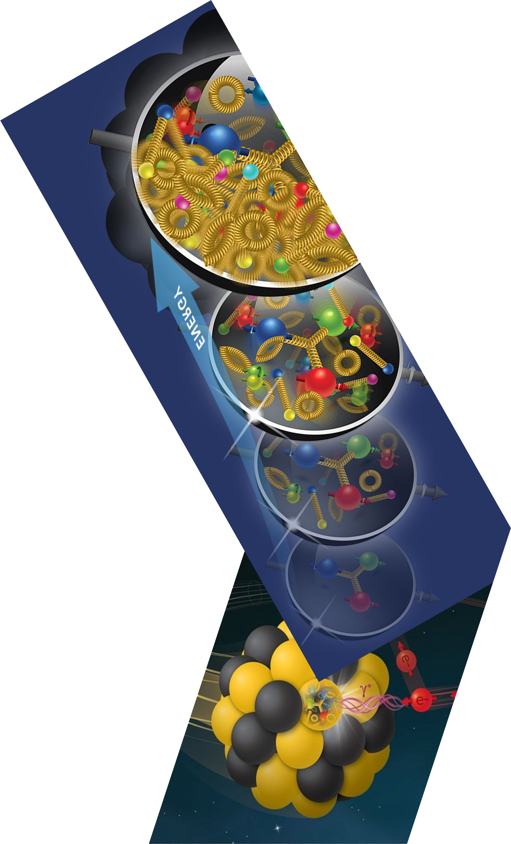
Outline
Intro of GUMP in the gluon sector
A hybrid framework for DV$J/ψ$P
Some results on the DV$J/ψ$P fit
Summary and outlook
Ian’s talk
Fatma’s talk
Gabriel’s talk

Slide 3
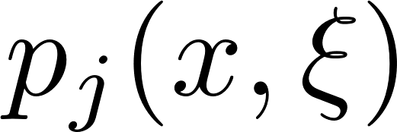
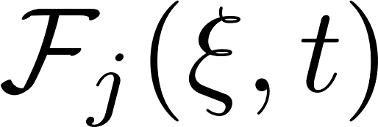
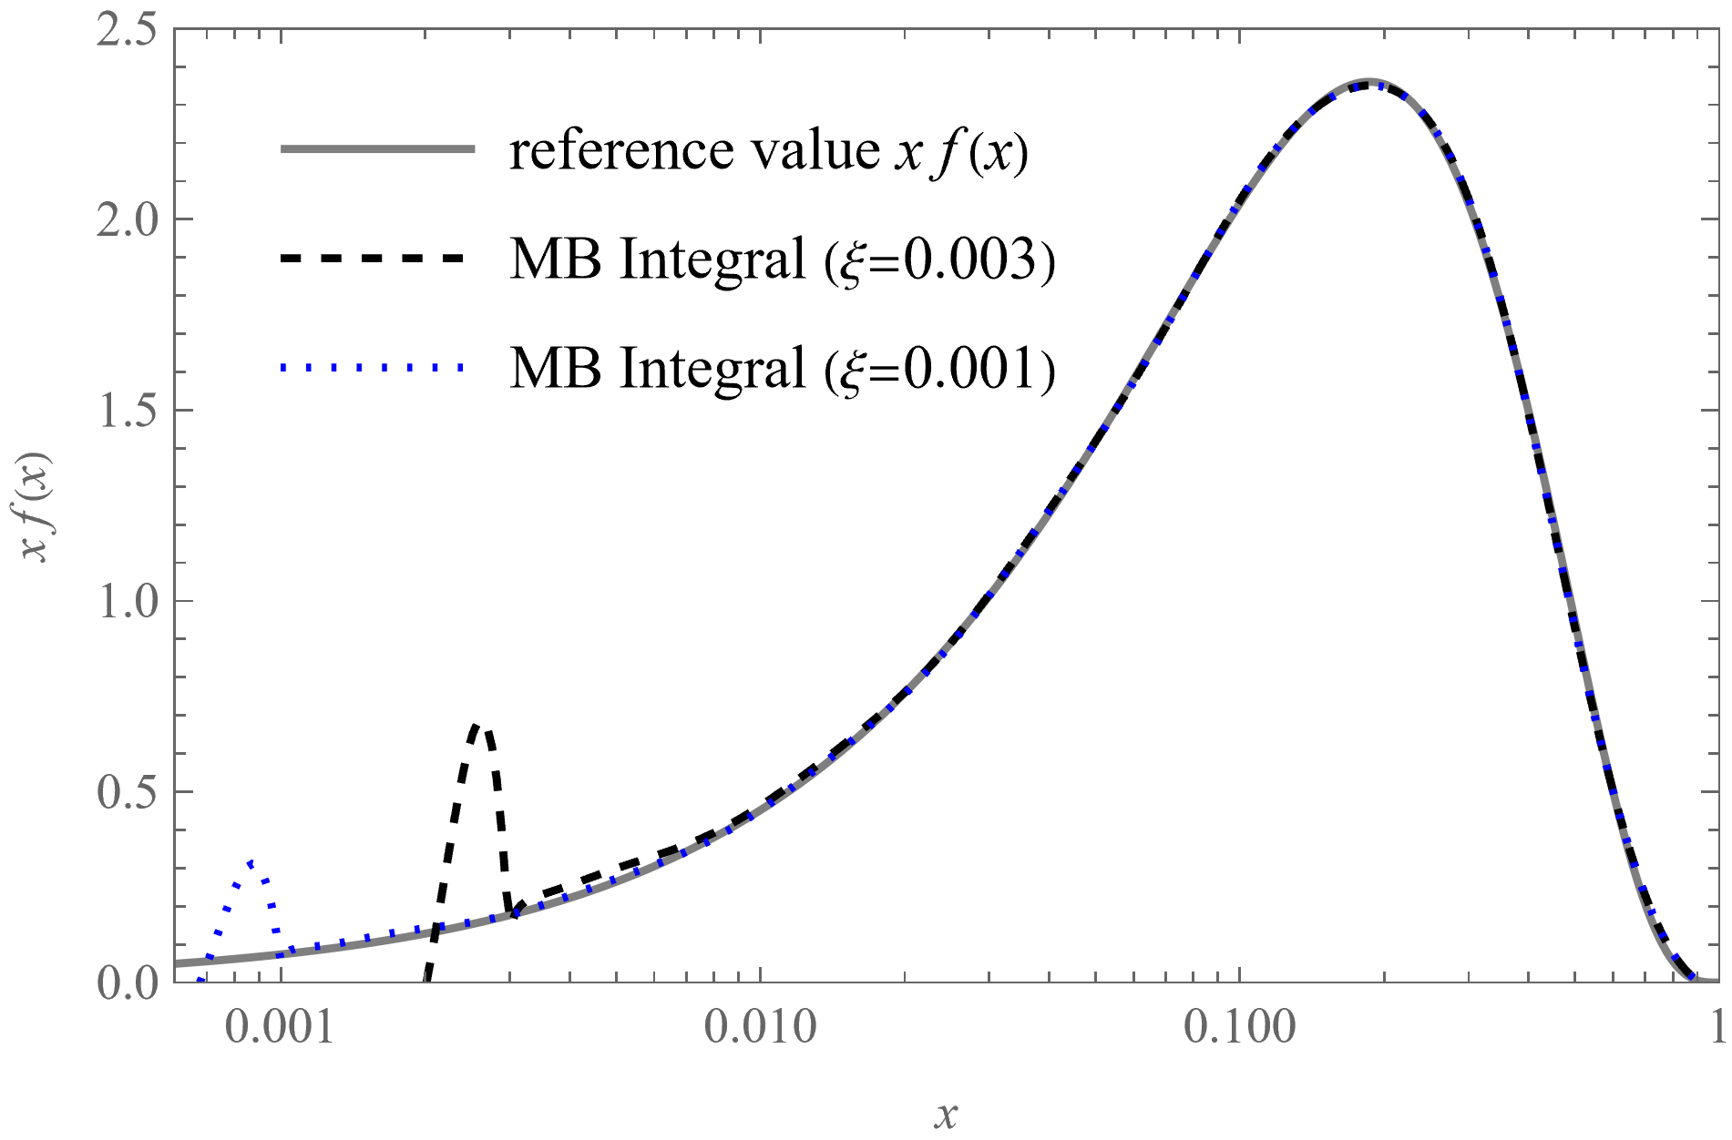
GPDs in terms of Moments
Fatma’s talk
GPDs can be formally expanded in the conformal moment space:
D. Mueller and A. Schafer 2006
: Orthogonal basis in terms of Gegenbauer polynomials
: Moments of GPDs to be parameterized
Whereas GPDs in x-space can be reconstructed by resumming all the moments through a complex integral in the moment space.
Example of the reconstruction of GPD in x-space with its moments

Slide 4
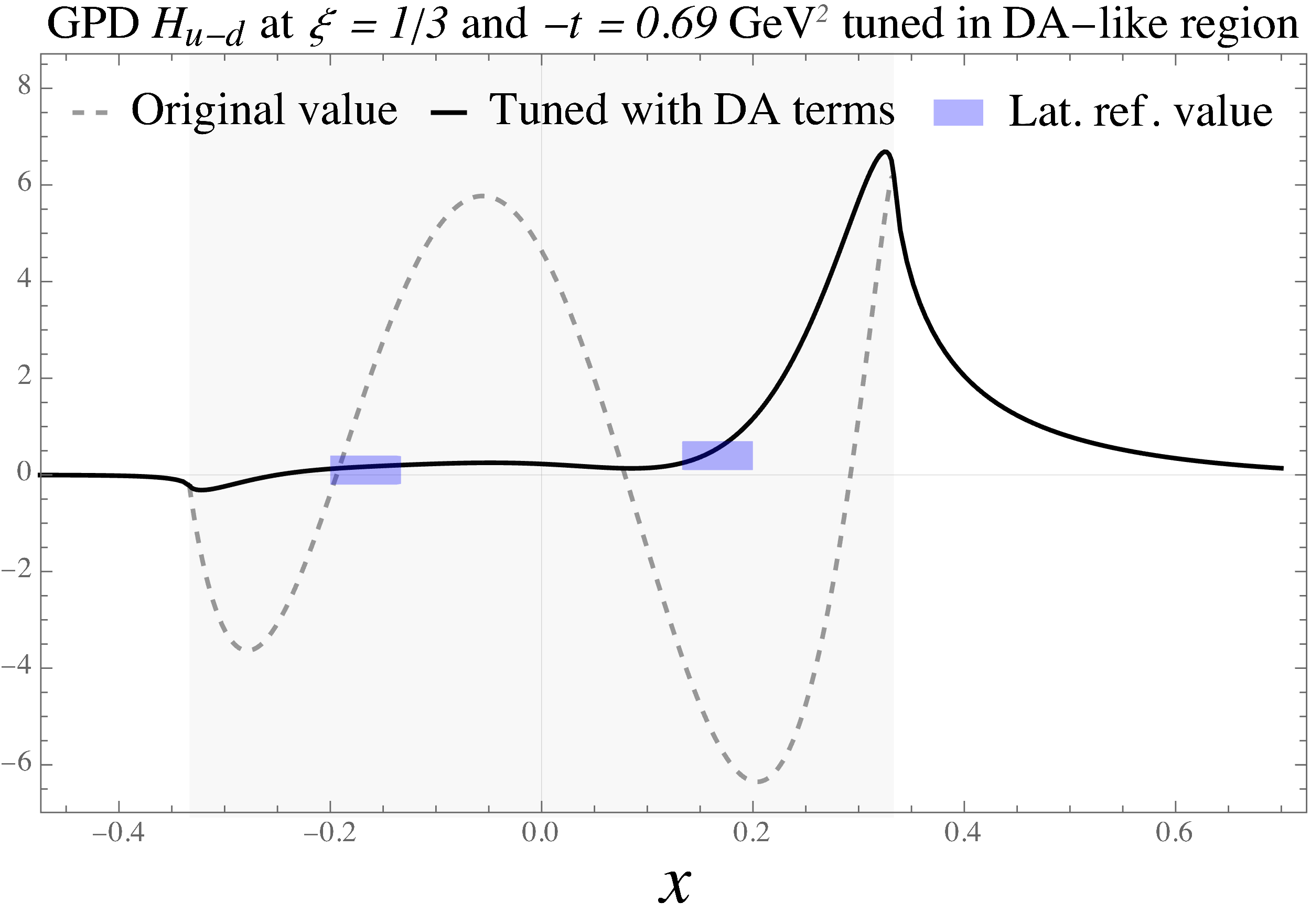
‘Missing’ gluons in GUMP 2023
Previously, we studied the quark GPDs combining lattice and experimental inputs.
Guo et. al. (2023)
Experimental data and constraints
Example of fit to DVCS at H1
Example of fit to DVCS at JLab
Polarized and unpolarized PDFs from global analysis
Alternatively, one can fit to (polarized) DIS directly
Neutron/ Proton charge form factors from global analysis
Deeply virtual Compton scattering data at JLab/HERA
Lattice QCD simulations
Joshua’s talk
Lattice simulations of nucleon generalized form factors
Lattice simulations of unpolarized and helicity GPDs at zero and non-zero skewness
Example of GPDs tuned to lattice input
Sequential fit as first step to accelerate the convergence
JAM (2022) PDF global analysis results
Globally extracted electromagnetic form factors (Z. Ye et al 2018)
Lattice GPDs (Alexandrou et al 2020) and form factors (Alexandrou et al 2022)
DVCS measurements from JLab (CLAS 2019 & 2021, Hall A 2018 & 2022) and HERA (H1 2010)

Slide 5
Gluons structures with heavy vector meson
It’s well-known that heavy vector meson production can access the gluonic structure.
⎼ assuming the intrinsic quark contributions are suppressed.
Collinear factorization of hard exclusive electroproduction of meson:
Collins, Frankfurt and Strikman (1996)
In the deeply virtual limit , including heavy and light mesons;
Factorized into GPDs, hard coefficients, and meson distribution amplitude (DA);
Only prove at leading-twist for longitudinal productions ⎼ higher-twist corrections;
It seems to require very high Q to observe the leading-twist scaling, for instance, HERA or future EIC;

Slide 6
Non-Relativistic (NR) QCD
Another approach is the Non-Relativistic QCD factorization:
Ivanov et. al. (2004)
Include meson mass and transverse photon cross-sections (higher-twist in M/Q)
Can be extended to photo-productions and threshold photoproductions case.
Do not apply to light meson production ⎼ the massless limit does not exist generally.
More complicated dependence on the meson mass and Q, phenomenology application could be harder.
At leading-order, the two frameworks can be matched seamlessly in the limit.
under the non-relativistic approximation of DA

Slide 7
A hybrid framework
DVMP Framework
NRQCD Framework
Equivalent treatment to light-meson productions;
The Q can be large within the HERA and future EIC data;
The $J/ψ$ mass is not as heavy;
Perturbative matching
The heavy mass corrections can be significant at lower Q;
The transverse-photon cross-sections can be calculated without the need of modeling;
In the current approximation, the hybrid framework only reduces to the DVMP framework in the large Q limit at NLO, but the dependence on the Jpsi mass are still unmatched to NRQCD at NLO (to be fixed!).

Slide 8
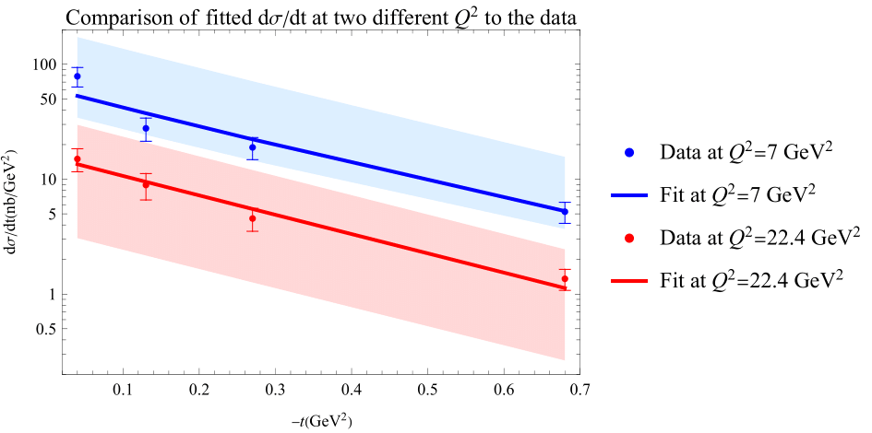
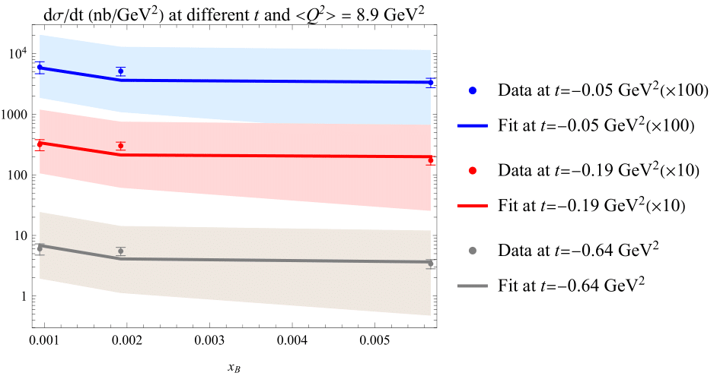
Some results from the fit
Gabriel’s talk
The differential cross-section can be fitted well (17 data points v.s. 4-5 off-forward parameters)
Both NLO corrections and the heavy mass corrections are necessary for the fit.
Large bands by varying the factorization scale by a factor of 2 (confirmed by other works)
Recent study founds that resummation can be helpful in photo-productions

Slide 9
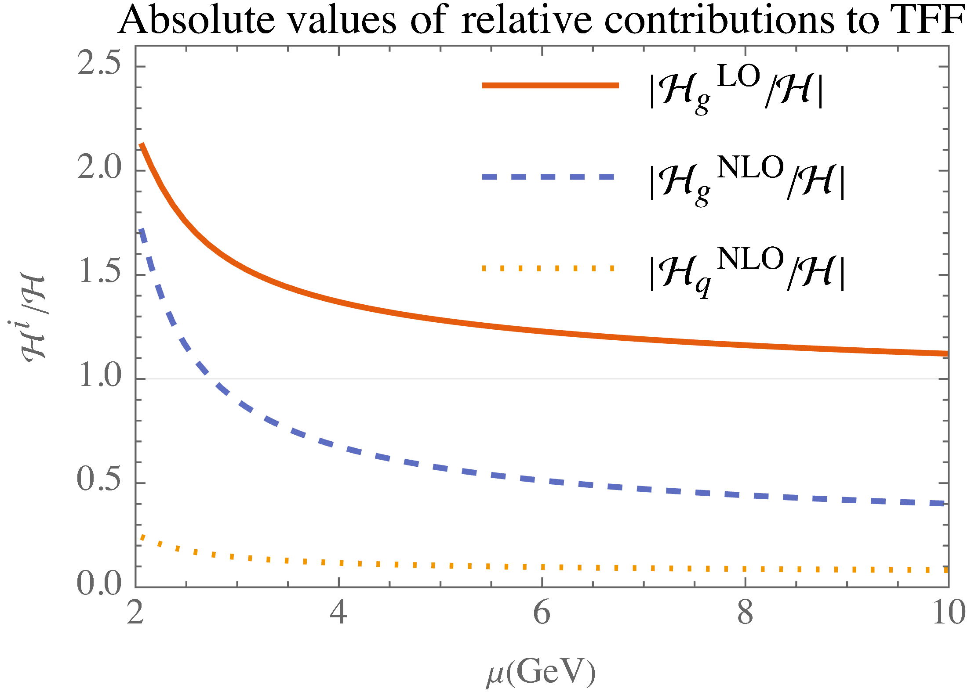
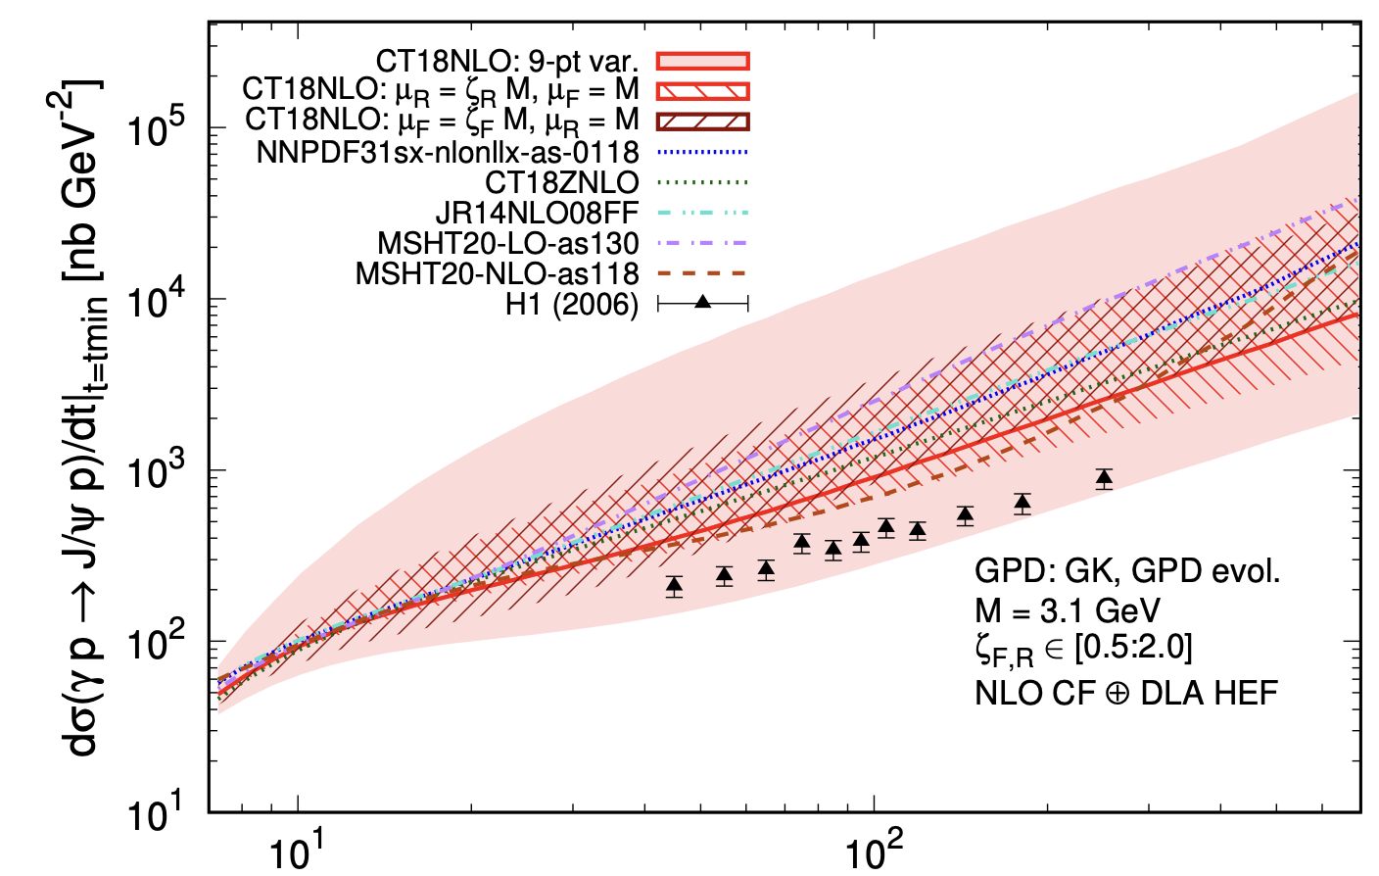
Perturbative corrections at NLO
A more direct evidence can be found in the transition form factors
C, Flett et. al. (2024)
There is relatively strong cancelations between LO and NLO contributions even at high factorization scale.

Slide 10
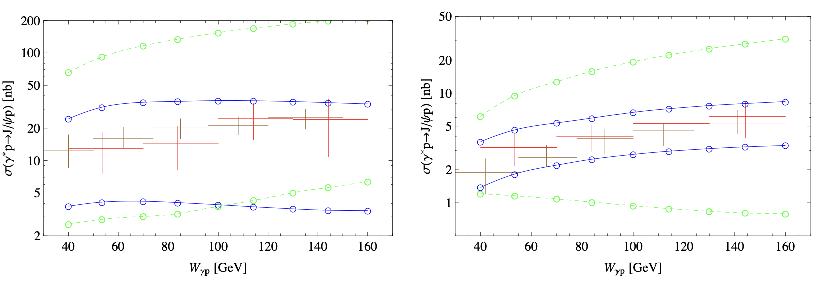
Lessons for the matching
It seems that our hybrid (modified DVMP) framework doesn’t deviate too much from the NRQCD
Chen and Qiao et. al. (2019)
Larger band in the hybrid framework: makes sense if the leading double log can be matched.

Slide 11
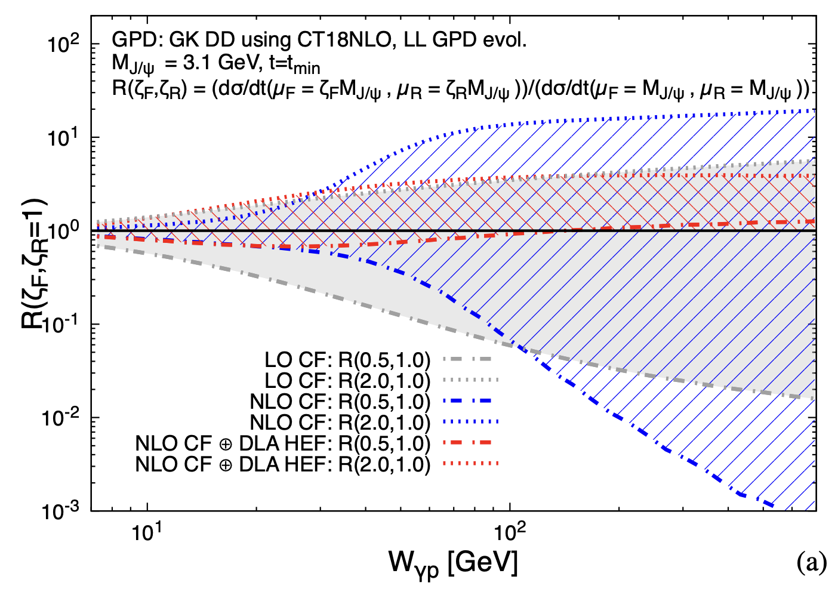
Resummation beyond NLO
Another recent works suggests that resummation of large log beyond NLO is necessary for photo-production
C, Flett et. al. (2024)
The same might be needed for the electro-productions or even the DVMP.

Slide 12
Summary and outlook
GUMP Milestones
2024: “Testing and improvement of GUMP framework that includes gluon GPDs and LO evolution effects.”
2025: “Release a state-of-the-art version of GUMP fitting code to the GPD community, allows users to extract twist-2 GPDs using available data.”
Summary
Heavy vector meson production for gluon GPDs at NLO
Full GPD evolution at NLO (Both forward and backward method)
Analysis of HERA data on J/psi production with small-x gluon PDF
Outlook
NLO matching of NRQCD and collinear frameworks
Include also larger-x gluon PDF and lattice form factors
DVCS and light-meson production analysis for quark GPDs at NLO
At NLO

Slide 13
Thank you!

